Slide 1
Lab 03 & 04 summary

Slide 2
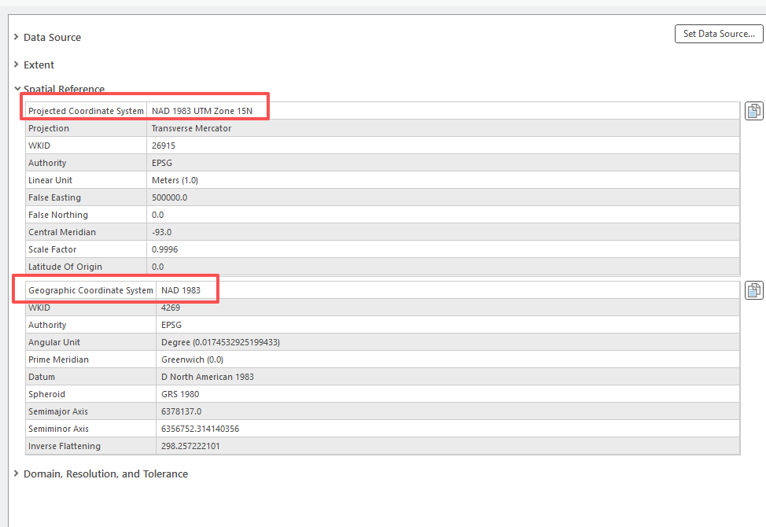
Lab 03
Question 2. Is this map currently being displayed in a geographic or projected coordinate system? (3 Points)
Answer: Projected coordinate system

Slide 3
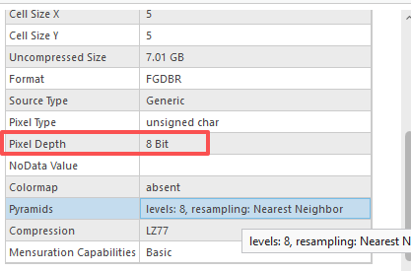

Lab 03
Question 8. What is the pixel depth? (3 Points)
Answer: 8 bit
The number of bits used to represent the color or value of each pixel.
The higher pixel depth means more bits are allocated per pixel, allowing for a greater range of values and a more accurate representation of color or intensity.
$$2^{n}= 2^{8}=256 possible value$$

Slide 4
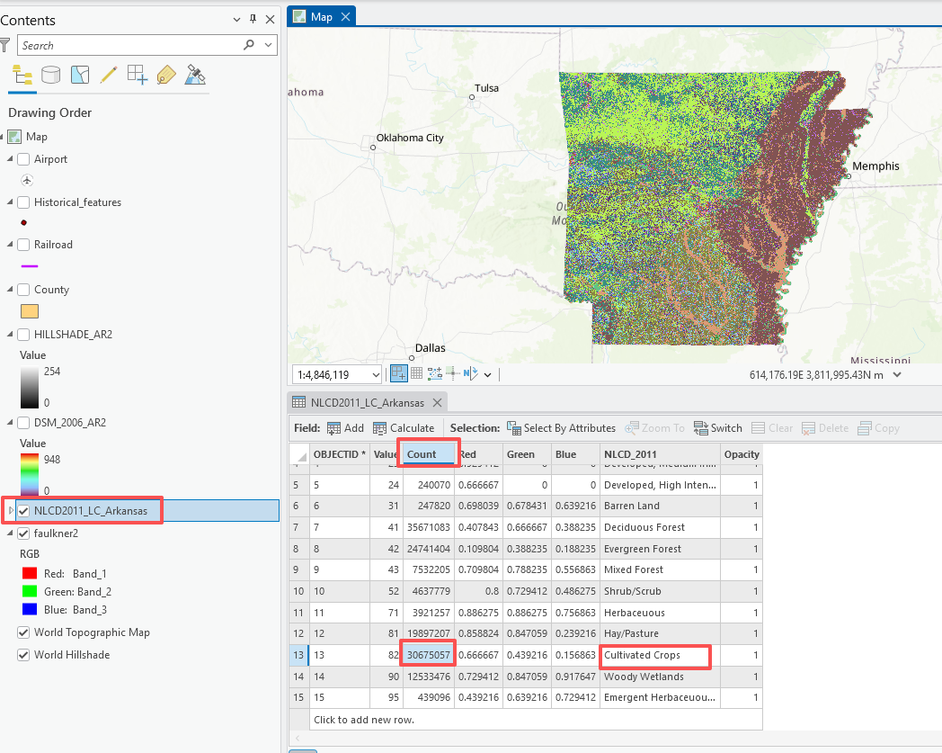
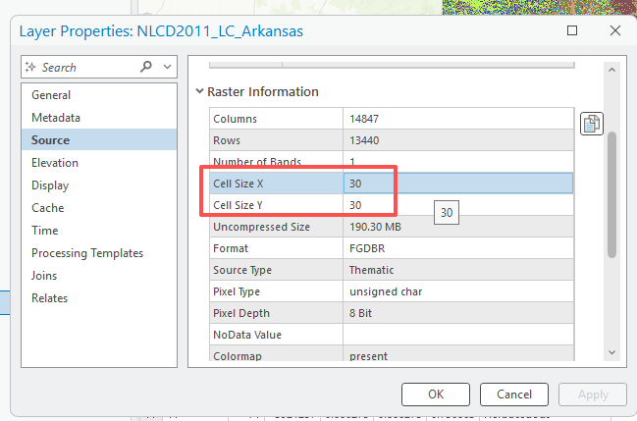
Lab 03
Question 10. What is the area for cultivated crop? (3 Points) (Hint, area= number of pixels x size of a pixel)

Slide 5
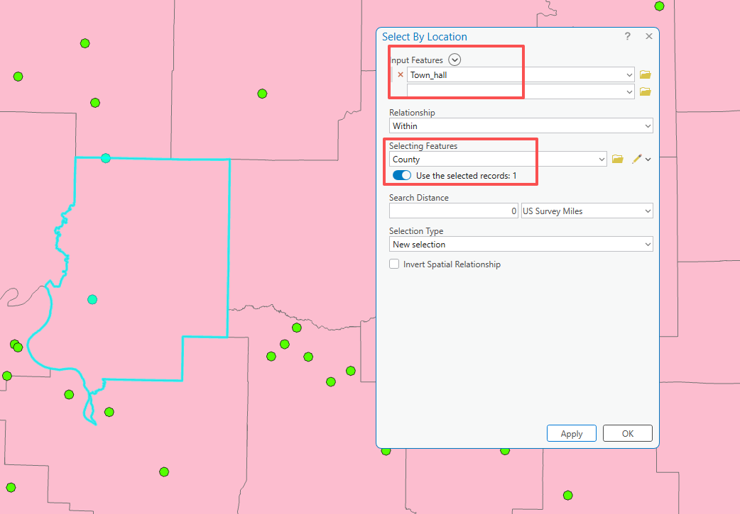
Lab 04
Question 5. How many town halls in Faulkner county? (5 points)
Answer: 2

Slide 6
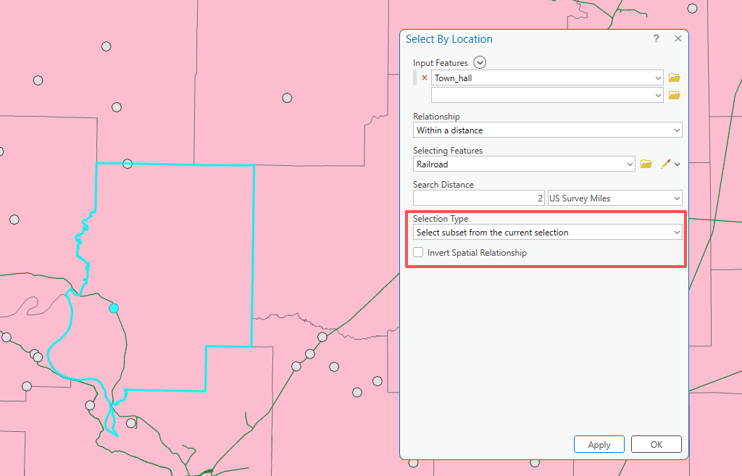
Lab 04
Question 6. How many town halls that are in Faulkner County and within 2 miles of a railroad? (5 points)
Answer: 1

Slide 7
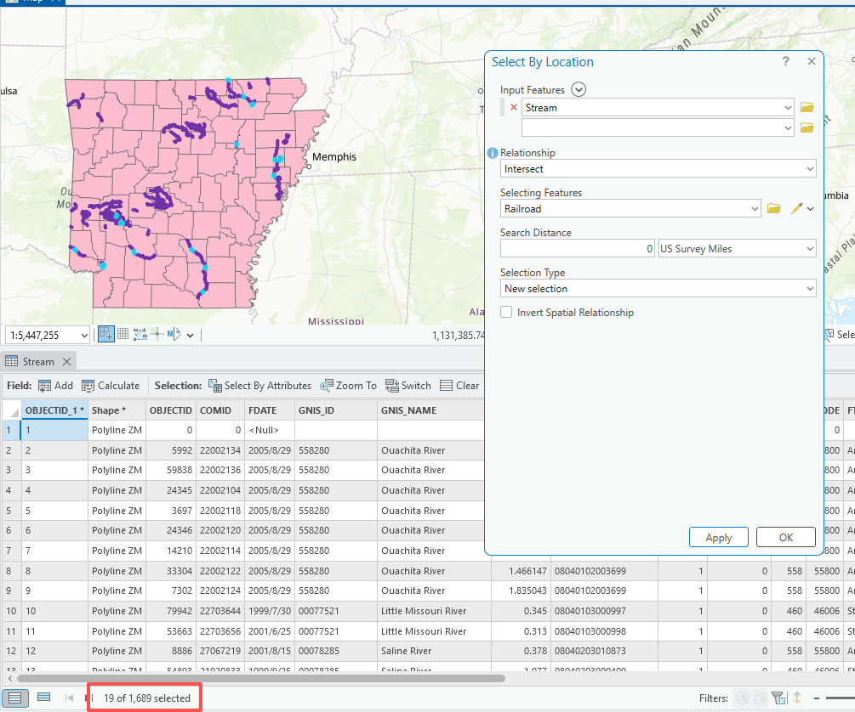
Lab 04
Question 7. How many streams intersect a railroad? (5 Points)
Answer: 19

Slide 8
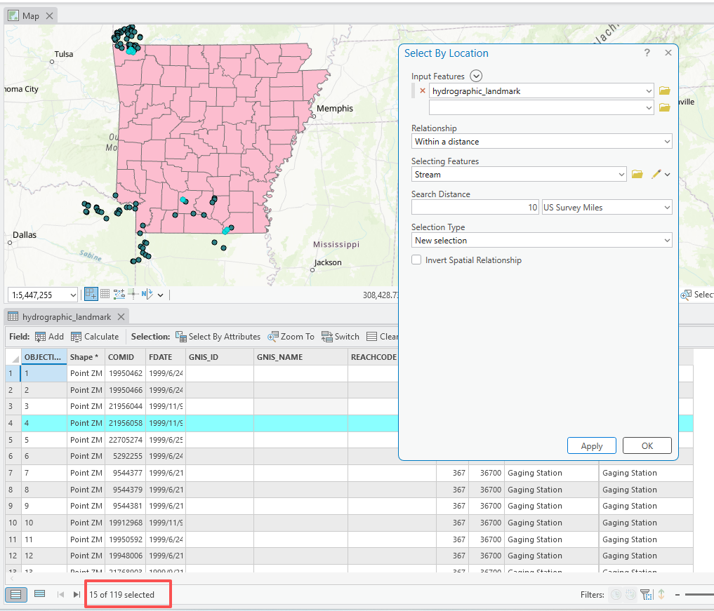
Lab 04
Question 8. How many hydrographic landmarks are within 10 miles of a stream? (5 Points).
Answer: 15

