Slide 1

WEEK 02 ArCGIS PRO lecture
Instructor: Yanan Wu
fALL 2025

Slide 2
2.1 KEY ASSUMPTION

Slide 3


What is GIS?
A geographic information system is a computerized system designed for the storage, retrieval , visualization and analysis of geographically referenced data
3

Slide 4
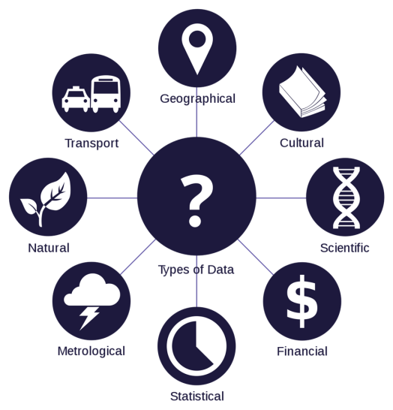
GIS uses advanced analytical tools to explore at a scientific level the spatial relationships, patterns, and processes of biological, cultural, demographic, economic, and physical phenomena
4

Slide 5
GIS is also a key technology for managing the daily operations of organizations
GIS uses workflow guides (tasks), macros (Model Builder models), and apps to process the daily flow of new data and provide access to GIS results using mobile computing
5

Slide 6
Feature classes and map layers
6

Slide 7
GIS stores related geographic features as separate collections of files called feature classes
can be easily reused, assembled into any number of map compositions, and overlaid for analysis
are associated with attribute tables of data
When symbolized and displayed as part of a map, a feature class is called a map layer
14

Slide 8
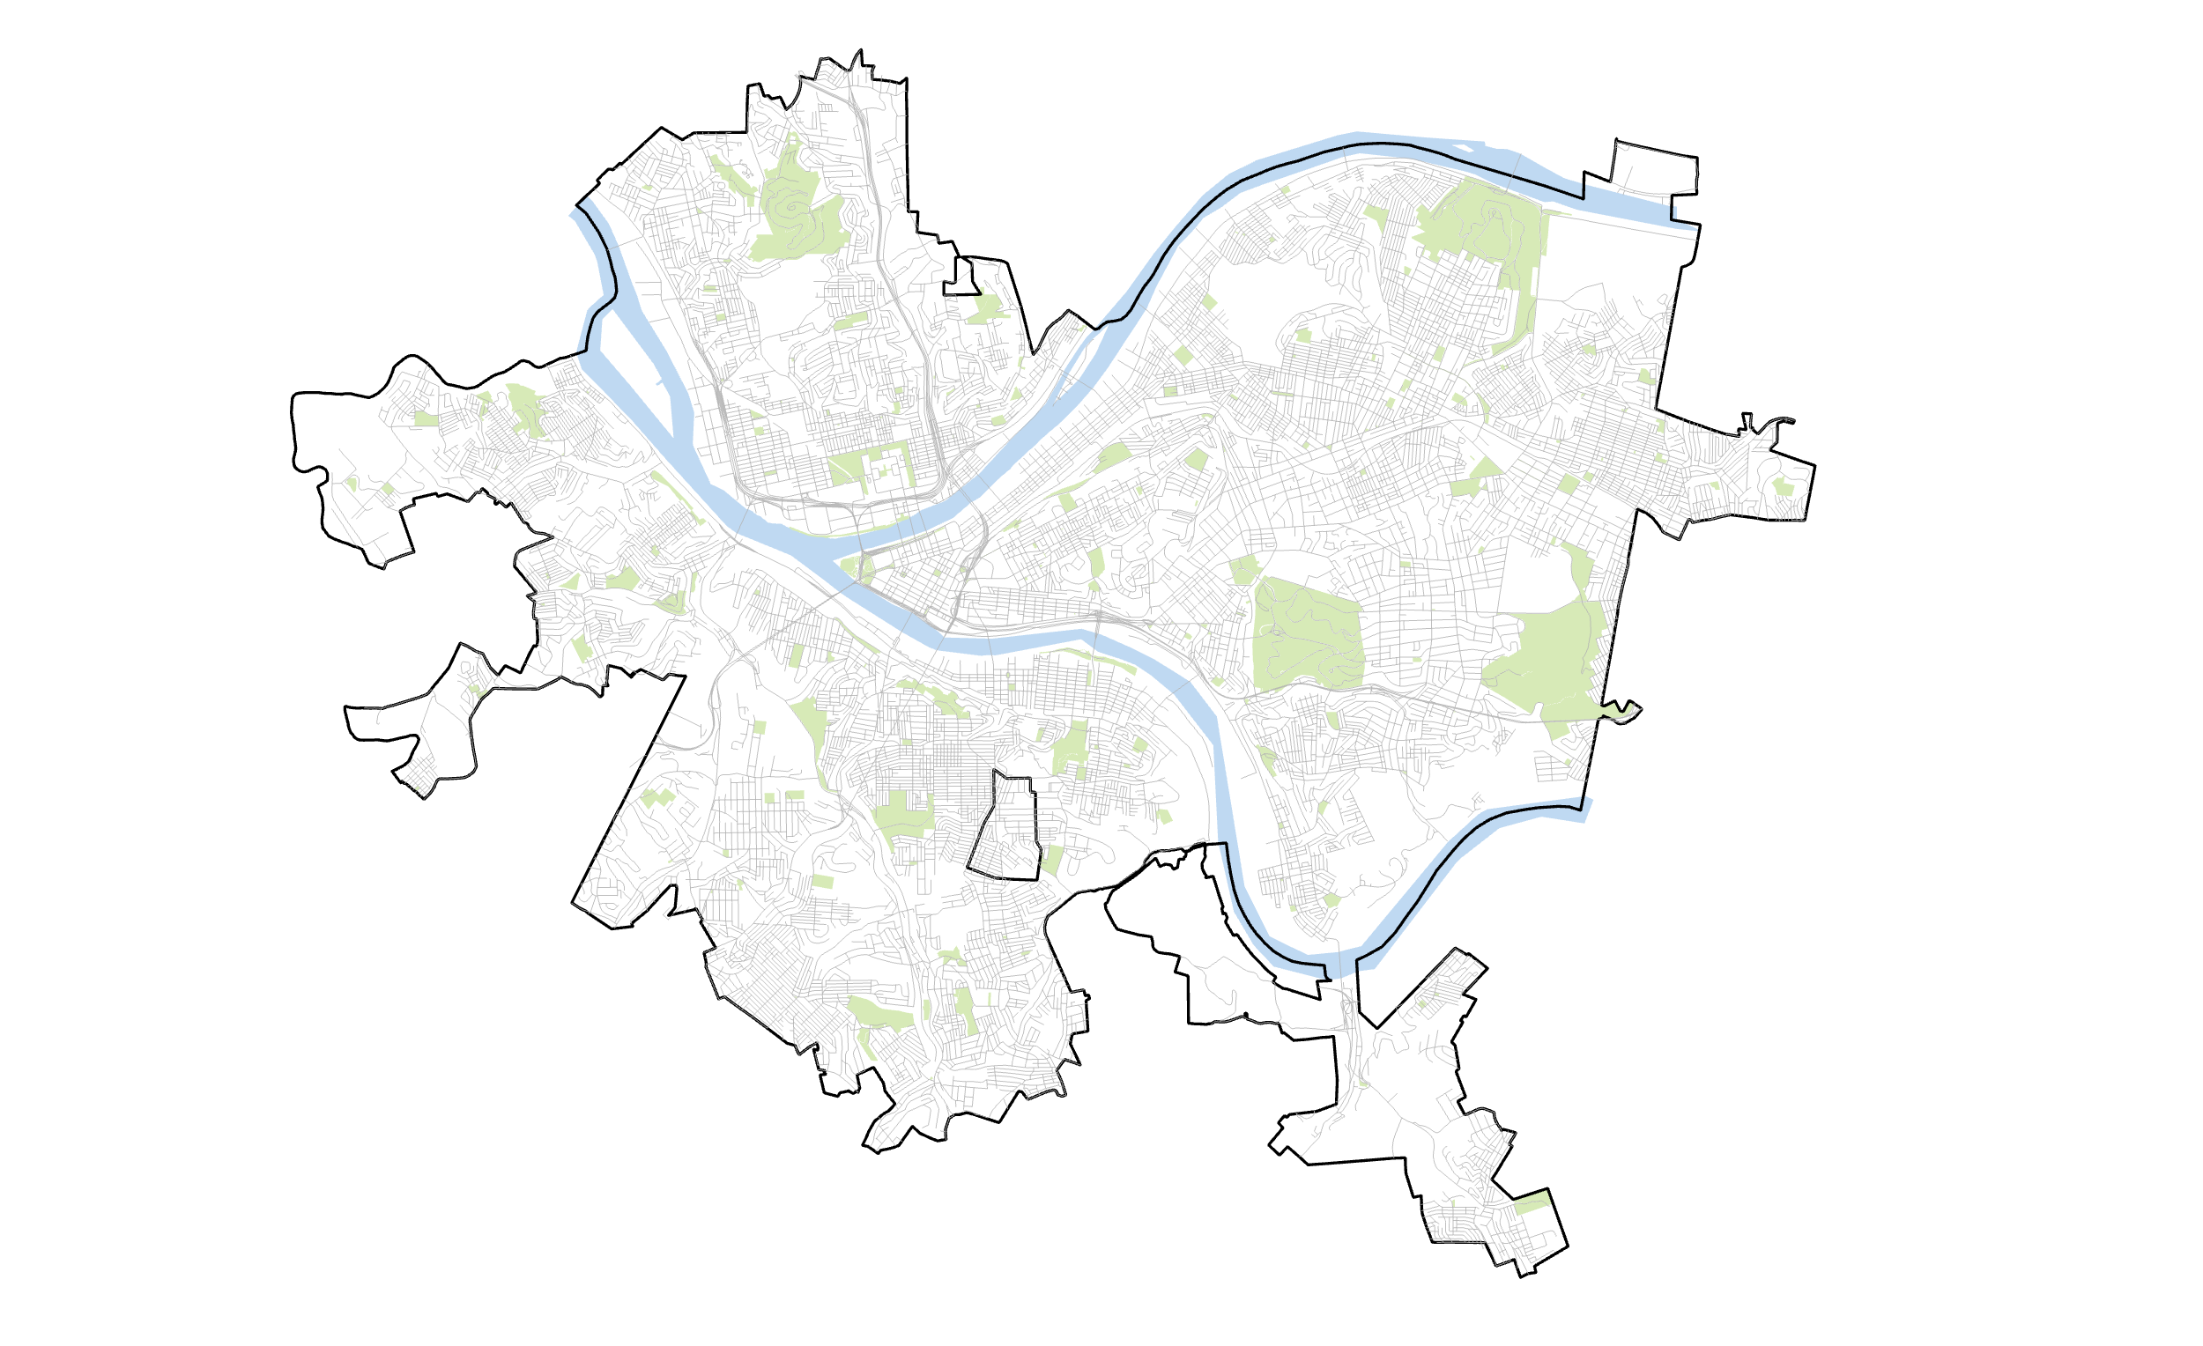
Physical features
(lakes, parks, rivers, roads, etc.)
8

Slide 9
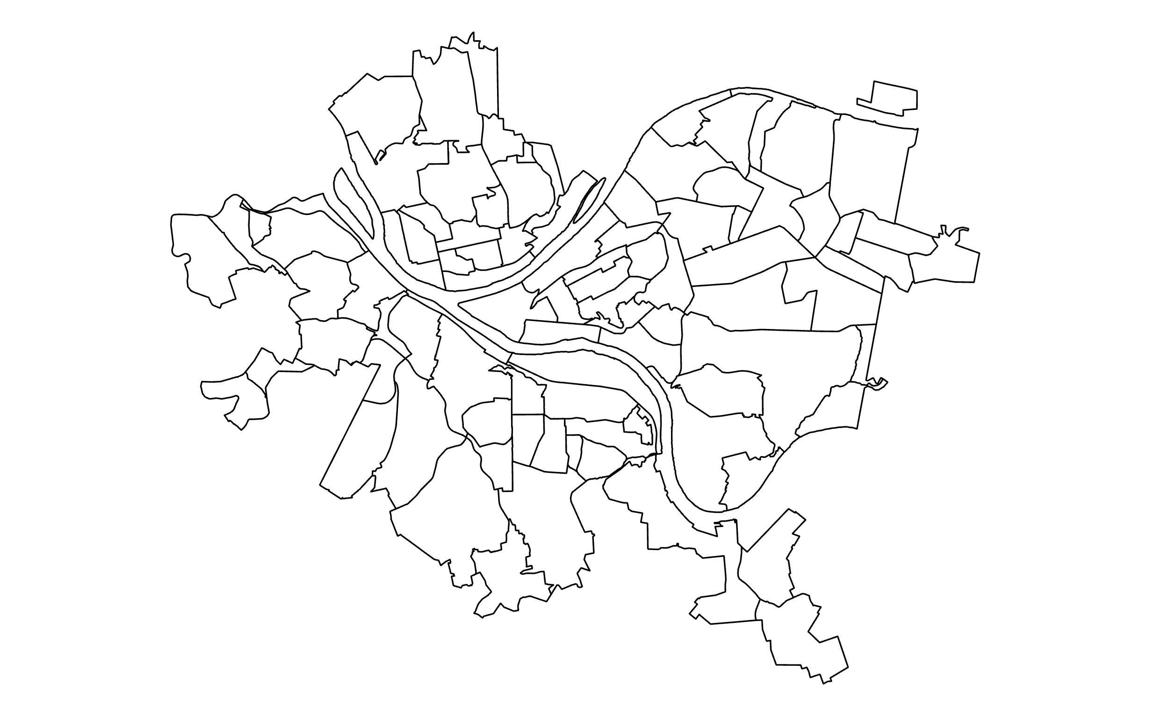
Political features
(states, provinces, municipalities, neighborhoods)
9

Slide 10
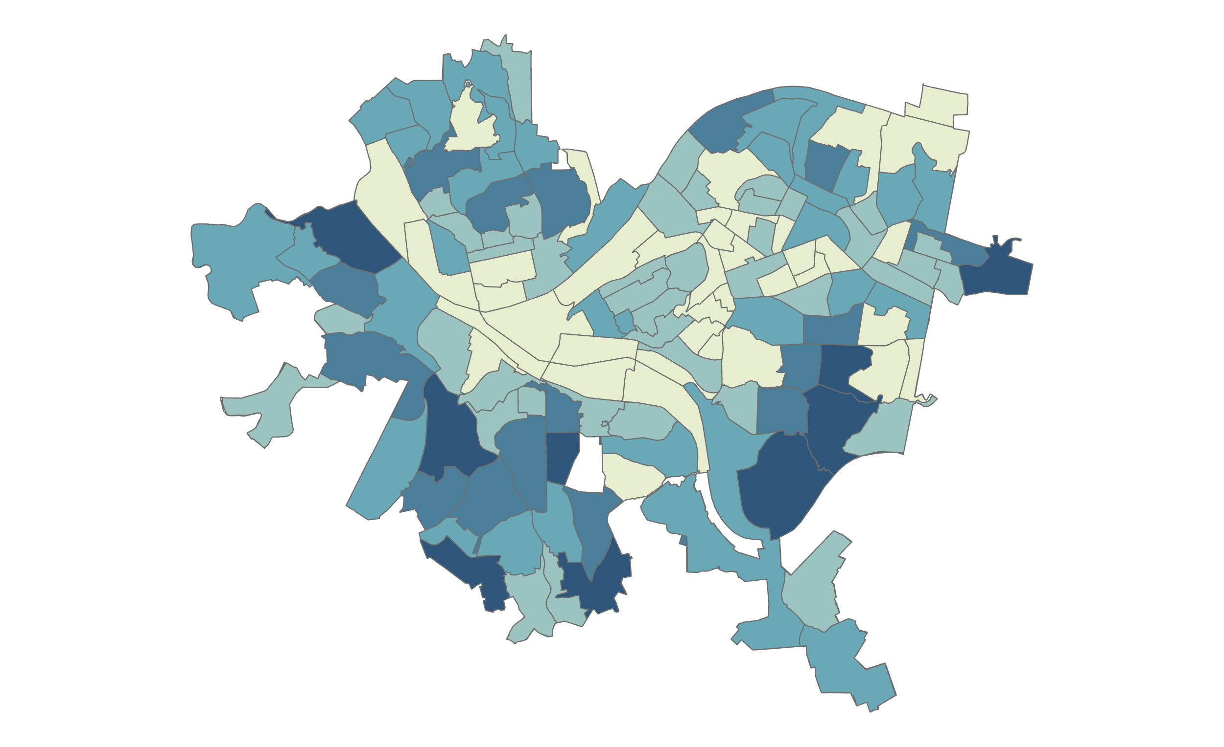
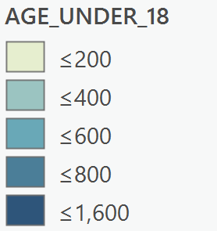
Statistical features
(Census tracts)
10

Slide 11
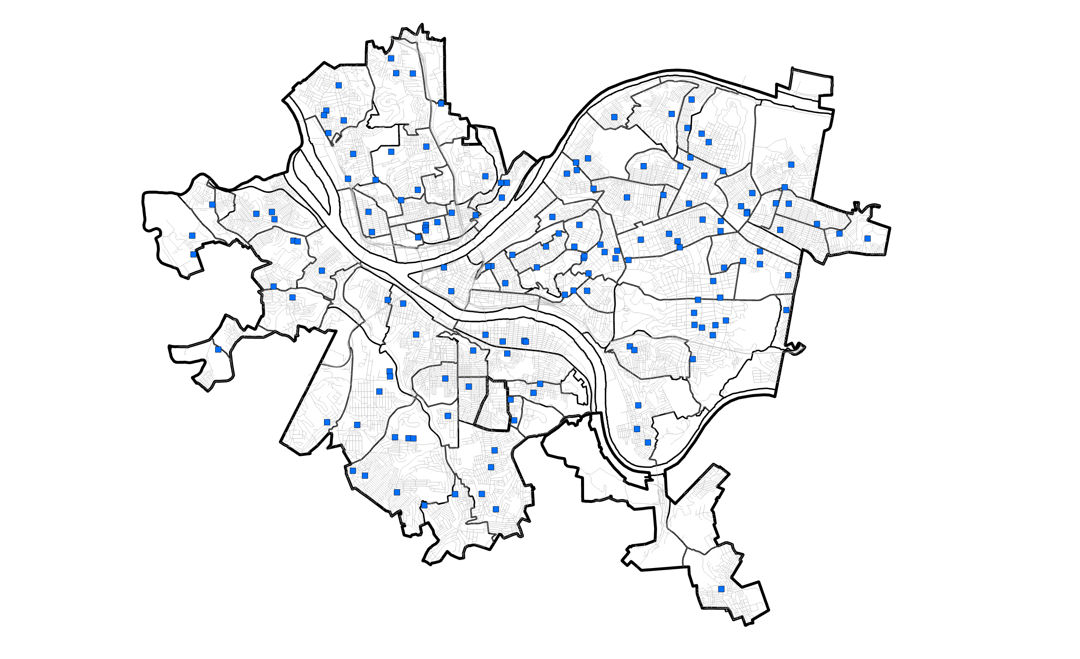
Administrative features
(schools, clinics, businesses, bus stops, etc.)
11

Slide 12
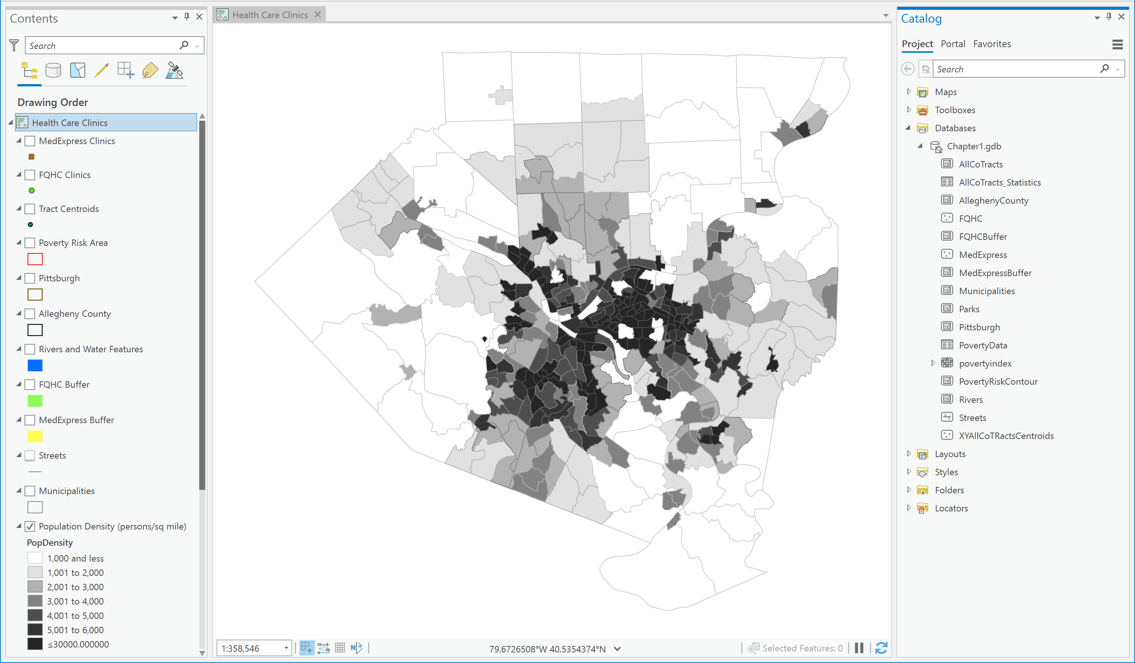
Layers and features as viewed in ArcGIS Pro
Feature Class
Layer

Slide 13
4.1 KEY ASSUMPTION

Slide 14
Software: ArcGIS Pro® , ArcGIS® Online, ArcGIS® Map Viewer, ArcGIS® StoryMaps, ArcGIS® Dashboards
External Drive:
for backing up files

Slide 15
GIS software and apps
ArcGIS Pro

Slide 16
WEEK 02 ArCGIS PRO Lab Session

Slide 17
4.1 KEY ASSUMPTION

Slide 18
WEEK 02 ArCGIS online lecture
Instructor: Yanan Wu
fALL 2025

Slide 19
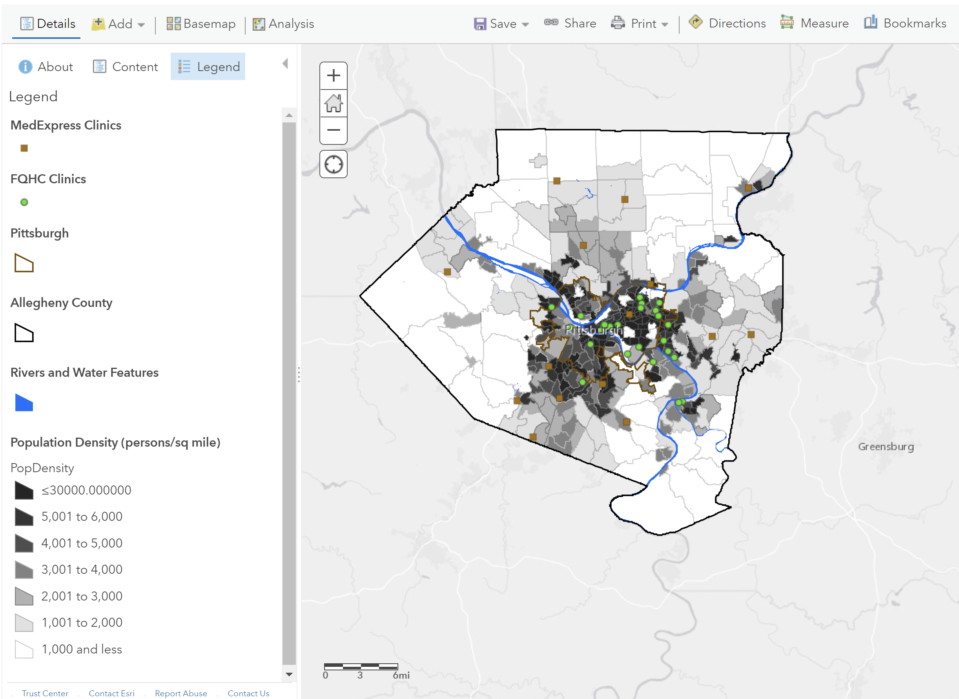
ArcGIS Online® (map viewer classic)
19

Slide 20
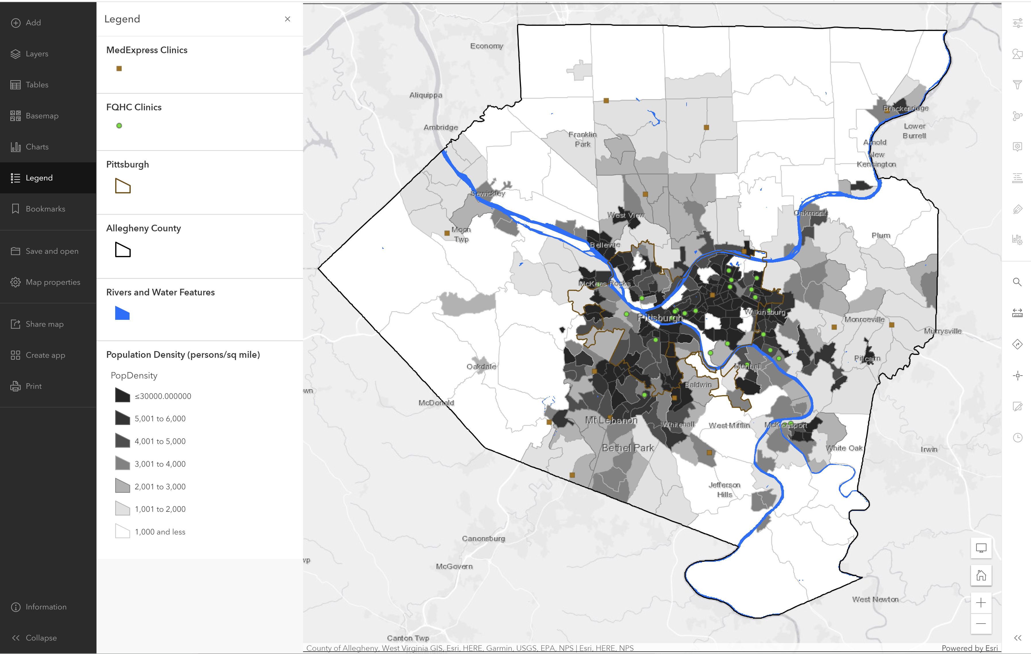
ArcGIS Map Viewer ®
20

Slide 21
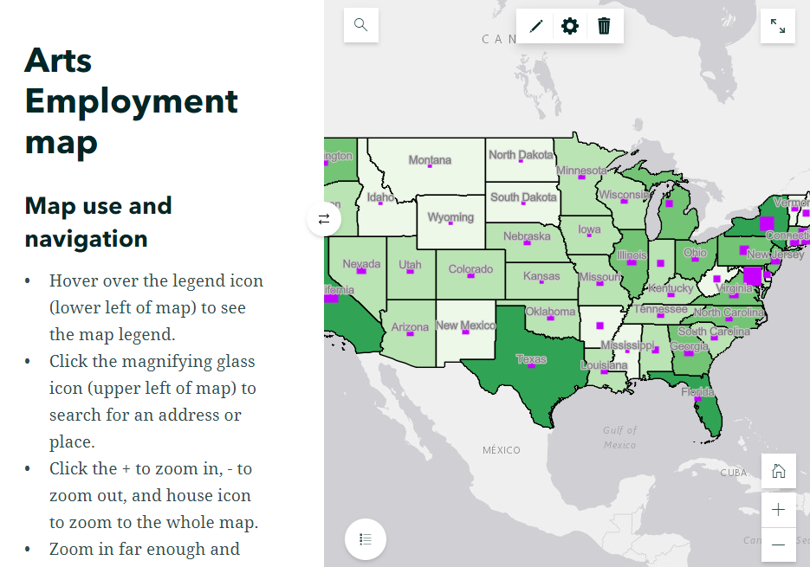
ArcGIS Story Maps®
21
21

Slide 22
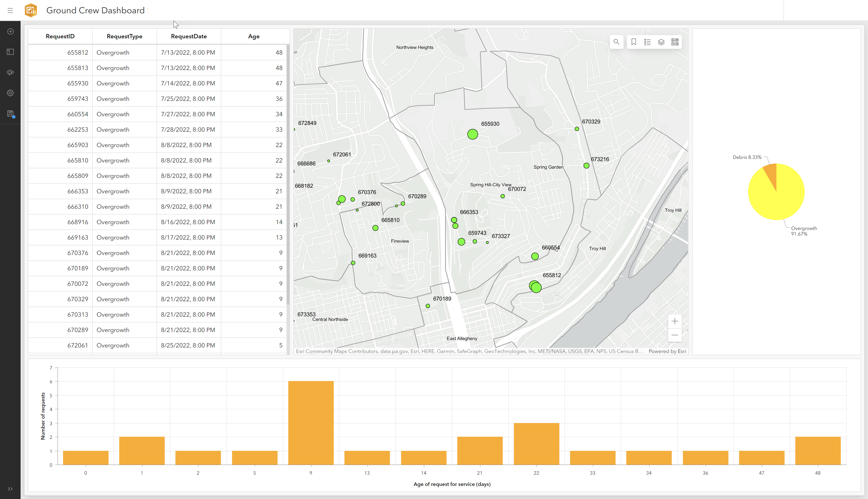
ArcGIS
Dashboard®
22

Slide 23
WEEK 02 ArCGIS online Lab Session

