Slide 1

GEOG 2475: Geographic Information Systems I
Lecture 07 Map Elements
Yaqian He, PhD
Assistant Professor
Department of Geography

Slide 2
Overview
Map Elements
Frame Line and Neat Line
Mapped Area
Inset
Title and Subtitle
Legend
Data Source
Scale
Orientation

Slide 3
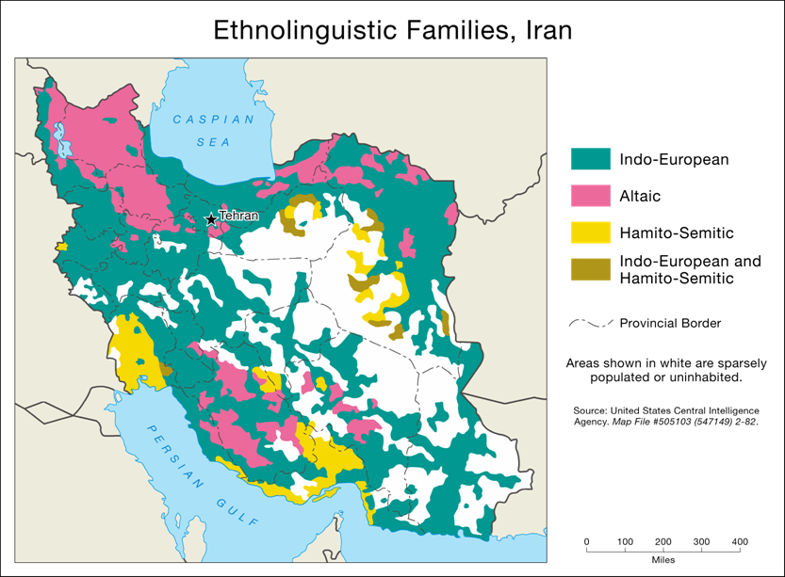
Map Elements
The building blocks of Cartographic Communication
All maps are created from a common set of map elements
GeoTech

Slide 4
Map Elements
Available Space
Areas on a page or screen that can be used to place map elements
“White Space”
The cartographer constantly evaluates the relationship between map elements and available space
Map elements are usually visually centered within appropriate areas of available space
It is the cartographer’s job to make all decisions regarding map elements
Which to include, and which to omit
How to implement them in the most appropriate manner

Slide 5
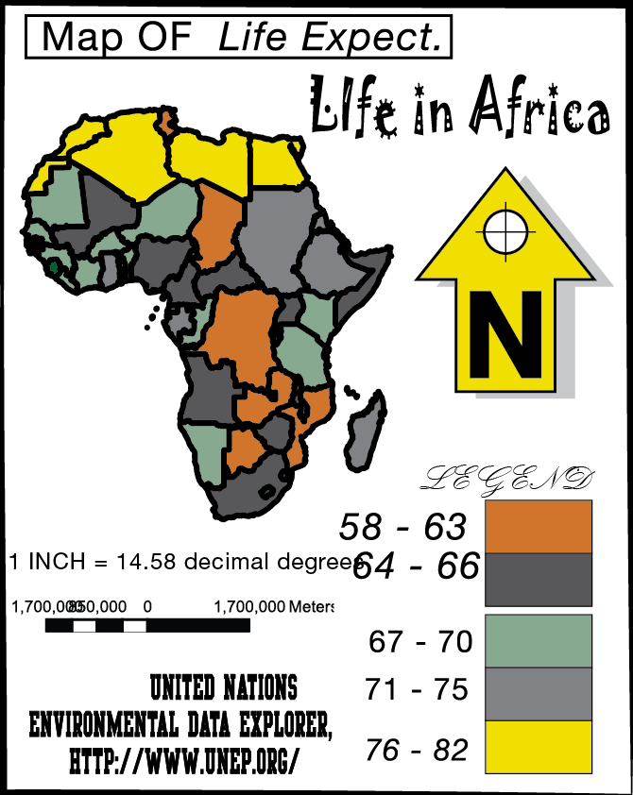
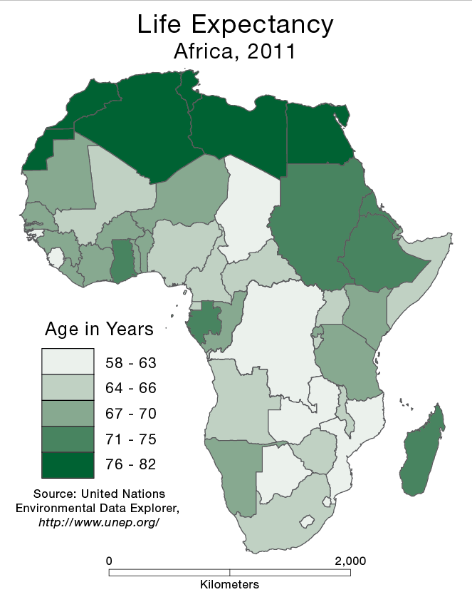
Map Elements
Which one is better?
Notes:
A noisy, inefficient communicator
A simple, efficient communicator

Slide 6
Map Elements
Frame Line and Neat Line
Mapped Area
Inset
Title and Subtitle
Legend
Data Source
Scale
Orientation
Decrease in size from top to bottom
Listed in the recommended order of placement: larger first, smaller last

Slide 7
Alignment and Centering
Alignment and centering of map features is a common task
Can be performed through “visual approximation”
Features look properly aligned or centered
Can also be performed through precise measurement
Features are exactly aligned or centered, using software controls

Slide 8
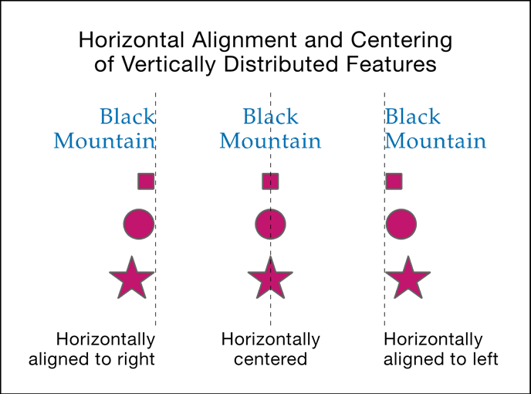
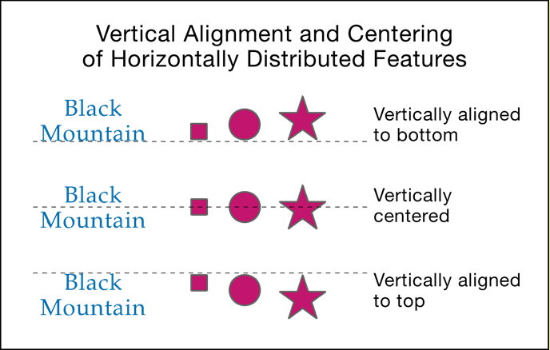
Alignment and Centering
It is important to understand the terminology
Horizontal and vertical are often confused
Horizontal
(Side-to-Side) Alignment and Centering
Vertical
(Top-to-Bottom) Alignment and Centering

Slide 9
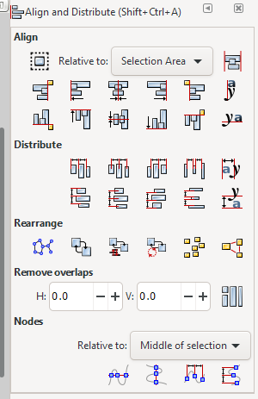
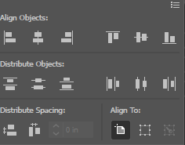
Alignment and Centering
Inkscape
Illustrator

Slide 10

Frame line and neat line
Help to organize the map’s contents, and define its extent
Frame Line
Encloses all other map elements
Should be the first map element placed, because it occupies the most area, and defines the initial available space
Neat Line
Is used to crop (limit the extent of) the mapped area
Separate elements to provide an organized look
Frame Line
Neat Line
GeoTech

Slide 11
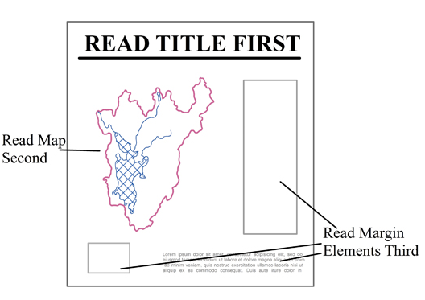
Frame line and neat line
Help to organize the map’s contents, and define its extent
Frame Line
Encloses all other map elements
Should be the first map element placed, because it occupies the most area, and defines the initial available space
Neat Line
Is used to crop (limit the extent of) the mapped area
Separate elements to provide an organized look
Peterson, 2021

Slide 12
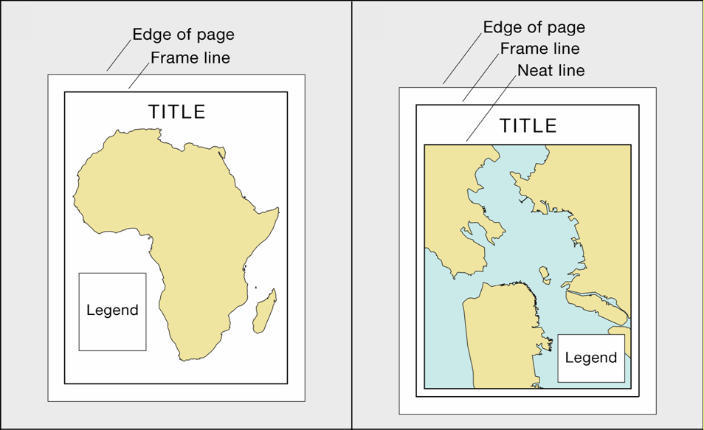
Frame line and neat line
A Frame Line should be used in most situations
A Neat Line is used when the mapped area needs to be cropped or elements need to be separated
GeoTech

Slide 13
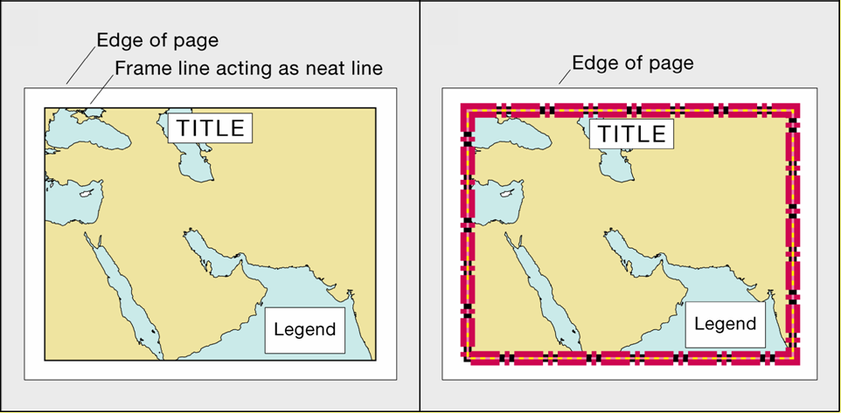
Frame line and neat line
In certain cases, a frame line can also act as a neat line
Enclosing all map elements and cropping the mapped area
GeoTech

Slide 14
Frame line and neat line
The style of these lines should be subtle
A single, thin, black line should be used in most cases
Slightly thicker lines are appropriate when working with large wall maps
These lines should focus attention on what is within them, not on themselves

Slide 15
Discussion
Which one is better?

Slide 16
Mapped area
The region of Earth being represented
Consists of Thematic Symbols
Thematic Symbols directly represent the map’s theme
Are visually dominant
Can also include base Information
Base Information provides a geographic frame of reference for the theme
Is subdued

Slide 17
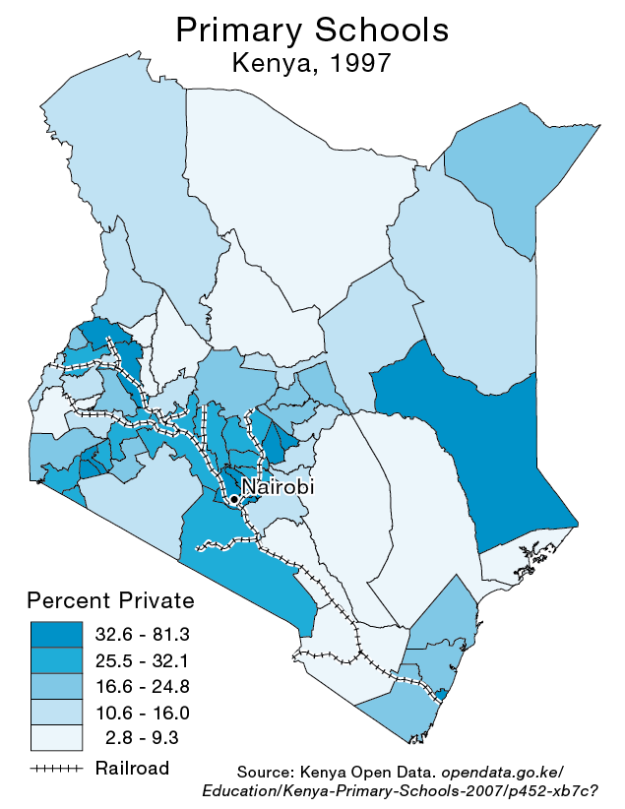
Mapped area
Thematic Symbols: Shaded Polygons
Base Information:
Railroads and
City Label

Slide 18
Mapped area
There are two varieties of mapped area, distinguished by how they represent the geographic region of interest
Floating
Cropped

Slide 19
Mapped area
Floating Mapped Area
Region of interest is disconnected from neighboring regions
Produces available space that often eases the placement of other map elements
Removes the region from its geographic context, possibly confusing the map user

Slide 20
Mapped area
Cropped Mapped Area
Represents the region of interest within its geographic context
More realistic, less abstract
Can make the placement of other map elements more difficult due to a lack of available space
Turkmenistan
Iraq
Afghanistan
Demonstration!
Notes:
Iraq, Turkmenistan, Afghanistan, Pr

Slide 21
Mapped area
Make the mapped area as large as possible within the available space
Without being “too close” to the frame line
While leaving ample room for the remaining map elements
Maximum area is important
The mapped area—thematic symbols in particular—is instrumental in communicating the map’s information

Slide 22
Mapped area
Try to visually center the mapped area both horizontally (side-to-side) and vertically (top-to-bottom)
Within the available space, as defined by the frame line
This will not always result in an appropriate placement
But should be tried first

Slide 23
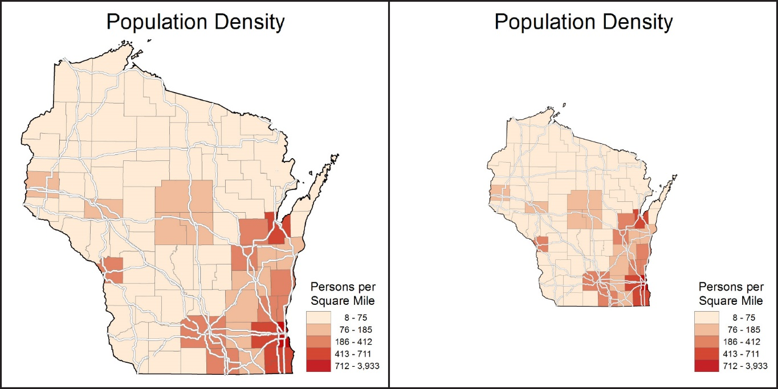
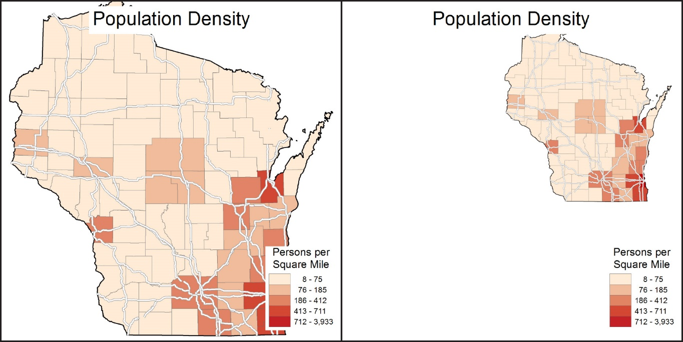
Discussion
Appropriately Sized
Too Small
Too Large
Too Small and Off Center

Slide 24
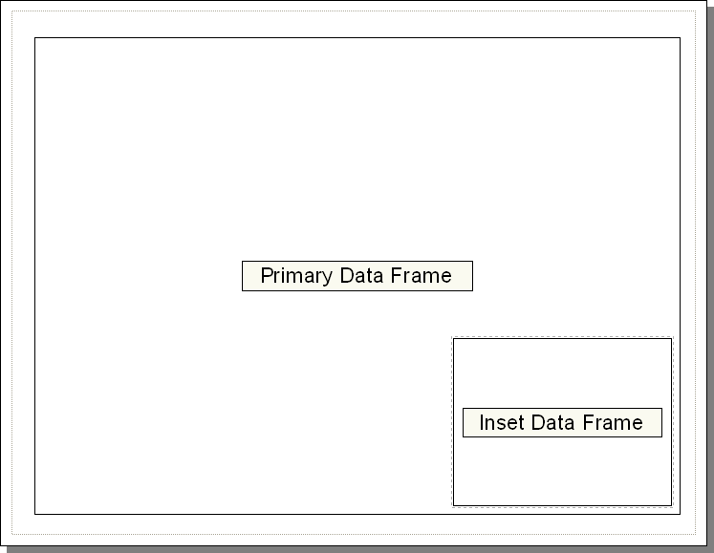
Inset
A smaller map included within the context of a larger map
Can serve several purposes
In the world of ArcGIS, the inset is usually a separate data frame

Slide 25
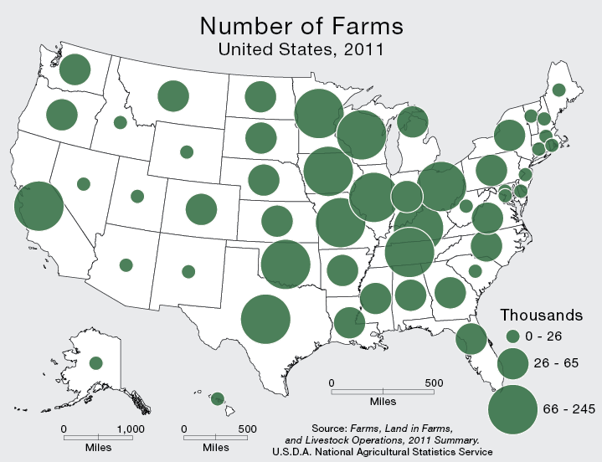
Features not in the correct geographic location
Inset

Slide 26
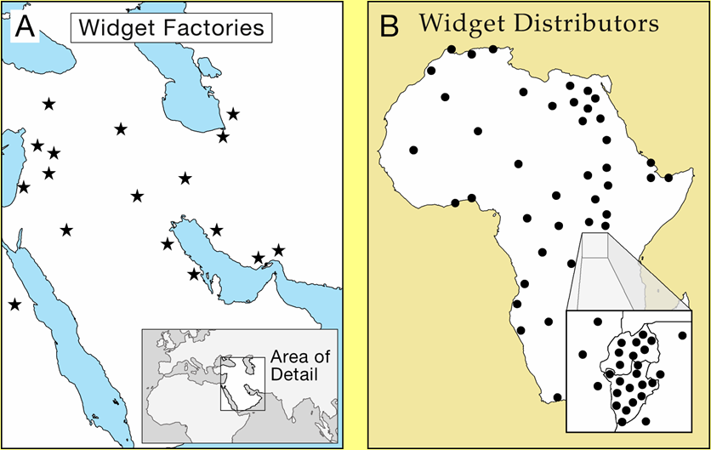
Inset
Can be used to show the primary mapped area in relation to a larger, more recognizable area (a locator map)
Shows Relative Location

Slide 27
Inset
Can be used to enlarge important or congested areas (a zoom, or blow-up map)
Shows Enlargement of an Area

Slide 28
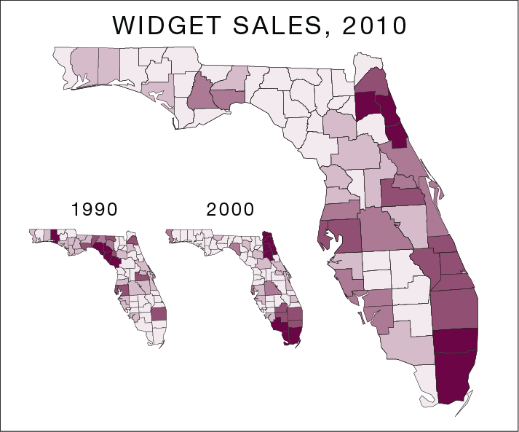
Inset
Can be used to show topics that are related to the map’s theme, or different dates of a common theme
Shows Related Themes or Dates

Slide 29
Title and Subtitle
The title and subtitle tell the map user what the map is about
Most thematic maps require a title
A title is sometimes omitted when a map is used as a figure in a written document, assuming that the title is clearly expressed in the figure caption
A well-crafted title can draw attention to a map

Slide 30
Title

Slide 31
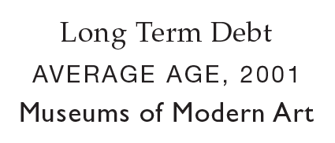

Title
The Title of a thematic map is a succinct description of the map’s theme
General reference maps typically employ the geographic region as the title
Unnecessary words should be omitted
But avoid cryptic abbreviations
Appropriate Titles
Inappropriate Titles
Notes:
Don’t include the word “Map” in a title!

Slide 32
Title with Subtitle
The subtitle, if employed, is used to further explain title
The geographic region and date are common components of the subtitle but is often omitted (when it is easily identifiable)
The subtitle should be horizontally centered below the title
The style of the Title and Subtitle should be plain

Slide 33
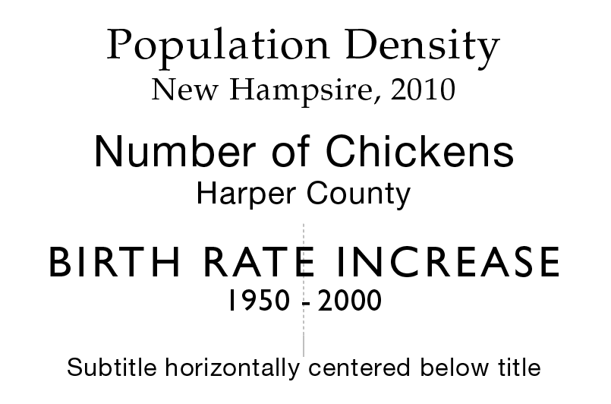
Title with Subtitle

Slide 34
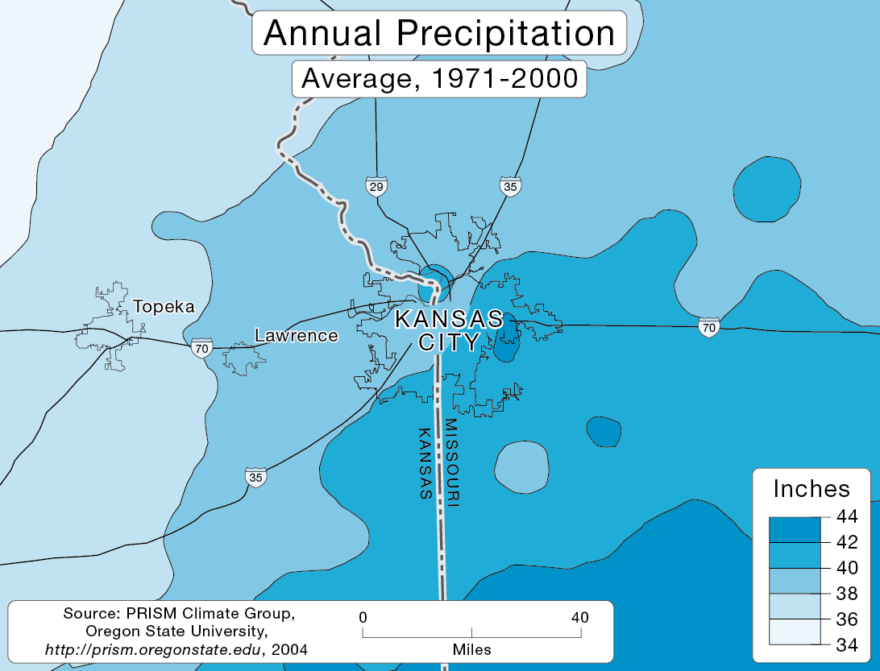
Title with Subtitle
Use a subtle mask behind the title and subtitle only if it is necessary to cover the underlying mapped area to improve legibility

Slide 35
Title with Subtitle
If possible, place the title at top-center,
The title should normally be the largest type on a thematic map – subtitle smaller
Both the title and subtitle should be short and to the point (limited to one line each)

Slide 36
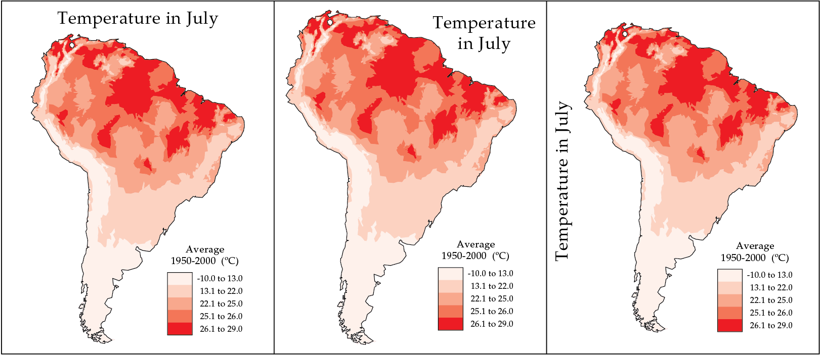
Discussion

Slide 37
Legend
Defines the symbols found on a map
On a thematic map, thematic symbols are defined, in addition to symbols for base information that are not self-explanatory
Legends for general reference maps often define all symbols found on the map—even if self-explanatory

Slide 38
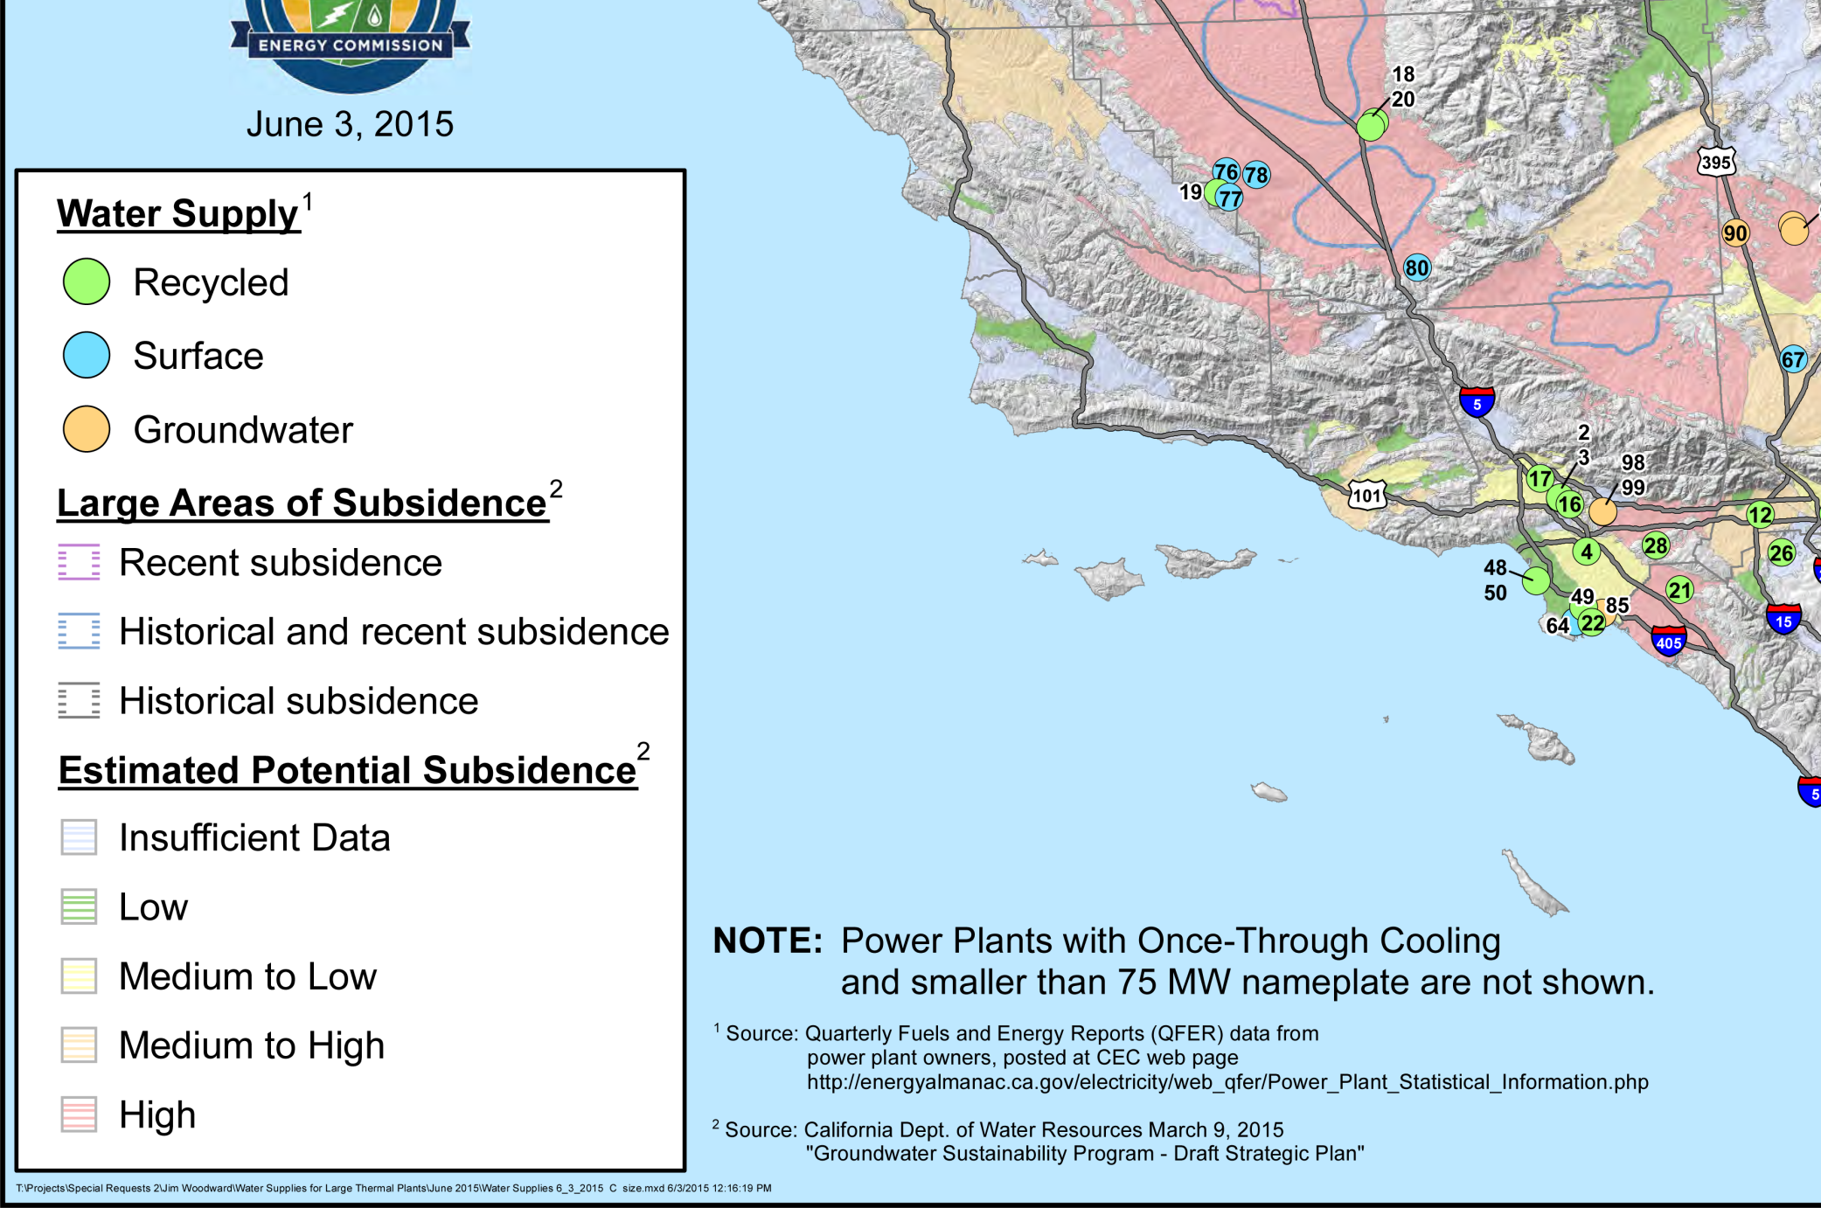
Legend

Slide 39
Legend
The style of the legend should be clear and straightforward
Use a subtle mask around the legend only if necessary to improve legibility
Symbols in the legend should be identical to those on the mapped area
This includes color and orientation
Don’t include the word “Legend”!
Notes:
size

Slide 40
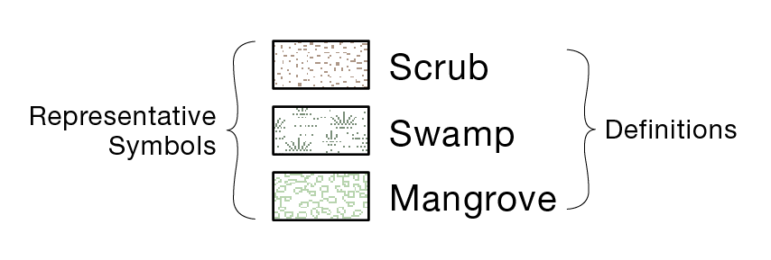
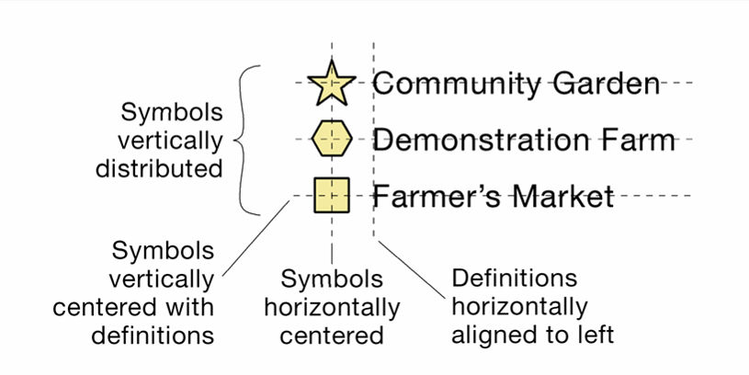
Legend
Representative symbols should be placed on the left and defined to the right
Symbols should be vertically centered with their definitions
Textual definitions and definitions consisting of individual numbers should be horizontally aligned to left

Slide 41
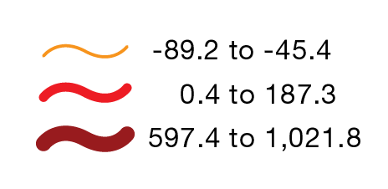
Legend
Definitions containing numbers of 1,000 or greater should incorporate commas
Decimal numbers smaller than one should incorporate a leading zero

Slide 42
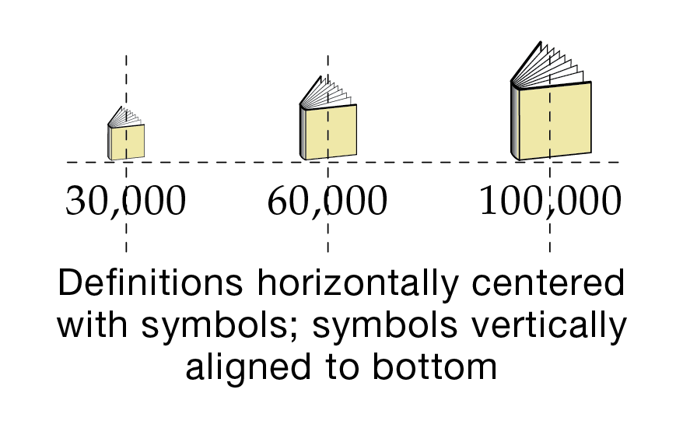
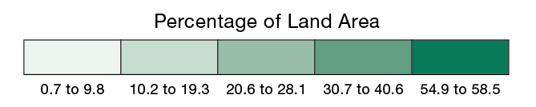
Legend
The legend can be oriented horizontally
Definitions are horizontally centered below the symbols they represent
Symbols are vertically aligned to bottom

Slide 43
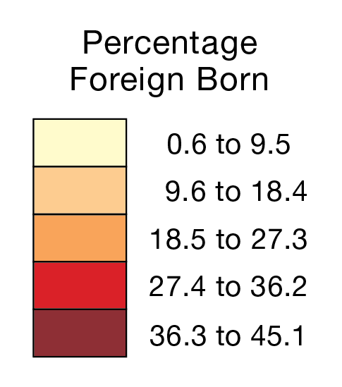
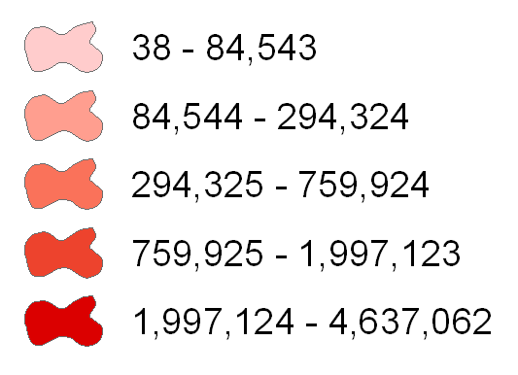
Legend
Legend rectangles should be connected when representing the magnitude of an attribute
Areal symbols on the mapped area are usually connected
Connected rectangles help to emphasize the idea that a continuum of values is being represented
Inappropriate

Slide 44
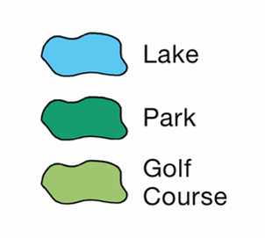
Legend
Areal symbols can be represented by irregular, amorphous polygons
Irregular polygons can look more natural
Most appropriate for qualitative categories of areal data (separated)
Appropriate

Slide 45
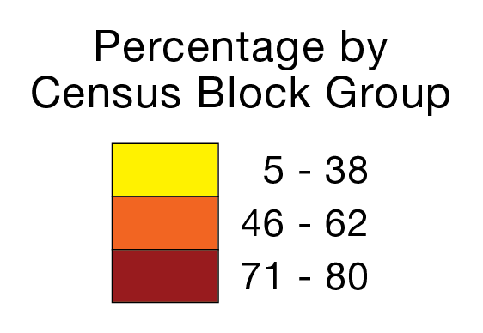
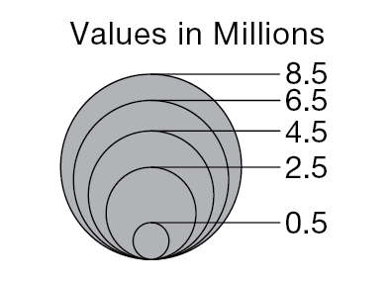
Legend
A legend heading is often included to further explain the map’s theme
The unit of measure (for quantitative data) and enumeration unit are common components of the legend heading

Slide 46
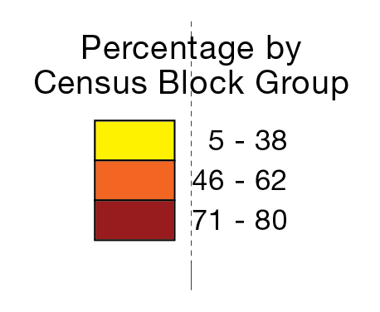
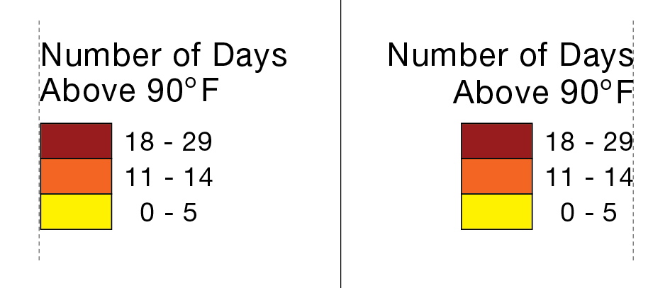
Legend
The legend heading should be placed above the legend, and be horizontally centered with it
Multiple lines of type can be horizontally centered (center justified)
Horizontal centering creates a self-balancing group of objects
Appropriate
Inappropriate

Slide 47
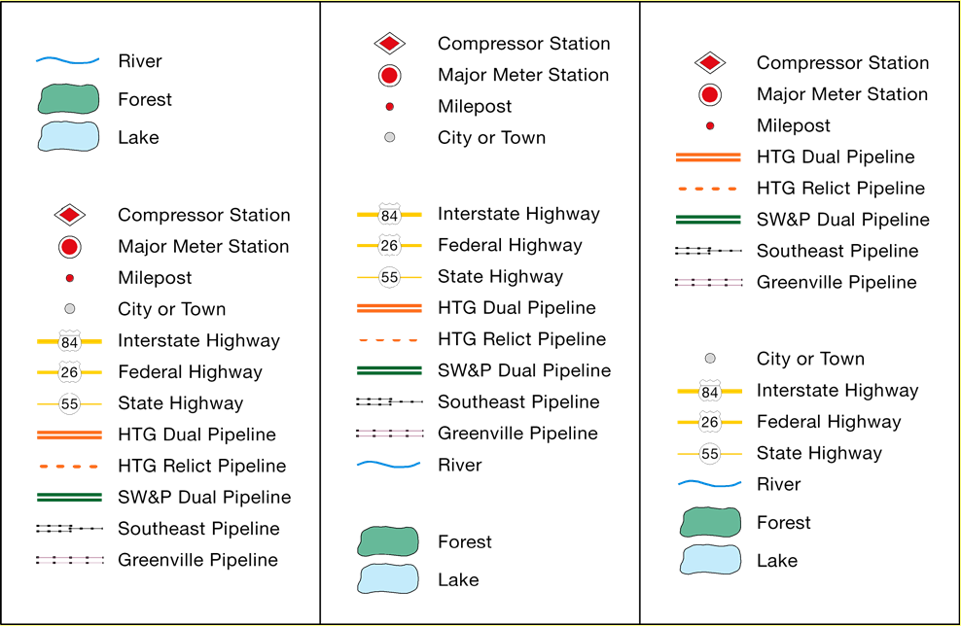
Legend
Legend symbols are often organized into groups, according to a certain logic

Slide 48
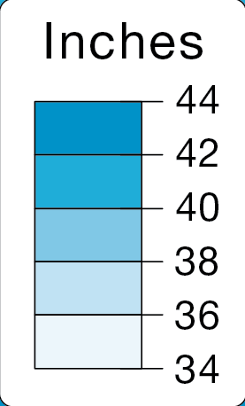
Legend
The legend should be large enough to be useful
But should not occupy vast areas of space, or challenge thematic symbols
Too Small
Too Large

Slide 49
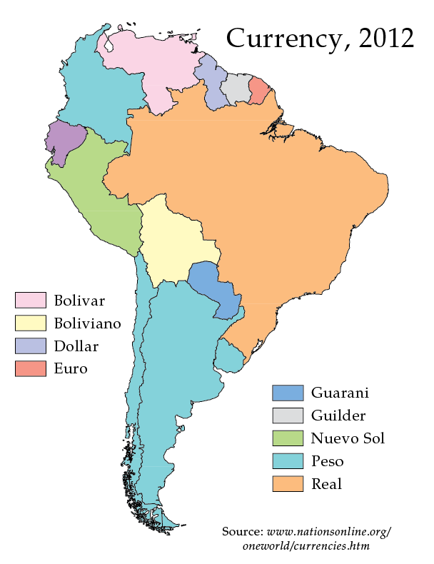
Legend
If possible, the legend should be visually centered within a larger portion of available space

Slide 50
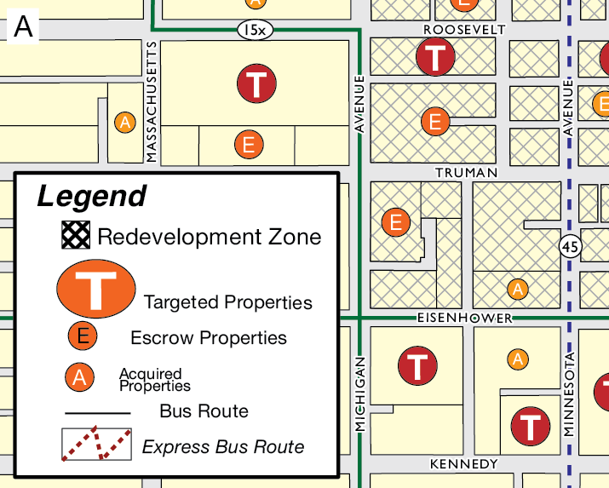
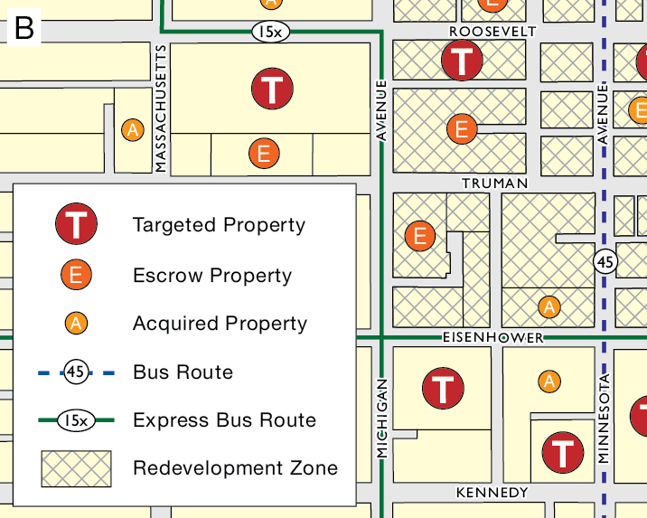
Discussion
Which one is better? And Why?

Slide 51
Data source
Allows the map user to determine where data were obtained
Sources of base information are normally omitted from thematic maps
Should be formatted similar to a standard bibliographic reference, but is often more concise and less formal

Slide 52
Data source
The words “Data Source:” or “Source:” should be included to avoid ambiguity
The data source indicates where data came from, not map authorship
A separate block of type can be used to indicate map authorship
The style of the data source should be plain and subtle
Publication names should be italicized
Multiple lines of type should be horizontally centered (center aligned)

Slide 53
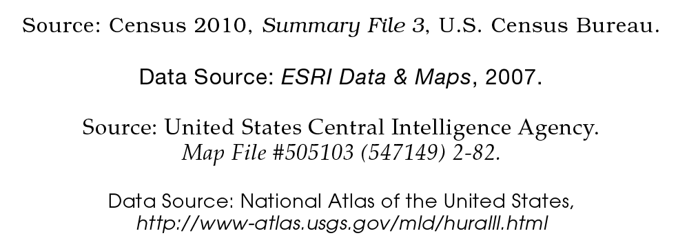
Data source

Slide 54
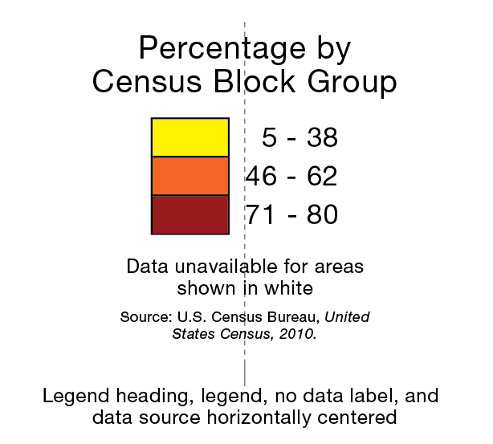
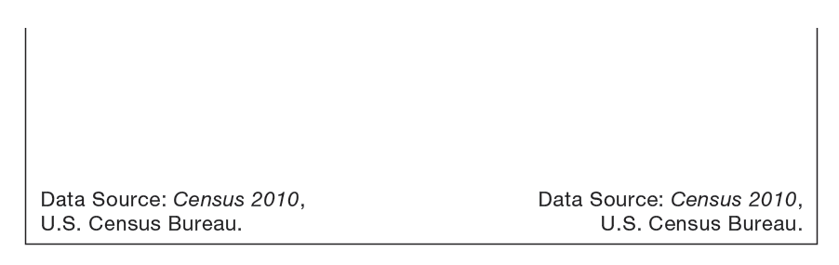
Data source
The data source should be among the smallest type on a map
Its purpose is to inform the curious, not to attract attention
Center it below the legend
Or tuck it into a lower corner

Slide 55
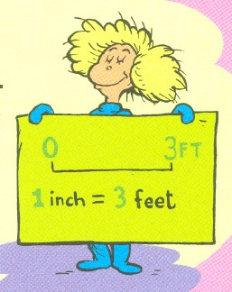
Scale
Indicates the amount of reduction that has taken place on a map, or allows the map user to measure distances
Can take three forms
Representative Fraction (1:24,000)
Verbal Scale (“One Inch to the Mile”)
Bar Scale or Scale Bar
Notes:
larger scale: greater detail and smaller area
Smaller scale: less detail and larger area

Slide 56
Scale

Slide 57
Scale
The bar scale is preferred format for inclusion on a thematic map
Resembles a ruler
Remains true when a map is enlarged or reduced (representative fractions and verbal scales don’t)
Include if distance information can enhance the map user’s understanding of the theme
Notes:
Layout view, it will not change

Slide 58
Scale

Slide 59
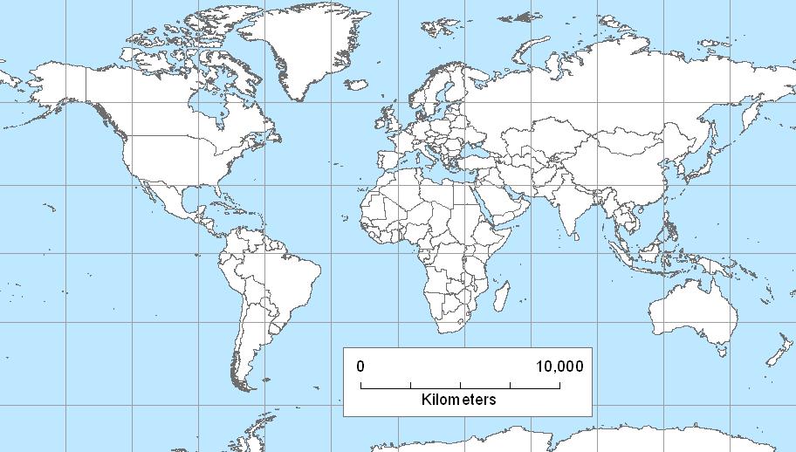
Scale
Use caution when employing bar scales on smaller scale maps
Scale is only accurate along standard lines
Scale is accurate only along the standard line
Notes:
Miller Cylindrical

Slide 60
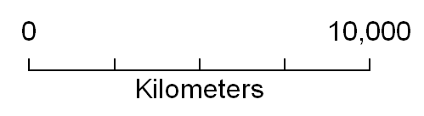
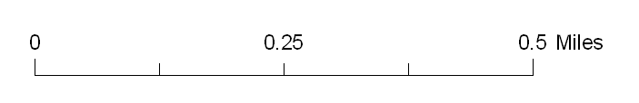
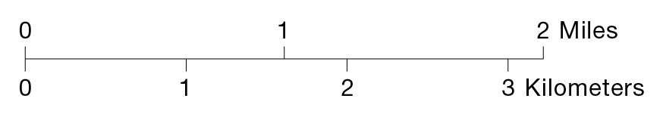
Scale
The maximum distance value should always be round and easy to work with
Incorporate a unit of measure that is appropriate for the intended audience
Incorporate both miles and kilometers if necessary
Choose a unit of measure that is appropriate for the maximum value

Slide 61
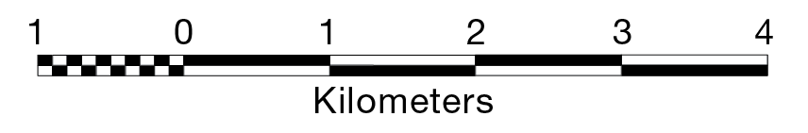
Scale
Don’t use an “extension scale” unless the map user requires it
Shows finer subdivisions of the scale bar allows for smaller distance measurements
The extension scale can be useful when employing a specific method of map measurement, but it can also be a source of confusion
And the “checkerboard” serves no purpose, other than to attract attention.
Notes:
An extension scale which shows finer subdivisions of the scale bar allows for smaller distance measurements.
If you have decided to use a scale bar and you have more than one mapped area (e.g., the coterminous U.S., Alaska and Hawaii), each mapped area requires its own scale bar if they are shown at different scales.

Slide 62
Scale
The style of the bar scale should be simple and subtle; it should not attract attention
Bulky and complex designs should be avoided
Line weights should be thin and type should be among the smallest on a map
Avoid the use of bold and italic type styles

Slide 63
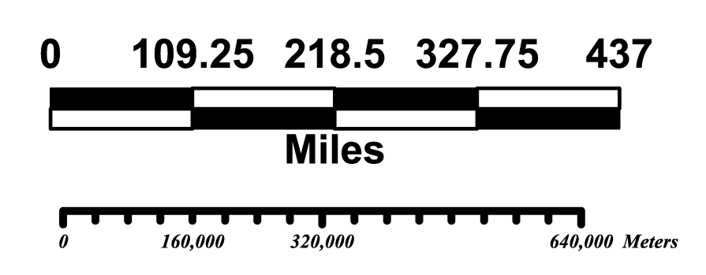
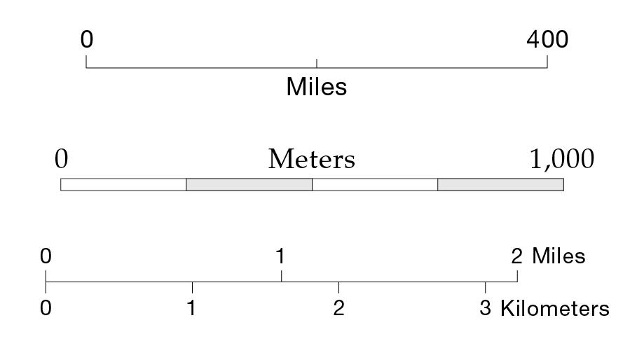
Discussion
Which group is better? And Why?
Poorly Designed
Well Designed

Slide 64

Scale
The compact form is more modern, the linear form is classic.
Peterson, 2021

Slide 65

Orientation
The indication of north on a map
Orientation can be indicated by a
North Arrow
Graticule (a system of grid lines, normally representing longitude and latitude)

Slide 66
Orientation
A north arrow is not required on every map!
The orientation of maps with north at the top is a long-standing tradition
It is assumed that “north is at the top” of most modern maps

Slide 67

Orientation
Include an indication of orientation if
The map is not oriented with geographic or “true” north at the top

Slide 68

Orientation
Include an indication of orientation if
The map is intended for use in navigation, surveying, orienteering, etc.

Slide 69

Orientation
Include an indication of orientation if
Geographic features are oriented in a manner that might confuse the map user

Slide 70

Orientation
A graticule indicates direction through the orientation of grid lines
Typically meridians that run north–south
The graticule can also provide positional information, such as latitude and longitude

Slide 71
Orientation
Use caution when using north arrows on smaller scale map
The direction of north can differ greatly in the maps with azimuthal and conic projection
N
N
N

Slide 72

Orientation
Use caution when using north arrows on smaller scale maps
Place the graticules beneath land masses
Peterson, 2021

Slide 73
Orientation
The style of the north arrow and graticule should be simple and subtle; they should not attract attention
Bulky and complex designs should be avoided
Line weights should be thin and type should be among the smallest on a map
Only north should be indicated

Slide 74


Discussion
Which group is better? And Why?
Poorly Designed
Well Designed

Slide 75

RELATIVE TYPE SIZES FOR CERTAIN MAP ELEMENTS
Sizes should decrease as follows
Title
Subtitle
Legend Heading
Legend Definitions
Source, scale, north arrow
Use the same type family for ALL map elements!

Slide 76
Which one is better?
Notes:
A noisy, inefficient communicator
A simple, efficient communicator

Slide 77
Thank you!

