Slide 1
Midterm Overview

Slide 2
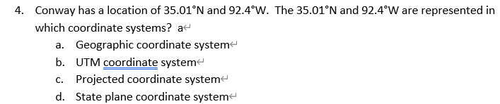

Slide 3
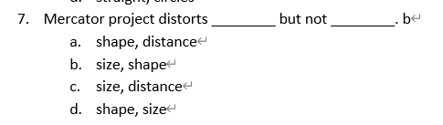
Mercator Projection

Slide 4
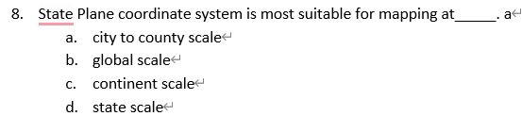
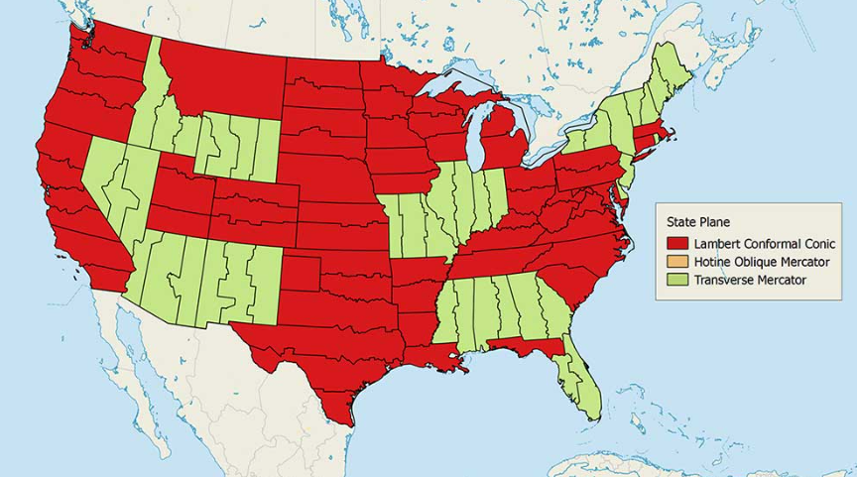

Slide 5
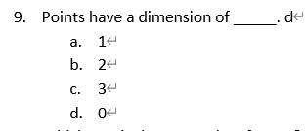
Point has no length, width, or height, only location

Slide 6
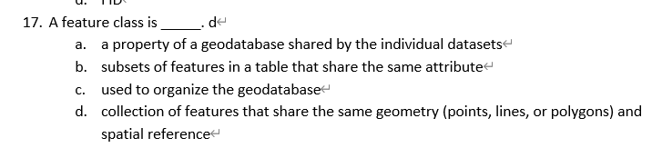

Slide 7
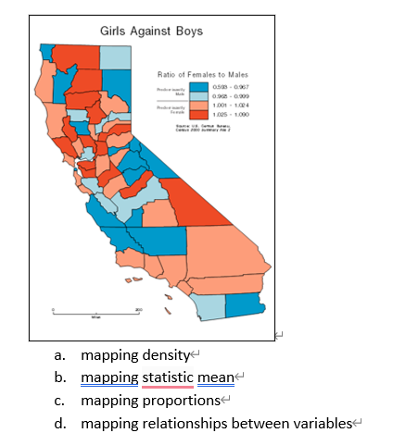

Slide 8
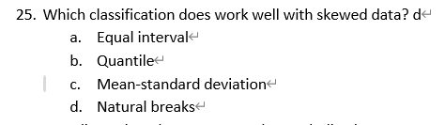
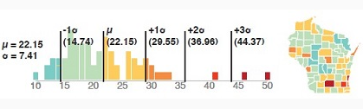
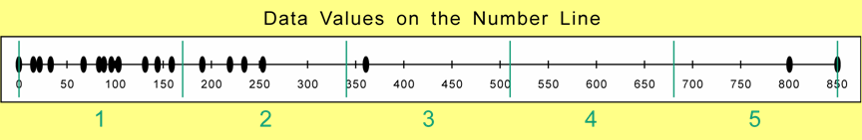
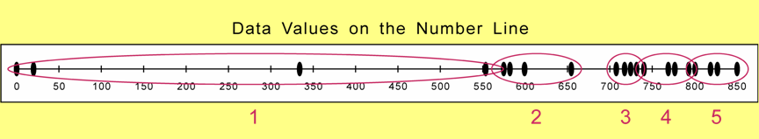
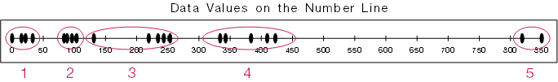
Mean- Standard deviation
Equal interval
Quantile
Natural Breaks

Slide 9
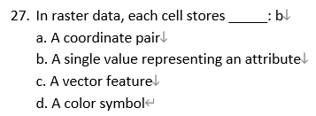
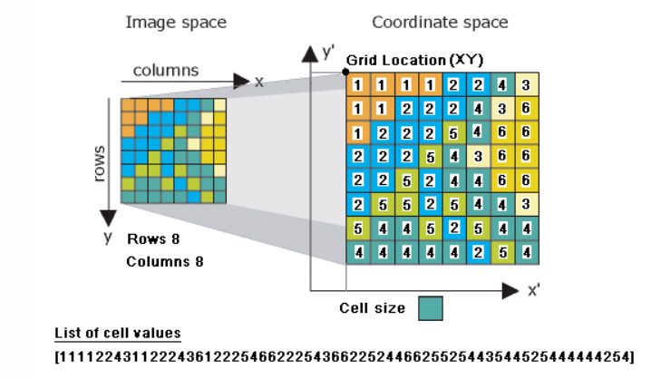

Slide 10
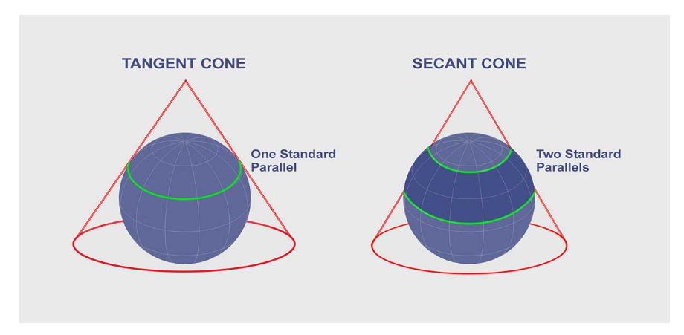
Map projections allow us to view 2D surface on the 3D Earth. F
There are no distortions at standard lines. T
There is a projection that produces no distortions. F

Slide 11
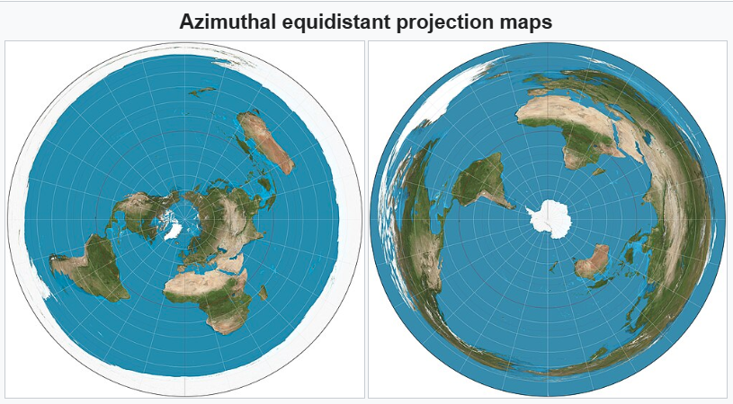
8. Azimuthal projections can maintain certain directions over the entire globe. F

Slide 12
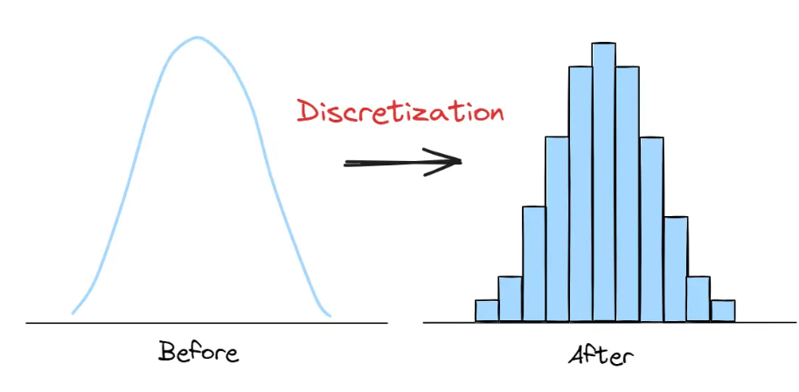
The process of grouping numeric data values into ranges or categories is called ___classification (discretization)

Slide 13
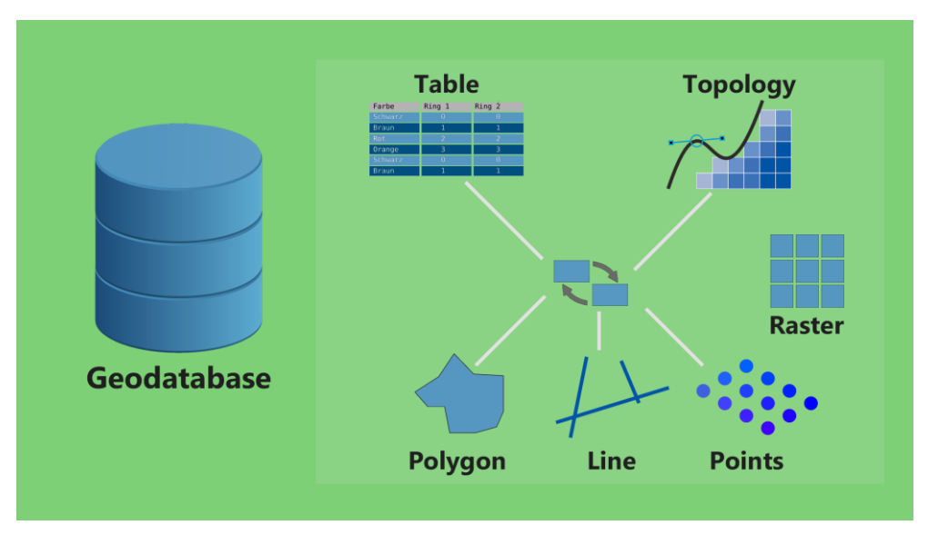
Name three types of data that can be stored in geodatabase_this is field type, not data type (short integer, long integer, text)_

