Slide 1

WEEK 03 Datum and projection
Instructor: Yanan Wu
fALL 2026

Slide 2
3.1 Datum

Slide 3
Overview
Datum
Shape of Earth
Geoid
Coordinate system
Geographic coordinate systems
Projected coordinate systems

Slide 4
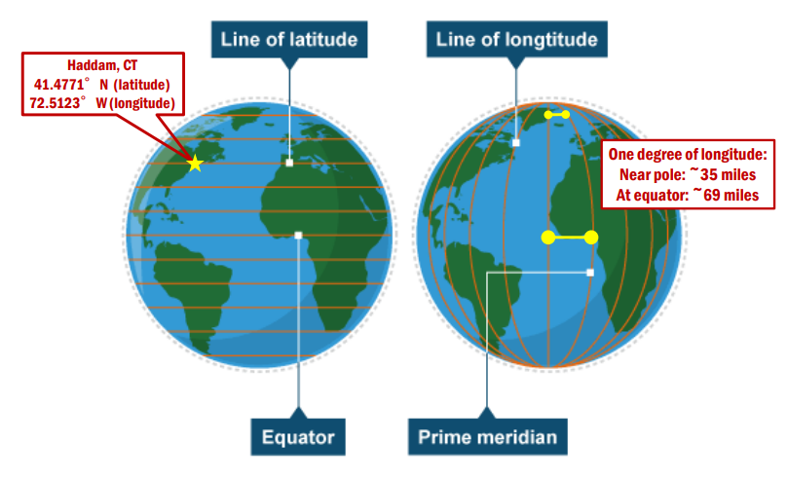
Latitude and longitude
To address this challenge, we need to transform the 3D Earth surface into a 2D map using datums, coordinate systems, and map projections.

Slide 5
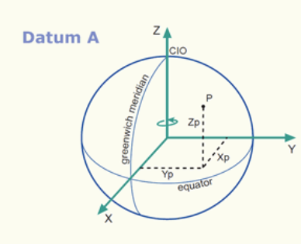
Datum
A datum characterizes the shape of the Earth’s surface and is defined by specifying the origin of the coordinate system, the orientation of the coordinate system, and the dimensions of the ellipsoid.
Notes:
The geoid is still a complex shape that cannot be modeled with a simple mathematical equation.
So, it is further simplified to an ellipsoid or spheroid model of the Earth.
This is a mathematical model that approximates the geoid as a smooth surface. Basically, this is a 3D ellipse.
Combining this model with ground survey data allows us to produce datums.
These datums serve as the reference systems by which we represent locations on Earth’s surface.
Our map and geospatial data will be referenced to one of these models.
The arc lengths may be measured by surface surveys, and the angles from astronomical observations

Slide 6
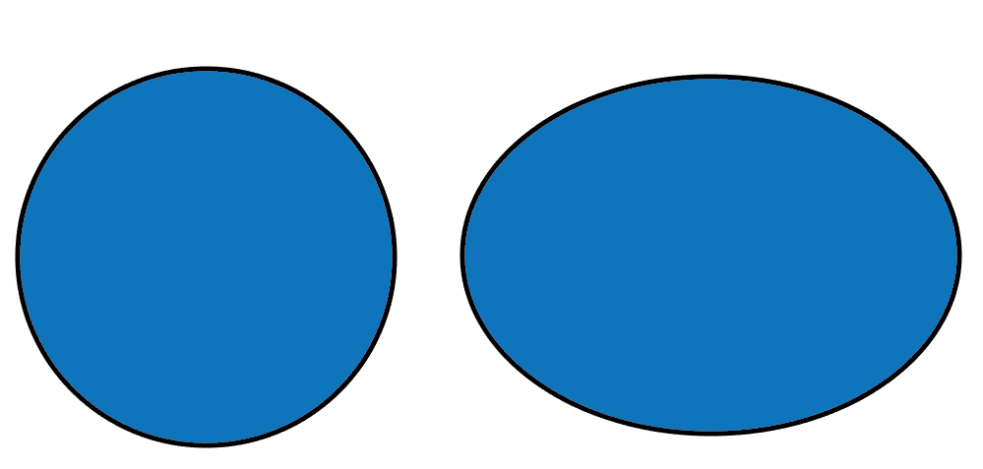
Shape of the Earth
Oblate spheroid
Equator has larger circumference than meridians
Mass not evenly distributed
Notes:
To begin, the Earth is not a perfect sphere. Instead, it is an oblate spheroid.
It is wider than it is tall. Or, the circumference of the equator is longer than the circumference of the prime meridian or any meridian.
This results from the centrifugal forces arising from the planet’s rotation.
Further, mass is not evenly distributed throughout the Earth.
So, the Earth is actually a fairly irregular shape, which results in complexity in regards to producing reference systems by which to reference our maps and data against it.

Slide 7
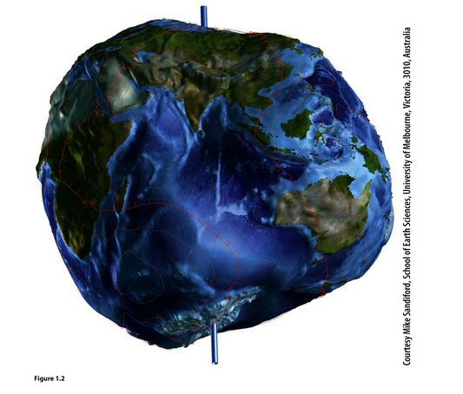
Shape of the Earth
Oblate spheroid
Equator has larger circumference than meridians
Mass not evenly distributed
Notes:
To begin, the Earth is not a perfect sphere. Instead, it is an oblate spheroid.
It is wider than it is tall. Or, the circumference of the equator is longer than the circumference of the prime meridian or any meridian.
This results from the centrifugal forces arising from the planet’s rotation.
Further, mass is not evenly distributed throughout the Earth.
So, the Earth is actually a fairly irregular shape, which results in complexity in regards to producing reference systems by which to reference our maps and data against it.

Slide 8
Which statement best describes the shape of the Earth?
A. A perfect sphere B. A flat circle C. An oblate spheroid D. A perfect ellipsoid

Slide 9
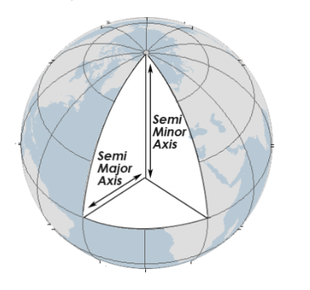
Shape of the Earth - Ellipsoid
An ellipsoid in GIS is a mathematically smooth, three-dimensional shape used to approximate the true, irregular shape of the Earth for coordinate calculations.
The major axis of an ellipse is the equatorial radius.
The minor axis is from the poles to the center.
Notes:
All spatial data must be referenced to the surface of the Earth so that they draw at the correct location in the map space.
This means that we need models of the Earth to which we can reference maps and data.
This is a component of the science of geodesy, which relates to measuring the Earth’s shape and positions on it.

Slide 10
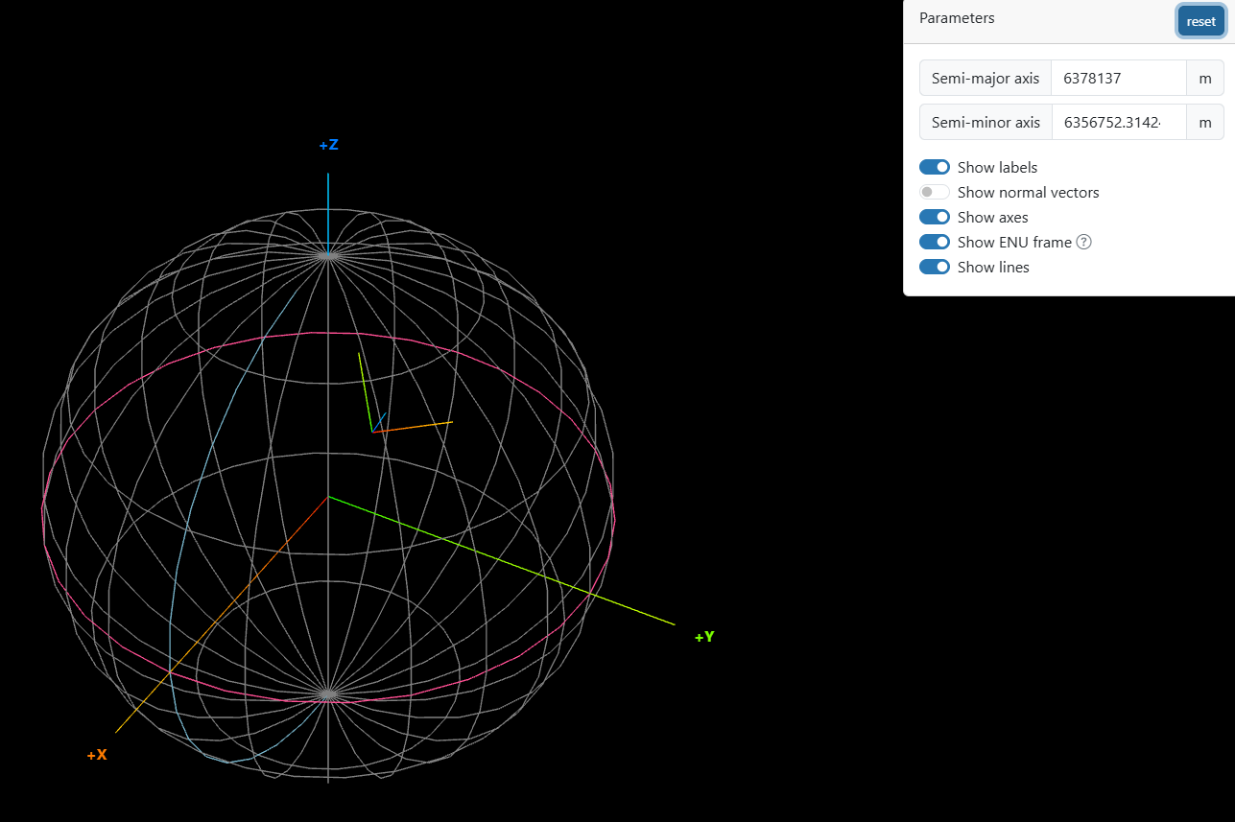
Visualize an ellipsoid.

Slide 11
True or False
An ellipsoid is designed to reproduce every mountain, valley, and ocean trench on Earth.

Slide 12
Which two measurements primarily define the size and shape of an ellipsoid?
A. Latitude and longitude B. Major axis and minor axis C. Elevation and depth D. Prime Meridian and Equator

Slide 13
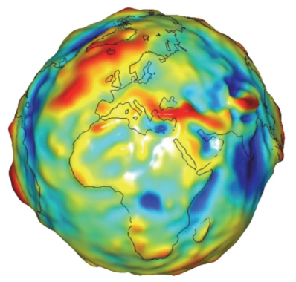
Shape of the Earth - Geoid
Geoid: gravity-related vertical reference
In geodesy, the geoid is an imaginary sea (mean sea level) that covers the entire Earth
It is not affected by wind, waves, the Moon, or forces other than Earth’s gravity.
The geoid is a gravity-based model of global mean sea level. It provides a reference surface for measuring elevation.
https://en.wikipedia.org/wiki/Geoid
Notes:
The geoid models the distribution of mass across the Earth, which is not uniform. The Earth is a bumpy surface.
This is partially accomplished by measuring gravitational forces across the globe.
A conceptualization of the geoid is a globe that is fully covered by water or has no continental masses.
Because there are differences in mass and gravitational forces across the globe, the water surface would not be smooth.
Instead, it would be a smoothly undulating shape.
This smoothly undulating shape that takes into account the distribution of mass is called the geoid.
The geoid surface can them be used as a reference for zero elevation.

Slide 14
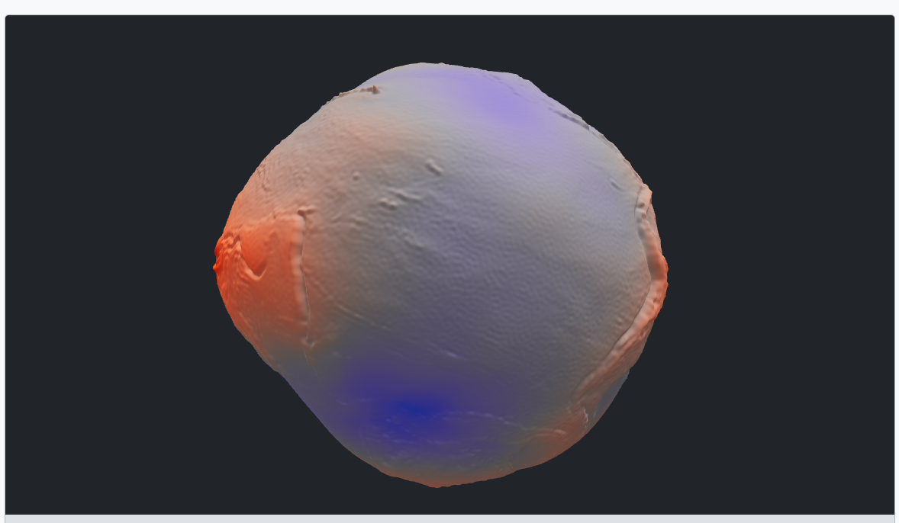
Geoid Height – Geoid 3D Model

Slide 15
True or False
The geoid is a perfectly smooth mathematical surface.
What causes the geoid to be irregular?
A. Political boundaries B. Uneven distribution of Earth’s mass C. Latitude lines D. Map projections

Slide 16
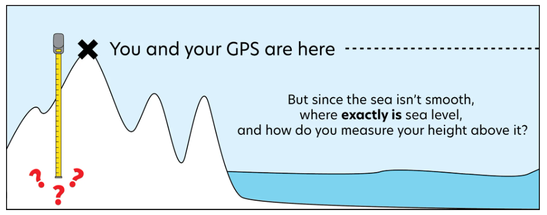
The Geoid and GPS Receiver Measurements

Slide 17
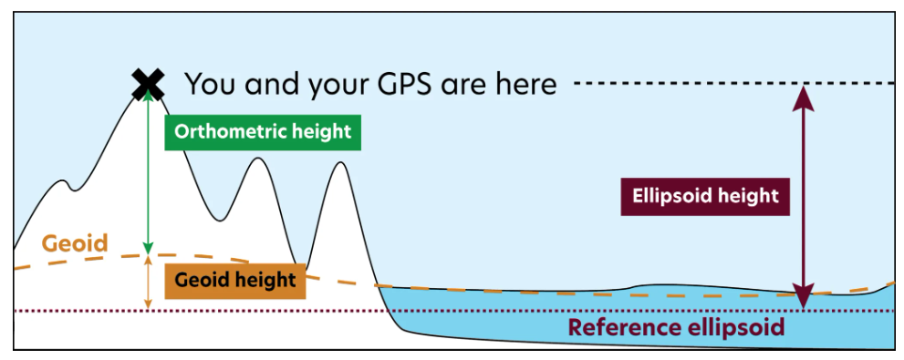
The Geoid and GPS Receiver Measurements

Slide 18
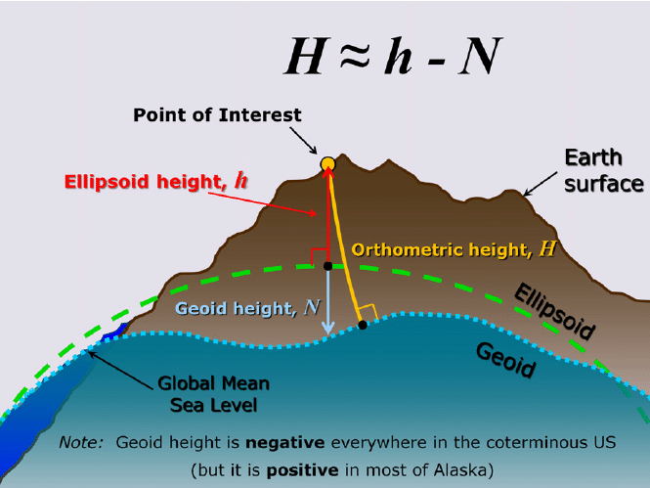
Geoid below ellipsoid

Slide 19
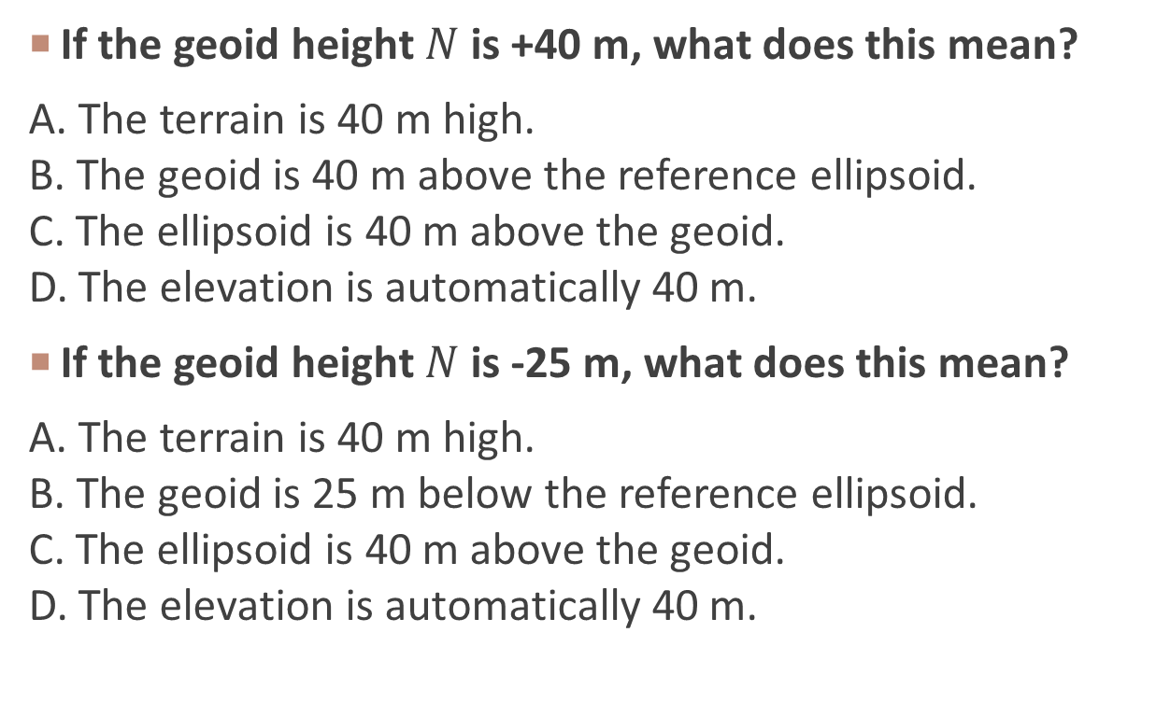
If the geoid height $N$is +40 m, what does this mean?
A. The terrain is 40 m high. B. The geoid is 40 m above the reference ellipsoid. C. The ellipsoid is 40 m above the geoid. D. The elevation is automatically 40 m.
If the geoid height $N$is -25 m, what does this mean?
A. The terrain is 40 m high. B. The geoid is 25 m below the reference ellipsoid. C. The ellipsoid is 40 m above the geoid. D. The elevation is automatically 40 m.

Slide 20
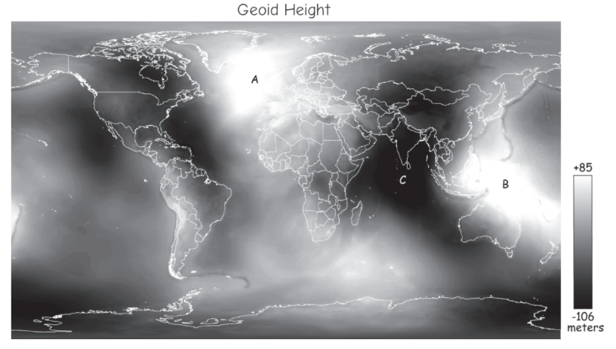
Geoid Height
🤔
Which areas have higher values of Geoid height?
A higher geoid height does not necessarily mean higher terrain, higher elevation, or more mountains.

Slide 21
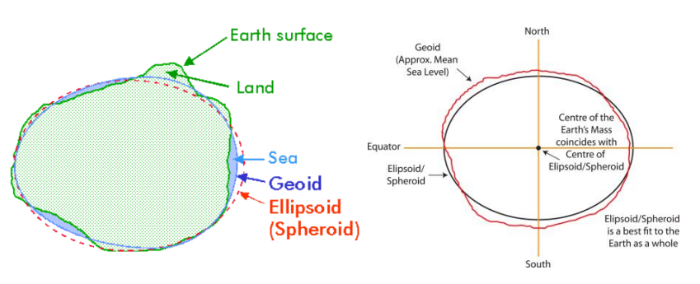
Ellipsoid and Geoid

Slide 22
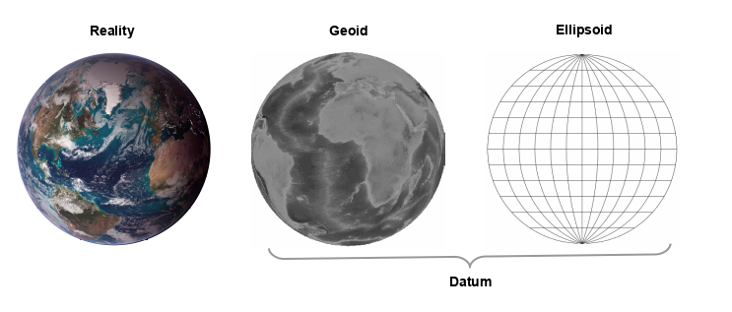
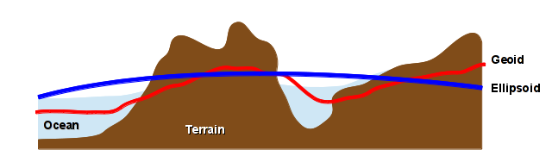
Relationship between terrain, an datum, and an ellipsoid
Notes:
NGS (National Geodetic Survey),Triangulation survey
For the most of the past 150 years, the most accurate observations were referenced to the Sun, stars, or other celestial bodies
Every few years

Slide 23
Which statement is correct?
A. Both the geoid and ellipsoid are perfectly smooth mathematical surfaces. B. The ellipsoid is gravity-based, while the geoid is purely mathematical. C. The ellipsoid is a smooth mathematical approximation; the geoid is gravity-based and irregular. D. The geoid represents mountains and terrain.

Slide 24
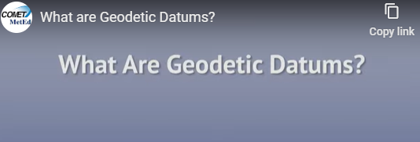
What is datum?

Slide 25
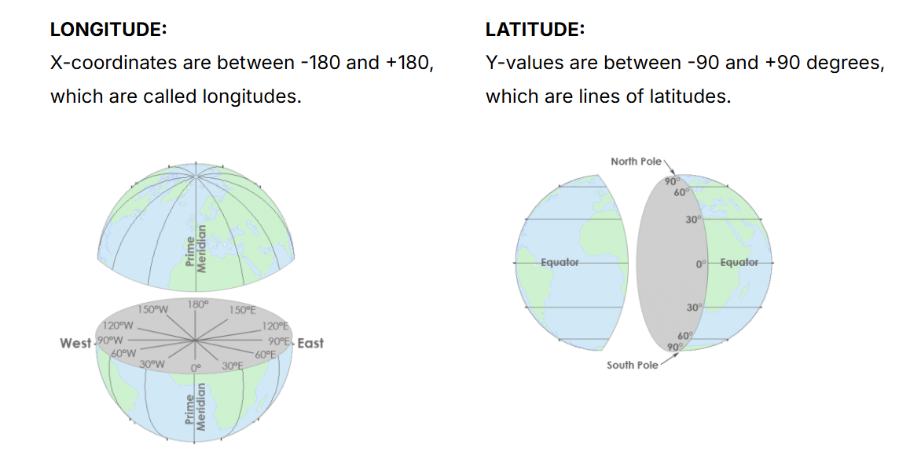
Horizontal datum
Ellipsoid model and reference system
It defines how to pinpoint locations on the Earth's surface using latitude and longitude coordinates

Slide 26
The World at Zero: Equator & Prime Meridian
Using Google Earth, find the location at the intersection of the Equator (0° latitude) and the Prime Meridian (0° longitude). Does this point fall on land or in the ocean?
Identify one country that lies near the Prime Meridian (0° longitude).
Identify one country that lies near the Equator (0° latitude).
* Click view – show gridlines to display gridlines on earth

Slide 27
Common Horizontal Datum
NAD27: North American Datum of 1927
NAD83: North American Datum of 1983
NAD83(xx), xx represents year, version of datum adjustment
NAD83(HARN/HPGN): High Accuracy Reference Networks or High Precision Geodetic Networks
WGS84: World Geodetic System 0f 1984
WGS84(xx)
ITRF: International Terrestrial Reference Frames
ITRF89, ITRF90, ITRF91
Notes:
There are different datums by which we reference are horizontal measurements or coordinates on the Earth.
Examples include the North American Datum of 1927 (or NAD27), the North American Datum of 1983 (or NAD83), and the World Geodetic System of 1984 (or WGS83).
In North America, it is common to reference data against NAD83 or WGS84.
Global Navigation Satellite Systems, or GNSS, often make use of WGS84 as a worldwide datum.
Again, think of these as different models of the Earth, all of which are simplifications.
The HARN and subsequent NAD83 adjustments are largely satellite-based, including WGS84 and ITRF

Slide 28
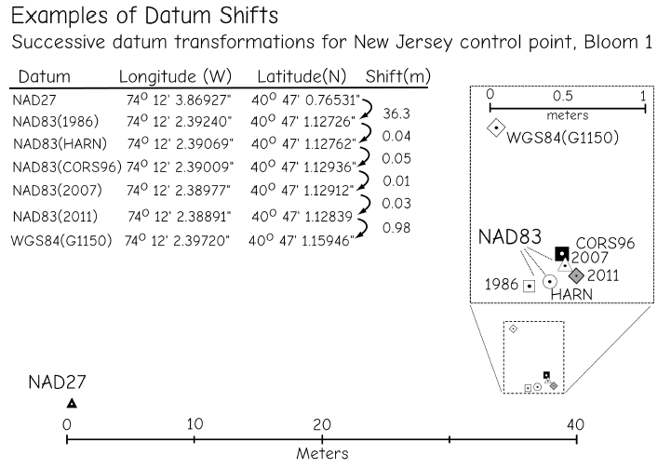
Datum
WGS84 and ITRF can be considered equivalent for most purpose, as difference between them since 1995 are generally only a few centimetres
Bolstad, 2019
Notes:
Tectonic movement, crustal deformation

Slide 29

Why are datums important?
Tracking land-based wildlife with GPS

Slide 30


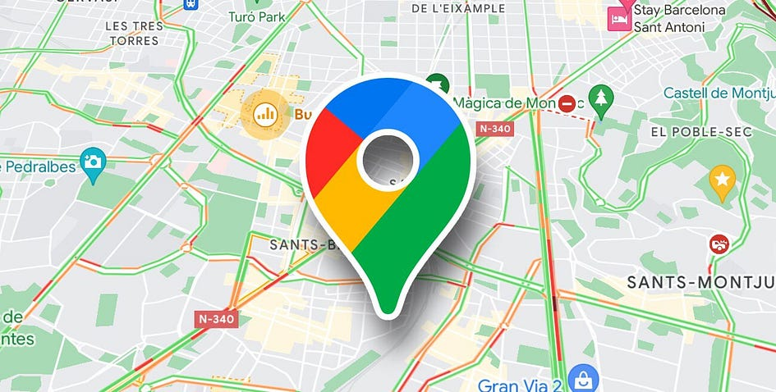
Which datum google map use?
NAD27 or WGS84?

Slide 31
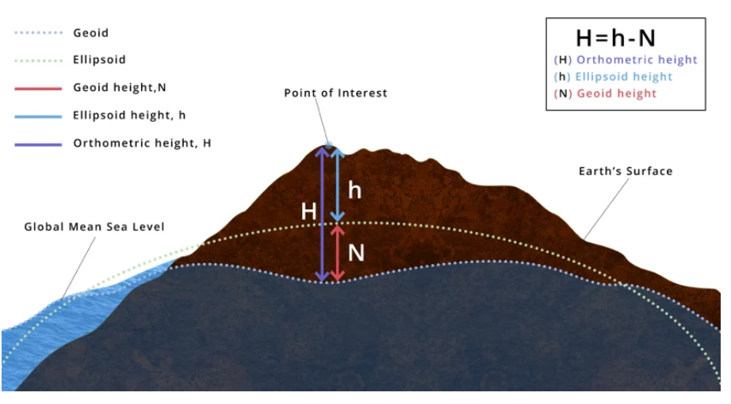
Vertical datum
A standardized reference surface used to define elevations and depths on the Earth's surface, serving as a "zero" point for measurements.

Slide 32
Vertical datum - examples
Elevation of cities and landmarks 🏔️
– Example: The elevation of Denver (“Mile High City”) is measured relative to NAVD88 in the U.S.
Flood levels & floodplain mapping 🌊
– FEMA flood maps use vertical datums (e.g., NAVD88) to define the Base Flood Elevation (BFE).

Slide 33
Common vertical datum
NGVD29: National Geodetic Vertical Datum of 1929
No geoid, mean sea level
NAVD88: North American Vertical Datum of 1988 (NAVD88)
GEOID03, GEOID09, GEOID12B
Notes:
Example vertical datums in North America include the National Geodetic Vertical Datum of 1929 (NGVD29) and the more recent North American Vertical Datum of 1988 (NAVD88).
As technologies advance, updated versions of horizontal and vertical datums will be released.
GEOID18 is intended for use with coordinates in the North American Datum of 1983 (2011) [NAD 83 (2011) epoch 2010.00]. It provides orthometric heights consistent with the North American Vertical Datum of 1988 (NAVD 88), the Puerto Rico Vertical Datum of 2002 (PRVD02), or the Virgin Islands Vertical Datum of 2009 (VIVD09).

Slide 34
A vertical datum primarily provides a reference for measuring:
A. Latitude B. Longitude C. Elevation and depth D. Map scale

Slide 35
Scenario Question
Two engineers measure the same floodwater surface:
Engineer A: elevation = 100.2 ft
Engineer B: elevation = 99.1 ft
Before concluding that one measurement is wrong, what should you check?
A. Map color B. Vertical datum C. Computer brand D. Latitude only

Slide 36
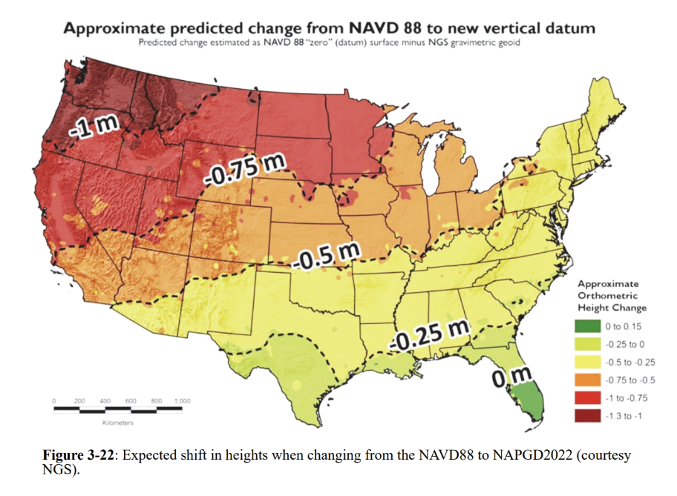
Datum Inconsistent

Slide 37
A researcher tracks the same bear for 10 years. The first dataset uses NAD27 and the new GPS dataset uses WGS84. Can the researcher immediately overlay the coordinates and assume they represent exactly the same locations?
A. Yes B. No

Slide 38
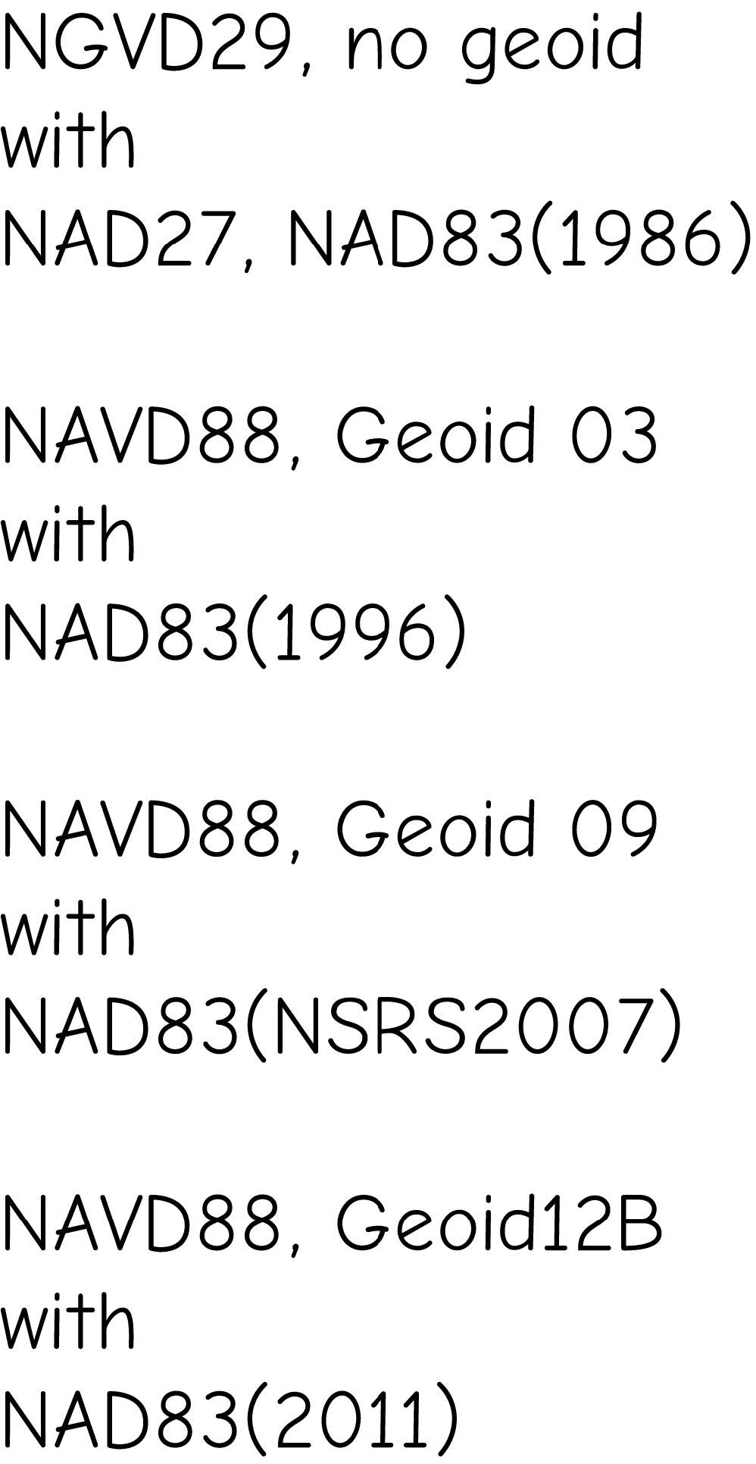
Datum Pairing
Pairing for horizontal and vertical datums for North America
Notes:
Example vertical datums in North America include the National Geodetic Vertical Datum of 1929 (NGVD29) and the more recent North American Vertical Datum of 1988 (NAVD88).
As technologies advance, updated versions of horizontal and vertical datums will be released.
GEOID18 is intended for use with coordinates in the North American Datum of 1983 (2011) [NAD 83 (2011) epoch 2010.00]. It provides orthometric heights consistent with the North American Vertical Datum of 1988 (NAVD 88), the Puerto Rico Vertical Datum of 2002 (PRVD02), or the Virgin Islands Vertical Datum of 2009 (VIVD09).

Slide 39
2.2 coordinate system

Slide 40
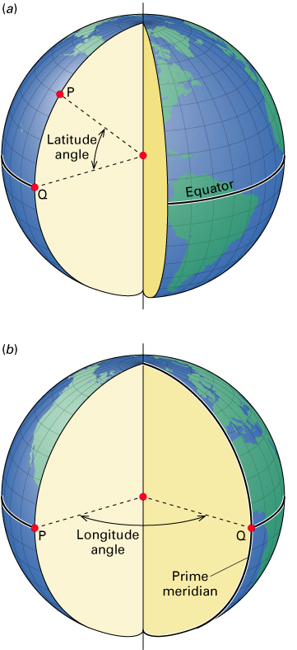
Geographic Coordinate Systems
Coordinates on a Sphere
Latitude and Longitude
Specified as angles or degrees
Latitude: Angles from equator
Range 0-90 N/S
Longitude: Angles from prime meridian
Range 0-180 E/W
© 2013 by John Wiley & Sons, Inc. All rights reserved.
Notes:
Coordinates on Earth are measured in degree units relative to the center of the Earth.
Latitude is measures as an angle of rise relative to the center of the Earth while longitude represents angles of rotation around the center of the Earth.
Note that it is not easy to make measures of distance using lengths on a spherical surface.

Slide 41
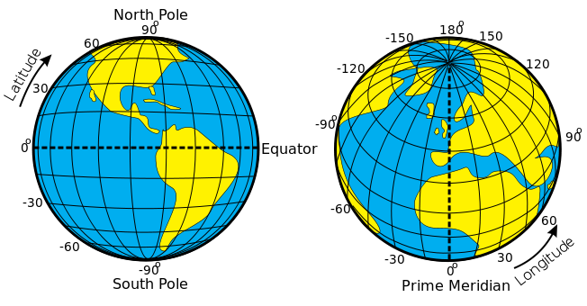
Geographic Coordinate Systems
Latitude (Parallels):
Measures north to south
90° in each hemisphere
Increases as you go north in the northern hemisphere
Increases as you go south in the southern hemisphere
Zero in Equator
https://commons.wikimedia.org/wiki/File:Latitude_and_Longitude_of_the_Earth.svg
Notes:
Latitude measures north to south or up and down. There are 90° of latitude in each hemisphere. The value increases as you move north or south relative to the equator. The equator has a latitude of 0° and the poles have a latitude of 90°.

Slide 42
Geographic Coordinate Systems
Longitude (Meridians)
Measures east to west
180° in each hemisphere
Increases as you go east in the eastern hemisphere
Increases as you go west in the western hemisphere
Zero is Prime Meridian, going through Greenwich, England
https://commons.wikimedia.org/wiki/File:Latitude_and_Longitude_of_the_Earth.svg
Notes:
Longitude measures east to west or side to side. There are 180° of longitude in each hemisphere, east and west. Longitude increases has you move west in the western hemisphere and increase as you move east in the eastern hemisphere. 0° longitude is refined relative to the prime meridian which passes through Greenwich, England.
It makes sense to use the equator to represent 0° latitude. The 0° reference for longitude is somewhat arbitrary.
We can specify the northern or southern hemispheres for latitude by including an “N” or “S” with the measurements. For longitude, we can use “E” or “W”.
In software, this can be problematic due to the mix of numbers and letters. So, instead we tend to use positive angles to represent the northern or eastern hemispheres and negative angles to represent the southern or western hemispheres.
Coordinates referenced to a datum representing the 3D Earth or globe are known as geographic coordinate systems as opposed to projected coordinate systems, which will be discussed later.

Slide 43
Geographic Coordinate Systems
1 Degree = 60 Minutes = 3600 Seconds
˚ = Degrees
‘ = Minutes
“ = Seconds
1.5 ˚ =1 ˚ 0.5X60’= 1 ˚ 30’
1 ˚ 30’ = 1° + (30’/60’) = 1.5°
Notes:
One degree of latitude or longitude can be a large distance. So, in order to provide precise measurements, we need to be able to further divide degrees into smaller units.
A degree can be divided into minutes and second, similar to an hour on a clock.
1 degree equals 60 minutes or 3600 seconds.
We can also use decimal degrees as opposed to minutes and seconds.
It is possible to convert between degrees, minutes, and second and degrees and decimal degrees.

Slide 44
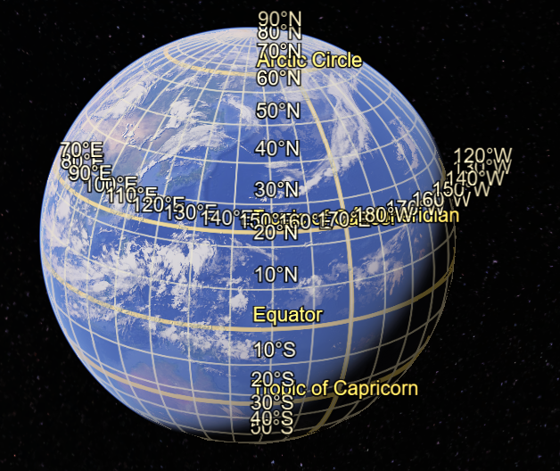
Geographic Coordinate Systems
Advantages:
Accurate representation
Latitude and longitude lines
Without distortion
Disadvantages
Expensive to make
Cumbersome to handle and store
Difficult to measure distance
Not fully visible at one view
Image from Google Earth
Notes:
There are some advantages to modeling the Earth as a 3D globe. First, this is an accurate representation in which map features and latitude and longitude lines can be plotted without distortion.
However, there are some disadvantages. Making globes can be expensive. They are also cumbersome to handle and store. It is also not easy to make distance measurements on the curved surface of the globe. Duo to the 3D nature of a globe, it is not possible to view the entirety of Earth’s surface from a single vantage point.
So, we need a means by which to represent the curved, 3D Earth in a flat map space. We do this using projections, which we will discuss next.

Slide 45
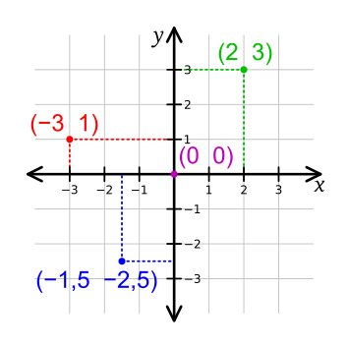
Projected Coordinate Systems
Map projections allow us to view the 3D Earth on a 2D surface
Earth is mathematically projected to a surface that can be made flat
We now make measurements in distance or length units as opposed to degrees
https://commons.wikimedia.org/wiki/File:Cartesian_coordinate_system_(comma).svg
Notes:
Instead of using a the 3D spherical globe, we can mathematically transform the Earth into a flat map space.
Now, instead of making measurements of distance or length in angles, we can make measurements in length units.
These 2D surfaces are known as projected coordinate systems or map projections.
They allow us to make measurements in a Cartesian coordinate system on a plane.

Slide 46
Projected Coordinate Systems
They allow us to make measurements in a Cartesian coordinate system on a plane
These 2D surface are known as map projections.
https://commons.wikimedia.org/wiki/File:Cartesian_coordinate_system_(comma).svg

Slide 47
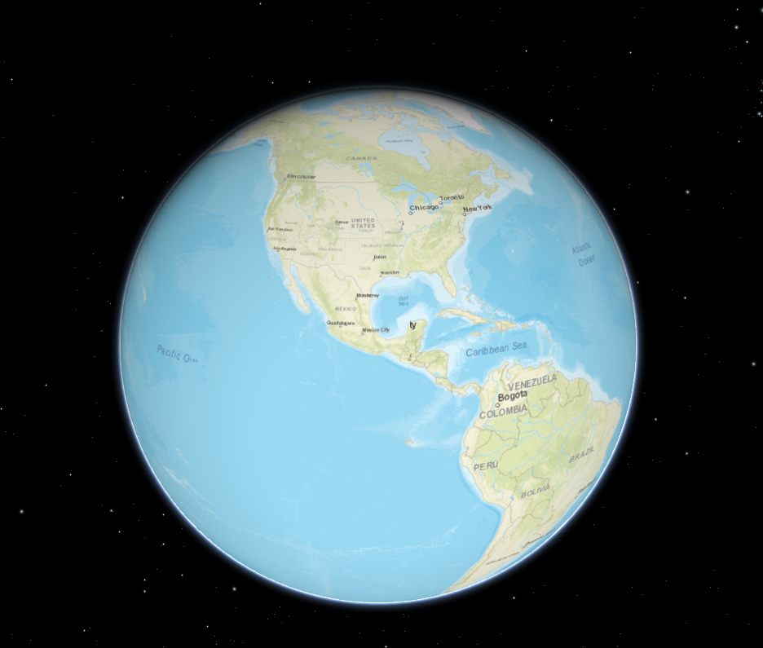
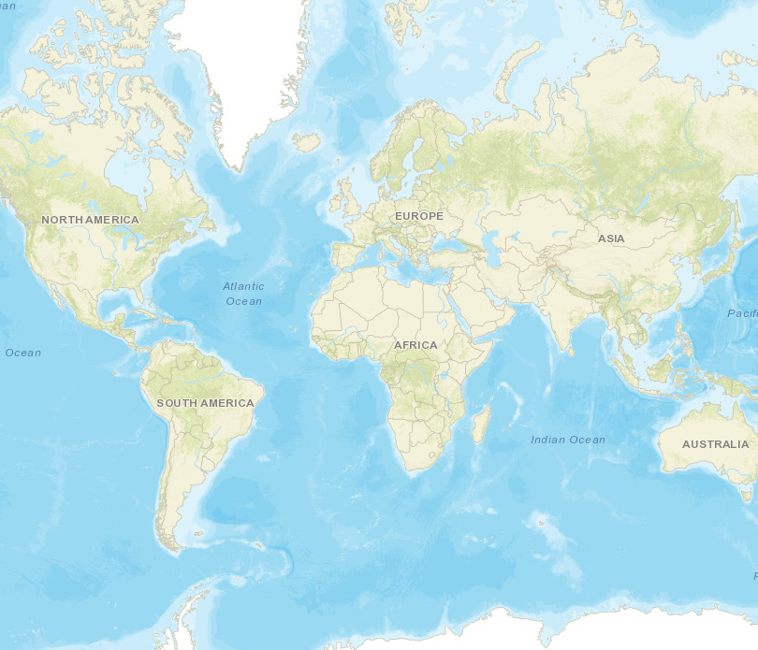
Geographic vs Projected Coordinate Systems
Image from ArcGIS API for JavaScript
Image from ArcGIS API for JavaScript
Notes:
This slide provides an example of the difference between geographic and projected coordinate systems.
The globe provides a 3D representation of the Earth where measurements are made in angles.
In contrast, projections are 2D and allow for measurements to be made in Cartesian coordinate space.

Slide 48
Well-Known ID - wkid
Defines a Coordinate System
It identifies a specific system for measuring locations on the Earth's surface, including geographic coordinates (like latitude and longitude) and projected coordinates.
Examples of WKIDs:
4326 (WGS 84)

Slide 49
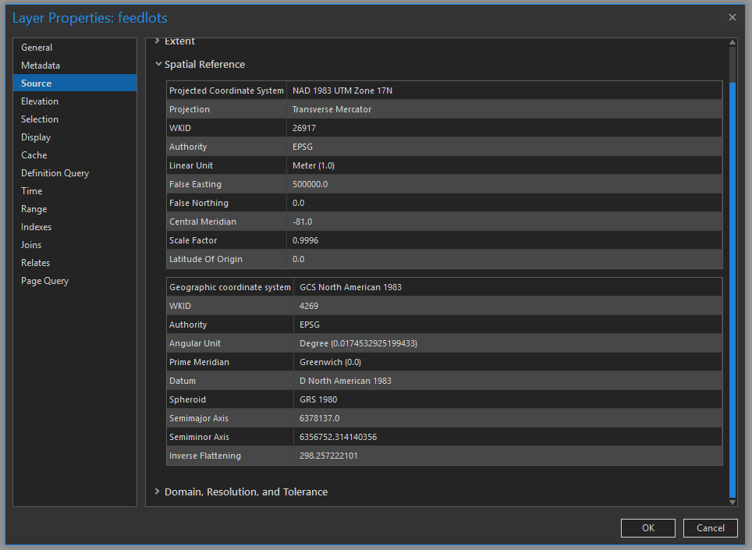
Datum/Projection Info in ArcGIS
Notes:
Datum and sometimes projection information are associated with maps and geospatial data layers.
In ArcGIS Pro, datum and projection information for a layer can be found in the Source tab.
We will talk about projections later in this module.

Slide 50
2.3 Lab session

Slide 51
Lab 02: datum and projection
Due by Midnight (11:59 pm) on Monday, Sep 8, 2025
Submit a word document only include question and answer

