Slide 1

WEEK 04 Geospatial Data lecture
Instructor: Yanan Wu
fALL 2026

Slide 2
4.1 Geospatial data

Slide 3
Overview
Geospatial data
Vector
Point
Line
Polygon
Raster
Pixel

Slide 4
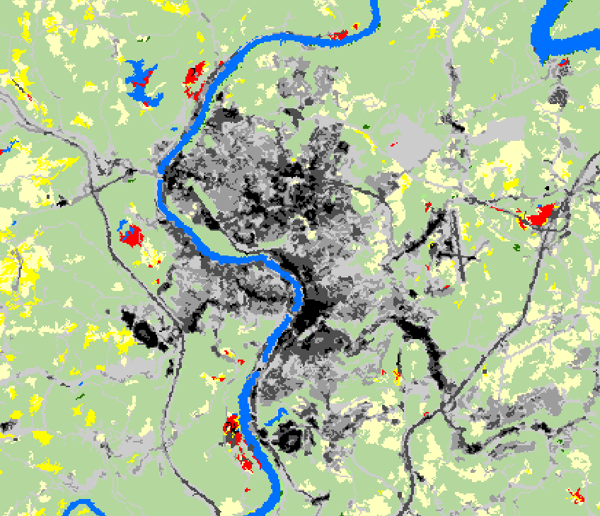
Geospatial data
Two data models
Vector Data
Discrete
Points, lines, and polygons
Raster Data
Space filling
Cell- or pixel-based
Vertex
Node
Notes:
Two broad types of geospatial data are available: vector data and raster data.
Vector data generally represent discrete features as points, lines, or polygons.
Raster data generally represent continuous features as pixels or grid cells.
We will begin with a discussion of vector data.

Slide 5
Vector Data
Vector Data Structure
Vector data are made up of connected vertices.
End vertices are called nodes.
Vertices can be connected as lines and polygons.
Vector data are made up of coordinate points.
Vertex
Node
Notes:
As mentioned above, all vector data are made up of coordinates. Points are individual coordinates while lines and polygons are made up of interrelated coordinates.
These individual coordinates are called vertices. Vertices that occur at or define the end of a line segment are called nodes.
Again, all vector data are made up of coordinate points.

Slide 6
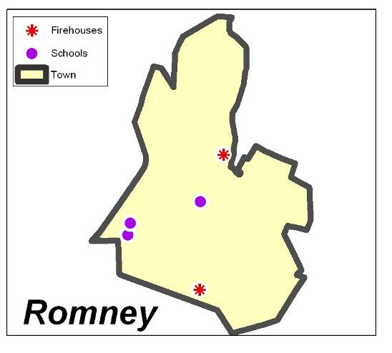
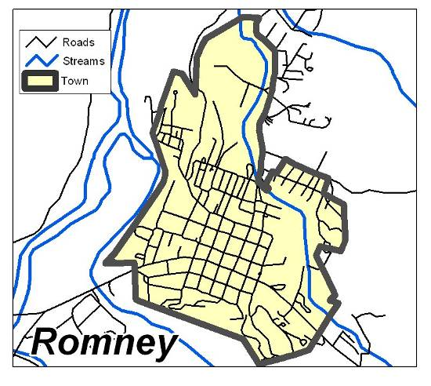
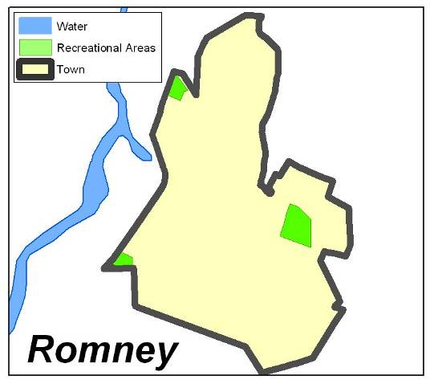
Vector Data
X,Y
X,Y
X,Y
X,Y
X,Y
X,Y
Points
Lines
Polygons
X,Y
X,Y
X,Y
Coordinate locations, Zero-dimensional
One-dimensional,
Length, No width
Two-dimensional,
Length and width, enclose an area
Examples by Dr. Mike and Dr. Jackie Strager
Notes:
Vector data can be represented as points, lines, or polygons.
Point data are simply coordinate pairs with associated attributes. They have no spatial dimensions, since they do not have length or width.
Lines are a series of coordinate pairs connected to form a line. They have one spatial dimension, since they have length but not width.
Polygons are a series of coordinates in which the first and last coordinates are connected to form a closed feature or area. They have both length and width, so have two spatial dimensions. Since they have length and width, they have an area.

Slide 7
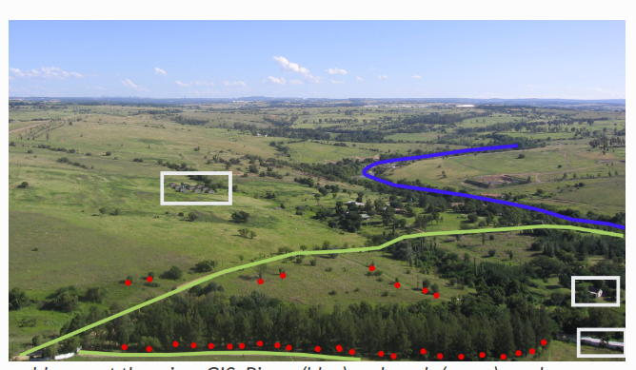
representation

Slide 8
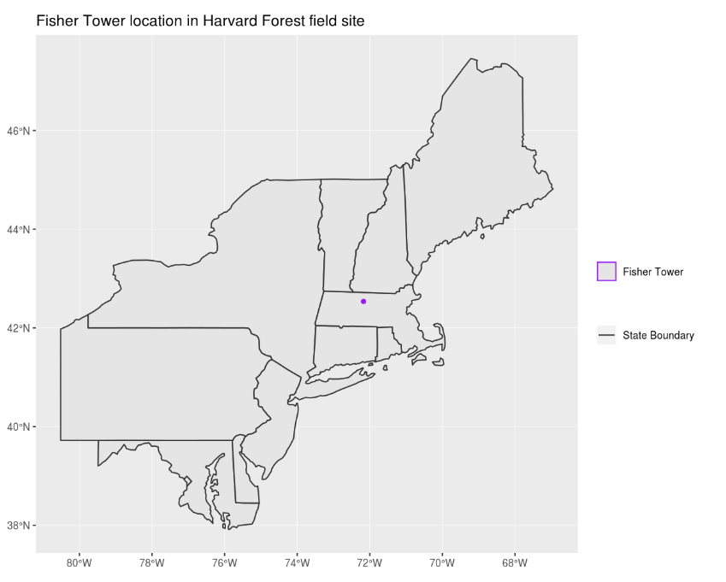
representation
🤔
Identify which features are represented by which vector type.

Slide 9
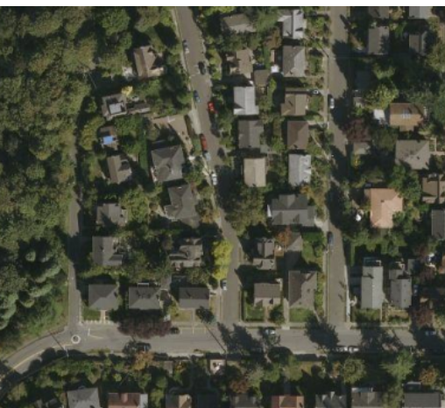

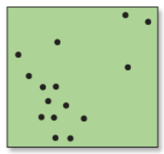
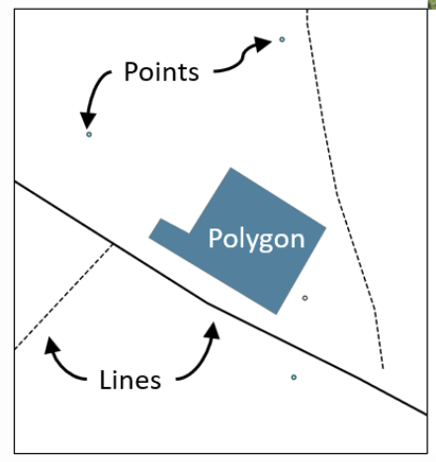
Same Feature, Different Vector Representations
If the same feature (like a house) is represented as a point vs. a polygon, what types of analysis can we do in each case?
🤔
Point
Polygon

Slide 10
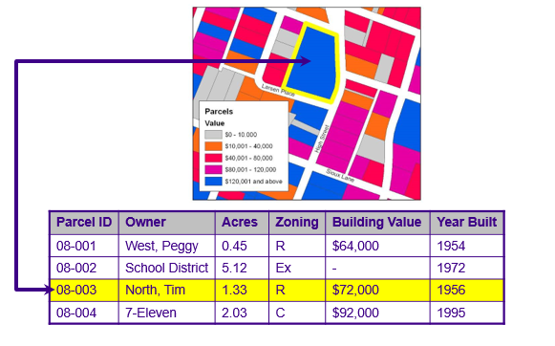
Vector Data
All types can store attribute information
Examples by Dr. Mike and Dr. Jackie Strager
Notes:
One powerful aspect of a GIS and geospatial data is the ability to relate spatial and tabulated data. Vector data are not just map coordinates. These features are also associated with tabulated information. For example, the parcels boundaries shown on this slide are attributed with a set of information. This allows us to relate spatial and tabulated data.

Slide 11
Rows and Columns in an Attribute Table
All types can store attribute information
Row = one record = one feature
Example: Parcel 08-003 (North, Tim) is one row in the table and one polygon on the map.
Each field (a column describing one property of all features) is represented by a column in the table.
Field = one type of information for all features
Example fields: Parcel ID, Owner

Slide 12
ATTRIBUTE FIELD TYPES
Field Type
What it stores
Example
Short Integer
Whole numbers; no decimals
25
Long Integer
Larger whole numbers; no decimals
2,000,000
Float
Decimal values (lower precision)
12.35
Double
Decimal values (higher precision)
12.3456789
Text
Strings / non-numeric values
Bridge
Date
Date information
09/16/2026
🤔
What field type is shown in the attribute table on the previous slide?

Slide 13
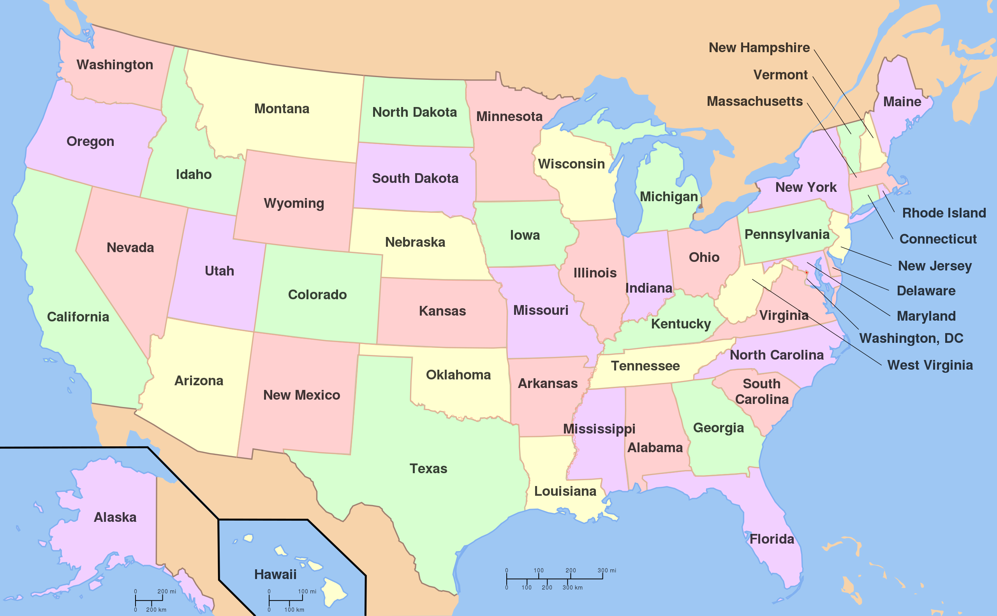
Vector Data
Topology
Study of properties of geometric objects that remain invariant under certain transformations such as bending or stretching (Massey 1967)
Spatial relationship between map features.
https://en.wikipedia.org/wiki/File:Map_of_USA_with_state_names.svg
Notes:
An important concept associated with vector data is the concept of topology. This is not to be confused with topography.
Topology is the study of properties of geometric objects, including map features, that remain invariant, or don’t change, under certain transformations such as bending or stretching.
Example topological relationships include adjacent to and incident with. For example, if the US state boundaries could be bent or stretched, the adjacently between states would be maintained. Or, adjacent states would still be next to each other and share boundaries. If map features were bent or stretched, features that occur within or are incident with other features would maintain this relationship with those other features. For example, cities would still fall within the correct state or country.
Arkansas and mississippi
A good example of topology is a subway map. On this slide, I have included the subway map for the city of Vancouver in British Columbia. The subway lines and other map features have been generalized such that the full complexity is not represented. However, important topological relationships have been maintained. For example, you know which stops occur along or are incident with which lines. You also know where different lines cross, or where you can transfer between lines. So, even though these data have been generalized, important topological rules have been maintained so that you can use the map to navigate the subway system.
Topology is important because it allows us to solve problems that require an understanding of the spatial relationship between map features.

Slide 14
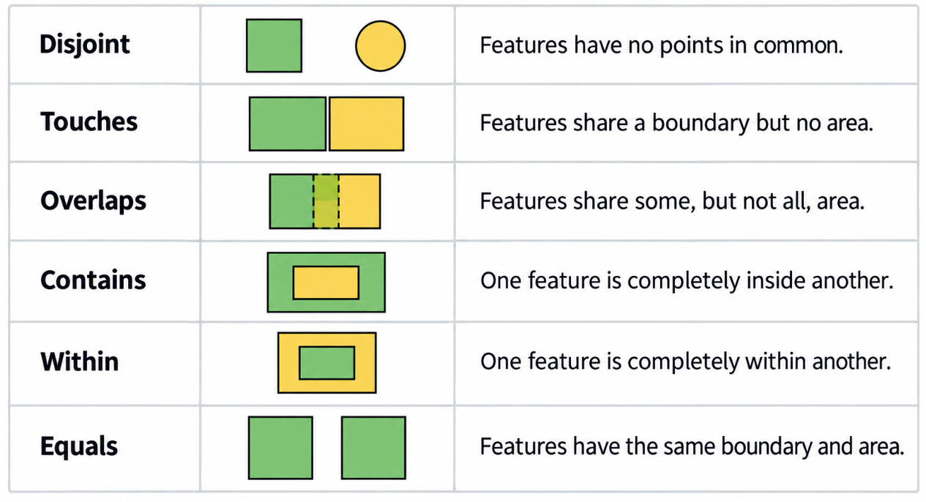
Examples of Topological Spatial Relationship

Slide 15
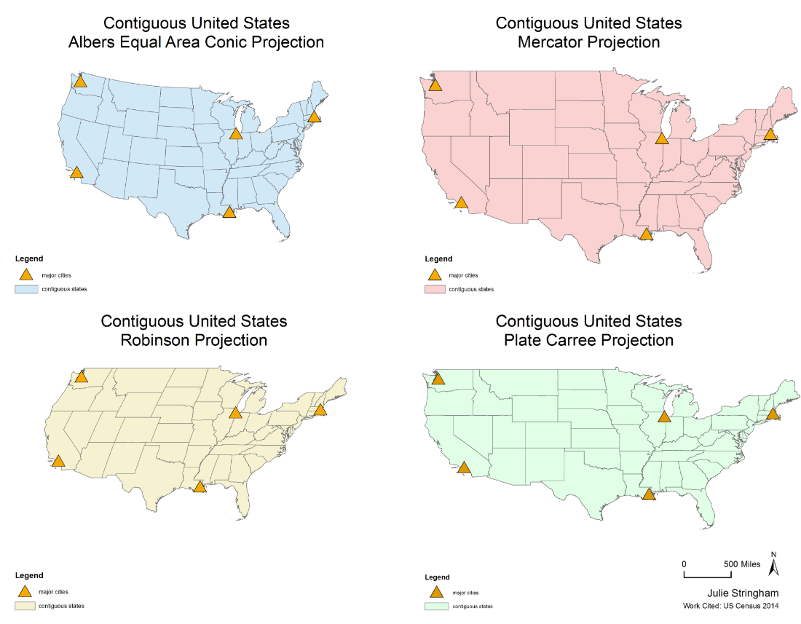
Topology Remains the Same Across Projections
🤔
If I want to know which states border Arkansas, does projection matter

Slide 16
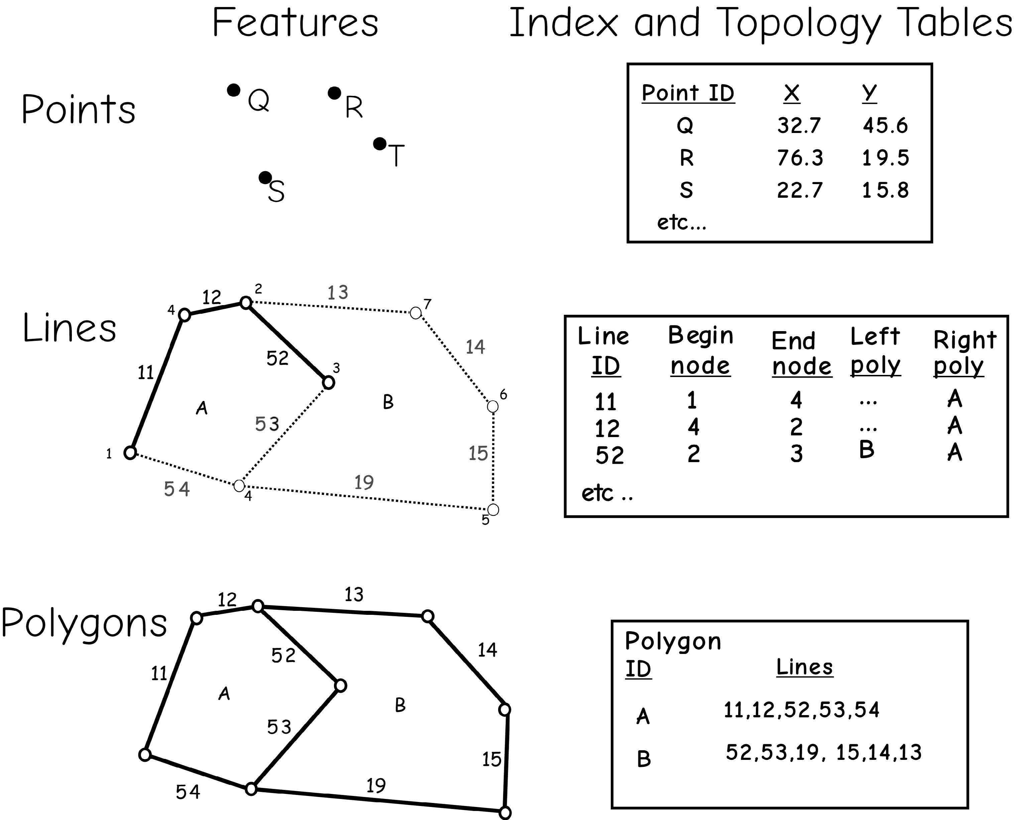
Vector Data
Topology
Often use codes and tables to record topology
Information on the adjacency (which polygons are next to which), connectivity (which lines connect to which), and other spatial relationships could be stored
🤔
1. Explain the topological information of Line 53.
Bolstad, 2019

Slide 17
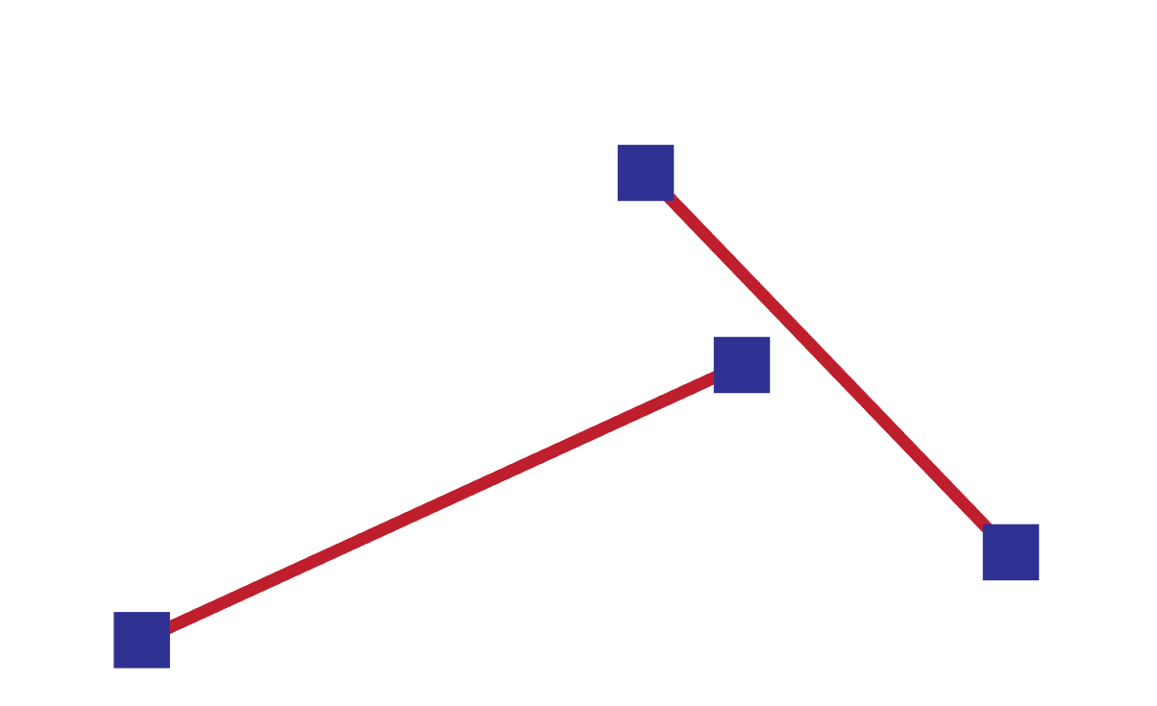
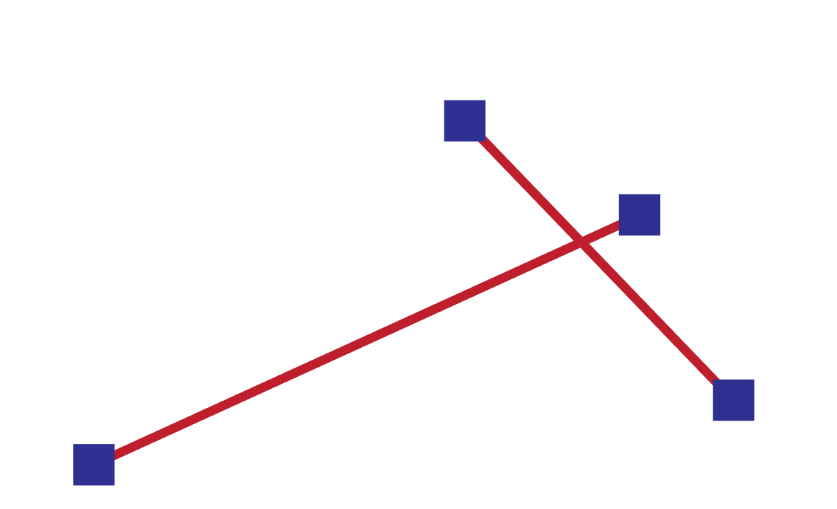
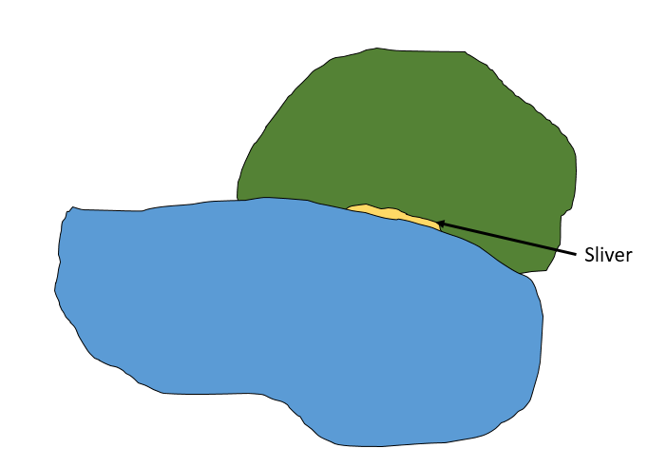
Vector Data
Topological issues
Dangles: two line features are supposed to connect, but not
Overshoots: one line segment is supposed to end but not
undershoots
Slivers: areas of non-overlap due to digitization error
Notes:
When creating new data, issues can arise that cause topological relationships to not be maintained.
Dangles occur when 2 line features are supposed to connect, such as at a road intersection, but they fall short. If you were trying to model movement along a road network, this would be an issue.
Overshoots occur when one line segment is supposed to end when it intersects another segment, but it continues or overshoots.
Slivers represent areas of non-overlap between features that could represent real patterns or result for digitization errors or scale difference in the input data.

Slide 18
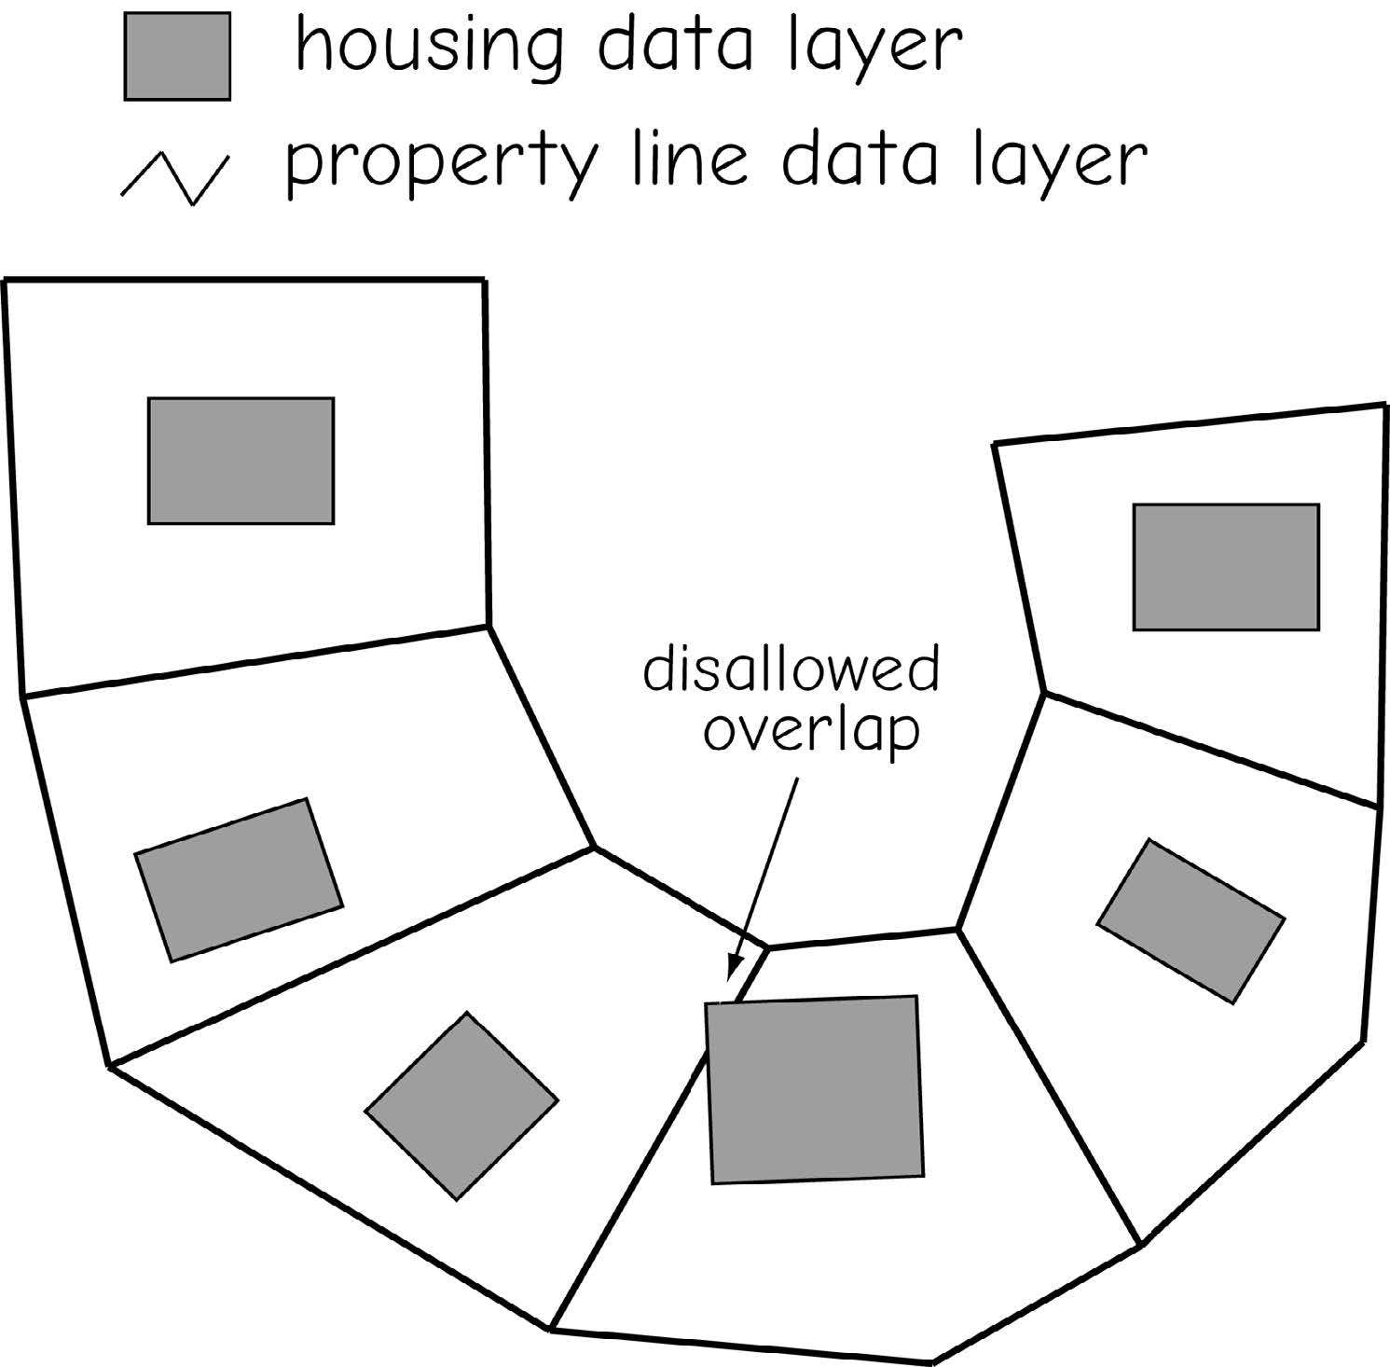
Vector Data
Topological issues
Between different layers
Bolstad, 2019

Slide 19
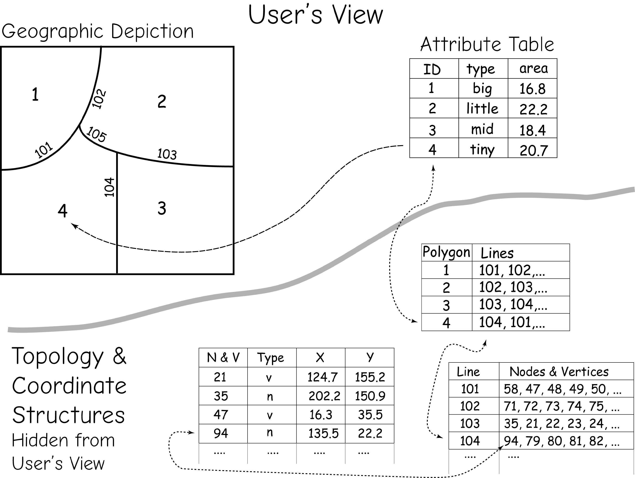
Vector Data
Topology
Topology and coordinate data are often hidden from the user, but linked to the attribute and geographic features through pointers and index variables.
Bolstad, 2019

Slide 20
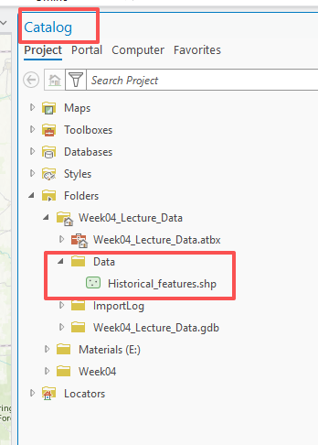
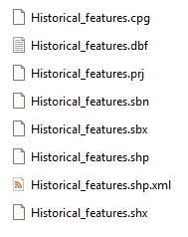
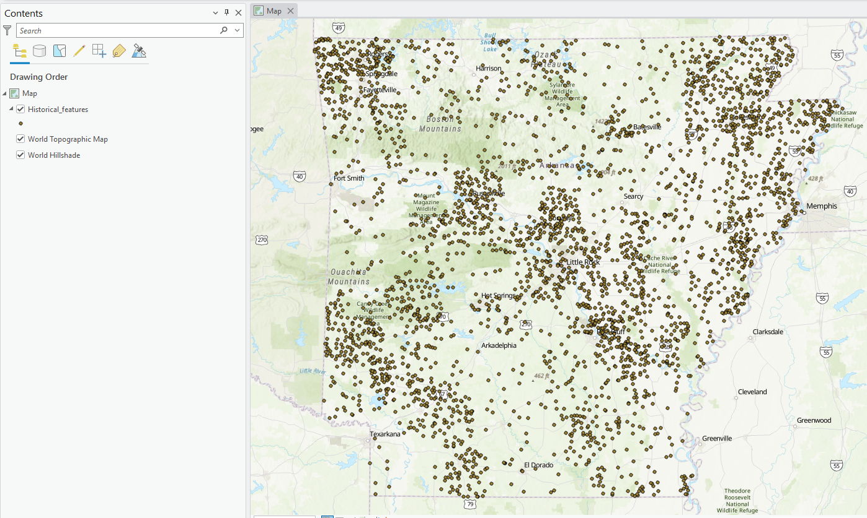
Vector Data
Shapefile
A shapefile is a commonly used vector data format in GIS.
It can represent points, lines, and polygons, together with their attribute information.
One shapefile dataset consists of multiple related files, not just a single .shp file.
Notes:
The shapefile is a georelational model that is still commonly used. It was originally developed by ESRI but is non-proprietary.
It is a nontopological model. Generally, nontopological data can display more rapidly on a computer than topological data. They can also be used across multiple software packages.
Although this is a nontopological model, topological relationships can be calculated on-the-fly to perform analyses.
The geometric information is stored in the .shp file while the .shx file provides an index of the geometry, which can speed up searching and display.
The attributed or tabulated data are stored in the .dbf file. This is why this is georelational model: geometry and attributes are stored in separate files. The .sbn and .sbx components provide indices for the attributes, which can speed of queries.
The projection information is stored in the .prj file. This component is important because it tells the computer what the projection is so that the data can be drawn at the correct location in the map space.
If metadata are created, this additional information can be stored in the .xml component.
cpg are optional plain text files that describes the encoding applied to create the shapefile. If your shapefile doesn't have a cpg file, then it has the system default encoding.

Slide 21
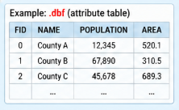
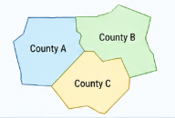
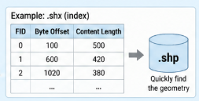
Vector Data - Shapefile
.dbf = attribute table/aspatial data
Stores the non-spatial, or aspatial, information associated with each feature, such as population
Components (Three mandatory files)
.shp = geometry data
Stores the shapes and coordinates of the geographic features, such as polygons.
.shx = index file for geometry (helps with speed)
Stores an index of the features in the .shp file so GIS software can locate and access each geometry more efficiently.
Notes:
The shapefile is a georelational model that is still commonly used. It was originally developed by ESRI but is non-proprietary.
It is a nontopological model. Generally, nontopological data can display more rapidly on a computer than topological data. They can also be used across multiple software packages.
Although this is a nontopological model, topological relationships can be calculated on-the-fly to perform analyses.
The geometric information is stored in the .shp file while the .shx file provides an index of the geometry, which can speed up searching and display.
The attributed or tabulated data are stored in the .dbf file. This is why this is georelational model: geometry and attributes are stored in separate files. The .sbn and .sbx components provide indices for the attributes, which can speed of queries.
The projection information is stored in the .prj file. This component is important because it tells the computer what the projection is so that the data can be drawn at the correct location in the map space.
If metadata are created, this additional information can be stored in the .xml component.
cpg are optional plain text files that describes the encoding applied to create the shapefile. If your shapefile doesn't have a cpg file, then it has the system default encoding.

Slide 22
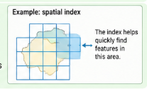
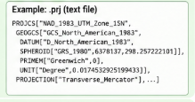

Vector Data - Shapefile
Components (Non - mandatory files)
.prj = spatial reference/projection information
Stores the coordinate system and projection information
.sbn and .sbx = index file for the attributes (speed of queries)
Help GIS software perform spatial searches and display features more efficiently.
.cpg = tells the software how to interpret the text encoding in the .dbf
.shp.xml = metadata
Stores information about the dataset, such as its source, creator, date, accuracy, and description.
Notes:
The shapefile is a georelational model that is still commonly used. It was originally developed by ESRI but is non-proprietary.
It is a nontopological model. Generally, nontopological data can display more rapidly on a computer than topological data. They can also be used across multiple software packages.
Although this is a nontopological model, topological relationships can be calculated on-the-fly to perform analyses.
The geometric information is stored in the .shp file while the .shx file provides an index of the geometry, which can speed up searching and display.
The attributed or tabulated data are stored in the .dbf file. This is why this is georelational model: geometry and attributes are stored in separate files. The .sbn and .sbx components provide indices for the attributes, which can speed of queries.
The projection information is stored in the .prj file. This component is important because it tells the computer what the projection is so that the data can be drawn at the correct location in the map space.
If metadata are created, this additional information can be stored in the .xml component.
cpg are optional plain text files that describes the encoding applied to create the shapefile. If your shapefile doesn't have a cpg file, then it has the system default encoding.

Slide 23
Class Activity: Exploring Arcgis Pro project
Create a new project in ArcGIS Pro.
Open the project location in File Explorer.
Identify the new local folder and its contents.
Reminder:
When you create a new project in ArcGIS Pro, a new local project folder is also created on your computer.
This folder usually contains:
the .aprx project file
the default geodatabase
the default toolbox
Keeping the project folder organized helps you manage GIS data more efficiently.

Slide 24
Class Activity: Exploring Shapefile Components
Open Week04_Lecture_Data .aprx.
Identify the components
Reminder:
A shapefile is not just one file.
If you want to share data, you must copy ALL shapefile components together, not just the .shp file.

Slide 25
Quick Way to Check Attributes in a Shapefile (.dbf file)
Locate the .dbf file in the local computer (e.g., Historical_features.dbf).
Open Excel, go to File → Open → Browse, then select the .dbf file.
The attribute table will appear as a spreadsheet:
Each row = one feature
Each column (field) = one type of data (ID, name, area, etc.).
You can now quickly check the attribute values without opening GIS software.
⚠️
Do not edit and save the .dbf in Excel (it can corrupt the shapefile).
Only use it for a quick look at the data.

Slide 26
Vector Data
Polygon inclusions and boundary generalization
Polygon inclusions: areas in a polygon that are different from the rest of the polygon, but still part of it
Boundary generalization: incomplete representation of boundary locations
Bolstad, 2019

Slide 27
Class Activity: Representing Indoor Features in GIS
Each group discusses which indoor features are best represented by:
Points
Lines
Polygons
After 5 minutes, share your answers with the class.

Slide 28
4.2 key points for the lab 3

Slide 29
LAYER SPATIAL REFERENCE VS. MAP COORDINATE SYSTEM
Airport layer
spatial reference
MAP
The map has its own coordinate system.
Railroad layer
spatial reference
DSM raster
spatial reference
Unless manually changed, the map is assigned the same coordinate system as the first layer added.
Check it in ArcGIS Pro: right-click Map → Properties → Coordinate System.

Slide 30
SUMMARIZING AN ATTRIBUTE FIELD
The Summarize command groups records using a case field.
The output table includes FREQUENCY: the number of records in each group.
Additional statistics can be calculated for a selected statistics field.
1. Choose a field
Example: FEATURE_CL
2. Summarize
Case field groups categories; add requested statistics
3. Output table
One row per category + FREQUENCY + calculated statistic
Exercise 3: FEATURE_CL is the case field; save the output table so you can find it later.

Slide 31
4.2 Lab session

Slide 32
Lab 03: exploring spatial data
Due by noon (12:00 PM) on Wednesday, Sep 16, 2026
Submit a word document only include question and answer

