Slide 1

WEEK 05 geodatabase lecture
Instructor: Yanan Wu
fALL 2025

Slide 2
5.1 geodatabase

Slide 3
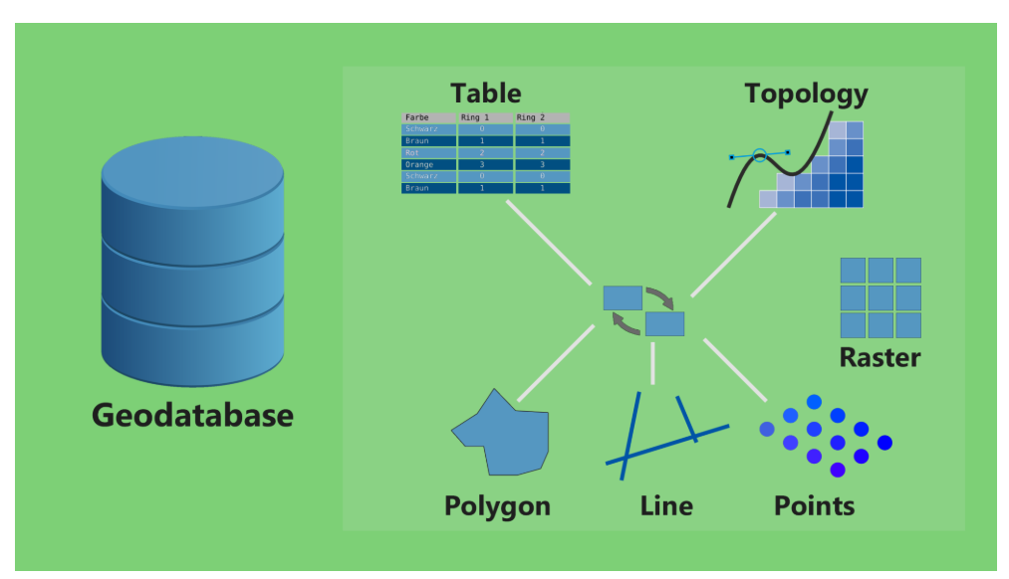
Fundamentals of the geodatabase
The geodatabase is a collection of geographic datasets of various types.

Slide 4
ESRI Geodatabase
File geodatabases
A file geodatabase is stored as multiple files in a folder with a .gdb extension.
Each dataset is contained in a single file.
By default, files can grow to 1 TB, but this can be changed to 4 or 256 TB using a configuration keyword.
Enterprise geodatabase
Edited by multiple users and supports versioning.
hey can be virtually unlimited in size and number of users.
Host locally or in an enterprise database system (Oracle, Microsoft SQL Server, IBM DB2, Informix, PostgreSQL).
Comparing types of geodatabases
Notes:
ESRI offers three types of relational databases.
Personal and File geodatabases are designed to receive edits from only one user at a time. However, multiple users can access the data at once. These databases are generally hosted or stored on a local machine as opposed to on a server using an enterprise database management system.
Enterprise geodatabases are meant to be stored on a server using a database management system and allow for multiple editors and users at once.
provides an editing environment that supports concurrent multiuser editing without creating multiple copies of the data. This editing environment is called versioning. an alternative, independent, persistent view of the database that does not involve creating a copy of the data
Note that personal geodatabase are being phased out. They are no longer supported in ArcGIS Pro but can be used in ArcMap.

Slide 5
Geodatabase Components
Feature classes
Feature dataset
Relationship class
Raster dataaset
Tables
Toolboxes
Attachments
Geometric network
Network dataset
Terrain
Topology
…
Notes:
A variety of different features can be stored in a geodatabase. Some of these features will be described in subsequent slides.

Slide 6
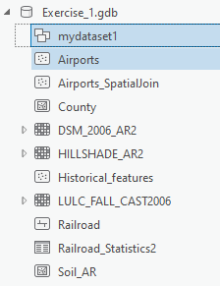
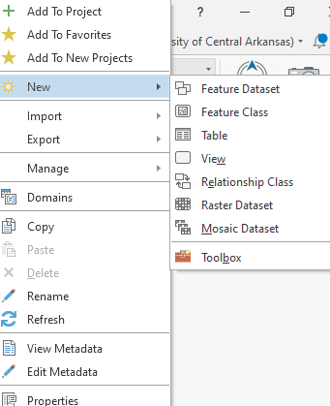
Geodatabase Components
Feature Class
Collection of features that share the same geometry (points, lines, or polygons) and spatial reference
Geodatabase
Feature Dataset
Feature Class
Feature Class
Feature Class
Notes:
Inside a geodatabase, vector data are stored as feature classes.
All features inside of a feature class must share the same geometry (points, lines, or polygons).
A spatial reference must be applied to a feature class.
This is an object-based model since the geometry and attribute data are stored in the same file. In a feature class, the geometry is stored as a column in a table as a binary large object or BLOB.
.gdb

Slide 7
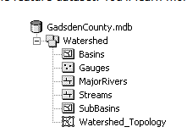
Geodatabase Components
Geodatabase
Feature Datasets
Collection of feature classes that have the same spatial reference
Can be used to organize the data
Can control data access and editing privileges
Can organize data for sharing
May be necessary
Build topology between features
Create a network dataset
Create a terrain dataset
Must define spatial reference upfront
Feature Dataset
Feature Class
Feature Class
Feature Class
Notes:
Feature datasets are collections of feature classes that have the same spatial reference.
You can think of feature datasets as subfolders within the database.
They can be used to organize your data. For example, if you have a geodatabase of utility data for a city, you could organize the electrical, water, and communication data into separate feature datasets.
You can also use feature datasets to control data access and editing privileges. For example, you could allow all utility workers access to data, but only those working on the with the electrical utilities could edit data in the feature dataset containing the electrical utility information.
Sometimes feature datasets are required. Examples include when you want to build or define topological relationships between layers, created network datasets, or create terrain datasets.
All data in the feature dataset must have the same spatial reference.
Common feature classes that act as data sources for terrains include the following:
Multipoint feature classes of 3D mass points created from a data source such as lidar or sonar
3D point and line feature classes created on photogrammetric workstations using stereo imagery
Study area boundaries used to define the bounds of the terrain dataset

Slide 8

Geodatabase Components
Domains
Attribute domains are rules that describe the available values of a field type.
They are used to constrain the values allowed in any particular attribute for a table or feature class.
Coded Values: discrete values that represent allowed entries
Ranged Values: stipulates that values can only be entered within a given range
Notes:
Domains are defined at the database level and can be applied to multiple features stored in the database.
They are used to define allowed values or entries to a field.
For example, if a field is meant to store a rating, you may only want the user to be able to enter between 0 and 5 stars.
Domains can also be used to define allowed categories. For example, a field of movie genres should only be able to store genres from a predefined list.
Coded values are generally used to set up allowed discrete entries or categories. A numeric code will be assigned to each category. For example, if you want to create a field that will store rock types for a geologic field collection, then you could associate a numeric code to each allowed rock type.
Ranged values are generally used when you want the user to be able to enter a number, but only within a defined range. For example, if a field is meant to store a percentage, then you would want the user to only be able to enter values between 0 and 100.
In the provide examples, coded values are being used to define the level of difficulty of a trail whereas ranged values are being used to specify the range of values allowed in a rating column.
Creating domains can be very useful. This will force the user to only enter valid data into a field.

Slide 9
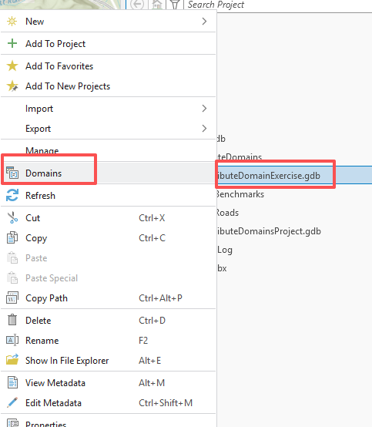
In Class – Attribute Domains
Create a Domain for the AttributeDomainExercise.gdb.
right-click on the geodatabase and select Domains
Source: https://www.e-education.psu.edu/spatialdb/node/2023
Notes:
Subtypes represent of features in a feature class or table that share the same attribute and are used to categorize data using coded values.
For example, in a layer that contains land parcels, subtypes could be defined relative to how the parcel is zoned (for example, public, commercial, or residential).
In the provided example, trails are being grouped into three subtypes as trail, motorized, and water.

Slide 10
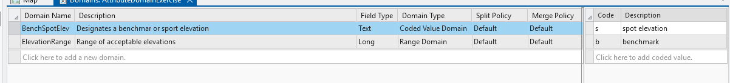
In Class – Attribute Domains
2. Define the Domain name, description, field type, Domain type, code and Description

Slide 11
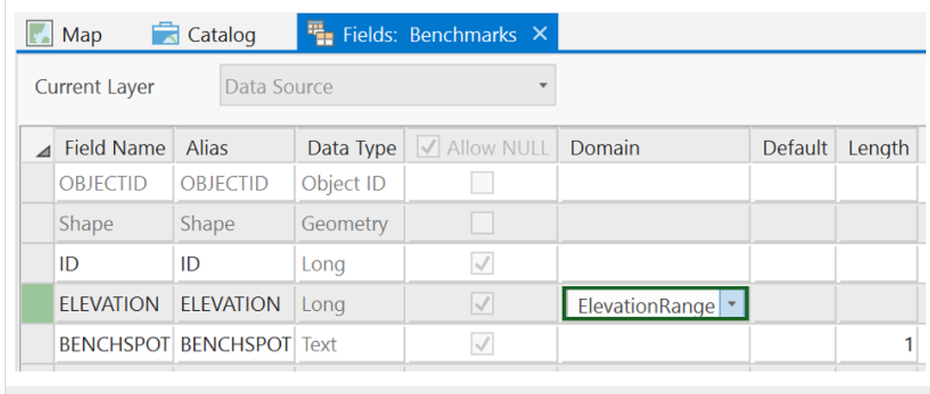
In Class – Attribute Domains
Right-click on the Benchmarks feature class, and select Design > Fields.
In the row for the ELEVATION field, access the dropdown list under the Domain heading and select the ElevationRange domain you just created.
Click the save button.
Notes:
A new file geodatabase can be created using ArcGIS Pro or ArcCatalog.
Once a database is created, you can create new empty feature classes within it or import data layers, such as shapefiles, tables, and raster grids.

Slide 12
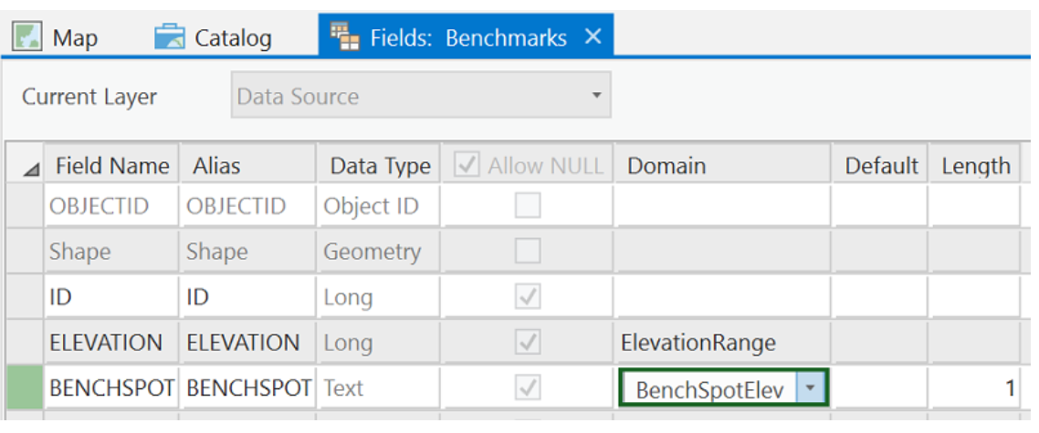
In Class – Attribute Domains
Now perform the same operation to assign the BenchSpotElev domain to the BENCHSPOT field
Click the Save button.

Slide 13
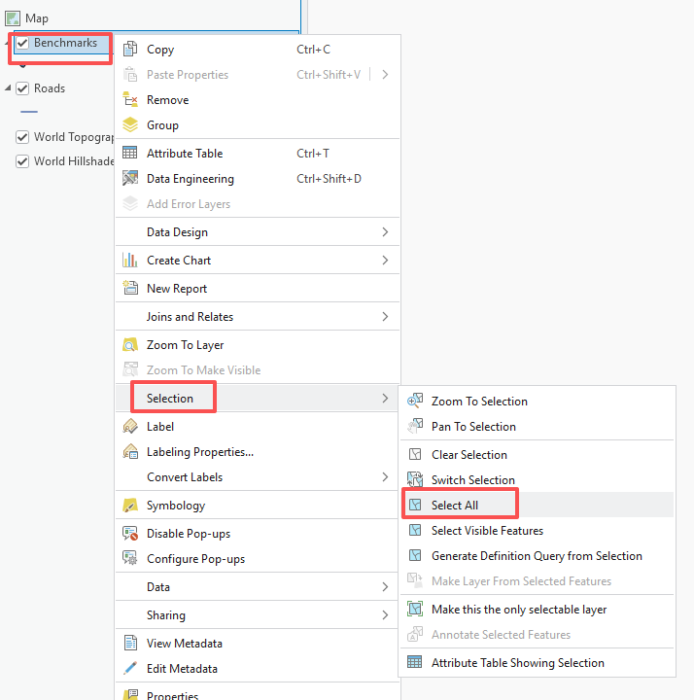
In Class – Attribute Domains
Right click Benchmarks – Selection – Select All

Slide 14
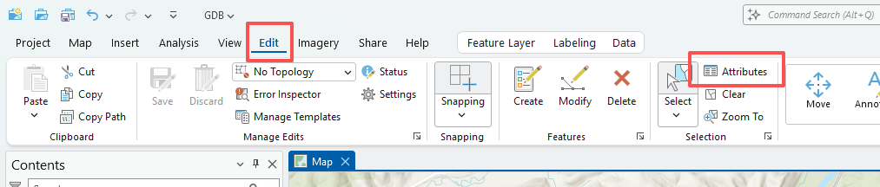
In Class – Attribute Domains
Under the Edit tab, click the Attributes button. This will open a panel in which all of the benchmark features are listed by their ID value in the top of the panel and the full set of attributes for the currently highlighted feature is listed in the bottom of the panel.

Slide 15
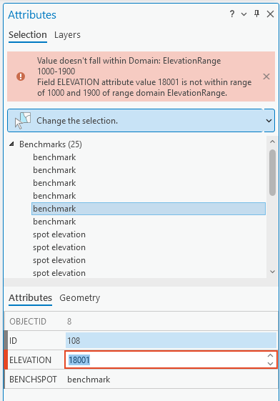
In Class – Attribute Domains

Slide 16
5.2 Lab session

Slide 17
Lab 03: Exploring Spatial Data
Due by Midnight (11:59 pm) on Monday, Sep 22, 2025
Submit a word document only include question and answer

