Slide 1

WEEK 05 attribute and geodatabase lecture
Instructor: Yanan Wu
fALL 2025

Slide 2
5.1 Attribute table

Slide 3
Overview
Attribute Table
Vector and Raster attribute table
Data Type
Editing (e.g., adding fields)
Query
Geodatabase
Relational model
ESRI Geodatabase
Components
Editing (e.g., create new database)

Slide 4
Attribute table: vector
Vector data
Columns = fields, items or attributes, stored for each record
Rows = Records
One record for each vector feature
Bolstad, 2019

Slide 5
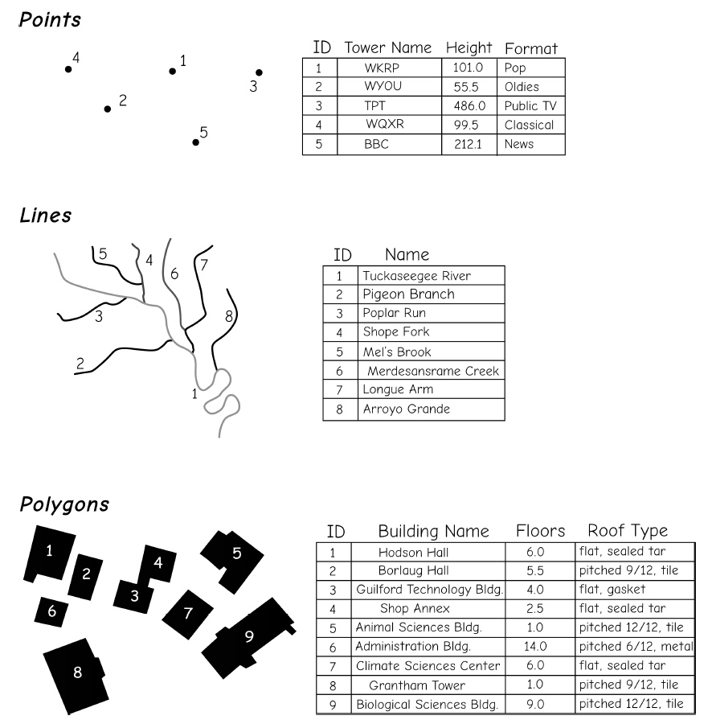
Attribute table: vector
Vector data
All shapefiles and feature classes have an attribute table.
Bolstad, 2019

Slide 6
FID
FID is essentially a kind of ObjectID (A system-managed value) that uniquely identifies a record or feature.
FID start at 0 and increments by 1.
When features are deleted, FIDs are renumbered to maintain a continuous sequence (no gaps).
🤔
In the attribute table of Historical Features, what is the largest FID? Does this number equal the total number of records?

Slide 7
shape
A system-managed field in every spatial dataset
Stores the geometry type (Point, Line, or Polygon) of each feature
Links the attribute table to the map display
🤔
In the attribute table of County and Historical Features, what is the Shape? Do they have same shape?

Slide 8
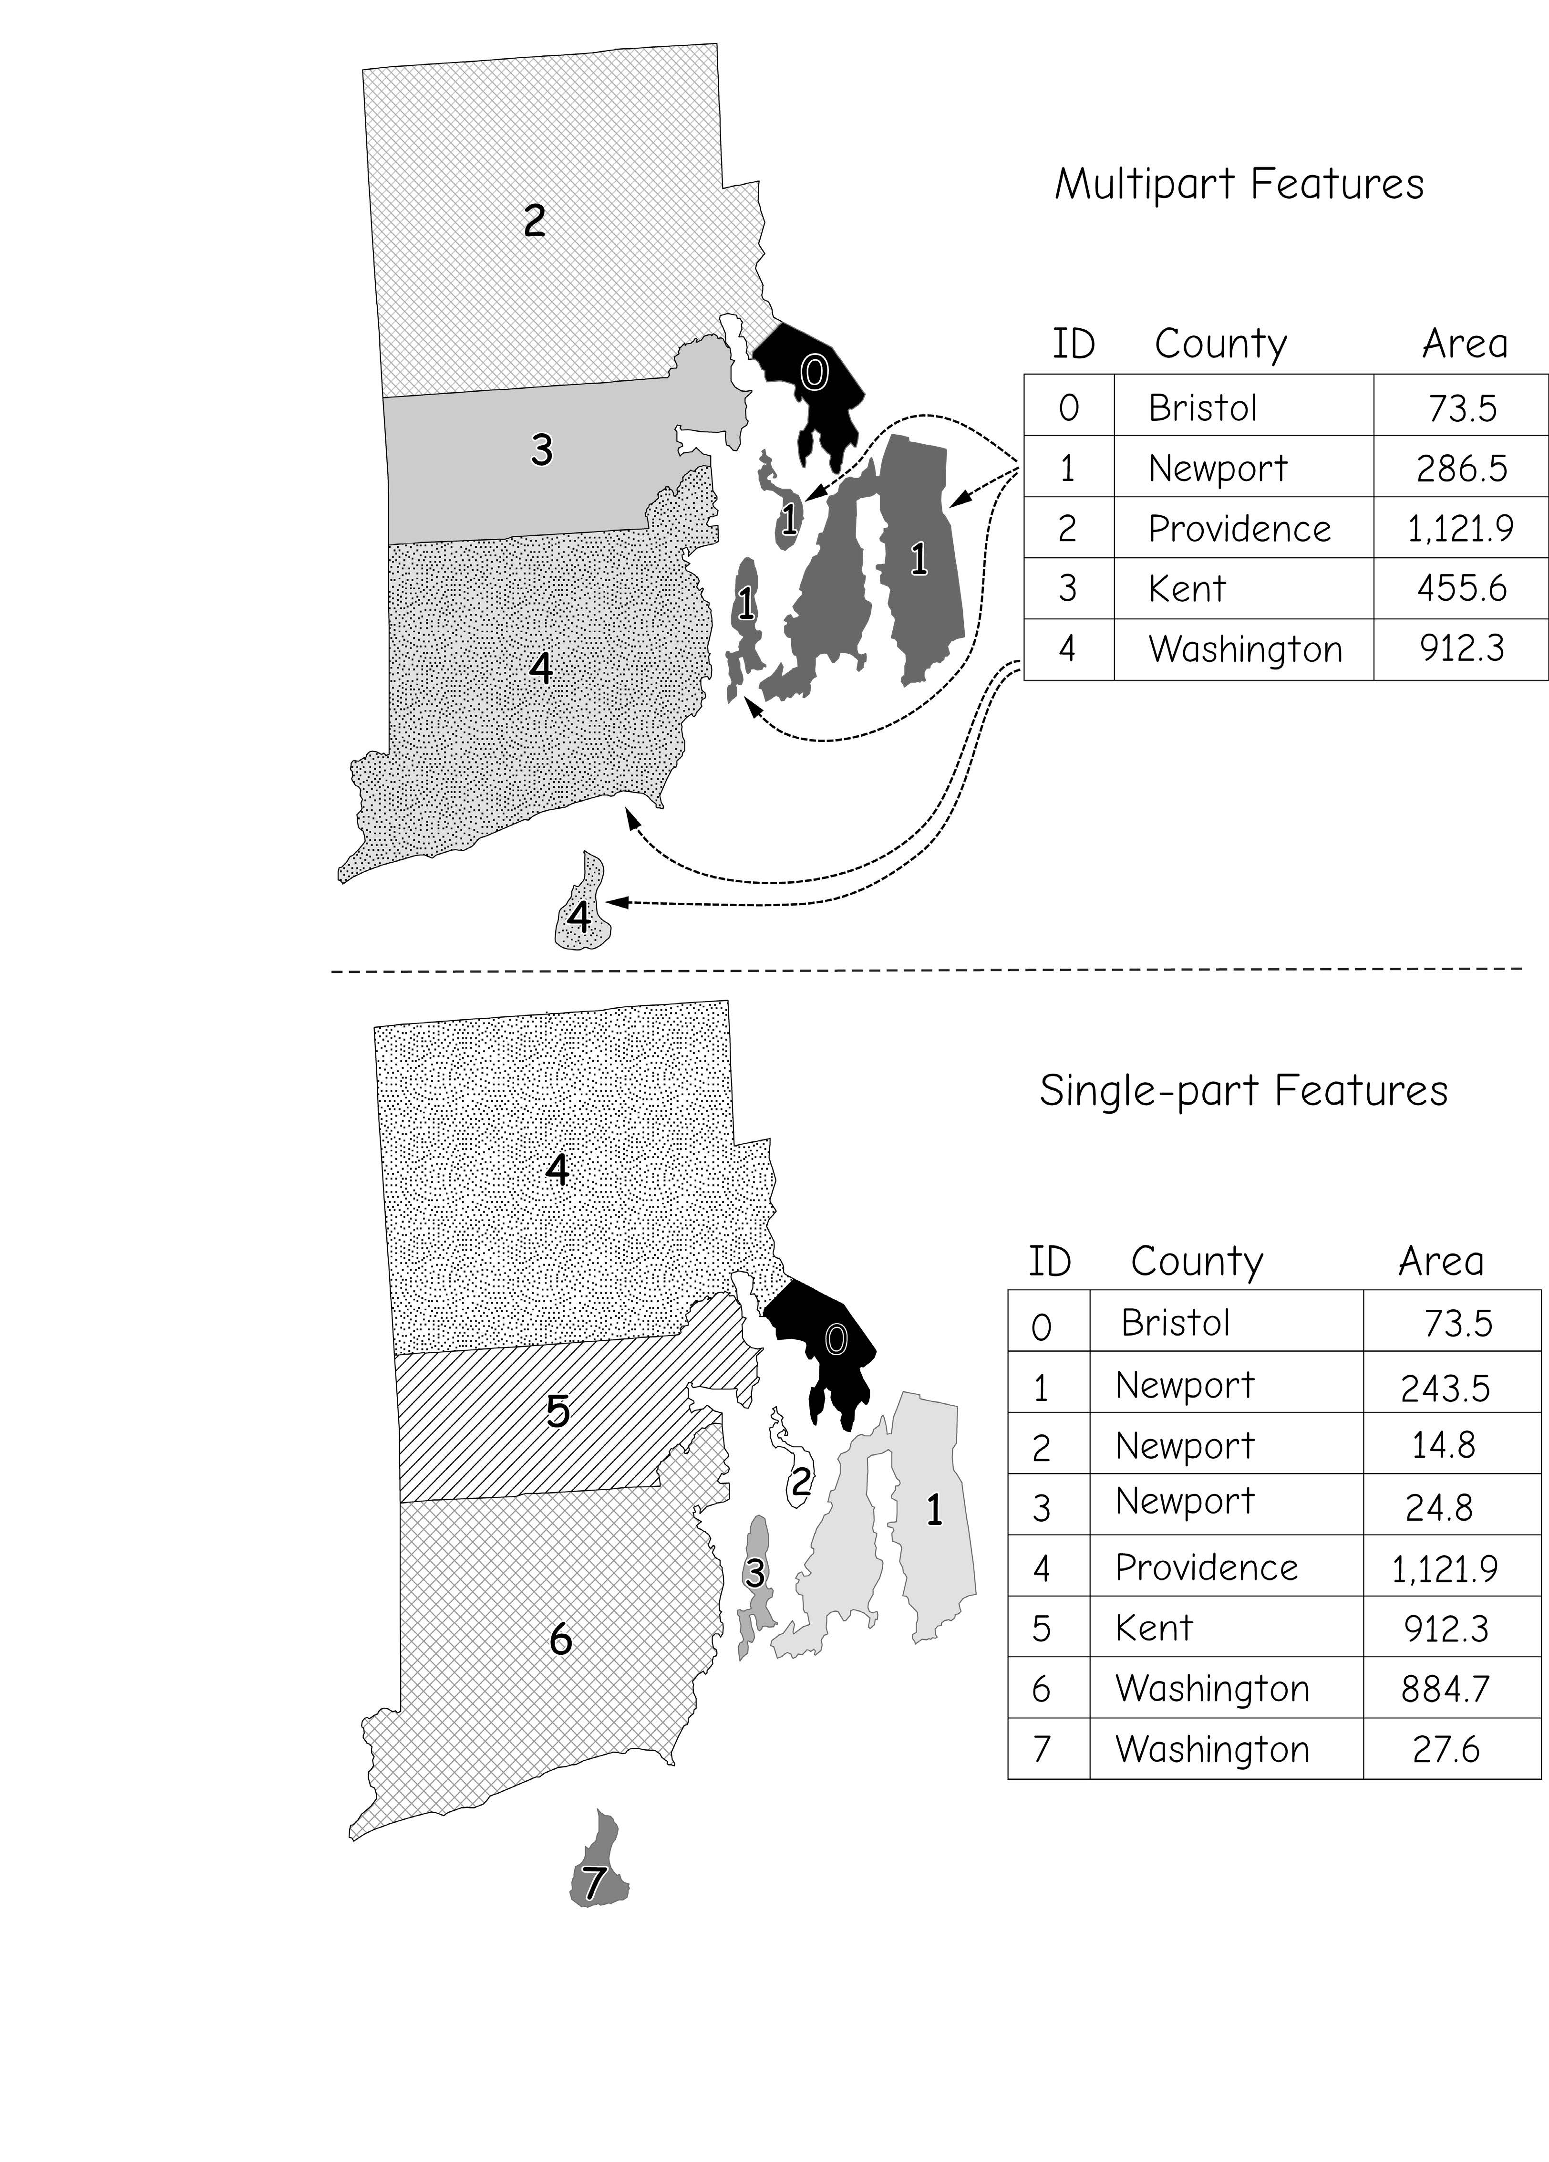
Attribute table: vector
Vector data
Relationship between features and records
one-to-one
many-to-one
Bolstad, 2019

Slide 9
Class activity - Exploring Features and Records
🤔
In the attribute table of Airports_Conway and Airports, what is the Shape? Do they have the same shape?
What relationship exists between features and records in Airports and Airports_Conway?
Tip: Click a row in the attribute table to see how many features are highlighted on the map

Slide 10
Class activity - designing Your Own Indoor GIS
Imagine you are building an Indoor GIS for a university building (e.g., library, classroom building, or student center).
Layers
What layers would you create (e.g., classroom)?
Attributes
For each layer, what attributes (fields) should be included?
5 minutes brainstorm
Each group shares the three examples: layers + attributes

Slide 11
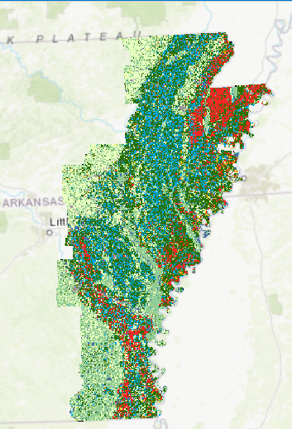

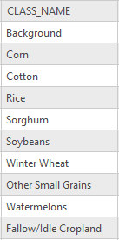

Attribute table: raster
Raster data
Some categorical raster data can have an attribute tables.
Continues raster data usually does not have
Notes:
This slide provides some examples of nominal data as county names, county FIPS codes, and land cover categories.
These are all unique categories with no implied order.
Note that it is possible to use numbers to represent categories. For example, FIPS, or Federal Information Processing Standard, codes are numbers. However, in this case they are not being used as numbers. Instead, they are being used to represent a specific feature. Another similar example would be ZIP codes.

Slide 12
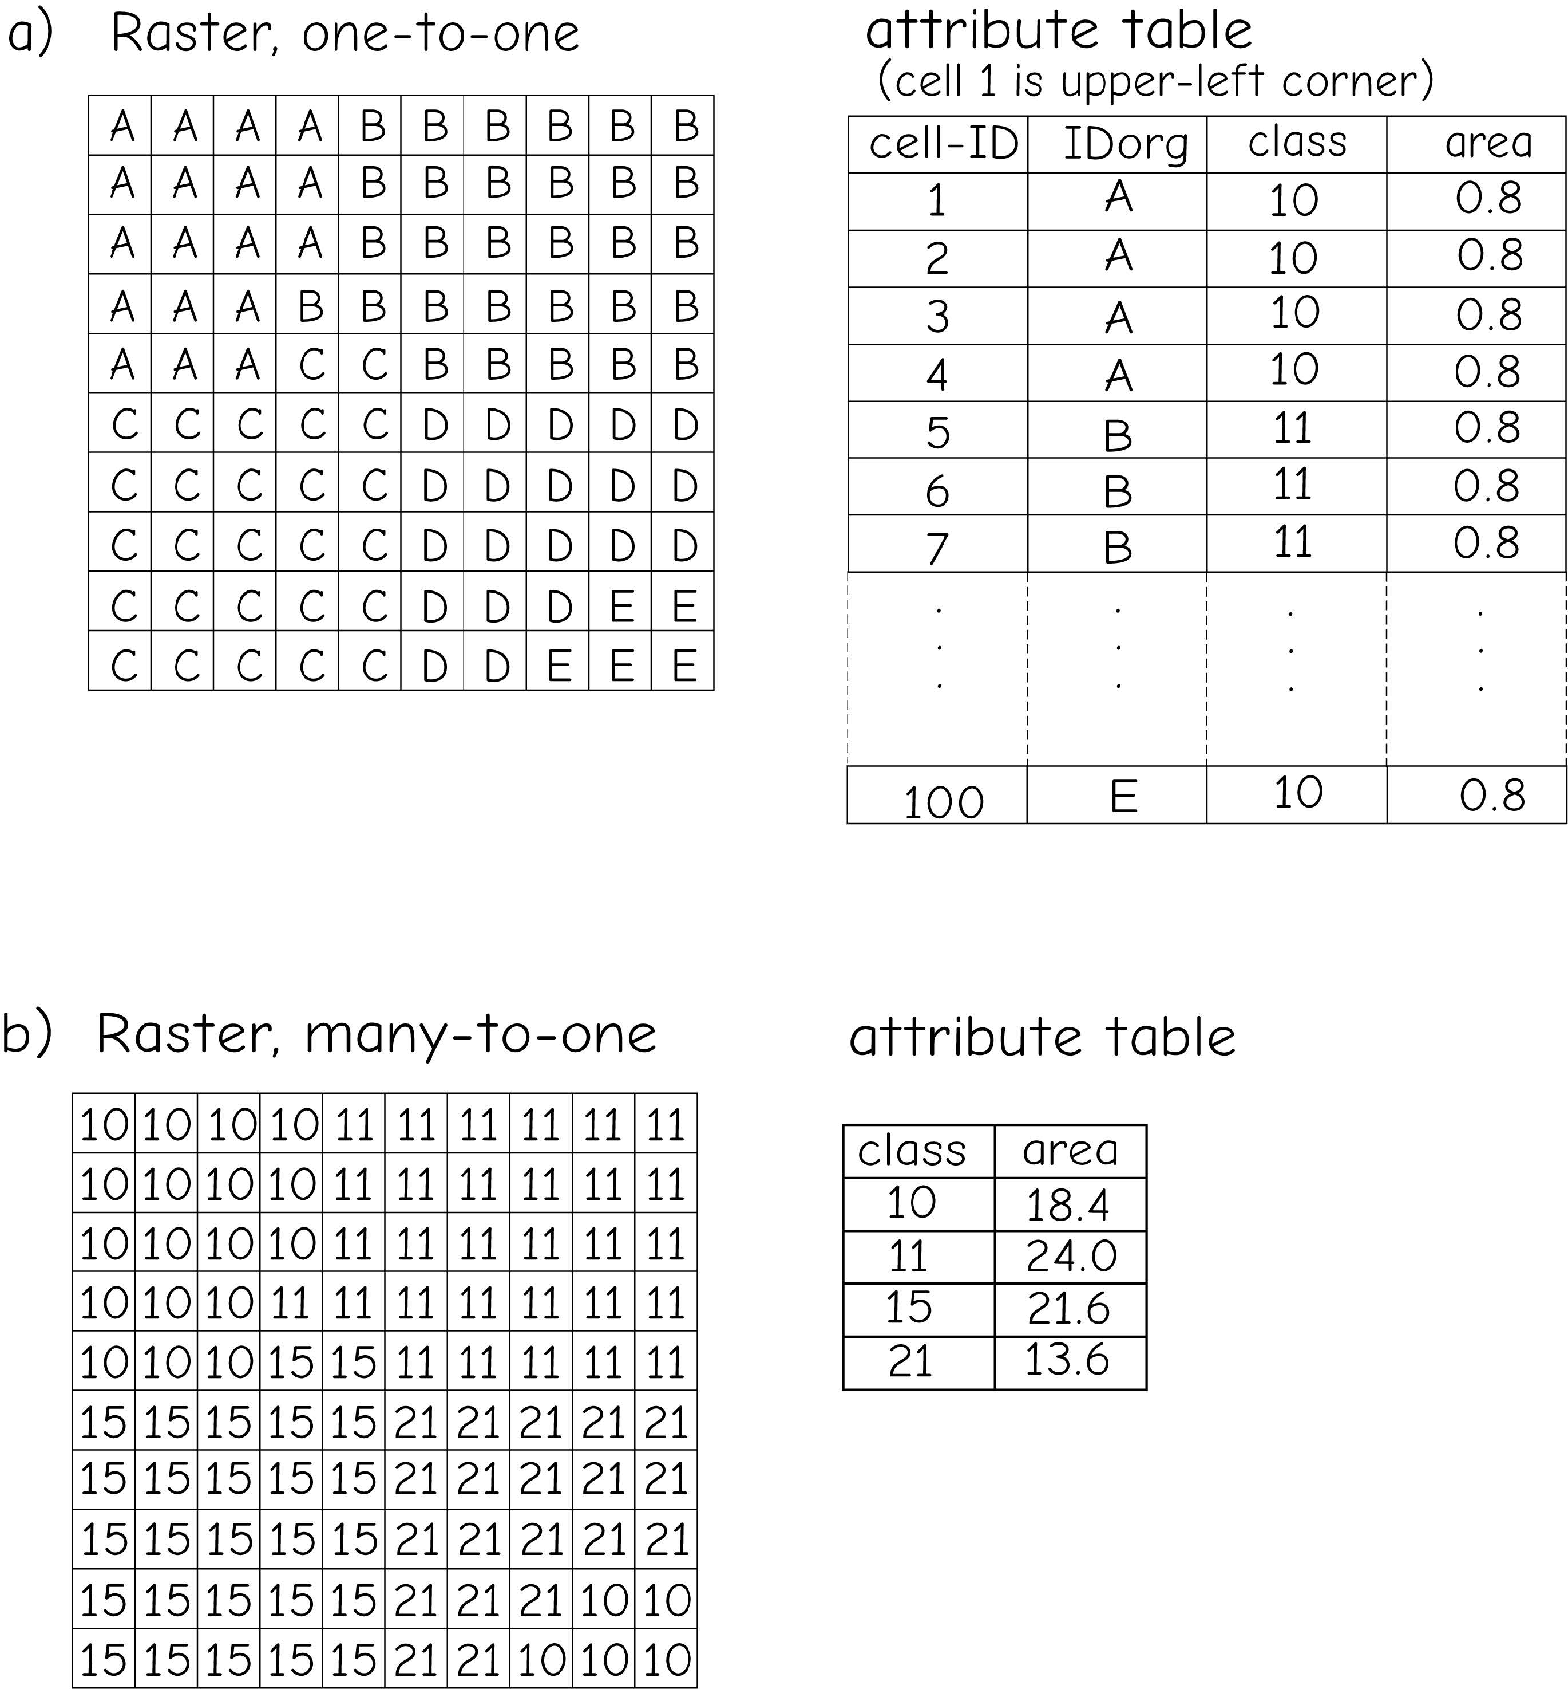
Attribute table: raster
Raster data
Relationship between features and records
one-to-one (produce unmanageably large attribute table)
many-to-one
Bolstad, 2019
Notes:
This slide provides some examples of nominal data as county names, county FIPS codes, and land cover categories.
These are all unique categories with no implied order.
Note that it is possible to use numbers to represent categories. For example, FIPS, or Federal Information Processing Standard, codes are numbers. However, in this case they are not being used as numbers. Instead, they are being used to represent a specific feature. Another similar example would be ZIP codes.

Slide 13
Data type
Non-Spatial Attributes in GIS
Attributes: non-spatial characteristics associated with spatial data
Nominal: A unique identifier
Ordinal: Ranked data
Interval: Difference between numbers is significant, but it lacks a true, absolute zero point.
Ratio: Difference between numbers is significant, and there is a fixed non-arbitrary zero value
Categorical
Numeric
Notes:
Data can be broken into two broad categories: categorical and numeric. Categorical data represent discrete categories that are either unordered (nominal) or ordered (ordinal).
Examples of nominal data include land cover types, soil types, or vegetation types while an example of ordinal data would be rankings such as 3rd place, 2nd place, and 1st place.
Numeric data represent continuous numbers or measures and can be further subdivided into interval and ratio types.
For both types the difference between subsequent numbers is fixed; for example, the length difference between 2 meters and 3 meters is the same as the difference between 7 meters and 8 meters.
However, they differ in regards to how the zero value is defined.
For interval data, the zero value is arbitrary whereas this value is non-arbitrary for ratio data.
Temperature in Fahrenheit or Celsius is an example of interval data as zero temperature on these scales do not mean “no temperature.” Further, ratios cannot be calculated for interval data because, without a fixed zero value, values that are twice as large do not indicate twice the magnitude. For example, 40° Celsius is not twice as hot as 20° Celsius.
Examples of ratio data include lengths, areas, and percentages since the zero value does have meaning or is non-arbitrary. For example, 0% unemployment indicates that no proportion of the working population is unemployed.

Slide 14
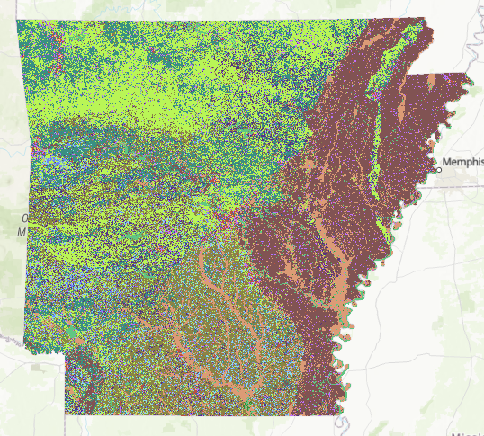
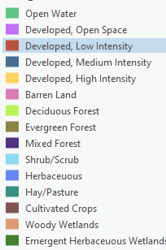


Data type
Nominal Data
Notes:
This slide provides some examples of nominal data as county names, county FIPS codes, and land cover categories.
These are all unique categories with no implied order.
Note that it is possible to use numbers to represent categories. For example, FIPS, or Federal Information Processing Standard, codes are numbers. However, in this case they are not being used as numbers. Instead, they are being used to represent a specific feature. Another similar example would be ZIP codes.

Slide 15
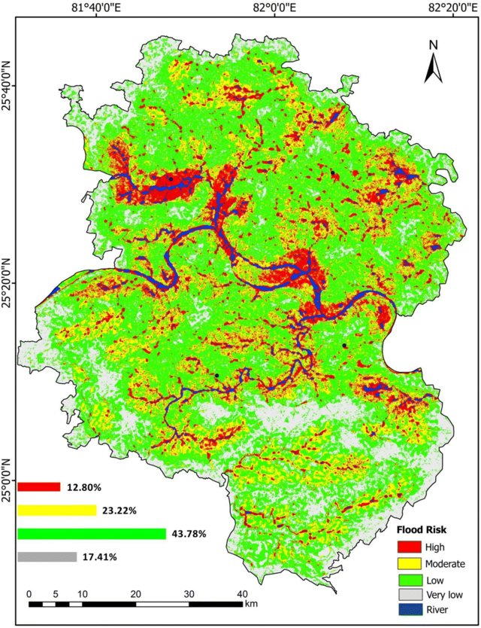
Data type
Ordinal Data
Flood risk map produced by GIS-AHP process
Map Source: Saha, A. K., & Agrawal, S. (2020). Mapping and assessment of flood risk in Prayagraj district, India: a GIS and remote sensing study. Nanotechnology for Environmental Engineering, 5(2), 11.
Notes:
Ordinal data represent categories with an applied order, such as ranks.
Survey questions, such as Strongly Disagree to Strongly Agree, are also ordinal data since there is an implied order in the groupings.

Slide 16
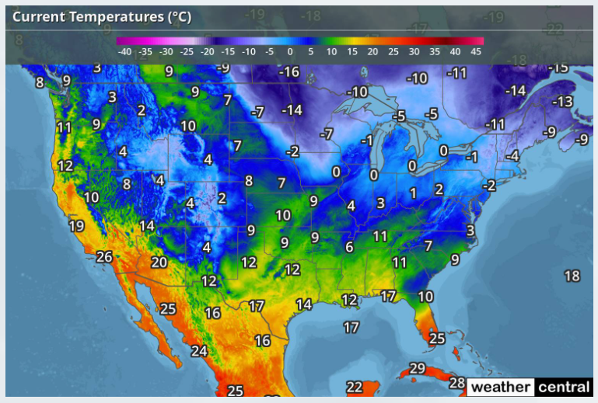
Data type
Interval Data
Image from the National Weather Service
Notes:
Temperature in Fahrenheit or Celsius and time are examples of interval data.
The zero value is arbitrary, and meaningful ratios cannot be calculated.

Slide 17
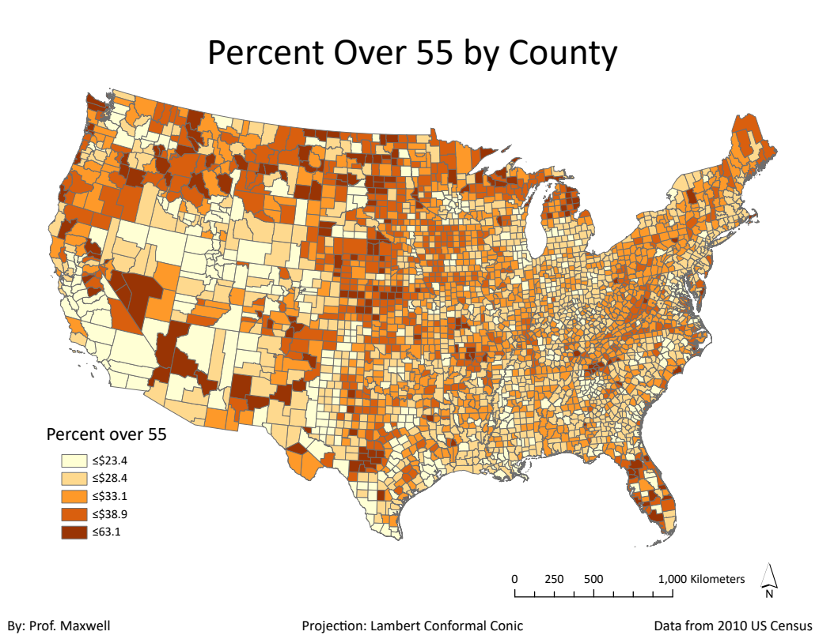
Data type
Ratio Data
Notes:
Percentages are examples of ratio data.
The zero value is not-arbitrary and meaningful ratios can be calculated.

Slide 18
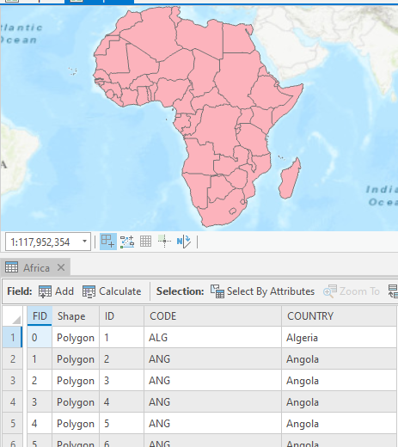
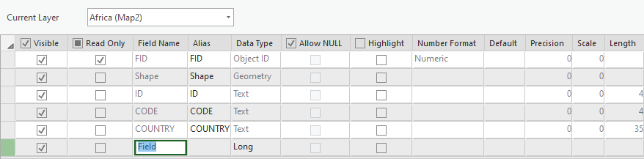
Editing
Adding Fields
Must define field name (less than 10 characters)
Can provide an alias
Make sure to define the correct data type
Notes:
When you create a new field you can define the field name, which must be less than 10 characters for shapefiles and geodatabases.
To make fields more interpretable, you can also include aliases, which provide more interpretable names or descriptions.
You must also define the field type, which we will discuss next.
You can also make fields not visible or read only if you don’t want to allow editing. Note that the feature ID, or FID, will be defined as read only since you don’t want to edit or change this unique identifier.

Slide 19
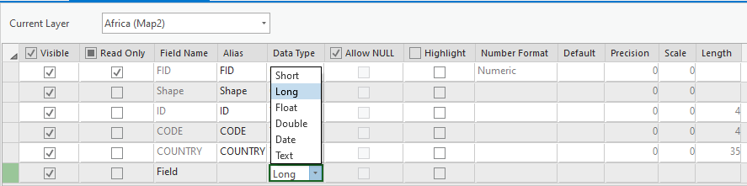
Editing
Adding Fields
Make sure to define the correct type
Data Type
Short Integer | Integer values between -32,768 and 32,767
Long Integer | Integer values between -2,147,483,648 and 2,147,483,647
Float | Decimal values with 1-6 decimal places
Double | Decimal values with more the 6 decimal places
Text | Text strings
Date | Data info (mm/dd/yyyy)
Notes:
When creating a new field, you will need to define the field type.
Short and long integer fields can only store integer or whole number values. Long integers can stored a wider range of numbers than short integers.
If you need to maintain decimal values, you cannot use a short or long integer. Instead, you must use a float or double type. Float fields can store up to 6 decimal places while double can store more than 6.
If you would like to store text or string data, you will do so in a text field. Note that numbers stored in text field will be treated like strings. They will not be treated line numbers. For example, you will not be able to perform mathematical operations on these data.
Date fields store dates and will treat the information as dates.

Slide 20
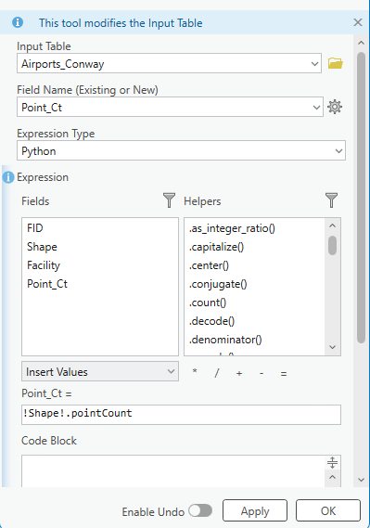
Using Python in ArcGIS Pro
Step 1: Create a New Field
Open the Attribute Table of Airports_Conway
On the Table ribbon, click Add Field.
In the Fields View:
Name = Point_Ct
Data Type = Long Integer (so it can hold numeric values)
Save your changes and close the Fields view.
Step 2: Open Calculate Field
In the attribute table, right-click the new Point_Ct field → Calculate Field.
Set Expression Type to Python.
Step 3: Write the Expression
In the Expression box, type:
!Shape!.pointCount

Slide 21
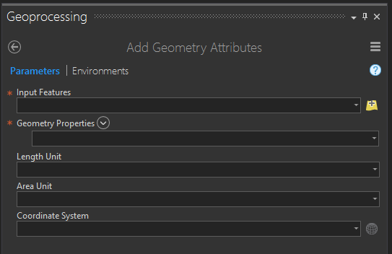
Editing
Adding Geometric Fields
Use Add (Calculate) Geometry Attributes Tool
Points | Lines | Polygons
X-coordinate | Start-X | Area
Y-coordinate | Start-Y | Perimeter
Z-coordinate (if z-enabled) | End-X | Centroid-X
M-coordinate (if m-enabled) | End-Y | Centroid-Y
… | Mid-X | …
 | Mid-Y
 | Length
 | ...
Notes:
Different geometric measures can be calculated and stored in the attribute table for points, lines, and polygon data.
For point data, it is possible to store the x and y coordinate. If the feature is z-enabled, or contains elevation or height information, this value can also be calculated. If it is M-enable, the M coordinate can be calculated. M-coordinates generally relate to positions along a network.
For lines, you can calculate the x and y coordinates for the start, end, and middle of the line segment. You can also calculate the length and bearing. The bearing is the compass direction of the line and is defined as the direction of travel from the start to the end node.
For polygons, you can calculate the area and perimeter. The perimeter is the length of all the lines that make up the boundaries of the area. You can also calculate the centroid, or geometric center, coordinates. Note that centroid coordinates can sometimes be misleading. For example, for irregular or elongated shapes, the centroid may not actually occur within the polygon. For a “C” shaped feature, the centroid would occur somewhere in the middle of the “C” as oppose to within the area that makes it up. So, be careful when using centroid measures.

Slide 22
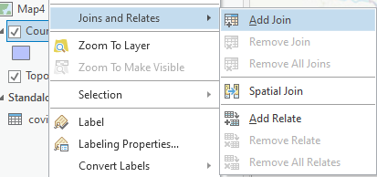
Editing
Joining non-spatial data and spatial data
Join
Non-spatial data can be joined to spatial data as long as there is a common field between the data.
Later, the joined fields can be used for analysis or to symbolize the features.
Shared fields must have the same data type
Relate
New fields are not added to table. However, a relationship is established.
Notes:
We discussed table joins in a prior lecture. Here I will provide a refresher.
Joins can be used to associated tables with spatial layers. If a table and a vector layer share a common field, then they can be joined based on this shared attribute. This is similar to the concepts of foreign and primary keys in relational databases.
For example, if a layer of county boundaries contains the county name or FIPS code in its attribute table, this could be used to join a table to the features if the table also contains the name or FIPS code. Note that table joins are generally case sensitive and the shared fields must have the same data type.
Joins are just temporary. If you would like to permanently add the new columns to the attribute table, you will need to make a copy of the data.
A relate is similar to a join; however, the fields from the related table are not temporarily added to the feature attribute table. Instead, a relationship is established between the features but the data are maintained as separate files.
I generally prefer to use join as opposed to relate.
Since both of these operations are just a temporary association, they can be removed. So, if you would like to remove the joined fields from the table, you can do so without any issues.

Slide 23
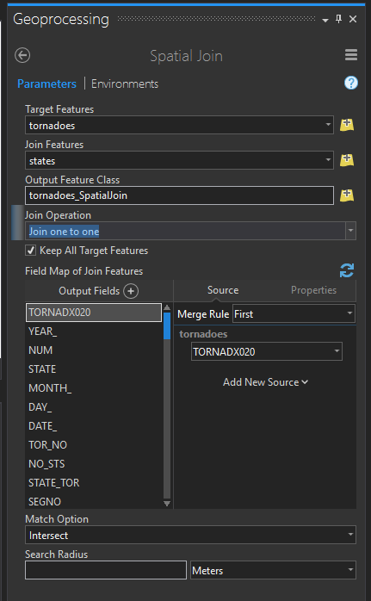
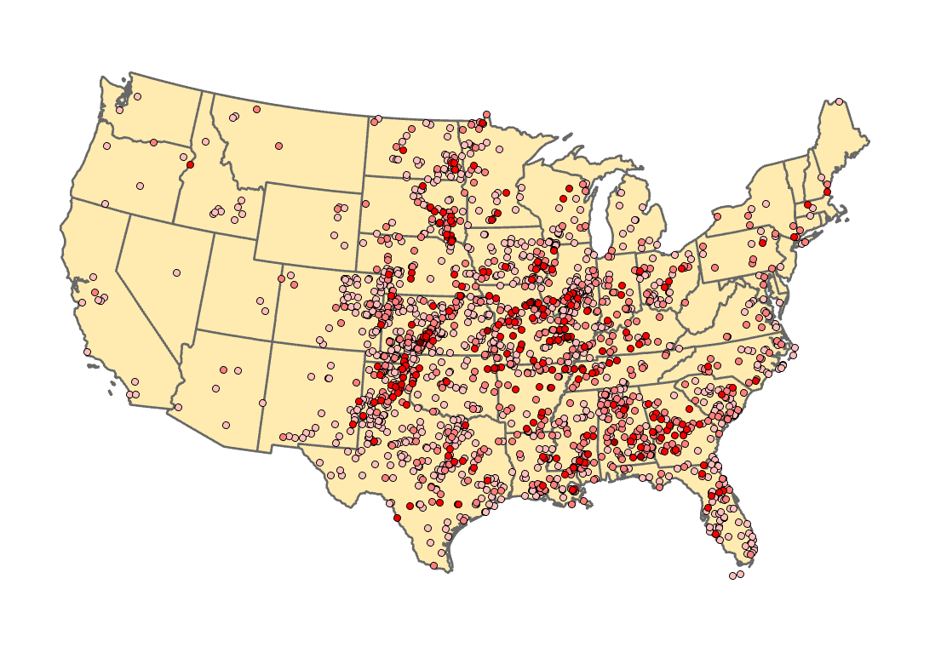
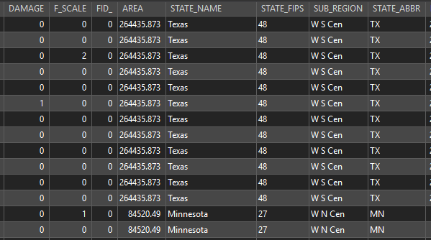
Editing
Spatial joins
Joins attributes based on spatial relationships
Notes:
In this example, the output would be the tornado point locations with an attribute table containing the original attributes for the tornadoes and the attributes for the state in which the tornado occurred.

Slide 24
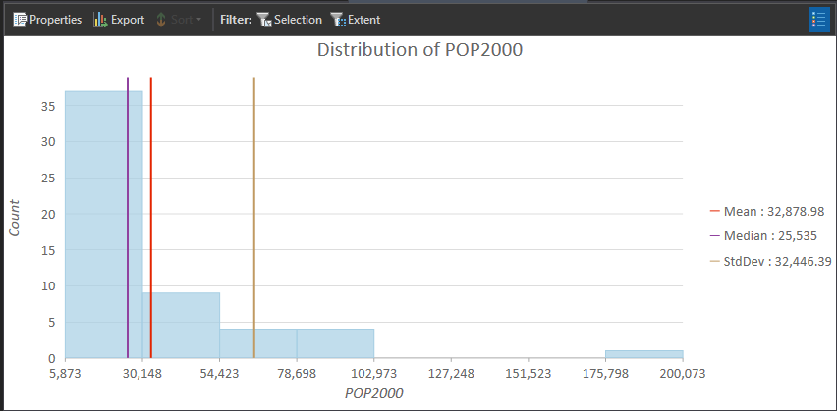
Editing
Field Statistics
Statistics for numeric fields
Notes:
It is possible to obtain summary statistics as tables and charts for attribute fields.
You can also obtain summaries by case or group using a categorical attribute.
For example, you could summarize the mean percent clay content by soil type as opposed to a single summary for all soil types.

Slide 25
Iin-class practice – field statistics
Why use it
Quickly visualize attribute data alongside maps
Simplifies explaining patterns in spatial datasets
Useful for decision-making and presentations
Right-click County in the Contents pane → Create Chart → Histogram
Configure different parameters

Slide 26
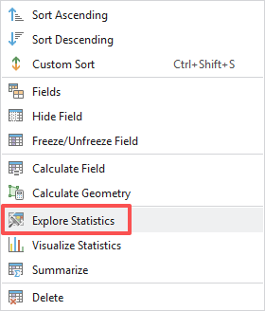
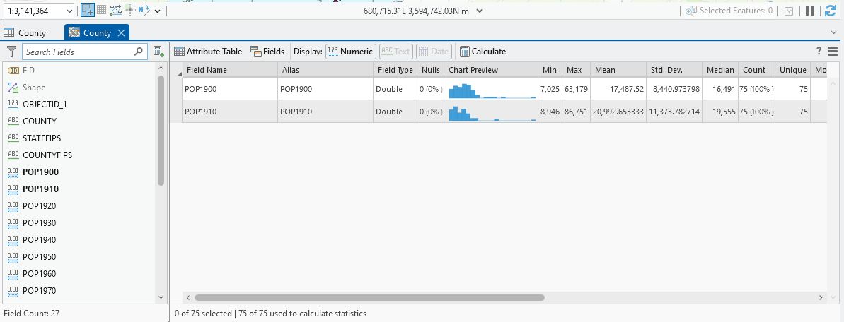
Editing
Explore Statistics
Statistics for multiple numeric fields
Notes:
It is possible to obtain summary statistics as tables and charts for attribute fields.
You can also obtain summaries by case or group using a categorical attribute.
For example, you could summarize the mean percent clay content by soil type as opposed to a single summary for all soil types.

Slide 27
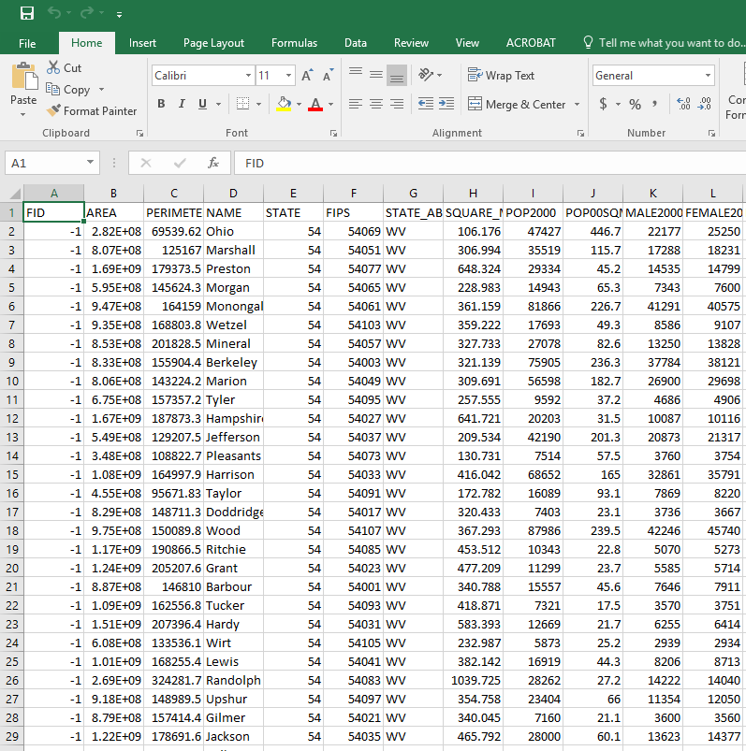

Editing
Export an Attribute Data
Types include: text, comma separated values (CSV), geodatabase tables, and dBASE tables
Can analyze aspatial or tabulated data outside of GIS software
Notes:
If you would like to work with the tabulated data and do not need the spatial component, attribute tables can be exported for use in data analysis or statistical software packages using a variety of formats, such as text files, comma separated values (or CSV) files, and database (or dBASE) files.

Slide 28
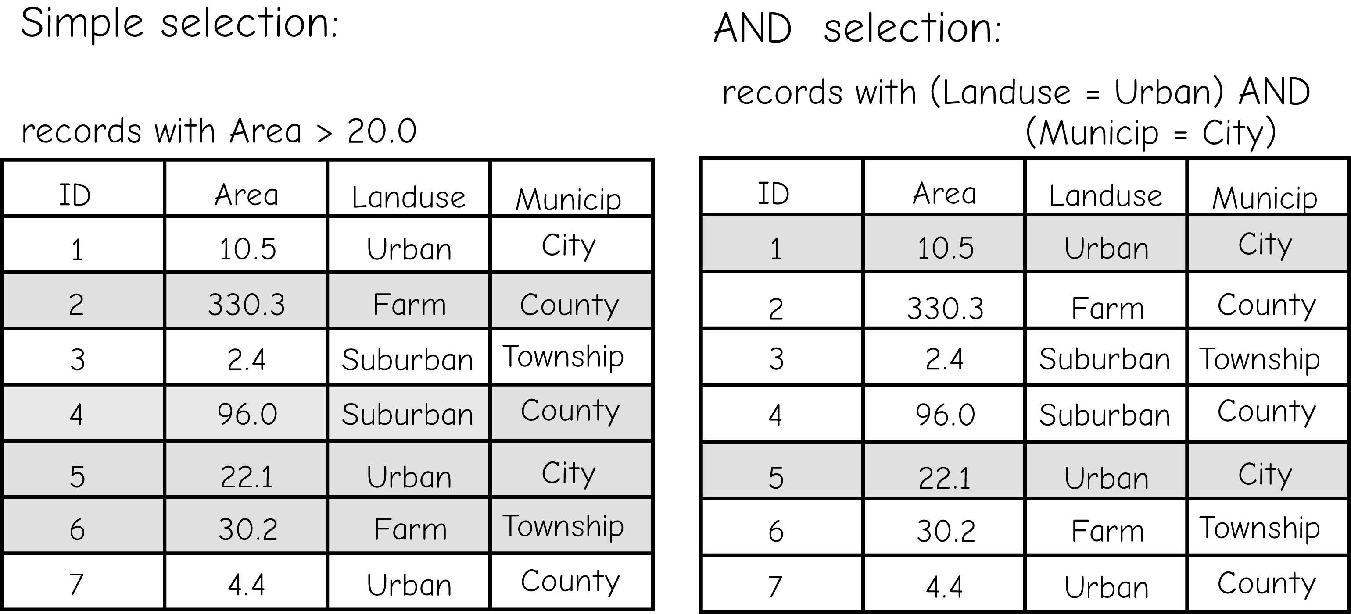
Query
Query
Structural Query Language (SQL)
Table or Aspatial Queries
Logical Operators
Equal: =
Not Equal: <>
Greater Than: >
Greater Than or Equal To: >=
Less Than: <
Less Than or Equal To: <=
Bolstad, 2019
Notes:
Data can be queried based on the information stored in the attribute table. Such queries are known as table or aspatial queries.
These queries can be performed using just attribute information.
The geometric information is not required to complete the query.
Queries make use of logical operators, such as equal to, not equal to, less than, and greater than or equal to. They can also make use of Boolean connectors if multiple criteria will be included.
In the example in this slide, counties are being queried. Specifically, the goal is to extract all counties that have a population greater than or equal to 20,000 and are in the Midwest region.
Because AND is use here, both criteria must be met for a feature to be selected.
Once a query is executed, selected features can be written to a new file.

Slide 29
Query
Query
Structural Query Language (SQL)
Table or Aspatial Queries
Logical Operators
Equal: =
Not Equal: <>
Greater Than: >
Greater Than or Equal To: >=
Less Than: <
Less Than or Equal To: <=
Landuse = Urban?
Bolstad, 2019
Notes:
Data can be queried based on the information stored in the attribute table. Such queries are known as table or aspatial queries.
These queries can be performed using just attribute information.
The geometric information is not required to complete the query.
Queries make use of logical operators, such as equal to, not equal to, less than, and greater than or equal to. They can also make use of Boolean connectors if multiple criteria will be included.
In the example in this slide, counties are being queried. Specifically, the goal is to extract all counties that have a population greater than or equal to 20,000 and are in the Midwest region.
Because AND is use here, both criteria must be met for a feature to be selected.
Once a query is executed, selected features can be written to a new file.

Slide 30
Query
Query
Structural Query Language (SQL)
Table or Aspatial Queries
Boolean Connectors
AND (A and B)
OR (A or B, including A and B)
NOT (A but not B)
(Landuse = Urban) AND (Municip = County) ?
Bolstad, 2019
Notes:
Data can be queried based on the information stored in the attribute table. Such queries are known as table or aspatial queries.
These queries can be performed using just attribute information.
The geometric information is not required to complete the query.
Queries make use of logical operators, such as equal to, not equal to, less than, and greater than or equal to. They can also make use of Boolean connectors if multiple criteria will be included.
In the example in this slide, counties are being queried. Specifically, the goal is to extract all counties that have a population greater than or equal to 20,000 and are in the Midwest region.
Because AND is use here, both criteria must be met for a feature to be selected.
Once a query is executed, selected features can be written to a new file.

Slide 31
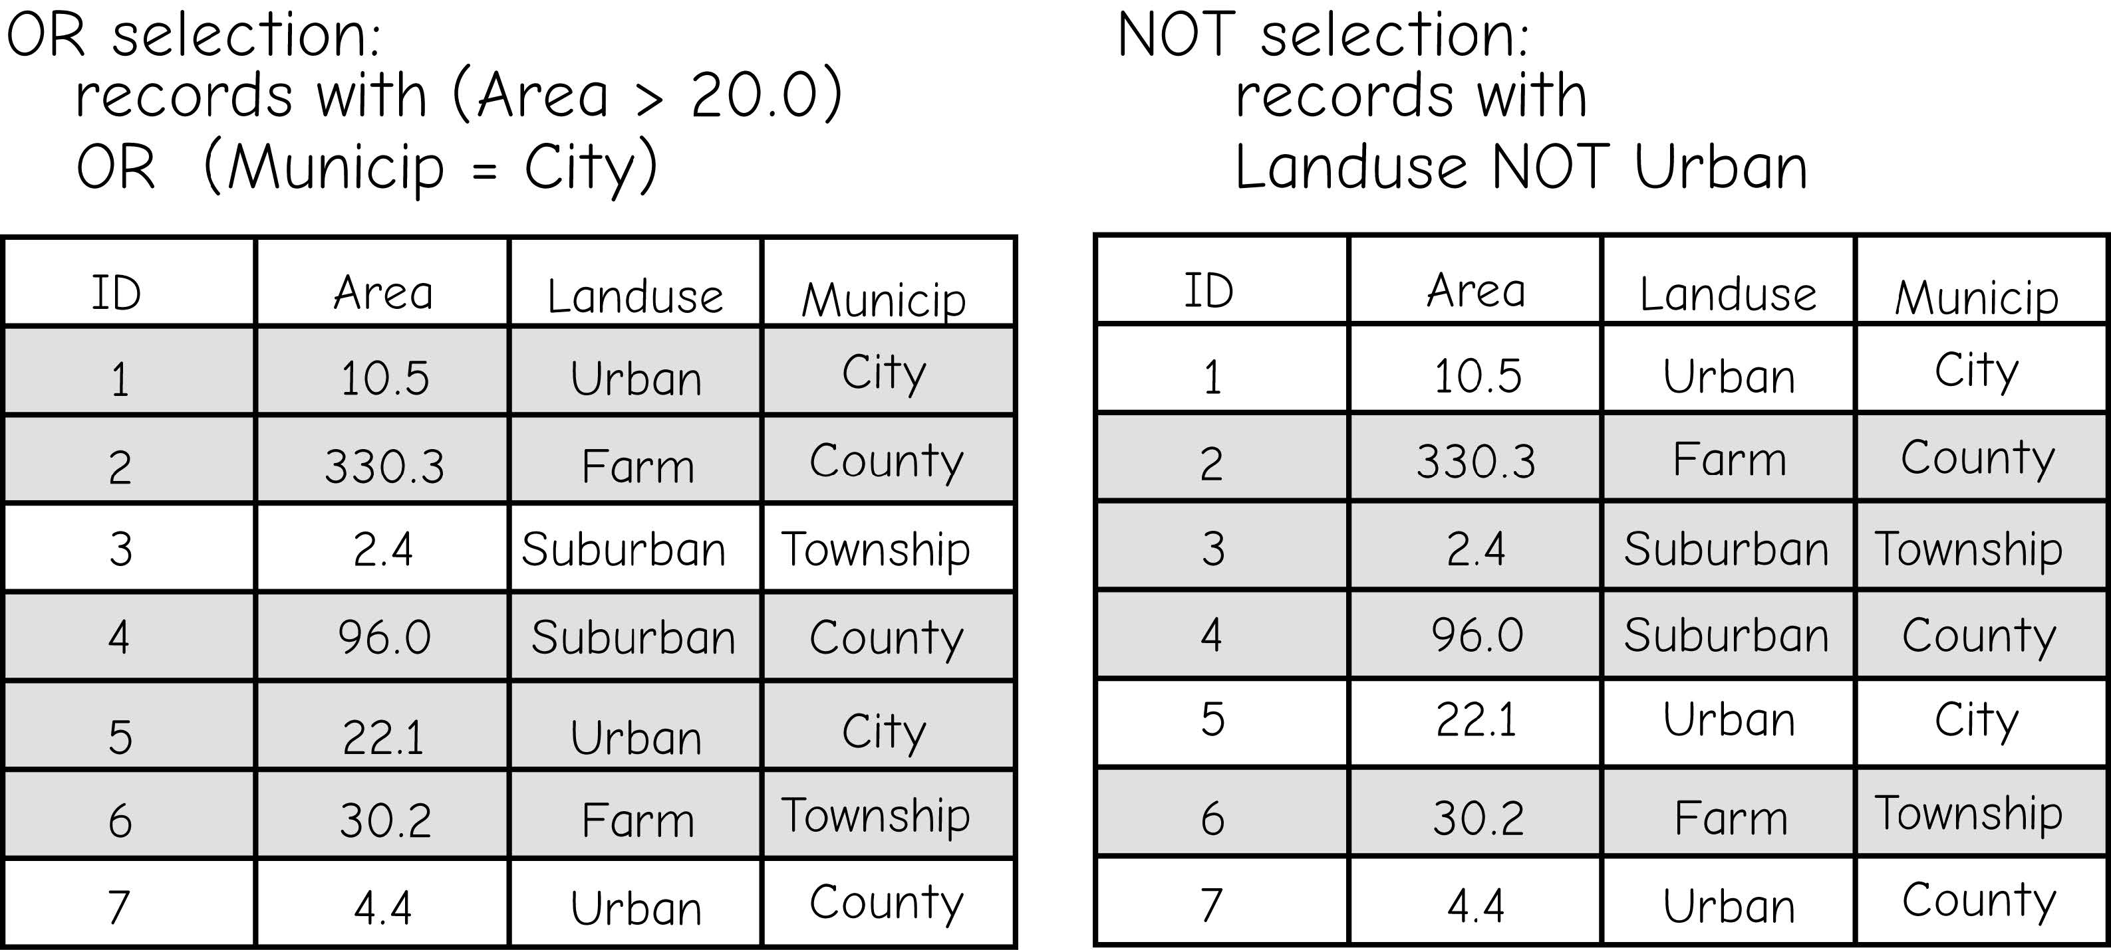
Query
Query
Structural Query Language (SQL)
Table or Aspatial Queries
Boolean Connectors
AND (A and B)
OR (A or B, including A and B)
NOT (A but not B)
(Landuse = Urban) OR (Municip = County) ?
Bolstad, 2019
Notes:
Data can be queried based on the information stored in the attribute table. Such queries are known as table or aspatial queries.
These queries can be performed using just attribute information.
The geometric information is not required to complete the query.
Queries make use of logical operators, such as equal to, not equal to, less than, and greater than or equal to. They can also make use of Boolean connectors if multiple criteria will be included.
In the example in this slide, counties are being queried. Specifically, the goal is to extract all counties that have a population greater than or equal to 20,000 and are in the Midwest region.
Because AND is use here, both criteria must be met for a feature to be selected.
Once a query is executed, selected features can be written to a new file.

Slide 32
Query
Query
Structural Query Language (SQL)
Table or Aspatial Queries
Boolean Connectors
AND (A and B)
OR (A or B, including A and B)
NOT (A but not B)
NOT (Municip = County) ?
Bolstad, 2019
Notes:
Data can be queried based on the information stored in the attribute table. Such queries are known as table or aspatial queries.
These queries can be performed using just attribute information.
The geometric information is not required to complete the query.
Queries make use of logical operators, such as equal to, not equal to, less than, and greater than or equal to. They can also make use of Boolean connectors if multiple criteria will be included.
In the example in this slide, counties are being queried. Specifically, the goal is to extract all counties that have a population greater than or equal to 20,000 and are in the Midwest region.
Because AND is use here, both criteria must be met for a feature to be selected.
Once a query is executed, selected features can be written to a new file.

Slide 33
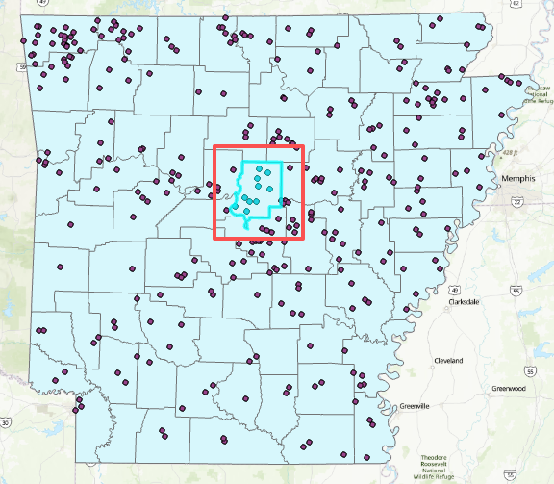
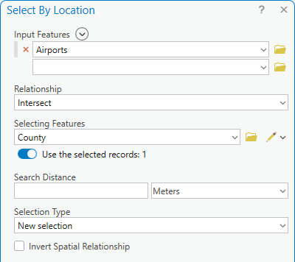
Query
Select by location
Select based on spatial relationships to other geographic features
Notes:
It is also possible to query features based on spatial relationships to other map features. Such queries are not possible for tabulated data since the geometric information is necessary to perform the analysis. So, this is unique to spatial data and highlights the value of having spatial information associated with tabulated data.
Using select by location, features can be selected based on their spatial relationship to other features.
The next two slides will describe some of the available spatial relationships.

Slide 34
Query
Select by location
Intersect: select input features that intersect the selecting features. This is the default.
Within a distance: select input features that are within the specified Euclidean distance of the selecting features.
Contains: Select any input feature that contains, even partially, a selecting feature.
Completely contains: select any input feature that completely contains a selecting feature.
Within: select any input feature that is within, even partially, a selecting feature.
Completely within: select any input feature that is completely within a selecting feature.
Notes:
Take some time to read through the spatial relationships presented here.
As an example, the intersect relationship can be used if you wan to select features that intersect another set of features. For example, you could select all counties that intersect a particular highway. The county will be selected if a highway intersects it or passes through it.
Within can be used to select features that are within other features. For example, you could select all of the homes that occur within a certain voting district. In contrast, contains could be used to select all of the voting districts that contain certain homes.

Slide 35
Query
Select by location
Are identical to: select any input feature that has identical geometry to a selecting feature.
Boundary touch: select any input feature that has a boundary that touches a selecting feature.
Share a line segment with: select any input feature that shares a line segment with a selecting feature.
Crossed by outline of: select any input feature that is crossed by the outline of a selecting feature.
Have their center in: select any input feature that has its center in the selecting features. The center for lines is defined as the midpoint and the center for polygons is defined as the centroid.
Notes:
Here are some additional spatial relationships.
As an example, are identical to is used to find features in one layer that are identical to features in another layer. For example, if you had a polygon vector dataset of buildings representing the city in 1990 and another layer representing buildings in the city in 2010, you could use this tool to find the identical buildings, or buildings that haven’t changes. You could then reverse the selection to find all new buildings.
Take some time to read through these examples.

Slide 36
5.2 Lab session

Slide 37
Lab 04: Exploring Spatial Data
Due by Midnight (11:59 pm) on Monday, Sep 22, 2025
Submit a word document only include question and answer

