Slide 1

WEEK 06 Data Standardization lecture
Instructor: Yanan Wu
fALL 2025

Slide 2
6.1 Standardization

Slide 3
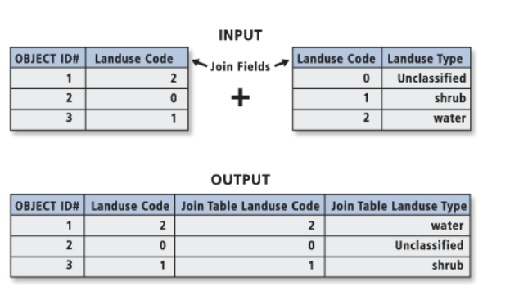
Join table
Joins a layer to another layer or table based on a common field.
This join is temporary.

Slide 4
Overview
Cartography
What is Cartography?
What is map?
Data Standardization
Density
Proportion
Relationship
Statistic summaries

Slide 5
What is Cartography?
Many different definitions, but only one ‘official’ definition for this course
The art, science, and technology of making maps, together with their study as scientific documents and works of art - by International Cartographic Association

Slide 6
GIS, Visualization, and Mapmaking
These terms are all used to describe the process of making maps. However, they are not synonymous with Cartography.
GIS
A computer-based system for collecting, managing, analyzing, modeling, and presenting geographic data for a wide range of application
Visualization has no agreed-upon definition.
The representation of data in a viewable medium or format – by ESRI
Include a reference to computer technologies and interactive maps
Mapmaking
Creating maps by any method

Slide 7
What’s a Map?
Many different definitions, but only one ‘official’ definition for this course
A map is a reduced, selective, and symbolized graphical representation of the environment
Reduced: we reduce the size of the spatial phenomenon being represented onto a more reasonably sized piece of paper.
Selective: The maps should only include items that are directly related to the message of the map.
Symbolized: The item being mapped by using a representative symbol.
Notes:
It is reduced because it is physically smaller than the size of the United States.
It is selective because it does not show the relevant information to the purpose of this map.
It is symbolized through the use of visual variables such as color, texture, size, and shape.

Slide 8
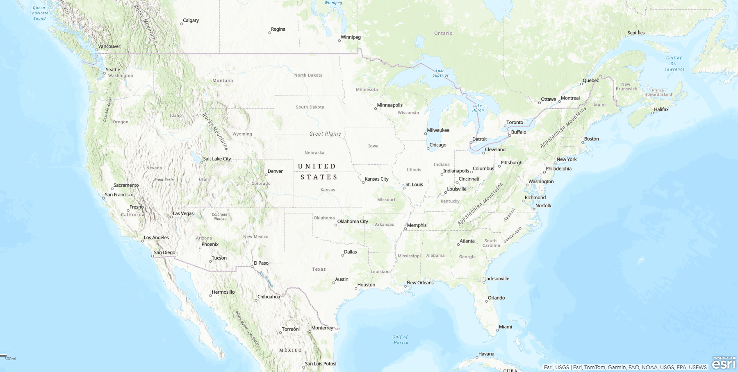
What is a Map?
General-reference maps – United States
It is reduced, selective, symbolized
General Reference Map United States

Slide 9
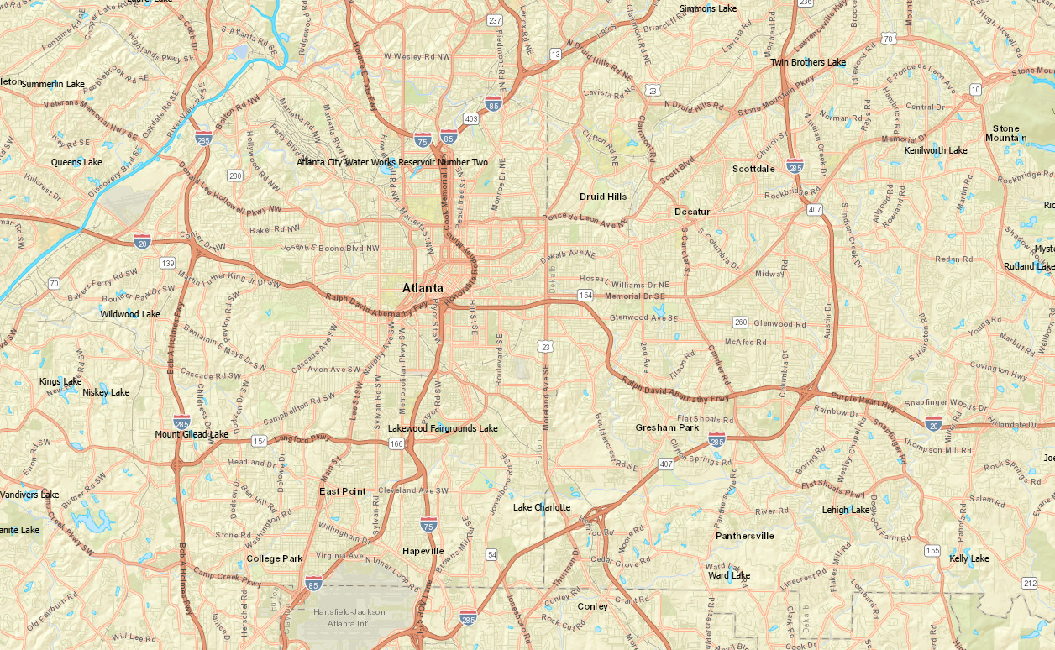
What is a Map?
General-reference maps – Atlanta Area
It is reduced, selective, symbolized

Slide 10
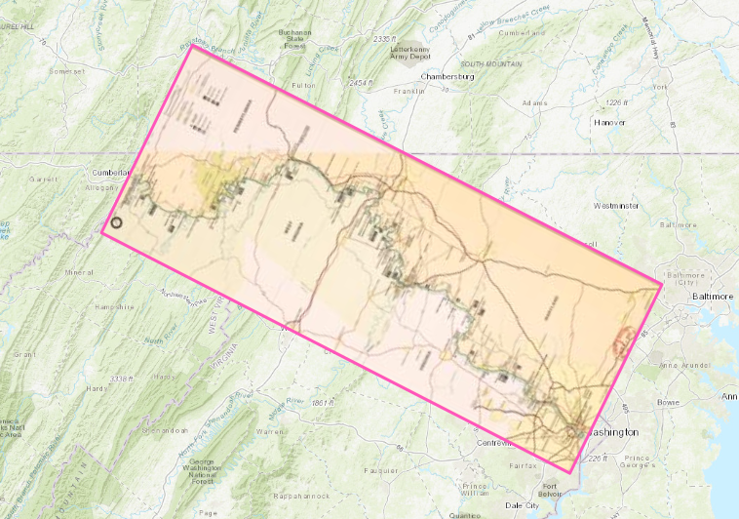
What is a Map?
Special-purpose maps
Large scale (showing a small area and much detail)
Canal maps

Slide 11
What is a Map?
Thematic maps
Represent a single topic or theme (a single attribute or variable)
Include only features that are directly related to the theme, or useful as reference
Represent fewer features, in more depth

Slide 12
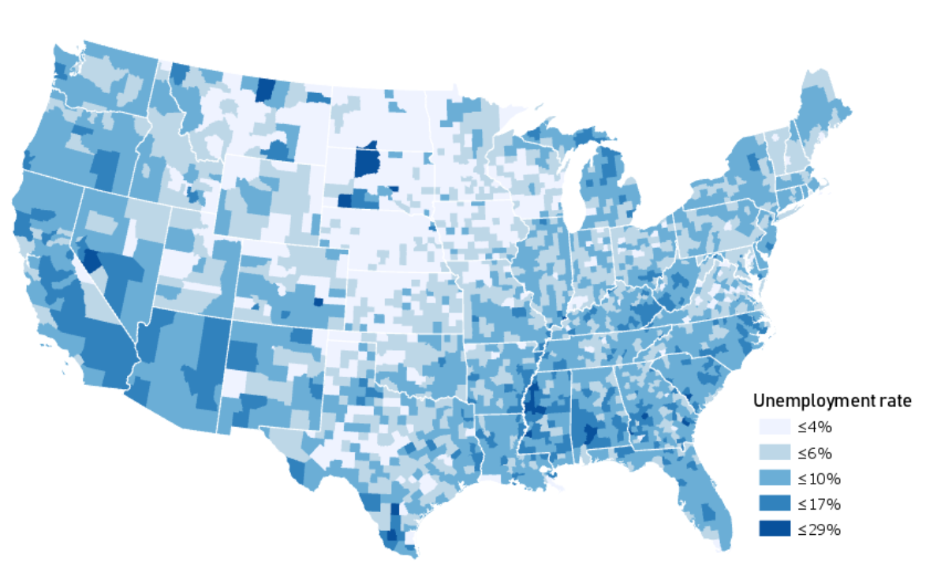
A county-level map of unemployment.
Credit: Cary Anderson© Penn State is licensed under CC BY-NC-SA 4.0(link is external). Data Sources: Esri, US Census Bureau

Slide 13
Standardization
Normalization
Transformation of raw data values to different, more meaningful values
To map densities instead of ‘raw’ values
To map proportions between variables
To map other relationships between variables
To map statistic summaries

Slide 14
Mapping Density
How much of a particular thing exists within a given area
Mapping density is not necessary if the goal is to show where ‘more’ is
Larger enumeration units often have ‘more’ of a particular thing
Accounting for the varying sizes of enumeration units can be more revealing
Notes:
Enumeration Unit: An areal unit by which enumerated data is aggregated and quantified. A common example of enumeration units is areal census units. Census data is aggregated into enumeration units that include blocks, block groups, census tracts, zip codes, and metropolitan areas, among many others.
Large areas can be perceived as ‘more important' and small areas as less

Slide 15
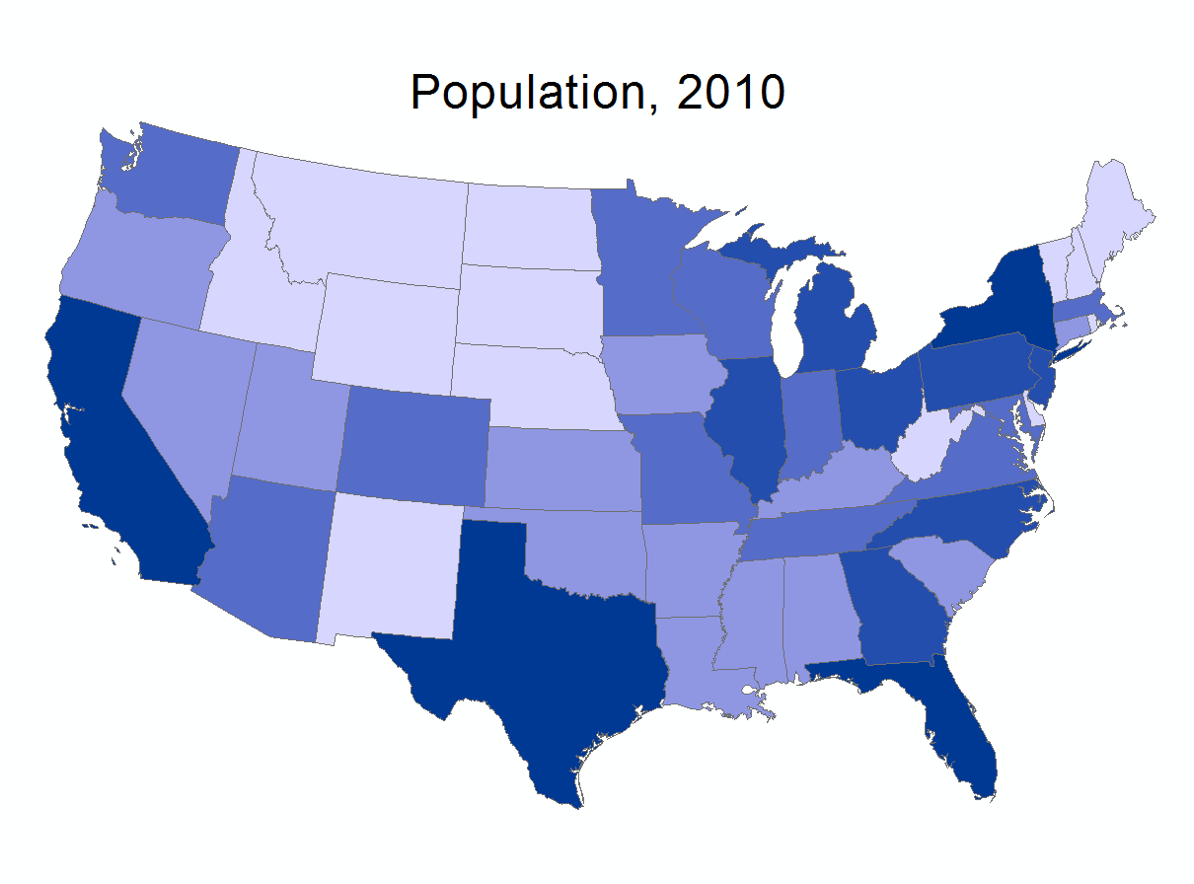
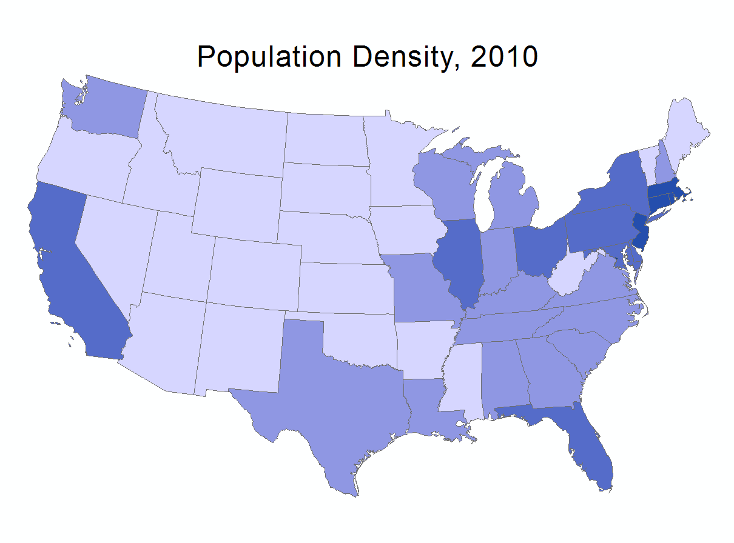
Mapping Density
Population/Area
“Persons per Square Miles”
Population, 2010
Population Density, 2010
National Geospatial Technology Center of Excellence
Notes:
contiguous
Connecticut

Slide 16
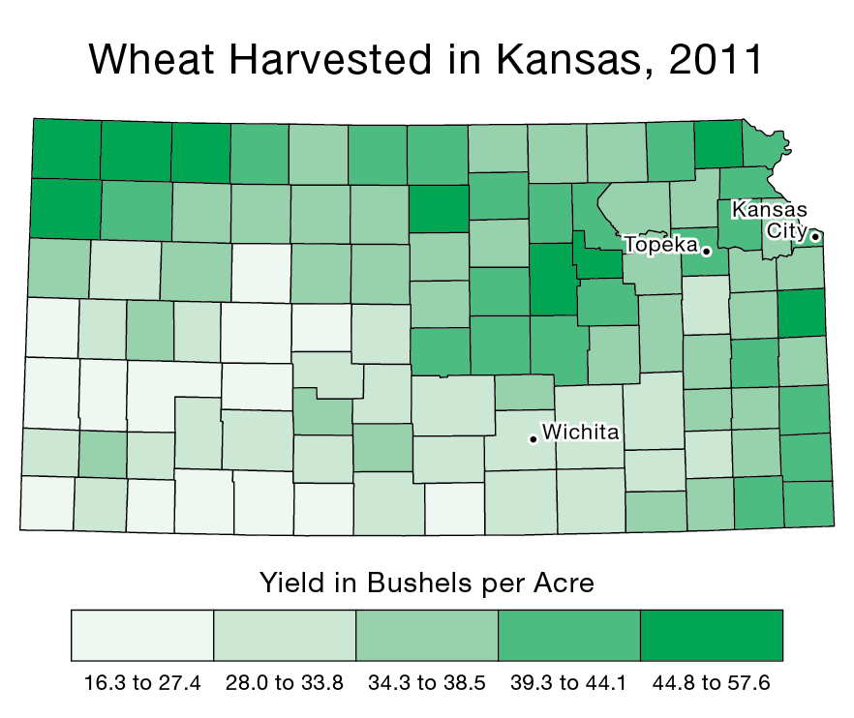
Mapping Density
Bushels/Area
“Bushels per Acre”
National Geospatial Technology Center of Excellence

Slide 17
Mapping Proportions
Proportions represent the relationship of a part to a whole
Several ways to express proportions
Quotient: 0.0 - 1.0
Percentage: 0 - 100%
Rate: 7 per 1,000

Slide 18
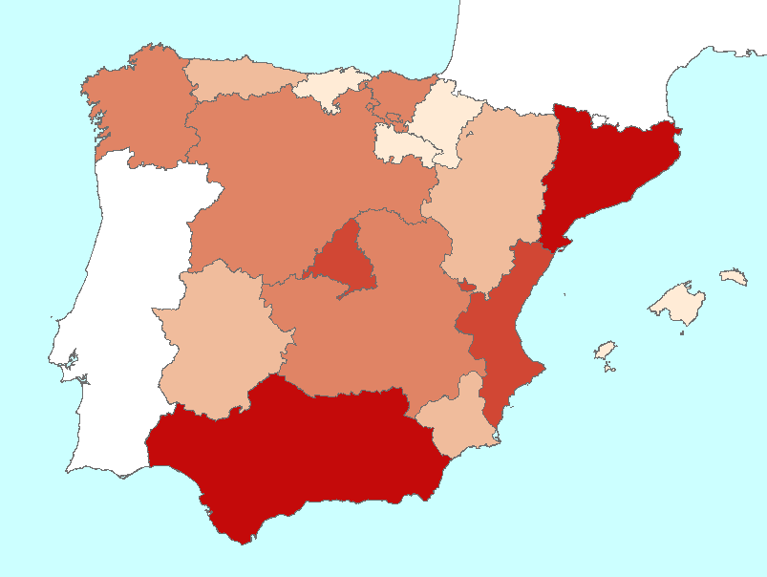
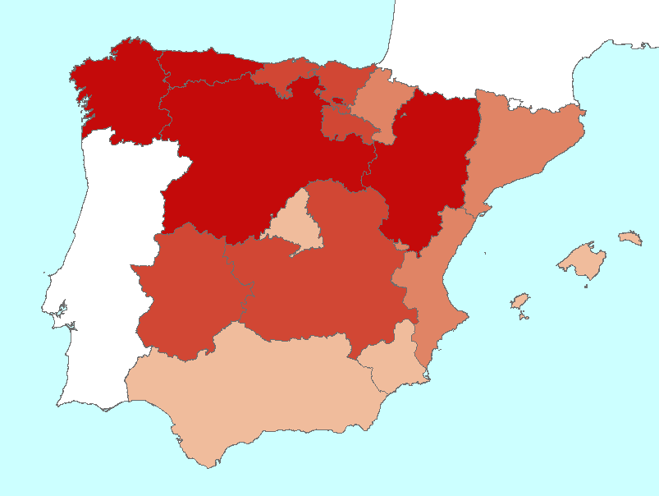
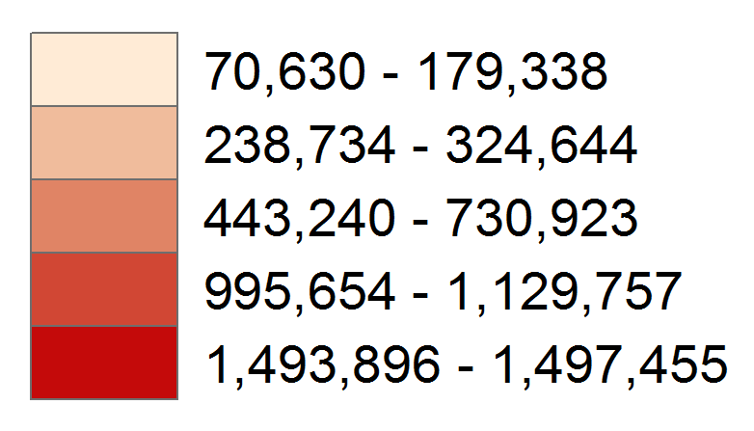
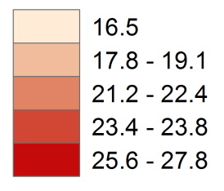
Mapping Proportions
Persons 60 and Over
Persons 60 and Over/Total Persons*100
“Percentage of Seniors”
National Geospatial Technology Center of Excellence
Notes:
Spain, Population ageing
28.7 % in Japan

Slide 19
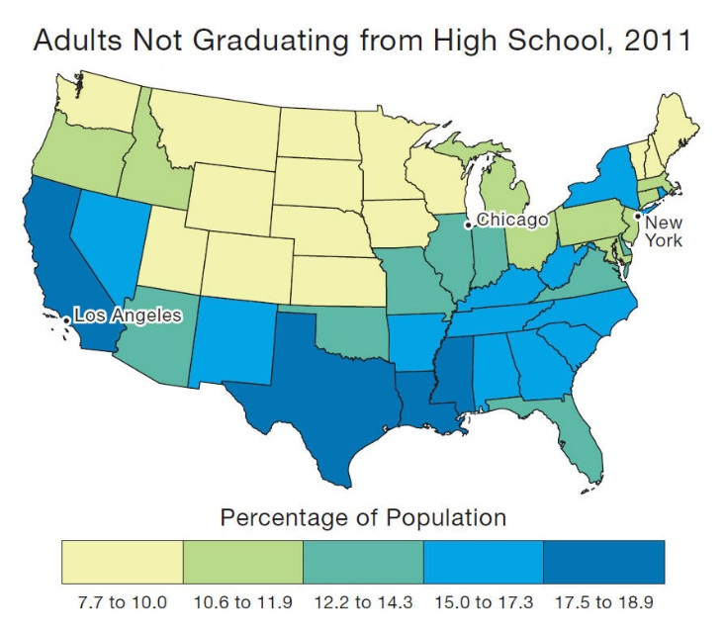
Mapping Proportions
Non Grads/Total Population*100
“Percentage of non Grads”
National Geospatial Technology Center of Excellence

Slide 20
Mapping Relationships
It can be revealing to show how two variables are related (in a manner that is not strictly proportional)
Several ways to express proportions
Quotient: 0.0 - infinity
Percentage: 0 - infinity%
Rate: 1,500 per 100

Slide 21
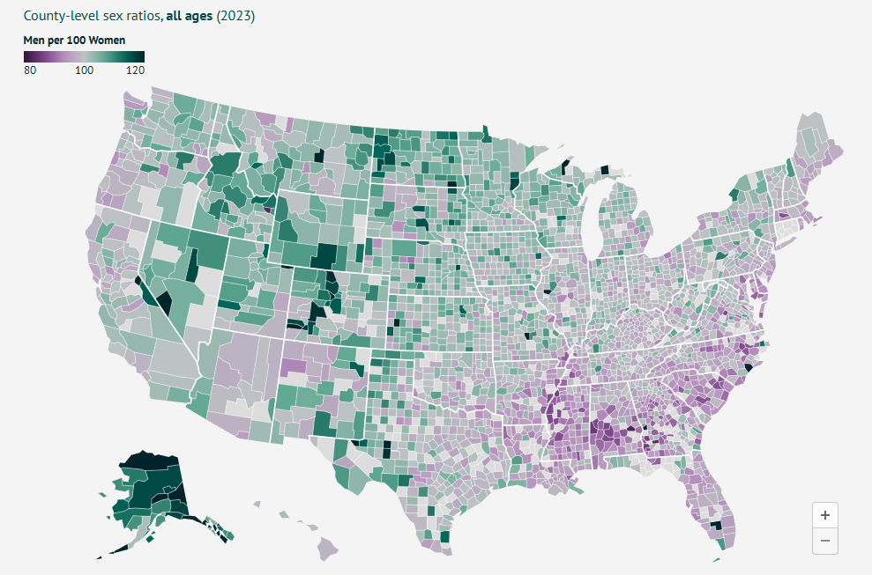
Mapping Relationships
Rate: Men per 100 women

Slide 22
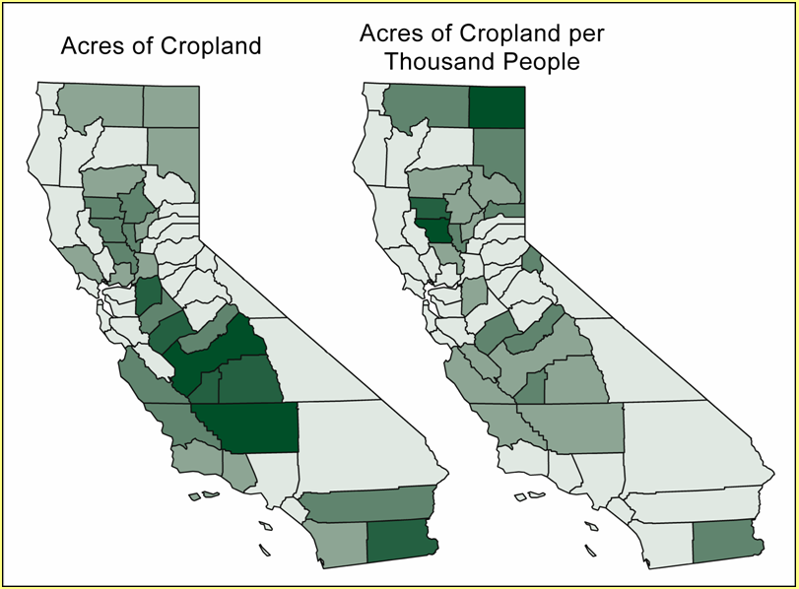
Mapping Relationships
Acres of Cropland/Population
“Acres per 1,000 People”
National Geospatial Technology Center of Excellence
Notes:
Intergovernmental Panel on Climate Change
Vatican

Slide 23
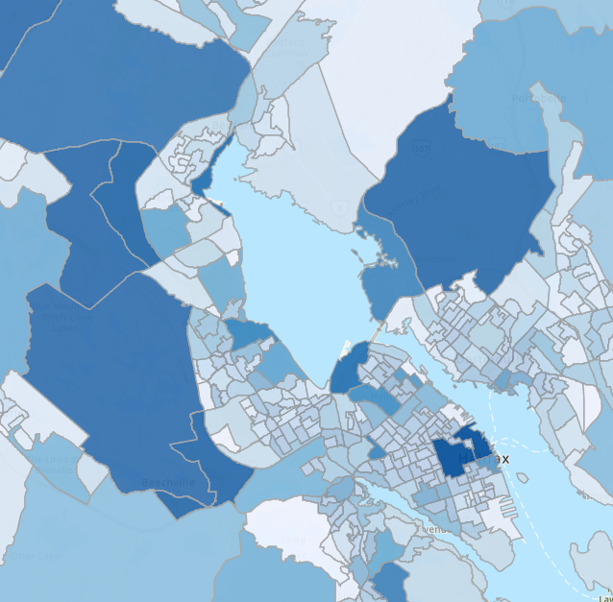
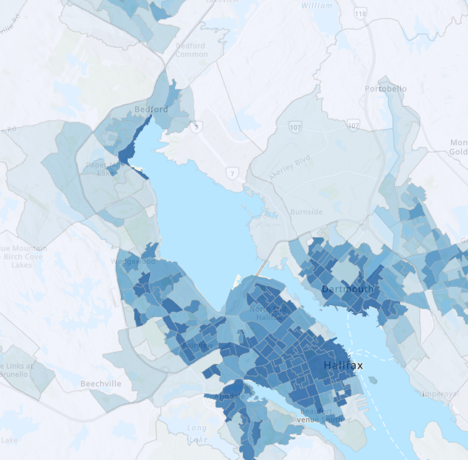
Choosing the Right Visual Type
b. Spatial Data – Choropleth Map
Raw values
Counts
Totals
Color
Derived values
Percentages
Averages
Rates
Ratios
Color

Slide 24
Mapping Stat Summaries
Enumeration units can be represented according to calculated statistics
Median
Mean (average)
Standard Deviation, etc.

Slide 25
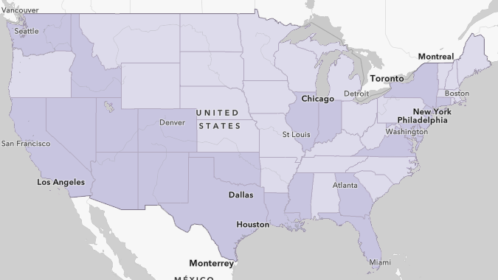
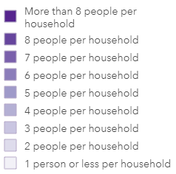
Mapping Stat Summaries
Average Household Size, 2020
https://uca-gis.maps.arcgis.com/home/webmap/viewer.html?webmap=36d7e68ce0ab416d951300479fc6fc04

Slide 26
Transformation of raw data values to different, more meaningful values
Densities, proportions, relationships, and statistical summaries
In conjunction with data classification, data standardization allows us to craft our message

Slide 27
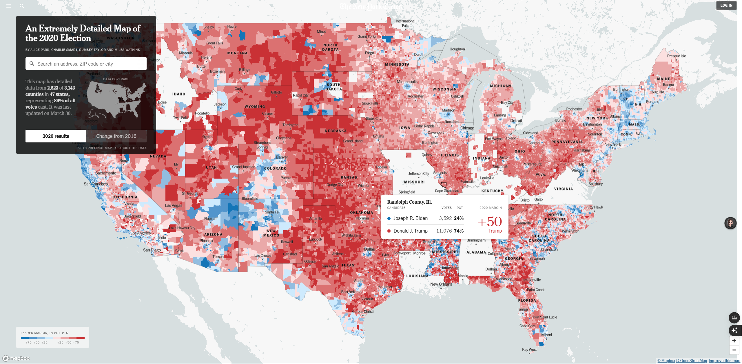
Interactive Vote Map(Web) from New York Times
What type of map is it?
What color scheme does it use?
Notes:
This is primarily a Choropleth Map. It uses colored geographic areas (counties, or possibly even smaller precincts given the title "Extremely Detailed") to represent the intensity or proportion of a variable – in this case, the 2020 US Presidential election results.
The map uses a Diverging Color Scheme. t employs two distinct hues: Red (typically representing the Republican candidate, Donald Trump) and Blue (typically representing the Democratic candidate, Joseph Biden).
The design uses a main map display area accompanied by a distinct left-hand sidebar. This is a common layout for interactive web maps. A clear legend is positioned unobtrusively in the bottom left corner.
The map utilizes interactive annotations (tooltips/pop-ups). Static labels for major features like state names are included directly on the map in a subtle color and font size, providing geographic orientation without dominating the visualization.

Slide 28
Hurricane Milton Strength Timeline, 10/5/2024 – 10/10/2024
Progression of Hurricane Milton's shape and intensity
Inset map: Temperature
Points: Wind speed and category along its path at specific times.

Slide 29
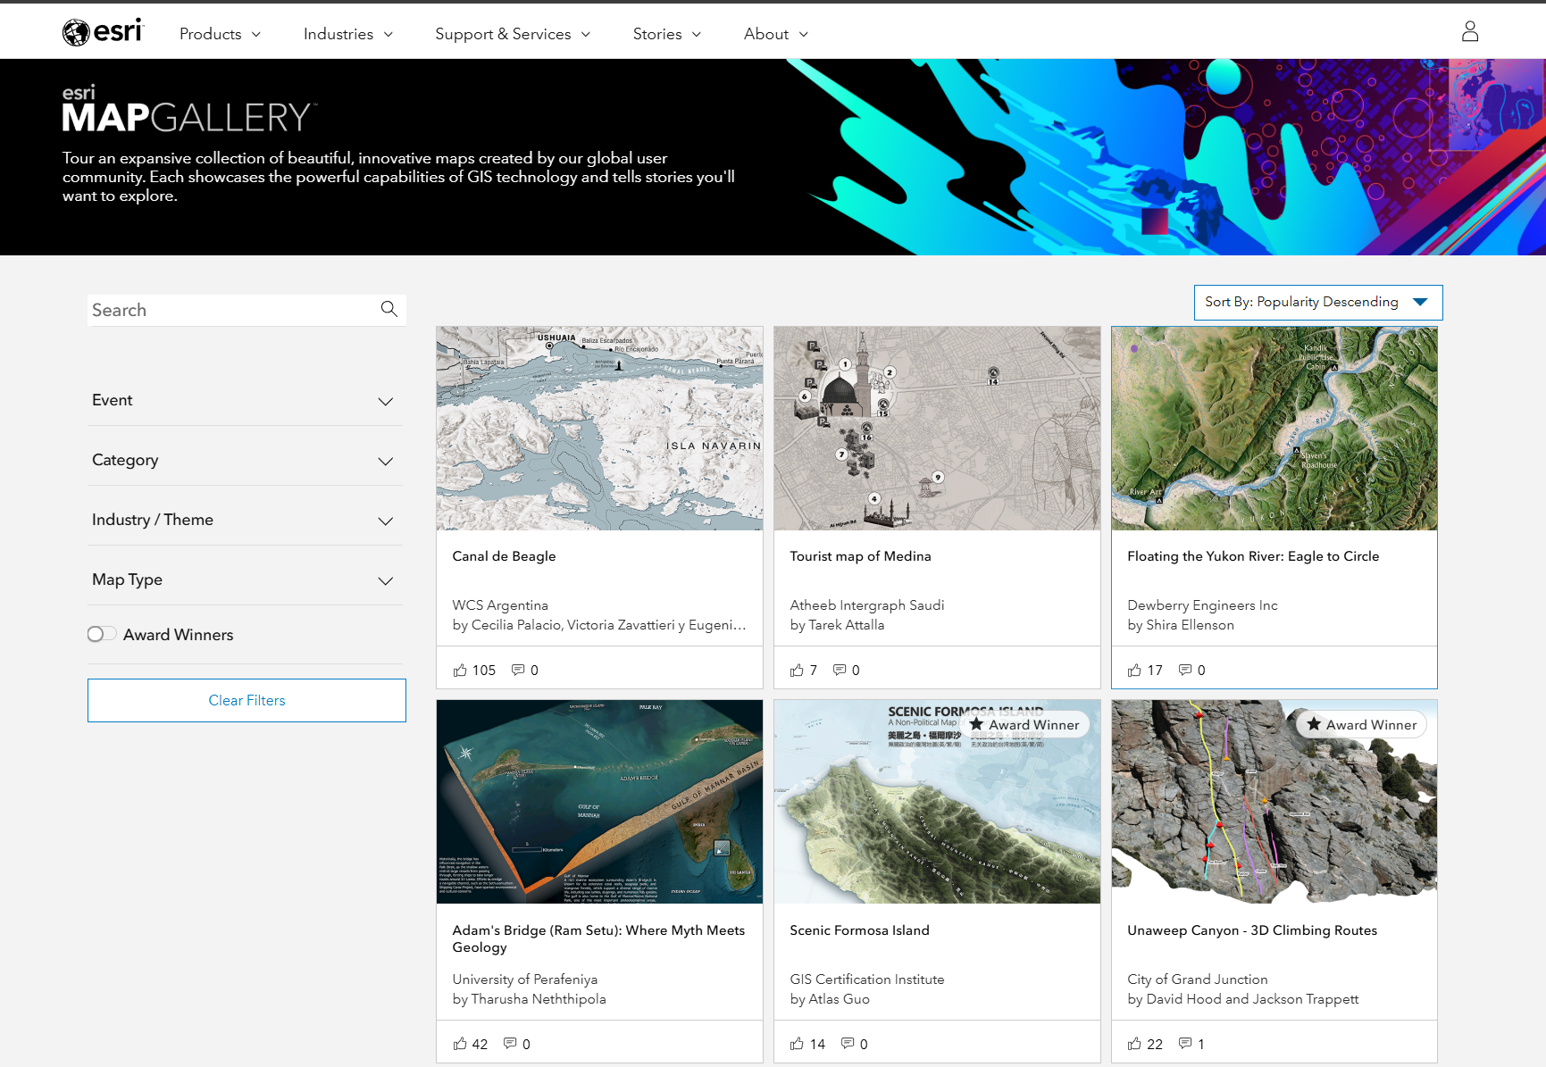
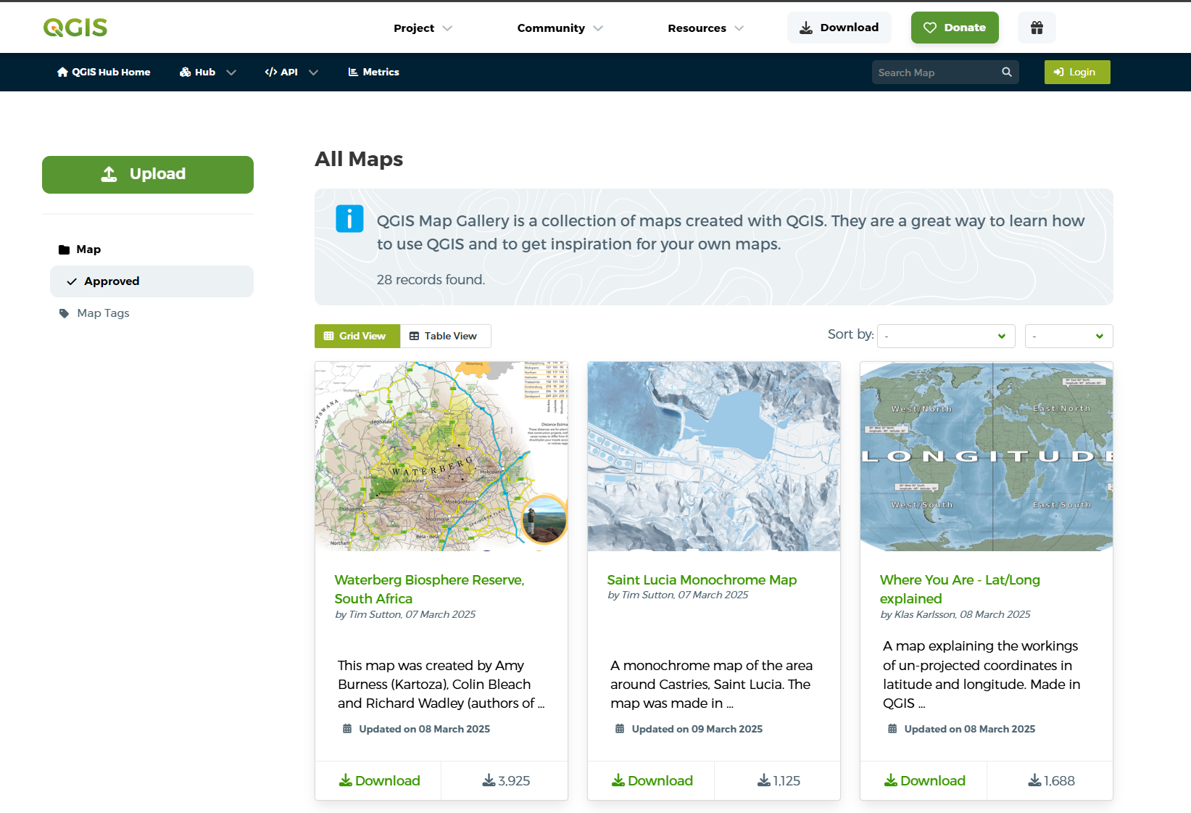
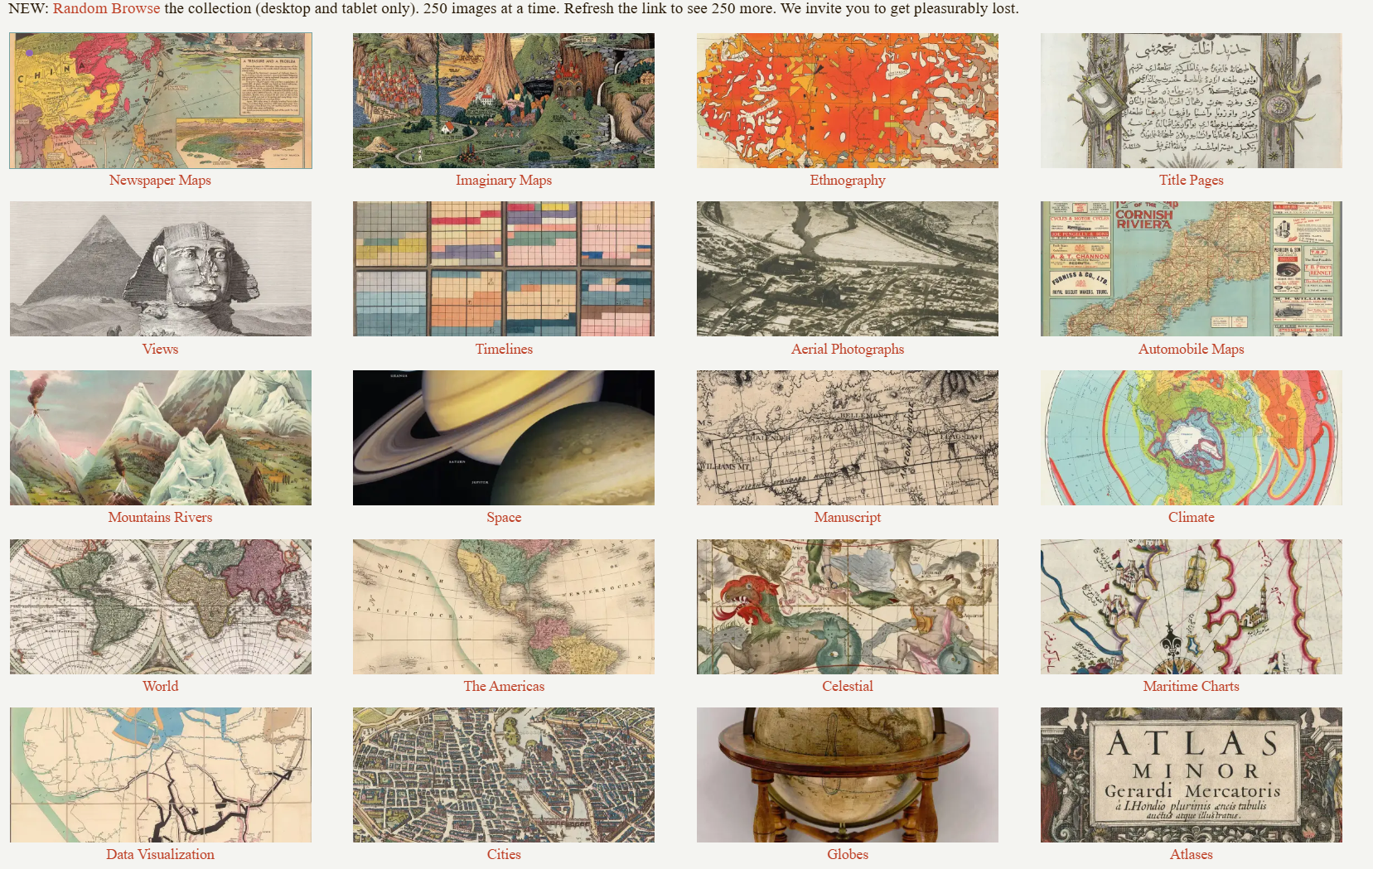
4.3 Resources for Good Maps
ESRI MAP GALLERY
QGIS MAP GALLERY
David Rumsey Map Collection
The historical map collection has over 139,000 maps and related images online.

Slide 30
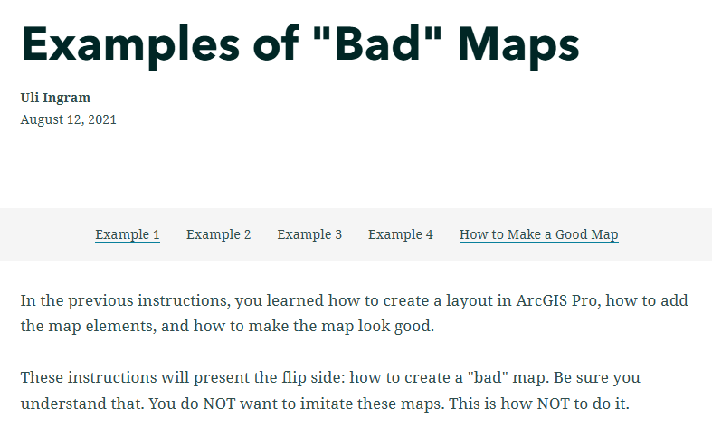
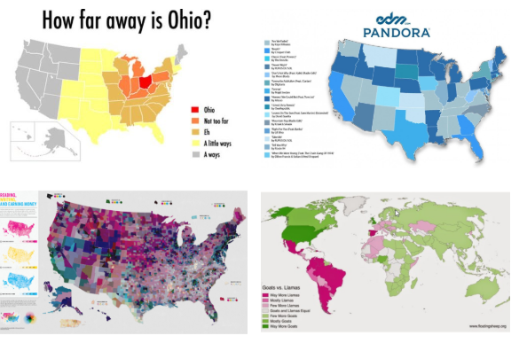
4.4 Resources for Bad Maps
Examples of Bad Maps
Examples of Bad Maps

Slide 31
6.2 Lab session

Slide 32
Lab 05: standardization and classification
Due by Midnight (11:59 pm) on Monday, Sep 29, 2025
Submit a word document only include question and answer

