Slide 1

Lecture 07 Map Elements lecture
Instructor: Yanan Wu
fALL 2025

Slide 2
7.1 MAP ELEMENTS

Slide 3
Data source
Allows the map user to determine where data were obtained
Sources of base information are normally omitted from thematic maps
Should be formatted similar to a standard bibliographic reference, but is often more concise and less formal

Slide 4
Data source
The words “Data Source:” or “Source:” should be included to avoid ambiguity
The data source indicates where data came from, not map authorship
A separate block of type can be used to indicate map authorship
The style of the data source should be plain and subtle
Publication names should be italicized
Multiple lines of type should be horizontally centered (center aligned)

Slide 5
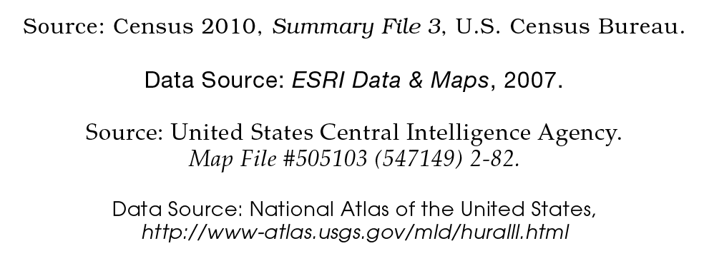
Data source

Slide 6
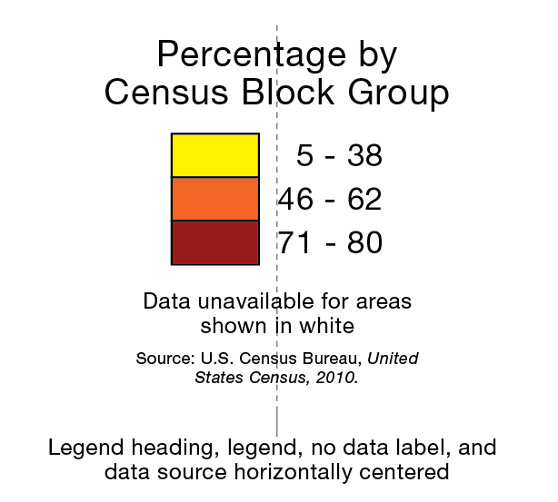
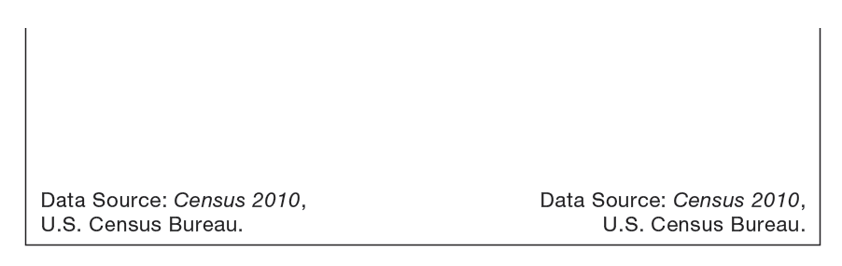
Data source
The data source should be among the smallest type on a map
Its purpose is to inform the curious, not to attract attention
Center it below the legend
Or tuck it into a lower corner

Slide 7
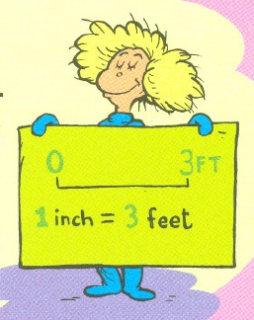
Scale
Indicates the amount of reduction that has taken place on a map, or allows the map user to measure distances
Can take three forms
Representative Fraction (1:24,000)
Verbal Scale (“One Inch to the Mile”)
Bar Scale or Scale Bar
Notes:
larger scale: greater detail and smaller area
Smaller scale: less detail and larger area

Slide 8
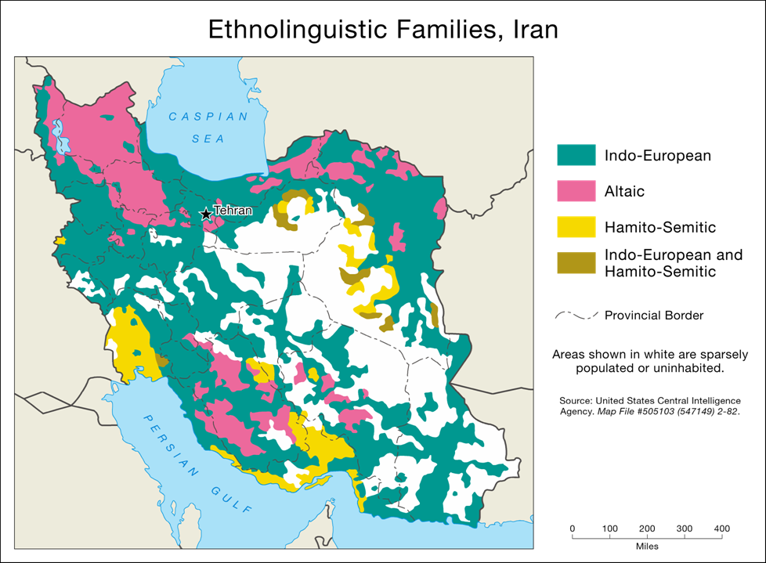
Scale

Slide 9
Scale
The bar scale is preferred format for inclusion on a thematic map
Resembles a ruler
Remains true when a map is enlarged or reduced (representative fractions and verbal scales don’t)
Include if distance information can enhance the map user’s understanding of the theme
Notes:
Layout view, it will not change

Slide 10
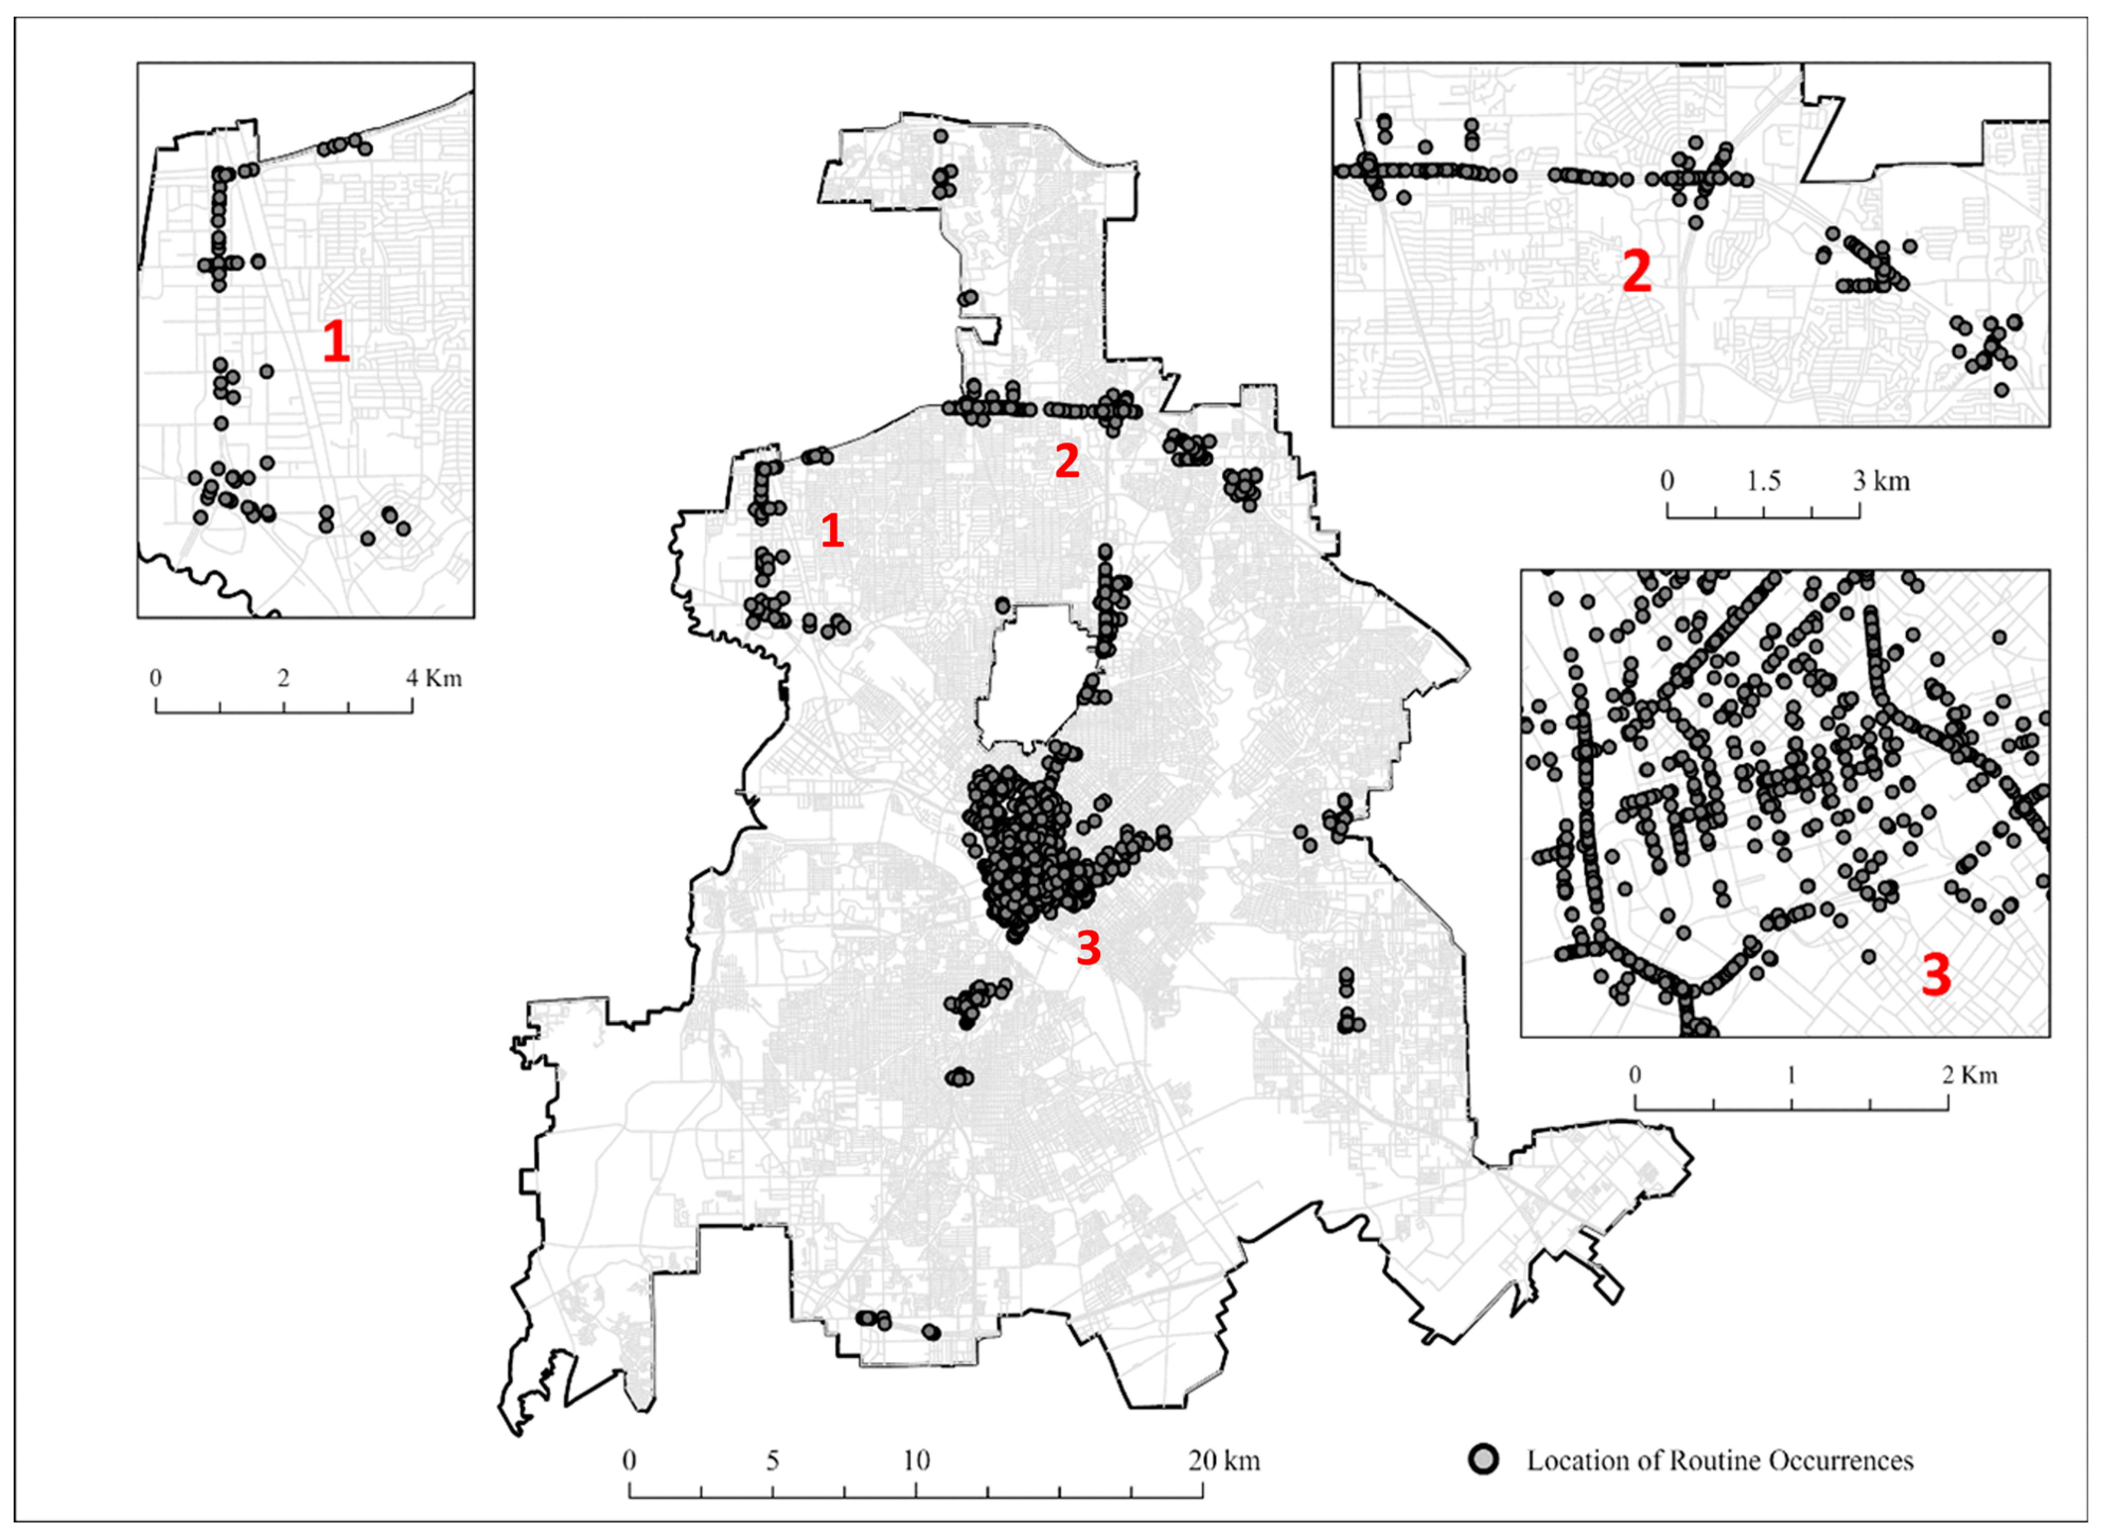
Scale

Slide 11
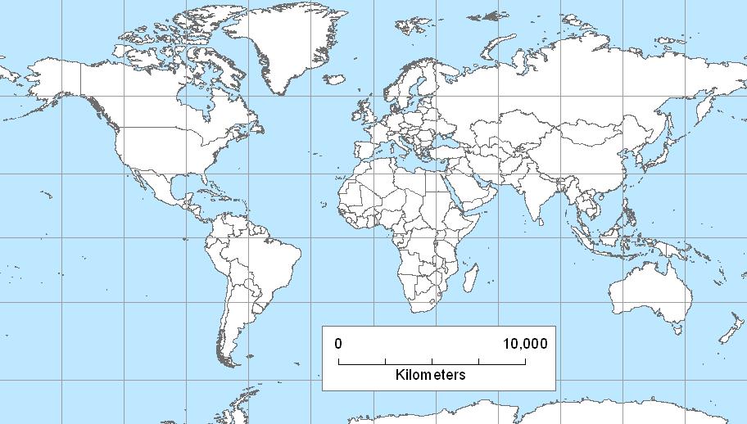
Scale
Use caution when employing bar scales on smaller scale maps
Scale is only accurate along standard lines
Scale is accurate only along the standard line
Notes:
Miller Cylindrical

Slide 12
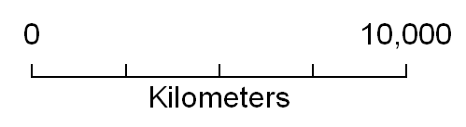
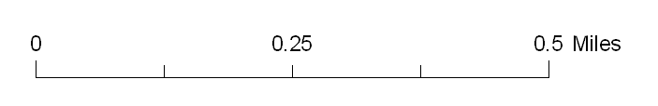
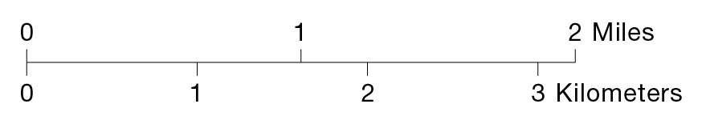
Scale
The maximum distance value should always be round and easy to work with
Incorporate a unit of measure that is appropriate for the intended audience
Incorporate both miles and kilometers if necessary
Choose a unit of measure that is appropriate for the maximum value

Slide 13
Scale
The style of the bar scale should be simple and subtle; it should not attract attention
Bulky and complex designs should be avoided
Line weights should be thin and type should be among the smallest on a map
Avoid the use of bold and italic type styles

Slide 14
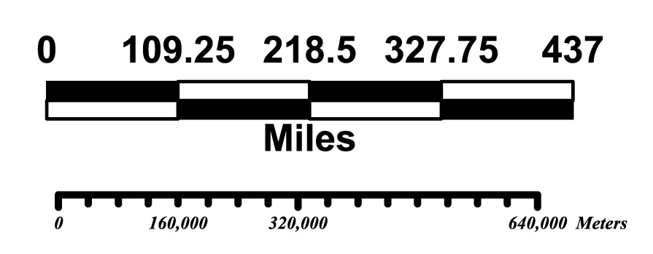
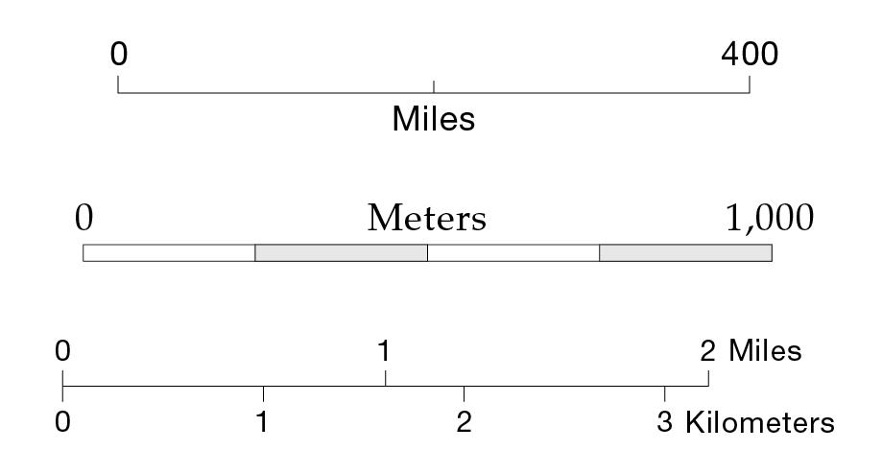
Discussion
Which group is better? And Why?
Poorly Designed
Well Designed

Slide 15
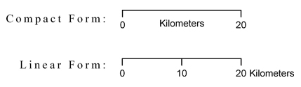
Scale
The compact form is more modern, the linear form is classic.
Peterson, 2021

Slide 16
Scale
Explore Scale in ArcGIS Pro

Slide 17
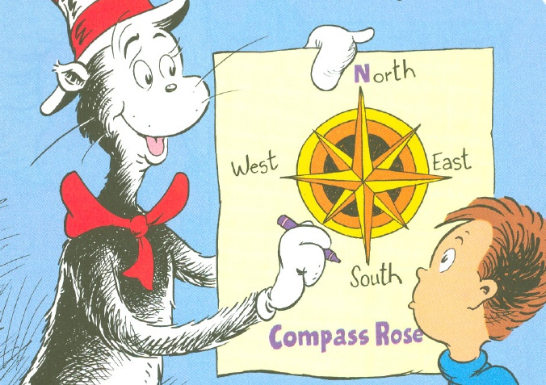
Orientation
The indication of north on a map
Orientation can be indicated by a
North Arrow
Graticule (a system of grid lines, normally representing longitude and latitude)

Slide 18
Orientation
A north arrow is not required on every map!
The orientation of maps with north at the top is a long-standing tradition
It is assumed that “north is at the top” of most modern maps

Slide 19
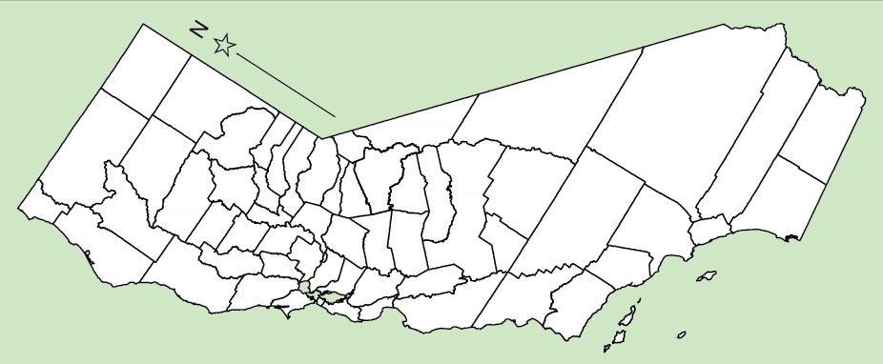
Orientation
Include an indication of orientation if
The map is not oriented with geographic or “true” north at the top

Slide 20
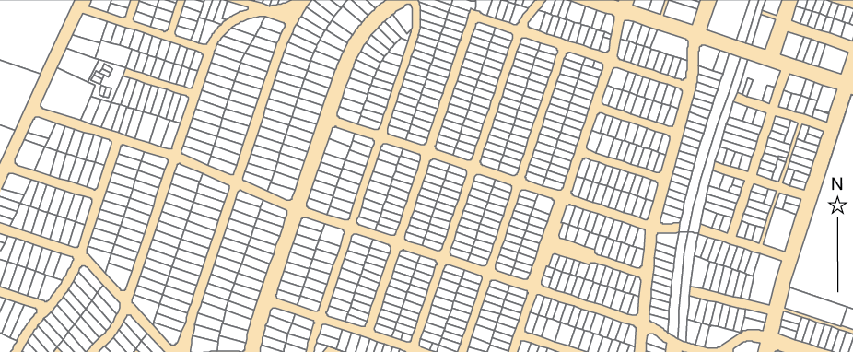
Orientation
Include an indication of orientation if
Geographic features are oriented in a manner that might confuse the map user

Slide 21
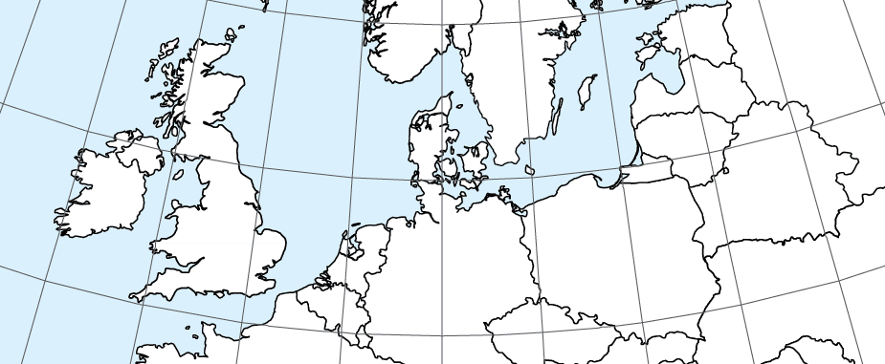
Orientation
A graticule indicates direction through the orientation of grid lines
Typically meridians that run north–south
The graticule can also provide positional information, such as latitude and longitude

Slide 22
Orientation
Use caution when using north arrows on smaller scale map
The direction of north can differ greatly in the maps with azimuthal and conic projection
N
N
N

Slide 23
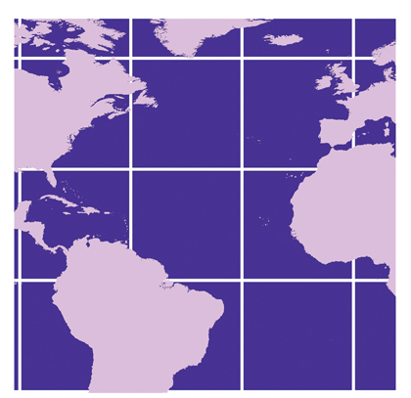
Orientation
Use caution when using north arrows on smaller scale maps
Place the graticules beneath land masses
Peterson, 2021

Slide 24
Orientation
The style of the north arrow and graticule should be simple and subtle; they should not attract attention
Bulky and complex designs should be avoided
Line weights should be thin and type should be among the smallest on a map
Only north should be indicated

Slide 25

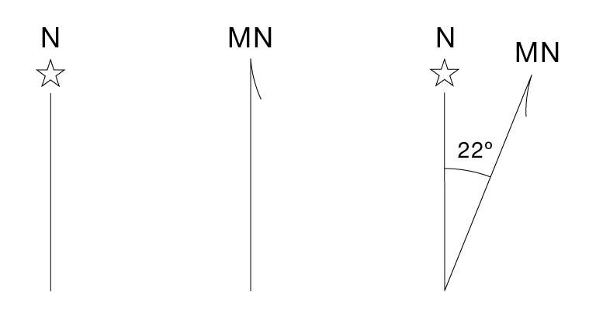
Discussion
Which group is better? And Why?
Poorly Designed
Well Designed

Slide 26
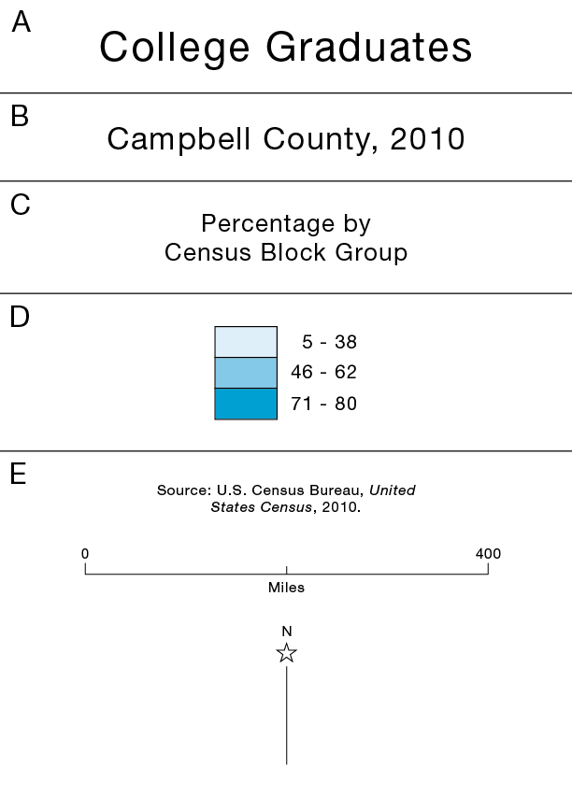
RELATIVE TYPE SIZES FOR CERTAIN MAP ELEMENTS
Sizes should decrease as follows
Title
Subtitle
Legend Heading
Legend Definitions
Source, scale, north arrow
Use the same type family for ALL map elements!

Slide 27
7.2 Lab session

Slide 28
Lab 05: standardization and classification
Due by Midnight (11:59 pm) on Monday, OCT 06, 2025
Submit a word document only include question and answer

