Slide 1

Lecture 07 Map Elements lecture
Instructor: Yanan Wu
fALL 2025

Slide 2
7.1 MAP ELEMENTS

Slide 3
Overview
Map Elements
Frame Line and Neat Line
Mapped Area
Inset
Title and Subtitle
Legend
Data Source
Scale
Orientation

Slide 4
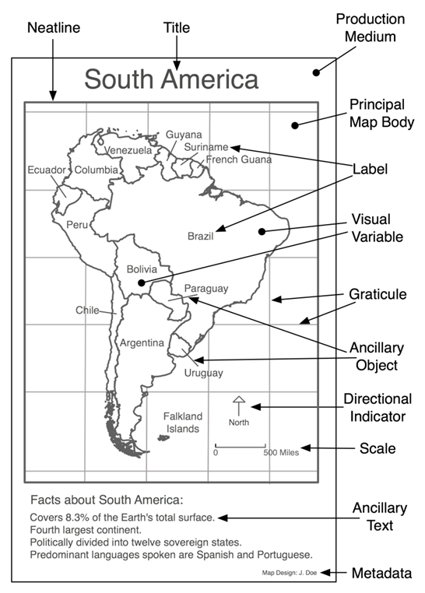
Map Elements
The building blocks of Cartographic Communication
All maps are created from a common set of map elements
GeoTech

Slide 5
Map Elements
Available Space
Areas on a page or screen that can be used to place map elements
“White Space”
The cartographer constantly evaluates the relationship between map elements and available space
Map elements are usually visually centered within appropriate areas of available space
It is the cartographer’s job to make all decisions regarding map elements
Which to include, and which to omit
How to implement them in the most appropriate manner

Slide 6
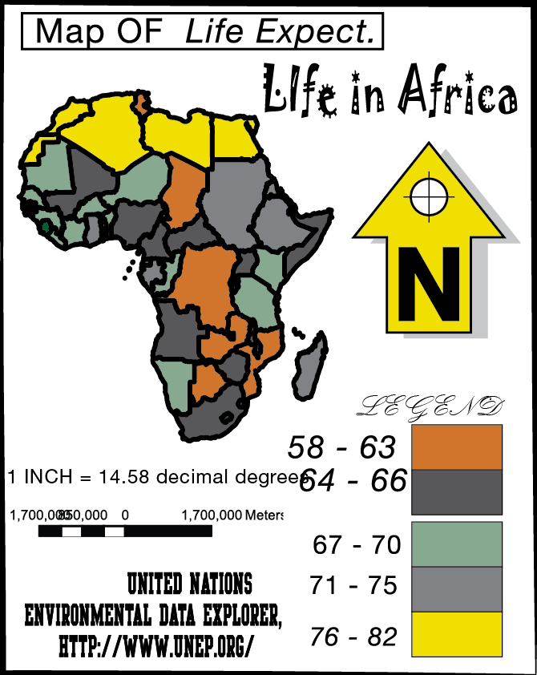
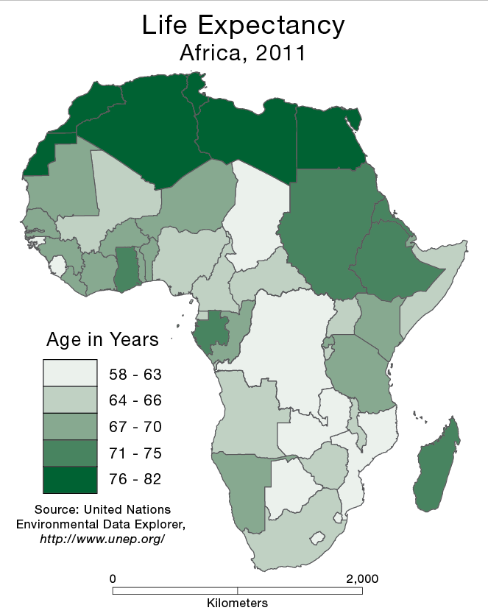
Map Elements
Which one is better?
Notes:
A noisy, inefficient communicator
A simple, efficient communicator

Slide 7
Map Elements
Frame Line and Neat Line
Mapped Area
Inset
Title and Subtitle
Legend
Data Source
Scale
Orientation
Decrease in size from top to bottom
Listed in the recommended order of placement: larger first, smaller last

Slide 8
Alignment and Centering
Alignment and centering of map features is a common task
Can be performed through “visual approximation”
Features look properly aligned or centered
Can also be performed through precise measurement
Features are exactly aligned or centered, using software controls

Slide 9
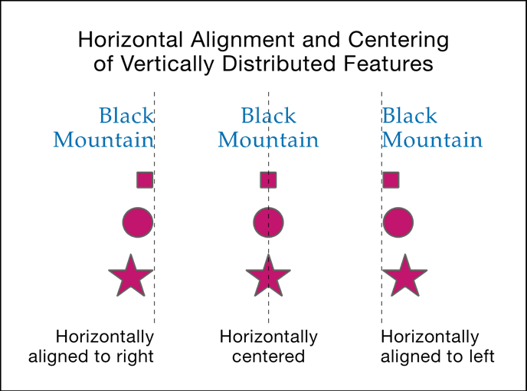
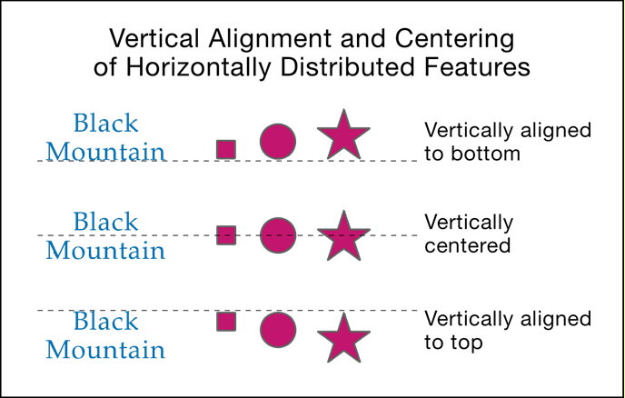
Alignment and Centering
It is important to understand the terminology
Horizontal and vertical are often confused
Horizontal
(Side-to-Side) Alignment and Centering
Vertical
(Top-to-Bottom) Alignment and Centering

Slide 10
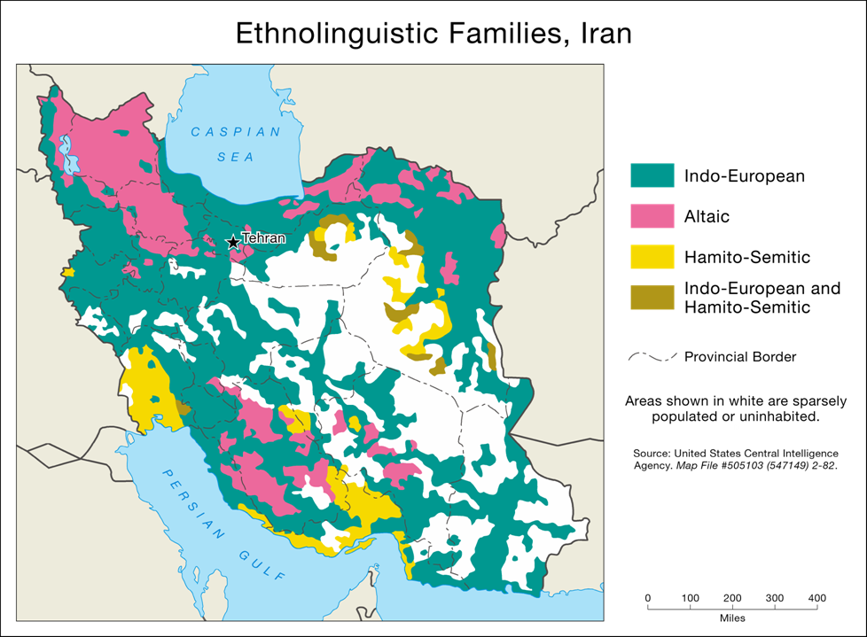
Frame line and neat line
Help to organize the map’s contents, and define its extent
Frame Line
Encloses all other map elements
Should be the first map element placed, because it occupies the most area, and defines the initial available space
Neat Line
Is used to crop (limit the extent of) the mapped area
Separate elements to provide an organized look
Frame Line
Neat Line
GeoTech

Slide 11
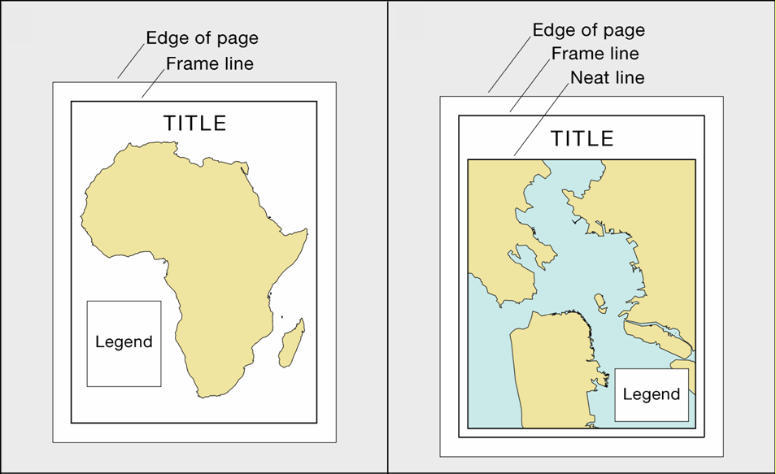
Frame line and neat line
A Frame Line should be used in most situations
A Neat Line is used when the mapped area needs to be cropped or elements need to be separated
GeoTech

Slide 12
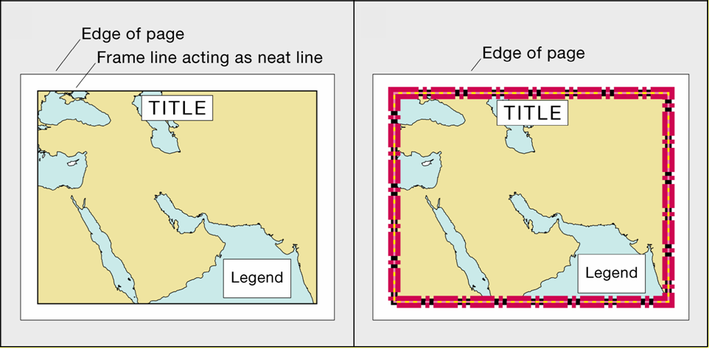
Frame line and neat line
In certain cases, a frame line can also act as a neat line
Enclosing all map elements and cropping the mapped area
GeoTech

Slide 13
Frame line and neat line
The style of these lines should be subtle
A single, thin, black line should be used in most cases
Slightly thicker lines are appropriate when working with large wall maps
These lines should focus attention on what is within them, not on themselves

Slide 14
Discussion
Which one is better?

Slide 15
Explore Frame Line in ArcGIS Pro
Download Lecture 7 data from Blackboard

Slide 16
Mapped area
The region of Earth being represented
Consists of Thematic Symbols
Thematic Symbols directly represent the map’s theme
Are visually dominant
Can also include base Information
Base Information provides a geographic frame of reference for the theme
Is subdued

Slide 17
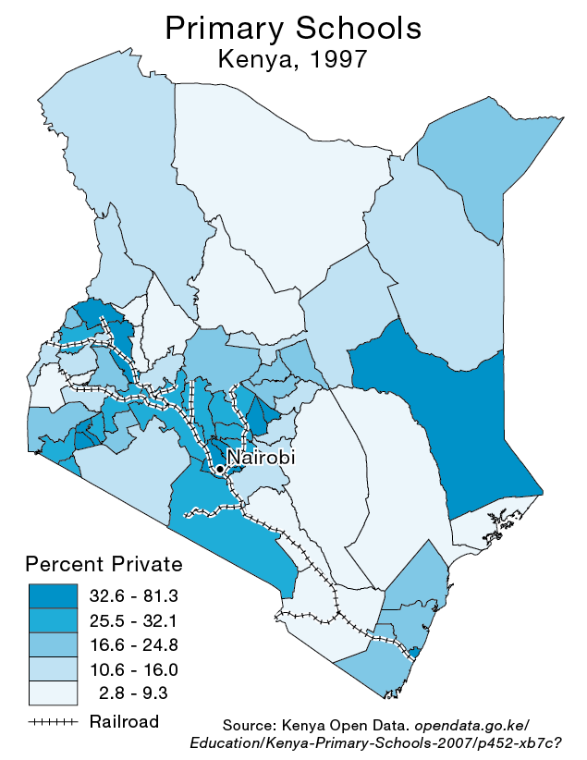
Mapped area
Thematic Symbols: Shaded Polygons
Base Information:
Railroads and
City Label

Slide 18
Mapped area
There are two varieties of mapped area, distinguished by how they represent the geographic region of interest
Floating
Cropped

Slide 19
Mapped area
Floating Mapped Area
Region of interest is disconnected from neighboring regions
Produces available space that often eases the placement of other map elements
Removes the region from its geographic context, possibly confusing the map user

Slide 20
Mapped area
Cropped Mapped Area
Represents the region of interest within its geographic context
More realistic, less abstract
Can make the placement of other map elements more difficult due to a lack of available space
Turkmenistan
Iraq
Afghanistan
Demonstration!
Notes:
Iraq, Turkmenistan, Afghanistan, Pr

Slide 21
Mapped area
Make the mapped area as large as possible within the available space
Without being “too close” to the frame line
While leaving ample room for the remaining map elements
Maximum area is important
The mapped area—thematic symbols in particular—is instrumental in communicating the map’s information

Slide 22
Mapped area
Try to visually center the mapped area both horizontally (side-to-side) and vertically (top-to-bottom)
Within the available space, as defined by the frame line
This will not always result in an appropriate placement
But should be tried first

Slide 23
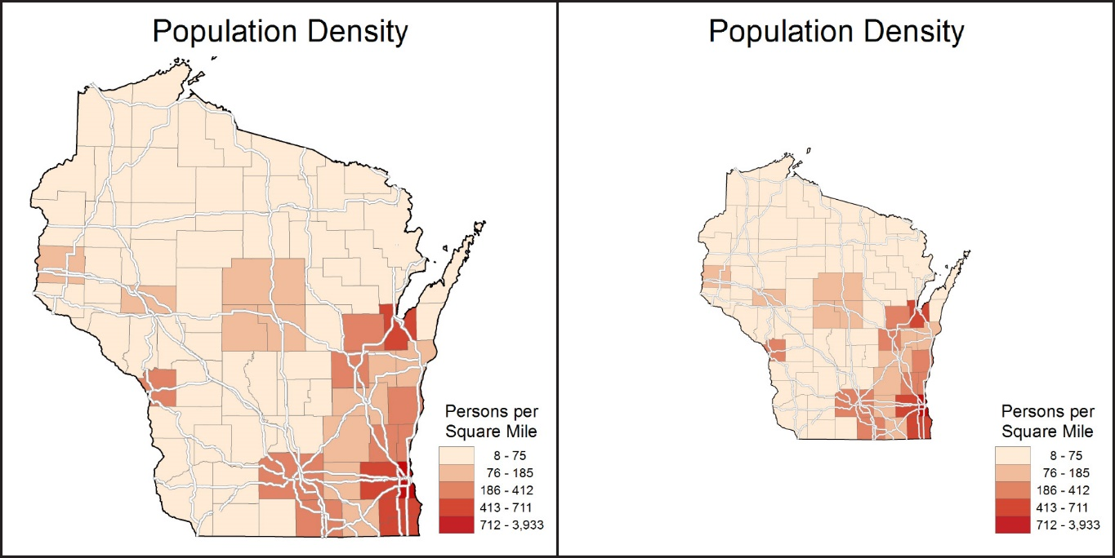
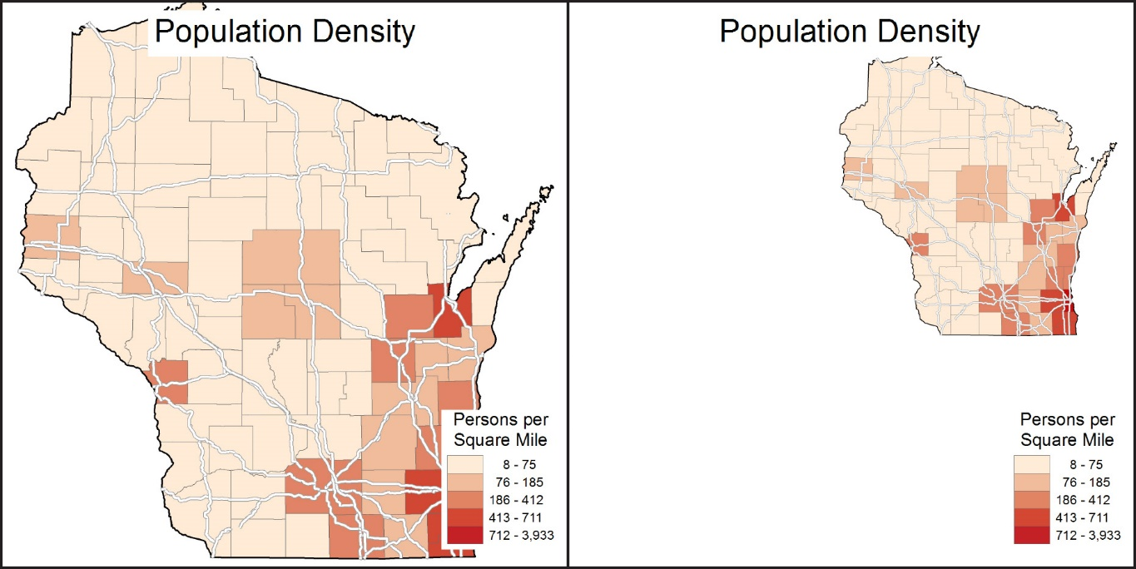
Discussion
Appropriately Sized
Too Small
Too Large
Too Small and Off Center

Slide 24
Explore mapped area
Floating or Cropped
Align to center of the page

Slide 25
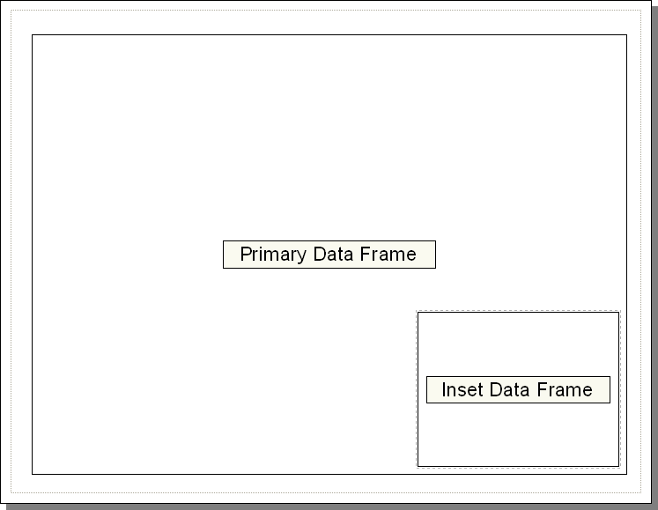
Inset
A smaller map included within the context of a larger map
Can serve several purposes
In the world of ArcGIS, the inset is usually a separate data frame

Slide 26
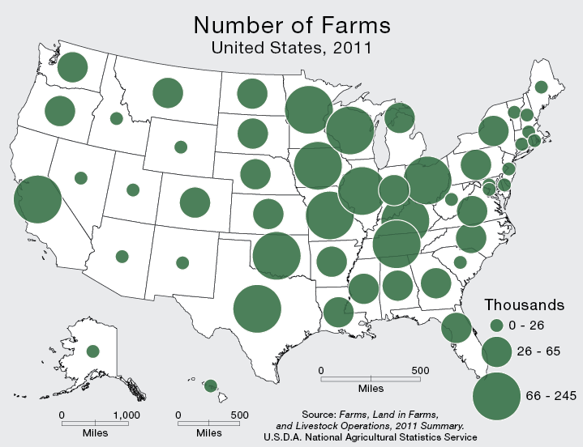
Features not in the correct geographic location
Inset

Slide 27
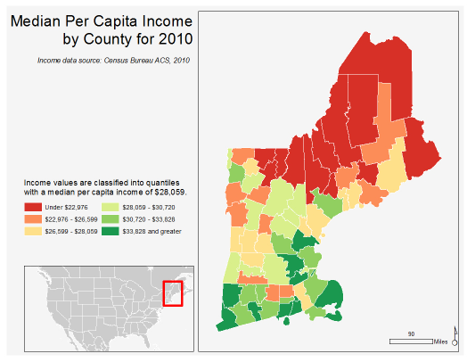
Inset
Can be used to show the primary mapped area in relation to a larger, more recognizable area (a locator map)
Shows Relative Location

Slide 28
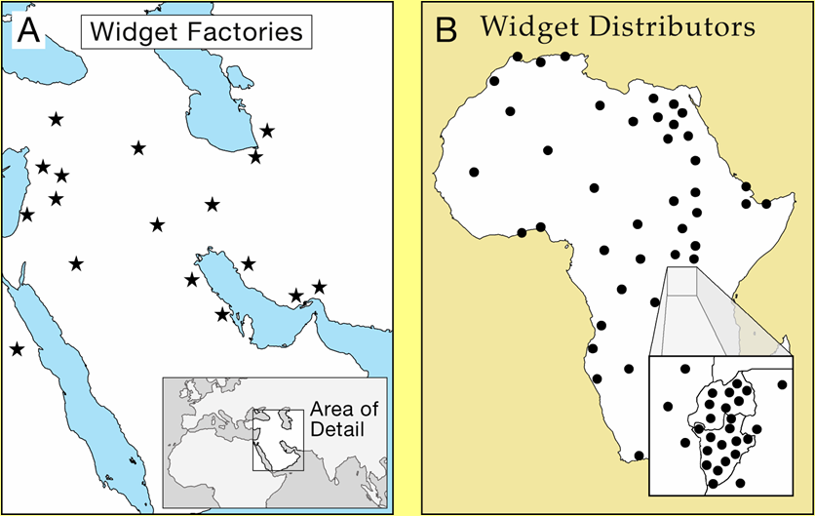
Inset
Can be used to enlarge important or congested areas (a zoom, or blow-up map)
Shows Enlargement of an Area

Slide 29
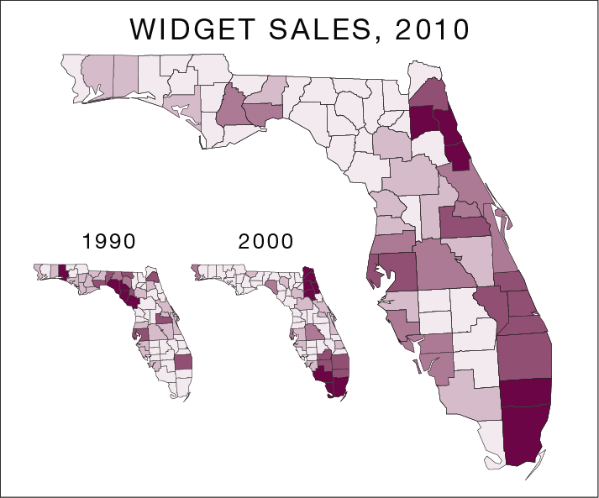
Inset
Can be used to show topics that are related to the map’s theme, or different dates of a common theme
Shows Related Themes or Dates

Slide 30
Explore inset map in arcgis pro
Create a new map
Include the State map in the new Map
Insert the State map as an inset map to show the relative location of Arkansas

Slide 31
Title and Subtitle
The title and subtitle tell the map user what the map is about
Most thematic maps require a title
A title is sometimes omitted when a map is used as a figure in a written document, assuming that the title is clearly expressed in the figure caption
A well-crafted title can draw attention to a map

Slide 32
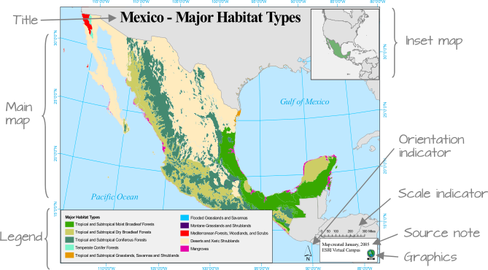
Title

Slide 33
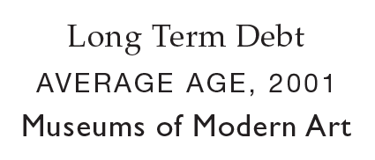

Title
The Title of a thematic map is a succinct description of the map’s theme
General reference maps typically employ the geographic region as the title
Unnecessary words should be omitted
But avoid cryptic abbreviations
Appropriate Titles
Inappropriate Titles
Notes:
Don’t include the word “Map” in a title!

Slide 34
Title with Subtitle
The subtitle, if employed, is used to further explain title
The geographic region and date are common components of the subtitle but is often omitted (when it is easily identifiable)
The subtitle should be horizontally centered below the title
The style of the Title and Subtitle should be plain

Slide 35
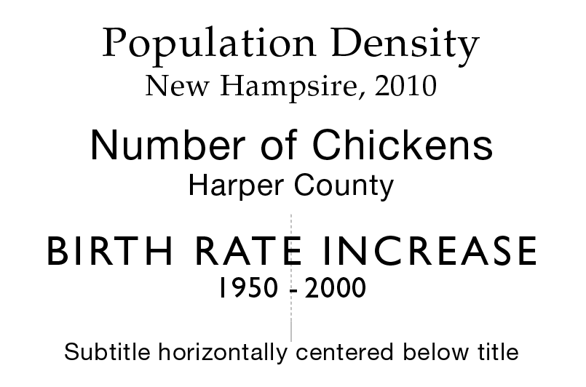
Title with Subtitle

Slide 36
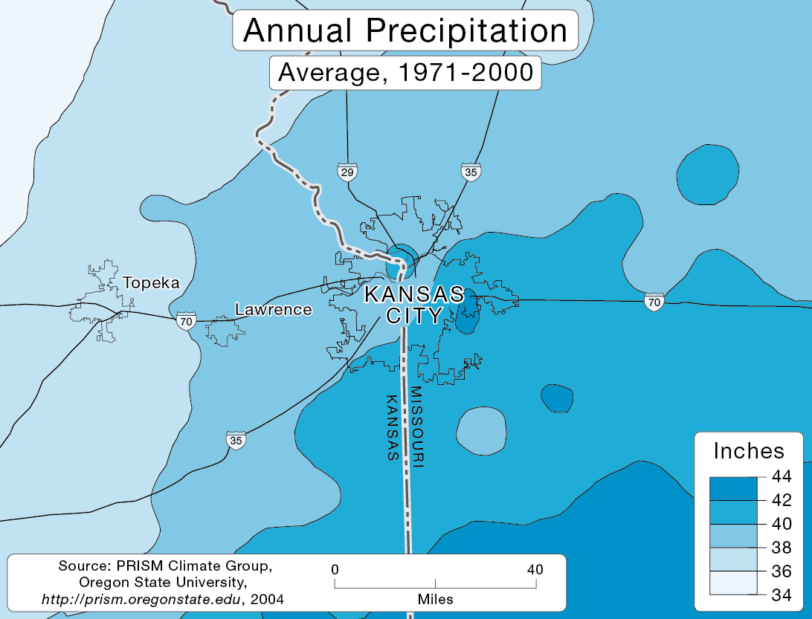
Title with Subtitle
Use a subtle mask behind the title and subtitle only if it is necessary to cover the underlying mapped area to improve legibility

Slide 37
Title with Subtitle
If possible, place the title at top-center,
The title should normally be the largest type on a thematic map – subtitle smaller
Both the title and subtitle should be short and to the point (limited to one line each)

Slide 38
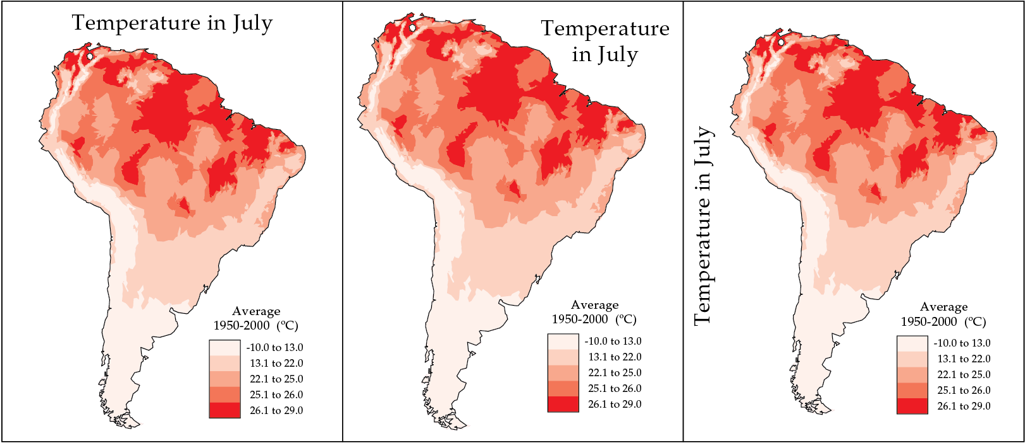
Discussion

Slide 39
Explore title in ArcGIS Pro
Title: Total Population in Arkansas, 2010

Slide 40
Legend
The style of the legend should be clear and straightforward
Use a subtle mask around the legend only if necessary to improve legibility
Symbols in the legend should be identical to those on the mapped area
This includes color and orientation
Don’t include the word “Legend”!
Notes:
size

Slide 41
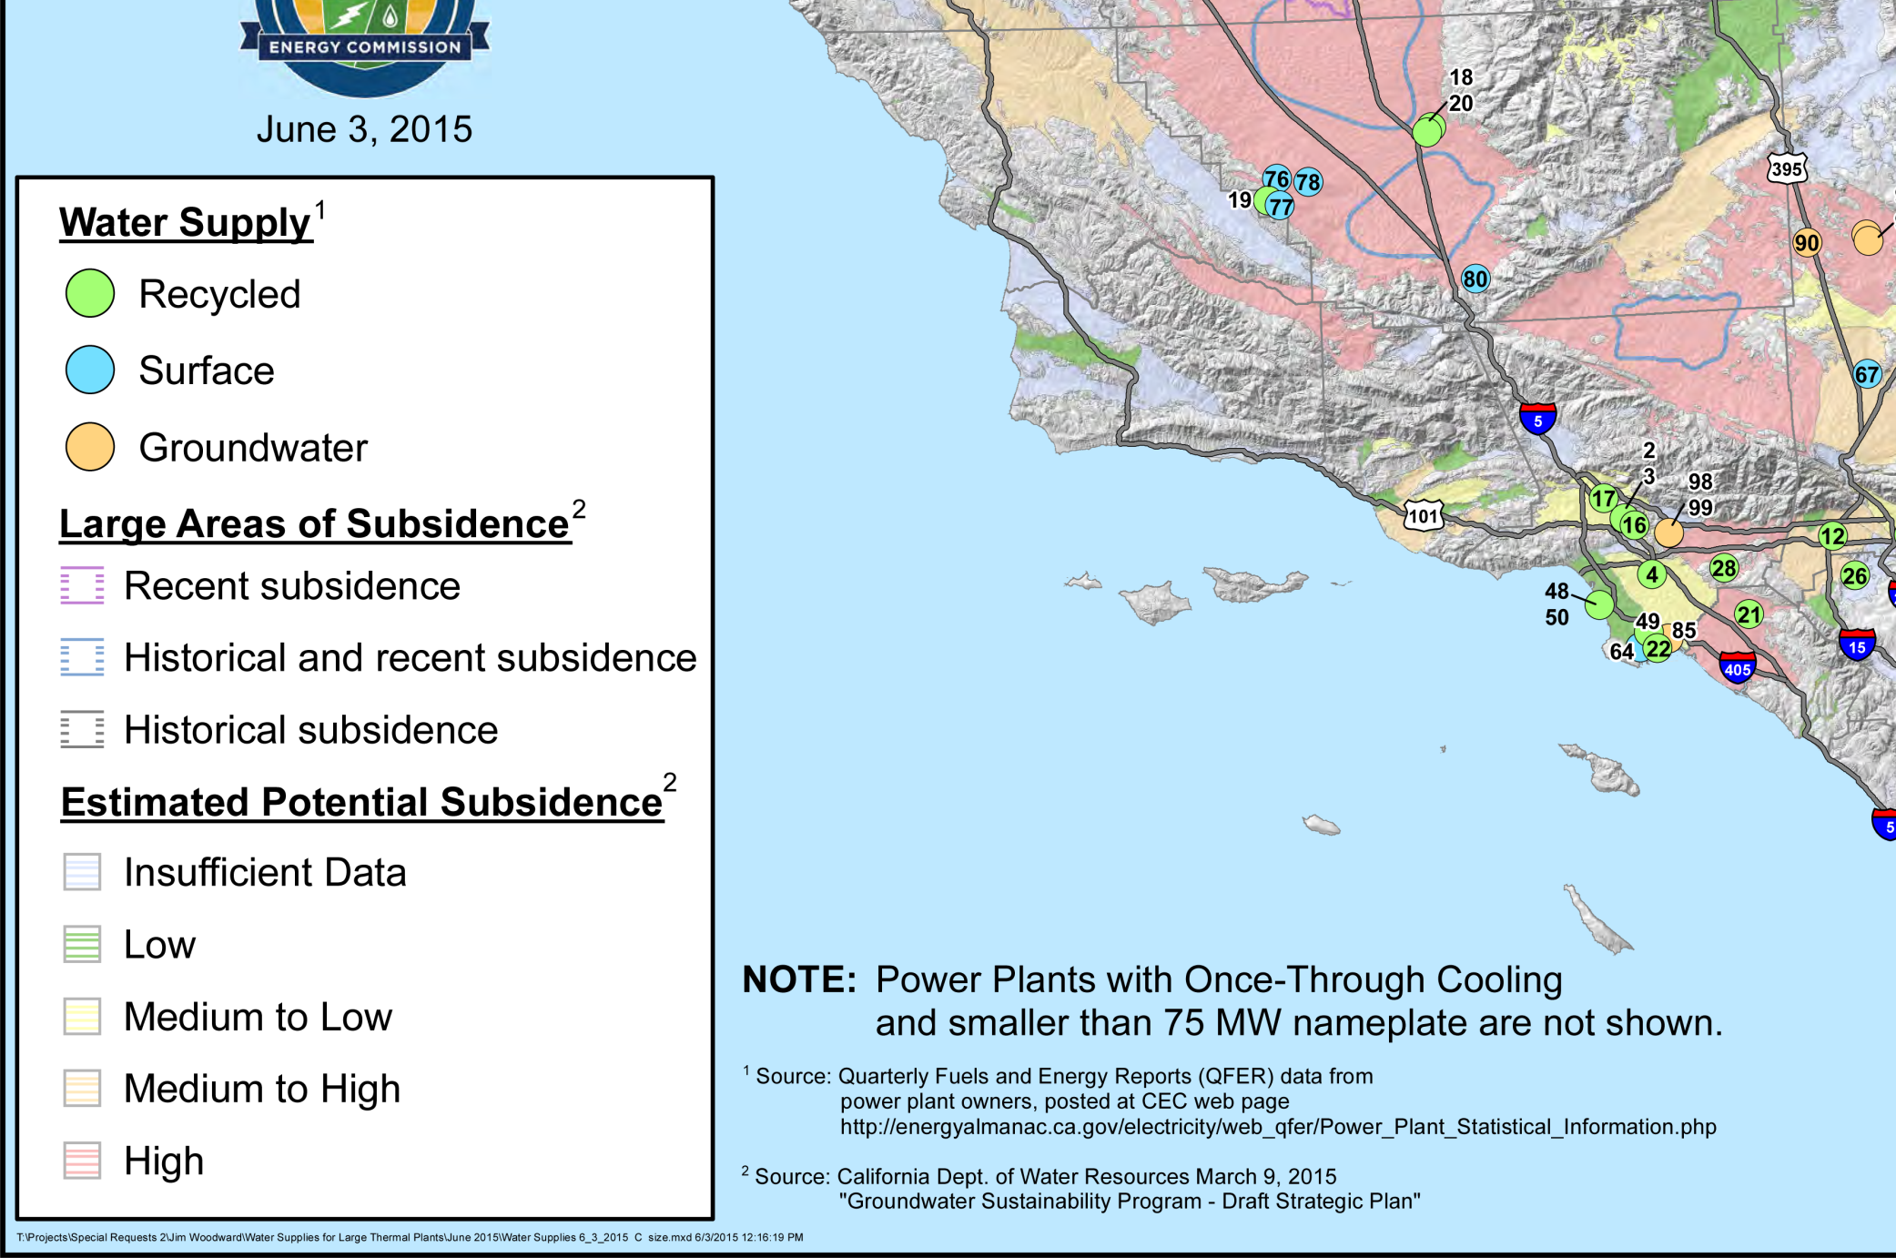
Legend

Slide 42
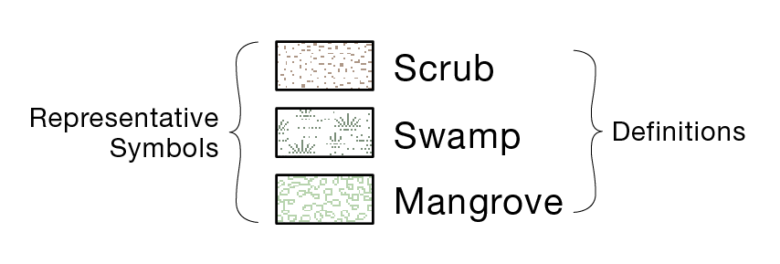
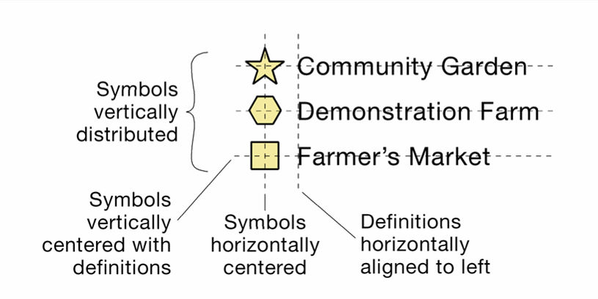
Legend
Representative symbols should be placed on the left and defined to the right
Symbols should be vertically centered with their definitions
Textual definitions and definitions consisting of individual numbers should be horizontally aligned to left

Slide 43
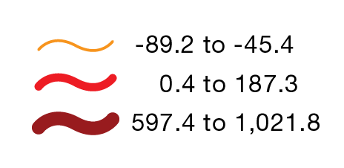
Legend
Definitions containing numbers of 1,000 or greater should incorporate commas
Decimal numbers smaller than one should incorporate a leading zero

Slide 44
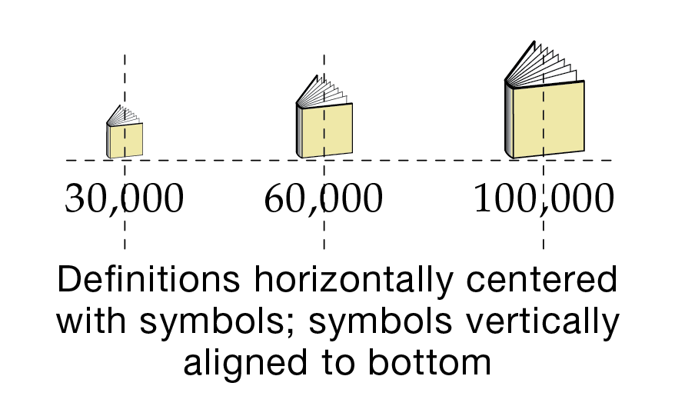
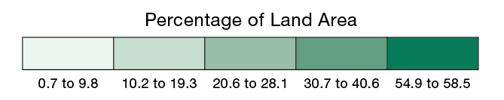
Legend
The legend can be oriented horizontally
Definitions are horizontally centered below the symbols they represent
Symbols are vertically aligned to bottom

Slide 45
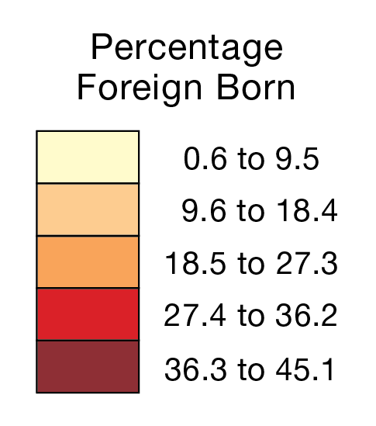
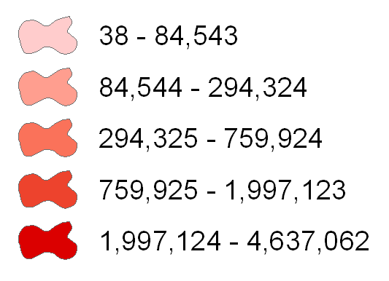
Legend
Legend rectangles should be connected when representing the magnitude of an attribute
Areal symbols on the mapped area are usually connected
Connected rectangles help to emphasize the idea that a continuum of values is being represented
Inappropriate

Slide 46
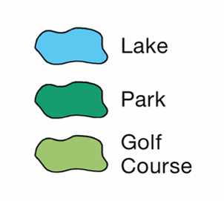
Legend
Areal symbols can be represented by irregular, amorphous polygons
Irregular polygons can look more natural
Most appropriate for qualitative categories of areal data (separated)
Appropriate

Slide 47
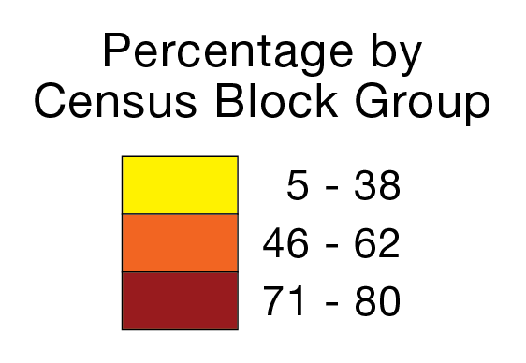
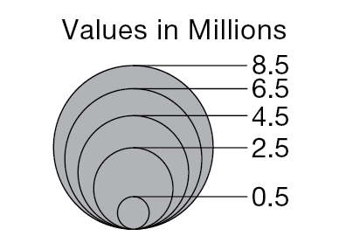
Legend
A legend heading is often included to further explain the map’s theme
The unit of measure (for quantitative data) and enumeration unit are common components of the legend heading

Slide 48
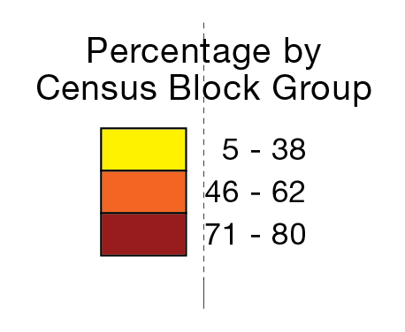
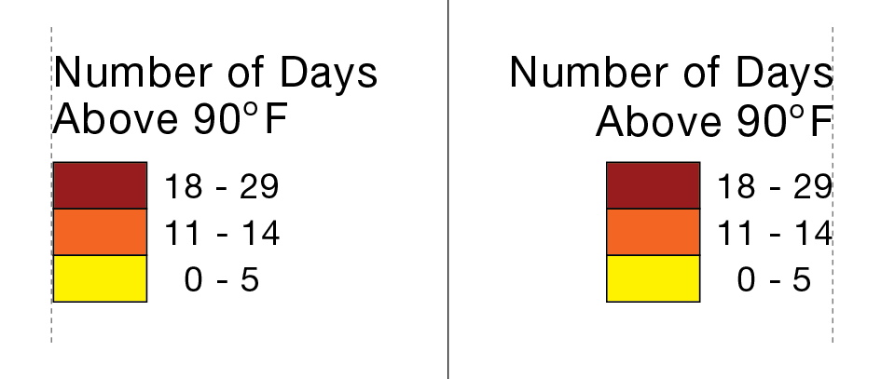
Legend
The legend heading should be placed above the legend, and be horizontally centered with it
Multiple lines of type can be horizontally centered (center justified)
Horizontal centering creates a self-balancing group of objects
Appropriate
Inappropriate

Slide 49
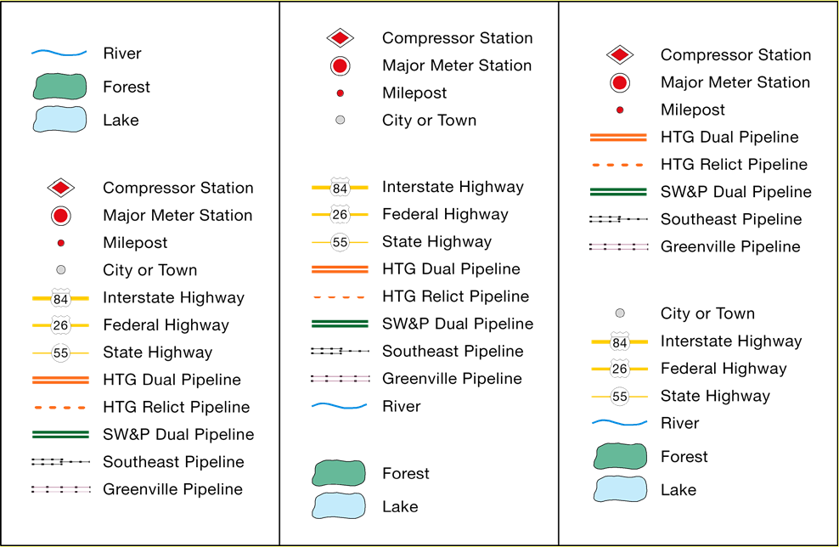
Legend
Legend symbols are often organized into groups, according to a certain logic

Slide 50
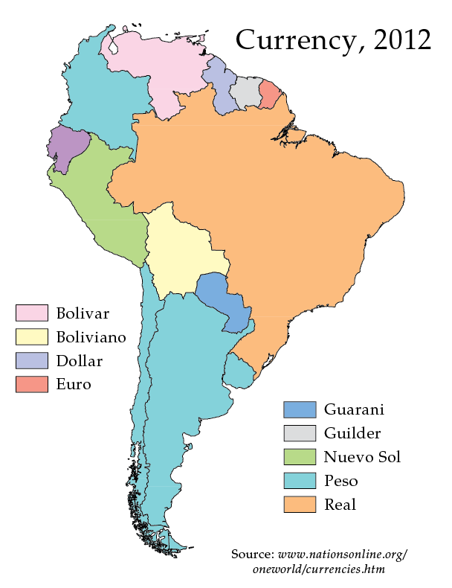
Legend
If possible, the legend should be visually centered within a larger portion of available space

Slide 51
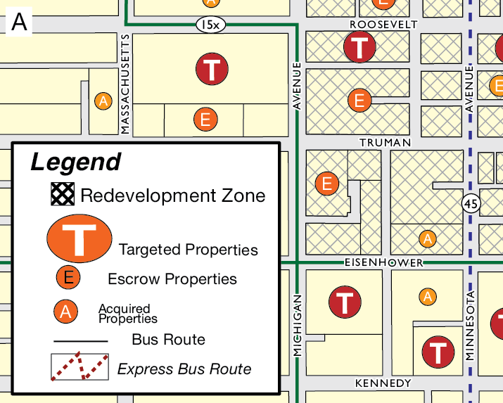
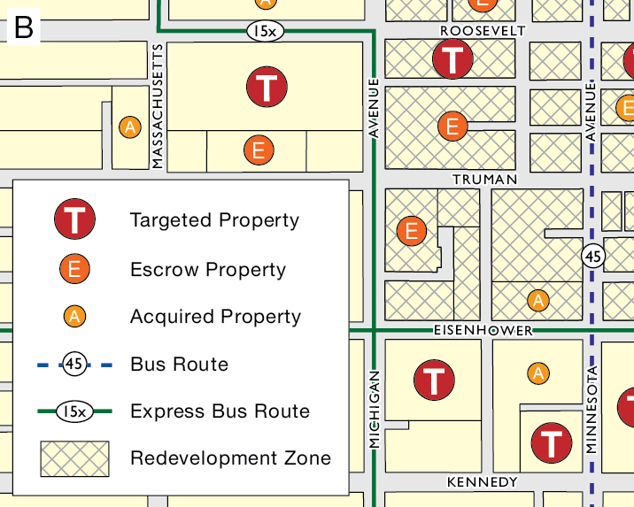
Discussion
Which one is better? And Why?

Slide 52
Explore legend in ArcGIS Pro
Insert Legend of the map

Slide 53
7.2 Lab session

Slide 54
Lab 05: standardization and classification
Due by Midnight (11:59 pm) on Monday, OCT 06, 2025
Submit a word document only include question and answer

