Slide 1

Lecture 07 Digitizing, Georeferencing, Resampling lecture
Instructor: Yanan Wu
fALL 2025

Slide 2
7.1 MAP ELEMENTS

Slide 3
Overview
Digitizing
Digitizing types
Digitizing steps
Snapping
Resampling
Resampling methods

Slide 4
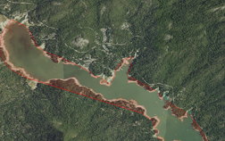
Digitizing
The process by which coordinates from a map, image, or other sources are converted into a vector layer in a GIS.
Notes:
The x, y coordinates of these features are automatically recorded and stored as spatial data.

Slide 5
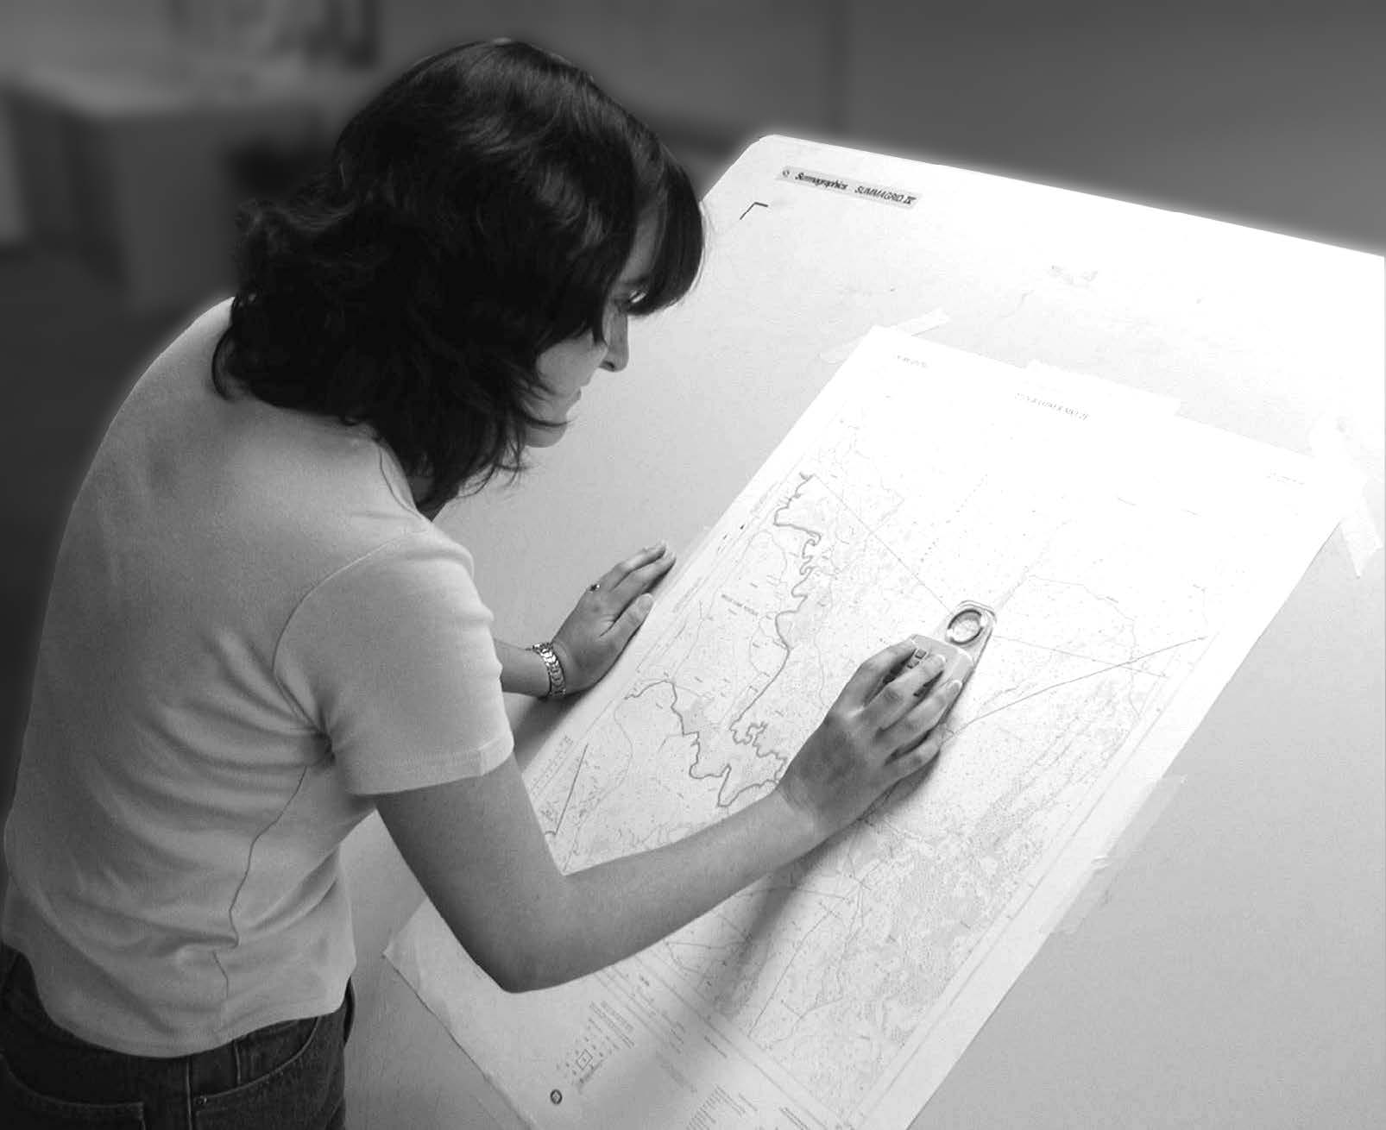
Digitizing
Manual digitization is human-guided coordinate capture from a map or image source.
Hardcopy digitizing
Human-guided coordinate capture from a paper, plastic, or other hardcopy map
Bolstad, 2019
Notes:
electrically sensitized puck. The most common digitizers are based on a wire grid embedded in or under a table

Slide 6
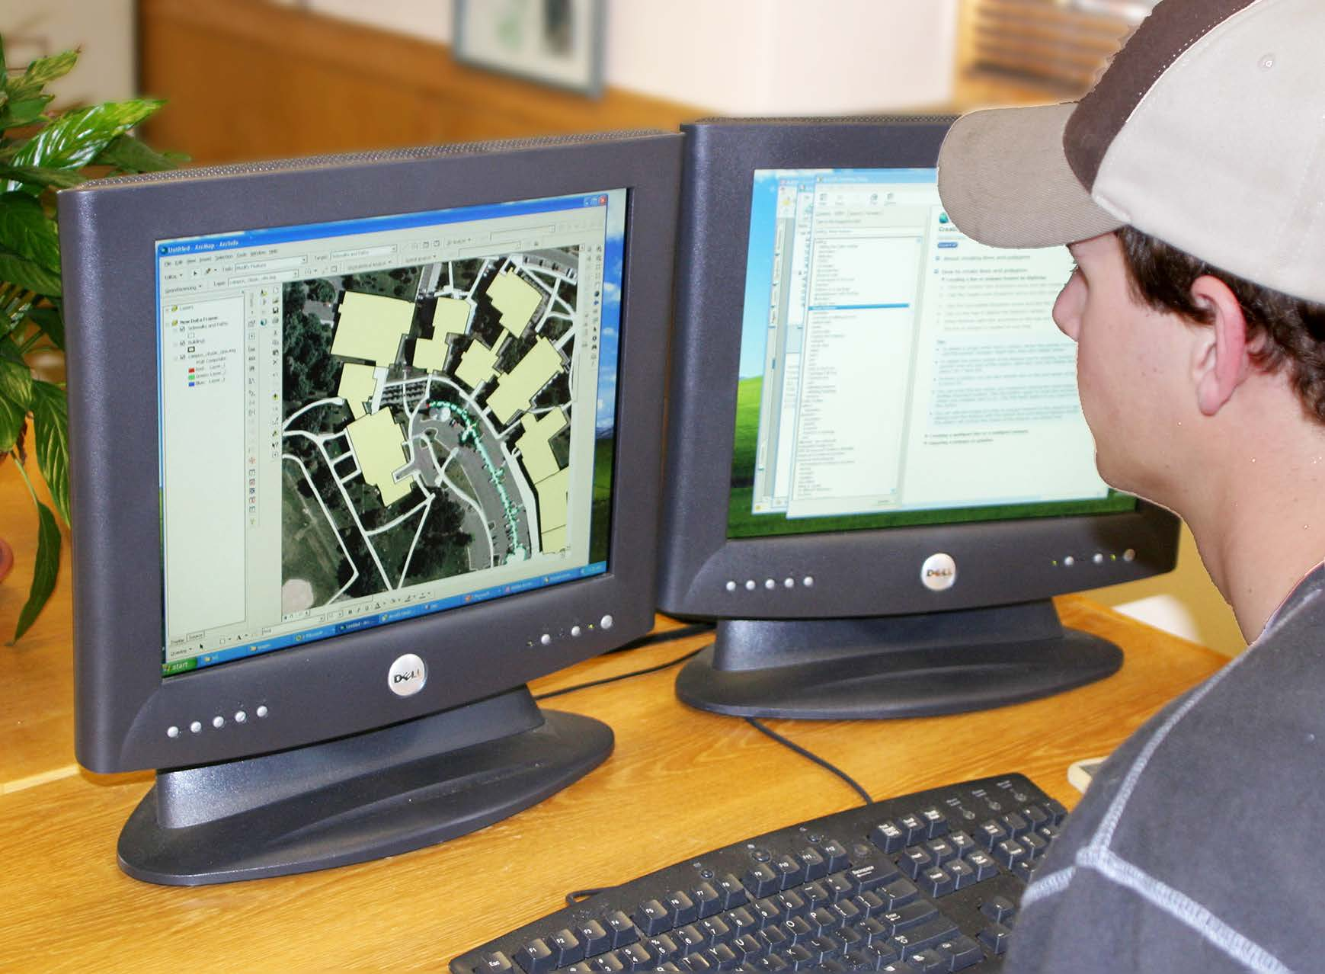
Digitizing
Manual digitization is human-guided coordinate capture from a map or image source.
On-screen digitizing
Heads-up digitizing, involves manually digitizing on a computer screen, using a digital image as a backdrop
Bolstad, 2019
Notes:
The x, y coordinates of these features are automatically recorded and stored as spatial data.

Slide 7
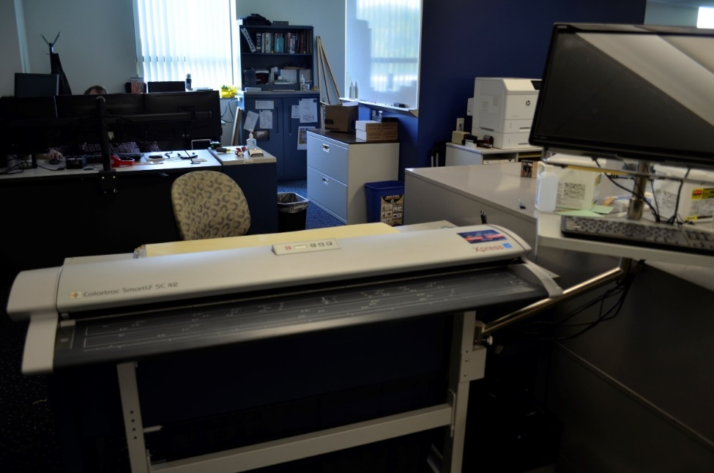
Digitizing
Manual digitization is human-guided coordinate capture from a map or image source.
Scan digitizing

Slide 8
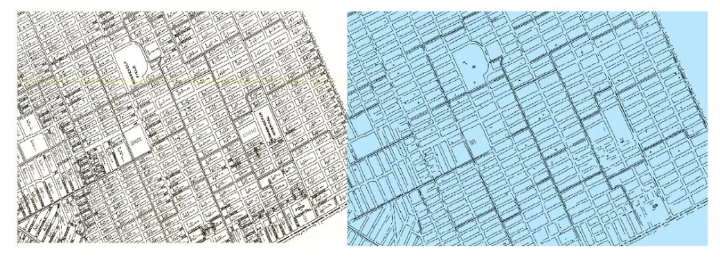
Digitizing
Digitizing scanned maps using AI in ArcGIS Pro
Detect Object using Deep Learning tool

Slide 9
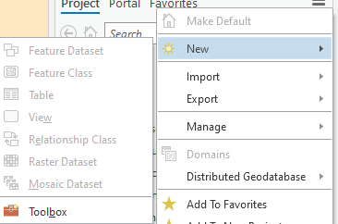
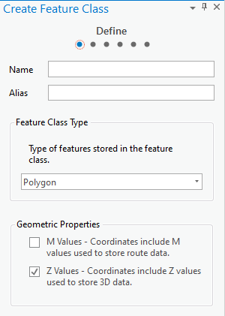
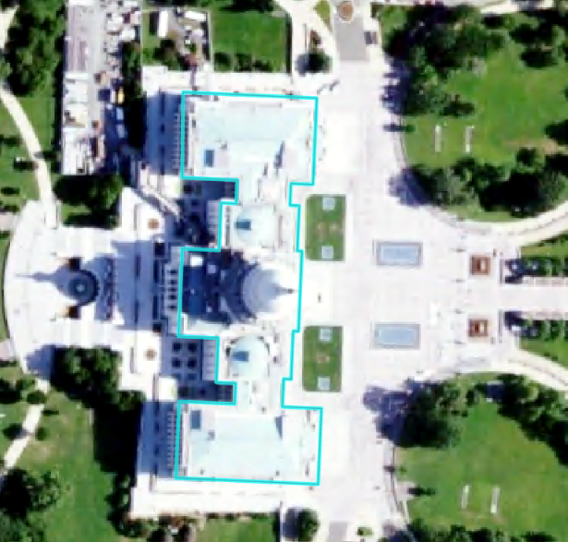
Digitizing Steps
Obtain input imagery or other reference data
Create a new file to edit
Define geometry (point, lines, or polygon)
Define projection
Create attribute fields
Digitizing
Edit attribute information
Check and validate your results
Notes:
Before beginning to digitize, you will need to obtain some input imagery or other reference data.
You will then need to create a new shapefile or feature class to draw into. This will require defining the geometry (point, line, or polygon), setting the projection or coordinate reference system, and creating any required attribute fields.
You can then draw the new features using the reference data. You will also need to edit the attribute table.
It is always important to validate your results for quality control purposes.

Slide 10
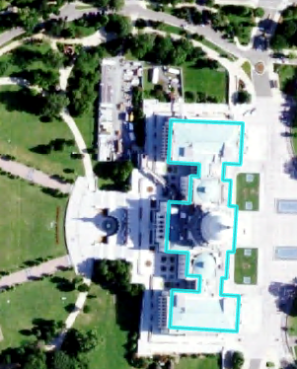
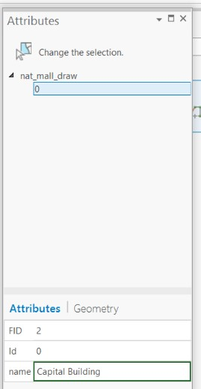
Digitizing in ArcGIS Pro
Use Edit tab
Remember to consider topology
Remember to edit attributes
Save often!!!!!!!
Notes:
Digitizing options are available in the Edit Tab.
As you edit the geometry and attributes, remember to save often so you don’t lose any work.

Slide 11
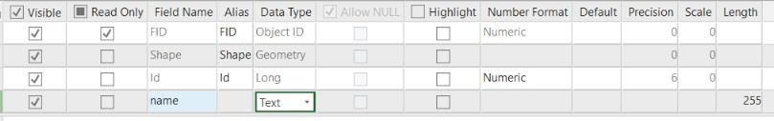
Adding Fields
Make sure to define the correct type
Data Type
Short Integer | Integer values between -32,768 and 32,767
Long Integer | Integer values between -2,147,483,648 and 2,147,483,647
Float | Decimal values with 1-6 decimal places
Double | Decimal values with more the 6 decimal places
Text | Text strings
Date | Data info (mm/dd/yyyy)
Notes:
When creating a new field, you will need to define the field type.
Short and long integer fields can only store integer or whole number values. Long integers can stored a wider range of numbers than short integers.
If you need to maintain decimal values, you cannot use a short or long integer. Instead, you must use a float or double type. Float fields can store up to 6 decimal places while double can store more than 6.
If you would like to store text or string data, you will do so in a text field. Note that numbers stored in text field will be treated like strings. They will not be treated line numbers. For example, you will not be able to perform mathematical operations on these data.
Date fields store dates and will treat the information as dates.

Slide 12
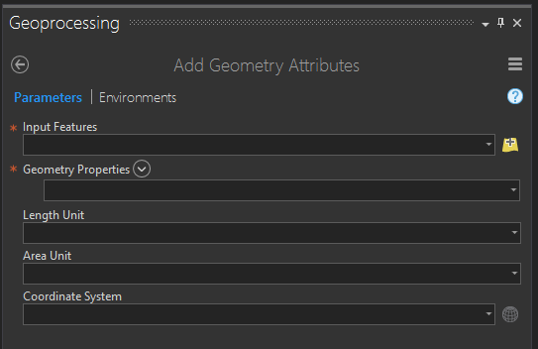
Adding Geometric Fields
Use Add/Calculate Geometry Attributes Tool
Points | Lines | Polygons
X-coordinate | Start-X | Area
Y-coordinate | Start-Y | Perimeter
Z-coordinate (if z-enabled) | End-X | Centroid-X
M-coordinate (if m-enabled) | End-Y | Centroid-Y
 | Mid-X
 | Mid-Y
 | Length
 | Bearing
Notes:
Different geometric measures can be calculated and stored in the attribute table for points, lines, and polygon data.
For point data, it is possible to store the x and y coordinate. If the feature is Z-enabled, or contains elevation or height information, this value can also be calculated. If it is M-enable, the M coordinate can be calculated. M-coordinates generally relate to positions along a network.
For lines, you can calculate the x and y coordinates for the start, end, and middle of the line segment. You can also calculate the length and bearing. The bearing is the compass direction of the line and is defined as the direction of travel from the start to the end node.
For polygons, you can calculate the area and perimeter. The perimeter is the length of all the lines that make up the polygon. You can also calculate the centroid, or geometric center, coordinates. Note that centroid coordinates can sometimes be misleading. For example, for irregular or elongated shapes, the centroid may not actually occur within the polygon. For a “C” shaped feature, the centroid would occur somewhere in the middle of the “C” as oppose to within the area that makes it up. So, be careful when using centroid measures.

Slide 13
class discussion
Digitizing the floor plan of UCA

Slide 14
Impacts on Digitizing Accuracy/ Precision
Factors affect accuracy of digitizing
Source data errors
The surface error caused by 1 millimeter digitizing error
Bolstad, 2019

Slide 15
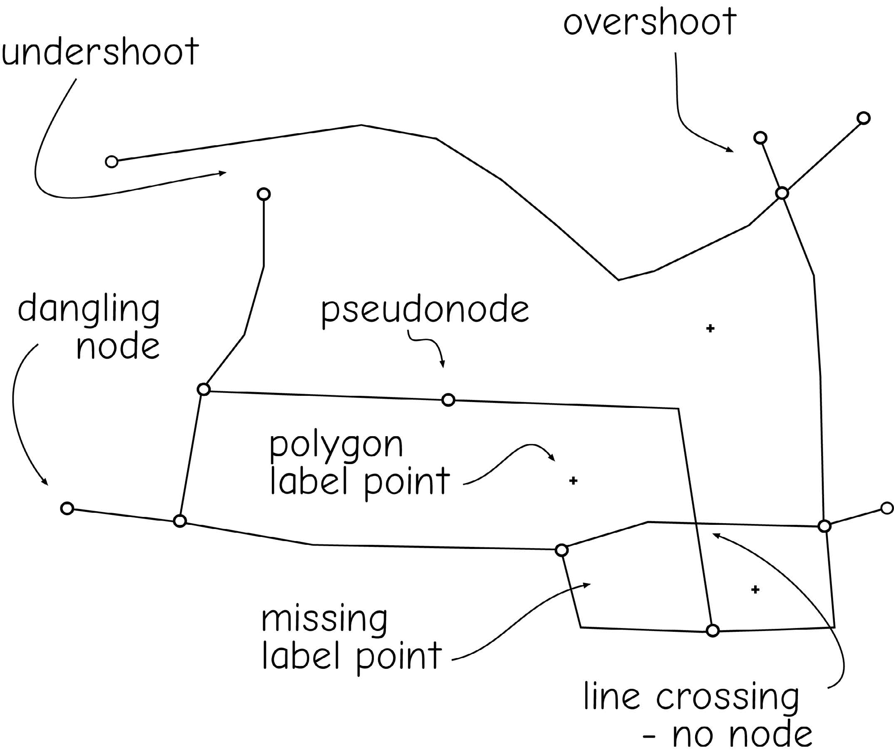
Impacts on Digitizing Accuracy/ Precision
Factors affect accuracy of digitizing
Precision of equipment
The abilities and attitude of the person digitizing affects the geometric quality of manually digitized data
Bolstad, 2019
Notes:
Dangling include overshoot and undershoot, and two lines with points not connected. Dangling node include undershoot and overshoot node.

Slide 16
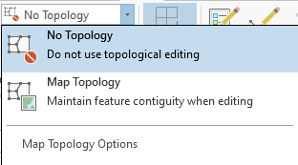
Impacts on Digitizing Accuracy/ Precision
Factors affect accuracy of digitizing
Precision of equipment
The abilities and attitude of the person digitizing affects the geometric quality of manually digitized data
Topology
Bolstad, 2019

Slide 17
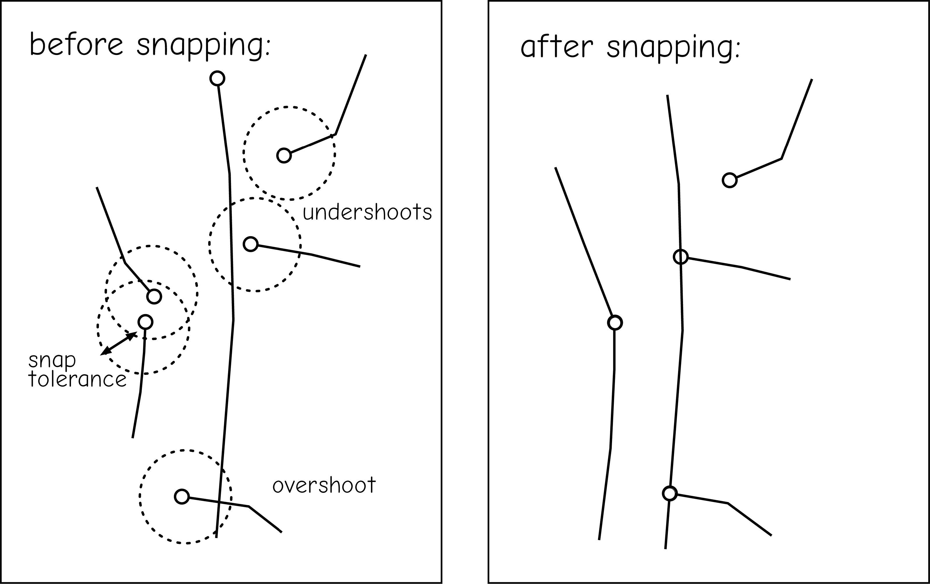
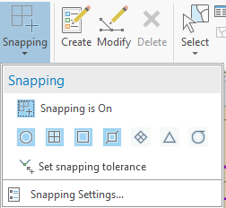
Impacts on Digitizing Accuracy/ Precision
Factors affect accuracy of digitizing
Precision of equipment
The abilities and attitude of the person digitizing affects the geometric quality of manually digitized data
Snapping
Bolstad, 2019

Slide 18
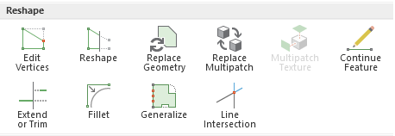
Impacts on Digitizing Accuracy/ Precision
Factors affect accuracy of digitizing
Precision of equipment
The abilities and attitude of the person digitizing affects the geometric quality of manually digitized data
Reshaping

Slide 19
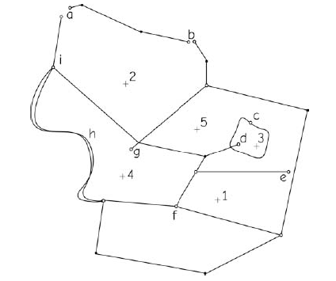
Class Discussion
Identify a characteristic feature or error in digitizing at each of the labeled letter locations in the drawing below.
Bolstad, 2019
Notes:
a-undershoot; b-undershoot; c-psuedonode; d-overshoot; e-undershoot; f-missing label; g-overshoot.

Slide 20
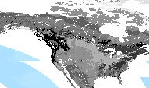
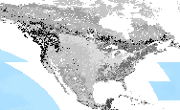
Resampling
Change the cell size
500 m cell size
Resampled 8,000 m cell size
Notes:
Resampling is used to change the cell size of raster data. Generally, cells are made larger, or the data are coarsened, since making the cells smaller will not really add information but will just duplicate existing values. You can’t increase the detail by simply resampling a coarser dataset to a finer resolution.
You may resample raster data to make it easier to process over large extents or to change the cell size to match other inputs in an analysis.
We will now talk about methods used to resample raster data.

Slide 21
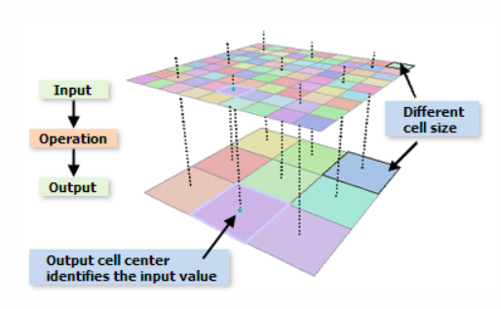
Resampling

Slide 22
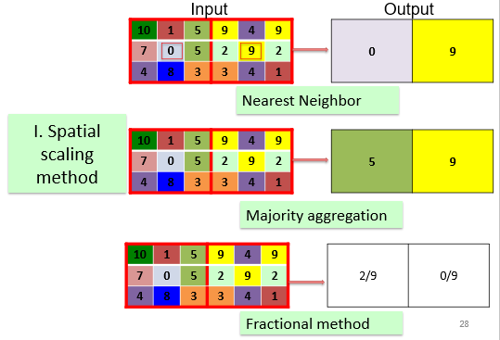
Resampling
Majority Resampling
Resamples using the most common cell value
Good for categorical data
Notes:
Majority resampling will assign the most common cell value of the original cells that fall within the new cell to the new cell.
This method is not generally used for continuous data. It is more commonly used for categorical data.
For example, if a land cover categorical raster grid was resampled using this method, each new cell would be assigned the majority land cover class from the smaller original cells that fall inside of it.

Slide 23
Resampling
Nearest Neighbor
New value will be the value of the original cell closest to the center of the new (larger) cell
Good for categorical data
Notes:
Nearest neighbor resampling assigns the closest cell value from the original raster grid to the new cell.
No averaging is performed, so this method can be used to resample both categorical and continuous data.

Slide 24
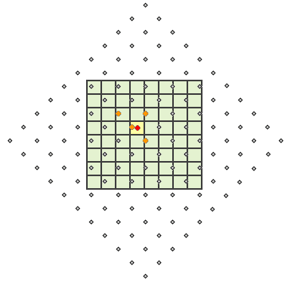
Resampling
Bilinear Interpolation
The cell centers of the input raster are in gray points
The output cells are shaded in green
The cell being processed is shaded in yellow.
Good for continuous data
Creates a smoothed surface
http://desktop.arcgis.com/en/arcmap/latest/extensions/spatial-analyst/performing-analysis/cell-size-and-resampling-in-analysis.htm
Notes:
Bilinear interpolation uses the inverse distance-weighted average of the four nearest pixel values in the original grid to estimate the new cell value.
The four cell centers from the input raster that are closest to the cell center for the output processing cell will be weighted based on inverse distance and then averaged. So, nearer cells will have a larger weight in the calculation than cells that are further away.
Since averaging is performed, this method is not appropriate for categorical data. However, it can be used for continuous data.
This method tends to smooth the image or raster data.

Slide 25
Bilinear Interpolation

Slide 26
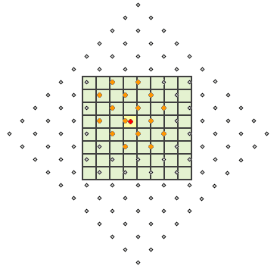
Resampling
Cubic Convolution
Similar to bilinear interpolation, except the 16 nearest input cell centers and their values are used
Good for continuous data
http://desktop.arcgis.com/en/arcmap/latest/extensions/spatial-analyst/performing-analysis/cell-size-and-resampling-in-analysis.htm
Notes:
Cubic convolution is similar to bilinear interpolation except that the nearest 16 cells are used as opposed to the nearest 4. Since it makes use of averaging, it is also not appropriate for categorical data but can be used for continuous data.
This method tends to sharpen edges more than bilinear interpolation.
Bilinear interpolation and cubic convolution are both commonly used to resample image data.

Slide 27
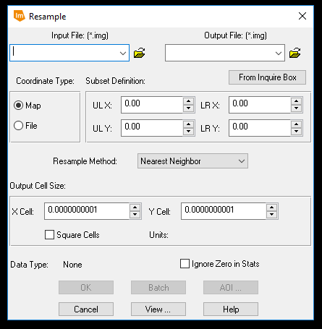
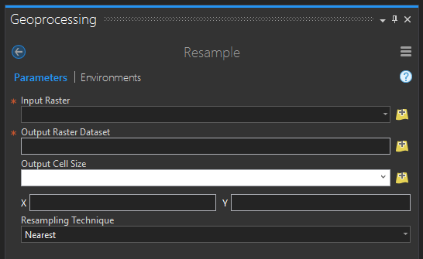
Resampling in ArcGIS Pro
A good resource:
http://desktop.arcgis.com/en/arcmap/latest/extensions/spatial-analyst/performing-analysis/cell-size-and-resampling-in-analysis.htm
Notes:
If you would like to read more about resampling, check out this ESRI link.
Note that resampling is made available in a variety of GIS and remote sensing software packages.

Slide 28
8.2 Lab session

Slide 29
Lab 08: Georeferencing and resampling
Due by Midnight (11:59 pm) on Monday, OCT 20, 2025
Submit a word document only include question and answer

