Slide 1

Lecture 07 Digitizing, Georeferencing, Resampling lecture
Instructor: Yanan Wu
fALL 2025

Slide 2
7.1 georeferencing

Slide 3
Overview
Georeferencing
Control points
Transformation methods
Digitizing
Digitizing types
Digitizing steps
Snapping

Slide 4
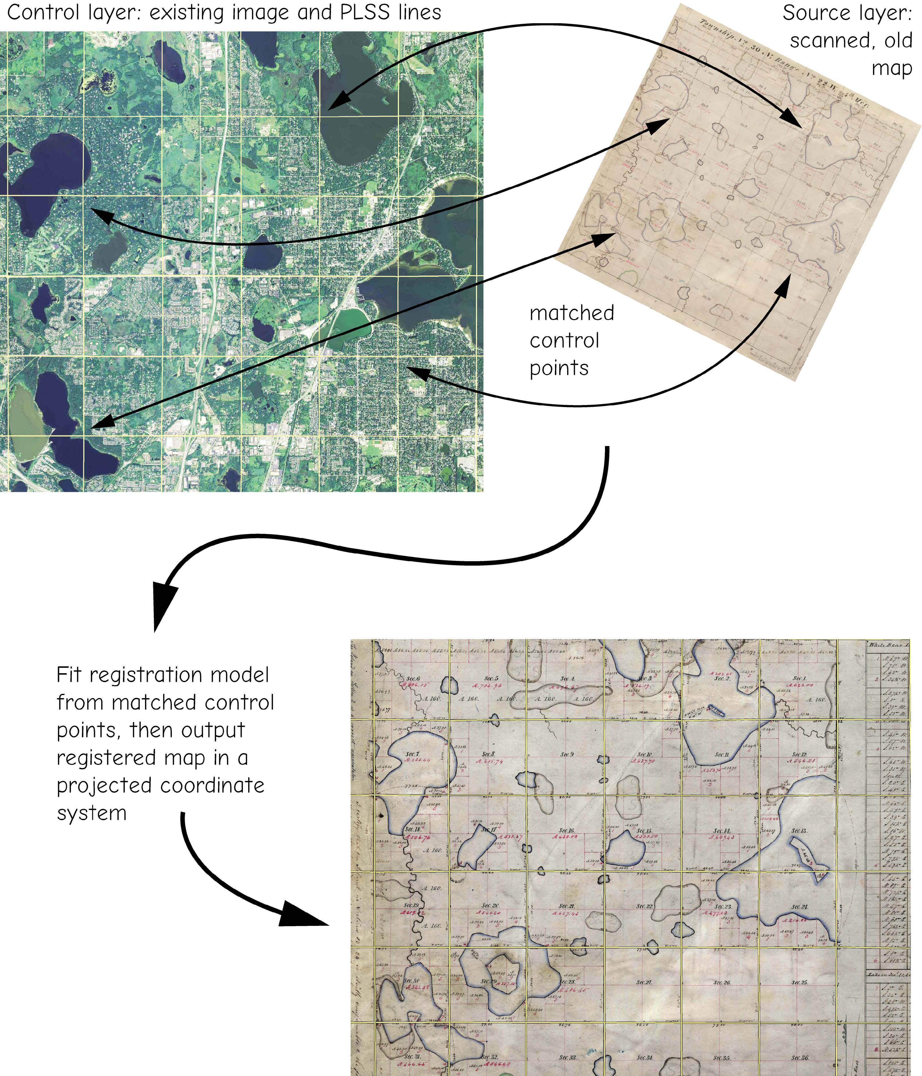
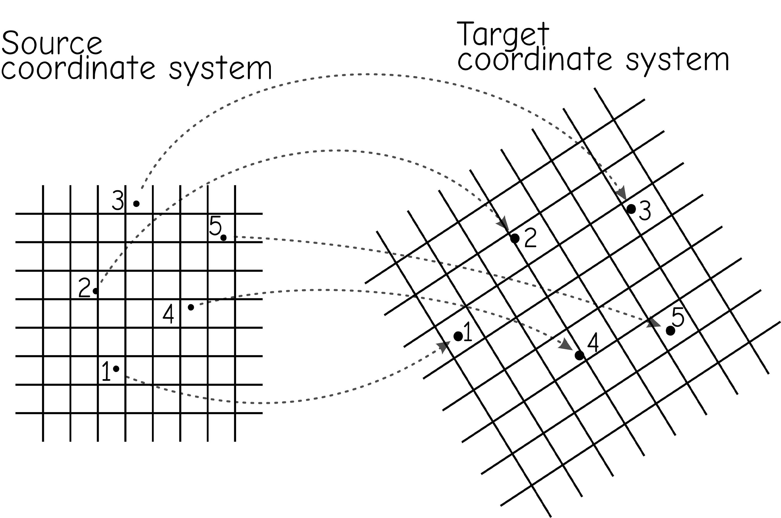
Georeferencing
Process of aligning an unreferenced dataset with one that has spatial reference information.
Bolstad, 2019
Notes:
Georeferencing is the process of aligning an unreferenced dataset with one that has spatial reference information.
As an example, you may want to use a paper map in your GIS. In order to use it effectively with other data layers, it will need to be referenced to the correct location in the map space. So, you will need to create a digital data file then apply a process to align it to other data layers in the map space. This is the process of georeferencing.
When aerial or satellite imagery are collected, they also need to be referenced to the correct location in the map space.
So, this is a common preparatory task when working with spatial data.
Many GIS and remote sensing software packages provide georeferencing tools.

Slide 5
Scanning
Convert paper map to digital raster data
Resolution and quality depends on the quality of original paper data and scanning settings (e.g., dots per inch (dpi))
Can be converted back to vector data via digitizing or tracing
Notes:
The quality of the scanned raster image will partially depend on the quality of the analog data. However, the scanning settings can also have an impact, such as the dpi used.
Make sure that you use adequate settings to scan in quality data.
Once data have been scanned in and georeferenced, vector data can be generated by digitizing or tracing over the map data.

Slide 6
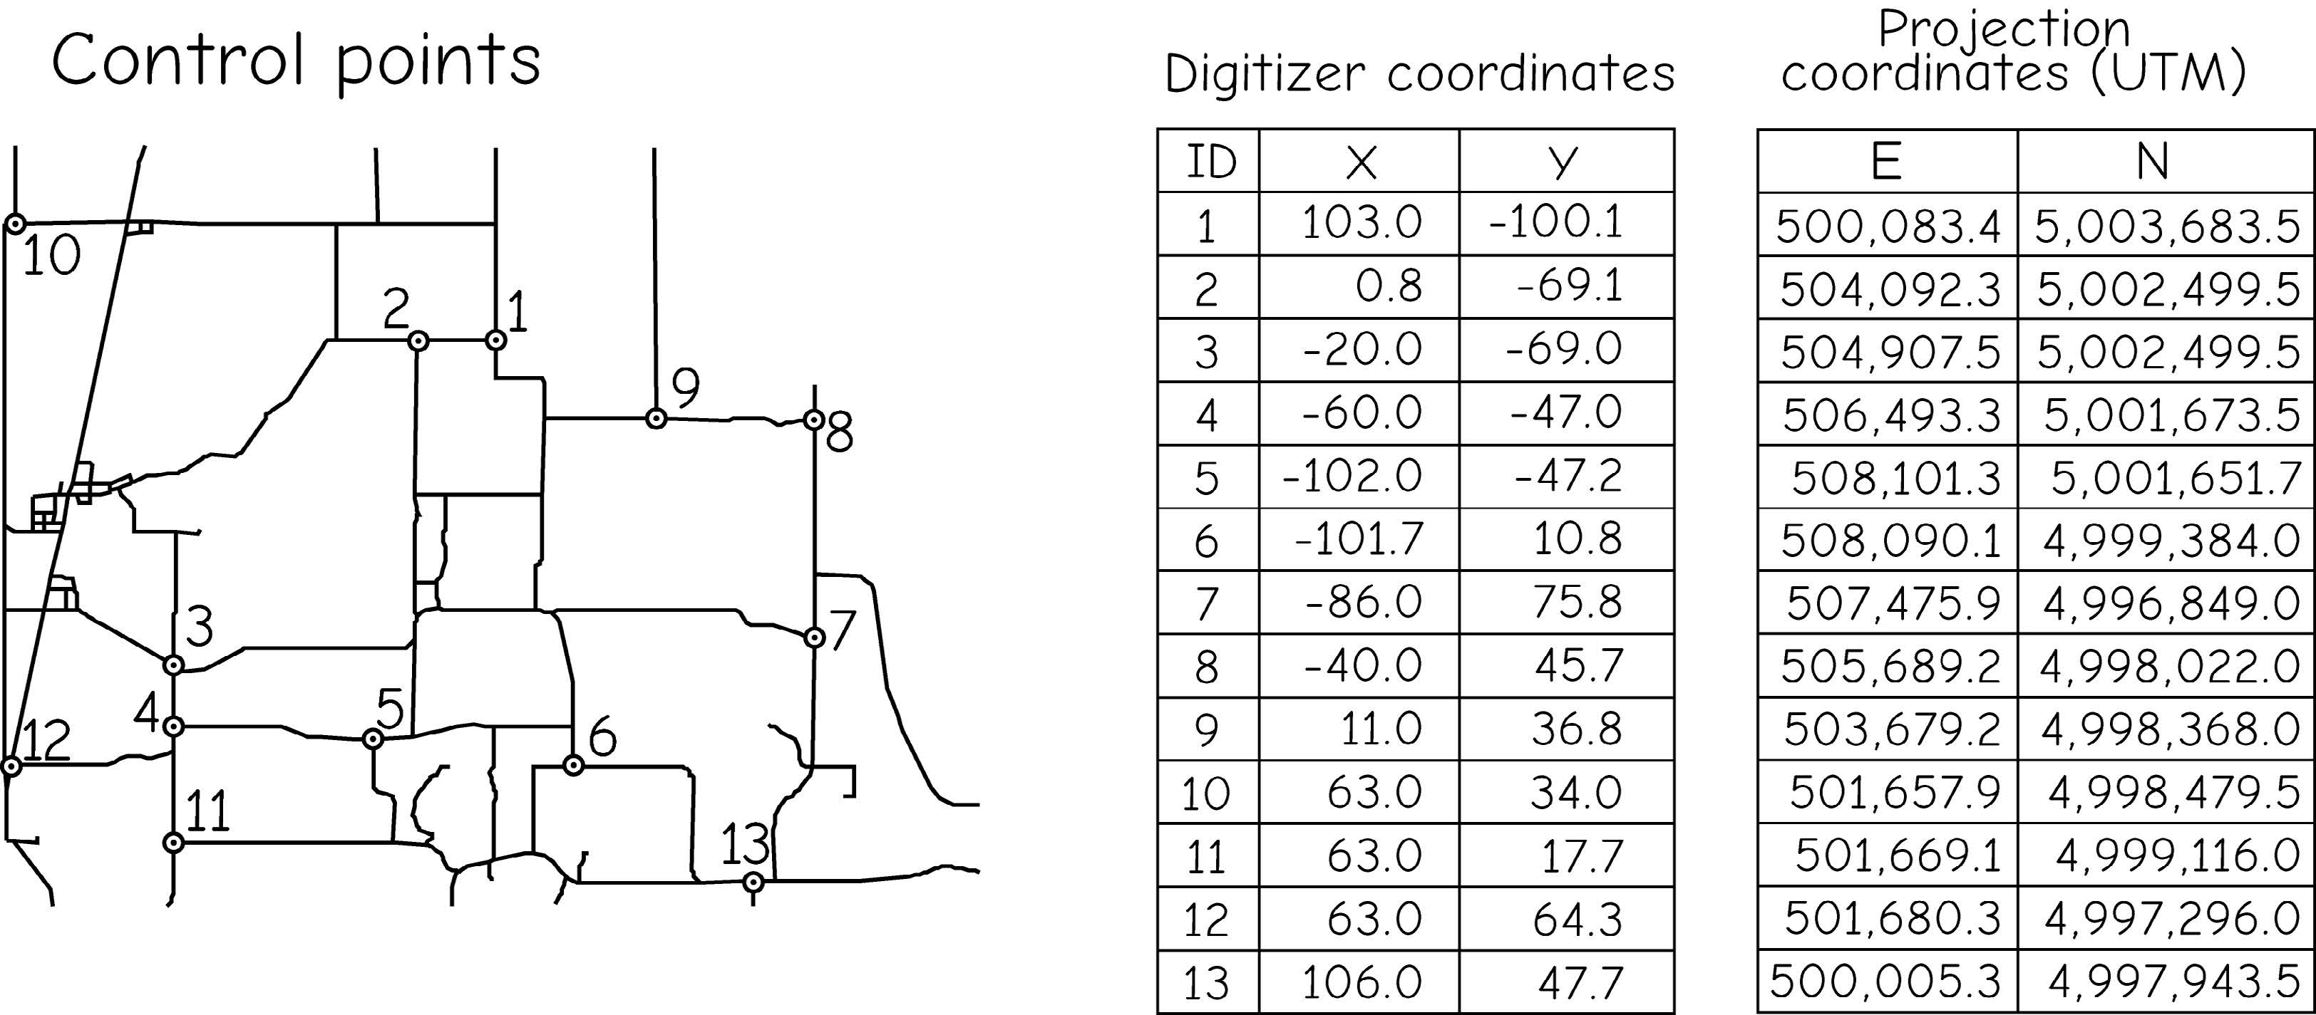
Control Points
Used to register dataset to known location
Used as reference and represent the same location in the data being referenced and reference data
Bolstad, 2019
Notes:
Control points are an important component of the georeferencing process.
Control points are used as reference and represent the same location in the data being referenced and reference data.
Control points can be created by digitizing examples on the screen.
Whenever aerial imagery is collected, it is common for ground control points to be placed on the ground prior to the data collection. These ground targets are surveyed using GPS equipment. An analyst can then use the ground targets in the image and their associated coordinates to georeference the data. This method generally produces quality results. However, this is only possible if control points can be placed in the image prior to the data collection.
So, many times were are forced to create control points on the computer screen and georeference our data relative to a dataset that has already been referenced, such as aerial imagery.

Slide 7
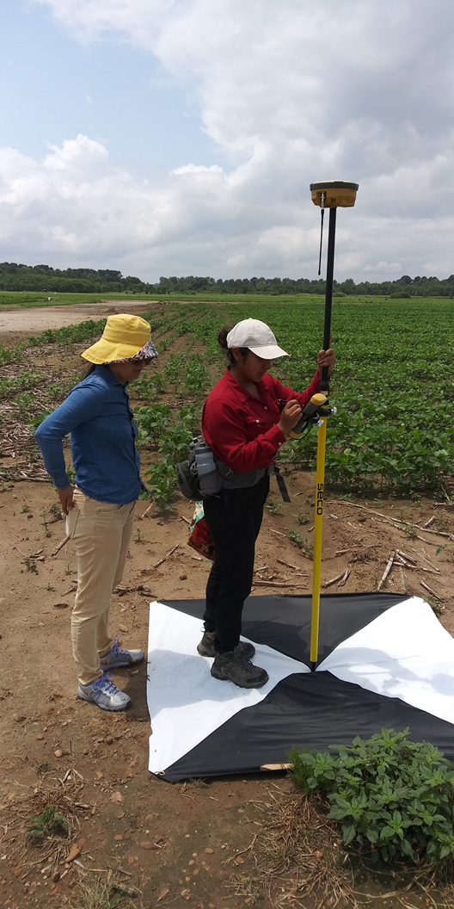
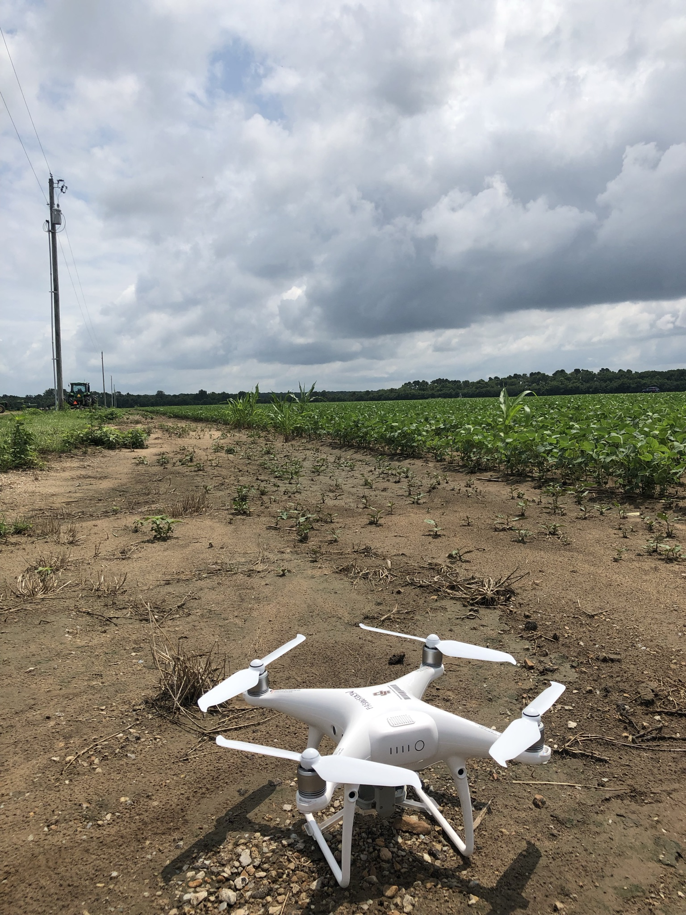
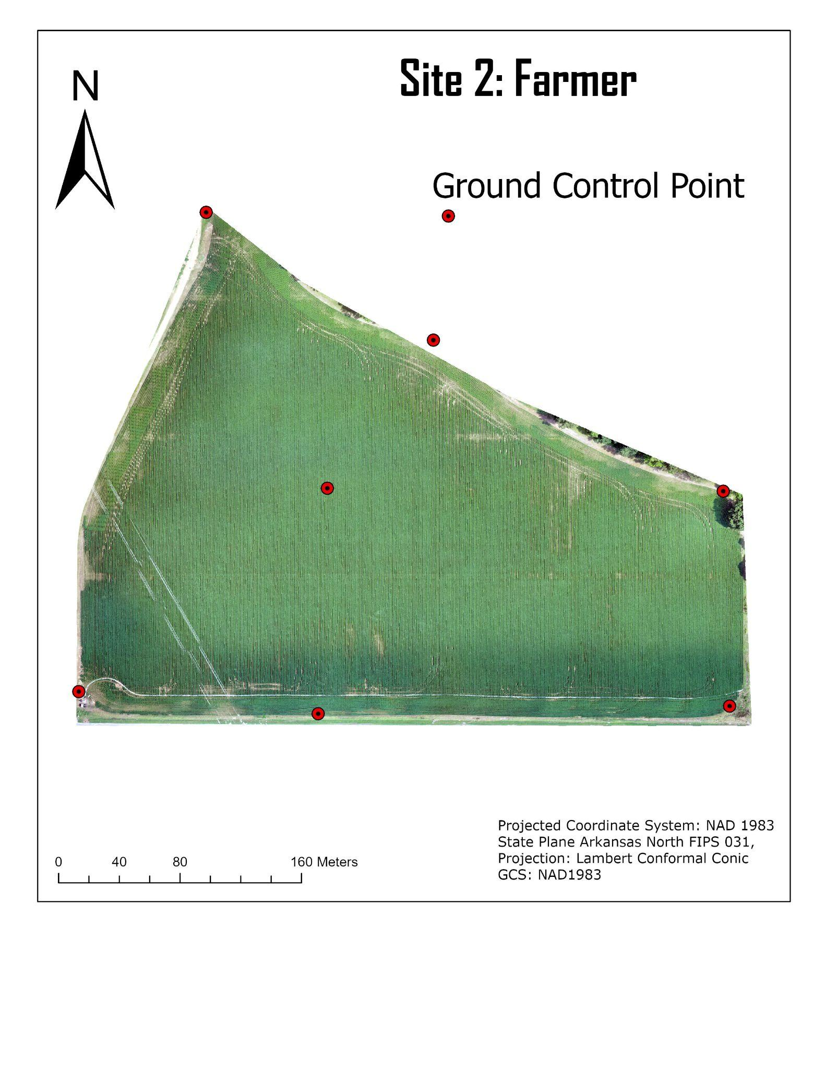
Control Points
Used to register dataset to known location
Used as reference and represent the same location in the data being referenced and reference data
Notes:
Control points are an important component of the georeferencing process.
Control points are used as reference and represent the same location in the data being referenced and reference data.
Control points can be created by digitizing examples on the screen.
Whenever aerial imagery is collected, it is common for ground control points to be placed on the ground prior to the data collection. These ground targets are surveyed using GPS equipment. An analyst can then use the ground targets in the image and their associated coordinates to georeference the data. This method generally produces quality results. However, this is only possible if control points can be placed in the image prior to the data collection.
So, many times were are forced to create control points on the computer screen and georeference our data relative to a dataset that has already been referenced, such as aerial imagery.

Slide 8
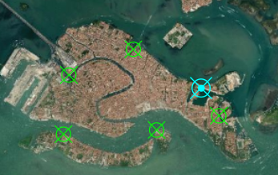
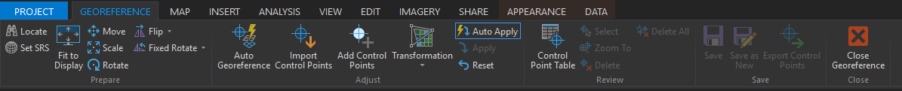
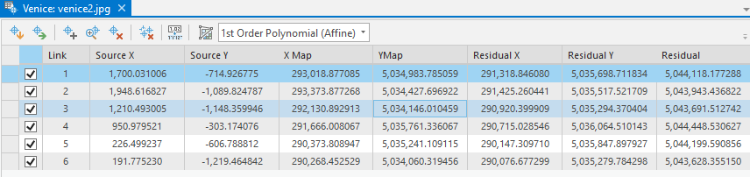
Control Points
Used to register dataset to known location
Used as reference and represent the same location in the data being referenced in reference data
Notes:
Control points are an important component of the georeferencing process.
Control points are used as reference and represent the same location in the data being referenced and reference data.
Control points can be created by digitizing examples on the screen.
Whenever aerial imagery is collected, it is common for ground control points to be placed on the ground prior to the data collection. These ground targets are surveyed using GPS equipment. An analyst can then use the ground targets in the image and their associated coordinates to georeference the data. This method generally produces quality results. However, this is only possible if control points can be placed in the image prior to the data collection.
So, many times were are forced to create control points on the computer screen and georeference our data relative to a dataset that has already been referenced, such as aerial imagery.

Slide 9
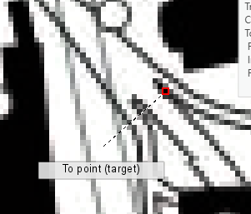
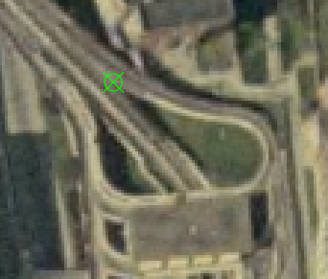
Control Points
Criteria for control points:
Spread evenly around study area
Enough points to use the algorithm of choice
Use highest accuracy dataset possible
Use locations identifiable on both datasets (known & unknown)
From Point: location on the data being referenced
To Point: same location on the reference data
Notes:
Collecting quality control points is key for successful georeferecning. Here are some suggestions for collecting quality control points.
First, the control points should be spread evenly around the study area. If the control points are only collected within the center of the image, the algorithm used will have a difficult time accurately referencing the margins of the image. So, make sure to include some points in the image margins.
You should have enough points to use the georeferecning algorithm of choice. The number of points needed depends on the algorithm, which we will discuss later.
Any positional errors in the input data will impact the georeferecning result. So, it is important to use quality reference data. Generally, we rely on high resolution imagery.
Locations must be identifiable in both datasets, the data being referenced and the reference imagery.
Generally, I try to obtain as many quality reference points as possible. However, adding more points that may be suboptimal can cause issues. So, make sure the points that you use can be accurately located in both images. Adding points that are of low quality can decrease the quality of the result.
When defining a control point, you will need to identify it in both datasets. The from point is the location on the data being referenced while the to point is the location relative to the reference data. The algorithm will attempt to move the from point location to the to point location.

Slide 10
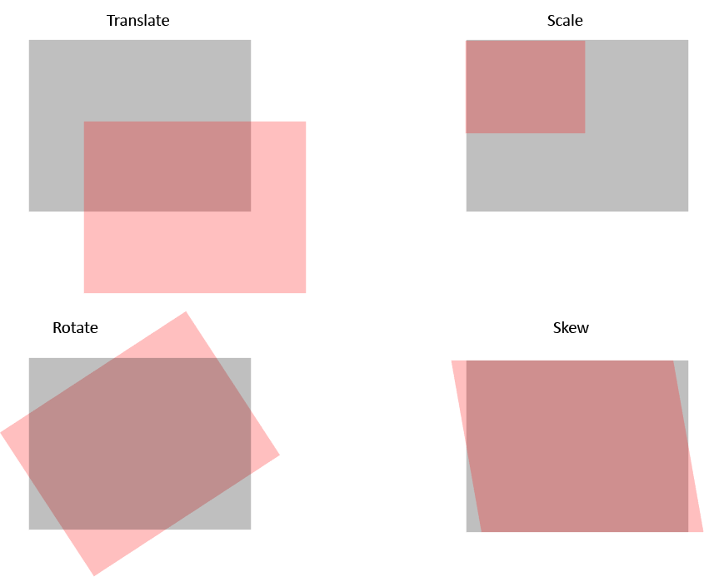
Transforming the Data
In order to georeferenced data, it may need to be:
Translate
Scale
Rotate
Skew
These transformations are applied mathematically.
Notes:
When performing georeferencing different transformations can be applied.
Translation implies moving the image without changing its shape or size.
Changing the scale means to change the size of the image but not the shape.
Rotation will reorient the scene relative to a point of rotation.
Skew is used to change or distort the shape of the data.
The transformations that can be applied depends on the algorithm used.

Slide 11
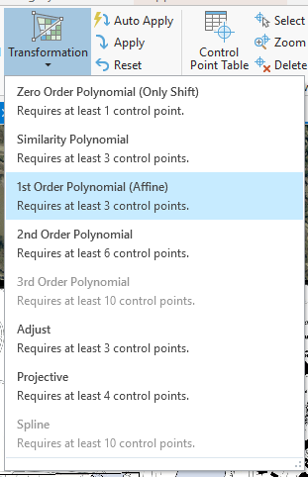
Transformation Method
Zero-Order Polynomial = just translate the data (need 1 control point)
First-Order Polynomial (Affine) = translate, scale, and rotate (need 3 control points)
Higher Order = more complex distortions can be corrected
Rarely use higher than third order
Need more control points
If raster dataset must be bent or curved, use a second- or third-order transformation
Notes:
Polynomial equations can be used for georeferencing.
Zero-order polynomials can only shift or translate the image and require only a single control point.
First-order polynomials can translate, scale, and rotate the data. However, they cannot change the shape or skew the image. Three control points are required.
Higher order polynomials can apply all four distortions and require more than three control points. We rarely use higher than third order polynomials for georeferencing.

Slide 12
First-Order Polynomial (Affine)
Transformation Method
x
X = Ax + By + C
Y = Dx + Ey + F
X = new x coordinate
Y = new y coordinate
x = original x coordinate y = original y coordinate
x
x
x
(Map) Northings (m)
x
Image Row #
Example by Dr. Tim Warner
Notes:
This slide provides an example of a first-order polynomial, also called an affine transformation.
Here, the new X and Y coordinates are predicted using the original x, and y coordinates. Note that both coordinates are used to predict each of the new coordinates.
The goal here is to determine appropriate coefficients to transform the data. Note that x and y are not raised to a power, as this in only first-order, so no square or cubed terms can be used.
The A term and D terms relate to changing the scale in the x and y directions, respectively. The B and E terms relate to rotation, and the C and F terms relate to translation. Again, this method does not allow for a skew to be applied.
The terms are determined using the control points.

Slide 13
Transformation Method
Adjust = combines polynomial and triangular irregular network (need 3 control point)
Similarity = first order transformation which tries to preserve the shape of the original raster (need 3 control points)
Projective = commonly used for image data (need 4 control points)
Spline = uses rubber sheeting (need 10 control points)
Notes:
Other methods are available that do not rely on or solely rely on polynomial equations. This slide provides some examples.
Again, different projection methods require different numbers of control points.
The optimal method will depend on the data being referenced, the control points used, and the required transformations.

Slide 14
class activity – georeferencing
Georeferencing the Conway Hall
Make a copy of the Conway hall
Do the georeferencing based on the copy using auto apply

Slide 15
class activity – georeferencing
Georeferencing the Conway Hall
Make a copy of the Conway hall
Do the georeferencing based on the copy
Select the transformation method

Slide 16
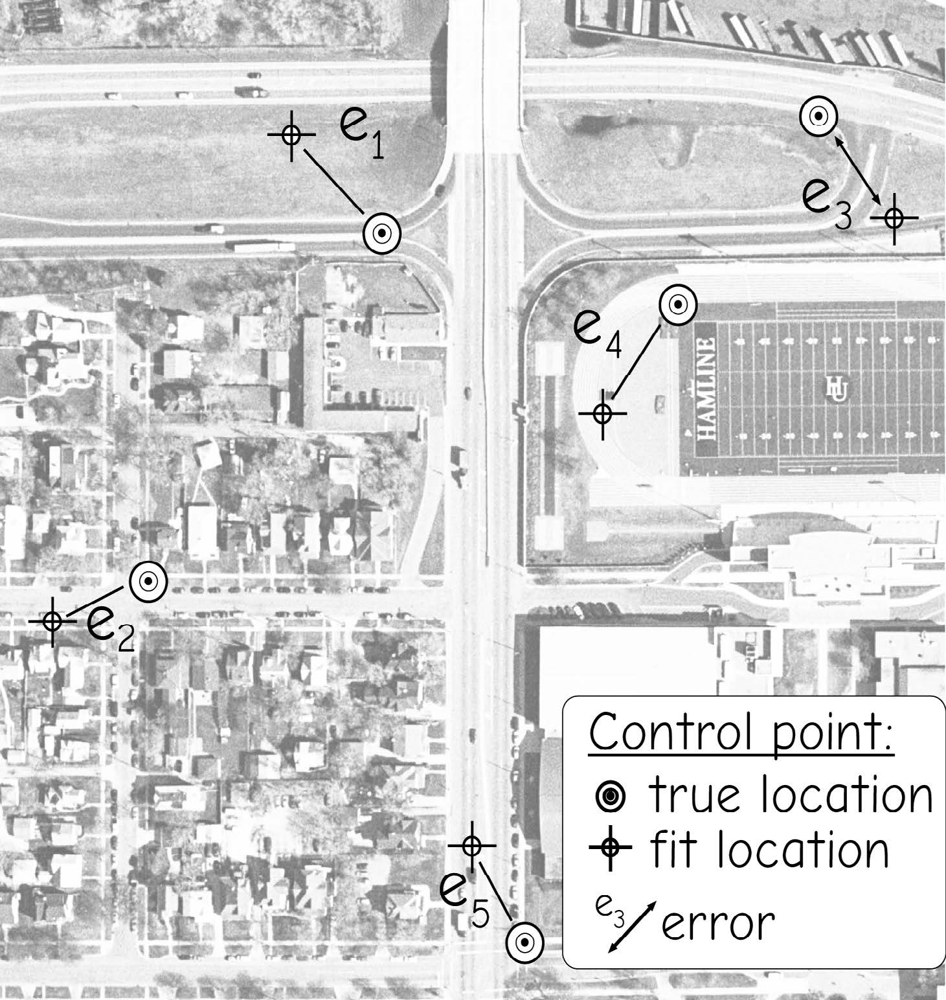
Assess the quality of georeferenced result
Root mean square error (RMSE)
Measure of how well the now-referenced data matches with the source
Obtained by comparing the known location of the control point with the computed coordinates of the control point.
RMSE_{x} = √ Σ(x_{predicted} – x_{actual})²/n
RMSE_{y} = √ Σ(y_{predicted} – y_{actual})²/n
RMSE = √ (RMSE_{x}² + RMSE_{y}²)
Bolstad, 2019
Notes:
Georeferencing is generally assessed using the root mean square error, or RMSE, statistic.
This measure provides an assessment of how well the now referenced data matches the source or reference image.
It is generally calculated by comparing the known location of the control point with the computed coordinates of the control point.
The predicted x and y coordinates are subtracted from the correct location to obtain a residual or error. The residuals are then squared, summed, then divided by the number of samples. Lastly the square root is taken. This will provide a RMSE for the x and y directions. These measures can then be combined to obtain a total RMSE.
RMSE will be reported in the map units or as number of pixels. Lower RMSE is better.

Slide 17
Assess the quality of georeferenced result
Correct X | Correct Y | Predicted X | Predicted Y | X residual | Y residual | X residual squared | Y residual squared
513,126.80 | 4,101,294.60 | 513,127.30 | 4,101,293.40 | 0.5000 | -1.2000 | 0.2500 | 1.4400
513,123.20 | 4,101,303.40 | 513,118.10 | 4,101,302.10 | -5.1000 | -1.3000 | 26.0100 | 1.6900
513,203.80 | 4,101,209.10 | 513,203.10 | 4,101,207.20 | -0.7000 | -1.9000 | 0.4900 | 3.6100
513,182.60 | 4,101,377.80 | 513,181.60 | 4,101,379.90 | -1.0000 | 2.1000 | 1.0000 | 4.4100
513,217.60 | 4,101,403.60 | 513,216.10 | 4,101,405.20 | -1.5000 | 1.6000 | 2.2500 | 2.5600
 |  |  |  |  |  | RMSE X | 2.45
 |  |  |  |  |  | RMSE Y | 1.66
 |  |  |  |  |  | RMSE | 2.96
Notes:
This slide provides an example of an RMSE calculation.
The correct and predicted x and y coordinates are differenced to obtain a residual. The residuals are then squared, summed, then divided by the number of samples. The last step is to take the square root.
Once the RMSE is obtained in the x and y directions, they can be combined to obtain a total RMSE.
In this example, the total RMSE is 2.96 meters. This suggest that each pixel is, on average, 2.96 meters from its correct location.
What is considered an acceptable RMSE? This depends on many factors. For example, coarser spatial resolution data will tend to have a larger RMSE than fine resolution data as the larger pixel or cell size will result in some spatial ambiguity.
For imagery, our goal is generally to obtain and RMSE that is smaller than the dimensions of a pixel or cell.
Some mapping tasks may require better georeferencing results than others. There will always be some georeferencing or positional error in your data.

Slide 18
Individual Activity
Calculate RMSEx, RMSEy, and RMSE using Excel sheet
Notes:
Positional uncertainty relates to differences in the position of your data relative to the correct location.
You can consider uncertainty in 2D space as x and y coordinates in a geographic or projected space.
You can also consider the uncertainty of elevation measurements.
Combining these, you can consider uncertainty in 3D space.
As an example, the image shows some uncertainty in a vector line road dataset in comparison to the orthophotography.
Positional error is generally assessed using root mean square error or RMSE, similar to how georeferencing results are assessed.
All spatial data have some positional uncertainty; however, this is only a concern if there is too much uncertainty to support your analysis or mapping needs.

Slide 19
RMSE Interpretation
The lower RMSE generally indicates a more accurate affine transformation
For imagery, we generally want the RMSE to be lower than the size of the pixel
Low RMSE can be misleading if the quality of the control points is poor
Sometimes the algorithm overfits to the control points, so the RMSE can be misleading
The RMSE is not useful when comparing among different model forms
Notes:
Here are some other notes regarding interpreting RMSE.
Note that RMSE can be misleading if the quality of the control points is suspect or poor.
Also, algorithms commonly overfit to the control points. So, if control points are used to calculate RMSE, the accuracy can be inflated.
It is best to withhold data points and calculate RMSE relative to these locations.

Slide 20
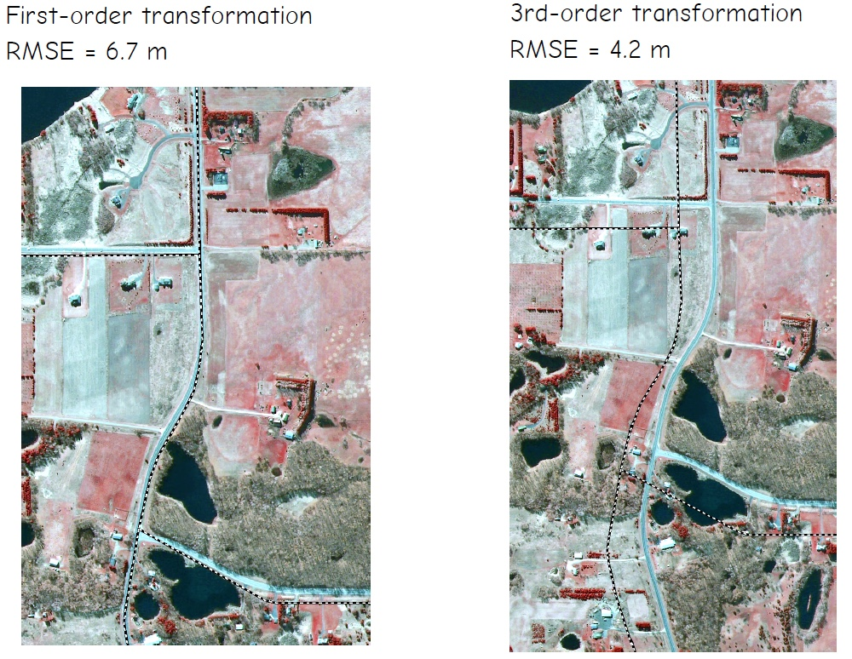
RMSE Interpretation
Bolstad, 2019
Notes:
Here are some other notes regarding interpreting RMSE.
Note that RMSE can be misleading if the quality of the control points is suspect or poor.
Also, algorithms commonly overfit to the control points. So, if control points are used to calculate RMSE, the accuracy can be inflated.
It is best to withhold data points and calculate RMSE relative to these locations.

Slide 21
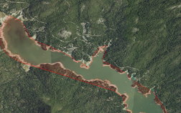
Digitizing
The process by which coordinates from a map, image, or other sources are converted into a vector layer in a GIS.
Notes:
The x, y coordinates of these features are automatically recorded and stored as spatial data.

Slide 22
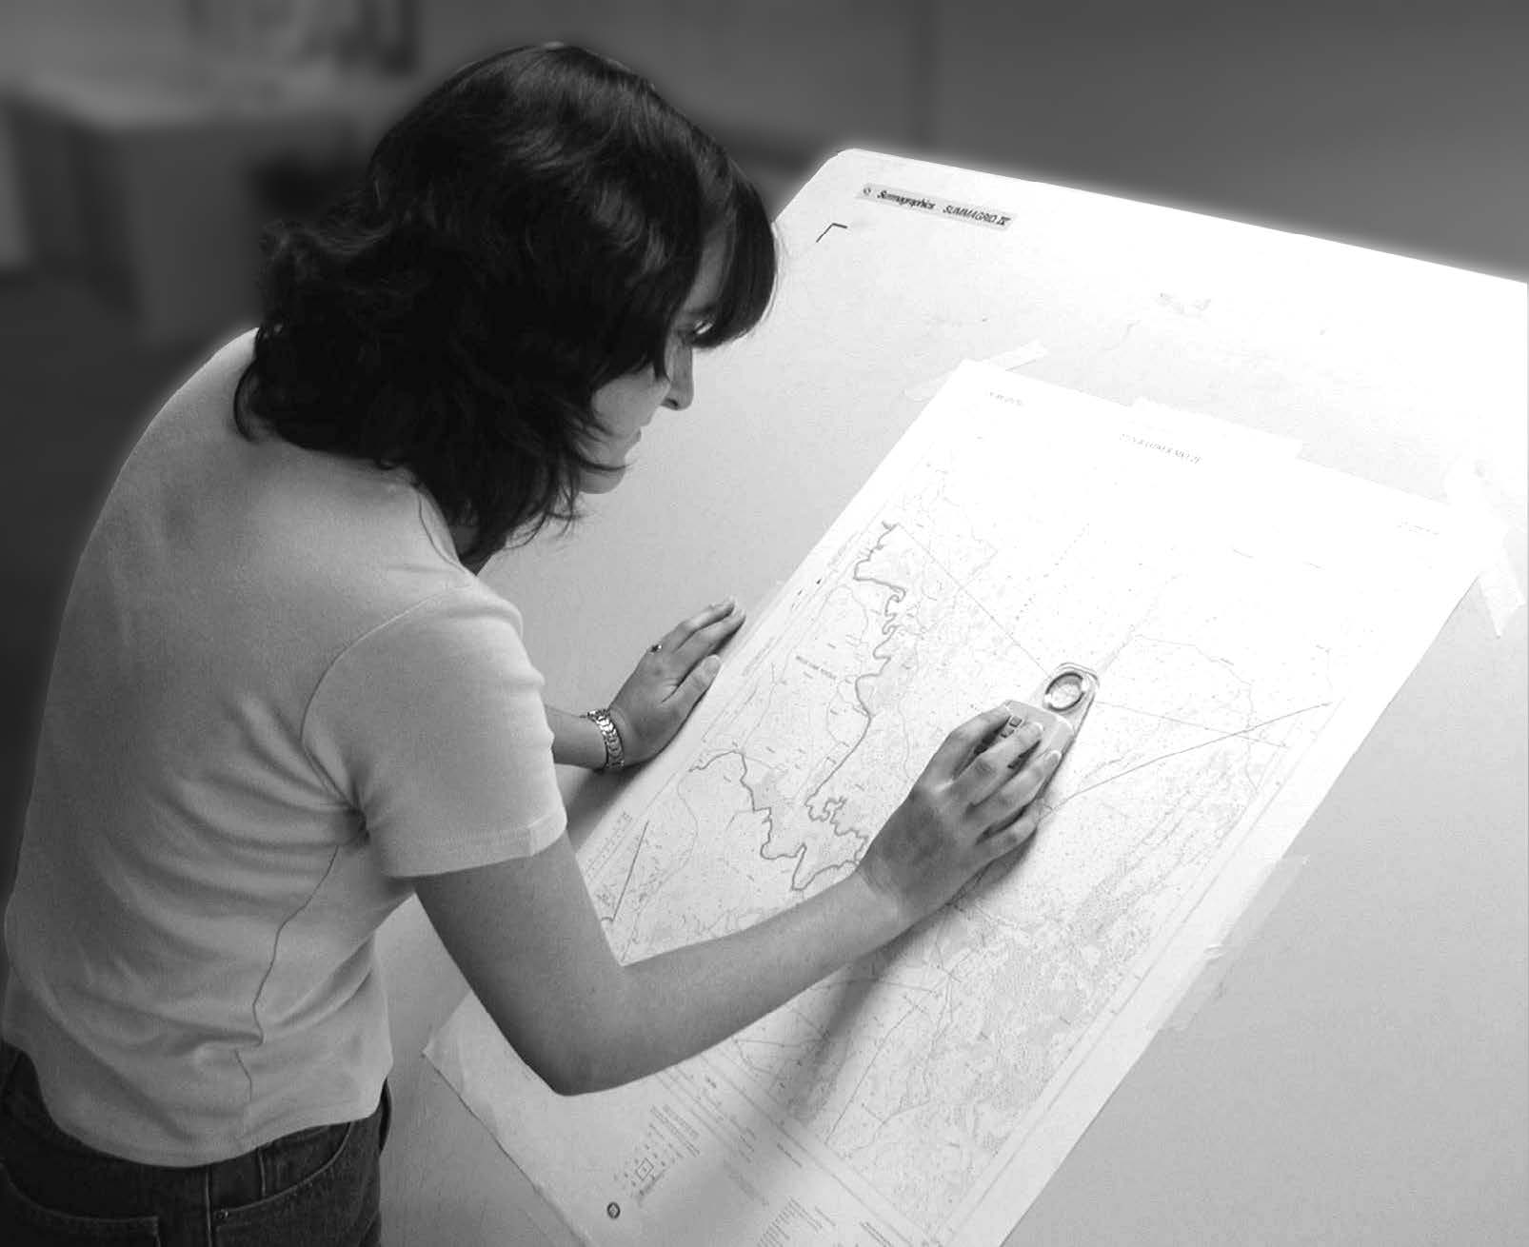
Digitizing
Manual digitization is human-guided coordinate capture from a map or image source.
Hardcopy digitizing
Human-guided coordinate capture from a paper, plastic, or other hardcopy map
Bolstad, 2019
Notes:
electrically sensitized puck. The most common digitizers are based on a wire grid embedded in or under a table

Slide 23
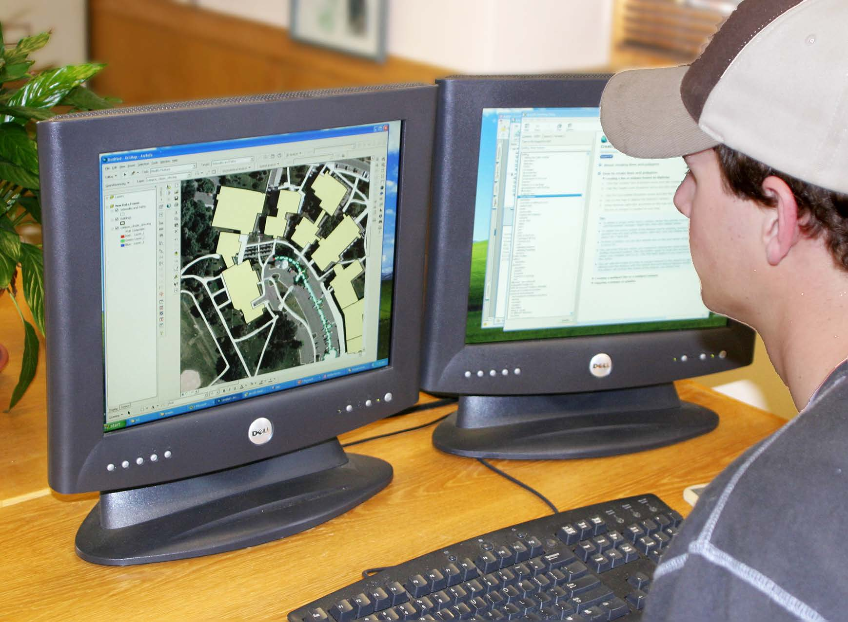
Digitizing
Manual digitization is human-guided coordinate capture from a map or image source.
On-screen digitizing
Heads-up digitizing, involves manually digitizing on a computer screen, using a digital image as a backdrop
Bolstad, 2019
Notes:
The x, y coordinates of these features are automatically recorded and stored as spatial data.

Slide 24
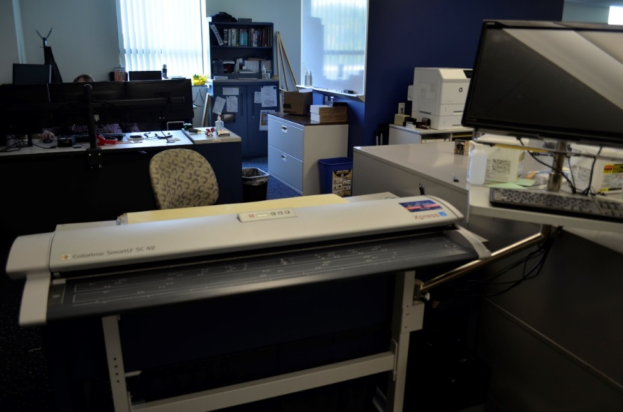
Digitizing
Manual digitization is human-guided coordinate capture from a map or image source.
Scan digitizing

Slide 25
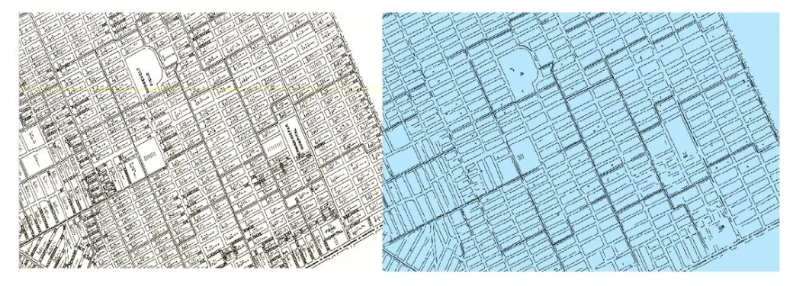
Digitizing
Digitizing scanned maps using AI in ArcGIS Pro
Detect Object using Deep Learning tool

Slide 26
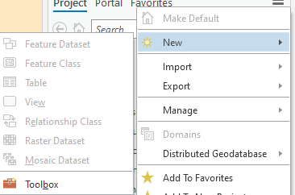
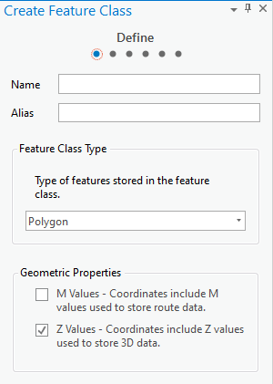
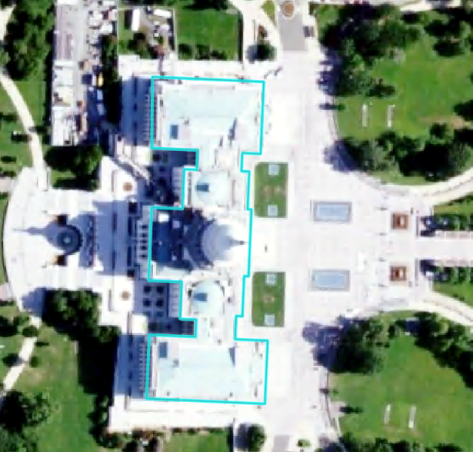
Digitizing Steps
Obtain input imagery or other reference data
Create a new file to edit
Define geometry (point, lines, or polygon)
Define projection
Create attribute fields
Digitizing
Edit attribute information
Check and validate your results
Notes:
Before beginning to digitize, you will need to obtain some input imagery or other reference data.
You will then need to create a new shapefile or feature class to draw into. This will require defining the geometry (point, line, or polygon), setting the projection or coordinate reference system, and creating any required attribute fields.
You can then draw the new features using the reference data. You will also need to edit the attribute table.
It is always important to validate your results for quality control purposes.

Slide 27
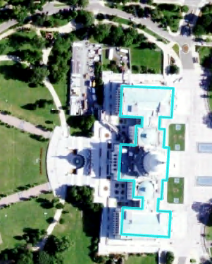
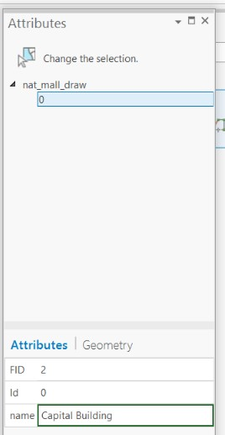
Digitizing in ArcGIS Pro
Use Edit tab
Remember to consider topology
Remember to edit attributes
Save often!!!!!!!
Notes:
Digitizing options are available in the Edit Tab.
As you edit the geometry and attributes, remember to save often so you don’t lose any work.

Slide 28
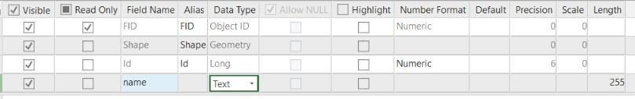
Adding Fields
Make sure to define the correct type
Data Type
Short Integer | Integer values between -32,768 and 32,767
Long Integer | Integer values between -2,147,483,648 and 2,147,483,647
Float | Decimal values with 1-6 decimal places
Double | Decimal values with more the 6 decimal places
Text | Text strings
Date | Data info (mm/dd/yyyy)
Notes:
When creating a new field, you will need to define the field type.
Short and long integer fields can only store integer or whole number values. Long integers can stored a wider range of numbers than short integers.
If you need to maintain decimal values, you cannot use a short or long integer. Instead, you must use a float or double type. Float fields can store up to 6 decimal places while double can store more than 6.
If you would like to store text or string data, you will do so in a text field. Note that numbers stored in text field will be treated like strings. They will not be treated line numbers. For example, you will not be able to perform mathematical operations on these data.
Date fields store dates and will treat the information as dates.

Slide 29
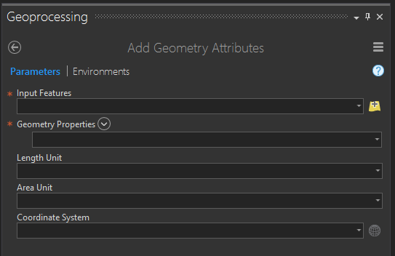
Adding Geometric Fields
Use Add/Calculate Geometry Attributes Tool
Points | Lines | Polygons
X-coordinate | Start-X | Area
Y-coordinate | Start-Y | Perimeter
Z-coordinate (if z-enabled) | End-X | Centroid-X
M-coordinate (if m-enabled) | End-Y | Centroid-Y
 | Mid-X
 | Mid-Y
 | Length
 | Bearing
Notes:
Different geometric measures can be calculated and stored in the attribute table for points, lines, and polygon data.
For point data, it is possible to store the x and y coordinate. If the feature is Z-enabled, or contains elevation or height information, this value can also be calculated. If it is M-enable, the M coordinate can be calculated. M-coordinates generally relate to positions along a network.
For lines, you can calculate the x and y coordinates for the start, end, and middle of the line segment. You can also calculate the length and bearing. The bearing is the compass direction of the line and is defined as the direction of travel from the start to the end node.
For polygons, you can calculate the area and perimeter. The perimeter is the length of all the lines that make up the polygon. You can also calculate the centroid, or geometric center, coordinates. Note that centroid coordinates can sometimes be misleading. For example, for irregular or elongated shapes, the centroid may not actually occur within the polygon. For a “C” shaped feature, the centroid would occur somewhere in the middle of the “C” as oppose to within the area that makes it up. So, be careful when using centroid measures.

Slide 30
class discussion – Indoor gis
Digitizing the floor plan of UCA

Slide 31
Impacts on Digitizing Accuracy/ Precision
Factors affect accuracy of digitizing
Source data errors
The surface error caused by 1 millimeter digitizing error
Bolstad, 2019

Slide 32
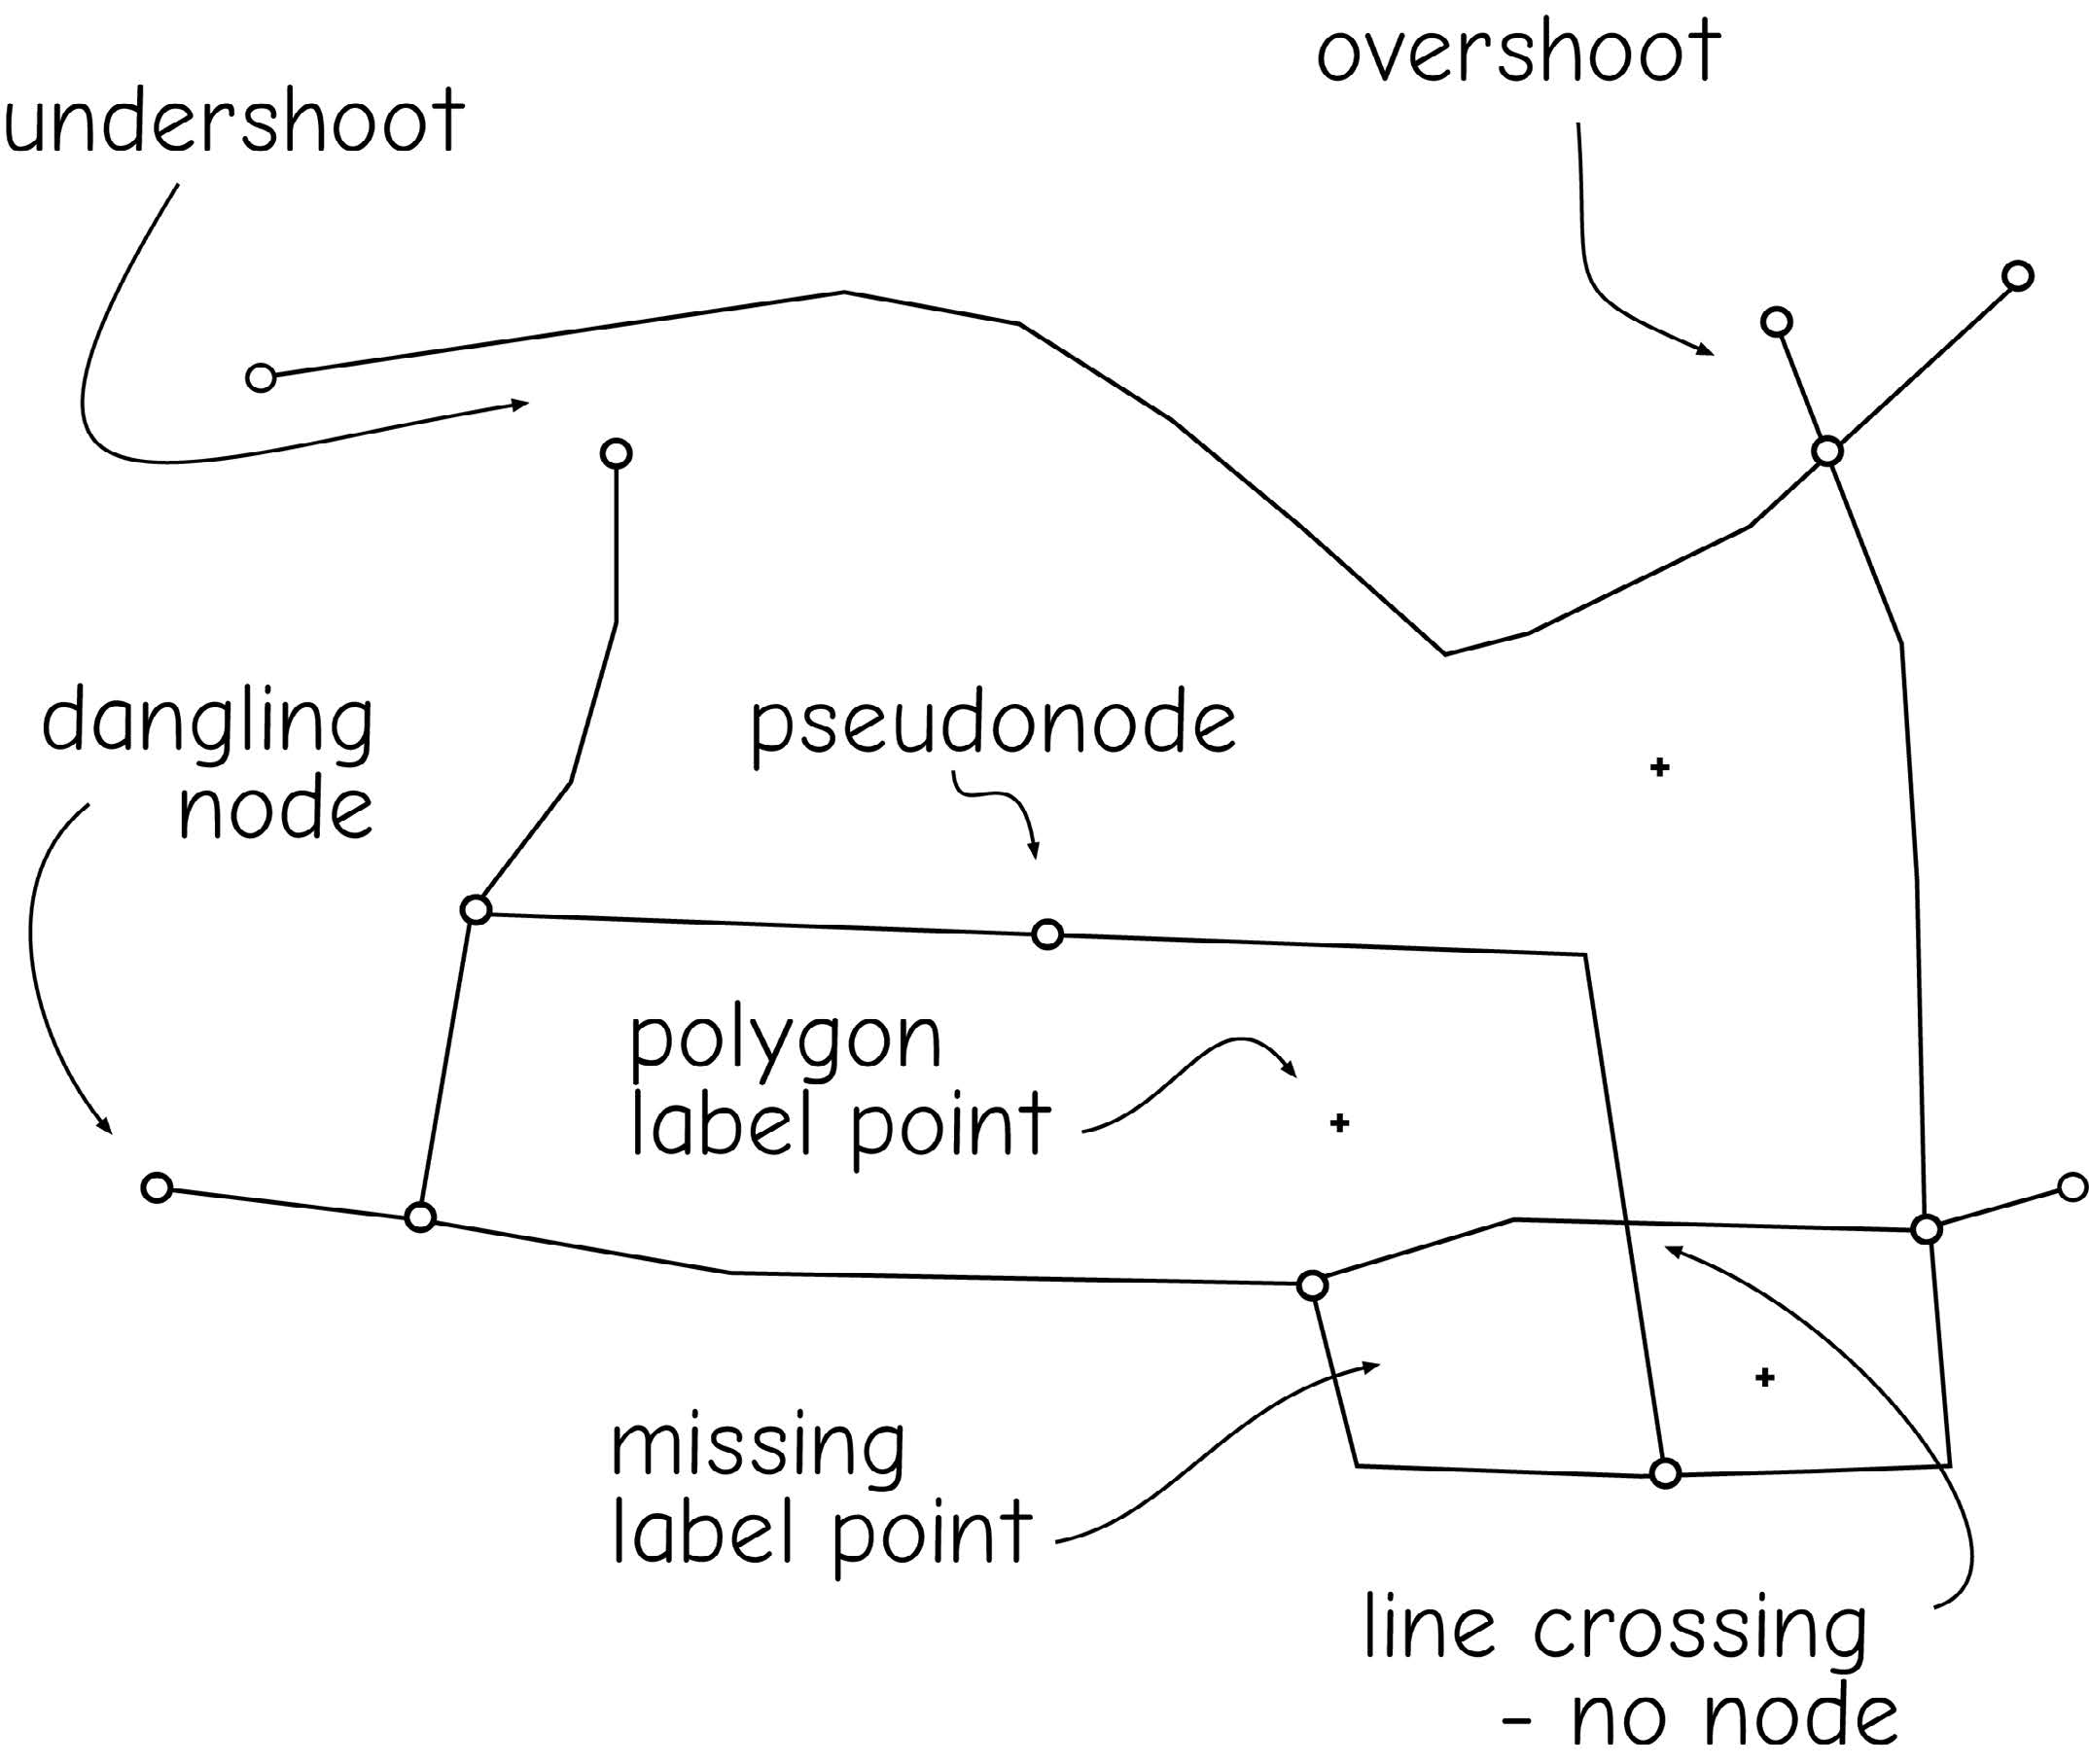
Impacts on Digitizing Accuracy/ Precision
Factors affect accuracy of digitizing
Precision of equipment
The abilities and attitude of the person digitizing affects the geometric quality of manually digitized data
Bolstad, 2019
Notes:
Dangling include overshoot and undershoot, and two lines with points not connected. Dangling node include undershoot and overshoot node.

Slide 33
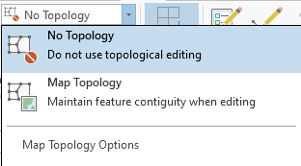
Impacts on Digitizing Accuracy/ Precision
Factors affect accuracy of digitizing
Precision of equipment
The abilities and attitude of the person digitizing affects the geometric quality of manually digitized data
Topology
Bolstad, 2019

Slide 34
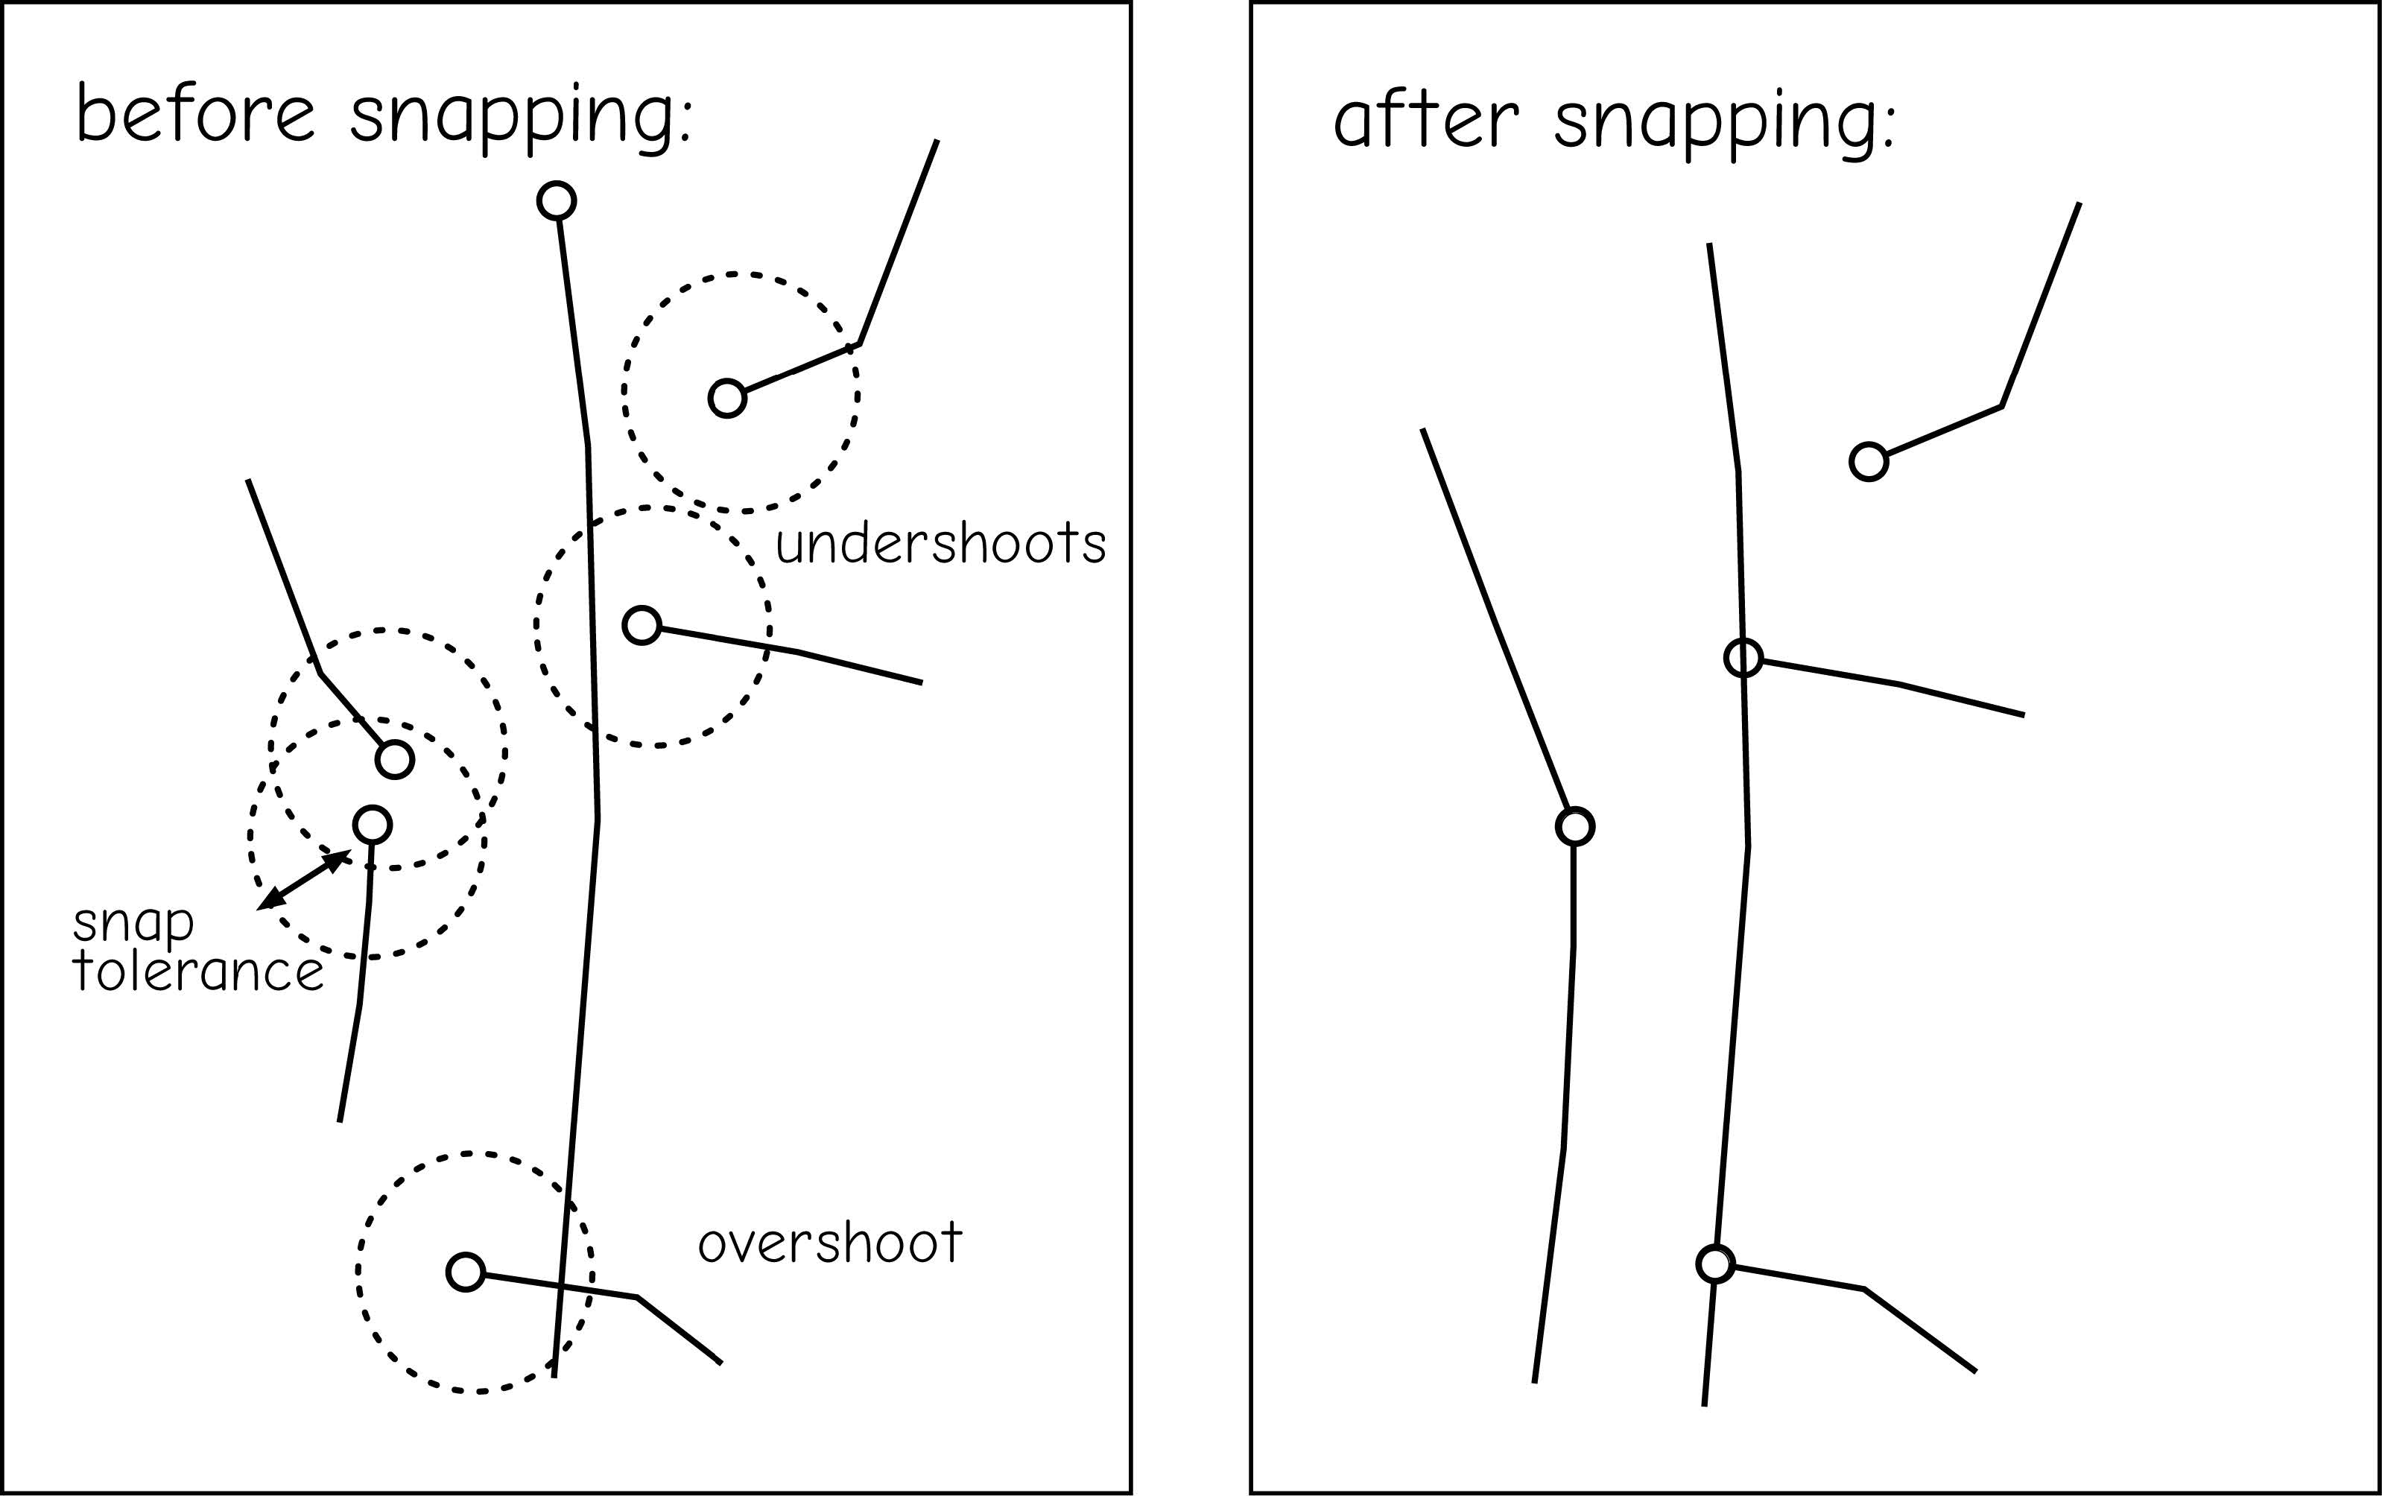
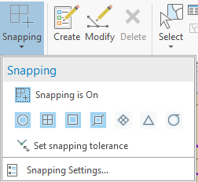
Impacts on Digitizing Accuracy/ Precision
Factors affect accuracy of digitizing
Precision of equipment
The abilities and attitude of the person digitizing affects the geometric quality of manually digitized data
Snapping
Bolstad, 2019

Slide 35
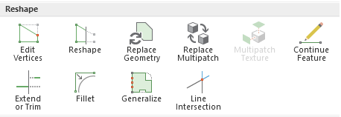
Impacts on Digitizing Accuracy/ Precision
Factors affect accuracy of digitizing
Precision of equipment
The abilities and attitude of the person digitizing affects the geometric quality of manually digitized data
Reshaping

Slide 36
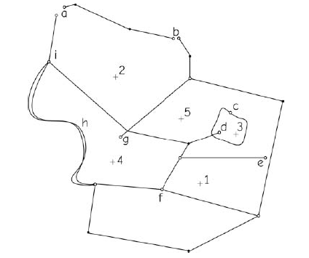
Group Activity
Identify a characteristic feature or error in digitizing at each of the labeled letter locations in the drawing below.
Bolstad, 2019
Notes:
a-undershoot; b-undershoot; c-psuedonode; d-overshoot; e-undershoot; f-missing label; g-overshoot.

Slide 37
8.2 Lab session

Slide 38
Lab 08: Georeferencing and resampling
Due by Midnight (11:59 pm) on Monday, OCT 20, 2025
Submit a word document only include question and answer

