Slide 1

Lecture 07 Data Accuracy and Precision lecture
Instructor: Yanan Wu
fALL 2025

Slide 2
7.1 MAP ELEMENTS

Slide 3
Data accuracy and precision
Accuracy types
Precision
Accuracy measurement
Uncertainty
Error
Scale and generalization
Fuzziness and definitions
Sampling of data
Timeliness
Metadata

Slide 4
Accuracy and Precision
Accuracy: A comparison of true values to the values presented in a spatial data set
Positional accuracy
Attribute accuracy
Logical consistency
Completeness

Slide 5
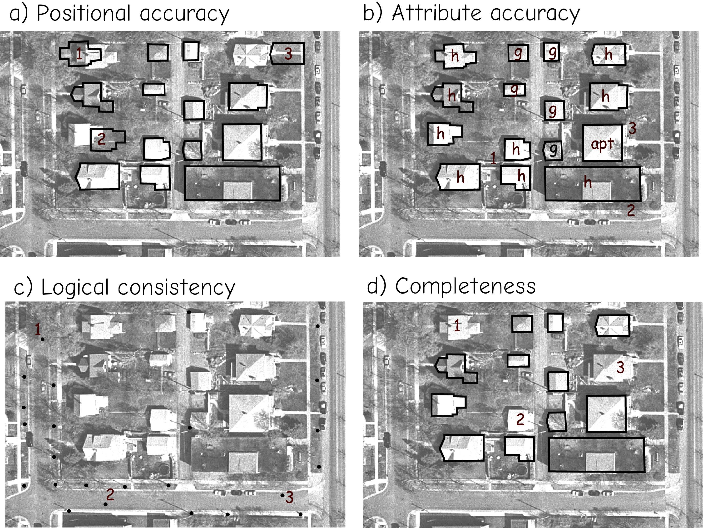
Accuracy and Precision
Positional accuracy
Describe how close the locations of objects represented in a digital data set correspond to the true locations for the real-world entities
Bolstad 2019

Slide 6
Accuracy and Precision
Attribute accuracy
Summarizes how different the attributes are from the true values
Bolstad 2019

Slide 7
Accuracy and Precision
Logical consistency
Reflects the presence, absence, or frequency of inconsistent data.
Street light
Bolstad 2019
Notes:
Light pole

Slide 8
Accuracy and Precision
Completeness
Describes how well the data set captures all the features.
Bolstad 2019

Slide 9
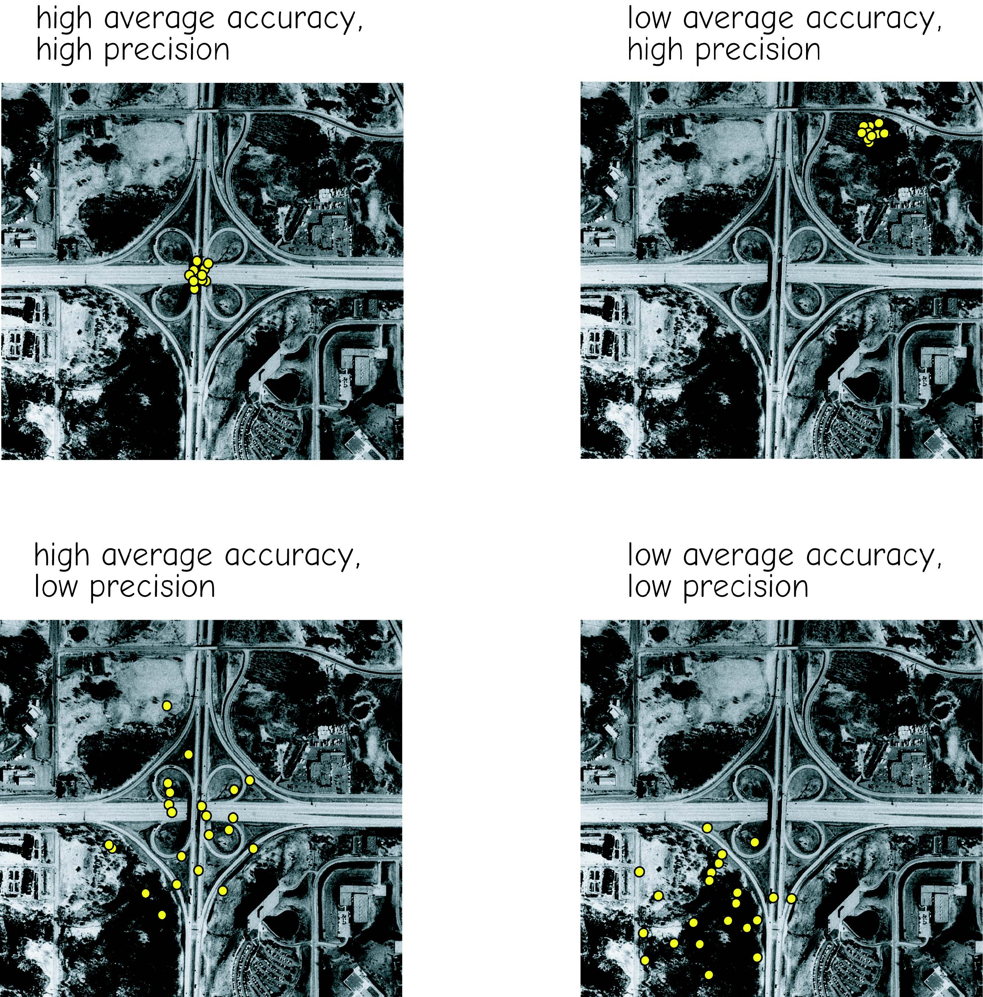
Accuracy and Precision
Precision: agreement with other measurements
Bolstad 2019
Notes:
Before we move on, I want to provide a review of the difference between accuracy and precision. Since we often use these terms interchangeably colloquially, this can be a bit confusing.
Accuracy represents agreement with truth or the correct measure. Here, we are concerned with whether or not the measurements agree with the correct value on average.
In contrast, precision had to do with whether data agree with each other or how repeatable measurements are. This has nothing to do with agreement with the correct value.
The difference here is often explained with a target where the bull’s eye represents the correct answer.
The example on the left represents an archer that is not accurate but precise. So, he or she is missing the bull’s eye, but each arrow hits in nearly the same place. So, he or she is consistent even if the bull’s eye is missed.
The next example shows a pattern that is less precise but accurate. There is more spread in the pattern, or the archer is less consistent, but the average position would be near the bull’s eye.
The third example is neither accurate nor precise since the archer is not consistent and the average location would not be near the bull’s eye.
The last pattern is both precise and accurate.
As a second example, imagine you are collecting GPS measurements at a location. If you get roughly the same coordinates each time you take a measurement, then the measurements are precise but not necessarily accurate, as there could be some systematic error or calibration issue causingthe measurements on average to not be close to the correct coordinates.

Slide 10
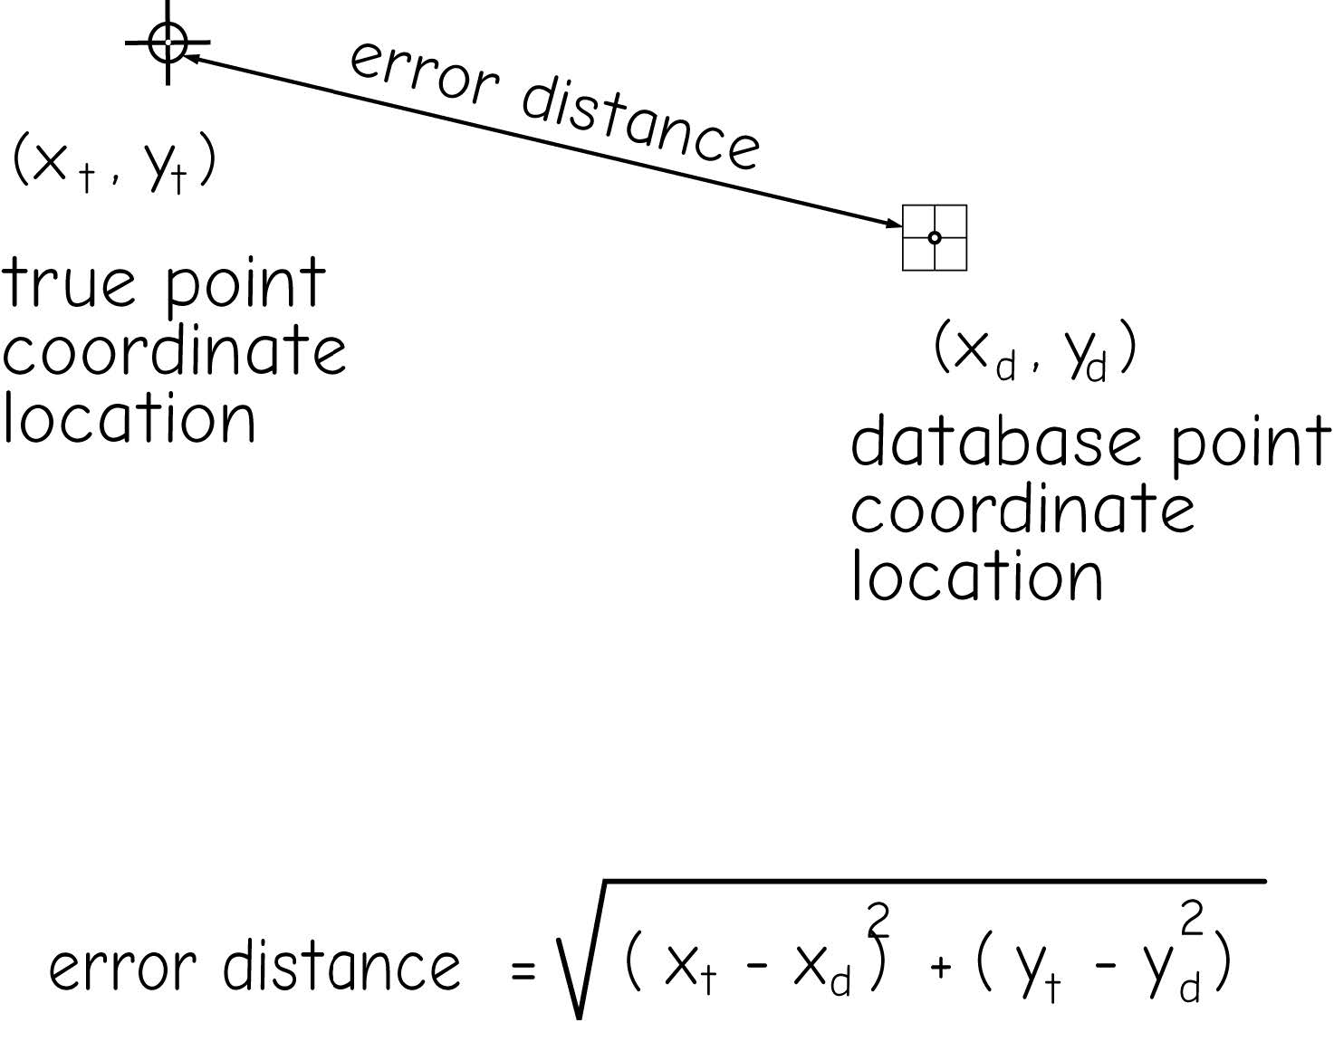
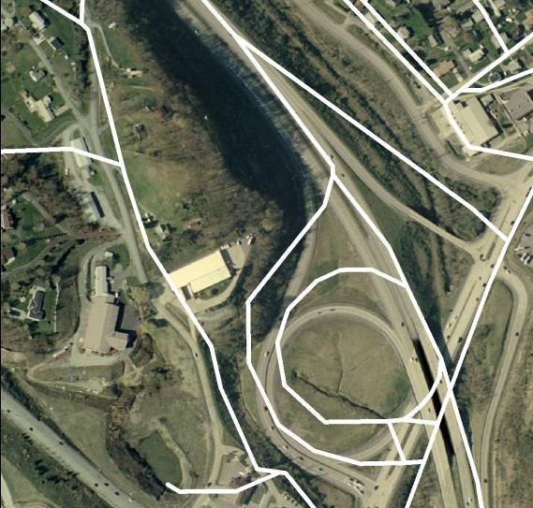
Accuracy measurement
Positional accuracy
Mean error: summing the errors and dividing the sum by the number of observations
Example from Jackie Strager
Notes:
Positional uncertainty relates to differences in the position of your data relative to the correct location.
You can consider uncertainty in 2D space as x and y coordinates in a geographic or projected space.
You can also consider the uncertainty of elevation measurements.
Combining these, you can consider uncertainty in 3D space.
As an example, the image shows some uncertainty in a vector line road dataset in comparison to the orthophotography.
Positional error is generally assessed using root mean square error or RMSE, similar to how georeferencing results are assessed.
All spatial data have some positional uncertainty; however, this is only a concern if there is too much uncertainty to support your analysis or mapping needs.

Slide 11
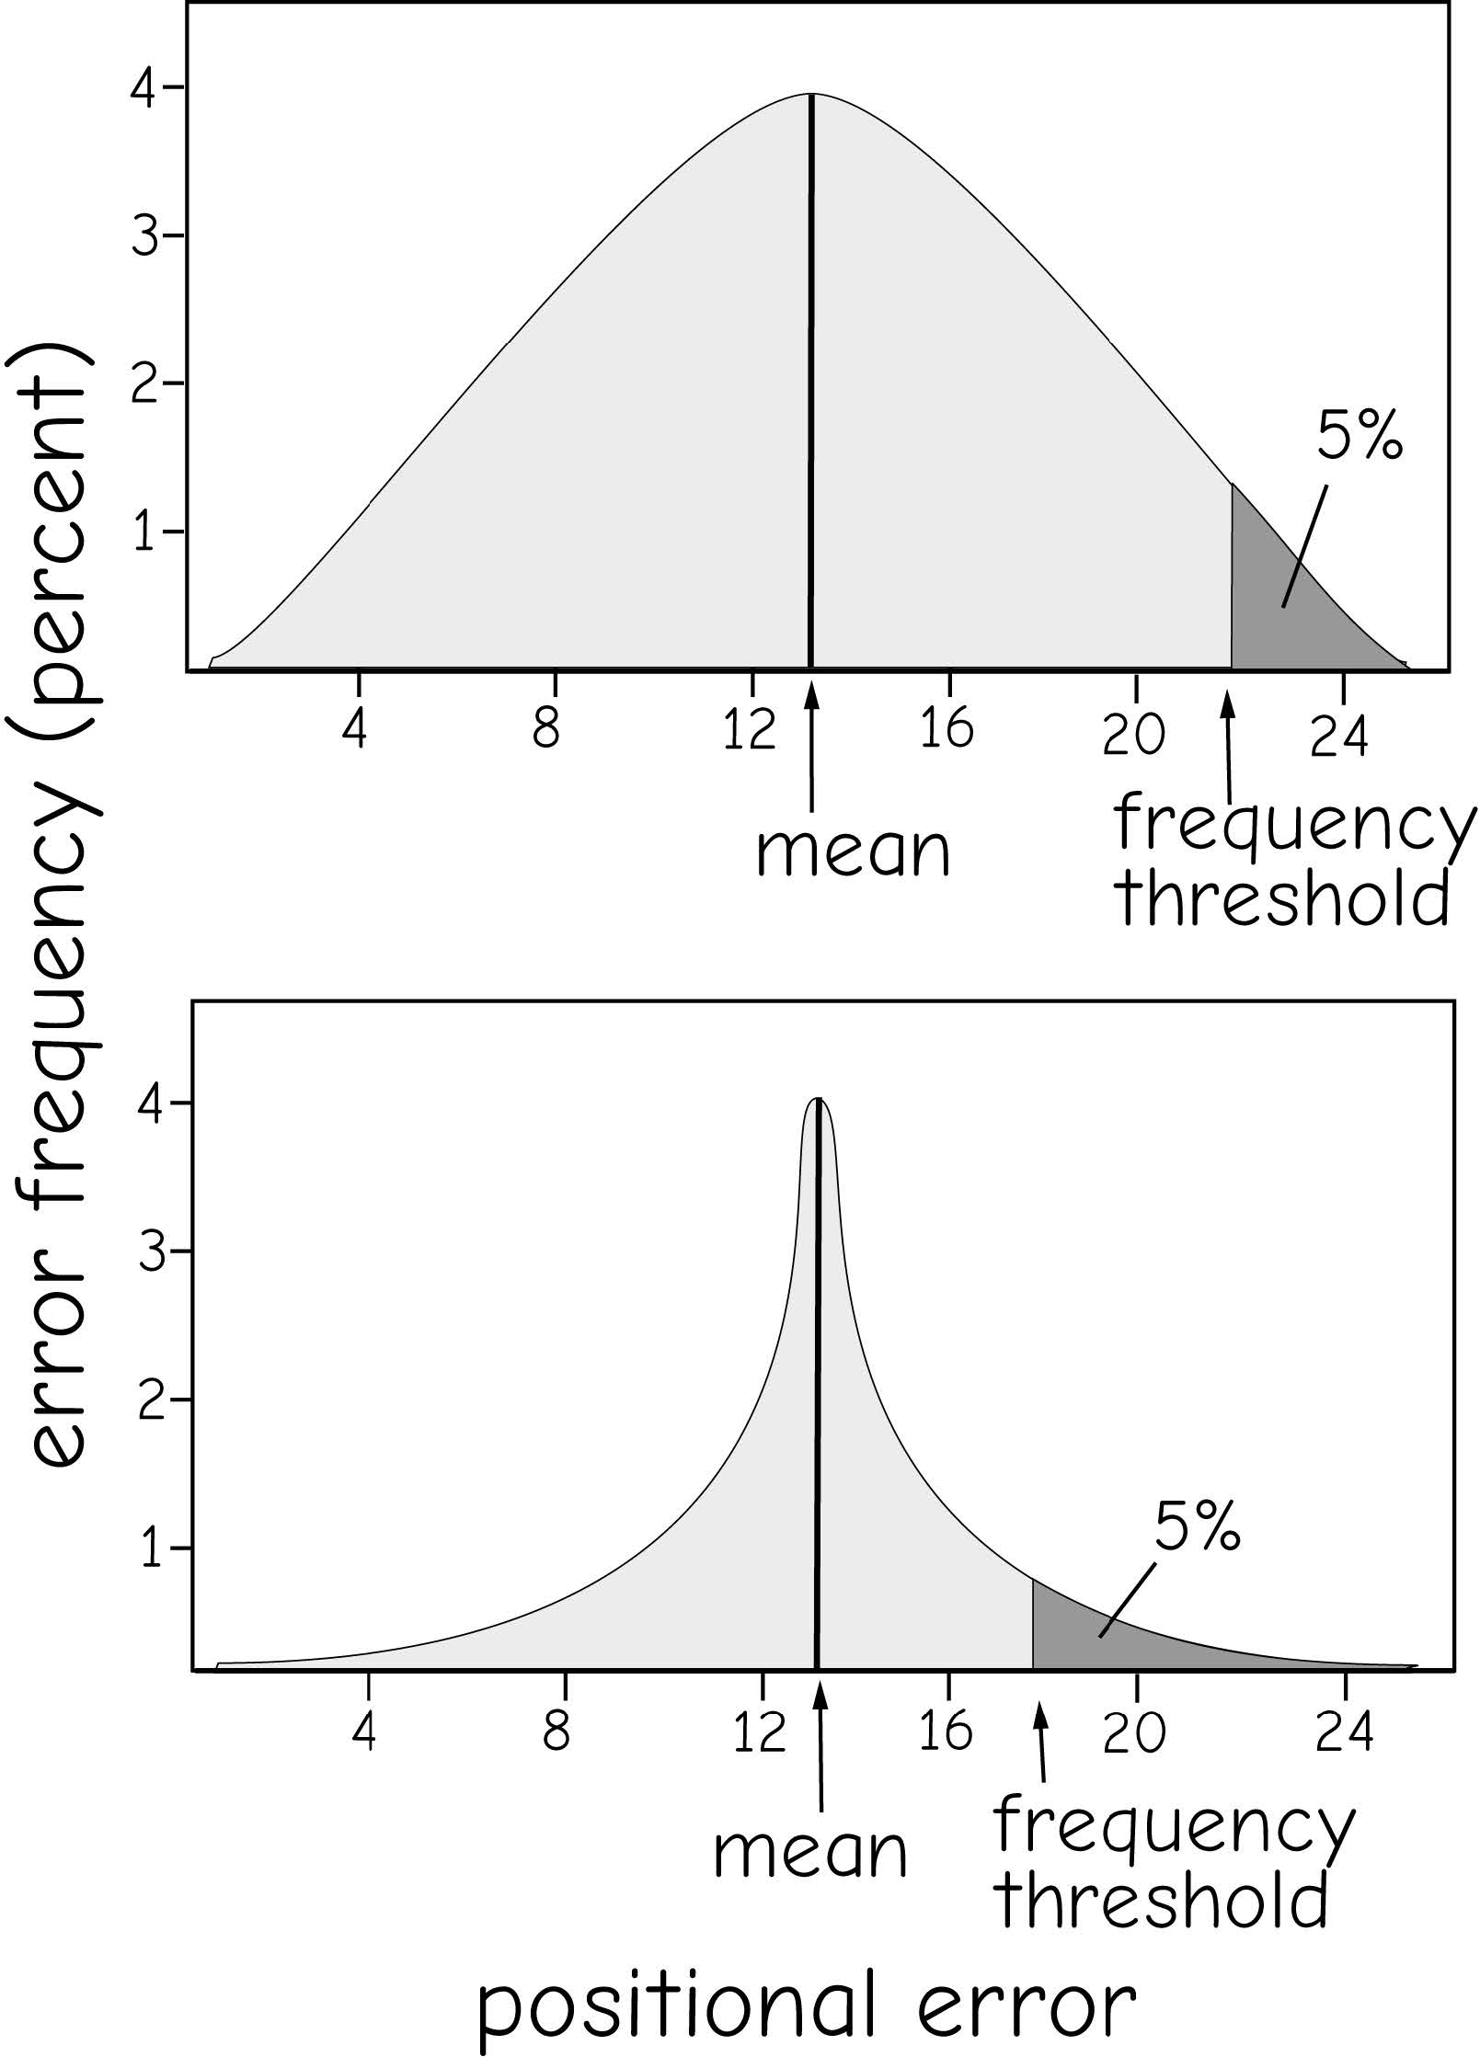
Accuracy measurement
Positional accuracy
Error frequency threshold: a value above or below which a proportion of the error observations occurs
The threshold usually placed such that 95% of the errors are smaller than the threshold.
Bolstad 2019
Notes:
Positional uncertainty relates to differences in the position of your data relative to the correct location.
Mean error, the bottom is better than the top, more close together

Slide 12
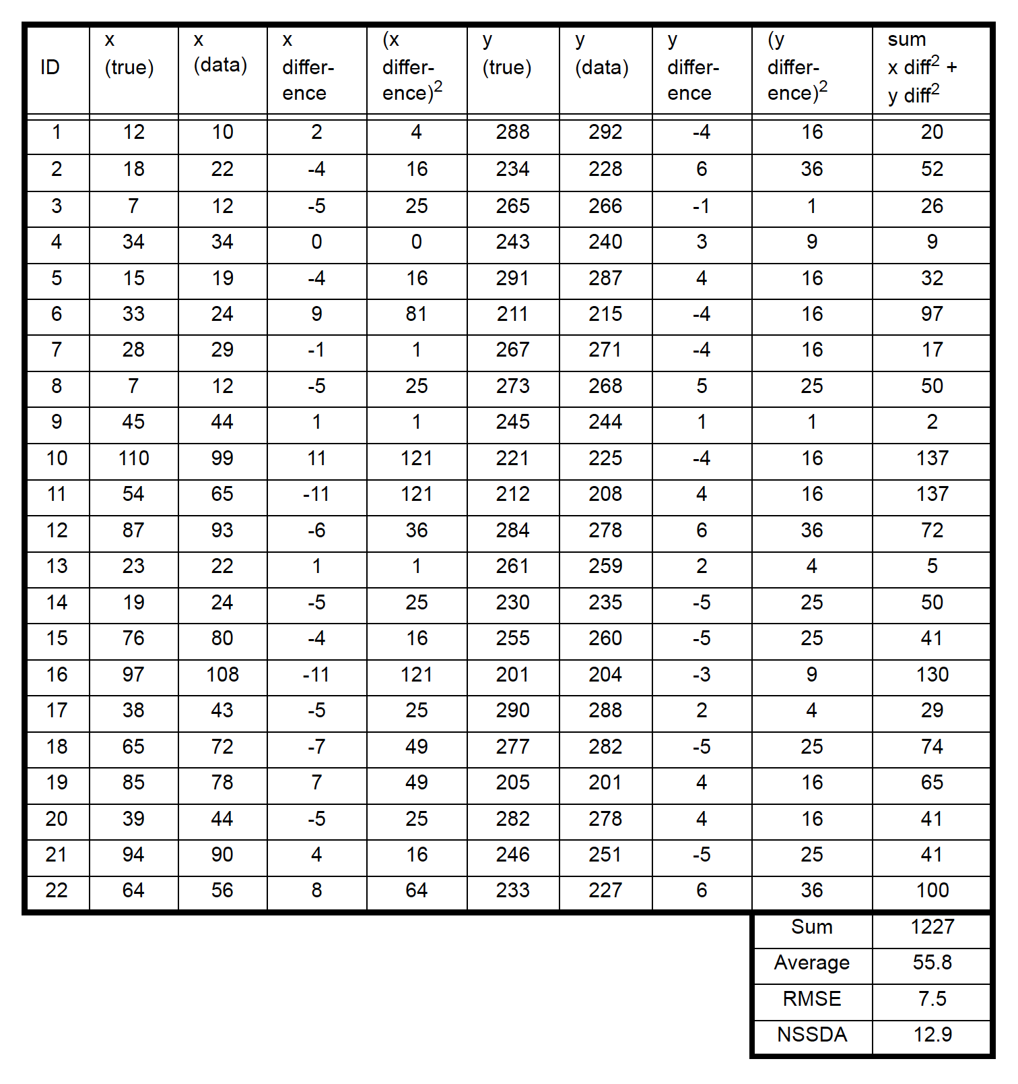
Accuracy measurement
Positional accuracy
Root mean square error (RMSE)
Horizontal (X, Y)
Vertical (Z)
RMSE_{x} = √ Σ(x_{predicted} – x_{actual})²/n
RMSE_{y} = √ Σ(y_{predicted} – y_{actual})²/n
RMSE = √ (RMSE_{x}² + RMSE_{y}²)
Bolstad 2019
Notes:
Positional uncertainty relates to differences in the position of your data relative to the correct location.
You can consider uncertainty in 2D space as x and y coordinates in a geographic or projected space.
You can also consider the uncertainty of elevation measurements.
Combining these, you can consider uncertainty in 3D space.
As an example, the image shows some uncertainty in a vector line road dataset in comparison to the orthophotography.
Positional error is generally assessed using root mean square error or RMSE, similar to how georeferencing results are assessed.
All spatial data have some positional uncertainty; however, this is only a concern if there is too much uncertainty to support your analysis or mapping needs.

Slide 13
Accuracy measurement
Attribute accuracy
Error matrix
Overall accuracy
User’s accuracy
Number of correctly assigned features divided by the row total
Producer’s accuracy
Number of correctly assigned features divided by the column
Bolstad 2019
Notes:
User’s

Slide 14
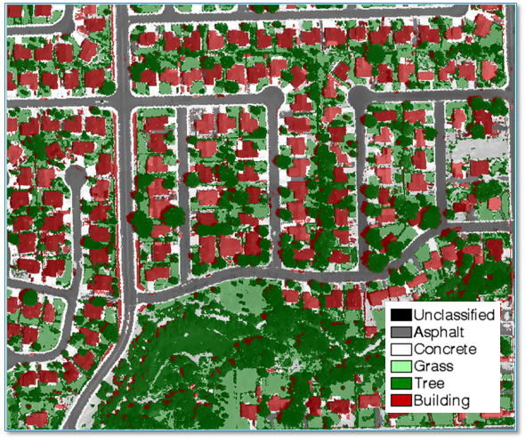
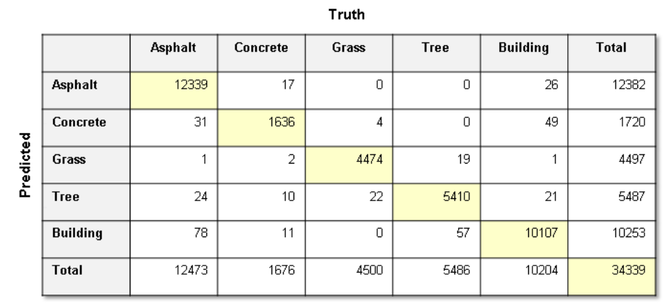
Accuracy measurement

Slide 15
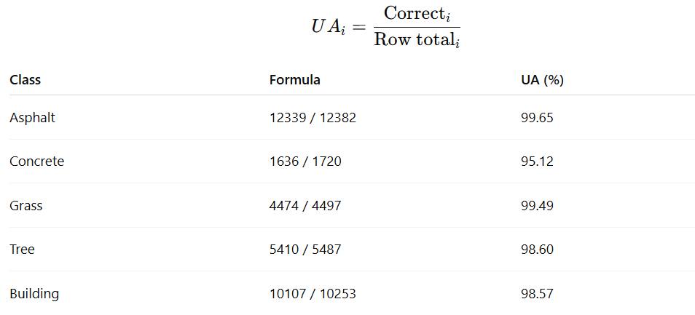
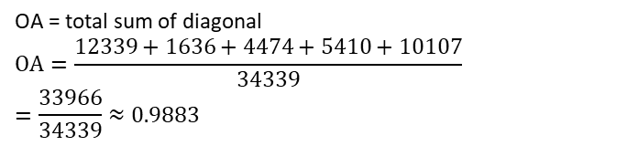
Accuracy measurement
OA = total sum of diagonal​
$$OA=\frac{12339+1636+4474+5410+10107}{34339}$$
$$=\frac{33966}{34339}≈0.9883$$

Slide 16
Uncertainty
The difference between the real world and its representation on a map
Many types of uncertainty: positional, errors, scale and generalization, fuzziness and definitions, sampling of data, timeliness
Notes:
Uncertainty is the difference between the real world and its representation on a map or within your datasets.
We will now investigate some types or causes of uncertainty in our maps and spatial data.

Slide 17
Errors
Inherent: present in source dataset
Operational: results from data operations and manipulations. Incorrect analyses, misinterpretations of features when digitizing, misclassifying map objects
Notes:
Errors include typos, simple mistakes, human bias, misinterpretation, and misclassification.
Specifically, inherent errors are present in the source data and are subsequently incorporated into your data product. For example, if you are copying data from a table into your database, errors in the table will be incorporated into your new data.
Operational errors result from data operations and manipulations. This could result from incorrect analyses, misinterpretations of features when digitizing, or misclassifying map objects.
Some errors exist in all datasets. Again, this is really only a concern when the errors could impact your map or analysis.

Slide 18
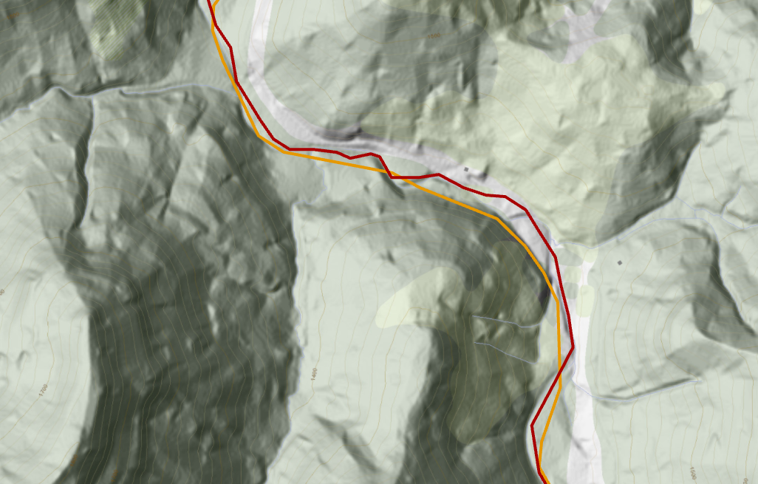
Scale and generalization
All maps are generalizations
Detail and presentation change with scale
1
2
1
= 1:24,000 scale county boundary
= 1:100,000 scale county boundary
2
Notes:
All maps and spatial data layers are generalizations of reality. We can’t map every blade of grass, atom, or quark.
The act of generalization produces uncertainty since generalizations produce differences between the real world object and its representation on the map.
As an example, the red line represents a county boundary digitized at 1:24,000 scale while the orange line represents the same boundary but at 1:100,000 scale. Uncertainty exists in both datasets and each boundary is not perfect.
Your concern should be whether the level of generalization is an issue for your specific analysis or mapping tasks.
You may also prefer to generalize the data further. For example, when designing a map you may find that you would like to provide a more generalized representation of the landscape that is more cartographically pleasing.

Slide 19
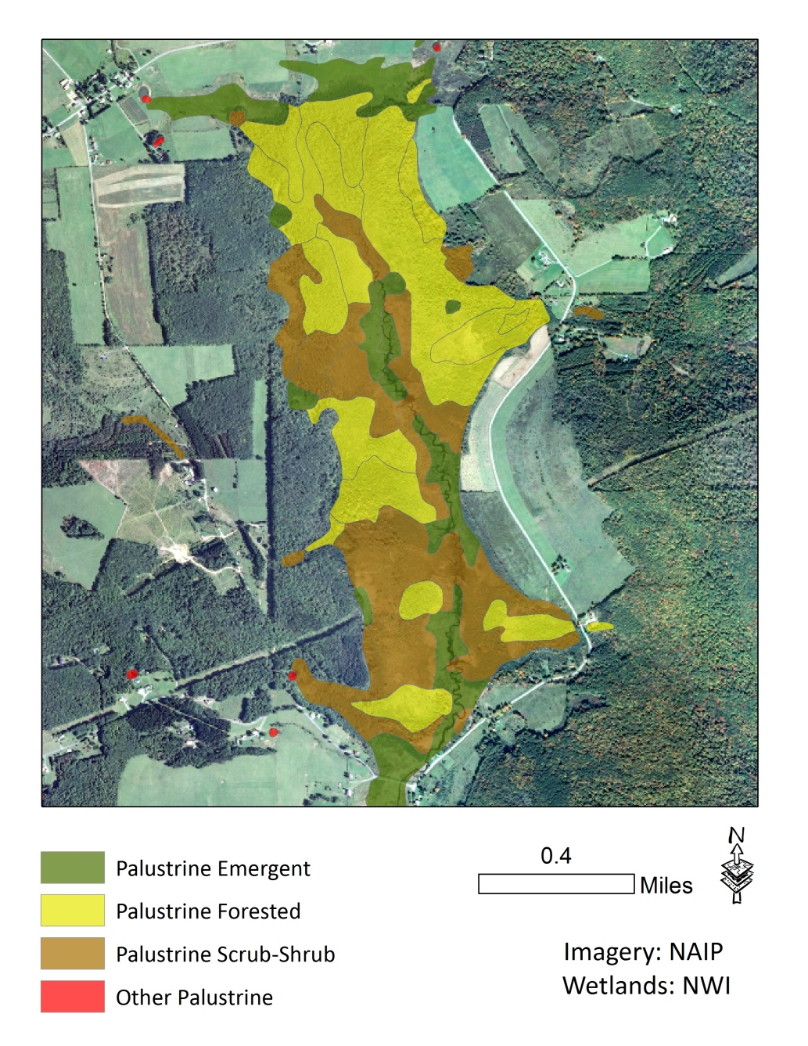
Fuzziness
Not all features have distinct boundaries
Wetland, upland, soil type
Not all categories have clear definitions
Urban, suburban
Notes:
Fuzziness arises from ambiguity in boundaries or definitions.
Some features have definitive boundaries and definitions. For example, roads and sidewalks generally are fairly discrete features with well defined definitions.
In contrast, the boundaries between wetlands and uplands or between soil types or groups are often gradational. So, if you draw a feature to represent a wetland it will automatically have some inherent uncertainty since you are representing a gradational or “gray” boundary as a hard line.
In regards to definitions, not all map features can be clearly defined. For example, the difference between urban areas and suburban areas may be difficult to clearly define. It may also be difficult to fully define a certain type of soil or forest.
Fuzziness arises from the complexity of the real world. The best we can do is create maps and features that describe the landscape that best that we can given this complexity and inherent limitations in how we map and model the landscape.

Slide 20
Temporal uncertainty
Things change
How important is timeliness?
How often should layers be updates?
City of Bellevue, Washington in 1936 and 1997
Bolstad 2019
Notes:
Temporal uncertainty arises form data being outdated.
For example, in the provided example the stream network has changed between 1996 and 2007 as a result of surface mining.
For certain tasks, having access to updated data may not be important. However, timeliness may be necessary for certain tasks.
Further, some features may change fairly regularly, such as development or demographics, whereas other features may change slowly, such as bedrock geology.

Slide 21
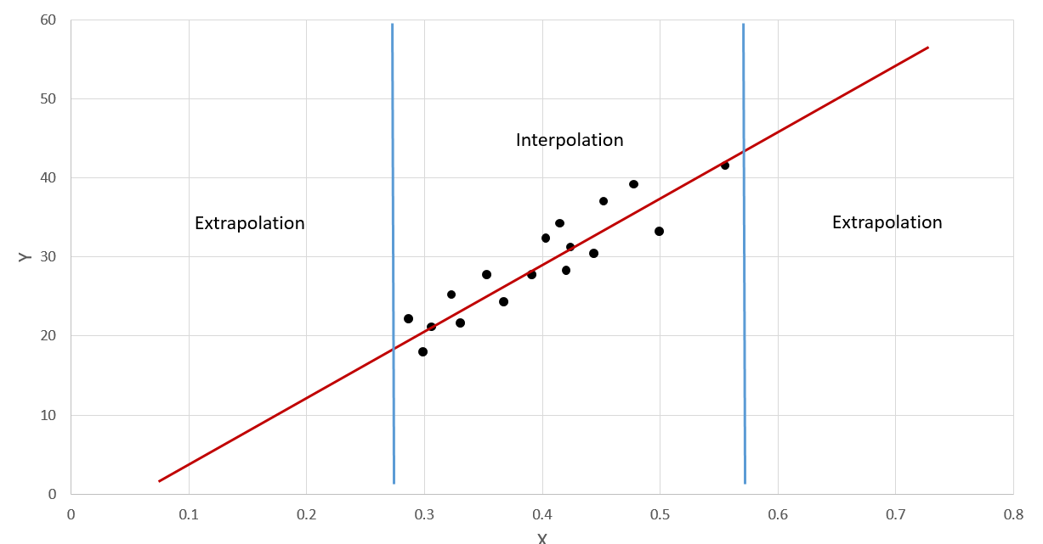
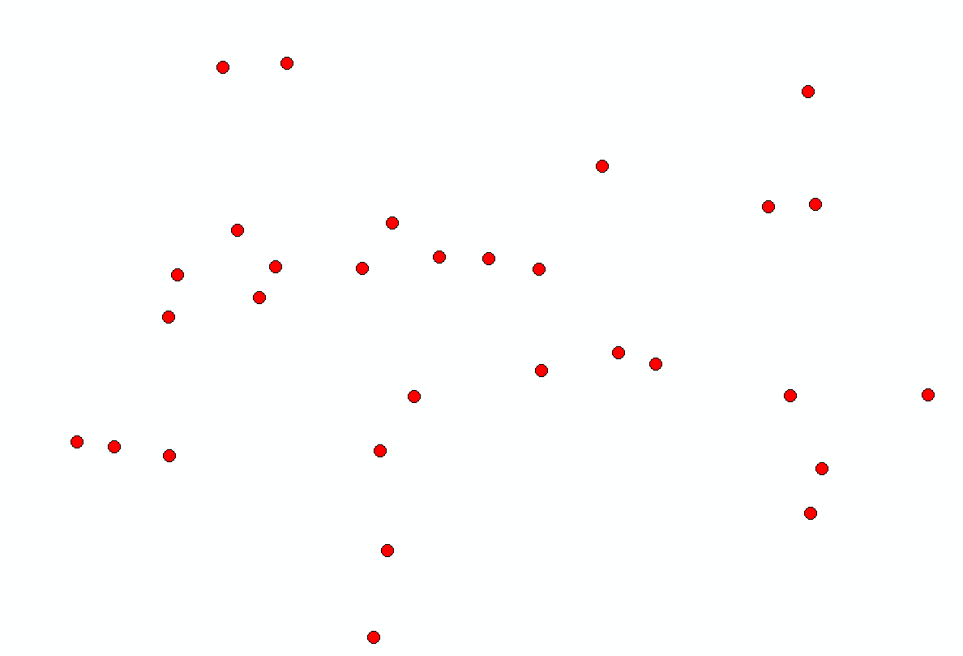
Sampling uncertainty
We can’t measure everything everywhere
However, sometime we need data at all locations
This requires interpolation, estimation, or guessing
Extrapolation VS interpolation
Notes:
We can’t measure everything everywhere.
For example, it is common to collect measurements at point locations, such as collecting climate or weather data at weather stations.
If you would like to estimate values at locations that were not sampled, you will need to apply interpolation or extrapolation as a means to obtain a continuous surface from your discrete measurements.
Since these locations were not actually measured but estimated from nearby sample locations, there will be some error or uncertainty in the product.
Extrapolation is generally considered to be more uncertain than interpolation.
As an example, if you are trying to predict a variable y using a variable x with a line or linear relationship, estimates within the bounds of your sample data will likely be less uncertain in comparison to estimates outside of the bounds of your data. Maybe outside of the bounds the relationship is no longer linear, begins to increase exponentially, or levels off. Without data points or samples, this would be hard to determine.
In a spatial context, extrapolation would be making an estimate outside of the geographic extent of your data, as represented by the yellow star. In contrast, interpolation would be making an estimate within the geographic bounds of your data, as represented by the orange star.

Slide 22
Minimizing uncertainty
Implement quality control
Use standardize procedures
Define scale
Define minimum mapping unit (MMU)
Double-check data
Create metadata
Document methods
Clearly define definitions
Measure uncertainty
Notes:
As GIS professionals and analysts, there are many methods available to minimize the uncertainty in our maps and data.
First, we can use quality control procedures, such as spot checking the results or having the results reviewed by multiple analysts.
If standard procedures or protocols are well defined for a specific task, we should follow these protocols. For example, standard protocols could be followed to georeference an image.
We should clearly define the scale or scale range at which the data were created and the scale or scale range at which they should be used. Data collected at 1:250,000 scale will often look fairly inaccurate when viewed at 1:10,000 scale. Or, these data may not be appropriate for an analysis being performed at 1:10,000 scale. Relating to this, it is important to define a minimal mapping unit, or MMU, for an analysis. This can help inform the appropriate use and scale of analysis to which the data can be applied.
You should double-check results and products. It is a good idea to have others review our work.
Metadata and method documentation should be provided that clearly define the data and how it was produced. Remember to create README files.
Definitions should be clearly defined when possible.
If appropriate and feasible, we should attempt to evaluate and measure the uncertainty or accuracy of our data.

Slide 23
Documenting your data: Metadata
Data about your data
A description of the basic characteristics of a data resource
Describes content, source, lineage, methods, developer, coordinate system, extent, structure, spatial accuracy, attributes, and responsible organization
Is data suitable for an intended use?
Accurate enough?
Cover area of interest?
Provide necessary information?
.xml = metadata
Notes:
Metadata are data about your data.
They commonly include a description of the basic characteristics of the data, content, source, lineage, methods, developer, coordinate system, extent, structure, spatial accuracy, attributes, and responsible organization.
Metadata can help the end user determine if the data are suitable for and accurate enough for an intended use or task and whether or not they cover the area of interest and provide the desired information.
It is generally considered good practice to create metadata.
Some projects may require the creation of metadata, such as those funded by the federal government.

Slide 24
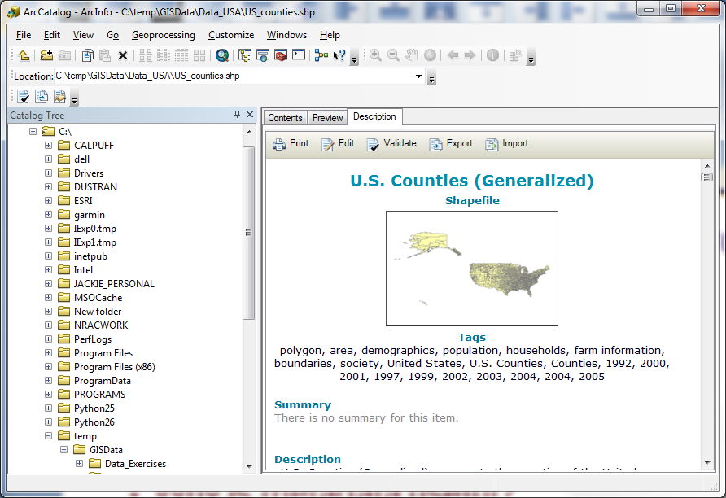
Why is metadata important
Makes your data more interpretable
Find out more about a dataset
Minimize assumptions and guesses
Contact dataset originator for more information
Ensures long-term viability of your data
Notes:
Metadata are important because they make your data more interpretable by the user.
They allow users to find out more about the data and minimize assumptions and guesses about the data characteristics and quality.
Most importantly, in my opinion, is that they ensure the long-term viability of your data. Someone in the distant future may want to use your data as part of the historic record. Without metadata, the data may not be useable or interpretable.

Slide 25
US: Federal Geographic Data Committee (FGDC) Content Standard for Digital Geospatial Metadata (CSDGM)
Identification, describing the dataset
Data quality
Spatial data organization
Spatial reference coordinate system
Entity and attribute
Distribution and options for obtaining the data set
Currency of metadata and responsible party
Citation
Time period information, used with other sections to provide temporal information
Contact organization or person
Notes:
The Federal Geographic Data Committee of the US federal government has established standards for geospatial metadata as the Content Standard for Digital Geospatial Metadata.
This slide provides a list of the attributes that are required or commonly included.

Slide 26
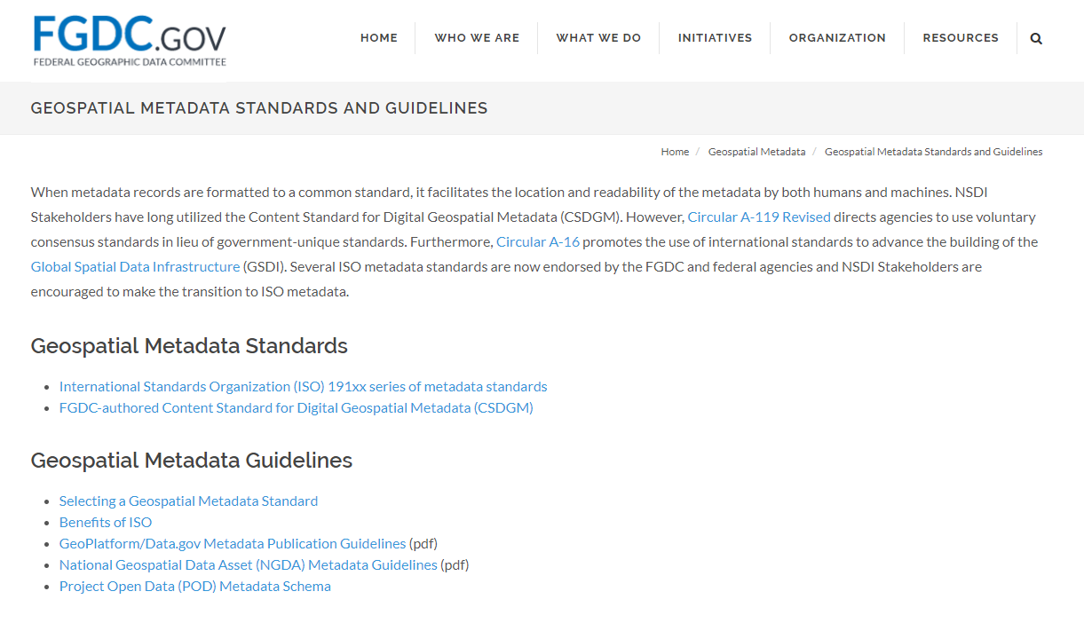
US: Federal Geographic Data Committee (FGDC) Content Standard for Digital Geospatial Metadata (CSDGM)
https://www.fgdc.gov/metadata/geospatial-metadata-standards
Notes:
Here is a link to the FGDC website.
As standards may change, this is a good site to reference.

Slide 27
International: ISO 19115 International Standards for Metadata
Two elements: mandatory and conditional
Mandatory: data title, dataset reference date, dataset language, dataset topic category, abstract, metadata point of contact, etc.
Conditional: dataset responsible party, geographic location by coordinates, dataset character set, spatial resolution, distribution format, spatial representation type, reference system, lineage statement, online resource, metadata file identifier, metadata standard name, metadata standard version, metadata language, and metadata character list
Notes:
International geospatial data standards have been established by the ISO 19115 International Standards for Metadata.
This standard defines some mandatory and conditional elements as highlighted here.

Slide 28
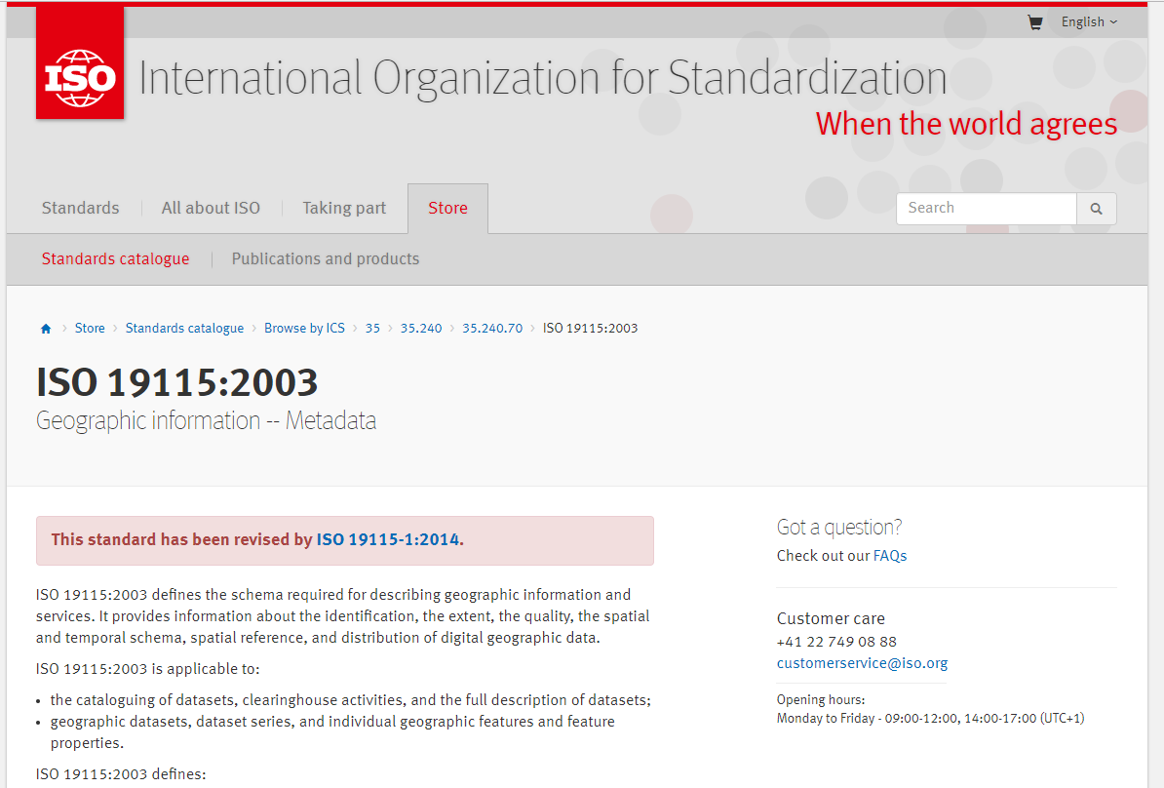
International: ISO 19115 International Standards for Metadata
https://www.iso.org/standard/26020.html
Notes:
Here is a link to the ISO 9115 standards.
As standards may change, this is a good site to reference.

Slide 29
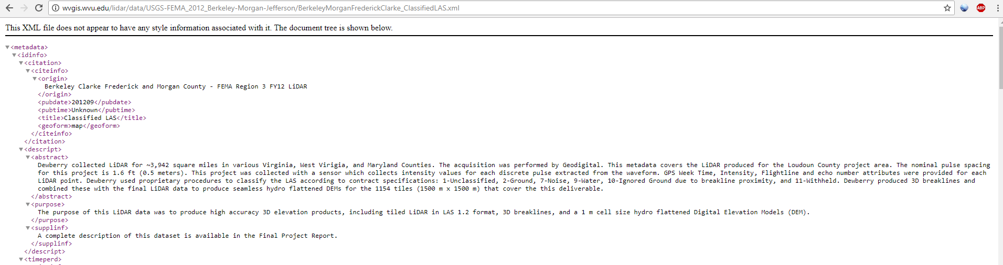
XML: eXtensible Markup Language
Metadata can be written using XML
A markup language like HTML
Information wrapped in tags
Can view in a web browser
Notes:
Different data formats can be used to store metadata.
One option is eXtensible Markup Language or XML.
This format is similar to HTML as it is a tagged text format.
XML files can be opened in any web browser.

Slide 30
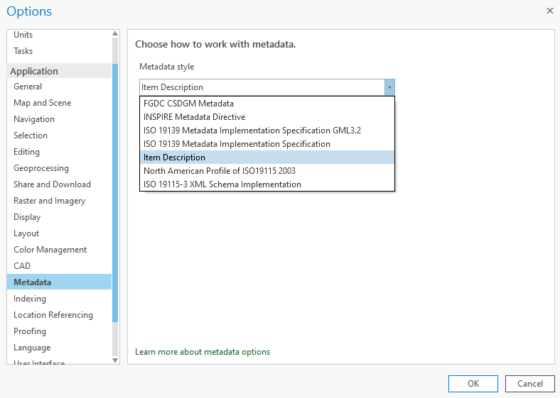
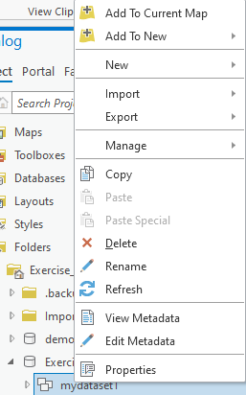
Creating metadata
Metadata can be created in ArcCatalog using a variety of standards
Notes:
Using ESRI software, metadata are commonly created in ArcCatalog or directly in ArcGIS Pro.
You can define what standard you are using and the software will guide you through entering required and optional elements.

Slide 31
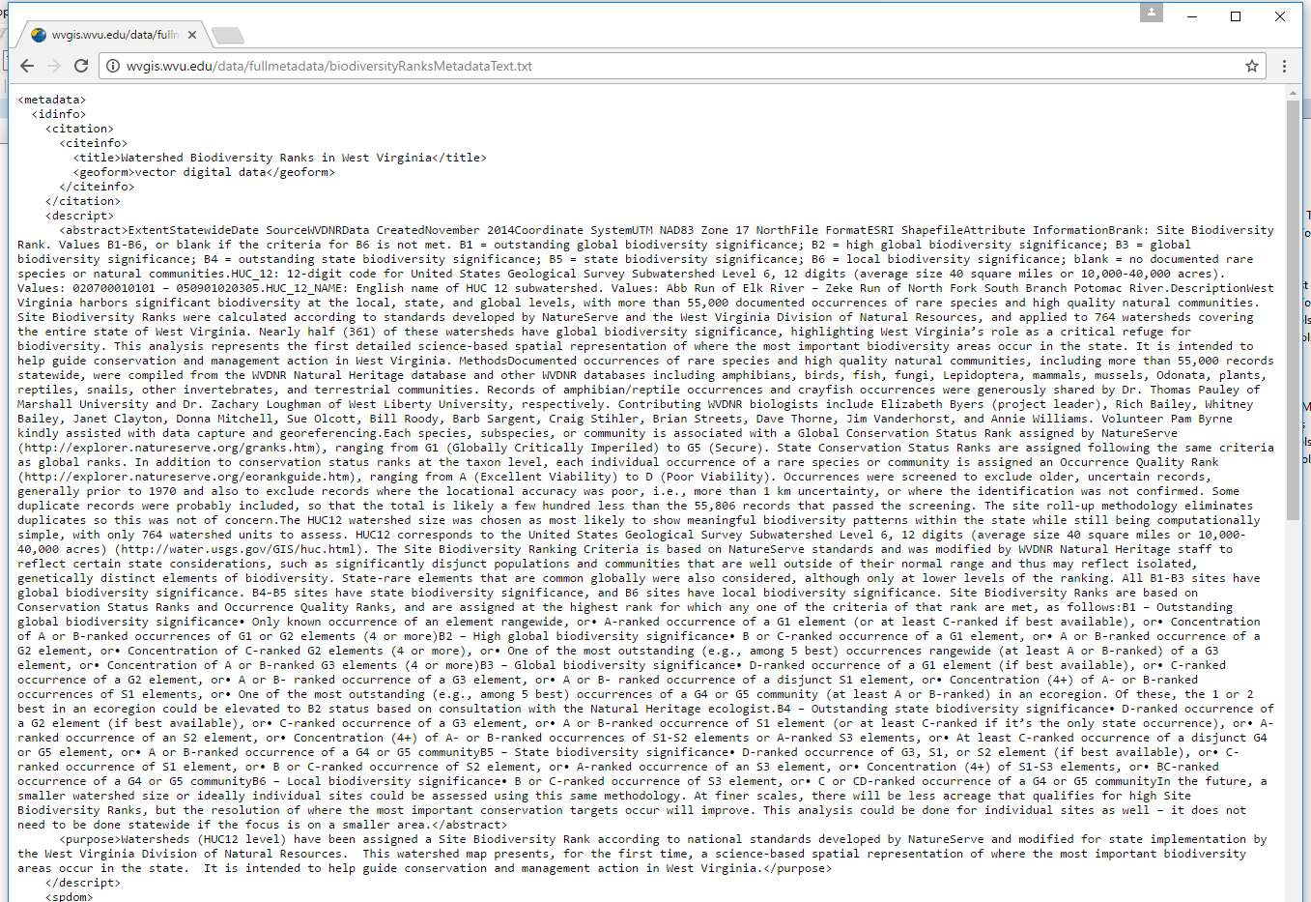
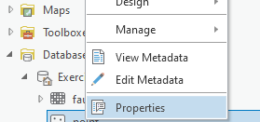
Viewing metadata
Metadata can be viewed in ArcCatalog, in ArcMap, in ArcGIS Pro, or online
Notes:
Metadata can generally be viewed in ArcCatalog, ArcMap, ArcGIS Pro, or using a web browser.

Slide 32

Thank you!

