Slide 1

Lecture 12 geocoding lecture
Instructor: Yanan Wu
fALL 2025

Slide 2
12.1 geocoding

Slide 3
Overview
What is geocoding?
Why geocoding?
Geocoding requirement
Geocoding process
Geocoding errors and solutions
Other geocoding layers

Slide 4
What is geocoding?
Geocoding is the process of converting location descriptions, such as addresses, into geographic coordinates that can be displayed on a map.
Address Matching assigns spatial coordinates (explicit location) to the Addresses (implicit location).

Slide 5
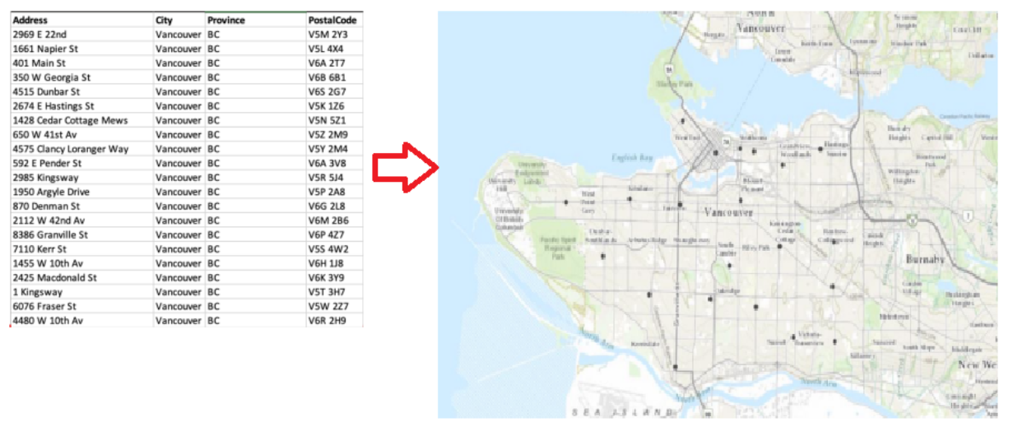
What is geocoding?
Displays tabular data containing addresses as points on a map.
https://guides.library.illinois.edu/Geocoding

Slide 6
Geocoding requirement
Geocoding requires two sets of data
A tabular address: individual street address is in a table.
A reference database: consists of a street map and attributes for each street segment such as the street name, address ranges, and ZIP codes.

Slide 7
Geocoding requirement
Geocoding requires two sets of data
A tabular address: source data
Formatted
Abbreviations should be standardized and grammatical errors corrected
When geocoding street addresses, data must include an address field with street number and name, and can include one or more of the following:
Street prefix direction (W. Redlands Blvd.)
prefix type (Avenue B)
street type (W. Redlands Blvd.)
suffix direction (Park Ave. West.)

Slide 8
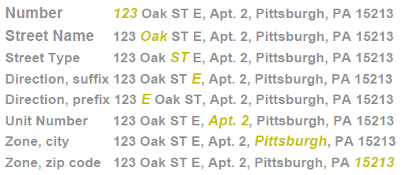
Geocoding requirement
Geocoding requires two sets of data
A tabular address: source data
Street intersections may also be included in the address field. (Main St. & Ave A)

Slide 9
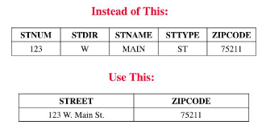
Geocoding requirement
Geocoding requires two sets of data
A tabular address: source data
ArcGIS require your address information to be contained in a single field
https://www.slideserve.com/nysa/geocoding-1313468-powerpoint-ppt-presentation

Slide 10
Geocoding requirement
Geocoding requires two sets of data
A reference database: destination data
In most cases, the reference database in the U.S. is some variant of the Topologically Integrated Geographic Encoding and Referencing (TIGER) files produced by the U.S. Census Bureau.
TIGER/Line files provide information on streets, rivers, railroads, and other line features, where they intersect, and the areas they enclose, in a form that can be processed by a computer.

Slide 11
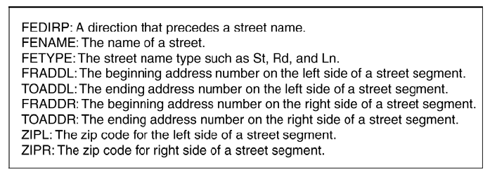
Geocoding requirement
Geocoding requires two sets of data
A reference database
TIGER/Line files to maintain the Topology
Notes:
lane

Slide 12
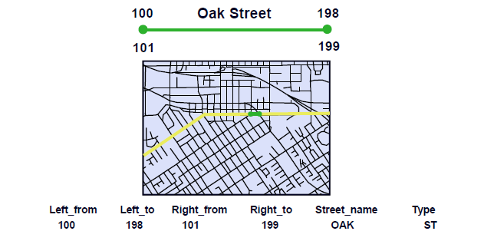
Geocoding requirement
Geocoding requires two sets of data
A reference database
TIGER/Line files

Slide 13
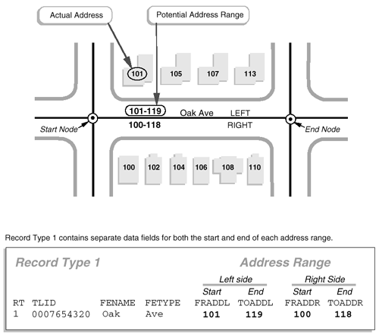
Geocoding requirement
Geocoding requires two sets of data
A reference database
TIGER/Line files
https://www.e-education.psu.edu/natureofgeoinfo/book/export/html/1730

Slide 14
Geocoding process
Address matching process consists of three phases: preprocessing, matching, and plotting.
The preprocessing phase involves parsing and addressing standardization
In the matching phase, the geocoding engine matches the address against a reference database
If an address is judged to be matched, it is plotted as a point feature by interpolating where the address falls within the address range

Slide 15
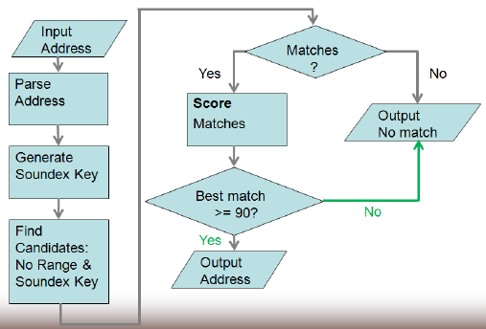
Geocoding process

Slide 16
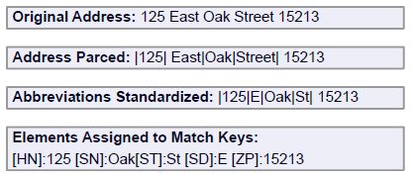
Geocoding process

Slide 17
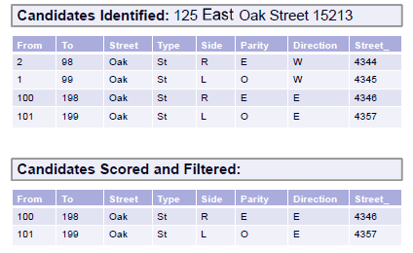
Geocoding process
A geocoding engine has provisions for relaxing the matching conditions but uses a scoring system to quantify the matches at the same time.
Because of the various matching options, we can expect to run the geocoding process more than once.

Slide 18
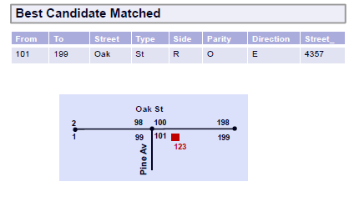
Geocoding process
(125-101)/(199-101) = 0.24
So, it is placed 24% along the given length for the segment
125

Slide 19
Individual activity 12-1
If the HN is 160, where it should be placed?

Slide 20
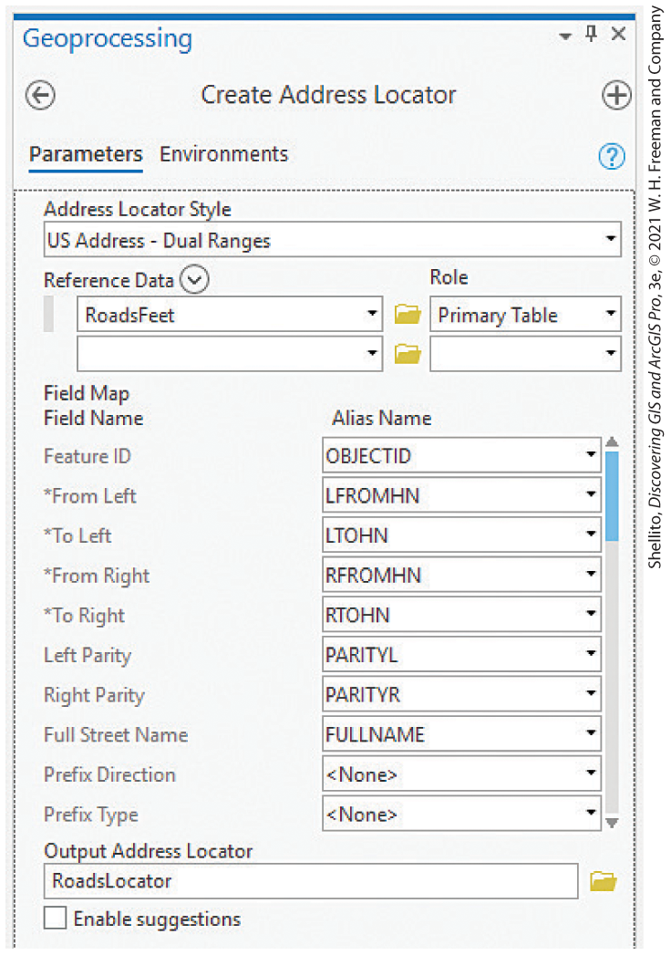
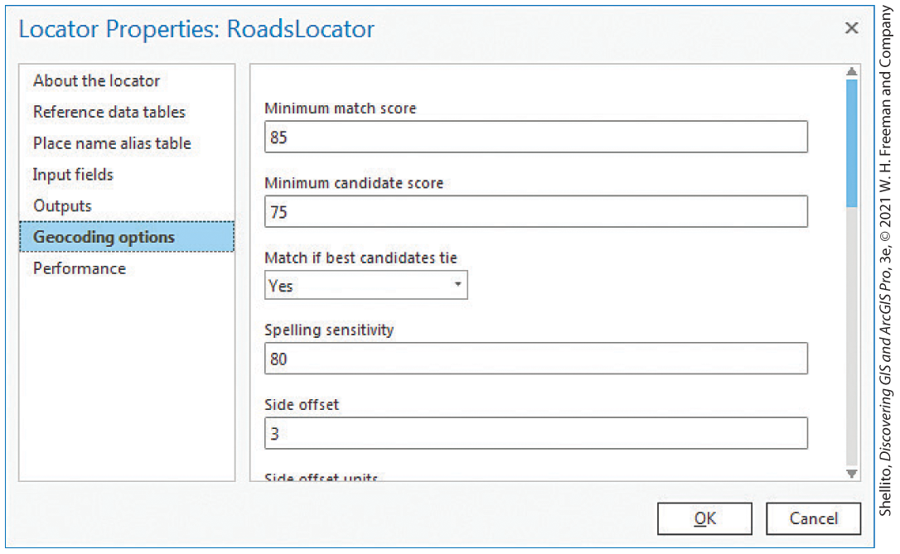
Geocoding process
Address matching requires an Address Locator which establishes explicit methods for matching (geocoding) address data to a specified reference database.
The result of geocoding is expressed as the percentage of addresses matched
For crime mapping and analysis, 85% matching score is required.

Slide 21
Geocoding errors and solutions
Data Entry Errors
Fidth Avenue
Sawmill Run
Place Names
White House, Heinz Field, Empire State Building
Intersections
5th AV and Craig ST
Post Office Boxes
P.X.Box 125

Slide 22
Geocoding errors and solutions
Use postal address standards
Publication 28 of the U.S. Post office provides standard street address formats
Use standard intersection connectors
& | @
Put street intersections in the address field
Forbes AV & Craig ST
Grant ST & 5th AV
E North Star RD & Duncan AV
Connectors
Any unusual character (e.g., &, @, |) be consistent

Slide 23
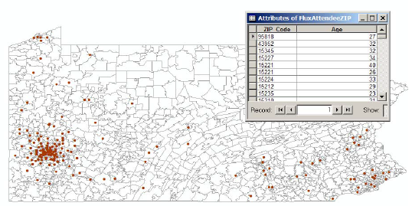
Polygon Geocoding
Points created at zip code centroids

Slide 24

Geocoding errors and solutions
Use Alias Table

Slide 25
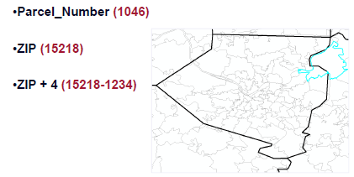
Polygon Geocoding
Polygon features can be identified by their parcel numbers, postal zip, or zip +4 codes

Slide 26
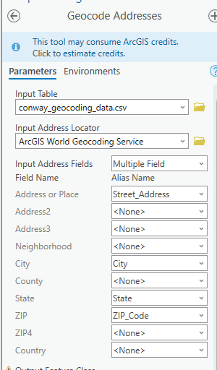
In-class activity
Geocode Address

Slide 27
12.2 Lab session

Slide 28
Lab 08: Vector Analysis
Due by Midnight (11:59 pm) on Monday, Nov 10, 2025
Submit a word document only include question and answer

