Slide 1

Lecture 13 raster Analysis lecture
Instructor: Yanan Wu
fALL 2025

Slide 2
13.1 raster analysis

Slide 3
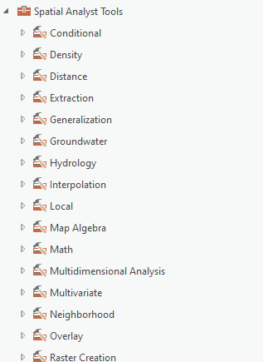
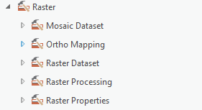
Overview
Raster Analysis
Raster math
Reclassification
Extraction
Neighborhood-based analysis
Distance
Raster generalization
Raster summarization
Estimating density
Mosaic
Spatial analysis tool

Slide 4
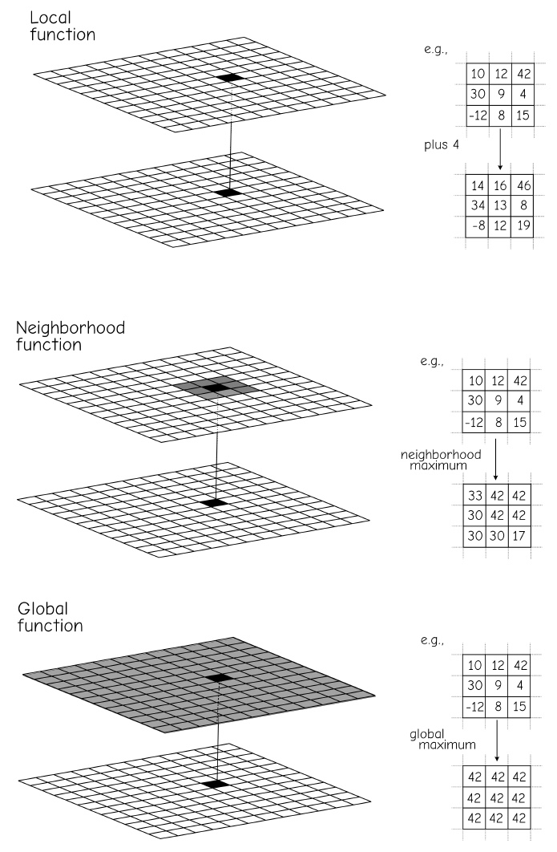
Raster Operation
Bolstad, 2019

Slide 5
Local function Raster Math

Slide 6
Operations Involving Multiple Raster
1 | 0 | 1
0 | 0 | 1
NoData | 1 | 1
1 | NoData | 1
0 | 1 | 0
NoData | 1 | NoData
1 | NoData | 1
0 | 0 | 0
NoData | 1 | NoData
x
=
1 | 0 | 1
0 | 0 | 1
NoData | 1 | 1
1 | NoData | 1
0 | 1 | 0
NoData | 1 | NoData
2 | NoData | 2
0 | 1 | 1
NoData | 2 | NoData
+
=
Notes:
It is also possible to perform calculations using multiple raster grids.
When multiple raster grids are used, cells that overlap will be involved in calculations.
In the example above, cells are being multiplied and added together.
Note that a NoData result will be returned any time at least on of the grids holds a NoData value at that location.
Calculations can only be performed when values are available for all grids at that location.
When cells do not align properly, how the grids overlay to perform these calculations can be ambiguous. This is one reason to use a snap raster.

Slide 7
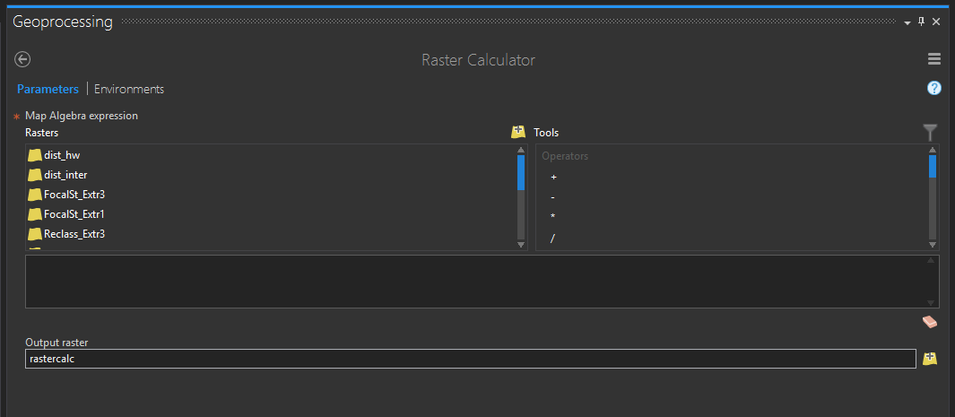
Raster Calculator
Perform mathematical calculations on a cell-by-cell basis
Notes:
The Raster Calculator Tool allows you to perform mathematical calculations on a cell-by-cell basis.
This tool is very flexible and can be used to perform a wide variety of raster-based calculations.
Examples will be provided in the following slides.

Slide 8
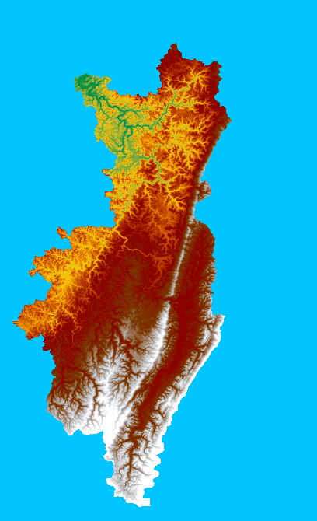
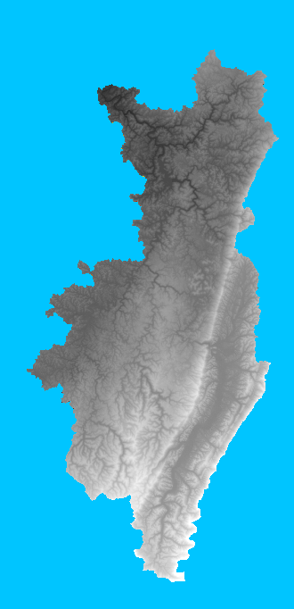
Operations Involving A single Raster
SquareRoot(“Elevation”)
29.2 | 26.5 | 28.6
24.5 | 28.6 | 30
NoData | 25.5 | 26.0
850 | 700 | 820
600 | 820 | 900
NoData | 650 | 675
Notes:
Operations can be performed that only require one raster input.
In the example above, the square root of the elevation value in the input raster will be returned to the output raster.
Other examples include converting grid cells from float to integer, taking the tangent of the cell values, and taking the natural log of the cell values.

Slide 9
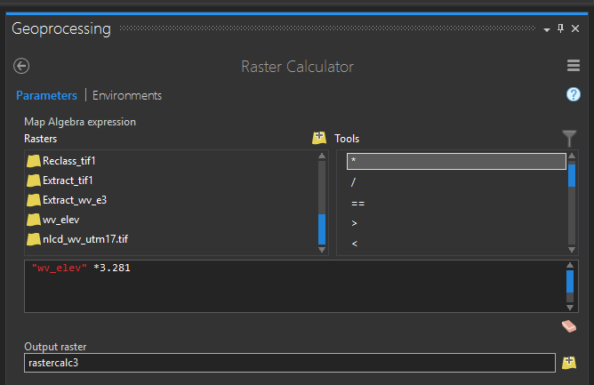
Operations Involving Constants
“Elevation” * 3.281 (meet to feet)
850 | 700 | 820
600 | 820 | 900
NoData | 650 | 675
2789 | 2297 | 2690
1969 | 2690 | 2953
NoData | 2133 | 2215
Notes:
Operations can also be performed that require raster grids and constants.
In the example, elevation values in meters are being multiplied by 3.281 to output elevation values in feet.
Unit conversion is a common use of such techniques.

Slide 10
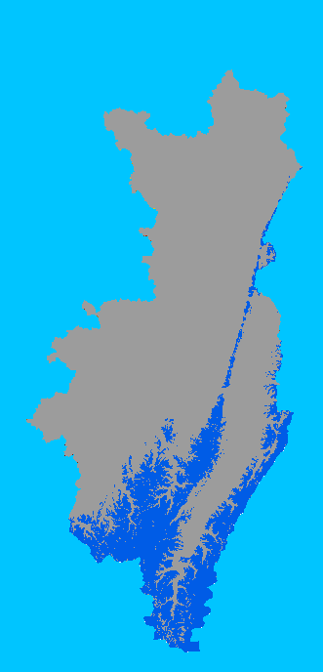
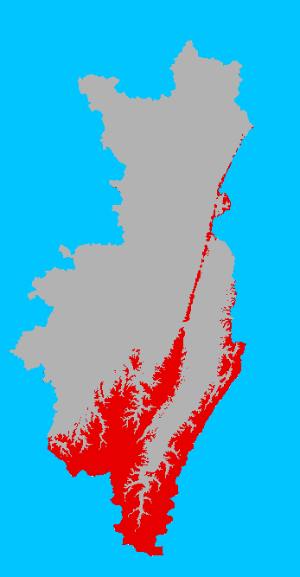
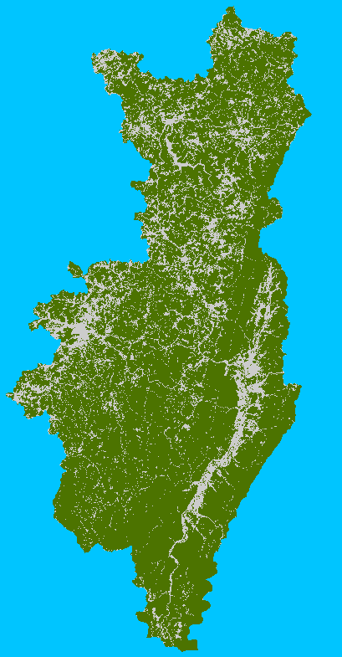
Operations Involving Multiple Raster
X
=
Forest
1: Forest
0: Non Forest
Elevation > 800 m
1: > 800 m
0: < 800 m
Forest at an elevation above 800 meters
Notes:
This is another example of raster math involving two grids. A binary surface separating forest and not forest is being multiplied by a binary grid representing locations with elevations above 800 meters. The result will return 1 only where the forest and elevation criteria are both true.
So, values of 1 in the output represent locations that are forest at an elevation above 800 meters.

Slide 11
Logical operations
“Elevation” > 800
1 = Yes = True
0 = No = False
850 | 700 | 820
600 | 820 | 900
NoData | 650 | 675
1 | 0 | 1
0 | 1 | 1
NoData | 0 | 0
Notes:
Raster Calculator can be used to produce binary, 0-1, or yes-no surfaces. In these outputs, cells that met the query criteria are coded as 1 and cells that do not meet the criteria are coded as zero.
1 always indicates true while 0 will indicates false.
In this example, I am querying the raster to find all cells in a digital elevation model that have an elevation greater than 800. Cells that hold an elevation value greater than 800 will be coded to 1 in the output. All other cells will be coded to 0.
The result is a binary output.

Slide 12
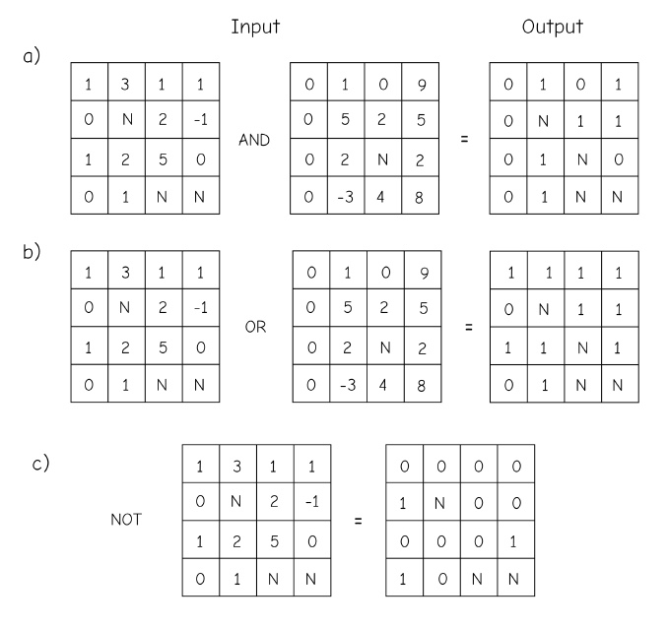
Logical operations
Bolstad, 2019

Slide 13
Some useful functions
+: Add
-: Subtract
*: Multiply
/: Divide
==: Equal to
!=: Not equal to
>: Greater than
>=: Greater than or equal to
<: Less than
<=: Less than or equal to
&: Boolean And
|: Boolean Or
^: Boolean XOr
~: Boolean Not
Notes:
Many functions are available for use within Raster Calculator. Take some time to review the available functions presented here. Note that these are not the only function available.
These are just examples.

Slide 14
Some useful functions
Abs: Absolute value
Exp: Base e exponential
Exp10: Base 10 exponential
Exp2: Base 2 exponential
Float: Convert from integer to float
Int: Convert from float to integer
Ln: Natural log
Log10: Base 10 log
Log: Bas 2 log
Square: Calculates square
SquareRoot: Calculates square root
IsNull: Identifies NoData cells
Notes:
Here are some additional functions available in Raster Calculator. Take some time to look over these functions.

Slide 15
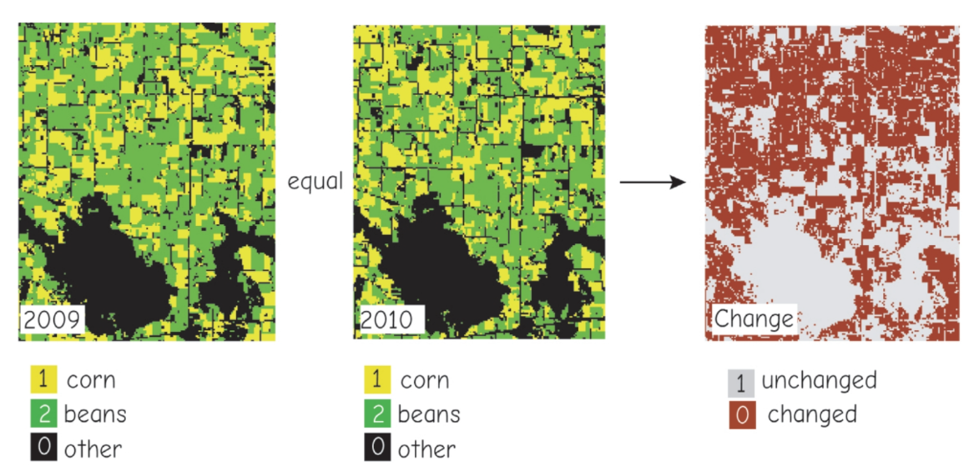
The logical equal comparison between two layers

Slide 16
Conditional statements
Con(set condition, what to return if true, what to return if false)
Example:
Con(“Land_Cover" = 41, 1, 0)
If the land cover raster grid is assigned a value of 41 (deciduous forest), return 1. If the land cover grid is assigned any other value, return 0.
Notes:
Conditional statements can also be integrated into Raster Calculator syntax. In a conditional statement, the first argument is the condition, the second argument defines what to return if the condition is true, and the last argument defines what to return in the condition is false.
In this example, the condition is that the land cover code must be equal to 41. This code represents deciduous forest. If the condition is met, or the location is coded as deciduous forest, the result will be 1. If the condition is not met, or the result is not deciduous forest, the result will be 0. So, the output here will be a binary output in which 1 indicates deciduous forest and 0 indicated not deciduous forest.

Slide 17
Impacts of NoData on Raster Math
NoData cells return NoData!!!!!!
Operations are only completed where all cell values are available
1 | 0 | 1
0 | 0 | 1
NoData | 1 | 1
1 | NoData | 1
0 | 1 | 0
NoData | 1 | NoData
1 | NoData | 1
0 | 0 | 0
NoData | 1 | NoData
x
=
Notes:
As a final note on raster calculations, a result will only be returned when values are available in all grids.
As an example, if you multiply 100 grids together, and they all have cell values at a location except one grid which has a NoData assignment at that location, the result will be NoData.
Values must be available in all grids at a location in order for a calculation to be performed.

Slide 18
Local function reclassification

Slide 19
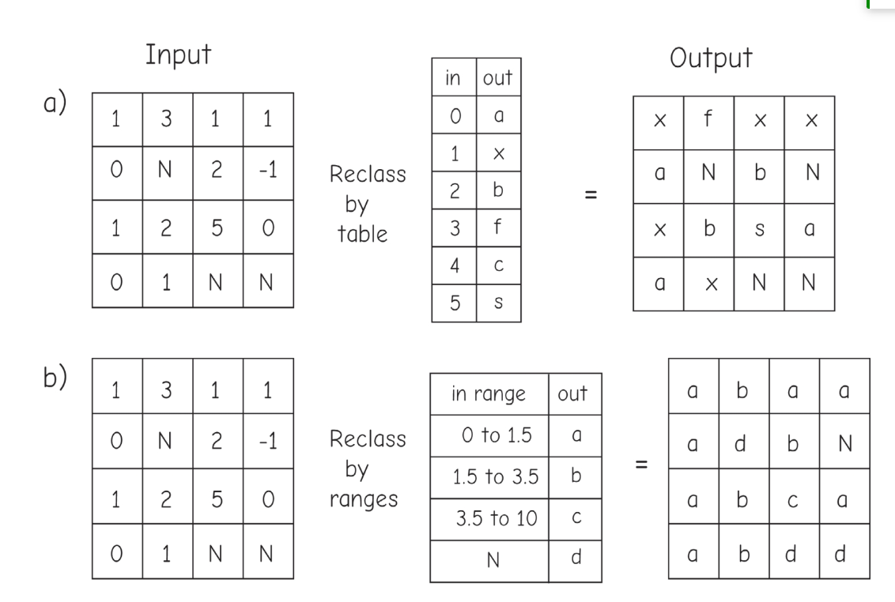
Reclassification

Slide 20
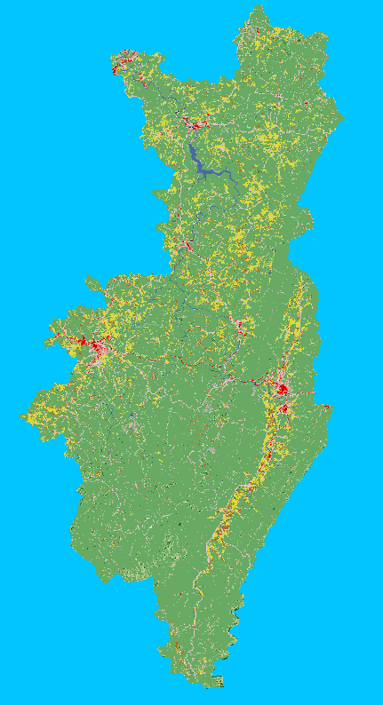
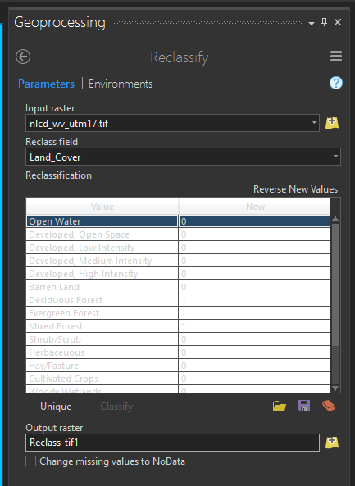
Reclassify Categorical Raster Data
Land cover
Forest =1; Non forest=0
Change cell values
Notes:
Reclassification allow you to change the cell values in a raster. The example in this slide demonstrates changing the cell values for a categorical raster grid, in this case a land cover grid from the National Land Cover Database. Here, all values corresponding to forest types were recoded to 1 and all other types were coded to 0. So, many categories were generalized to forest vs. not forest.

Slide 21
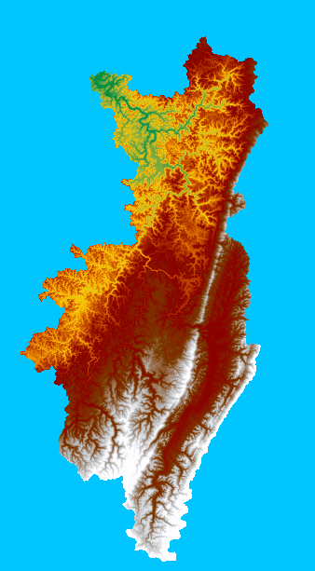
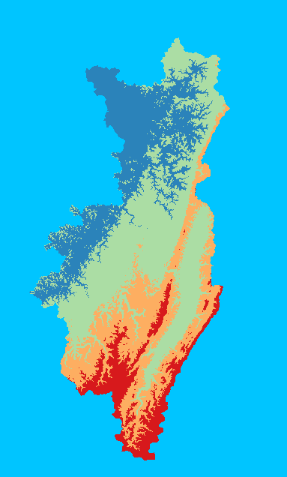
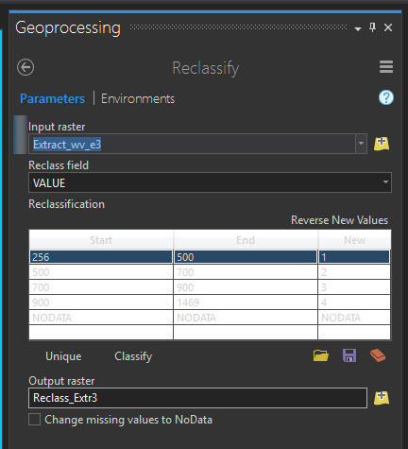
Reclassify Continuous Raster Data
DEM
Notes:
It is also possible to reclassify continuous raster data. In this example, a digital elevation model is being reclassified into four categories. Each category represents a range of elevation measurements.

Slide 22
Local function Extraction

Slide 23
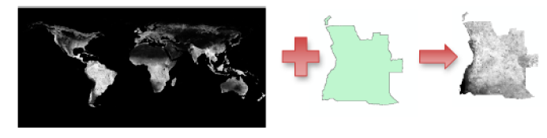
Extraction Methods
Extract by Circle: extract cells that fall into a circle that is defined by a center coordinate and radius
Extract by Mask: extract cells that fall within a raster or polygon mask
Extract by Point: extract cells at point locations
Extract by Polygon: extract cells that fall within the extent of a polygon as defined by its vertices
Extract by Rectangle: extract cells that fall within a rectangular extent
NDVI
Angola
Notes:
A common raster pre-processing task is to extract a portion of a raster from a larger dataset. In the example here, a portion of a DEM is being extracted from a larger DEM.
A variety of methods are available to extract a portion of a raster grid as defined on the slide. I commonly use Extract by Mask. To use this tool, a polygon mask or raster mask is used. Cells that fall within this mask will be written to a new file. That is how the example on the page was produced.
Take some time here to read through the descriptions of the different extraction methods.

Slide 24
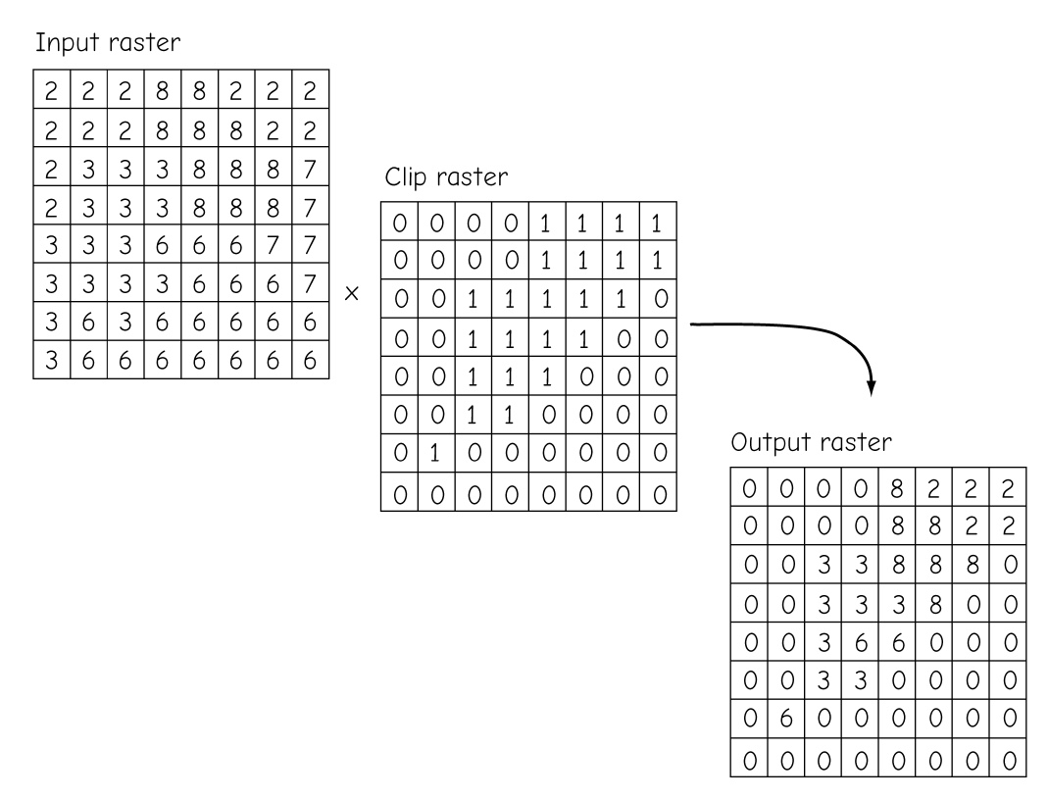
Extraction Methods
A raster clip/extraction operation may be performed via multiplication of a binary mask
Bolstad, 2019
Notes:
A common raster pre-processing task is to extract a portion of a raster from a larger dataset. In the example here, a portion of a DEM is being extracted from a larger DEM.
A variety of methods are available to extract a portion of a raster grid as defined on the slide. I commonly use Extract by Mask. To use this tool, a polygon mask or raster mask is used. Cells that fall within this mask will be written to a new file. That is how the example on the page was produced.
Take some time here to read through the descriptions of the different extraction methods.

Slide 25
Local function Stack

Slide 26
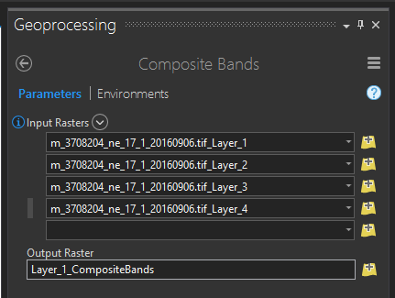
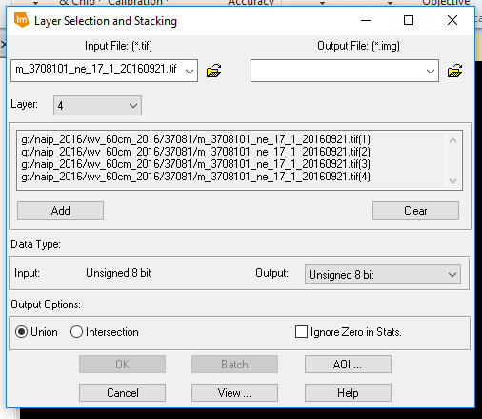

Stack Grids
Stack or combine individual grids into a multiband raster
Commonly used for image data
Can be used for all raster data, not just images
Output bands or layers will all have the same pixel type (e.g., 8-bit+16-bit→16-bit)
Bands will be layered in the order provided
Composite Bands Tool
Stack Tool
Demonstration!
Notes:
You may have many raster grids that you would like to combine to a single file by stacking the separate grids or bands as a single multiband file.
As an example, when Landsat data are downloaded they are often provided as individual bands. However, you may want to use these data as a multiband image for analysis or symbology. So, you would need to combine the bands into a single raster with multiple bands.
This can be accomplished using the Composite Bands Tool in ArcGIS Pro or the Stack Tool in Erdas Imagine.
Note that it is possible to stack more than just image bands. For example, you could stack a set of topographic variables into a multiband file. I have found this to be useful when preparing data for modeling.
Note that all bands or layers in a stack must have the same pixel type. For example, if you stack three 8-bit grids and one 16-bit grid, all the data will be converted to 16-bit. If one of your input grids is float, then all your grids will be converted to float.

Slide 27
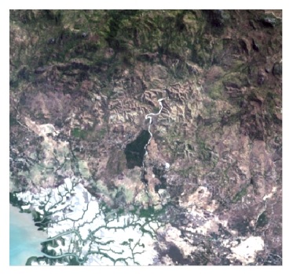
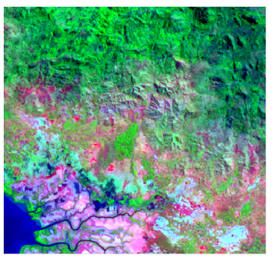
Band Stack of Landsat 8
Band 10,5,4
The burn area appears as a bright red
Band 1,3,4

Slide 28
Neighborhood-Based Analysis

Slide 29
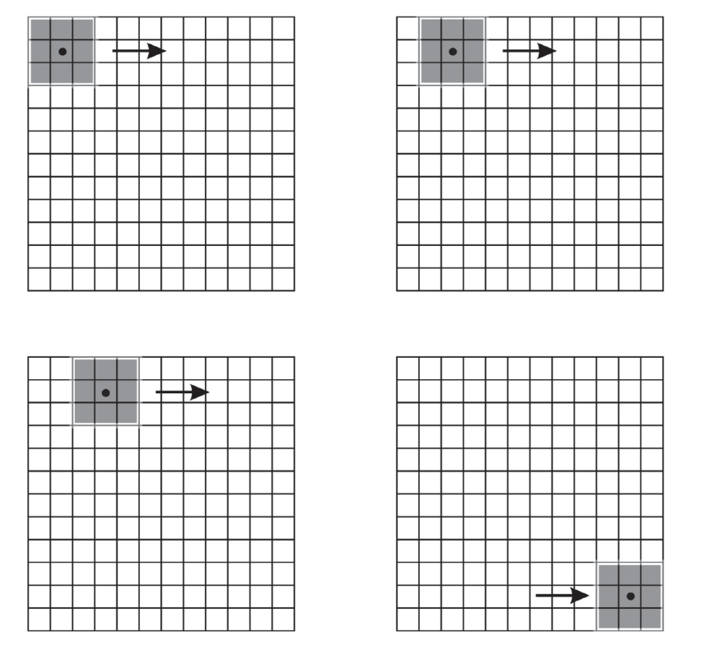
Neighborhood Function
A moving window is a configuration of raster cells used to specify the input values for an operation.
The window is positioned at a given location over the input raster.
An operation is applied that involves the cells contained in the window.

Slide 30
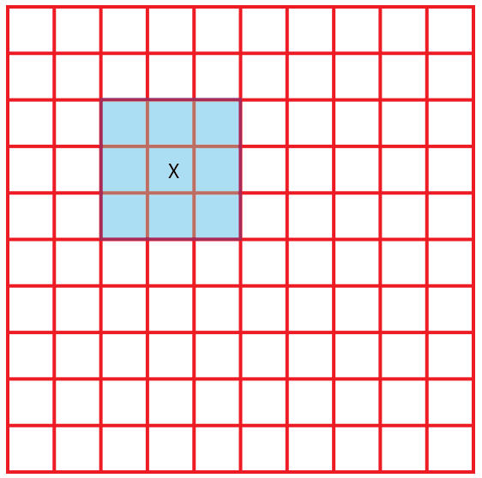
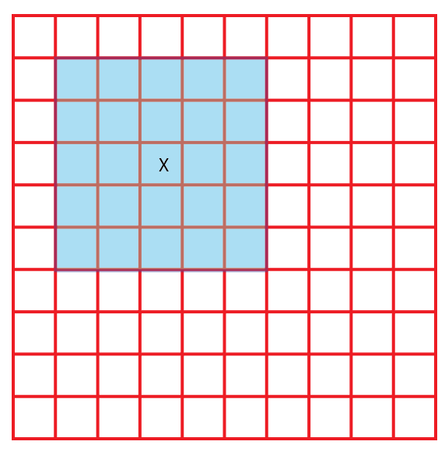
Defining a Neighborhood
Rectangle, Width = 3 cells Height = 3 cells
Rectangle, Width = ? cells Height = ? cells

Slide 31
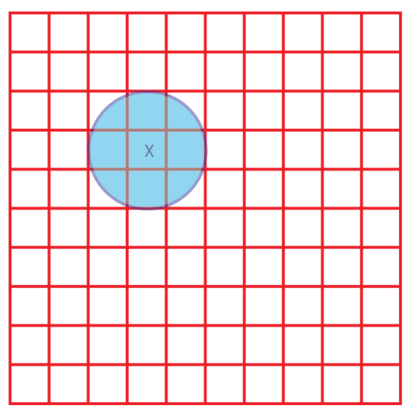
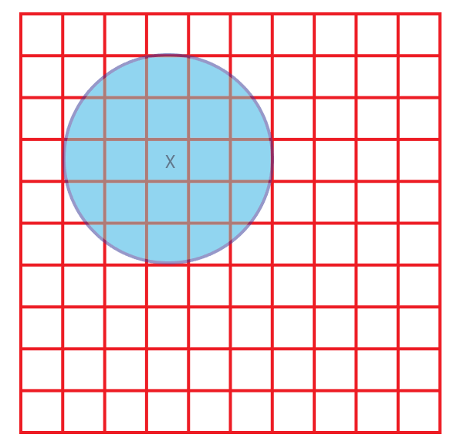
Defining a Neighborhood
Circle, Radius = 1.5 cell
Circle, Radius = 2.5 cells
Notes:
Circular windows can also be used. When using a circular window, a radius is defined relative to the map units or a number of cells. The examples here represent circular windows with radii of 1 and 2 cells.

Slide 32
Neighborhood function Focal STATISTICS

Slide 33
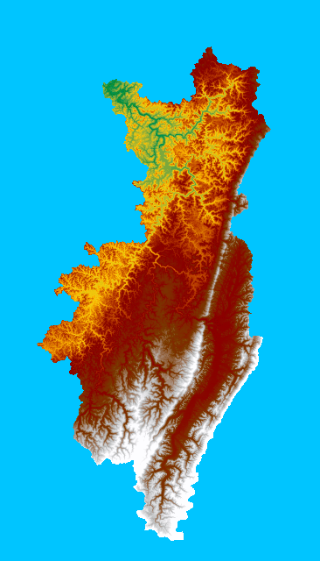
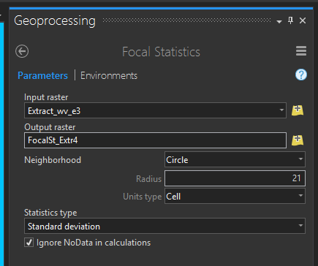
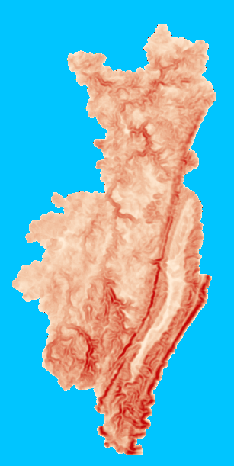
Focal Statistics
A type of window analysis
Calculates a statistic within the window
Stores result on center cell in new output
Completes operations for all cells
Notes:
Focal statistics is a type of moving window analysis. As the name implies, this method is used to calculate a statistic within a moving window.
As the window progresses over the raster grid, the resulting statistic is written to a new cell at the center cell location. The process continues to perform the calculation using all the cells in the original grid as the center cell.

Slide 34
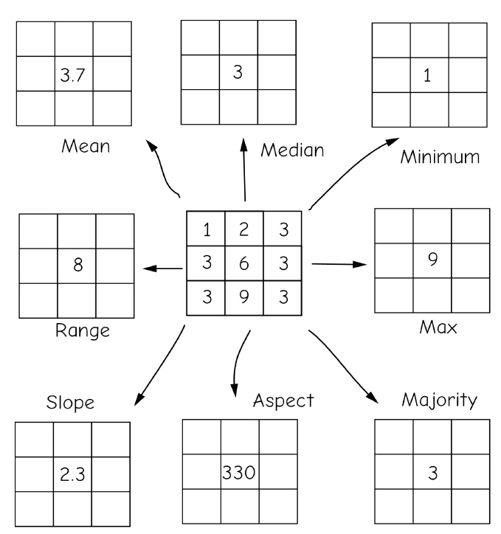
Focal Statistics
Bolstad, 2019
Notes:
Circular windows can also be used. When using a circular window, a radius is defined relative to the map units or a number of cells. The examples here represent circular windows with radii of 1 and 2 cells.

Slide 35
Focal Statistics
MEAN: Calculates the mean (average value) of the cells in the neighborhood.
MAJORITY: Calculates the majority (value that occurs most often) of the cells in the neighborhood.
MAXIMUM: Calculates the maximum (largest value) of the cells in the neighborhood.
MEDIAN: Calculates the median of the cells in the neighborhood.
MINIMUM: Calculates the minimum (smallest value) of the cells in the neighborhood.
MINORITY: Calculates the minority (value that occurs least often) of the cells in the neighborhood.
Notes:
A variety of statistics can be calculated using focal statistics.
For a continuous surface, such as a digital elevation model or a topographic slope grid, the mean, maximum, median, minimum, range, standard deviation, or sum may be calculated.
Many statistical values don’t make sense for categorical raster grids, such as land cover. However, the majority, minority, or variety could be calculated.
As an example, the variety measure would calculate the number of unique categories within the moving window.
Take some time to review the available statistics presented on this slide.
As a final note, larger windows sizes are generally used to represent more coarse or generalized patterns while smaller windows are used to represent more local patterns.
There is not necessarily a correct window size. Instead, this depends on the use case. If you are not sure what window size to use, I would recommend experimenting with multiple window sizes.
It is also possible to make a calculation using different window sizes then take an average.

Slide 36
Focal Statistics
RANGE: Calculates the range (difference between largest and smallest value) of the cells in the neighborhood.
STD: Calculates the standard deviation of the cells in the neighborhood.
SUM: Calculates the sum (total of all values) of the cells in the neighborhood.
VARIETY: Calculates the variety (the number of unique values) of the cells in the neighborhood.
Notes:
Moving window analyses also have applications in remote sensing.

Slide 37
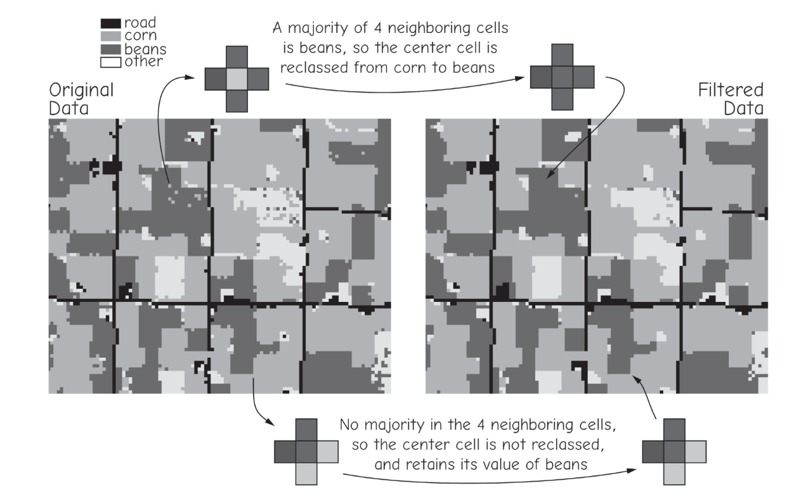
Focal Statistics - Majority
Many isolated cells are converted to the category of the dominant surrounding class.

Slide 38
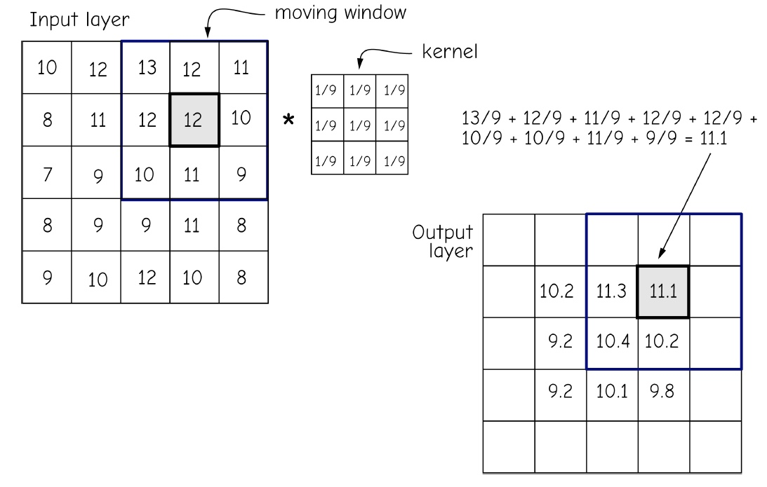
Focal Statistics
A kernel for a moving window func-tion is the set of cell constants for a given window size and shape.
Notes:
Circular windows can also be used. When using a circular window, a radius is defined relative to the map units or a number of cells. The examples here represent circular windows with radii of 1 and 2 cells.

Slide 39
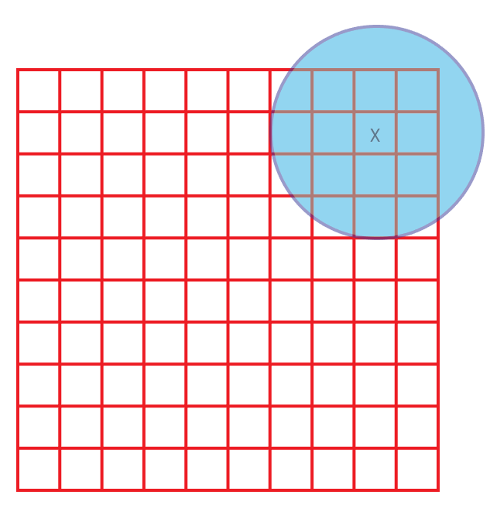
Edge Cells
Edge cells will not have a full set of neighbors
calculated using only the available cells
calculated for cells that have a full set of neighbors (the size of the raster will be reduced)
Recommend: calculated a larger area to cover the study region
Notes:
It may have occurred to you that cells near the edge of the raster may not have a full set of neighbors as demonstrated in this slide.
In these situations, two options are available. First, the result could be calculated using only the available cells. Second, results could only be calculated for cells that have a full set of neighbors.
If the second option is used, the size of the raster grid, or the number of rows and columns, will be reduced.
If you are concerned with this issue, I would recommend running an analysis using a larger extent than is required. That way, you will always have a full set of cells to cover the extent of interest.

Slide 40
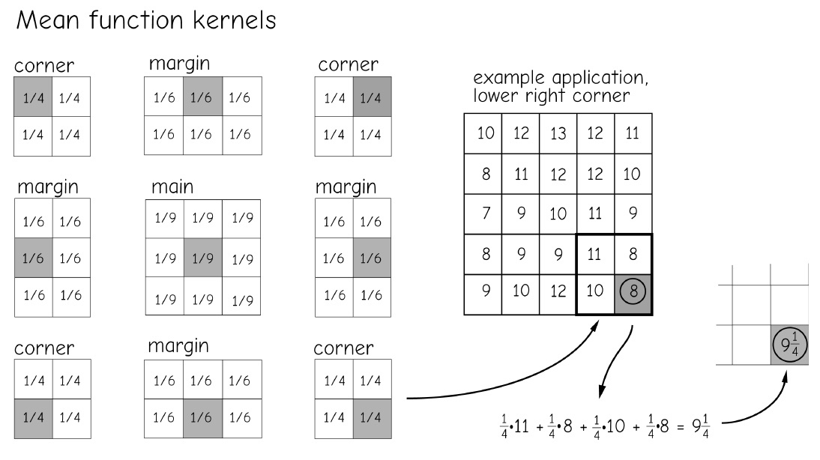
Edge Cells
Edge cells will not have a full set of neighbors
Using different kernel in the edge
Bolstad, 2019
Notes:
It may have occurred to you that cells near the edge of the raster may not have a full set of neighbors as demonstrated in this slide.
In these situations, two options are available. First, the result could be calculated using only the available cells. Second, results could only be calculated for cells that have a full set of neighbors.
If the second option is used, the size of the raster grid, or the number of rows and columns, will be reduced.
If you are concerned with this issue, I would recommend running an analysis using a larger extent than is required. That way, you will always have a full set of cells to cover the extent of interest.

Slide 41
Neighborhood function distance

Slide 42
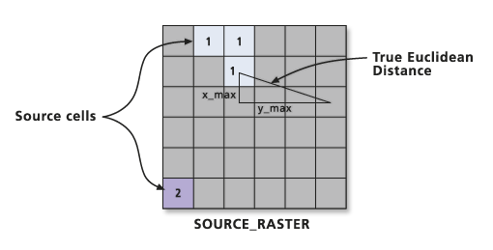
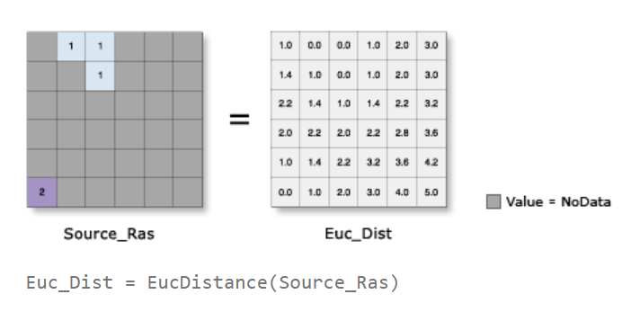
Euclidean Distance

Slide 43

Euclidean Distance
Straight line or Euclidean distance from the cell to a source
Map showing the distance to the nearest town for each location
Map showing the distance to the nearest town for each location
Notes:
Euclidean distance simply represents the straight line distance from a cell to the nearest input feature. As an example, the surface shown here represents the straight line distance from the cell to the nearest major road.
Each cell is coded with the distance to the nearest input feature.
It is also possible to define a maximum distance. If a cell is further then the maximum distance from the nearest input feature, then it will not be calculated.

Slide 44
Euclidean Distance
1. Which location is closer to the town? A or B?
B
D
A
1. Which location is closer to the town? C or D?
C

Slide 45
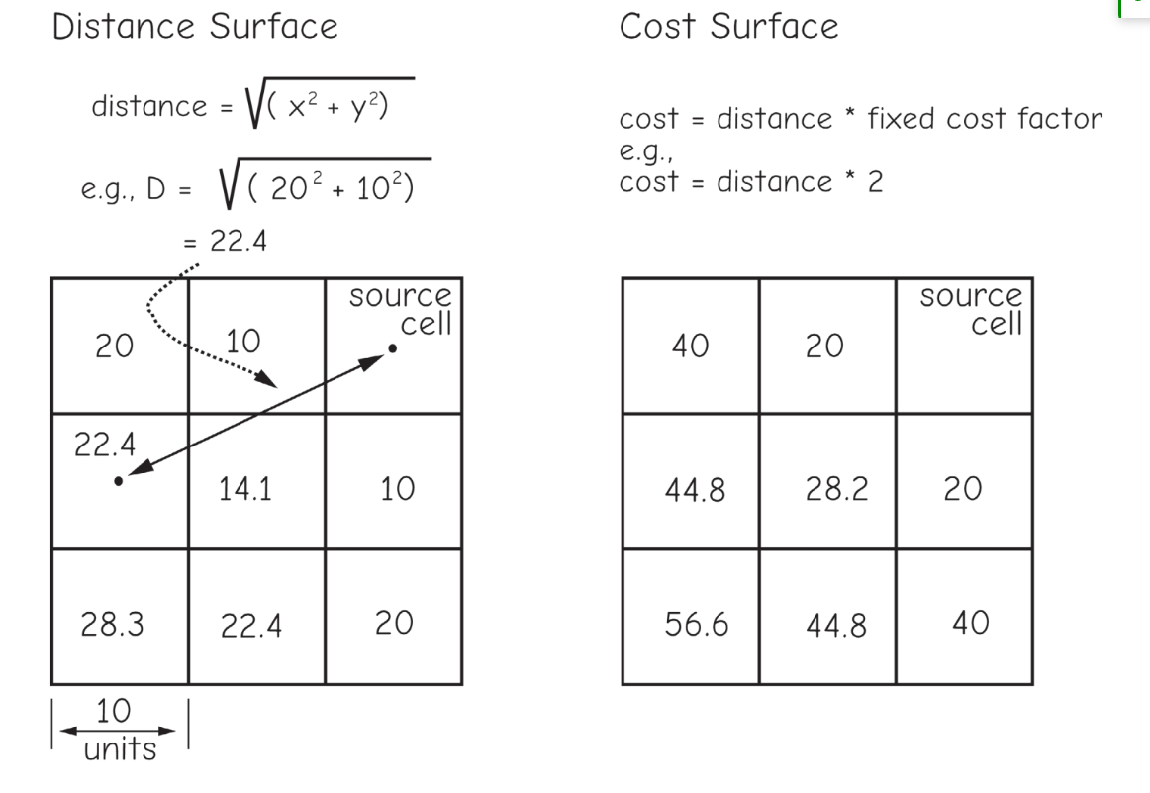
Cost Distance
Cost can be:
Preference
Energy expended
Time
Dollars
Risk

Slide 46
13.2 Lab session

Slide 47
Lab 09: raster Analysis
Due by Midnight (11:59 pm) on Monday, Nov 18, 2025
Submit a word document only include question and answer

Slide 48

Thank you!

