Slide 1

Lecture 14 Model builder lecture
Instructor: Yanan Wu
fALL 2025

Slide 2
13.1 raster analysis

Slide 3
Overview
What is Model Builder
ModelBuilder vocabulary
Use Model Builder

Slide 4
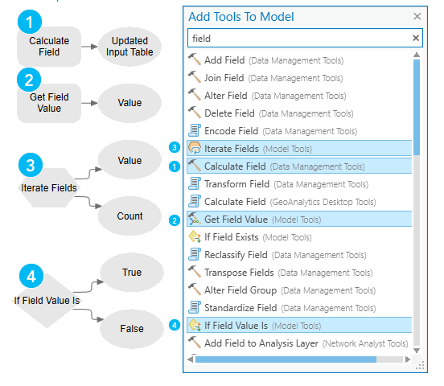
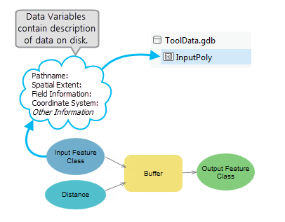
Connecting data and tools
Add Data
Add Tool

Slide 5
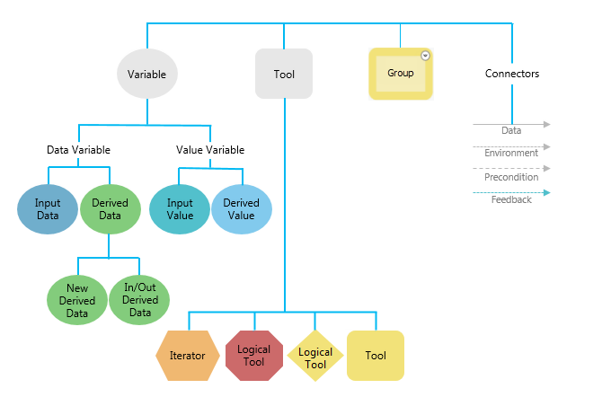
Model builder vocabulary
It refers to the key terms, components, and concepts used when building workflows in ArcGIS ModelBuilder.

Slide 6
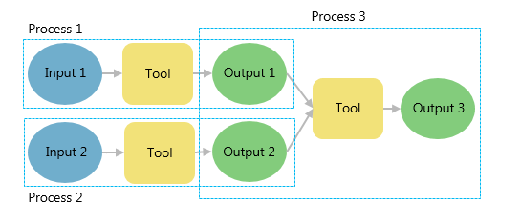
Process and state
A model process consists of a tool and all variables connected to it.
Connector lines indicate the sequence of processing.
Many processes can be chained together to create a larger process.

Slide 7
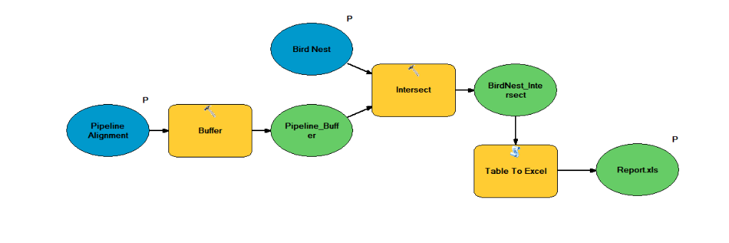
Visualize your workflow sequence as an easy-to-understand diagram.

Slide 8
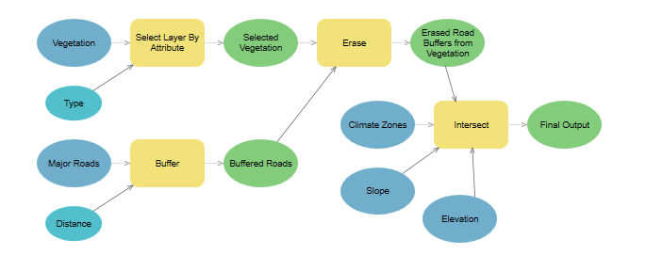
Iterative Processing of All Workspace Data

Slide 9
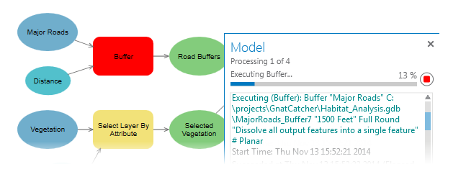
Run a model
Running a model in ModelBuilder means that you open the model for editing and run it in the ModelBuilder window.
You can run a single tool, a sequence of tools, or the entire model.

Slide 10
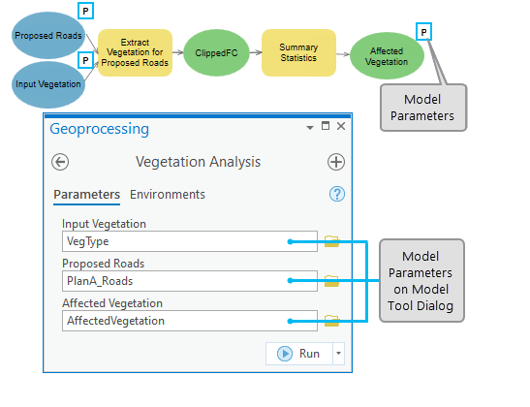
Create a model tool
Make your model into a geoprocessing tool that can be shared or can be used in Python scripting and other models.

Slide 11
14.1 Lab session

Slide 12
Lab 10: model builder
Due by Midnight (11:59 pm) on Monday, Nov 24, 2025
Submit a word document only include question and answer

