Slide 1

Lecture 12 Vector Analysis lecture
Instructor: Yanan Wu
fALL 2025

Slide 2
7.1 MAP ELEMENTS

Slide 3
Overview
Vector Analysis
Join
Query
Generalization
Proximity analysis
Extract
Overlay
General
Statistics
Cartography refinement
Feature to points
Minimum bounding geometry

Slide 4
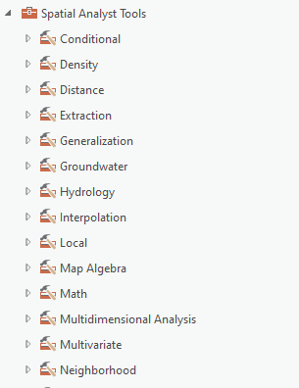
Spatial Analysis in ArcGIS
Spatial Analyst Toolbox for Vector and Raster Spatial Analysis
Notes:
The Analyst Toolbox provides access to a wide variety of vector analysis tools. This toolbox is embedded into ArcGIS Pro and does not require an additional license.
In contrast, the Spatial Analyst Toolbox is used primarily for raster-based analysis and does require an additional license.
In this lecture, we will discuss many of the tools available in the Analyst Toolbox. However, we will not limit our discussion to these tools. Many other toolboxes provide access to tools that are of value when working with vector data.

Slide 5
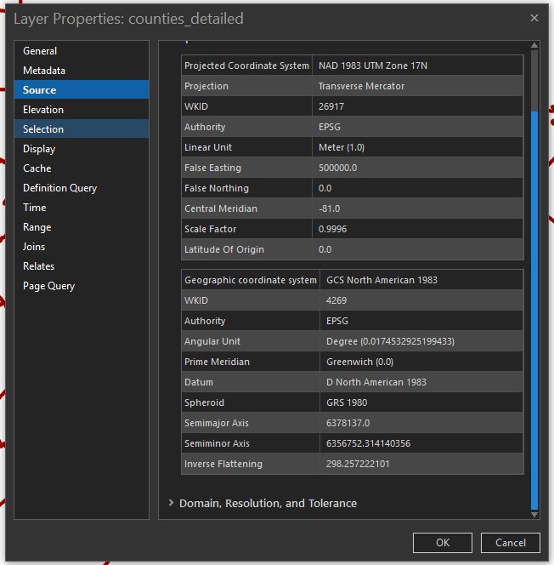
Spatial Analysis in ArcGIS
A note on spatial reference and projection
When undertaking spatial analysis, it is best if your data are all in the same spatial reference or projection
Notes:
When visualizing data or making map layouts, it is not always necessary to have all data layers in the same projection since ArcGIS Pro is capable of on-the-fly projection.
However, if your goal is to perform spatial analysis with the data layers, I would recommend using the same projection for all layers. This may require reprojection.
Again, this is best practice when performing spatial analysis.

Slide 6
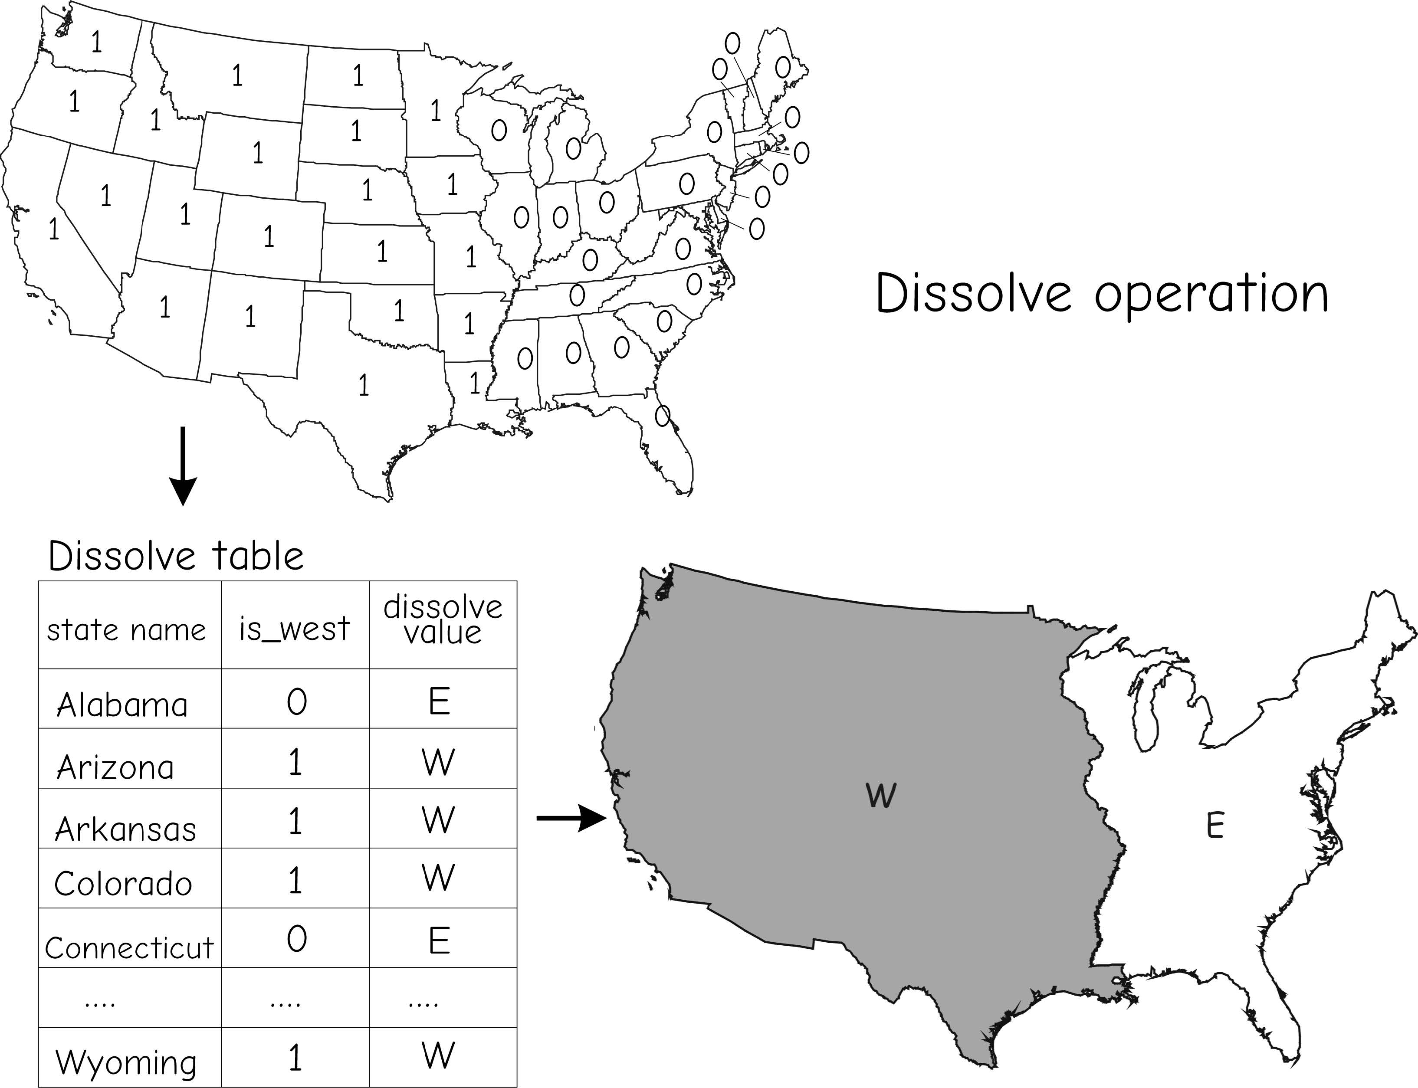
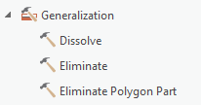
Generalization: Dissolve
Generalize boundaries
Combine all features to one feature
Adjacent polygons may have identical values for an attribute
Bolstad, 2019
Notes:
Dissolve is one of the most common tools that I use.
This tool is specifically used for boundary generalization. Detailed boundaries can be combined to less detailed boundaries.

Slide 7
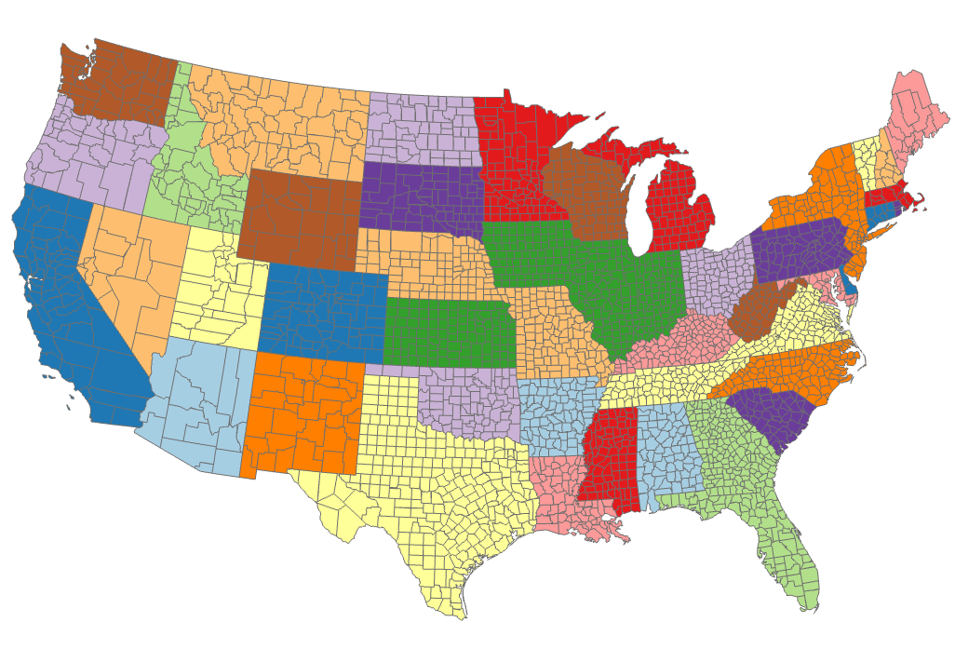
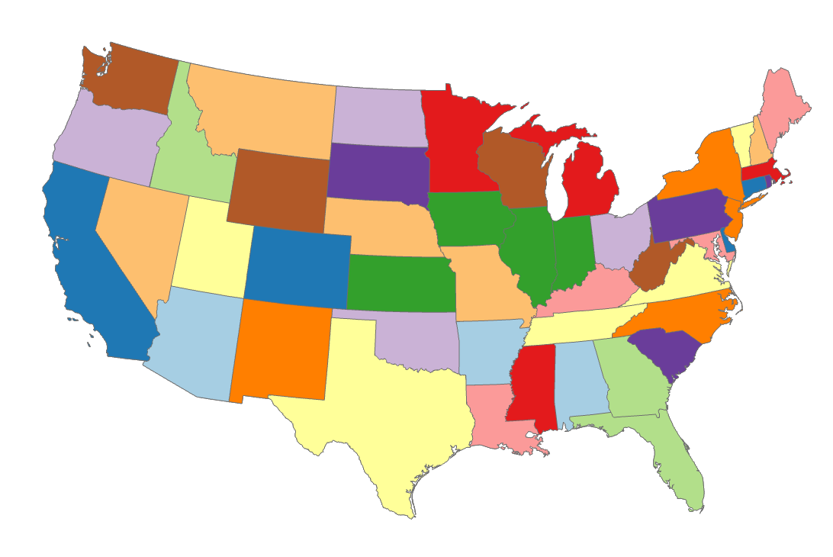
Generalization: Dissolve
Before
Generalize boundaries
Combine all features to one feature
Adjacent polygons may have identical values for an attribute
After
Notes:
To obtain this result, all counties that shared the same state attribute were dissolved to one feature. Or, counties were dissolved to states.
If an attribute column is not defined on which to group the features, then all features will be dissolved to a single feature. In this case, the result would have been the country boundary as opposed to state boundaries.

Slide 8
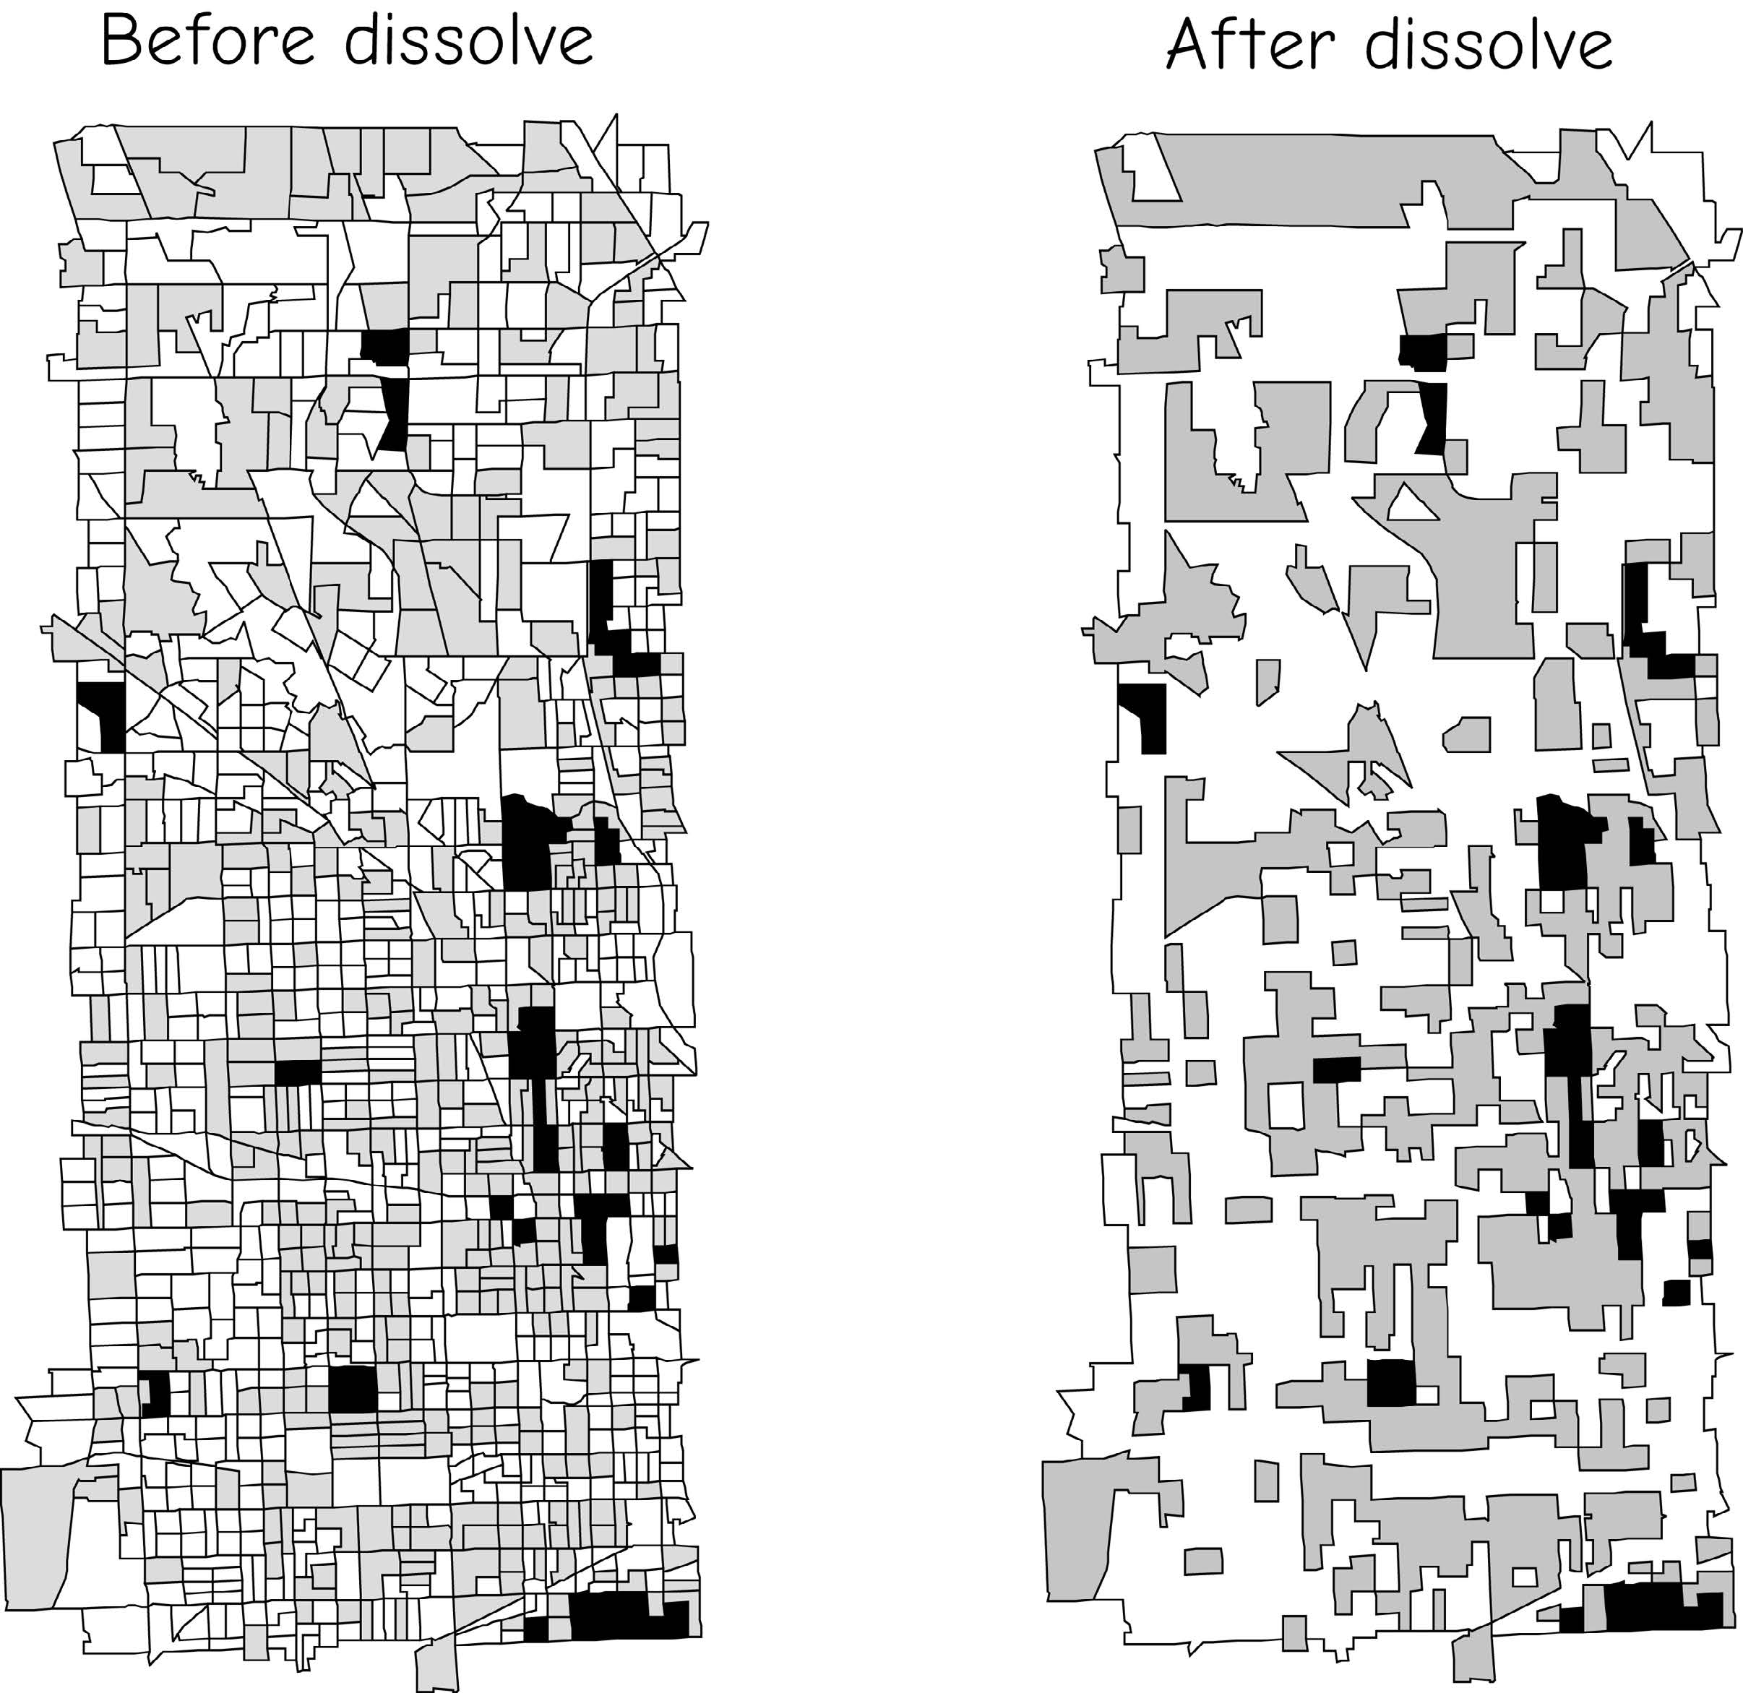
Generalization: Dissolve
Generalize boundaries
Combine all features to one feature
Adjacent polygons may have identical values for an attribute
Bolstad, 2019

Slide 9
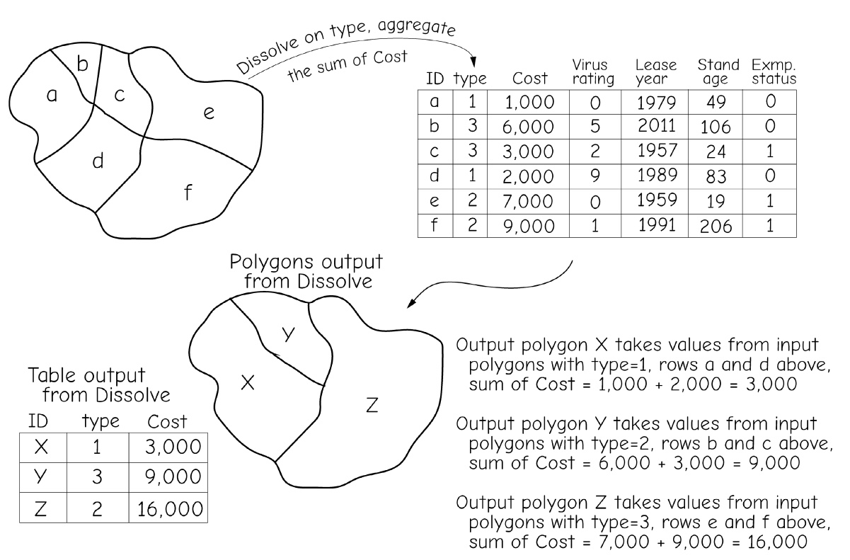
Generalization: Dissolve
Attribute aggregation: we may sum, average, calculate the range, maximum, minimum, etc. and assign these to the output polygons
Bolstad, 2019

Slide 10
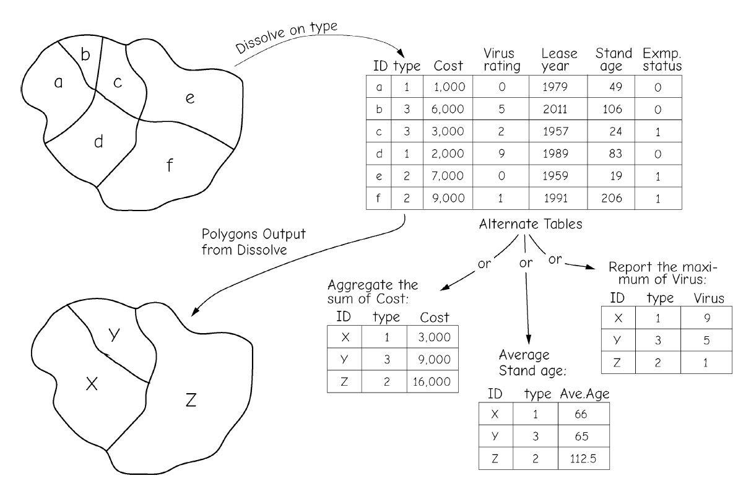
Generalization: Dissolve
Attribute aggregation: we may sum, average, calculate the range, maximum, minimum, etc. and assign these to the output polygons
Bolstad, 2019

Slide 11
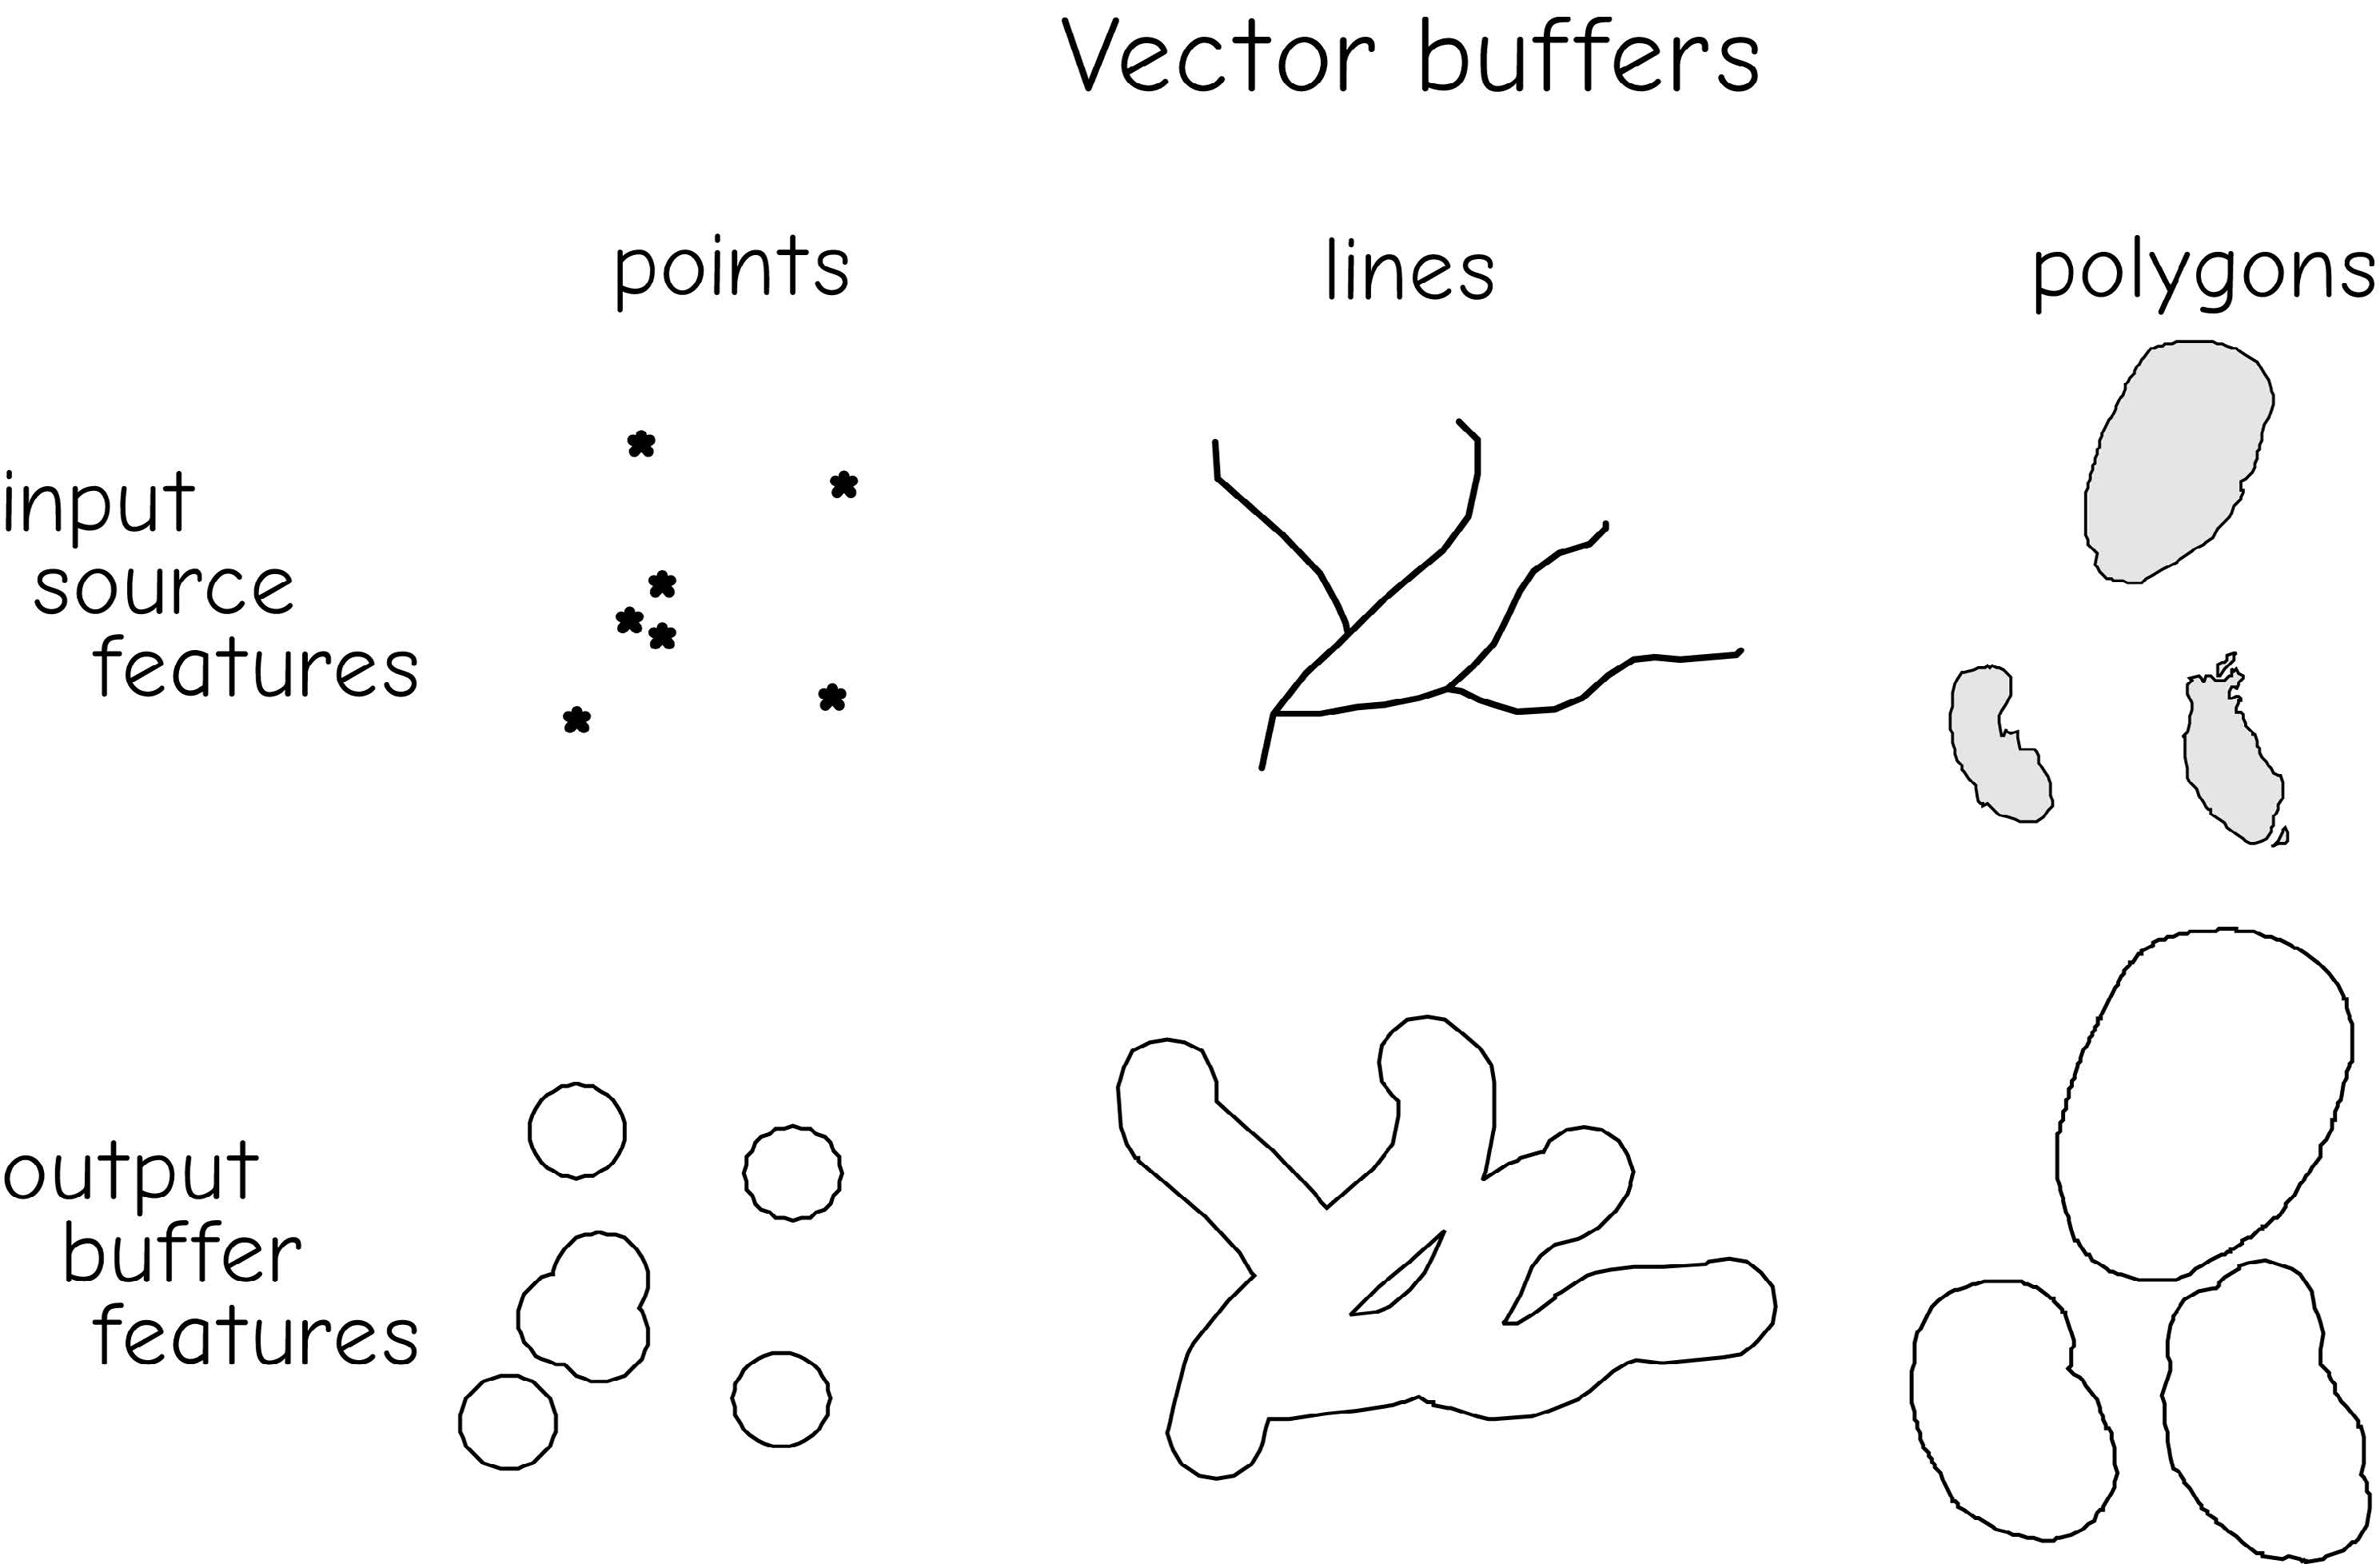
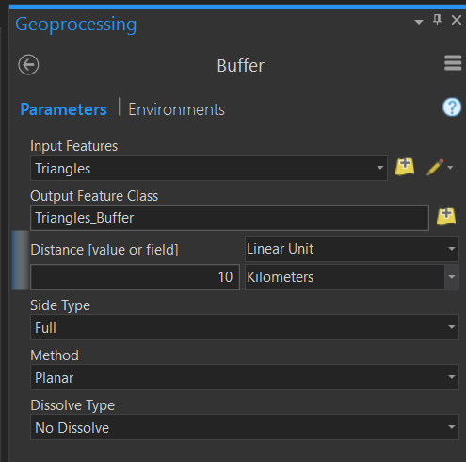
Proximity analysis: Buffer
Buffering is the process of creating an output polygon layer containing a zone (or zones) of a specified width around an input point, line, or polygon feature.
The result of buffer is always a polygon
Bolstad, 2019
Notes:
Buffer is a form of proximity analysis. The goal is to find all the land area that is within a defined distance of an input feature.
If you buffer a point, the result will be a circular polygon. If you buffer a line, the result will be a polygon, and if you buffer a polygon the result will be a polygon.
So, the result of buffer is always a polygon or area.
All of the area within the polygon will be within the defined distance or proximity to the input feature.

Slide 12
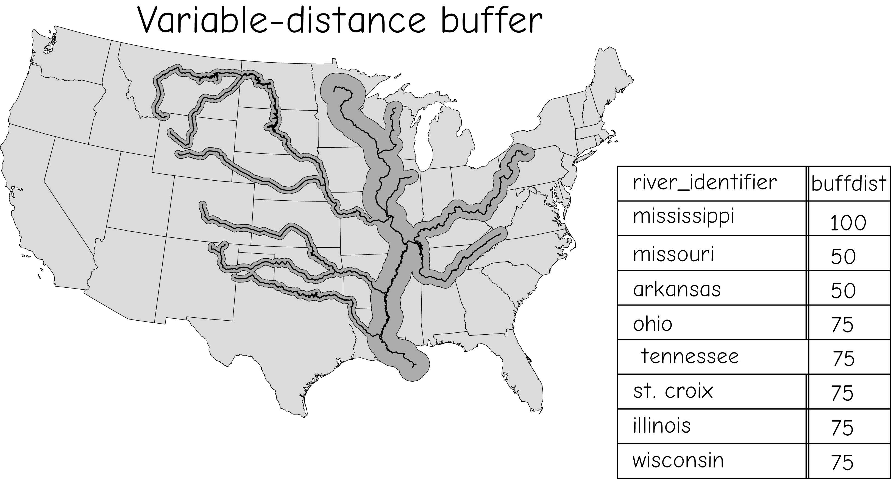
Proximity analysis: Variable Width Buffers
Distance represent buffer width of all features based on a field
Bolstad, 2019

Slide 13
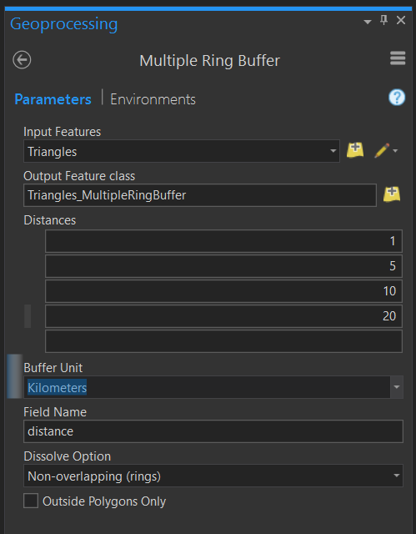
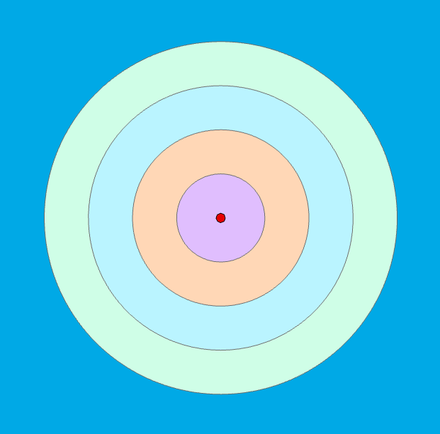
Proximity analysis: Buffer
Multiple Ring Buffer
Notes:
It is also possible to create multiple ring buffers. In this case, multiple distance will be defined and buffers will be produced for each of these distances.

Slide 14
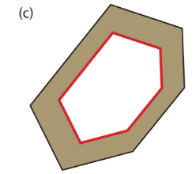
Proximity analysis: Doughnut Buffer

Slide 15
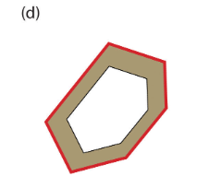
Proximity analysis: Setback buffer
Only buffer the area inside of the polygon boundary.

Slide 16
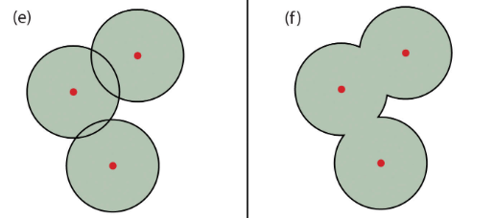
Proximity analysis: Nondissolved Buffer & Dissolved Buffer
Map Source

Slide 17
Class Discussions
A highway runs through Conway and Little Rock. You want to analyze how far highway noise may influence nearby neighborhoods and schools.
Question:
What is the name of this highway?
Question: Which buffer type best shows how noise levels decrease at different distances (e.g., 200 m, 400 m, 600 m) from the highway corridor?
🤔
Variable Width Buffer
Multiple Ring Buffer
Doughnut Buffer
Dissolved Buffer

Slide 18
Class Discussions
You’re studying air-quality patterns near the industrial zone of Little Rock. Pollution is severe within 500 m, moderate between 500–1000 m, and negligible beyond that.
Question:
Which regions of little rock have more industrial zone based on land use zone map?
Question:
If you only want to study the “moderate-impact zone” (500–1000 m), which buffer type should you use?
Multiple Ring Buffer
Doughnut Buffer
Nondissolved Buffer
Variable Width Buffer

Slide 19
Class Discussions
To protect water quality, Arkansas State Parks prohibit construction within 100 m of the shoreline of largest lake in Arkansas.
Question:
Which lake is the largest lake in Arkansas?
Question: Which buffer type defines the restricted inland area from the lake boundary?
Setback Buffer
Doughnut Buffer
Dissolved Buffer
Variable Width Buffer

Slide 20
Class Discussions
The county’s Environmental Office wants to map 500 m protection zones around each public well but keep them separate for individual monitoring.
Question: Which buffer type keeps each well’s protection area distinct?
Dissolved Buffer
Nondissolved Buffer
Doughnut Buffer
Multiple Ring Buffer

Slide 21
Class Discussions
You are evaluating the total influence area of all public parks in Little Rock. Overlapping zones should merge into one continuous “green-influence” region.
Question: Which buffer type combines all park buffers into a single area?
Nondissolved Buffer
Dissolved Buffer
Doughnut Buffer
Setback Buffer

Slide 22
Class Discussions
You want to model the effective width of state highways. Interstate highways should have 50 m buffers, state highways 30 m, and county roads 10 m.
Question: Which buffer type lets you assign different buffer distances based on road class?
Variable Width Buffer
Multiple Ring Buffer
Setback Buffer
Doughnut Buffer

Slide 23
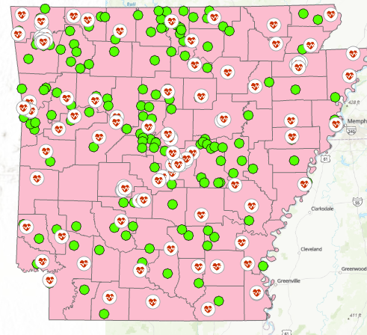
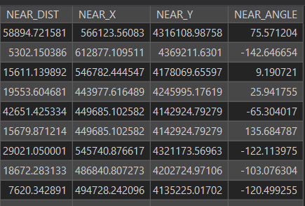
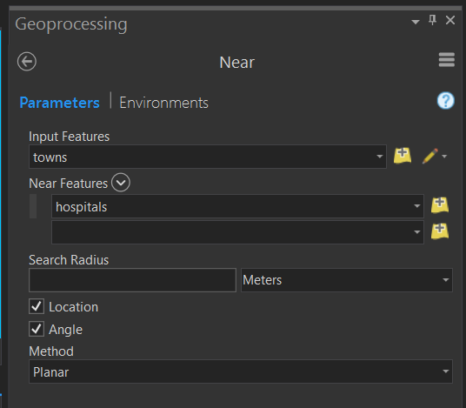
Proximity analysis: Near
Calculates distance and additional proximity information between the input features and the closest feature in another layer or feature class.
Calculate distance from towns to nearest hospital
Notes:
Near is used to relate features in the input layer with the nearest feature in the near layer.
It calculates the distance and additional proximity measures between the input features and the closest feature in another layer or feature class.
In the provided example, the input layer contains points representing towns. New attributes will be calculated for each town relating to the nearest hospital, including the distance to the nearest hospital, x- and y-coordinates of the nearest hospital, and the angle or compass bearing to the nearest hospital.

Slide 24
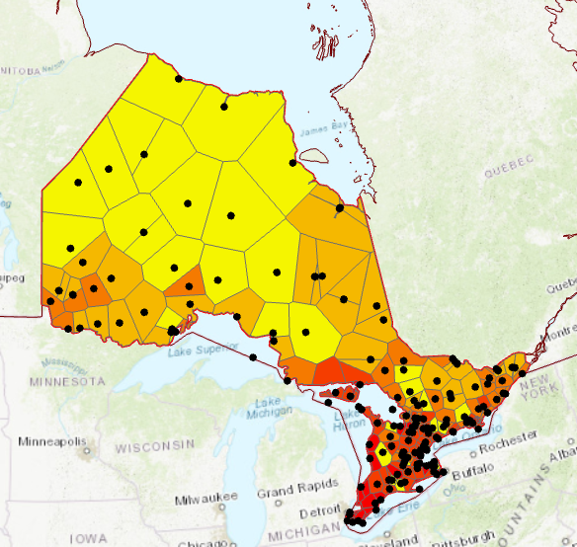
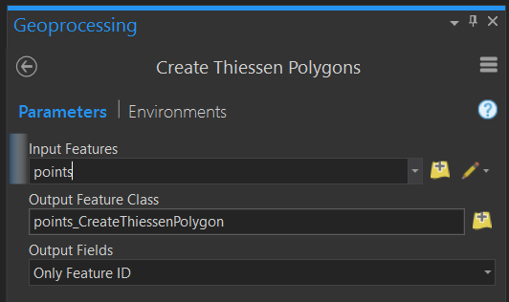
Proximity: Thiessen (Voronoi) Polygons
Defines the area that is closer to one point than any other points in a dataset
Notes:
Thiessen (Voronoi) Polygons represent the area that is closer to one point than any other points in a dataset.
The polygon can be attributed with the attributes of the input point layer.
This method is a simple spatial interpolation method. It allow for a continuous surface of polygons to be generated from discrete point measurements.
In the examples provided, Thiessen polygons and point measurements in Ontario that represent weather stations are being used to estimate mean annual temperature for the entire province.

Slide 25
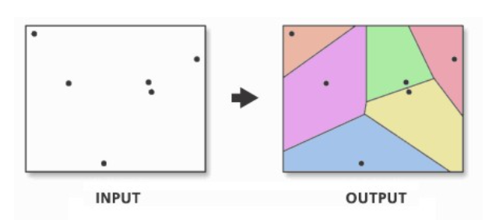
Create Thiessen Polygons (Analysis)
Interactive Thiessen Polygon Tool

Slide 26
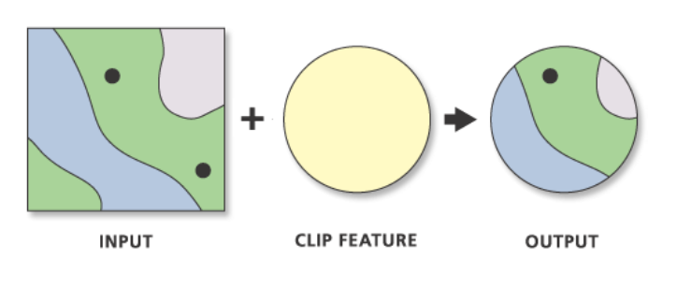
Extract: Clip
Extracts input features that overlay the clip features.
Notes:
Clip is probably the vector analysis tool I use most often.
You can think of clip as a cookie cutter. Features or portions of features that wall within another feature will be extracted to a new file or layer.
In this example, the points within the circle are being clipped or extracted. The points are the input feature, or the features we are attempting to extract, and the circle is the clip feature, or the area being used to extract the points. It is the cookie cutter.
Input features can be points, lines, or polygons. However, the clip feature must be a polygon. When points are clipped, points that fall within the clip feature will be returned. When lines are clipped, the portion of the lines that fall within the clip feature will be returned. When a polygon is clipped, the portion of the polygon within the clip feature will be returned.

Slide 27
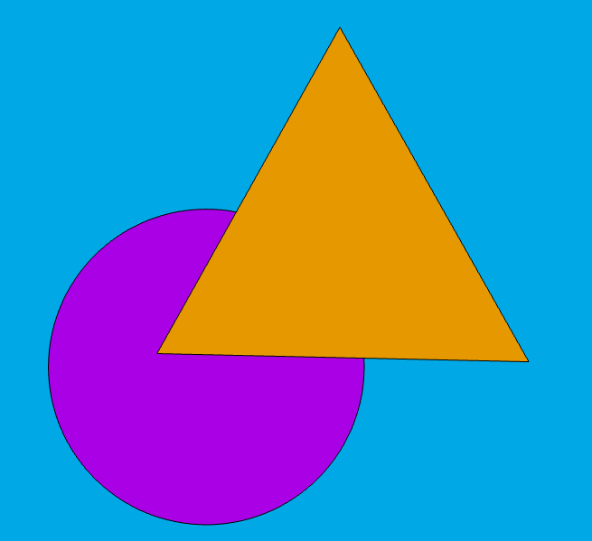
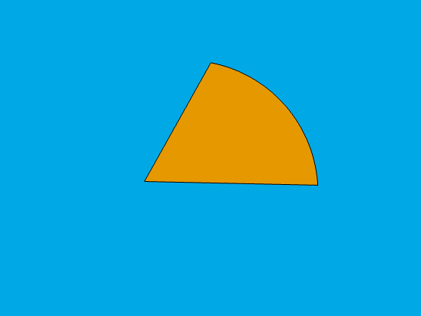
Extract: Clip
Input = Triangle
Clip Feature = Circle
Output = Portion of Triangle in Circle
Notes:
This is an example of performing a clip between two polygon features. In this example, the input feature is the triangle and the clip feature is the circle.
The result will be the portion of the triangle in the circle. Only the attributes for the triangle will be returned.

Slide 28
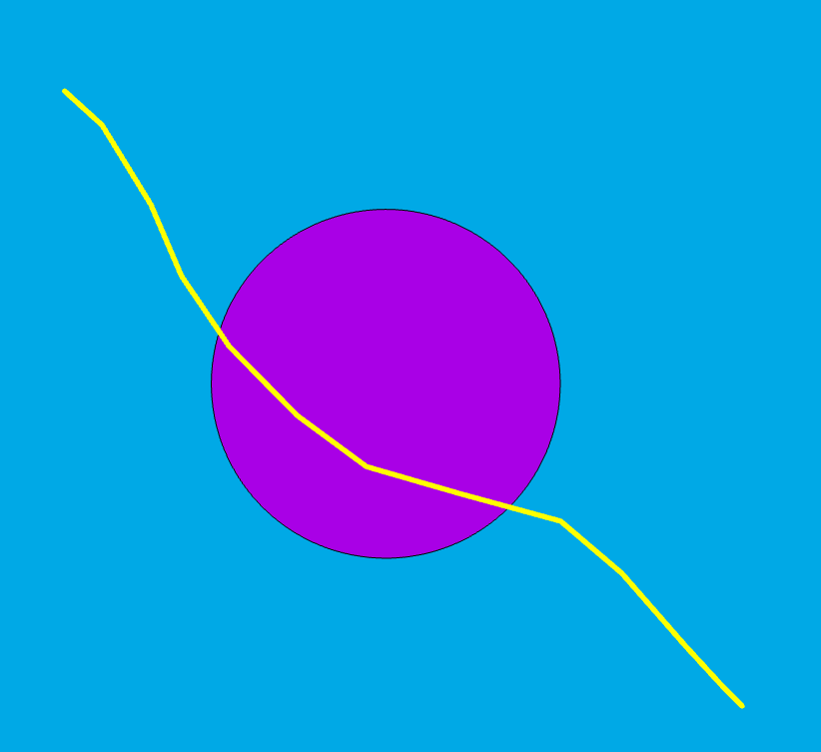

Extract: Clip
Input = Line
Clip Feature = Circle
Output = Portion of Line in circle
Notes:
This is an example of clipping a line feature.
In this example, the line is the input feature and the circle is the clip feature.
The portion of the line in the triangle will be returned. Only the line attributes will be included in the output.

Slide 29
Extract: Clip
Clip feature attributes are not added to the output
For shapefiles, geometric fields will not be updated in attribute table
Input Feature Attributes
Type
Point
Point
Point
Point
Output Feature Attributes
Type
Point
Point
Point
Point
Clip Feature Attributes
Type
Circle
Circle
Circle
Circle
Notes:
When a clip is performed, only the attributes from the input feature will be returned. The attributes from the clip feature will not be added to the output.
Only the geometry of the clip feature is used to perform the clip. The attributes are not used and will not be added to the output.

Slide 30
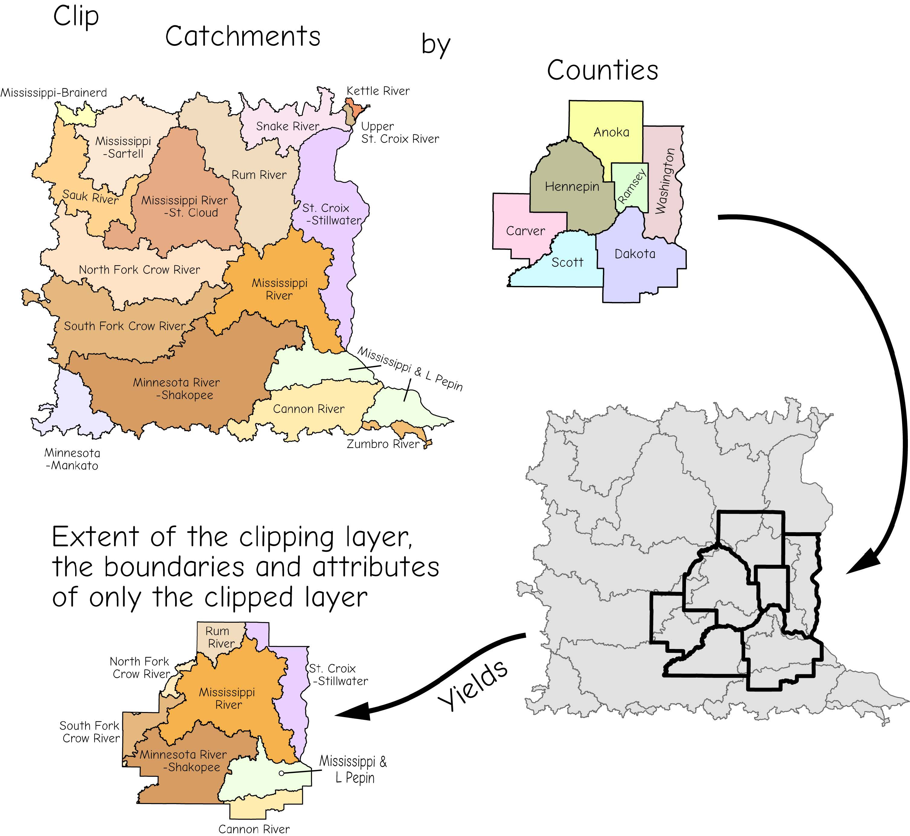
Extract: Clip
Clip feature attributes are not added to the output
For shapefiles, geometric fields will not be updated in attribute table
Bolstad, 2019
Notes:
When a clip is performed, only the attributes from the input feature will be returned. The attributes from the clip feature will not be added to the output.
Only the geometry of the clip feature is used to perform the clip. The attributes are not used and will not be added to the output.

Slide 31
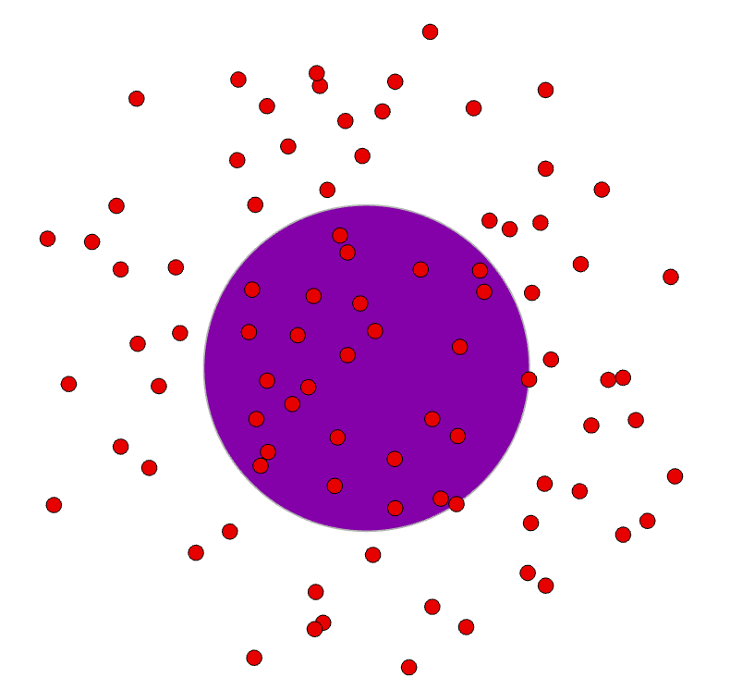
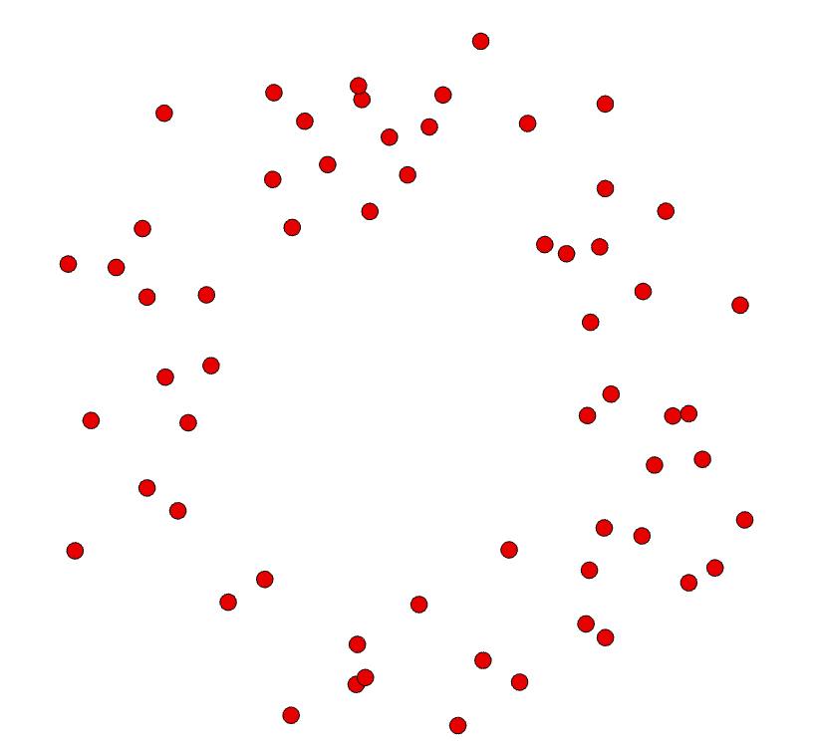
Overlay: Erase
The opposite of clip
Input = Points
Erase Feature = Circle
Notes:
Erase is the opposite of clip. Instead of maintaining features within the erase feature, those features are removed.
In this example the input feature is the points and the erase feature is the circle. The points outside of the circle are returned.
Similar to clip, the erase feature attributes will not be added to the output. So in this example, only the point attributes will be returned.

Slide 32
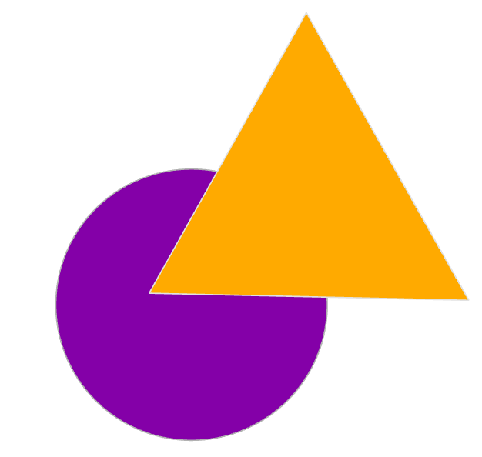

Overlay: Erase
The opposite of clip
Input = Triangle
Erase Feature = Circle
Notes:
This is an example of performing erase for two polygons.
The triangle is the input feature and the circle is the erase feature.
The portion of the triangle outside the circle is maintained.
Only the triangle attributes will be returned.

Slide 33
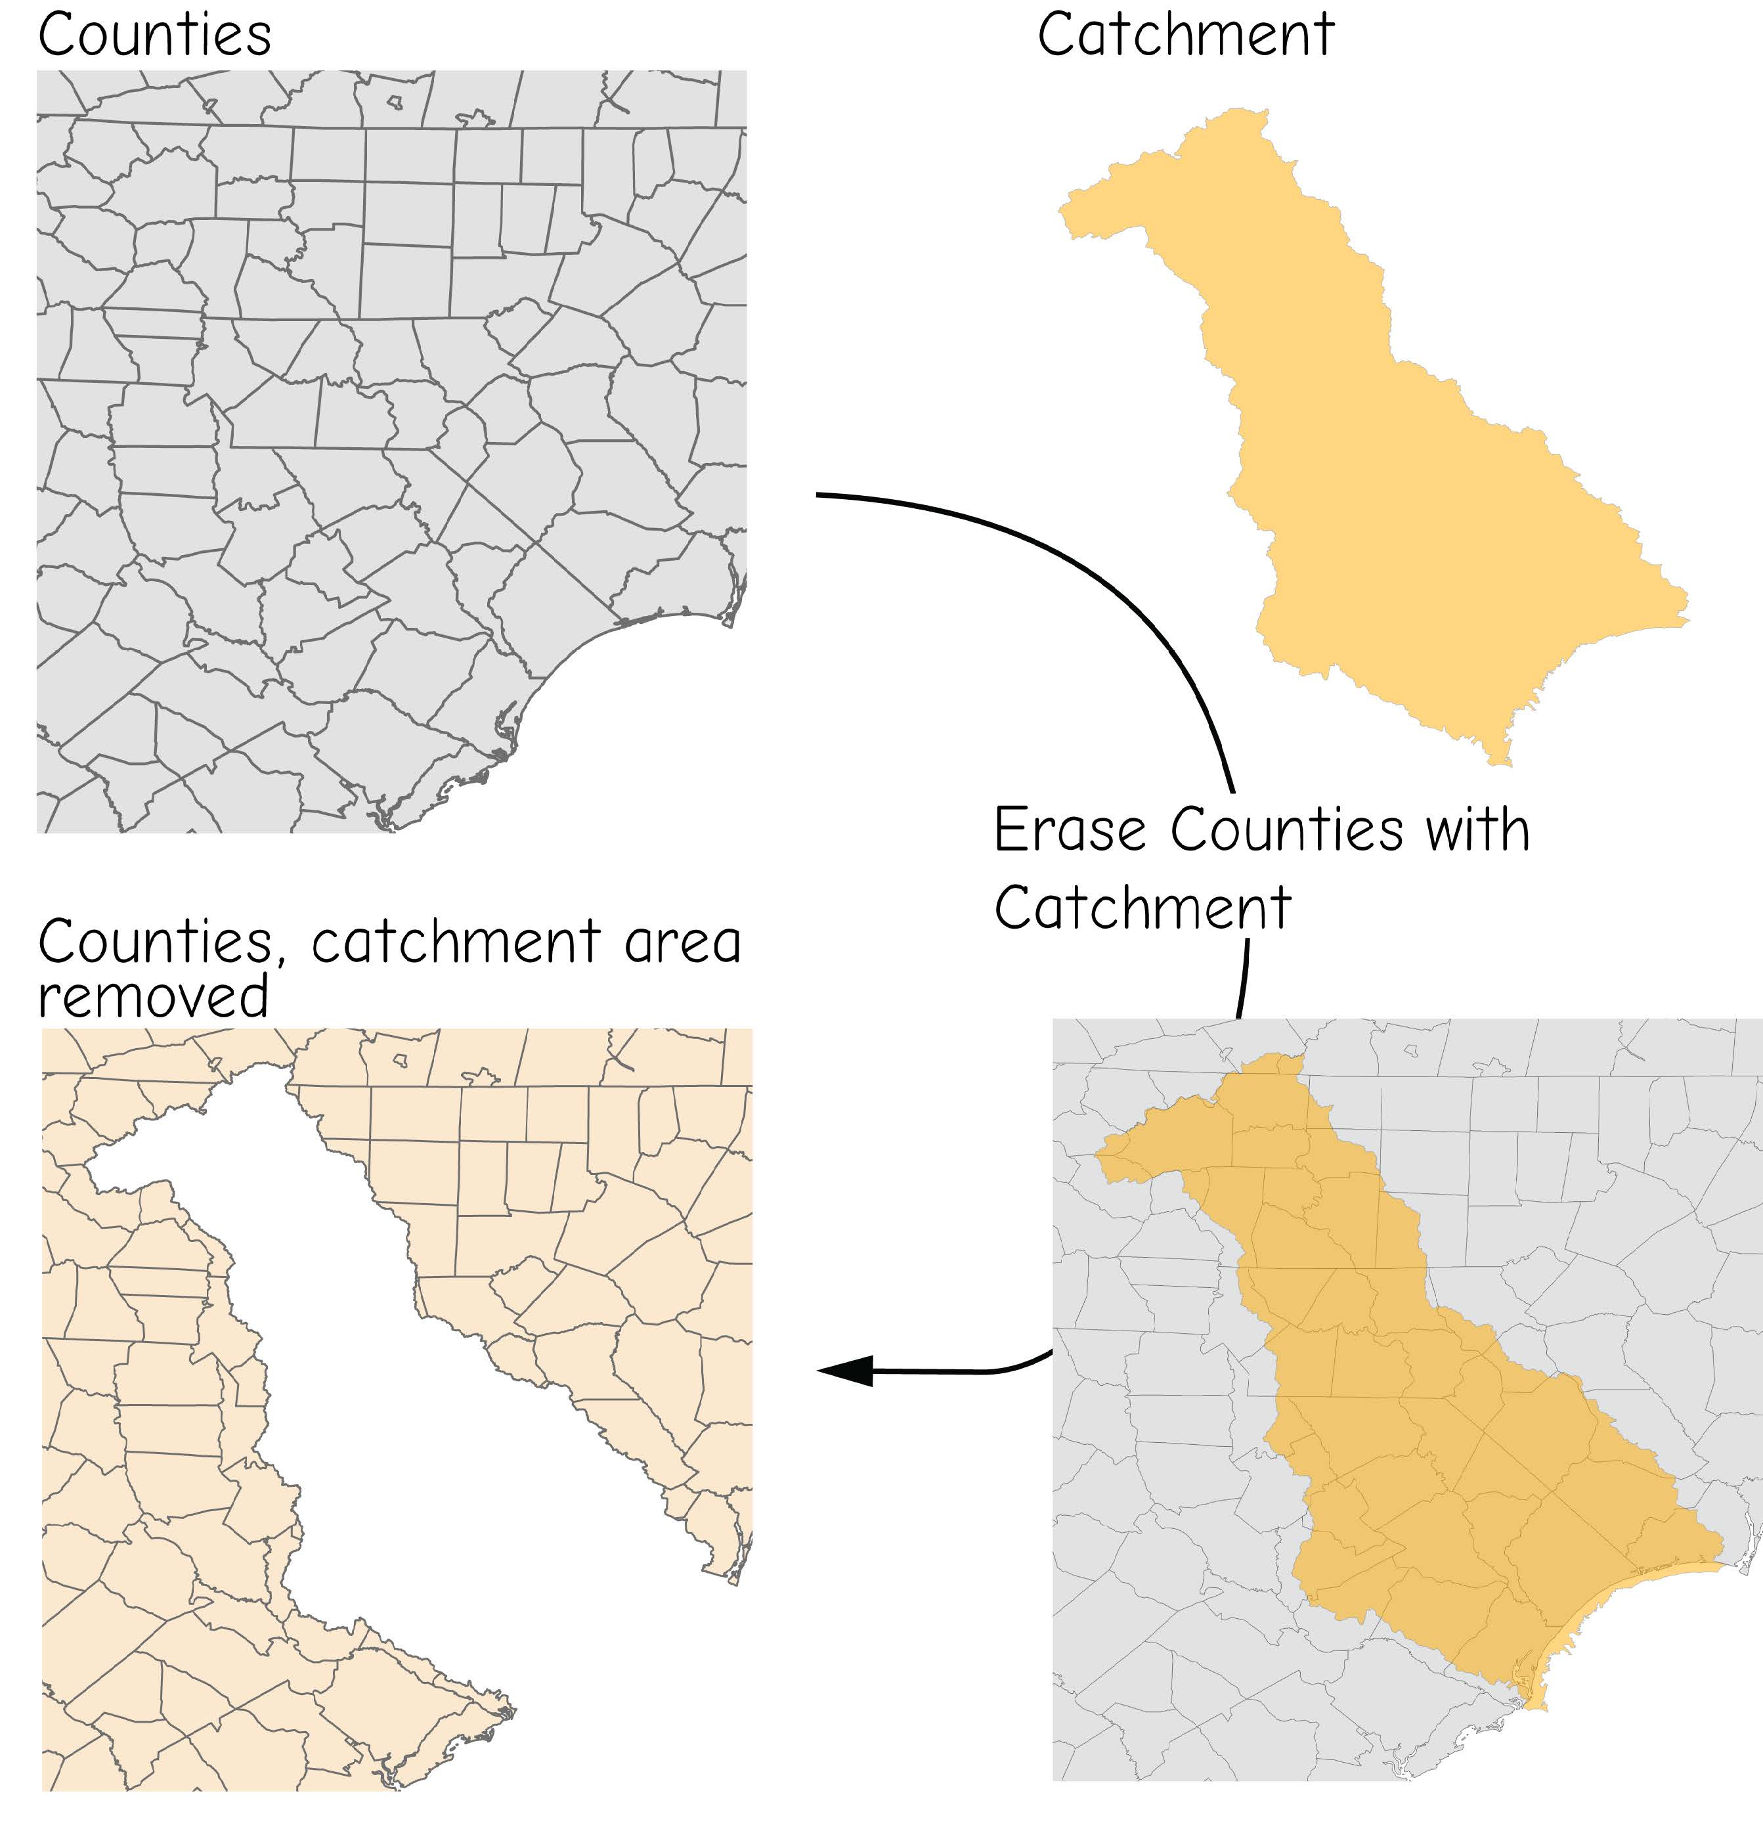
Overlay: Erase
Erase feature attributes are not added to the output

Slide 34
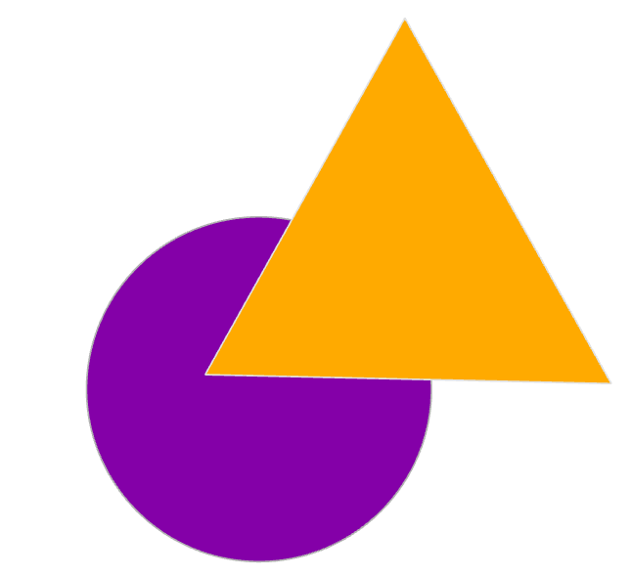
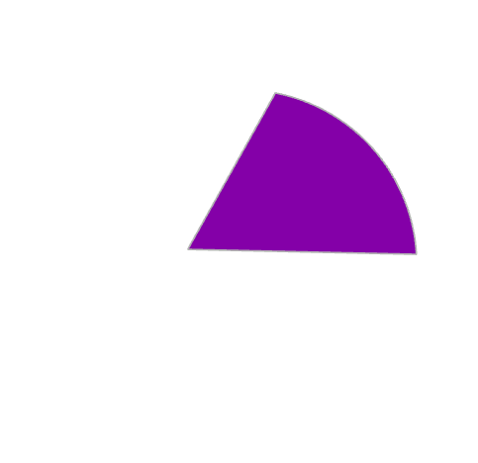
Overlay: Intersect
Intersect can be thought of as a spatial AND
Geometrically, this is same output as clip
Keep common area and boundaries in that common area
Notes:
Intersect can be thought of as a spatial AND.
In this case, only the shared area between input features will be maintained.
So, geometrically, this is the same output as clip.
However, in this case the attributes from both inputs, in this case the triangle and circle, will be maintained.
The shared geometry is returned and the total set of attributes.
It is also possible to intersect more than two features.

Slide 35
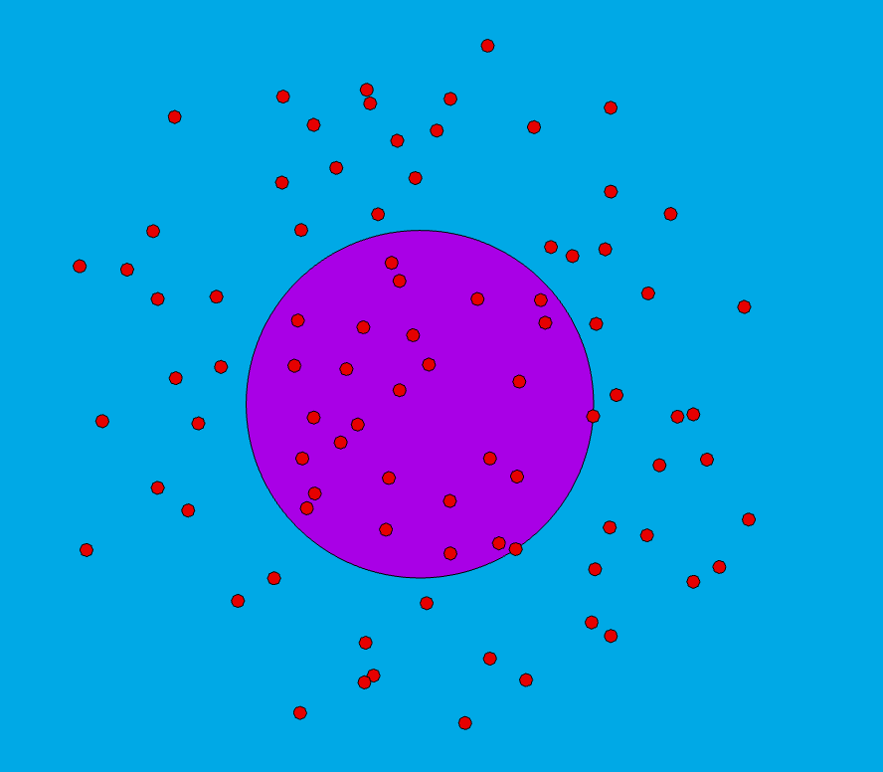
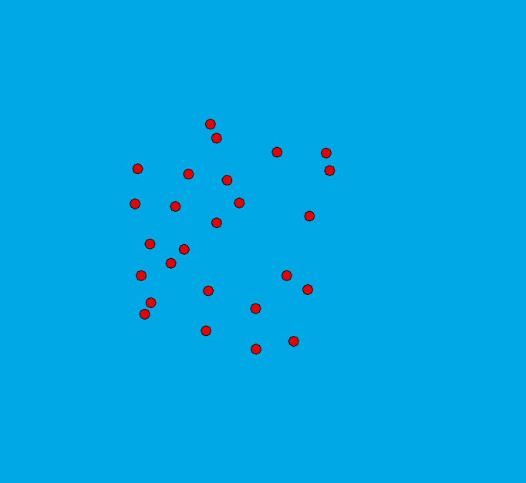
Overlay: Intersect
Notes:
This is another example of intersect in which points are being intersected with a circle.
The output geometry will be the same as clip: the points within the circle.
However, now the points will have the attributes for the circle associated with them.

Slide 36
Overlay: Intersect
Notes:
In this example, a line and circle are being intersected.
The output geometry is the same as that for clip: the portion of the line within the circle.
However, now the line and circle attributes will be returned as oppose to just the line attributes.

Slide 37
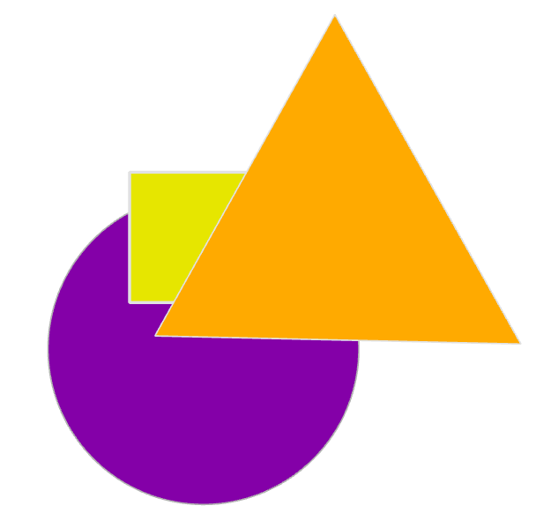

Overlay: Intersect
You can intersect more than two layers
Notes:
This is an example of a union involving three input polygons.
The output will be the area shared by all three features and all attributes will be returned.

Slide 38
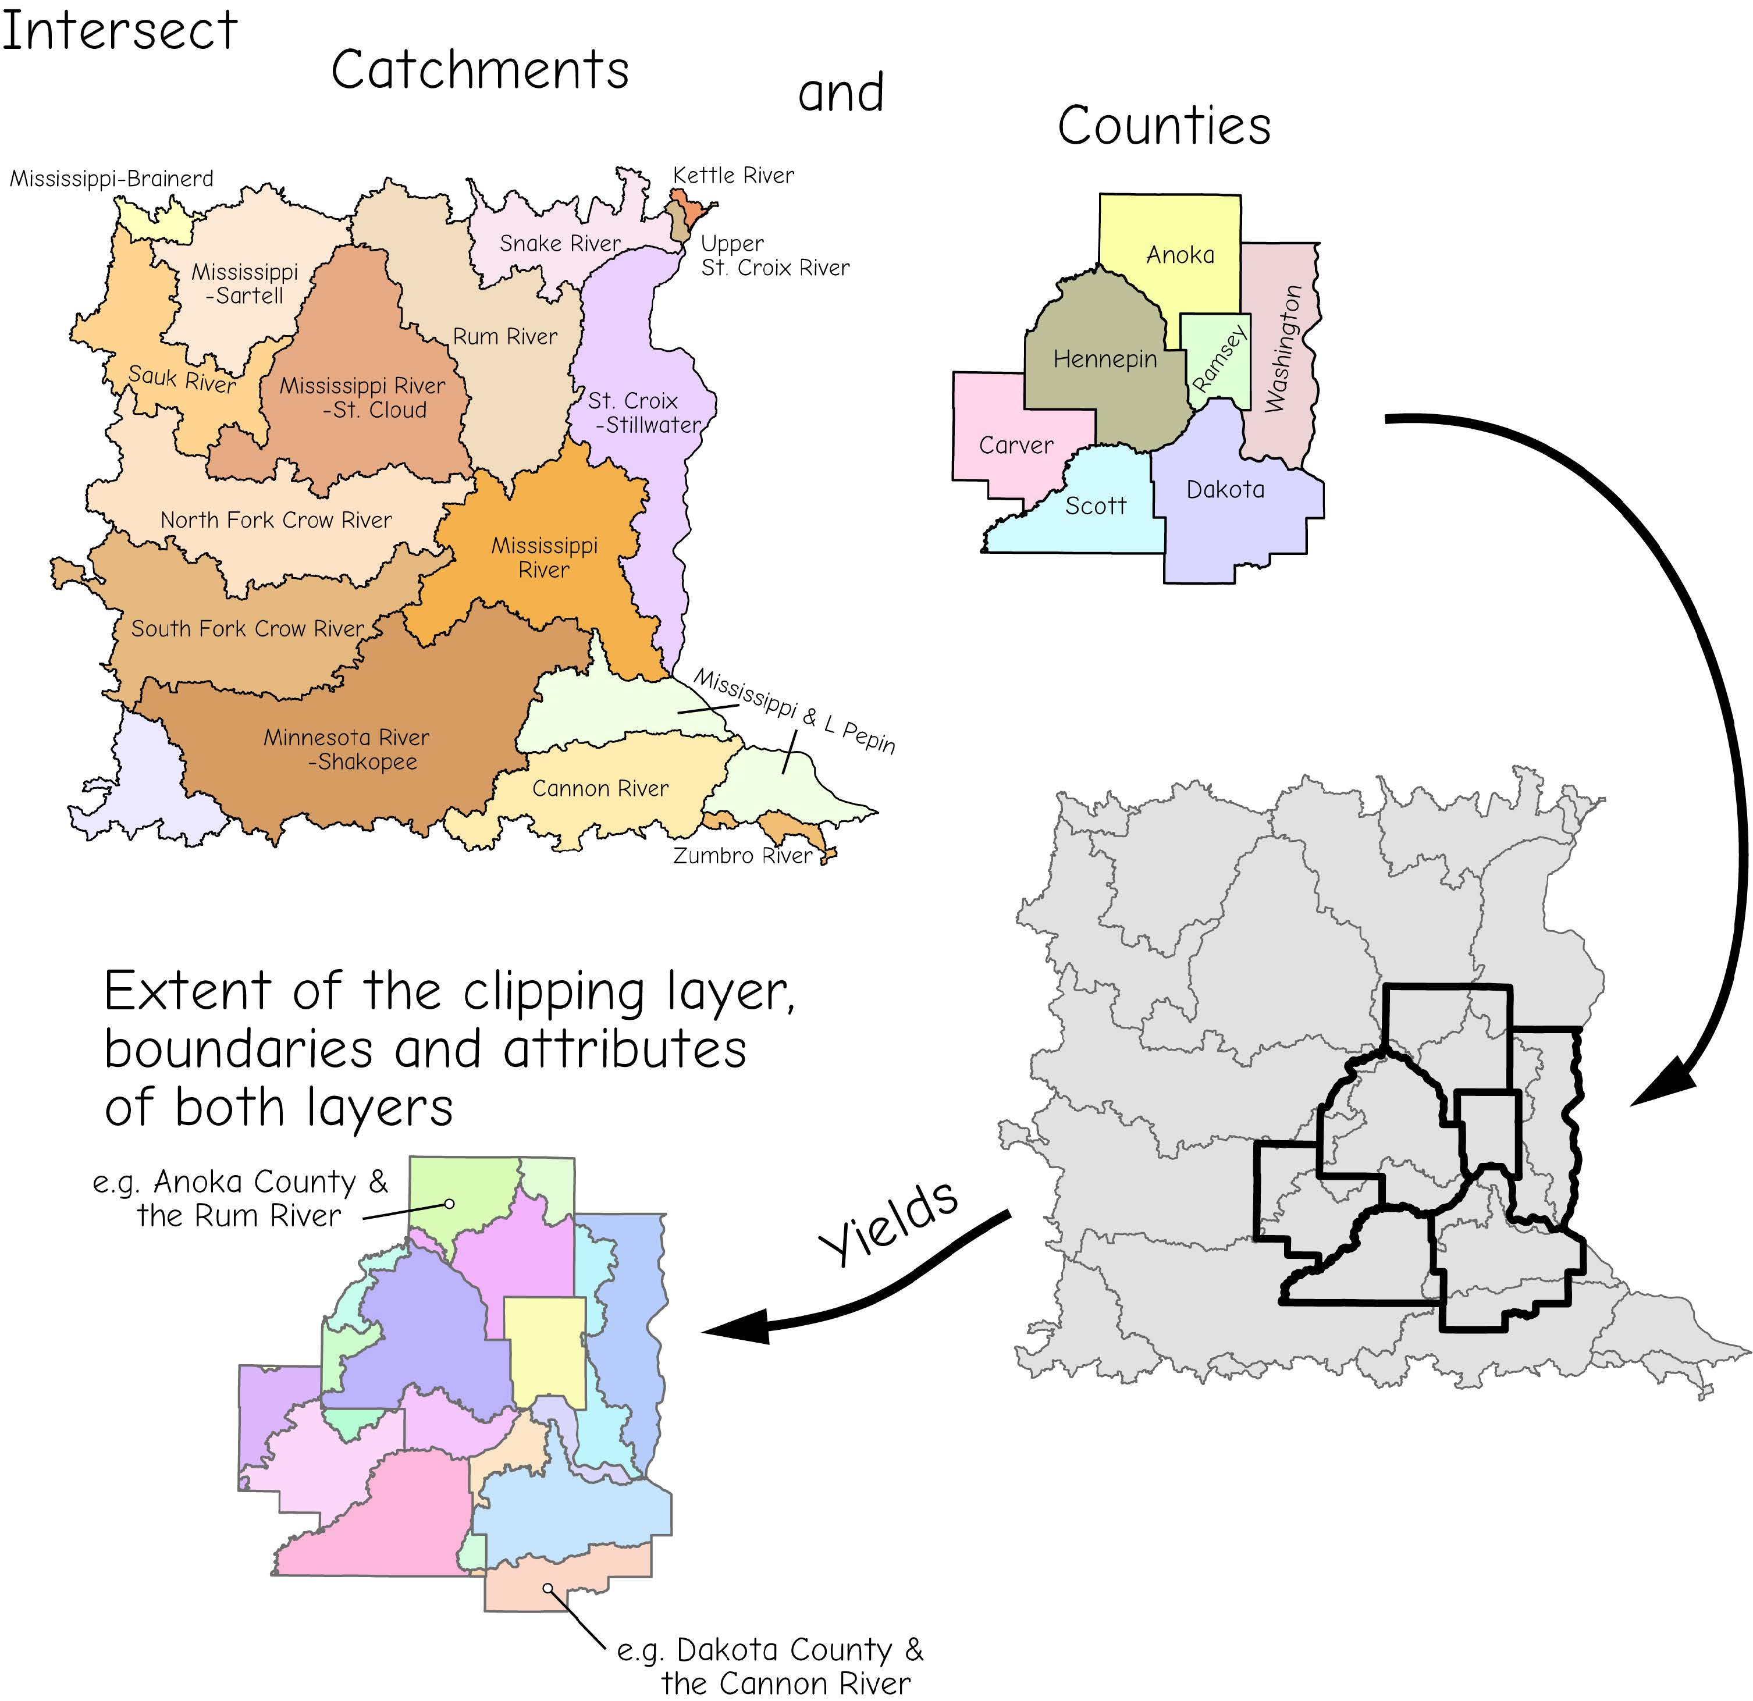
Overlay: Intersect
Although the geometry is the same as Clip, the attribute table will have all of the attributes
Bolstad, 2019
Notes:
In this example, a line and circle are being intersected.
The output geometry is the same as that for clip: the portion of the line within the circle.
However, now the line and circle attributes will be returned as oppose to just the line attributes.

Slide 39
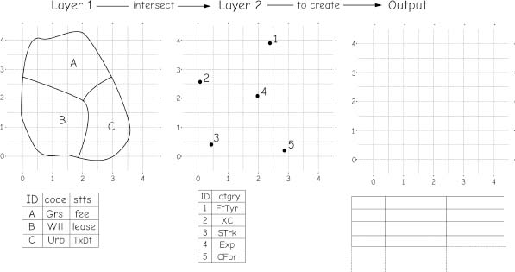
Group activity 11-1
Complete the table for the vector point overlay

Slide 40
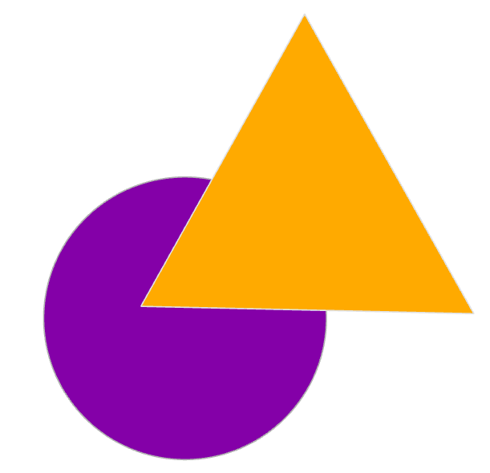

Overlay: Symmetrical Difference
Opposite of Intersect = only maintains areas that are not shared
All input attributes are maintained
Notes:
Symmetrical difference is a spatial XOR. Only areas that occur in one feature but not the other will be returned. Areas that occur in both features will not be returned or will be removed.
In this example, the portion of the circle that is not within the triangle is returned along with the portion of the triangle not in the circle.
The shared area is not returned., and all attributes will be maintained.

Slide 41
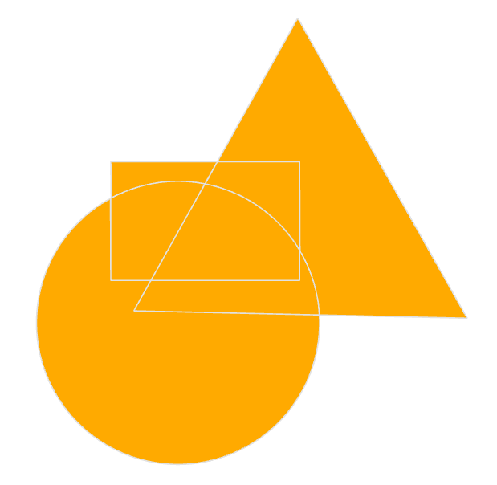
Overlay: Union
Spatial OR
Keep all boundaries and attributes
Used for polygon data only
Notes:
Union is a spatial OR.
In this case, all areas of all the features will be returned, but they will be sliced up along the intersecting boundaries.
In this example, a circle, rectangle, and triangle are inputs to union. The output is the full spatial extent of all three features, now sliced up along the intersections.
All attributes from all features will be returned.
Note that union is only performed for polygons. Lines and points cannot be inputs to union.

Slide 42
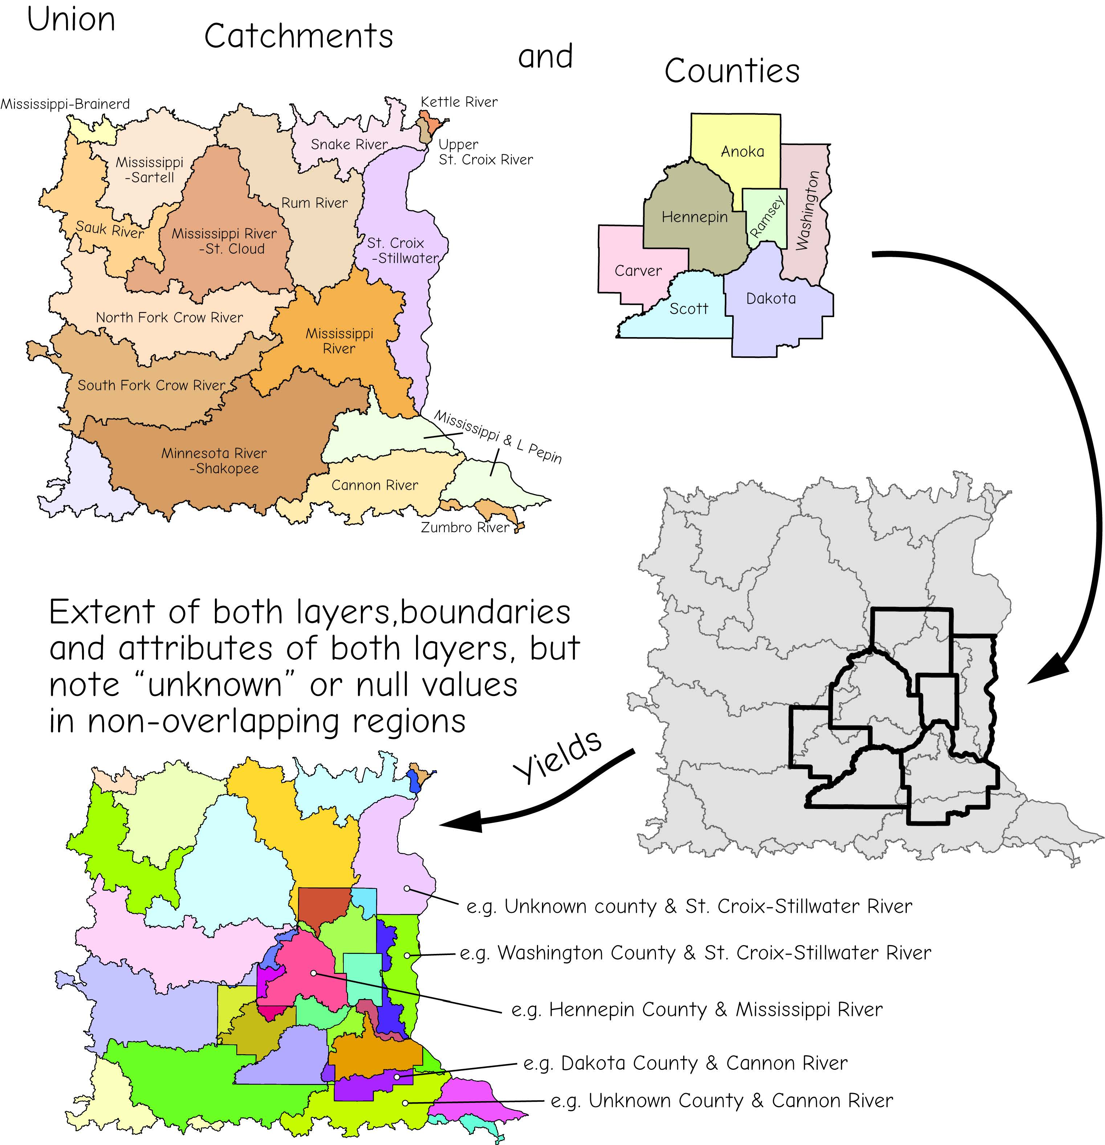
Overlay: Union
Spatial OR
Keep all boundaries and attributes
Used for polygon data only
Bolstad, 2019

Slide 43
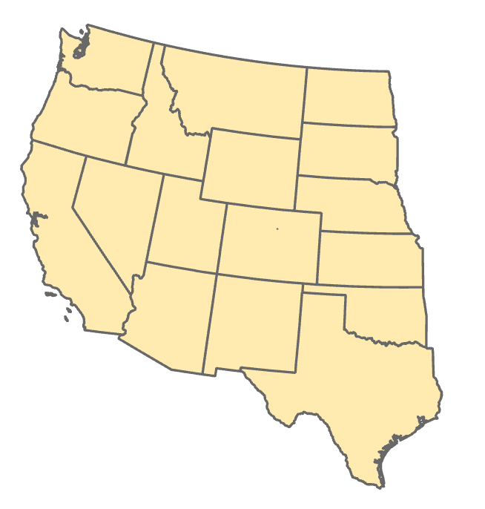
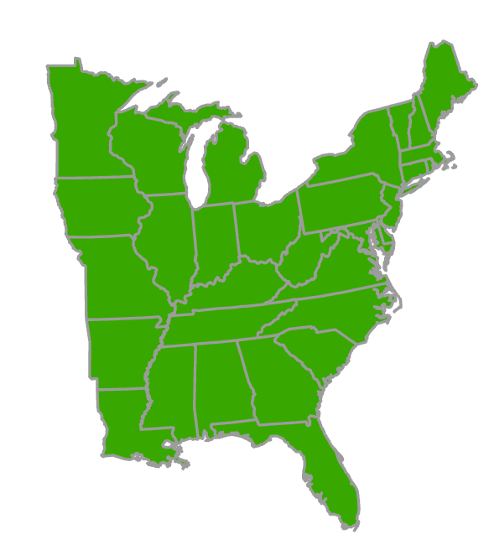
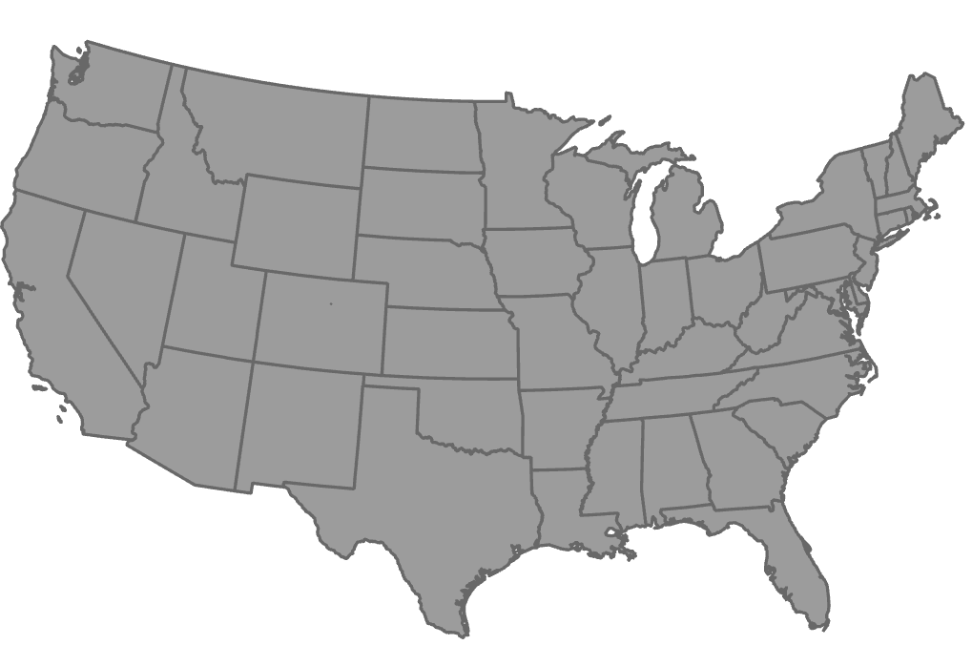
General: Merge
Combine datasets of the same type: points, lines, or polygons
Create a new file
+
=
Layer 1
Layer 2
Notes:
Merge is often confused with union. However, in this case no spatial intersections are being performed. Instead. Features from multiple files are simply being combined to a single file.
This would be similar to copying all the text from one text document and all the text from a second text document into a combined new document.
A spatial example would be combining all the roads in Pennsylvania with all the roads in New York into a new file that contains all the roads.
Merge is more of a data management tool as opposed to an analysis tool.

Slide 44
General: Append
Append new features to a target dataset
Instead of creating a new file, features from one file are added to the features in an existing file
+
=
Target
New Features
Notes:
Append is very similar to merge. However, instead of created a new file, features from one file are added to the features in an existing file.
This would be similar to copying the content from one text document into another document that already contains text.

Slide 45
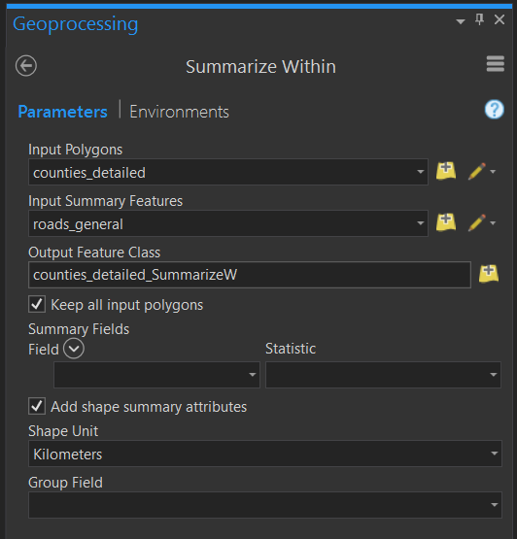
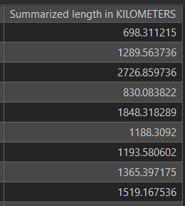
Statistics: Summarize Within
Overlays a polygon layer with another layer to summarize the number of points, length of the lines, or area of the polygons within each polygon, and calculate attribute field statistics about those features within the polygons.
Example: summarize length of roads in each county
Notes:
Summarize Within is used to summarize vector data relative to polygons.
It can be used to calculated the number of points in polygons, the length of lines in polygons, or the area of polygons within another polygon.
You can also generate summary statistics for provide attributes.
Note that this tool is not used to summarize raster data relative to zones or polygons. We will discuss methods for summarizing raster grids in the raster analysis module.

Slide 46
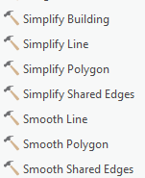
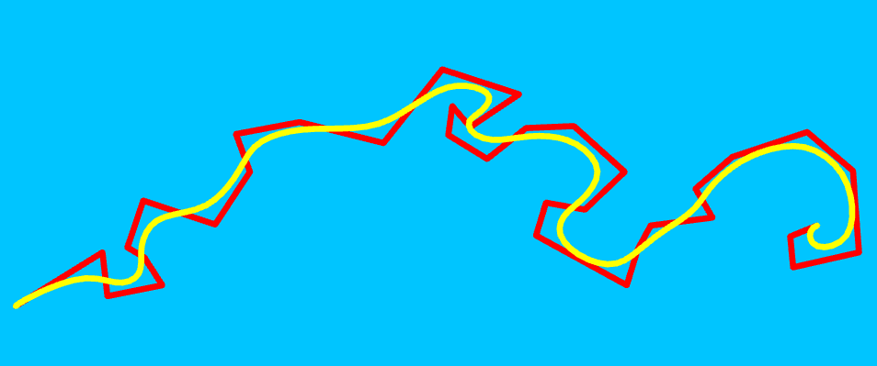
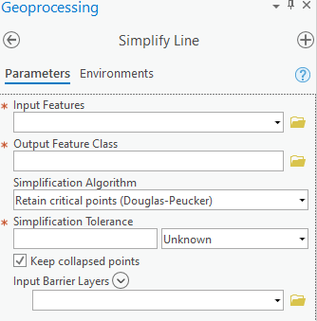
Cartography: Line Generalization
Remove unnecessary vertices
Smooth curves
For cartographic generalization
Simplify Line Tool
Smooth Line Tool
Available under Generalization Tools in the Cartography Toolbox
Notes:
Generalization methods are generally used for cartographic design. You may want to smooth or generalize features for cartographic generalization.
For line features, simplify is used to remove vertices while smooth is used to smooth curves in the lines. In the provided example, the yellow line represents a smoothed version of the red line, which may be deemed more appropriate for cartographic visualization.
In order to apply simplification or smoothing, an algorithm is used. You may have to experiment with the provided settings to obtain the desired result. This is often accomplished using trial-and-error.

Slide 47

Cartography: Polygon Generalization
Remove unnecessary vertices
Smooth curves
For cartographic generalization
Simplify Polygon Tool
Smooth Polygon Tool
Aggregate Polygons Tool
Available under Generalization Tools in the Cartography Toolbox
Notes:
Polygons can also be simplified or smooth to remove vertices or smooth curves, respectively.
It is also possible to aggregate smaller polygons into larger polygons for cartographic generalization. For example, polygons representing smaller neighborhoods could be aggregated into a larger polygons representing a generalization of the smaller neighborhood boundaries.

Slide 48


Cartography: Point Aggregation
Aggregate points to polygon
Can be used for cartographic generalization
Point Aggregation Tool
Available under Generalization Tools in the Cartography Toolbox
Notes:
Points can be aggregated into polygons.
Based on an algorithm and specified settings, near points will be used to define a new polygon extent.

Slide 49


Feature to Points
Multipoint feature: the output point will be located at the average x and y coordinates of all the points in the multipoint feature
Input line feature: the output point will be located at the weighted average x and y coordinates of the midpoints of all line segments in the line feature
Polygon feature: the output point will be located at the center of gravity (centroid) of the polygon.
Can force result to be inside of polygons
Notes:
Feature to point will generate a point for each input feature.
The input can be multipoint, line, or polygon features. The output will always be points.
This slide provides explanations as to how points are generated for different input features.

Slide 50




Minimum Bounding Geometry
Creates a feature class containing polygons which represent a specified minimum bounding geometry enclosing each input feature or each group of input features
Rectangle by Area or Width
Convex Hull
Notes:
Minimal bounding polygons represent a specified minimal bounding geometry that encloses an input feature or group of input features.
A convex hull represents the area that encompasses a set of input features without any concave angles or sides. This can be conceptualized as stretching a rubber band between the outlying features or points.
A minimal bounding rectangle can be defined based on minimal area or minimal width. If area is used, then the rectangle with the smallest area that completely encompasses the input feature or features will be returned. Using width, the rectangle with the smallest width will be returned.

Slide 51


Minimum Bounding Geometry
Creates a feature class containing polygons which represent a specified minimum bounding geometry enclosing each input feature or each group of input features
Envelope
Circle
Notes:
The minimal bounding envelope is often confused with the minimal bounding rectangle. The minimal bounding envelop is different from the minimal bounding rectangle because the sides of the rectangle must occur along the cardinal directions (north-south and east-west). It cannot be rotated relative to these directions.
The minimal bounding circle represents the smallest circle, based or radius, that encompasses the input feature or features.

Slide 52

A Note on Slivers
Can remove features smaller than a certain size, considering minimal mapping unit (MMU)
Can merge with adjacent polygons
Notes:
Slivers represent noise in vector overlay processes. They represent areas of non-overlap between features that could represent real patterns or result from digitizing errors or scale difference in the input data.
When you perform analyses that combine vector extents, such as union, slivers are often generated.
For example, if you perform a union of a state boundary generated a 1:100,000 scale with the same state boundary generated at 1:24,000 scale, the extents will likely not be the same, as the 1:100,000 scale boundary will be more generalized.
So, the result from the union operation will contain areas that (1) occur in both features, (2) occur in the 1:100,000 scale feature but not the 1:24,000 scale feature, and (3) occur in the 1:24,000 scale feature but not the 1:100,000 scale feature.
Method are available to deal with this issue. You could choose to simply ignore the issue or include the slivers in the analysis. As another option, you could remove areas that are smaller than a defined size, potentially based on a minimal mapping unit. Or, you could merge features that are smaller than a certain size with adjacent larger features.

Slide 53
A Note on Geometry
Remember, that geometric fields are not updated with geoprocessing. Make sure geometry is correct before you use it.
For example, remember to update length, area, perimeter, etc. after performing a clip.
Notes:
This is an important consideration.
Fields in attribute tables that contain geometric measures, such as length, area, or perimeter, are not automatically updated following geoprocessing operations.
For example, if Interstate 68 was clipped using the West Virginia boundary so that only the portion of the interstate within West Virginia was returned, length fields in the attribute table would not be automatically updated.
So, they would be wrong.
For this reason, my general rule is to not trust geometric measures in attribute tables. If you need these measures to complete your analysis, they should be recalculated to make sure they are correct.
One exception to this issue are fields that are automatically generated for feature classes in geodatabases when a new feature class is created, such as Shape_Length or Shape_Area.
In summary, make sure that geometric fields are correct before using the information provided. It is very simple to perform these calculations, so there is no excuse for not making sure the numbers are correct.

Slide 54

Thank you!

