Slide 1

WEEK 05
GEODATABASE
LECTURE
INSTRUCTOR: YANAN WU
FALL 2026
1

Slide 2
5.1
GEODATABASE

Slide 3
FUNDAMENTALS OF THE GEODATABASE
A geodatabase is the native ArcGIS structure for organizing, storing, editing, and managing GIS datasets.
🗂️ Stores data
🧱 Manages structure
✅ Improves quality
Feature classes, tables, raster datasets, attachments, and more.
Geometry type, spatial reference, fields, indexes, and relationships.
Domains, subtypes, topology, and rules help prevent bad data.
Key idea: a geodatabase is not just a folder. It is a data model for managing GIS information.

Slide 4
WHY USE A GEODATABASE?
A shapefile stores one layer as several related files.
A geodatabase can store many related GIS datasets together.
It can define rules for valid attribute values.
It supports advanced GIS behavior, such as topology and relationships.
📁 Folder of files
.shp + .dbf + .shx + .prj + ...
🗄️ File geodatabase
Roads + buildings + tables + domains + attachments

Slide 5
TYPES OF GEODATABASES
💻 File geodatabase
📱 Mobile geodatabase
🏢 Enterprise geodatabase
.gdb folder on a local drive or shared drive.
Best for course projects, local editing, and data organization.
Single .geodatabase file based on SQLite.
Useful for portable and mobile workflows.
Stored in an enterprise DBMS; supports many users, versioning, and organization-wide editing.
For this class, we mainly use file geodatabases because they are easy to create and manage in ArcGIS Pro.

Slide 6
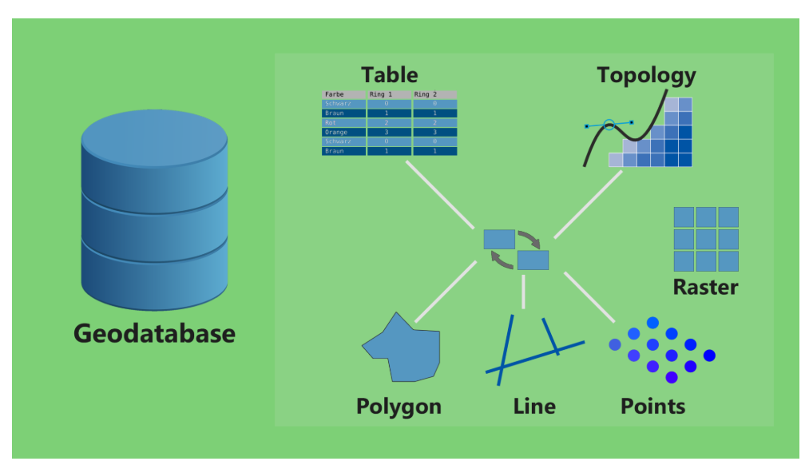
GEODATABASE COMPONENTS
A geodatabase can contain many kinds of GIS datasets and rules.
Feature class
Table
points, lines, polygons
nonspatial records
Raster dataset
Domains
grid/pixel data
valid attribute values
Subtypes
Topology
categories inside one feature class
spatial relationship rules
Think of a geodatabase as a structured GIS workspace, not just a storage folder.

Slide 7
FEATURE CLASSES
A feature class is the main way vector data are stored in a geodatabase.
📍 Same geometry
📋 Same fields
🌐 Spatial reference
All features must be points, lines, or polygons—not mixed.
All rows share the same attribute schema.
Coordinates are tied to a defined coordinate system.
Example
A RoadDamage feature class stores each damaged location as one point feature with fields such as damage_type, severity, photo, and priority_score.

Slide 8
FEATURE CLASS VS. SHAPEFILE
Shapefile
Feature class in geodatabase
Traditional exchange format
ArcGIS data management format
• Multiple files must stay together
• One geometry type per layer
• Limited field names and data types
• No built-in domains or subtypes
• Stored inside a .gdb
• One geometry type per feature class
• Better field/schema management
• Can use domains, subtypes, topology, attachments
Q: Please check the type of ‘Airport’ Data in geodatabase and folder

Slide 9
TABLES AND RASTER DATASETS
📊 Tables
🧩 Raster datasets
Tables store records that may not have geometry. They can still be related to spatial features using common IDs.
Example: maintenance history table linked to road-damage points.
A geodatabase can also store raster data such as elevation, land cover, or imagery.
Example: a DEM stored with vector roads in the same project geodatabase.

Slide 10
ATTRIBUTE DOMAINS
A domain is a rule that limits what values can be entered in a field.
🔢 Coded-value domain
📏 Range domain
A fixed list of allowed categories.
Road condition:
• good
• fair
• poor
A numeric field must fall within a valid range.
Inspection score:
0 to 100
Why it matters: domains prevent inconsistent entries such as “Poor,” “bad,” “damaged,” and “p00r.”

Slide 11
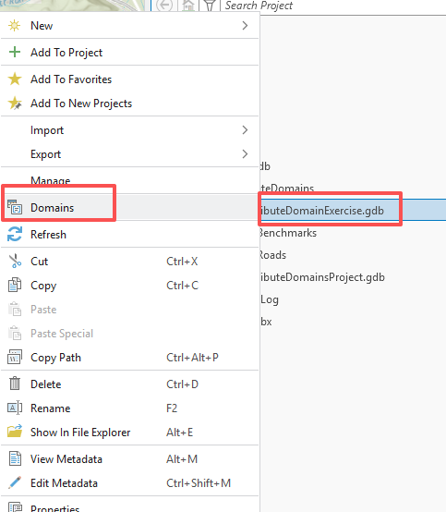
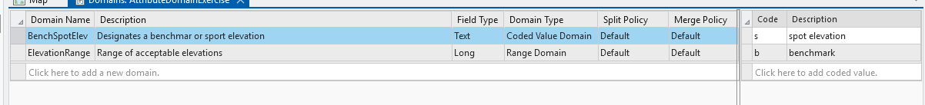
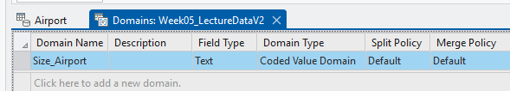
DEMO: CREATE A CODED-VALUE DOMAIN
Class demo: create a coded-value domain to standardize location of airports.
Steps
1. Right-click the geodatabase → Domains
2. Create Locations as Text + Coded Value
3. Add South, North, East, West
4. Assign the domain to the field
5. Try entering an invalid value

Slide 12

DEMO: CREATE A RANGE DOMAIN
Range domains are useful when the answer should be numeric but must stay within a reasonable range.
Steps
⛰️ Example: Area range
1. Right-click the geodatabase → Domains
2. Create Area as Double + Min and Max
3. Add 0 as Minimum and 500 as Maximum
4. Assign the domain to the field
5. Try entering an invalid value
Field: Area
Allowed values: 0–500 acres
Purpose: prevent impossible values for the airport area.
Field: SCORE
Allowed values: 1–5
Purpose: standardize inspection rating.
Q: Please try to enter -8, 180, and 650 in the Area field.
Which values are accepted, and which values violate the range domain? Explain what you observe.

Slide 13
SUBTYPES
Subtypes divide one feature class into meaningful groups using a coded integer field.
Subtype 1
Road damage
Why use subtypes?
🛣️ One feature class
Infrastructure
Different groups can have different default values, domains, and editing rules.
Subtype 2
Sidewalk issue
Subtype 3
Sign problem
Question: Should potholes, sidewalk cracks, and broken signs be separate layers or subtypes?

Slide 14
TOPOLOGY RULES
Topology rules help maintain correct spatial relationships between features.
Must not overlap
Must not have gaps
Must be covered by
Parcel polygons should not overlap each other.
County polygons should cover the area without slivers.
Buildings should fall inside parcel polygons.
Topology does not just store shapes. It checks whether the shapes make spatial sense.

Slide 15
GEODATABASE DATA MANAGEMENT WORKFLOW
A good geodatabase workflow moves from storing data to designing data behavior.
Create .gdb
Import data
Design schema
Add rules
Use products
Make a project geodatabase
Bring in shapefiles, tables, rasters
Fields, data types, spatial reference
Domains, subtypes, topology
Maps, analysis, dashboards, StoryMaps
Class connection: organize source data first, then create maps, dashboards, and StoryMaps.

Slide 16
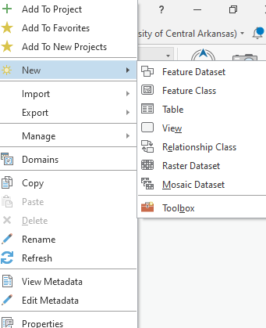
CLASS DEMO: CREATE A FILE GEODATABASE
Goal: students see that a file geodatabase is created as a .gdb folder inside the project.
Open ArcGIS Pro and create or open a project.
In the Catalog pane, right-click Databases or a folder connection.
Choose New File Geodatabase.
Name it: UCA_RoadDamage.gdb.
Open the .gdb folder in File Explorer.
Reminder: do not manually edit the files inside the .gdb folder.

Slide 17
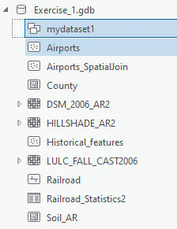
CLASS DEMO: IMPORT DATA INTO A GEODATABASE
Goal: move data into the geodatabase and compare old and new storage formats.
Right-click the target geodatabase → Import.
Choose Feature Class(es) for vector data or Raster Dataset for raster data.
Select a shapefile such as roads or campus points.
Name the output feature class clearly.
Open the attribute table and compare fields before/after import.
Discuss: what changed when the shapefile became a feature class?
Task: identify the new feature class inside the geodatabase.

Slide 18
5.2
LAB SESSION

Slide 19
Lab 04: Spatial queries
Due by NOON (12:00 pm) on THURSDAY, Sep 24, 2025
Submit a word document only include question and answer

