Slide 1

GEOG 2475: Geographic Information Systems I
Lecture 02 Datum and Projection
Yaqian He, PhD
Assistant Professor
Department of Geography

Slide 2
Overview
Datum
Shape of Earth
Geoid
Coordinate system
Geographic coordinate systems
Projected coordinate systems
Projections
Plane projection
Conic projection
Cylindrical projection
Examples: Global, continental, and state scales

Slide 3
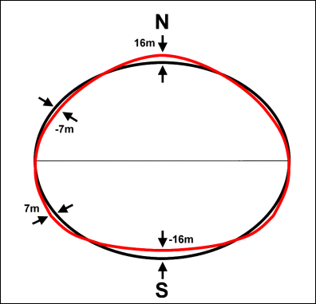
Shape of the Earth
Geodesy
Science of measuring Earth’s shape
https://commons.wikimedia.org/wiki/File:Geoundnsrp.png
Notes:
All spatial data must be referenced to the surface of the Earth so that they draw at the correct location in the map space.
This means that we need models of the Earth to which we can reference maps and data.
This is a component of the science of geodesy, which relates to measuring the Earth’s shape and positions on it.

Slide 4
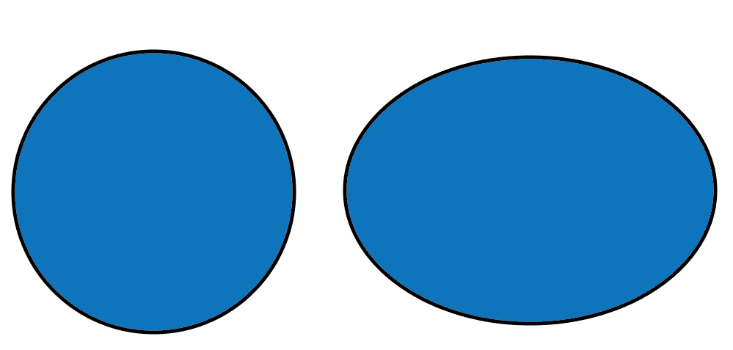
Shape of the Earth
Oblate spheroid
Equator has larger circumference than meridians
Mass not evenly distributed
Notes:
To begin, the Earth is not a perfect sphere. Instead, it is an oblate spheroid.
It is wider than it is tall. Or, the circumference of the equator is longer than the circumference of the prime meridian or any meridian.
This results from the centrifugal forces arising from the planet’s rotation.
Further, mass is not evenly distributed throughout the Earth.
So, the Earth is actually a fairly irregular shape, which results in complexity in regards to producing reference systems by which to reference our maps and data against it.

Slide 5
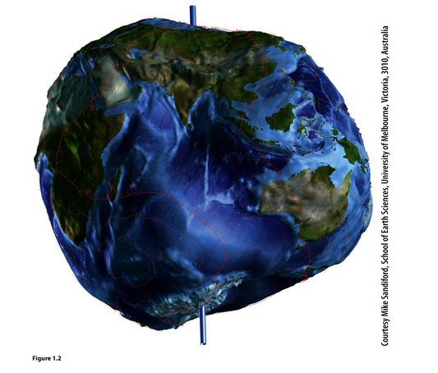
Shape of the Earth
Oblate spheroid
Equator has larger circumference than meridians
Mass not evenly distributed
Notes:
To begin, the Earth is not a perfect sphere. Instead, it is an oblate spheroid.
It is wider than it is tall. Or, the circumference of the equator is longer than the circumference of the prime meridian or any meridian.
This results from the centrifugal forces arising from the planet’s rotation.
Further, mass is not evenly distributed throughout the Earth.
So, the Earth is actually a fairly irregular shape, which results in complexity in regards to producing reference systems by which to reference our maps and data against it.

Slide 6
Modeling the Earth
Geoid
True Earth surface
Geoid (Includes ocean)
Ellipsoid
Notes:
In order to model the Earth, simplification is required.
The true Earth surface need to be generalized. First, it is generalized to a geoid.
This is further simplified to an ellipsoid.
We will explore these concepts now.

Slide 7
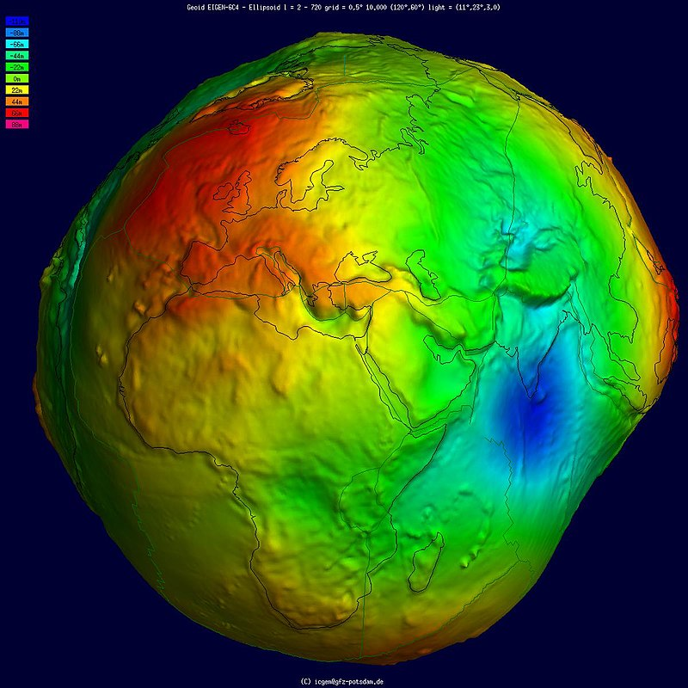
Geoid
The geoidal surface can be thought of as an imaginary sea that covers the entire Earth and is not affected by wind, waves, the Moon, or forces other than Earth’s gravity.
https://en.wikipedia.org/wiki/Geoid
Notes:
The geoid models the distribution of mass across the Earth, which is not uniform. The Earth is a bumpy surface.
This is partially accomplished by measuring gravitational forces across the globe.
A conceptualization of the geoid is a globe that is fully covered by water or has no continental masses.
Because there are differences in mass and gravitational forces across the globe, the water surface would not be smooth.
Instead, it would be a smoothly undulating shape.
This smoothly undulating shape that takes into account the distribution of mass is called the geoid.
The geoid surface can them be used as a reference for zero elevation.

Slide 8
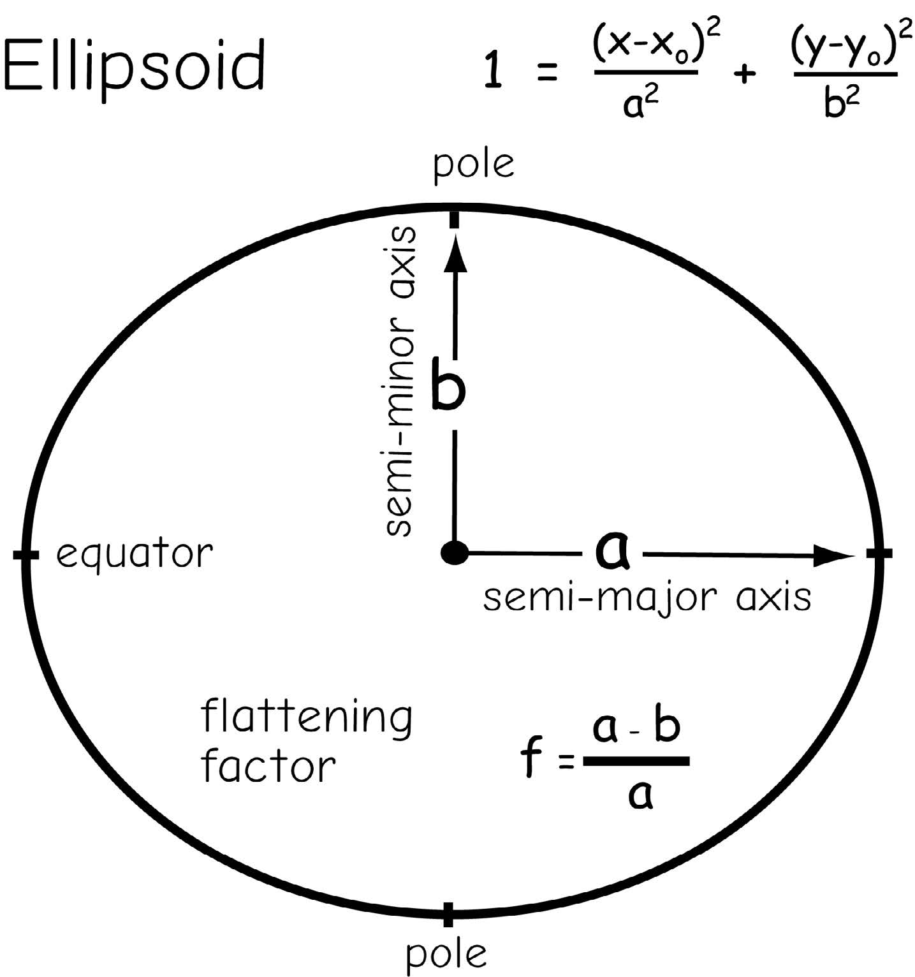
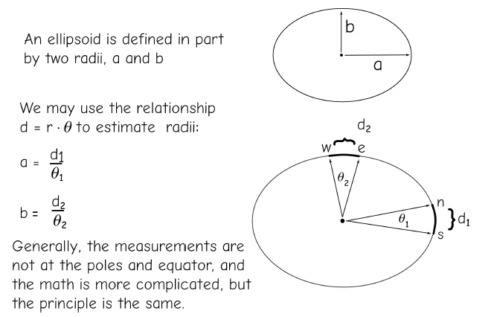
Datum
We need a mathematically simple model of the Earth’s Surface
We use an ellipsoid/ spheroid
There are different ellipsoids/ spheroids used
Combined with ground survey data, we call these datums
Bolstad, 2019
Notes:
The geoid is still a complex shape that cannot be modeled with a simple mathematical equation.
So, it is further simplified to an ellipsoid or spheroid model of the Earth.
This is a mathematical model that approximates the geoid as a smooth surface. Basically, this is a 3D ellipse.
Combining this model with ground survey data allows us to produce datums.
These datums serve as the reference systems by which we represent locations on Earth’s surface.
Our map and geospatial data will be referenced to one of these models.
The arc lengths may be measured by surface surveys, and the angles from astronomical observations

Slide 9
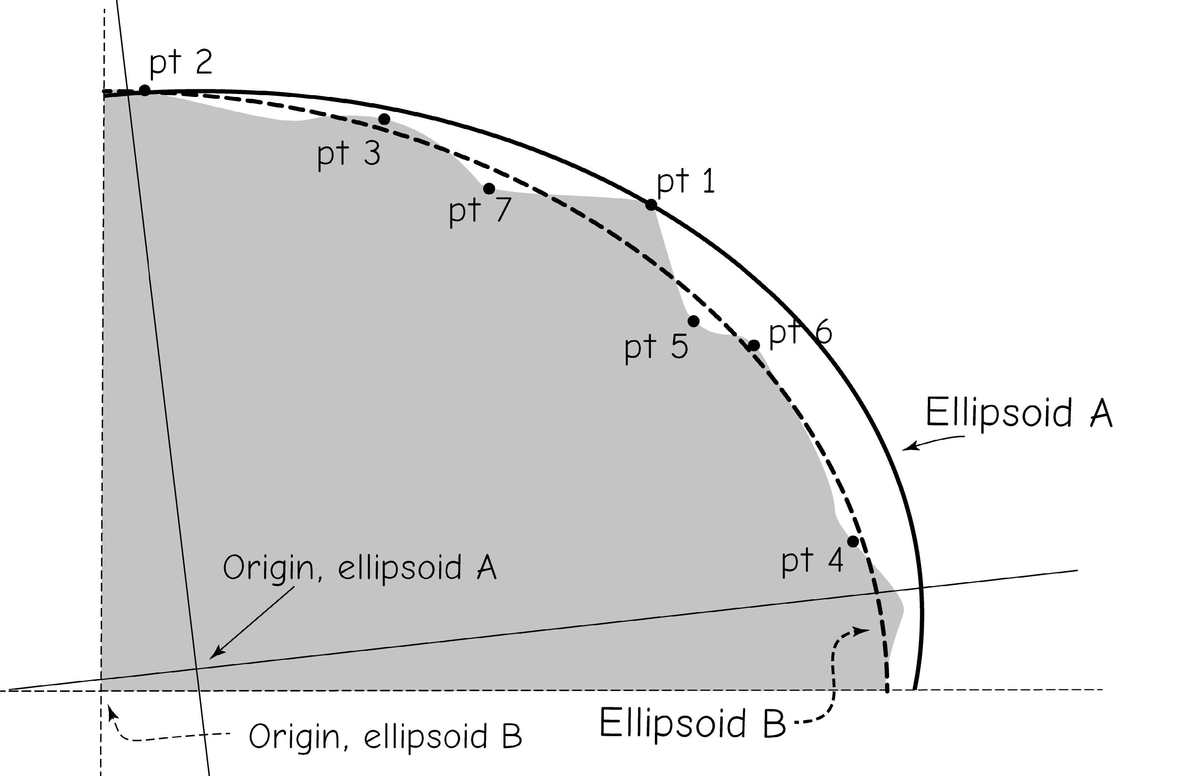
Datum
Datum changes through time due to more survey measurements available or improvement on measurement methods
Before satellite era and after satellite era
Datum adjustment
Bolstad, 2019
Notes:
NGS (National Geodetic Survey),Triangulation survey
For the most of the past 150 years, the most accurate observations were referenced to the Sun, stars, or other celestial bodies
Every few years

Slide 10
Datum
NAD27: North American Datum of 1927
NAD83: North American Datum of 1983
NAD83(xx), xx represents year, version of datum adjustment
NAD83(HARN/HPGN): High Accuracy Reference Networks or High Precision Geodetic Networks
WGS84: World Geodetic System 0f 1984
WGS84(xx)
ITRF: International Terrestrial Reference Frames
ITRF89, ITRF90, ITRF91
Notes:
There are different datums by which we reference are horizontal measurements or coordinates on the Earth.
Examples include the North American Datum of 1927 (or NAD27), the North American Datum of 1983 (or NAD83), and the World Geodetic System of 1984 (or WGS83).
In North America, it is common to reference data against NAD83 or WGS84.
Global Navigation Satellite Systems, or GNSS, often make use of WGS84 as a worldwide datum.
Again, think of these as different models of the Earth, all of which are simplifications.
The HARN and subsequent NAD83 adjustments are largely satellite-based, including WGS84 and ITRF

Slide 11
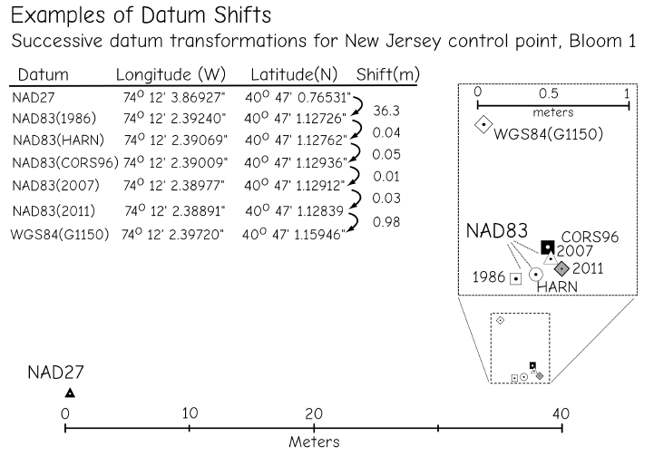
Datum
WGS84 and ITRF can be considered equivalent for most purpose, as difference between them since 1995 are generally only a few centimetres
Bolstad, 2019
Notes:
Tectonic movement, crustal deformation

Slide 12
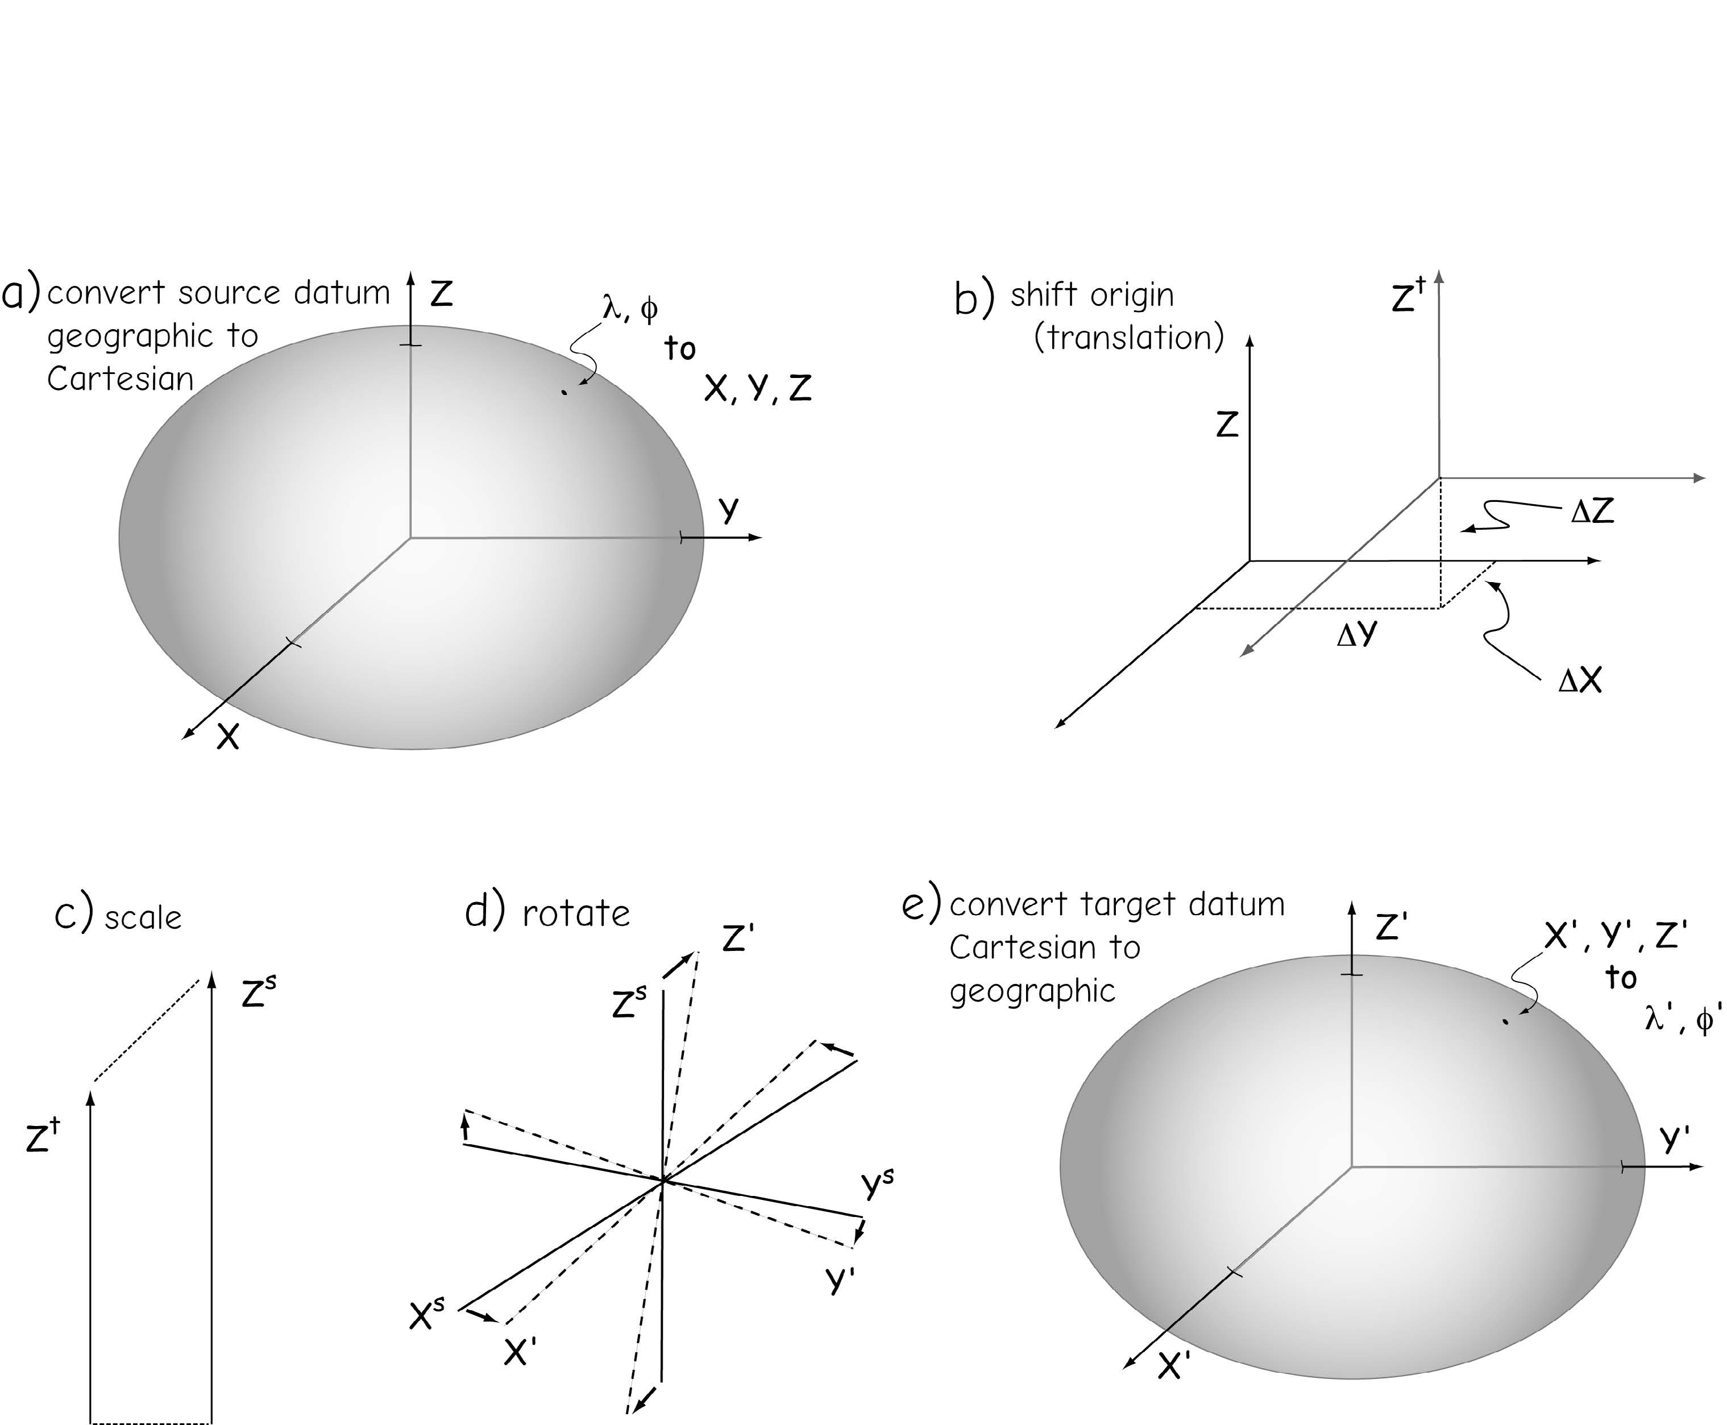
Datum
Transformation
Converting coordinates from one datum to another
Shift origin
Scale
rotation
Bolstad, 2019

Slide 13
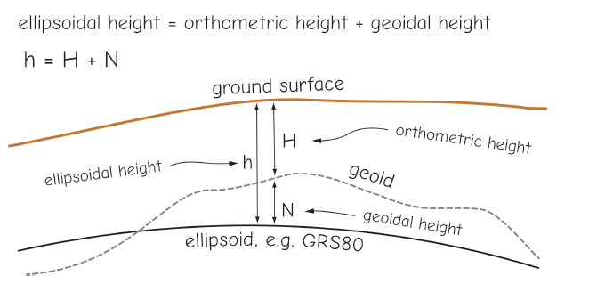
Datum
Orthometric Height (H)
Height above geoid
Ellipsoidal Height (h)
height above ellipsoid
Geoid Height (N)
Geoid above ellipsoid
Bolstad, 2019
Notes:
Orthometric heights are important, because these are the type of height found on innumerable topographic maps and in paper and digital data sets.
https://community.trimble.com/community/find-answers/mapping-and-gis-solutions-community/blog/2020/04/04/orthometric-heights-with-trimble-gnss-esri-collector-part-1-of-4
There are separate vertical datums that height or elevation measurements are referenced to.
Further, elevations can be referenced against an ellipsoid model of the Earth or a geoid model.
Elevations referenced to a geoid are called orthometric heights whereas those referenced against an ellipsoid are called ellipsoidal heights.
N represents the difference between the orthometric and ellipsoidal heights at a location.
N varies based on the location on the Earth and the orthometric and ellipsoidal models used. Sometimes the ellipsoidal height is higher than the orthometric height and sometimes the orthometric height is higher.
When comparing elevation measurements, you should make sure that either orthometric or ellipsoidal heights are used for all surfaces so that this difference does not invalidate the comparison.
Orthometric heights have replaced our elevations above mean sea level because, as mentioned earlier, modern vertical heights are referenced to a geoid.
We most often combine models of geoidal height with measurements of ellipsoidal height to establish orthometric heights.

Slide 14
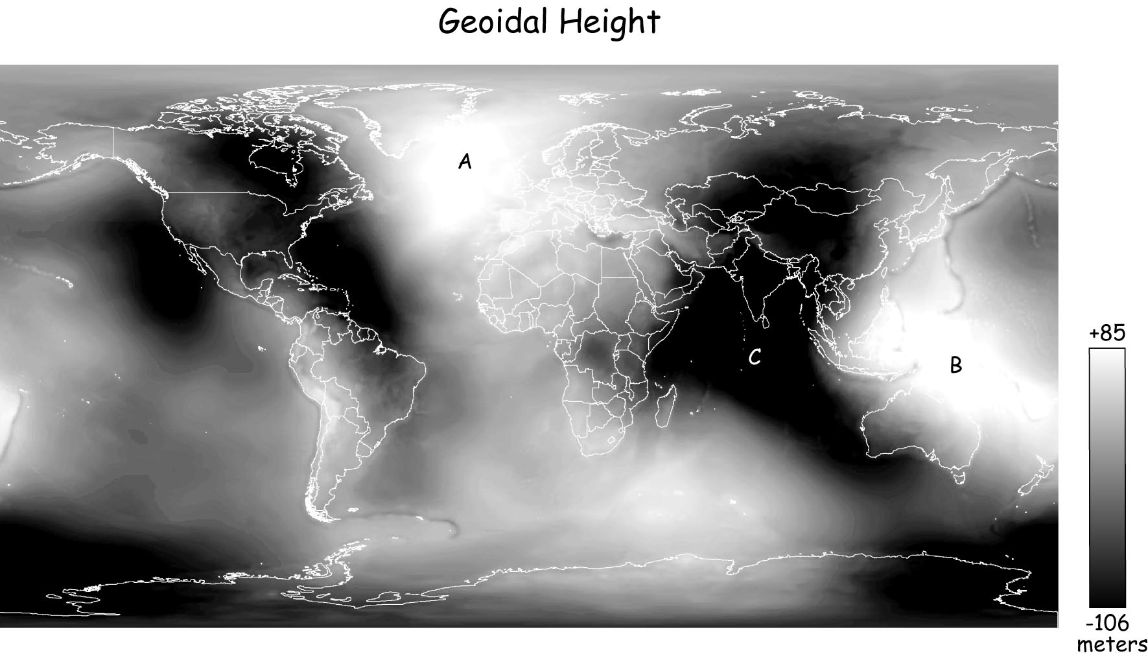
Datum
Orthometric Height (H)
Height above geoid
Ellipsoidal Height (h)
height above ellipsoid
Geoid Height (N)
Geoid above ellipsoid
Bolstad, 2019
Notes:
In north America, we no longer use mean sea level as a base for orthometric heights (elevation); except for specific projections near the seashore, as mean sea level varies too much in time and space due to solar and lunar cycles, water density with temperature, salinity, and ocean currents
This height difference is measured relative to the ellipsoid.

Slide 15
Common vertical datum
NGVD29: National Geodetic Vertical Datum of 1929
No geoid, mean sea level
NAVD88: North American Vertical Datum of 1988 (NAVD88)
GEOID03, GEOID09, GEOID12B
Notes:
Example vertical datums in North America include the National Geodetic Vertical Datum of 1929 (NGVD29) and the more recent North American Vertical Datum of 1988 (NAVD88).
As technologies advance, updated versions of horizontal and vertical datums will be released.
GEOID18 is intended for use with coordinates in the North American Datum of 1983 (2011) [NAD 83 (2011) epoch 2010.00]. It provides orthometric heights consistent with the North American Vertical Datum of 1988 (NAVD 88), the Puerto Rico Vertical Datum of 2002 (PRVD02), or the Virgin Islands Vertical Datum of 2009 (VIVD09).

Slide 16
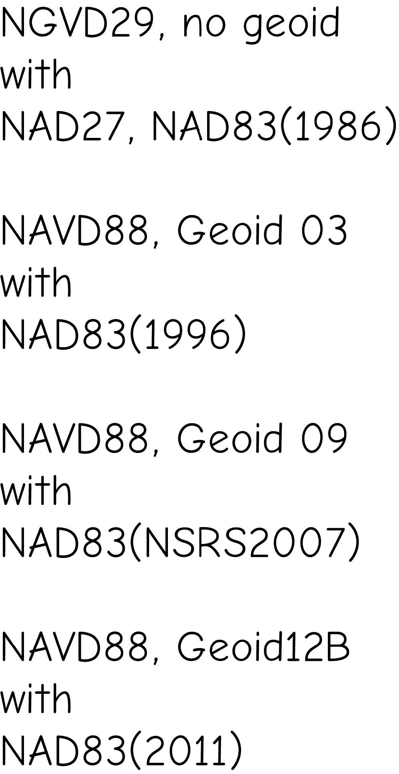
Common vertical datum
Pairing for horizontal and vertical datums for North America
Notes:
Example vertical datums in North America include the National Geodetic Vertical Datum of 1929 (NGVD29) and the more recent North American Vertical Datum of 1988 (NAVD88).
As technologies advance, updated versions of horizontal and vertical datums will be released.
GEOID18 is intended for use with coordinates in the North American Datum of 1983 (2011) [NAD 83 (2011) epoch 2010.00]. It provides orthometric heights consistent with the North American Vertical Datum of 1988 (NAVD 88), the Puerto Rico Vertical Datum of 2002 (PRVD02), or the Virgin Islands Vertical Datum of 2009 (VIVD09).

Slide 17
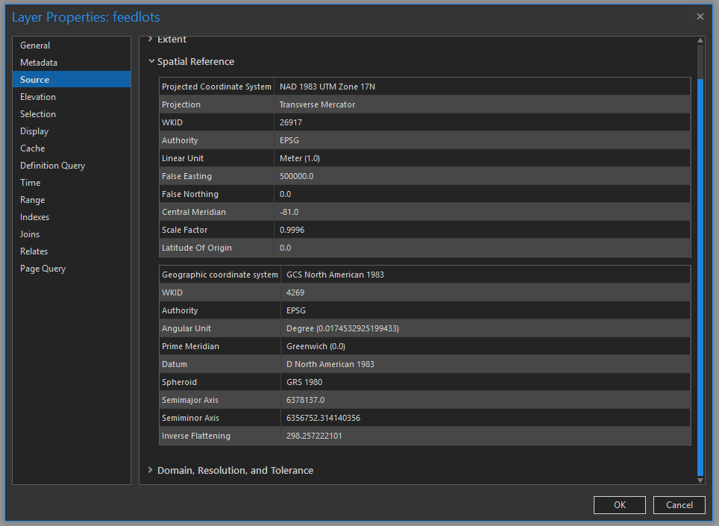
Datum/Projection Info in ArcGIS
ArcPro
Notes:
Datum and sometimes projection information are associated with maps and geospatial data layers.
In ArcGIS Pro, datum and projection information for a layer can be found in the Source tab.
We will talk about projections later in this module.

Slide 18
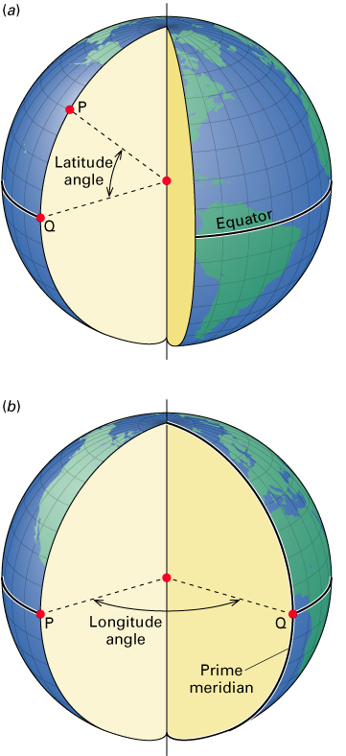
Geographic Coordinate Systems
Coordinates on a Sphere
Latitude and Longitude
Specified as angles or degrees
Latitude: Angles from equator
Range 0-90 N/S
Longitude: Angles from prime meridian
Range 0-180 E/W
© 2013 by John Wiley & Sons, Inc. All rights reserved.
Notes:
Coordinates on Earth are measured in degree units relative to the center of the Earth.
Latitude is measures as an angle of rise relative to the center of the Earth while longitude represents angles of rotation around the center of the Earth.
Note that it is not easy to make measures of distance using lengths on a spherical surface.

Slide 19
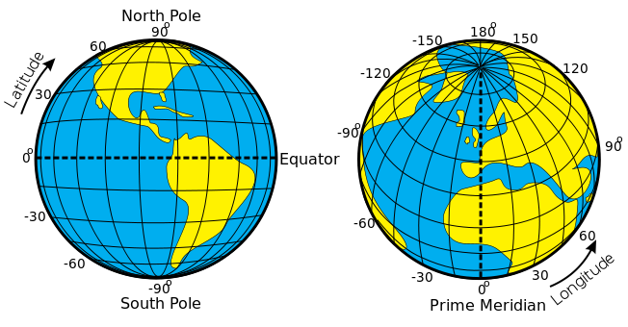
Geographic Coordinate Systems
Latitude (Parallels):
Measures north to south
90° in each hemisphere
Increases as you go north in the northern hemisphere
Increases as you go south in the southern hemisphere
Zero in Equator
https://commons.wikimedia.org/wiki/File:Latitude_and_Longitude_of_the_Earth.svg
Notes:
Latitude measures north to south or up and down. There are 90° of latitude in each hemisphere. The value increases as you move north or south relative to the equator. The equator has a latitude of 0° and the poles have a latitude of 90°.

Slide 20
Geographic Coordinate Systems
Longitude (Meridians)
Measures east to west
180° in each hemisphere
Increases as you go east in the eastern hemisphere
Increases as you go west in the western hemisphere
Zero is Prime Meridian, going through Greenwich, England
https://commons.wikimedia.org/wiki/File:Latitude_and_Longitude_of_the_Earth.svg
Notes:
Longitude measures east to west or side to side. There are 180° of longitude in each hemisphere, east and west. Longitude increases has you move west in the western hemisphere and increase as you move east in the eastern hemisphere. 0° longitude is refined relative to the prime meridian which passes through Greenwich, England.
It makes sense to use the equator to represent 0° latitude. The 0° reference for longitude is somewhat arbitrary.
We can specify the northern or southern hemispheres for latitude by including an “N” or “S” with the measurements. For longitude, we can use “E” or “W”.
In software, this can be problematic due to the mix of numbers and letters. So, instead we tend to use positive angles to represent the northern or eastern hemispheres and negative angles to represent the southern or western hemispheres.
Coordinates referenced to a datum representing the 3D Earth or globe are known as geographic coordinate systems as opposed to projected coordinate systems, which will be discussed later.

Slide 21
Geographic Coordinate Systems
1 Degree = 60 Minutes = 3600 Seconds
˚ = Degrees
‘ = Minutes
“ = Seconds
1.5 ˚ =1 ˚ 0.5X60’= 1 ˚ 30’
1 ˚ 30’ = 1° + (30’/60’) = 1.5°
Notes:
One degree of latitude or longitude can be a large distance. So, in order to provide precise measurements, we need to be able to further divide degrees into smaller units.
A degree can be divided into minutes and second, similar to an hour on a clock.
1 degree equals 60 minutes or 3600 seconds.
We can also use decimal degrees as opposed to minutes and seconds.
It is possible to convert between degrees, minutes, and second and degrees and decimal degrees.

Slide 22
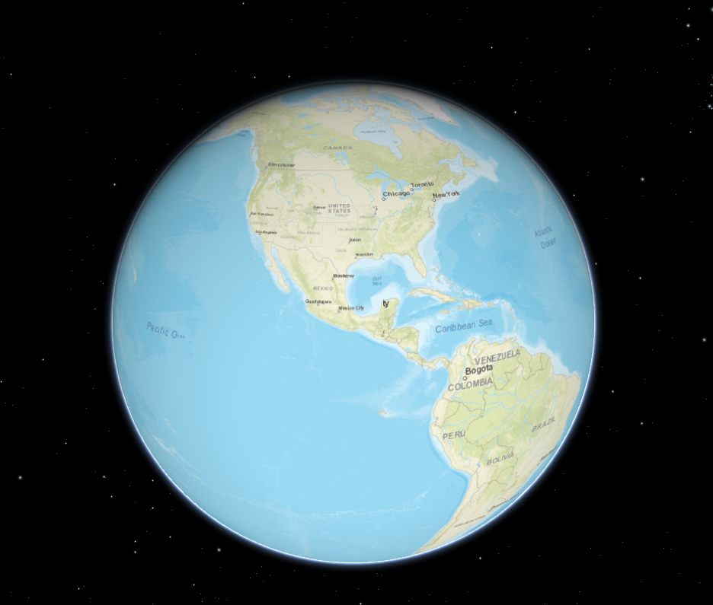
Geographic Coordinate Systems
Advantages:
Accurate representation
Latitude and longitude lines
Without distortion
Disadvantages
Expensive to make
Cumbersome to handle and store
Difficult to measure distance
Not fully visible at one view
Image from ArcGIS API for JavaScript
Notes:
There are some advantages to modeling the Earth as a 3D globe. First, this is an accurate representation in which map features and latitude and longitude lines can be plotted without distortion.
However, there are some disadvantages. Making globes can be expensive. They are also cumbersome to handle and store. It is also not easy to make distance measurements on the curved surface of the globe. Duo to the 3D nature of a globe, it is not possible to view the entirety of Earth’s surface from a single vantage point.
So, we need a means by which to represent the curved, 3D Earth in a flat map space. We do this using projections, which we will discuss next.

Slide 23
Class Activity 2-1
Explore the NGS Coordinate Conversion and Transformation Tool ( NCAT) available from the U.S. NOAA/NGS website (https://www.ngs.noaa.gov/NCAT/index.xhtml;jsessionid=9190FFFE418DF889CAB0942A91BA7B9F) to convert the locations between different horizontal datums. And discuss:
What are your converted lats/lons?
Are the locations different with different datums?
Convert locations from NAD27 to NAD83(86)
Wisconsin: lat: 43°07’59”N and lon: 89°20’11’’W
Colorado: lat 40°00’00’’N and lon: 105°16’01’’ W
Convert locations from NAD83(86) to NAD27
Wash. D.C.: lat: 38°51’10.4052’N and lon: 77°02’19.9165’’ W
Notes:
Vdatum to convert different vertical datum

Slide 24
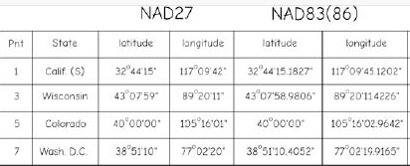
Class Activity 2-1
Use the NCAT software available from the U.S. NOAA/NGS website (https://www.ngs.noaa.gov/NCAT/) to fill the following table. Note that all of these points are in the continental United States (CONUS) and longitudes are west, but entered as positive numbers.

Slide 25
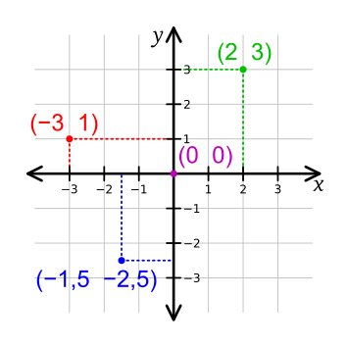
Projected Coordinate Systems
Map projections allow us to view the 3D Earth on a 2D surface
Earth is mathematically projected to a surface that can be made flat
We now make measurements in distance or length units as opposed to degrees
https://commons.wikimedia.org/wiki/File:Cartesian_coordinate_system_(comma).svg
Notes:
Instead of using a the 3D spherical globe, we can mathematically transform the Earth into a flat map space.
Now, instead of making measurements of distance or length in angles, we can make measurements in length units.
These 2D surfaces are known as projected coordinate systems or map projections.
They allow us to make measurements in a Cartesian coordinate system on a plane.

Slide 26
Projected Coordinate Systems
They allow us to make measurements in a Cartesian coordinate system on a plane
These 2D surface are known as map projections.
https://commons.wikimedia.org/wiki/File:Cartesian_coordinate_system_(comma).svg

Slide 27
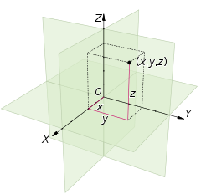
Projected Coordinate Systems
X, Y, Z
https://en.wikipedia.org/wiki/Cartesian_coordinate_system
Notes:
Cartesian coordinate systems can also be expanded to include a z component to make measurements in 3D space.

Slide 28
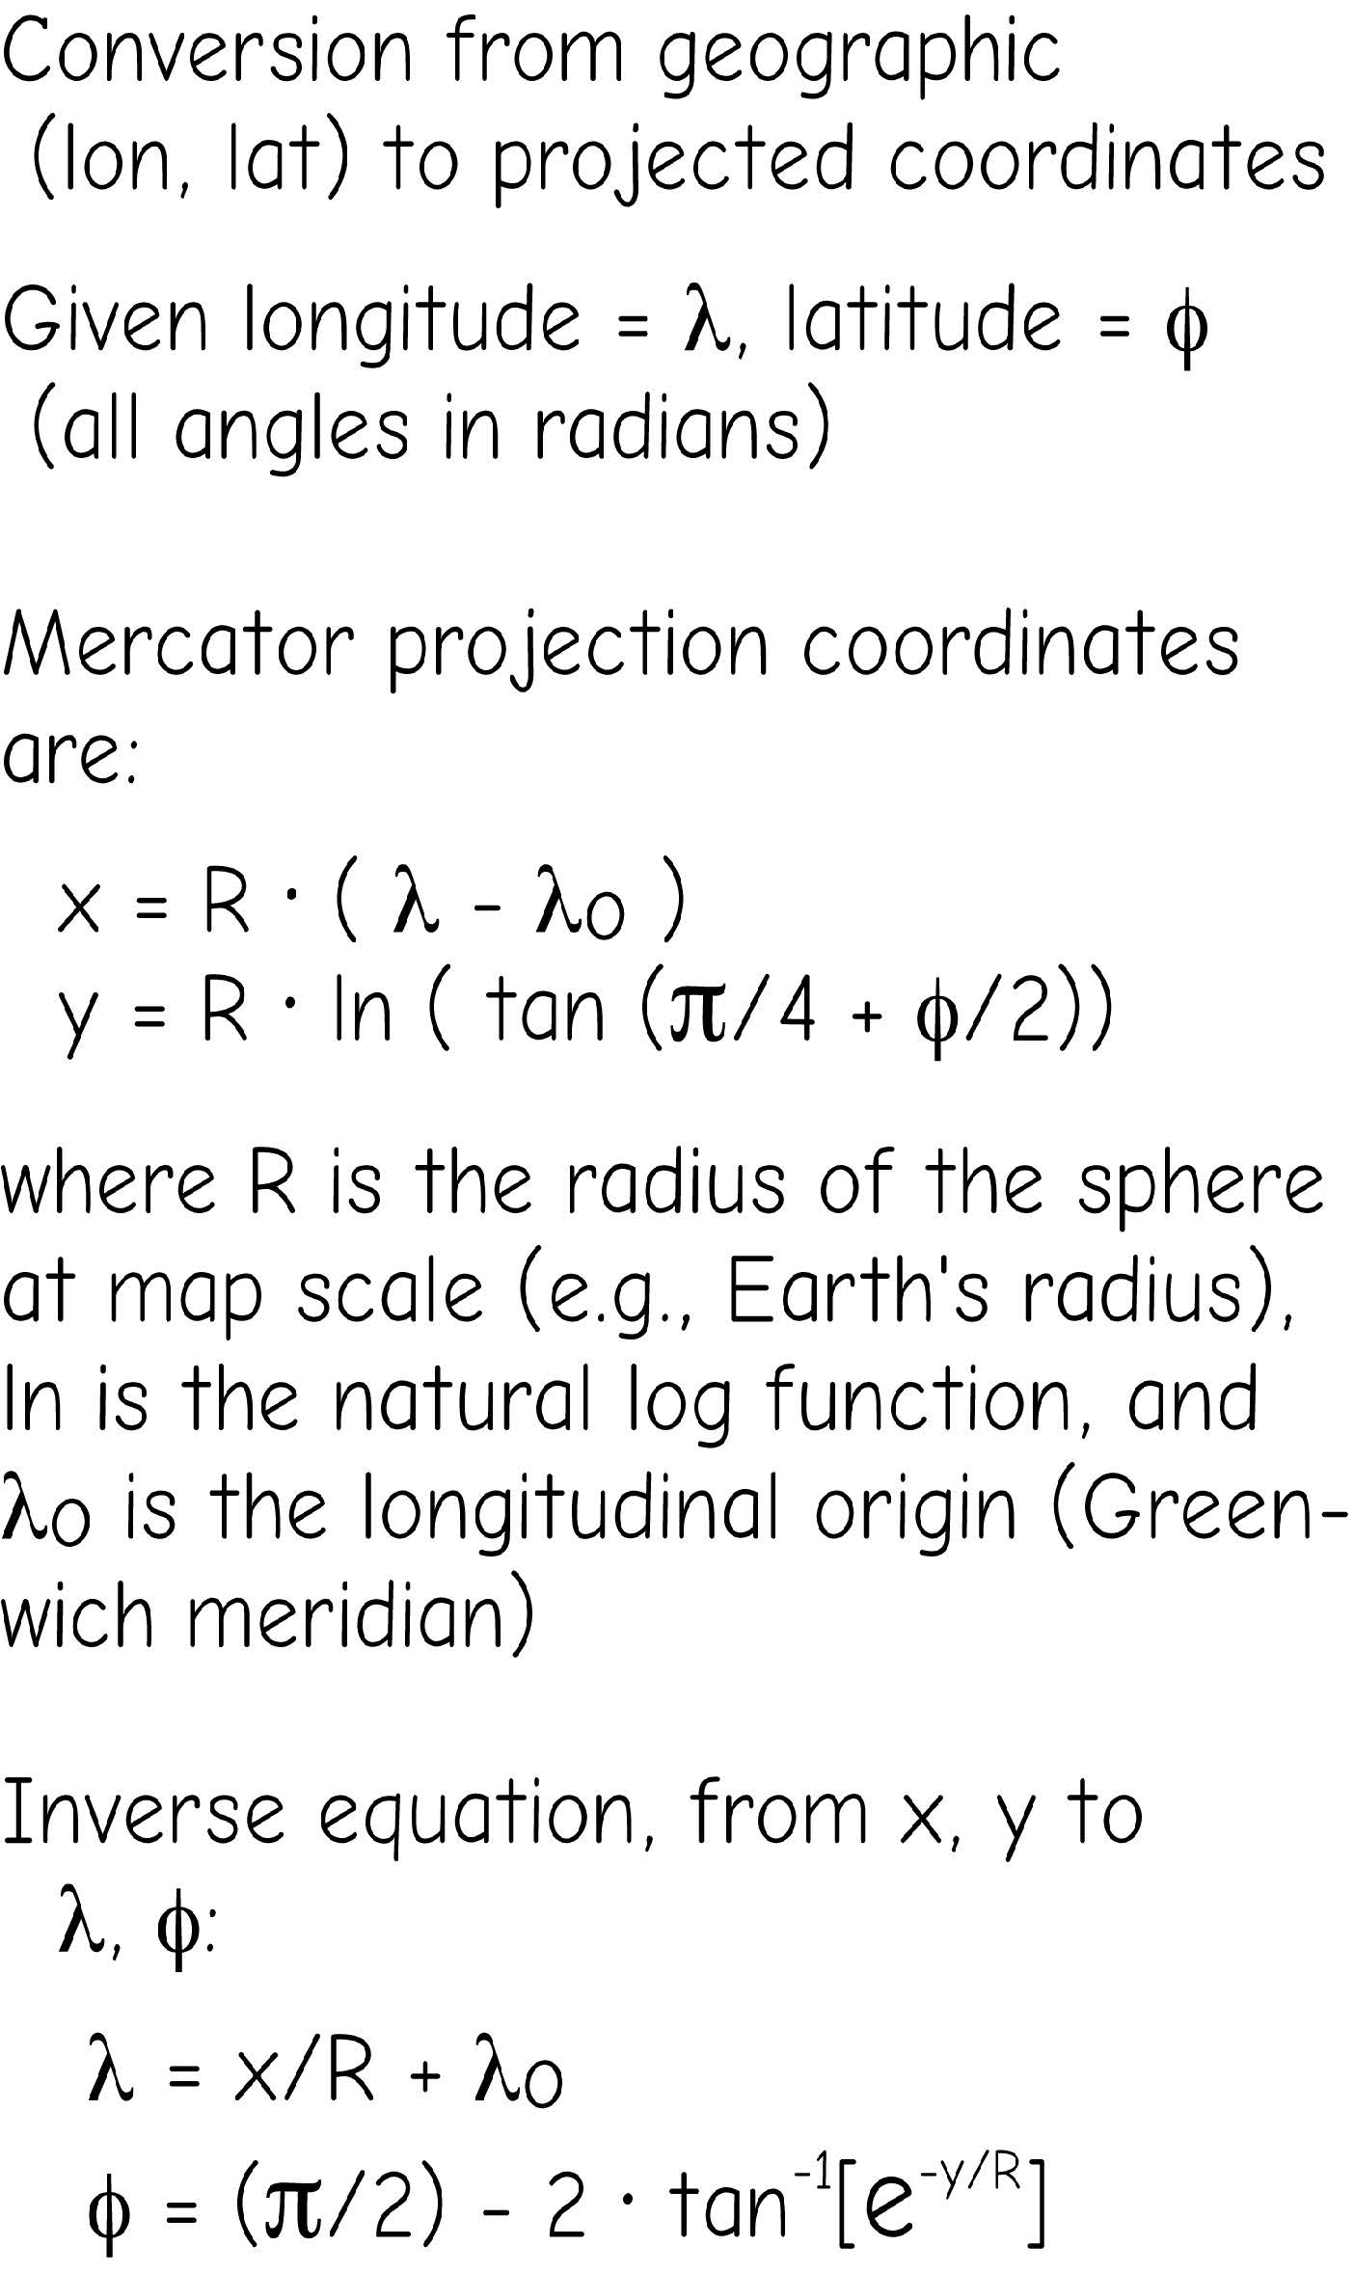
Geographic vs Projected Coordinate Systems
Conversion from geographic to projected coordinates
Bolstad, 2019

Slide 29
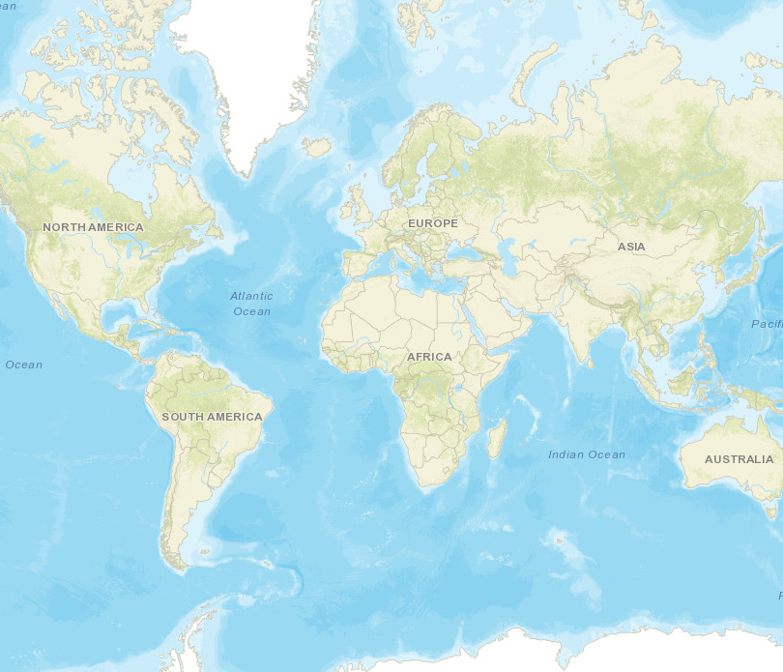
Geographic vs Projected Coordinate Systems
Image from ArcGIS API for JavaScript
Image from ArcGIS API for JavaScript
Notes:
This slide provides an example of the difference between geographic and projected coordinate systems.
The globe provides a 3D representation of the Earth where measurements are made in angles.
In contrast, projections are 2D and allow for measurements to be made in Cartesian coordinate space.

Slide 30
Map projection
How?
Shine a light from center of earth
Onto a “physical surface:” 1. Plane 2. Cone 3. Cylinder

Slide 31
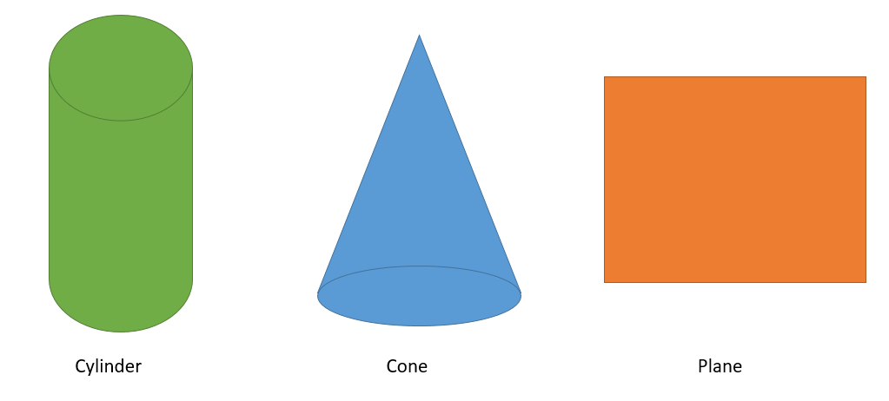
Map projection
Developable Surfaces
Geometric surface that can be flattened
Cylindrical Projections = Cylinder Conic Projections = Cone Azimuthal Projections = Plane
Notes:
In order to flatten the Earth, coordinates on the globe must be mathematically transformed or moved to a geometric surface that can be flattened. These are called developable surfaces.
The most commonly used surfaces are cylinders, cones, and planes. Cylindrical projections use cylinders, conic projections use cones, and azimuthal projections use planes.
There are other shapes available or shapes can be combined. Here, we will focus on just these most commonly used surfaces.
Note that all three of these surface can be flattened. If you cut a cylinder, it can be folded out to a plane. A cone can be folded out into a fan shape.

Slide 32
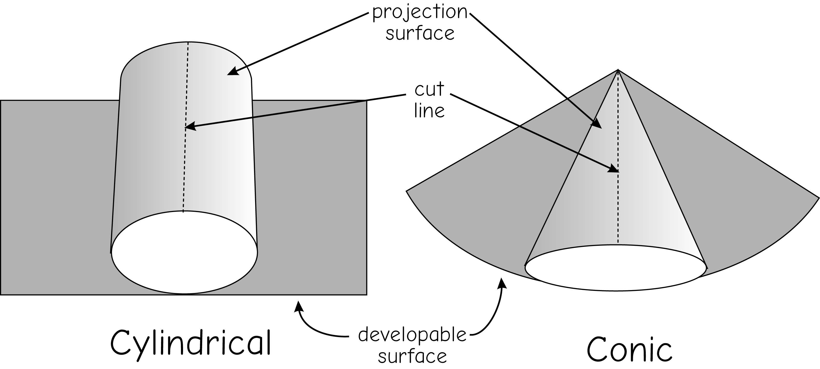
Map projection
Developable Surfaces
Geometric surface that can be flattened
Bolstad, 2019

Slide 33
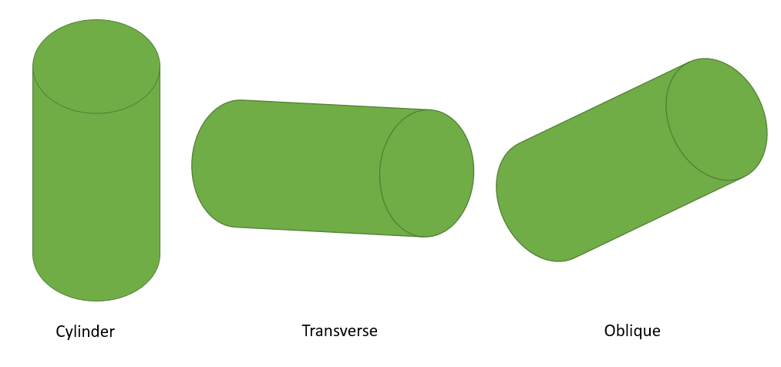
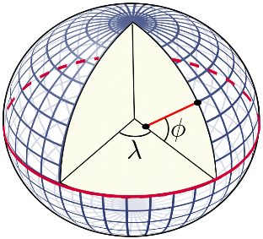
Map projection
Developable Surfaces
Different orientation of developable surface with Earth
Normal Transverse Oblique
https://commons.wikimedia.org/wiki/File:Latitude_and_longitude_graticule_on_an_ellipsoid.svg
Notes:
Orientation relates to how a developable surface is oriented or positioned relative to the globe.
For example, for a cylinder the normal orientation is oriented up-and-down relative to the globe. Or, the long axis will be place perpendicular to the equator.
In contrast, the transverse orientation will be oriented parallel to the equator.
Oblique orientations are another orientation other than normal or transverse.
So, given the wide variety of developable surfaces and orientations, the number of possible map projections are infinite.

Slide 34
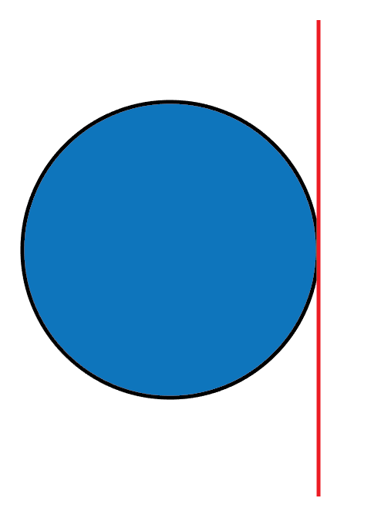
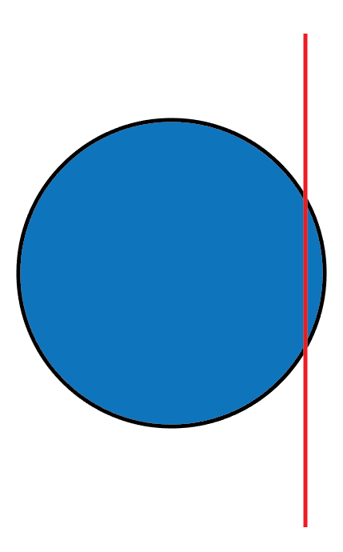
Tangency Secancy
Map projection
Developable Surfaces
Standard Line: where projection touches the globe
Standard Parallel: standard line on a parallel
Standard Meridian: standard line on a meridian
Notes:
Projections can also vary in regards to where and how they intersect the surface of the Earth or globe.
Tangency occurs when the developable surface only touches the globe at a single location while secancy occurs when the surface touches the globe along two latitude or longitude lines.
Standard lines are where the projection touches or spatially co-occurs with the globe. Standard parallels are parallels or latitude lines where the projected surface intersects the globe while standard meridians are meridians or longitude lines.
Generally, there are no distortions where the globe and developable surface co-occur, since the coordinates do not need to be transformed or moved.
Distortions tend to increase with distance from the standards.
Again, given the wide variety of developable surfaces, orientations, and standard lines, the number of possible map projections is infinite.

Slide 35
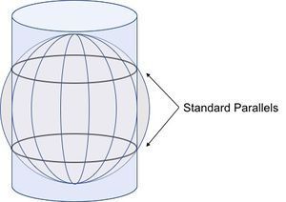
Map projection
Developable Surfaces
Standard Line: where projection touches the globe
Standard Parallel: standard line on a parallel
Standard Meridian: standard line on a meridian
http://wiki.gis.com/wiki/index.php/Standard_parallel#:~:text=Standard%20parallels%20are%20parallel%20lines,is%20only%20one%20standard%20parallel.

Slide 36
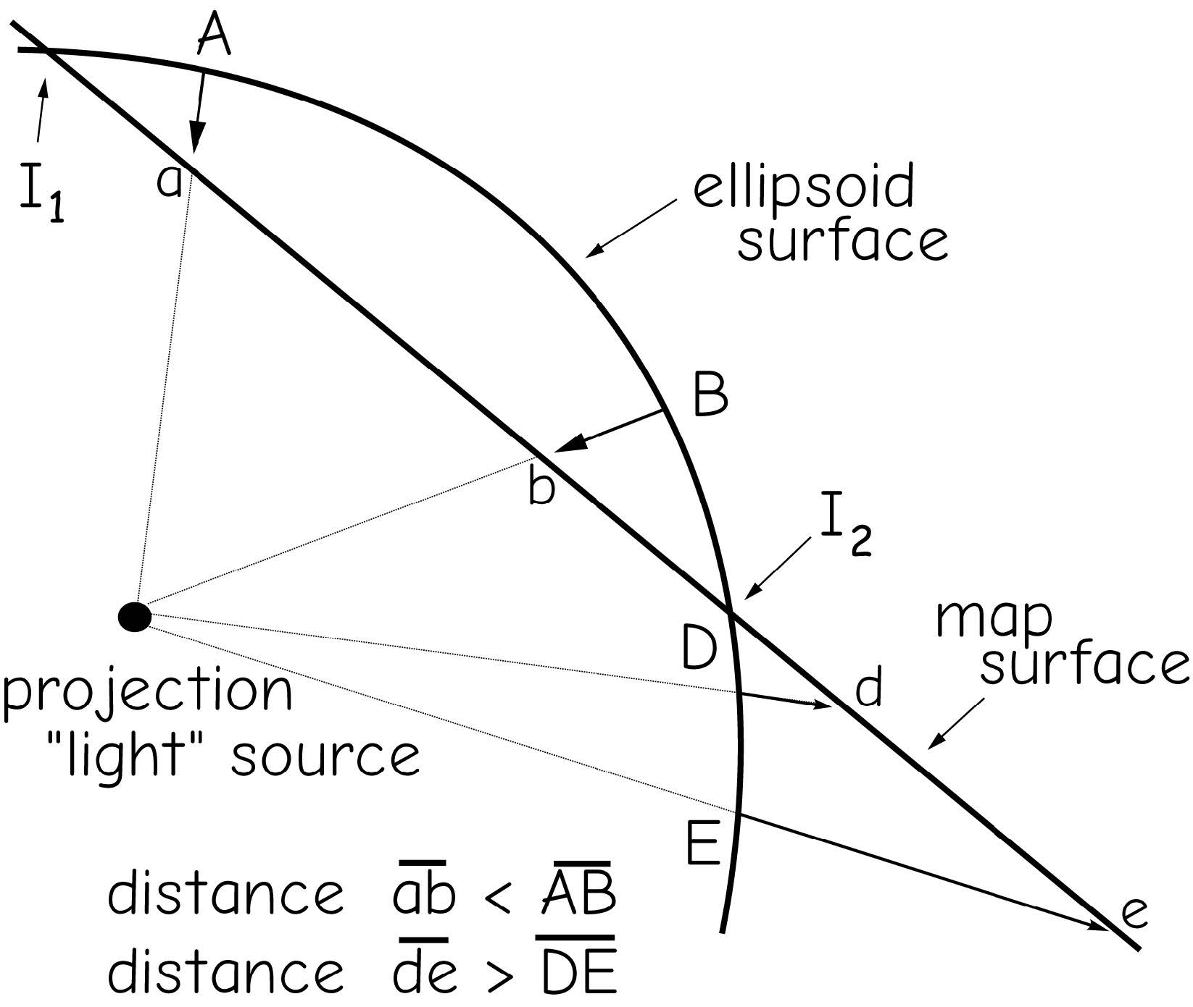
Map projection
Developable Surfaces
Standard Line: where projection touches the globe
No distortions at these locations! Distortions tend to increase with distance from the standards.
Bolstad, 2019

Slide 37
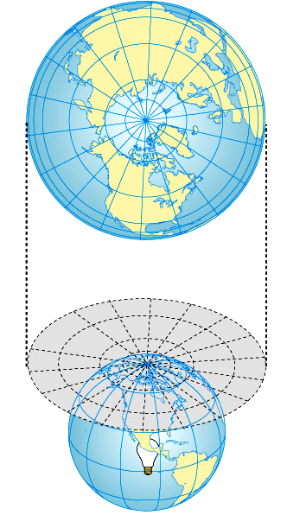
Map projection
Plane projection
Plane positioned at pole
Grid:
Longitude: straight, radiating
Latitude: circles
Distortion increases away from center ("principal point")
Good for polar regions
Can't show more than half the world.

Slide 38
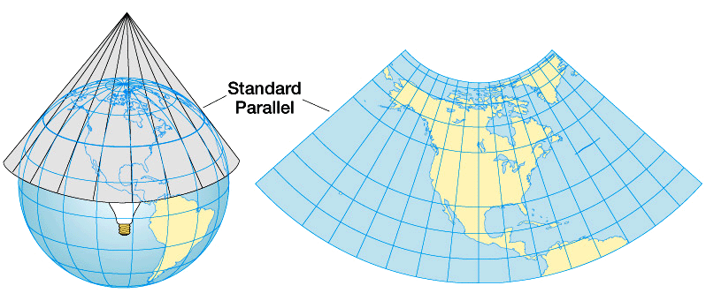
Map projection
Conic projection
Hold cone over pole
Grid:
Longitude: straight, converge
Latitude: curve
Distortion increases away from standard parallel
Good for Mid-latitudes

Slide 39
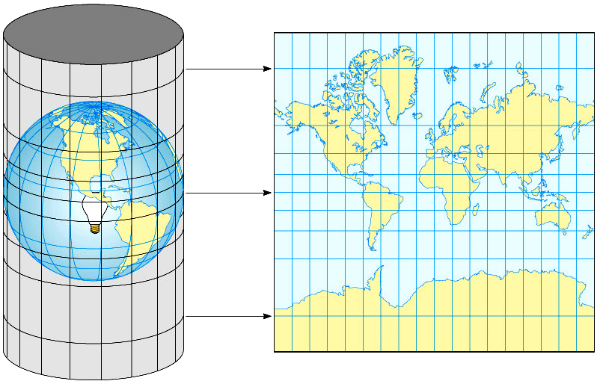
Map projection
Cylindrical projection
Cylinder around the equator
Latitude & longitude:
straight, intersect at 90°
Distortion greatest at poles
Good for low-latitude areas
Good for navigation
Mercator’s Projection
Notes:
how straight lines are Rhumb line. a rhumb line, thumb, (/rʌm/) or loxodrome is an arc crossing all meridians of longitude at the same angle, that is, a path with constant bearing as measured relative to true or magnetic north.

Slide 40
Map projection
All map projections produce distortions of at least one of the following:
Shape
Area
Distance
Direction
3D Earth
2D Map
Shape
Area
Distance
Direction
Notes:
Since the curved, 3D surface of the Earth is converted to a flat space, some distortions will be produced.
It is not possible to convert a curved 3D surface into a flat surface without some distortions.
Specifically, map projections can produce distortions in feature shape, relative area of features, distance between features, and direction between locations.
The type and magnitude of the distortions produced depends on the projection used.

Slide 41
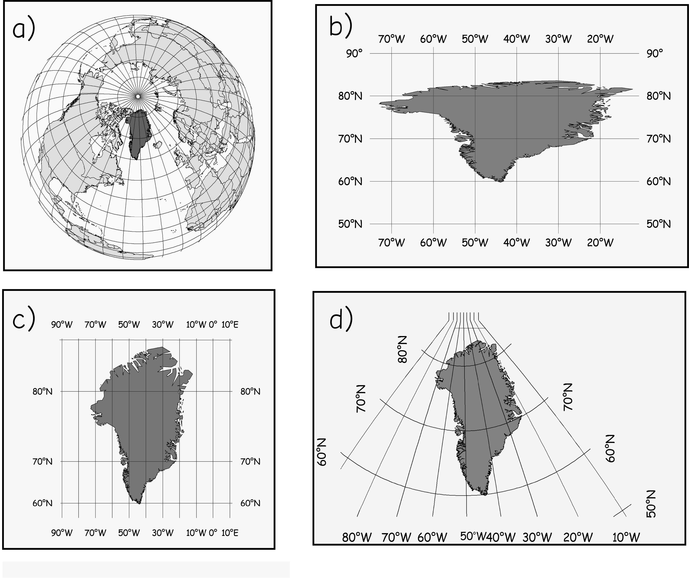
Map projection
All map projections produce distortions of at least one of the following:
Shape
Area
Distance
Direction
Mercator
Transverse Mercator
Bolstad, 2019

Slide 42
Class Activity 2-2
Explore the true size tool https://thetruesize.com, discuss with your group members:
Do you know there are some distortions in the map before the class?
What did surprise you?

Slide 43
Map projection
Why all world maps are wrong?

Slide 44
Map projection
Type
Conformal Projections: preserves local angles and shape
Equivalent Projections: represents areas in correct relative size
Equidistant Projections: maintains consistent scale or distance along certain lines
Azimuthal Projections: maintains certain accurate directions relative to certain vantage point
Conformal and equivalent projections’ properties are mutually exclusive
Conformal and equivalent projections’ properties are global properties
Equidistant and azimuthal projections’ properties are local properties and may be true only from or to the center of the map projection
Notes:
Four broad types of projections exist based on what map properties are maintained.
Conformal projections maintain local angles and shapes. Equivalent projections maintain areas of features in correct relative size. Both are global properties, or shape or size can be maintained across the entire globe not just for specific areas. Also, these properties are mutually exclusive. Or, you cannot maintain both shape and relative size.
Equidistant projections maintain scale or distance along certain lines while azimuthal projections maintain accurate directions relative to a certain vantage point. Equidistant and azimuthal properties are local properties and may be true only from or to the center of the map projection. You cannot maintain distance or direction between all points in the map space.

Slide 45
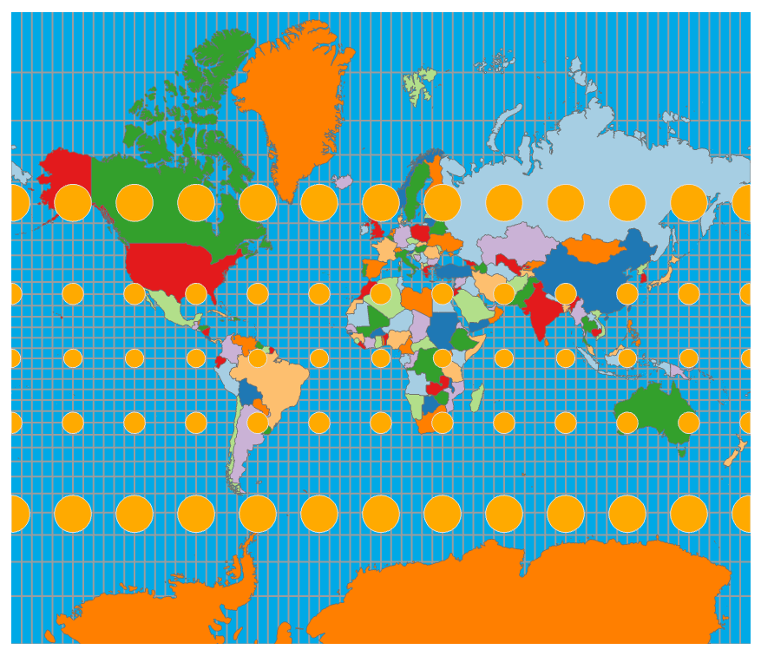
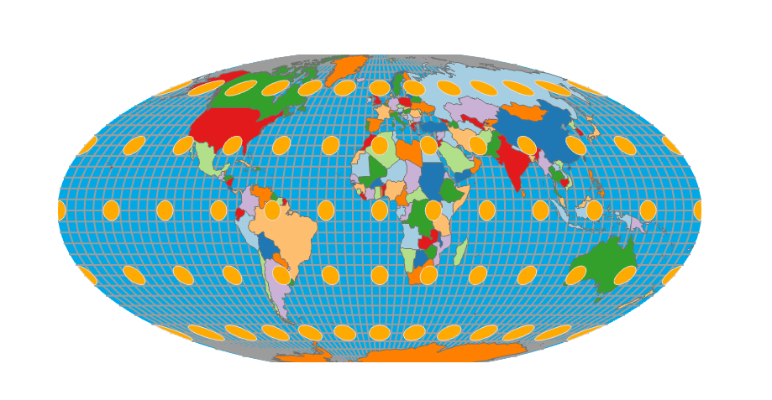
Map projection
Tissot Indicatrix
Without any distortions, the circles will all be the same shape, perfect circles, and size
Mercator projection
Distort size but not shape
Mollweide projection
Distort shape but not size
Notes:
One tool that is commonly used to visualize size and shape distortions resulting from map projections is the Tissot Indicatrix.
Without any distortions, or if these features are plotted on the globe, the circles will all be the same shape, perfect circles, and size.
Any deviation in shape or size is a result of map projection distortions.
For example, the Mercator projection on the left distorts size, since the circles are not the same size, but not shape, since the circles are still circular.
The Mollweide projection to the right distorts shape, since the circles are no longer perfect circles, but not size, since each circle still has the same area.

Slide 46
Map projection
Examples
Projected coordinate systems do not use longitude and latitude to measure locations
Instead, they use map units of the projection itself:
Meters (UTM, Albers, most others)
Feet (State Plane, few others)

Slide 47
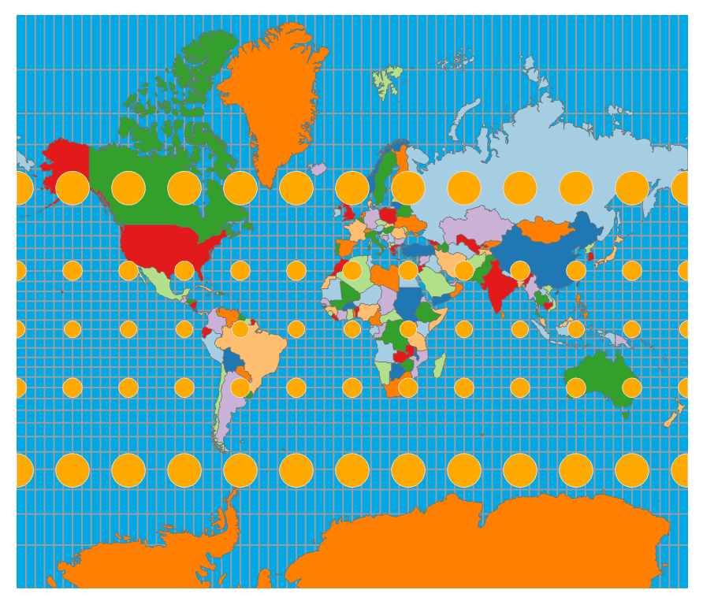
Map projection
World Projections: Mercator
Cylindrical conformal projection
Maintains shape
Distorts size
Parallels and meridians cross at right-angles
Tissot Indicatrix
Notes:
Mercator projections are examples of cylindrical projections that are conformal, or maintain shape and local angles. (To preserve individual angles describing the spatial relationships, a Conformal projection must show the perpendicular graticule lines intersecting at 90-degree angles on the map)
Relative size tends to be heavily distorted. For example, the Tissot Indicatrix suggests that sizes close to the poles are much larger than they should be in comparison to equatorial features. Remember from the example above that Greenland is actually smaller than Australia.
In Mercator projections, parallels and meridians will cross at right-angles.

Slide 48
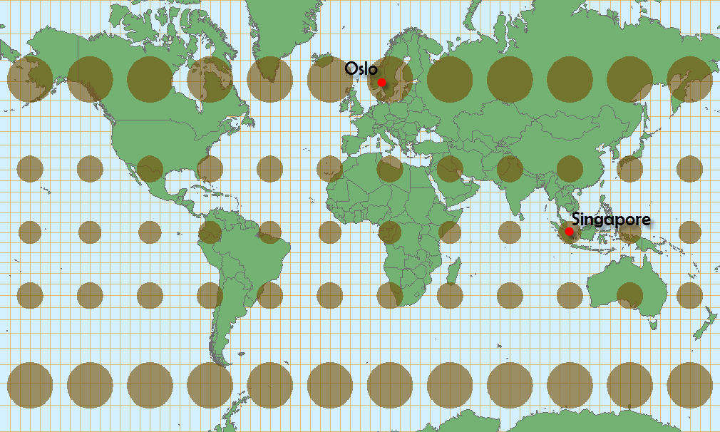
Map projection
World Projections: Web Mercator
Modification of Mercator projection that is commonly used for web maps
Bing Maps, OpenStreetMap, Google Maps, MapQuest, ArcGIS Online
Uses a sphere as opposed to a spheroid
http://cartonerd.blogspot.com/2014/08/web-mercator-and-comparisons.html
Notes:
Web Mercator is a modification of the Mercator projection that is commonly used in web maps including Bing Maps, OpenStreetMap, Google Maps, MapQuest, and ArcGIS Online.
It uses a true sphere as opposed to a spheroid.
One reason this projection is used on the web is that it is easy to generate tiles from data since latitude and longitude lines intersect at right angles.

Slide 49
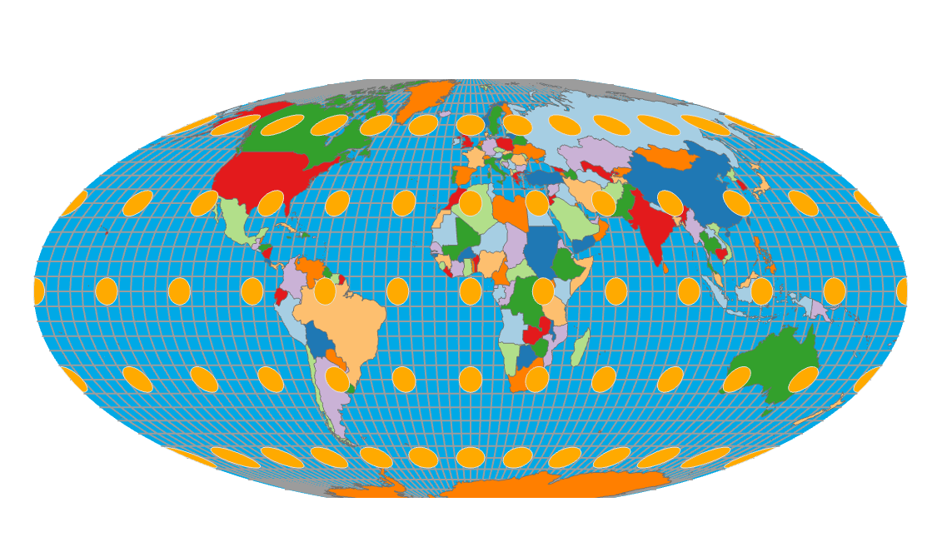
Map projection
World Projections: Mollweide
Equivalent projection
Maintains area
Distorts shape and angle
Pseudocylindrical
Not based on developable surface
Notes:
Mollweide is an example of a equivalent projection that maintains relative size or area but distorts shape and local angles.
It is pseudosylindrical, which means that is uses multiple cylinders as opposed to one in an attempt to further minimize distortions.

Slide 50
Map projection
World Projections: Azimuthal Equidistant
Azimuthal and Equidistant
Correct distance from center of map
Correct angle from center of map
Distorts shape and relative size
© 2013 by John Wiley & Sons, Inc. All rights reserved.
Notes:
The azimuthal equidistant projection maintains the correct distance and angle or compass bearing form the center of the map.
In the provided example, the center of the map occurs at 0° latitude and 0° longitude, or where the equator and prime meridian intersect.
So, distance and direction relative to this location are correct. All points on the map are at the correct azimuth (direction) from the center point
Note that this projection distorts shape and relative size.
Although the projection can display the entire globe, its practical usage is often limited to a hemisphere. This projection is most commonly used for maps of polar regions and routes of air and sea navigation with appropriate aspect. The oblique aspect is sometimes used for important cities and their surrounding area.

Slide 51
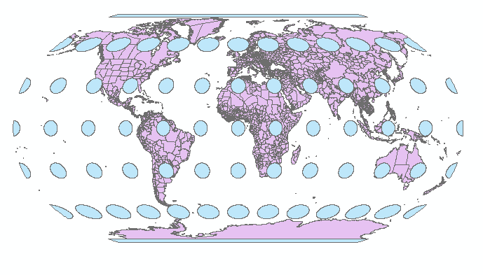
Map projection
World Projections: Robinson
Neither equivalent or conformal
Strikes a balance between shape and size
Meridians curve gently
Notes:
The Patterson projection is neither equivalent nor conformal.
Instead, it tries to strike a balance between shape and size distortions.
Note that the meridians are gently curved.

Slide 52
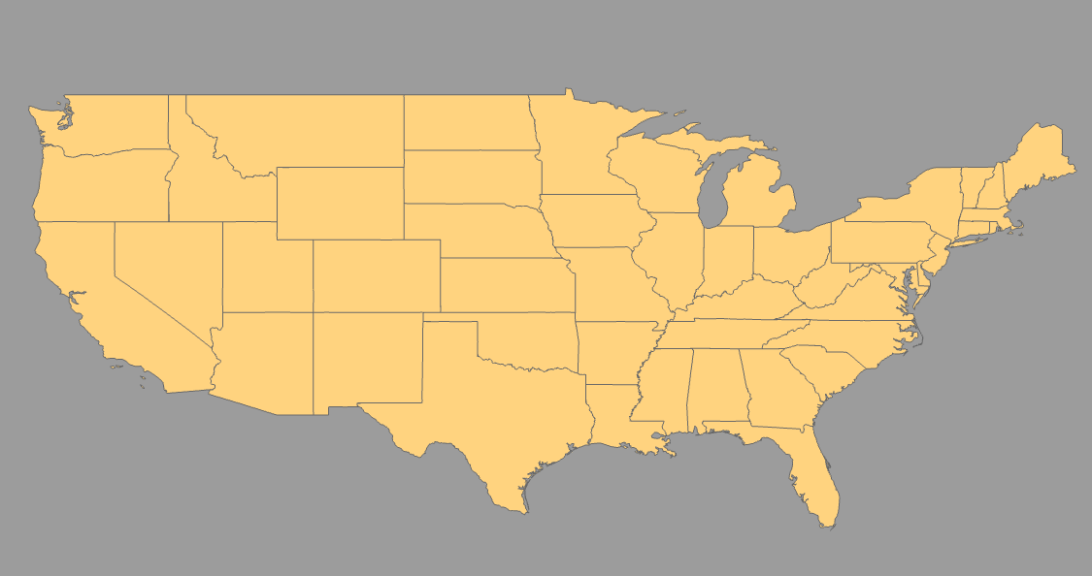
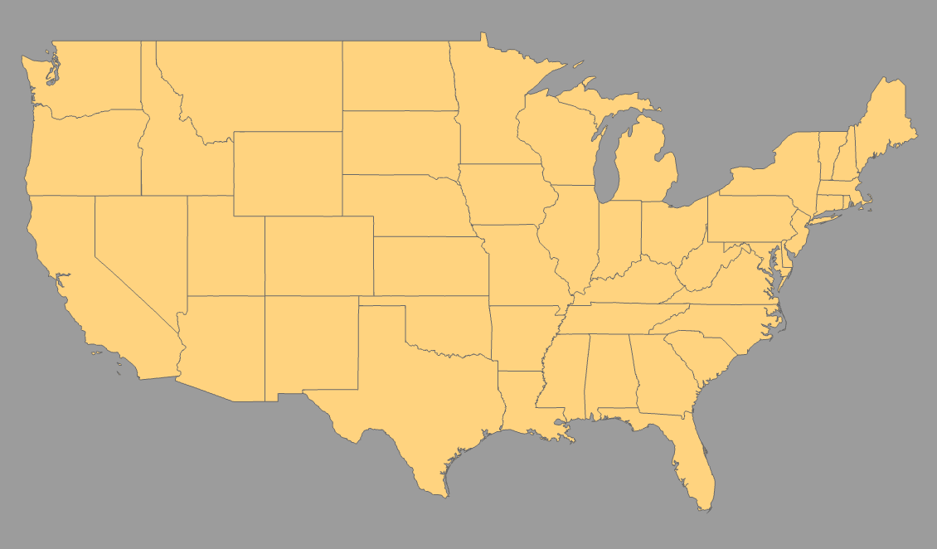
Map projection
US projections
Not Projected
Mercator
Notes:
We will now discuss continental-scale projections using the United States as an example.
The first image shows the US as not projected. Or, latitude and longitude are being treated like Cartesian coordinates in flat space. This results in some extreme distortions and should be avoided.
The second image shows a Mercator projection for the US. Here, shape and local angle is maintained but relative size is distorted.

Slide 53
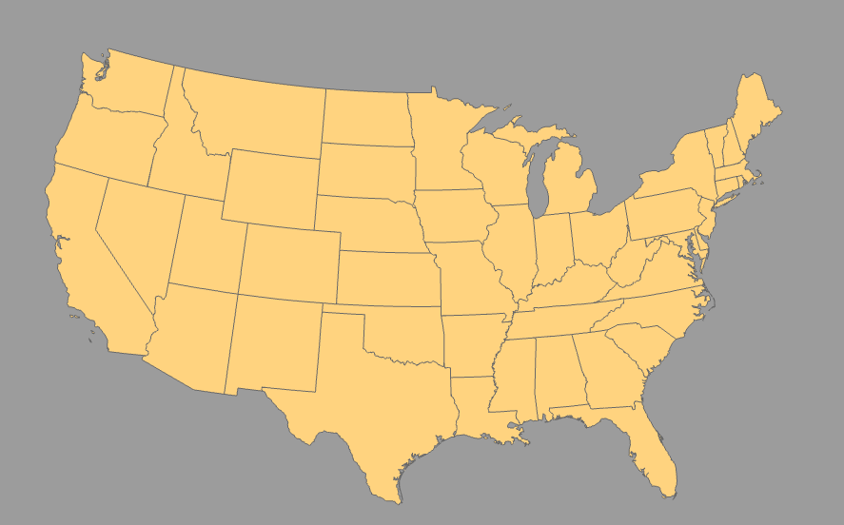
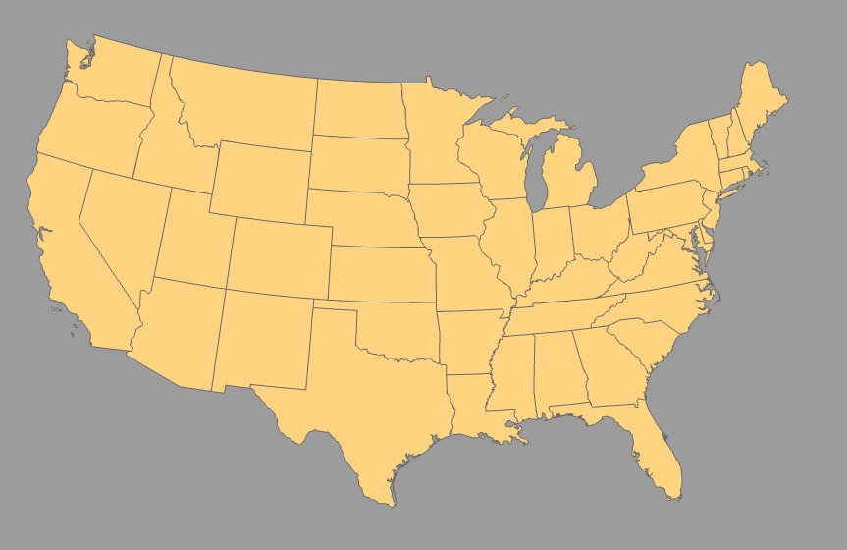
Map projection
US projections
Albers Equal Area
Lambert Conformal Conic
Notes:
When creating maps of the US, I prefer to use Albers Equal Area or Lambert Conformal Conic.

Slide 54
Map projection
US projections: Albers Equal Area
Conic
Equivalent
Maintains area
Distort shape and local angles
Two standard parallels
Notes:
Albers Equal Area uses a conic developable surface with two standard parallels. It is equivalent, so it maintains relative size but distorts shape and local angles.
However, distortions are generally pretty minimal.

Slide 55
Map projection
US projections: Lambert Conformal Conic
Conic
Conformal
Maintains shape and local angles
Distorts local size
Two standard parallels
Notes:
Lambert Conformal Conic also uses a cone with two standard parallels. Since it is conformal it maintains shape and local angles but distorts local size.
However, distortions are minimal.
So, if I want to created a map of the US that maintains relative size, I tend to use Albers Equal Area. If I want to maintain shape, I will use Lambert Conformal Conic.

Slide 56
Map projection
Universal Transverse Mercator (UTM)
60 zones
Location provided in meters as Easting and Northing
Northing: meters north of equator
In northern hemisphere, equator is assigned a value of 0 meters, add as you go up
In southern hemisphere, equator is assigned a value of 10,000,000 meters, subtract as you go down
Easting: distance from central meridian in UTM zone
Central meridian is assigned a value of 500,000 meters
Add as you go east
Subtract as you go west
Notes:
We will now discuss projections that are appropriate at more local scales, such as for states, counties, or cities.
Universal Transverse Mercator is a set of projections that are commonly used at these scales.
This is not one system but a set of systems in which the Earth is broken into 60 zones.
Within each zone coordinates are provided in length units, generally meters, as northing and easting.
Northing measures up and down or north to south. In the northern hemisphere, the equator is assigned a value of 0 meters, and you add as you move north. So, this is effectively the distance from the equator. In the southern hemisphere, the equator is assigned a value of 10,000,000 meters, and you subtract as you move south.
Easting is calculated relative to the central meridian or center line in each zone. The central meridian is assigned a value of 500,000 meters, and you add as you move east of it and subtract if you move west.

Slide 57
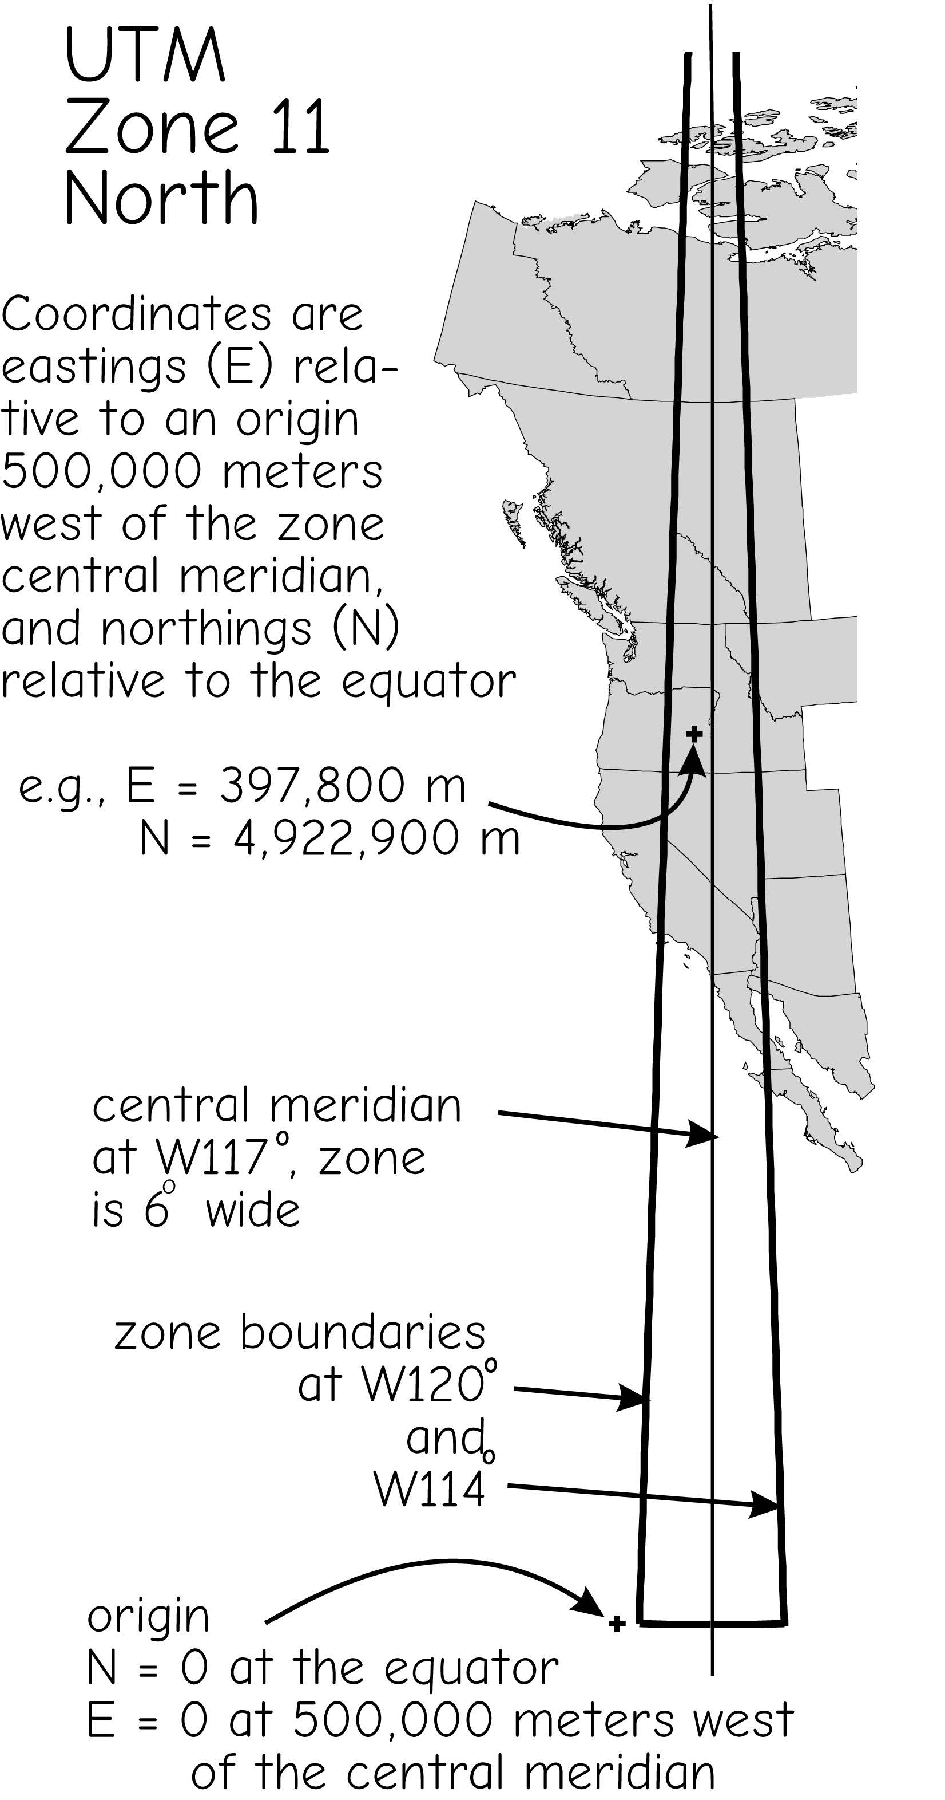
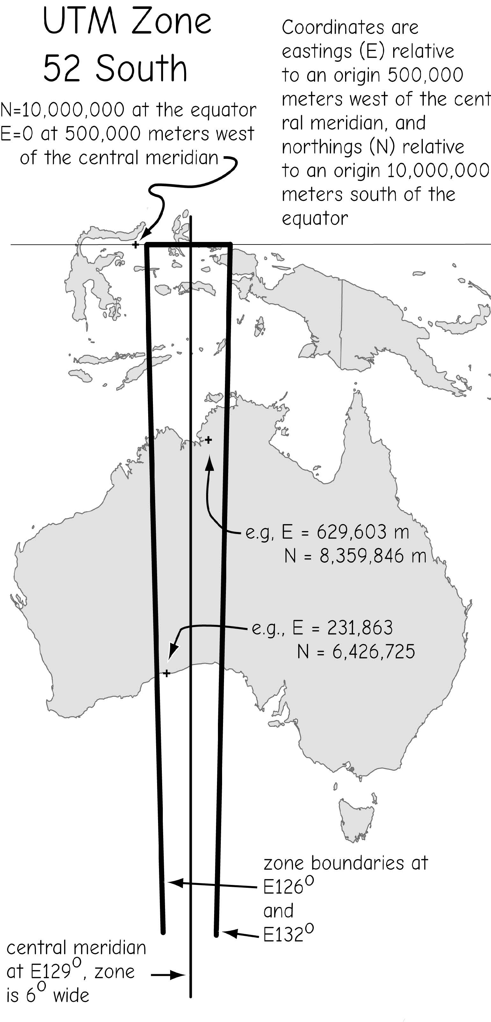
Map projection
Universal Transverse Mercator (UTM)
Northern hemisphere
Southern hemisphere
Bolstad, 2019
Notes:
The UTM systems break the Earth into 60 zones vertically.
Each zone is only appropriate for areas within it. You should not project the entire Earth to a single UTM projection.
Easting values will be defined relative to the central meridian in each zone.
In the US, the zone number increases as you move east and decreases as you move west.
The majority of Arkansas is in UTM Zone 15 North. So, this is a common projection for Arkansas. So, Arkansas generally uses a geographic coordinate system of NAD83 or WGS84 and a projected coordinate system of UTM Zone 15 North.
Some states fit well into a single UTM zone, for example Nevada, Utah, and Alabama. Others do not, such as California or Pennsylvania.
For states that do not fit well into one UTM zone, other projections are generally used to display them.

Slide 58
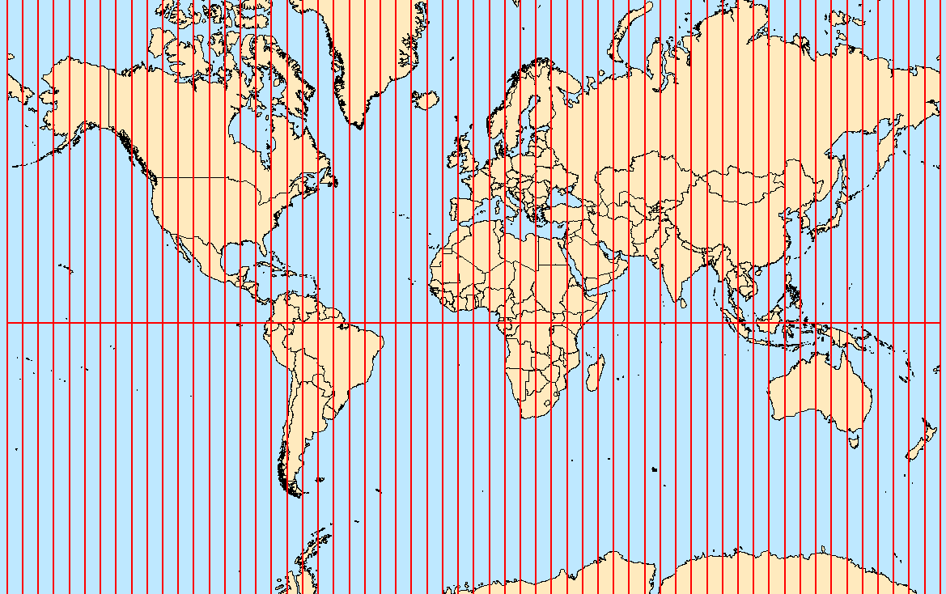
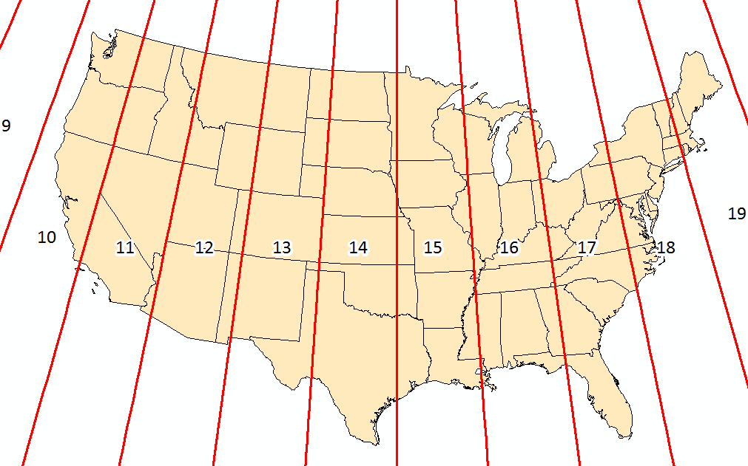
Map projection
Universal Transverse Mercator (UTM)
Bolstad, 2019
Notes:
The UTM systems break the Earth into 60 zones vertically.
Each zone is only appropriate for areas within it. You should not project the entire Earth to a single UTM projection.
Easting values will be defined relative to the central meridian in each zone.
In the US, the zone number increases as you move east and decreases as you move west.
The majority of Arkansas is in UTM Zone 15 North. So, this is a common projection for Arkansas. So, Arkansas generally uses a geographic coordinate system of NAD83 or WGS84 and a projected coordinate system of UTM Zone 15 North.
Some states fit well into a single UTM zone, for example Nevada, Utah, and Alabama. Others do not, such as California or Pennsylvania.
For states that do not fit well into one UTM zone, other projections are generally used to display them.

Slide 59
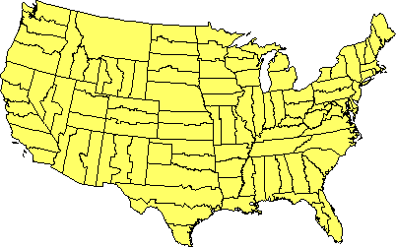
Map projection
State Plane Coordinate System
125 geographic zones designed for specific regions in the United States
Zones follow county boundaries
city- to county-scale
https://www.e-education.psu.edu/natureofgeoinfo/c2_p26.html
Notes:
For mapping smaller extents within states, state plane coordinate systems are commonly used.
It is common for surveyors to use these systems. Measurements are commonly made in feet or meters. Each coordinate system has a defined baseline, like northing and a false meridian, like easting, to which the coordinate measurements are referenced. Different projections are used depending on the specific coordinate system.
These systems allow for very accurate measurements and are commonly used at the city- to county-scale.
120 different zones generally follow county boundaries (except in Alaska). Larger states are divided into multiple zones, such as the “Colorado North Zone.” States with a long north-south axis (such as Idaho and Illinois) are usually mapped using a Transverse Mercator projection, while states with a long east-west axis (such as Washington and Pennsylvania) are usually mapped using a Lambert Conformal projection. In either case, the projection's central meridian is generally run down the approximate center of the zone.
SPCS 27 and SPCS 83
The boundaries of which usually follow county lines
States that are long in the east–west direction are typically divided into zones that are also long east–west. These zones use the Lambert conformal conic projection, because it is good at maintaining accuracy along an east–west axis, due to the projection cone intersecting the earth's surface along two lines of latitude. Zones that are long in the north–south direction use the Transverse Mercator projection because it is better at maintaining accuracy along a north–south axis, due to the circumference of the projection cylinder being oriented along a meridian of longitude.
125 (as of 2001). There are 110 zones in the contiguous US, with 10 more in Alaska, 5 in Hawaii, and one for Puerto Rico and US Virgin Islands.

Slide 60
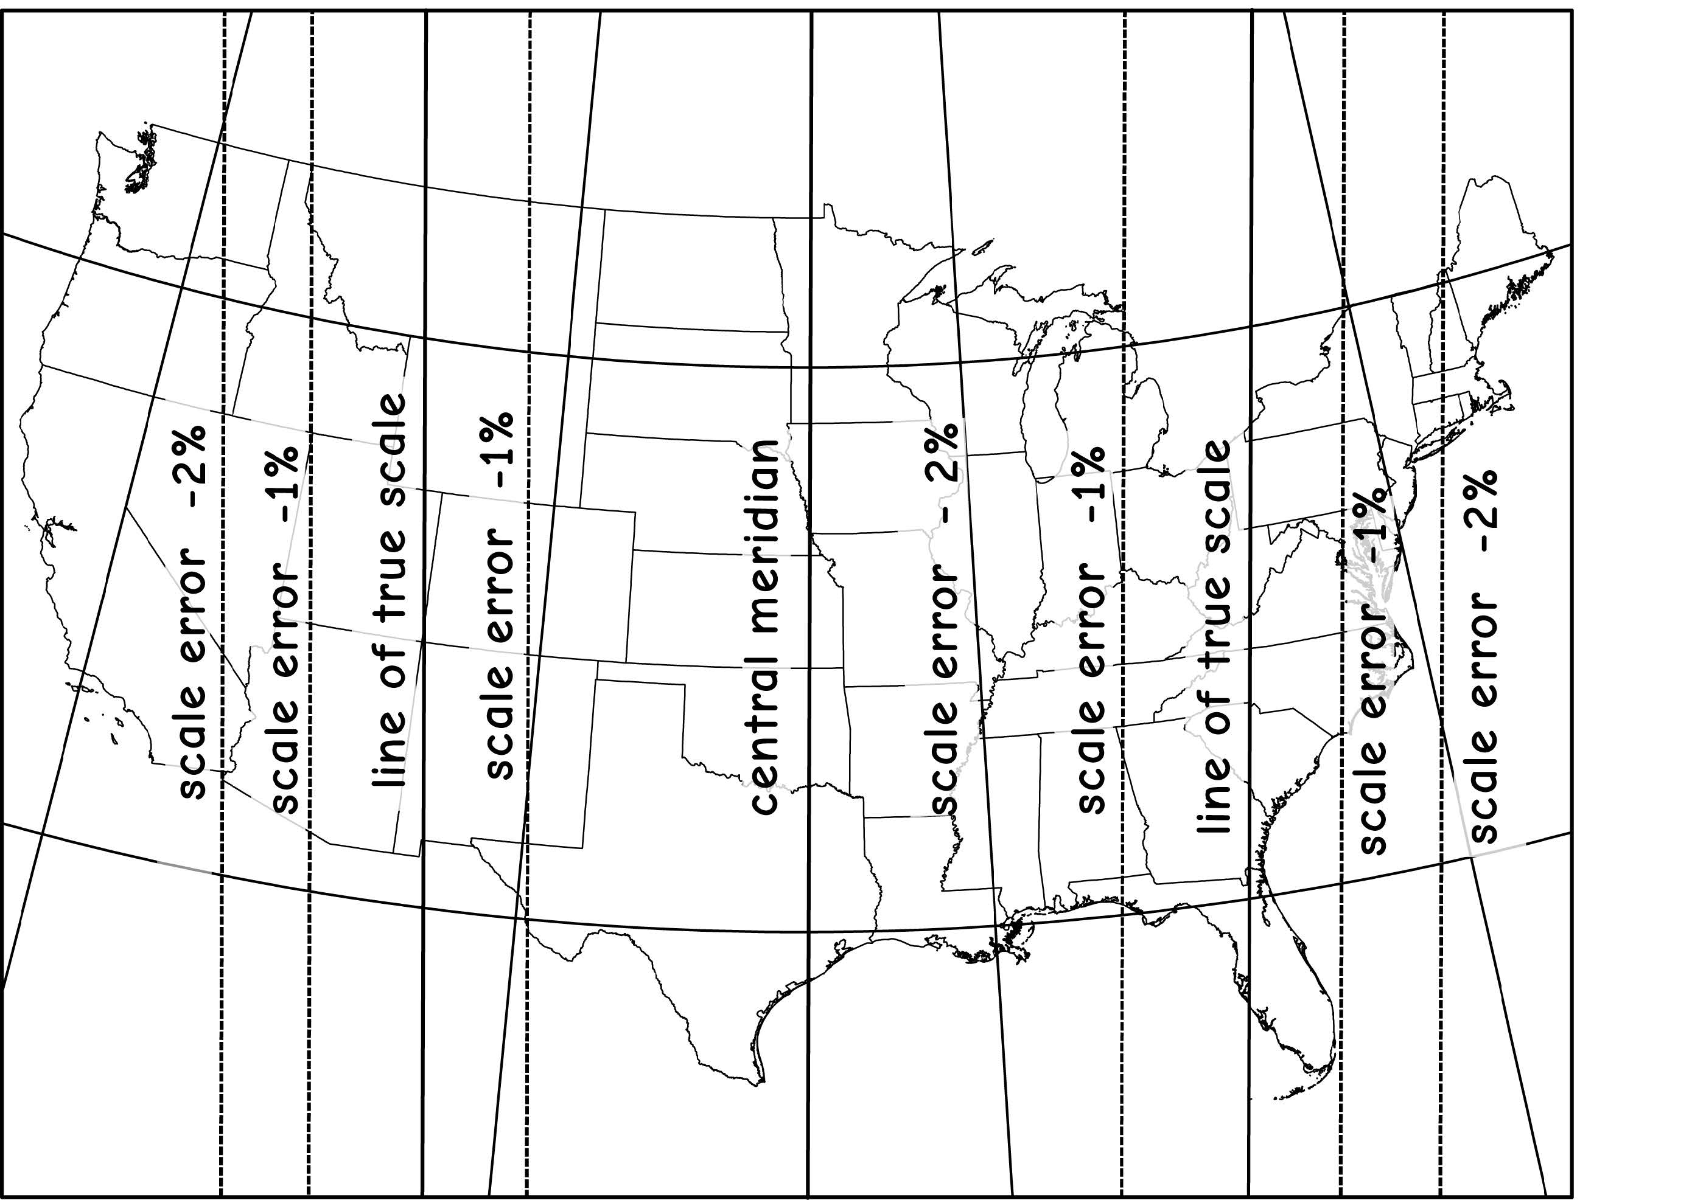
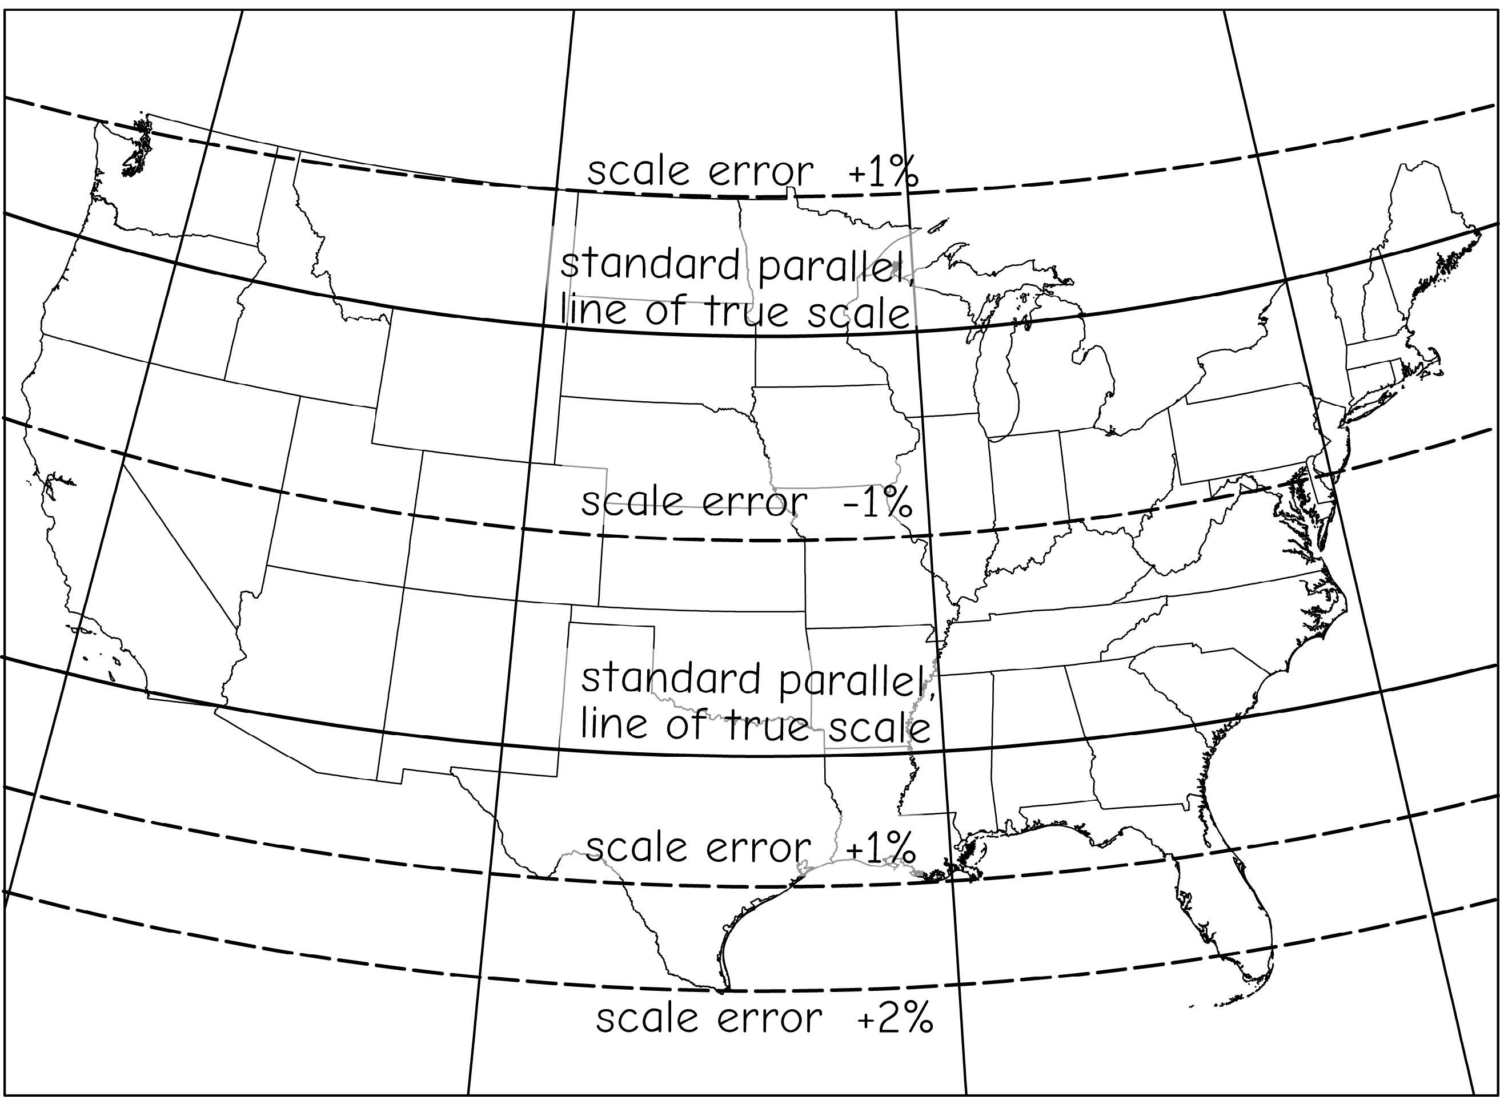
Map projection
State Plane Coordinate System
Transverse Mercator projection (for states with long north-south axis)
Lambert conformal conic projection (for states with long east-west axis)
Transverse Mercator
Lambert conformal conic
Bolstad, 2019
Notes:
For mapping smaller extents within states, state plane coordinate systems are commonly used.
It is common for surveyors to use these systems. Measurements are commonly made in feet or meters. Each coordinate system has a defined baseline, like northing and a false meridian, like easting, to which the coordinate measurements are referenced. Different projections are used depending on the specific coordinate system.
These systems allow for very accurate measurements and are commonly used at the city- to county-scale.
120 different zones generally follow county boundaries (except in Alaska). Larger states are divided into multiple zones, such as the “Colorado North Zone.” States with a long north-south axis (such as Idaho and Illinois) are usually mapped using a Transverse Mercator projection, while states with a long east-west axis (such as Washington and Pennsylvania) are usually mapped using a Lambert Conformal projection. In either case, the projection's central meridian is generally run down the approximate center of the zone.
SPCS 27 and SPCS 83
The boundaries of which usually follow county lines
States that are long in the east–west direction are typically divided into zones that are also long east–west. These zones use the Lambert conformal conic projection, because it is good at maintaining accuracy along an east–west axis, due to the projection cone intersecting the earth's surface along two lines of latitude. Zones that are long in the north–south direction use the Transverse Mercator projection because it is better at maintaining accuracy along a north–south axis, due to the circumference of the projection cylinder being oriented along a meridian of longitude.
125 (as of 2001). There are 110 zones in the contiguous US, with 10 more in Alaska, 5 in Hawaii, and one for Puerto Rico and US Virgin Islands.

Slide 61

Map projection
State Plane Coordinate System
The zones may change!
Bolstad, 2019
Notes:
For mapping smaller extents within states, state plane coordinate systems are commonly used.
It is common for surveyors to use these systems. Measurements are commonly made in feet or meters. Each coordinate system has a defined baseline, like northing and a false meridian, like easting, to which the coordinate measurements are referenced. Different projections are used depending on the specific coordinate system.
These systems allow for very accurate measurements and are commonly used at the city- to county-scale.
120 different zones generally follow county boundaries (except in Alaska). Larger states are divided into multiple zones, such as the “Colorado North Zone.” States with a long north-south axis (such as Idaho and Illinois) are usually mapped using a Transverse Mercator projection, while states with a long east-west axis (such as Washington and Pennsylvania) are usually mapped using a Lambert Conformal projection. In either case, the projection's central meridian is generally run down the approximate center of the zone.
SPCS 27 and SPCS 83
The boundaries of which usually follow county lines
States that are long in the east–west direction are typically divided into zones that are also long east–west. These zones use the Lambert conformal conic projection, because it is good at maintaining accuracy along an east–west axis, due to the projection cone intersecting the earth's surface along two lines of latitude. Zones that are long in the north–south direction use the Transverse Mercator projection because it is better at maintaining accuracy along a north–south axis, due to the circumference of the projection cylinder being oriented along a meridian of longitude.
125 (as of 2001). There are 110 zones in the contiguous US, with 10 more in Alaska, 5 in Hawaii, and one for Puerto Rico and US Virgin Islands.

Slide 62

Public Land Survey System
It is not a coordinate system, but used widely for land parcels since 1800s
Divided lands by north-south lines, 6 miles apart
East-west lines were surveyed perpendicular to those north-south lines, also at 6 miles intervals
30 states adopted PLSS
Bolstad, 2019
Notes:
For mapping smaller extents within states, state plane coordinate systems are commonly used.
It is common for surveyors to use these systems. Measurements are commonly made in feet or meters. Each coordinate system has a defined baseline, like northing and a false meridian, like easting, to which the coordinate measurements are referenced. Different projections are used depending on the specific coordinate system.
These systems allow for very accurate measurements and are commonly used at the city- to county-scale.
120 different zones generally follow county boundaries (except in Alaska). Larger states are divided into multiple zones, such as the “Colorado North Zone.” States with a long north-south axis (such as Idaho and Illinois) are usually mapped using a Transverse Mercator projection, while states with a long east-west axis (such as Washington and Pennsylvania) are usually mapped using a Lambert Conformal projection. In either case, the projection's central meridian is generally run down the approximate center of the zone.
SPCS 27 and SPCS 83
The boundaries of which usually follow county lines
States that are long in the east–west direction are typically divided into zones that are also long east–west. These zones use the Lambert conformal conic projection, because it is good at maintaining accuracy along an east–west axis, due to the projection cone intersecting the earth's surface along two lines of latitude. Zones that are long in the north–south direction use the Transverse Mercator projection because it is better at maintaining accuracy along a north–south axis, due to the circumference of the projection cylinder being oriented along a meridian of longitude.
125 (as of 2001). There are 110 zones in the contiguous US, with 10 more in Alaska, 5 in Hawaii, and one for Puerto Rico and US Virgin Islands.

Slide 63

Public Land Survey System
Place roads, powerlines, and other public services
Bolstad, 2019
Notes:
The PLSS is important because:
1) The PLSS lines are often property boundaries, they form natural corridors in which to place roads, powerlines, and other public services; they are often evident on the landscape. Many road intersections occur at PLSS corner points, and these can be viewed and referenced on many maps or imagery used for GIS database development efforts. Further, PLSS corners are sometimes resurveyed using high precision methods to provide property line control, particularly when a GIS is to be developed.

Slide 64
Map projection
Projection used is related to type of map and area covered by map (extent)
Continental-scale data (North America)
Geographic projection (decimal degrees)
Lambert Conformal Conic
Albers Equal Area
State-scale data (Arkansas)
UTM Projection, Zone 15N
County, city-scale data
State Plane
Notes:
The best map projection to use partially depends on the extent being mapped or the scale of the map.
We will now investigate some common map projections that can be used at different scales.
Note that all maps and spatial data layers will be referenced to a datum or geographic coordinate system.
If the map or data have been projected, they will also have a projected coordinate system where measurements are made in length units as opposed to angles.
We will begin with a discussion of some common global-scale projections followed by continent- and sate-scale options.

Slide 65
Best Practice
Should use same projection and datum for all data
Use projection appropriate for scale and extent
Think about what map properties are maintained or distorted
Notes:
This slide highlights best practices for working with projections.
First, it is generally best to use the same projection for all data layers in a map or project to avoid any issues with misalignment.
You should use a projection appropriate for the scale and extent of the map. For example, you would not use a specific UTM zone to project the entire globe. On the other hand, a global projection would not be the best choice for data just within Arkansas.
You should also think about what map properties are maintained or distorted. If you are interested in maintaining relative size, then you should use an equivalent projection.

Slide 66
Projection-on-the-Fly (ArcGIS)
ArcGIS can apply a projection transformation on-the-fly
So, it is not always necessary to reproject data
Okay if you are visualizing the data
Need to reproject if you plan to perform an analysis
Notes:
Note that ArcGIS Pro can apply a projection transformation on-the-fly or in memory.
So, data that are read into a map that are in a different projection than the map can be reprojected to match the map on-the-fly.
So, it is not always necessary to reproject data if you are simply visualizing it or making a map layout.
However, I suggest transforming all data layers into the same projection if you plan to perform spatial analysis.

Slide 67
Thank you!

