Slide 1

WEEK 04 Geospatial Data lecture
Instructor: Yanan Wu
fALL 2025

Slide 2
4.1 Geospatial data

Slide 3
Overview
Geospatial data
Vector
Point
Line
Polygon
Raster
Pixel

Slide 4
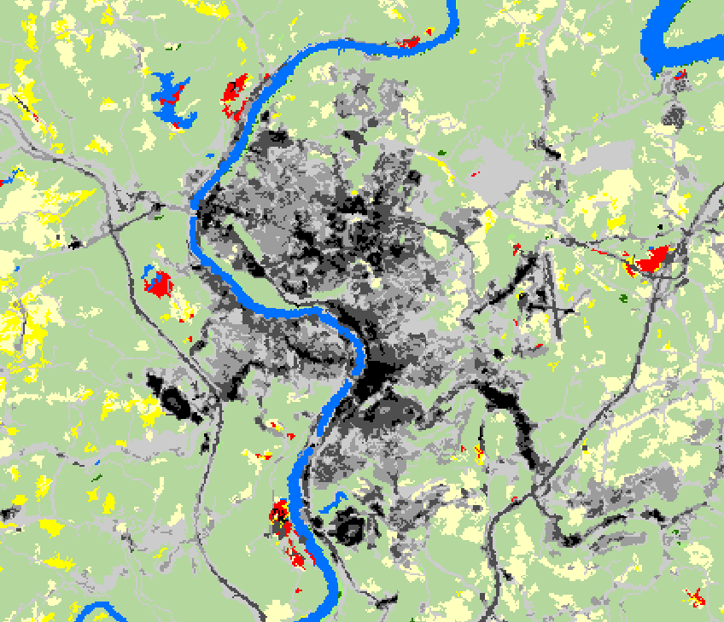
Geospatial data
Two data models
Vector Data
Discrete
Points, lines, and polygons
Raster Data
Space filling
Cell- or pixel-based
Vertex
Node
Vector and raster graphics
Notes:
Two broad types of geospatial data are available: vector data and raster data.
Vector data generally represent discrete features as points, lines, or polygons.
Raster data generally represent continuous features as pixels or grid cells.
We will begin with a discussion of vector data.

Slide 5
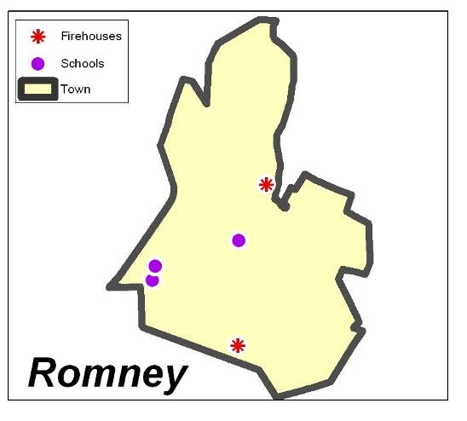
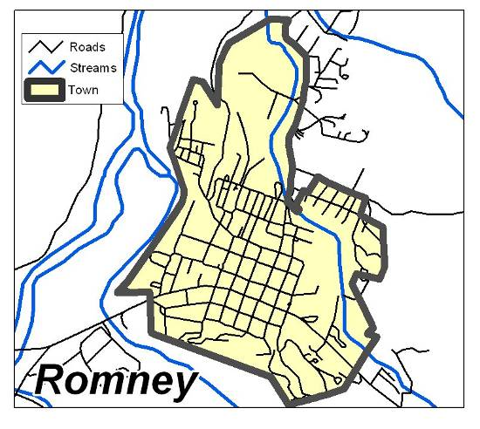
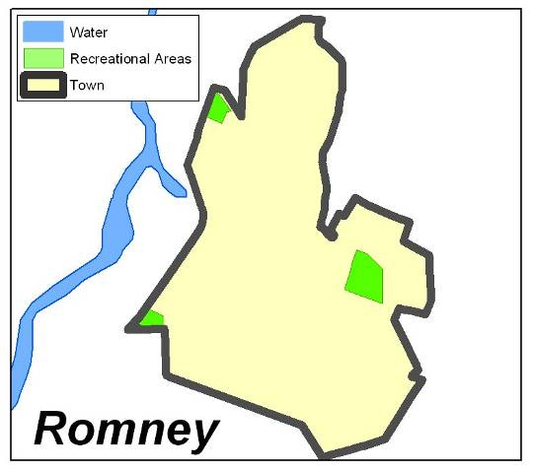
Vector Data
X,Y
X,Y
X,Y
X,Y
X,Y
X,Y
Points
Lines
Polygons
X,Y
X,Y
X,Y
Coordinate locations, Zero-dimensional
One-dimensional,
Length, No width
Two-dimensional,
Length and width, enclose an area
Examples by Dr. Mike and Dr. Jackie Strager
Notes:
Vector data can be represented as points, lines, or polygons.
Point data are simply coordinate pairs with associated attributes. They have no spatial dimensions, since they do not have length or width.
Lines are a series of coordinate pairs connected to form a line. They have one spatial dimension, since they have length but not width.
Polygons are a series of coordinates in which the first and last coordinates are connected to form a closed feature or area. They have both length and width, so have two spatial dimensions. Since they have length and width, they have an area.

Slide 6
Vector Data
Vector Data Structure
Vector data are made up of connected vertices.
End vertices are called nodes.
Vertices can be connected as lines and polygons.
Vector data are made up of coordinate points.
Vertex
Node
Notes:
As mentioned above, all vector data are made up of coordinates. Points are individual coordinates while lines and polygons are made up of interrelated coordinates.
These individual coordinates are called vertices. Vertices that occur at or define the end of a line segment are called nodes.
Again, all vector data are made up of coordinate points.

Slide 7
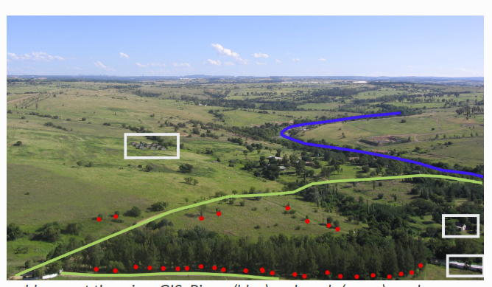
representation

Slide 8
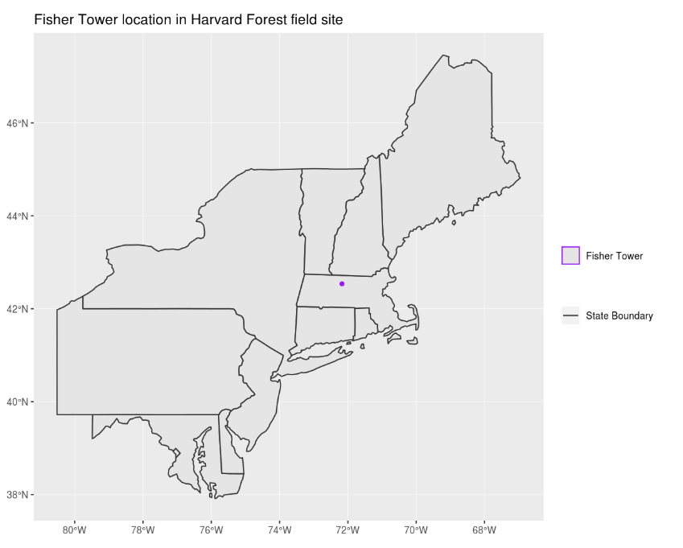
representation
🤔
Identify which features are represented by which vector type.

Slide 9
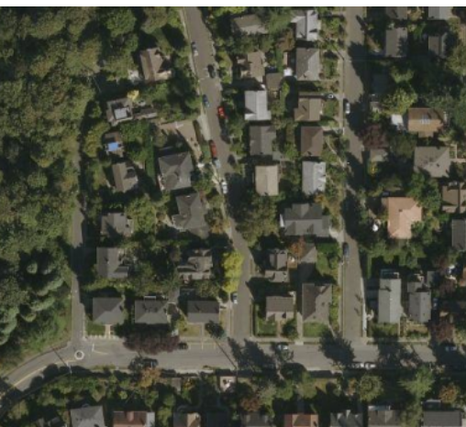

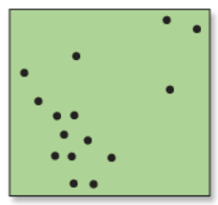
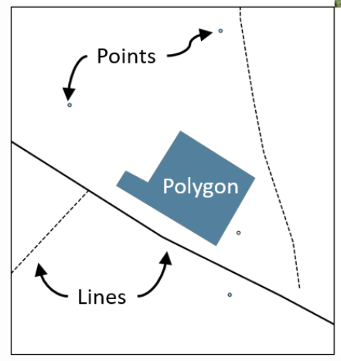
Same Feature, Different Vector Representations
If the same feature (like a house) is represented as a point vs. a polygon, what types of analysis can we do in each case?
🤔
Point
Polygon

Slide 10
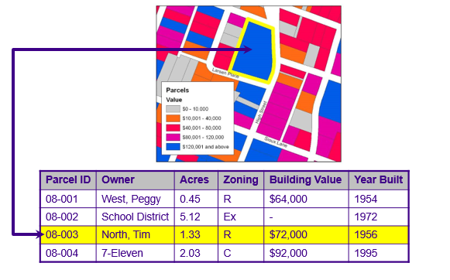
Vector Data
All types can store attribute information
Examples by Dr. Mike and Dr. Jackie Strager
Notes:
One powerful aspect of a GIS and geospatial data is the ability to relate spatial and tabulated data. Vector data are not just map coordinates. These features are also associated with tabulated information. For example, the parcels boundaries shown on this slide are attributed with a set of information. This allows us to relate spatial and tabulated data.

Slide 11
Rows and Columns in an Attribute Table
Row = one record = one feature
Example: Parcel 08-003 (North, Tim) is one row in the table and one polygon on the map.
Each field (a column describing one property of all features) is represented by a column in the table.
Field = one type of information for all features
Example fields: Parcel ID, Owner

Slide 12
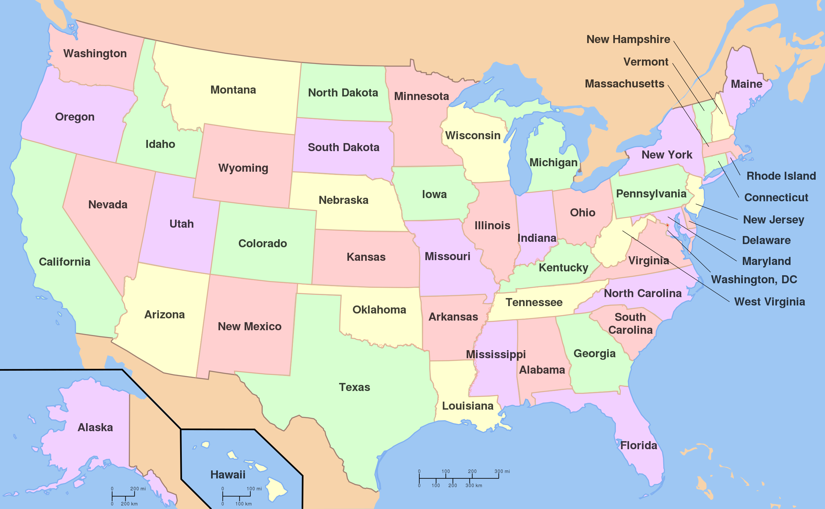
Vector Data
Topology
Study of properties of geometric objects that remain invariant under certain transformations such as bending or stretching (Massey 1967)
Spatial relationship between map features.
Examples:
Adjacent to
https://en.wikipedia.org/wiki/File:Map_of_USA_with_state_names.svg
Notes:
An important concept associated with vector data is the concept of topology. This is not to be confused with topography.
Topology is the study of properties of geometric objects, including map features, that remain invariant, or don’t change, under certain transformations such as bending or stretching.
Example topological relationships include adjacent to and incident with. For example, if the US state boundaries could be bent or stretched, the adjacently between states would be maintained. Or, adjacent states would still be next to each other and share boundaries. If map features were bent or stretched, features that occur within or are incident with other features would maintain this relationship with those other features. For example, cities would still fall within the correct state or country.
Arkansas and mississippi
A good example of topology is a subway map. On this slide, I have included the subway map for the city of Vancouver in British Columbia. The subway lines and other map features have been generalized such that the full complexity is not represented. However, important topological relationships have been maintained. For example, you know which stops occur along or are incident with which lines. You also know where different lines cross, or where you can transfer between lines. So, even though these data have been generalized, important topological rules have been maintained so that you can use the map to navigate the subway system.
Topology is important because it allows us to solve problems that require an understanding of the spatial relationship between map features.

Slide 13
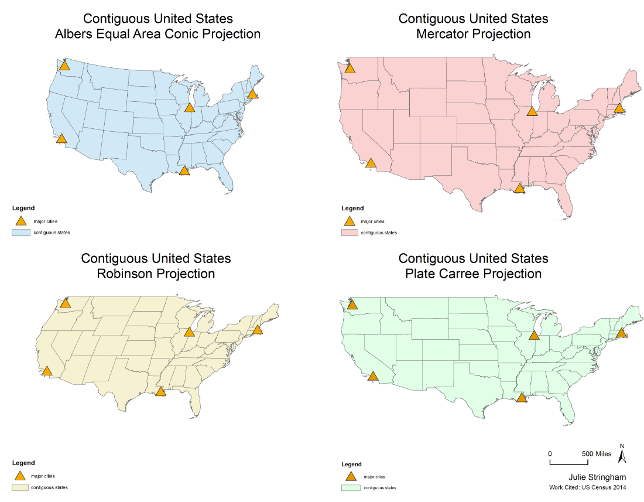
Topology Remains the Same Across Projections
🤔
If I want to know which states border Arkansas, does projection matter

Slide 14
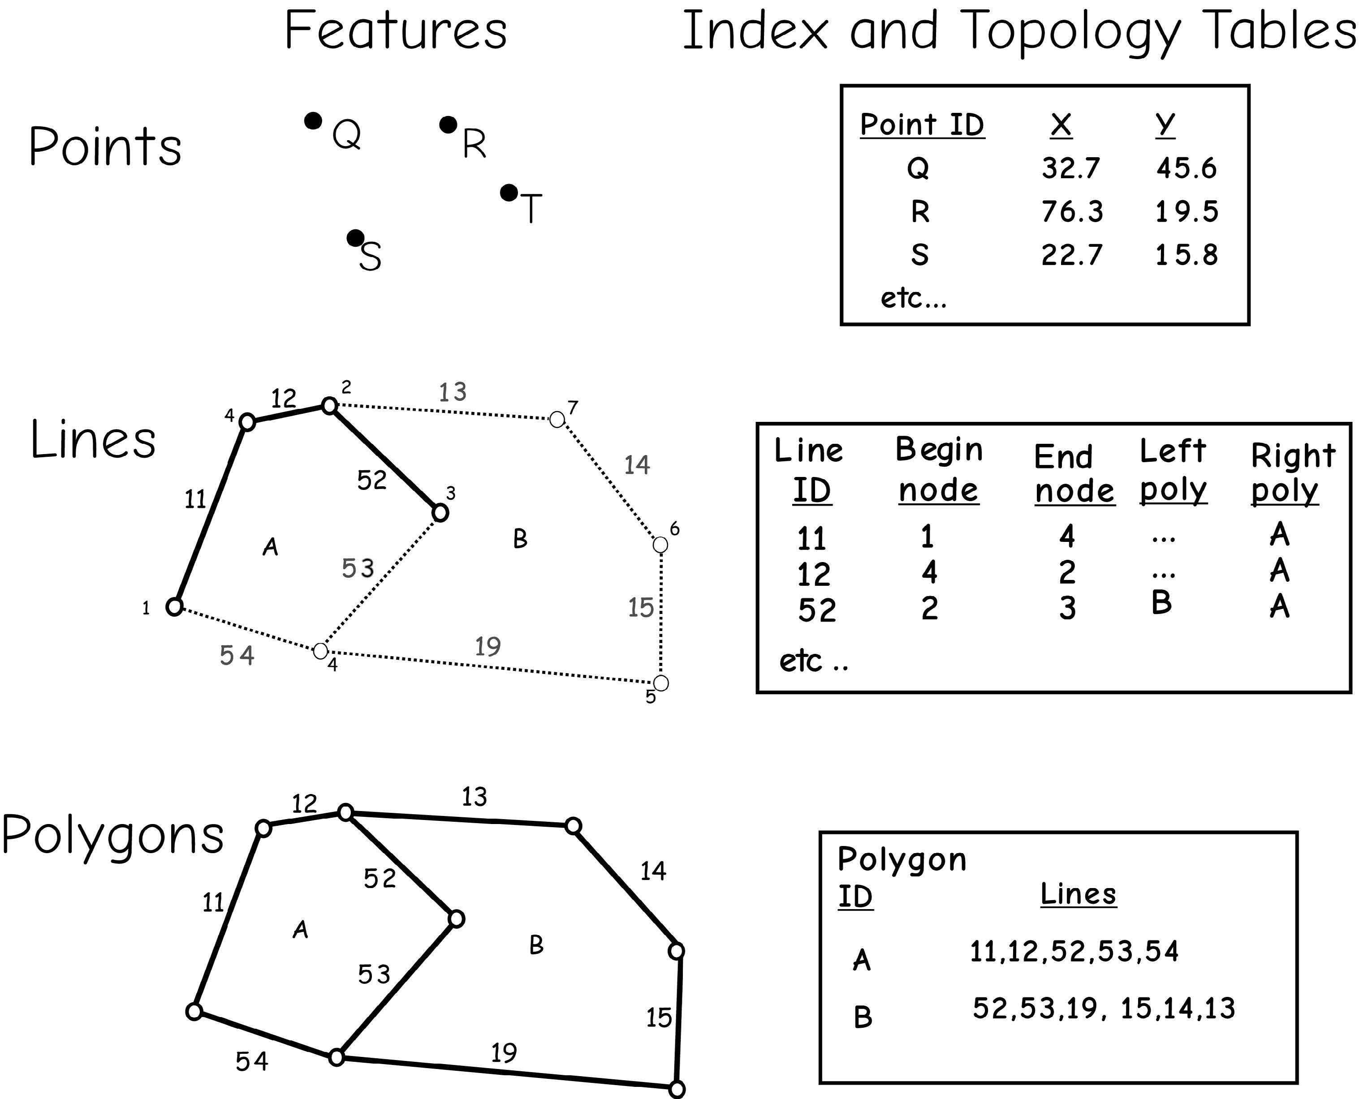
Vector Data
Topology
Often use codes and tables to record topology
Information on the adjacency (which polygons are next to which), connectivity (which lines connect to which), and other spatial relationships could be stored
Bolstad, 2019

Slide 15
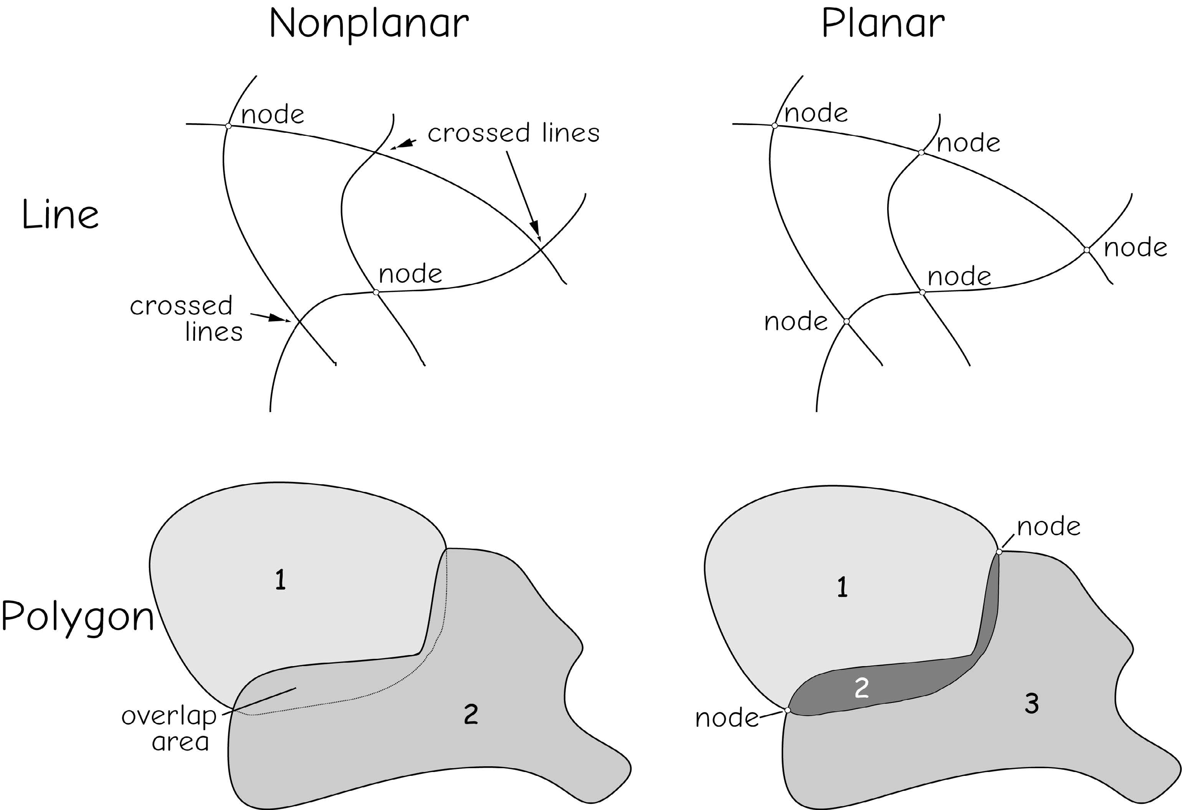
Vector Data
Topological models
Planar topology: requires that all features occur on a two-dimensional surface.
Lines may not cross over or under other lines
At each lines crossing there must be an intersection
Recommended
Nonplanar topology
Bolstad, 2019

Slide 16
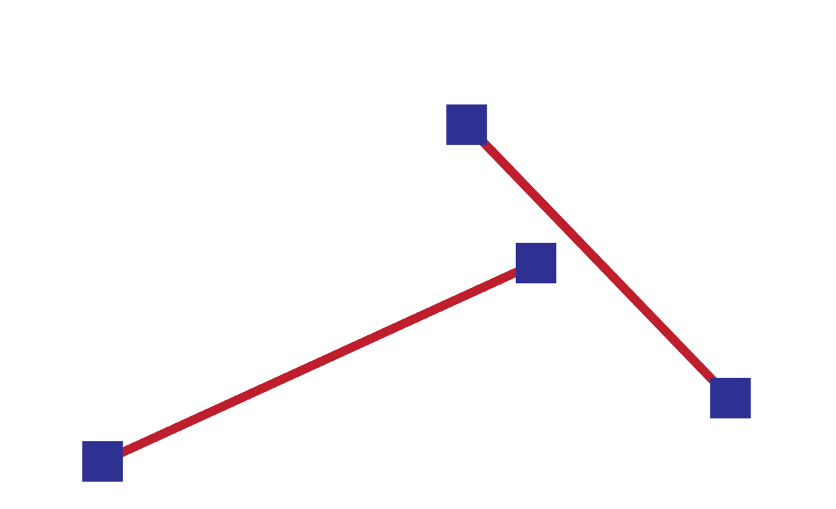
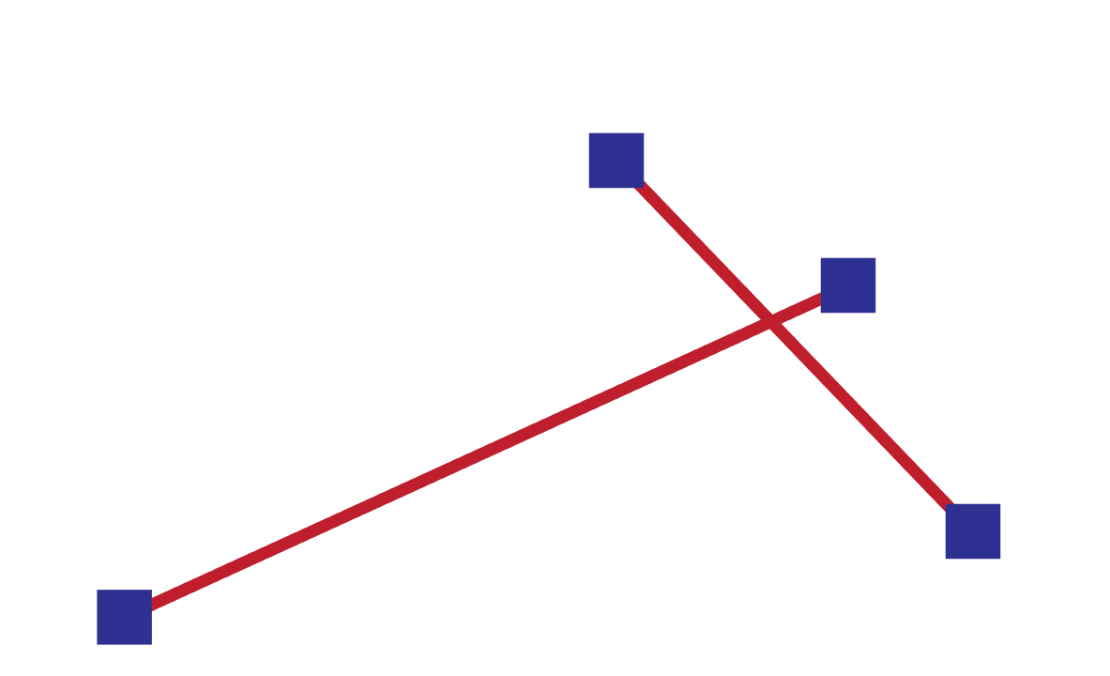
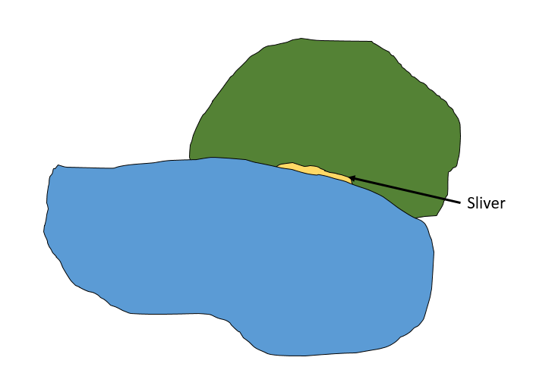
Vector Data
Topological issues
Dangles: two line features are supposed to connect, but not
Overshoots: one line segment is supposed to end but not
undershoots
Slivers: areas of non-overlap due to digitization error
Notes:
When creating new data, issues can arise that cause topological relationships to not be maintained.
Dangles occur when 2 line features are supposed to connect, such as at a road intersection, but they fall short. If you were trying to model movement along a road network, this would be an issue.
Overshoots occur when one line segment is supposed to end when it intersects another segment, but it continues or overshoots.
Slivers represent areas of non-overlap between features that could represent real patterns or result for digitization errors or scale difference in the input data.

Slide 17
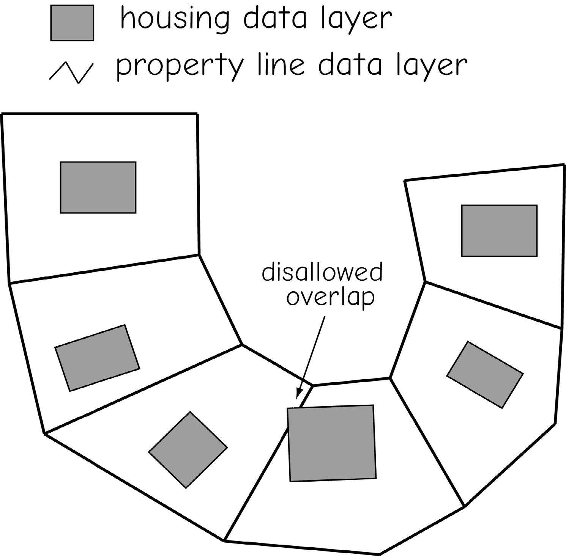
Vector Data
Topological issues
Between different layers
Bolstad, 2019

Slide 18
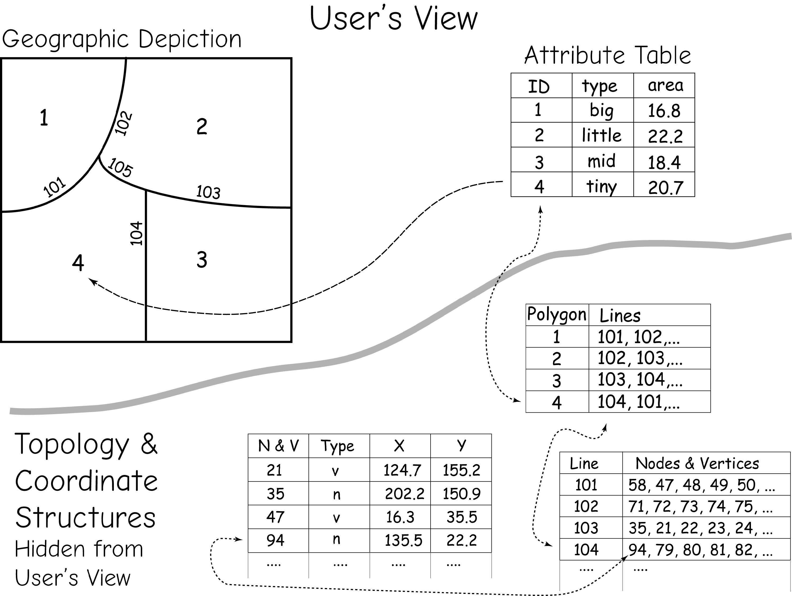
Vector Data
Topology
Topology and coordinate data are often hidden from the user, but linked to the attribute and geographic features through pointers and index variables.
Bolstad, 2019

Slide 19
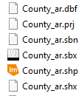
Vector Data
The Shapefile
Nontopological
No file describe the spatial relationships among geographic objects
Although this is a nontopological model, topological relationships can be calculated on-the-fly to perform analyses
Components (Three mandatory files)
.shp = geometry data
.prj = spatial reference/projection information
.dbf = attribute table/aspatial data
.shx = index file for geometry (helps with speed)
.sbn and .sbx = index file for the attributes (speed of queries)
.xml = metadata
Notes:
The shapefile is a georelational model that is still commonly used. It was originally developed by ESRI but is non-proprietary.
It is a nontopological model. Generally, nontopological data can display more rapidly on a computer than topological data. They can also be used across multiple software packages.
Although this is a nontopological model, topological relationships can be calculated on-the-fly to perform analyses.
The geometric information is stored in the .shp file while the .shx file provides an index of the geometry, which can speed up searching and display.
The attributed or tabulated data are stored in the .dbf file. This is why this is georelational model: geometry and attributes are stored in separate files. The .sbn and .sbx components provide indices for the attributes, which can speed of queries.
The projection information is stored in the .prj file. This component is important because it tells the computer what the projection is so that the data can be drawn at the correct location in the map space.
If metadata are created, this additional information can be stored in the .xml component.
cpg are optional plain text files that describes the encoding applied to create the shapefile. If your shapefile doesn't have a cpg file, then it has the system default encoding.

Slide 20
Class Activity: Exploring Shapefile Components
Open the folder containing your shapefile.
Identify the components
Reminder:
A shapefile is not just one file.
If you want to share data, you must copy ALL shapefile components together, not just the .shp file.

Slide 21
Quick Way to Check Attributes in a Shapefile (.dbf file)
Locate the .dbf file in your shapefile folder (e.g., Historical_features.dbf).
Open Excel, go to File → Open → Browse, then select the .dbf file.
The attribute table will appear as a spreadsheet:
Each row = one feature
Each column (field) = one type of data (ID, name, area, etc.).
You can now quickly check the attribute values without opening GIS software.
⚠️
Do not edit and save the .dbf in Excel (it can corrupt the shapefile).
Only use it for a quick look at the data.

Slide 22
Vector Data
Polygon inclusions and boundary generalization
Polygon inclusions: areas in a polygon that are different from the rest of the polygon, but still part of it
Boundary generalization: incomplete representation of boundary locations
Bolstad, 2019

Slide 23
Class Activity: Representing Indoor Features in GIS
Divide into three groups.
Each group discusses which indoor features are best represented by:
Points
Lines
Polygons
After 5 minutes, share your answers with the class.

Slide 24

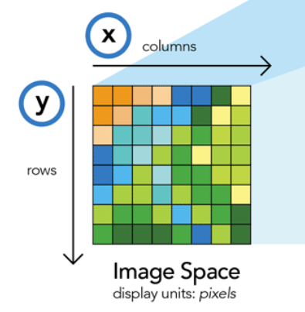

Raster Data
Array of cells or pixels
Origin is generally as the coordinate of the upper-left corner of the grid extent
pixels
Notes:
We will now move on to discuss raster data.
In contrast to vector data, raster data have a simple data structure.
Raster data are a matrix or array of values stored in cells.
This matrix or array is spatially referenced so that each cell has a defined extent on the landscape.
The origin is generally defined as the coordinate of the upper-left corner of the grid extent.
So, if the origin, projection, cell size, and number of rows and columns is known, then the data can be rendered to a map space.
The raster data model can be used to store a variety of data types, including categorical data, continuous variables, and multiband imagery.

Slide 25
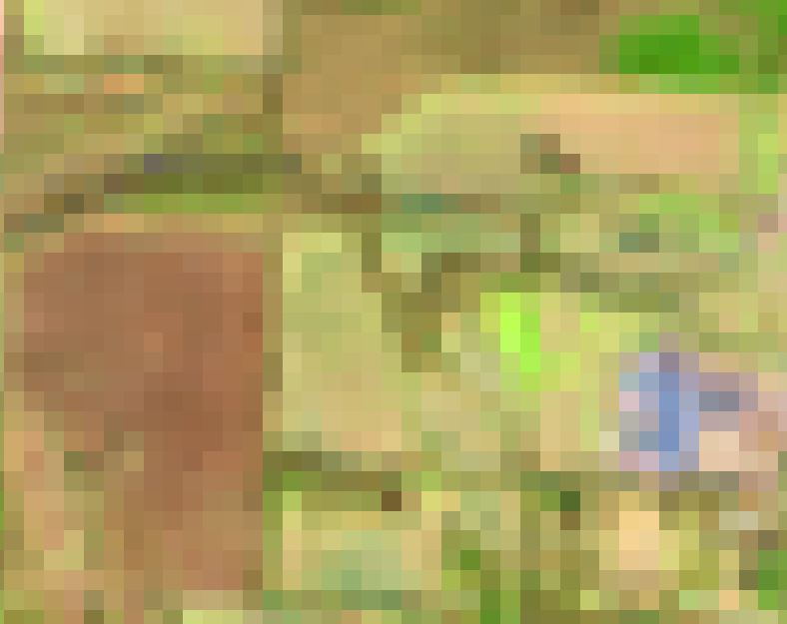
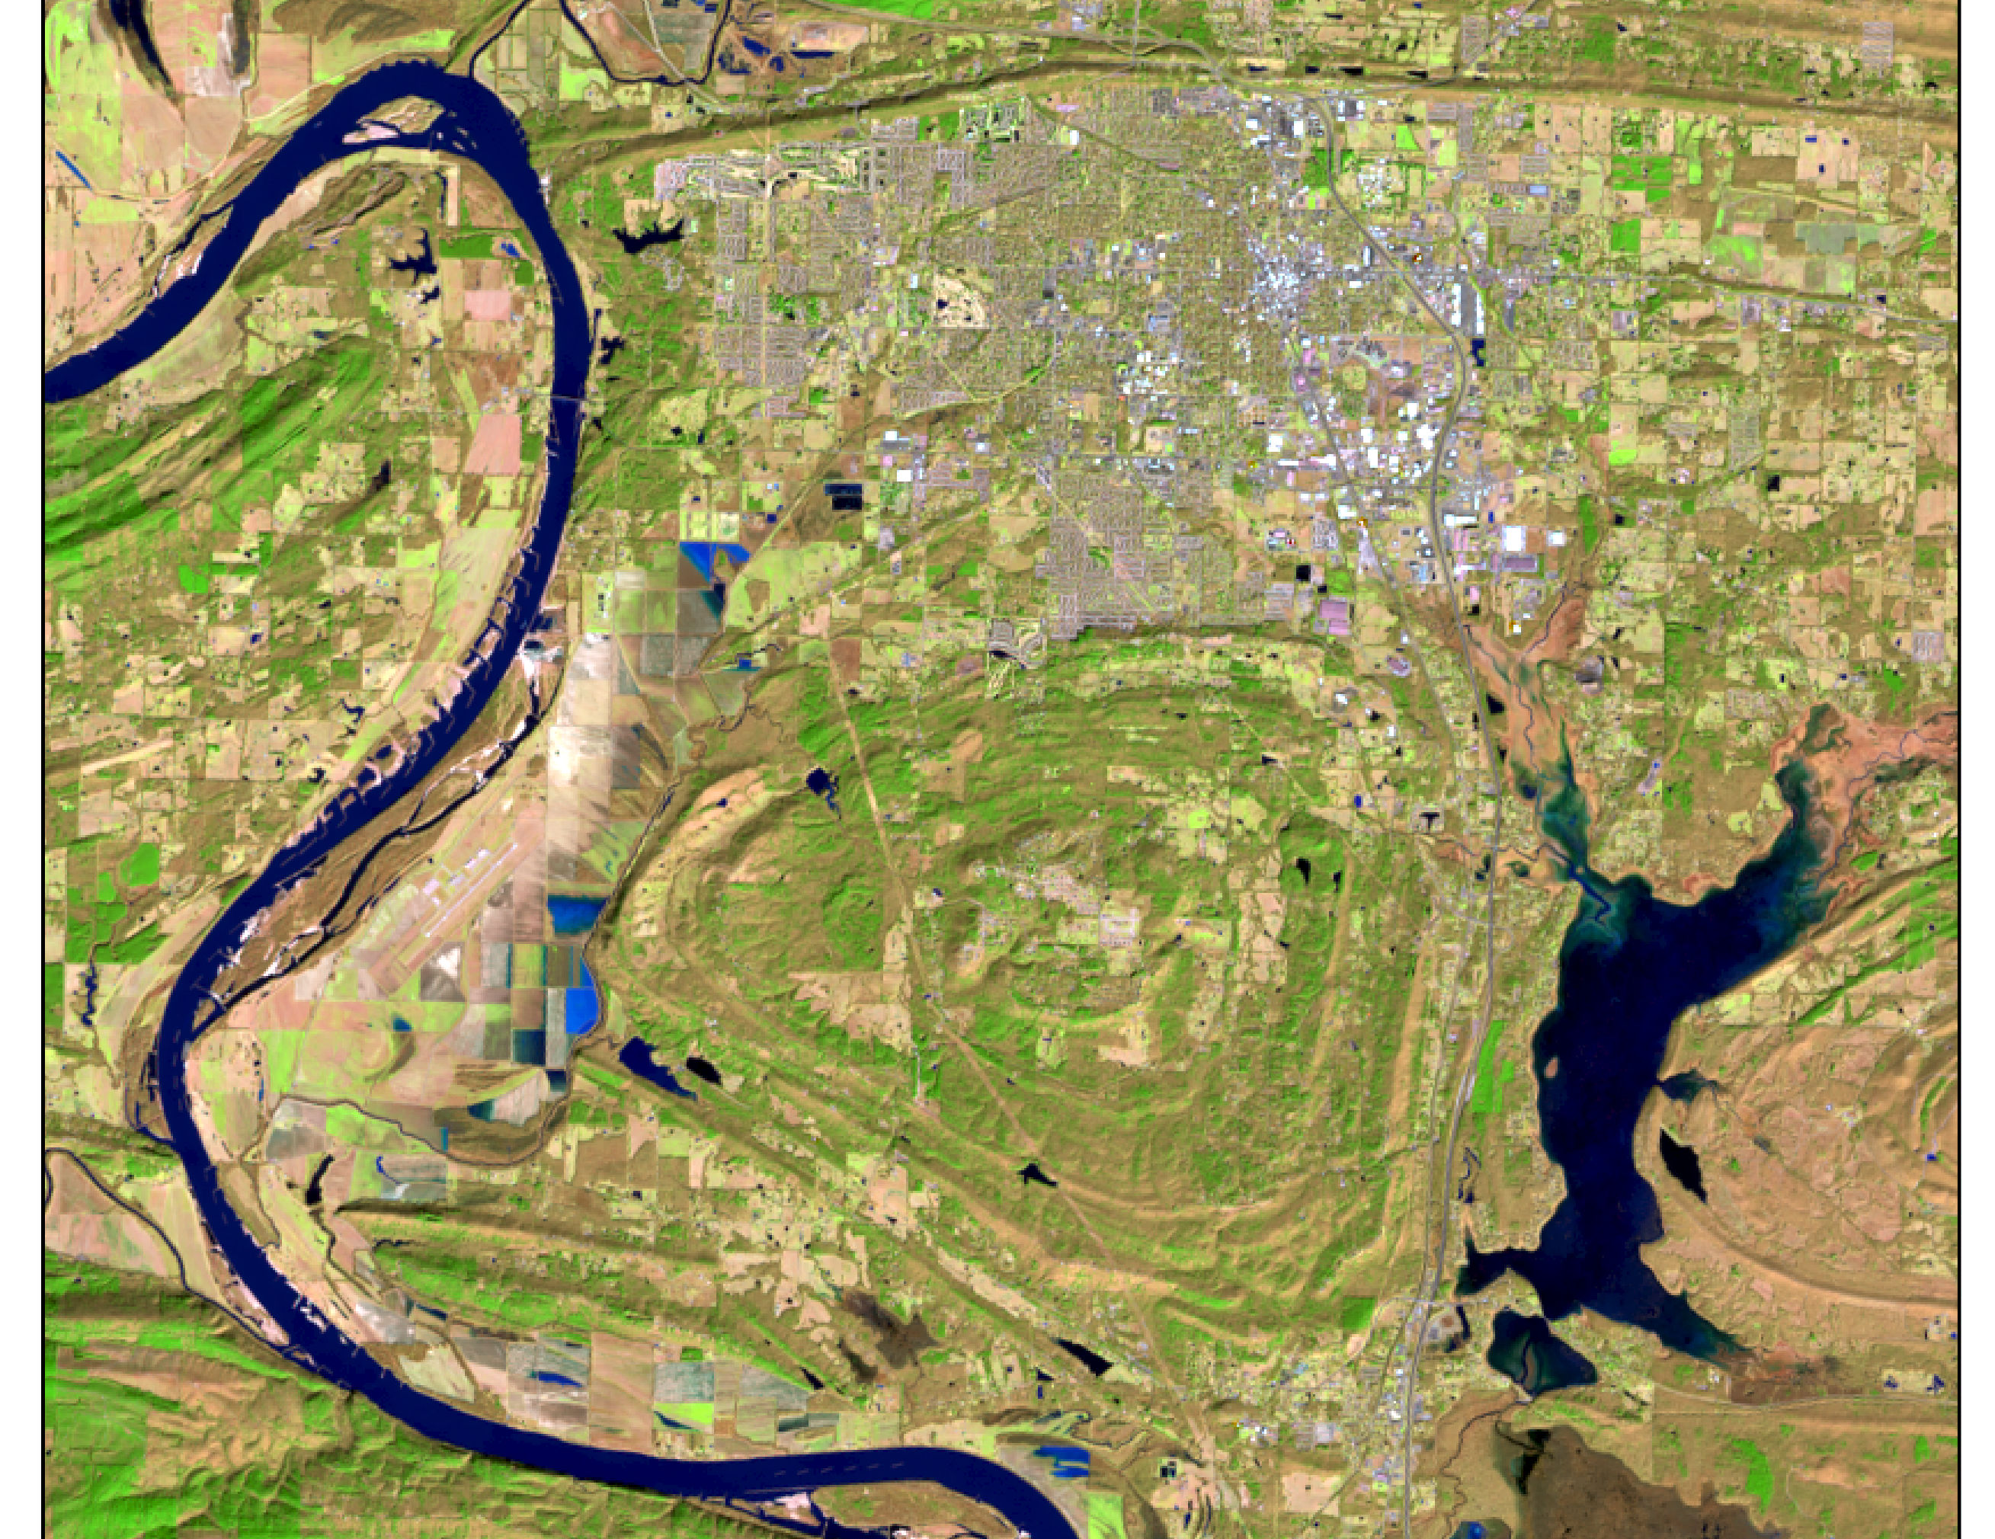
It is stored in raster format, which represents information as a grid of cells (or pixels).

Slide 26
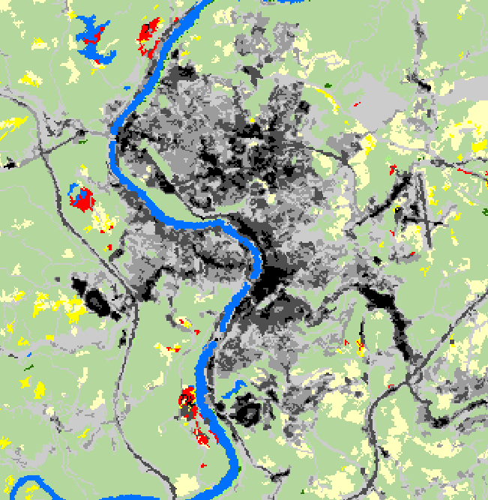
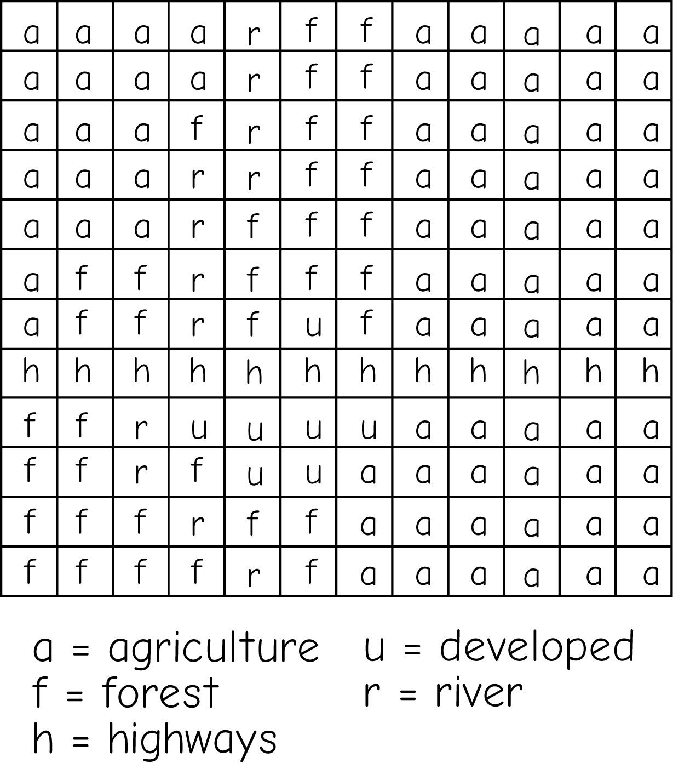
Raster Data
Categorical
Cells hold a value
Value is a place holder for a category (nominal data)
Commonly has attribute table
Value = 42
Bolstad, 2019
Notes:
Categorical raster grids represent nominal or categorical data.
Examples of data that could be appropriately modeled as categorical grids include land cover, vegetation types, wetland types, soil types, and land ownership.
Each cell in a categorical grid will hold a number. This number will be a stand in or placeholder for a category. For example, the value 41 could represent deciduous forest.
Categorical grids generally have attribute tables. This attribute table can have many fields, but it generally has at least a value field which provides the code that represents the category of interest. It also contains a count field that provides the number of cells in that category.
It is possible to provide additional fields, for example you could include a name field to provide the category name.

Slide 27
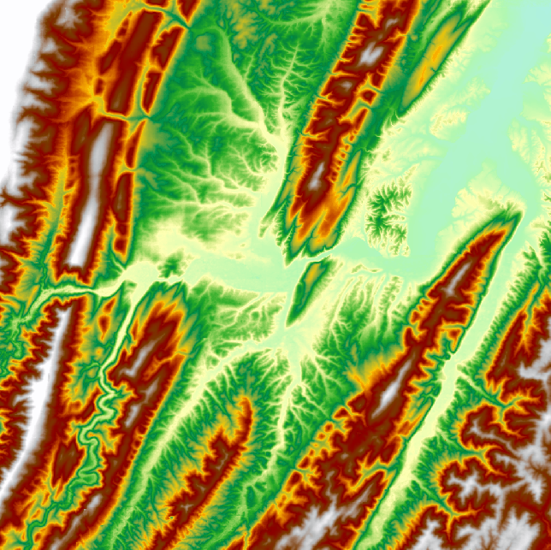
Raster Data
Continuous
Cells hold a value
Value is a true quantity (numeric data), not a place holder
Value = 896 m
Notes:
A continuous raster grid is used to represent continuous data, including interval and ratio type data.
The value stored in the cell represents the actual measure. It is not a placeholder for a category.
Examples of data that could be appropriately modeled using a continuous raster grid are elevation, topographic slope, topographic aspect, depth to bedrock, depth to water table, precipitation, temperature, and barometric pressure.
The example provided represents elevation measurements. So, each cell holds an elevation measurement.

Slide 28
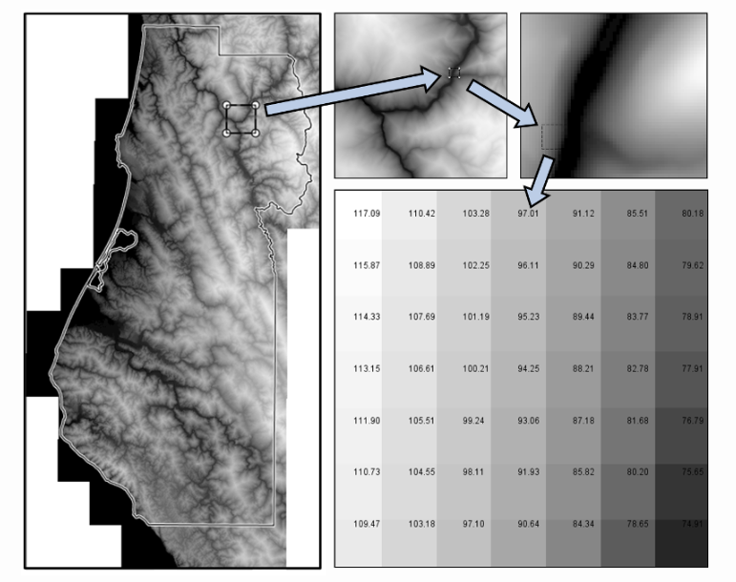
Digital Elevation Model - DEM
- where each pixel contains the average elevation of the land the pixel covers.
🤔
Why do you think we say “average elevation” instead of just “elevation”?

Slide 29
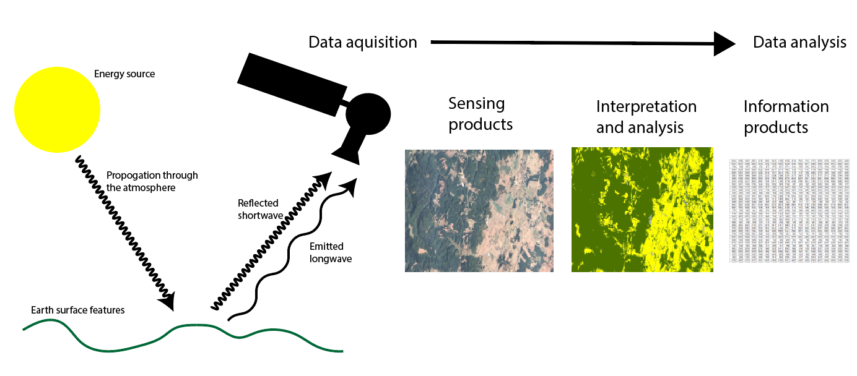
Raster Data
Remote sensing imagery
Value = 896 m
Notes:
Other than panchromatic, or black-and-white, imagery, image datasets contain more than one band.
For example, a true color image will contain three bands: red, green, and blue.
For multiband images, the raster data structure is that of an array. Each cell location holds multiple measurements, or a single measurement in each band.
You can think of a multiband raster as a stack of single band layers that act as one file.
Although we will focus on multiband imagery here, you can actually create multiband raster grids from a variety of raster data layers.

Slide 30
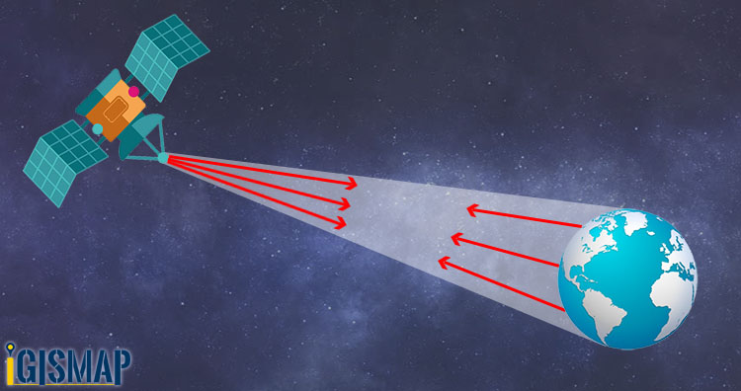
RASTER DATA COLLECTION
Satellite imagery: passive
Satellite imagery: active
Aerial image: Drone

Slide 31

More Infor about satellite
What if every satellite suddenly disappeared?

Slide 32
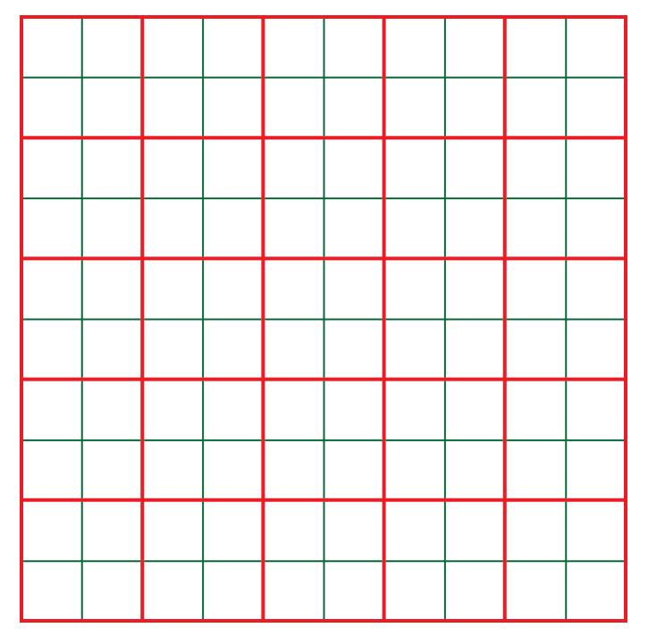
Raster Data
Cell size (spatial resolution)
Red: 100 mx100 m (lower resolution)
Green: 50 mx50 m (higher resolution)
Notes:
Reducing the cell size can have a large impact on the total number of cells and, as a result, the file size.
For example, in the image above the red grid represents cells that are 100 by 100 meters.
The green grid represents cells that are 50 by 50 meters.
Each 100 by 100 meter cell contains four as opposed to two 50 by 50 meters cells.
So, decreasing the cell size by half quadruples the number of pixels.
As another example, a 10 by 10 meter cell would contain 100 1 by 1 meter cells.
So, high spatial resolution raster grids can be very large files, especially if they cover a large spatial extent.

Slide 33
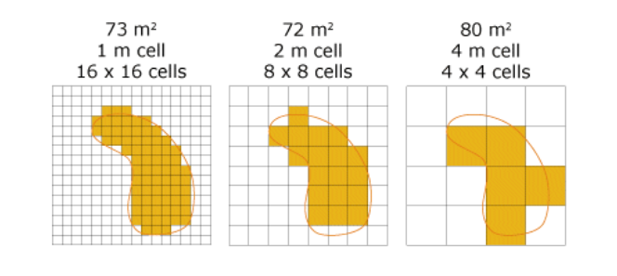
Spatial resolution
Higher spatial resolution:
Resolve and analyze smaller ground objects.

Slide 34
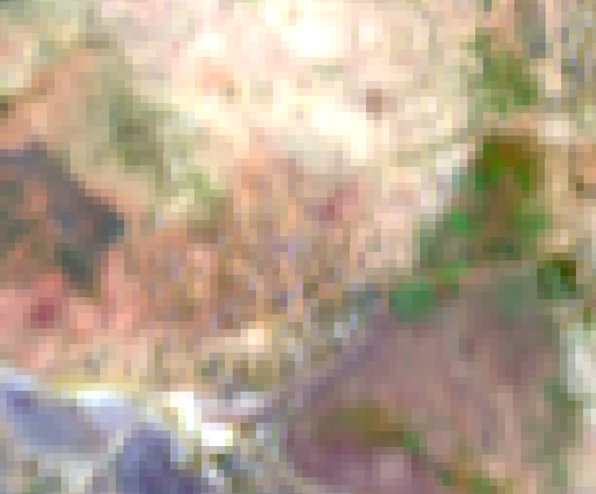
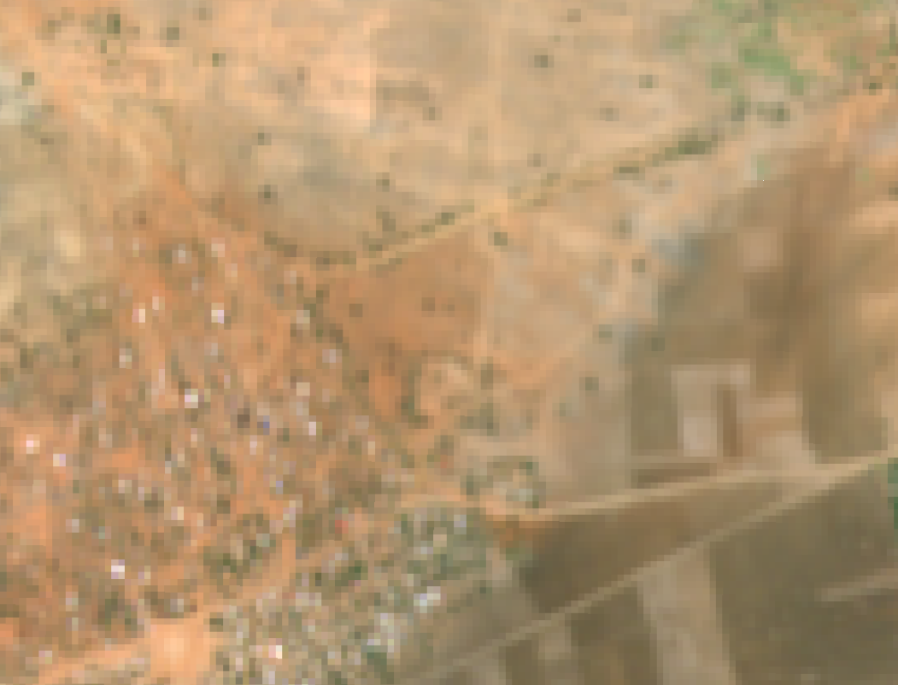
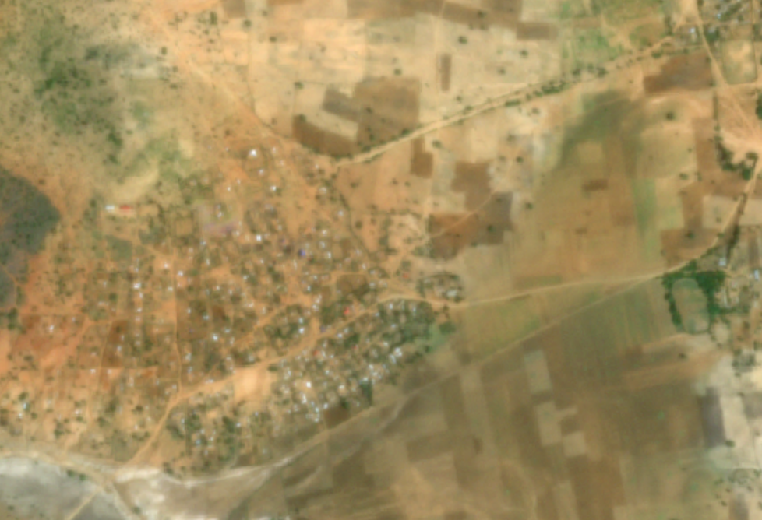
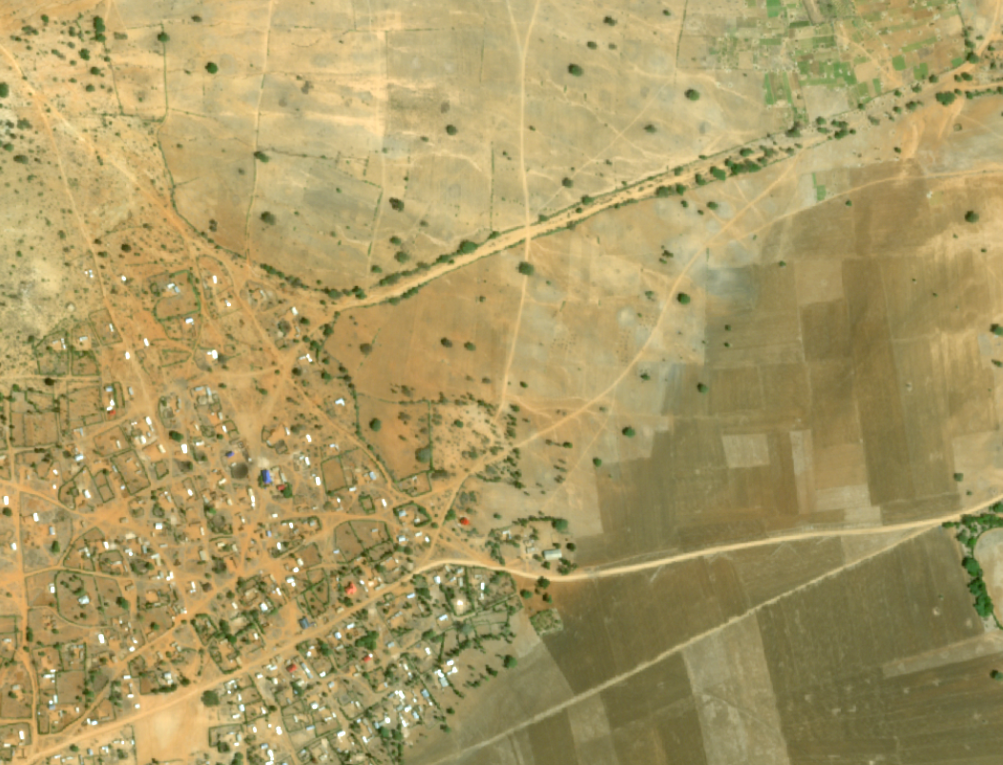
compare SPATIAL RESOLUTION
30 m
10m
Looking at the four images (30m, 10m, 3m, 0.5m resolution):
Which resolution would you choose if you only need to see main roads but want small file size?
3m
0.5m

Slide 35
Raster Data
Raster File Formats
ESRI Grid
Erdas Imagine (.img)
GeoTIFF (.tif)
Notes:
There are a variety of raster grid formats. However, I commonly use ESRI grids, Erdas Imagine, or GeoTIFF files.

Slide 36
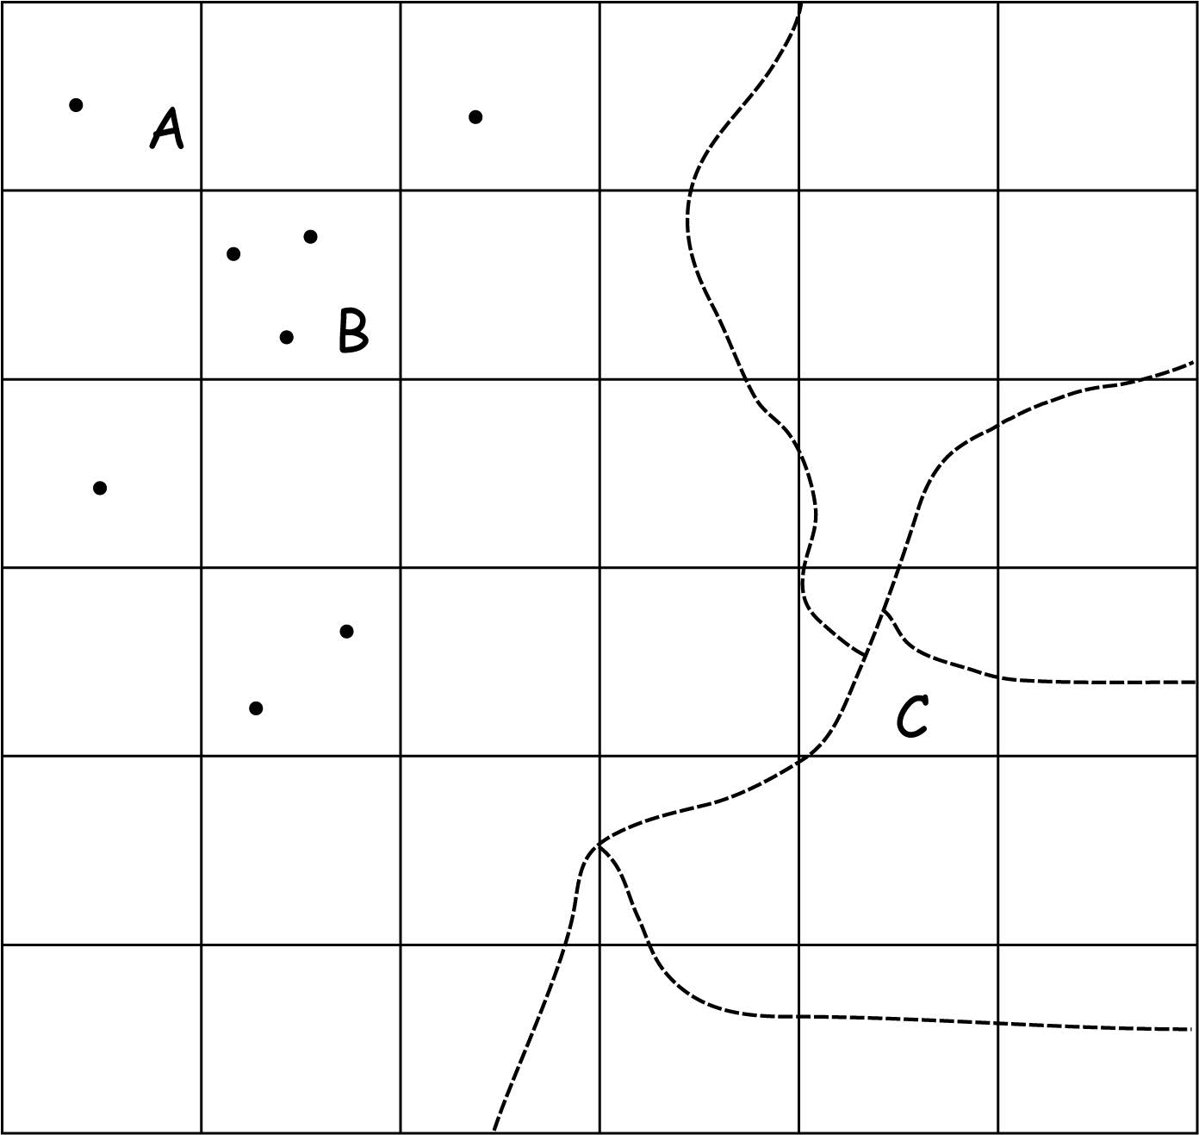
Raster Data
Raster cell values assignment maybe complicated
When they are multiple features within a single cell
Select a representative feature, and use the attribute from that feature
Reduce the cell size to include only one feature in each cell

Slide 37
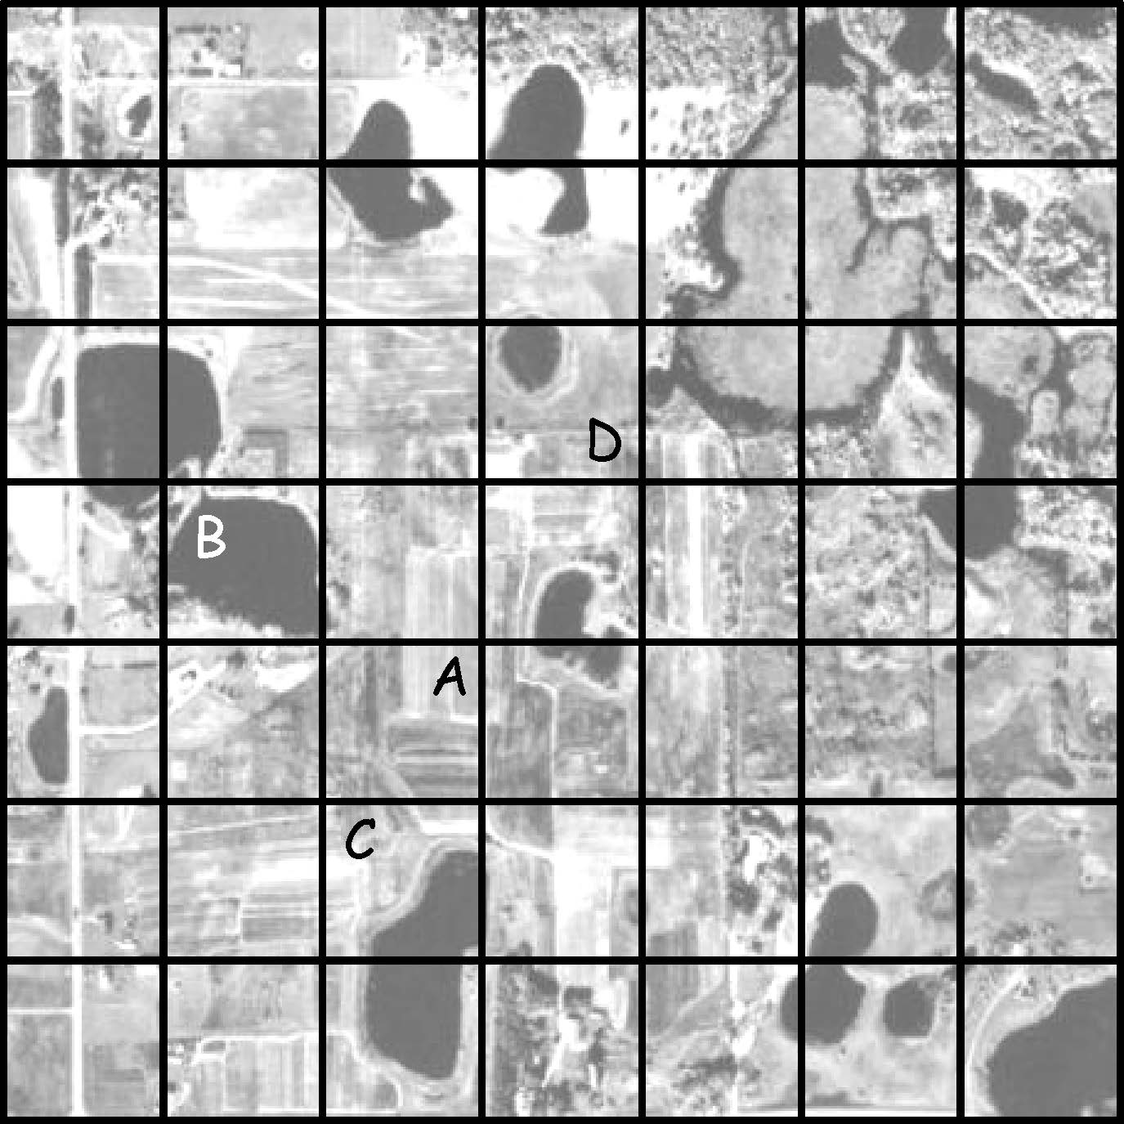
Raster Data
Raster cell values assignment maybe complicated
When they are multiple features within a single cell
Winner-take-all or majority
User’s preference
Bolstad, 2019

Slide 38
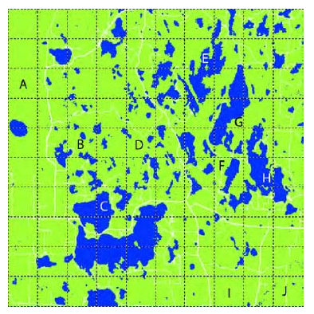
Group Activity
Discuss with your peers:
List the labels (A, B, C…J) of raster cells that would be assigned as water (dark blue) or land (light green) under a majority coverage rule (i.e., winner-take-all) and User’s preference (i.e., water)
Notes:
E,H,J

Slide 39
4.2 Lab session

Slide 40
Lab 04: attribute and geodatabase
Due by Midnight (11:59 pm) on Monday, Sep 15, 2025
Submit a word document only include question and answer

