Slide 1

WEEK 03
Projection
Instructor: Yanan Wu
fALL 2025

Slide 2
3.1 map projection

Slide 3
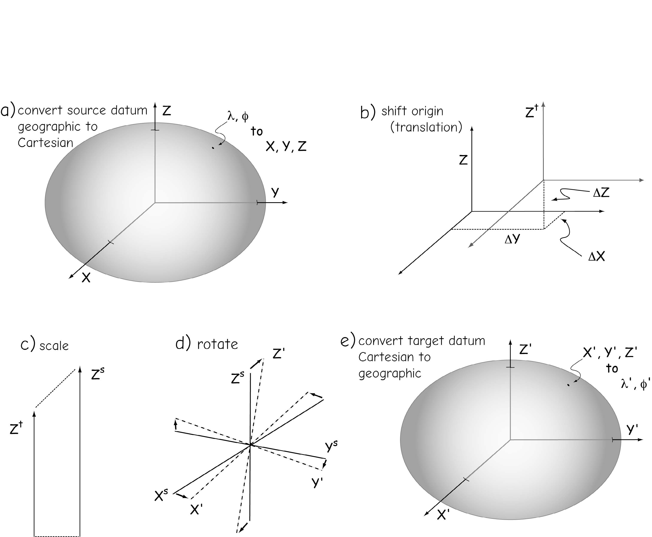
Transformation
  Converting coordinates from one datum to another
    Shift origin
    Scale
    rotation
Bolstad, 2019

Slide 4
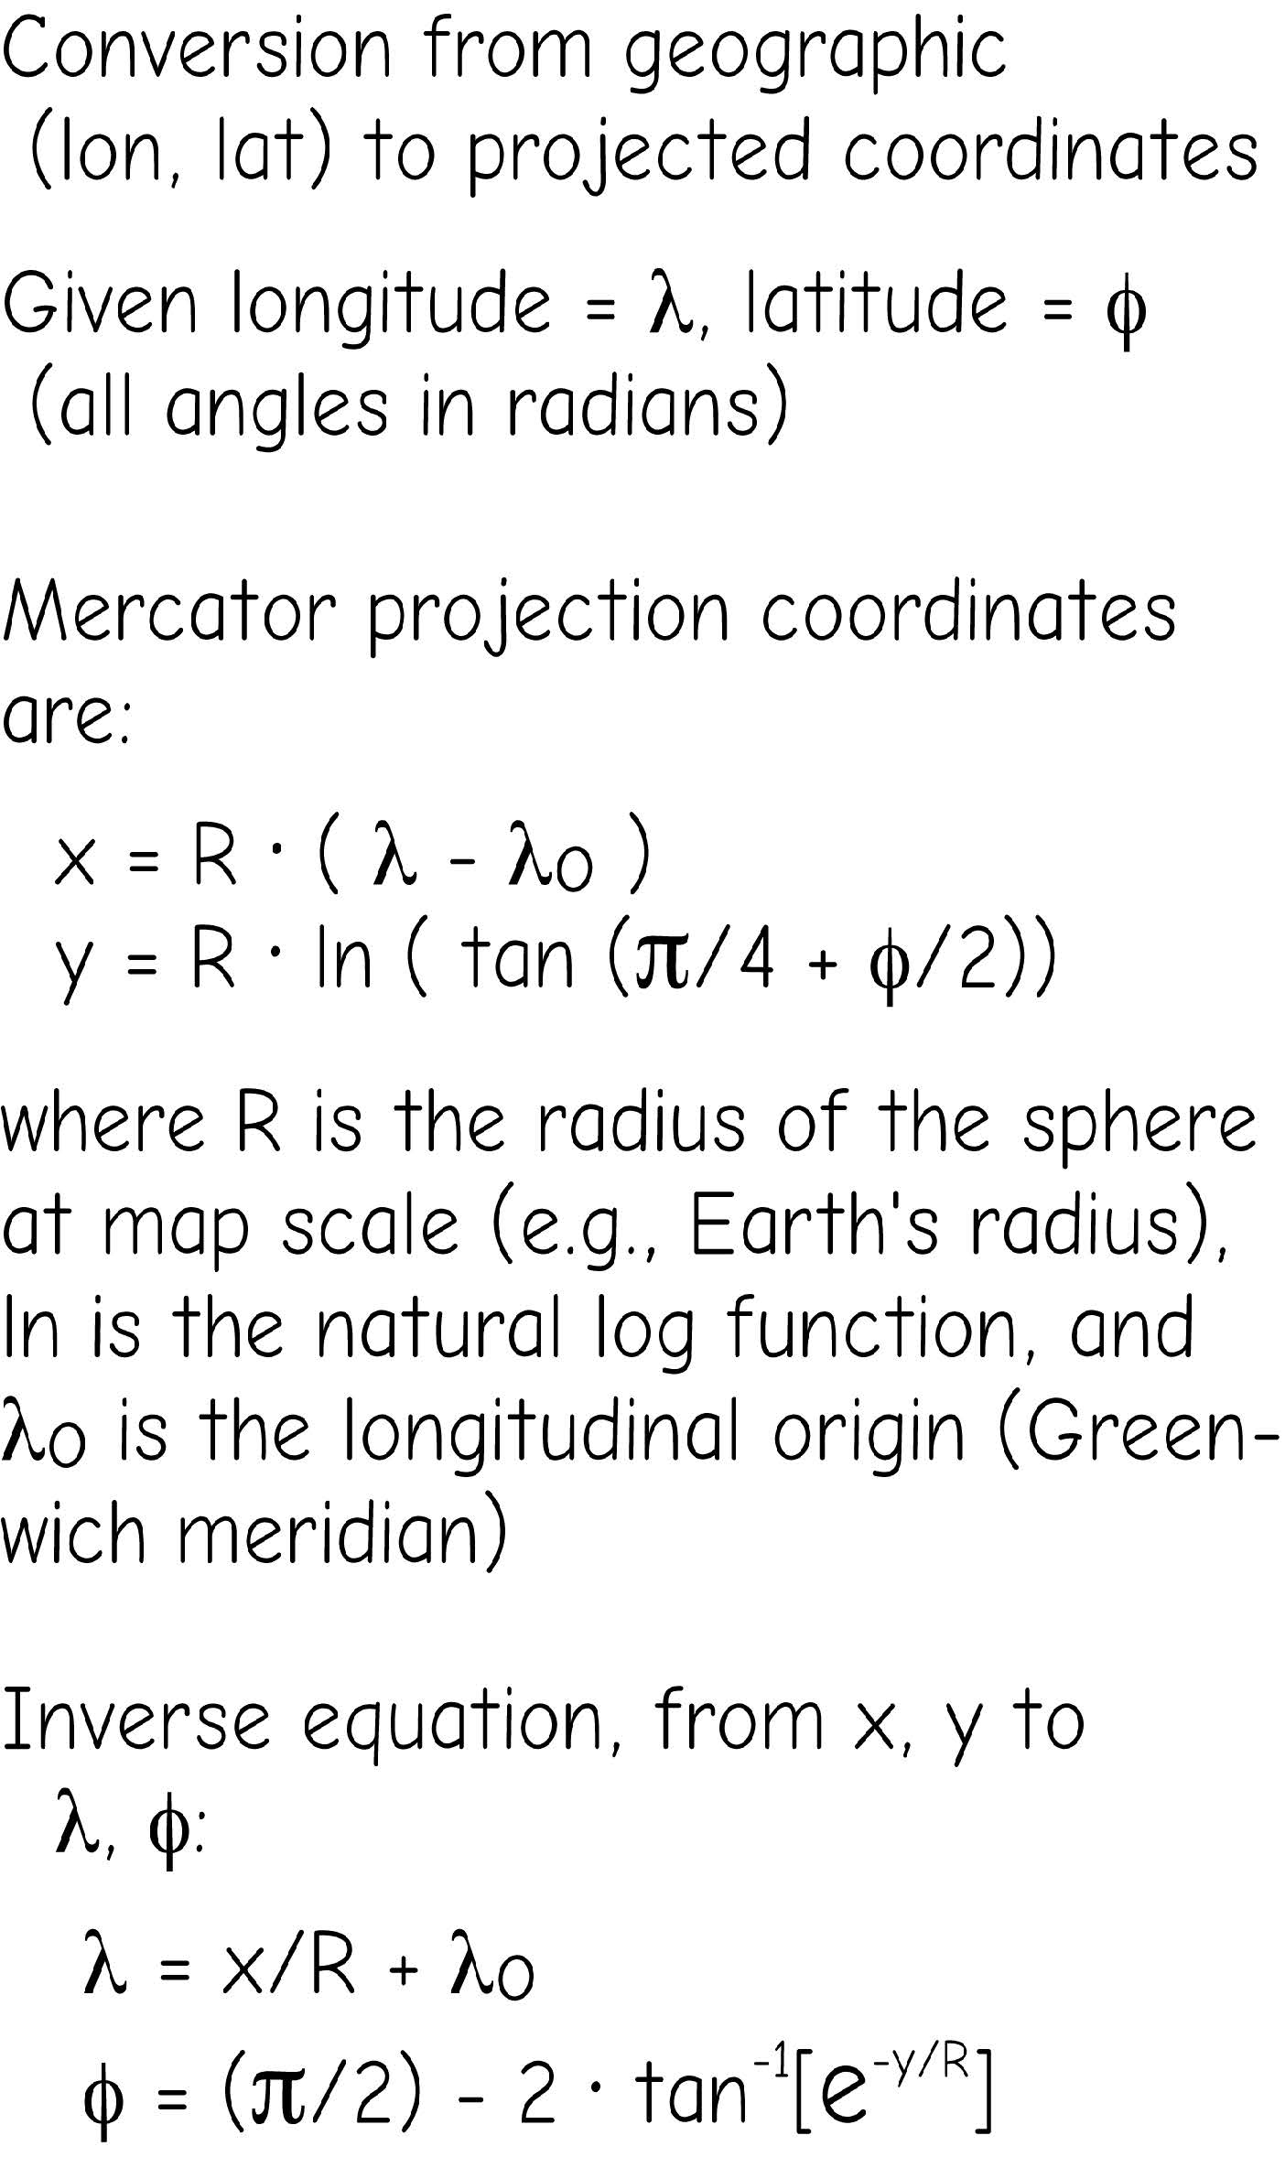
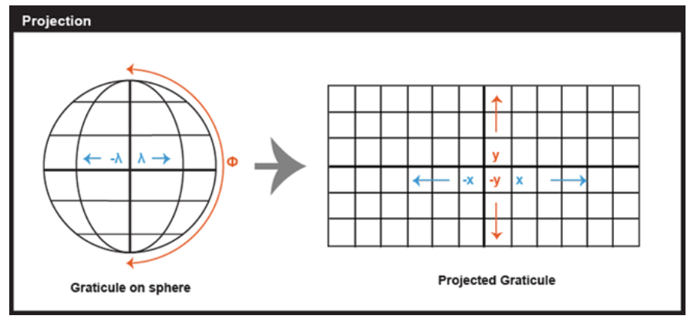
MAP PROJECTION
Conversion from geographic to projected coordinates
Bolstad, 2019

Slide 5
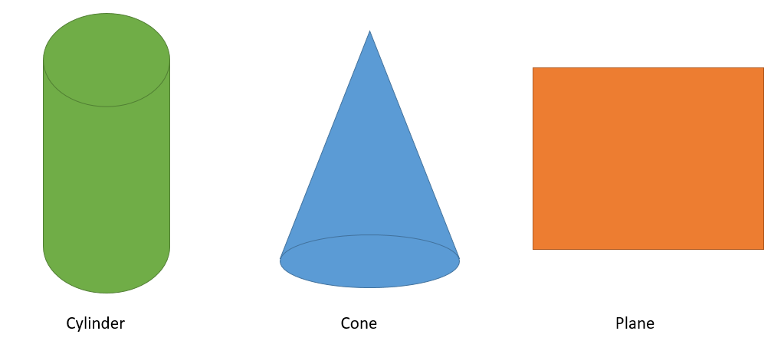
Map projection
Three Common Developable Surfaces
  Geometric surface that can be flattened
Cylindrical Projections = Cylinder Conic Projections = Cone Azimuthal Projections = Plane
Notes:
In order to flatten the Earth, coordinates on the globe must be mathematically transformed or moved to a geometric surface that can be flattened. These are called developable surfaces.
The most commonly used surfaces are cylinders, cones, and planes. Cylindrical projections use cylinders, conic projections use cones, and azimuthal projections use planes.
There are other shapes available or shapes can be combined. Here, we will focus on just these most commonly used surfaces.
Note that all three of these surface can be flattened. If you cut a cylinder, it can be folded out to a plane. A cone can be folded out into a fan shape.

Slide 6
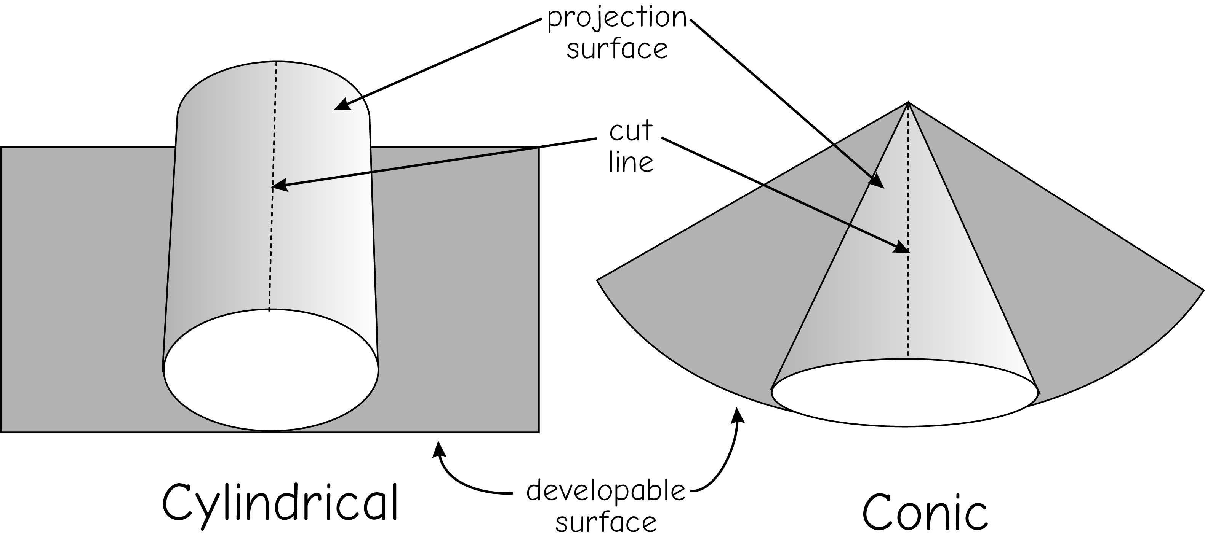
Map projection
Developable Surfaces
  Geometric surface that can be flattened
Bolstad, 2019
Notes:
To transform the curved Earth to a flat map, we can conceptually imagine projecting the Earth onto a developable surface.

Slide 7
Map projection
All map projections produce distortions of at least one of the following:
  Shape
  Area
  Distance
  Direction
3D Earth
2D Map
Shape
Area
Distance
Direction
Notes:
Since the curved, 3D surface of the Earth is converted to a flat space, some distortions will be produced.
It is not possible to convert a curved 3D surface into a flat surface without some distortions.
Specifically, map projections can produce distortions in feature shape, relative area of features, distance between features, and direction between locations.
The type and magnitude of the distortions produced depends on the projection used.

Slide 8
🤔
It is possible to convert the curved Earth to a flat map without distortion.

Slide 9
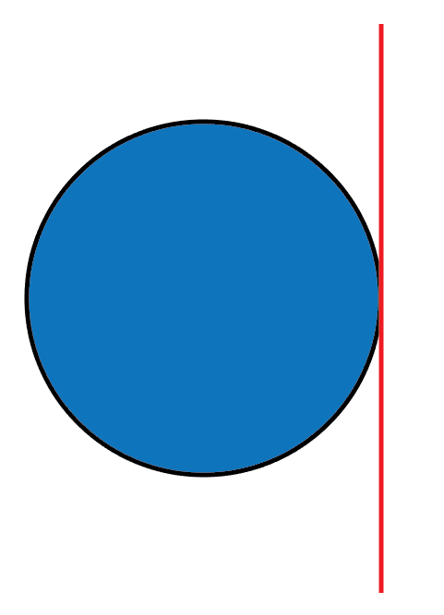
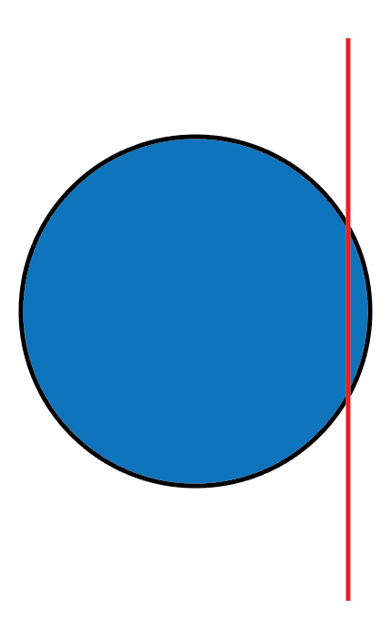
Tangency Secancy
Map projection
Standard Line
- At the point or line where the developable surface touches the globe, the scale is true and distortion is minimized.
  Tangent projections:
  The flat projection surface touches the globe along a single standard line.
  Secant projections:
  The flat surface cuts slightly into the globe, creating standard lines where the surfaces intersect
Notes:
Projections can also vary in regards to where and how they intersect the surface of the Earth or globe.
Tangency occurs when the developable surface only touches the globe at a single location while secancy occurs when the surface touches the globe along two latitude or longitude lines.
Standard lines are where the projection touches or spatially co-occurs with the globe. Standard parallels are parallels or latitude lines where the projected surface intersects the globe while standard meridians are meridians or longitude lines.
Generally, there are no distortions where the globe and developable surface co-occur, since the coordinates do not need to be transformed or moved.
Distortions tend to increase with distance from the standards.
Again, given the wide variety of developable surfaces, orientations, and standard lines, the number of possible map projections is infinite.

Slide 10
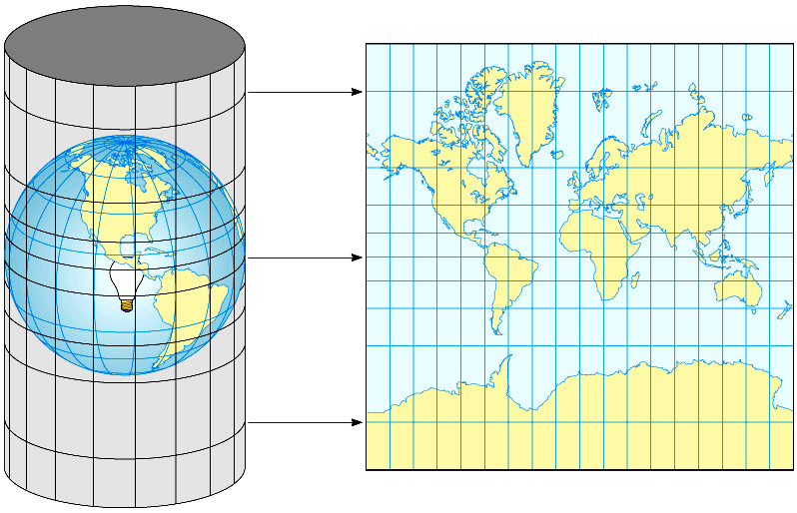
Cylindrical Projection
✓ Produces a regular rectangular grid, making latitude and longitude easy to locate
✓ Meridians (longitude) are straight, vertical, and parallel lines
✓ Parallels (latitude) are straight, horizontal, and parallel lines
✓ Meridians and parallels intersect at right angles
* Creation of cylindrical projection

Slide 11
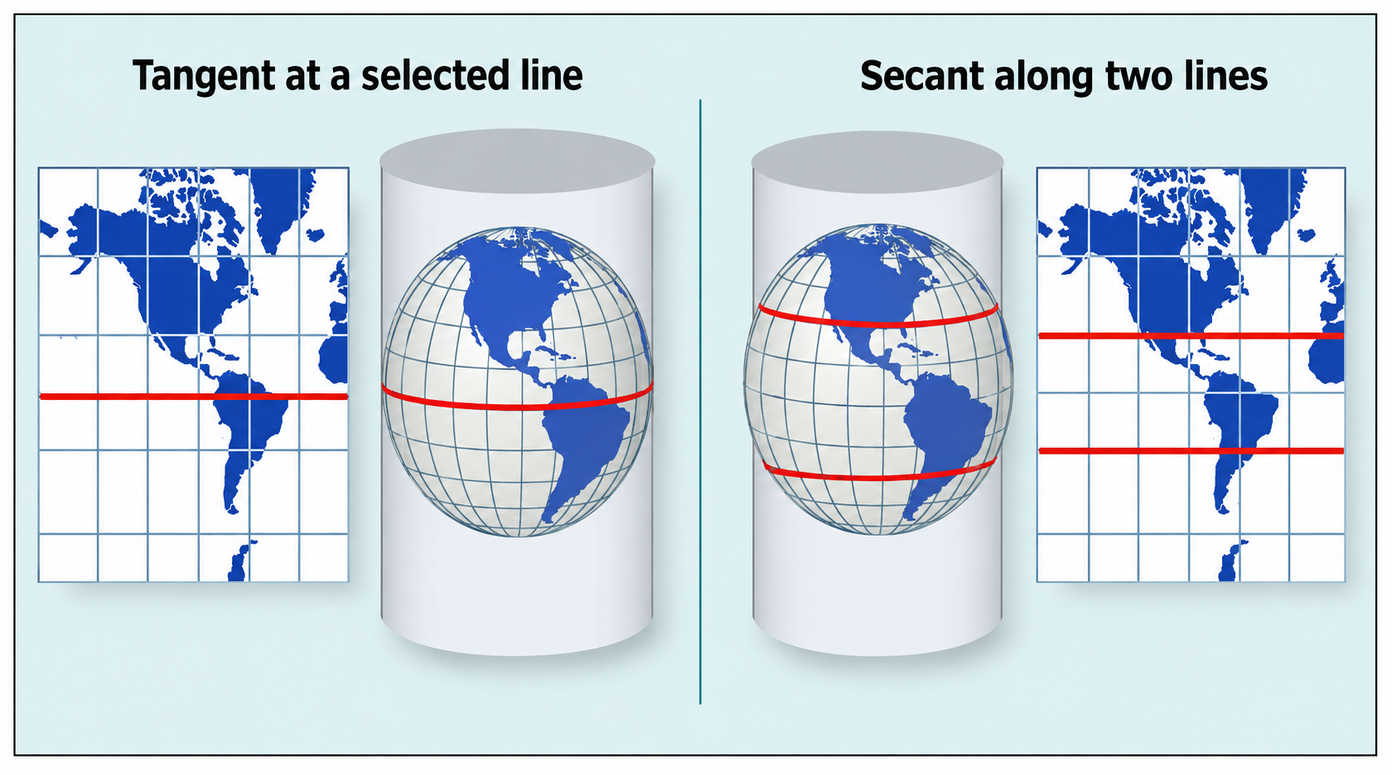
Standard parallel - cylindrical
Can be tangent or secant to the globe, depending on how the cylinder intersects the Earth
The location of the tangent line or secant lines depends on how the cylinder is positioned relative to the globe.

Slide 12
Distortion in cylindrical projection
✓ Least distortion near the standard line(s)
✓ Distortion increases toward the poles
✓ High-latitude areas become increasingly stretched

Slide 13
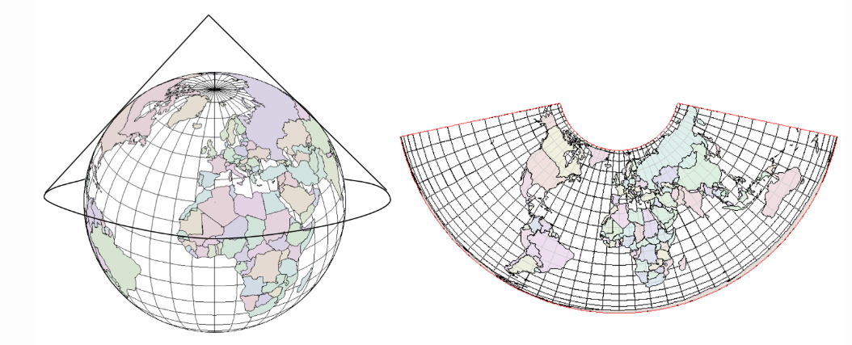
Conic projection
Conic projection
Hold cone over pole
Meridians (longitude) : straight, converge
Parallels (latitude) : curve
Data source

Slide 14
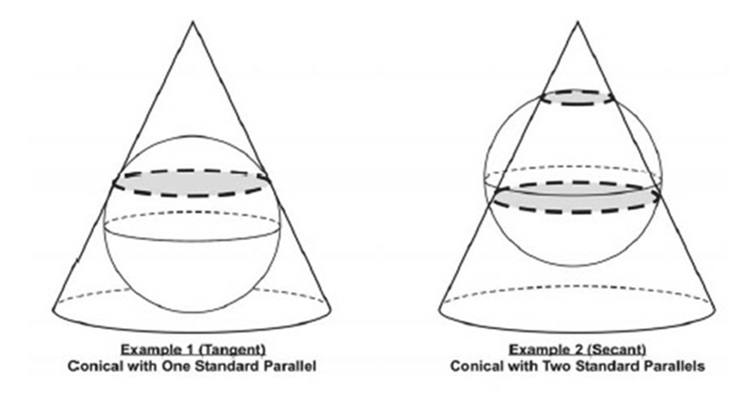
Conic projection – Standard Parallel
🤔
Compare location A and B, which location has greater distortion?
Compare location C,D and E, which two locations have the least distortion?
C
A
D
E
B

Slide 15
Distortion in conic projection
✓ Least distortion along the standard parallel(s)
✓ Distortion increases away from the standard parallels

Slide 16
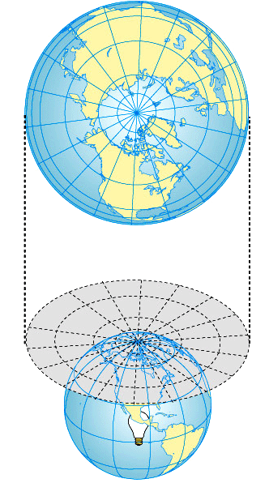
Plane projection
Plane projection
Plane positioned at pole
Grid:
  Longitude: straight, radiating
  Latitude: circles
Distortion increases away from center ("principal point")
Good for polar regions
Can't show more than half the world.

Slide 17
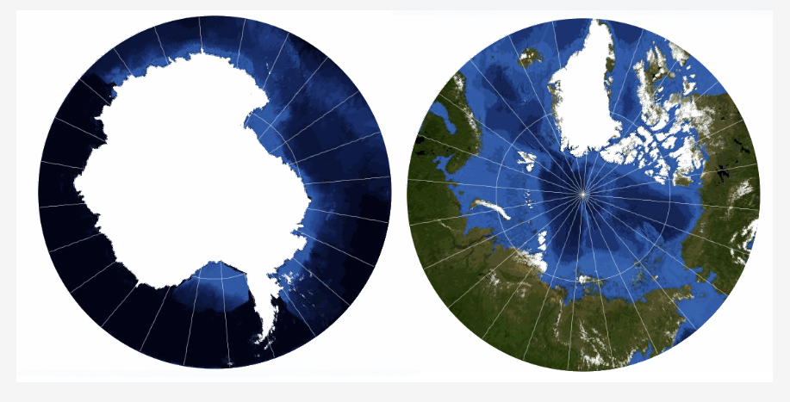
Stereographic projection over polar areas
Stereographic; centred on 140° East and 90° South (the South Pole) and 90° North (the North Pole), with a radius of 30° out from each Pole.

Slide 18
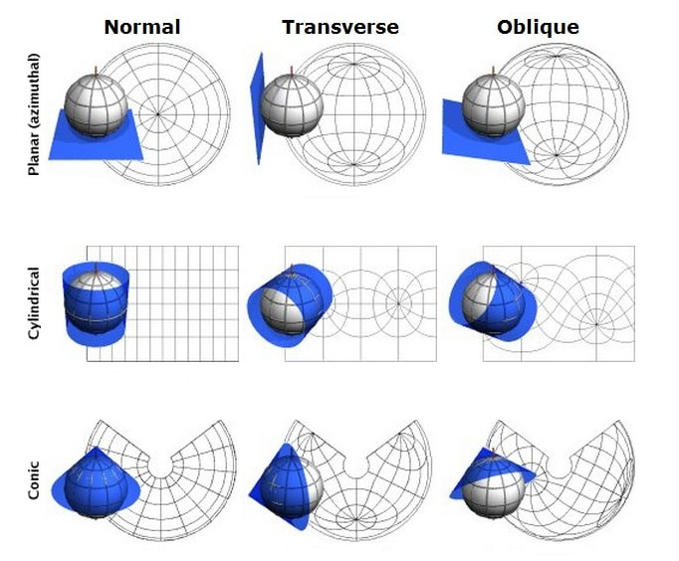
Projection aspects for all the developable surfaces
Source: Furuti, 2002

Slide 19
1. Distortion is generally lowest along the standard line.
2.In a normal cylindrical projection, what do the meridians usually look like?
A. Curved and converging
B. Straight, vertical, and parallel
C. Circular
D. Randomly curved

Slide 20
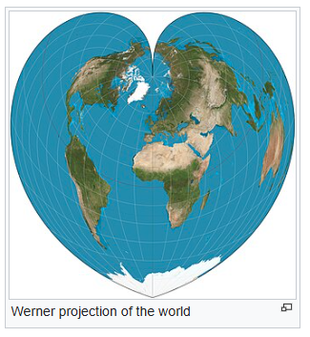
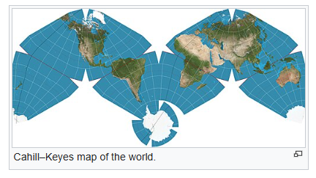
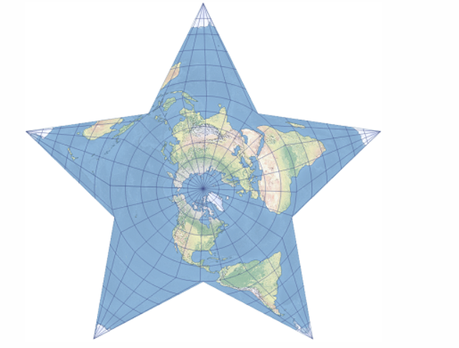
Examples of Projection with Interesting Shape
Berghaus

Slide 21
Map projection
Type
Conformal Projections: preserve angles and shape
Equivalent Projections: represent areas in correct relative size
Equidistant Projections: maintain consistent scale or distance along certain lines
Azimuthal Projections: maintain certain accurate directions relative to central point
Conformal and equivalent projections’ properties are mutually exclusive
Notes:
Four broad types of projections exist based on what map properties are maintained.
Conformal projections maintain local angles and shapes. Equivalent projections maintain areas of features in correct relative size. Both are global properties, or shape or size can be maintained across the entire globe not just for specific areas. Also, these properties are mutually exclusive. Or, you cannot maintain both shape and relative size.
Equidistant projections maintain scale or distance along certain lines while azimuthal projections maintain accurate directions relative to a certain vantage point. Equidistant and azimuthal properties are local properties and may be true only from or to the center of the map projection. You cannot maintain distance or direction between all points in the map space.

Slide 22
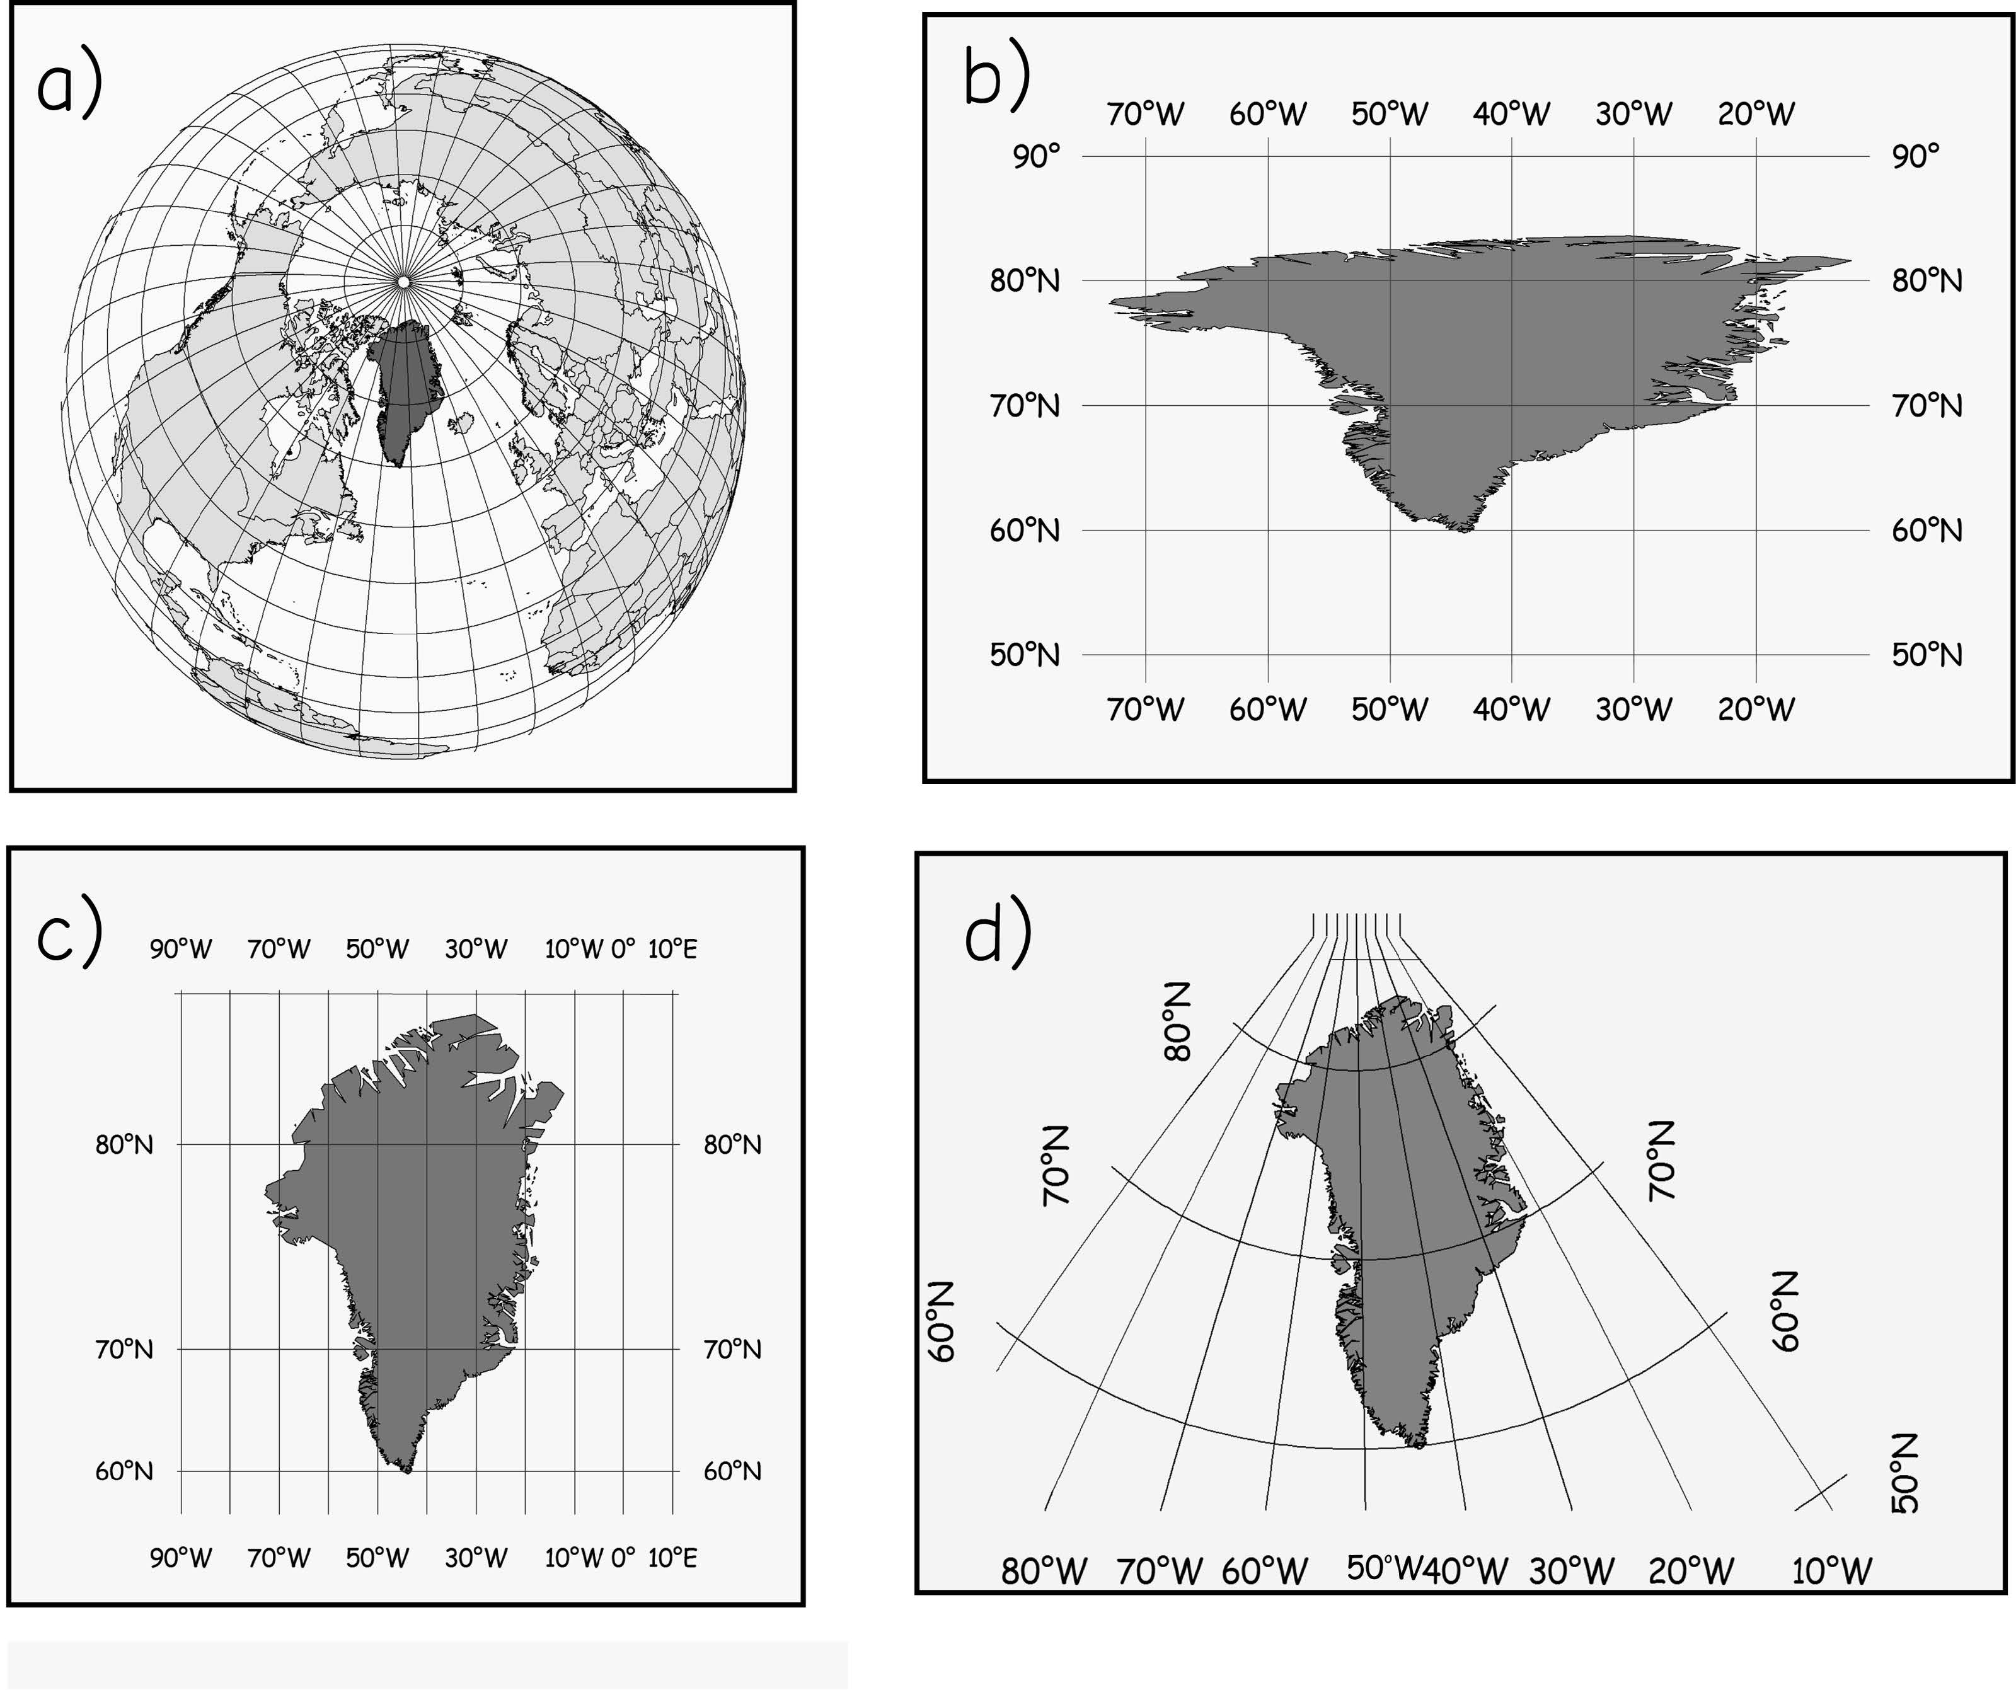
Map projection
Approximately unprojected
Geographic coordinates on a plane
Mercator projection
Transverse Mercator projection.

Slide 23
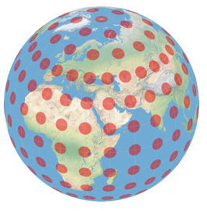
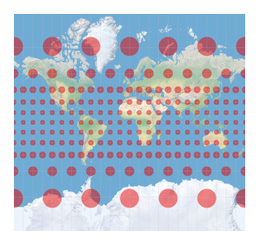
Tissot Indicatrix
Tissot’s Indicatrix is a method to visualize the distortions of a map projection. It was introduced in 1859 by the French mathematician Nicolas Auguste Tissot.
Mercator projection

Slide 24
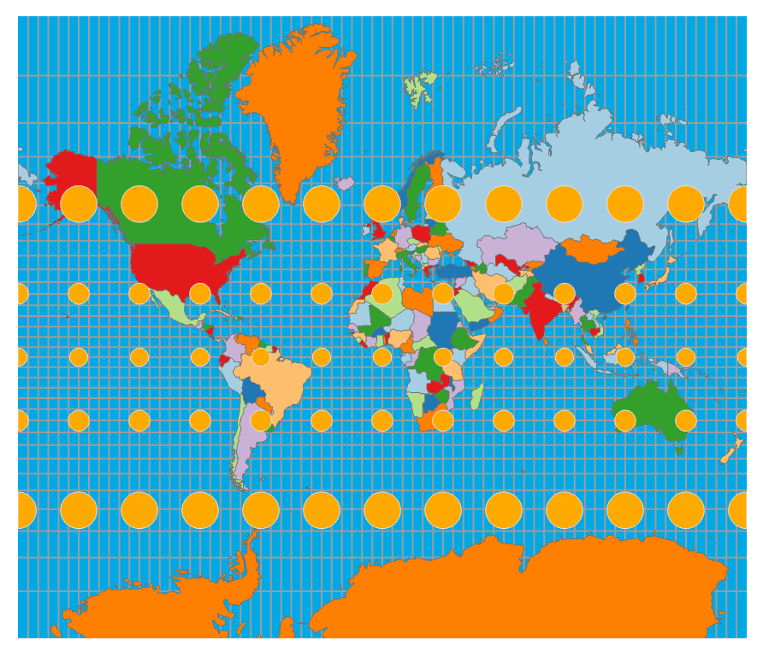
World projection - Mercator
  Without any distortions, the circles will all be the same shape and size
  Cylindrical conformal projection
  Parallels and meridians cross at right-angles
Distort area but not shape
🤔
Q: In the projection, are the circles distorted in shape or in area?
Tissot Indicatrix
Notes:
Mercator projections are examples of cylindrical projections that are conformal, or maintain shape and local angles. (To preserve individual angles describing the spatial relationships, a Conformal projection must show the perpendicular graticule lines intersecting at 90-degree angles on the map)
Relative size tends to be heavily distorted. For example, the Tissot Indicatrix suggests that sizes close to the poles are much larger than they should be in comparison to equatorial features. Remember from the example above that Greenland is actually smaller than Australia.
In Mercator projections, parallels and meridians will cross at right-angles.

Slide 25
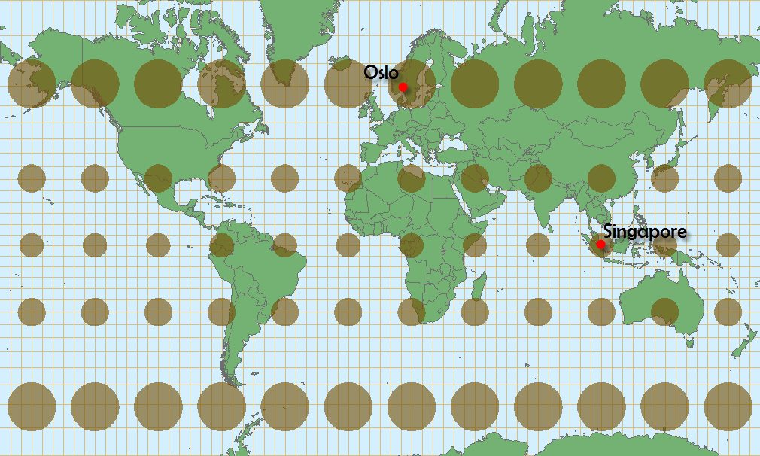
Map projection – Web Mercator
  Modification of Mercator projection that is commonly used for web maps
  Bing Maps, OpenStreetMap, MapQuest, ArcGIS Online
http://cartonerd.blogspot.com/2014/08/web-mercator-and-comparisons.html
Notes:
Web Mercator is a modification of the Mercator projection that is commonly used in web maps including Bing Maps, OpenStreetMap, Google Maps, MapQuest, and ArcGIS Online.
It uses a true sphere as opposed to a spheroid.
One reason this projection is used on the web is that it is easy to generate tiles from data since latitude and longitude lines intersect at right angles.

Slide 26
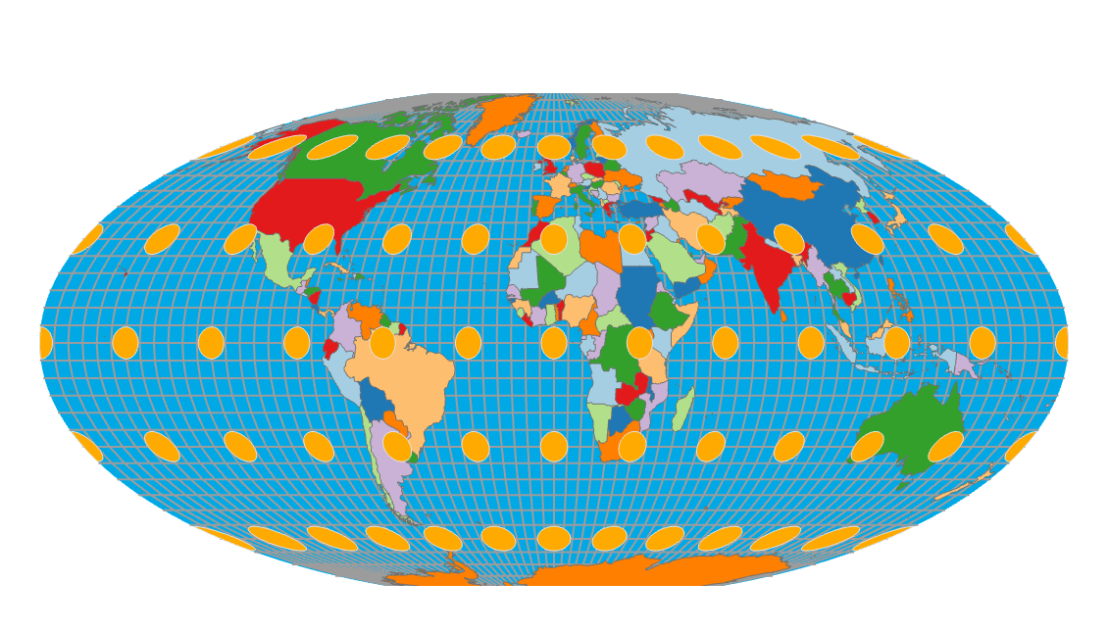
Map projection - Mollweide
  Equivalent projection
  Pseudo cylindrical
  Not based on developable surface
Distort shape but not area
🤔
Q: In the projection, are the circles distorted in shape or in area?
Notes:
Mollweide is an example of a equivalent projection that maintains relative size or area but distorts shape and local angles.
It is pseudosylindrical, which means that is uses multiple cylinders as opposed to one in an attempt to further minimize distortions.

Slide 27
Class Activity
Explore the true size tool https://thetruesize.com/#.
  Does Greenland look larger or smaller than Brazil on the basemap?
  Search for ‘Greenland’
  Drag Greenland over Brazil to compare their areas
The True Size Of… is an interactive map designed to show how Mercator projection distorts the apparent size of places, especially at high latitudes.

Slide 28
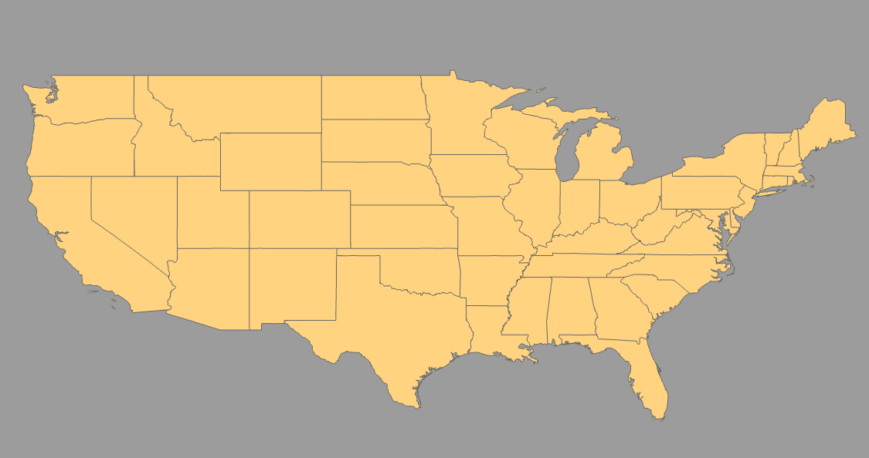
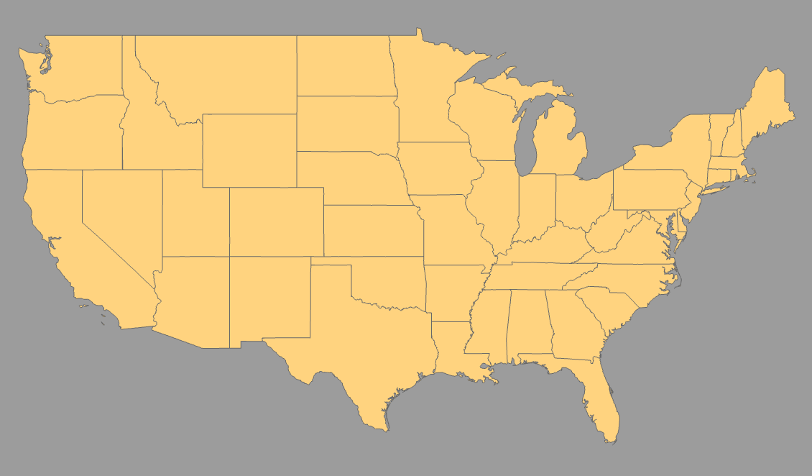
Map projection
US projections
Not Projected
Mercator
Notes:
We will now discuss continental-scale projections using the United States as an example.
The first image shows the US as not projected. Or, latitude and longitude are being treated like Cartesian coordinates in flat space. This results in some extreme distortions and should be avoided.
The second image shows a Mercator projection for the US. Here, shape and local angle is maintained but relative size is distorted.

Slide 29
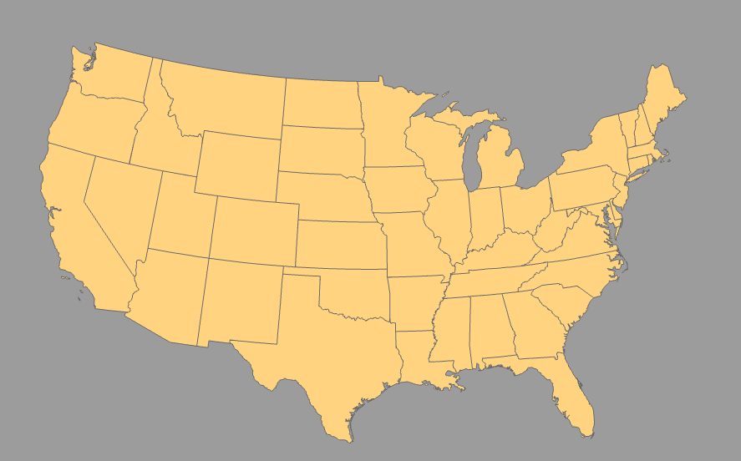
Map projection
US projections: Albers Equal Area
  Conic
  Equivalent
  Maintains area
  Distorts shape and local direction
Notes:
Albers Equal Area uses a conic developable surface with two standard parallels. It is equivalent, so it maintains relative size but distorts shape and local angles.
However, distortions are generally pretty minimal.

Slide 30
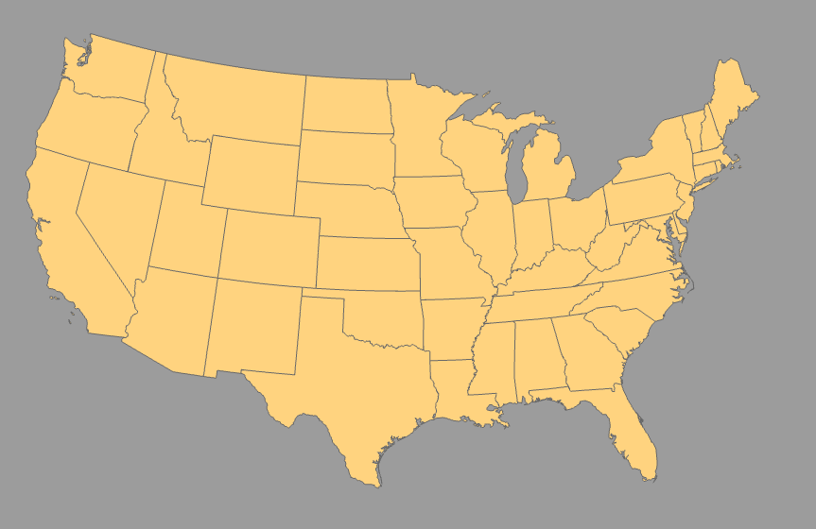
Map projection
US projections: Lambert Conformal Conic
  Conic
  Conformal
  Maintains shape and local direction
  Distorts local area
Notes:
Lambert Conformal Conic also uses a cone with two standard parallels. Since it is conformal it maintains shape and local angles but distorts local size.
However, distortions are minimal.
So, if I want to created a map of the US that maintains relative size, I tend to use Albers Equal Area. If I want to maintain shape, I will use Lambert Conformal Conic.

Slide 31
Map projection
US projections
Albers Equal Area
Lambert Conformal Conic
Notes:
When creating maps of the US, I prefer to use Albers Equal Area or Lambert Conformal Conic.

Slide 32
Example Scenarios
An airline wants to create flight maps across the contiguous U.S.
The U.S. Census Bureau makes a map of population density by state.
🤔
Q: Which projection we should use in above scenario?

Slide 33
Map projection
Universal Transverse Mercator (UTM)
  60 zones
  Each zone covers 6° of longitude
  Uses meters as the coordinate unit
  Preserves local shapes and angles
Notes:
We will now discuss projections that are appropriate at more local scales, such as for states, counties, or cities.
Universal Transverse Mercator is a set of projections that are commonly used at these scales.
This is not one system but a set of systems in which the Earth is broken into 60 zones.
Within each zone coordinates are provided in length units, generally meters, as northing and easting.
Northing measures up and down or north to south. In the northern hemisphere, the equator is assigned a value of 0 meters, and you add as you move north. So, this is effectively the distance from the equator. In the southern hemisphere, the equator is assigned a value of 10,000,000 meters, and you subtract as you move south.
Easting is calculated relative to the central meridian or center line in each zone. The central meridian is assigned a value of 500,000 meters, and you add as you move east of it and subtract if you move west.

Slide 34
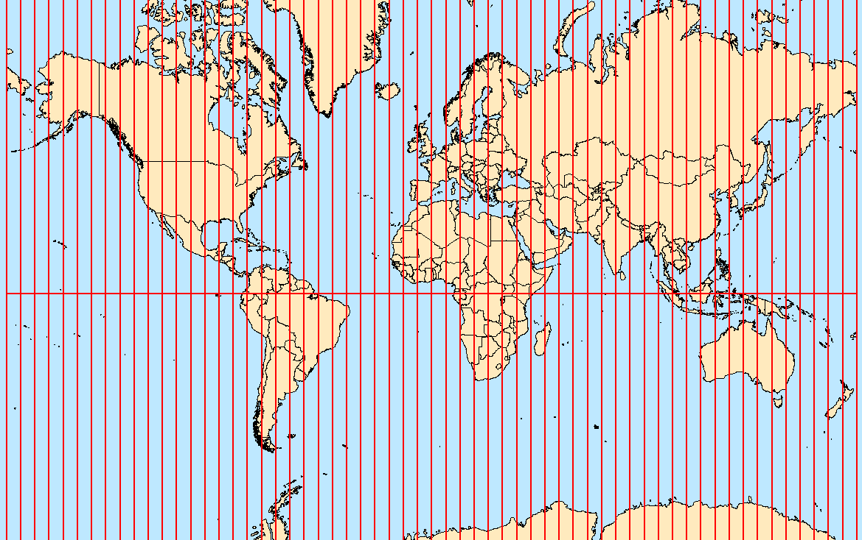
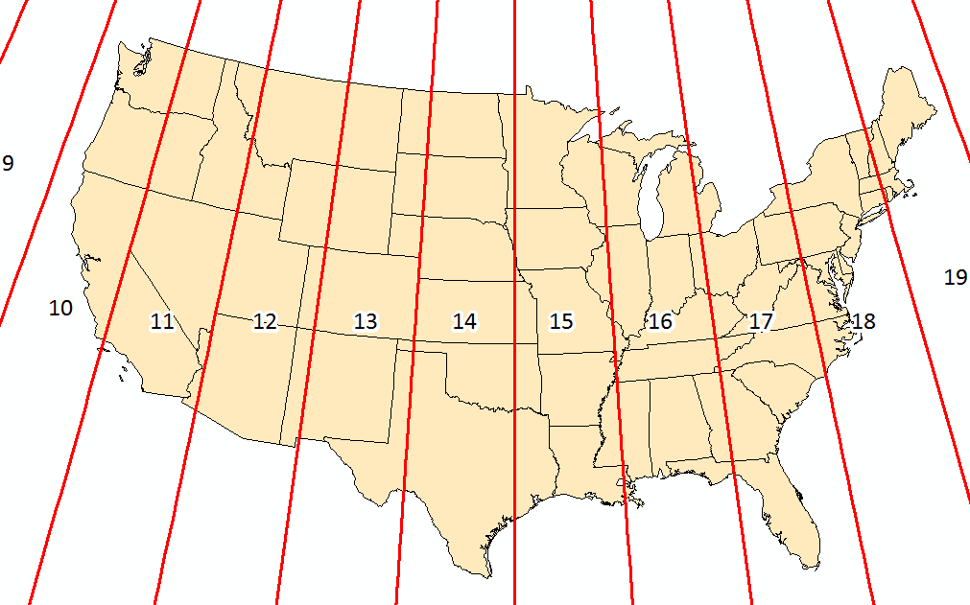
Map projection
Universal Transverse Mercator (UTM)
Which UTM zone is Conway located in?
Bolstad, 2019
Notes:
The UTM systems break the Earth into 60 zones vertically.
Each zone is only appropriate for areas within it. You should not project the entire Earth to a single UTM projection.
Easting values will be defined relative to the central meridian in each zone.
In the US, the zone number increases as you move east and decreases as you move west.
The majority of Arkansas is in UTM Zone 15 North. So, this is a common projection for Arkansas. So, Arkansas generally uses a geographic coordinate system of NAD83 or WGS84 and a projected coordinate system of UTM Zone 15 North.
Some states fit well into a single UTM zone, for example Nevada, Utah, and Alabama. Others do not, such as California or Pennsylvania.
For states that do not fit well into one UTM zone, other projections are generally used to display them.

Slide 35
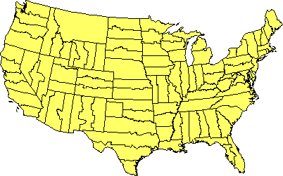
Map projection
State Plane Coordinate System
  125 geographic zones designed for specific regions in the United States
  Designed for accurate mapping in the United States and its territories
  Divides each state into one or more zones to minimize distortion
  Coordinate units may be meters or feet
🤔
How many State Plane Coordinate System zones does Arkansas have?
https://www.e-education.psu.edu/natureofgeoinfo/c2_p26.html
Notes:
For mapping smaller extents within states, state plane coordinate systems are commonly used.
It is common for surveyors to use these systems. Measurements are commonly made in feet or meters. Each coordinate system has a defined baseline, like northing and a false meridian, like easting, to which the coordinate measurements are referenced. Different projections are used depending on the specific coordinate system.
These systems allow for very accurate measurements and are commonly used at the city- to county-scale.
120 different zones generally follow county boundaries (except in Alaska). Larger states are divided into multiple zones, such as the “Colorado North Zone.” States with a long north-south axis (such as Idaho and Illinois) are usually mapped using a Transverse Mercator projection, while states with a long east-west axis (such as Washington and Pennsylvania) are usually mapped using a Lambert Conformal projection. In either case, the projection's central meridian is generally run down the approximate center of the zone.
SPCS 27 and SPCS 83
The boundaries of which usually follow county lines
States that are long in the east–west direction are typically divided into zones that are also long east–west. These zones use the Lambert conformal conic projection, because it is good at maintaining accuracy along an east–west axis, due to the projection cone intersecting the earth's surface along two lines of latitude. Zones that are long in the north–south direction use the Transverse Mercator projection because it is better at maintaining accuracy along a north–south axis, due to the circumference of the projection cylinder being oriented along a meridian of longitude.
125 (as of 2001). There are 110 zones in the contiguous US, with 10 more in Alaska, 5 in Hawaii, and one for Puerto Rico and US Virgin Islands.

Slide 36
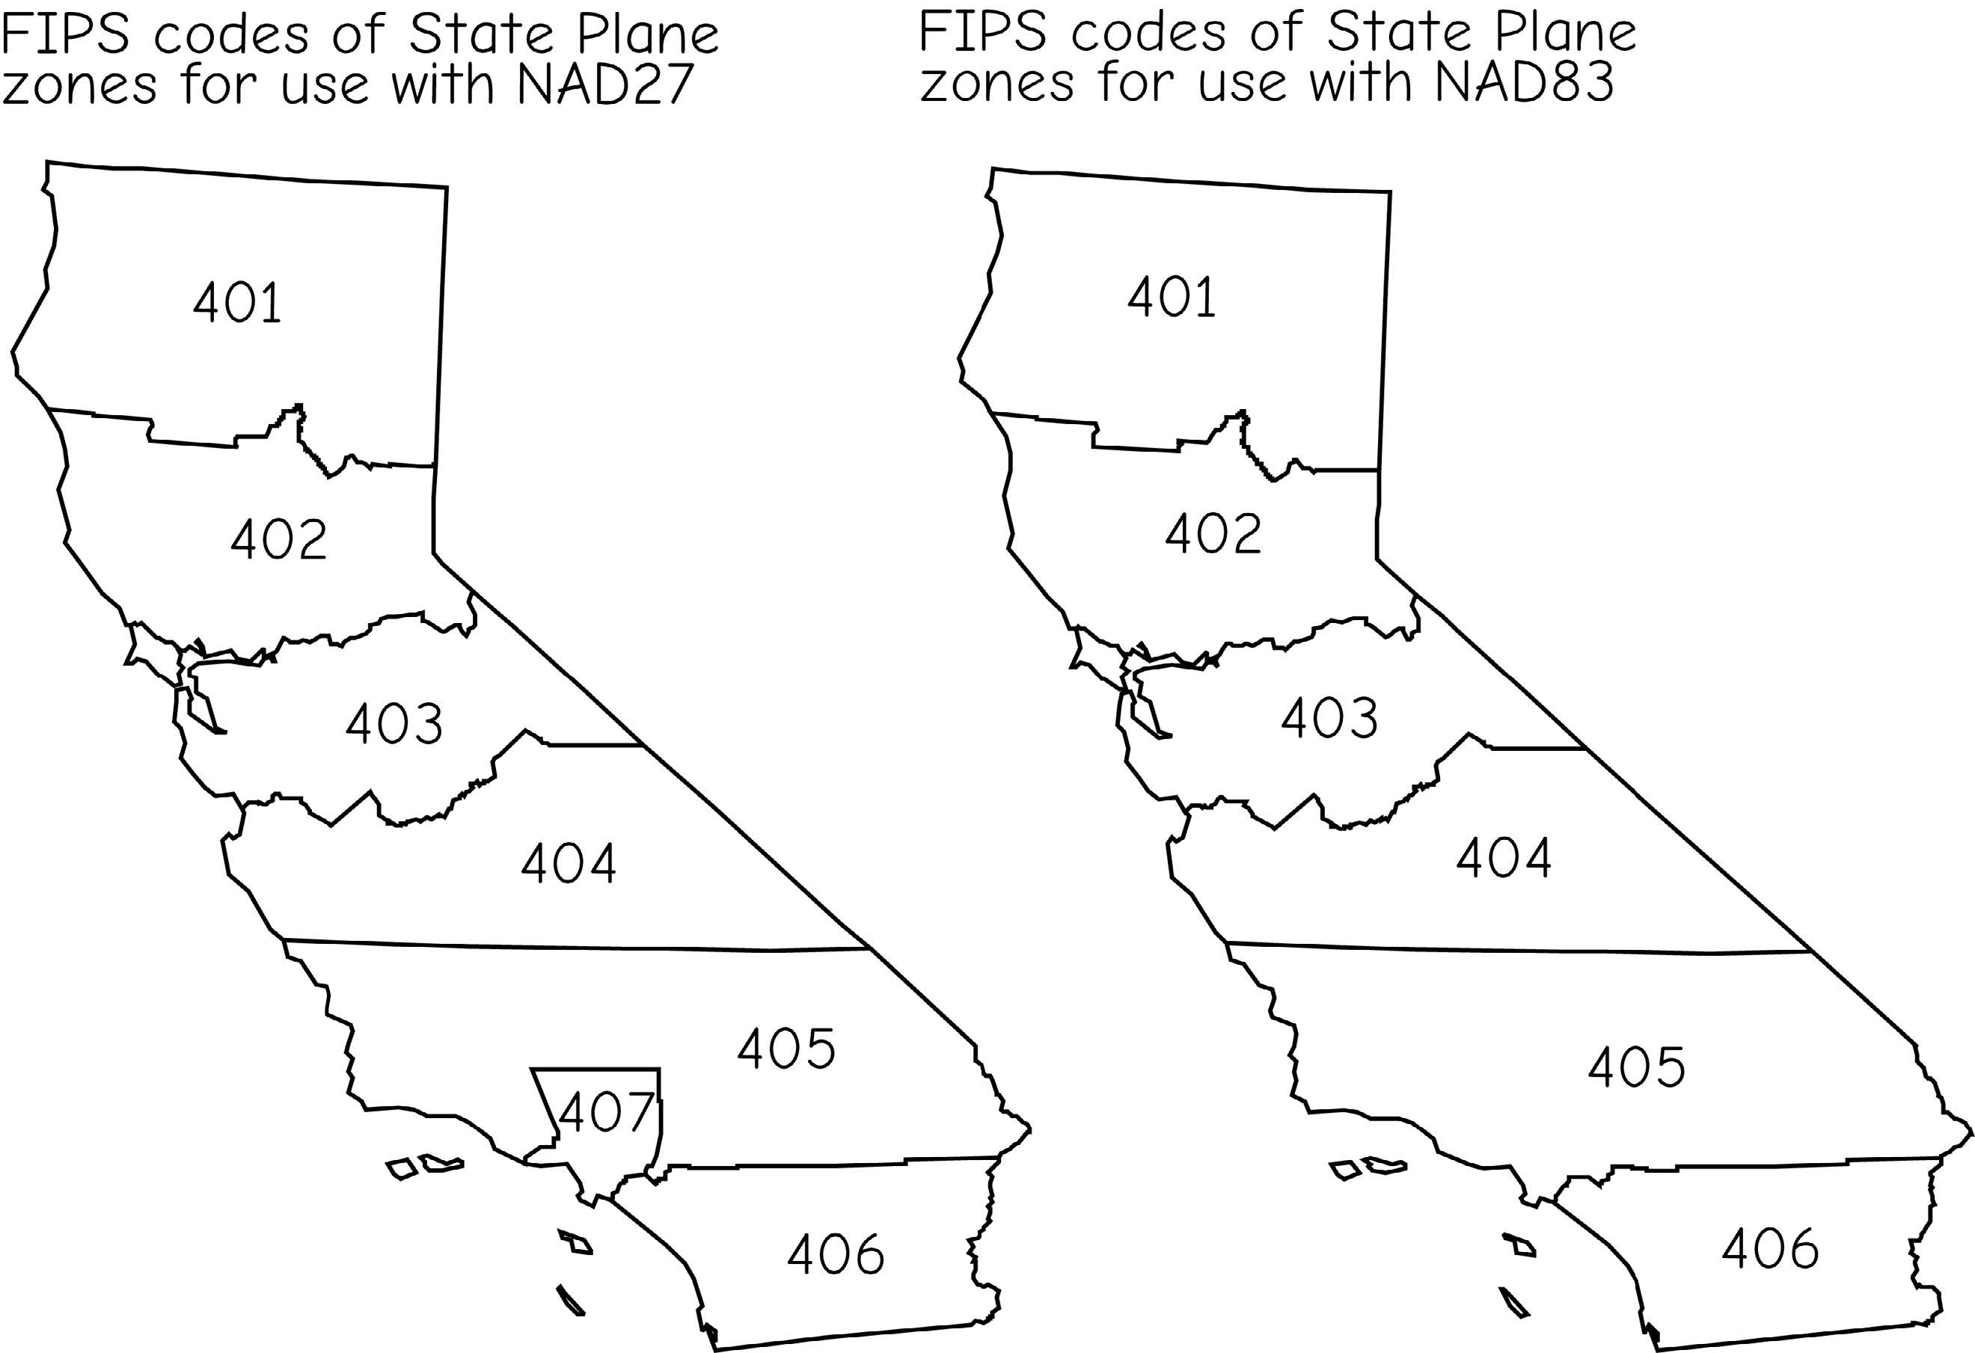
Map projection
State Plane Coordinate System
  The zones may change!
Bolstad, 2019
Notes:
For mapping smaller extents within states, state plane coordinate systems are commonly used.
It is common for surveyors to use these systems. Measurements are commonly made in feet or meters. Each coordinate system has a defined baseline, like northing and a false meridian, like easting, to which the coordinate measurements are referenced. Different projections are used depending on the specific coordinate system.
These systems allow for very accurate measurements and are commonly used at the city- to county-scale.
120 different zones generally follow county boundaries (except in Alaska). Larger states are divided into multiple zones, such as the “Colorado North Zone.” States with a long north-south axis (such as Idaho and Illinois) are usually mapped using a Transverse Mercator projection, while states with a long east-west axis (such as Washington and Pennsylvania) are usually mapped using a Lambert Conformal projection. In either case, the projection's central meridian is generally run down the approximate center of the zone.
SPCS 27 and SPCS 83
The boundaries of which usually follow county lines
States that are long in the east–west direction are typically divided into zones that are also long east–west. These zones use the Lambert conformal conic projection, because it is good at maintaining accuracy along an east–west axis, due to the projection cone intersecting the earth's surface along two lines of latitude. Zones that are long in the north–south direction use the Transverse Mercator projection because it is better at maintaining accuracy along a north–south axis, due to the circumference of the projection cylinder being oriented along a meridian of longitude.
125 (as of 2001). There are 110 zones in the contiguous US, with 10 more in Alaska, 5 in Hawaii, and one for Puerto Rico and US Virgin Islands.

Slide 37
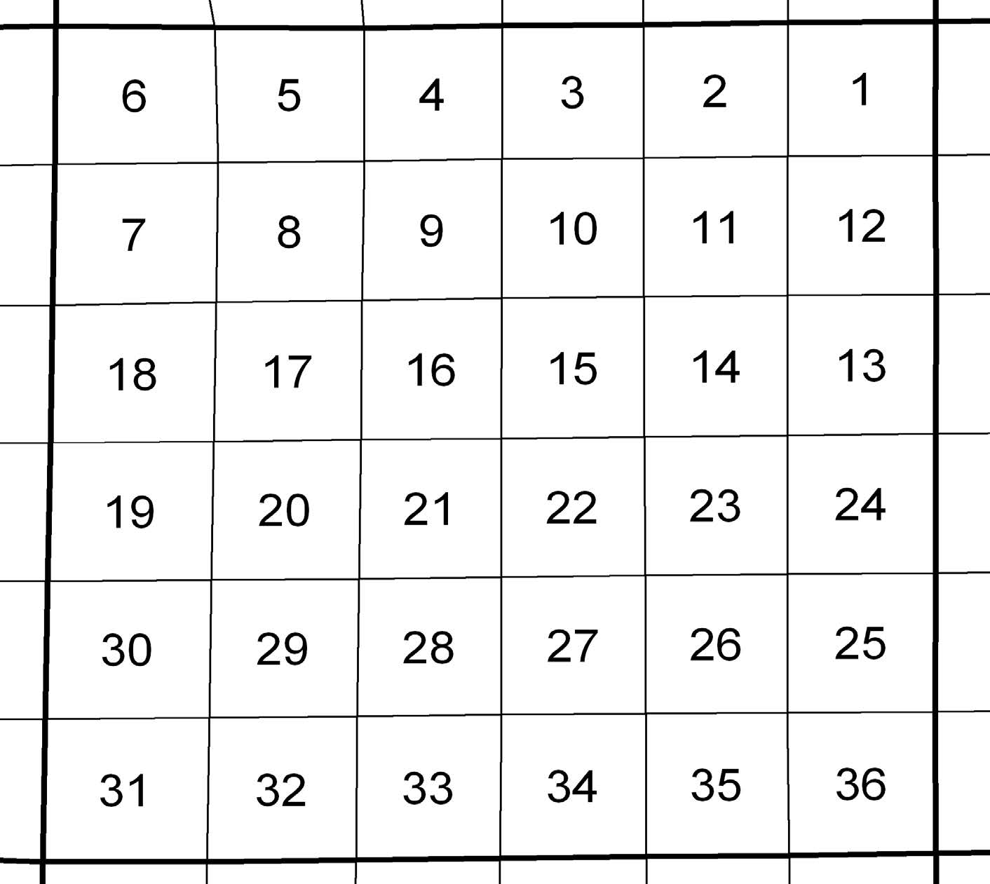
Public Land Survey System
It is not a coordinate system, but used widely for land parcels since 1800s
  Divided lands by north-south lines, 6 miles apart
  East-west lines were surveyed perpendicular to those north-south lines, also at 6 miles intervals
  30 states adopted PLSS
Bolstad, 2019
Notes:
For mapping smaller extents within states, state plane coordinate systems are commonly used.
It is common for surveyors to use these systems. Measurements are commonly made in feet or meters. Each coordinate system has a defined baseline, like northing and a false meridian, like easting, to which the coordinate measurements are referenced. Different projections are used depending on the specific coordinate system.
These systems allow for very accurate measurements and are commonly used at the city- to county-scale.
120 different zones generally follow county boundaries (except in Alaska). Larger states are divided into multiple zones, such as the “Colorado North Zone.” States with a long north-south axis (such as Idaho and Illinois) are usually mapped using a Transverse Mercator projection, while states with a long east-west axis (such as Washington and Pennsylvania) are usually mapped using a Lambert Conformal projection. In either case, the projection's central meridian is generally run down the approximate center of the zone.
SPCS 27 and SPCS 83
The boundaries of which usually follow county lines
States that are long in the east–west direction are typically divided into zones that are also long east–west. These zones use the Lambert conformal conic projection, because it is good at maintaining accuracy along an east–west axis, due to the projection cone intersecting the earth's surface along two lines of latitude. Zones that are long in the north–south direction use the Transverse Mercator projection because it is better at maintaining accuracy along a north–south axis, due to the circumference of the projection cylinder being oriented along a meridian of longitude.
125 (as of 2001). There are 110 zones in the contiguous US, with 10 more in Alaska, 5 in Hawaii, and one for Puerto Rico and US Virgin Islands.

Slide 38
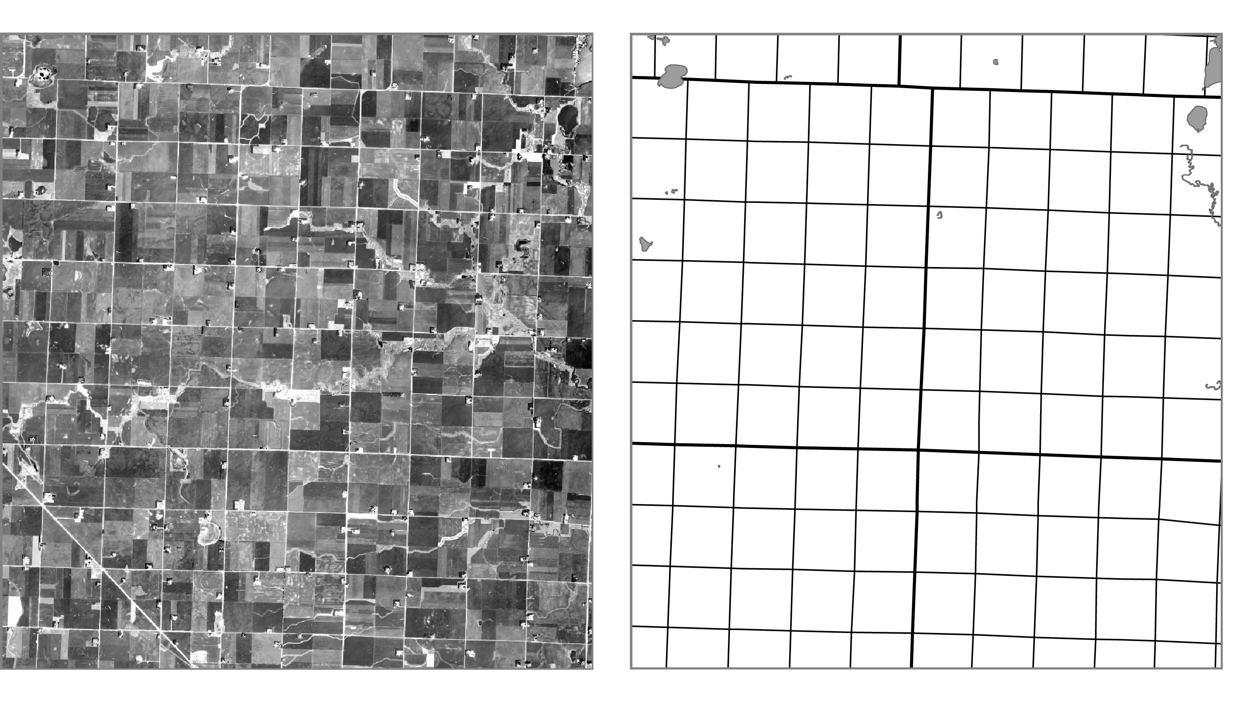
Public Land Survey System
Place roads, powerlines, and other public services
Bolstad, 2019
Notes:
The PLSS is important because:
1) The PLSS lines are often property boundaries, they form natural corridors in which to place roads, powerlines, and other public services; they are often evident on the landscape. Many road intersections occur at PLSS corner points, and these can be viewed and referenced on many maps or imagery used for GIS database development efforts. Further, PLSS corners are sometimes resurveyed using high precision methods to provide property line control, particularly when a GIS is to be developed.

Slide 39
Map projection
Continental-scale data (North America)
  Lambert Conformal Conic
  Albers Equal Area
State-scale data (Arkansas)
  UTM Projection, Zone 15N
  County, city-scale data
  State Plane
Notes:
The best map projection to use partially depends on the extent being mapped or the scale of the map.
We will now investigate some common map projections that can be used at different scales.
Note that all maps and spatial data layers will be referenced to a datum or geographic coordinate system.
If the map or data have been projected, they will also have a projected coordinate system where measurements are made in length units as opposed to angles.
We will begin with a discussion of some common global-scale projections followed by continent- and sate-scale options.

Slide 40
Best Practice
Should use same projection and datum for all data
Use projection appropriate for scale and extent
Think about what map properties are maintained or distorted
Notes:
This slide highlights best practices for working with projections.
First, it is generally best to use the same projection for all data layers in a map or project to avoid any issues with misalignment.
You should use a projection appropriate for the scale and extent of the map. For example, you would not use a specific UTM zone to project the entire globe. On the other hand, a global projection would not be the best choice for data just within Arkansas.
You should also think about what map properties are maintained or distorted. If you are interested in maintaining relative size, then you should use an equivalent projection.

Slide 41
Map projection
Why all world maps are wrong?

Slide 42
3.2
Lab session

Slide 43
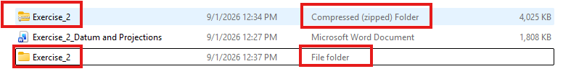
Data File
Exercise_2 is a compressed (zipped) file. You need to extract all files from the zipped folder first.

Slide 44
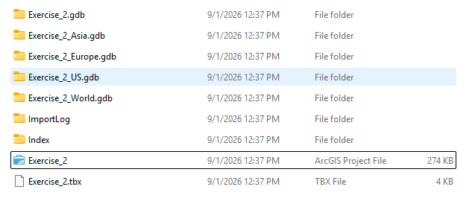
Open Arcgis project file
Open the ArcGIS Project File in ArcGIS Pro
  Find the file path in your local folder
Double-click to open

Slide 45
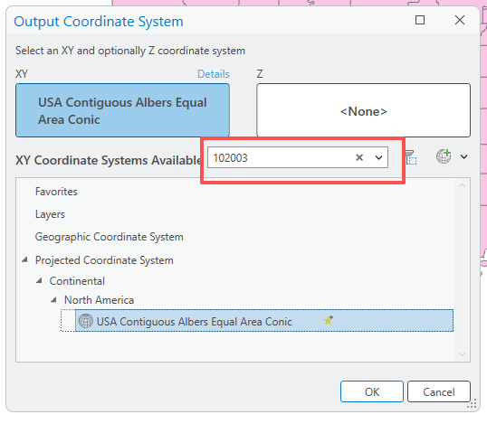
If the coordinate systems are organized differently in your version of ArcGIS Pro, use WKID 102003 to search for USA Contiguous Albers Equal Area Conic.

Slide 46
Lab 02: datum and projection
Due by NOON (12:00 PM) on WEDNESDAY, Sep 9, 2025
Submit a word document only include question and answer

