Slide 1

Lecture 13 raster Analysis lecture
Instructor: Yanan Wu
fALL 2025

Slide 2
13.1 raster analysis

Slide 3
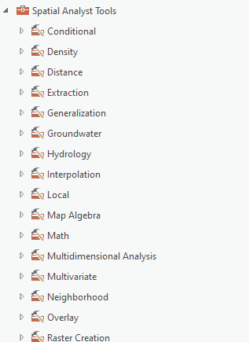
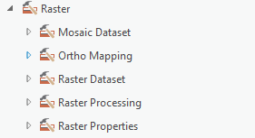
Overview
Raster Analysis
Raster math
Reclassification
Extraction
Neighborhood-based analysis
Distance
Raster generalization
Raster summarization
Estimating density
Mosaic
Spatial analysis tool

Slide 4
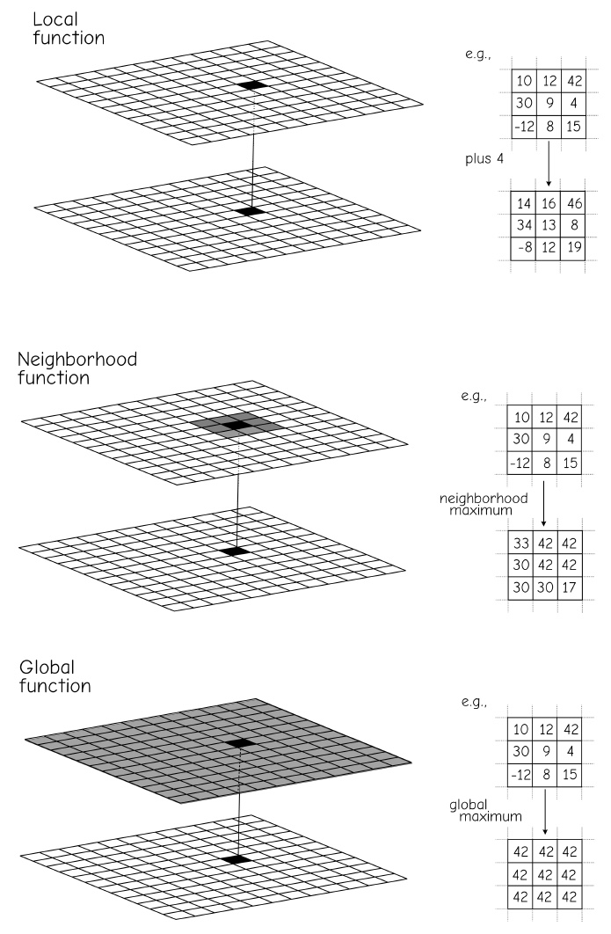
Raster Operation
Bolstad, 2019

Slide 5
Local function Raster Math

Slide 6
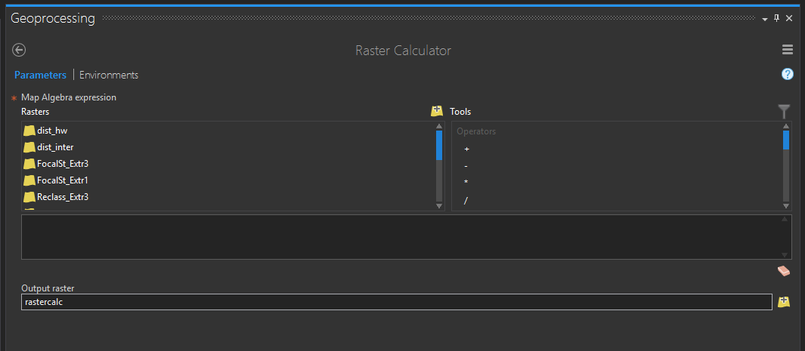
Raster Calculator
Perform mathematical calculations on a cell-by-cell basis
Notes:
The Raster Calculator Tool allows you to perform mathematical calculations on a cell-by-cell basis.
This tool is very flexible and can be used to perform a wide variety of raster-based calculations.
Examples will be provided in the following slides.

Slide 7
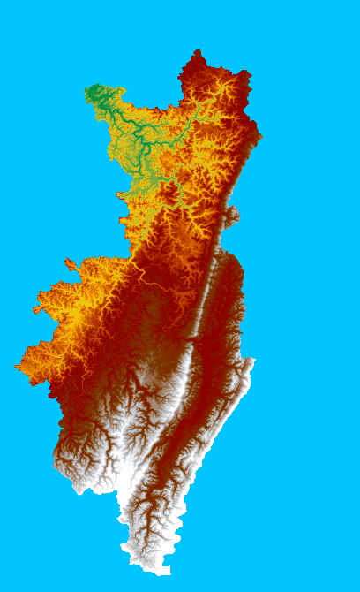
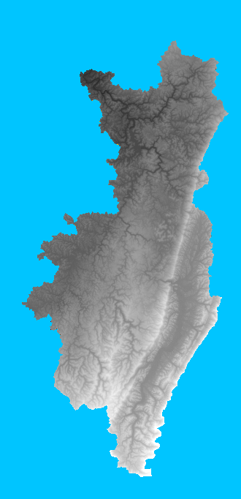
Operations Involving A single Raster
SquareRoot(“Elevation”)
29.2 | 26.5 | 28.6
24.5 | 28.6 | 30
NoData | 25.5 | 26.0
850 | 700 | 820
600 | 820 | 900
NoData | 650 | 675
Notes:
Operations can be performed that only require one raster input.
In the example above, the square root of the elevation value in the input raster will be returned to the output raster.
Other examples include converting grid cells from float to integer, taking the tangent of the cell values, and taking the natural log of the cell values.

Slide 8
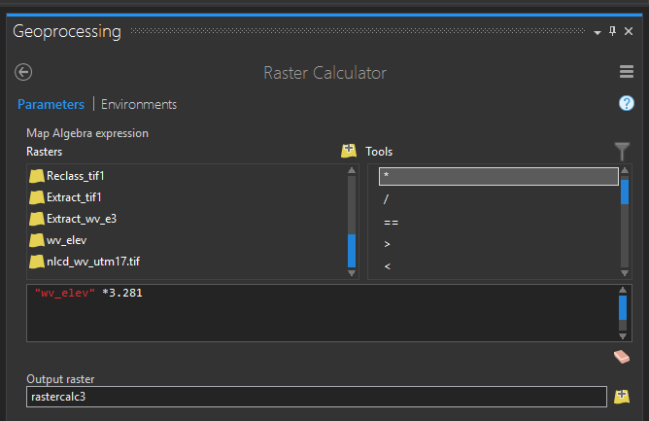
Operations Involving Constants
“Elevation” * 3.281 (meet to feet)
850 | 700 | 820
600 | 820 | 900
NoData | 650 | 675
2789 | 2297 | 2690
1969 | 2690 | 2953
NoData | 2133 | 2215
Notes:
Operations can also be performed that require raster grids and constants.
In the example, elevation values in meters are being multiplied by 3.281 to output elevation values in feet.
Unit conversion is a common use of such techniques.

Slide 9
Operations Involving Multiple Raster
1 | 0 | 1
0 | 0 | 1
NoData | 1 | 1
1 | NoData | 1
0 | 1 | 0
NoData | 1 | NoData
1 | NoData | 1
0 | 0 | 0
NoData | 1 | NoData
x
=
1 | 0 | 1
0 | 0 | 1
NoData | 1 | 1
1 | NoData | 1
0 | 1 | 0
NoData | 1 | NoData
2 | NoData | 2
0 | 1 | 1
NoData | 2 | NoData
+
=
Notes:
It is also possible to perform calculations using multiple raster grids.
When multiple raster grids are used, cells that overlap will be involved in calculations.
In the example above, cells are being multiplied and added together.
Note that a NoData result will be returned any time at least on of the grids holds a NoData value at that location.
Calculations can only be performed when values are available for all grids at that location.
When cells do not align properly, how the grids overlay to perform these calculations can be ambiguous. This is one reason to use a snap raster.

Slide 10
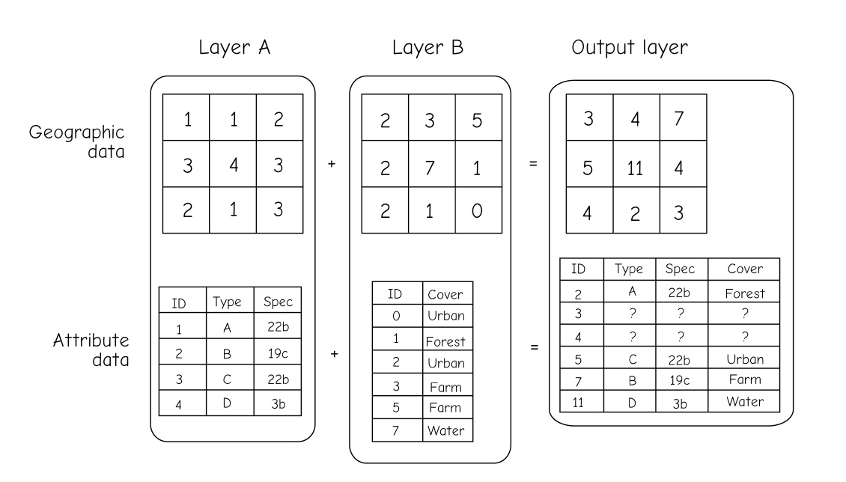
Operations Involving Multiple Raster
Raster addition will lead to ambiguous output when different combinations of inputs lead to identical output combinations
Bolstad, 2019
Notes:
It is also possible to perform calculations using multiple raster grids.
When multiple raster grids are used, cells that overlap will be involved in calculations.
In the example above, cells are being multiplied and added together.
Note that a NoData result will be returned any time at least on of the grids holds a NoData value at that location.
Calculations can only be performed when values are available for all grids at that location.
When cells do not align properly, how the grids overlay to perform these calculations can be ambiguous. This is one reason to use a snap raster.

Slide 11
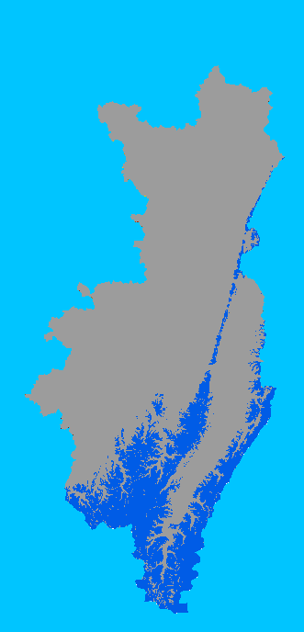
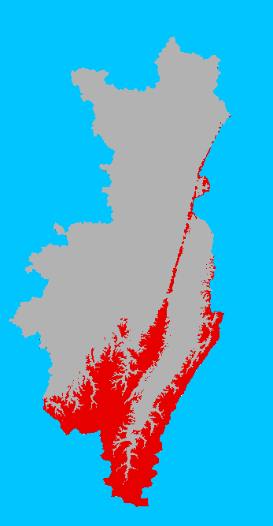
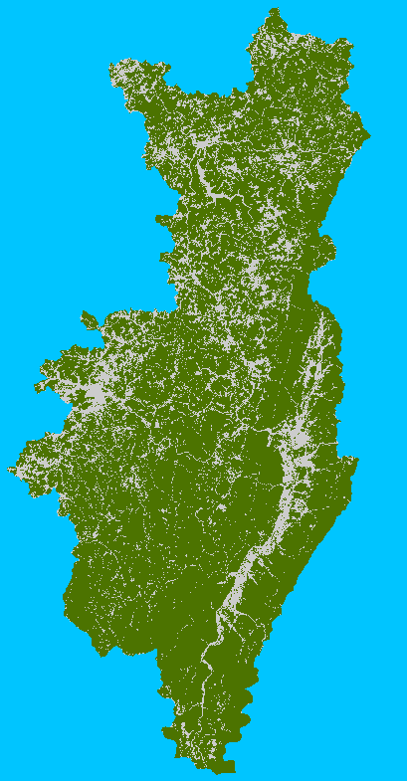
Operations Involving Multiple Raster
X
=
Forest
Elevation > 800 m
Forest at an elevation above 800 meters
Notes:
This is another example of raster math involving two grids. A binary surface separating forest and not forest is being multiplied by a binary grid representing locations with elevations above 800 meters. The result will return 1 only where the forest and elevation criteria are both true.
So, values of 1 in the output represent locations that are forest at an elevation above 800 meters.

Slide 12
Logical operations
“Elevation” > 800
1 = Yes = True
0 = No = False
850 | 700 | 820
600 | 820 | 900
NoData | 650 | 675
1 | 0 | 1
0 | 1 | 1
NoData | 0 | 0
Notes:
Raster Calculator can be used to produce binary, 0-1, or yes-no surfaces. In these outputs, cells that met the query criteria are coded as 1 and cells that do not meet the criteria are coded as zero.
1 always indicates true while 0 will indicates false.
In this example, I am querying the raster to find all cells in a digital elevation model that have an elevation greater than 800. Cells that hold an elevation value greater than 800 will be coded to 1 in the output. All other cells will be coded to 0.
The result is a binary output.

Slide 13
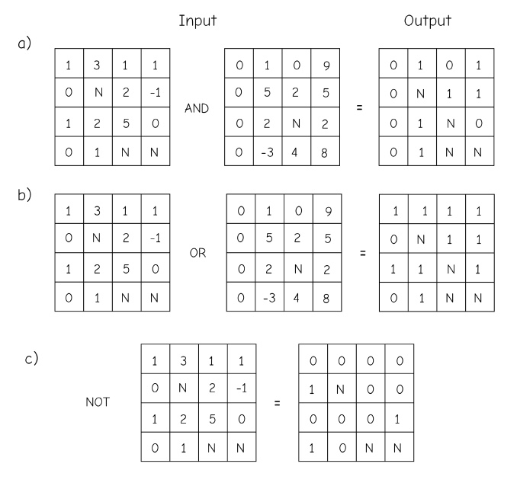
Logical operations
Bolstad, 2019

Slide 14
Some useful functions
+: Add
-: Subtract
*: Multiply
/: Divide
==: Equal to
!=: Not equal to
>: Greater than
>=: Greater than or equal to
<: Less than
<=: Less than or equal to
&: Boolean And
|: Boolean Or
^: Boolean XOr
~: Boolean Not
Notes:
Many functions are available for use within Raster Calculator. Take some time to review the available functions presented here. Note that these are not the only function available.
These are just examples.

Slide 15
Some useful functions
Abs: Absolute value
Exp: Base e exponential
Exp10: Base 10 exponential
Exp2: Base 2 exponential
Float: Convert from integer to float
Int: Convert from float to integer
Ln: Natural log
Log10: Base 10 log
Log: Bas 2 log
Square: Calculates square
SquareRoot: Calculates square root
IsNull: Identifies NoData cells
Notes:
Here are some additional functions available in Raster Calculator. Take some time to look over these functions.

Slide 16
Conditional statements
Con(set condition, what to return if true, what to return if false)
Example:
Con(“Land_Cover" = 41, 1, 0)
If the land cover raster grid is assigned a value of 41 (deciduous forest), return 1. If the land cover grid is assigned any other value, return 0.
Notes:
Conditional statements can also be integrated into Raster Calculator syntax. In a conditional statement, the first argument is the condition, the second argument defines what to return if the condition is true, and the last argument defines what to return in the condition is false.
In this example, the condition is that the land cover code must be equal to 41. This code represents deciduous forest. If the condition is met, or the location is coded as deciduous forest, the result will be 1. If the condition is not met, or the result is not deciduous forest, the result will be 0. So, the output here will be a binary output in which 1 indicates deciduous forest and 0 indicated not deciduous forest.

Slide 17
Impacts of NoData on Raster Math
NoData cells return NoData!!!!!!
Operations are only completed where all cell values are available
1 | 0 | 1
0 | 0 | 1
NoData | 1 | 1
1 | NoData | 1
0 | 1 | 0
NoData | 1 | NoData
1 | NoData | 1
0 | 0 | 0
NoData | 1 | NoData
x
=
Notes:
As a final note on raster calculations, a result will only be returned when values are available in all grids.
As an example, if you multiply 100 grids together, and they all have cell values at a location except one grid which has a NoData assignment at that location, the result will be NoData.
Values must be available in all grids at a location in order for a calculation to be performed.

Slide 18
Local function reclassification

Slide 19
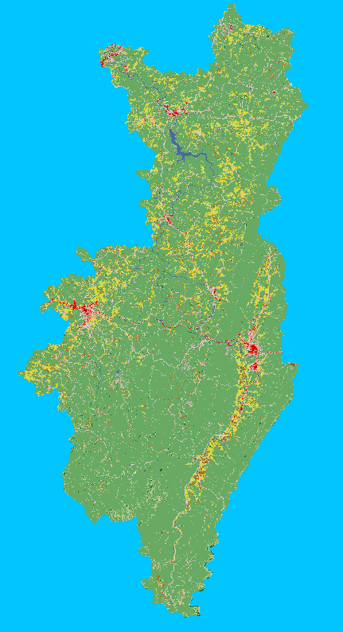
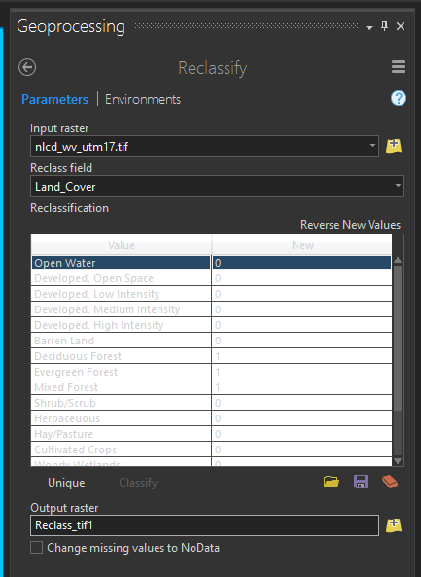
Reclassify Categorical Raster Data
Land cover
Forest =1; Non forest=0
Change cell values
Notes:
Reclassification allow you to change the cell values in a raster. The example in this slide demonstrates changing the cell values for a categorical raster grid, in this case a land cover grid from the National Land Cover Database. Here, all values corresponding to forest types were recoded to 1 and all other types were coded to 0. So, many categories were generalized to forest vs. not forest.

Slide 20
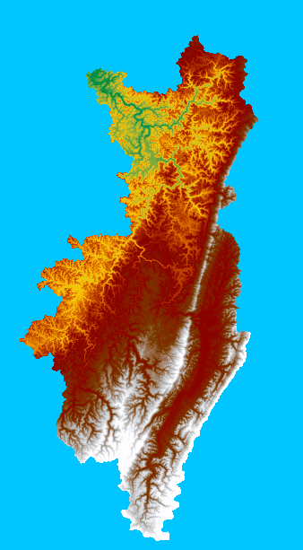
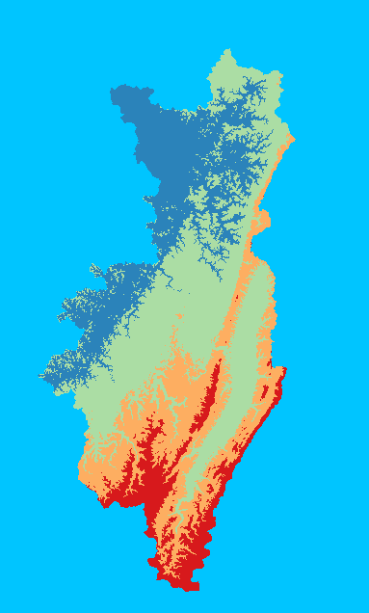
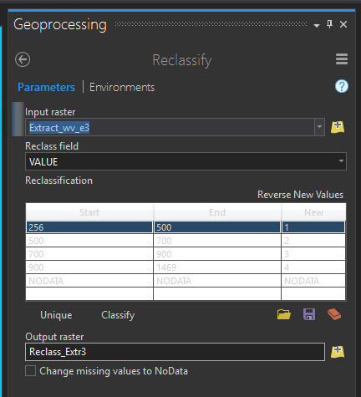
Reclassify Continuous Raster Data
DEM
Notes:
It is also possible to reclassify continuous raster data. In this example, a digital elevation model is being reclassified into four categories. Each category represents a range of elevation measurements.

Slide 21
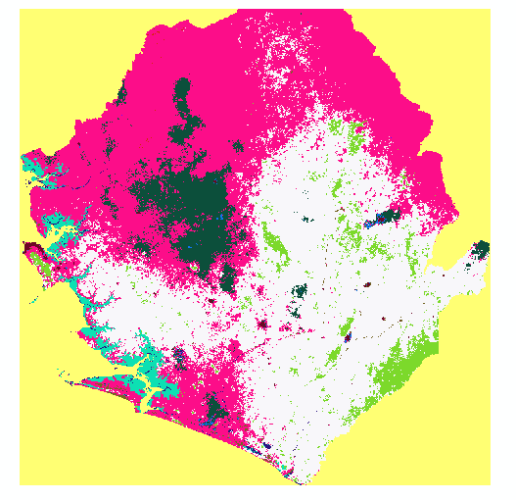
Reclassify NoData
Can reclassify NoData to a new value
Sierra Leona
Notes:
NoData cells can also be reclassified. Or, other cell values can be reclassified to NoData.

Slide 22
Local function Extraction

Slide 23
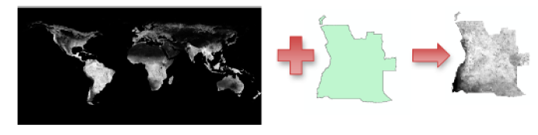
Extraction Methods
Extract by Circle: extract cells that fall into a circle that is defined by a center coordinate and radius
Extract by Mask: extract cells that fall within a raster or polygon mask
Extract by Point: extract cells at point locations
Extract by Polygon: extract cells that fall within the extent of a polygon as defined by its vertices
Extract by Rectangle: extract cells that fall within a rectangular extent
NDVI
Angola
Notes:
A common raster pre-processing task is to extract a portion of a raster from a larger dataset. In the example here, a portion of a DEM is being extracted from a larger DEM.
A variety of methods are available to extract a portion of a raster grid as defined on the slide. I commonly use Extract by Mask. To use this tool, a polygon mask or raster mask is used. Cells that fall within this mask will be written to a new file. That is how the example on the page was produced.
Take some time here to read through the descriptions of the different extraction methods.

Slide 24
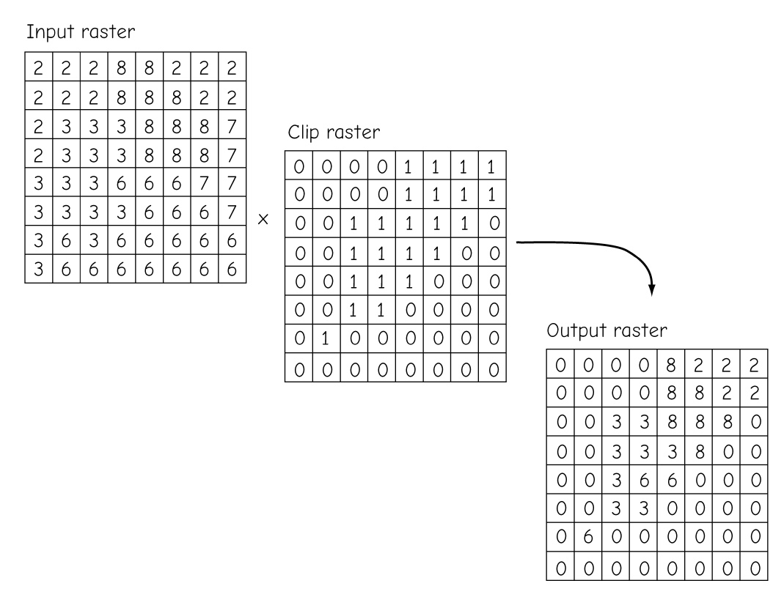
Extraction Methods
A raster clip/extraction operation may be performed via multiplication of a binary mask
Bolstad, 2019
Notes:
A common raster pre-processing task is to extract a portion of a raster from a larger dataset. In the example here, a portion of a DEM is being extracted from a larger DEM.
A variety of methods are available to extract a portion of a raster grid as defined on the slide. I commonly use Extract by Mask. To use this tool, a polygon mask or raster mask is used. Cells that fall within this mask will be written to a new file. That is how the example on the page was produced.
Take some time here to read through the descriptions of the different extraction methods.

Slide 25
Local function Stack

Slide 26
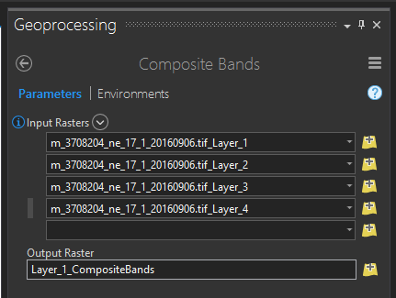
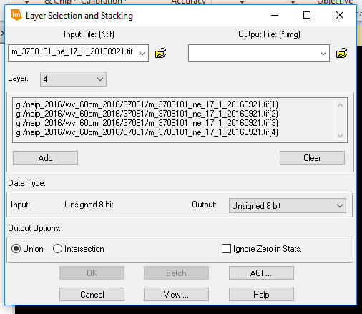

Stack Grids
Stack or combine individual grids into a multiband raster
Commonly used for image data
Can be used for all raster data, not just images
Output bands or layers will all have the same pixel type (e.g., 8-bit+16-bit→16-bit)
Bands will be layered in the order provided
Composite Bands Tool
Stack Tool
Demonstration!
Notes:
You may have many raster grids that you would like to combine to a single file by stacking the separate grids or bands as a single multiband file.
As an example, when Landsat data are downloaded they are often provided as individual bands. However, you may want to use these data as a multiband image for analysis or symbology. So, you would need to combine the bands into a single raster with multiple bands.
This can be accomplished using the Composite Bands Tool in ArcGIS Pro or the Stack Tool in Erdas Imagine.
Note that it is possible to stack more than just image bands. For example, you could stack a set of topographic variables into a multiband file. I have found this to be useful when preparing data for modeling.
Note that all bands or layers in a stack must have the same pixel type. For example, if you stack three 8-bit grids and one 16-bit grid, all the data will be converted to 16-bit. If one of your input grids is float, then all your grids will be converted to float.

Slide 27
Neighborhood-Based Analysis

Slide 28
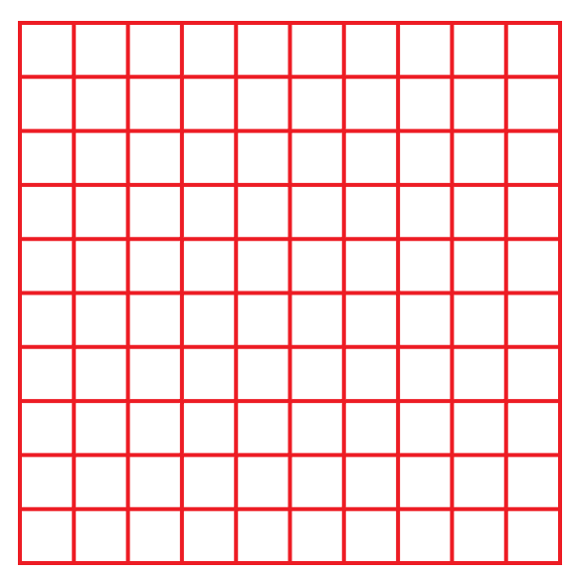
What is a neighborhood?
Neighborhood analysis, moving window analysis, focal operation, kernel analysis
Make calculation or compare cell values around a center cell
Notes:
Many raster analysis tasks rely on comparing a raster grid cell value to the values in neighboring cells. These types of processes go by many names including neighborhood analysis, moving window analysis, focal operations, and kernel analysis.
2828
Further, these types of processes are not limited to geospatial analysis. Similar techniques are used to blur or sharpen photographs in digital photo editing software packages.
These methods function by moving a window over the raster surface. A calculation is performed based on the cell values within the moving window. The result is then written to a new raster at the location associated with the cell at the center of the window.
The window then moves on to the next cell, using a different center cell and window. The calculation is performed again and the process continues until all cells have been used as the center cell.
Advance through the following slides to see the progression of the moving window. This 3 by 3 cell window will move over the raster grid and perform a calculation. For example, the mean of the cells within the window could be calculated then returned to a new cell at the location of the center cell in the grid. The window will then move on to the next cell and perform the calculation again.

Slide 29
What is a neighborhood?
Neighborhood analysis, moving window analysis, focal operation, kernel analysis
Make calculation or compare cell values around a center cell

Slide 30
What is a neighborhood?
Neighborhood analysis, moving window analysis, focal operation, kernel analysis
Make calculation or compare cell values around a center cell

Slide 31
What is a neighborhood?
Neighborhood analysis, moving window analysis, focal operation, kernel analysis
Make calculation or compare cell values around a center cell

Slide 32
What is a neighborhood?
Neighborhood analysis, moving window analysis, focal operation, kernel analysis
Make calculation or compare cell values around a center cell

Slide 33
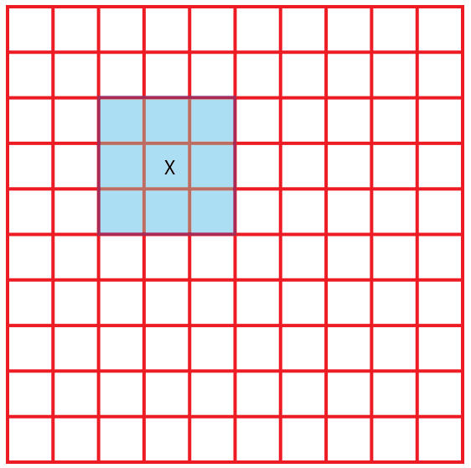
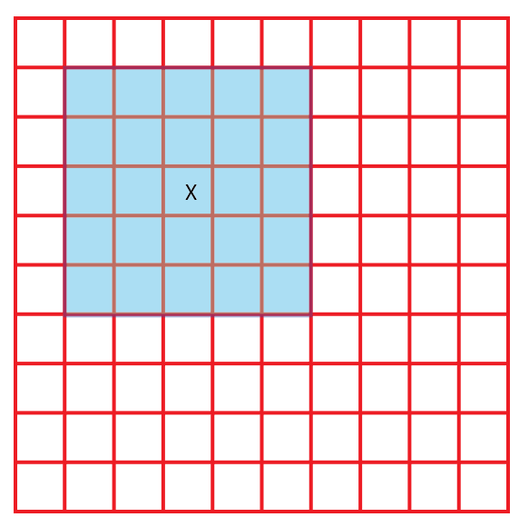
Defining a Neighborhood
Rectangle, Width = 3 cells Height = 3 cells
Rectangle, Width = 5 cells Height = 5 cells
Notes:
Moving windows can have different sizes and shapes. The examples here represent rectangular or square windows. The first example measures 3 by 3 cells and the second measures 5 by 5 cells.
Generally, an odd number is used so that there is a center cell.

Slide 34
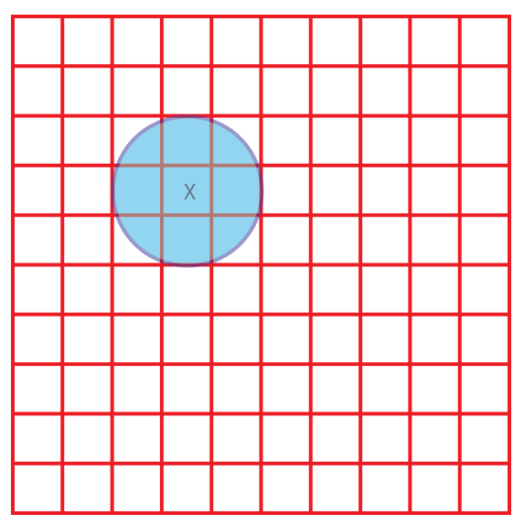
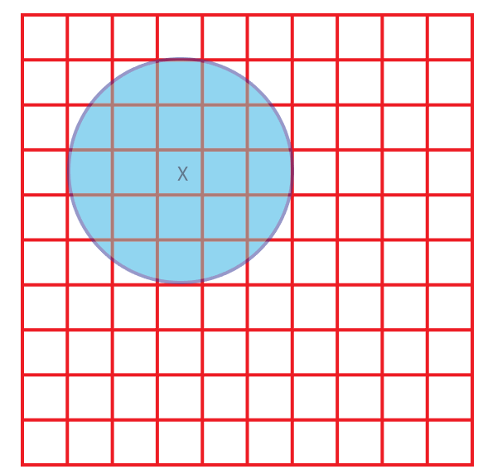
Defining a Neighborhood
Circle, Radius = 1.5 cell
Circle, Radius = 2.5 cells
Notes:
Circular windows can also be used. When using a circular window, a radius is defined relative to the map units or a number of cells. The examples here represent circular windows with radii of 1 and 2 cells.

Slide 35
Neighborhood function Focal STATISTICS

Slide 36
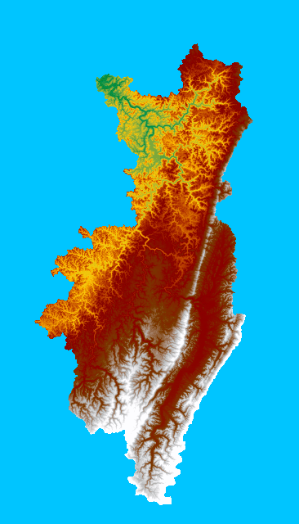
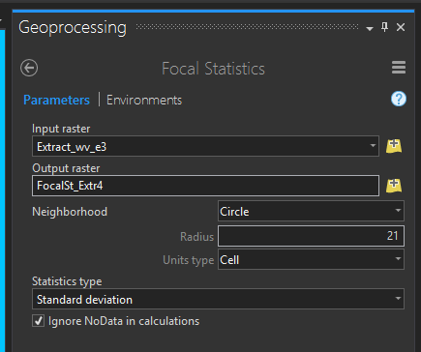
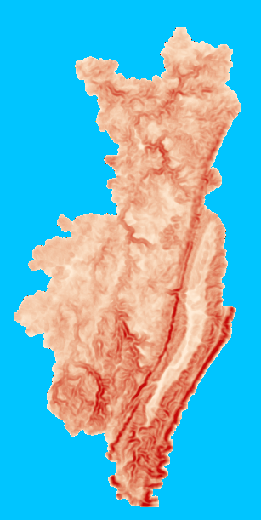
Focal Statistics
A type of window analysis
Calculates a statistic within the window
Stores result on center cell in new output
Completes operations for all cells
Notes:
Focal statistics is a type of moving window analysis. As the name implies, this method is used to calculate a statistic within a moving window.
As the window progresses over the raster grid, the resulting statistic is written to a new cell at the center cell location. The process continues to perform the calculation using all the cells in the original grid as the center cell.

Slide 37
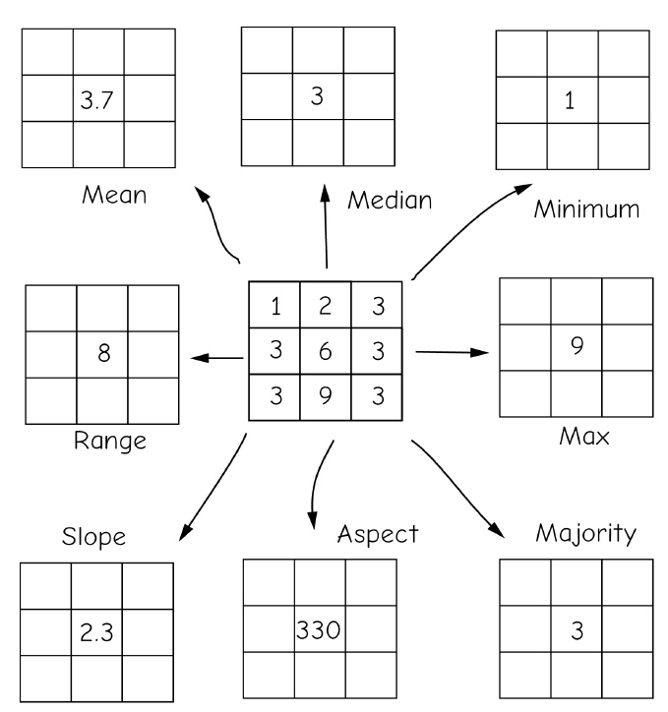
Focal Statistics
Bolstad, 2019
Notes:
Circular windows can also be used. When using a circular window, a radius is defined relative to the map units or a number of cells. The examples here represent circular windows with radii of 1 and 2 cells.

Slide 38
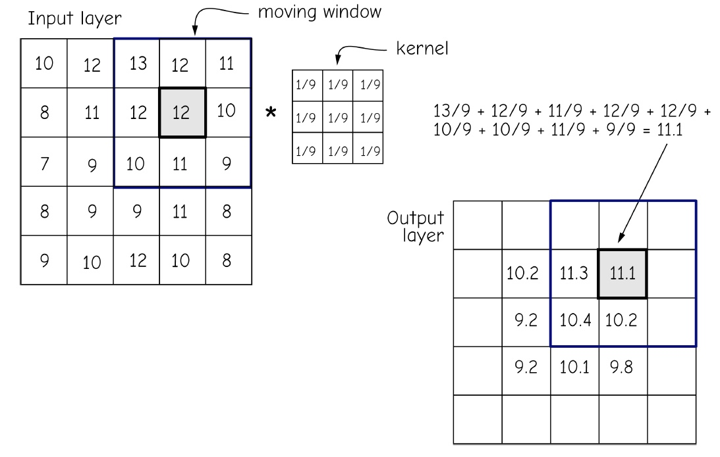
Focal Statistics
Bolstad, 2019
Notes:
Circular windows can also be used. When using a circular window, a radius is defined relative to the map units or a number of cells. The examples here represent circular windows with radii of 1 and 2 cells.

Slide 39
Focal Statistics
MEAN: Calculates the mean (average value) of the cells in the neighborhood.
MAJORITY: Calculates the majority (value that occurs most often) of the cells in the neighborhood.
MAXIMUM: Calculates the maximum (largest value) of the cells in the neighborhood.
MEDIAN: Calculates the median of the cells in the neighborhood.
MINIMUM: Calculates the minimum (smallest value) of the cells in the neighborhood.
MINORITY: Calculates the minority (value that occurs least often) of the cells in the neighborhood.
Notes:
A variety of statistics can be calculated using focal statistics.
For a continuous surface, such as a digital elevation model or a topographic slope grid, the mean, maximum, median, minimum, range, standard deviation, or sum may be calculated.
Many statistical values don’t make sense for categorical raster grids, such as land cover. However, the majority, minority, or variety could be calculated.
As an example, the variety measure would calculate the number of unique categories within the moving window.
Take some time to review the available statistics presented on this slide.
As a final note, larger windows sizes are generally used to represent more coarse or generalized patterns while smaller windows are used to represent more local patterns.
There is not necessarily a correct window size. Instead, this depends on the use case. If you are not sure what window size to use, I would recommend experimenting with multiple window sizes.
It is also possible to make a calculation using different window sizes then take an average.

Slide 40
Focal Statistics
RANGE: Calculates the range (difference between largest and smallest value) of the cells in the neighborhood.
STD: Calculates the standard deviation of the cells in the neighborhood.
SUM: Calculates the sum (total of all values) of the cells in the neighborhood.
VARIETY: Calculates the variety (the number of unique values) of the cells in the neighborhood.
Notes:
Moving window analyses also have applications in remote sensing.

Slide 41
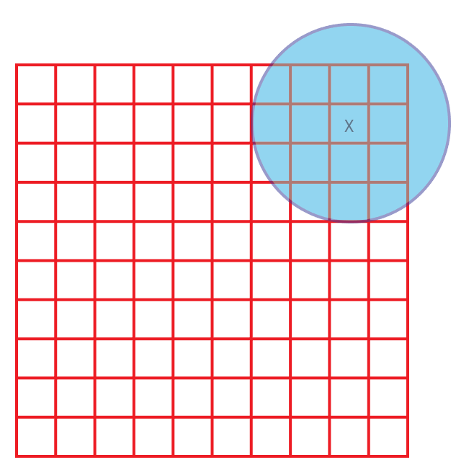
Edge Cells
Edge cells will not have a full set of neighbors
calculated using only the available cells
calculated for cells that have a full set of neighbors (the size of the raster will be reduced)
calculated larger area to cover the study region
Notes:
It may have occurred to you that cells near the edge of the raster may not have a full set of neighbors as demonstrated in this slide.
In these situations, two options are available. First, the result could be calculated using only the available cells. Second, results could only be calculated for cells that have a full set of neighbors.
If the second option is used, the size of the raster grid, or the number of rows and columns, will be reduced.
If you are concerned with this issue, I would recommend running an analysis using a larger extent than is required. That way, you will always have a full set of cells to cover the extent of interest.

Slide 42
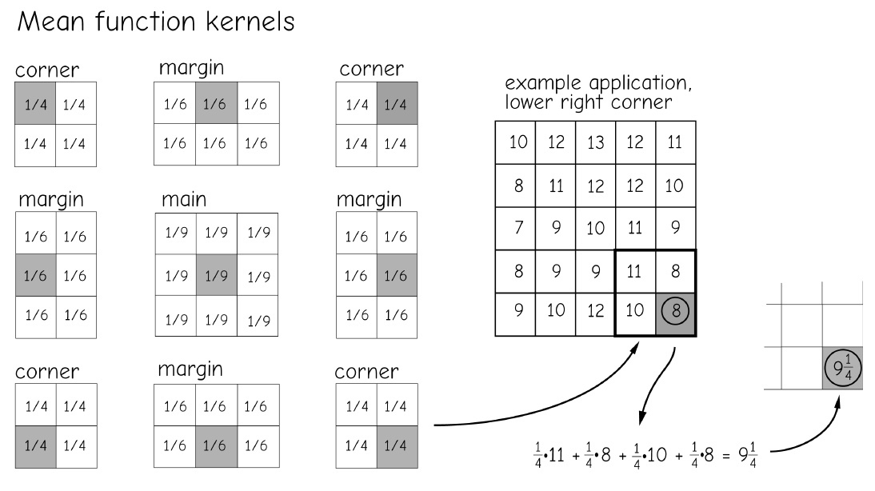
Edge Cells
Edge cells will not have a full set of neighbors
Using different kernel in the edge
Bolstad, 2019
Notes:
It may have occurred to you that cells near the edge of the raster may not have a full set of neighbors as demonstrated in this slide.
In these situations, two options are available. First, the result could be calculated using only the available cells. Second, results could only be calculated for cells that have a full set of neighbors.
If the second option is used, the size of the raster grid, or the number of rows and columns, will be reduced.
If you are concerned with this issue, I would recommend running an analysis using a larger extent than is required. That way, you will always have a full set of cells to cover the extent of interest.

Slide 43
Neighborhood function distance

Slide 44
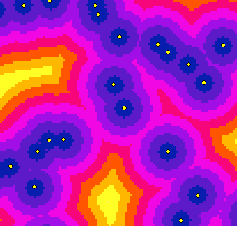
Euclidean Distance
Straight line or Euclidean distance from the cell to a source
Map showing the distance to the nearest town for each location
Map showing the distance to the nearest town for each location
Notes:
Euclidean distance simply represents the straight line distance from a cell to the nearest input feature. As an example, the surface shown here represents the straight line distance from the cell to the nearest major road.
Each cell is coded with the distance to the nearest input feature.
It is also possible to define a maximum distance. If a cell is further then the maximum distance from the nearest input feature, then it will not be calculated.

Slide 45
Euclidean Distance
1. Which location is closer to the town? A or B?
B
D
A
1. Which location is closer to the town? C or D?
C

Slide 46
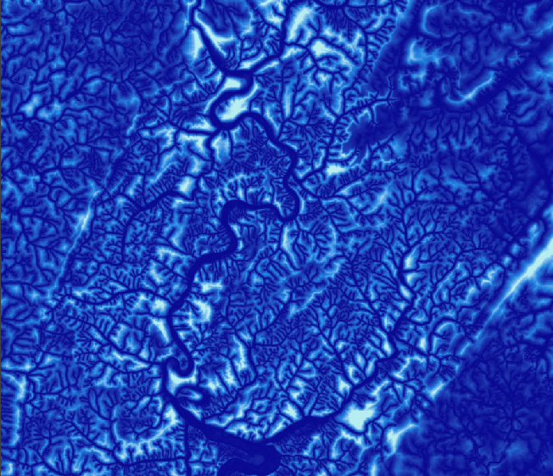
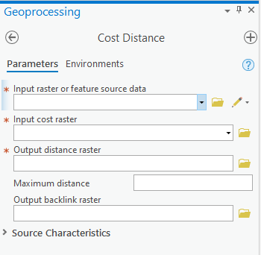
Cost Distance
Euclidean distance but with a cost or impedance applied
Example: Distance from streams weighted by slope
Slope is used as a measure of cost or impedance of travel away from streams
Notes:
Cost distance is similar to Euclidean distance. However, it allows for a measure of cost or impedance to be applied.
The example in this slide represents distance from streams weighted by slope. So, topographic slope is being used as a measure of cost or impedance of travel away from streams.
This specific result could be useful for delineating floodplains or riparian areas.

Slide 47
Neighborhood function Raster Generalization

Slide 48
Majority Filter
Only applicable to categorical raster grids
Replace center cell with majority value in 3 x 3 cell window
MAJORITY vs. HALF: Must have a majority or at least half to change value
FOUR vs. EIGHT: use just orthogonal cells or orthogonal and diagonal cells
Four: only orthogonal cells
Eight: both orthogonal and diagonal
Salt and pepper effect
30 | 20 | 30
30 | 20 | 20
40 | 30 | 20
Notes:
The raster generalization methods that we will discuss here are only applicable to categorical raster grids, such as land cover.
First, we will discuss majority filtering. Majority filtering can be used to replace a cell value with a different value based on neighboring cells.
Generally, this is performed using a 3 by 3 moving window, so this is another example of a method that makes use of neighborhood analysis.
Specifically, this method is used to replace a cell value with the majority cell value of the neighboring cells.
If the FOUR method is used, then only orthogonal cells will be considered. These are the cells that share a side with the center cell.
If the EIGHT method is used, then all eight neighboring cells will be considered, or the four orthogonal and four diagonal cells.
If the Majority setting is applied, then the cell value will only be changed if a majority or more than half of the neighbors contain the new cell value.
If the Half setting is used, then at least half of the neighboring cells must contain the cell value.
In the example provided here, if EIGHT and Majority were used then the cell value would be changed to 30. This is because 30 is the majority value in the eight neighboring cells, as five of the eight cells contain this value.
If the FOUR and majority method were used, then the center cell value would be maintained as 20, since there are two 30 and two 20 cells in regards to the orthogonal neighbors, so there is no majority.
Regardless of the settings used, the 3 by 3 moving window will move through the grid to perform this calculation using each cell as the center cell.
A common application of majority filtering is to reduce the salt and pepper effect that commonly results from image classification. Pixels that are different from their neighbors can be recoded to the majority value of their neighbors, thus reducing the salt and pepper issue.

Slide 49
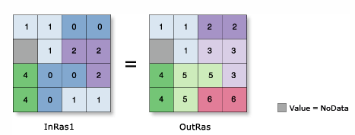
Region Group
Group cells with the same code in a categorical raster and code them with a unique identifier
Identify contiguous regions of the same category
Notes:
Region group is used to code all regions in a categorical raster to a unique code. So, any contiguous set of pixels that have the same code will be grouped, and each of these unique regions will be assigned a unique code.
The goal here is to identify contiguous regions of the same category.

Slide 50
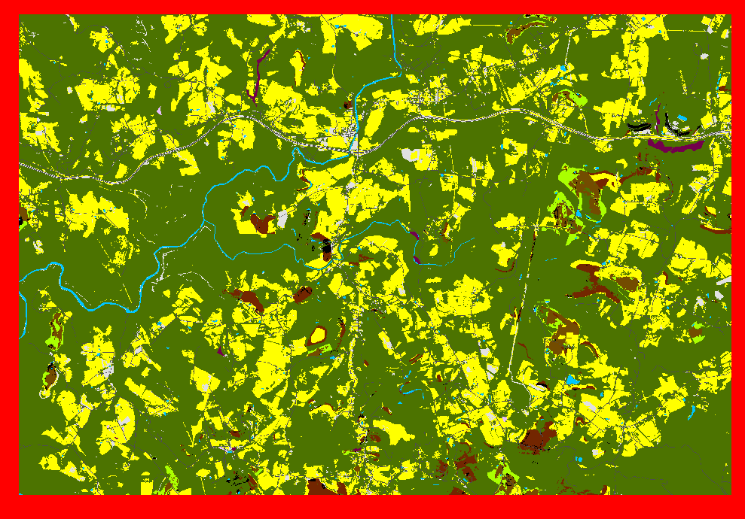
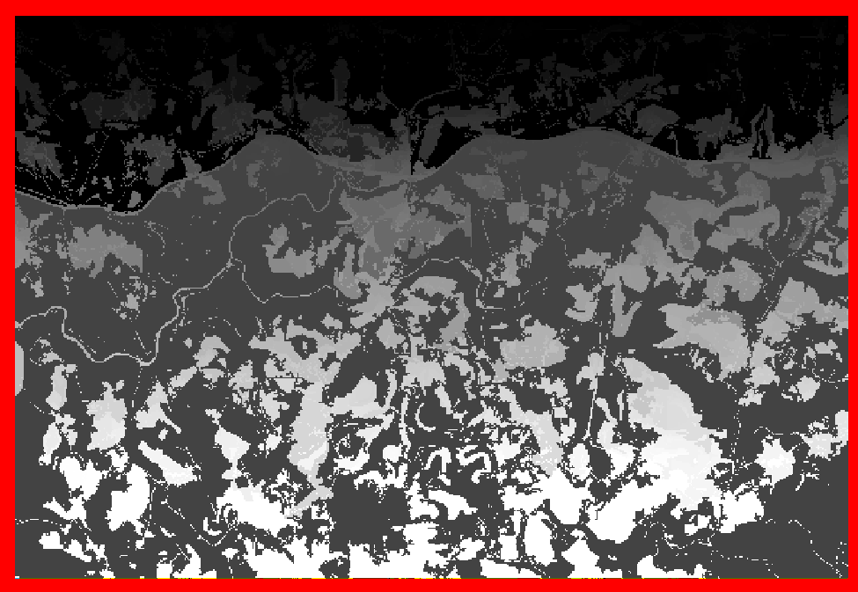
Region Group
Group cells with the same code in a categorical raster and code them with a unique identifier

Slide 51
Region Group
Must decide between the FOUR or EIGHT method
Four: area will only be considered contiguous if the cells share a side
Eight: area will be considered contiguous even if the pixels only touch diagonally
Can convert to polygons after regions are grouped
Will needed to decide if you want to simply the polygons
Notes:
When performing region grouping, similar to majority filtering, the FOUR or EIGHT methods can be applied.
If the EIGHT method is applied, an area of the same code will be considered contiguous even if the pixels only touch diagonally.
In contrast, when using the FOUR method an area will only be considered contiguous if the cells share a side, or are orthogonal.
Generally, the FOUR method will yield more unique regions than the EIGHT method.
Once regions have been assigned unique codes, they can be converted to polygons with or without simplification.
If no simplification is applied, then the polygons will follow the boundaries of the cells.
Defines connectivity between cells of the same value only if the cells are directly to the left, right, above, or below each of the four nearest neighbors. If two cells with the same value are diagonal from one another, they are not considered connected.

Slide 52
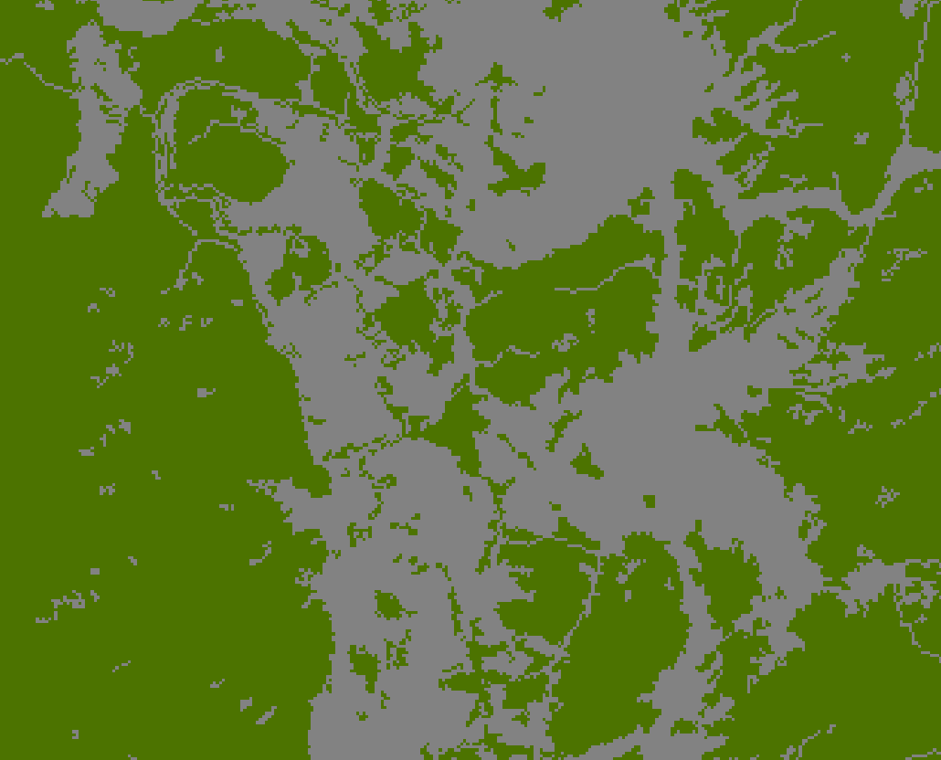
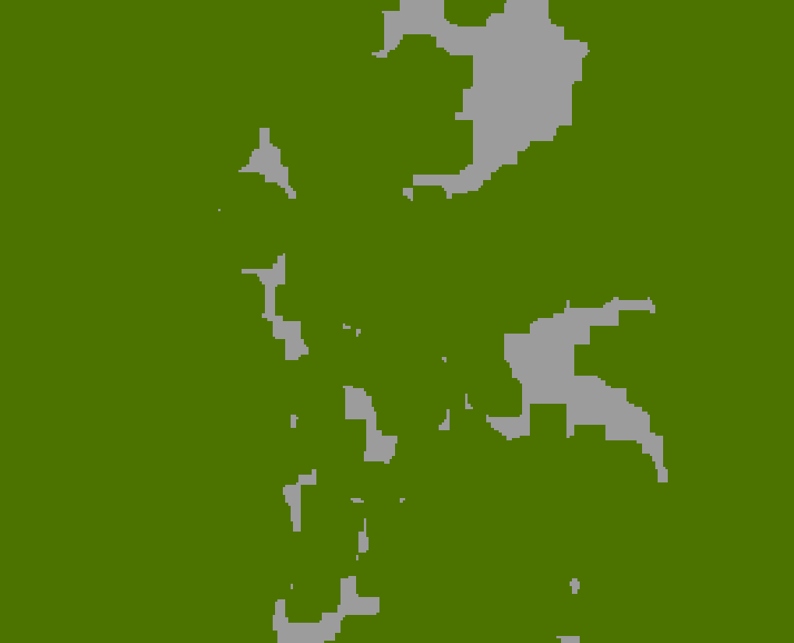
Expand
Expand out a specific category in a categorical raster by a specified number of cells
Green expanded by 5 30 m pixels
Notes:
Expand is used to extend a certain code or category out by a defined number of cells.
In the example provided, the green cells represent forest and the gray cells represent all other categories.
Using Expand, the forest areas have been expand by 5 cells or 150 meters, reducing the area of not forest.

Slide 53
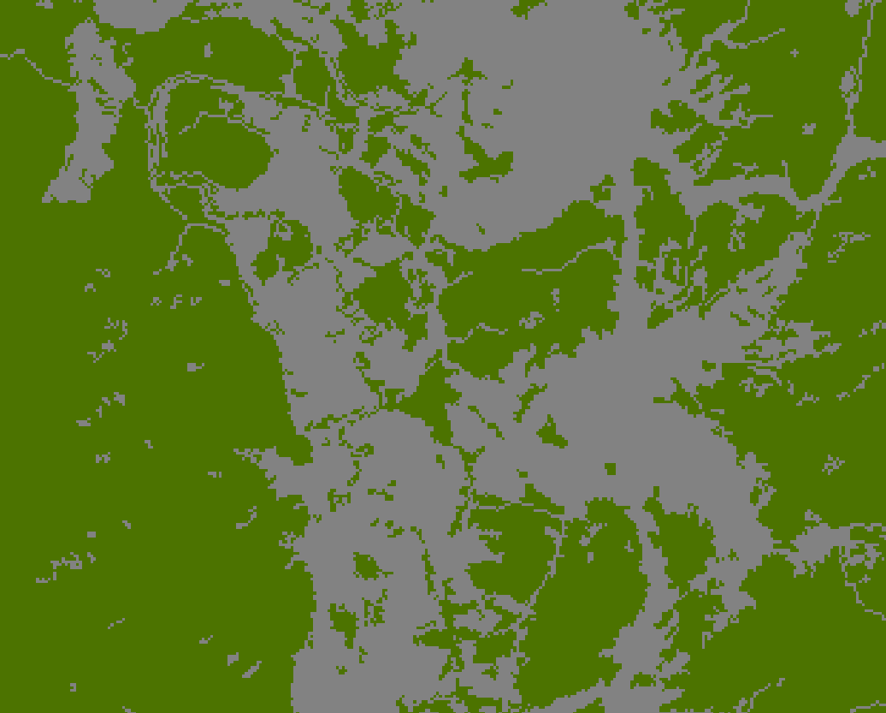
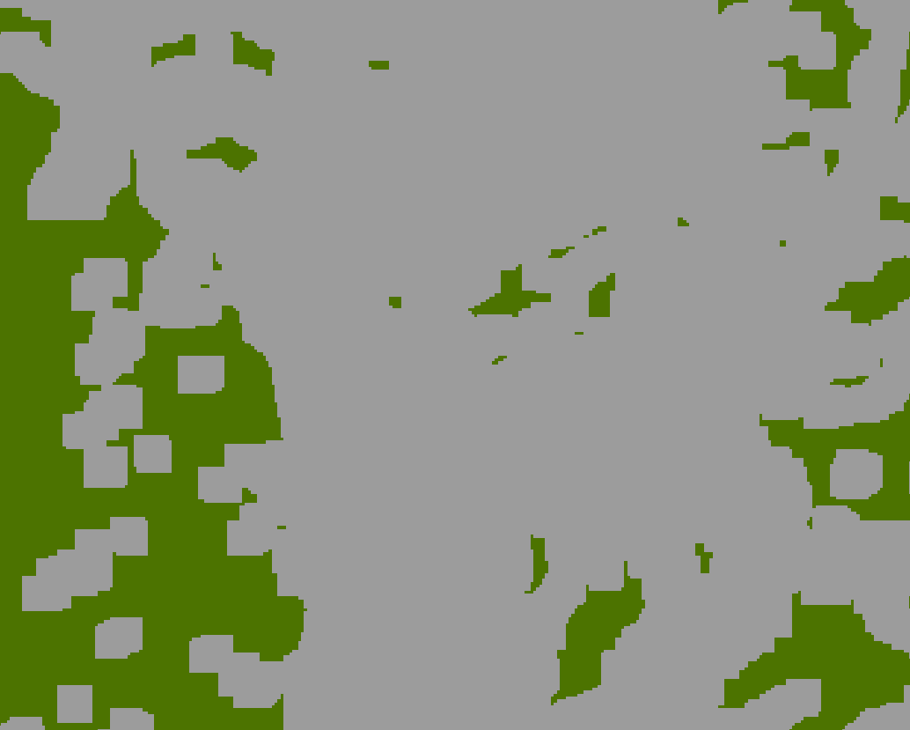
Shrink
Shrink a specific category in a categorical raster by a specified number of cells by replacing them with the values of the cell that is most frequent in its neighborhood
Green shrank by 5 30 m pixels and replaced with gray
Notes:
Shrink is the opposite of expand. Instead of expanding areas with a certain code or value, that code or value is reduced.
The areas that are reduced for this class are replaced with the most frequent value or code in its neighborhood.
In the example above, the forest class has been reduced by 5 cells or 150 meters. Cells in these areas have been recoded as not forest.

Slide 54
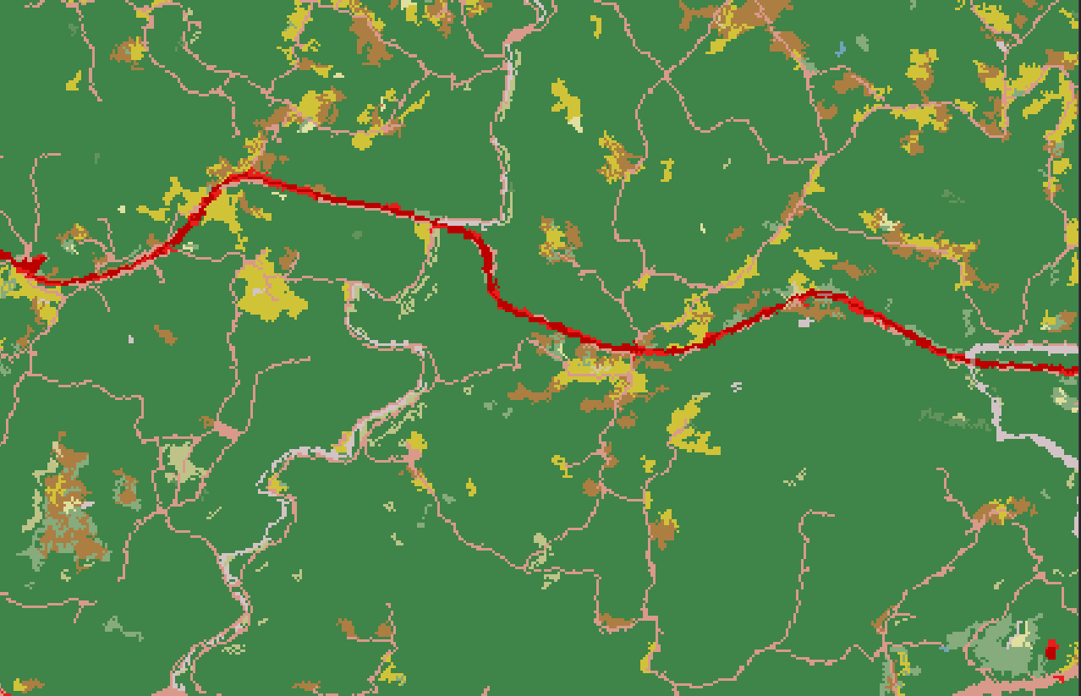
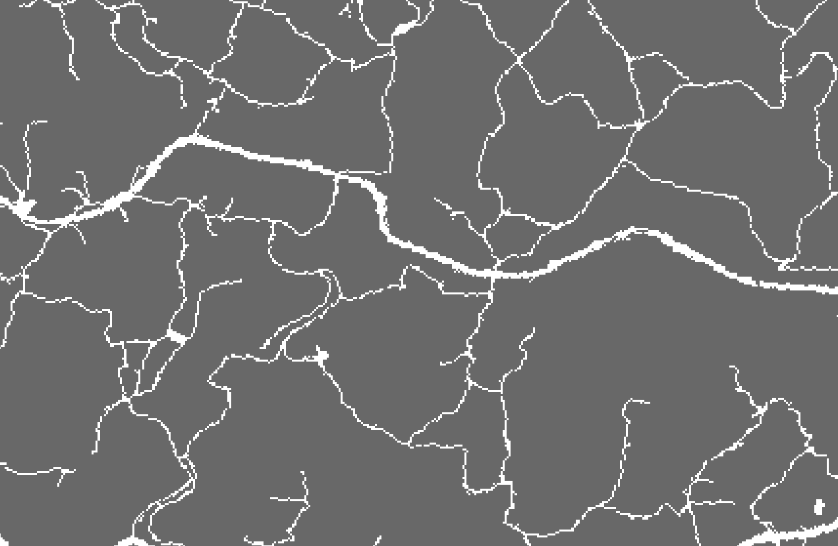
Nibble
Replace cells of a raster corresponding to a mask with the values of the nearest neighbor
Notes:
Nibble is used to replace cells values with the nearest cell value that is not masked out.
In the example above, the red areas indicate some level of development. We would like to remove these areas and replace them with the nearest non-developed category.
To accomplish this task, a mask is produced. This mask is used to mask out all developed areas.
Using this mask, areas that are developed will be recoded as the nearest code that is not developed, since all developed areas were masked out.
Progress to the next slide to see the result.

Slide 55
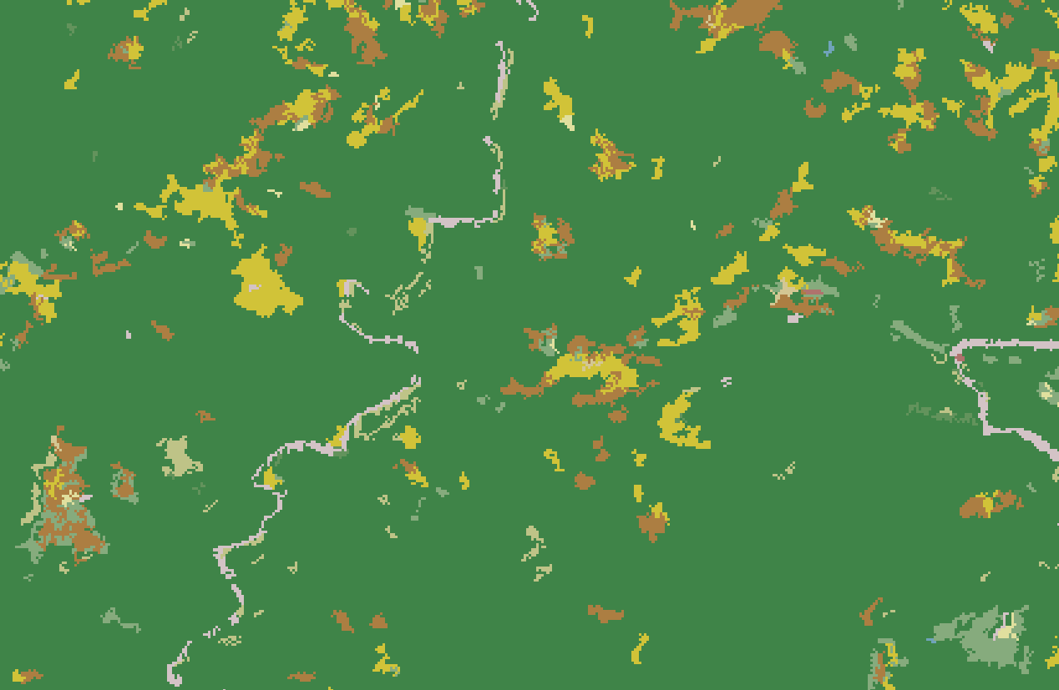
Nibble
Replace cells of a raster corresponding to a mask with the values of the nearest neighbor
Notes:
As you can see, the developed cells have now been replaced by the nearest non-developed category, effectively removing this class from the dataset.

Slide 56
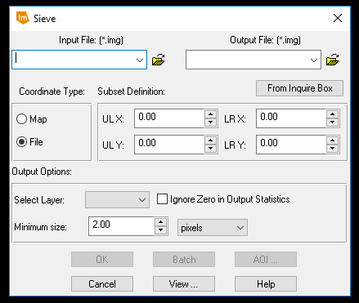
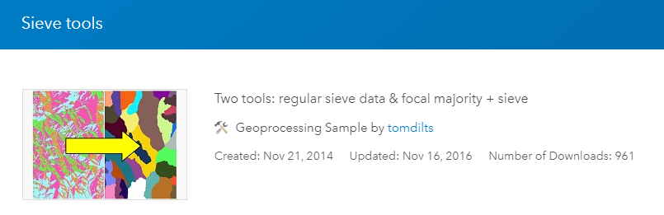
Sieving
Replace regions smaller than a certain size in a categorical raster with the surrounding class
Can be used to approximate a minimal mapping unit (MMU)
Notes:
As a last example of raster generalization methods, sieving can be used to remove areas of the same category that are smaller than a certain size.
The user must define a minimal size area to maintain as a land area or number of cells.
The tool will then find all contiguous regions that are smaller than this defined size. Once these areas are found they will be removed and assigned to the surrounding class.
As an example, this tool could be used to remove small areas in a land cover classification that are smaller than a defined size. For example, small barren areas within a forested extent could be removed and coded as forest.
This method can be used to remove the salt and pepper effect common in land cover classifications.
Additionally, this method can be used to approximate a minimal mapping unit. Areas smaller than the minimal mapping unit can be recoded and assigned to the surrounding class.

Slide 57
Neighborhood function Raster summarization

Slide 58
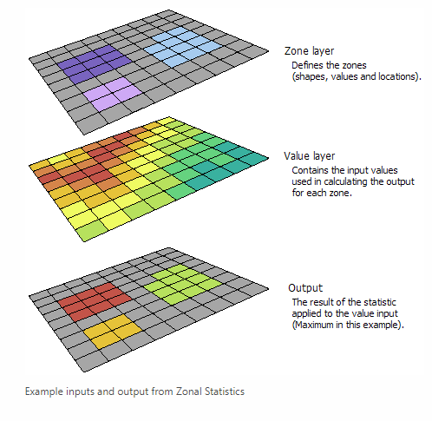
Zonal statistics
Used to obtain statistics from a continuous raster within an area or zone as defined by another raster or a polygon vector layer
Can obtain results as a raster surface for a single statistic
All cells in the zone have same value
https://desktop.arcgis.com/en/arcmap/10.3/tools/spatial-analyst-toolbox/h-how-zonal-statistics-works.htm
Notes:
A common spatial analysis task is to summarize raster data relative to vector data. For example, you may want to summarize continuous raster data relative to polygons.
This can be accomplished using the Zonal Statistics Tool.
This method will calculate a statistical measure, such as the mean, median, standard deviation, minimum, or maximum, from the cell values within a zone.
The zones can be defined using a categorical raster or vector polygons. If vector polygons are used, then they will be converted to raster zones prior to the summarization.
As a result, this method generally will not work correctly if overlapping polygons are used, since only one code can be assigned to each cell.
The result will be a statistical measure that will be the same for each cell within each zone.
The example above shows the range of elevation for each county in West Virginia. Since the zones were defined as counties, all cells in the same county were assigned the same value, in this case the elevation range.
Since a singe band raster is produced, only one statistical measure can be generated at a time.

Slide 59

Zonal statistics
Bolstad, 2019
Notes:
A common spatial analysis task is to summarize raster data relative to vector data. For example, you may want to summarize continuous raster data relative to polygons.
This can be accomplished using the Zonal Statistics Tool.
This method will calculate a statistical measure, such as the mean, median, standard deviation, minimum, or maximum, from the cell values within a zone.
The zones can be defined using a categorical raster or vector polygons. If vector polygons are used, then they will be converted to raster zones prior to the summarization.
As a result, this method generally will not work correctly if overlapping polygons are used, since only one code can be assigned to each cell.
The result will be a statistical measure that will be the same for each cell within each zone.
The example above shows the range of elevation for each county in West Virginia. Since the zones were defined as counties, all cells in the same county were assigned the same value, in this case the elevation range.
Since a singe band raster is produced, only one statistical measure can be generated at a time.

Slide 60

Zonal Statistics as Table
Used to obtain statistics from a continuous raster within an area or zone as defined by another raster or a polygon vector layer
Can obtain multiple statistics as a table: mean, majority, maximum, median, minimum, minority, range, standard deviation, sum, and variety
Can use table join to join the results back to the zone data
Elevation statistics by county
Notes:
If you would like to calculate multiple statistics in a table format, this can be accomplished using Zonal Statistics as Table.
Instead of producing a raster output for a single statistical measure, a table output is generated that can provide multiple statistical measures.
Each row in the table will correspond to a zone, in this example a specific county.
If you would like to associate these results with the original zones, this can be accomplished using a table join. Here, this table could be joined back to the county vector file using the shared NAME field.

Slide 61

Tabulate Area
Used to obtain areas for categories in a categorical raster within an area or zone as defined by another raster or polygon vector layer
Areas will be in square map units
Can use table join to join the results back to the zone data
Area of land cover by county
Notes:
The Zonal Statistics tools are designed to provide summary statistics relative to zones and are generally more applicable for summarizing continuous raster data, such as a digital elevation model.
If you would like to summarize categorical raster data, such as land cover, this can be accomplished using the Tabulate Area Tool.
The output will be a table that provides the land area of each category within each zone.
If you would like to obtain the percentage of the land area as opposed to the area, then you could perform table calculations in new fields.
This table could also be joined to the original zone using a table join for further analysis.
Similar to the Zonal Statistics tools, vector polygon zones will be converted to raster zones to perform the summarization. So, incorrect results will be produced for overlapping polygons.

Slide 62



Extract Values to Points
Extract raster values at point locations and add the data to the attribute table
Can use: Extract Multi Values to Points Tool or Extract Values to Points Tool
Notes:
It is also possible to extract values at points. The result will be a new field in the attribute table for the point layer that holds the cell value from a raster grid occurring at that location.
This is an easy way to extract cell values at point locations in preparation for later analysis.

Slide 63
Neighborhood function Estimating Densities

Slide 64

Point Density/ Line Density
Calculates the magnitude per unit area for point or line features that fall within a neighborhood around each cell
Line length/area
Number of points/area
Can incorporate weights
Must specify neighborhood shape and size
Notes:
You may be interested in obtaining a raster-based measure of density for point or line features. This can be accomplished using the Point Density or Line Density tools.
These tool are yet another example of methods that make use of neighborhood analysis or moving windows.
The user must define the size and shape of the moving window. The tool then will calculate the number of points or length of lines within the window.
On the center cell for each window, the tool will return a measure of density. For points this will be the number of points per unit area.
For lines, this will be the length of lines per unit area.
The size and shape of the window can have a large impact on the output. More global or generalized patterns will be produced with larger windows whereas more local patterns will be observed if a smaller window is used.
There is not necessarily a correct window size, as this depends on the goals of the analysis.

Slide 65



Kernel Density
Fits a kernel function to estimate density
Notes:
Kernel density is similar to point or line density, accept that a different method is used to calculate density.
Specifically, this method makes use of a kernel function. The next slide provides and explanation of this method.
Please take the time to read through this explanation.

Slide 66
Mosaic

Slide 67

Mosaic to New Raster
Combine single band or multiband raster grids into a single raster
Can be used for all types or raster grids, including images
https://www.pinterest.com/pin/326440672980405218/
Notes:
Instead of extracting a portion of a raster grid, you might be interested in combining multiple raster grids. This is a common task performed for image data. As another example, multiple digital elevation models could be merged to create an elevation surface that fills a larger spatial extent. This process can be accomplished using the Mosaic to New Raster Tool.
This tool will require you to define a pixel type (8-bit, 16-bit, float, etc.), a file extension (I commonly use Image or TIFF), an output cell size, and the number of bands.

Slide 68

Mosaic to New Raster
Must specify: file extension, pixel type, cell size, and number of bands
Notes:
Instead of extracting a portion of a raster grid, you might be interested in combining multiple raster grids. This is a common task performed for image data. As another example, multiple digital elevation models could be merged to create an elevation surface that fills a larger spatial extent. This process can be accomplished using the Mosaic to New Raster Tool.
This tool will require you to define a pixel type (8-bit, 16-bit, float, etc.), a file extension (I commonly use Image or TIFF), an output cell size, and the number of bands.

Slide 69

Mosaic to New Raster
Assigning values at overlapping locations:
FIRST: The output cell value of the overlapping areas will be the value from the first raster dataset mosaicked into that location.
LAST: The output cell value of the overlapping areas will be the value from the last raster dataset mosaicked into that location. This is the default.
BLEND: The output cell value of the overlapping areas will be a horizontally weighted calculation of the values of the cells in the overlapping area.
NAIP Orthophotography
Notes:
When you have overlapping values, a method must be applied to obtain the cell value in the overlapping areas. When there is no overlap, the decision is easy, as there is only on cell value.
For continuous data, many methods are available, including first, last, mean, maximum, and minimum. Since categorical data cannot be averaged, first or last are commonly used.
Take some time to review the methods described on the slide.

Slide 70
Mosaic to New Raster
Assigning values at overlapping locations:
MEAN: The output cell value of the overlapping areas will be the average value of the overlapping cells.
MINIMUM: The output cell value of the overlapping areas will be the minimum value of the overlapping cells.
MAXIMUM: The output cell value of the overlapping areas will be the maximum value of the overlapping cells.
SUM: The output cell value of the overlapping areas will be the total sum of the overlapping cells.
NAIP Orthophotography
Categorical data: first or last are commonly used.
Continuous data: All methods are ok
Demonstration!
Notes:
When you have overlapping values, a method must be applied to obtain the cell value in the overlapping areas. When there is no overlap, the decision is easy, as there is only on cell value.
For continuous data, many methods are available, including first, last, mean, maximum, and minimum. Since categorical data cannot be averaged, first or last are commonly used.
Take some time to review the methods described on the slide.

Slide 71

Mosaic Outside of ArcGIS
Erdas Imagine
ENVI
Notes:
As a note, other tools are available to mosaic raster data. The Mosaic Pro Tool within Erdas Imagine is commonly used to mosaic image data. I have found this tool to be fast. It also offers more advanced color balancing methods that can be of great value when combining images. It also allows you to write the result to multiple files as opposed to a single, continuous dataset. This is valuable if the output will be very large.

Slide 72


Pyramids
Reduce spatial resolution versions of the data to aid in faster display
Notes:
Raster datasets can be large files, especially if they cover a large spatial extent and/or have a small cell size. This can result in slow display.
Building pyramid layers provides a means to improve the display speed and performance or raster layers.
Pyramids are reduced spatial resolution versions of the data. When you are zoomed out, the reduce resolution data are drawn. The high spatial resolution data are not drawn until you zoom in.
This can greatly improve display speed as you zoom in and out or pan around.
If you plan to work with raster data, especially if you will need to zoom and pan around the data, such as when digitizing, I highly recommend building pyramids. This process can be slow, but it may save you time in the long run.

Slide 73
Spatial Analysis Tools

Slide 74







Software Options
ArcGIS Pro
ArcMap
Erdas Imagine
ITT ENVI
QGIS/GRASS/SAGA
R
Logos were obtained from organization websites.
Notes:
There are many other environments that are available in which to perform spatial analysis and work with raster data.
Although we mainly work with ArcGIS Pro in this course, I wanted to take the time to note some other options.
There are several open-source and free software packages that can be used to perform spatial analysis, including QGIS and R.
Additionally, spatial analysis methods focused on imagery are provided by remote sensing software packages, such as Erdas Imagine and ENVI.
You will be introduced to these tools in our more advanced courses.

Slide 75


Python
https://esripress.esri.com/display/index.cfm?fuseaction=display&websiteID=276&moduleID=0
Script by Jeff Evans
Notes:
Lastly, spatial analysis can be performed in a code-based environment.
Using ESRI products, including ArcGIS Pro, Python can be applied to undertake a variety of tasks.
Python can be especially useful if you need to loop through data layers or automate a sequence of steps.
Python will be investigated in some of our more advanced courses.

Slide 76

Thank you!

