Slide 1

WEEK 04 Geospatial Data lecture
Instructor: Yanan Wu
fALL 2025

Slide 2
4.1 Introduction to gis

Slide 3
Overview
Geospatial data
Vector
Point
Line
Polygon
Raster
Pixel
Triangulated Irregular Network
Objected Data Model
Three-Dimensional Data Models

Slide 4
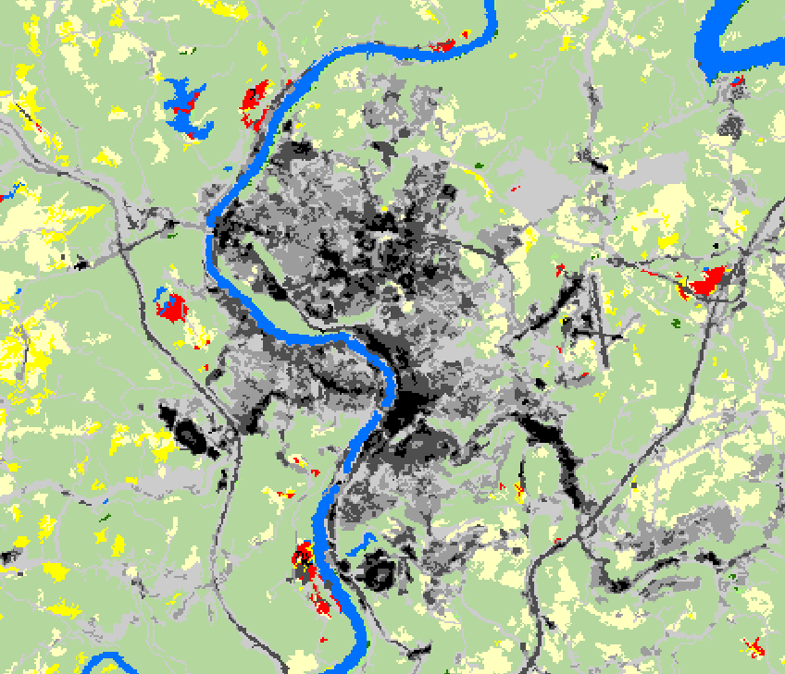
Geospatial data
Two data models
Vector Data
Discrete
Points, lines, and polygons
Raster Data
Space filling
Cell- or pixel-based
Vertex
Node
Vector and raster graphics
Notes:
Two broad types of geospatial data are available: vector data and raster data.
Vector data generally represent discrete features as points, lines, or polygons.
Raster data generally represent continuous features as pixels or grid cells.
We will begin with a discussion of vector data.

Slide 5
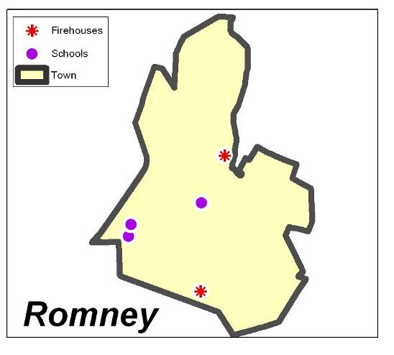
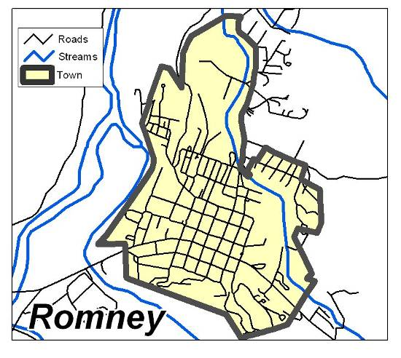
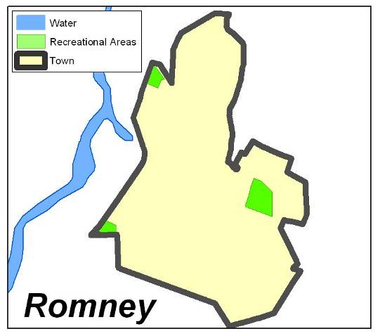
Vector Data
X,Y
X,Y
X,Y
X,Y
X,Y
X,Y
Points
Lines
Polygons
X,Y
X,Y
X,Y
Coordinate locations, Zero-dimensional
One-dimensional,
Length, No width
Two-dimensional,
Length and width, An area
Examples by Dr. Mike and Dr. Jackie Strager
Notes:
Vector data can be represented as points, lines, or polygons.
Point data are simply coordinate pairs with associated attributes. They have no spatial dimensions, since they do not have length or width.
Lines are a series of coordinate pairs connected to form a line. They have one spatial dimension, since they have length but not width.
Polygons are a series of coordinates in which the first and last coordinates are connected to form a closed feature or area. They have both length and width, so have two spatial dimensions. Since they have length and width, they have an area.

Slide 6
Vector Data
Vector Data Structure
Vector data are made up of connected vertices.
End vertices are called nodes.
Vertices can be connected as lines and polygons.
Vector data are made up of coordinate points.
Vertex
Node
Notes:
As mentioned above, all vector data are made up of coordinates. Points are individual coordinates while lines and polygons are made up of interrelated coordinates.
These individual coordinates are called vertices. Vertices that occur at or define the end of a line segment are called nodes.
Again, all vector data are made up of coordinate points.

Slide 7
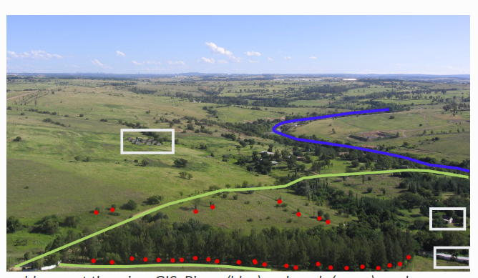
representation

Slide 8
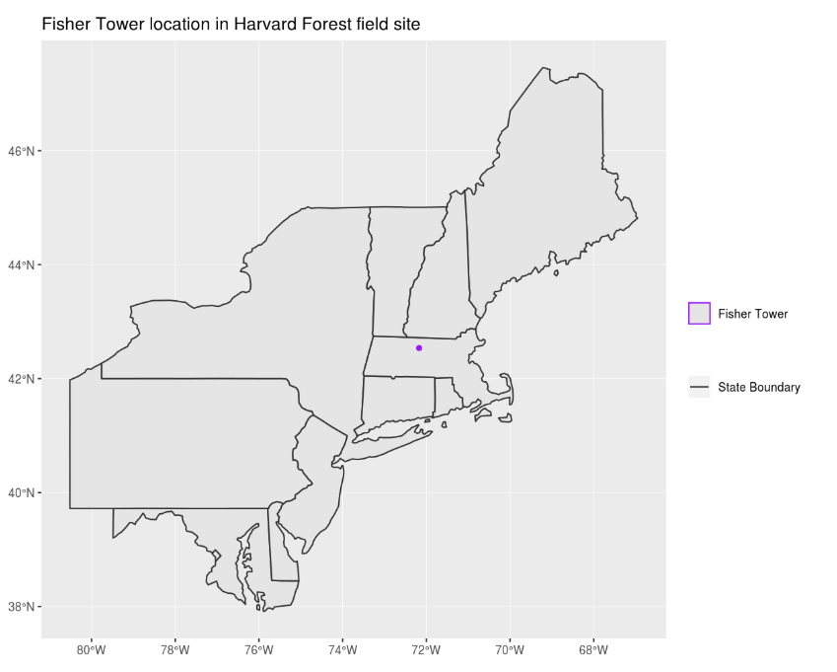
representation
🤔
Identify which features are represented by which vector type.

Slide 9
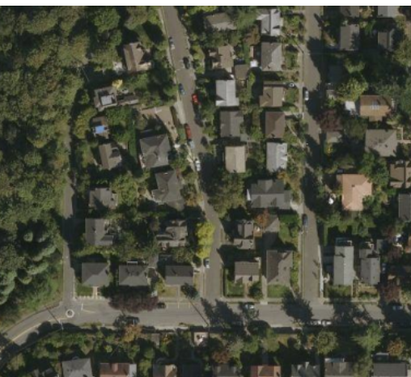

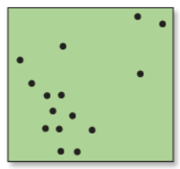
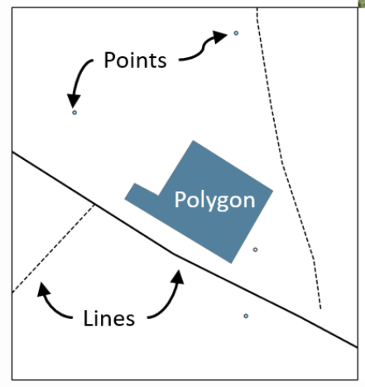
Same Feature, Different Vector Representations
If the same feature (like a house) is represented as a point vs. a polygon, what types of analysis can we do in each case?
🤔
Point
Polygon

Slide 10
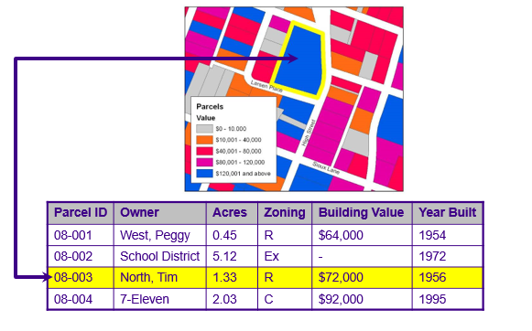
Vector Data
All types can store attribute information
Examples by Dr. Mike and Dr. Jackie Strager
Notes:
One powerful aspect of a GIS and geospatial data is the ability to relate spatial and tabulated data. Vector data are not just map coordinates. These features are also associated with tabulated information. For example, the parcels boundaries shown on this slide are attributed with a set of information. This allows us to relate spatial and tabulated data.

Slide 11
Rows and Columns in an Attribute Table
Row = one record = one feature
Example: Parcel 08-003 (North, Tim) is one row in the table and one polygon on the map.
Each field (a column describing one property of all features) is represented by a column in the table.
Field = one type of information for all features
Example fields: Parcel ID, Owner

Slide 12
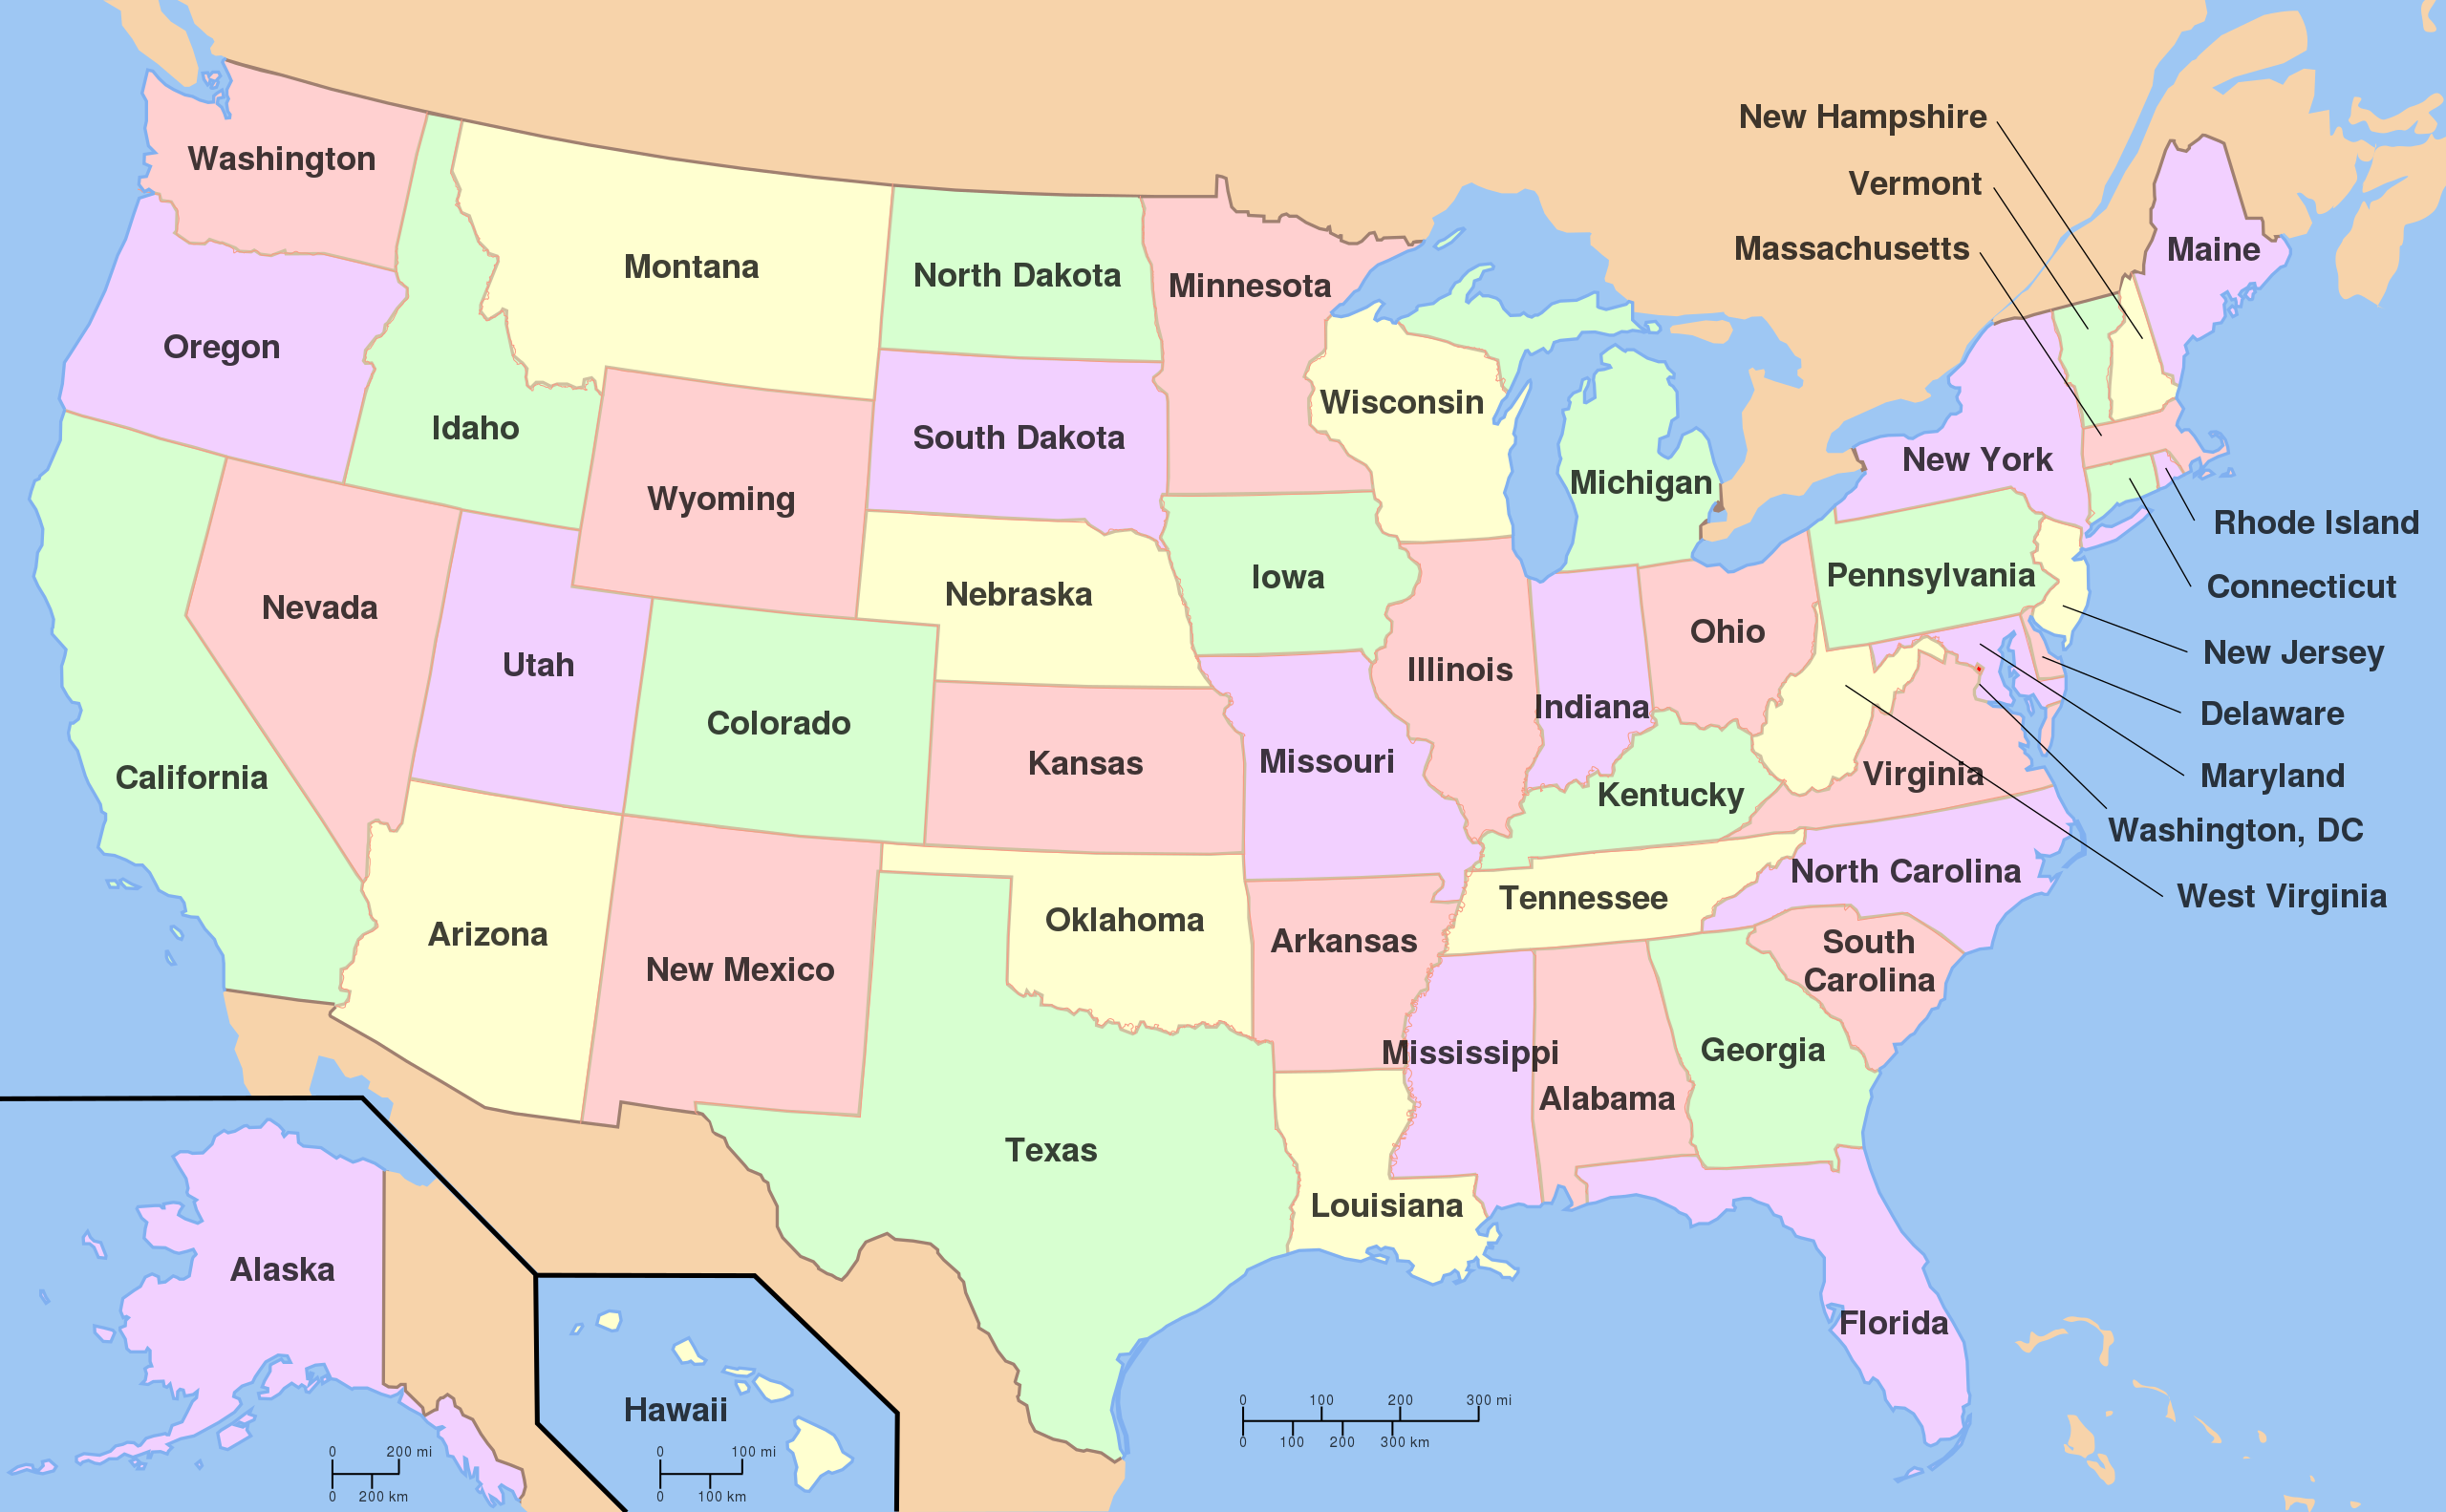
Vector Data
Topology
Study of properties of geometric objects that remain invariant under certain transformations such as bending or stretching (Massey 1967)
Spatial relationship between map features.
Examples:
Adjacent to
https://en.wikipedia.org/wiki/File:Map_of_USA_with_state_names.svg
Notes:
An important concept associated with vector data is the concept of topology. This is not to be confused with topography.
Topology is the study of properties of geometric objects, including map features, that remain invariant, or don’t change, under certain transformations such as bending or stretching.
Example topological relationships include adjacent to and incident with. For example, if the US state boundaries could be bent or stretched, the adjacently between states would be maintained. Or, adjacent states would still be next to each other and share boundaries. If map features were bent or stretched, features that occur within or are incident with other features would maintain this relationship with those other features. For example, cities would still fall within the correct state or country.
Arkansas and mississippi
A good example of topology is a subway map. On this slide, I have included the subway map for the city of Vancouver in British Columbia. The subway lines and other map features have been generalized such that the full complexity is not represented. However, important topological relationships have been maintained. For example, you know which stops occur along or are incident with which lines. You also know where different lines cross, or where you can transfer between lines. So, even though these data have been generalized, important topological rules have been maintained so that you can use the map to navigate the subway system.
Topology is important because it allows us to solve problems that require an understanding of the spatial relationship between map features.

Slide 13
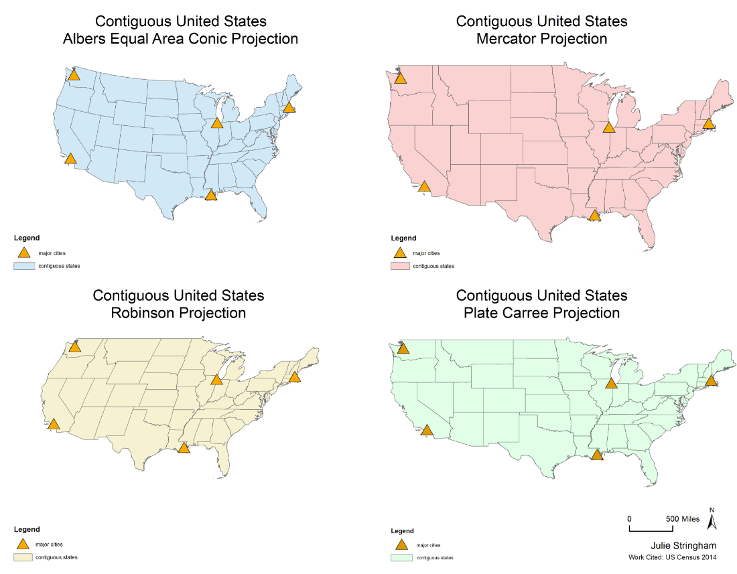
Topology Remains the Same Across Projections
🤔
If I want to know which states border Arkansas, does projection matter

Slide 14
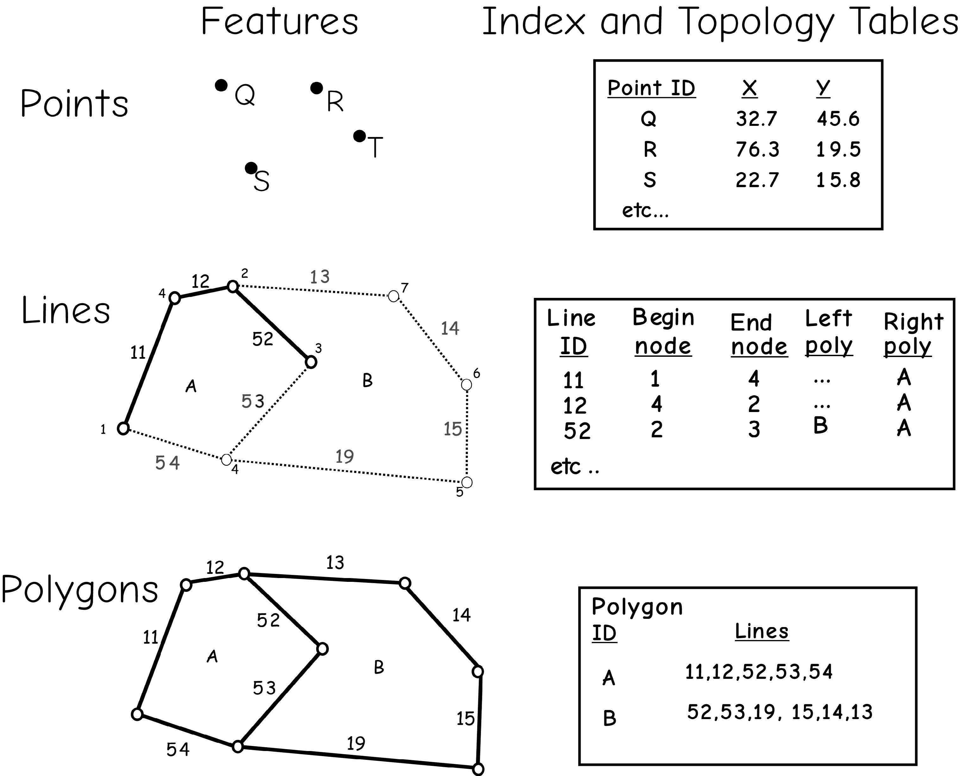
Vector Data
Topology
Often use codes and tables to record topology
Information on the adjacency (which polygons are next to which), connectivity (which lines connect to which), and other spatial relationships could be stored
Bolstad, 2019

Slide 15
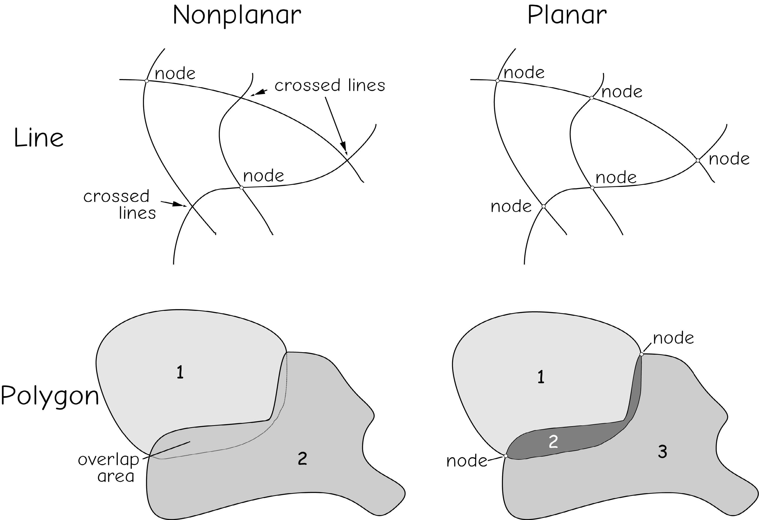
Vector Data
Topological models
Planar topology: requires that all features occur on a two-dimensional surface.
Lines may not cross over or under other lines
At each lines crossing there must be an intersection
Recommended
Nonplanar topology
Bolstad, 2019

Slide 16
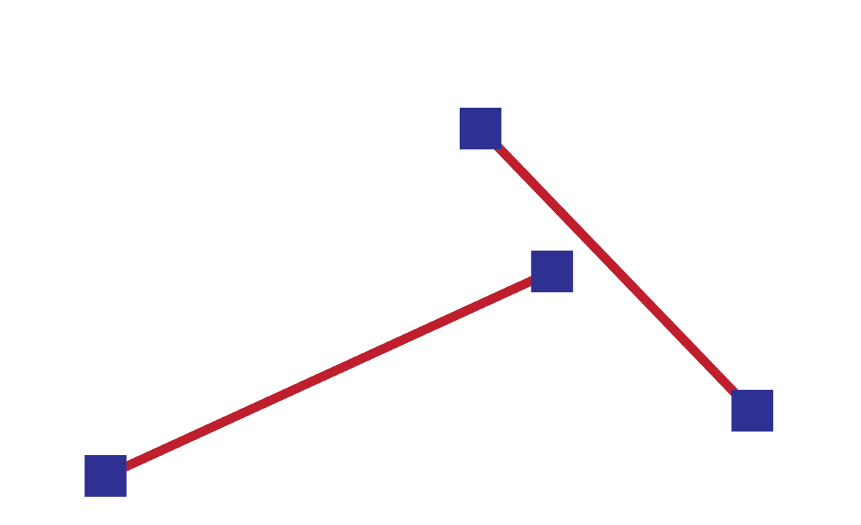
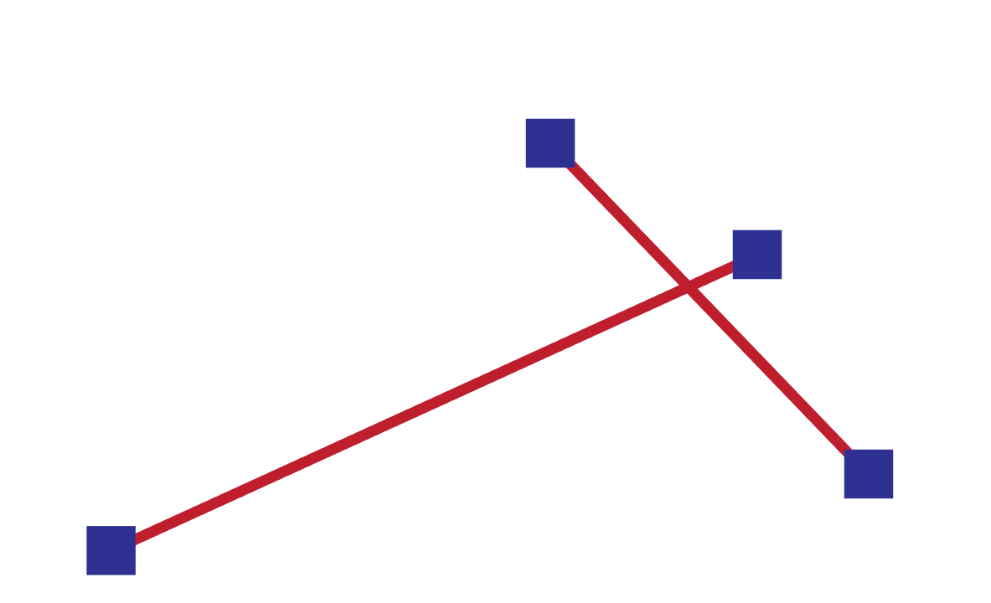
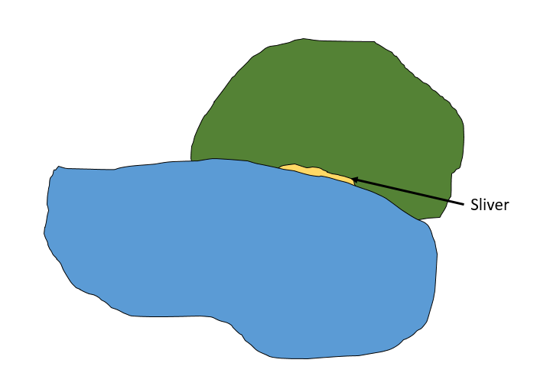
Vector Data
Topological issues
Dangles: two line features are supposed to connect, but not
Overshoots: one line segment is supposed to end but not
undershoots
Slivers: areas of non-overlap due to digitization error
Notes:
When creating new data, issues can arise that cause topological relationships to not be maintained.
Dangles occur when 2 line features are supposed to connect, such as at a road intersection, but they fall short. If you were trying to model movement along a road network, this would be an issue.
Overshoots occur when one line segment is supposed to end when it intersects another segment, but it continues or overshoots.
Slivers represent areas of non-overlap between features that could represent real patterns or result for digitization errors or scale difference in the input data.

Slide 17
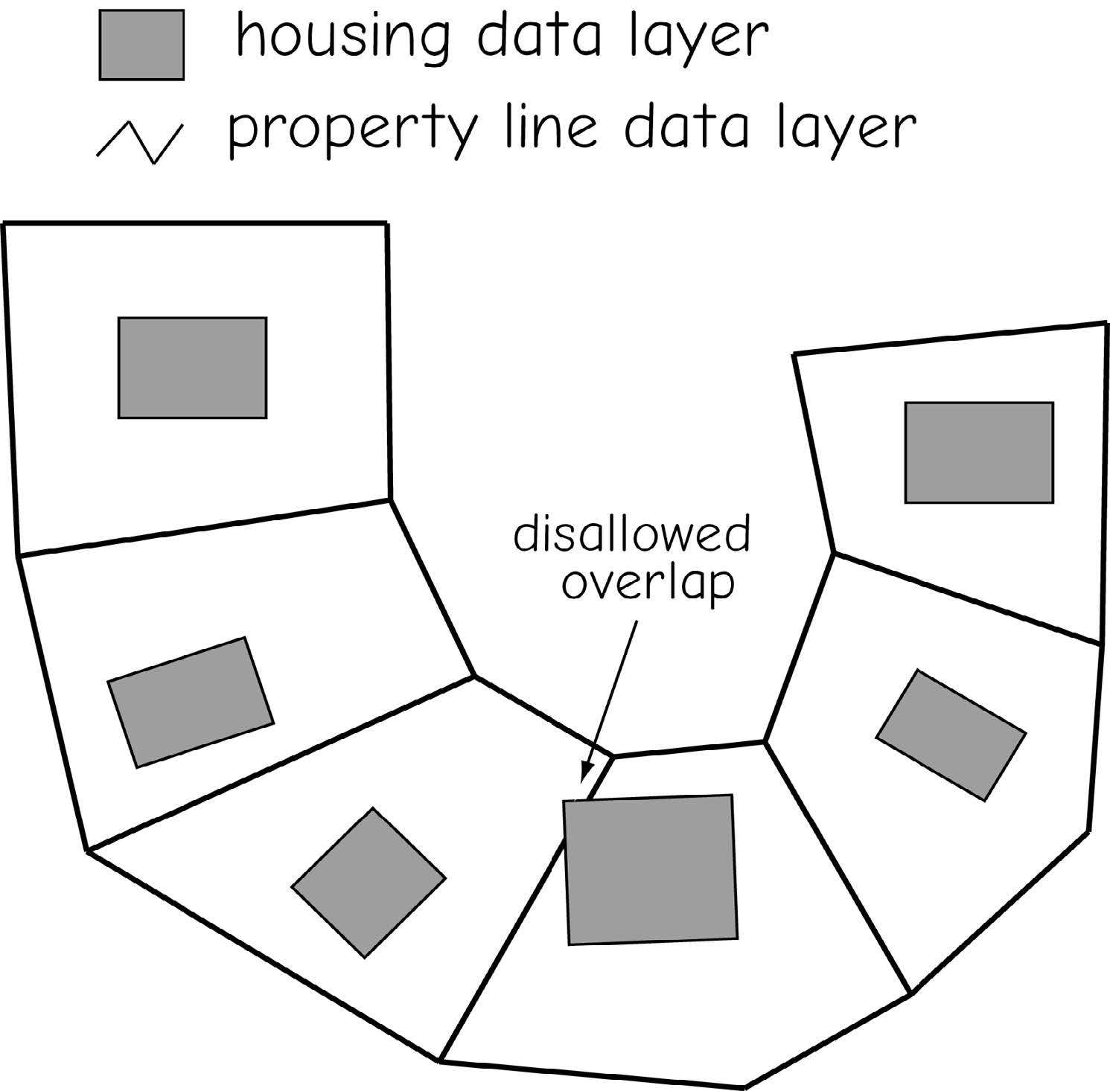
Vector Data
Topological issues
Between different layers
Topological rules and constraints may be enforced, both within and between layers!
Bolstad, 2019

Slide 18
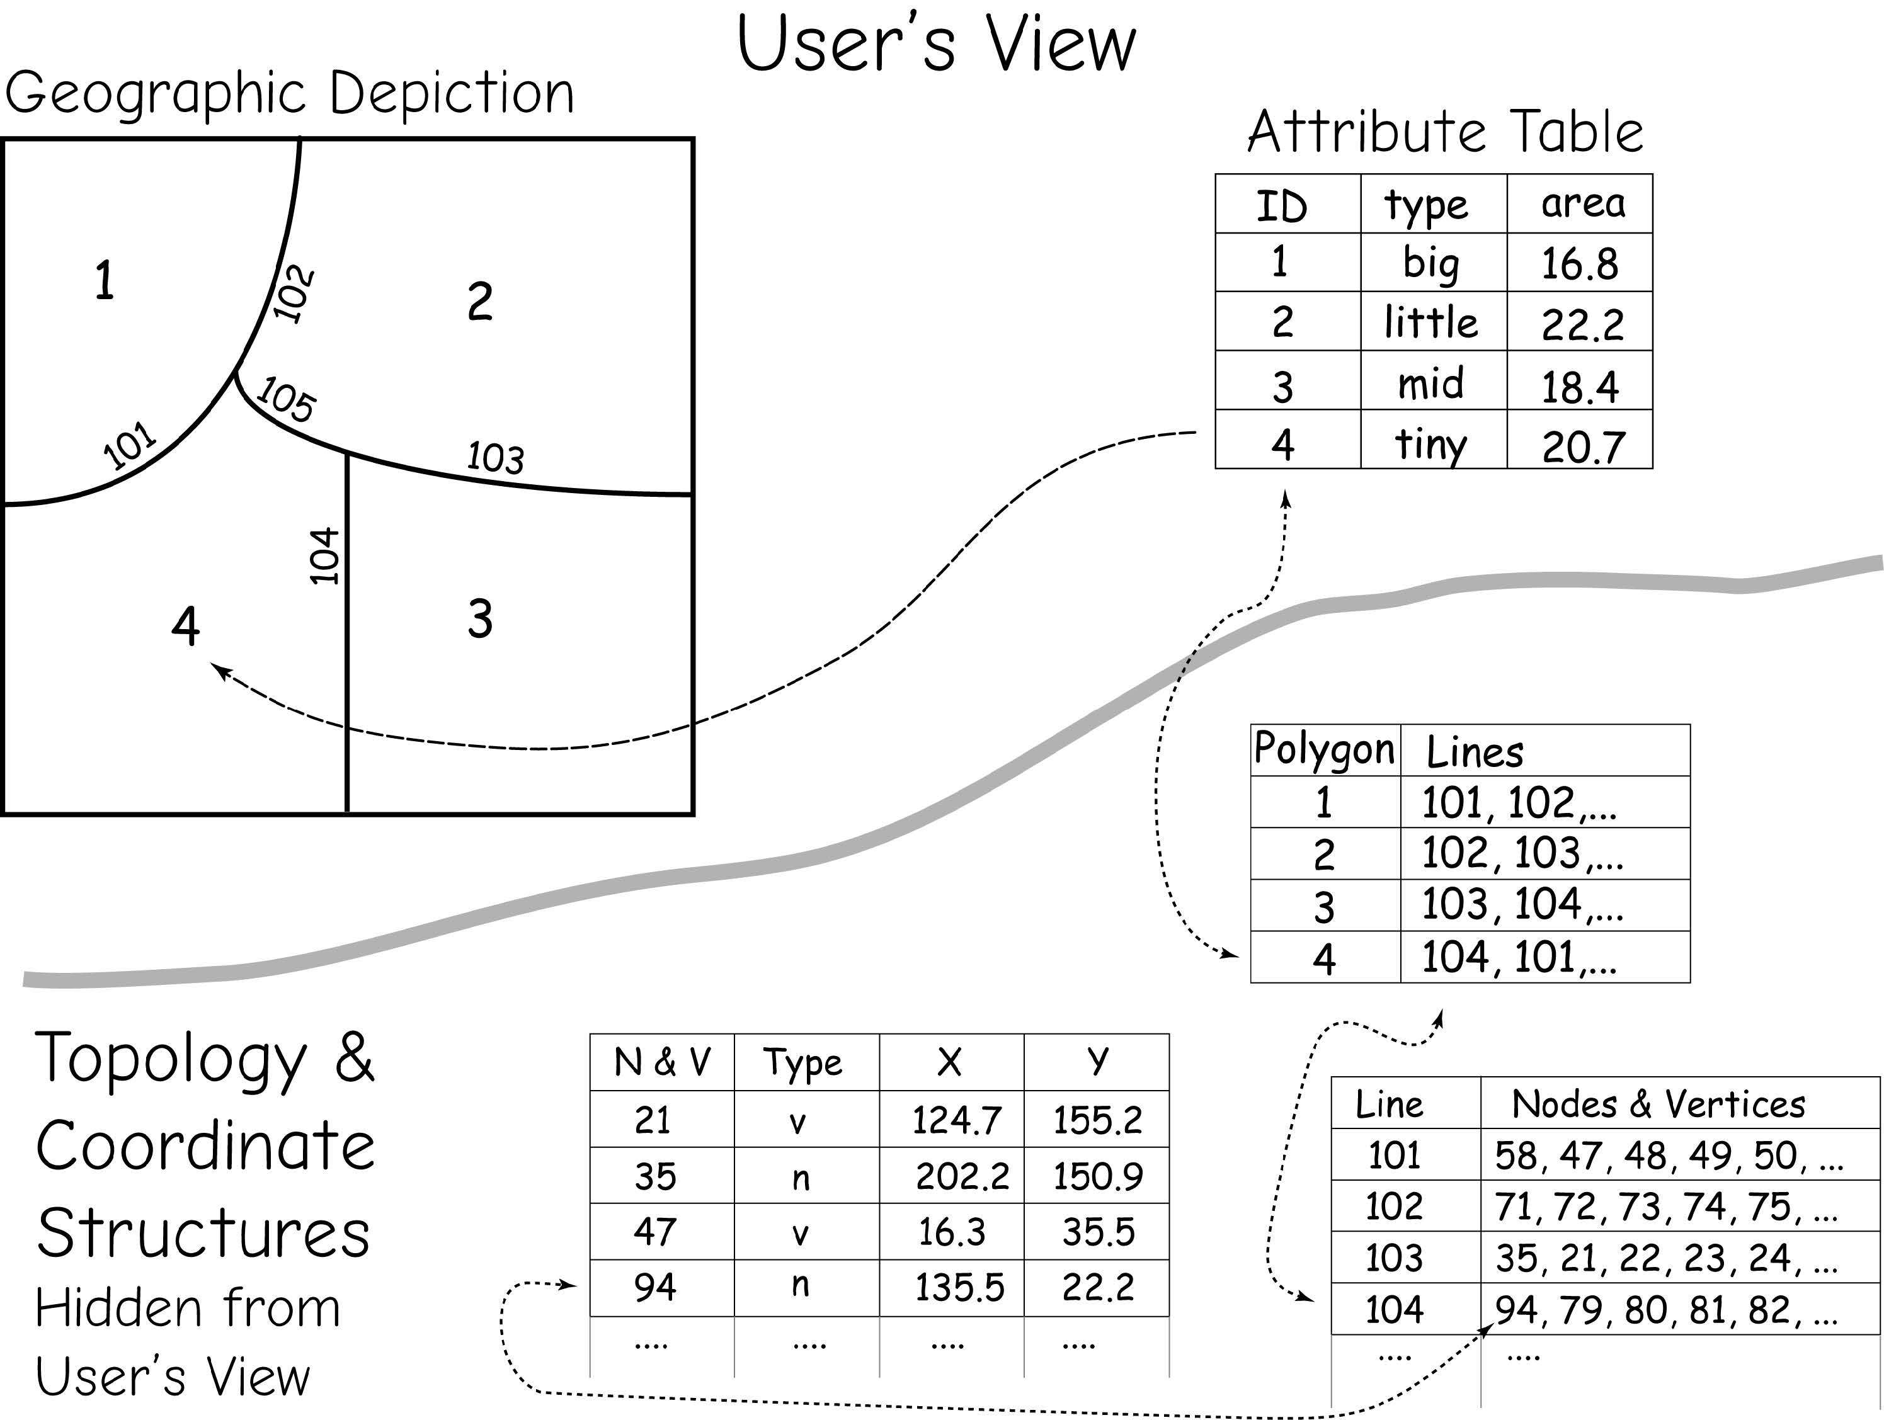
Vector Data
Topology
Topology and coordinate data are often hidden from the user, but linked to the attribute and geographic features through pointers and index variables.
Bolstad, 2019

Slide 19
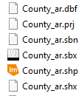
Vector Data
The Shapefile
Nontopological
No file describe the spatial relationships among geographic objects
Although this is a nontopological model, topological relationships can be calculated on-the-fly to perform analyses
Components (Three mandatory files)
.shp = geometry data
.prj = spatial reference/projection information
.dbf = attribute table/aspatial data
.shx = index file for geometry (helps with speed)
.sbn and .sbx = index file for the attributes (speed of queries)
.xml = metadata
Notes:
The shapefile is a georelational model that is still commonly used. It was originally developed by ESRI but is non-proprietary.
It is a nontopological model. Generally, nontopological data can display more rapidly on a computer than topological data. They can also be used across multiple software packages.
Although this is a nontopological model, topological relationships can be calculated on-the-fly to perform analyses.
The geometric information is stored in the .shp file while the .shx file provides an index of the geometry, which can speed up searching and display.
The attributed or tabulated data are stored in the .dbf file. This is why this is georelational model: geometry and attributes are stored in separate files. The .sbn and .sbx components provide indices for the attributes, which can speed of queries.
The projection information is stored in the .prj file. This component is important because it tells the computer what the projection is so that the data can be drawn at the correct location in the map space.
If metadata are created, this additional information can be stored in the .xml component.
cpg are optional plain text files that describes the encoding applied to create the shapefile. If your shapefile doesn't have a cpg file, then it has the system default encoding.

Slide 20
Class Activity: Exploring Shapefile Components
Open the folder containing your shapefile.
Identify the components
Reminder:
A shapefile is not just one file.
If you want to share data, you must copy ALL shapefile components together, not just the .shp file.

Slide 21
Quick Way to Check Attributes in a Shapefile (.dbf file)
Locate the .dbf file in your shapefile folder (e.g., Historical_features.dbf).
Open Excel, go to File → Open → Browse, then select the .dbf file.
The attribute table will appear as a spreadsheet:
Each row = one feature
Each column (field) = one type of data (ID, name, area, etc.).
You can now quickly check the attribute values without opening GIS software.
⚠️
Do not edit and save the .dbf in Excel (it can corrupt the shapefile).
Only use it for a quick look at the data.

Slide 22
Vector Data
Polygon inclusions and boundary generalization
Polygon inclusions: areas in a polygon that are different from the rest of the polygon, but still part of it
Boundary generalization: incomplete representation of boundary locations
Bolstad, 2019

Slide 23
Class Activity: Representing Indoor Features in GIS
Divide into three groups.
Each group discusses which indoor features are best represented by:
Points
Lines
Polygons
After 5 minutes, share your answers with the class.

Slide 24

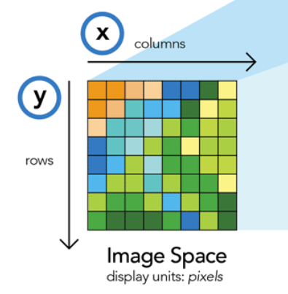

Raster Data
Array of cells or pixels
Origin is generally as the coordinate of the upper-left corner of the grid extent
pixels
Notes:
We will now move on to discuss raster data.
In contrast to vector data, raster data have a simple data structure.
Raster data are a matrix or array of values stored in cells.
This matrix or array is spatially referenced so that each cell has a defined extent on the landscape.
The origin is generally defined as the coordinate of the upper-left corner of the grid extent.
So, if the origin, projection, cell size, and number of rows and columns is known, then the data can be rendered to a map space.
The raster data model can be used to store a variety of data types, including categorical data, continuous variables, and multiband imagery.

Slide 25
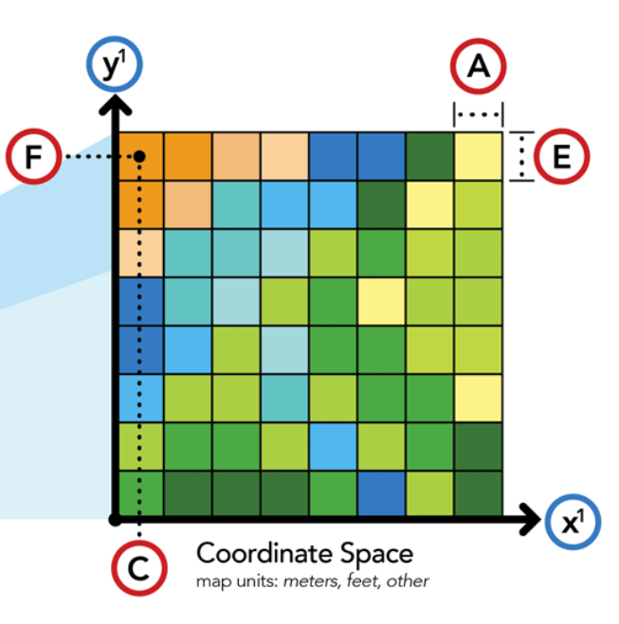
Raster Data
Coordinates for each pixel

Slide 26
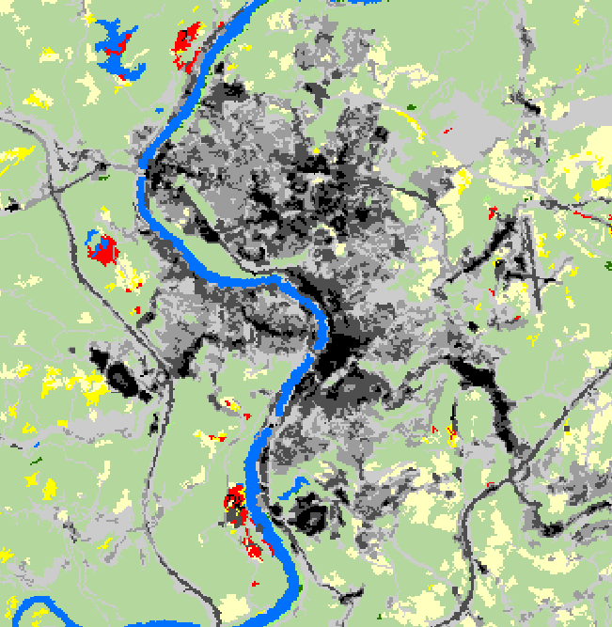
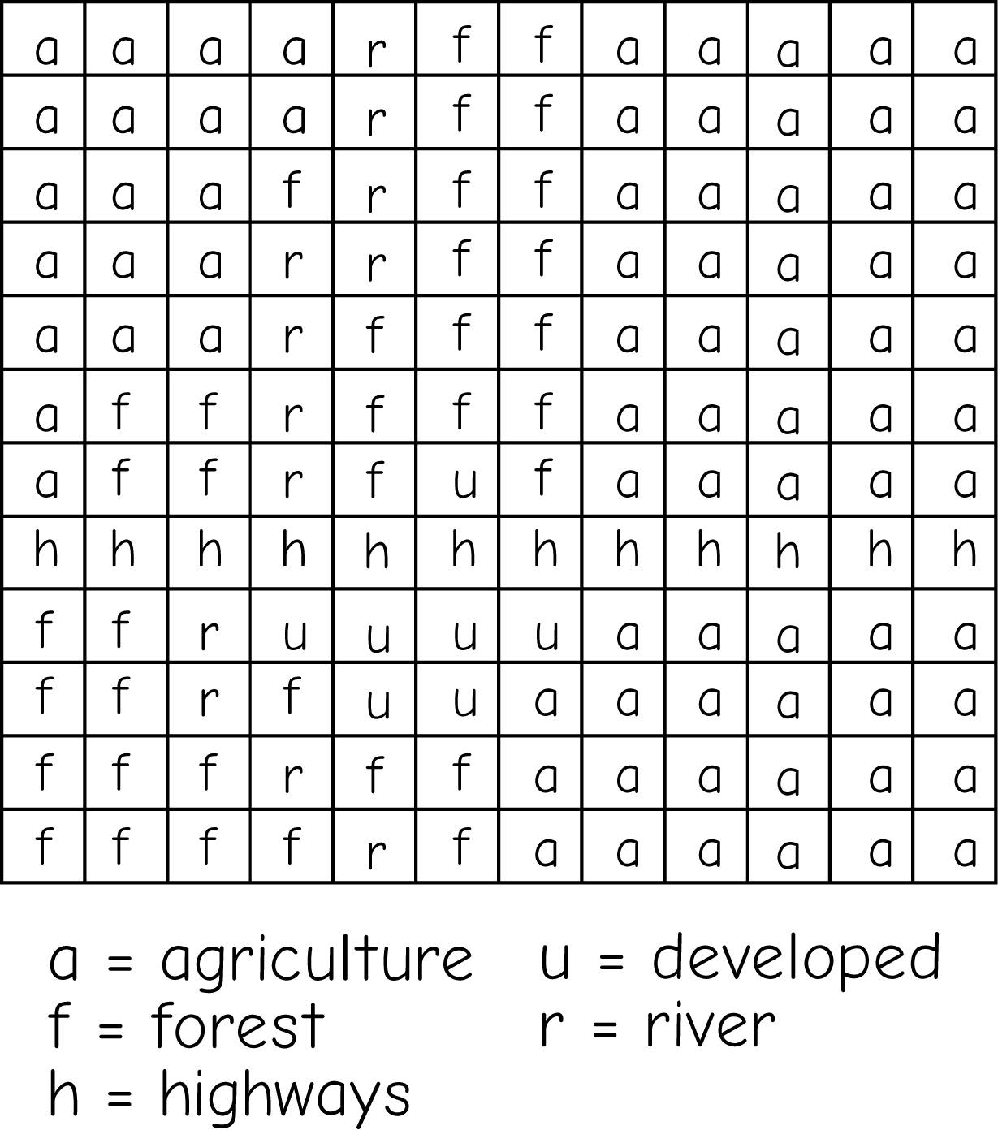
Raster Data
Categorical
Cells hold a value
Value is a place holder for a category (nominal data)
Commonly has attribute table
Value = 42
Bolstad, 2019
Notes:
Categorical raster grids represent nominal or categorical data.
Examples of data that could be appropriately modeled as categorical grids include land cover, vegetation types, wetland types, soil types, and land ownership.
Each cell in a categorical grid will hold a number. This number will be a stand in or placeholder for a category. For example, the value 41 could represent deciduous forest.
Categorical grids generally have attribute tables. This attribute table can have many fields, but it generally has at least a value field which provides the code that represents the category of interest. It also contains a count field that provides the number of cells in that category.
It is possible to provide additional fields, for example you could include a name field to provide the category name.

Slide 27
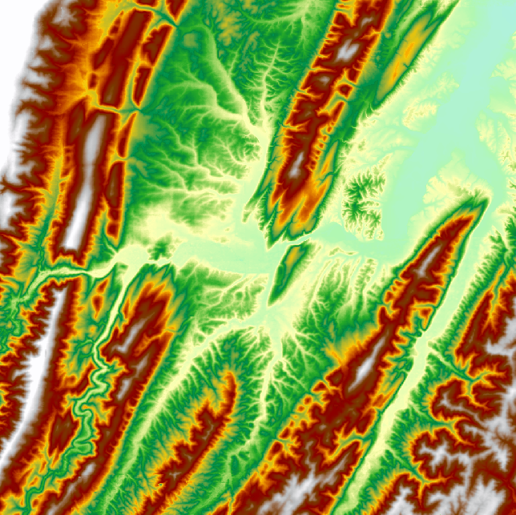
Raster Data
Continuous
Cells hold a value
Value is a true quantity (numeric data), not a place holder
Value = 896 m
Notes:
A continuous raster grid is used to represent continuous data, including interval and ratio type data.
The value stored in the cell represents the actual measure. It is not a placeholder for a category.
Examples of data that could be appropriately modeled using a continuous raster grid are elevation, topographic slope, topographic aspect, depth to bedrock, depth to water table, precipitation, temperature, and barometric pressure.
The example provided represents elevation measurements. So, each cell holds an elevation measurement.

Slide 28
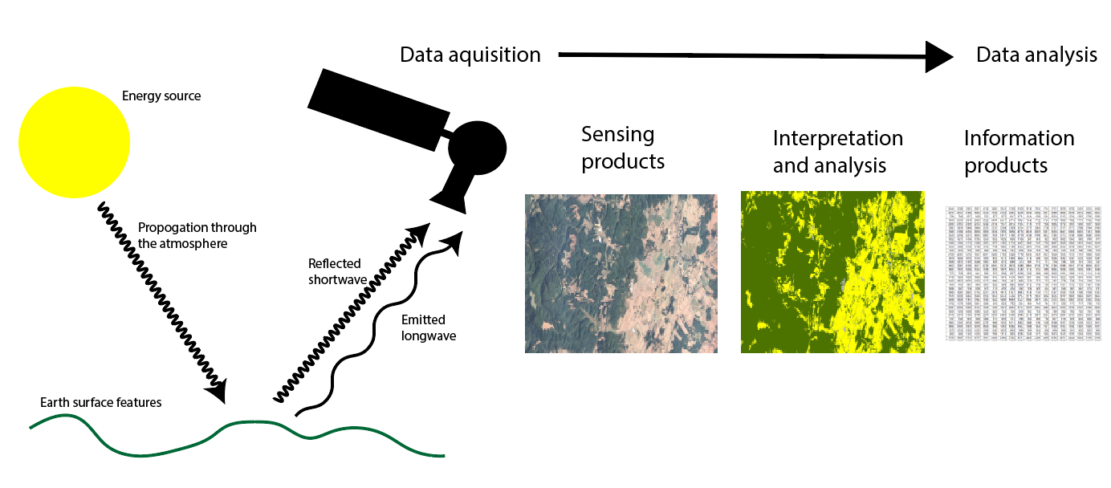
Raster Data
Remote sensing imagery
Value = 896 m
Notes:
Other than panchromatic, or black-and-white, imagery, image datasets contain more than one band.
For example, a true color image will contain three bands: red, green, and blue.
For multiband images, the raster data structure is that of an array. Each cell location holds multiple measurements, or a single measurement in each band.
You can think of a multiband raster as a stack of single band layers that act as one file.
Although we will focus on multiband imagery here, you can actually create multiband raster grids from a variety of raster data layers.

Slide 29
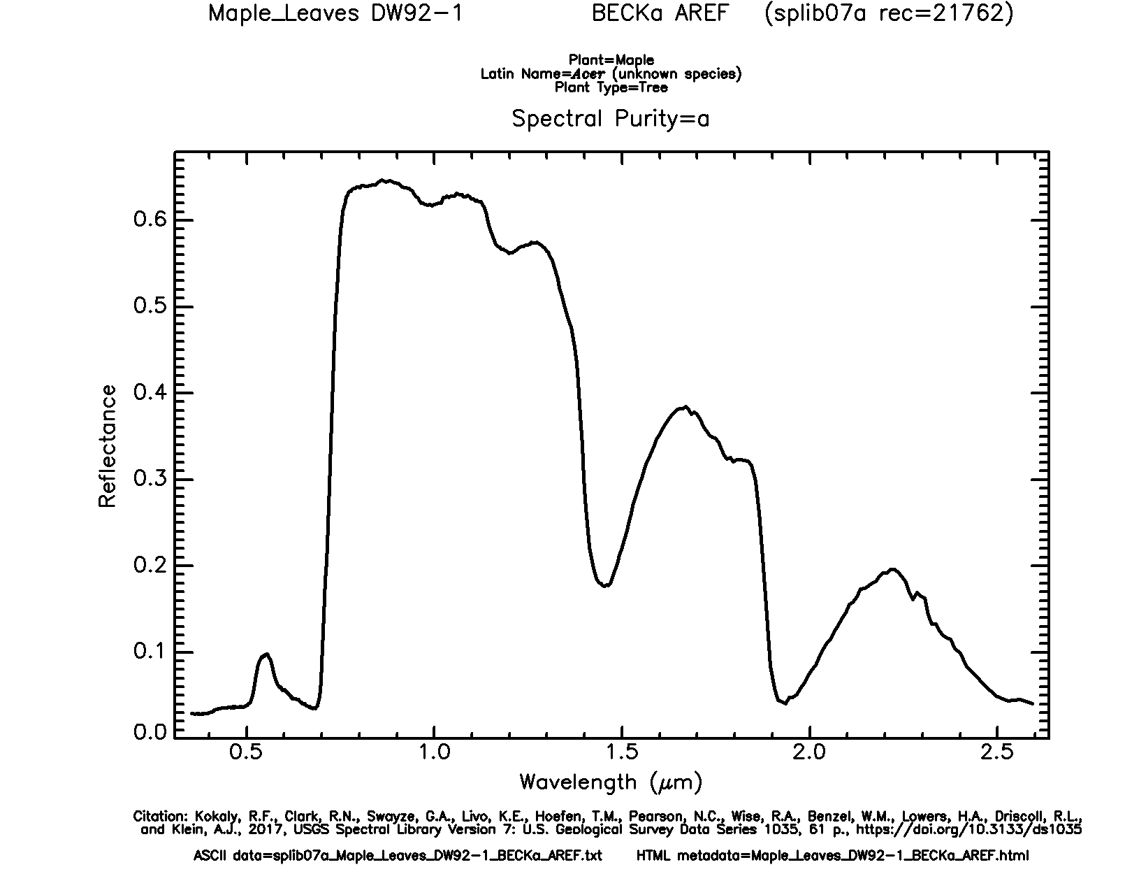
Spectral Reflectance of Vegetation
Blue = absorption by pigments
Green = less absorption by pigment
Red = absorption by pigments
Near Infrared = reflect and
scattered by interior cell walls
Shortwave Infrared = absorption by water in plant tissue
X
X
X
X
X
X
Example: Maple Leaf
Data from USGS Spectral Library Version 7
Notes:
Let’s explore the spectral reflectance of this maple leaf further.
Here, I have color coded different spectral ranges with different color “Xs.”
This leaf tends to absorb as opposed to reflect a lot of visible radiation. However, it absorbs more blue and red in comparison to green. This is why leaves appear green to us. This absorption results from the pigments in the leaf, such as chlorophyll, that interact with Sunlight in the process of photosynthesis to make energy and sugars for the plant. During the winter, when the tree is not photosynthetically active, the leaf will no longer appear green to us.
Green, healthy, and photosynthetically active leaves tend to scatter or reflect a larger proportion of incident near infrared radiation than visible light due to how this radiation interacts with cell walls. So, if we could sense near infrared radiation, a leaf would appear to be near infrared as opposed to green. However, this has no physical meaning since we can’t see near infrared radiation.
In the shortwave infrared range there are some absorption features associated with water in the plant tissue.
This graph highlights the wavelength specific nature of spectral reflectance.

Slide 30
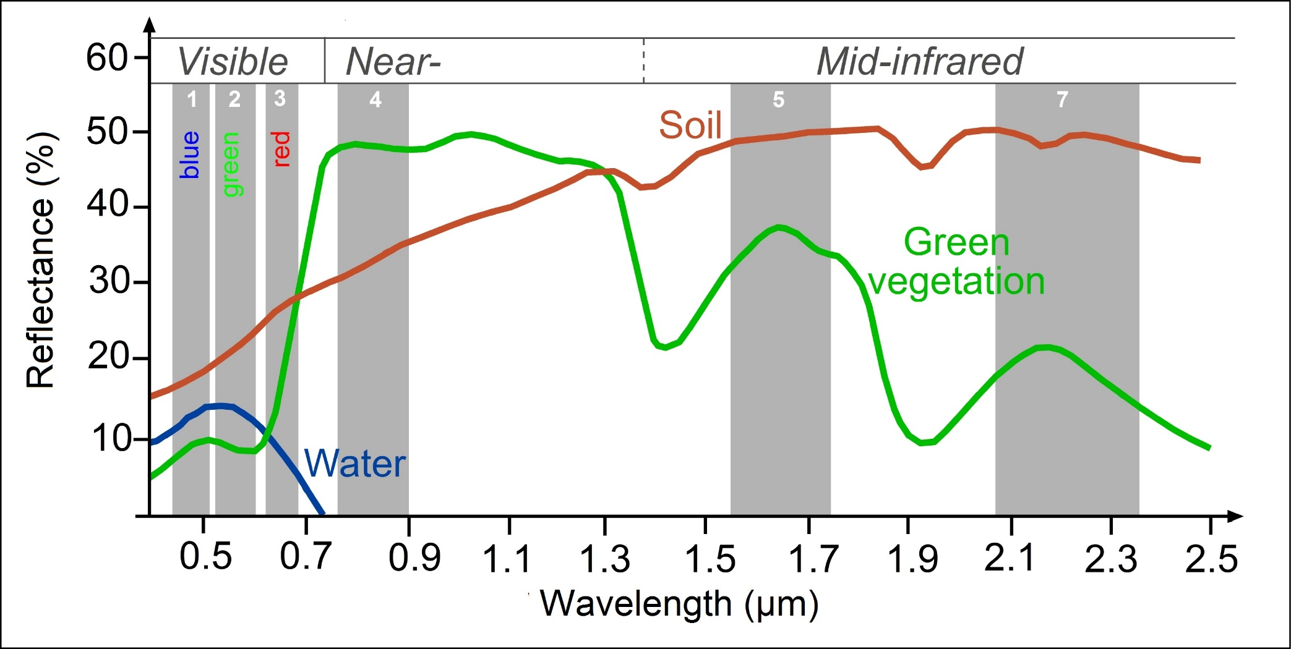
Different materials have different reflectance properties
http://www.seos-project.eu/modules/classification/classification-c01-p05.html
Notes:
This graph provides another comparison.
Soil tends to show greater spectral reflectance in the shortwave infrared range in comparison to near infrared or visible wavelengths, a pattern that is much different from green vegetation.
Water tends to absorb most near infrared and shortwave infrared radiation.
So, using these patterns, we could potentially differentiate these different surface materials.
You may notice some small troughs in the shortwave range for soil that align with the deeper troughs for green vegetation. This results from water in the soil, just as the troughs in the green vegetation curve relate to water in the plant tissue.

Slide 31
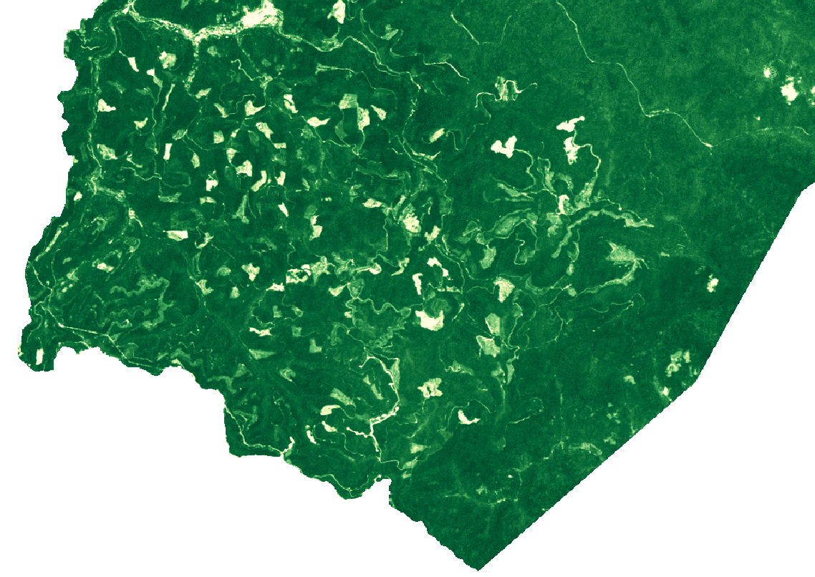
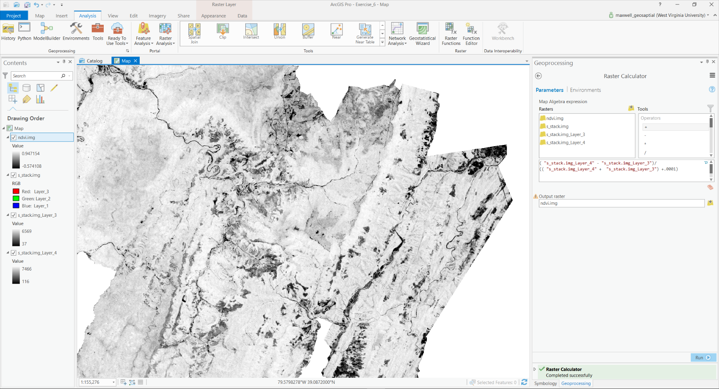

Normalized Difference Vegetation Index (NDVI)
$$\frac{(NIR −Red)}{(NIR+Red)}$$
Data from Landsat 5 Thematic Mapper
Notes:
It is often valuable to compare the spectral reflectance in different wavelength ranges or bands.
To accomplished this task, we can produce ratios from input bands.
As an example, the normalized difference vegetation index, or NDVI, compares near infrared and red reflectance.
Based on our previous discussions, you now know that green, healthy, photosynthetically active vegetation tends to reflect more infrared radiation than it does red radiation. This is because pigments absorb the red radiation in the process of photosynthesis.
High values of this index indicate the presence of green, healthy, photosynthetically active vegetation where as low values indicate that vegetation is not present, it is not photosynthetically active, or it is not healthy for some reason.
As an example, the image on the left shows NDVI for a small area in West Virginia. Dark green areas indicate high NDVI or healthy vegetation. In contrast, the white or light green areas indicate lower NDVI. Many of these large patches of lower NDVI are associated with forest harvesting.
There are many other examples of band ratios that can be used to map, assess, or monitor different landscape features. Here, I am just providing NDVI as an example.

Slide 32
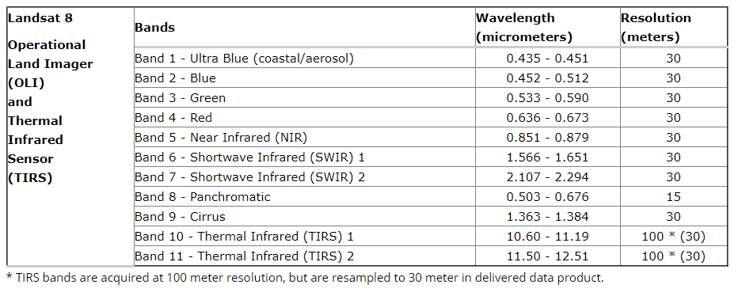
Imagery bands
https://landsat.usgs.gov/what-are-band-designations-landsat-satellites
Notes:
The most recent Landsat, Landsat 8, carries the Operational Land Imager and the Thermal Infrared Sensor.
In comparison to Landsat 7 ETM+, the Landsat 8 sensor adds a ultra blue band for coastal mapping and aerosol mapping and a cirrus cloud band for detecting high clouds and cloud contamination.
It also provides 2 thermal bands as opposed to one.
Landsat 9 will have similar specifications to Landsat 8 and is expected to launch in December of 2020.

Slide 33
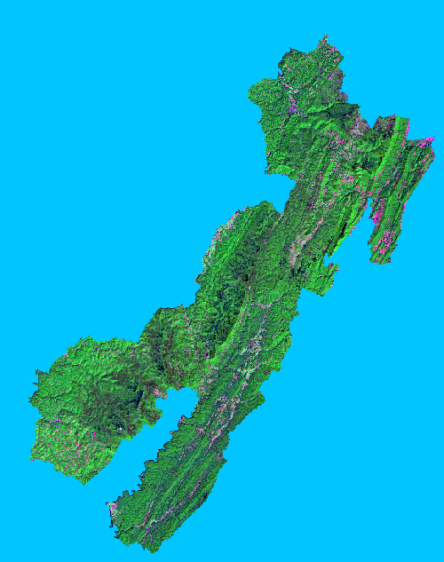
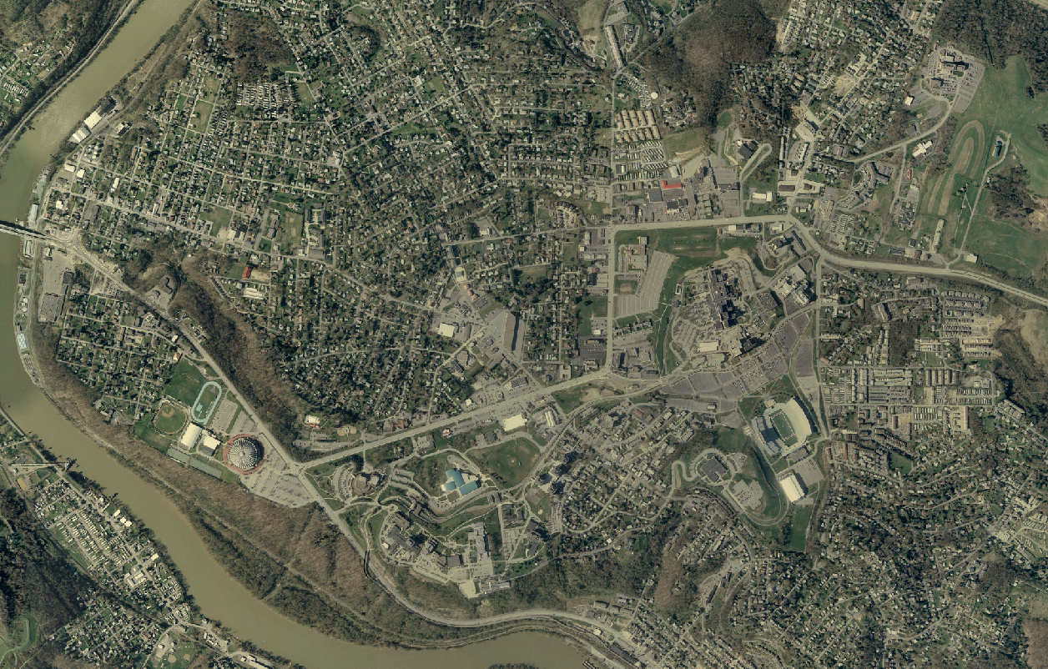

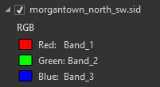
Raster Data
Remote sensing imagery
Multiple layers or bands that are stacked to produce an image
Value = 896 m
Notes:
Other than panchromatic, or black-and-white, imagery, image datasets contain more than one band.
For example, a true color image will contain three bands: red, green, and blue.
For multiband images, the raster data structure is that of an array. Each cell location holds multiple measurements, or a single measurement in each band.
You can think of a multiband raster as a stack of single band layers that act as one file.
Although we will focus on multiband imagery here, you can actually create multiband raster grids from a variety of raster data layers.

Slide 34
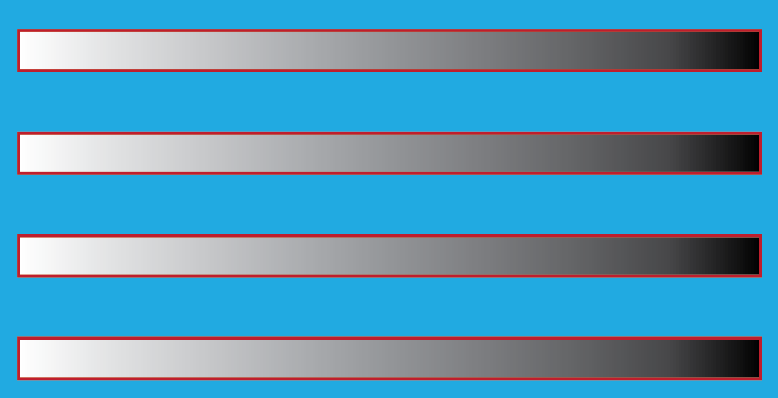
Raster Data
Radiometric Resolution
Pixel Type/Pixel Depth
4-bit = 2⁴ (16) unique values
8-bit = 2⁸ (256) unique values
16-bit = 2¹⁶ (65,536) unique values
32-bit = 2³² (4,294,967,296) unique values
1-bit, 2-bit, 11-bit, 12-bit, etc.
0
16
0
255
0
65,536
0
4,294,967,295
Can think of this as the degree of brightness difference that can be quantified
Notes:
Radiometric resolution has to do with what levels in brightness can be differentiated.
This relates to the pixel type or pixel depth of an image. For example, a 4-bit image would be able to differentiate 16, or 2 to the 4th power, discrete levels of brightness. In contrast an 8-bit image could differentiate 256, or 2 to the 8th power, discrete levels of brightness.
A 16-bit image could differentiate a large number of discrete brightness differences.
As an extreme case, a 1-bit image could only differentiate 2 to the 1st power, or 2, levels of brightness. So, the result would be black and white, or on and off.
You can think of this as the precision of the measurement. As an analogy, increasing radiometric resolution is like making length measurements to the nearest millimeter as oppose to the nearest meter. Or, you will be able to differentiate smaller differences in length.
Many older sensor recorded 8-bit data. However, modern sensors are increasingly providing 11-bit or 16-bit data. Again, this allows for more precise differentiation of brightness or spectral reflectance. The trade-off is larger file size and greater data volumes.

Slide 35
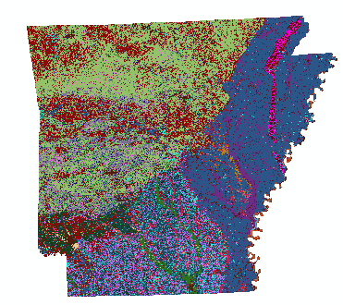
Raster Data
Raster data are always rectangular
No data cells still exist
Notes:
All grid cells are rectangular even if data are not provided in each cell.
This is because each row and column must have a full set of cells.
Grid cells that do not hold a measurement still exist, but they store a NoData assignment.
When the computer sees this value, it interprets it to mean empty, null, or missing.
For example, for an 8-bit raster grid either the lowest value, 0, or the highest value, 255, is commonly reserved as the NoData value.
In the example above, all cells within the state of Arkansas hold an elevation measurement. However, the full extent of the grid is rectangular.
So, the remaining cells, shown here in pink, are coded with the NoData assignment.

Slide 36
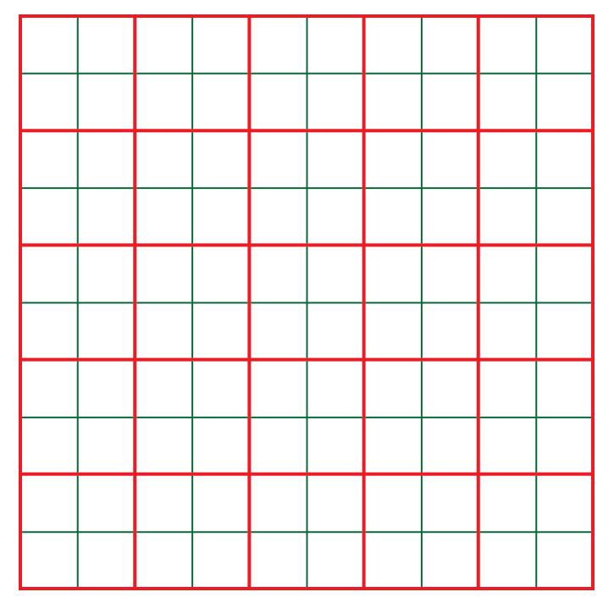
Raster Data
Cell size (spatial resolution)
Red: 100 mx100 m (lower resolution)
Green: 50 mx50 m (higher resolution)
Notes:
Reducing the cell size can have a large impact on the total number of cells and, as a result, the file size.
For example, in the image above the red grid represents cells that are 100 by 100 meters.
The green grid represents cells that are 50 by 50 meters.
Each 100 by 100 meter cell contains four as opposed to two 50 by 50 meters cells.
So, decreasing the cell size by half quadruples the number of pixels.
As another example, a 10 by 10 meter cell would contain 100 1 by 1 meter cells.
So, high spatial resolution raster grids can be very large files, especially if they cover a large spatial extent.

Slide 37
Raster Data
Raster File Formats
ESRI Grid
Erdas Imagine (.img)
GeoTIFF (.tif)
Notes:
There are a variety of raster grid formats. However, I commonly use ESRI grids, Erdas Imagine, or GeoTIFF files.

Slide 38
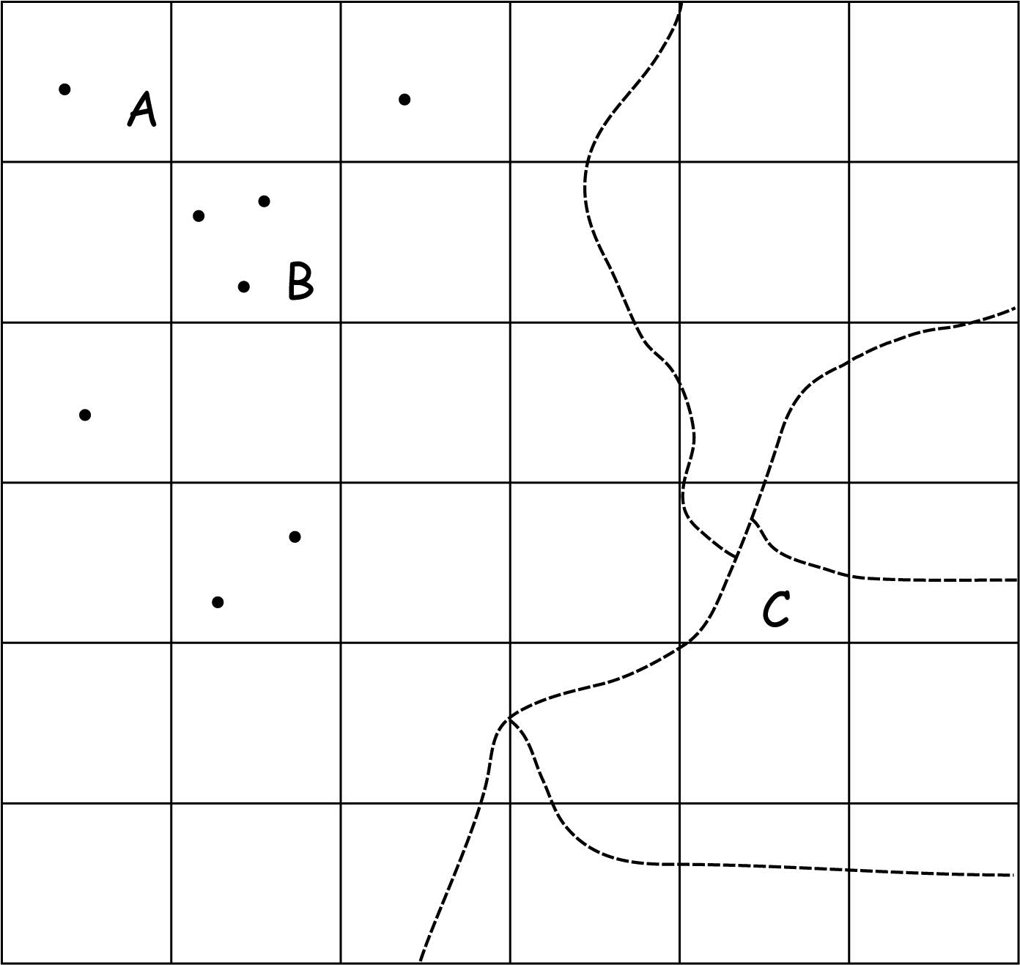
Raster Data
Raster cell values assignment maybe complicated
When they are multiple features within a single cell
Select a representative feature, and use the attribute from that feature
Reduce the cell size to include only one feature in each cell
Bolstad, 2019

Slide 39
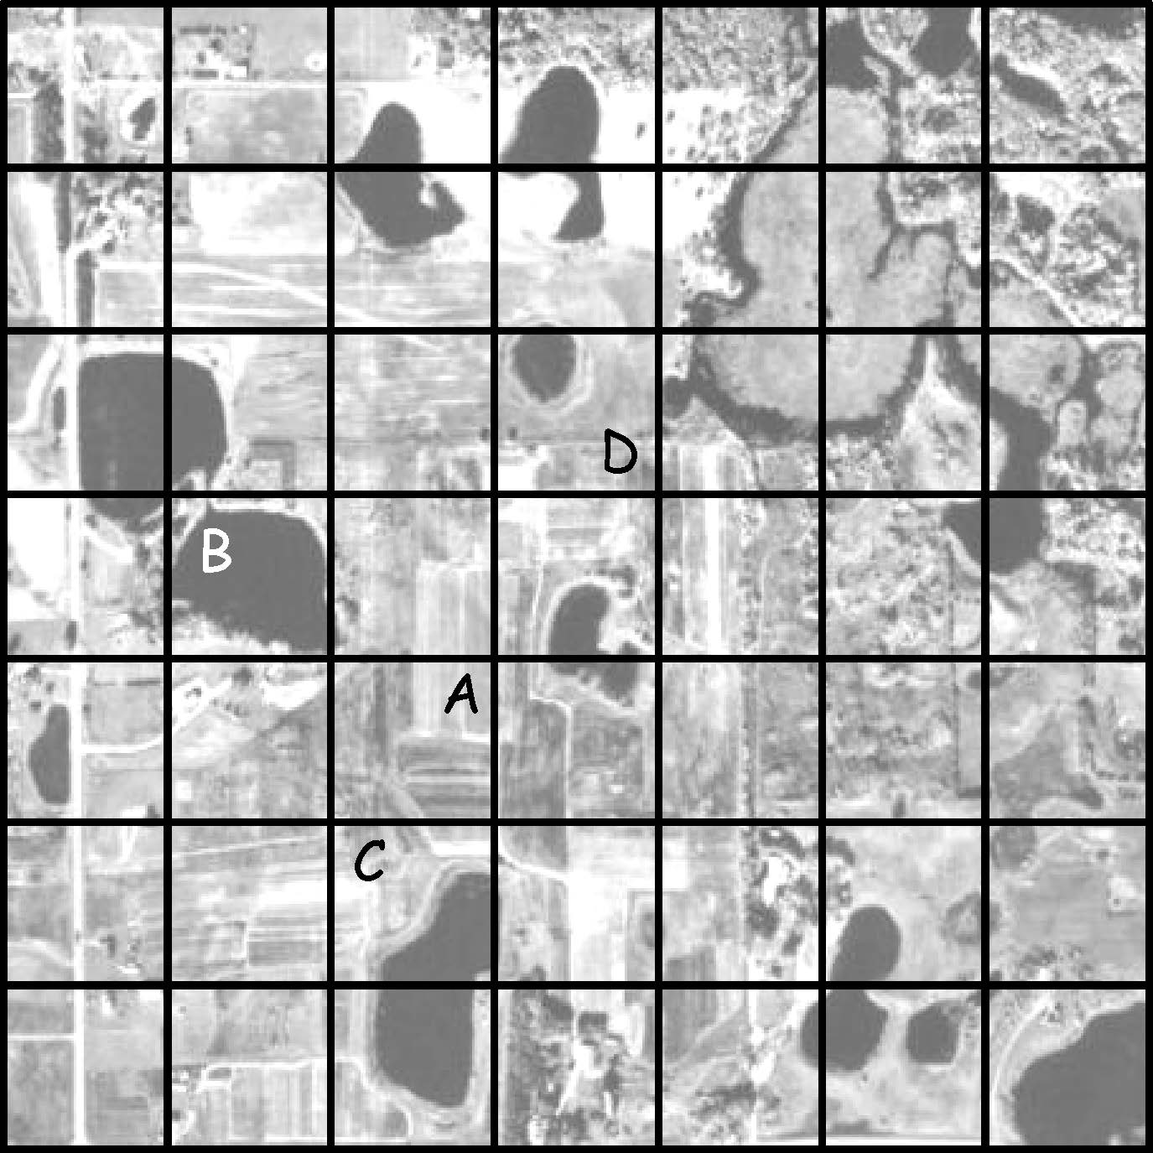
Raster Data
Raster cell values assignment maybe complicated
When they are multiple features within a single cell
Winner-take-all or majority
User’s preference
Bolstad, 2019

Slide 40
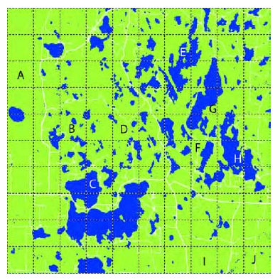
Group Activity 3-1
Discuss with your peers:
List the labels (A, B, C…J) of raster cells that would be assigned as water (dark blue) or land (light green) under a majority coverage rule (i.e., winner-take-all) and User’s preference (i.e., water)
Bolstad, 2019
Notes:
E,H,J

Slide 41
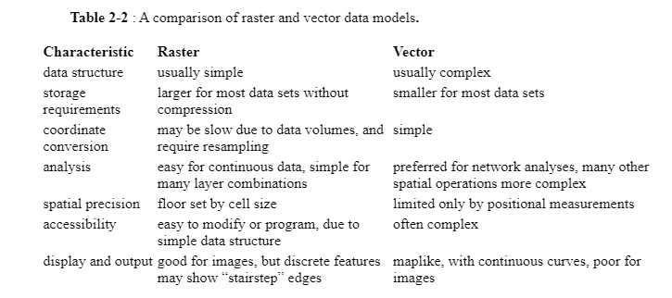
Vector and Raster Models Comparison
Bolstad, 2019

Slide 42
Vector and Raster Models Conversion
Vector to Raster
Assign a value to a cell if a vector line intersects with any part of the cell
Assign a value to a cell only when the cell center is near a vector line segment
Vector to Raster
Bolstad, 2019

Slide 43
Vector and Raster Models Conversion
Raster to Vector
Each vector point feature is usually assigned the coordinate of the corresponding cell center
Raster to Vector
Bolstad, 2019

Slide 44
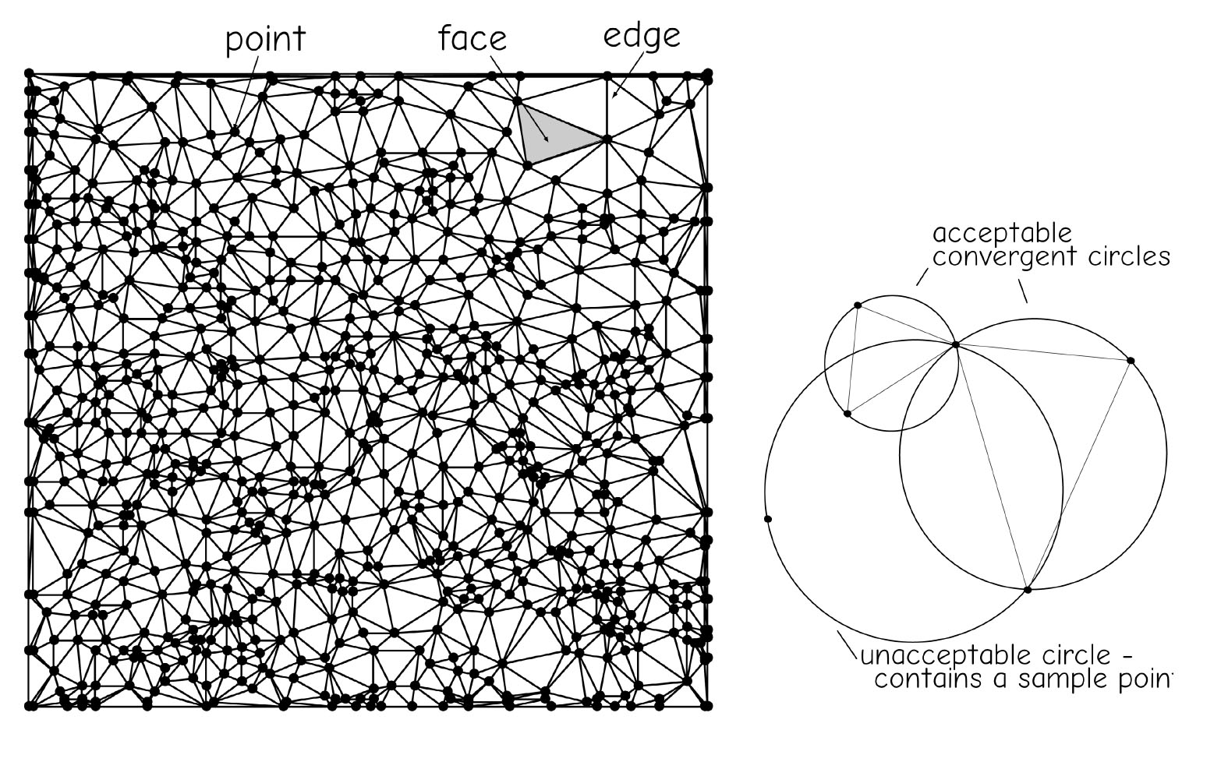
Triangulated Irregular Networks
TIN is a data model commonly used to represent terrain heights
There points are connected such that the smallest triangle possible spans any three adjacent points.
A trainable is drawn only if the corresponding convergent circle contains no other sampling points
Higher variable region, more smaller triangles
Flat region, less but large triangles
Bolstad, 2019

Slide 45
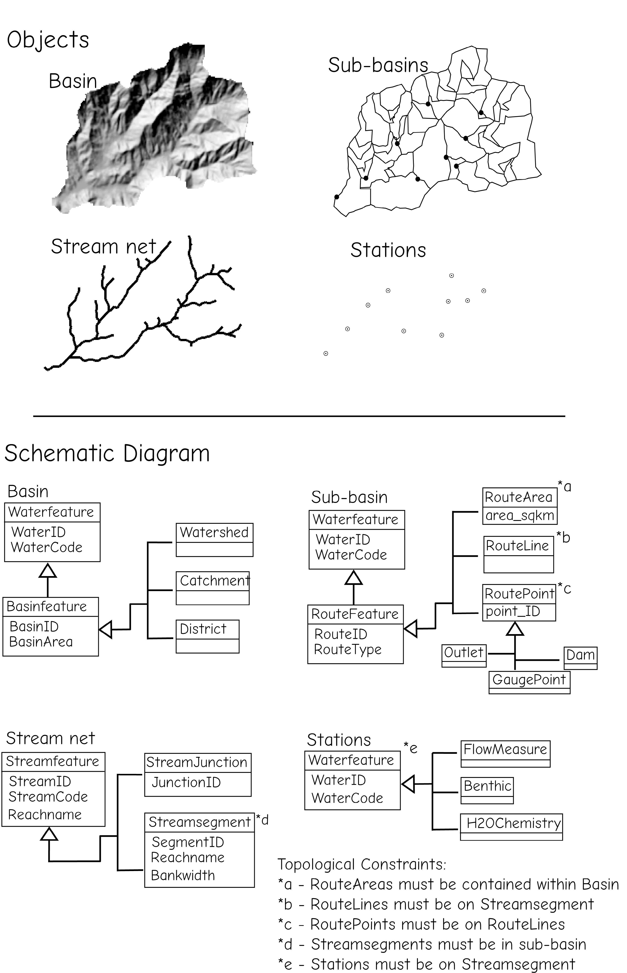
Object Data Model
Objects are often geographic features, with spatial and attribute data and topological relationship
A river basin
Bolstad, 2019

Slide 46
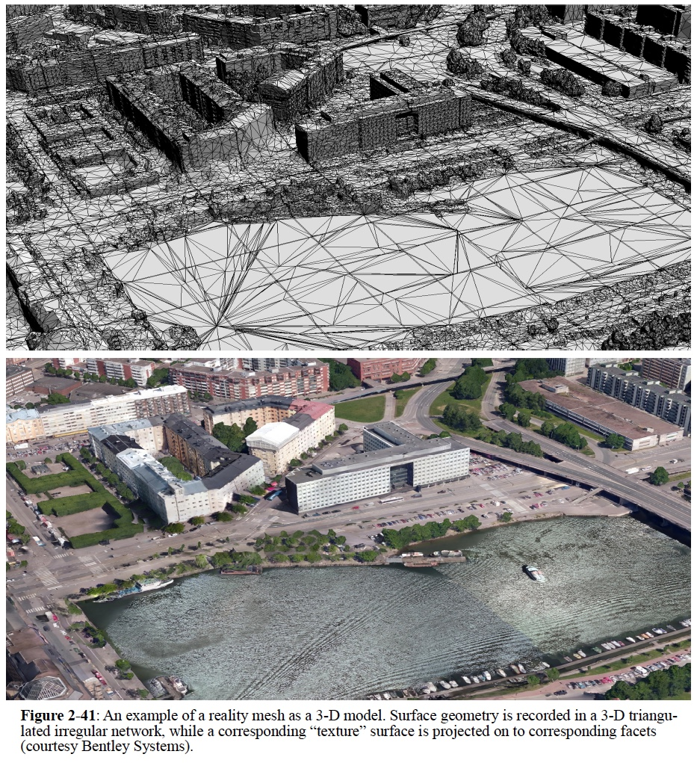
3-D Data Model
Reality mesh combines a three-dimensional triangulated irregular network with an image-based texture surface
Useful for height-related characteristics, such as building height, roof shapes
Bolstad, 2019

Slide 47

Thank you!

