Slide 1
Lab 03 & 04 summary

Slide 2
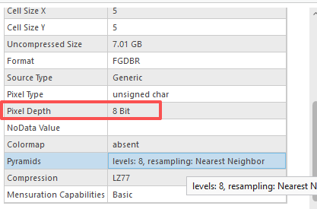

Lab 03
Question 8. What is the pixel depth? (3 Points)
Answer: 8 bit
The number of bits used to represent the color or value of each pixel.
The higher pixel depth means more bits are allocated per pixel, allowing for a greater range of values and a more accurate representation of color or intensity.
$$2^{n}= 2^{8}=256 possible value$$

