Slide 1

GEOG 2475: Geographic Information Systems I
Lecture 01 Introduction
Yanan Wu, PhD
Assistant Professor
Department of Geography

Slide 2
Overview
Introduction
Who am I?
Who you are?
Course overview and expectations
Syllabus
Software
ArcGIS Pro
Inkscape
What is GIS?
Functions of GIS
GIS components
GIS applications
Careers in GIS

Slide 3
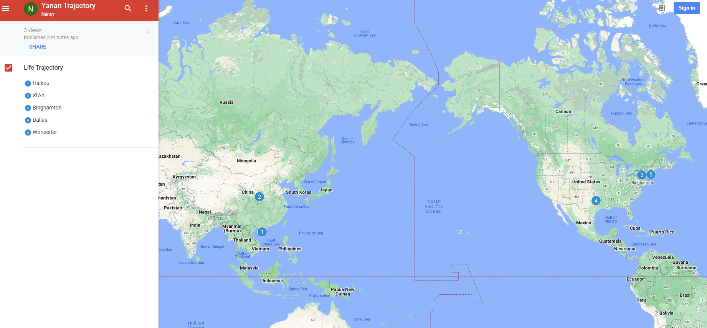
Who am I?

Slide 4


Past Teaching Experience
Python Programming
Spatial Database
Manipulating Spatial Data
Web Mapping
Processing Raster
Data Analysis
Creating Custom Tool
Data Visualization
…
Geodatabase
SQL
Proximity Analysis
Geometry processing
Raster processing
PostSQL with python
…

Slide 5

Past Teaching Experience
Web Mapping
Intermediate Statistics
Bivariate regression
Logistics regression
PCA
GWR
Spatial Autocorrelation
…
HTML
CSS
JS
Python Web Mapping
R Web Mapping
ArcGIS Maps for JavaScript
…

Slide 6

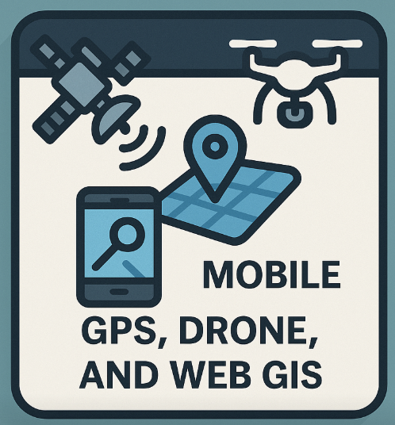
Teaching in UCA
GIS I
Geographic Field Techniques
Spatial Data
GIS software
Geodatabase
Cartography
Raster
Programming in GIS
…
GPS
Drone
Esri Mobile App
Field Map
Survey 123
ArcGIS Dashboard
…

Slide 7
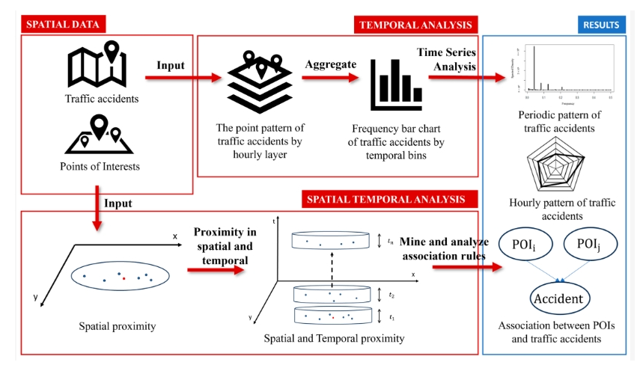
Research
Repetitive Pattern of Traffic Accidents in City of Dallas, TX
Notes:
Southwestern Energy Research Fellow

Slide 8
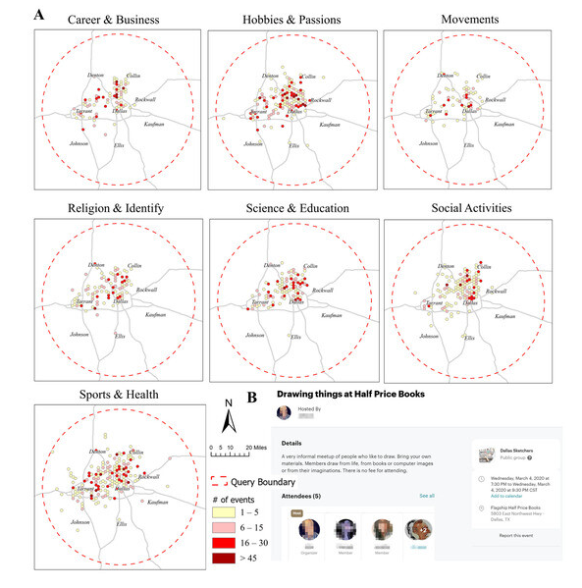
Research
What Local Environments Drive Opportunities for Social Events?
Funded by NASA EPSCoR

Slide 9
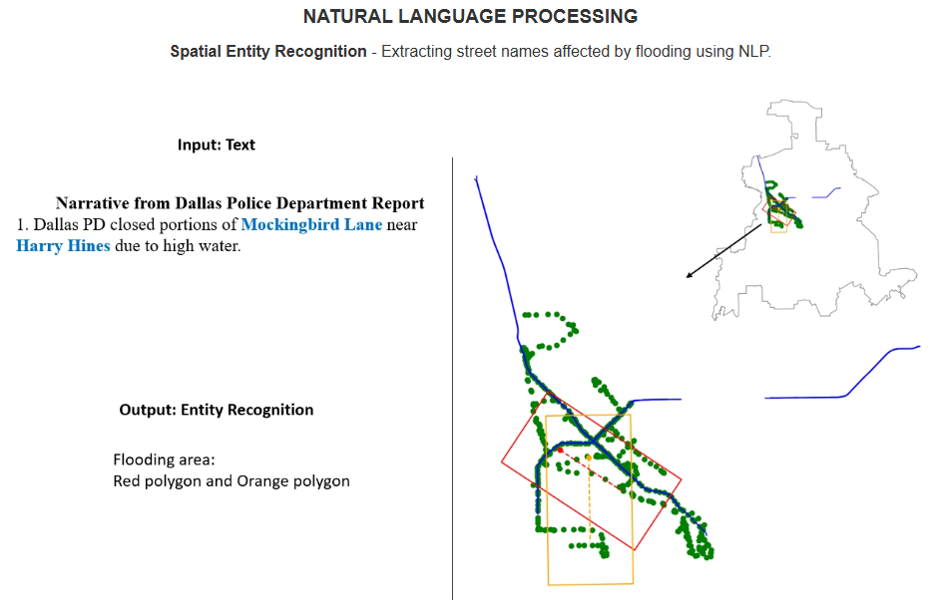
Research

Slide 10
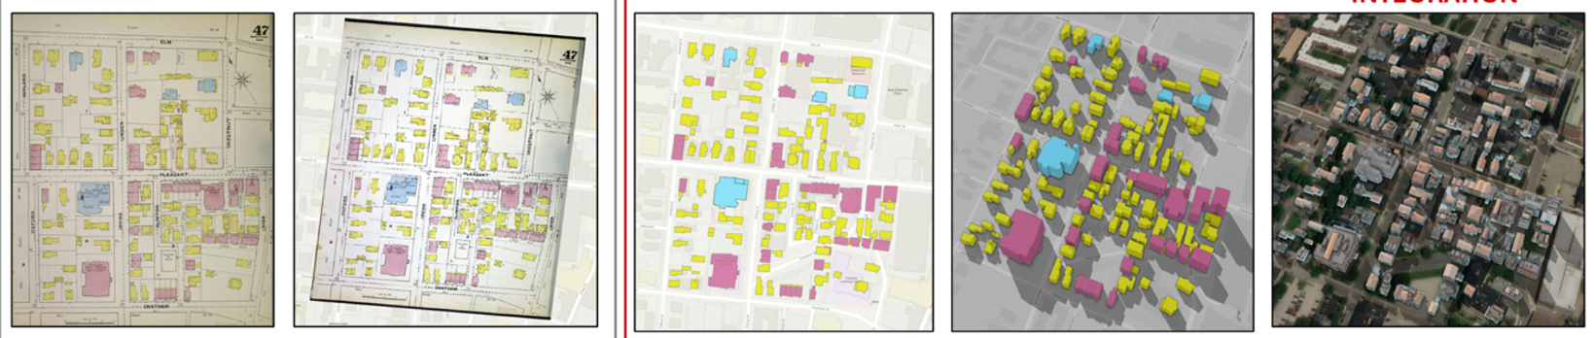
Research
Sanborn Historical Map

Slide 11
Indoor GIS

Slide 12
About you
Your background (e.g., name, major)
Share something from your summer break
What relevant experience do you have with GIS?
What are your expectations for this course?

Slide 13
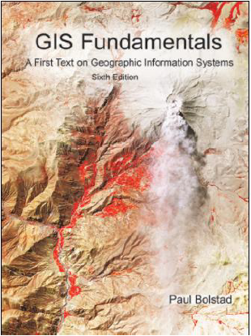
Course overview and expectations
Book
GIS Fundamentals by Paul Bolstad (ISBN-10: 978-0971764736; ISBN-13: 0971764735)

Slide 14
Course overview and expectations
Book
Discovering GIS and ArcGIS Pro by Bradley A. Shellito (ISBN-10: 131923075X; ISBN-13: 978-1319230753)

Slide 15
Course overview and expectations
Book
Principles of Map Design by Judith A. Tyner. (ISBN 978-1-60623-544-7, 978-1-4625-1712-1)

Slide 16
Software
Windows system
Software requirement: Microsoft .NET
Hardware requirement: https://pro.arcgis.com/en/pro-app/latest/get-started/arcgis-pro-system-requirements.htm

Slide 17
Course overview and expectations
Course Structure (4-credit)
Lecture (TR 10:50- 12:05 pm)
Interactive and inclusive environment
Feel free at any time during lecture to ask a question and make a comment
Lecture will be recorded and delivered to the students if necessary
Lab exercise (TR: 12:15- 1:30 pm)
Work individually on the in-class exercise
Guidance will be provided; demonstration will be provided if necessary
When submit exercise, copy questions in the lab and provide answers in a word file
Feel free at any time to ask a question

Slide 18
Course overview and expectations
Course Structure
Exam
Middle exam delivery on brightspace
Multiple choice, true/false, and short answers
Exam time is specified, may be different with the University one
Final project
For 4-credit version of this course only
Design your own research, get your own data, process the data, generate maps, and write a final report
You can refer to the previous exercise to get help

Slide 19
Course Schedule
Oct. 1
Conference: no class & lab
Oct. 13
Midterm
Oct. 15
Fall Break: no class & lab
Oct. 22
Discuss the project ideas
Nov.16-20
Project analysis
Nov.30 – Dec. 4
Final Presentation
Nov.30 – Dec. 4
Final Report

Slide 20
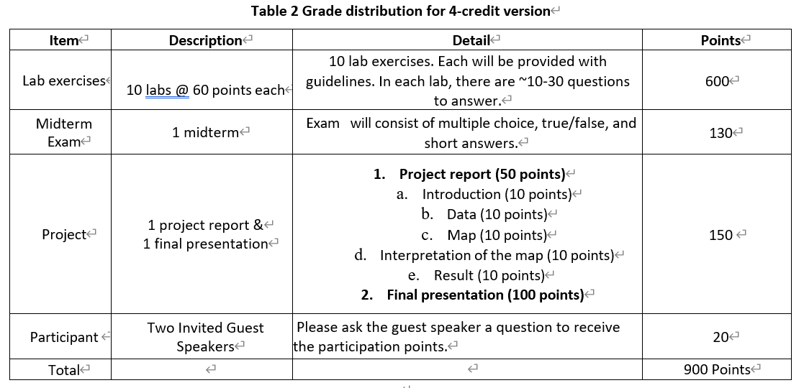
Course overview and expectations
Grading (20% later deduction)
4-credit version

Slide 21
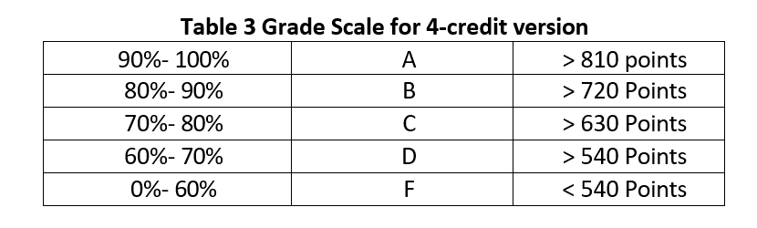
Course overview and expectations
Grading

Slide 22
Course overview and expectations
Late penalty for lab
Labs that are not turned in by the due date can be turned in up to 2 days late with a 20% penalty. Labs will not be accepted after this 2-day period.
Midterm exam
Make-up exams for absences due to any other reason will be at the discretion of the instructor.
You must notify the instructor beforehand if you need to miss an exam, the instructor will not let you make up an exam without prior notification.
Final presentation
The final presentation cannot be rescheduled. You are expected to do the final presentation at the time specified.

Slide 23
Course overview and expectations
Attendance
Prolonged absence from class will inhibit your understanding of the lecture material and prevent you from receiving help on assignments
We may do some bonus exercises during the class time. If you are not shown up, you simply lose it
Up to 3 times of absence may result in moving out from this class
If you cannot attend class, please contact me before class
Sick leave is acceptable, please contact me for re-arranging lab exercise etc.

Slide 24
Course overview and expectations
Feedback Response Time
The instructor generally replies to emails within 48 hours, except during holidays.
Often the instructor replies much more quickly, but you should not count on a same-day reply.
Please plan accordingly so that you don’t miss deadlines.

Slide 25
Course overview and expectations
Classroom Etiquette
Switch cell phones off and place them out of view. Do not use phones during class. Resist the impulse!
Computers are permitted for notetaking only.
Do not sleep in class or leave once a lecture has started.
Do not pack up and prepare to leave until the instructor has indicated that class is over
No eCigarettes permitted in the classroom.
You are encouraged to think critically and ask stimulating questions, but always respect your fellow students and your instructor.

Slide 26
Course overview and expectations
Evaluations
Student evaluations of a course and its professor are a crucial element in helping faculty achieve excellence in the classroom and the institution in demonstrating that students are gaining knowledge.
Students will receive evaluation notification from university.

Slide 27
Course overview and expectations
Structure
In-person
Lecture
Lab
Midterm (delivery through Brightspace)
Office hour
Please schedule in advance, MTWR: 1:30 - 2:30 pm
Please regularly check your Brightspace and or email

Slide 28
Course overview and expectations
After this course
explain GIS principles and concepts
acquire the knowledge of how computers store spatial data using the vector and raster data structures
find geospatial data using the web
apply cartographic principles to symbolize and classify geographic data
produce audience-oriented maps using spatial data
build geodatabase and query attribute table
geocode address
conduct basic spatial analyses
gain experience of GIS software (ESRI ArcGIS)

Slide 29
Course overview and expectations
Contact Info
Burdick 315
Email: ywu@uca.edu

Slide 30
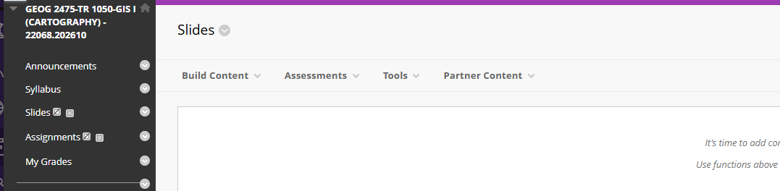
Course overview and expectations
Place for slides, and submitting lab exercise

Slide 31
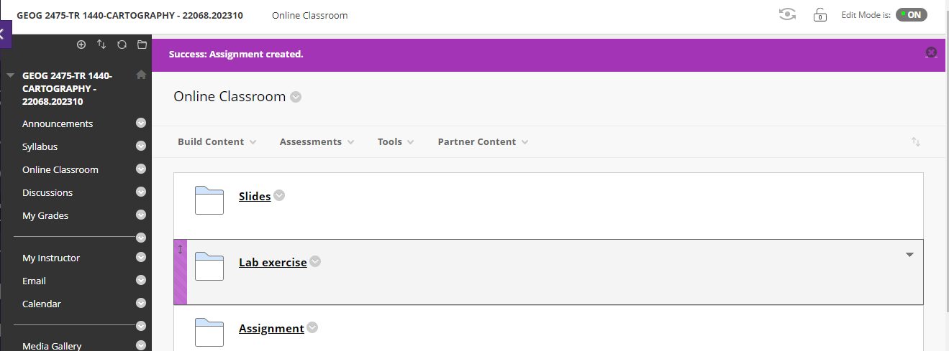
Course overview and expectations
Place for slides, and submitting lab exercise

Slide 32
ESRI https://pro.arcgis.com/en/pro-app/latest/get-started/run-pro-on-a-mac.htm Harvard https://gis.harvard.edu/faq/how-installing-arcgis-desktop-or-pro-mac-computer
Software
ArcGIS Pro installed on Mac/other computer
Mac
Other PCs (e.g., Chromebook, Microsoft surface)
Please talk with/email to me

Slide 33
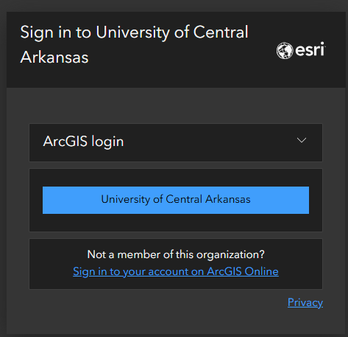
Software – ArcGIS Online
ArcGIS Online
Log in ArcGIS online
https://uca.edu/geography/gis/

Slide 34

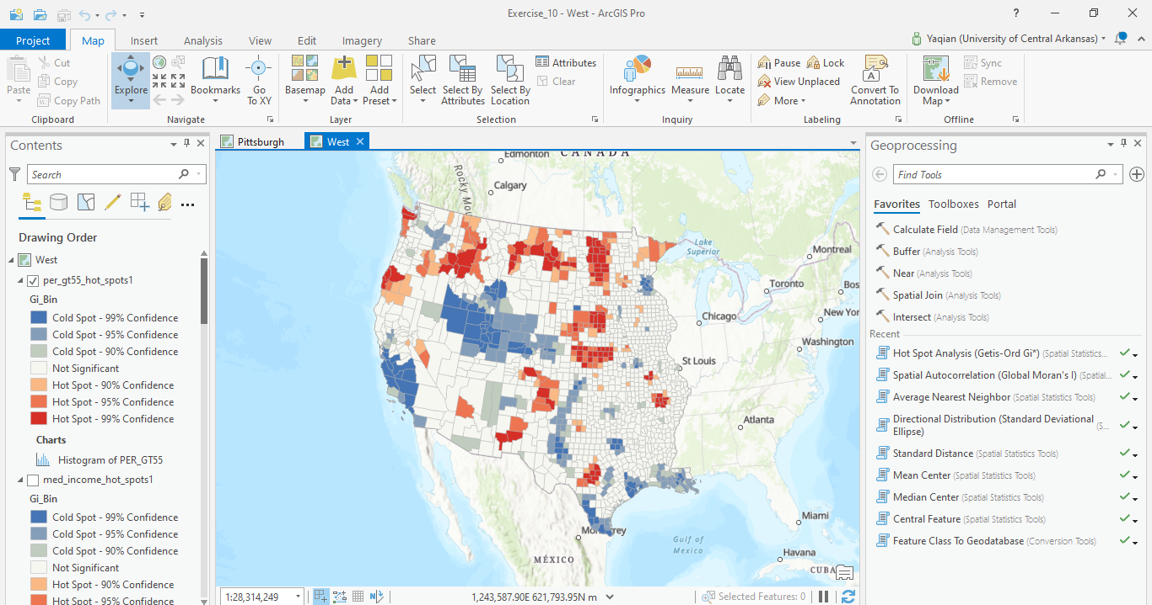
Software – ArcGIS Pro
ESRI ArcGIS Pro

Slide 35
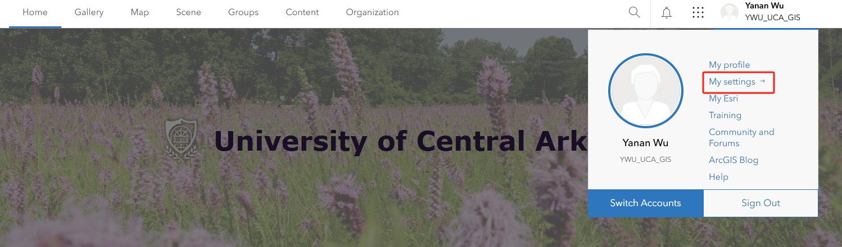
Software
ArcGIS Pro installed in your own PC

Slide 36
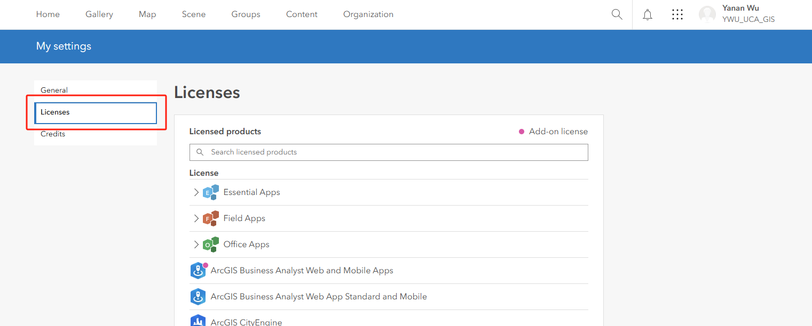
Software
ArcGIS Pro installed in your own PC

Slide 37
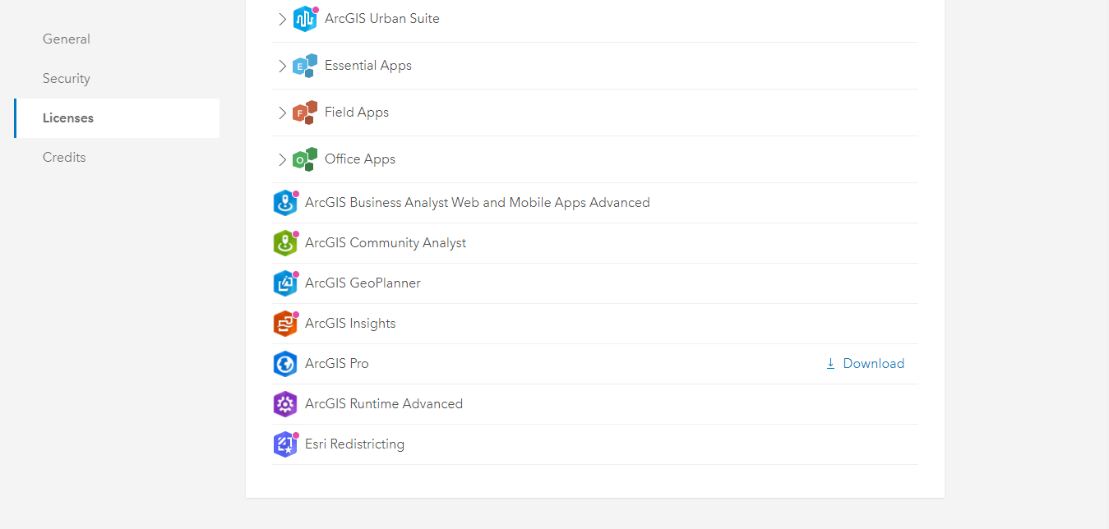
Software
ArcGIS Pro installed in your own PC

Slide 38
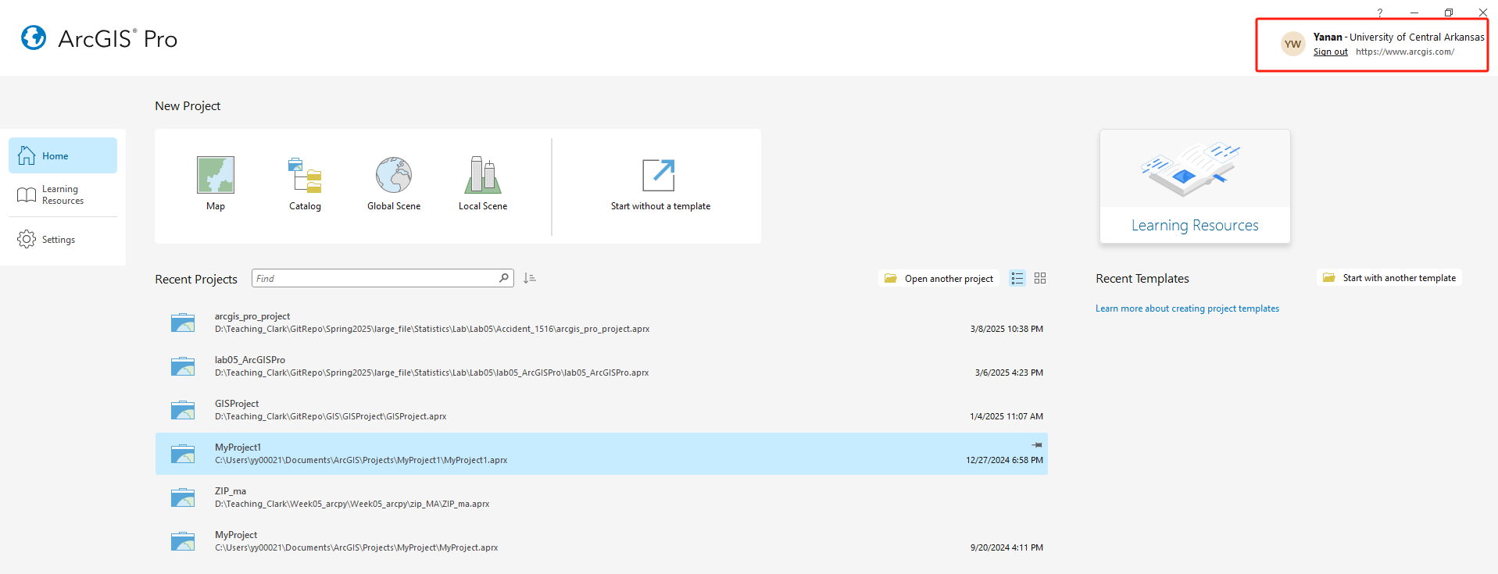
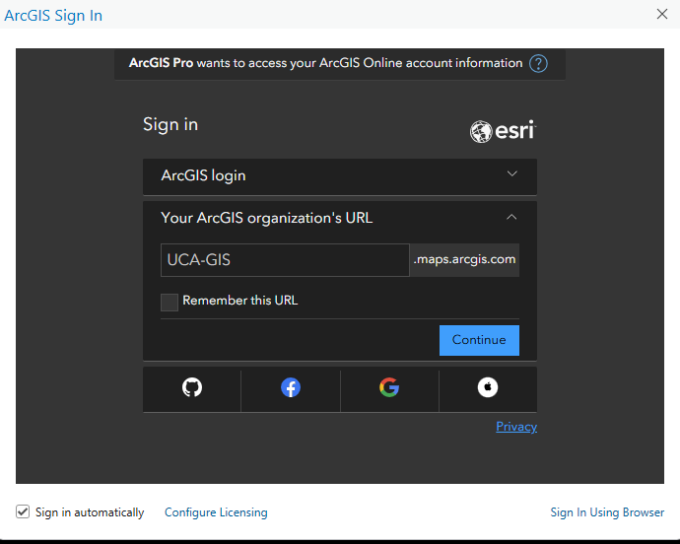
ArcGIS online account
ArcGIS Pro

Slide 39

Conference
SWAAG Conference
Student Competition
Geobowl

Slide 40
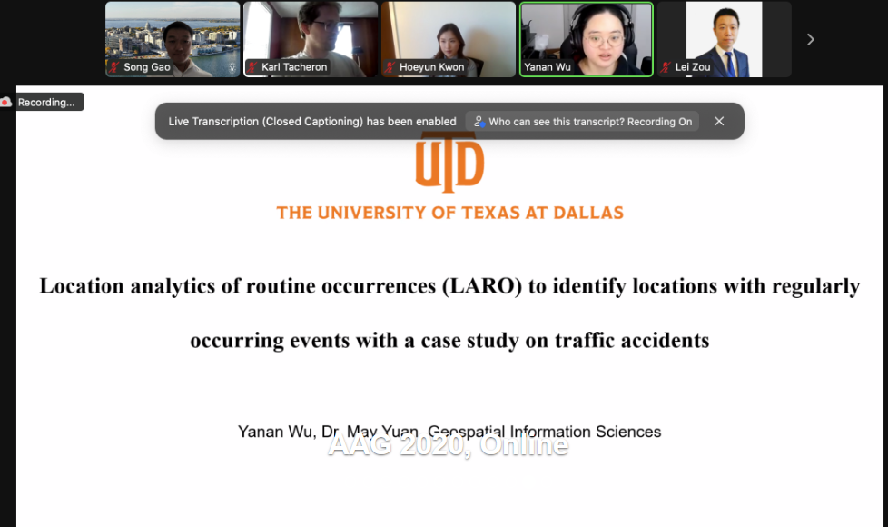
Conference
AAG Conference
Awards and grants

Slide 41
Invited Guest Speaker
Student Speaker
Logan Stevens
BS in Geography
Topic: GIS Internship
Guest Speaker
Matt Anderson
GIS Manager at Conway
Topis: Application of GIS

Slide 42


Notes:
Before class, I would like to ask a question, do you think you have used GIS in your daily life?
Yes, nowadays, GIS has been widely used in our daily life. You may realize it or not realize it, everyone are using GIS everyday. From booking a car using UBER or finding a restaurant using Yelp.
So today I would like to briefly introduce this amazing science.

Slide 43
What is a GIS? No easy answer anymore!
Geographic Information
information about places on the earth’s surface
knowledge about “what is where when”
GIS--what’s in the S?
Systems: the technology
Science: the concepts and theory
Notes:
So firstly, let us think about what is GIS? It is not a simple answer question.
GI usually represent geographic information. Geographic information is different from other general information. Because it is the information about places on the earth’s surface. This information always has location attribute. And it is not only about location, it is also related to knowledge behind an event that happened in a certain location. For example, I am presenting lecture here today, because I want to share the GIS knowledge to you. So geographic information is about location and knowledge about ‘what is where when’.
S has different meanings. It can be systems, which is directly related to the technology. It can also be science, meaning the concepts and theory behind the technology.
So with different S, we have different definitions of GIS.

Slide 44
GI Systems
A computer-based system to aid in the collection, maintenance, storage, analysis, output, and distribution of spatial data and information
-Paul Bolstad
https://www.xanedu.com/higher-education/educators/custom-books%20catalog/gis_fundamentals/
Notes:
This slide provides a definition of geographic information system as provided by Dr. Paul Bolstad, who is the first one to write a GIS text book ‘GIS Fundamentals’.
So Dr. Bolstad defined a geographic information systems is a computer-based system to aid in the collection, maintenance, storage, analysis, output, and distribution of spatial data and information. So it focuses on the functions of the computer-based system.

Slide 45
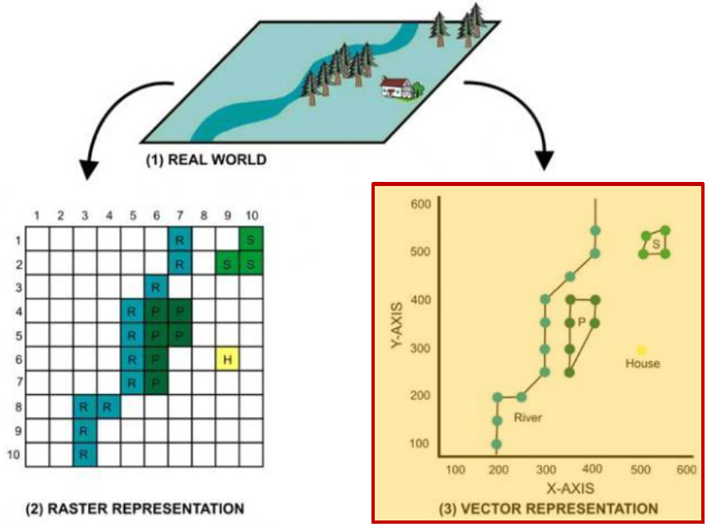
GI Science
Geographic Information Science focuses the generic issues that surround the use of GIS technology, impede its successful implementation, or emerge from an understanding of its potential capabilities.
- Michael Goodchild
https://sqlserverrider.wordpress.com/tag/raster-graphics/
Goodchild, M. F. (1992).
Notes:
According to Dr. Michael Goodchild, Geographic Information Science focuses the generic … so it is the science behind geographic information systems
Geographic information systems and science are NOT isolated, they are intertwined together. This course will discuss both geographic information systems and science.

Slide 46
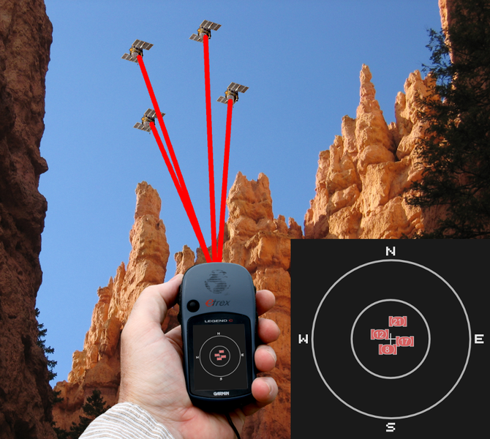
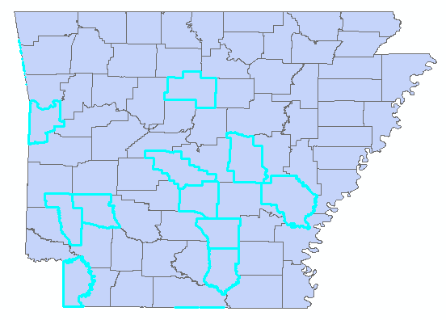

GI technologies
3S
Global Positioning Systems
GPS
GIS
Remote Sensing
RS
https://landsat.usgs.gov/landsat-8
https://commons.wikimedia.org/wiki/File:Bad_gdop.png
Notes:
We also heard a lot about geographic information technologies, or geospatial technologies. When we refer to that, we usually mean triple S technologies, including remote sensing, RS, Global Positioning Systems, GPS, and geographic information systems and science, GIS.

Slide 47
GI technologies
3S
RS
use of satellites or aircraft to capture information about the earth’s surface
GPS
a system of earth-orbiting satellites which can provide precise location on the earth’s surface (in lat/long coordinates or equiv.)
GPS and RS are sources of input data for a GIS
Notes:
Remote sensing is collecting information without contacting with that object. Examples include collecting images from satellites or aircraft.
GPS is using satellites to find your location on Earth. So it usually provides lat/long coordinates or equivalent.
RS and GPS are main sources of input data for a GIS. A GIS provides for storing and manipulating GPS and RS data.
RS and GPS are considered sister disciplines of GIS.
So far, is there any questions?

Slide 48


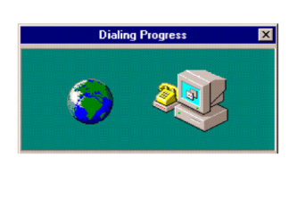


History
Harvard Laboratory for Computer Graphics:
SYMAP
1960s
Dr. Roger Tomlinson
1965
Mr. Howard Fisher
1969
Mr. Jack Dangermond
https://www.esri.com/en-us/what-is-gis/history-of-gis
https://en.wikipedia.org/wiki/Geographic_information_system
Arc/info, MapInfo
1970s
1980s
1990s
Notes:
Next, let us go to the history of modern GIS.
During the early 1960s, GIS started as computers and early concepts of quantitative and computational geography emerged. Dr. Roger Tomlinson has been acknowledged as the "father of GIS.“ His work on creating a manageable inventory of Canadian natural resources during 1960s is the first computerized GIS in the world. He also gave GIS its name.
1965: Mr. Howard Fisher, a Chicago architect, established the Harvard Laboratory for Computer Graphics. Some of the first computer map-making software was created and refined at the Lab, such as one of the first mapping software SYMAP. Many of the early concepts of GIS and applications were also conceived at the lab.
1969: Jack Dangermond, a member of the Harvard Lab and his wife Laura founded ESRI (Environmental Systems Research Institute). This consulting firm applied this computer mapping and spatial analysis to help land use planners and land resource managers make informed decisions. Now it develops and cover almost entire sectors. ERSI also developed toolboxes and work-flows, which are now standard of GIS. The ArcGIS created by ESRI are the most popular GIS software.
1970s: During the era of satellite, starting around early 1970s, National agencies, such as NOAA and NASA developed very quickly to capture data from space.
1980s: Commercial GIS emerged, such as the Arc/Info, the first commercial GIS software and Mapping Display and Analysis System (the first desktop GIS product) developed by Manpinfo cooperation.
Begin 1990s: Users started to explore GIS data through internet and mobile phone. And some open source software, such as QGIS is developing.
In the future: Web and cloud computing GIS will continue developing. Integration with real-time information via the Internet of Things, GIS will become more dynamics.

Slide 49
Functions of a GIS
1. Capture
2. Store
3. Query
4. Analyze
5. Display
Notes:
A fully functional GIS should be able to capture, store, query, analyze, and display spatial data and information. We will go one by one.

Slide 50
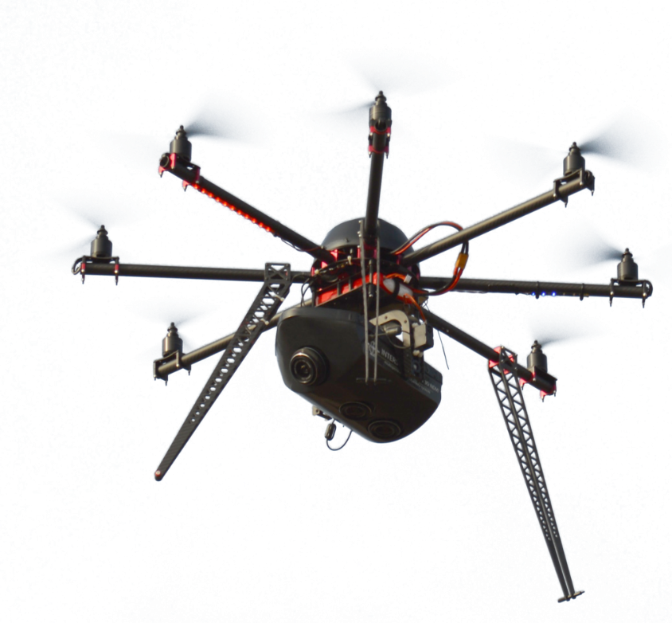
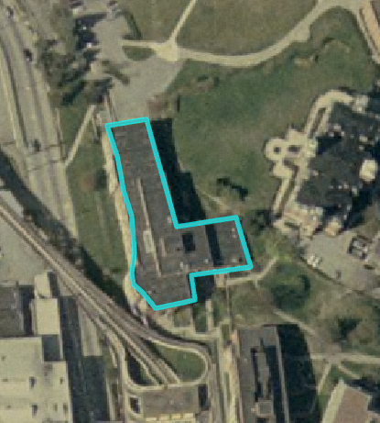
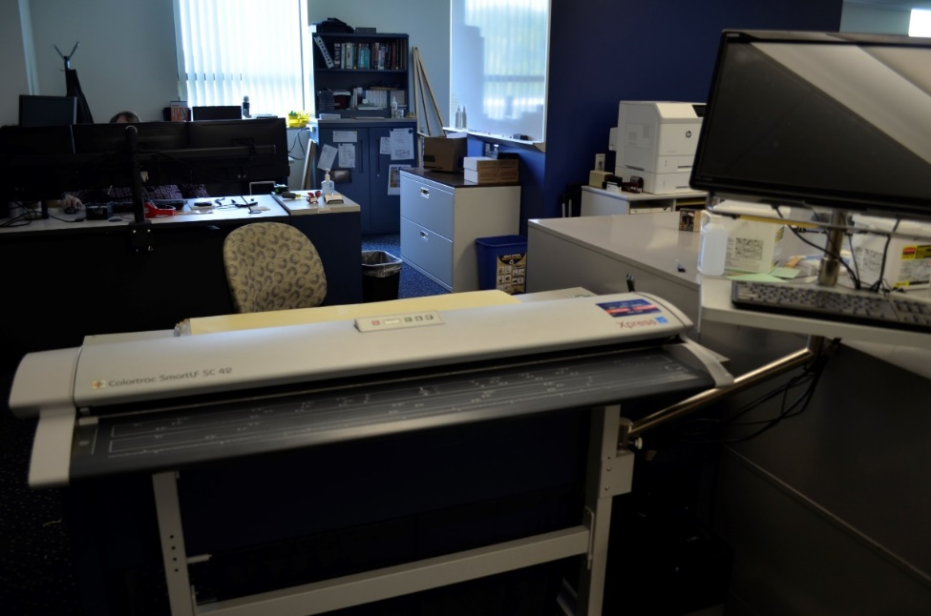
Functions: Capture
https://commons.wikimedia.org/wiki/File:Interspect_UAV_B_3.1.png
https://landsat.usgs.gov/landsat-8
https://commons.wikimedia.org/wiki/File:Bad_gdop.png
Notes:
This slide shows a variety of methods that can be used to capture new geospatial data including digitizing using software and scanner, GPS technology, and collection using a variety of sensors, such as drone and satellite.

Slide 51
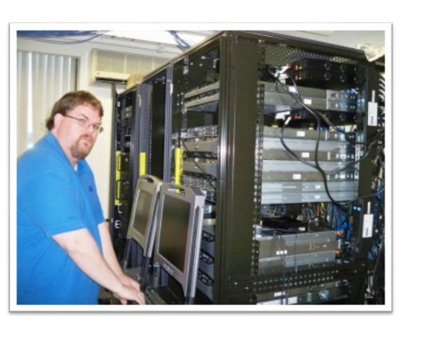


Functions: Store
Local disk
Server
Cloud
Notes:
Data storage can occur on local disks, on servers, or in the cloud.
Dropbox, onedrive, etc

Slide 52
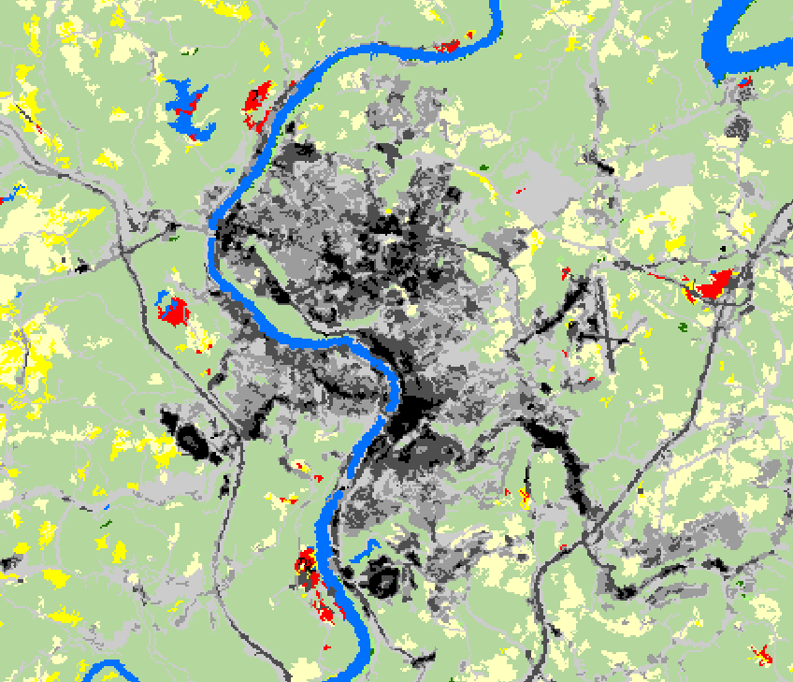
Functions: Store
Vertex
Node
Raster
Vector
Notes:
Raster and Vector format are the population data format that used to store spatial data.

Slide 53
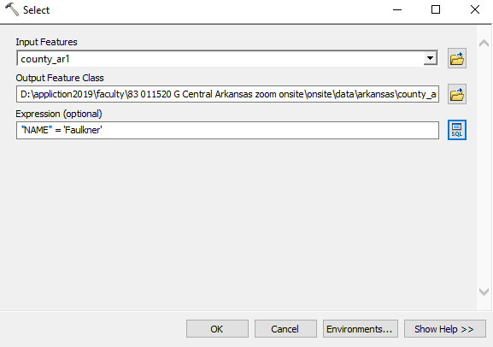
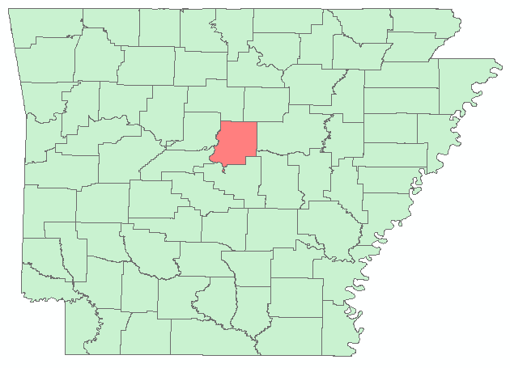
Functions: Query
Structured Query Language (SQL)
Notes:
In some cases, we do not need all of the data, we just want some data that meet our criteria. So we need to query our data. For example, we only want the data in the county where our university of central Arkansas located, so we can use Structured Query Language (SQL) to the data. We select the name and let the name be the Faulkner. The data of Faulkner will be selected. SQL is very common query methods used in a traditional database. We will go detail in our following classes.

Slide 54
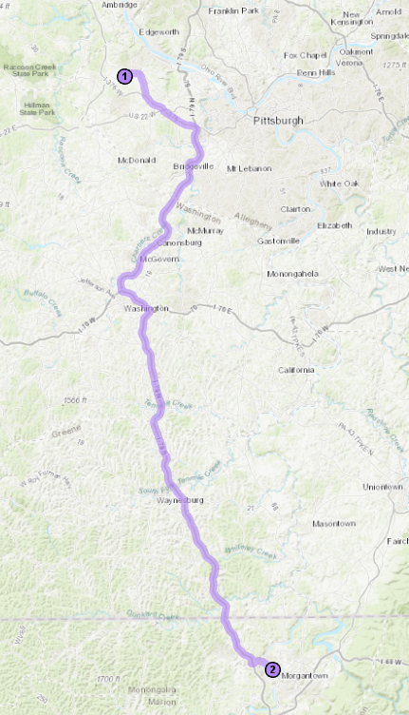
Functions: Analyze
Directions
Buffer
Proximity
Suitability
Likelihood
Best locations
Worst locations
Etc.
Notes:
We can use GIS to conduct a lot of analyses, for example find the directions, create a buffer for a railroad to avoid noise, find the most suitable places for a wild animal, and find a best location for restaurant, and so on.

Slide 55
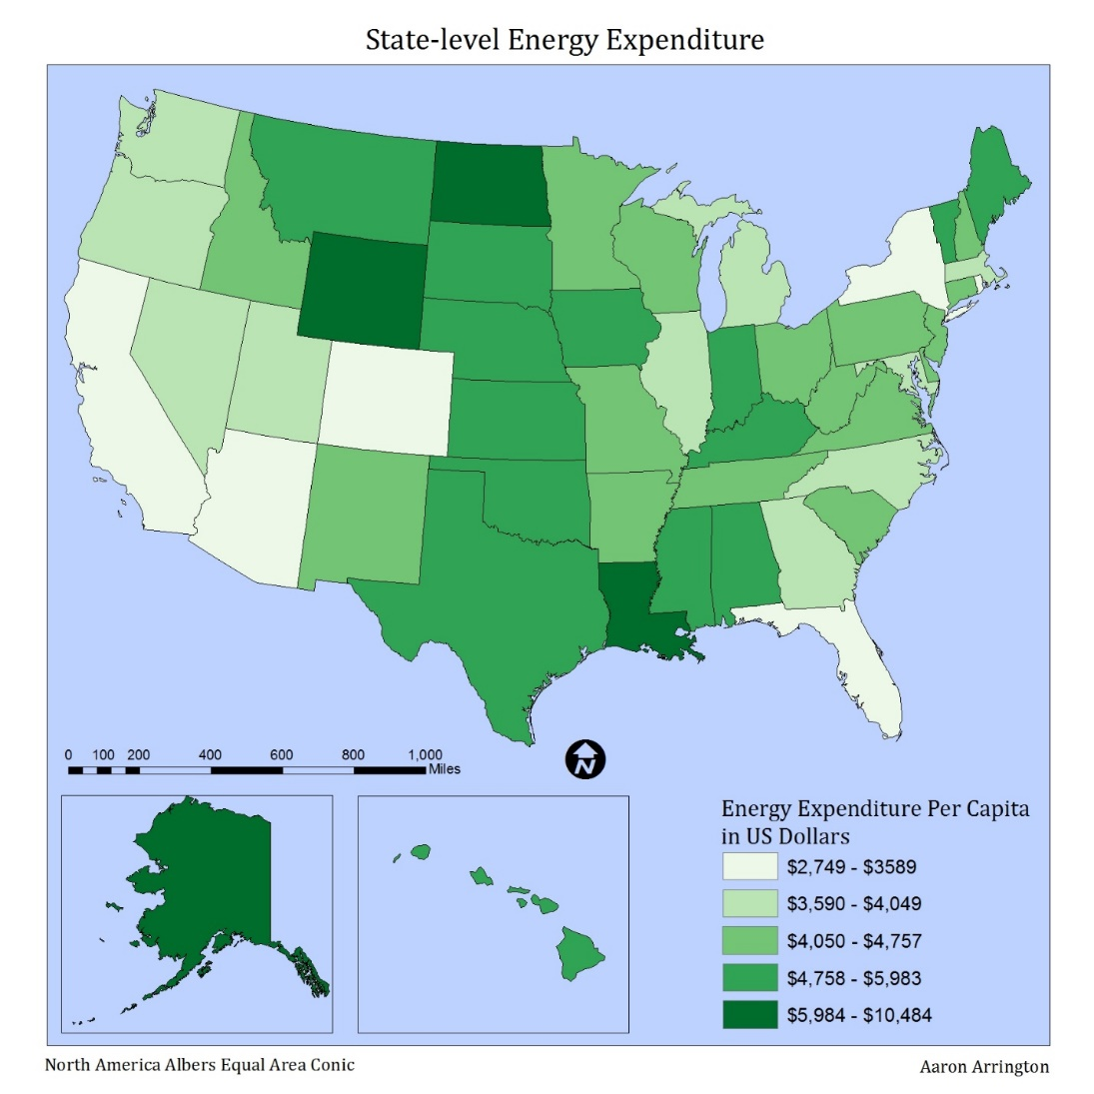
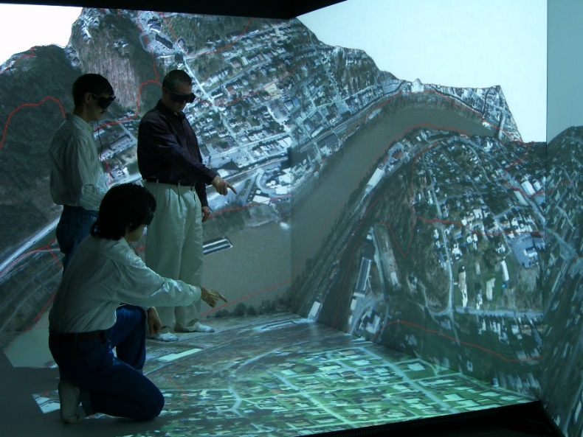
Functions: Display
Virtual Reality
Notes:
In this class, we will learn to produce map layouts. The goal of a map is to communicate information to an intended audience. So, we will learn to produce audience specific maps. Using GIS, we can display 2D maps, and 3D visualization using virtual reality.
So far do you have any questions?

Slide 56
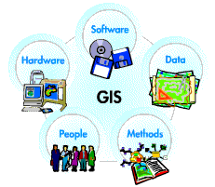
Components of a GIS
People
Data
Hardware
Software
Methods/Protocol
https://www.rst2.org/ties/GENTOOLS/comp_gis.html
Notes:
A GIS requires people, data, hardware, software, and methods/protocols.
With that you will know how to use the appropriate data, hardware, software, and methods/protocols to address questions that have a spatial component.

Slide 57






Components: People
https://www.argisusers.org/
http://www.aag.org/
https://www.asprs.org/
https://www.gisci.org/
https://www.esri.com/training/
Logos were obtained from organization websites
Notes:
GIS is of limited value without the people who manage the system and develop plans for applying it to real-world problems. People is an important components of GIS
There are many sources that can help use to become more professional in GIS. They provide a variety of information, training, and workshops, which we can attend. For example, the Arkansas GIS users Forum, the American Association of Geographers, the American Society of Photogrammetry and Remote Sensing (ASPRS), the GIS certification Institute, and ESRI Academy for training. Note that these organizations may offer student discounts for membership fees and conference fees.
GIS is growing very fast, outside the classroom, especially after this course, if you want to be a GIS professions, theses sources are very helpful.

Slide 58

Components: People
Department of Geography @UCA

Slide 59
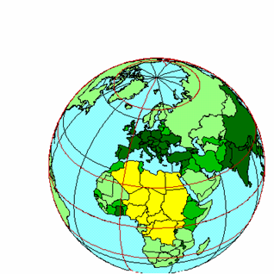
Components: Data
Administrative Boundaries
Utilities
Zoning
Buildings
Parcels
Hydrography
Streets
Digital Orthophoto
Data is organized by layers, coverages or themes, with each layer representing a common feature.
Layers are integrated using explicit location on the earth’s surface, thus geographic location is the organizing principal.
Notes:
11
The data in GIS is organized by…For example, all of the building will be in the buildings layer and all of the street will be in the street layer.
Layers are integrated according to location, so …

Slide 60
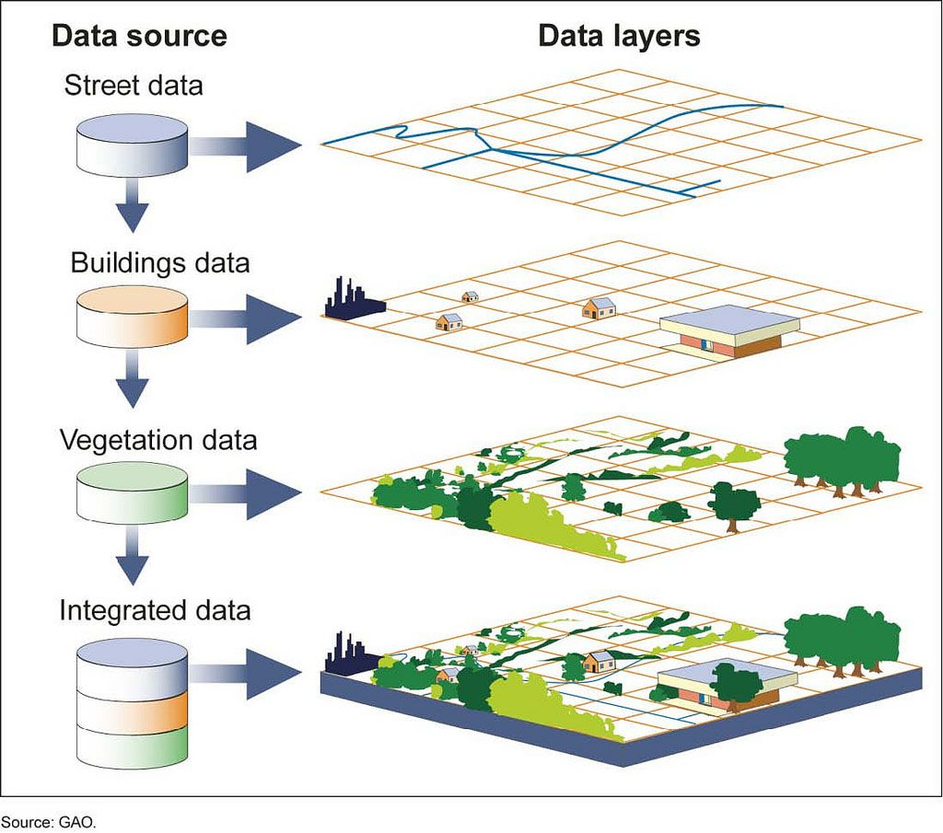
Components: Data
Notes:
Here I have an example,

Slide 61












Components: software
Logos were obtained from organization websites
Notes:
Currently, there are many GIS software.
Commercial software
– Powerful, but expensive
– ArcGIS, ERDAS,…
Open source
– Free, contributed by many participants
– Grass GIS, QGIS, GeoDa,…
In this class, we will use ArcGIS, because it is the standard GIS software used across the globe.

Slide 62
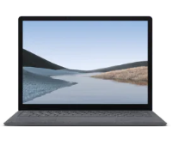
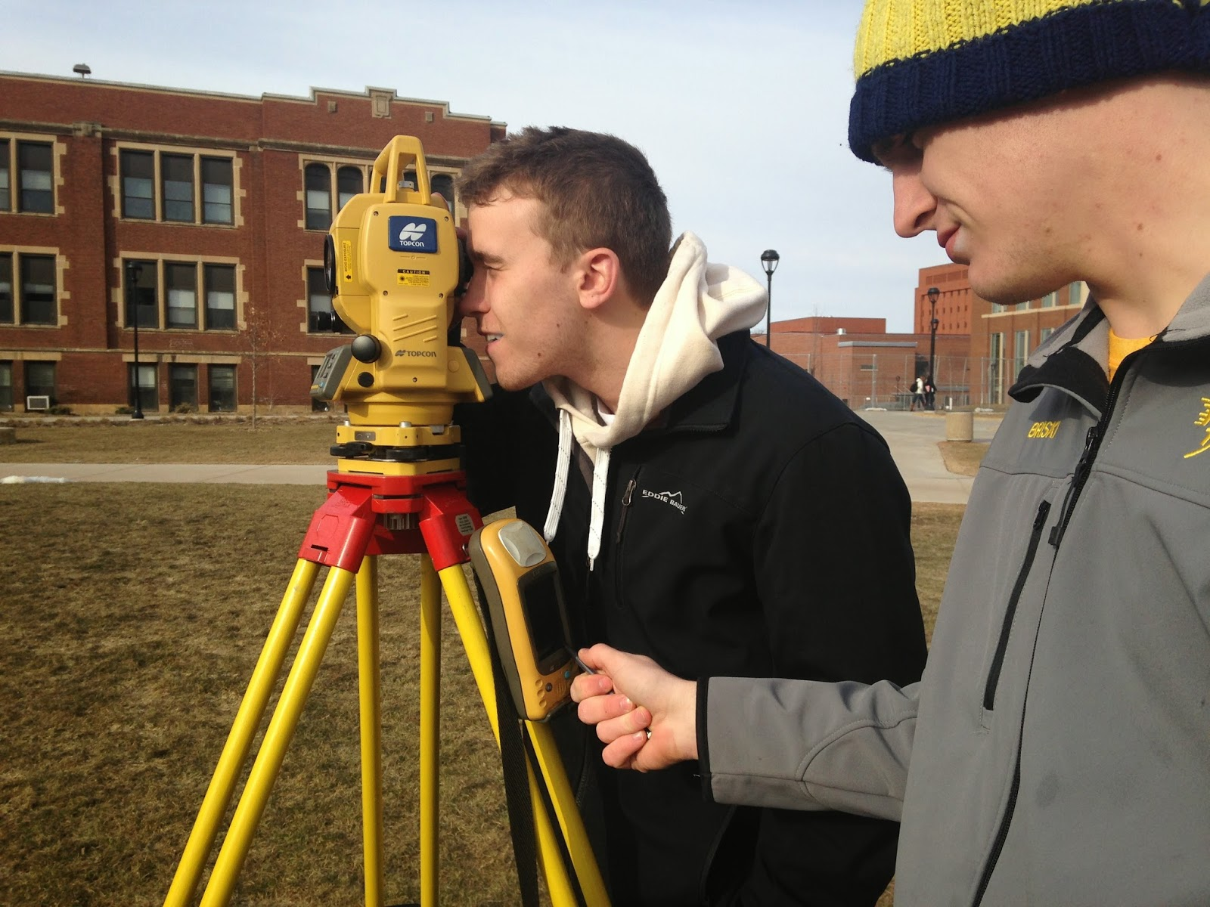
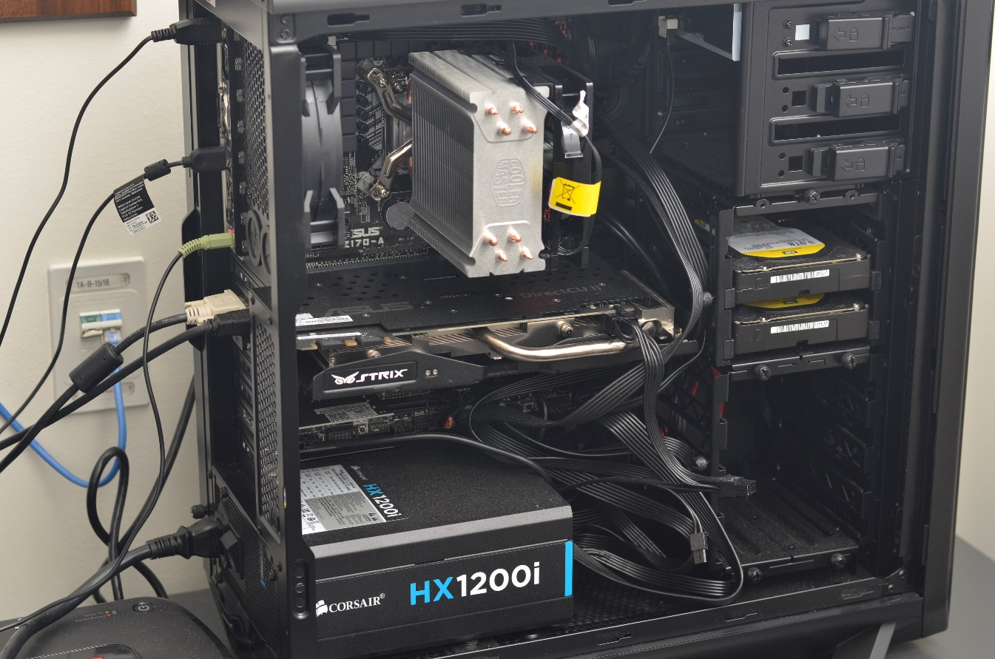
Components: hardware
https://www.microsoft.com/en-us/p/surface-laptop-3/8VFGGH1R94TM/F29J?activetab=overview&source=googleshopping&OCID=AID2000022_SEM_mRUxj5Qp
https://commons.wikimedia.org/wiki/File:Interspect_UAV_B_3.1.png
http://geospatialfieldmethodstanner.blogspot.com/2014/04/field-activity-9-surveying-with-topcon.html
Notes:
We use a variety of hardware in GIS to collect data, store data, and analyzing data, including drone and gps, computer, and servers.

Slide 63
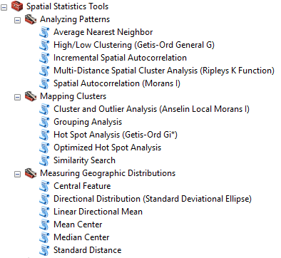
Components: Method
Table Query
Map design
Digitizing
Georeferencing
Resampling
Vector spatial analysis
Raster spatial analysis
Digital terrain analysis
Geospatial modeling
ArcGIS Model Builder
Weighted overlay
Spatial statistical analysis
Spatial interpolation
Notes:
There many spatial analysis methods that we can use, including vector spatial analysis, raster spatial analysis, digital terrain analysis, geospatial modeling, Model Builder, weighted overlay, spatial statistical analysis, and spatial interpolation. Most of these methods we can find in the ArcGIS. We will cover majority of these methods in this class.

Slide 64
GIS MORE than maps
Notes:
Although one of the main functions of GIS is to produce maps, but GIS is more than maps. GIS is fundamentally about solving real-world problems.” (Longley, et al., p. 40)
In its early years, GIS was most successful at describing how the world looks. Now the bigger questions concern how GIS is useful in analyzing how the world works.
“The five Ms of GIS application are mapping, measurement, monitoring, modeling and management.” (Longley, et al., p. 41)

Slide 65
Applications
Urban Planning, Management & Policy
Land acquisition
Housing renovation programs
Emergency response
Crime analysis
Tax assessment
Environmental Sciences
Monitoring environmental risk
Modeling stormwater runoff
Management of watersheds, floodplains, wetlands, forests, aquifers
Hazardous or toxic facility siting
Groundwater modeling and contamination tracking
Political Science
Redistricting
Analysis of election results
Predictive modeling
Notes:
7
GIS has a lot of application. It has been applied in…

Slide 66
Application
Civil Engineering/Utility
Locating underground facilities
Designing alignment for freeways, transit
Coordination of infrastructure maintenance
Business
Demographic Analysis
Market Penetration/ Share Analysis
Site Selection
Education Administration
Attendance Area Maintenance
Enrollment Projections
School Bus Routing
Real Estate
Neighborhood land prices
Traffic Impact Analysis
Determination of Highest and Best Use
Health Care
Epidemiology
Needs Analysis
Service Inventory
Notes:
7

Slide 67
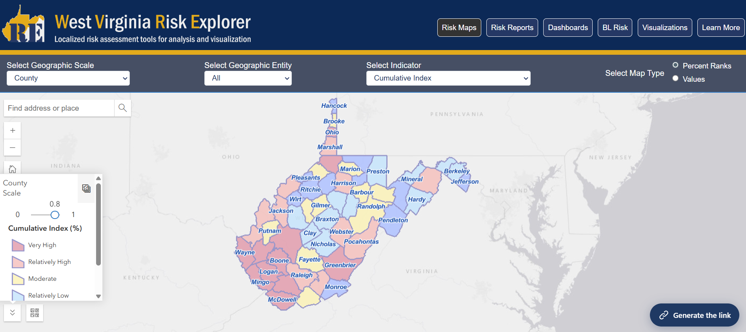
Example: GIS in Environmental Science
West Virginia Risk Explorer
Notes:
This is the interactive Flooding zone online mapping system. With this system, we can clearly monitor the affected areas by flooding, which not only help insurance company to assess damage, but also help to evacuate people during flooding season.
Federal Emergency Management Agency

Slide 68
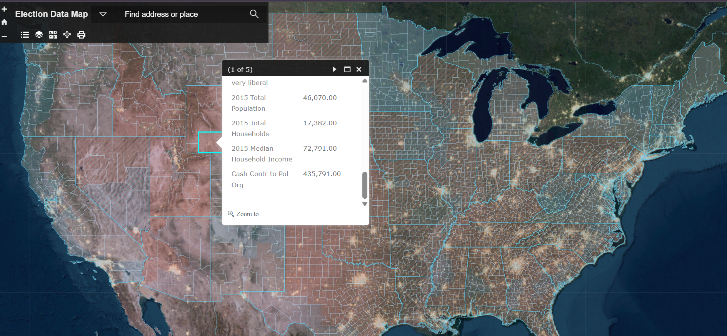
Example: GIS in Political Science
2020 Presidential Election
Election Data Map
Notes:
Here is another application of GIS in presidential election in 2008. With additional data, it may be able to predict election patterns, which is helpful to plan election campaign.

Slide 69
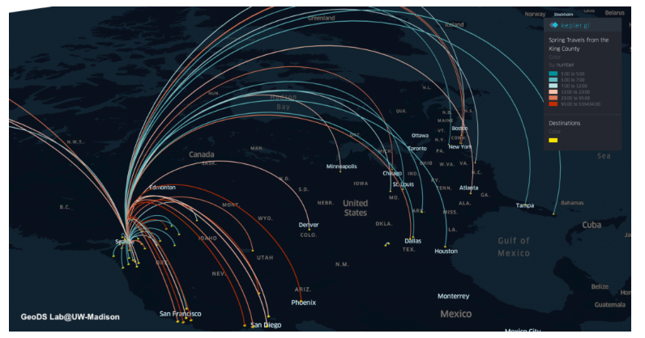
Example: GIS in Health Care
Traveling during early stage of COVID-19 period
https://geods.geography.wisc.edu/
Notes:
The last one is the GIS application in infectious disease, the last COVID-19. This figures shows People reside in the King County, the first area of outbreak of COVID-19, traveled to other places during early March 2019. Different colors means different number of peoples traveled to other places. Majority of people went to big cities, such as boston, new York, dallas, and atlanta. It would be very helpful for decision makers to made some actions to prevent the infections of COVID-19

Slide 70
GIS Application in Modern World

Slide 71

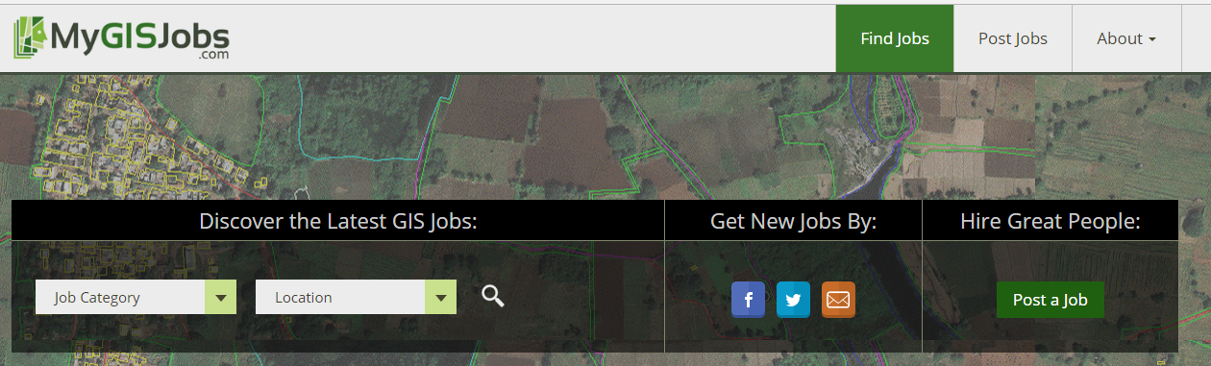
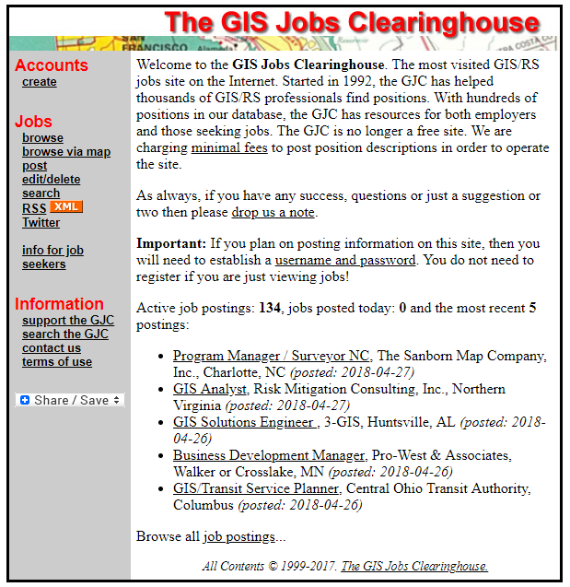
GISer Job Market
Local Government
Planning and environmental management
property records and appraisal
Real Estate and Marketing
Retail site selection, site evaluation
Public safety and defense
Crime analysis, fire prevention, emergency management, military/defense
Natural resource exploration/extraction
Petroleum, minerals, quarrying
Transportation
Airline route planning, transportation planning/modeling
Public health and epidemiology
The Geospatial Industry
Data development, application development, programming
https://www.gisjobs.com/
https://www.mygisjobs.com/
http://www.gjc.org/
Notes:
With this wide application, people with GIS specialty has lots of opportunities for their career.
I would recommend the GIS Jobs website if you are interested in searching for geospatial career opportunities: http://www.gjc.org/.

Slide 72


Geography Students placement @UCA
2020-2021
Four students worked as full time at ARDOT
Three students in master GIS program @UCA (One student is supported by Arkansas Space Grant Consortium project)
2022
Two current students worked as part-time at ARDOT

Slide 73
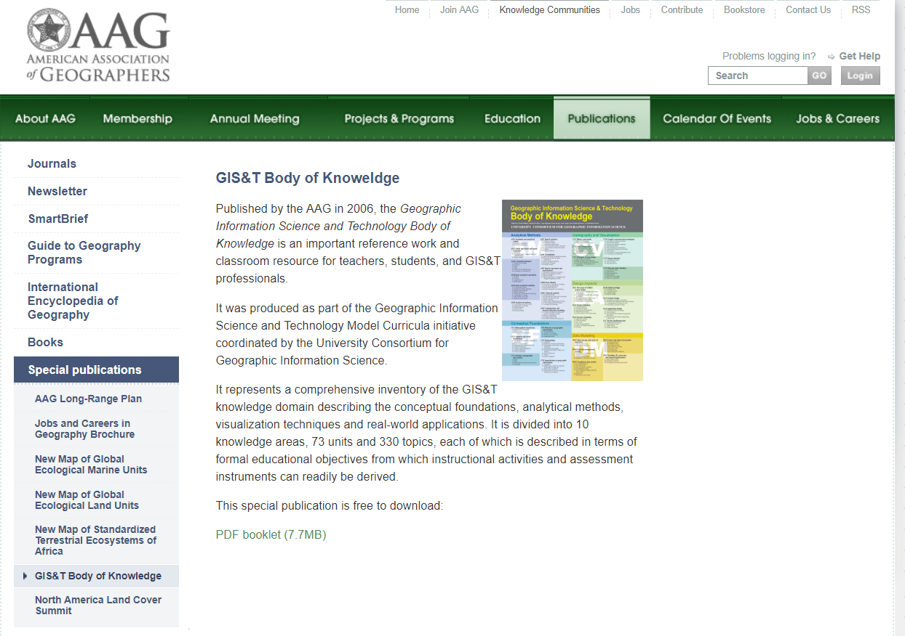
Geospatial Skillsets
Spatial problem solving
Spatial analysis
Software troubleshooting
Statistics
Spatial predictive modeling
Database management
Web GIS
Python scripting
Cartography/Map design
Graphic design
Image interpretation
GPS tracking
http://www.aag.org/cs/publications/special/gist
Notes:
These are the important geospatial skillsets for geospatial professionals. After this course, you will get some of this abilities. To get more advanced understanding and skillsets, I highly recommend to take advanced GIS and Cartography courses.
Since GIS is a fast growing field that relies heavily on technology. You will need to continue to develop your skillset throughout your professional career and you can check the professional associations.

Slide 74

Esri Summer Internship
Notes:
These are the important geospatial skillsets for geospatial professionals. After this course, you will get some of this abilities. To get more advanced understanding and skillsets, I highly recommend to take advanced GIS and Cartography courses.
Since GIS is a fast growing field that relies heavily on technology. You will need to continue to develop your skillset throughout your professional career and you can check the professional associations.

Slide 75
Thank you!

