Slide 1
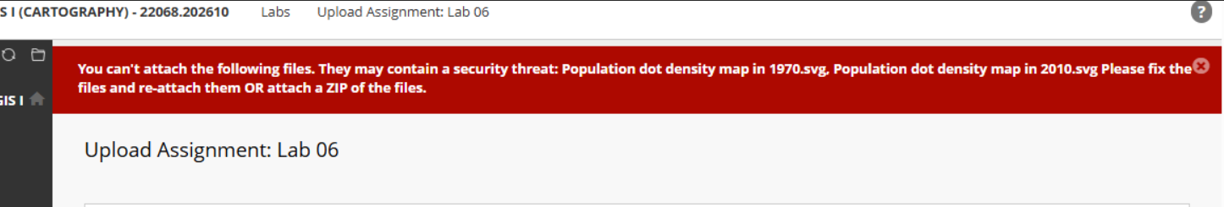
Lab 06

Slide 2
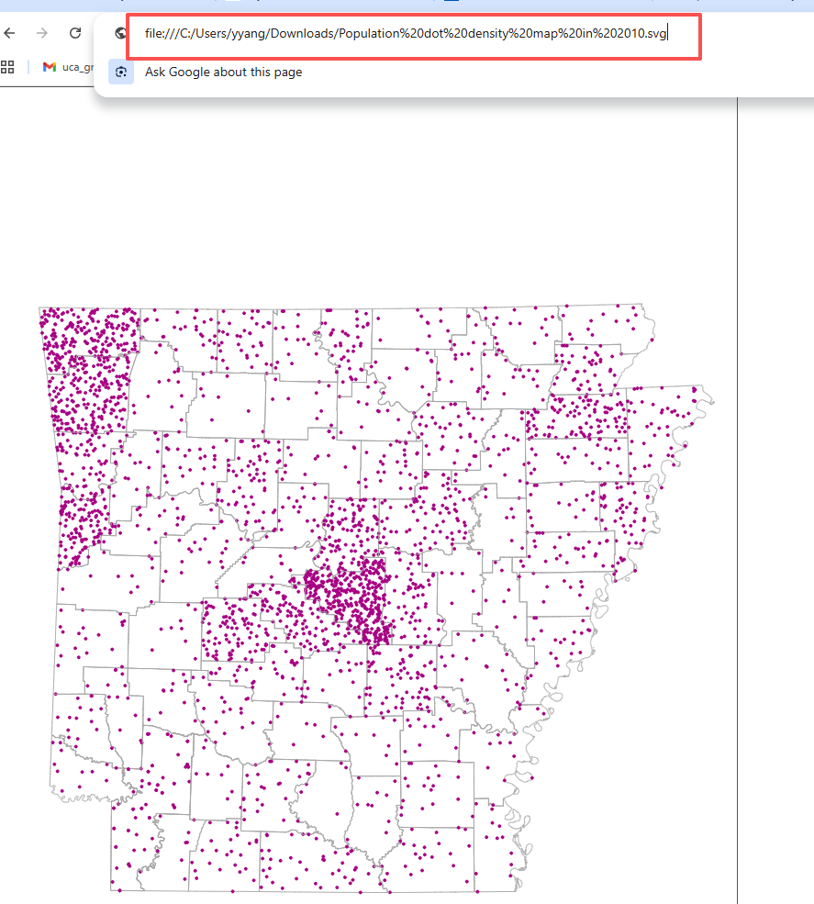
Lab 06
Svg File Link
file:///C:/Users/Usersname/OneDrive/Documents/Population%20dot%20density%20map%20in%202010.svg

Slide 3
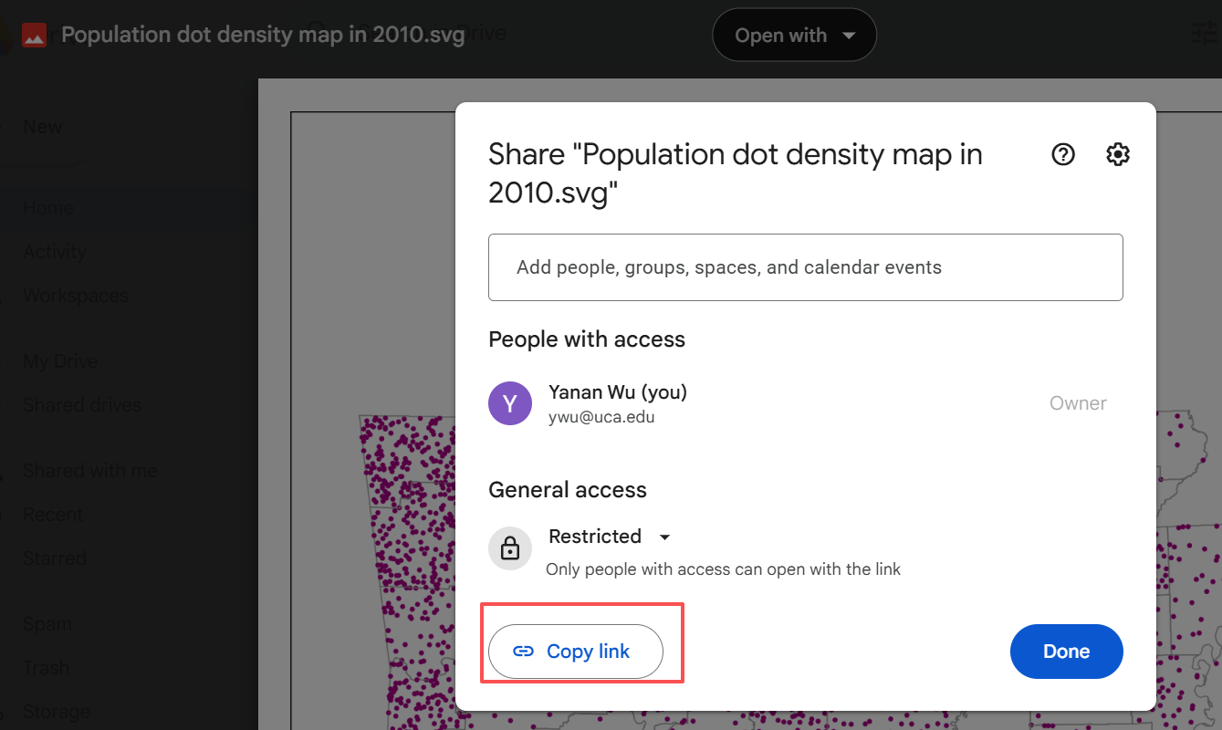
Lab 06
https://drive.google.com/file/d/1n2ibIfMY21sYPGcMGzXw1GWLp90rxYFj/view?usp=sharing

