Slide 1

WEEK 04 Geospatial Data lecture
Instructor: Yanan Wu
fALL 2025

Slide 2
4.1 Introduction to gis

Slide 3
Overview
Geospatial data
Vector
Point
Line
Polygon
Raster
Pixel
Triangulated Irregular Network
Objected Data Model
Three-Dimensional Data Models

Slide 4
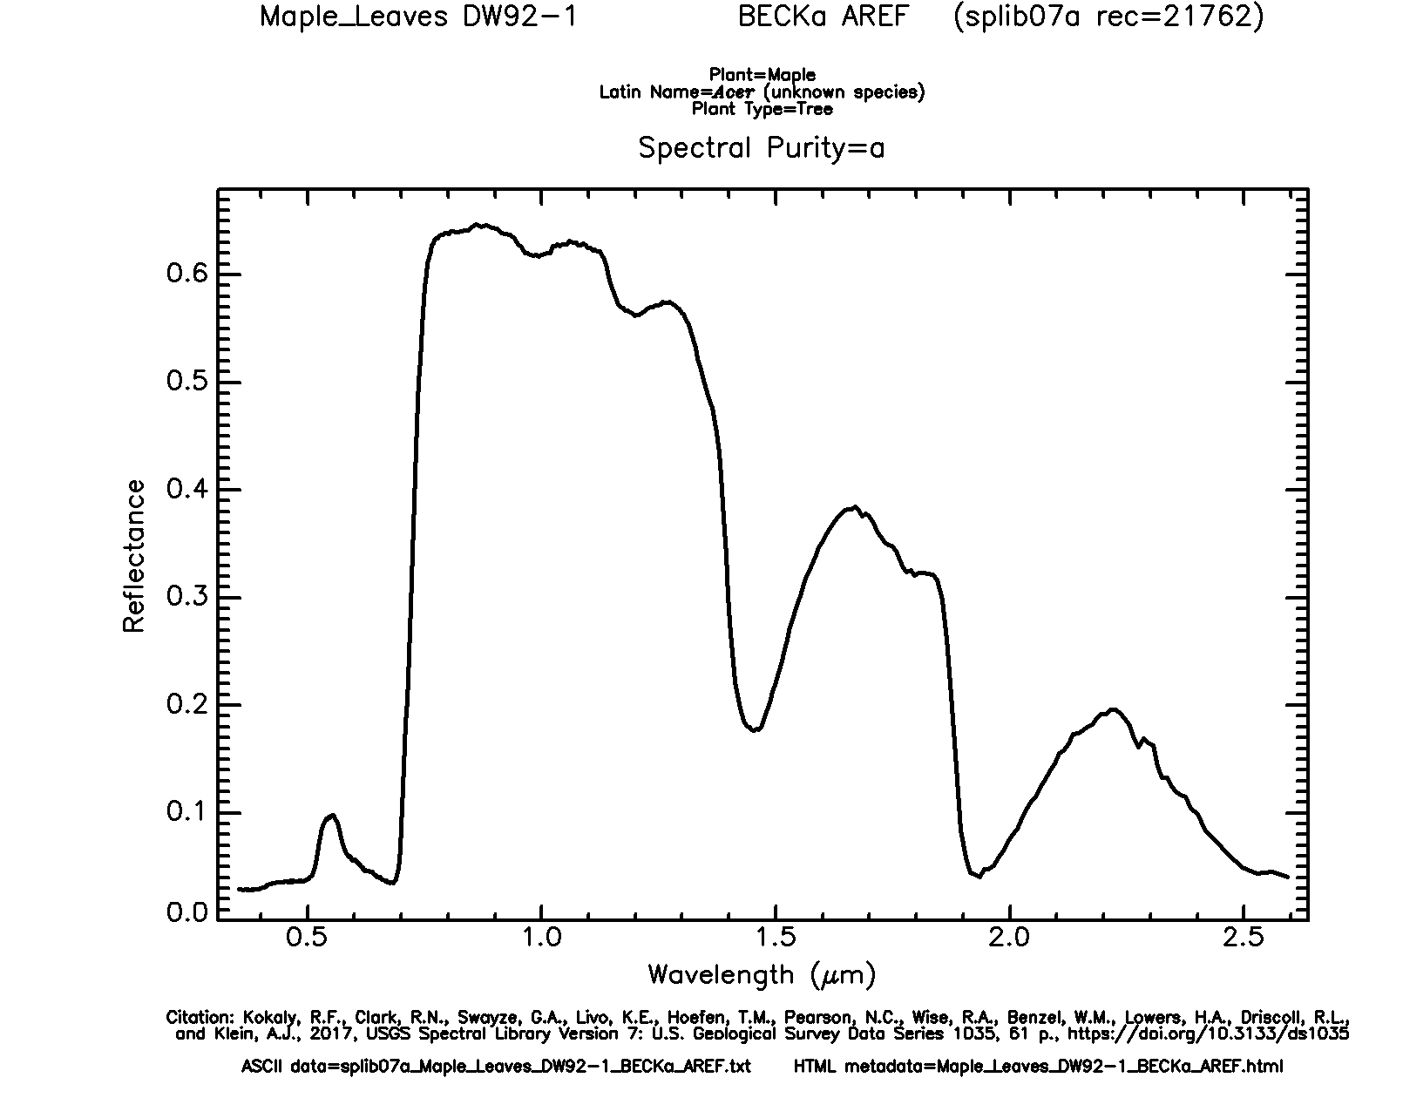
Spectral Reflectance of Vegetation
Blue = absorption by pigments
Green = less absorption by pigment
Red = absorption by pigments
Near Infrared = reflect and
scattered by interior cell walls
Shortwave Infrared = absorption by water in plant tissue
X
X
X
X
X
X
Example: Maple Leaf
Data from USGS Spectral Library Version 7
Notes:
Let’s explore the spectral reflectance of this maple leaf further.
Here, I have color coded different spectral ranges with different color “Xs.”
This leaf tends to absorb as opposed to reflect a lot of visible radiation. However, it absorbs more blue and red in comparison to green. This is why leaves appear green to us. This absorption results from the pigments in the leaf, such as chlorophyll, that interact with Sunlight in the process of photosynthesis to make energy and sugars for the plant. During the winter, when the tree is not photosynthetically active, the leaf will no longer appear green to us.
Green, healthy, and photosynthetically active leaves tend to scatter or reflect a larger proportion of incident near infrared radiation than visible light due to how this radiation interacts with cell walls. So, if we could sense near infrared radiation, a leaf would appear to be near infrared as opposed to green. However, this has no physical meaning since we can’t see near infrared radiation.
In the shortwave infrared range there are some absorption features associated with water in the plant tissue.
This graph highlights the wavelength specific nature of spectral reflectance.

Slide 5
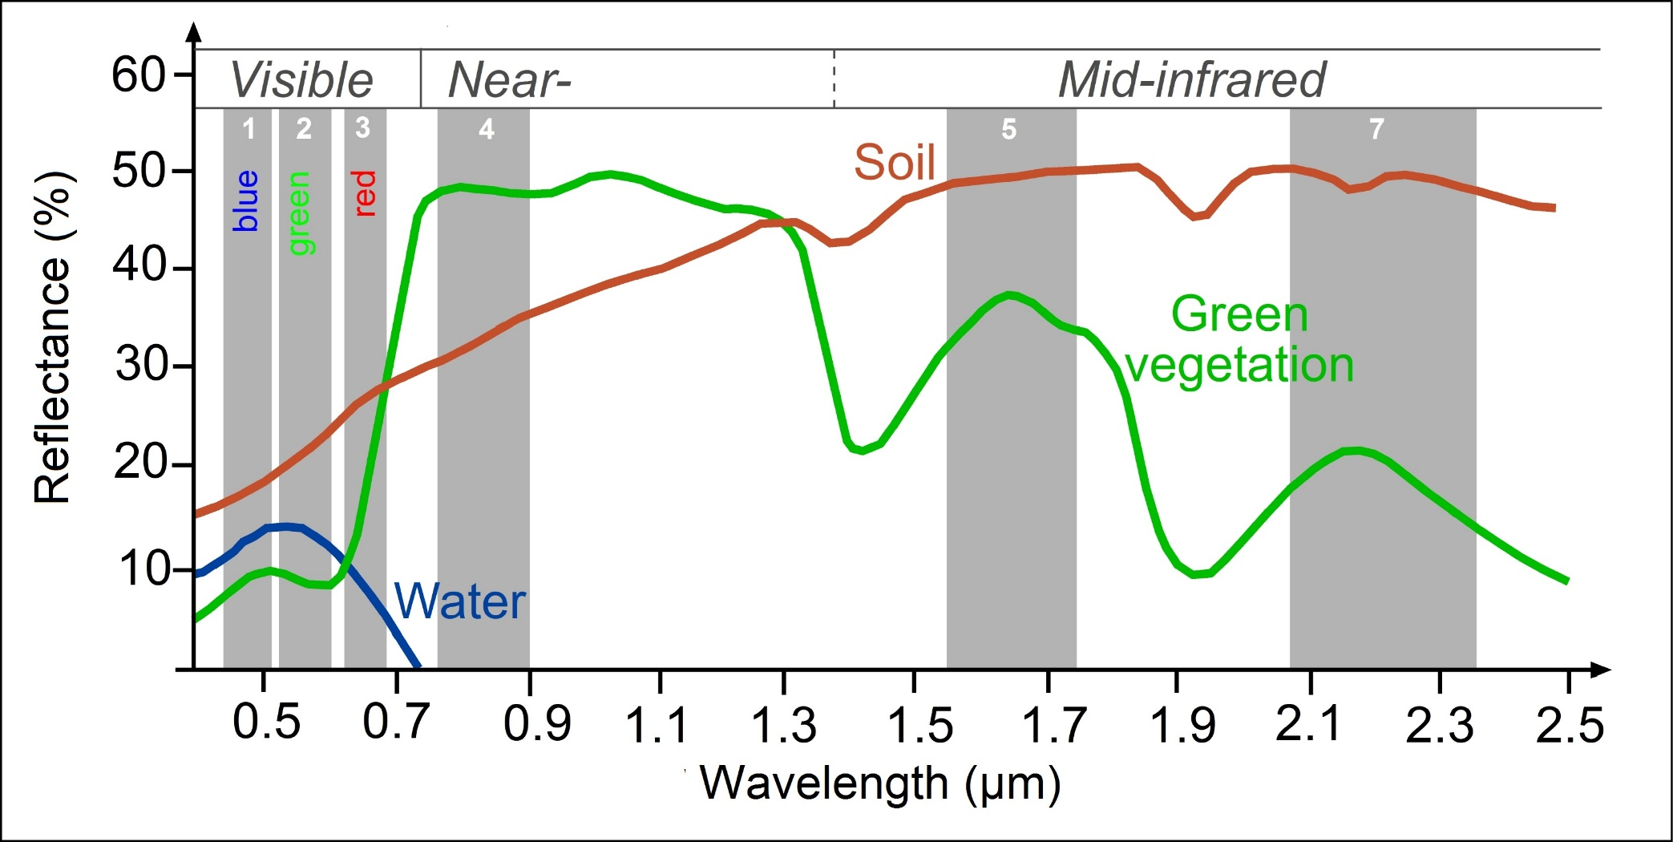
Different materials have different reflectance properties
http://www.seos-project.eu/modules/classification/classification-c01-p05.html
Notes:
This graph provides another comparison.
Soil tends to show greater spectral reflectance in the shortwave infrared range in comparison to near infrared or visible wavelengths, a pattern that is much different from green vegetation.
Water tends to absorb most near infrared and shortwave infrared radiation.
So, using these patterns, we could potentially differentiate these different surface materials.
You may notice some small troughs in the shortwave range for soil that align with the deeper troughs for green vegetation. This results from water in the soil, just as the troughs in the green vegetation curve relate to water in the plant tissue.

Slide 6
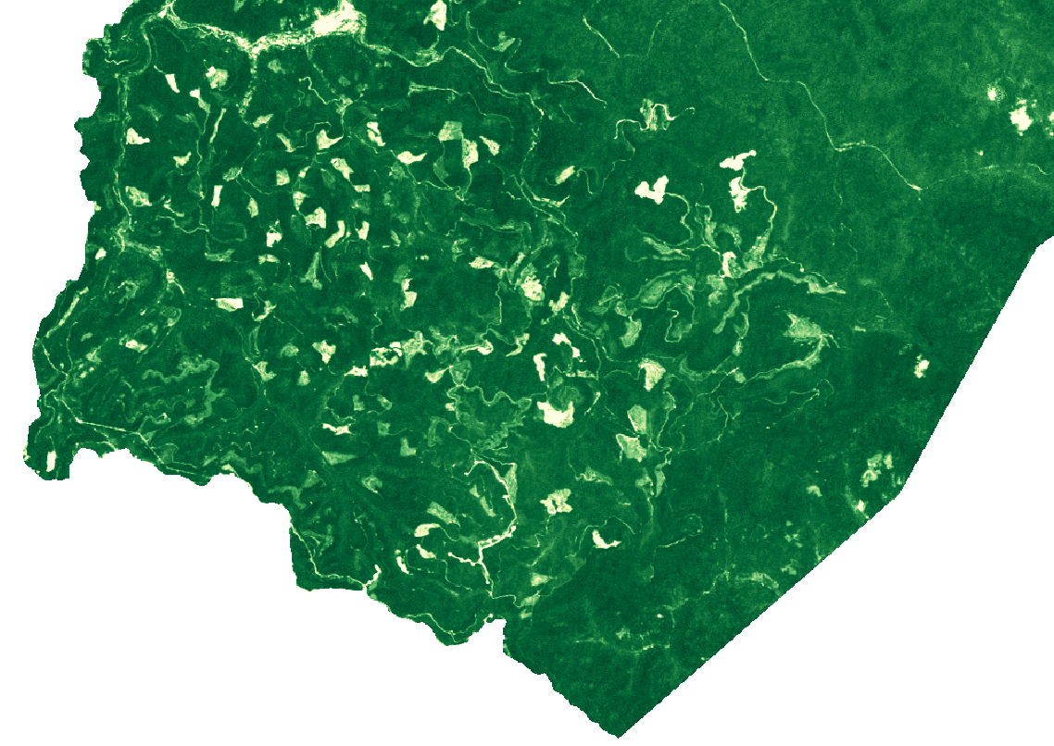
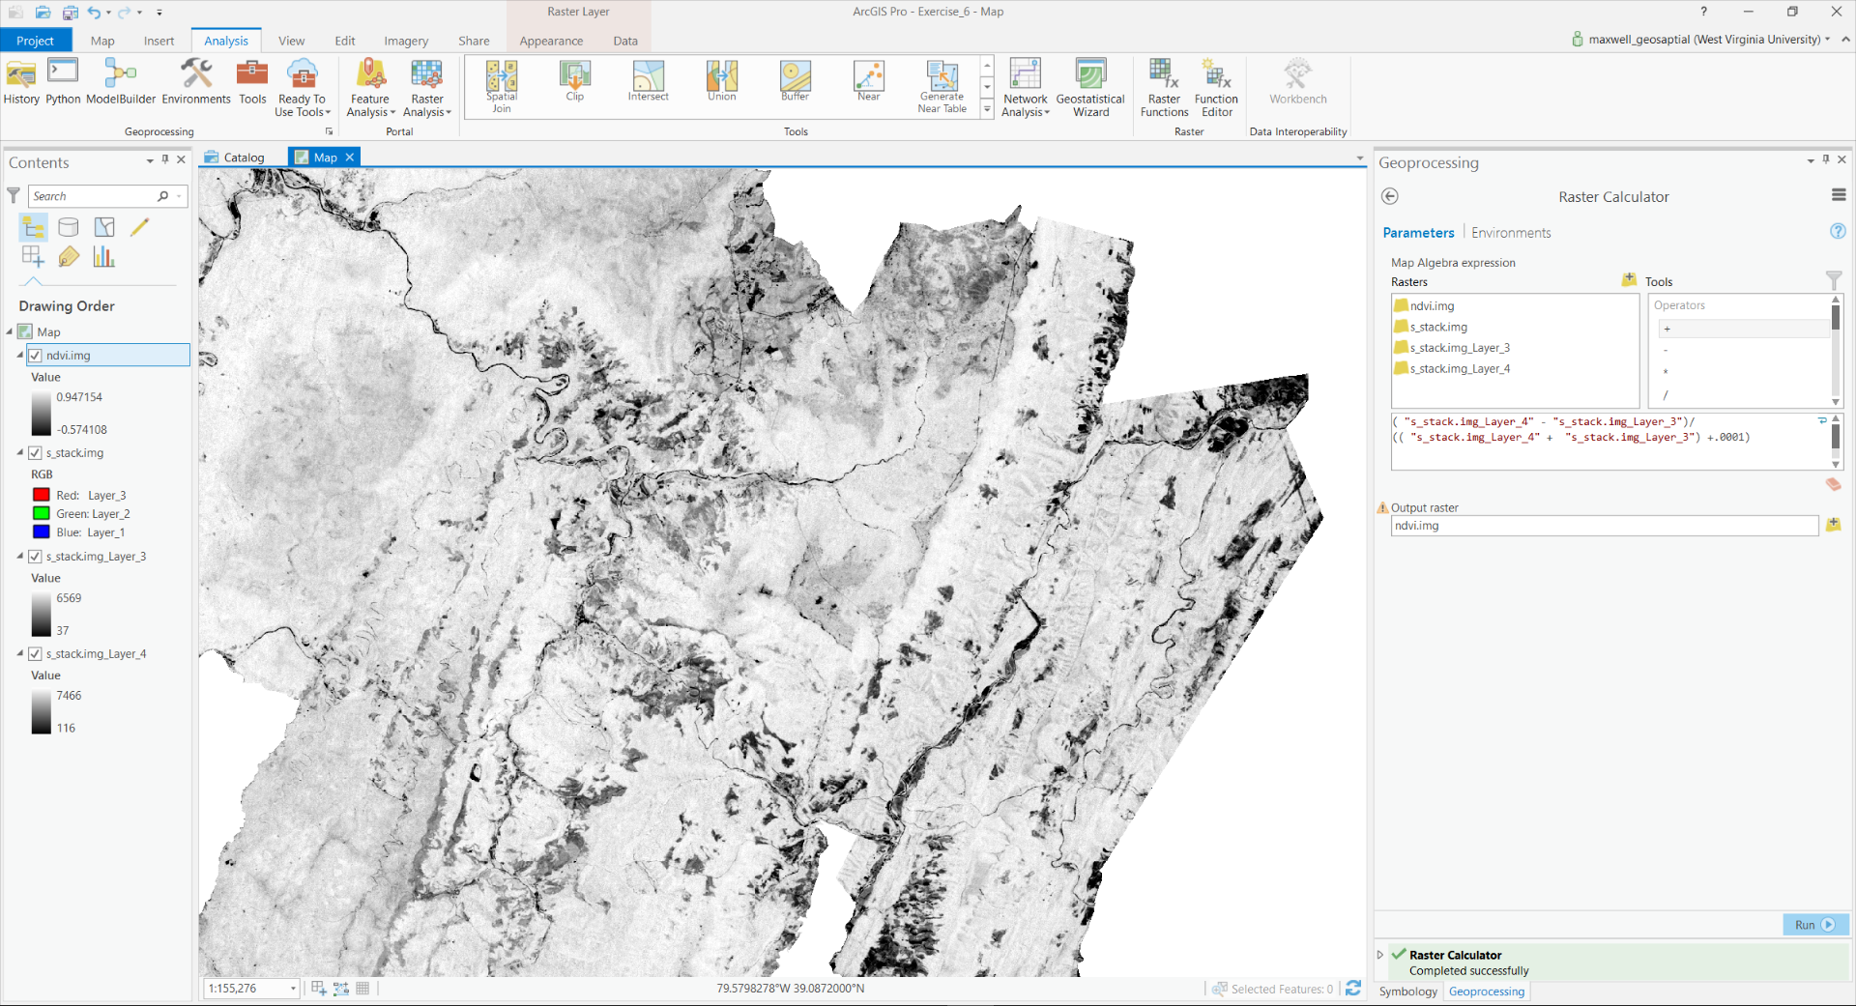

Normalized Difference Vegetation Index (NDVI)
$$\frac{(NIR −Red)}{(NIR+Red)}$$
Data from Landsat 5 Thematic Mapper
Notes:
It is often valuable to compare the spectral reflectance in different wavelength ranges or bands.
To accomplished this task, we can produce ratios from input bands.
As an example, the normalized difference vegetation index, or NDVI, compares near infrared and red reflectance.
Based on our previous discussions, you now know that green, healthy, photosynthetically active vegetation tends to reflect more infrared radiation than it does red radiation. This is because pigments absorb the red radiation in the process of photosynthesis.
High values of this index indicate the presence of green, healthy, photosynthetically active vegetation where as low values indicate that vegetation is not present, it is not photosynthetically active, or it is not healthy for some reason.
As an example, the image on the left shows NDVI for a small area in West Virginia. Dark green areas indicate high NDVI or healthy vegetation. In contrast, the white or light green areas indicate lower NDVI. Many of these large patches of lower NDVI are associated with forest harvesting.
There are many other examples of band ratios that can be used to map, assess, or monitor different landscape features. Here, I am just providing NDVI as an example.

Slide 7
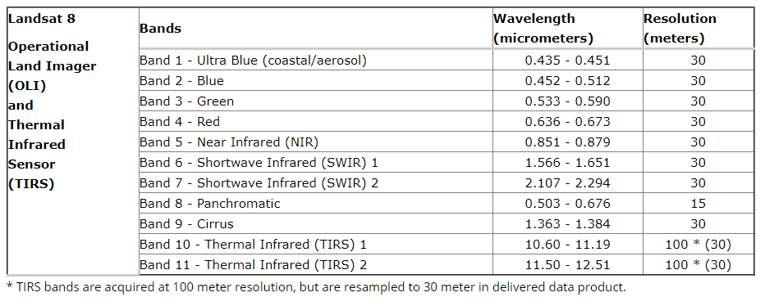
Imagery bands
https://landsat.usgs.gov/what-are-band-designations-landsat-satellites
Notes:
The most recent Landsat, Landsat 8, carries the Operational Land Imager and the Thermal Infrared Sensor.
In comparison to Landsat 7 ETM+, the Landsat 8 sensor adds a ultra blue band for coastal mapping and aerosol mapping and a cirrus cloud band for detecting high clouds and cloud contamination.
It also provides 2 thermal bands as opposed to one.
Landsat 9 will have similar specifications to Landsat 8 and is expected to launch in December of 2020.

Slide 8
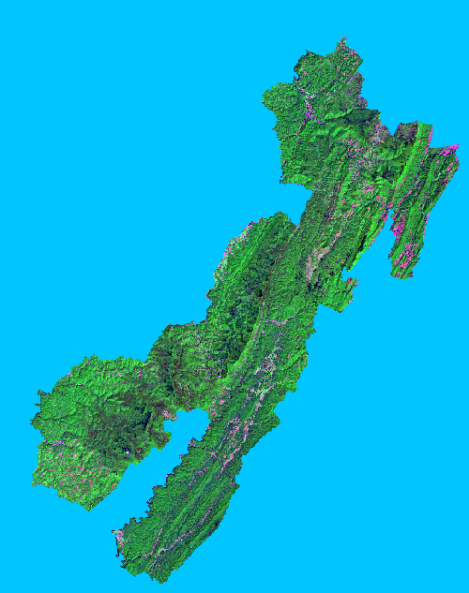
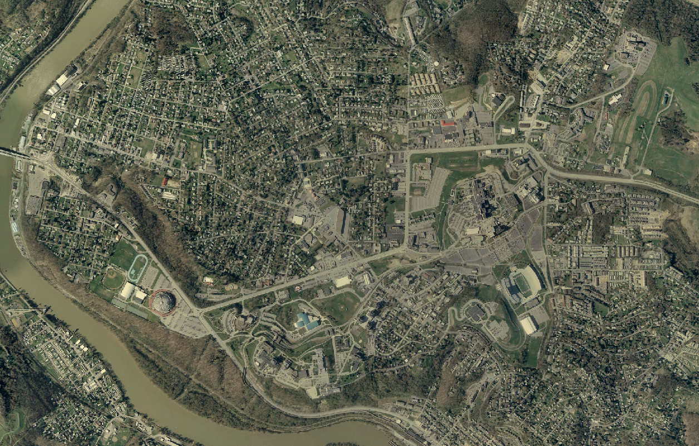

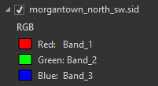
Raster Data
Remote sensing imagery
Multiple layers or bands that are stacked to produce an image
Value = 896 m
Notes:
Other than panchromatic, or black-and-white, imagery, image datasets contain more than one band.
For example, a true color image will contain three bands: red, green, and blue.
For multiband images, the raster data structure is that of an array. Each cell location holds multiple measurements, or a single measurement in each band.
You can think of a multiband raster as a stack of single band layers that act as one file.
Although we will focus on multiband imagery here, you can actually create multiband raster grids from a variety of raster data layers.

Slide 9
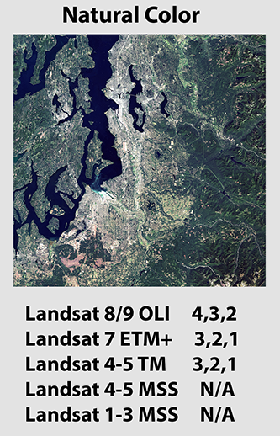
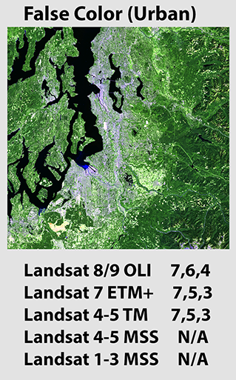
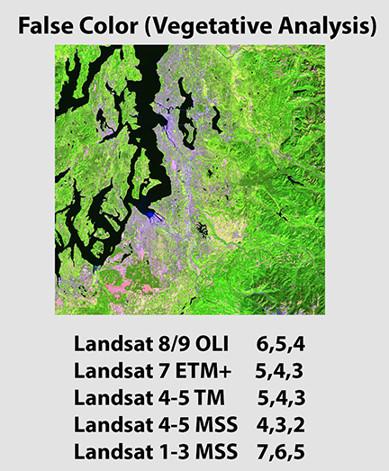
Band combination

Slide 10
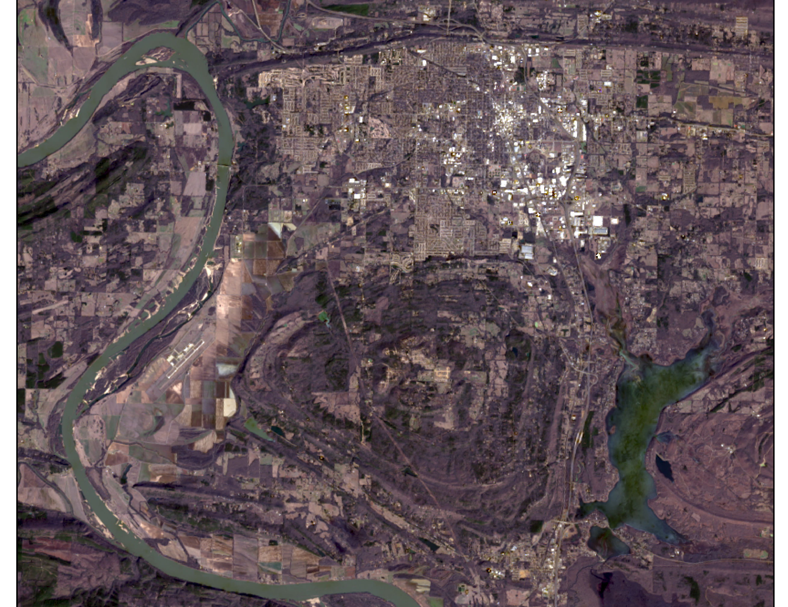
Observe the imagery
Images: Landsat 9 acquired January 23, 2025.
Band number displayed as R, G, B
Natural Color: 4, 3, 2
Notes:
One way to use the bands is to choose three of them and to combine them to produce a composite image. There are many possible band combinations and each one shows the imagery differently. Some combinations can be particularly good at highlighting specific types of landscape features or properties.

Slide 11
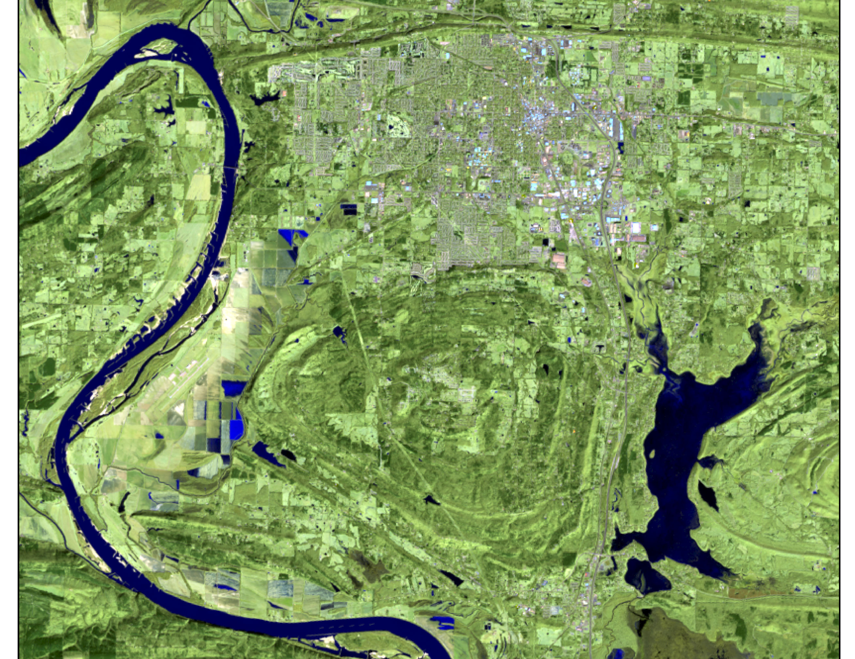
Observe the imagery
Images: Landsat 9 acquired January 23, 2025.
Band number displayed as R, G, B
False Color (Urban): 7,6,4

Slide 12
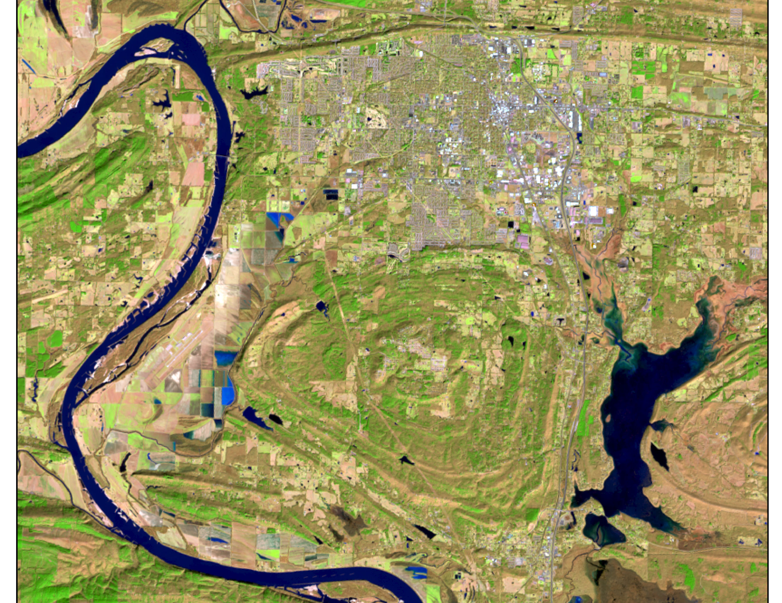
Observe the imagery
Images: Landsat 9 acquired January 23, 2025. Band number displayed as R, G, B
False Color (Vegatation): 6,5,4

Slide 13

Raster Data
Radiometric Resolution
Pixel Type/Pixel Depth
4-bit = 2⁴ (16) unique values
8-bit = 2⁸ (256) unique values
16-bit = 2¹⁶ (65,536) unique values
32-bit = 2³² (4,294,967,296) unique values
1-bit, 2-bit, 11-bit, 12-bit, etc.
0
16
0
255
0
65,536
0
4,294,967,295
Can think of this as the degree of brightness difference that can be quantified
Notes:
Radiometric resolution has to do with what levels in brightness can be differentiated.
This relates to the pixel type or pixel depth of an image. For example, a 4-bit image would be able to differentiate 16, or 2 to the 4th power, discrete levels of brightness. In contrast an 8-bit image could differentiate 256, or 2 to the 8th power, discrete levels of brightness.
A 16-bit image could differentiate a large number of discrete brightness differences.
As an extreme case, a 1-bit image could only differentiate 2 to the 1st power, or 2, levels of brightness. So, the result would be black and white, or on and off.
You can think of this as the precision of the measurement. As an analogy, increasing radiometric resolution is like making length measurements to the nearest millimeter as oppose to the nearest meter. Or, you will be able to differentiate smaller differences in length.
Many older sensor recorded 8-bit data. However, modern sensors are increasingly providing 11-bit or 16-bit data. Again, this allows for more precise differentiation of brightness or spectral reflectance. The trade-off is larger file size and greater data volumes.

Slide 14
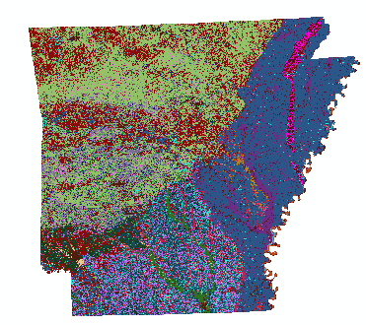
Raster Data
Raster data are always rectangular
No data cells still exist
Notes:
All grid cells are rectangular even if data are not provided in each cell.
This is because each row and column must have a full set of cells.
Grid cells that do not hold a measurement still exist, but they store a NoData assignment.
When the computer sees this value, it interprets it to mean empty, null, or missing.
For example, for an 8-bit raster grid either the lowest value, 0, or the highest value, 255, is commonly reserved as the NoData value.
In the example above, all cells within the state of Arkansas hold an elevation measurement. However, the full extent of the grid is rectangular.
So, the remaining cells, shown here in pink, are coded with the NoData assignment.

Slide 15
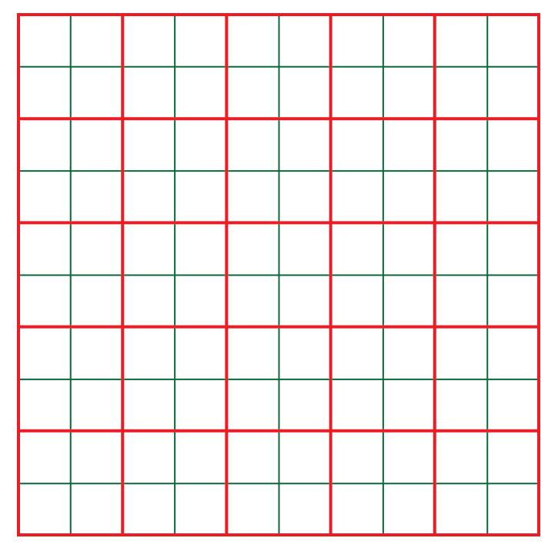
Raster Data
Cell size (spatial resolution)
Red: 100 mx100 m (lower resolution)
Green: 50 mx50 m (higher resolution)
Notes:
Reducing the cell size can have a large impact on the total number of cells and, as a result, the file size.
For example, in the image above the red grid represents cells that are 100 by 100 meters.
The green grid represents cells that are 50 by 50 meters.
Each 100 by 100 meter cell contains four as opposed to two 50 by 50 meters cells.
So, decreasing the cell size by half quadruples the number of pixels.
As another example, a 10 by 10 meter cell would contain 100 1 by 1 meter cells.
So, high spatial resolution raster grids can be very large files, especially if they cover a large spatial extent.

Slide 16
Raster Data
Raster File Formats
ESRI Grid
Erdas Imagine (.img)
GeoTIFF (.tif)
Notes:
There are a variety of raster grid formats. However, I commonly use ESRI grids, Erdas Imagine, or GeoTIFF files.

Slide 17
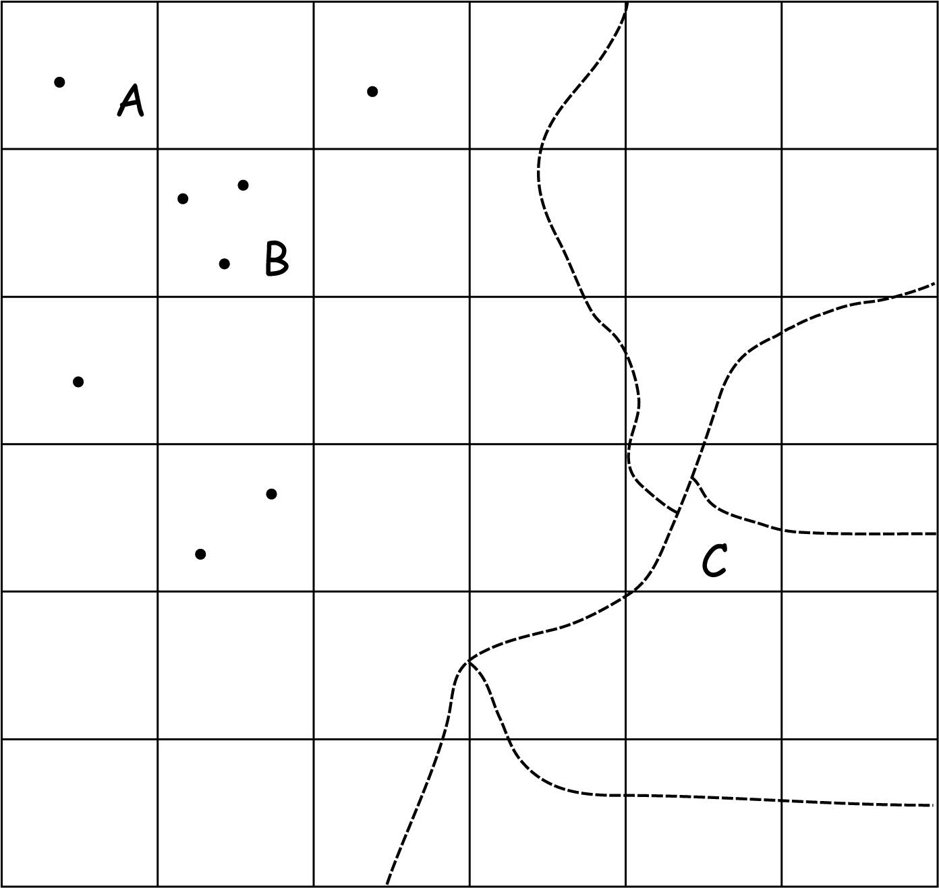
Raster Data
Raster cell values assignment maybe complicated
When they are multiple features within a single cell
Select a representative feature, and use the attribute from that feature
Reduce the cell size to include only one feature in each cell
Bolstad, 2019

Slide 18
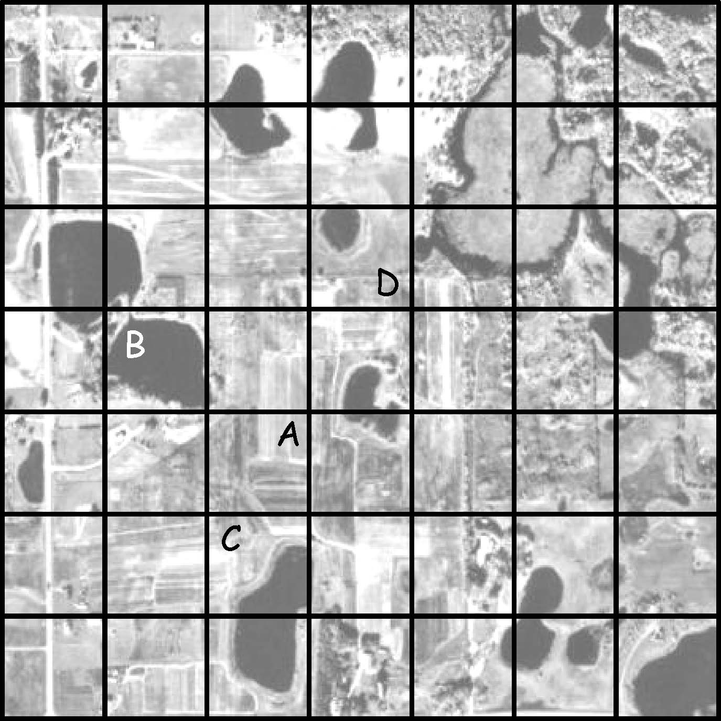
Raster Data
Raster cell values assignment maybe complicated
When they are multiple features within a single cell
Winner-take-all or majority
User’s preference
Bolstad, 2019

Slide 19
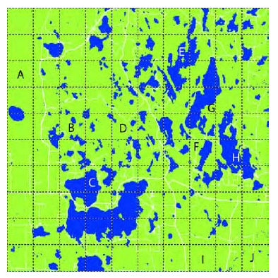
Group Activity 3-1
Discuss with your peers:
List the labels (A, B, C…J) of raster cells that would be assigned as water (dark blue) or land (light green) under a majority coverage rule (i.e., winner-take-all) and User’s preference (i.e., water)
Bolstad, 2019
Notes:
E,H,J

Slide 20
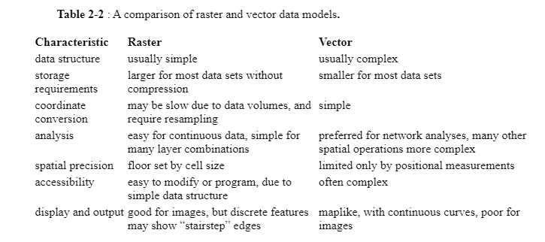
Vector and Raster Models Comparison
Bolstad, 2019

Slide 21
Vector and Raster Models Conversion
Vector to Raster
Assign a value to a cell if a vector line intersects with any part of the cell
Assign a value to a cell only when the cell center is near a vector line segment
Vector to Raster
Bolstad, 2019

Slide 22
Vector and Raster Models Conversion
Raster to Vector
Each vector point feature is usually assigned the coordinate of the corresponding cell center
Raster to Vector
Bolstad, 2019

Slide 23
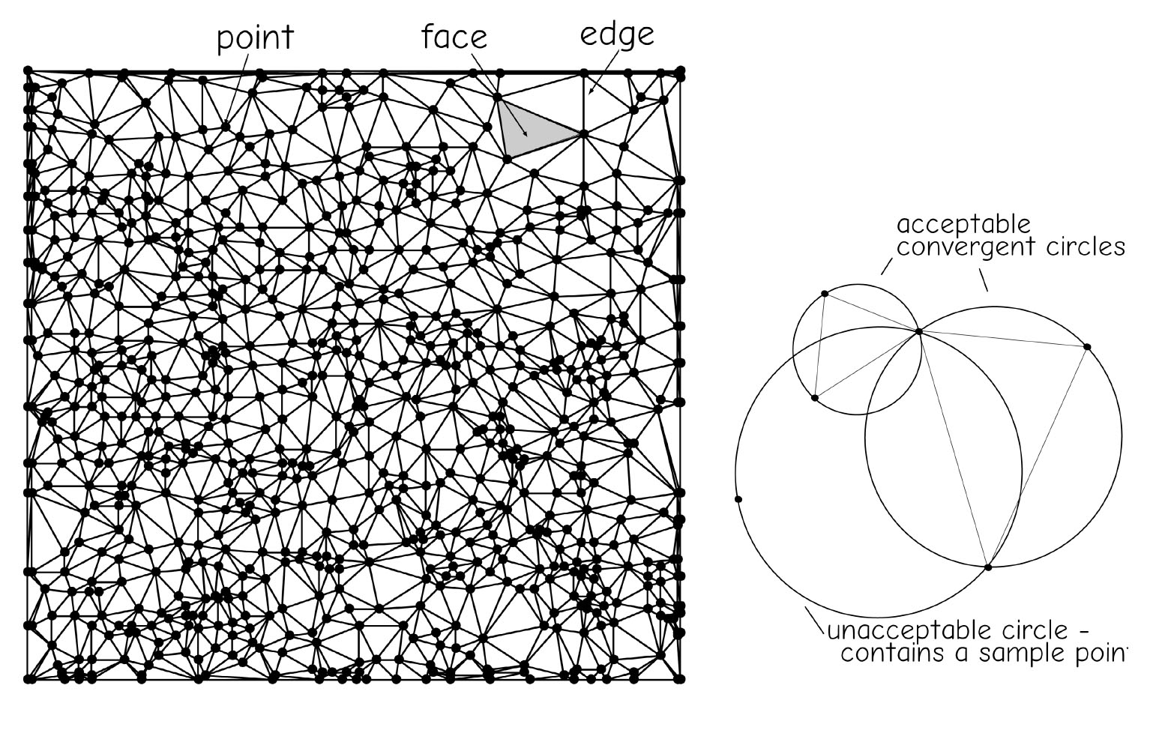
Triangulated Irregular Networks
TIN is a data model commonly used to represent terrain heights
There points are connected such that the smallest triangle possible spans any three adjacent points.
A trainable is drawn only if the corresponding convergent circle contains no other sampling points
Higher variable region, more smaller triangles
Flat region, less but large triangles
Bolstad, 2019

Slide 24
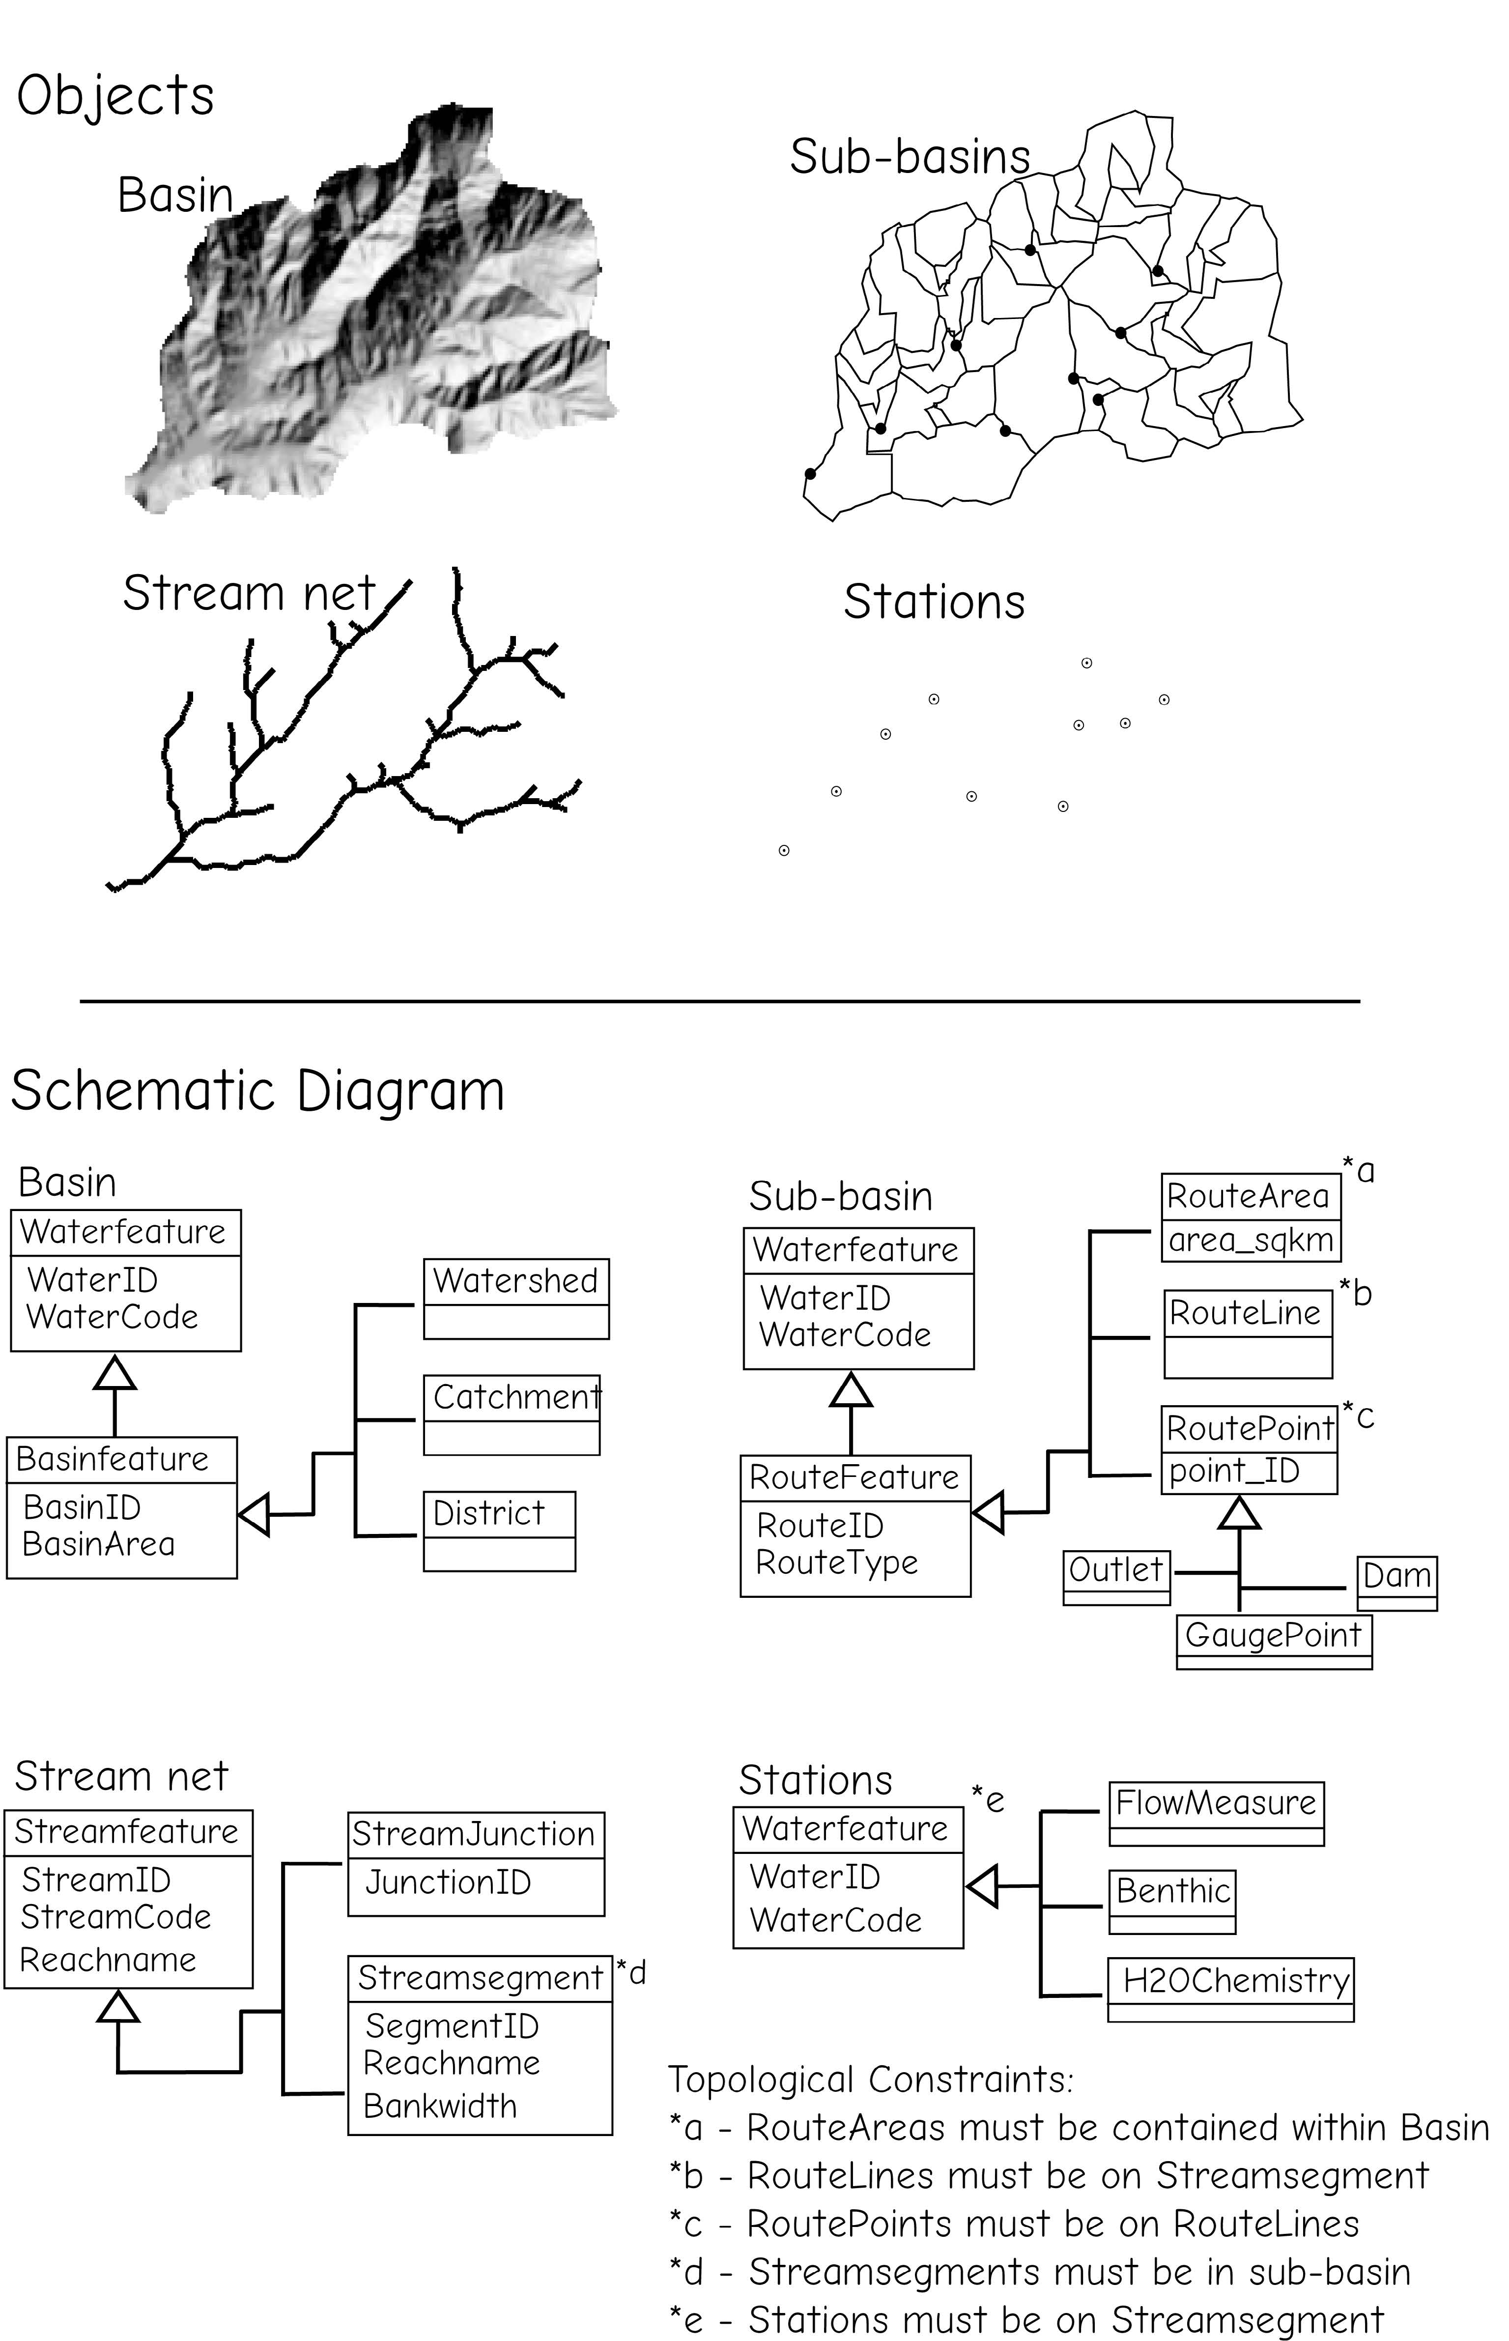
Object Data Model
Objects are often geographic features, with spatial and attribute data and topological relationship
A river basin
Bolstad, 2019

Slide 25
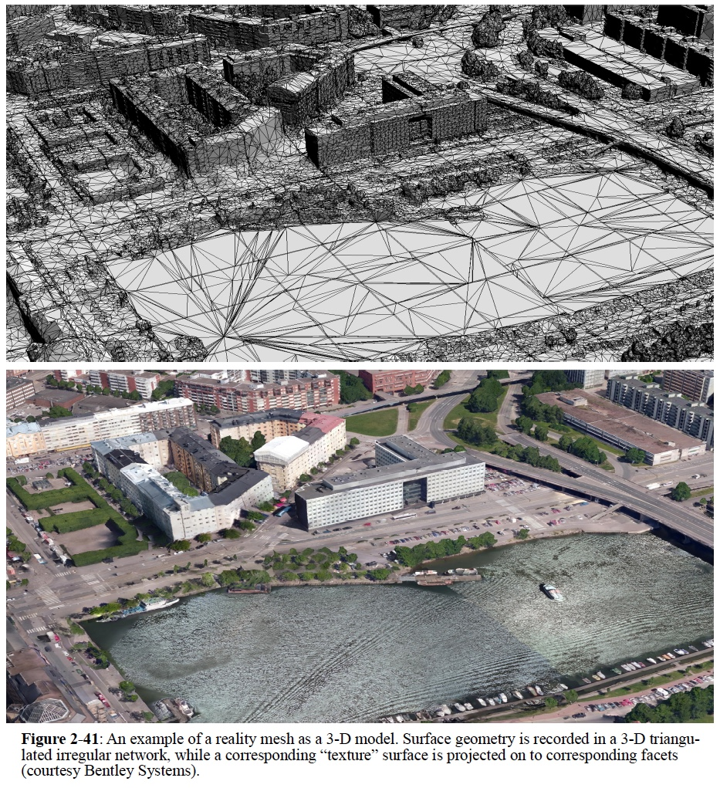
3-D Data Model
Reality mesh combines a three-dimensional triangulated irregular network with an image-based texture surface
Useful for height-related characteristics, such as building height, roof shapes
Bolstad, 2019

Slide 26

Thank you!

