Slide 1

GEOG 3403: Geographic Information Systems II
Lecture 02 Network Analysis
Yanan Wu, PhD
Assistant Professor
Department of Geography

Slide 2
Overview
What is network?
Network dataset elements
Attribute
Evaluator
Network application
Best route
Closest facility
Service areas
Location-allocation
Origin-destination matrix

Slide 3

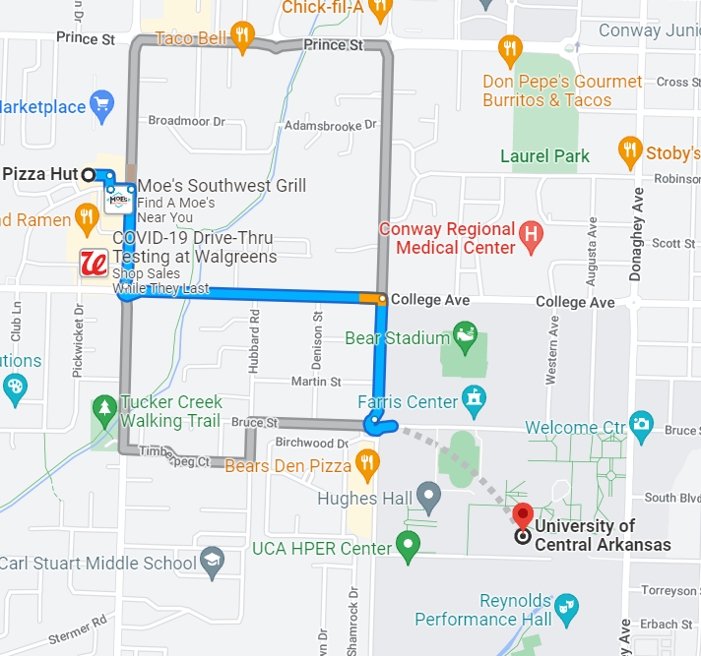
What is Network?
Euclidean Distance (shortest distance)

Slide 4
What is Network?
A network is a system composed of interconnected parts or elements. These elements are combined to represent possible routes from one location to another. Likes, roads, railroads, electrical power lines, streams, pipelines, etc.
Networks are used for the transportation of people, resources, and goods.
Notes:
https://www.youtube.com/watch?v=GRe0xVeerMI
https://www.youtube.com/watch?v=-NAno1uE7_E

Slide 5
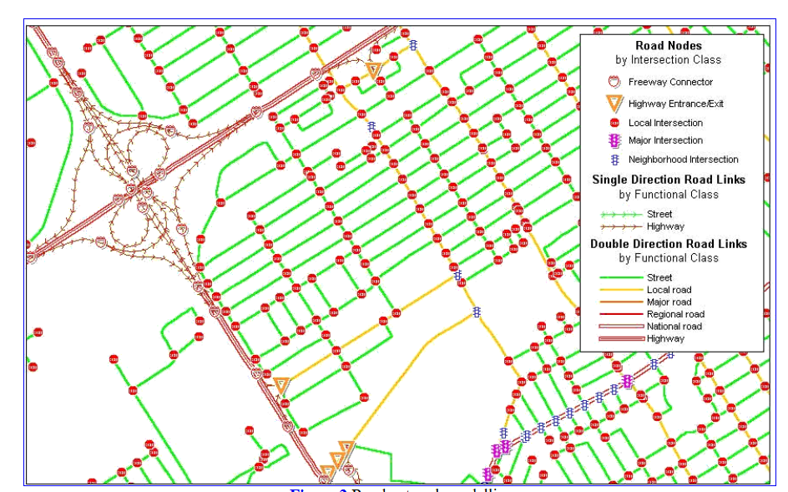
Network Dataset
A network dataset is used to model real-world networks and facilitate analysis.
Information stored in Network Dataset
Location?
Relationship? Intersect or non-intersect?
Turns are allowed or prohibited?
Notes:
Network dataset not only contains the locations and attributes of streets and highways but also includes information about how they are related to each other.
Roads can be connected, have turns that are allowed or prohibited, and provide other details (e.g., speed limit) that affect what travel paths are possible and how long travel might take.

Slide 6
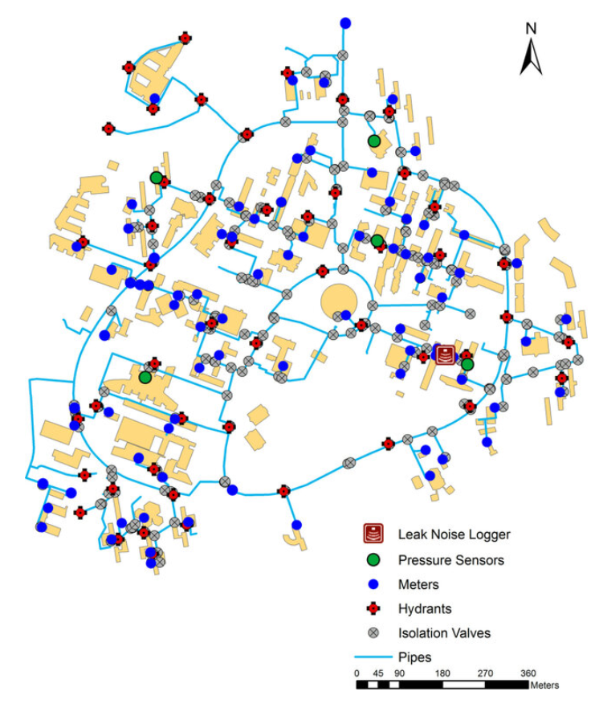
Network Dataset vs Facility Network
Agent (e.g., water) only travel in on direction at a time.
Can agent control the direction?
Data Source
Notes:
Facility networks refer to things like utilities or rivers. The agent in a facility network can only travel in on direction at a time, and the direction is not controlled by the agent, but rather by gravity, water pressure, or mechanical means.
In the network dataset, the agent is free to choose the direction of travel and the destination. Facility networks are best modeled using geometric networks in ArcGIS.
The ArcGIS Network Analyst extension and this course only cover network datasets.

Slide 7
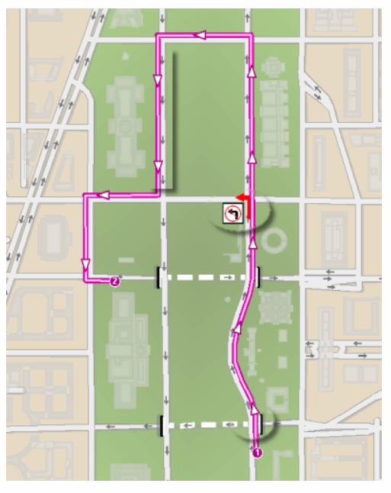
Network Dataset Elements
Network = System of linear features that has the appropriate attributes for the flow of objects
Appropriate attributes:
Direction? One-way or two-way?
Turn restriction?
Route between two stops.
https://desktop.arcgis.com/en/arcmap/latest/manage-data/network-datasets/what-is-a-network-dataset.htm

Slide 8
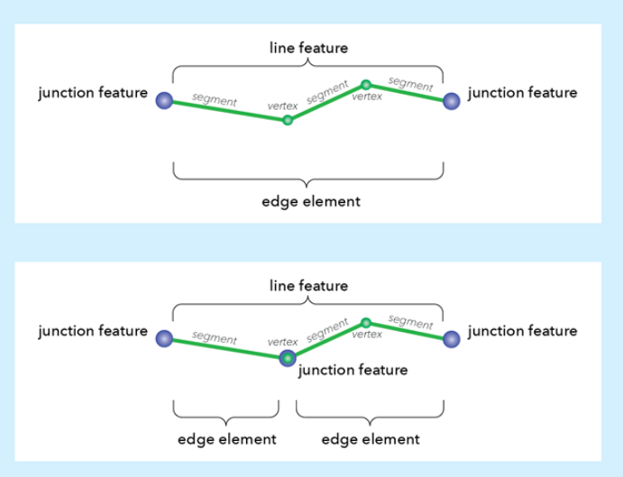
Network Dataset Elements
Edges: An edge is a line that represents a connection or path between two nodes in a network.
Junctions connect edges and facilitate from one edge to another.
Notes:
Edges connect to other elements using junctions and are linked over which agents travel. Linear source feature classes become edge elements in the network dataset. Edges are also directional, so there can be both a From-To edge and a To-From edge.

Slide 9
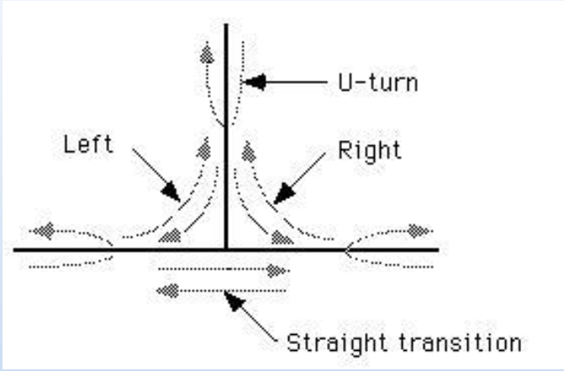
Network Dataset Elements
Turns store information that can affect movement between two or more edges. For instance, a right turn might be restricted from one particular edge to another.

Slide 10
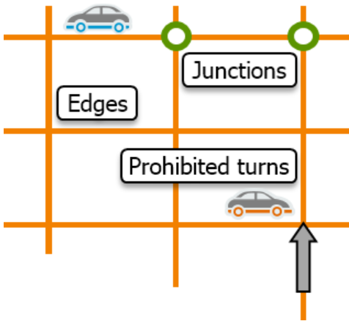
Network Dataset Elements
Edges and junctions form the basic structure of any network. Turns are optional elements.
ESRI Academy

Slide 11
Network Dataset Elements
Network connectivity includes the connection of edges and junctions to each other, and it is essential for network analysis.
Simple features, like line features that represent streets, are not aware of one another until they are added to a network dataset and connectivity is established from vertices and links.
Network datasets determine connectivity and create connectivity rules from the ways that points, line endpoints, and vertices coincide geometrically.

Slide 12
Network Dataset Elements
Network connectivity
Street network
Barriers
Bridge
Pedestrian network
Access restrictions
Bus/train network
Stops
Route differs by day
Pickup/ dropoff restrictions?

Slide 13
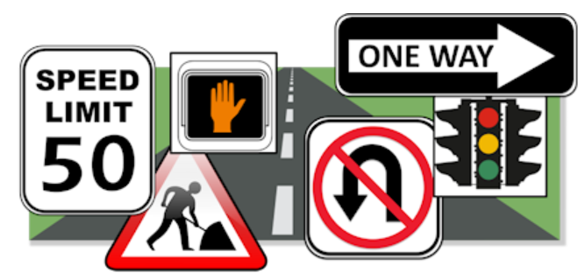
Network Dataset Attributes
Network elements have attributes that control navigation over the network. Vital to analysis, attributes are used to hold details and properties about your network dataset.
ESRI Academy

Slide 14
Network Dataset Attributes
Cost
The value the network uses to measure how “expensive” it is to travel along an edge, such as time, distance, or effort.
Network datasets must have at least one cost attribute.

Slide 15
What is the cost type in the following scenario?
🤔
I need to take 10 minutes to get to UCA.
I want to walk to a nearby café and choose the shortest path, not the fastest.
An emergency vehicle wants to avoid roads with many traffic lights or sharp turns.

Slide 16
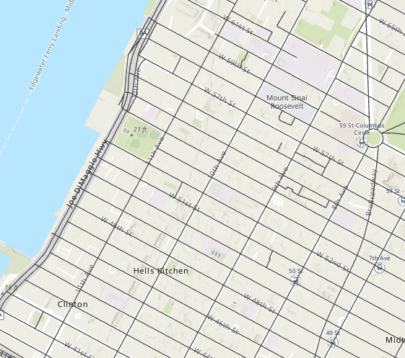
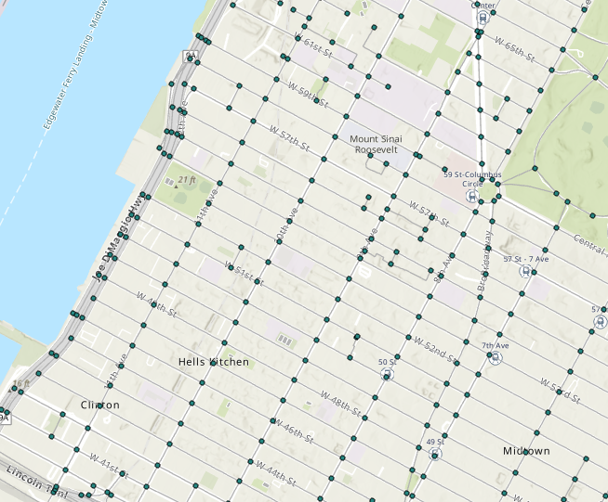
Network Dataset Elements
Network dataset elements are created from source features such as road feature classes.
The geometry of the source features defines how network elements connect, allowing the network dataset to be used for analysis.
Road feature class
Road network

Slide 17
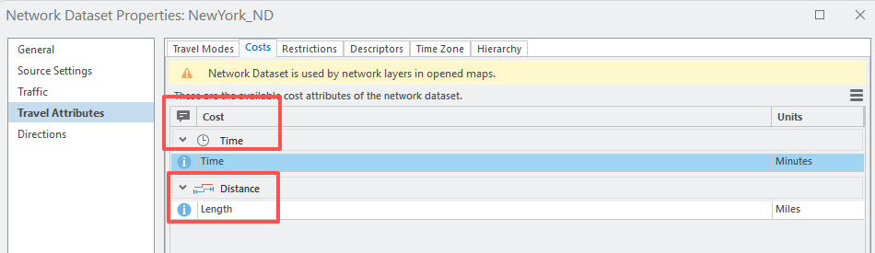
Network Dataset Attributes
Cost
Minimization of a cost
Find the best route (e.g., fastest route or shortest route)
ArcGIS Pro
Notes:
https://pro.arcgis.com/en/pro-app/latest/help/analysis/networks/cost-attributes.htm

Slide 18
Network Dataset Attributes
Descriptor
Descriptors contain general information, often referenced by one of the other three attribute types, to calculate their values
Unlike costs, descriptors are not apportioned. This means that the value does not depend on the length of the edge element.
Example: Number of lanes, speed limit
Notes:
Although it is not a cost attribute and cannot be used as an impedance, it can be used in conjunction with distance to create a cost attribute (for example, drive time) that can be used as an impedance.

Slide 19
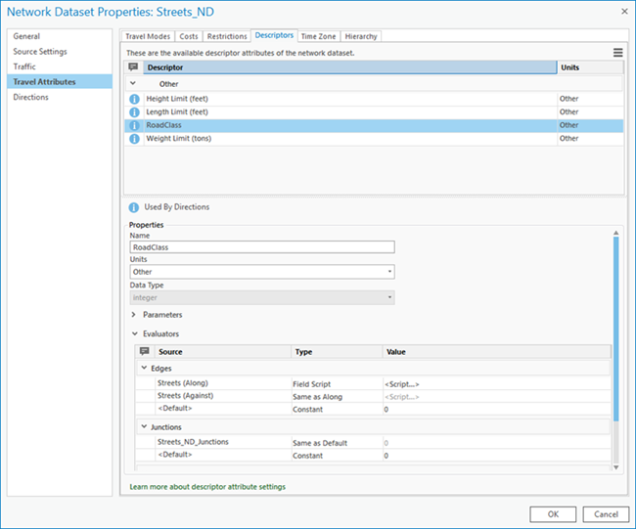
Network Dataset Attributes
Descriptor
ArcGIS Pro
Notes:
https://pro.arcgis.com/en/pro-app/latest/help/analysis/networks/cost-attributes.htm

Slide 20
Network Dataset Attributes
Restriction
Traversing roads with certain characteristics is prohibited entirely, avoided, or even preferred
The most common use of a restriction is to prohibit traversal that prohibits traversing certain edges in certain directions.
A restriction attribute is either on or off, that is restricted or traversable.
Example: One-way street, road construction, closures, travel restrictions.
Notes:
Restrictions can be configured on a network data source such that, during an analysis, traversing roads with certain characteristics is prohibited entirely, avoided, or even preferred. For example, restrictions can be used to prevent pedestrians from walking on highways or to prevent tall trucks from traveling on roads with insufficient overhead clearance.
The most common use of a restriction is to prohibit traversal. For example, one-way streets can be modeled with a restriction attribute so they can only be traversed from one end to another, but not in the reverse direction. Similarly, a restriction attribute on walkways can completely prohibit traversal so that the network elements identified as walkways are excluded from any route that is generated for a motorized vehicle.
Instead of prohibiting traversal on certain network elements, you may want to lessen a prohibit restriction whereby the solver avoids traversing the elements, unless it is impossible or too costly to do so. For instance, if you are routing commercial delivery vehicles and want them to avoid driving on private roads, you can use a restriction attribute and set its Usage Type property to Avoid. This way, private roads are avoided in most cases, but if a delivery happens to be on a private road, the route can still reach the destination.
Consider a truck carrying hazardous materials (hazmat). There are some roads where transporting hazmat is illegal, some where it is allowed, and some where it is preferred because an accident occurring along those roads would be easiest for emergency responders to reach and contain.

Slide 21
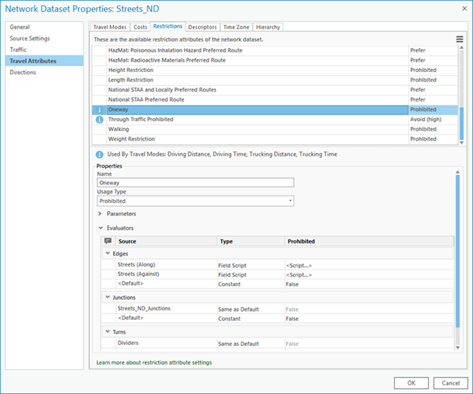
Network Dataset Attributes
Restriction
ArcGIS Pro
Notes:
In all cases, a restriction attribute is configured to return a Boolean (true or false) value for each network element of the network data source. For a given network element, if the restriction returns true, it means the usage type is applied to that element during analysis for travel modes that include the restriction; false means the restriction has no impact on the particular network element being evaluated.
The preferred method for controlling the restrictions that are used for a particular analysis is through travel modes.
https://pro.arcgis.com/en/pro-app/latest/help/analysis/networks/cost-attributes.htm

Slide 22
Network Dataset Attributes
Hierarchy
Hierarchy differentiates among road types to help network analysis, and it allows a network dataset to assign priority.
Using wider, faster roads when available is quicker and more efficient.
Example: Highway, arterial, primary route, secondary route, side street

Slide 23
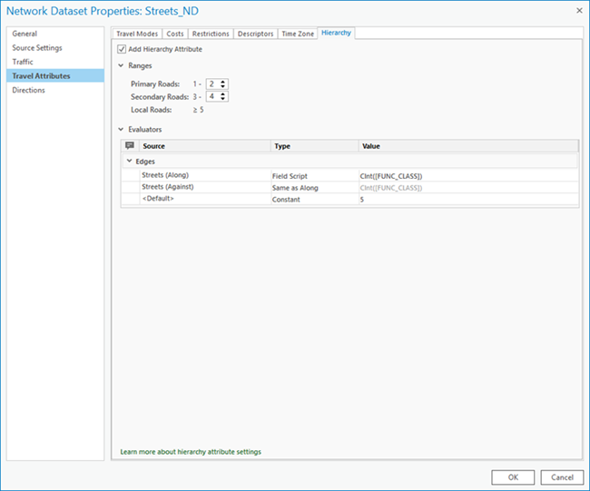
Network Dataset Attributes
Hierarchy
ArcGIS Pro

Slide 24
Network Dataset Evaluator
Evaluators determine attribute values
After you have identified network element attributes, they must have values assigned.
An evaluator is used to calculate a value for each attribute to determine total costs.
There is an evaluator for attributes of each of the network elements (edges, junctions, and turns) and each of their source feature classes.

Slide 25
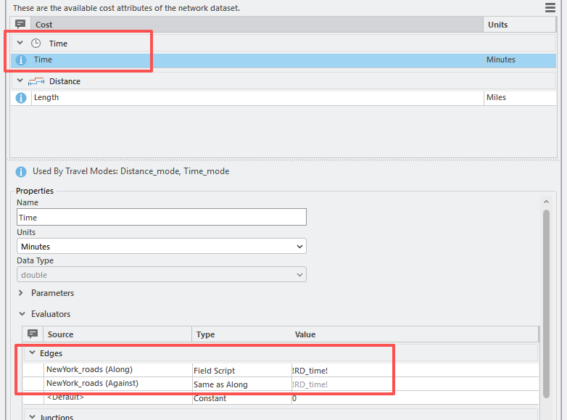
Network Dataset Evaluator
Evaluators determine attribute values
ArcGIS Pro

Slide 26
Network Dataset Evaluator
Evaluators determine attribute values
Evaluator types are based on the source data or another source or calculated
Field script: Field evaluators use values from fields in the source feature class.
Constant: Constant evaluators assign a single value to all elements in a group. It can be numeric for cost, descriptor, and hierarchy attributes, or a Boolean data type of Use Restriction for a restriction attribute
Notes:
For cost attributes with units of distance, use the Shape field in the Field Script evaluator to return the geodesic length of the line feature in the units of the network attribute. This is in contrast to using the system-managed Shape_Length field that contains the planar length of each line feature in the feature class's coordinate system, which is subject to the coordinate system's distortions.

Slide 27
Network Dataset Evaluator
Evaluators determine attribute values
Evaluator types are based on the source data or another source or calculated
Element script: Attributes can be assigned from the result of executing a VBScript or Python script at the time of analysis. It is calculated whenever analysis requires the use of an attribute to ensure that the value is as current as possible.
VBScript executes faster than those written in Python. Use VBScript.
ArcGIS Server (Linux) can interpret Python only.
Notes:
https://pro.arcgis.com/en/pro-app/latest/help/analysis/networks/types-of-evaluators-used-by-a-network.htm
Unlike other evaluators, the Element Script evaluator does not assign values when a network is built. Instead, it assigns values when a network analysis requires the use of that attribute, which can occur at solve time. If the values of an attribute change constantly, the use of the Element Script evaluator can ensure that attributes are updated for each network analysis.

Slide 28
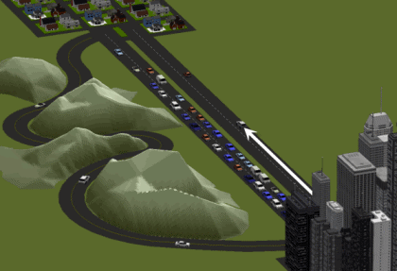
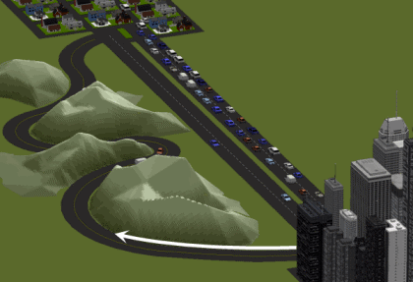
Network Dataset Evaluator
Evaluators determine attribute values
Evaluator types are based on the source data or another source or calculated
Traffic: Traffic evaluators are designed for traffic data.
They can provide travel times for a given time of day and day of the week using historical or live data.
https://pro.arcgis.com/en/pro-app/latest/help/analysis/networks/traffic.htm
8:00 am
5:00 pm
Notes:
At 8:00 a.m., commuter traffic to the city is heavy, but traffic to the suburbs is light; therefore, the quickest route from the city to the suburbs at this time is along the divided highway.
At 5:00 p.m., commuters are driving home from the city, which increases the travel time in that direction. Travel has become slow enough on the divided highway that the serpentine alternative now offers a quicker route to the suburbs.
https://pro.arcgis.com/en/pro-app/latest/help/analysis/networks/traffic.htm

Slide 29
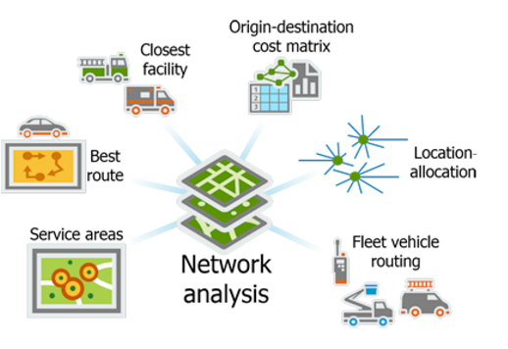
Network Analysis Application
ESRI Academy

Slide 30


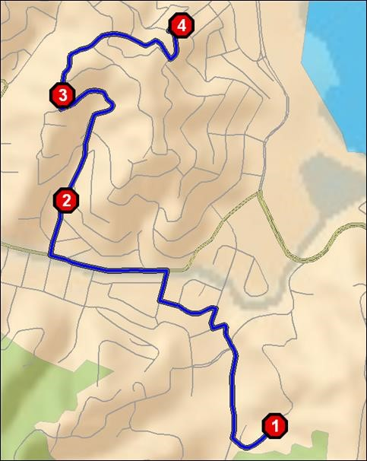
Network Analysis Application
Best route
Simple route- Point-to-point routing between stops in the given sequence
Optimized route- Find the best route and sequence for visiting a series of stops
ESRI Training

Slide 31


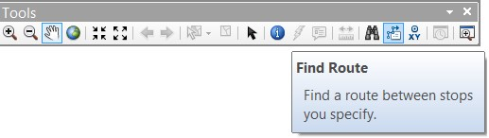
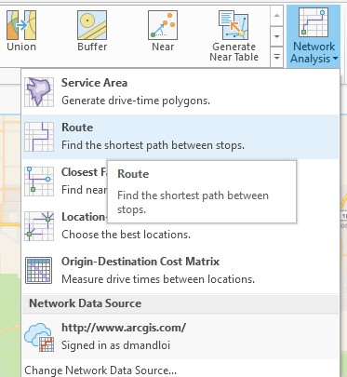
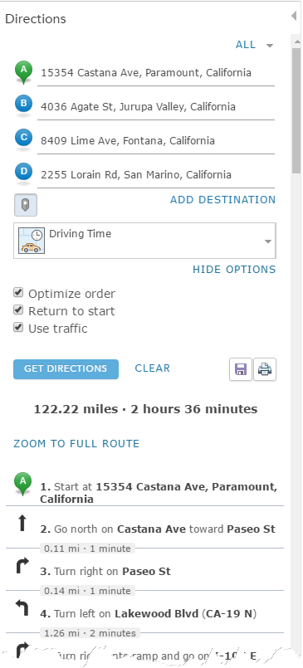


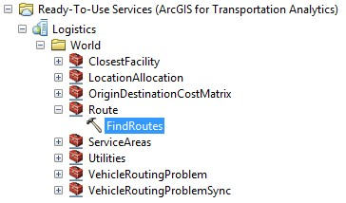

Network Analysis Application
Best route
ArcGIS online
Directions
ArcGIS Pro
ArcMap
ESRI Training

Slide 32


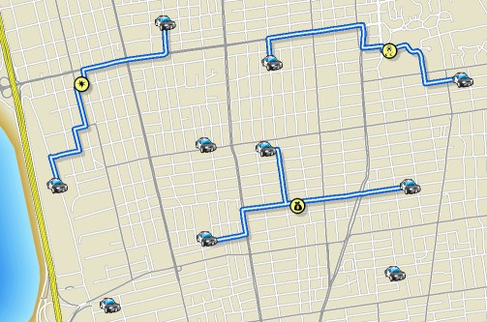
Network Analysis Application
Closest facility service
Find the closest facilities from each incident
Facilities: provide service
Incidents: need service
Generate routes and driving directions
You can also
Limit the search distance
Limit the number of facilities to find
ESRI Training

Slide 33



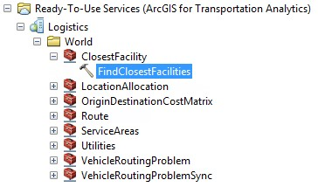
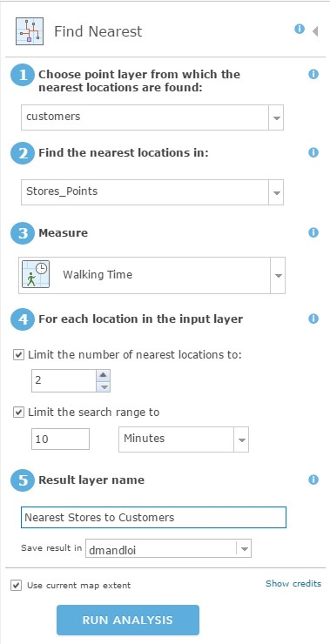

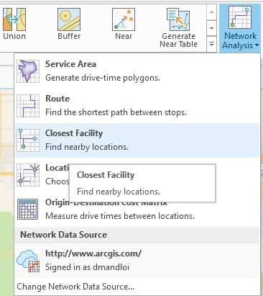
Network Analysis Application
Closest facility service
ArcGIS Pro
ArcMap
ArcGIS online
ESRI Training

Slide 34
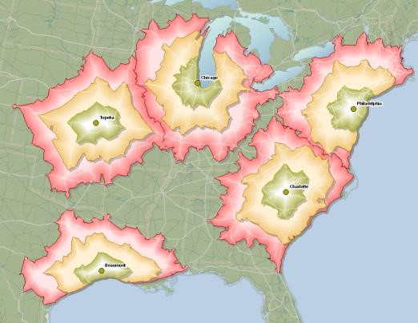
Network Analysis Application
Service areas
Find the area you can reach from a location in a given time period/distance
You can also
Solve for many locations
Use multiple drive time/distance values
Analyze for different times of the day
ESRI Training

Slide 35
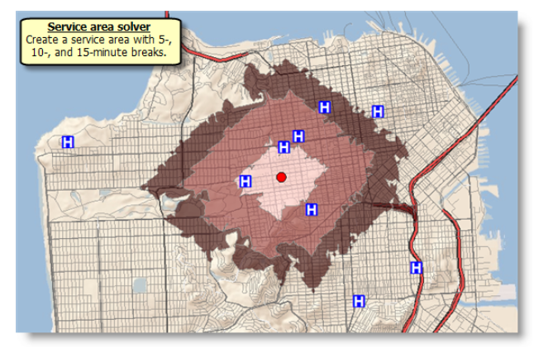
Create service area of a Lily’s home (red points) with 5 min, 10 min, 15 min driving time
Why doesn’t the service area form a perfect circle?
Why are the service area boundaries in the blue circles more irregular than those in the red circle?
How many hospitals fall outside the 15-minute driving service area?
How many hospitals (H) within 10 mins driving time?

Slide 36
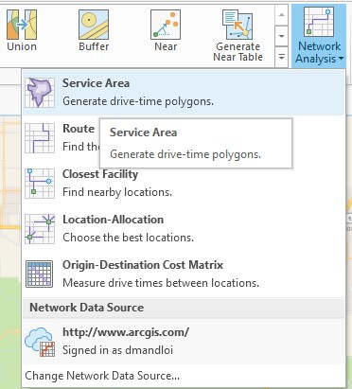
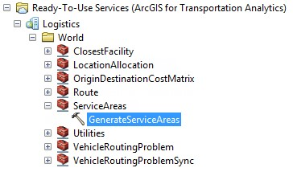
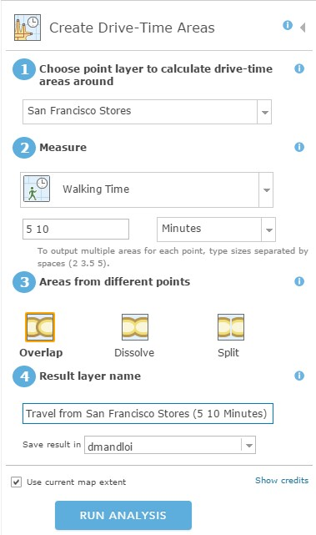
Network Analysis Application
Service areas service
ArcGIS Pro
ArcMap
ArcGIS online
ESRI Training

Slide 37
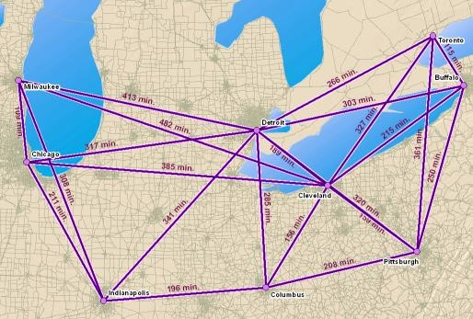
Network Analysis Application
Origin destination cost matrix service
Generate a table containing travel times and travel distances between all origins and all destinations
You can also
Specify a cutoff
Limit the number of destinations to find
Analyze for different times of the day
ESRI Training

Slide 38
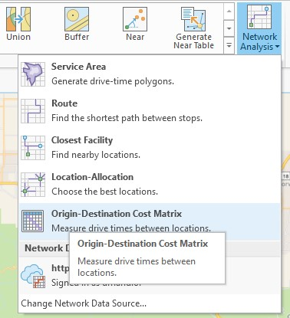
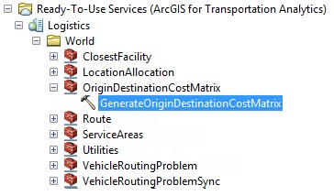
Network Analysis Application
Origin destination cost matrix service
ArcGIS Pro
ArcMap
ArcGIS online
Currently, no available tool in Map Viewer
ESRI Training

Slide 39
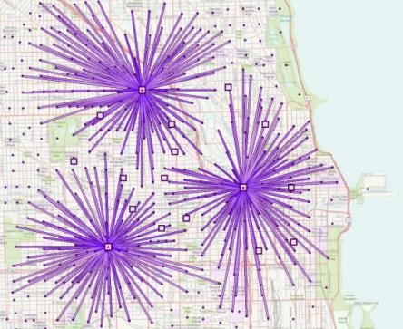
Network Analysis Application
Location- allocation service
Determine the best location for a facility, based on demand conditions
You can also
Limit the capacity of facilities
Analyze for different times of day
ESRI Training

Slide 40
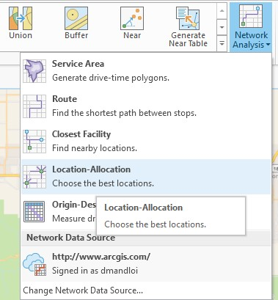
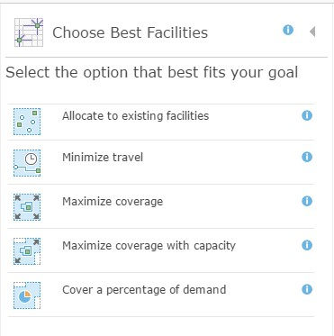
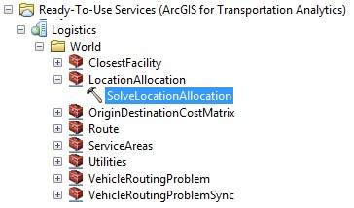
Network Analysis Application
Location- allocation service
ArcGIS Pro
ArcMap
ArcGIS online
ESRI Training

Slide 41
Network Analysis Application
Every successful request deducts credits from the organization
How many service credits do network analysis services use?
Network Analysis | Credits Used
Simple Routes | 0.005 credits per route
Optimized Routes | 0.5 credits per optimized route
Drive Time (Service Areas) | 0.5 credits per drive time
Closest Facilities | 0.5 credits per closest facility route
Multi-Vehicle Routes( VRP) | 1 credits per route
Location-Allocation | 0.1 credit per allocated demand point
Origin Destination Cost Matrix | 0.0005 credits per input origin and destination pair
Traffic | 0 credits
ESRI Academy

Slide 42
Create Network Dataset
Create network dataset from polyline
Obtain polyline data (Census TIGER: https://www.census.gov/cgi-bin/geo/shapefiles/index.php)
Set up connectivity policies
Add costs
Add restrictions and descriptors if any
Add a hierarchy attribute if any
Add travel mode
Set up directions
Build the network dataset
Notes:
https://www.census.gov/cgi-bin/geo/shapefiles/index.php

Slide 43
Lab 01: Network distance
Due by Midnight (11:59 pm) on Wednesday, Jan 21, 2026
Submit a word document only include question and answer

