Slide 1

GEOG 3403: Geographic Information Systems II
Lecture 03 Digital Terrain and Hydrological Analysis
Yanan Wu, PhD
Assistant Professor
Department of Geography

Slide 2
Overview
Terrain Analysis
Elevation data and its source
Triangulated Irregular Network
Derivatives
Slope
Aspect
Hillshade
Slopeshade
Surface curvature
Contours
Viewshed
Cut and fill
Profile
Slope position
Roughness
Dissection
Hydrological analysis

Slide 3
Terrain analysis
Bolstad 2019

Slide 4
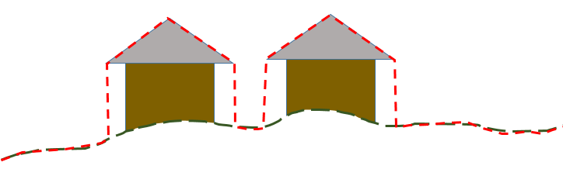
Elevation data in a GIS
DTM (Digital Terrain Model): A representation of a terrain surface calculated by measuring elevation values at a series of locations
DEM (Digital Elevation Model): A model of the terrain surface
DSM (Digital Surface Model): Ground surface + objects above the ground surface
DSM
DTM, DEM
Notes:
Three different terms can be used to explain digital elevation data, and they are commonly confused. So, I will define them here.
A Digital Terrain Model, or DTM, represents just the ground surface. It does not include aboveground features.
Although more ambiguous, a digital elevation model, or DEM, also generally refers to a model representing the ground surface.
In contrast to DTMs and DEMs, digital surface models, or DSMs, include aboveground features, such as trees and buildings.
In the example image, the green line would represent a DTM or DEM whereas the red line would represent a DSM.
If you would like to calculate the height of features above the ground surface, you can subtract a DTM or DEM from a DSM. This product is known as an normalized digital surface model, or nDSM.

Slide 5
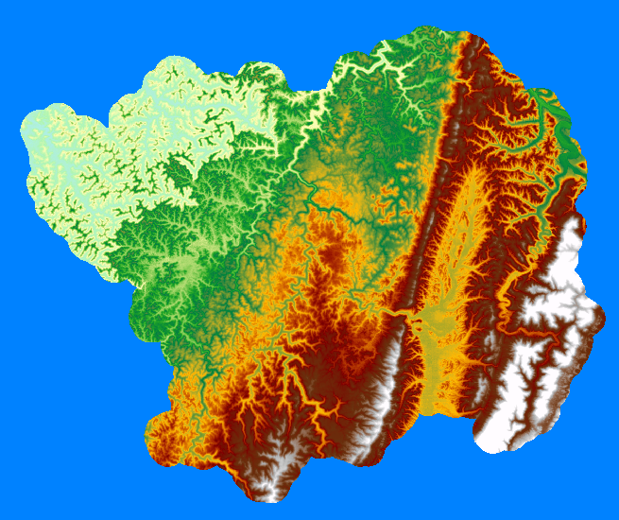
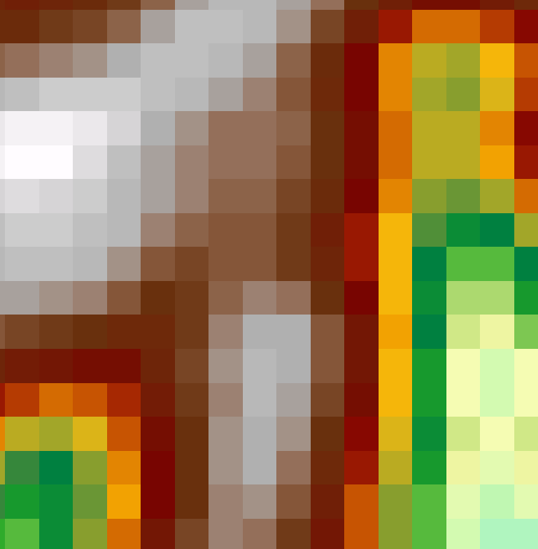
Digital elevation models (DEMs)
A continuous raster-based representation of terrain
Each pixel holds an elevation measurement in feet or meters
Notes:
Elevation or terrain data can be represented as a continuous raster grid.
Each cell will hold an elevation measurement in some height units, such as feet or meters.

Slide 6
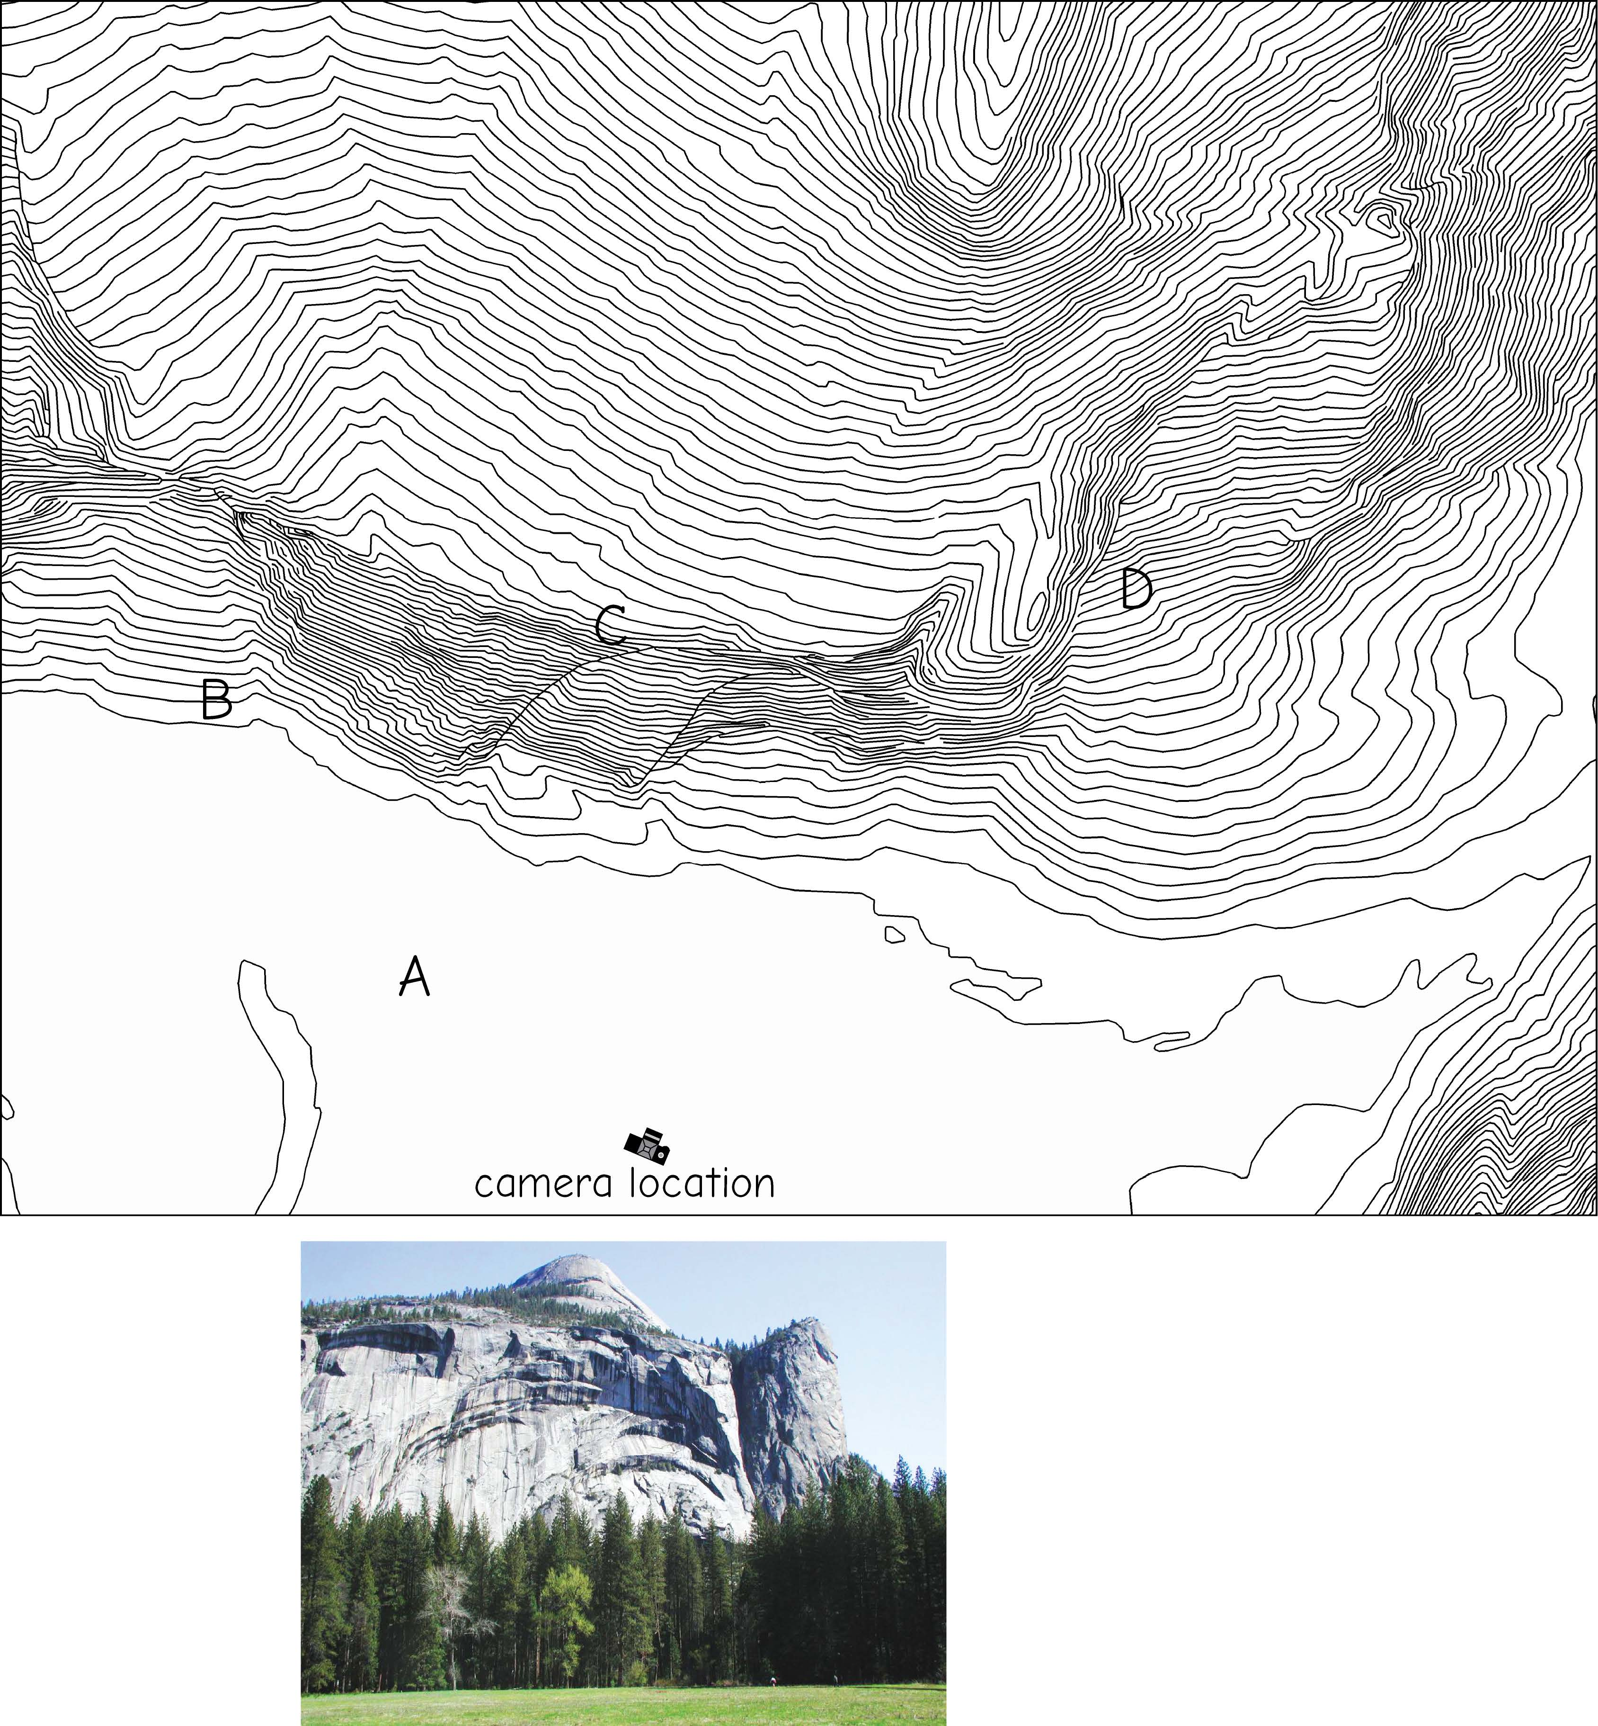
Contours
Topographic contours are connected lines of uniform elevation that run at right angles to the local slope
Steep areas and cliffs are depicted by an increase in contour density
Peaks, such as the top of Washington’s column, D appear as concentric rings
Bolstad 2019
Notes:
You can generate contour lines from raster-based digital elevation data.
When generating contours, you must decide on an adequate contour interval so that the contours are not too sparse or crowded.
After generating contours, you might find that you need to smooth or generalize the result to make the lines more cartographically pleasing.
This can be accomplished using the vector generalization methods discussed in a prior module.

Slide 7
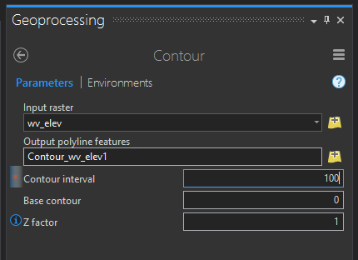
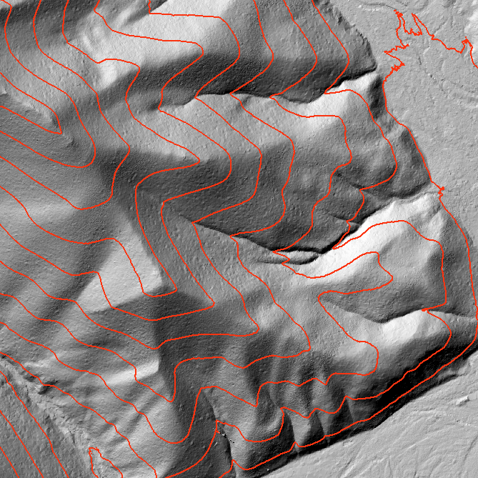
Contours
Contour lines from raster-based elevation data
Raster → vector
Must define an interval
May require some smoothing
Notes:
You can generate contour lines from raster-based digital elevation data.
When generating contours, you must decide on an adequate contour interval so that the contours are not too sparse or crowded.
After generating contours, you might find that you need to smooth or generalize the result to make the lines more cartographically pleasing.
This can be accomplished using the vector generalization methods discussed in a prior module.

Slide 8
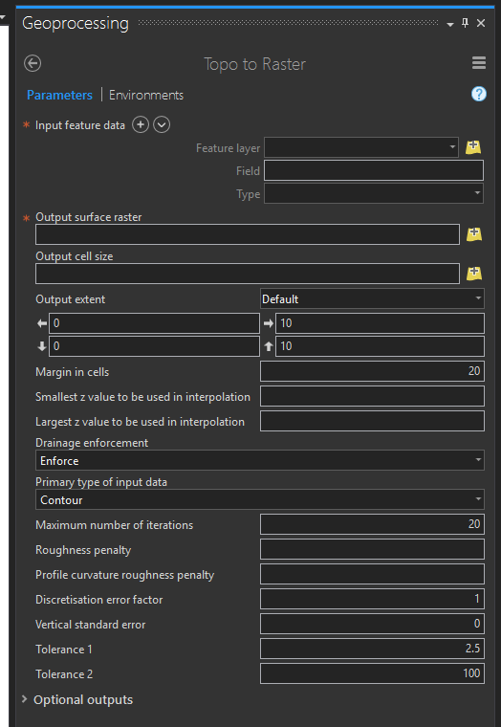
Contours to DEM
Vector → Raster
Notes:
It is also possible to generate raster-based digital terrain surfaces from contour lines.

Slide 9
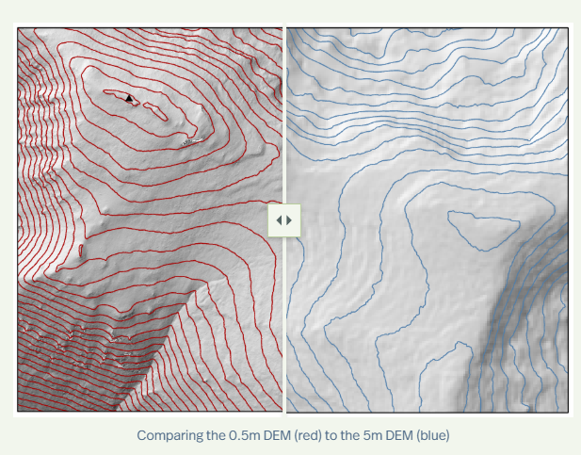
Digital elevation models (DEMs)
DEM model with different resolution

Slide 10
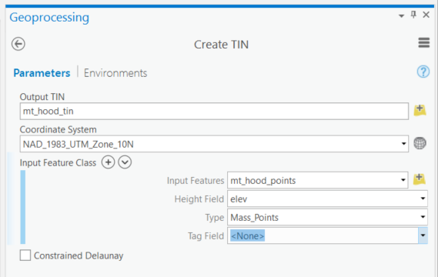
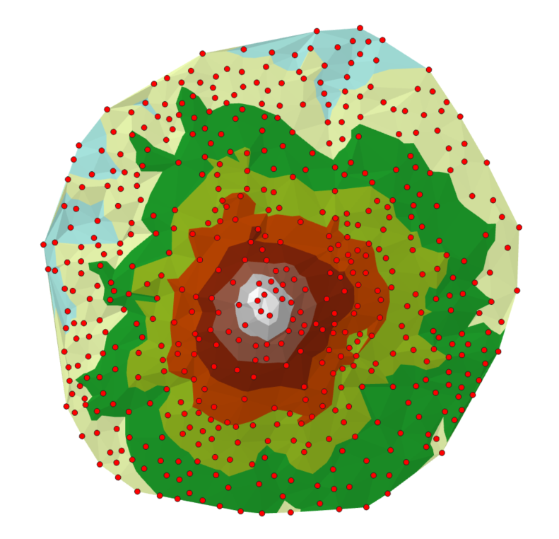
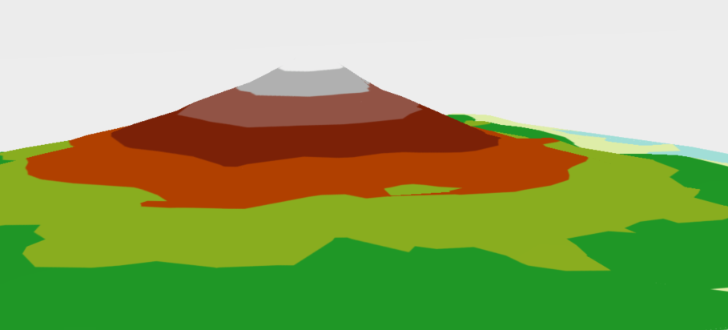
TIN (Triangulated Irregular Networks)
Good for representing terrain data
A space filling model
Notes:
As mentioned in a prior module, it is possible to represent continuous variables using a vector data model as a TIN or Triangulated Irregular Network.

Slide 11
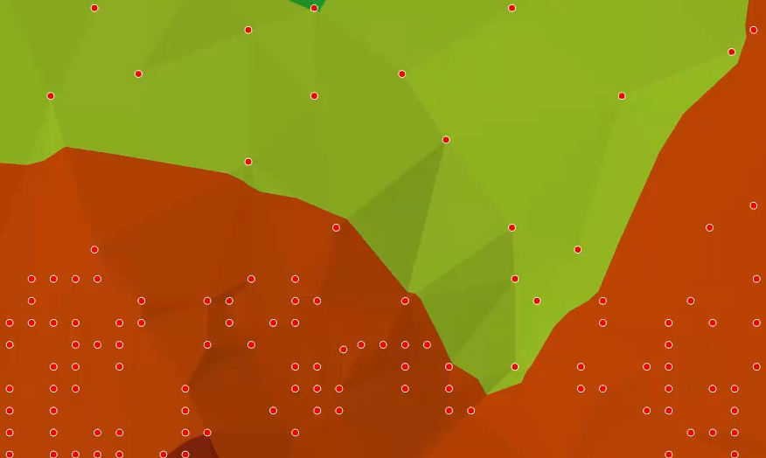
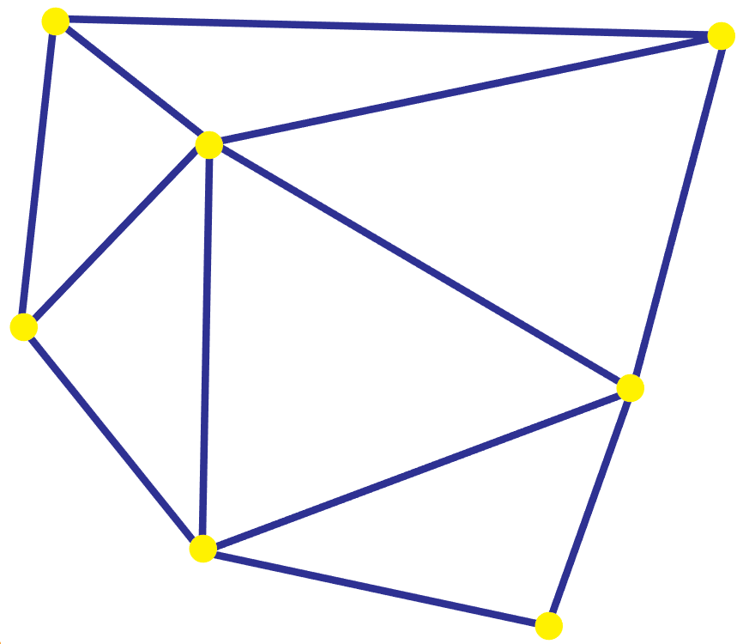
TIN (Triangulated Irregular Networks)
Connecting measurement points to form a triangle (face)
Lines connecting points = edges
Can be used to represent a terrain (or other continuous surfaces)
Notes:
TINs are generally produced from mass points or discrete measurements.
Near points are connected to form triangular faces or facets. The lines connecting the points are called edges.
The triangles hold a measure derived from the connected points. Delaunay triangulation method
If the phenomenon of interest changes abruptly, breaklines can also be included. Breaklines represent breaks in the surface. For example, road cuts could be modeled as breaklines in a terrain surface.
There are pros and cons when representing a continuous surface as a TIN vs. a raster grid.
TINs are inherently multiresolution. Smaller triangles or more detailed surfaces will be produced in areas with more point measurements whereas larger triangles or less detailed surfaces will be produced in areas with less point measurements. In contrast, a raster-based surface most have the same cell size across the entire extent. TINs can also be smaller files in comparison to raster grids, though this depends on many factors.
Many of the tools available for performing terrain analysis or overlay are designed for raster data. So, it might be necessary to convert the TIN to a raster grid to undertake these analyses.

Slide 12
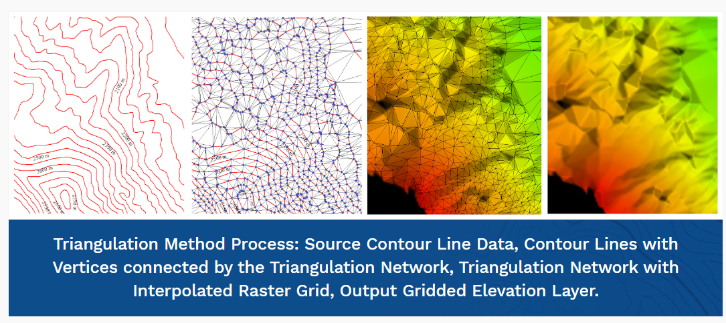
TIN (Triangulated Irregular Networks)
Good for representing terrain data
Image source
Notes:
As mentioned in a prior module, it is possible to represent continuous variables using a vector data model as a TIN or Triangulated Irregular Network.

Slide 13
Terrain Derivatives

Slide 14
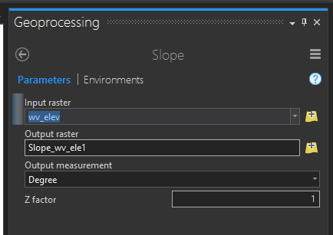
Z-Factor
Many terrain analysis provide a Z-factor option
If vertical and horizontal units are different, you can correct for this with a Z factor
You can also use a Z factor to exaggerate the vertical relative to the horizontal
Use a z-factor of 0.3048 to convert your z-units from feet to meters (1 foot = 0.3048 meters)
Notes:
Many terrain analysis tools provide a Z-factor option.
This setting can be used to change the vertical units to match the horizontal units.
For example, if your data are referenced to a UTM zone for the horizontal datum and the units are in meters, you would likely want the vertical units to also be in meters.
So, if the vertical units are in feet, you could use the feet-to-meters conversion factor to convert the units so that there is a one-to-one relationship between the horizontal and vertical scales.
In situations where you would like to exaggerate or de-exaggerate the vertical scale relative to the horizontal scale, a Z-factor can be used to accomplish this.

Slide 15
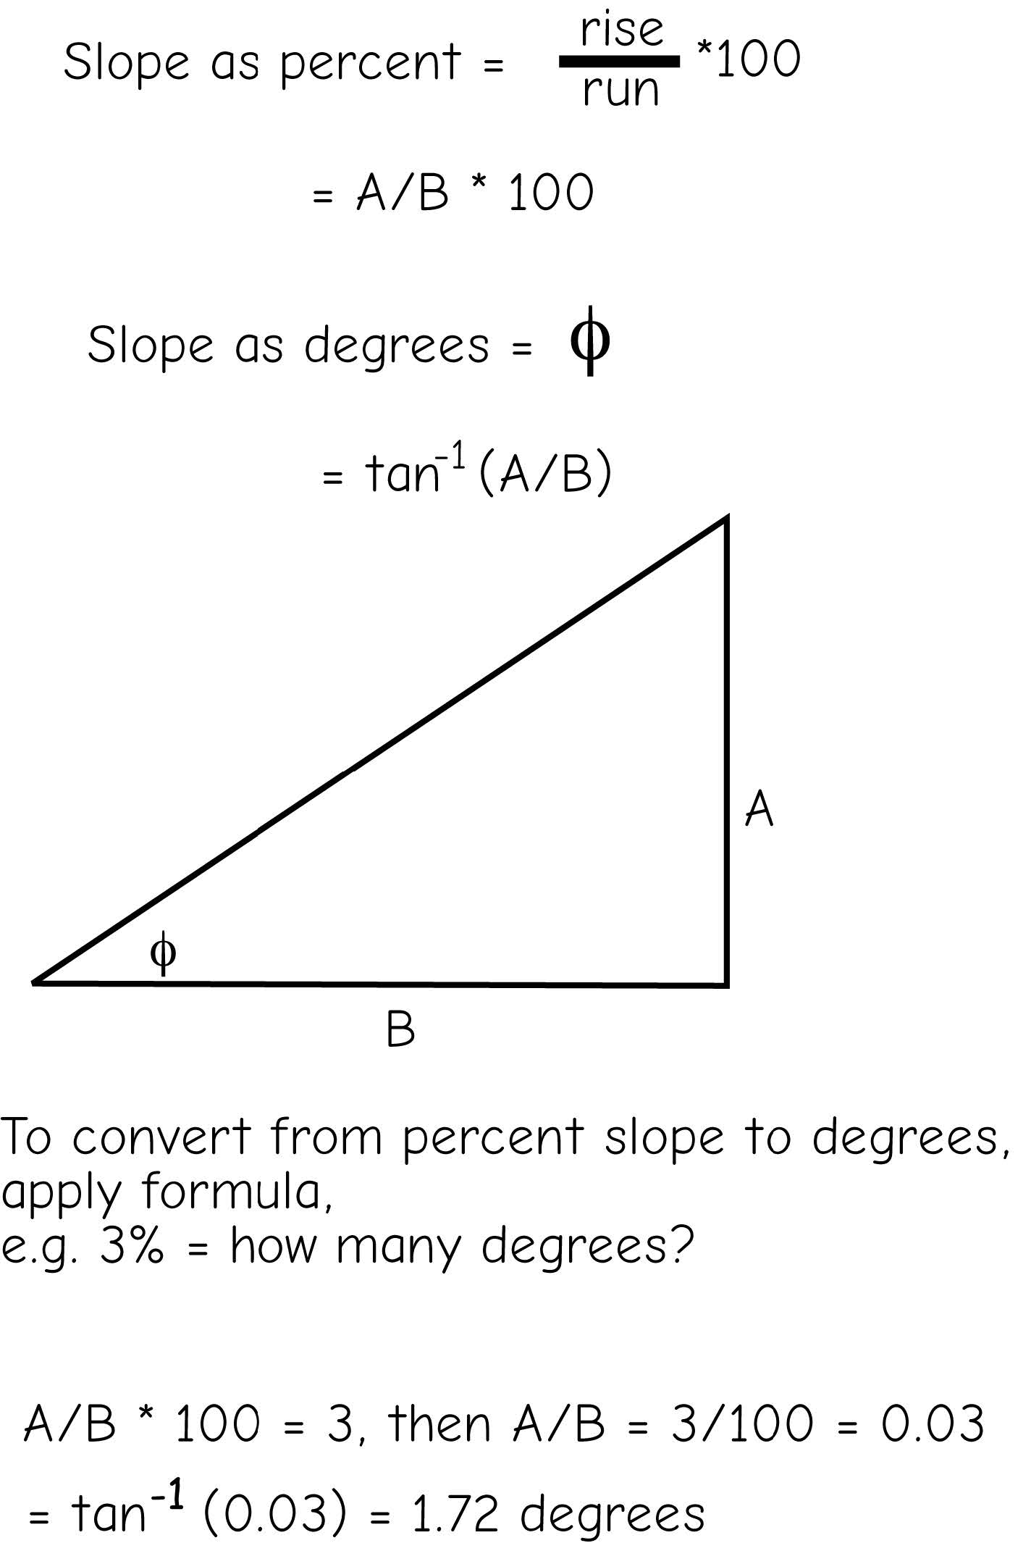
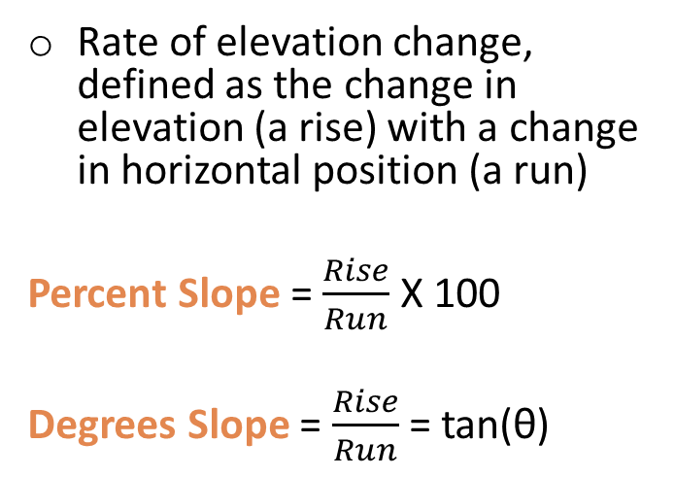
Topographic Slope
Rate of elevation change, defined as the change in elevation (a rise) with a change in horizontal position (a run)
Percent Slope = $\frac{Rise}{Run}$ X 100
Degrees Slope = $\frac{Rise}{Run}$ = tan(θ)
)
Bolstad 2019
Notes:
One common terrain derivative from digital elevation data is topographic slope.
Topographic slope represent the rate of change of elevation or how steep the landscape is.
Using raster data and GIS software, this calculation is made using a 3 by 3 moving window.
Slope can be calculated as percent slope, which is simply rise over run times 100. Think of this as grade for a road.
It can also be calculated in degrees relative to the horizon.

Slide 16
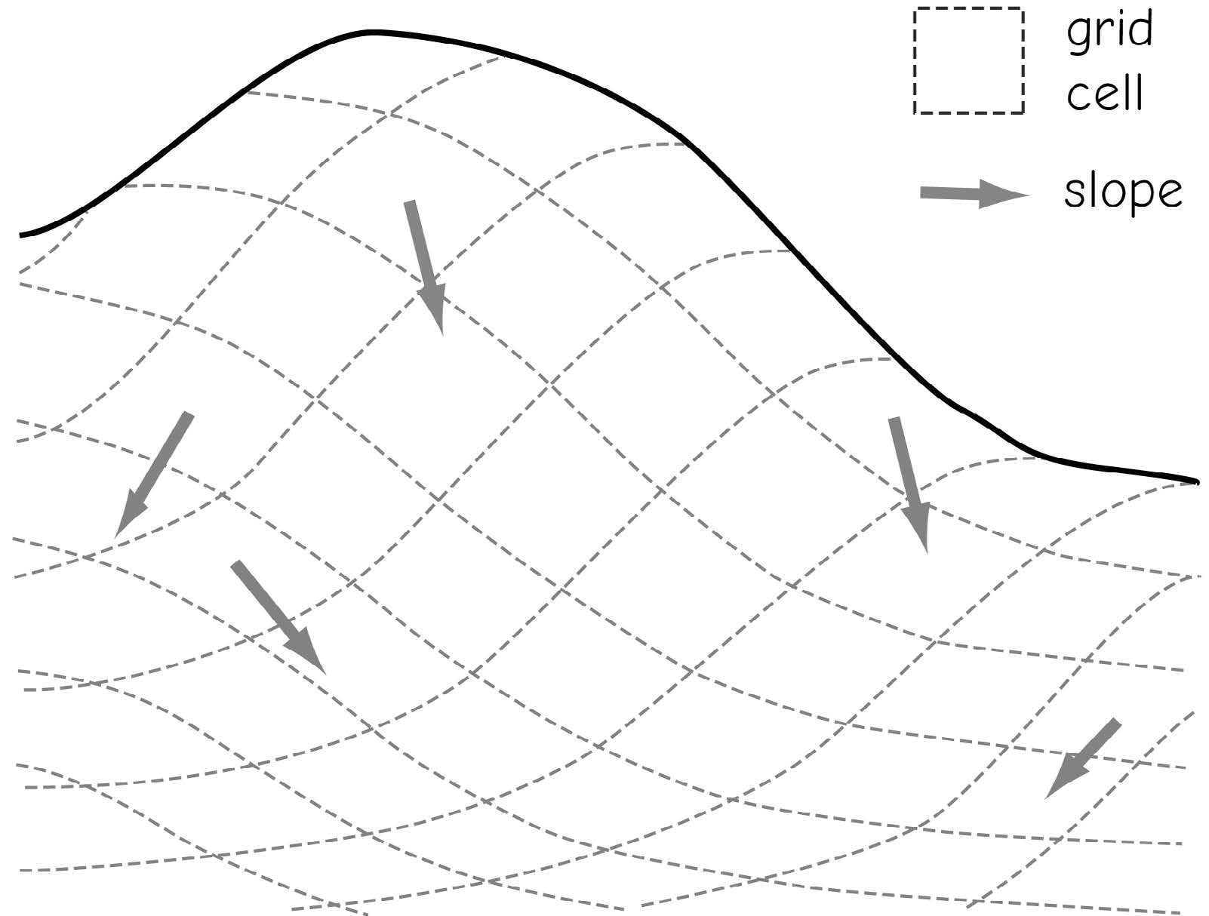
Topographic Slope
Slope direction is typically measured in the steepest direction of elevation change
)
Bolstad 2019
Notes:
One common terrain derivative from digital elevation data is topographic slope.
Topographic slope represent the rate of change of elevation or how steep the landscape is.
Using raster data and GIS software, this calculation is made using a 3 by 3 moving window.
Slope can be calculated as percent slope, which is simply rise over run times 100. Think of this as grade for a road.
It can also be calculated in degrees relative to the horizon.

Slide 17

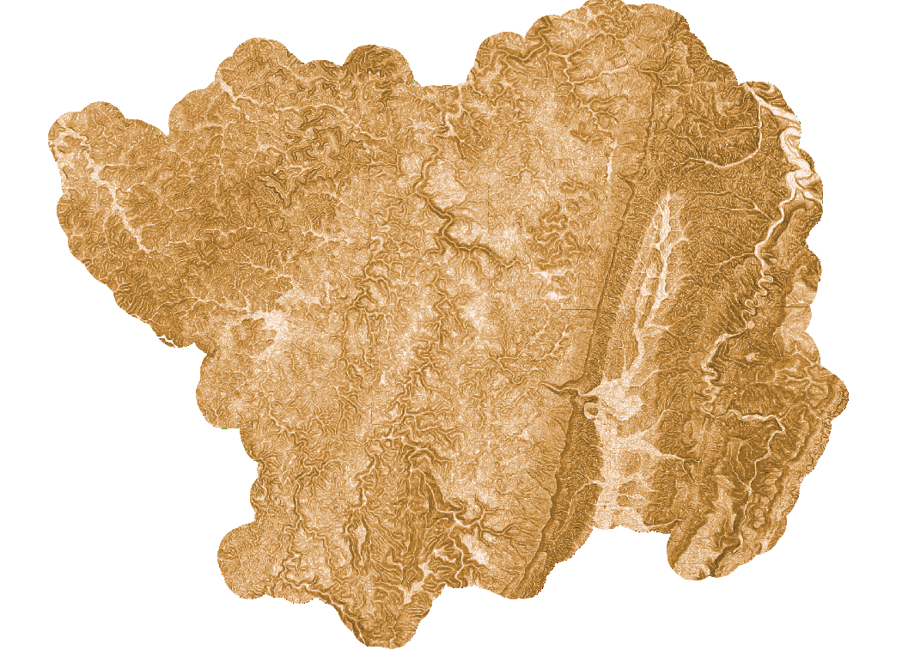
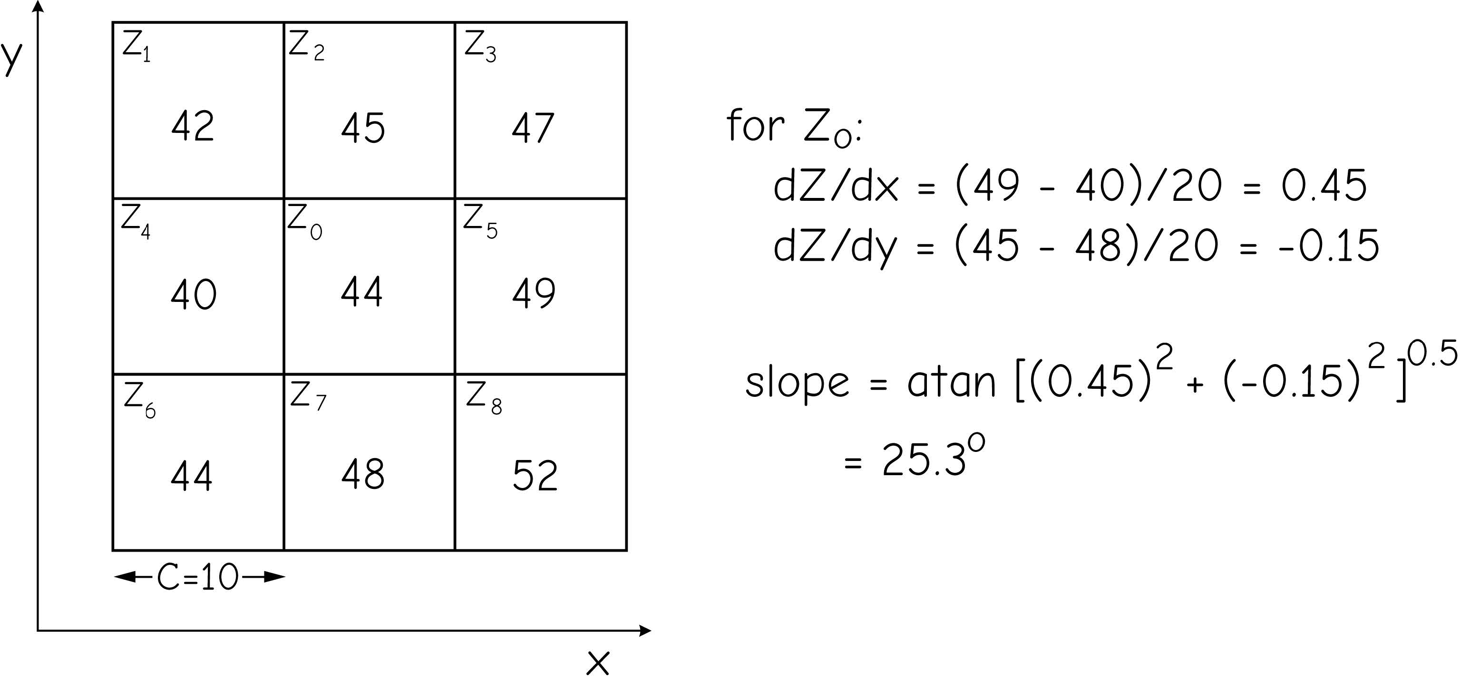
Topographic Slope
Calculated using a 3 x 3 window
)
Bolstad 2019
Notes:
One common terrain derivative from digital elevation data is topographic slope.
Topographic slope represent the rate of change of elevation or how steep the landscape is.
Using raster data and GIS software, this calculation is made using a 3 by 3 moving window.
Slope can be calculated as percent slope, which is simply rise over run times 100. Think of this as grade for a road.
It can also be calculated in degrees relative to the horizon.

Slide 18
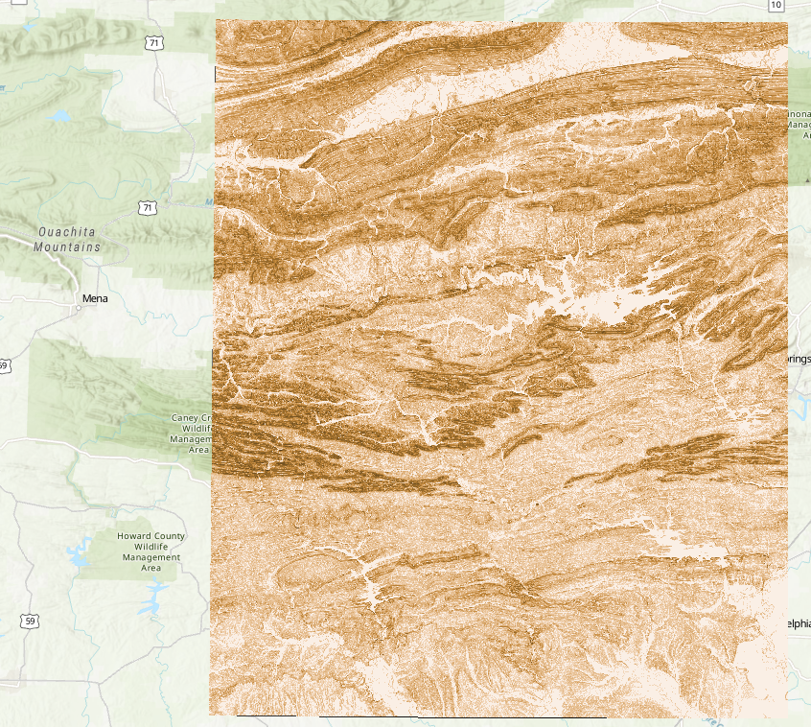

Slope image around Qunchita Mountain
Range of slope: 0–90°
Slope in degree

Slide 19
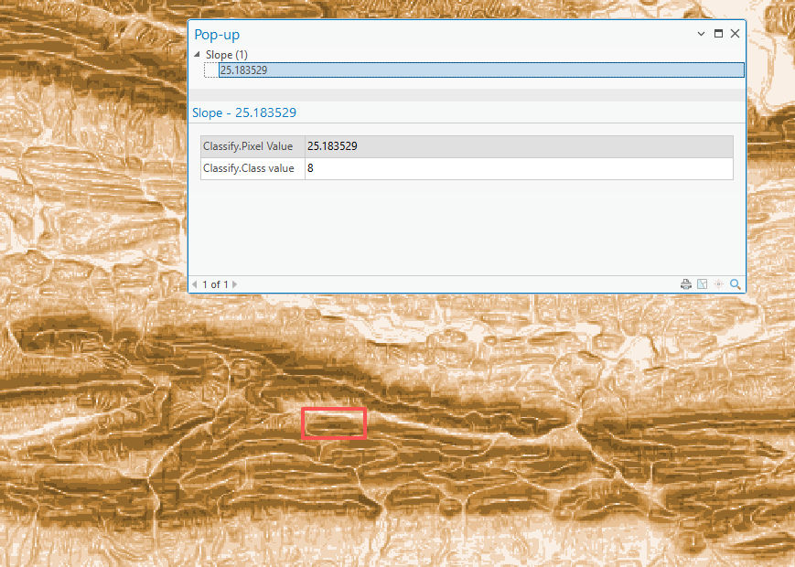
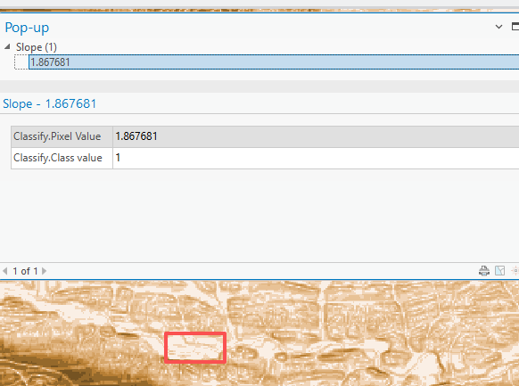
What does each pixel in this image represent?

Slide 20
Group Discussion
If you were a city planner, where would you choose to build a city based only on this slope map?

Slide 21
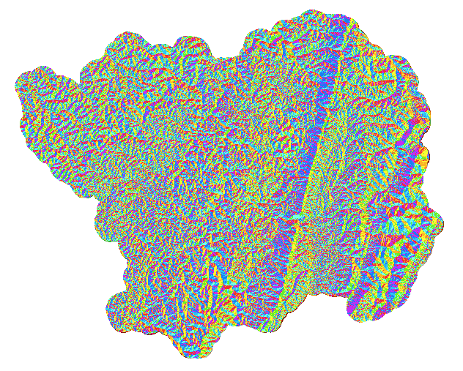
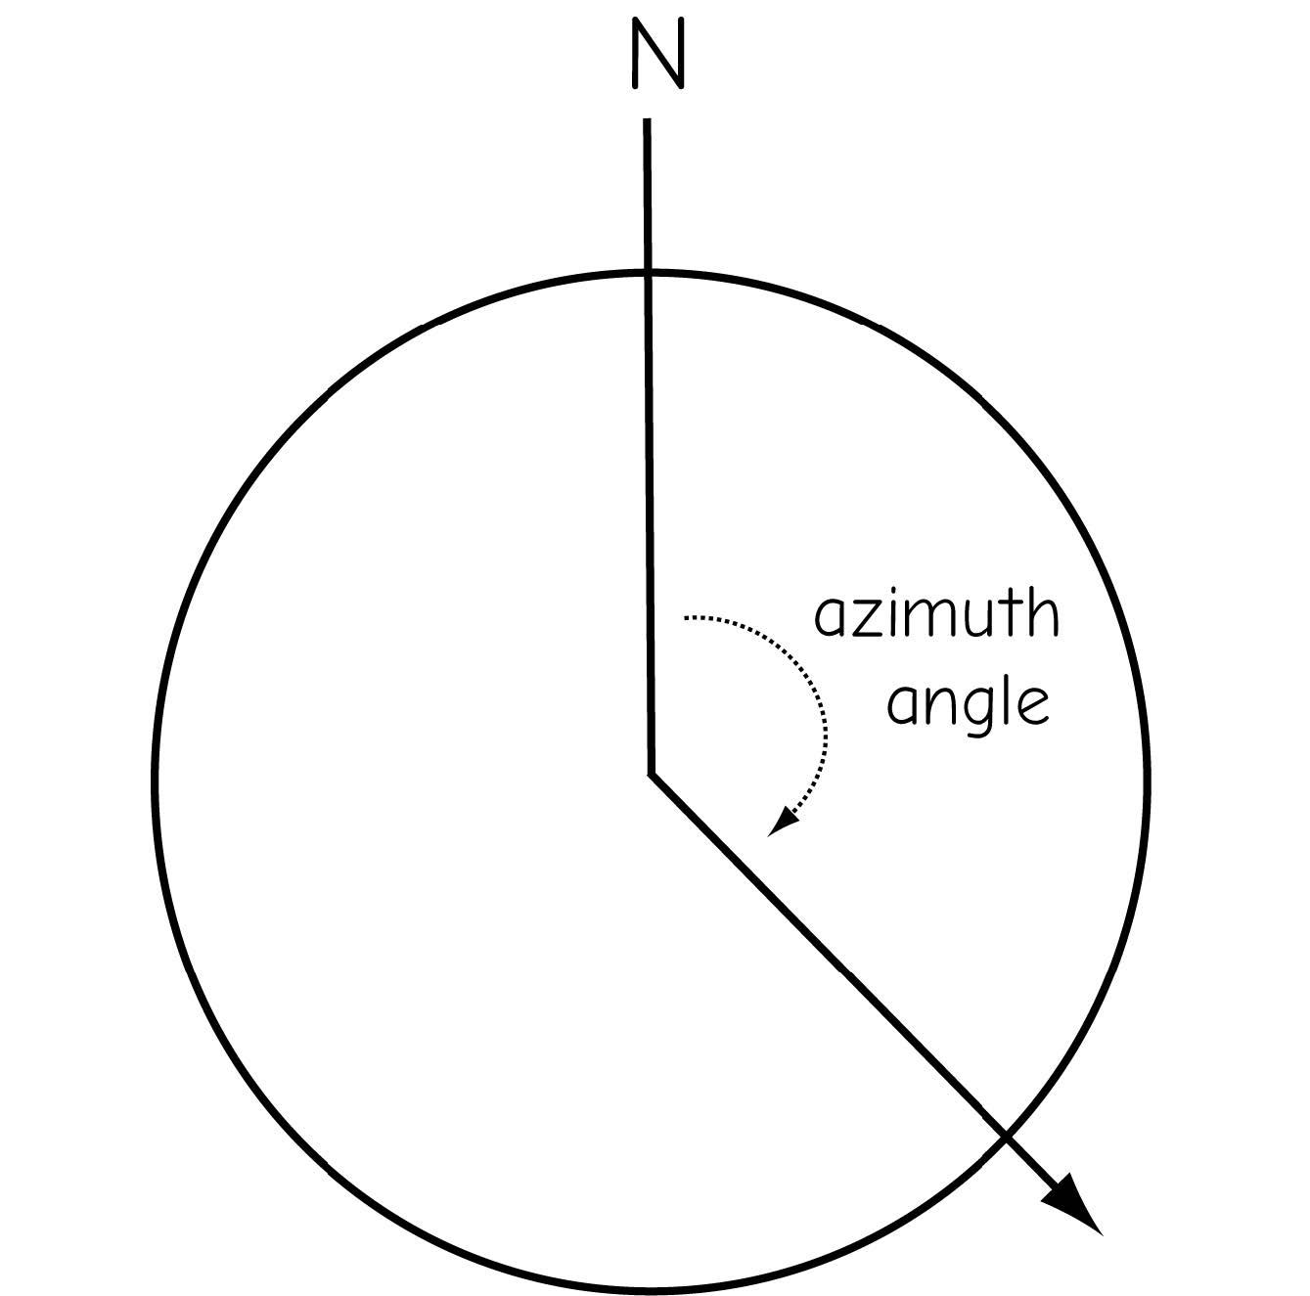

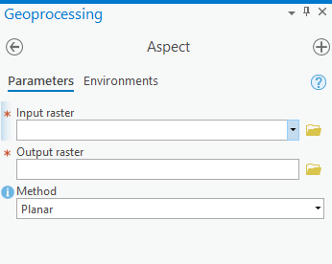
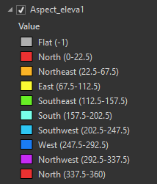
Topographic Aspect
Direction of steepest downhill slope
Reported as a compass bearing
For flat area, the value is -1
Bolstad 2019
Notes:
Topographic aspect represents the compass direction or bearing of maximum slope.
Or, it represents the direction that the slope faces.
North facing slopes would be coded as 0 or 360, east facing slopes as 90, south facing slopes as 180, and west facing slopes as 270.
Aspect cannot be calculated for flat areas because there is no direction of maximum slope. These locations are coded as -1.
Aspect can be generated from continuous elevation surfaces. For example, the aspect recorded for a TIN face is the steepest downslope direction of the face, and the aspect of a cell in a raster is the steepest downslope direction of a plane defined by the cell and its eight surrounding neighbors.

Slide 22
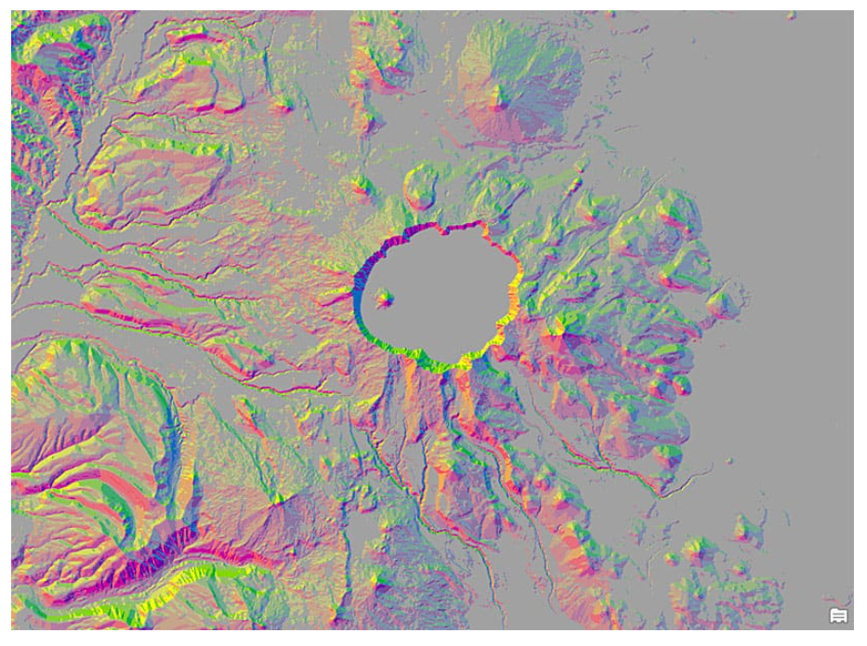
Aspect-slope map: Crater Lake area in Oregon
Image source

Slide 23
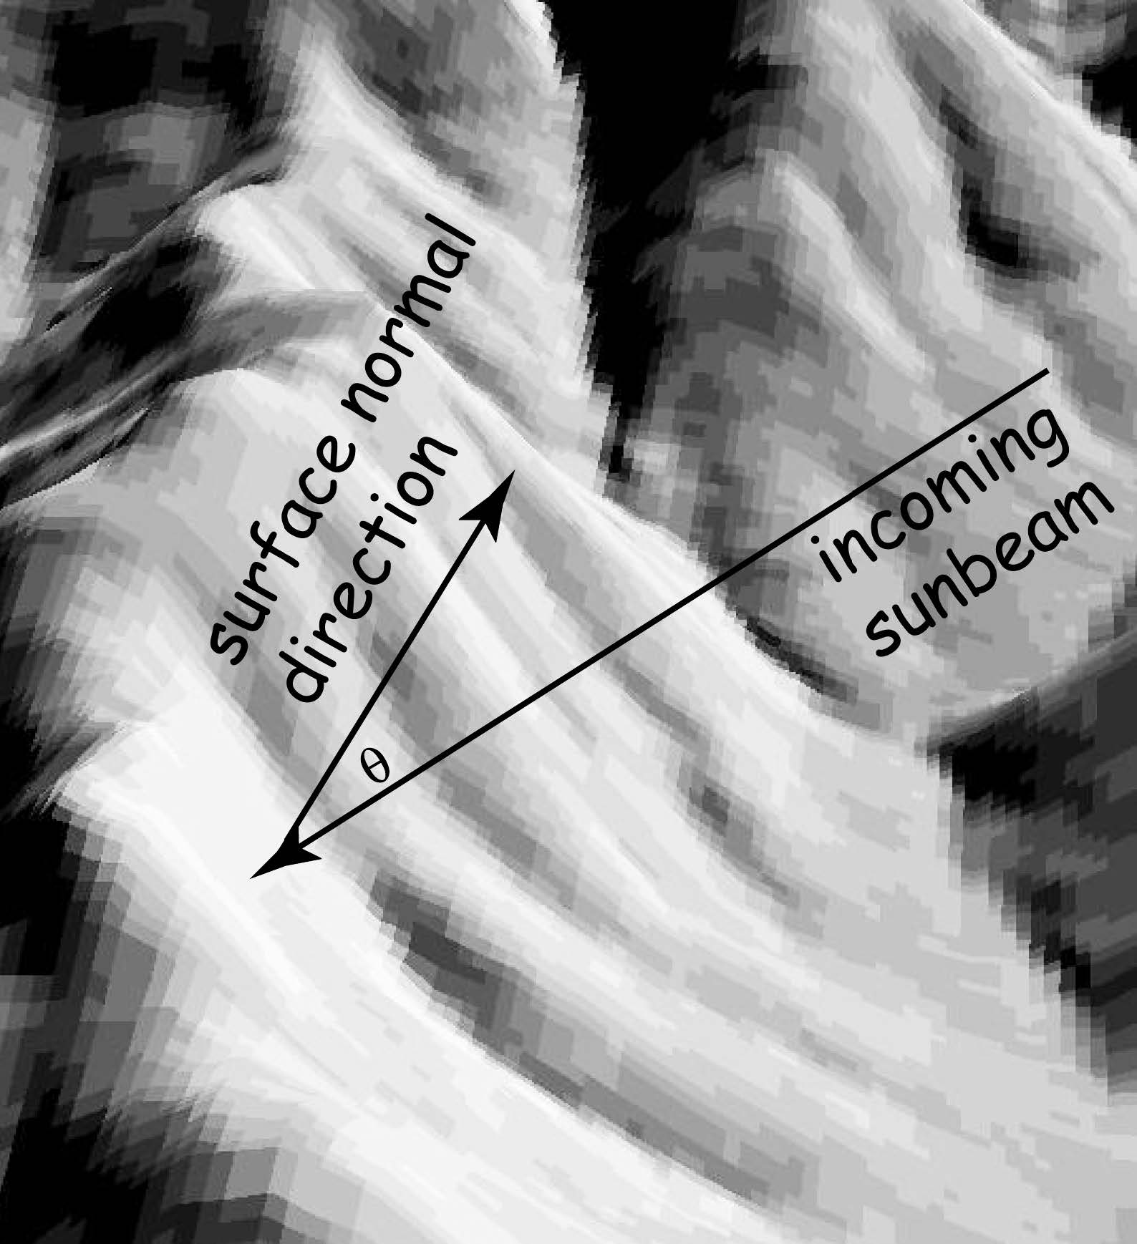
Hillshade
Depiction of the brightness of terrain reflection given a terrain surface and sun location
A visual representation of a terrain using shadows
Shadows are cast over the landscape to create a shaded relief surface
Bright areas represent areas of Sun exposure whereas dark areas are shadowed.
Bolstad 2019
Notes:
Hillshades offer a means to visualize digital terrain data.
In a hillshade, a Sun is placed in the sky to cast shadows over the terrain surface. The result is a shaded relief surface.
The position of the Sun is defined using the compass bearing or direction of the Sun, this setting is known as azimuth, and the angle of the Sun above the horizon, or altitude.
Using azimuth and altitude, you can position the Sun anywhere in the local sky.
Imagine a dome over your head. If you would like to locate an object on this dome, you would need to specify the compass direction to look, or azimuth, and how high up to look, or altitude.

Slide 24
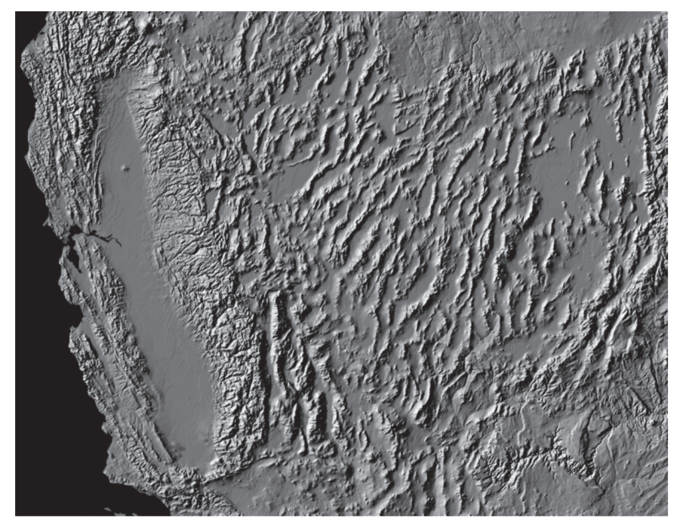
Example: hillshade map, created from a Digital Elevation Model (DEM)
The computer simulates sunlight coming from the upper-left direction.
Bright areas: slopes facing the light
Dark areas: slopes facing away from the light
Gray areas: relatively flat terrain

Slide 25
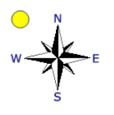
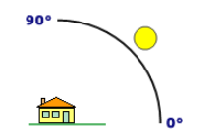
Hillshade
Sun Position
Azimuth: compass bearing of Sun
The default sun azimuth (direction) for hillshade is 315 degrees.
Altitude: height of Sun above horizon (as an angle)
The default sun altitude for hillshade is 45 degrees.

Slide 26
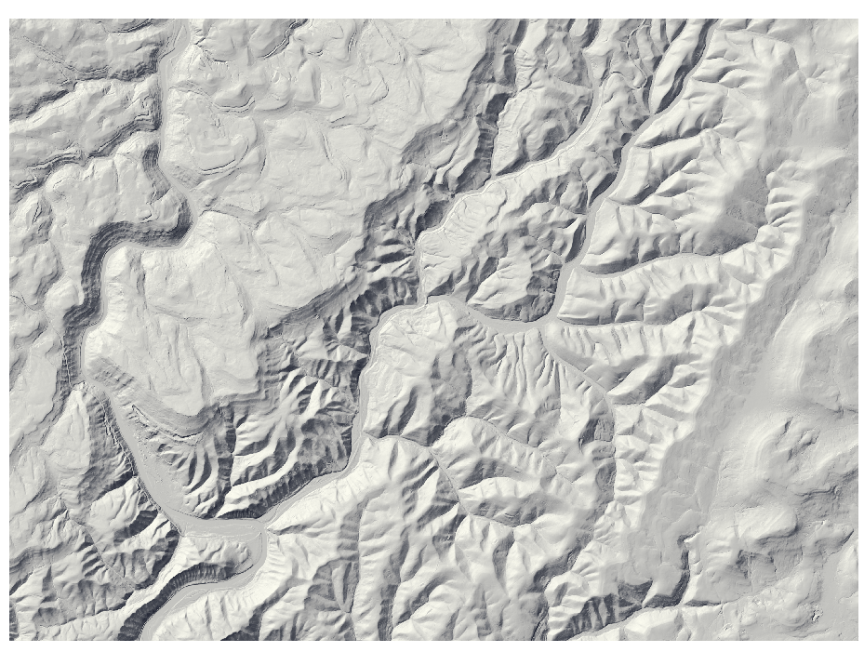
Sun position matters
Azimuth = 315, Altitude = 45
Notes:
The location of the Sun can have a large impact on the effectiveness and look of a hillshade.
In ArcGIS Pro, the default settings are an azimuth of 315 and an altitude of 45.
So, the Sun would be in a northwest position and halfway between the horizon and zenith, or top of the sky.
Since we generally see features illuminated from above or by the Sun, we expect shadows to be cast downward. This is mimicked with a Sun position in the northwest azimuth.
If we move the Sun to a southeast azimuth, then features will be illuminated from below.
This will created a strange optical illusion where the topography looks inverted. Or, ridges will be interpreted as valleys and valleys as ridges.
So, we tend to avoid using southeast azimuth positions.

Slide 27
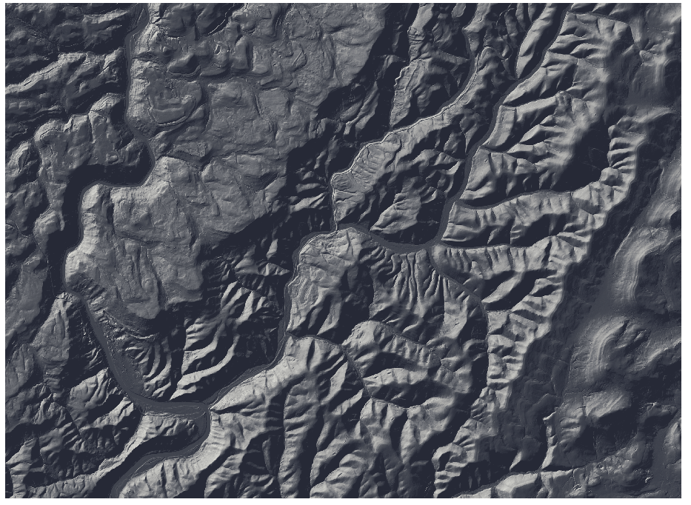
Sun position matters
Azimuth = 315, Altitude = 45
Azimuth = 315, Altitude = 10
Notes:
We also tend to avoid using low altitudes as this can create very contrasted hillshade images with very dark and bright slopes.
Placing the Sun very close to the zenith can make hillshade images look very “washed out” or low contrast.
I have generally found the default settings to work well. However, you may want to experiment with different settings.
Different settings may be optimal in different terrains.

Slide 28
🏔️What terrain features can we see?
Valley (low area of land located between higher ground)?
Mountain ridges?
Steep slopes?
River?

Slide 29
Terrain analysis
🌊Why does terrain matter for flooding?
Flooding is more likely in:
Low-lying areas
Flat valleys
Places where many slopes drain into one location
Terrain determines:
Where floods occur
How fast water moves
How large flood zones become

Slide 30
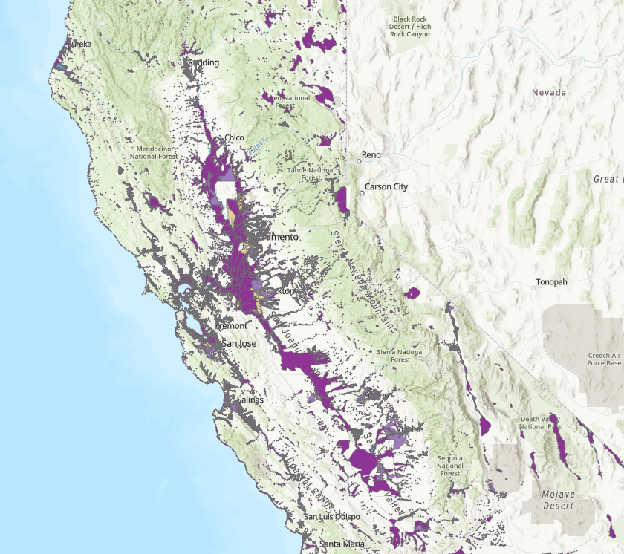
Terrain analysis
Terrain image vs California Flood Hazard Aras
🤔How does the terrain image help us infer flooding zones?

Slide 31
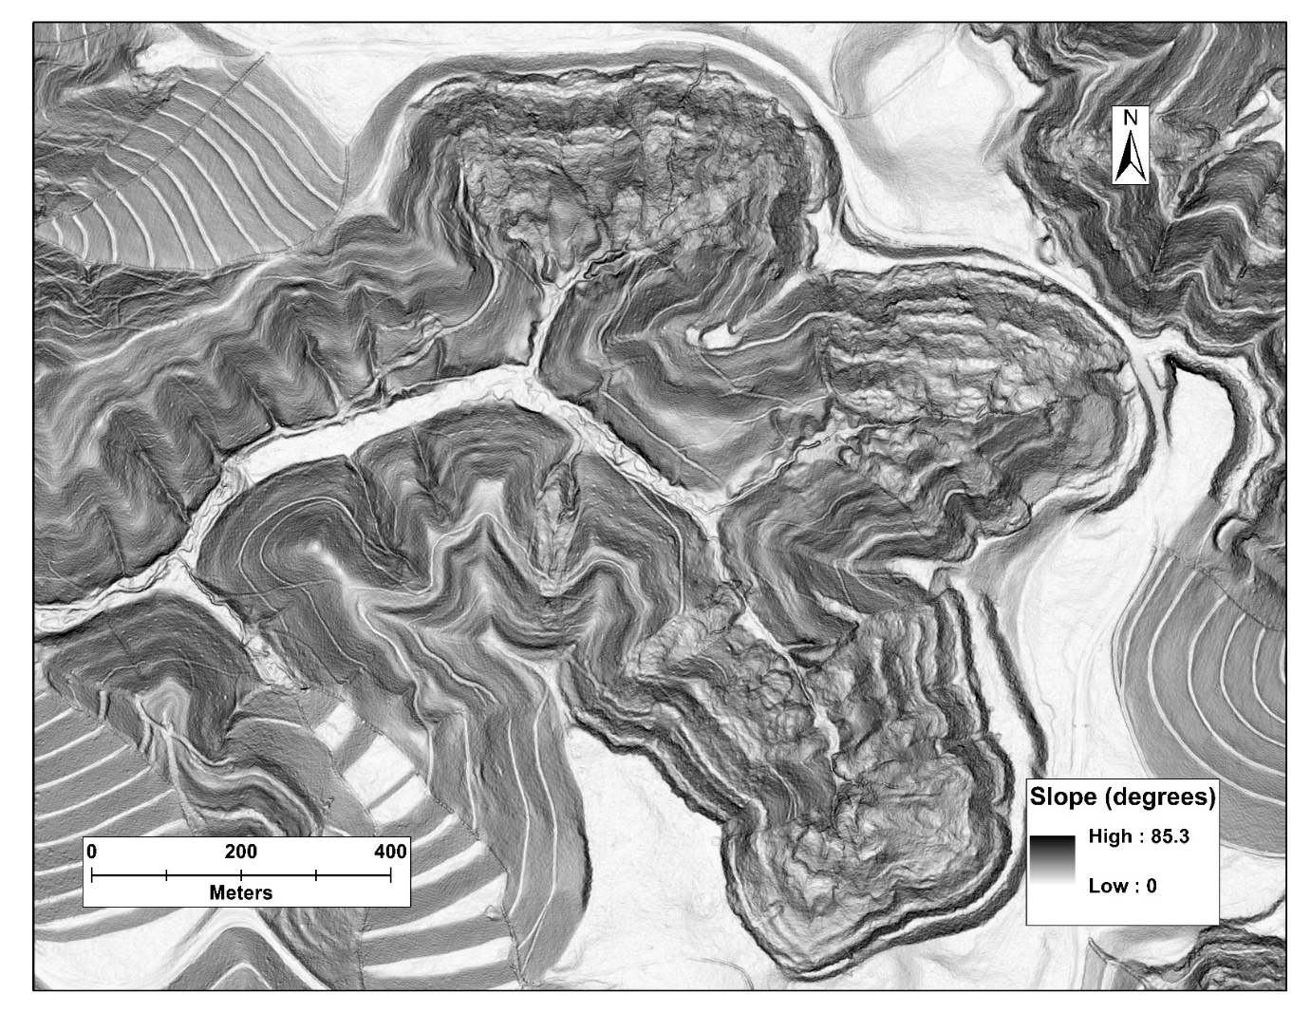
Slopeshade
Display slope using a white-black stretch
White = shallow slopes
Black = steep slopes
Map by Miles Reed
Notes:
A slopeshade offers and alternative to hillshades and does not require a Sun position to be defined.
In a slopeshade, a slope grid is generated.
A color ramp is then applied in which white represents shallow slopes and black represents steep slopes.
You may want to experiment with slopeshades as an alternative to hillshades.

Slide 32
Surface Curvature
Ttwo other local topographic indices that are important in terrain analysis and may be derived from gridded elevation data. Profile and plan curvature are helpful in measuring and predicting soil water content, overland flow, rainfall-runoff response in small catchments, and the distribution of vegetation.

Slide 33
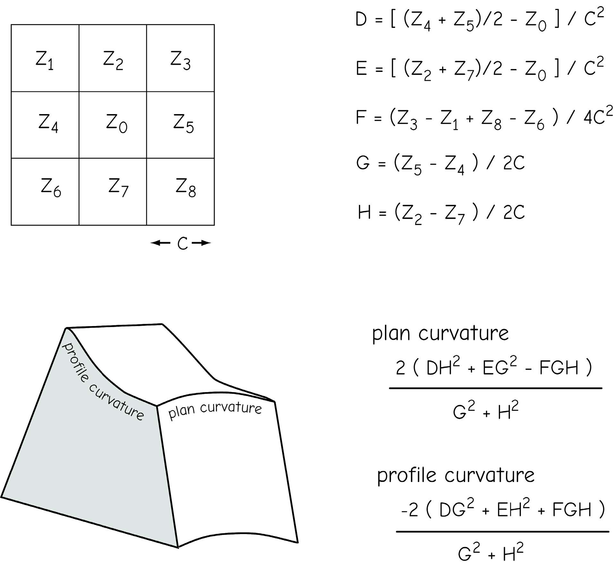
Surface Curvature
Concavity/convexity of a surface
Profile Curvature: curvature in direction of steepest downhill slope
Planform (plan) Curvature: curvature perpendicular to direction of slope
Bolstad 2019
Notes:
Surface curvature makes use of a moving window analysis and represents the convexity or concavity of the landscape.
Negative values indicate concavity, positive values indicate convexity, and values near zero indicate near flat or no curvature.
It is also possible to calculate curvature in the direction of maximum slope, or profile curvature, and curvature perpendicular to slope, or planar curvature.

Slide 34
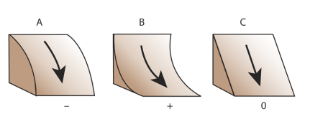
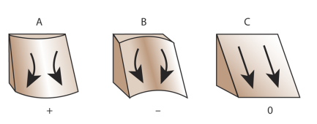
Surface Curvature
 | Convex | Concave | Flat
Profile curvature: curvature in direction of slope
Plan curvature: curvature perpendicular to direction of slope
negative
positive
0
positive
negative
0
https://www.esri.com/arcgis-blog/products/product/imagery/understanding-curvature-rasters/
Notes:
Surface curvature makes use of a moving window analysis and represents the convexity or concavity of the landscape.
Negative values indicate concavity, positive values indicate convexity, and values near zero indicate near flat or no curvature.
It is also possible to calculate curvature in the direction of maximum slope, or profile curvature, and curvature perpendicular to slope, or planar curvature.
Negative = convergence

Slide 35
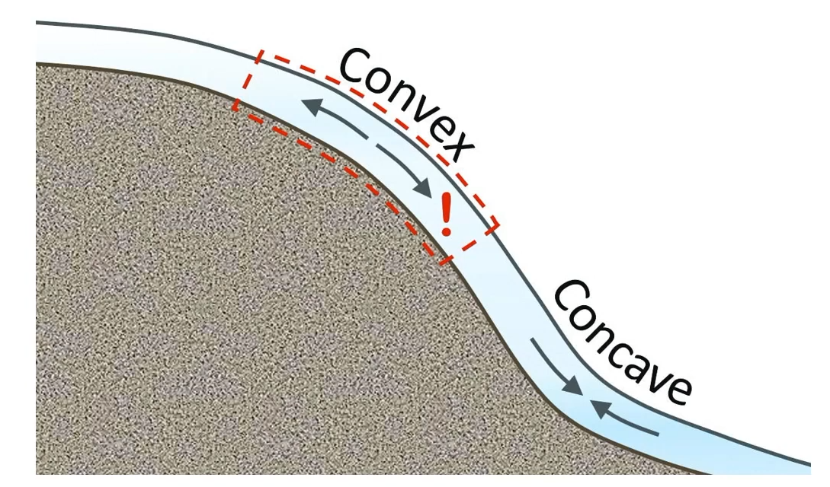
Visualize Convex and Concave from side

Slide 36
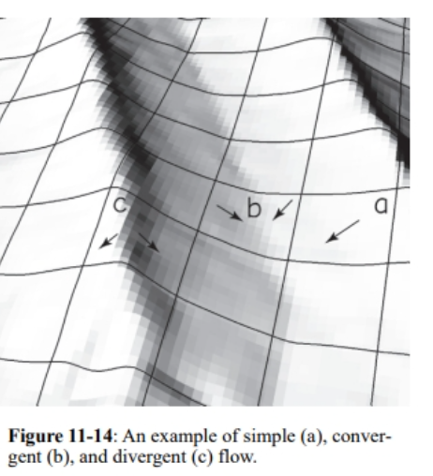
Plan curvature influence Flow direction
Flow
Convex - Convergent
Concave - Divergent
Flat - Simple

Slide 37
How surface curvature influences runoff flow
 | Convex | Concave | Flat
Profile curvature: curvature in direction of slope
Plan curvature: curvature perpendicular to direction of slope
Flow will be decelerated
Flow will be accelerated
Flow will be divergent
Flow will be congergent

Slide 38
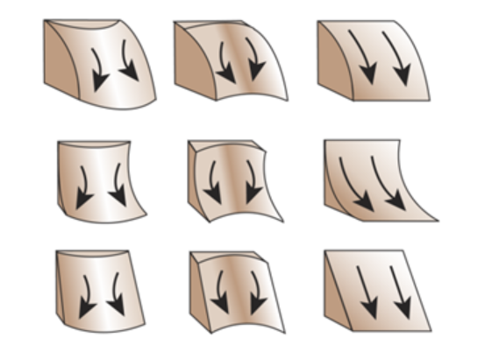
Surface Curvature
Standard Curvature:
The Standard curvature combines both the profile and planform curvatures.

Slide 39
LECTURE 3: Terrain Analysis
Thank you!

