Slide 2
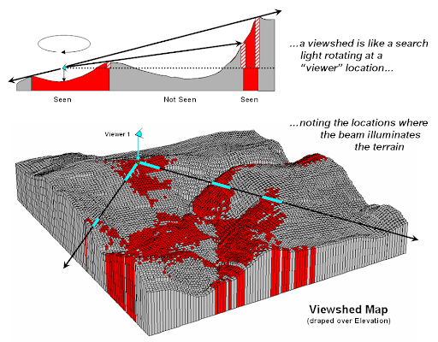
Viewshed Analysis
Given terrain conditions, what can you see from a vantage point?
Requires: DEM and location of vantage point
Just takes into account topography
Above Ground Level Output: raster output of height that must be added to the cell in order for it to be visible from the vantage point
https://mapscaping.com/blogs/geo-candy/make-your-own-viewshed
Notes:
Viewshed analysis is used to determine what areas are visible from a vantage point or location based on the terrain characteristics.
To undertake such an analysis, you will need to provide a vantage point, such as a point location, and a digital terrain surface.
The output will be binary with 1 indicating areas that are visible based on the topography.
Note that this only takes into account topography. If you would like to incorporate above-ground features that could impact visibility, you should input a DSM as opposed to a DTM.
More complex visibility analyses can be performed using 3D GIS.

Slide 3
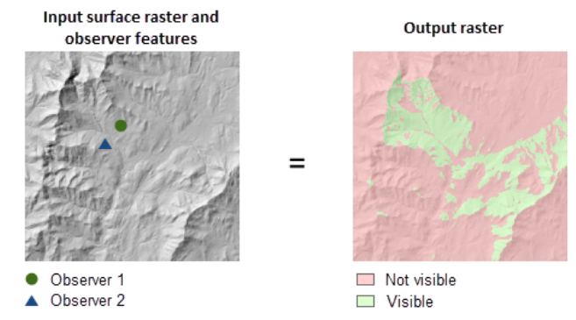
Viewshed Analysis
https://pro.arcgis.com/en/pro-app/latest/tool-reference/spatial-analyst/viewshed.htm
Notes:
Viewshed analysis is used to determine what areas are visible from a vantage point or location based on the terrain characteristics.
To undertake such an analysis, you will need to provide a vantage point, such as a point location, and a digital terrain surface.
The output will be binary with 1 indicating areas that are visible based on the topography.
Note that this only takes into account topography. If you would like to incorporate above ground features that could impact visibility, you should input a DSM as opposed to a DTM.
More complex visibility analyses can be performed using 3D GIS.

Slide 4
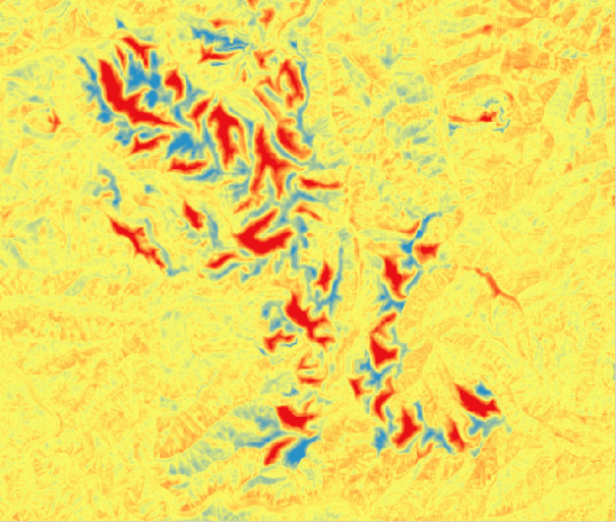
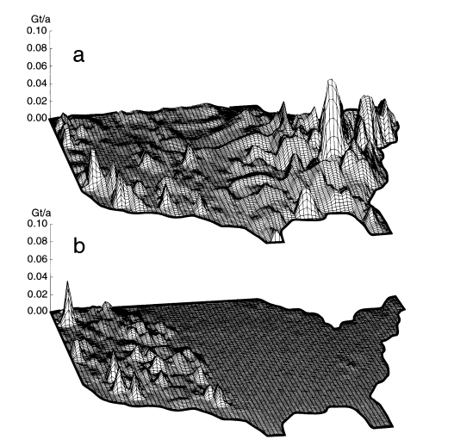
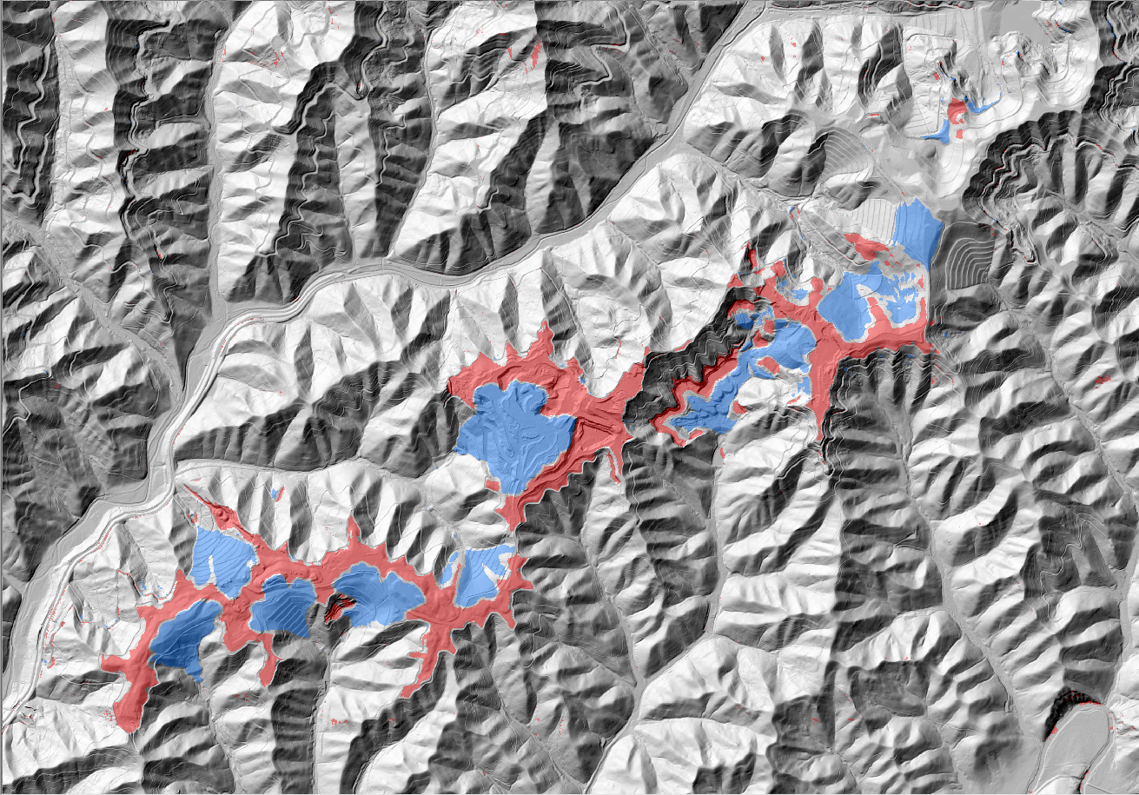
Cut and Fill Analysis
Subtract DEM surfaces pre- and post- terrain change
Cut areas represent elevation loss or areas of excavation whereas fill areas represent areas of fill or elevation gain.
Hooke, R.L. (1999). “Spatial distribution of human geomorphic activity in the United States: comparison to rivers,” Earth Surface Processes, 24: 687-692.
Notes:
Cut and fill analysis allows you to map area of elevation change by comparing two elevation surfaces.
Cut areas represent elevation loss or areas of excavation whereas fill areas represent areas of fill or elevation gain.
Cut and fill analysis can be impacted by the error and quality of the input digital elevation data. Misregistration between the datasets can be an issue.
If you compare two DEMs, they should use the same vertical datum and units and both represent ellipsoidal or orthometric heights.
Topographic change can result from natural processes or human-induced alterations. Hooke (1999) suggests that humans move more material than river!

Slide 5
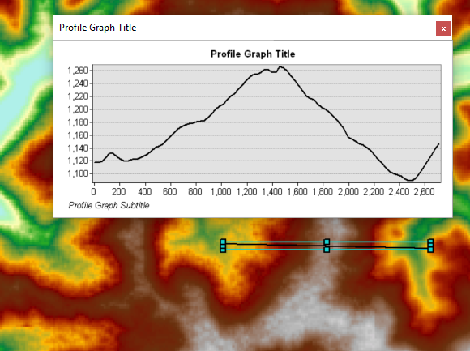
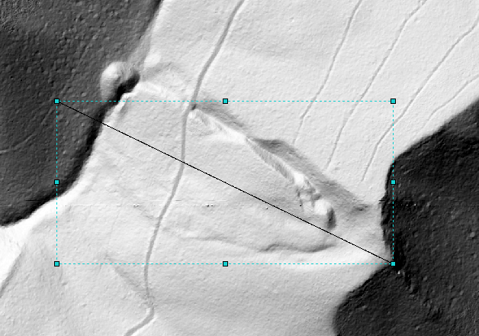
Profiles
Display elevation against distance in a graph
Available with 3D Analyst or Profile Function
Can export to a table
Notes:
You can generate profiles to extract elevation values along a transect, line, or path.
A profile is generated based on the raster cell values that intersect the path.
Once a profile is generated, graphs can be created and the results can be exported as tables for further analysis in other software packages.
https://www.youtube.com/watch?v=gk_CBD6AETg

Slide 6
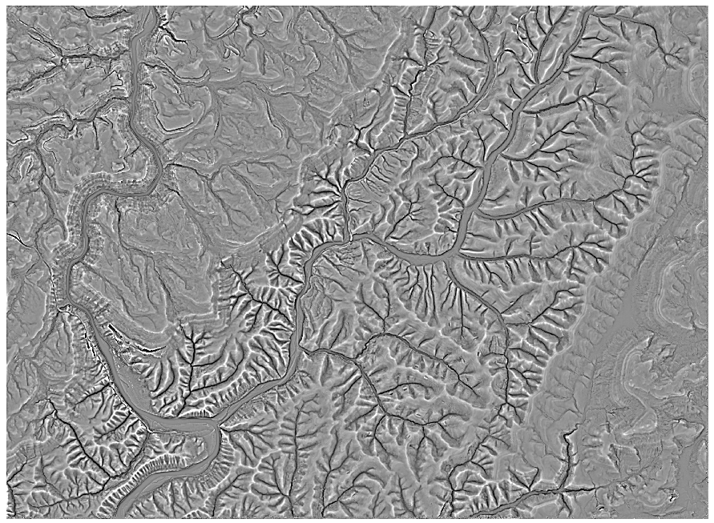
Slope position
Ridge vs. valley
Elevation at cell compared to elevation of surrounding cells
Must calculate mean using neighborhood analysis
Dark areas represent valleys or areas where the center cell is lower than its neighbors.
Notes:
We will now discuss some more advanced and specific terrain analysis techniques.
Slope position provides a measure of slope position or ridge vs. valley by comparing the elevation of a center cell to the mean elevation of its neighbors.
This is just another example of a tool that makes use of a moving window.
Increasing the window size will result in a more generalized pattern whereas smaller window sizes will highlight more local patterns.
There is not necessarily a correct window size, as this depends on the scale and question of interest.
It is possible to make this calculation using multiple window sizes for comparison or even average the results.
In the example provided, bright areas represent ridges or areas where the center cell is higher than its neighbors.
Dark areas represent valleys or areas where the center cell is lower than its neighbors.

Slide 7
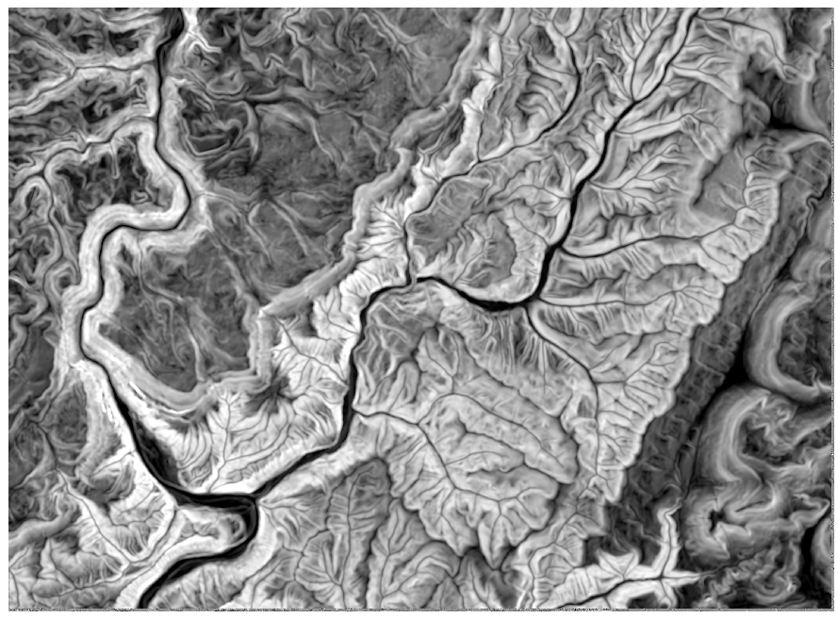
Topographic roughness
Measure of topographic variability
Square root of standard deviation of elevation measurements within a neighborhood
Notes:
Topographic roughness is a measure of how variable or rough a terrain is within a local neighborhood.
So, it also makes use of moving window analysis. Larger windows will produce more generalized patterns whereas smaller windows will highlight more local patterns.
This measure is calculated as the square root of the standard deviations of the elevation measurements within a neighborhood.
Larger values indicate more rough or variable terrain and lower values indicate smoother or less variable terrain.

Slide 8
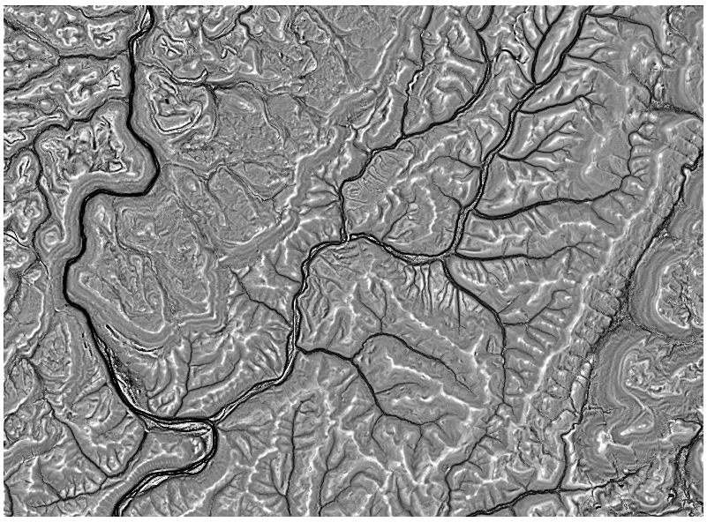

Topographic dissection
Measure of incision
$$\frac{Elevation −Minimum Elevation}{Maximum Elevation −Minimum Elevation}$$
Low values indicate more incision whereas high values indicate less incision.
Notes:
Topographic dissection is a measure of incision.
It is calculated by subtracting the lowest elevation value in a moving window from the center cell value then dividing by the range of values in the window.
So, like many of the other terrain analysis tools, this calculation makes use of a moving window.
Low values indicate more incision whereas high values indicate less incision.

Slide 9
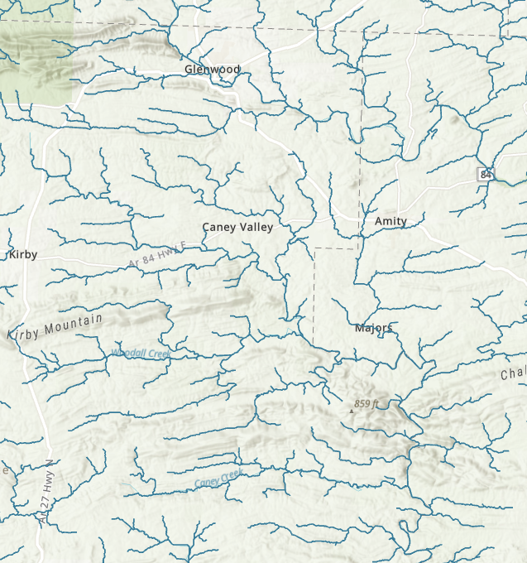
Hydrological analysis
Watershed

Slide 10
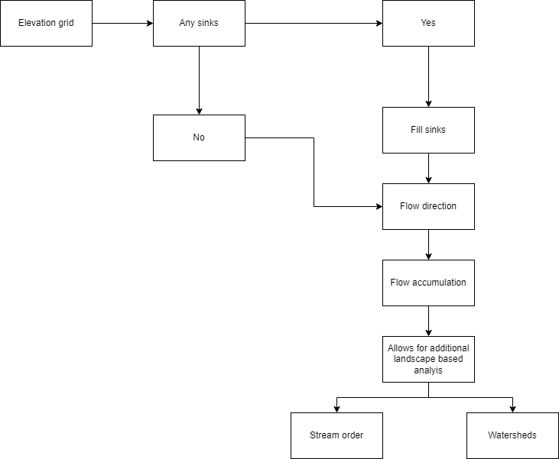
Hydrological analysis
Surface hydrological modeling process

Slide 11
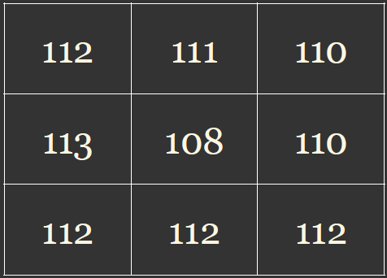
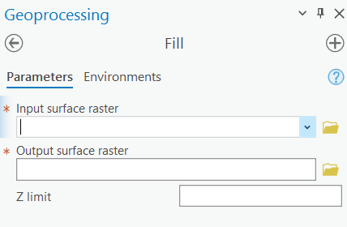
Hydrological analysis
Fill sinks
Depression in the DEM where water gets trapped
A sink prohibits calculating future flow direction grid values
A sink occurs when all neighboring cells are higher than the processing cell
Sometimes they are natural features
Input = original DEM
Notes:
The first task is to fill sinks. Sinks represent depressions in the landscape that hinder the flow of water over the landscape.
In order to perform surface hydrologic analysis, we need to be able to model the flow of water from the ridge to the valley.
So, if water gets trapped in a local depression, this is an issue. A sink prohibits calculating future flow direction values, and they occur when all neighboring cells are higher than the processing cell, as demonstrated in the provided example.
Sometimes sinks represent errors or artifacts from creating the data. Sometimes they represent real features on the landscape. Regardless, sinks must be filled to perform the analysis. A generalized representation of the terrain is required.
The required input is a DEM or DTM. Once sinks have been filled, the result is a hydrologically corrected DEM.

Slide 12
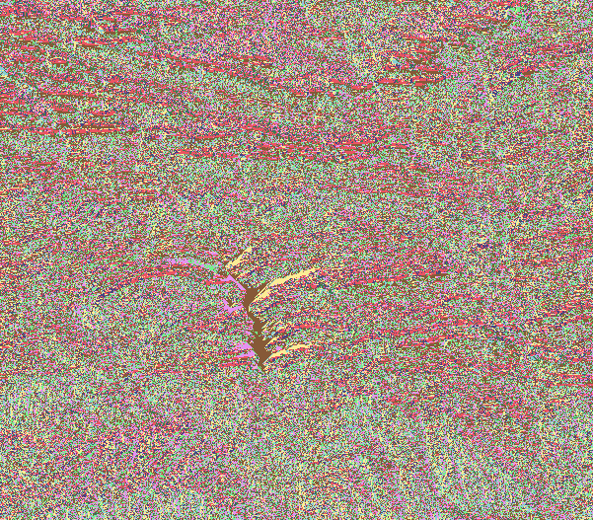
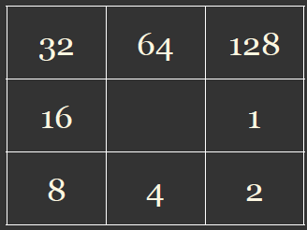
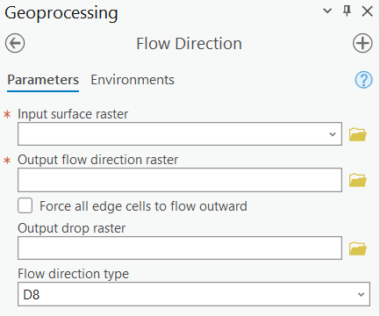
Hydrological analysis
Flow direction
Created from an elevation surface
Direction values are assigned
Flow direction grids are used in many hydro GIS functions
Input = Filled DEM
Code
Notes:
Flow direction represents the direction of flow from a center cell to its neighbors.
Flow will progress to the cell with the greatest downhill slope in comparison to the center cell.
The 3 by 3 window provided here shows the codes used to indicate different flow directions.
For example, a code of 16 suggests that water will flow to the cell to the left.
The required input for a flow direction calculation is a filled or hydrologically corrected DEM.
This example relates specifically to the D8 method. Other methods are available to calculate flow direction, as will be discussed later.

Slide 13

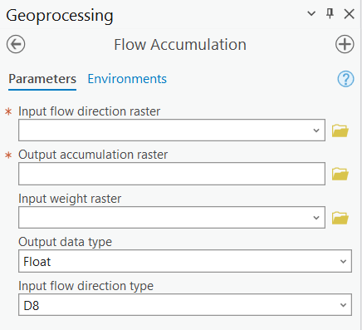
Hydrological analysis
Flow accumulation
Accumulated flow = number of cells flowing into each cell in the output grid. The current processing cell is not considered in this accumulation.
Output cells with a high flow accumulation are areas of concentrated flow and may be used to identify stream channels.
Output cells with a flow accumulation of zero are local topographic highs and may be used to identify ridges
Input = Flow direction grid

Slide 14
Hydrological analysis
Calculations from a flow accumulation grid
Estimating drainage area
Flow accumulation value x cell area x required conversion factors to other area units
Estimating discharge
Discharge = Volume of Water / Unit Time (ft³/s, cm³/s, etc.)
Flow accumulation 1/ Discharge 1 = Flow accumulation 2/ discharge 2
Notes:
Flow accumulation values represent the number of cells flowing into the processing cell. They do not represent a contributing or drainage area.
If you would like to calculate drainage area you will need to multiply the flow accumulation value by the cell size. You can then use conversion factors to convert to other area units.
For example, if 812 cells flow into a processing cell and the cell size is 15 by 15 meters, then the contributing area would be calculated as 812 times 15 times 15, or 182,700 square meters. You can then convert to other area units, such as hectares or acres, using the necessary conversion factors.
Discharge represents the volume of water passing a point in a given amount of time. Units of measurements include cubic feet per second and cubic centimeters per second.
Discharge can be calculated from flow accumulation using the ratio method by comparison to a location of known discharge.
For example, if discharge is measured at a gauging station and flow accumulation is calculated using surface hydrologic modeling methods, then discharge can be estimated using the flow accumulation at another location.
Although this method allows for an estimate of discharge from flow accumulation, it is generally considered a rough measure, as there are many factors that this simple ratio method does not take into account. For example, this method does not take into account variability in topographic slope, stream channel morphology, watershed shape, soil characteristics, and land cover. All these factors could impact stream discharge.
Even given the limitations, this method can provide a useful estimate.

Slide 15
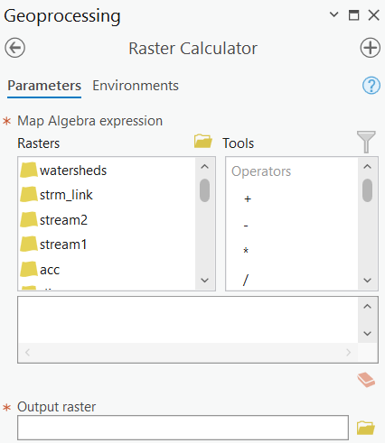
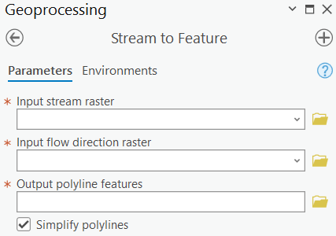
Hydrological analysis
Calculations from a flow accumulation grid
How much flow accumulation is required to create a stream?
A threshold value must be defined in terms of flow accumulation. All cells with a flow accumulation higher than this value will be coded as a stream. All other cells will be coded as not a stream.
However, the exact value depends on many factors including how the stream is initiated, soil conditions, terrain characteristics, and land cover.
The stream network can be converted to vector line features
Notes:
Once a flow accumulation surface is generated, it is possible to generate a synthetic stream network.
A threshold value must be defined in terms of flow accumulation. All cells with a flow accumulation higher than this value will be coded as a stream. All other cells will be coded as not a stream.
This calculation can be performed using Raster Calculator. So, the calculation is fairly easy.
Once a synthetic stream network is generated, the raster data can be converted to vector line features. Simplification can be applied if desired.

Slide 16
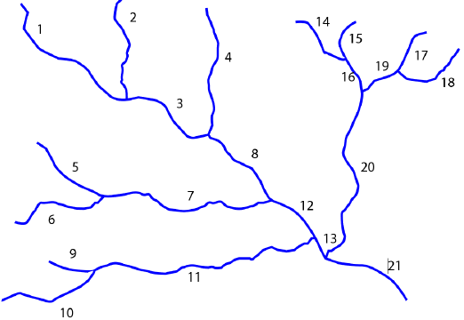
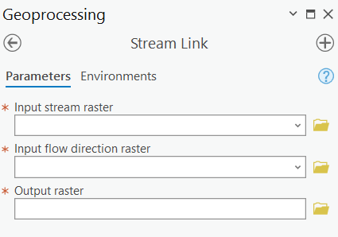
Hydrological analysis
Calculations from a stream grid
Assigns unique values to sections of a raster linear network between intersections
Input = Stream raster and flow direction
Notes:
In a stream link grid, unique values are assigned to sections of a raster linear stream network.
Each section between intersections or confluences are assigned a unique value, as demonstrated in the provided example.
The required inputs are a stream raster grid and flow direction grid.

Slide 17
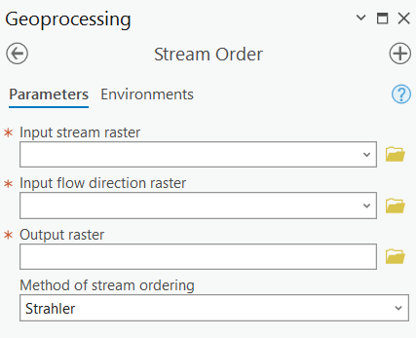
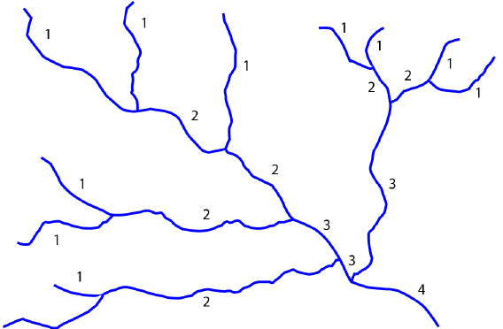
Hydrological analysis
Calculations from a stream grid
The smallest stream segments are labeled as 1st order streams. When two 1st order streams come together, a 2nd order stream is formed.
In order for a 3rd order stream to form, two 2nd order streams must come together. If a 1st and 2nd order stream come together, the result will still be a 2nd order stream.
Input = Stream raster and flow direction
Notes:
It is also possible to calculate stream order from stream raster grids and flow direction grids.
There are different methods for calculating stream order. Here, I will demonstrate the Strahler Method.
Using the Strahler Method, the smallest stream segments are labelled as 1st order streams. When two 1st order streams come together, a 2nd order stream is formed.
In order for a 3rd order stream to form, two 2nd order streams must come together. If a 1st and 2nd order stream come together, the result will still be a 2nd order stream.

Slide 18
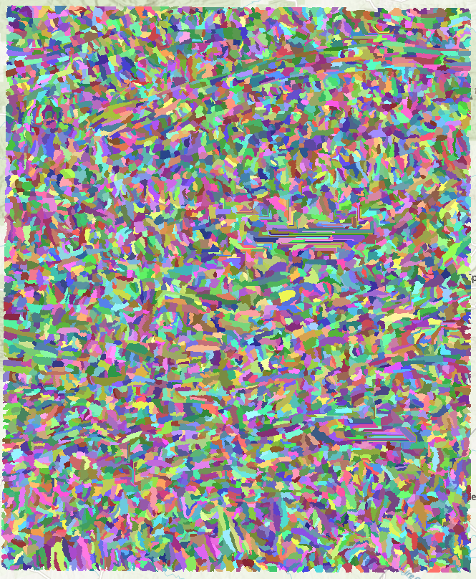
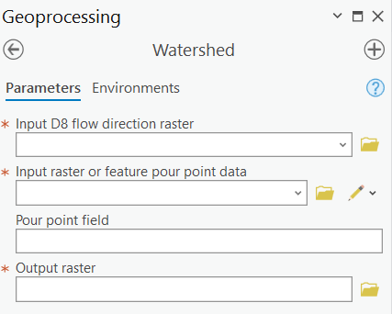
Hydrological analysis
Create your own watersheds
Input = Flow direction raster and pour points (can use stream link)
Notes:
Using a flow direction grid and a stream link grid, it is possible to generate watersheds.
A drainage area will be calculated for each unique segment of the stream link grid.
These areas will be assigned the same code as the stream segment to which they are associated.
Using this method, it is possible to generate watershed boundaries for an entire spatial extent.
The result will be a raster grid. Once it is generated, it is possible to convert the raster grid to polygons.

Slide 19
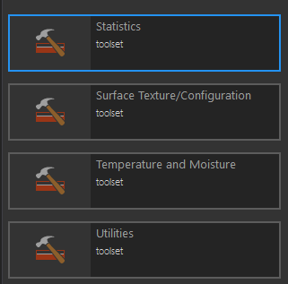
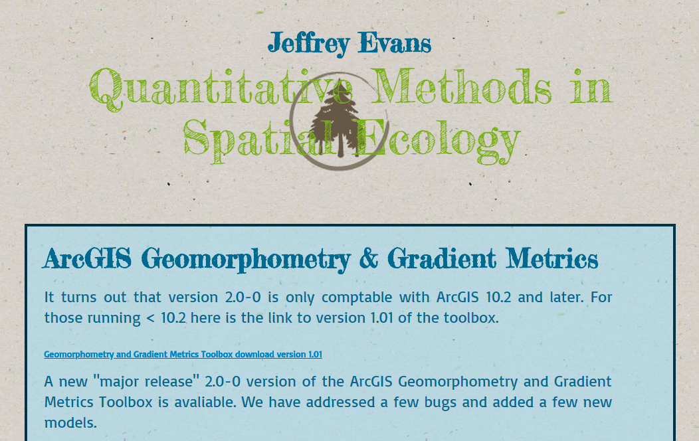
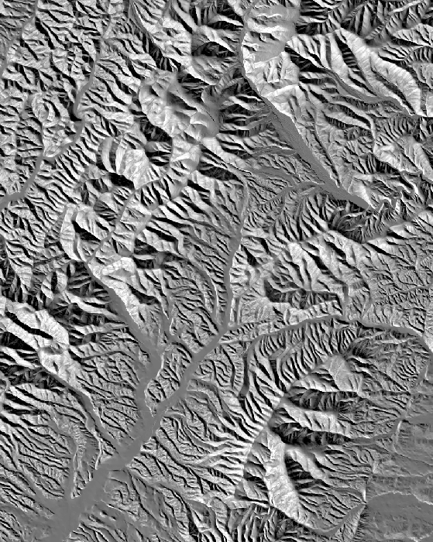
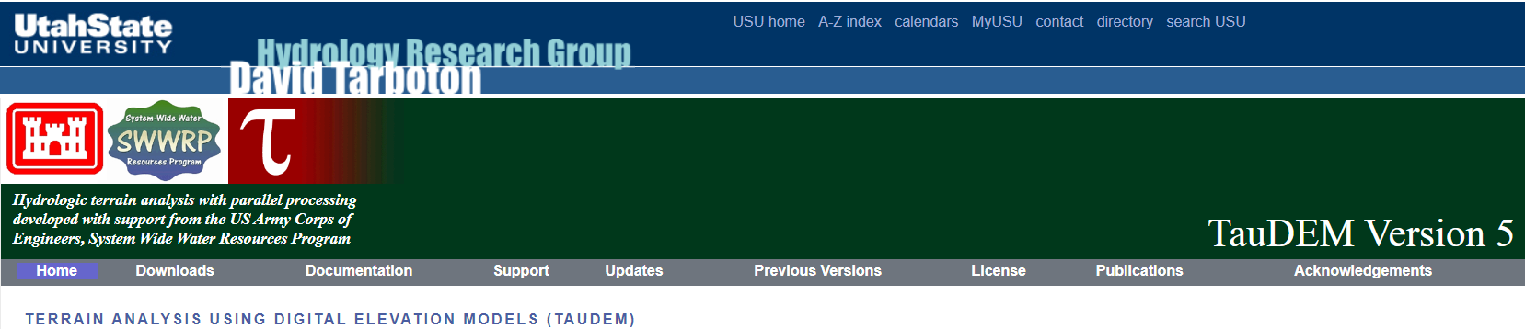
Geomorphometry & Gradients Metrics Toolbox
Slope position
Dissection
Topographic roughness
Compound topographic moisture index (CTMI)
Heat load index
Ecological land units (ELUs)
http://evansmurphy.wixsite.com/evansspatial/arcgis-gradient-metrics-toolbox
https://hydrology.usu.edu/taudem/taudem5/index.html
Notes:
If you are interested in performing terrain analysis in ArcGIS, I would suggest the Geomorphometry & Gradients Metrics Toolbox made available by Jeff Evans.
QGIS, including GRASS and SAGA, also provide many terrain analysis tools.

Slide 20
Data # 2: DEM Data Downloading Demonstration
USGS 3DEP LidarExplorer
https://apps.nationalmap.gov/lidar-explorer/#/

