Slide 1

GEOG 3403: Geographic Information Systems II
Lecture 04 Remote Sensing
Yanan Wu, PhD
Assistant Professor
Department of Geography

Slide 2
Overview
Remote Sensing
History
Electromagnetic Spectrum
Spectral reflectance

Slide 3
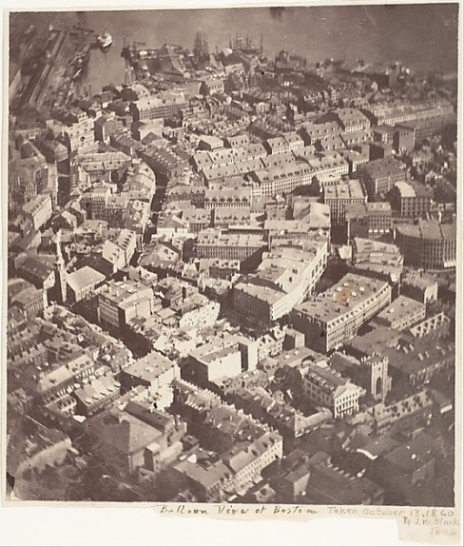
History
Aerial photography
1858: Gaspard-Félix “Nadar” Tournachon takes the first aerial photograph of Paris from a hot air balloon
1860: James Black takes aerial photograph of Boston from a balloon
1906: Aerial photograph from kite of San Francisco in the wake of an earthquake by George Lawrence
1903: First flight by Wright Brothers.
Value = 896 m
https://www.smithsonianmag.com/smart-news/this-picture-of-boston-circa-1860-is-the-worlds-oldest-surviving-aerial-photo-14756301/

Slide 4
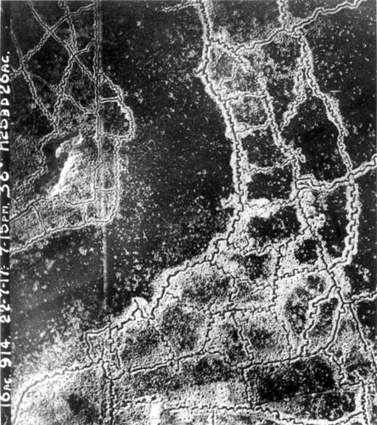
History
Aerial photography
1908: First aerial photograph from an airplane of Le Mans, France (Wilbur Wright and cameraman)
World War I: Aerial photography implemented during ware
World War II: Continued use during war efforts
Value = 896 m
https://nzhistory.govt.nz/media/photo/trench-systems-somme
Notes:
Trench warfare

Slide 5
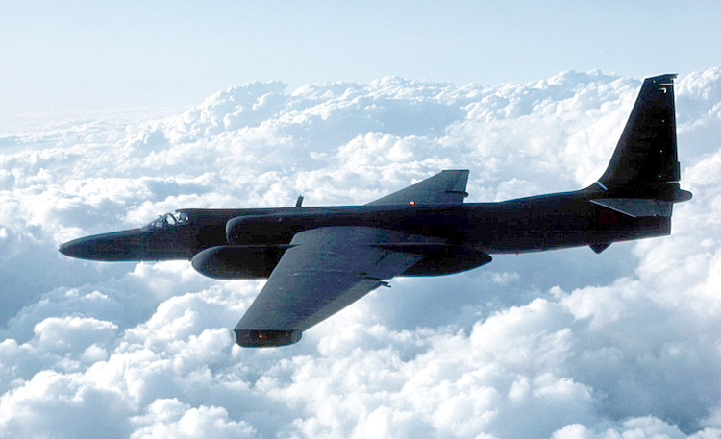
History
Aerial photography
1950: U-2 spy plane in use
Post World War Era: Development of commercial aerial surveying
Value = 896 m
https://commons.wikimedia.org/wiki/File:Usaf.u2.750pix.jpg
Notes:
Trench warfare

Slide 6
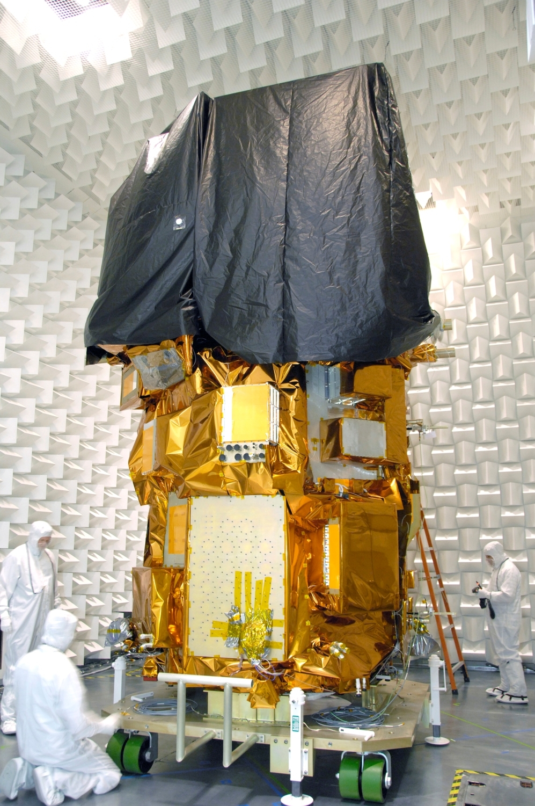
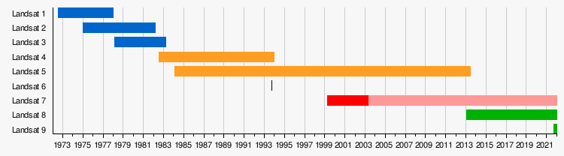
History
Space satellite
1972: Landsat
Value = 896 m
https://en.wikipedia.org/wiki/Landsat_program
Notes:
Trench warfare

Slide 7

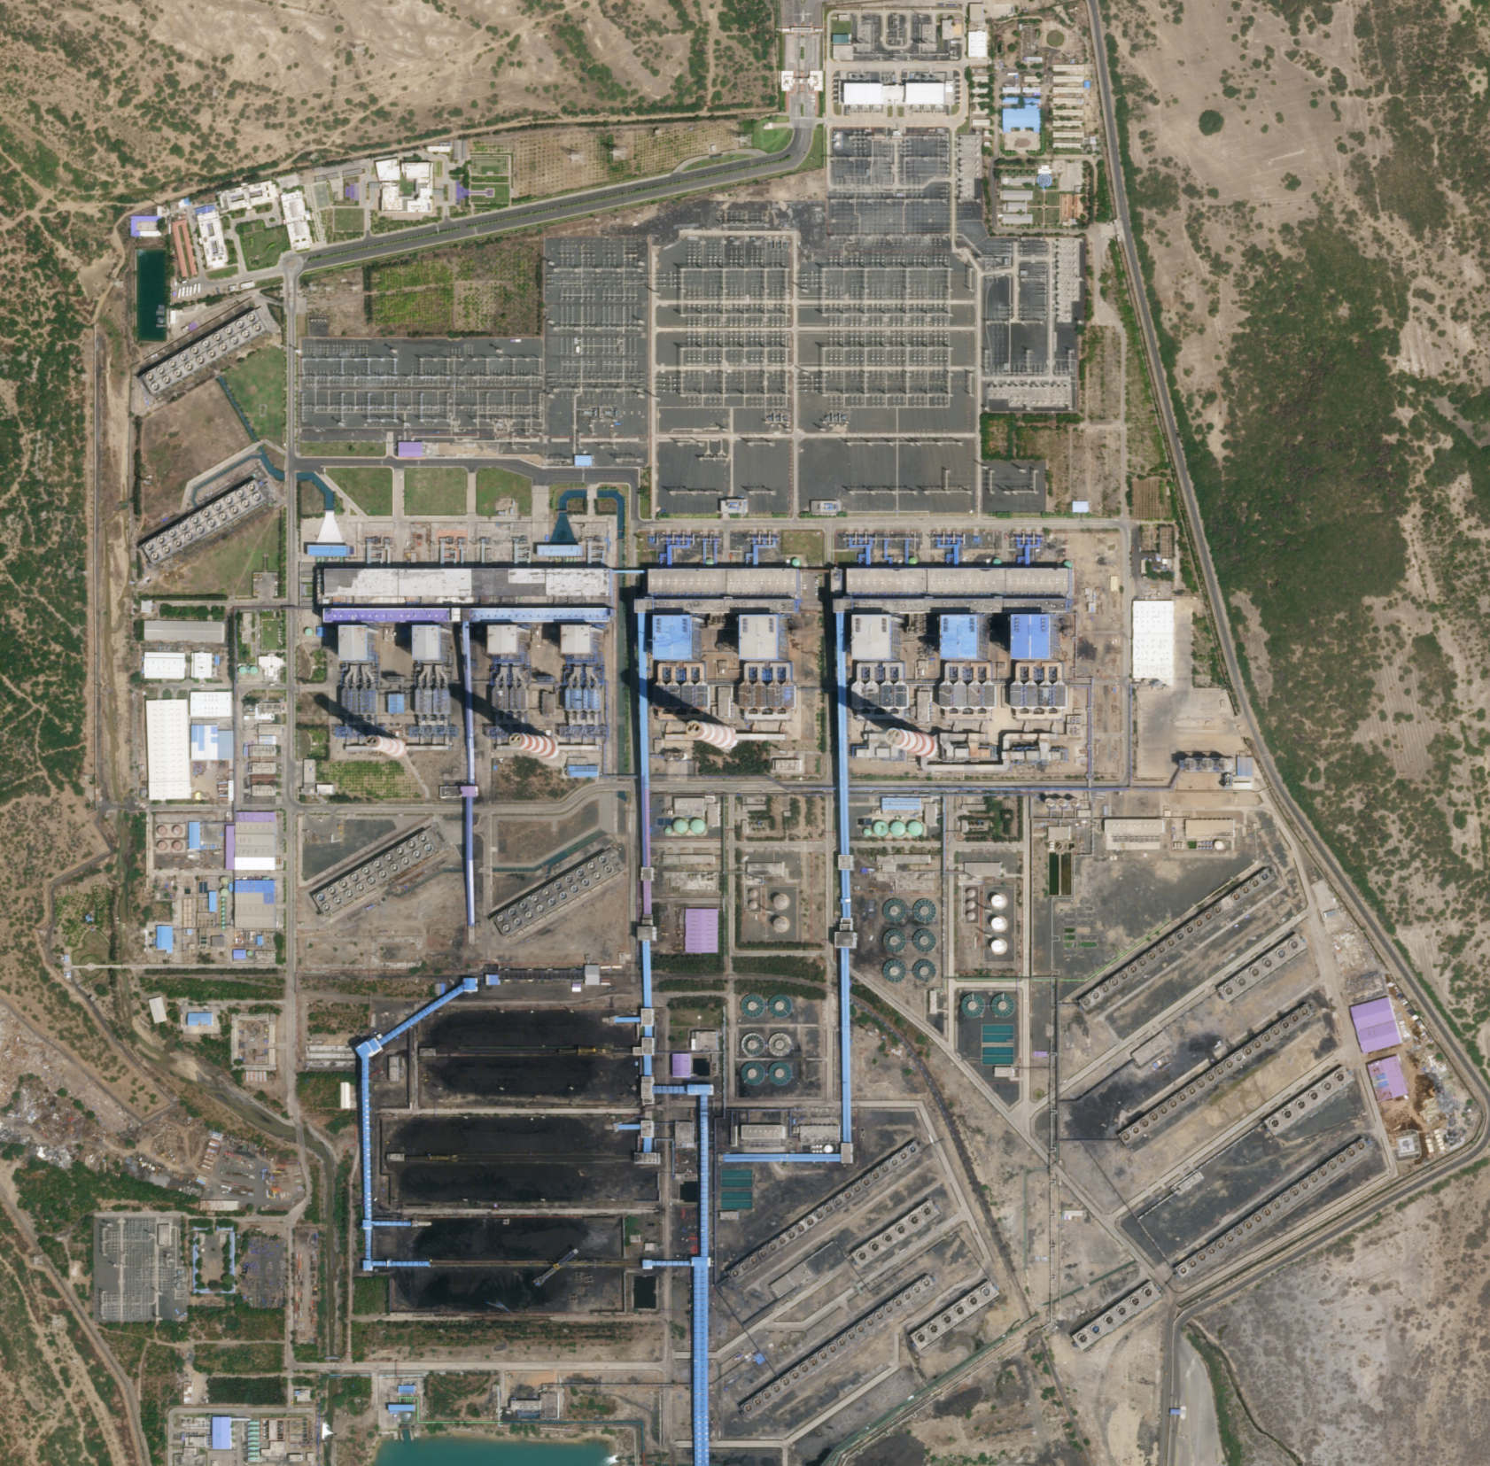
History
Space satellite
Planet
50 cm
Value = 896 m
https://www.planet.com/50cm/
Notes:
Trench warfare

Slide 8
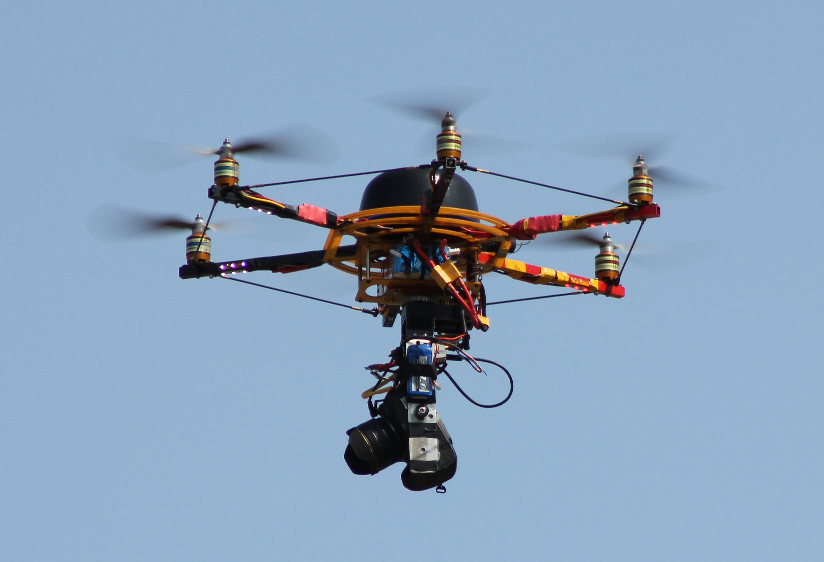
History
Unmanned Aerial Vehicles (UAV)
https://commons.wikimedia.org/wiki/File:Drone_im_Himmel_IMG_2423BE2.jpg
Notes:
Trench warfare

Slide 9
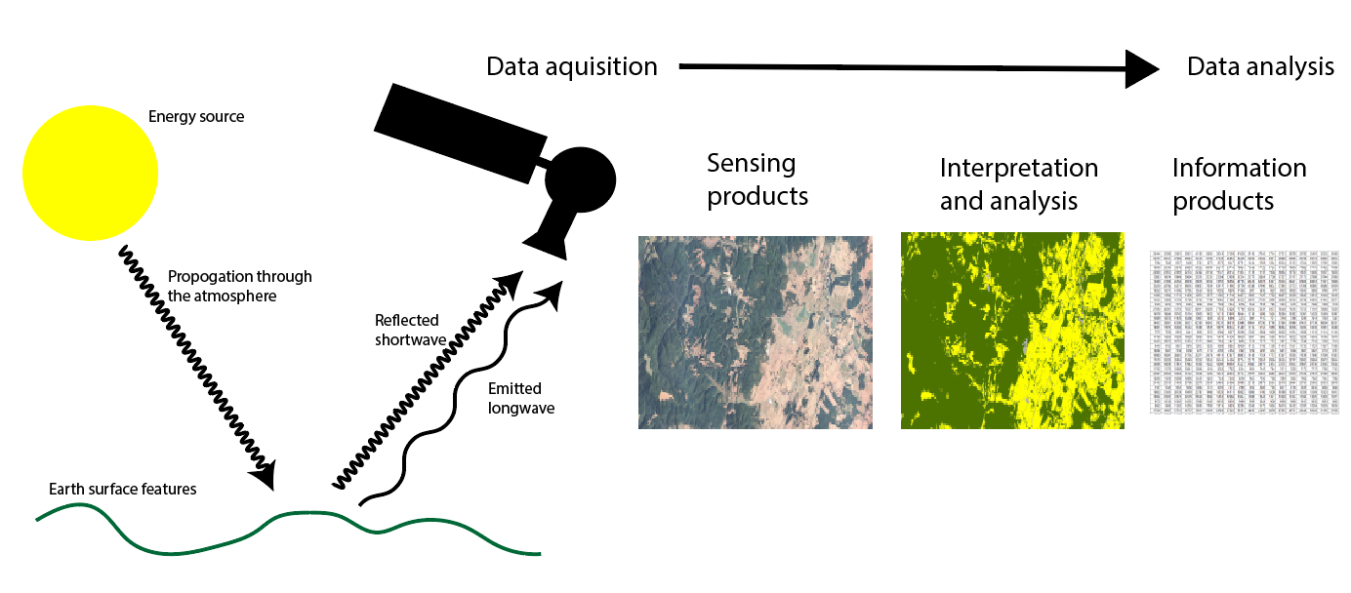
Electromagnetic spectrum
Value = 896 m
From Dr. Arron Maxwell
Notes:
Other than panchromatic, or black-and-white, imagery, image datasets contain more than one band.
For example, a true color image will contain three bands: red, green, and blue.
For multiband images, the raster data structure is that of an array. Each cell location holds multiple measurements, or a single measurement in each band.
You can think of a multiband raster as a stack of single band layers that act as one file.
Although we will focus on multiband imagery here, you can actually create multiband raster grids from a variety of raster data layers.

Slide 10
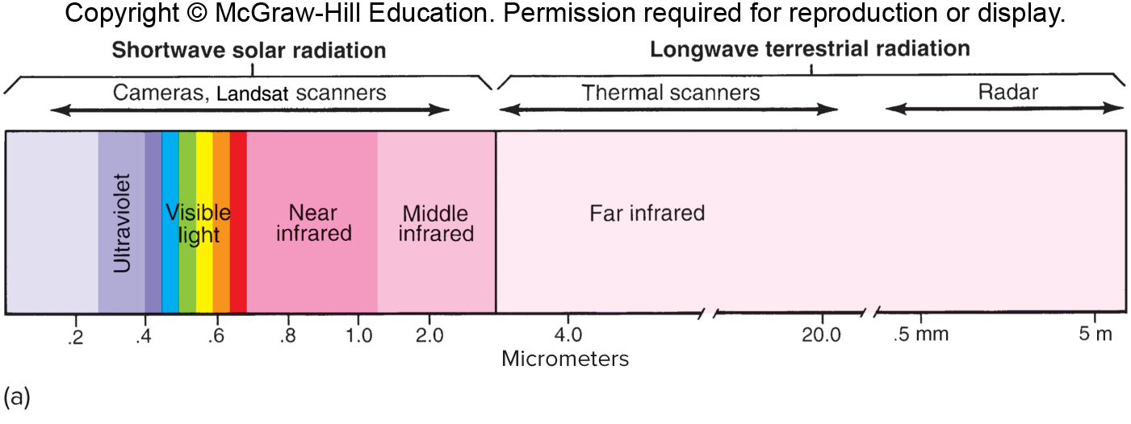
Electromagnetic spectrum
Ultraviolet (UV) = less than 0.4 µm
Visible light = 0.4 to 0.7 µm
Blue = 0.4 to 0.5 µm
Green = 0.5 to 0.6 µm
Red = 0.6 to 0.7 µm
Infrared = 0.7 to µm
Near Infrared (NI) = 0.7 to 1.3 µm
Mid IR/Shortwave IR = 1.3 to 3 µm
Thermal IR = 3 to 14 µm
Microwaves = 1 mm to 1 m
Bjeland et al. Introduction to Geography
Notes:
Wavelengths of the electromagnetic spectrum in micrometers. One micrometer equals one-millionth of a meter. Sunlight is made up of different wavelengths. The human eye is sensitive to only some of these wavelengths, the ones we see in the colors of the rainbow.

Slide 11
Electromagnetic spectrum
Although invisible, near infrared wavelengths can be recorded on special sensitized film and by scanners on satellites. The scanners measure reflected light in both the visible and near infrared portions of the spectrum. Wavelengths longer than 4.0 micrometers characterize terrestrial radiation.
Bjeland et al. Introduction to Geography

Slide 12
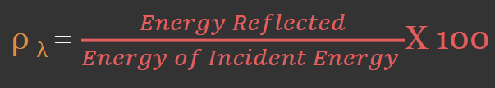
Spectral Reflectance
What happens when radiation hits the surface?
Transmission: energy passes through a target
Absorption: energy is trapped and held by a target
Reflection: energy bounces off a target
Incident energy: the total amount of energy that interacts with an object
Spectral reflectance = the percentage of the total incident energy that is reflected from a surface

Slide 13
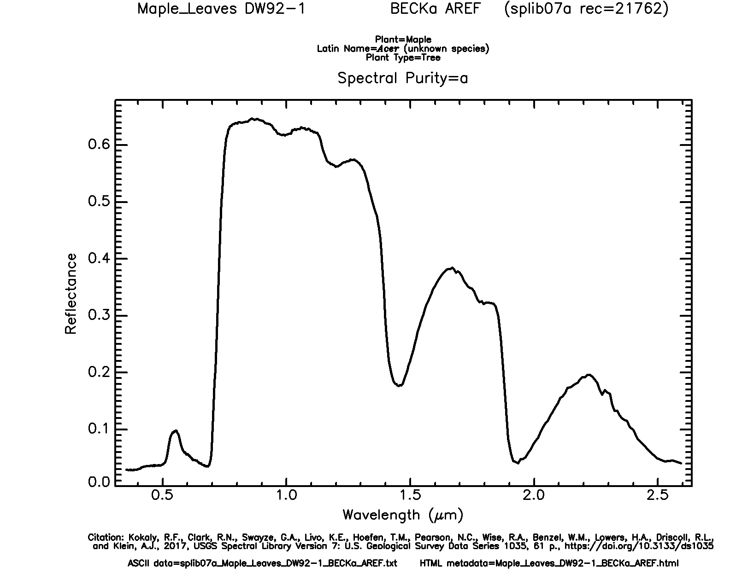
Spectral Reflectance
Vegetation
Blue = absorption by pigments
Green = less absorption by pigment
Red = absorption by pigments
Near Infrared = reflect and
scattered by interior cell walls
Shortwave Infrared = absorption by water in plant tissue
X
X
X
X
X
X
Example: Maple Leaf
Data from USGS Spectral Library Version 7
Notes:
Let’s explore the spectral reflectance of this maple leaf further.
Here, I have color coded different spectral ranges with different color “Xs.”
This leaf tends to absorb as opposed to reflect a lot of visible radiation. However, it absorbs more blue and red in comparison to green. This is why leaves appear green to us. This absorption results from the pigments in the leaf, such as chlorophyll, that interact with Sunlight in the process of photosynthesis to make energy and sugars for the plant. During the winter, when the tree is not photosynthetically active, the leaf will no longer appear green to us.
Green, healthy, and photosynthetically active leaves tend to scatter or reflect a larger proportion of incident near infrared radiation than visible light due to how this radiation interacts with cell walls. So, if we could sense near infrared radiation, a leaf would appear to be near infrared as opposed to green. However, this has no physical meaning since we can’t see near infrared radiation.
In the shortwave infrared range there are some absorption features associated with water in the plant tissue.
This graph highlights the wavelength specific nature of spectral reflectance.

Slide 14
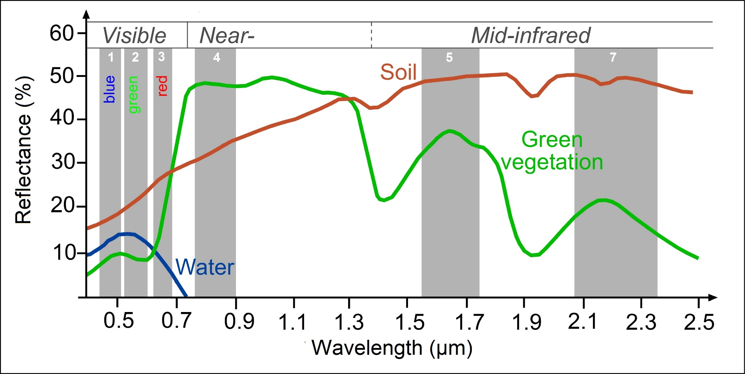
Spectral Reflectance
Different materials have different reflectance properties
http://www.seos-project.eu/modules/classification/classification-c01-p05.html
Notes:
This graph provides another comparison.
Soil tends to show greater spectral reflectance in the shortwave infrared range in comparison to near infrared or visible wavelengths, a pattern that is much different from green vegetation.
Water tends to absorb most near infrared and shortwave infrared radiation.
So, using these patterns, we could potentially differentiate these different surface materials.
You may notice some small troughs in the shortwave range for soil that align with the deeper troughs for green vegetation. This results from water in the soil, just as the troughs in the green vegetation curve relate to water in the plant tissue.

Slide 15
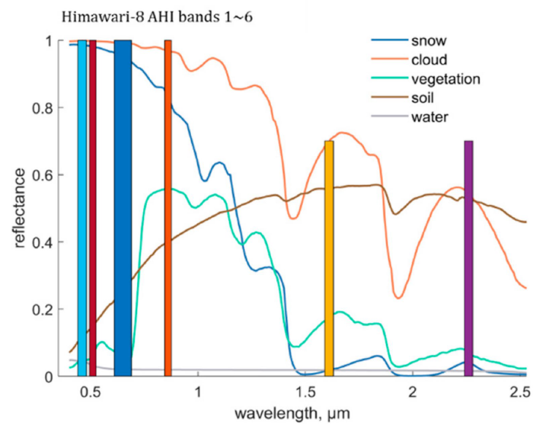
Spectral Reflectance
Different materials have different reflectance properties
Wang, G., Jiang, L., Shi, J., Liu, X., Yang, J. and Cui, H., 2019. Snow-Covered Area Retrieval from Himawari–8 AHI Imagery of the Tibetan Plateau.Remote Sensing,11(20), p.2391.

