Slide 1

WEEK 06 remote sensing lecture
Instructor: Yanan Wu
fALL 2025

Slide 2
6.1 land cover and land use

Slide 3
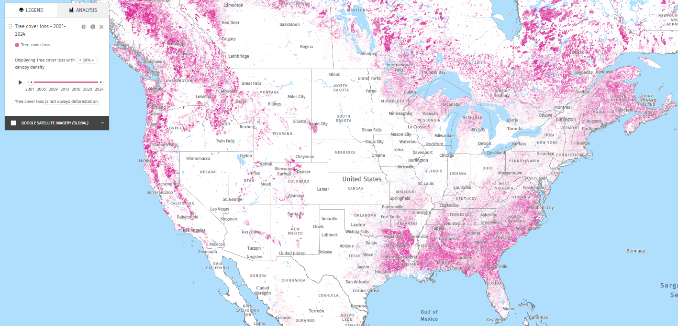
Forest Disturbance: Global Forest Watch
Identifies areas of tree cover loss from 2001-2017
30 m spatial resolution
Includes location and amount of disturbance but not cause

Slide 4
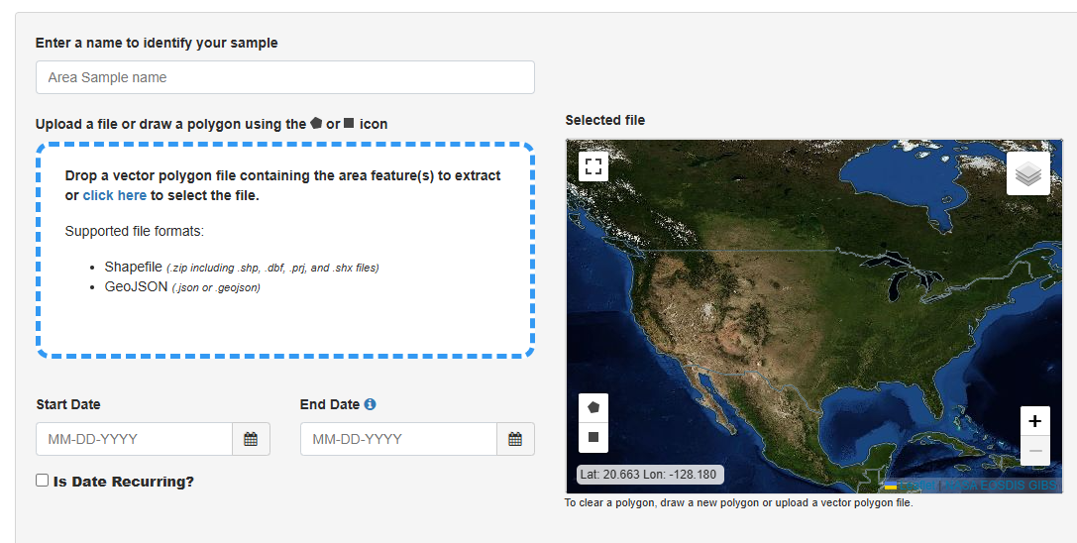
Change Detection and Analysis: AppEEARS
Cloud-based computing using MODIS and other imagery (not Landsat yet)
Time series analysis of user-specified points or areas
Outputs include time series data in csv format for easy analysis
Example: Monitoring changing in Conway, Arkansas

Slide 5
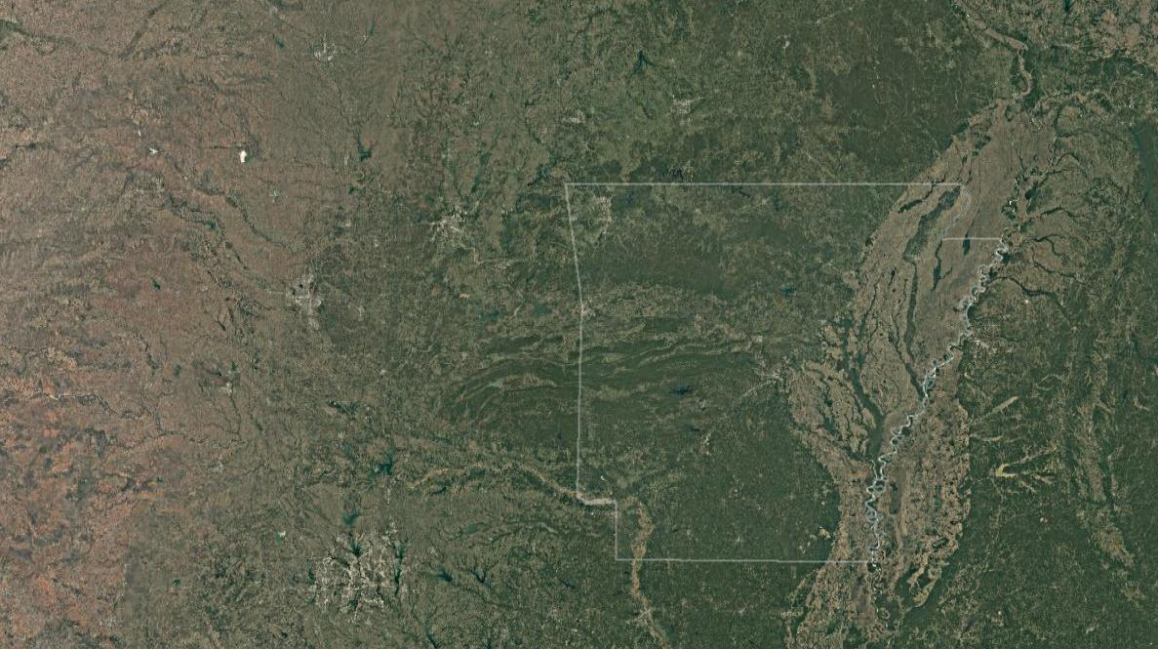
System for Earth Observations, Data Access, Processing, and Analysis for Land Monitoring (SEPAL)
Developed by UN Food and Agriculture Organization (FAO), with funding from Norway, to help countries develop National Forest Monitoring Systems
Cloud-based computing platform for data access and processing
Includes two-date change detection and time series analysis
https://sepal.io

Slide 6
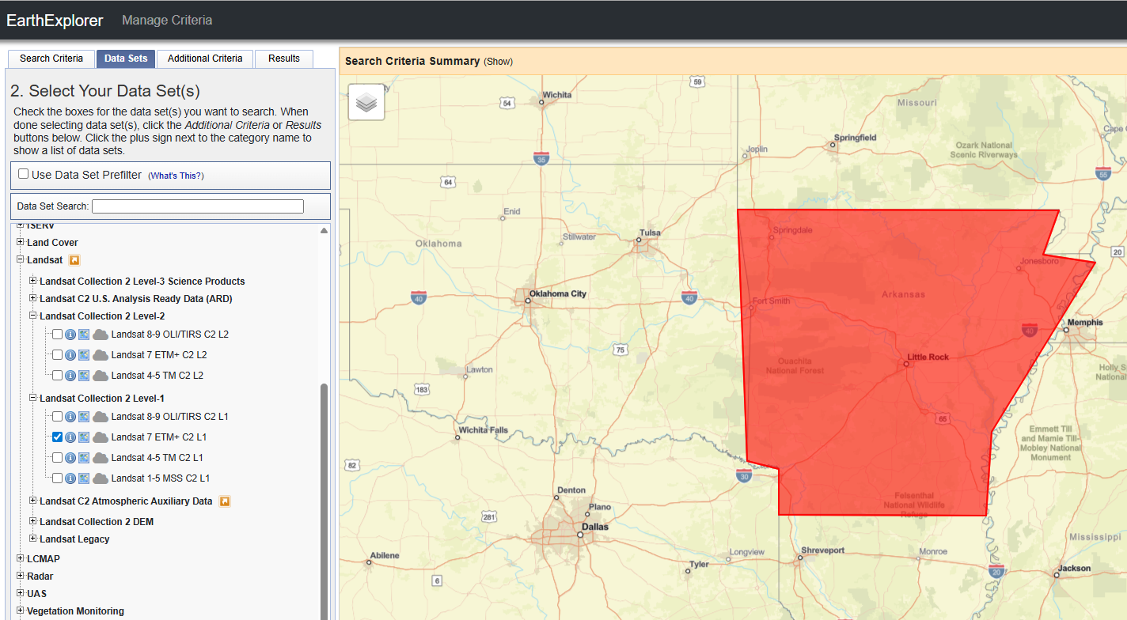
Earth explorer
Level-2 data are atmospherically corrected and ready to use, making analysis more straightforward
Level-1 data provide the most complete archive but require users to perform their own atmospheric correction.

Slide 7
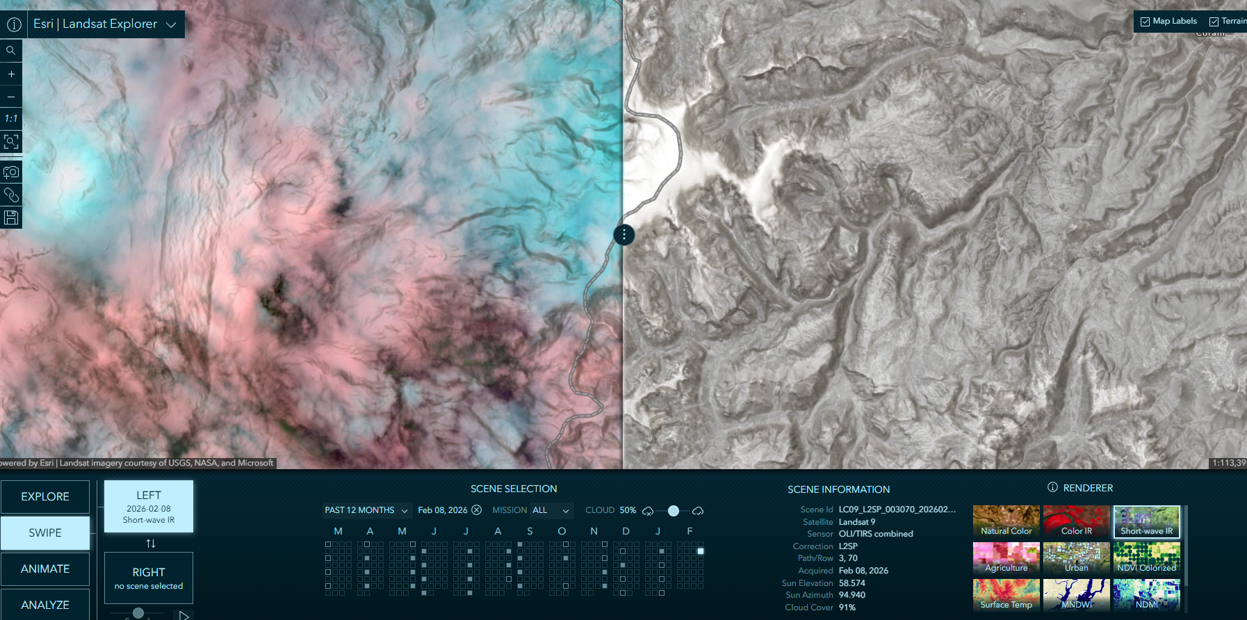
ESRI LANDSAT EXPLORER

Slide 8
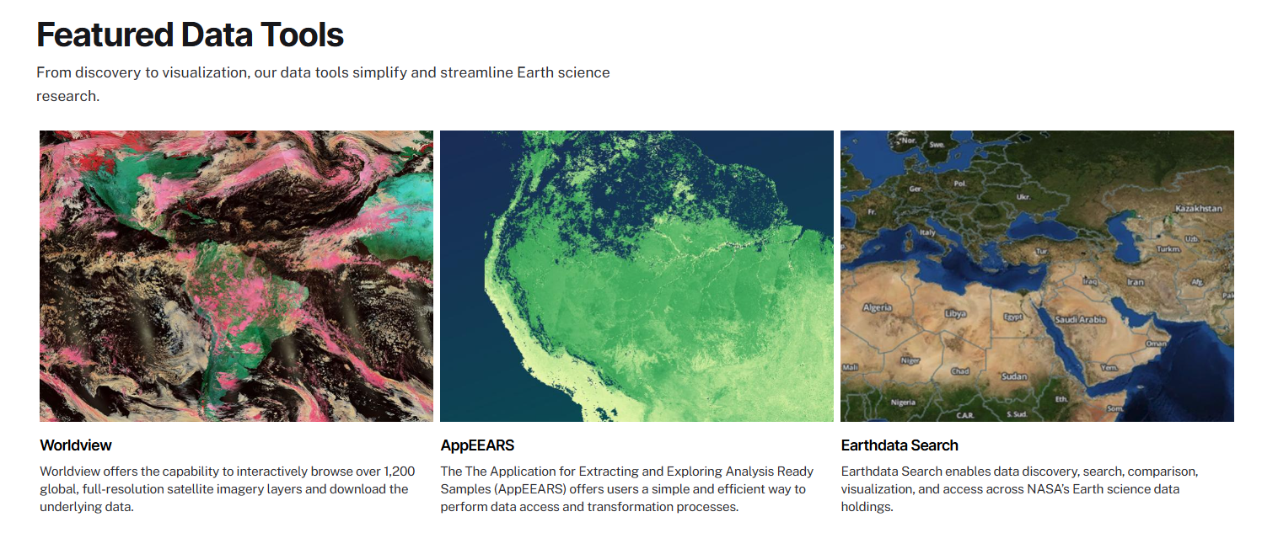
DATATOOL IN NASA
Which data tool is right for you?

Slide 9
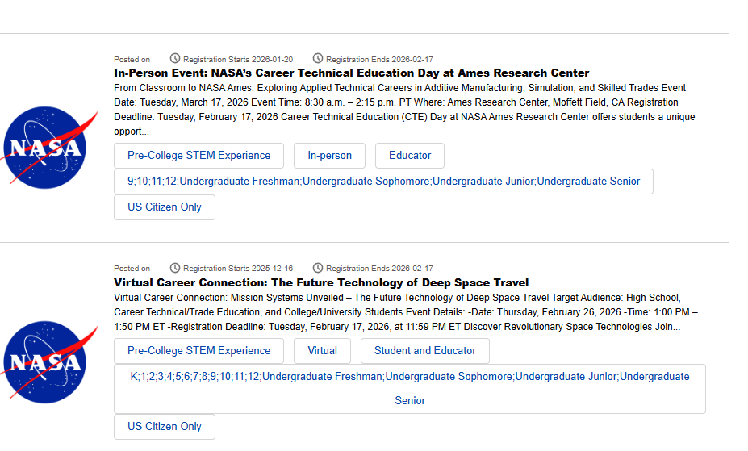
NASA SUMMER INTERNSHIP
Deadline
Summer 2026: Feb. 27, 2026, 11:59 p.m. ET
Fall 2026: May 22, 2026, 11:59 p.m. ET

Slide 10
Any question?

