Slide 2
Land use and land cover
Land cover refers to variations in continuous biophysical characteristics of the Earth’s surface, such as vegetation type and soil properties, across a landscape.
Land-use, in contrast, describes changes in how humans use or manage a particular area of land.
Lan use and Land cover

Slide 3
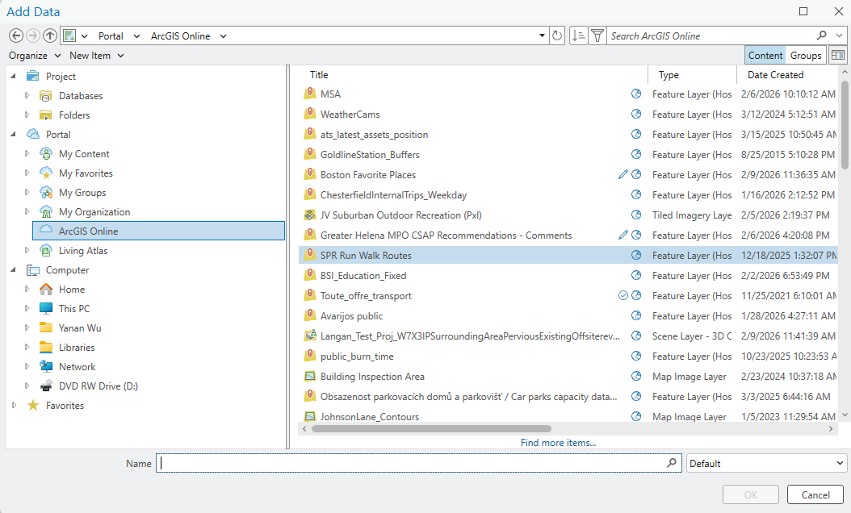
EXERCISE 1: EXPLORE DATA IN ARCGIS ONLINE AND LIVING ATLAS

Slide 4
What is Change Detection?
The conversion of the landscape from one dominant feature type to another
Examples:
Changes in tree cover due to wildfire or land clearing
Urbanization
Land degradation due to over grazing
Information that can be derived from satellites:
Where and when has change taken place?
How much and what kind of change has occurred?
What are the cycles and trends in the change?

Slide 5
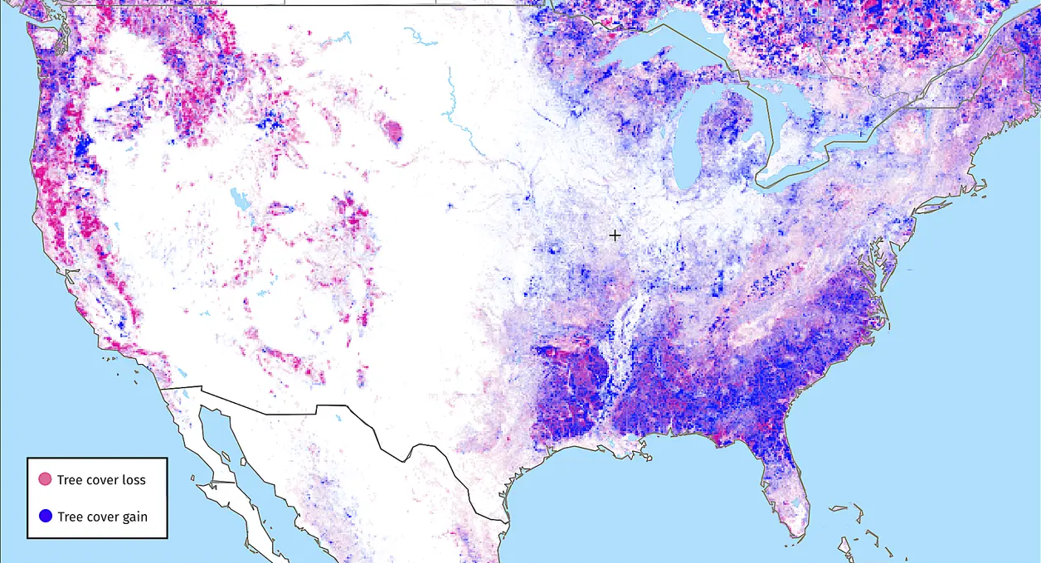
Changes in U.S. tree cover
Data Source
Changes in U.S. tree cover since 2000. Global Forest Watch

Slide 6
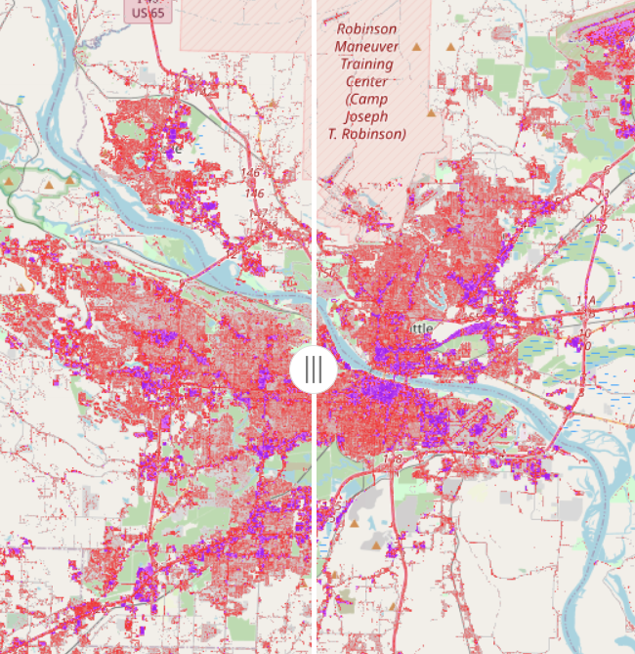
Urbanization
impervious surface change in Conway and Little Rock

Slide 7
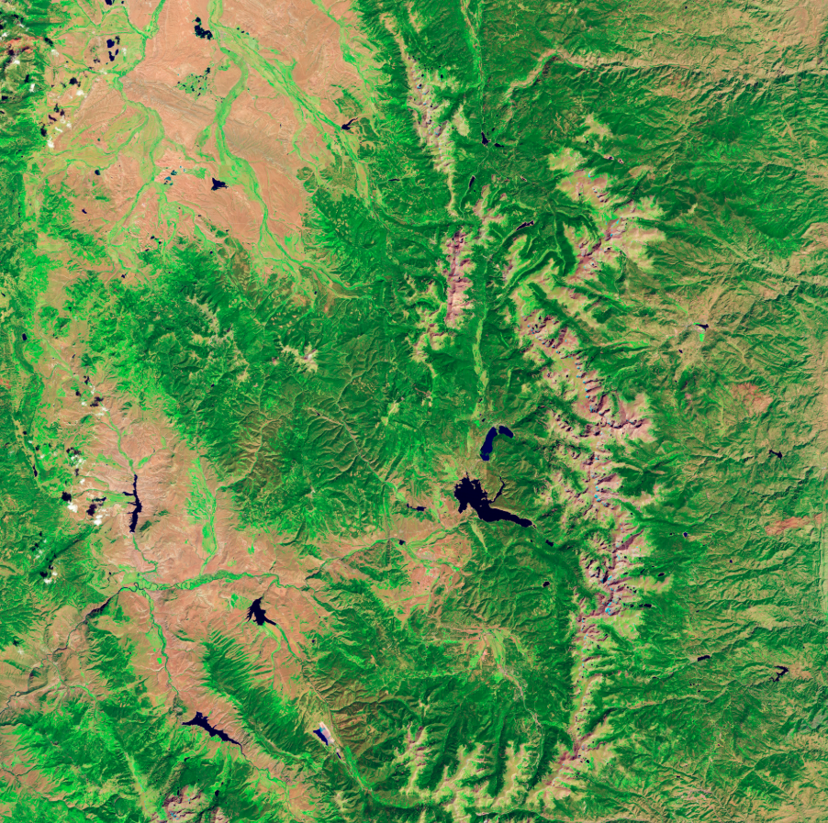
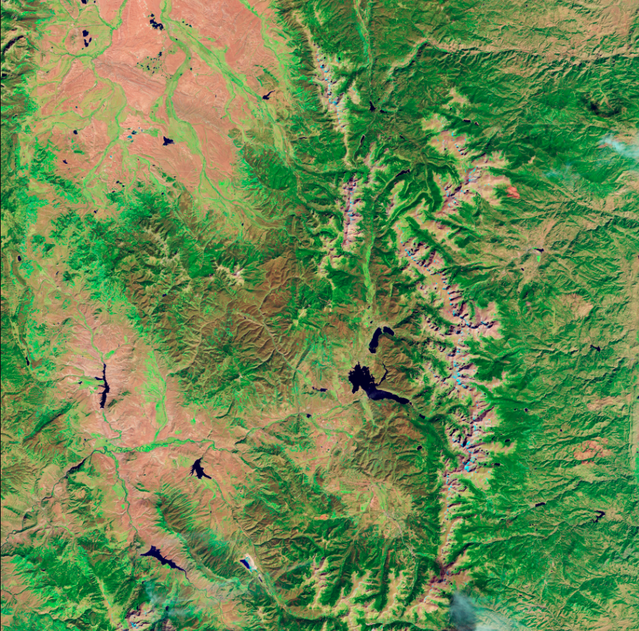
forest degradation due to insect
September, 2005
September, 2011
Pine bark beetles are tiny—about the size of a grain of rice—but large outbreaks can severely damage forest ecosystems.
In Colorado, a major beetle infestation spread across the Rocky Mountains since 2000, killing vast areas of pine forests, with impacts clearly visible in Landsat satellite imagery.

Slide 8
Change Detection Goals
Change Detection Goals
Identification of the geographical location and types of changes
Quantification of changes
Assessment of the accuracy of the change
Identifying the location of and quantifying change is easy.
Identifying the cause of change is not

Slide 9
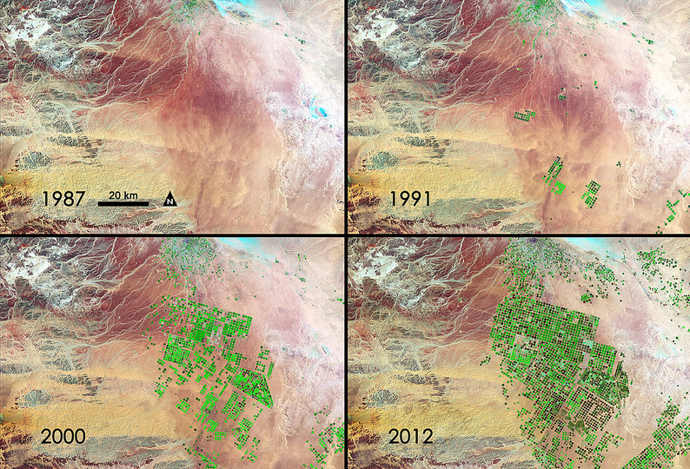
Brings Green to Saudi Arabia
Over the past 25 years, NASA’s Landsat satellites have documented the rapid expansion of agriculture in the northern Syrian Desert of Saudi Arabia using center-pivot irrigation.
This farming relies on deep underground water in an extremely arid region that receives only about one inch of rainfall per year and may remain economically viable for roughly 50 years.

Slide 10
What are the criteria for image selection
The challenge is to separate real change from spectral change. Choose images that are:
Collected at a similar time of day
Collected during the same season
Nearly cloud free
Co-registered with one another
Radiometrically and Atmospherically corrected

Slide 11
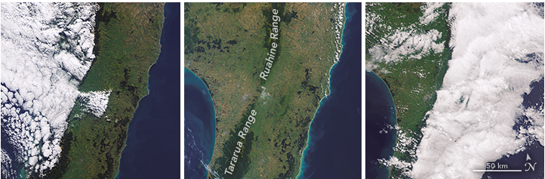
Image with cloud coverage and without
Data Source

Slide 12
Collection Time and Dates
Collection Time and Dates
Images need to be collected at about the same time of day to reduce differences in sun angle
Ideally, images from different years should be within the same month to avoid seasonal and phenological differences
Differences in vegetation greenness
Be aware of different annual precipitation amounts
Drought years vs. non-drought years

Slide 13
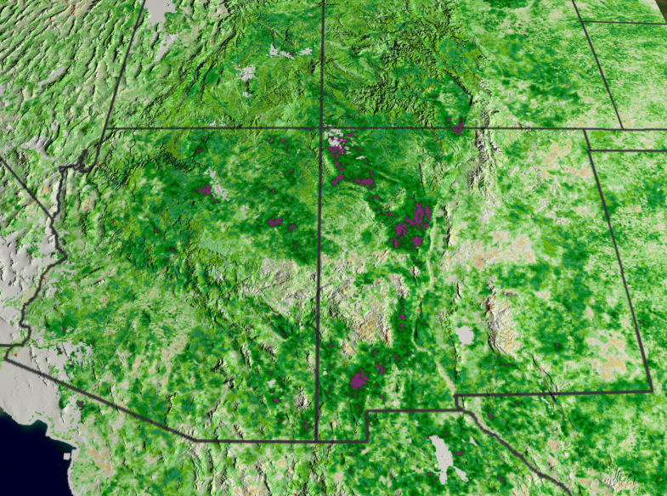
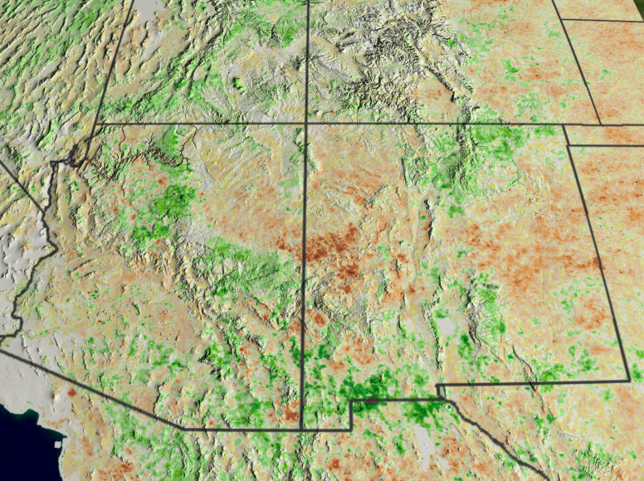
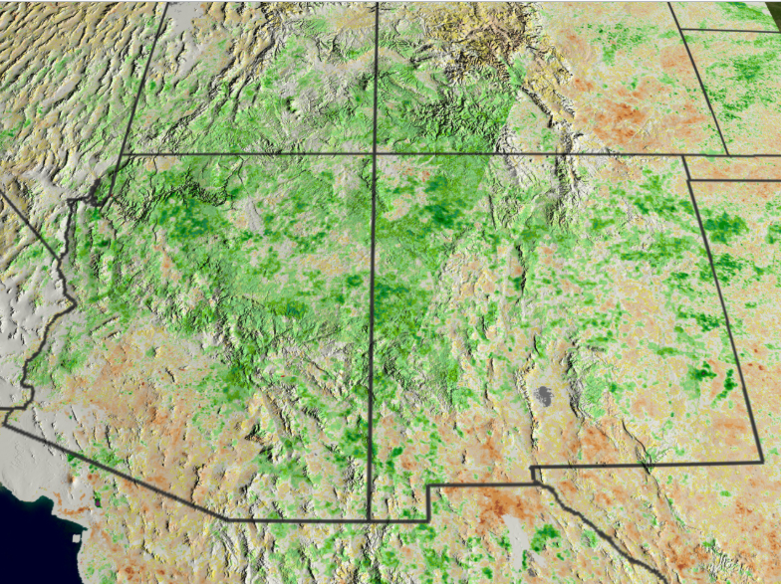
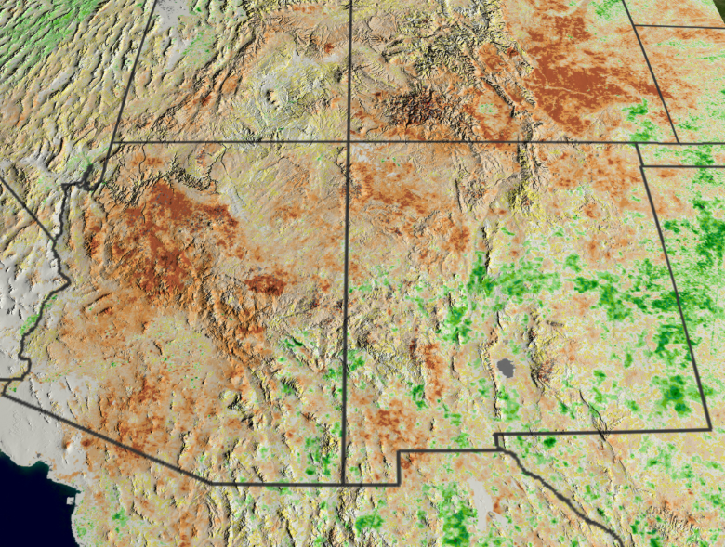
Drought areas change
August 1999
August 2000
August 2001
August 2002
Data Source

Slide 14
Change Detection Methods
Visual Analysis
Classification Approaches
Image Differencing
Temporal Trajectories

Slide 15
Visual inspection
Visual interpretation involves the delineation of change on a computer screen (rather than a paper map)
This allows production of results that are automatically in digital form
Good for large changes like shape or size of large patches
Not as good for subtle changes like land degradation
Does not take advantage of spectral response

Slide 16
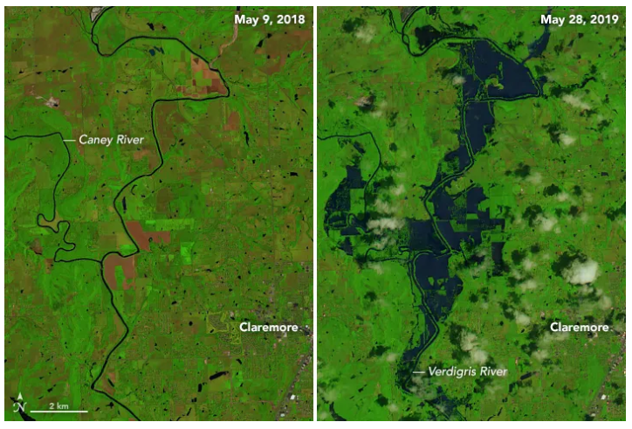
Case study: flooding along the river in arkansas
Data Source

Slide 17
Classification Approaches
Post-Classification Comparison
Land cover classification of two dates separately
Subtract one image from another to identify change

Slide 18
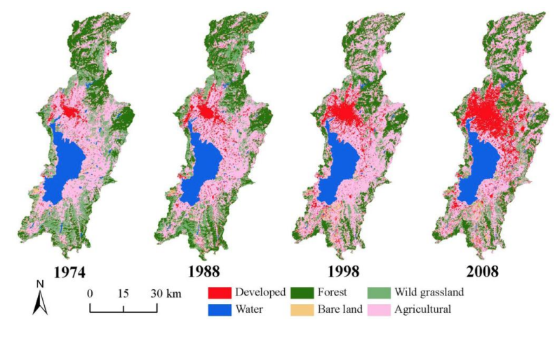
Land cover and lake management: classification-based approach
Examining Land-use/Land-cover change in the Lake Dianchi Watershed of the Yunnan-Guizhou, China
Land cover types classified
Indentifies increases in agricultural regions and urban development in the watershed
Data Source

Slide 19
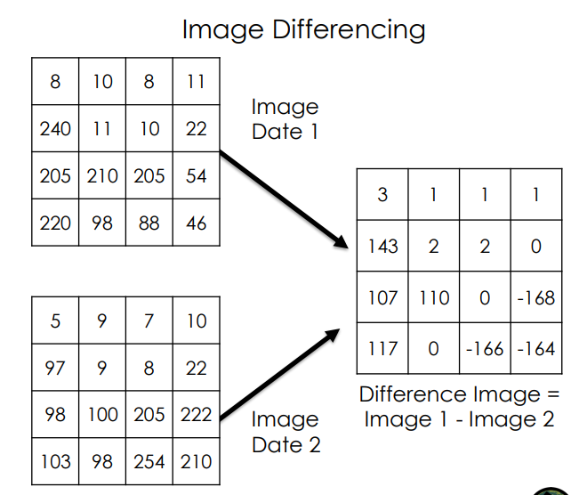
Image Differencing
Subtract image date 1 from image date 2
0 means no change; positive or negative values indicate change
Image dates can be individual bands or image transformations (NDVI, NBR, etc.)
Advantages
Can be used to detect subtle changes – Easy to compute
Disadvantage: Can be difficult to interpret

Slide 20
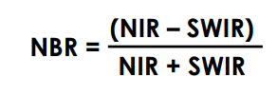
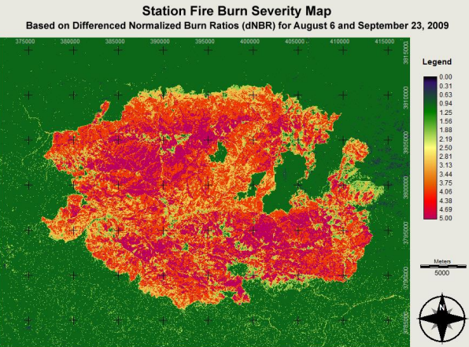

Example: Vegetation Image Differencing
Wildfire burn extent and severity with the Normalized Burn Ratio (NBR)
Compare pre- and post-burn images to identify burn extent and severity with a differenced map

Slide 21
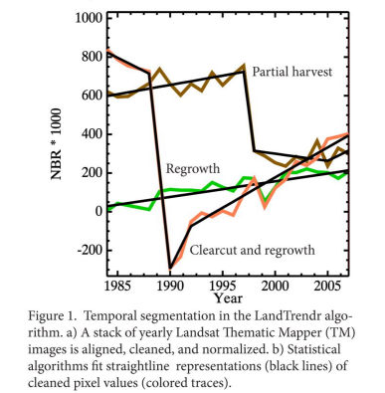
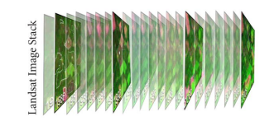
Temporal Trajectories and Time Series
Can take advantage of the entire satellite image archive (i.e. Landsat: 1985-current) by using an annual time series to examine changes and trends
Example: Landtrendr (Kennedy et al., 2010) products include
Magnitude of change: 1-100 percent tree cover loss
Duration: 1-25 years
Year of onset of disturbance
Credit: Oregon State University

Slide 22
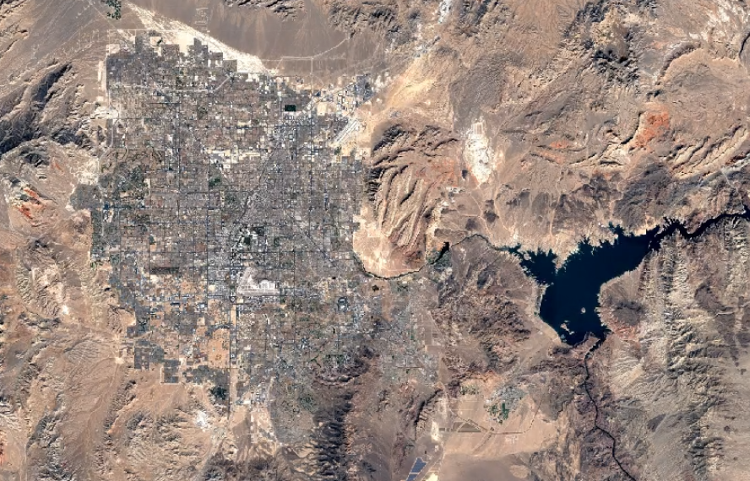
Google earth engine timelapse

