Slide 1

GEOG 3403: Geographic Information Systems II
Lecture 07 Lidar and Visualization
Yanan Wu, PhD
Assistant Professor
Department of Geography

Slide 2
Overview
What is LiDAR?
Why use LiDAR?
How does LiDAR work?
Points clouds
Derivatives from LiDAR
LiDAR platform
Sources of error
LiDAR Visualization

Slide 3
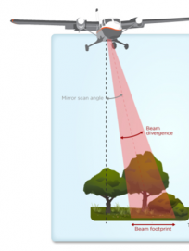
What is LiDAR?
LiDAR stands for Light Detection and Ranging, commonly known as Laser Radar
https://www.neonscience.org/data-collection/lidar

Slide 4
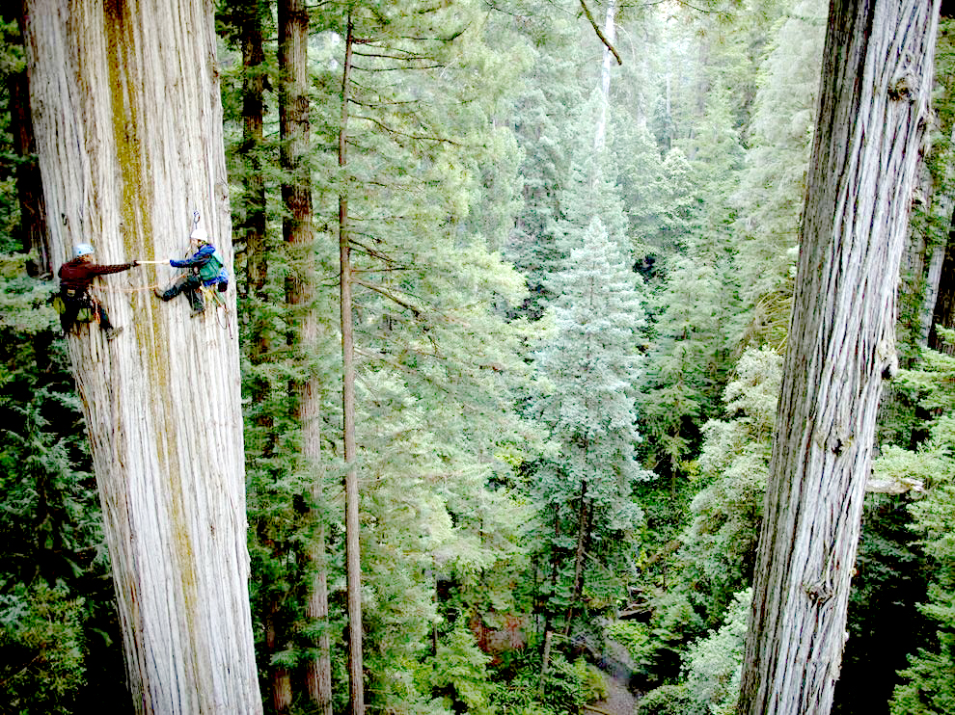
Why use LiDAR?
LiDAR can be used to map structures including vegetation height, density, and other characteristics across a region.
LiDAR is not only replacing conventional sensors, but also creating new methods with unique properties that could not be achieved before.
https://www.neonscience.org/resources/learning-hub/tutorials/lidar-basics

Slide 5
Why use LiDAR?
LiDAR | Photogrammetric
Day or night data acquisition | Day time collection only
Photogrammetry relies on visible light imagery.
It requires natural sunlight to illuminate the surface, making image quality dependent on time of day, weather conditions, shadows, and seasonal lighting differences.
Nighttime Lights Data

Slide 6
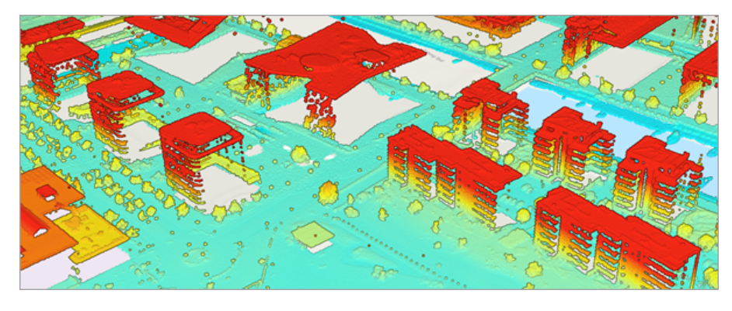
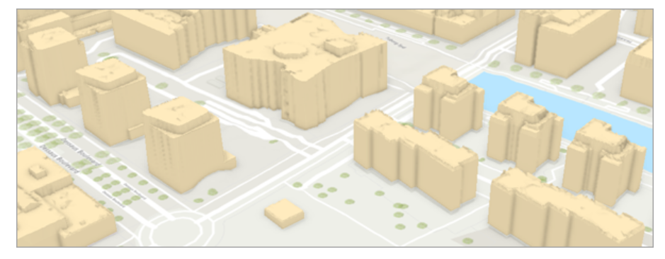
Why use LiDAR?
LiDAR | Photogrammetric
Direct acquisition of 3D collection | Complicated and sometimes unreliable procedures
Extract 3D building from lidar data

Slide 7
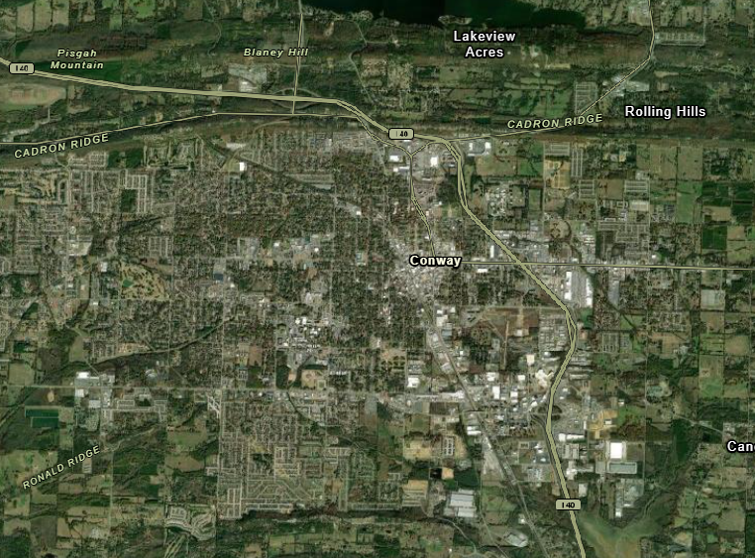
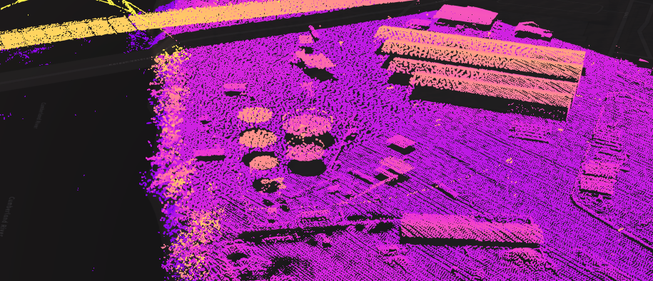
Why use LiDAR?
LiDAR | Photogrammetric
Point cloud difficult to derive semantic information; however, intensity values can be used to produce a visually rich image like product (example of an intensity image) | Rich in semantic information

Slide 8
How does LiDAR Work?
Notes:
Light speed: 3×108 m/s

Slide 9
How does LiDAR Work?
LiDAR is an active remote sensing system. An active system means that the system itself generates energy- in this case, light – to measure things on the ground. In a LiDAR system, light is emitted from a rapidly firing laser.
Each time the laser is pulsed:
Pulse is reflected off an object (e.g., buildings and trees) and returns to the LiDAR sensor where it is recorded
High-speed counter measures the time of flight from the start pulse to the return pulse
Time measurement is converted to a distance: Distance = (Time X speed of light)/ 2
The distance is converted to elevation.
Notes:
Light speed: 3×108 m/s

Slide 10
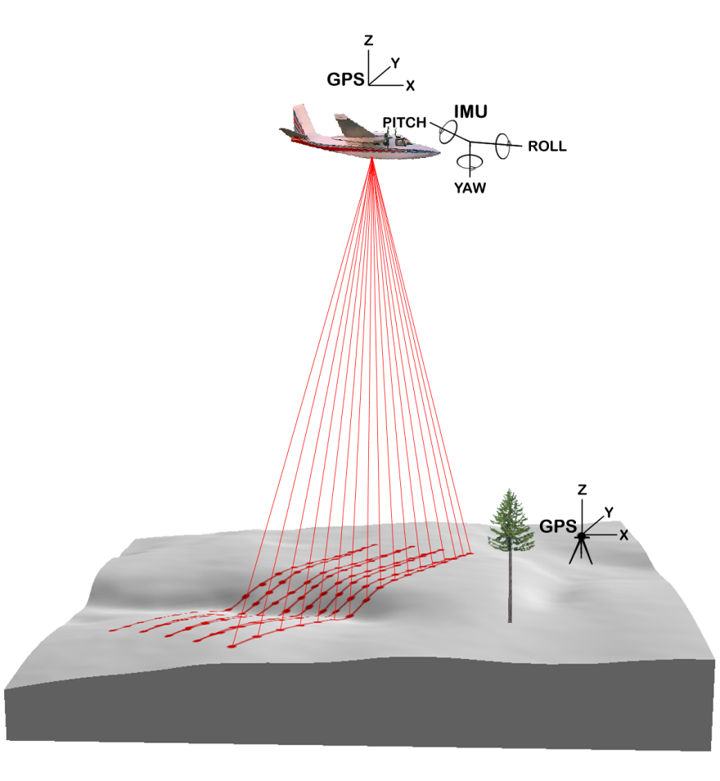
How does LiDAR Work?
Key components of a LiDAR system
GPS to identifies the X, Y, Z location o the light energy
Internal Measurement Unit that provides the orientation of the plane in the sky
https://commons.wikimedia.org/wiki/File:Roll_Pitch_Yaw.JPG
Dr. Moskal
Notes:
Inertial Measurement Unit (IMU) = angular orientation of the laser with respect to the ground
The position and angle of the aircraft relative to the ground impacts the travel path of the transmitted laser pulse.

Slide 11
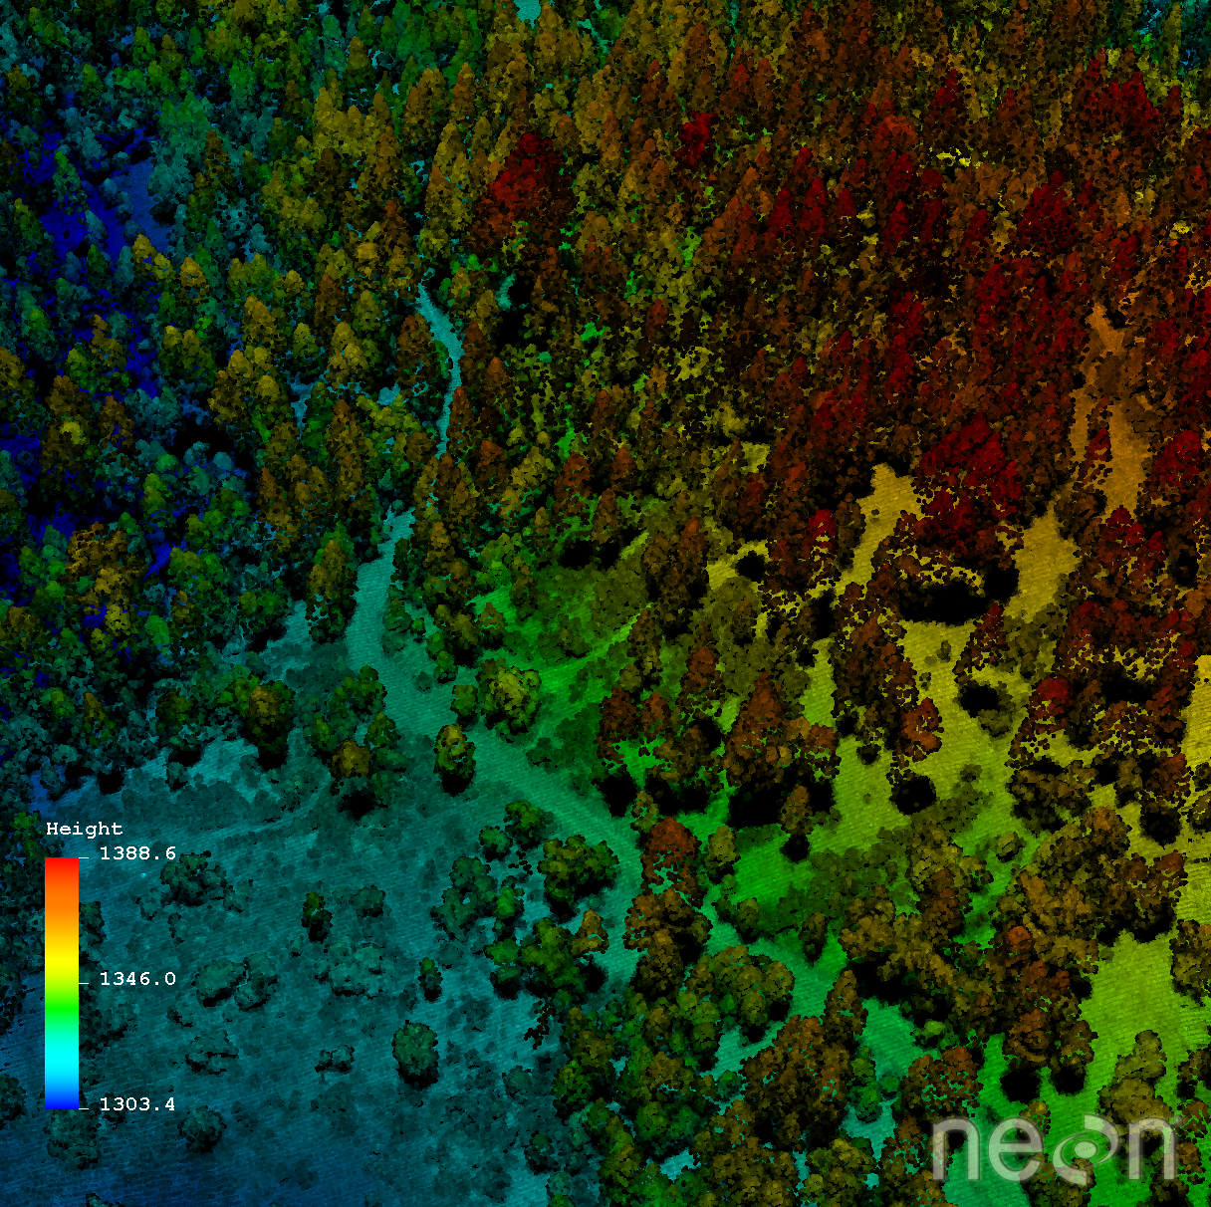
How does LiDAR Work?
Up to 200,000+ pulses/second
Everything that can be seen from the aircraft is measured
https://www.neonscience.org/resources/learning-hub/tutorials/lidar-basics

Slide 12
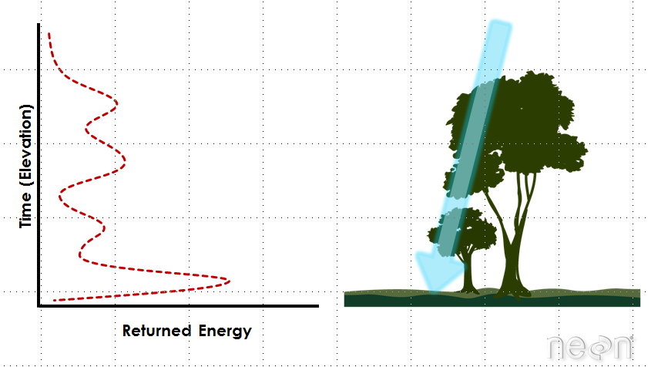
How does LiDAR Work?
Multiple returns can be measured for each pulse
Because some photons reflect off of things like branches but others continue down towards the ground, multiple reflections may be recorded from one pulse of light.
LiDAR waveforms
The distribution of energy that returns to the sensor creates what we call a waveform. The amount of energy that returned to the LiDAR sensor is known as intensity. Theses peaks in the waveform often represent objects on the ground like - a branch, a group of leaves or a building.
https://www.neonscience.org/resources/learning-hub/tutorials/lidar-basics
Notes:
If the object is small, and there are gaps surrounding it that allow light to pass through, some light continues down towards the ground.
The areas where more photons or more light energy returns to the sensor create peaks in the distribution of energy.

Slide 13
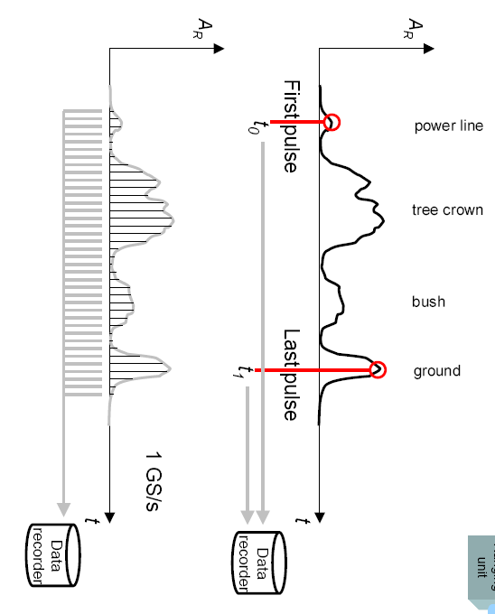
How does LiDAR Work?

Slide 14
LiDAR system
Discrete Return LiDAR
Records individual (discrete) points for the peaks in the waveform curve.
These discrete or individual points are called returns.
May record 1-4 returns from each laser pulse.
LiDAR waveforms
Records a distribution of returned light energy.
More complex to process
Mallet, C. and Bretar, F., 2009. Full-waveform topographic lidar: State-of-the-art. ISPRS Journal of photogrammetry and remote sensing, 64(1), pp.1-16.

Slide 15

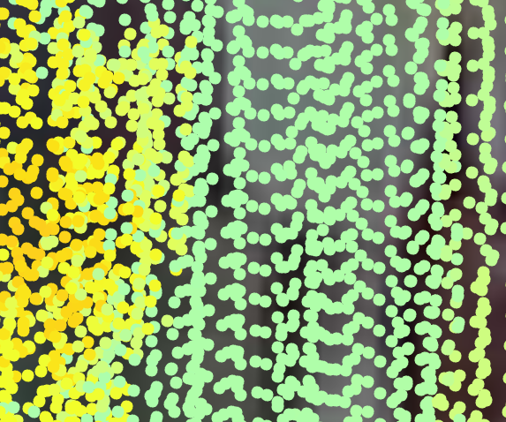
Point Clouds
LiDAR has a unique data structure. Instead of being stored as an array of values, or a raster grid, each 3D measurement is stored as a point measurement.
These point measurements are combined to form a point cloud.
It is common f a single point could file to include millions or tens of millions of measurements.
https://www.neonscience.org/resources/learning-hub/tutorials/lidar-basics
Notes:
Cross section showing LiDAR point cloud data superimposed on the corresponding landscape profile. Source: NEON.

Slide 16
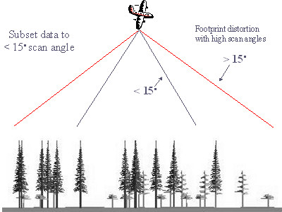
Point Clouds
Density of points is controlled by
Pulse rate: how many pulses are released a second
Scan frequency: how fast the sensor scans back-and-forth
Maximum Scale Angle: maximum angle of the scan, < 18º
Flight height: height of the sensor above the ground
Flight speed: average flight speed
Overlapping coverage: area overlapped
Dr. Moskal

Slide 17
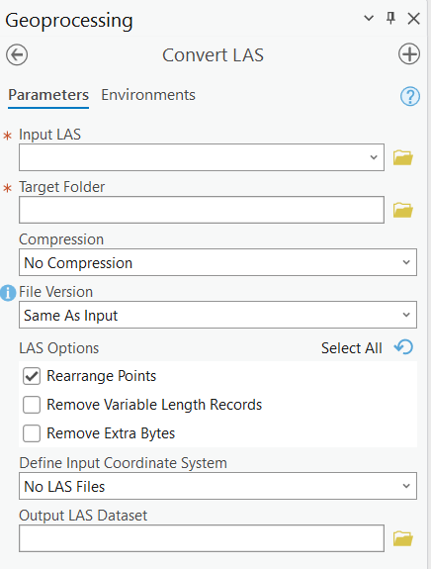
Point Clouds
Raw data is stored in LAS format, supported by the American Society of Photogrammetry and Remote Sensing (ASPRS).
Recently, the LAZ format has been developed by Martin Isenberg of LasTools. The difference is that LAZ is a highly compressed version of LAS

Slide 18
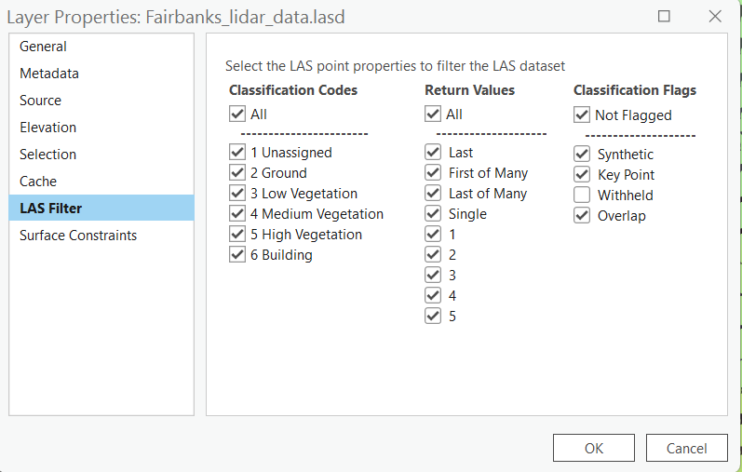
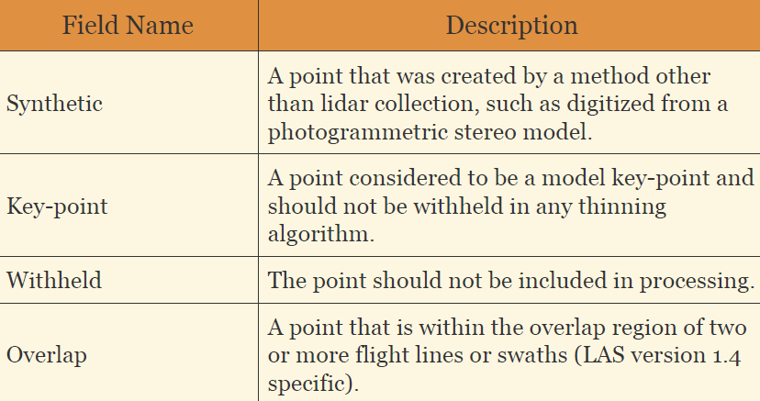
Point Clouds
Point Attributes
Return Number = 1st, 2nd, 3rd, 4th
Classification = Unassigned, Ground, Low Vegetation, Medium Vegetation, High Vegetation, Building, etc.
Notes:
For example, 'first of many' means it is the first return back of several returns per that one pulse. So that means it is return #1 of n (let's say 4) total returns. In the 'last of many' case, that means it is return #4 out of 4 total returns per pulse. 'intermediate' would mean that it could be return # 2 or #3 of four total returns back from that pulse. 'First and only' means that you had only one return come back from that pulse. So that means it is return #1 of 1 total returns coming back from that pulse. (https://groups.google.com/g/lastools/c/MHDqhoJoCqQ?pli=1)

Slide 19
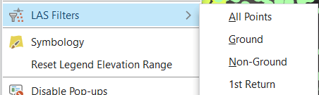
Point Clouds
Point Filtering

Slide 20
Point Clouds
Point Filtering

Slide 21
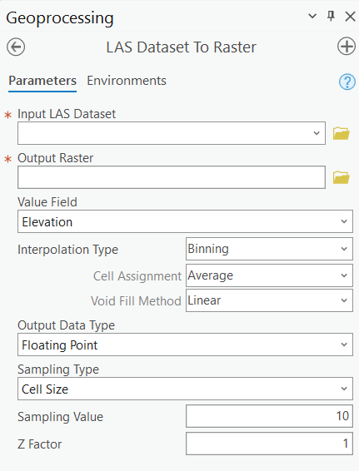
Derivatives from LiDAR
Data products derived from LiDA R point cloud data are often raster files that may be in GeoTIFF (.tif) formats.
Intensity: measure of the amount of energy returning to the sensor
Elevation: DEM or DSM
RGB: assign image RGB values to points

Slide 22
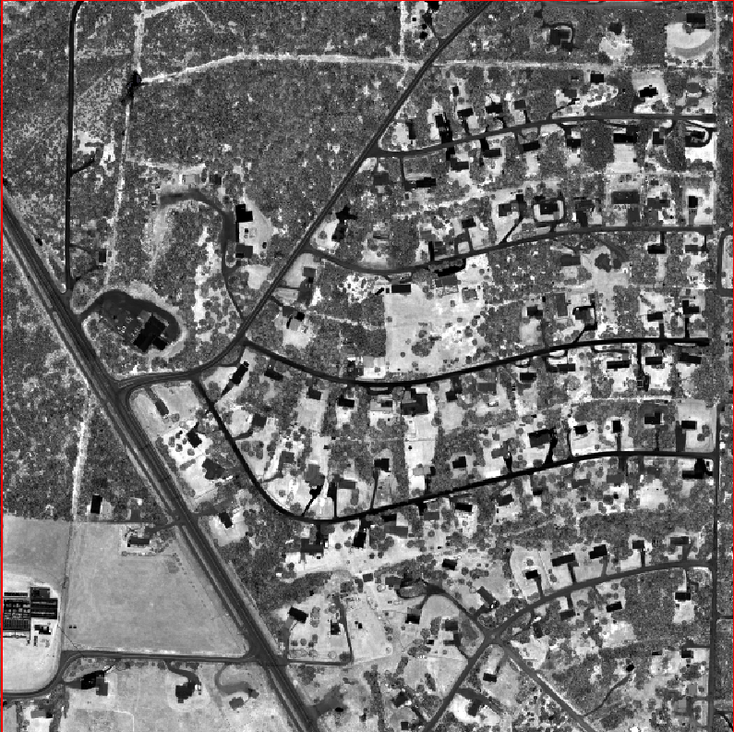
Derivatives from LiDAR
Intensity: measure of the amount of energy returning to the sensor
Return number
Surface material
Moisture level

Slide 23


Derivatives from LiDAR
Elevation: DEM or DSM
DEM
DSM

Slide 24

LiDAR Platform
Satellite
Airplane
Helicopter
Drone
Vehicle
Tripod
Phone
https://www.nasa.gov/press-release/nasa-television-to-air-launch-of-global-ice-measuring-satellite
https://www.geospatialworld.net/blogs/why-lidar-is-important-for-autonomous-vehicle/

Slide 25
Sources of Error
Equipment/signal error
Multipath
Non-ground objects (e.g., dust, aerosols, water vapor)
Bad processing
etc.

Slide 26
LiDAR Visualization
Elevation
Intensity
Classification
Last/first returns
etc.

Slide 27
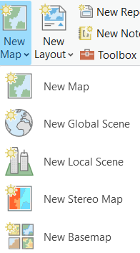
LiDAR Visualization
Elevation
2D
3D

Slide 28
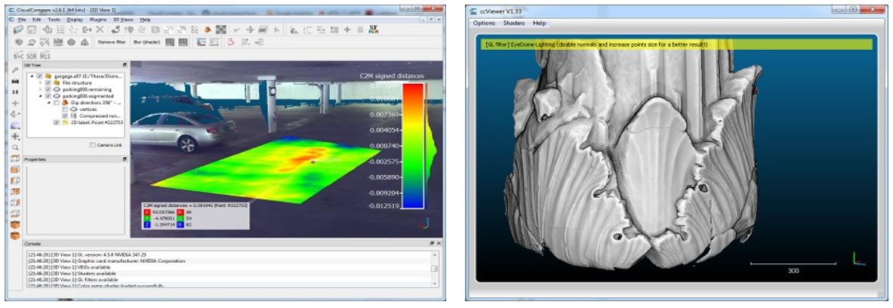
Other LiDAR Software
CloudCompare
Free
https://www.cloudcompare.org/

Slide 29
LiDAR Application
3D visualization
Urban mapping
Utility line mapping
Geomorphology
Hydrology
Archeology
Landscape architecture
Surveying
Self-driving cars

Slide 30
Data # 4: LiDAR Data Downloading Demonstration
USGS 3DEP LidarExplorer
https://apps.nationalmap.gov/lidar-explorer/#/

Slide 31
Thank you!

