Slide 1
Downloading LiDAR & Exploring in ArcGIS Pro
Focus: Download → Metadata → Explore → Process

Slide 2
Learning Goals
Download LiDAR from USGS LiDAR Explorer
Read and interpret LiDAR metadata
Load LiDAR into ArcGIS Pro
Explore LAS Dataset properties
Perform basic LiDAR processing

Slide 3
USGS LiDAR Explorer
Web portal for discovering LiDAR datasets
• Provides dataset footprints & details
• Download LAS / LAZ tiles

Slide 4
Download Workflow
1. Open USGS LiDAR Explorer
• 2. Navigate to area of interest (AOI)
• 3. Draw selection box
• 4. Choose dataset & product (LAZ preferred)
• 5. Download tiles

Slide 5
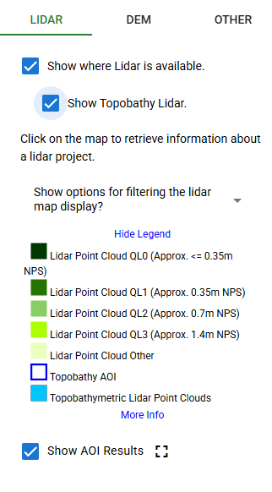
LiDAR Data Categories (USGS/NPS)
LiDAR Point Cloud LQ0 (≤ ~0.35 m NPS) – Highest resolution / quality
LiDAR Point Cloud QL1 (~0.35 m NPS) – High-density, high accuracy
LiDAR Point Cloud QL2 (~0.7 m NPS) – Moderate density
LiDAR Point Cloud QL3 (~1.4 m NPS) – Lower density, regional coverage
LiDAR Point Cloud Other – Non-standard specifications
Topobathy AOI – Areas of interest for topobathymetric surveys
Topobathymetric LiDAR Point Clouds – Combined land + shallow water mapping
Note: NPS = Nominal Pulse Spacing (average distance between LiDAR points)

Slide 6
Key LiDAR File Formats
LAS → Standard LiDAR format (uncompressed)
• LAZ → Compressed LAS (smaller size)
• Both supported in ArcGIS Pro

Slide 7
Understanding LiDAR Metadata
Metadata = dataset description
• Look for acquisition date
• Check point density (pts/m²)
• Review accuracy information
• Verify coordinate system & units

Slide 8
Why Metadata Matters
Determines data quality
• Ensures correct analysis
• Avoids projection/elevation errors

Slide 9
Loading LiDAR into ArcGIS Pro
Create new ArcGIS Pro project
Add folder connection
Use 'Create LAS Dataset' tool
Input LAS/LAZ files

Slide 10
Exploring LAS Properties
Right-click LAS Dataset → Properties
Check number of points
Review spatial reference
• View classification statistics
• Examine elevation range

Slide 11
VISUALIZATION
LAS Dataset layer in Contents pane
Point cloud visualization
Elevation-based coloring

Slide 12
Basic LiDAR Visualization
Elevation
Classification
Intensity
Return number

Slide 13
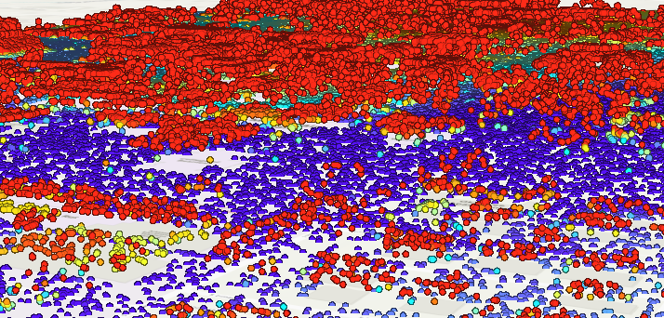
Lidar in 3d
VISUALIZE LIDAR POINT IN SCENE MODE
Insert Tab → New Map → New Local Scene
Local Scene = best for city / project-scale LiDAR
Map Tab → Add Data → Browse → Select your .lasd
LiDAR points will appear in 3D

