Slide 1

GEOG 3403: Geographic Information Systems II
Lecture 08 Spatial Statistics
Yanan Wu, PhD
Assistant Professor
Department of Geography

Slide 2
Overview
Spatial statistics
What is unique about geographic data
Sampling
Random, systematic sampling, systematic sampling along transects
Spatial Central Tendency and Dispersion
Central feature, mean, median, standard distance, standard deviation ellipse
Analyzing point patterns
Interpret a statistical test
Average nearest neighbor
Global spatial autocorrelation
Local spatial autocorrelation

Slide 3
What is unique about geographic data?
Occurs over a map surface
Spatial heterogeneity/spatial autocorrelation
Temporal heterogeneity/temporal autocorrelation
Modifiable areal unit problem
Notes:
Unique concerns arise when we want to explore and analyze spatial data statistically.
First, they occur over a map space, so issues of spatial heterogeneity and spatial autocorrelation arise, which can make it difficult to apply traditional statistical methods that assume samples are independent of one another.
Although this issue is not necessarily unique to spatial data, there can also be issues with temporal heterogeneity and autocorrelation.
As mentioned in previous modules, the scale of the data aggregation can impact the analysis results, which we term the Modifiable Areal Unit Problem or MAUP.

Slide 4
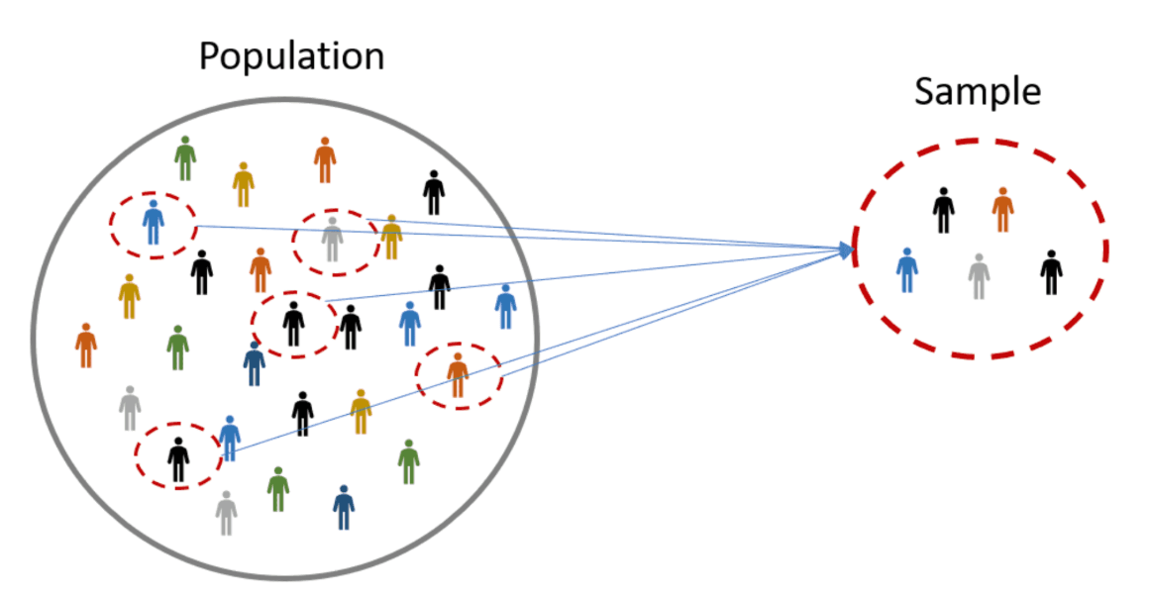
Sampling
A sample is a set of measurements taken from a larger group or population.
Notes:
It is generally not possible to measure all members of a population. For example, if you wanted to conduct a study in which all undergraduates at a university were considered the population, it would be very difficult to collect data for every single student. As additional examples, it would not be feasible to measure every tree in a forest or every fish in a river.
So, we must collect a sample from the larger population. In order to draw unbiased conclusion about the population from the sample, it must be an unbiased representation of the population. This is accomplished using random sampling. Using appropriate sampling methods will allow you to approximate the mean and variance of the population with the sample.

Slide 5
Population vs Sample
🤔
UCA wants to determine how many hours per day its students spend studying. The university randomly surveyed 300 students. In this case, what are the population and the sample?

Slide 6
Sampling
Sample means and variances can serve as estimates for their population.
Easier to measure with samples, then draw conclusions about entire population.

Slide 7
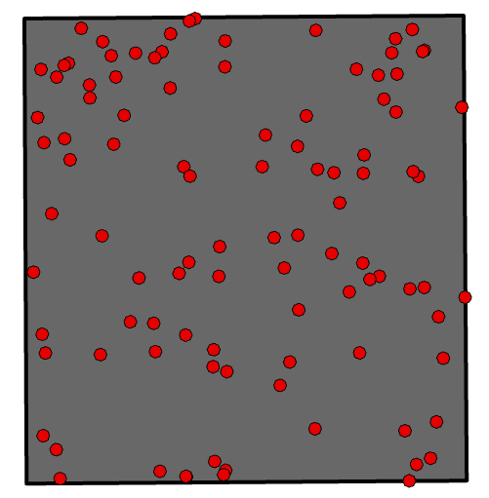
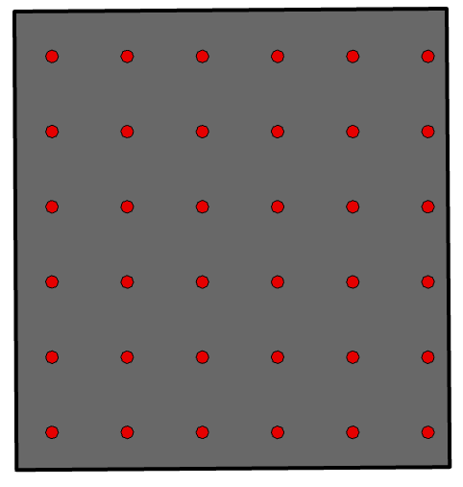
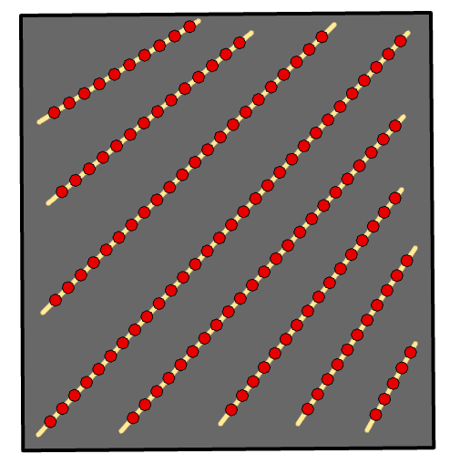
Types of Sampling
Systematic Sampling
Systematic Sampling Along Transects
Simple Random Sampling
Notes:
Different types of sampling methods are available. Here, I will focus on sampling methods used over map space.
When using simple random sampling, random locations are selected across a study area extent as random x, y coordinate pairs. So, this is purely random.
In contrast, systematic sampling involves sampling using a fixed pattern or spacing. For example, a sample could be collected every 50 meters.
Random or systematic sampling can also be performed along transects. This is a common method used by ecologists and foresters.

Slide 8
Which sampling method would you choose?
You are measuring soil moisture in a large agricultural field.
A. Random B. Systematic grid C. Transect D. Cluster
🤔

Slide 9
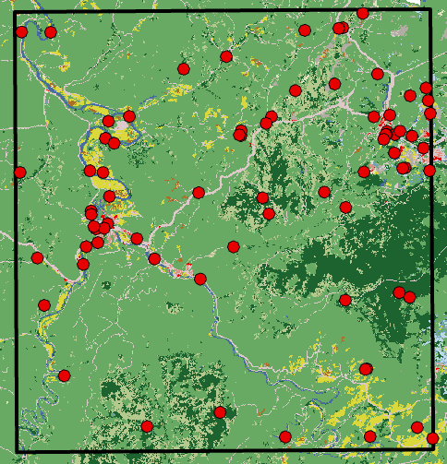
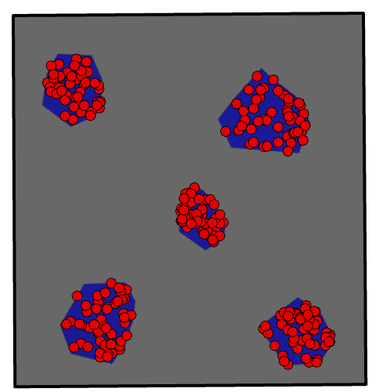
Types of Sampling
Stratified Random Sampling (By land cover type)
Random Sampling within Clusters
Notes:
Stratified random sampling involves collecting a defined number of random samples per category. For example, a fixed number of samples could be collected for each land cover class.
Random sampling within clusters involves defining clusters or smaller extents within the larger extent of interest and then selecting random samples within these extents. This method is commonly used when it is too difficult or infeasible to collect random samples across the entire extent of interest.

Slide 10
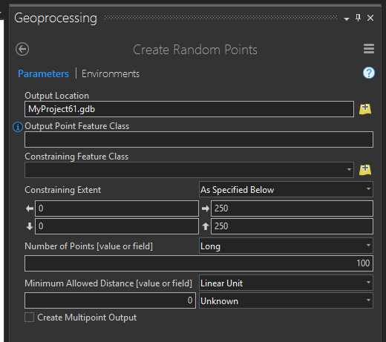
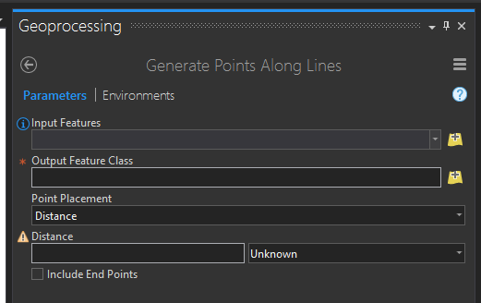
Tools of Sampling
QGIS
R
ArcGIS Pro
Generate Random Points
Generate Points Along Line
Generate Tessellation
Create Fishnet
Notes:
Many tool are available in geospatial software packages to perform random sampling.
For example, ArcGIS Pro has a tool to generate random points and points along lines or transects.

Slide 11
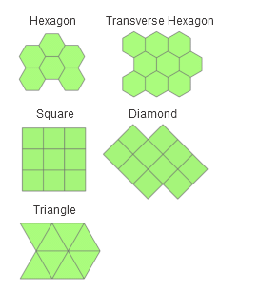
Tessellation
Filling a plane completely with non-overlapping geometric shapes
Can use generated features as sampling or aggregation units
https://pro.arcgis.com/en/pro-app/tool-reference/data-management/generatetesellation.htm
Notes:
Tessellation involves filling a plane completely with non-overlapping geometric shapes. Commonly used shapes include hexagons, triangles, and squares.
These units can then be used to define sampling strategies or aggregate data.

Slide 12
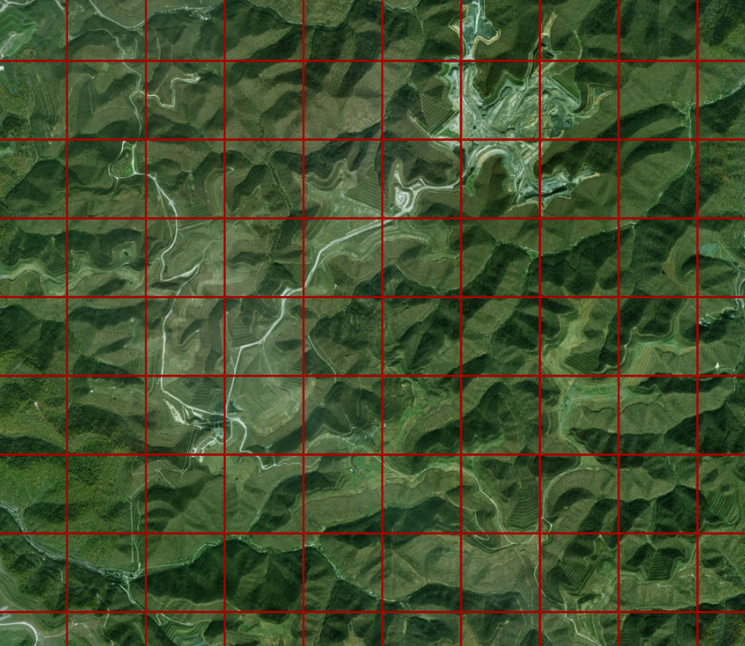
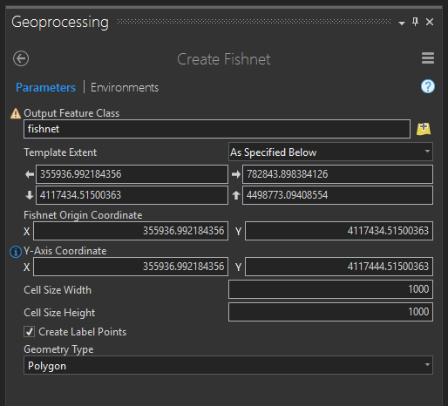
Fishnets
Creates a fishnet of regular cells
Imagery from ESRI Basemap
Notes:
Fishnets can be used to generate grids over spatial extents. They can be useful in planning or defining sampling strategies.
I have also found them to be useful to aid in digitizing over large areas, as they can act as tiles to subset the task and as guides while digitizing.

Slide 13
Spatial Central Tendency and Dispersion

Slide 14
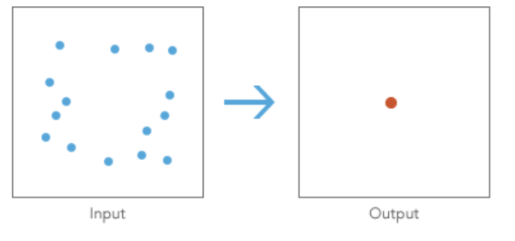
Spatial Central Tendency
Describes the center or typical location of geographic features.

Slide 15
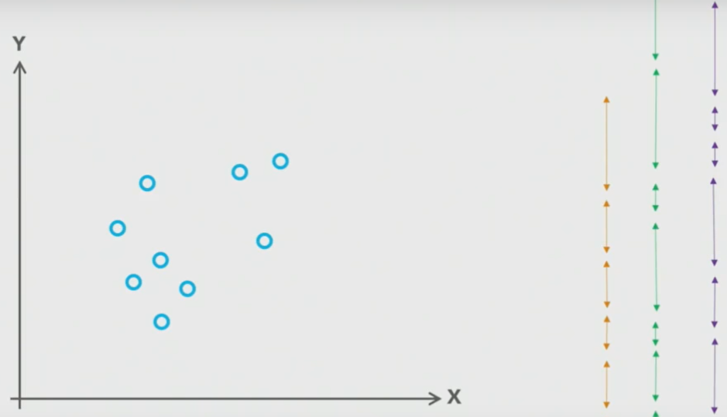
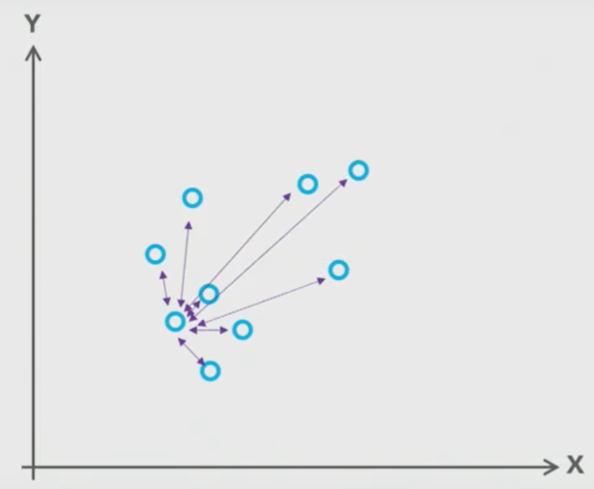
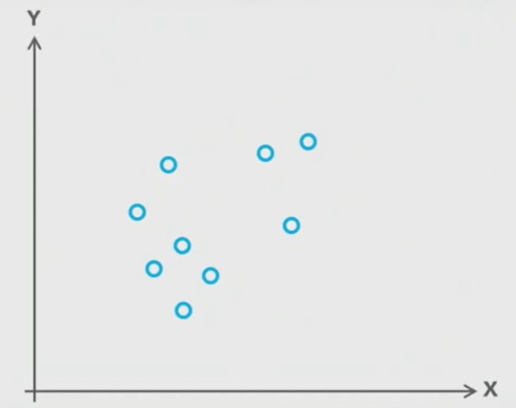
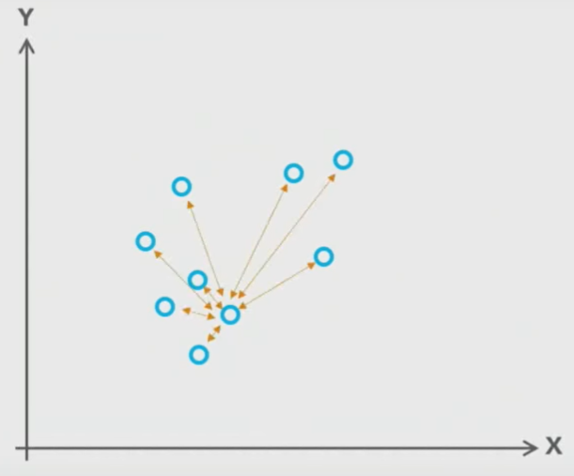
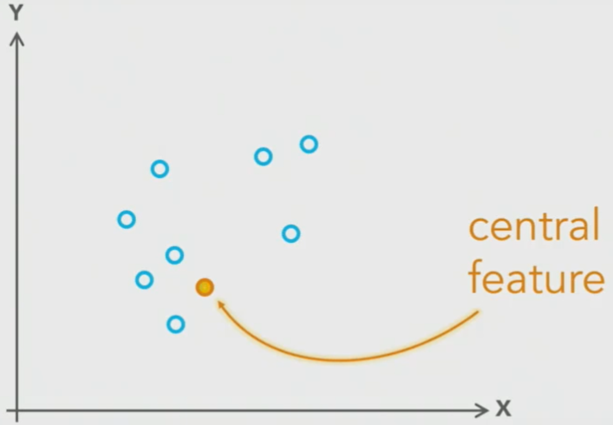
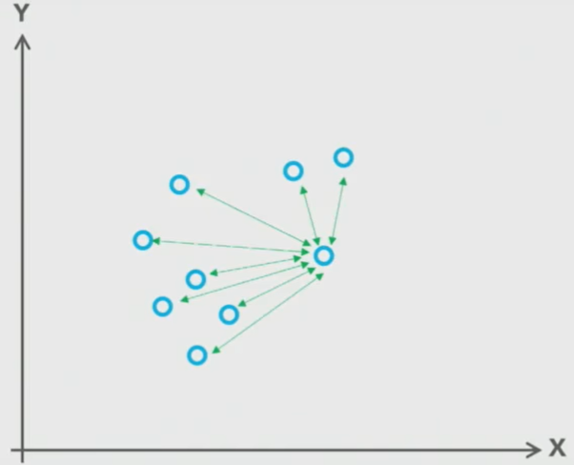
Central Feature
Identifies the most centrally located feature in a point, line, or polygon feature class
Esri events
https://www.youtube.com/watch?v=3d_8nQpSCgE
Notes:
The first one is central feature. Central feature is used to…So what does it mean? Let’s say that we have a dataset of points and we can measure the distance from each point to all of the other points in the data set and then we’re add up those distances and see which point has the shortest distance to all of the other point and then that point will become our central feature.

Slide 16
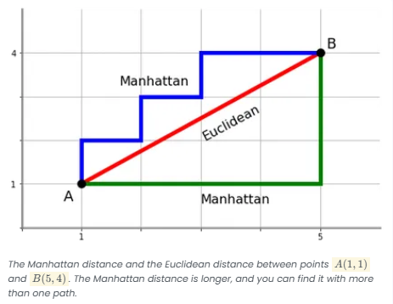
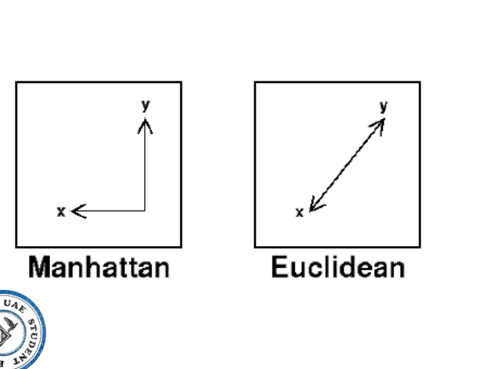
Central Feature
Identifies the most centrally located feature in a point, line, or polygon feature class
Euclidean Distance: straight-line distance
Manhattan Distance: sum of distance in x and y directions
http://www.ieee.ma/uaesb/pdf/distances-in-classification.pdf
Notes:
We need to pay attention is that the distance can be defined using the Euclidean or Manhattan methods. Euclidean distance is the straight line distance between 2 points while Manhattan distance is the sum of the distance in the x and y directions.
The Manhattan and Euclidean distance can be the same length if the two features are exactly north or south or east to west of each other. However, the Manhattan distance is generally longer.

Slide 17
Mean Center
Identifies the geographic center (or the center of concentration) for a set of features
A new location, one of the input features will not be selected
Notes:
This mean center usually is a new location, which is different with central feature

Slide 18
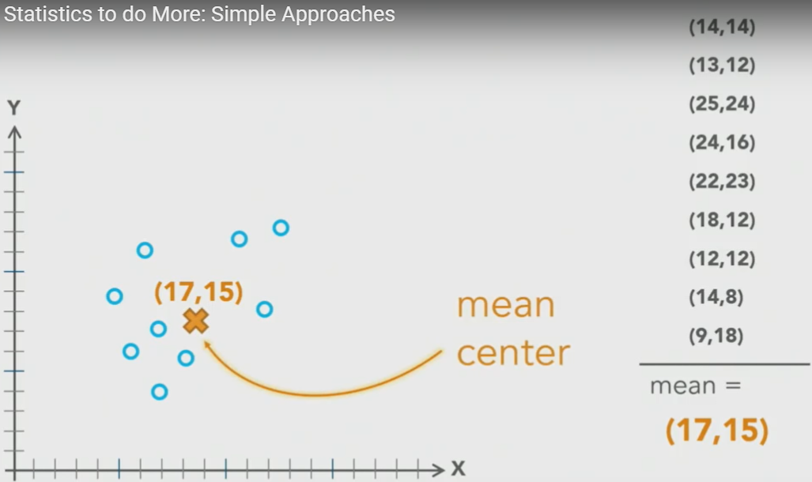
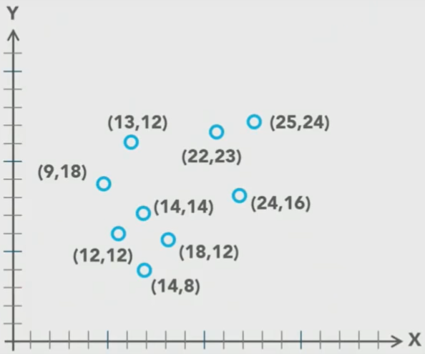
Mean Center
Identifies the geographic center (or the center of concentration) for a set of features
Esri events
https://www.youtube.com/watch?v=3d_8nQpSCgE
Notes:
The second is Mean Center. Mean center… We have x and y values for each point in the data and we average all of the x and y values and that will become our mean center

Slide 19
🤔
Mean Center results in:
A. Always an existing point B. A new coordinate C. The densest point D. The median point

Slide 20
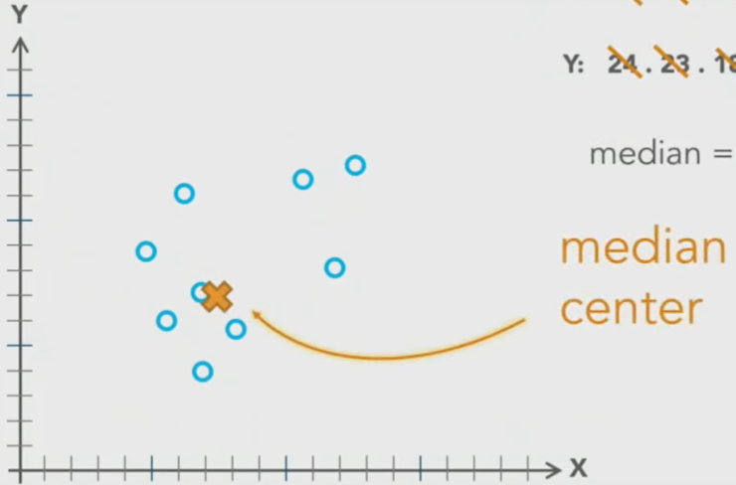
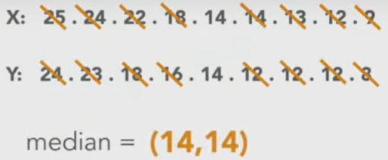
Median Center
Identifies the geographic center (or the center of concentration) for a set of features
Esri events
https://www.youtube.com/watch?v=3d_8nQpSCgE
Notes:
The third one is median center. Median Center is also… but it is based on median. With same example, rather than averaging x and Y values, we find the median X and median Y. And this point is the median center.

Slide 21
Median Center
Identifies the geographic center (or the center of concentration) for a set of features
A new location, one of the input features will not be selected
Median is more robust to outliers
1
0
Notes:
This will also return a new coordinates.
Compare to mean center, median is more robust to outliers, because it can exclude outliers. For example, if we change the last numbers to 1 and 0, it will not influence median values, but it will cause mean values to be smaller.
Did I make sense so far?

Slide 22
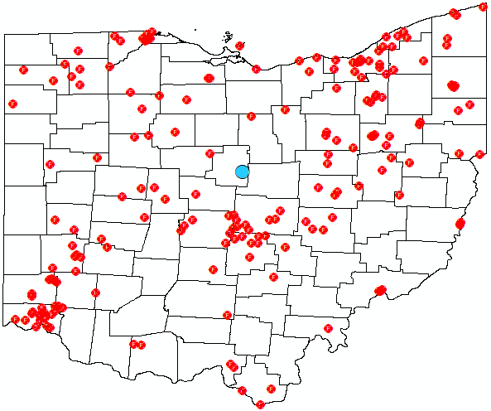

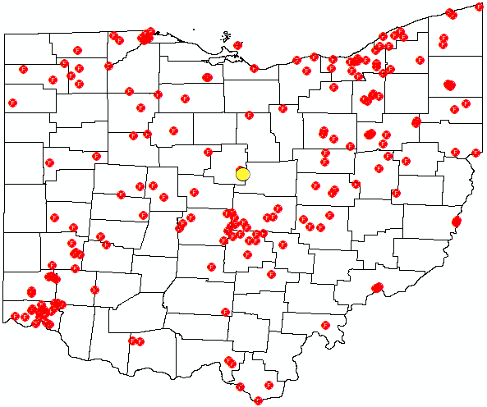
Examples
🤔
If building a new facility is NOT allowed, which measure is most useful?
Blue= Central Feature Green = Mean Center Yellow = Median Center
Notes:
Here we give three examples. These figures show the distribution of airport in United States, the blue is central feature, green is mean feature, and the yellow is median center. Both green and yellow are new locations, not the established airport. So if we want to choose a central airport without building a new airport to say money, it is better to use central feature.
You can also incorporate weights into the calculation. For example, for the airport example provided here you could include a weight as the number of passengers per year. You can also obtain different central features by category as defined by an attribute. For example, you could get different central features for international and regional airports.

Slide 23
Dispersion
Describes how spread out or clustered the features are.

Slide 24
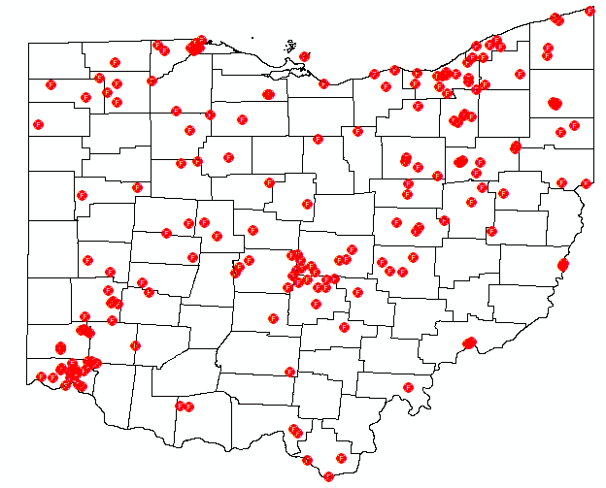
How does the fire stations distribute spatially?
Are fire stations evenly distributed across Ohio?
Are there areas with fewer fire stations compared to others?

Slide 25
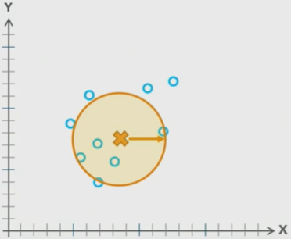
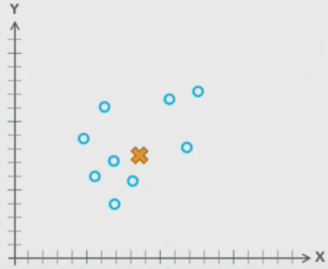
Standard Distance
Measures the degree to which features are concentrated or dispersed around the geometric mean center
Esri events
https://www.youtube.com/watch?v=3d_8nQpSCgE
Notes:
Central feature, mean center, and median center, provide a measure of spatial central tendency. But They do not represent dispersion.
Standard distance can be used to obtain a measure of dispersion. It provides a measure of the degree to which features are concentrated or dispersed around the geometric mean center using standard deviations.
For example, we get the mean center from the previous example. We then calculate the standard deviation of X and Y. We use the standard deviation as radius to draw the circle. This circle shows the standard distance of the data.

Slide 26
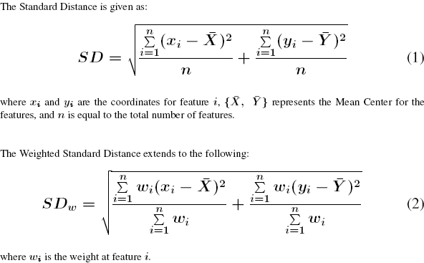

Slide 27
Standard Distance
Measures the degree to which features are concentrated or dispersed around the geometric mean center
Larger = more spatial dispersion
Smaller = less spatial dispersion
Center = mean center
Can specify the number of standard deviations
Notes:
Smaller circles indicate less dispersion while larger circles indicate more dispersion.
Standard distance for different datasets can be compared to get a sense of how they differ in regards to spatial dispersion.
We need to pay attention is that the center is the mean center and we can also specify the number of standard deviations. In our example, we choose one standard deviation. We can also choose two standard deviation, three standard deviation.
Similar to the central tendency, weights can be applied and separate standard distances can be obtained by category or group.

Slide 28
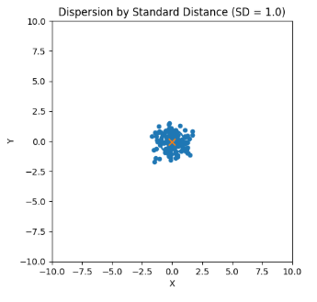
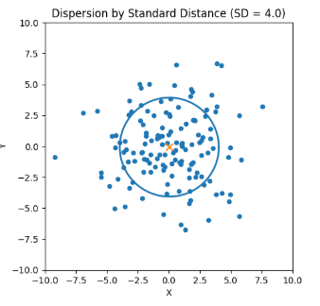
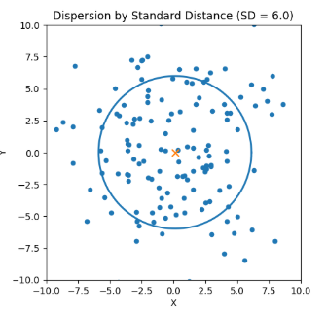
Standard Distance

Slide 29
🤔
What does a larger standard distance indicate?
A. More points B. Greater dispersion C. Higher density D. Randomness

Slide 30
Standard Distance
Measures the degree to which features are concentrated or dispersed around the geometric mean center
Notes:
1 standard deviation means we choose 68.3% of the data are within one standard deviation of the mean, 95.4% of the data are within two standard deviations of the mean, and 99.7% of the data are within three standard deviations of the mean.
68.3% of the data are within one standard deviation of the mean
95.4% of the data lie within two standard deviations of the mean
99.7% of the data lie within three standard deviations of the mean

Slide 31
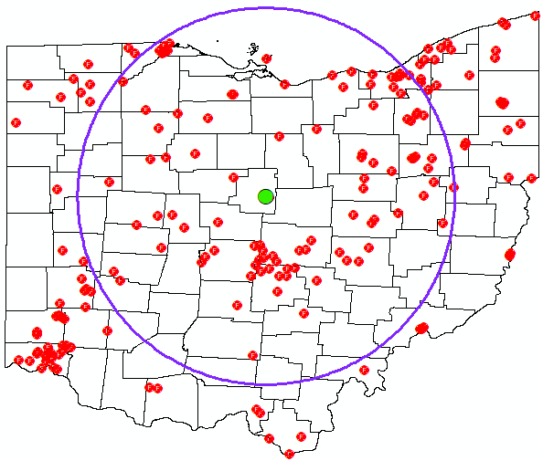
Examples
Notes:
Here we give examples of standard distance and standard deviation ellipse. In standard distance, in all direction, it shows same radius, and in standard deviation ellipse, the maximum dispersion in this direction and minimum dispersion in this direction.
Did I make sense so far? Do you have some questions?
You can also incorporate weights into the calculation. For example, for the airport example provided here you could include a weight as the number of passengers per year. You can also obtain different central features by category as defined by an attribute. For example, you could get different central features for international and regional airports.

Slide 32

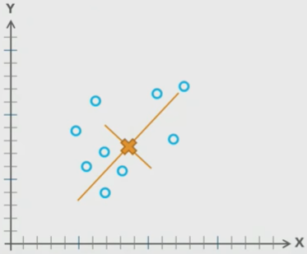
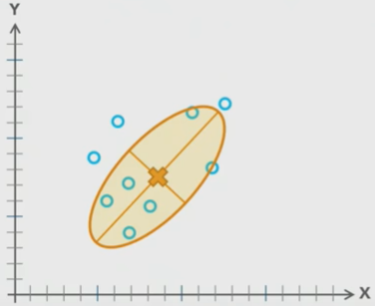
Standard deviation ellipse
Creates an ellipse that summarizes: spatial central tendency, spatial dispersion, and directional trends
Ellipse long axis represents?
A. Density B. Directional trend C. Outliers D. Sample size
🤔
Esri events
https://www.youtube.com/watch?v=3d_8nQpSCgE
Notes:
Standard distance does not provide any measure of directional trends.
Standard deviation ellipse summarizes the spatial central tendency, spatial dispersion, and directional trends.
For example, the center of the ellipse is also the mean center. We then calculate the standard deviation for x and y, respectively. Based on this x and y standard deviation, we draw the ellipse. This ellipse is the standard deviation ellipse.
The size of the ellipse relates to spatial dispersion, and the long and short axis relate to directional trends.
Similar to the central tendency, weights can be applied and separate standard deviation ellipses can be obtained by category or group.

Slide 33
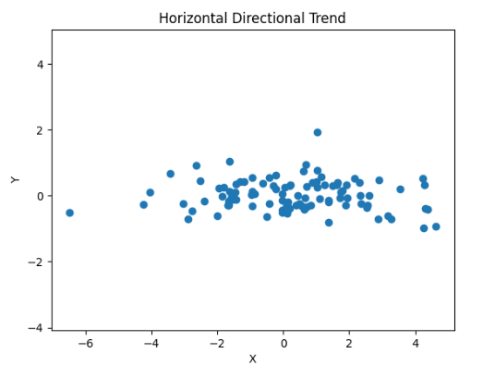
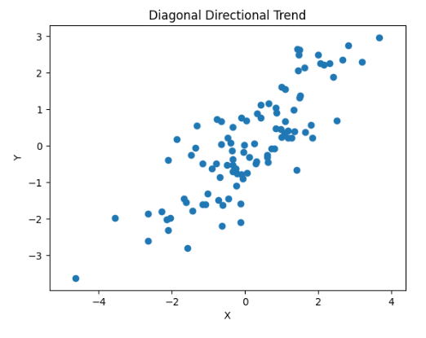
Dispersion in different directional trends

Slide 34
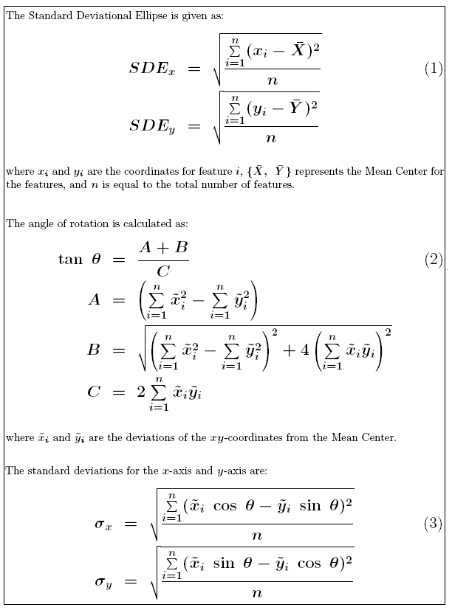

Slide 35
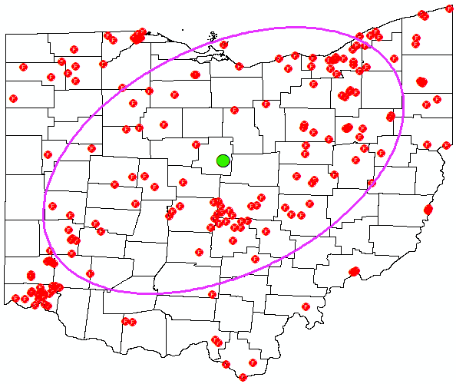
Examples
If ellipse is circular, what does that suggest?
A. No dispersion B. Equal dispersion in all directions C. Random pattern D. Error
Notes:
Here we give examples of standard distance and standard deviation ellipse. In standard distance, in all direction, it shows same radius, and in standard deviation ellipse, the maximum dispersion in this direction and minimum dispersion in this direction.
Did I make sense so far? Do you have some questions?
You can also incorporate weights into the calculation. For example, for the airport example provided here you could include a weight as the number of passengers per year. You can also obtain different central features by category as defined by an attribute. For example, you could get different central features for international and regional airports.

Slide 36
Are fire stations concentrated on one or two places?

Slide 37
Analyzing Point Patterns

Slide 38
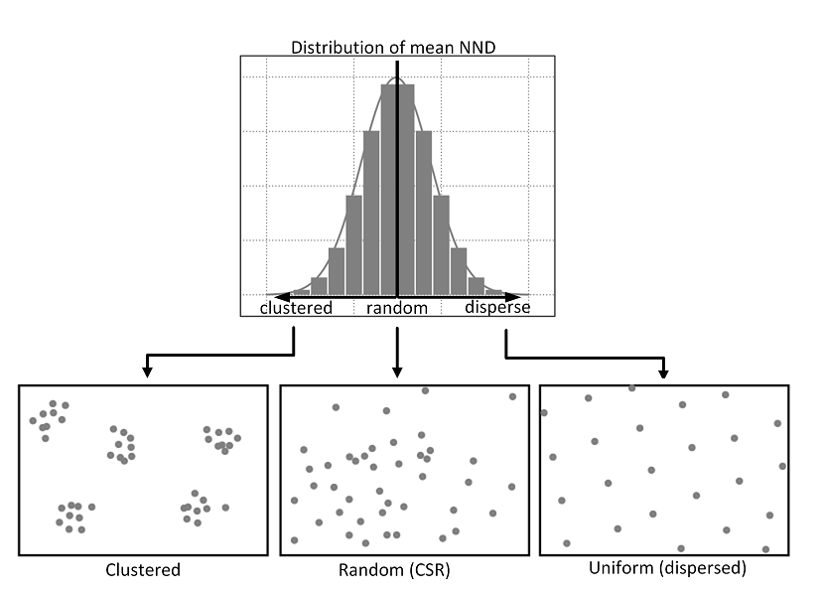
Point Pattern

Slide 39
Interpret a Statistical Test
Concepts | Meaning
Null Hypothesis (H₀) | NO statistical significance or difference
Alternative Hypothesis (H_{a}) | There is statistical significance or difference
Notes:
In this section, we will analyze patterns using statistic significant test.
So first, we will review how to interpret statistical tests.
Statistical tests include two hypothesis, one is null hypothesis means no statistical significance or difference, indicating the happening of this event is by chance.
The alternative hypothesis means there is statistical significance or difference, indicating the happening of this event is not by chance. It is happened.
If we accept the null hypothesis, this suggests there is no statistical significance or that the results were not significant. In contrast, if the null hypothesis is rejected, this suggests statistical significance or difference.

Slide 40
Interpret a Statistical Test
Concepts | Meaning
Null Hypothesis (H₀) | NO statistical significance or difference
Alternative Hypothesis (H_{a}) | There is statistical significance or difference
P-value (0.01, 0.05, 0.1) | There is less than a 1%, 5%,10% chance of obtaining the result by random chance
P-value < 0.1 Reject null hypothesis
Notes:
We usually use p value to decide whether to accept null hypothesis or not.
A p-value of 0.01 suggest that there is less than a 1% change of obtaining the result by random chance. It means it is more than 99% chance that the result happens is not by chance. So the result is significant. We need to reject the null hypothesis and accept the alternative hypothesis.
A p-value of 0.05 and 0.1 are also commonly used. In this section, if the p-value less 0.1 to reject null hypothesis.
A specific statistical test will commonly produce a statistic or index. This is then compared to a distribution, such as a z-distribution or normal distribution. Comparison to this distribution will allow for the calculation of a p-value.

Slide 41
Average Nearest Neighbor
Test to determine if a point pattern/distribution is random, clustered, or dispersed
Concepts | Meaning
Null Hypothesis (H₀) | Point pattern is random
Alternative Hypothesis (H_{a}) | Point pattern is NOT random (clustered or dispersed)
Notes:
Ok, the first analyzing patterns method that we will explore is average nearest neighbor. This test is used to determine if a point pattern or distribution is random, clustered, or dispersed.
The null hypothesis is that the pattern is random. While the alternative hypothesis is that the points are not random, or that they are clustered or dispersed.

Slide 42
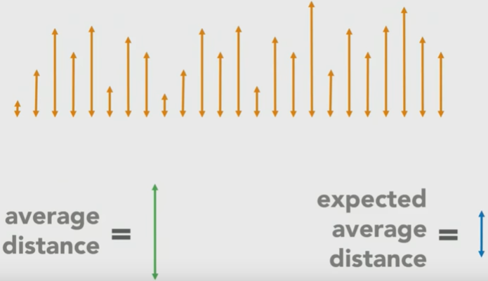
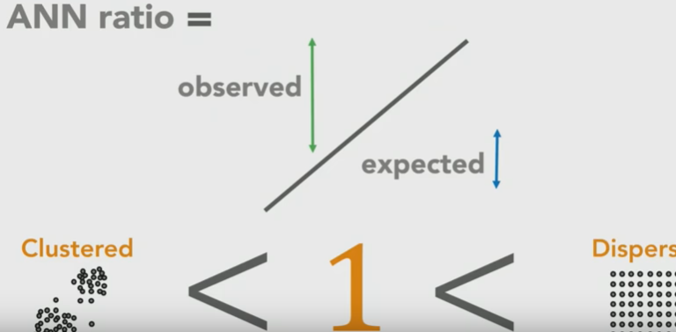
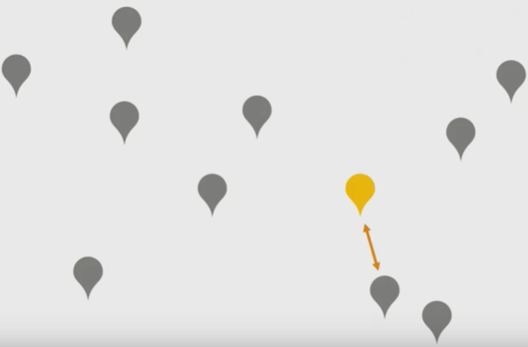
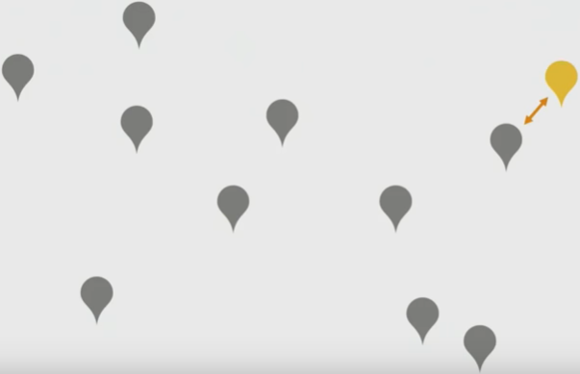
Average Nearest Neighbor
Test to determine if a point pattern/distribution is random, clustered, or dispersed
ANN > 1 suggests:
A. Clustered B. Random C. Dispersed
random
Clustered
Dispersed
Esri events
https://www.youtube.com/watch?v=3d_8nQpSCgE
Notes:
Let’s see how it works.
Here are point locations. We can measure distance between each location and its nearest neighbor. We go through all of these points and get all of the distances. Then we average this distance and compare it with expected average distance. We calculate a ratio. If the ratio is significantly less than 1, the points are clustered, if it is significantly large than 1, the points are dispersed.
This is based on the calculation of the nearest neighbor ratio, which is based on a comparison of the actual point distribution to a hypothetical one. Distances in this test can be calculated using Euclidean distance or Manhattan distance.
Note that this test does not consider the actual attributes stored on the points. It only looks at the point pattern.

Slide 43
Average Nearest Neighbor
Test to determine if a point pattern/distribution is random, clustered, or dispersed
Only looks at the spatial distribution of points, not the attributes stored on the points
Can calculate distance using the Euclidean or Manhattan method
Notes:
We need to pay attention is that this test only…
For example, if the points means the location of a school. So the point has x and y values and number of students in this school. So in here, we only consider x and y values, but not number of students.
Distances in this test can be calculated using Euclidean distance or Manhattan distance. In our example, we use Euclidean distance.

Slide 44
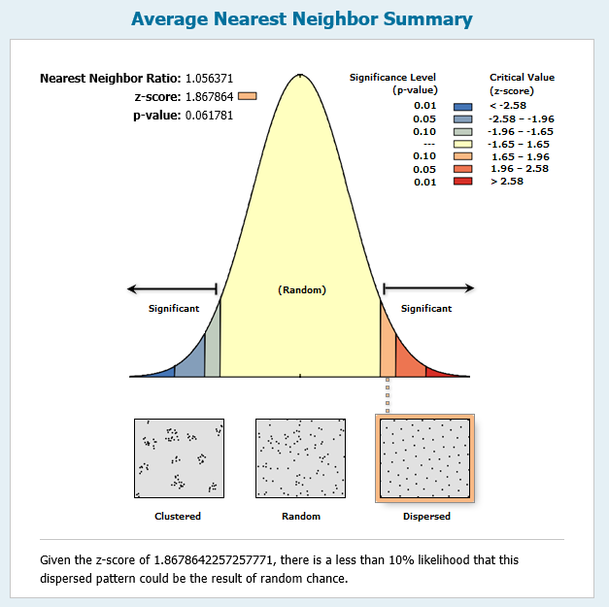
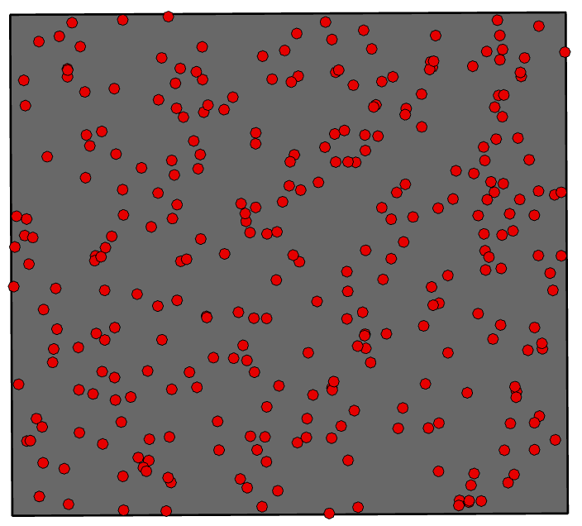
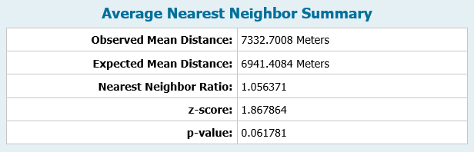
Average Nearest Neighbor
Notes:
Here is an example output for average nearest neighbor for the point distribution. Can anyone tell it is clustered, random, or dispersed?
The nearest neighbor ratio is greater than 1 and the p-value is 0.062. This suggest it is dispersed.
However, this is not statistically significant at the 95% confidence interval.

Slide 45
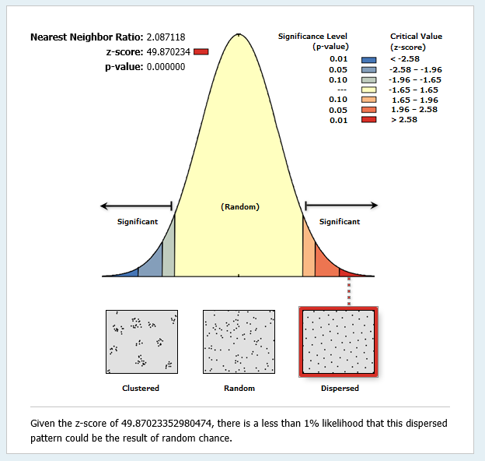
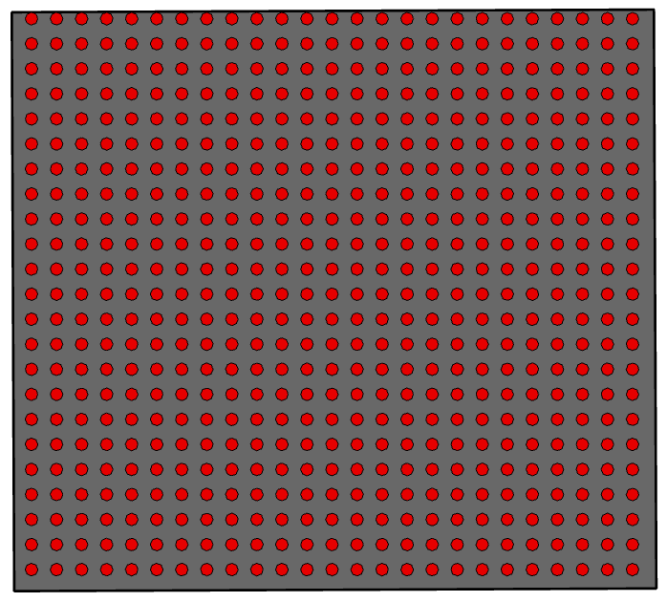

Average Nearest Neighbor
Notes:
How about this one?
This is a perfectly dispersed pattern. The nearest neighbor ratio is greater than 1 and the p-value is 0, suggesting stronger significance.
So this pattern is suggested to be disperse.

Slide 46



Average Nearest Neighbor
Notes:
How about this one?
For this result, the nearest neighbor ratio is less than 1 and the p-value is zero, suggesting strong significance for a clustered pattern.
So far, did I make sense?

Slide 47
Thank you!

