Slide 1

GEOG 3403: Geographic Information Systems II
Lecture 06 Spatial Statistics
Yanan Wu, PhD
Assistant Professor
Department of Geography

Slide 2
Global Spatial Autocorrelation

Slide 3
Tobler’s First Law of Geography
Everything is related to everything else, but near things are more related than distant things.
Tobler, W. (1970) “A computer movie simulating urban growth in the Detroit region.” Economic Geography, 45(2): 234-240.
Notes:
One key concept in geography is Tobler’s First Law of Geography that states that everything is related to everything else, but near things are more related than distant things.
For example, we are all gathering into this classroom, as we have more similar interests in remote sensing and GIS courses than the students outside this classroom.
You would also expect individuals that have clustered into Flyers communities to have more similar beliefs and customs than individuals in different communities.
This suggests that there are patterns across geographic space that can be explored and studied.
This is the concept behind spatial statistics.

Slide 4
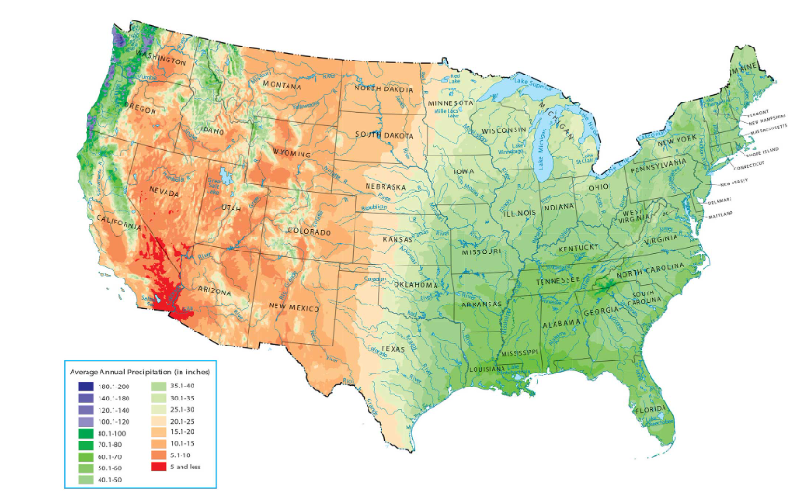
US Precipitation Map
🤔
Looking at the US Precipitation Map, which spatial pattern is most visible?
A. Random distribution
B. Clustered regions of similar precipitation
C. Perfect dispersion

Slide 5
🤔
Which example best reflects Tobler’s First Law?
A. Housing prices vary randomly B. Nearby neighborhoods have similar housing price C. Location does not influence patterns

Slide 6
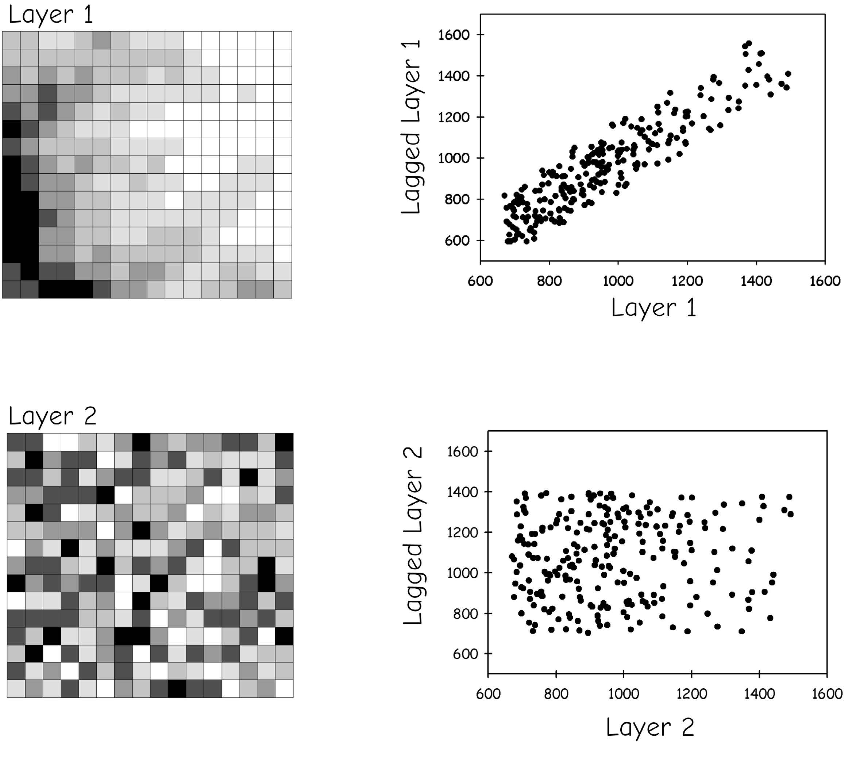
Spatial autocorrelation
Spatial autocorrelation describes the degree to which the values of a variable are similar (or dissimilar) across geographic space.
In simple terms:
Do nearby locations have similar values?
Bolstad 2019
Notes:
One key concept in geography is Tobler’s First Law of Geography that states that everything is related to everything else, but near things are more related than distant things.
For example, we are all gathering into this classroom, as we have more similar interests in remote sensing and GIS courses than the students outside this classroom.
You would also expect individuals that have clustered into Flyers communities to have more similar beliefs and customs than individuals in different communities.
This suggests that there are patterns across geographic space that can be explored and studied.
This is the concept behind spatial statistics.

Slide 7
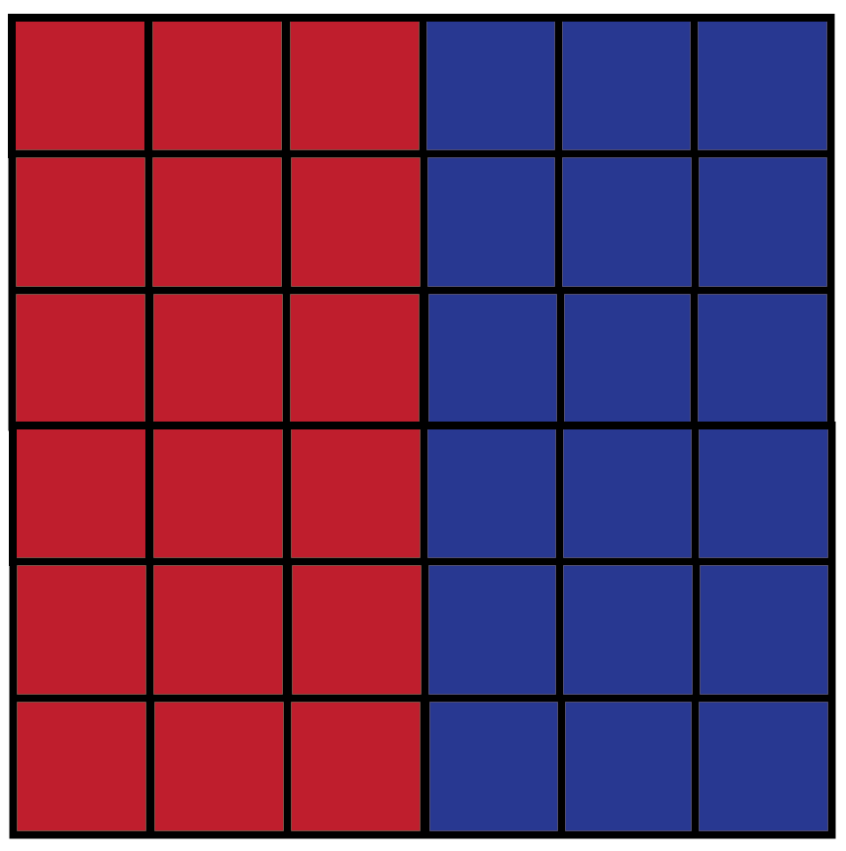
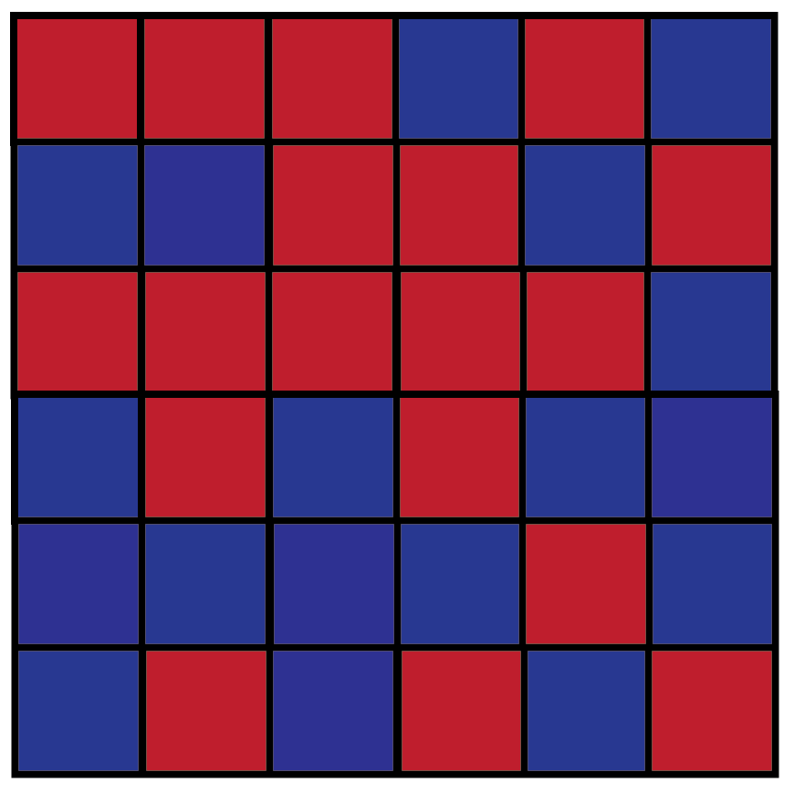
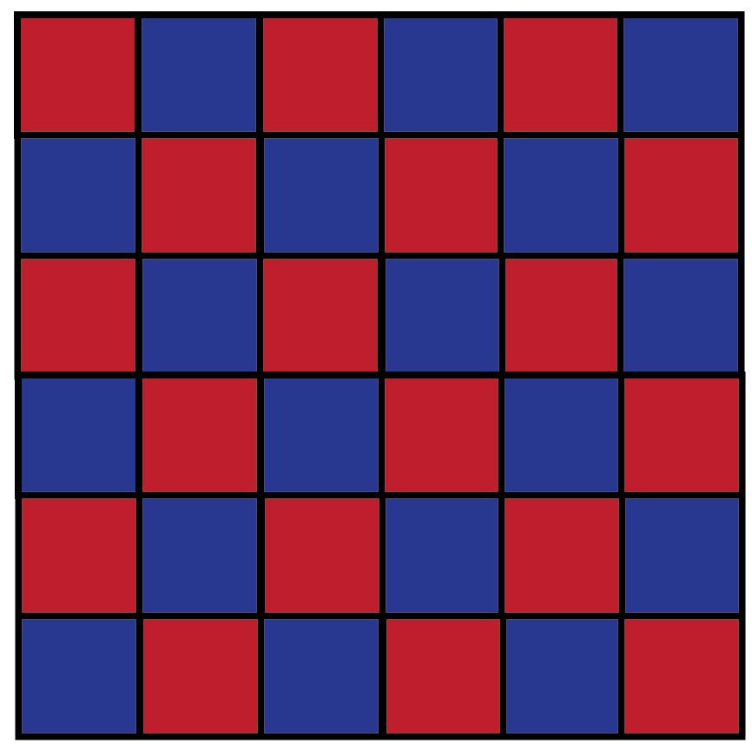
Spatial autocorrelation
+
-
Clustered
Random
Dispersed
Positive
spatial autocorrelation
Negative
spatial autocorrelation
Notes:
We will first see what is spatial autocorrelation. This figures show three spatial autocorrelation patterns.
Positive spatial autocorrelation suggests clustering, that near features are more similar than features that are more separated.
The first example provided here is an example of clustering since all the red cells are on one side and all the blue cells are on the other.
Negative spatial autocorrelation suggests dispersion, that more similar values are actually more separated over space. For example, the dispersed example above is dispersed because the different colors are as spread out as they can be.
No spatial autocorrelation is Random patterns, implying no patterns across space.

Slide 8
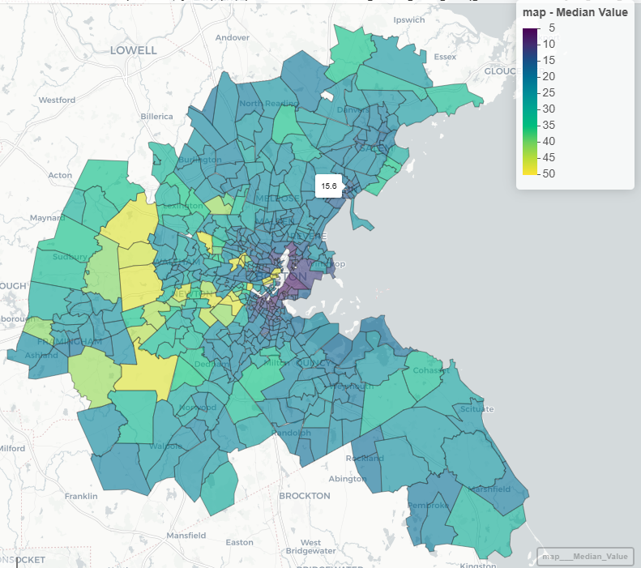
Housing Price in Boston
What spatial patterns do you observe in the housing prices?
clustered
dispersed
random

Slide 9
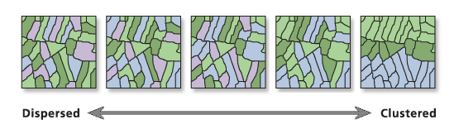
Moran’s I
Measures spatial autocorrelation based on feature locations and attribute values using the Global Moran’s I statistic. Moran’s I measure the spatial autocorrelation of attribute values.
-1
1
Notes:
Average Nearest Neighbor is only dealing with locations, Moran’s I measures…
For example, we have some points and the points have some values and locations. For example, the 14 is 20 kilometers away from the 32, and 14 is 3 kilometers away from 16. There is also data space, 14 is 18 away from 32, and is 2 away from 16. So we look for correlation in these values and distances.
We want to see if these points get father apart, do their values become more similar or less similar.

Slide 10
Moran’s I close to +1 suggests:
A. Dispersion B. Clustering of similar values C. Randomness
Which method uses attribute values?
A. Average Nearest Neighbor B. Moran’s I C. Ripley’s K

Slide 11

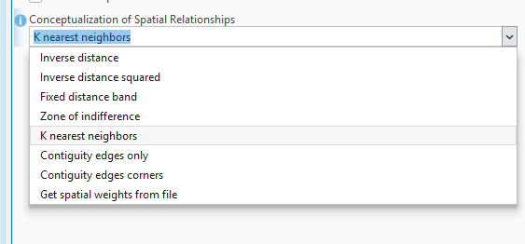
Moran’s I
Measures spatial autocorrelation based on feature locations and attribute values using the Global Moran’s I statistic
s² = (Σ(y_{i}– ̄y)²)/n)
Spatial Weight between i and j
Spatial weights define neighbor relationships
Notes:
Moran’s I is the same idea. The difference is that Moran’s I incorporates a spatial weight between locations I and j, in order to get one value for the entire maps.
This spatial weight can be calculated using inverse distance, so that the near things will have larger weight and far away things will have less weight.
Values of I usually range from −1 to +1. Positive spatial autocorrelation will show values that are clustered. Negative autocorrelation is dispersed. Random is close to zero.
The Moran’s I index will be a value between -1 and 1. The moran’s I near -1 indicates negative spatial auto-correlation and the Moran’s I near 1 indicated positive spatial auto-correlation.
Values significantly below -1/(N-1) indicate negative spatial autocorrelation and values significantly above -1/(N-1) indicate positive spatial autocorrelation. For statistical hypothesis testing, Moran's I values can be transformed to z-scores.

Slide 12
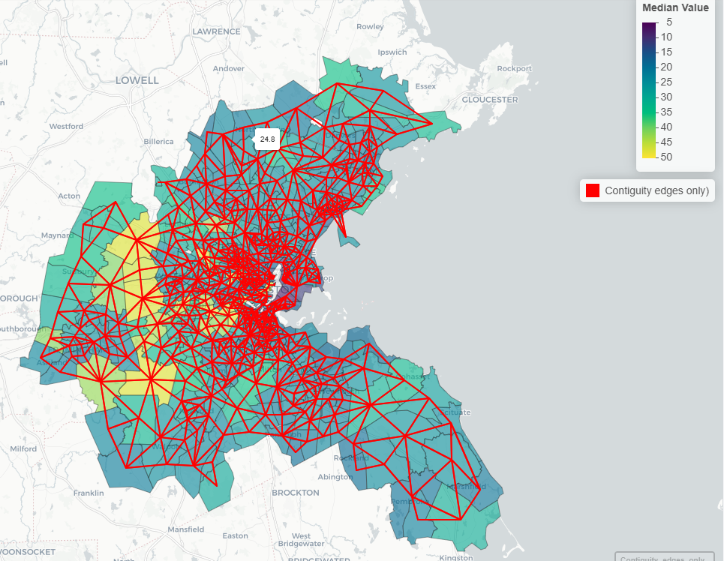
Contiguity edges only
Contiguity-based weights connect spatial units that share a boundary
Here we define neighborhoods purely based on adjacency. Only units sharing boundaries are considered neighbors.

Slide 13
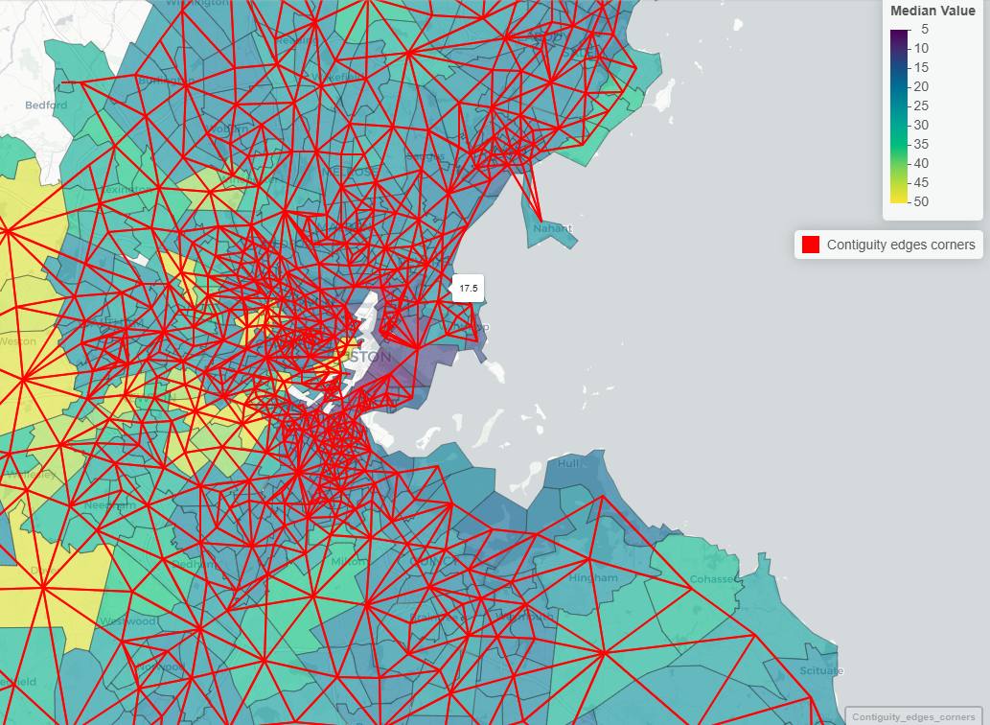
Contiguity edges corners
Contiguity-based weights connect spatial units that share a boundary or a corner (vertex)

Slide 14
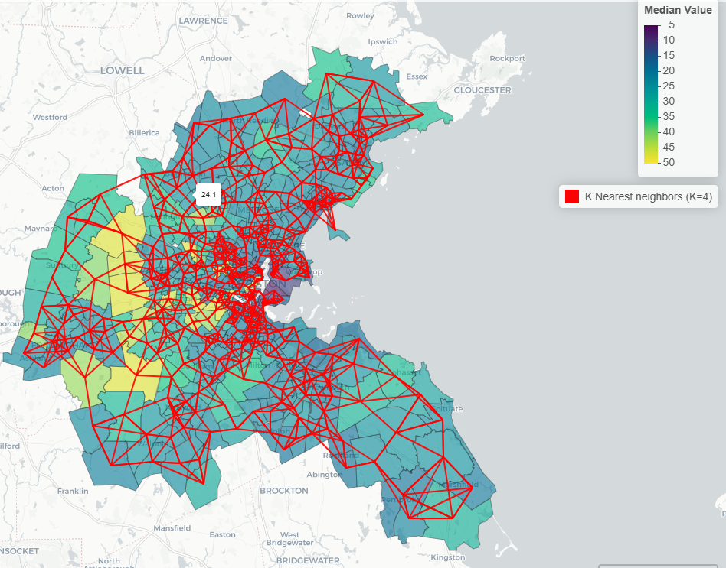
K nearest neighbor
Each spatial unit is connected to its K closest neighbors

Slide 15
Conceptualization of Spatial Relationships
INVERSE DISTANCE: Nearby neighboring features have a larger influence on the computations for a target feature than features that are far away.
INVERSE DISTANCE SQUARED: Same as INVERSE_DISTANCE except that the slope is sharper, so influence drops off more quickly, and only a target feature's closest neighbors will exert substantial influence on computations for that feature.
FIXED DISTANCE BAND: Each feature is analyzed within the context of neighboring features. Neighboring features inside the specified critical distance (Distance_Band_or_Threshold) receive a weight of one and exert influence on computations for the target feature. Neighboring features outside the critical distance receive a weight of zero and have no influence on a target feature's computations.
ZONE OF INDIFFERENCE: Features within the specified critical distance (Distance_Band_or_Threshold) of a target feature receive a weight of one and influence computations for that feature. Once the critical distance is exceeded, weights (and the influence a neighboring feature has on target feature computations) diminish with distance.
CONTIGUITY EDGES ONLY: Only neighboring polygon features that share a boundary or overlap will influence computations for the target polygon feature.
CONTIGUITY EDGES CORNERS: Polygon features that share a boundary, share a node, or overlap will influence computations for the target polygon feature.
GET SPATIAL WEIGHTS FROM FILE: Spatial relationships are defined by a specified spatial weights file. The path to the spatial weights file is specified by the Weights_Matrix_File parameter.
http://pro.arcgis.com/en/pro-app/tool-reference/spatial-statistics/spatial-autocorrelation.htm
Notes:
Since Moran’s I requires that values associated with a feature be compared to values for nearby features, you must define what you mean by neighboring or near features.
Different methods are available, as describe on this slide.
As an example, when using inverse distance nearby neighbors have a larger influence on the computations for a target feature than features that are further away.
When a fixed distance band is used only features within a defined distance are considered.
For zone of indifference, features within a critical distance are assigned a weight of 1. The weight diminishes with distance past the critical distance.
When contiguity edges only is used only features that share a boundary or overlap will be considered in the computation for the target feature.
There is not necessarily a correct method to use, as this is case specific. However, you should make and attempt to justify your decision based on the nature of the data and the question being investigated.

Slide 16
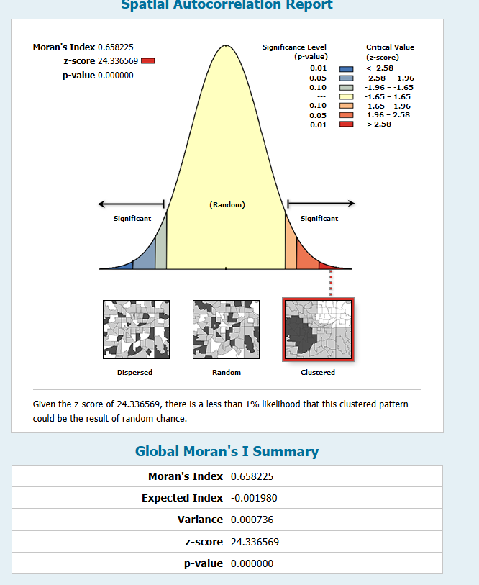
Examples
Moran’s I assesses the clustering of similar values
This statistic specifically looks for the clustering of high and low values globally
Null Hypothesis: high values or low values aren’t clustered
Alternative Hypothesis: high and/or low values are clustered
Can use Euclidean Distance or Manhattan Distance
Must specify a conceptualization of spatial relationships
Positive G = High clusters
Negative G = Low clusters
p value < 0.01, reject the null hypothesis
Notes:
Here is an example result for Moran’s I. Specifically, we are investigating spatial autocorrelation for percent poverty at the census tract scale. Can anyone tell me this pattern?
Here, a positive Moran’s I of 0.25 is obtained and a p-value of 0. This indicates that there is clustering or positive spatial autocorrelation globally for percent poverty as summarized on census tracts.
Near census tracts tend to have more similar percent poverty rates.
Used contiguity edges only

Slide 17
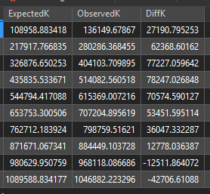
Ripley’s K
Assess patterns at multiple scales or distances
When the observed K value is larger than the expected K value for a particular distance, the distribution is more clustered than a random distribution at that distance (scale of analysis).
When the observed K value is smaller than the expected K value, the distribution is more dispersed than a random distribution at that distance.
Notes:
Average nearest neighbor offers a global assessment of the point pattern. However, different patterns could exist at different spatial scales.
Ripley’s K provides this comparison at different scales. This test will be performed at a variety of different distances.
When the observed K value is larger than the expected K value for a particular distance, the distribution is more clustered than a random distribution at that distance.
When the observed K value is smaller than the expected K value, the distribution is more dispersed than a random distribution at that distance.

Slide 18
Local Spatial Autocorrelation

Slide 19
Hot Spot Analysis (Getis-Ord Gi*)
This is a local version of the Getis-Ord General G
It looks for local clustering of high or low values
Hot Spot: Cluster of high values
Cold Spot: Cluster of low values
Null Hypothesis: No local cluster of high or low values
Alternative Hypothesis: Local cluster of high or low values
Can use Euclidean Distance or Manhattan Distance
Must specify a conceptualization of spatial relationships
Larger z-score = clustering of high values
Smaller z-score = clustering of low values
Notes:
The Getis-Ord Gi* provides a local version of the Getis-Ord General G. This test is also known as hot spot analysis.
It is used to find local clusters of high values, called hot spots, or local clusters of low values, called cold spots.
The null hypothesis is that there are no local clusters of high or low values while the alternative is that there are hot and/or cold spots.
The provided example represents an assessment of population change between 2000 and 2010. Red indicates hot spots, or clusters of counties that have seen population growth during this time period. Blue areas indicate clusters of counties that have seen population decreases during this time period. Tan indicates no pattern.

Slide 20
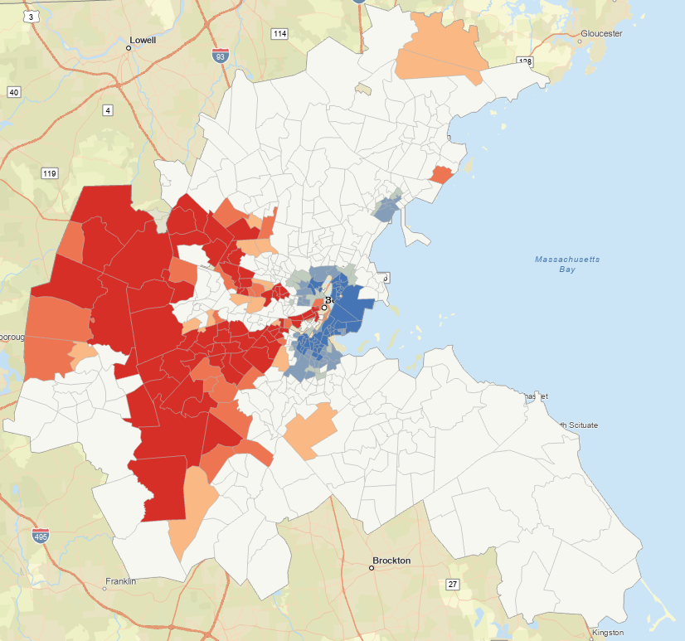
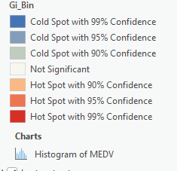
Hot Spot Analysis (Getis-Ord Gi*)
Notes:
As another example, this slide represents results for a hot spot analysis of percent poverty at the census tract scale.
Red indicates clusters of high poverty while blue indicates clusters of low poverty. White suggests no pattern.

Slide 21
Quiz 1 — Due by midnight, Wednesday, March 4
You have 3 hours to complete Quiz 1.
Question types: Multiple choice and True/False

