Slide 1
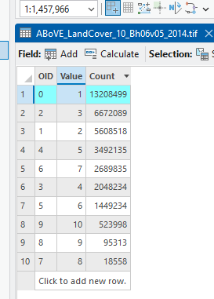
Lab 04
Answer: 1984: Evergreen Forest. 2014:Evergreen Forest

Slide 2
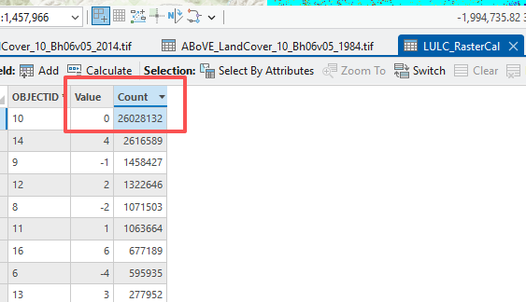
Question 4. Which value was dominant in the change map? (2 Points)
Answer: 0, no change

Slide 3
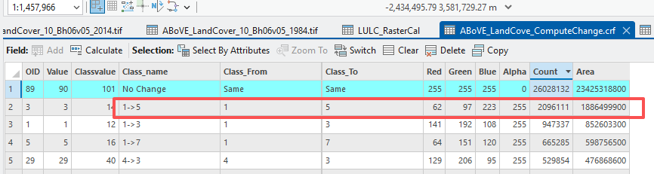
Q7: Excepting pixels with no change, which transition was dominant? How much land experienced such a transition? Please give the class name, not the place-holders. (4 Points) (Hint, you can sort the table by right-clicking on the column, followed by Sort Descending or Sort Ascending; you can find the transitions in CLASS_NAME field and area in AREA field)

Slide 4
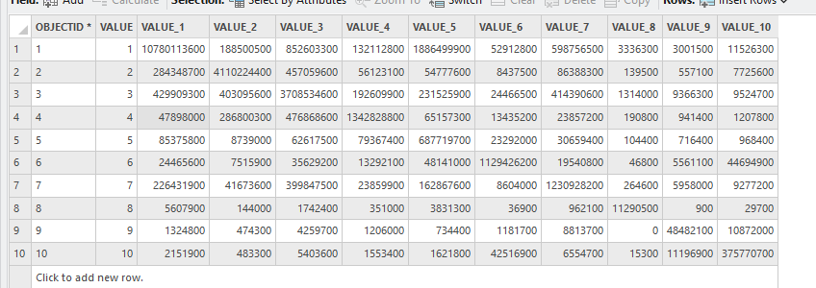
Question 10. How much land changed from Shallows/Littoral (9) to Bog (8)? (2 Points)
Row is 1984
Column is 2014

Slide 5
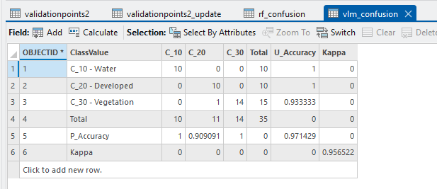
Lab 03
Accuracy of the models

