Slide 1

GEOG 3403: Geographic Information Systems II
Lecture 07 Geographically Weighted Regression
Yanan Wu, PhD
Assistant Professor
Department of Geography

Slide 2
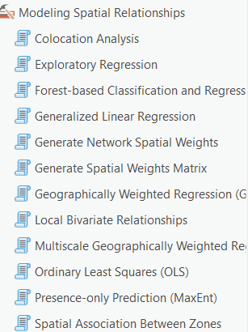
Overview
Spatial statistics
Regression
Simple regression
Multiple regression
Geographically weighted regression (GWR)
Model assessment
GWR example

Slide 3
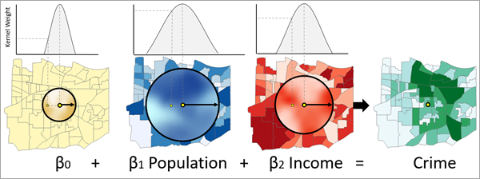
Multiscale GWR (MGWR)
The number of neighbors to be used in the model for each independent variable are different.
https://pro.arcgis.com/en/pro-app/latest/tool-reference/spatial-statistics/multiscale-geographically-weighted-regression.htm

Slide 4
What makes MGWR different from traditional GWR?
A. It uses only one predictor B. Each independent variable can have a different spatial scale C. It ignores spatial relationships D. It does not use regression

Slide 5
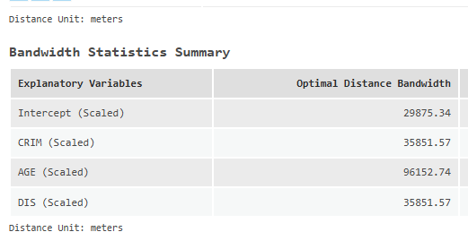
Multiscale GWR (MGWR)
The number of neighbors to be used in the model for each independent variable are different.

Slide 6
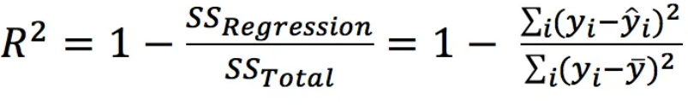
Model Assessment
R²
Measures how much variability in the dependent variables can be explained by the model.
Ranges from 0 to 1. 1 means 100% of the variability in the dependent variables can be explained by the model.
In general, a higher R-squared indicates a better fit for the model.
The problem of R² is that additional input variable will make the R² stay the same or increase, even if the additional input variables show no relationship with the output variables.

Slide 7
If R² = 0.85, this means:
A. 85% of the spatial pattern is random B. 85% of variation in Y is explained by the model C. The model is perfect D. The model has no residuals

Slide 8

Local $R^{2}$ in MGWR
Negative local R² values indicate that the local model performs worse than the global mean prediction at that location.

Slide 9
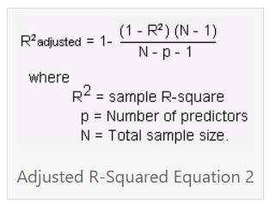
Model Assessment
Adjusted R²
A modified version of R² that adjusts for predictors that are not significant in a regression model.
Measures how much variability in the dependent variables can be explained by the model.
Ranges from 0 to 1. 1 means 100% of the variability in the dependent variables can be explained by the model.

Slide 10
Why is Adjusted R² preferred over R² in multiple regression?
A. It always gives a higher value B. It penalizes unnecessary predictors C. It removes residuals D. It ignores sample size

Slide 11
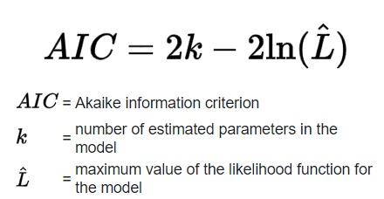

Model Assessment
Akaike's Information Criterion (AIC)
An estimator of prediction error
The lower the AIC value, the better the model performance
When the sample size is small, AIC will select models that have too many parameters
Akaike's Information Criterion Correction Version (AICc)
The lower the AIC value, the better the model performance

Slide 12
When comparing two models:
Model A: AIC = 120 Model B: AIC = 105
Which model is better?

Slide 13
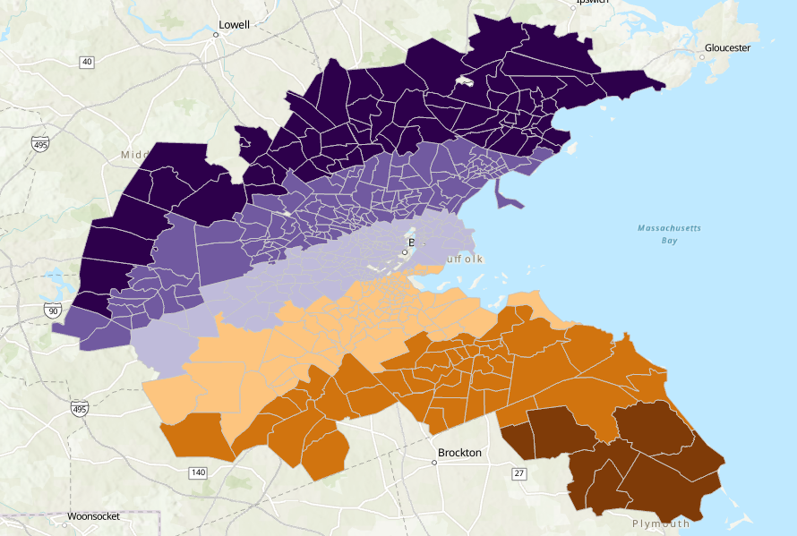
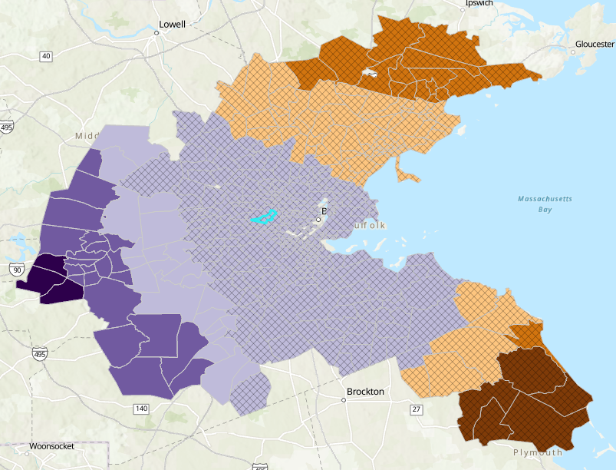
Multiscale GWR Example
Coefficient Distance
Coefficient Age
Figure 1

Slide 14
Thank you!

