Slide 1

GEOG 3403: Geographic Information Systems II
Lecture 08 Spatial Interpolation
Yanan Wu, PhD
Assistant Professor
Department of Geography

Slide 2
Spatial Interpolation Methods

Slide 3
Why Do We Need Spatial Interpolation?
Example: Weather Stations and Temperature
Weather stations record temperature at specific locations. However, we often want to know the temperature everywhere across a region, not just at the stations.
Spatial interpolation helps us estimate temperature at locations where no measurements exist.

Slide 4
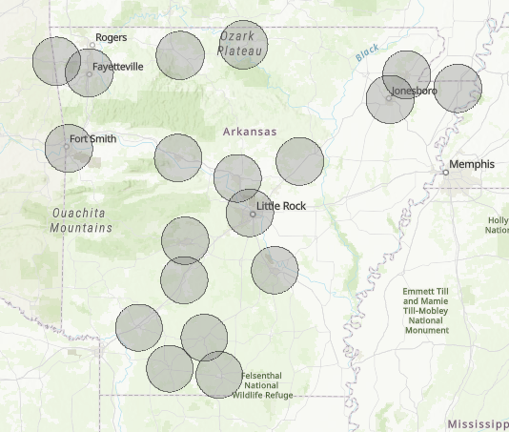
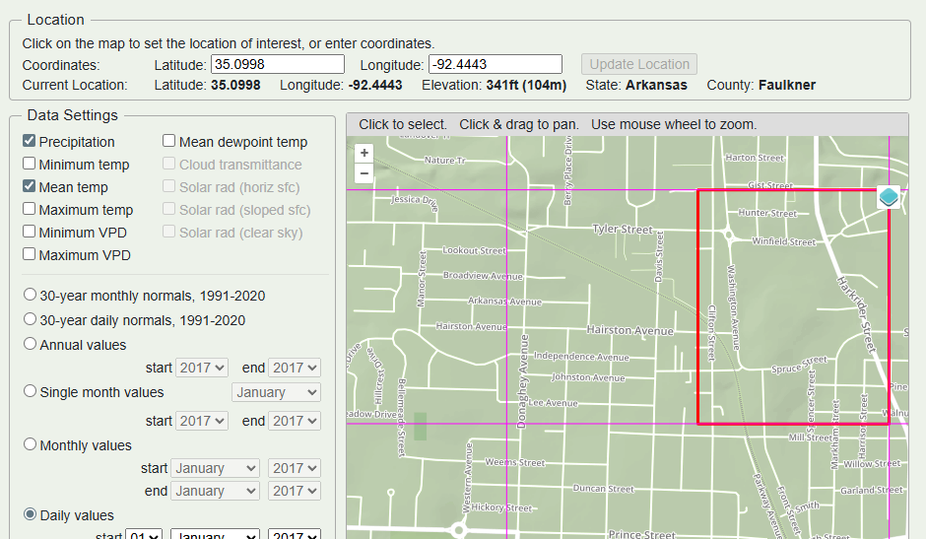
Weather Data Represented as weather station and Continuous Surface
weather station points
Weather data in continuous surface

Slide 5
Weather Data
https://www.ncei.noaa.gov/access/past-weather/CONWAY%20AR
https://www.ncei.noaa.gov/cdo-web/results

Slide 6
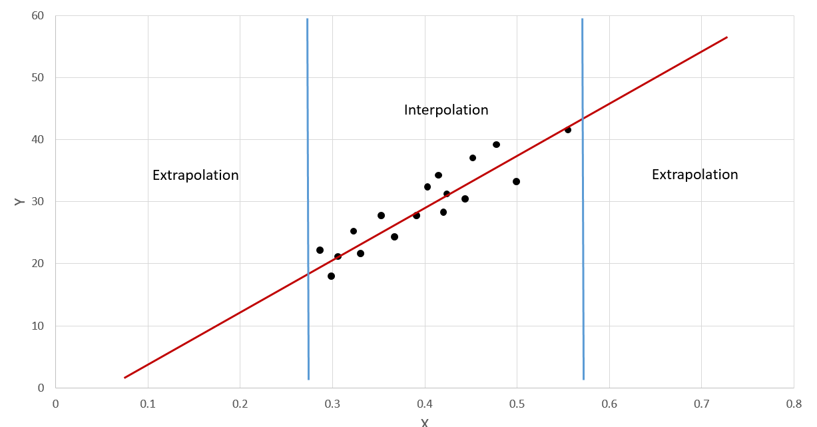
What is Spatial Interpolation?
A location outside the region where measurements exist
A location within the area surrounded by existing data.
Notes:
We can’t measure everything everywhere.
For example, it is common to collect measurements at point locations, such as collecting climate or weather data at weather stations.
If you would like to estimate values at locations that were not sampled, you will need to apply interpolation or extrapolation as a means to obtain a continuous surface from your discrete measurements.
Since these locations were not actually measured but estimated from nearby sample locations, there will be some error or uncertainty in the product.
Extrapolation is generally considered to be more uncertain than interpolation.
As an example, if you are trying to predict a variable y using a variable x with a line or linear relationship, estimates within the bounds of your sample data will likely be less uncertain that estimates outside of the bounds of your data. Maybe outside of the bounds the relationship is no longer linear, begins to increase exponentially, or levels off. Without data points or samples, this would be hard to determine.
In a spatial context, extrapolation would be making an estimate outside of the geographic bounds of your data, as represented by the yellow star. In contrast, interpolation would be making an estimate within the geographic bounds of your data, as represented by the orange star.

Slide 7
Question 1
If we estimate temperature between two weather stations, is this:
A Interpolation B Extrapolation
Question 2
If we estimate temperature outside the region where we collected data, is this:
A Interpolation B Extrapolation

Slide 8
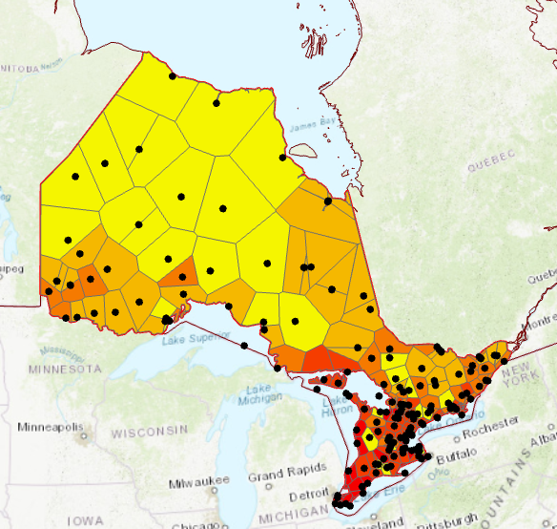
Thiessen polygons
Nearest neighbor interpolation
Defines the area that is closer to one point than any other points in a dataset
Ontario
Notes:
One fairly simple method to perform interpolation is Thiessen (Voronoi) Polygons.
Thiessen (Voronoi) Polygons represent the area that is closer to one point than any other points in a dataset.
The polygon can be attributed with the attributes of the input point layer.
In the examples provided, Thiessen polygons and point measurements in Ontario that represent weather stations are being used to estimate mean annual temperature for the entire province. In the West Virginia example, the entire area of the state has been divided into regions that are closer to one city than any other provided city.

Slide 9
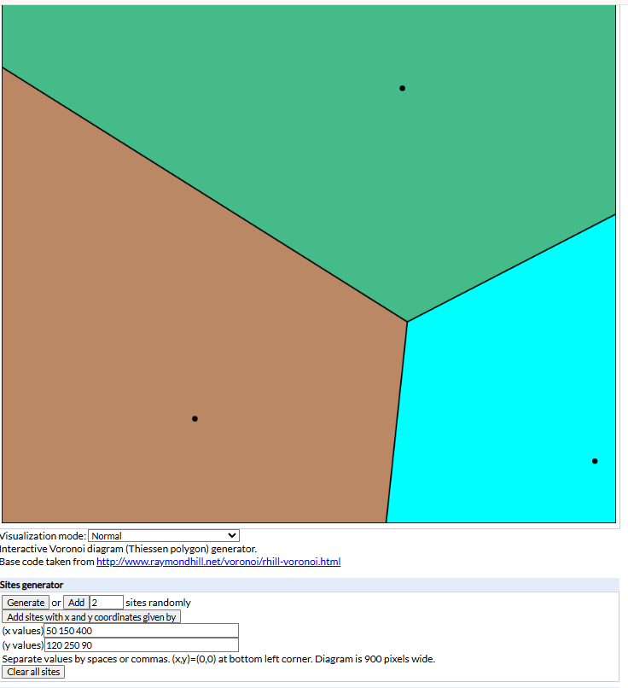
Interactive Thiessen Polygon Generator

Slide 10
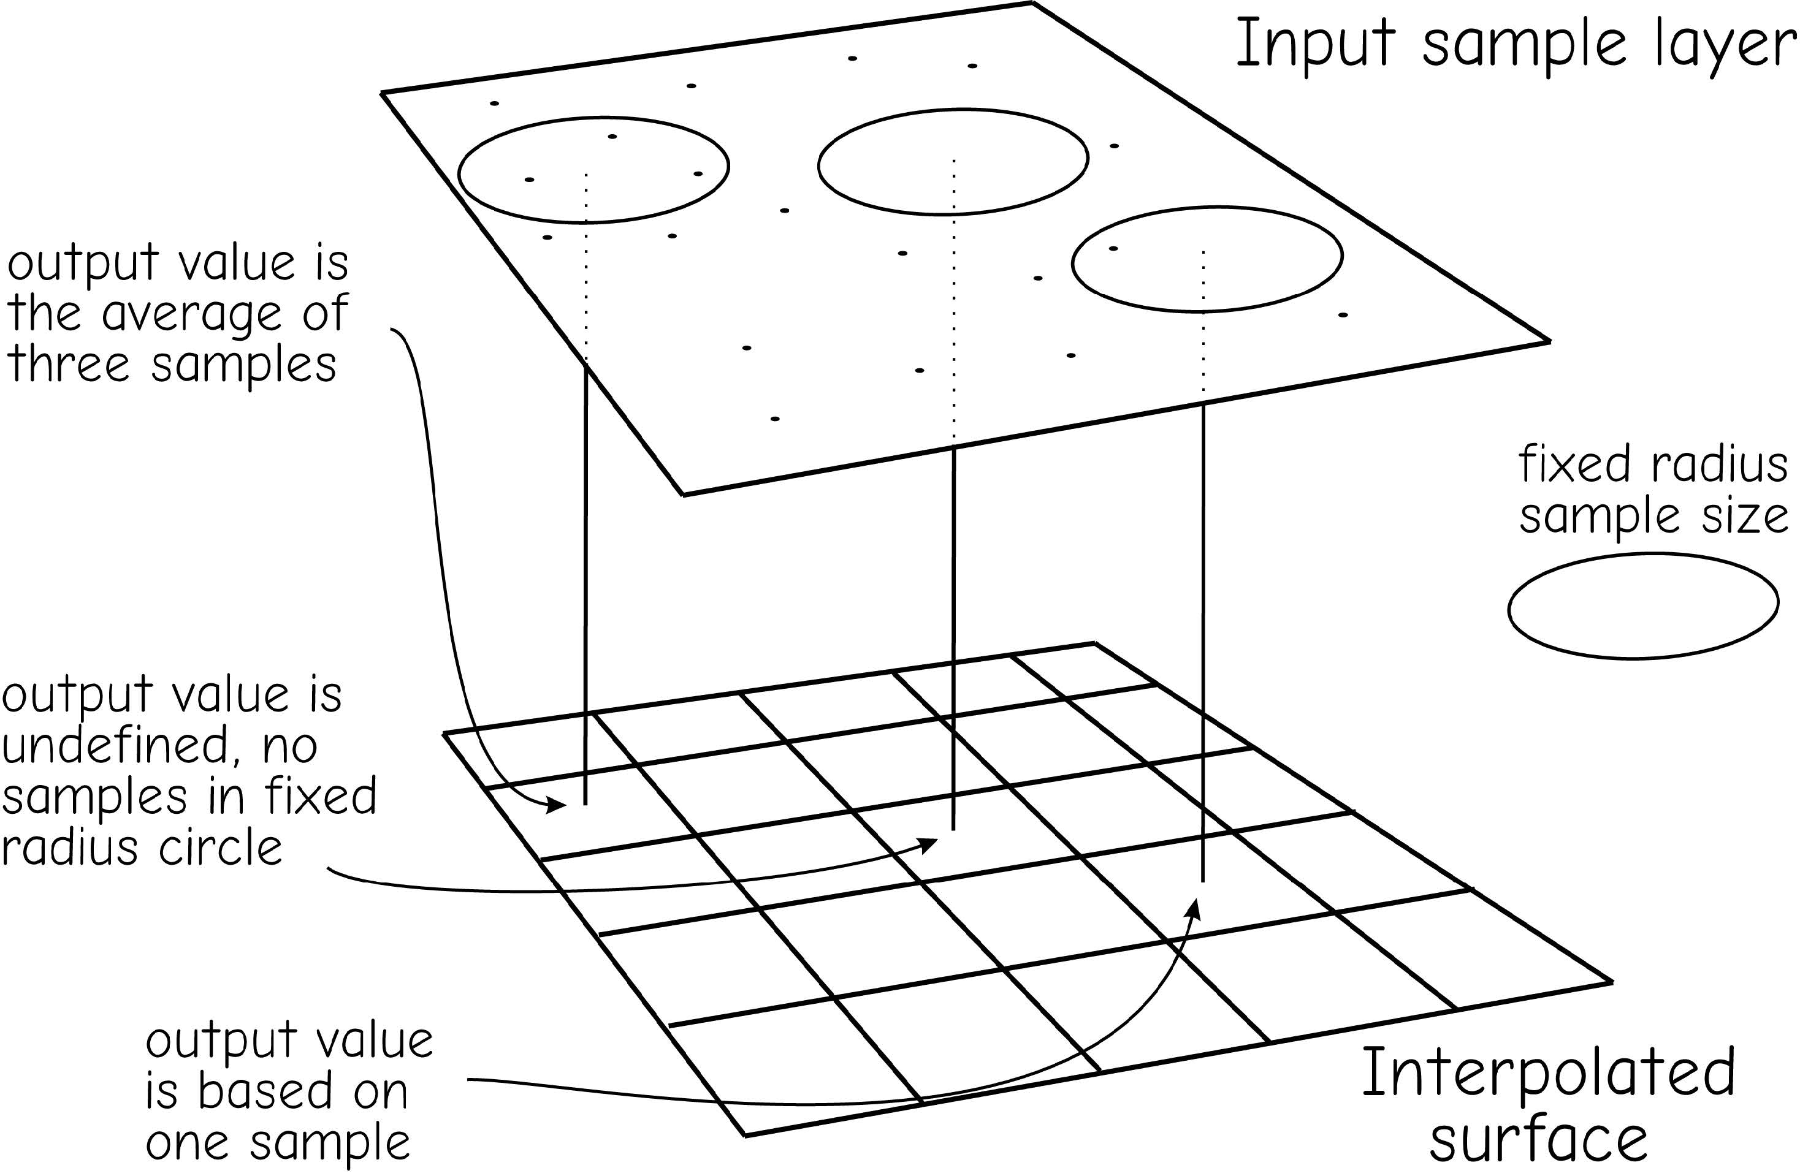
Fixed radius
Local averaging
Cell values are estimated based on the average of nearby samples
Bolstad 2019

Slide 11
Influence of fixed distance on interpolation
If the search radius is very small, what might happen?
What happens if the search radius is very large?

Slide 12
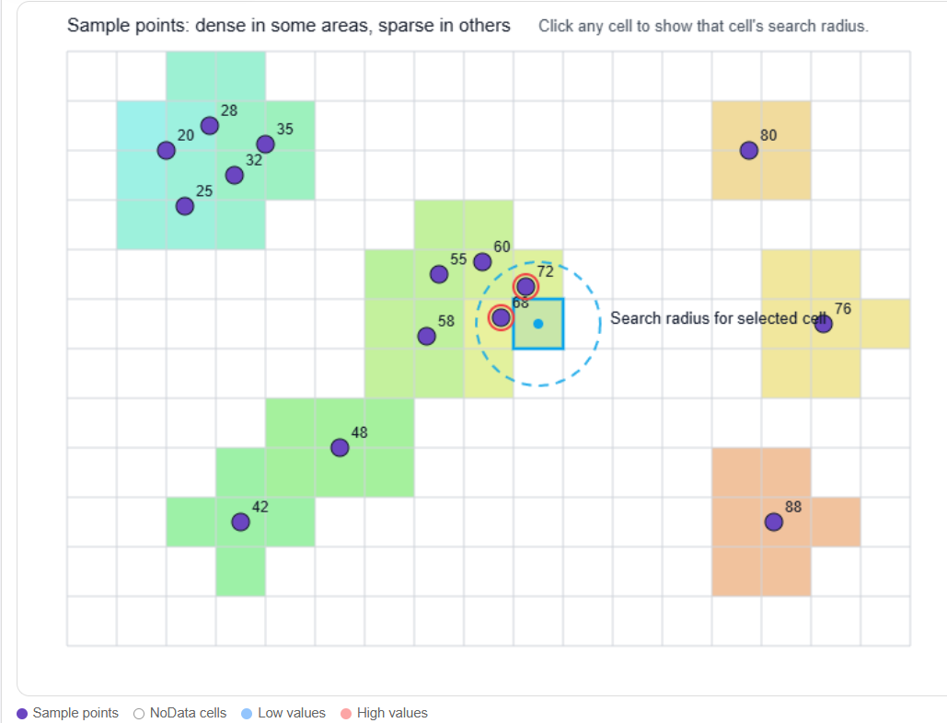
Interactive tool on Fixed Radius Interpolation Practice

Slide 13
Inverse distance weighting (IDW)
Inverse distance weighted average of near sample points
Power: controls the significance of surrounding points
Higher power = less influence by distant points
Lower power = more influence by distant points
Radius: specifies which input point will be considered
Variable = does not specify a distance but a number of points
Can specify number of points to use
Can specify the maximum distance over which to search
Fixed = specify a distance over which to search
Can specify a minimum number of points that is used to increase the search radius
Notes:
Another spatial interpolation method is inverse distance weighting or IDW.
Using this method the value at a new location or cell is determined based on an inverse distance weighted average of nearby samples.
The power setting controls the significance of surrounding points. Using a higher power will cause the near points to have a higher weight than more distant points.
The radius setting specifies what samples will be used to estimate a value at a new location or cell. A variable radius is used to specify a number of samples as opposed to a fixed distance. For example, the nearest 12 points could be used. When using the variable method, you can also set a maximum distance. So, if 12 points are not available within the maximum distance then less points will be used. When using a fixed method, a fixed radius or distance is defined as opposed to a number of points. When using the fixed method, a minimum number of points can be set. So, if this minimum number of points do note exist within the search radius it will be expanded to include more samples.

Slide 14
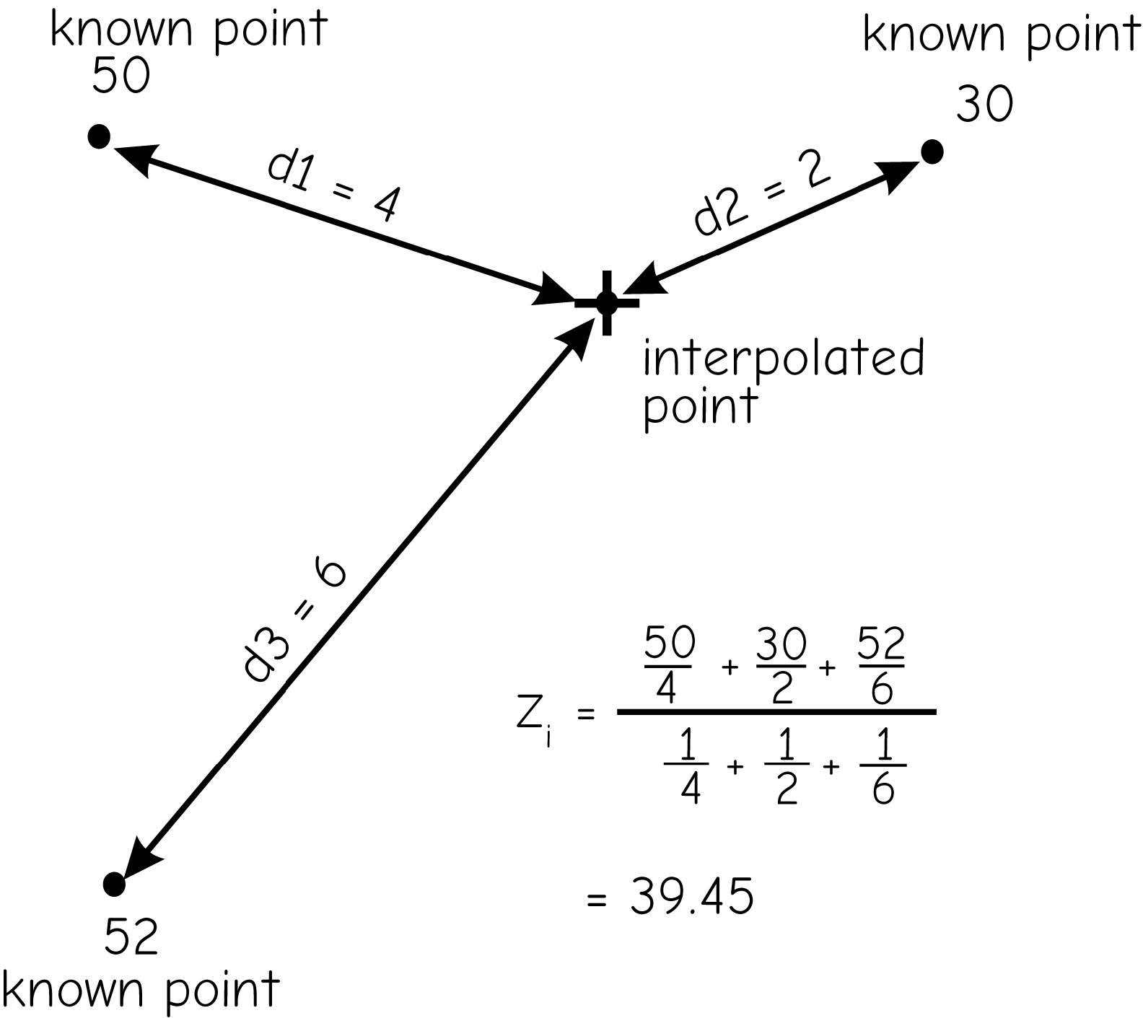
Inverse distance weighting (IDW)
Bolstad 2019
Notes:
This slide shows an example output from IDW.
Here, bathymetric or water depth point measurements are being interpolated to a raster grid using a power of 2 and variable search radius with no maximum distance and 12 as the number of points.
If you are not sure what settings to use, I would recommend experimenting with the settings and visualizing the result.

Slide 15
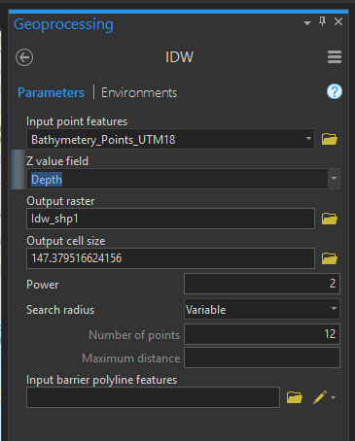
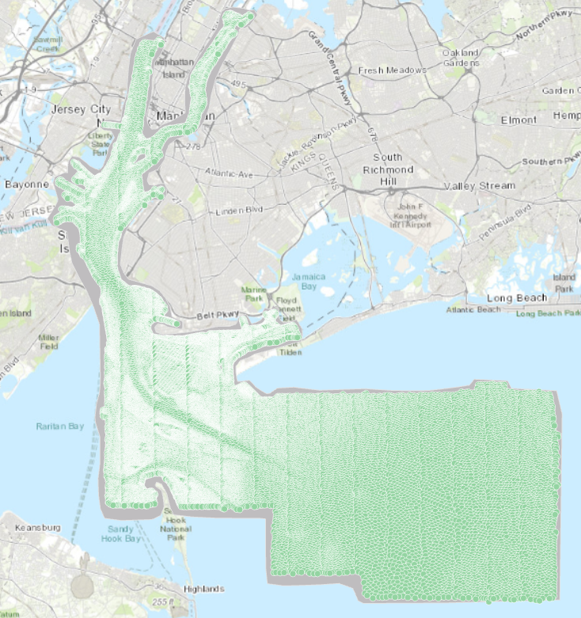
Inverse distance weighting (IDW)
Bathymetric or water depth point
Notes:
This slide shows an example output from IDW.
Here, bathymetric or water depth point measurements are being interpolated to a raster grid using a power of 2 and variable search radius with no maximum distance and 12 as the number of points.
If you are not sure what settings to use, I would recommend experimenting with the settings and visualizing the result.

Slide 16
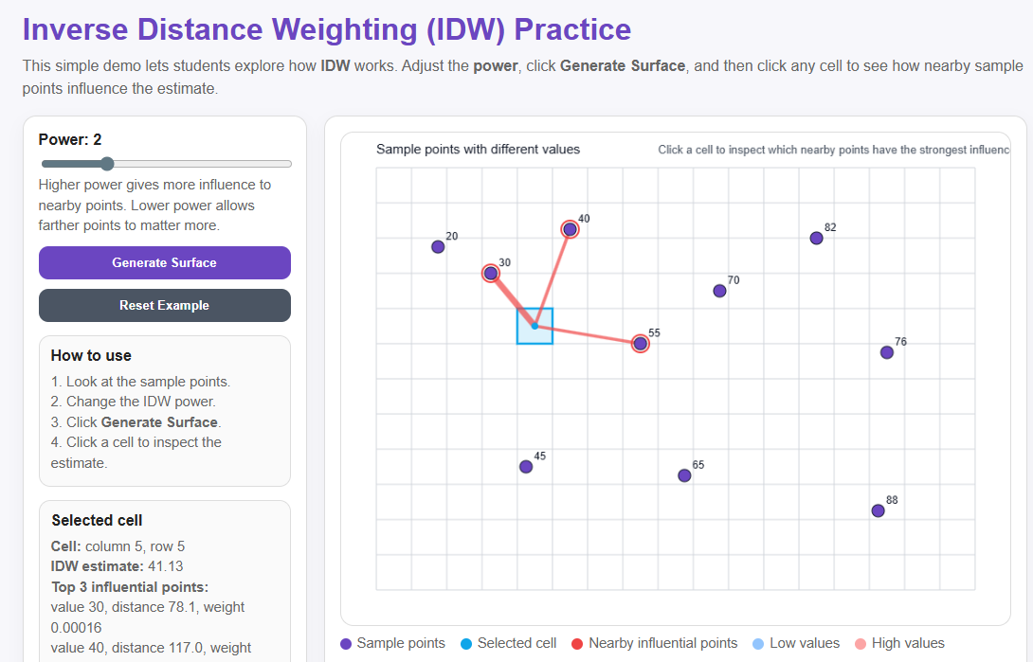
IDW Interactive Tool

Slide 17
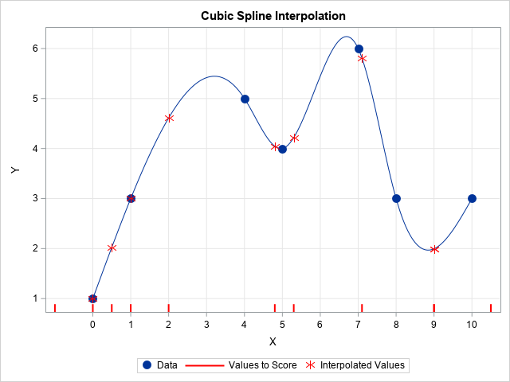
Spline
Points extrude to the height of their magnitude
Spline bends a sheet of rubber that passes through the input points while minimizing the total curvature of the surface
Fits a mathematical function (joined polynomial functions) to a specific number of near input points while passing through the sample points
Surface passes through sample points and has minimum curvature
This method is best for interpolating smooth surface that do not change abruptly
https://blogs.sas.com/content/iml/2020/05/11/cubic-interpolation-sas.html
Notes:
Another interpolation method is spline.
Conceptually, point samples are extruded to a height relative to the its magnitude for the attribute being interpolated. Spline then bends a sheet of rubber that passes through the input points while minimizing total curvature of the surface. It fits a mathematical function to a specific number of near input points while passing through the sample points. The goal is for the surface to pass through the sample points while minimizing the curvature of the surface.
Generally, this method is best for interpolating smooth surfaces that do not change abruptly. It generally is inappropriate for patterns or phenomena that can change abruptly.

Slide 18
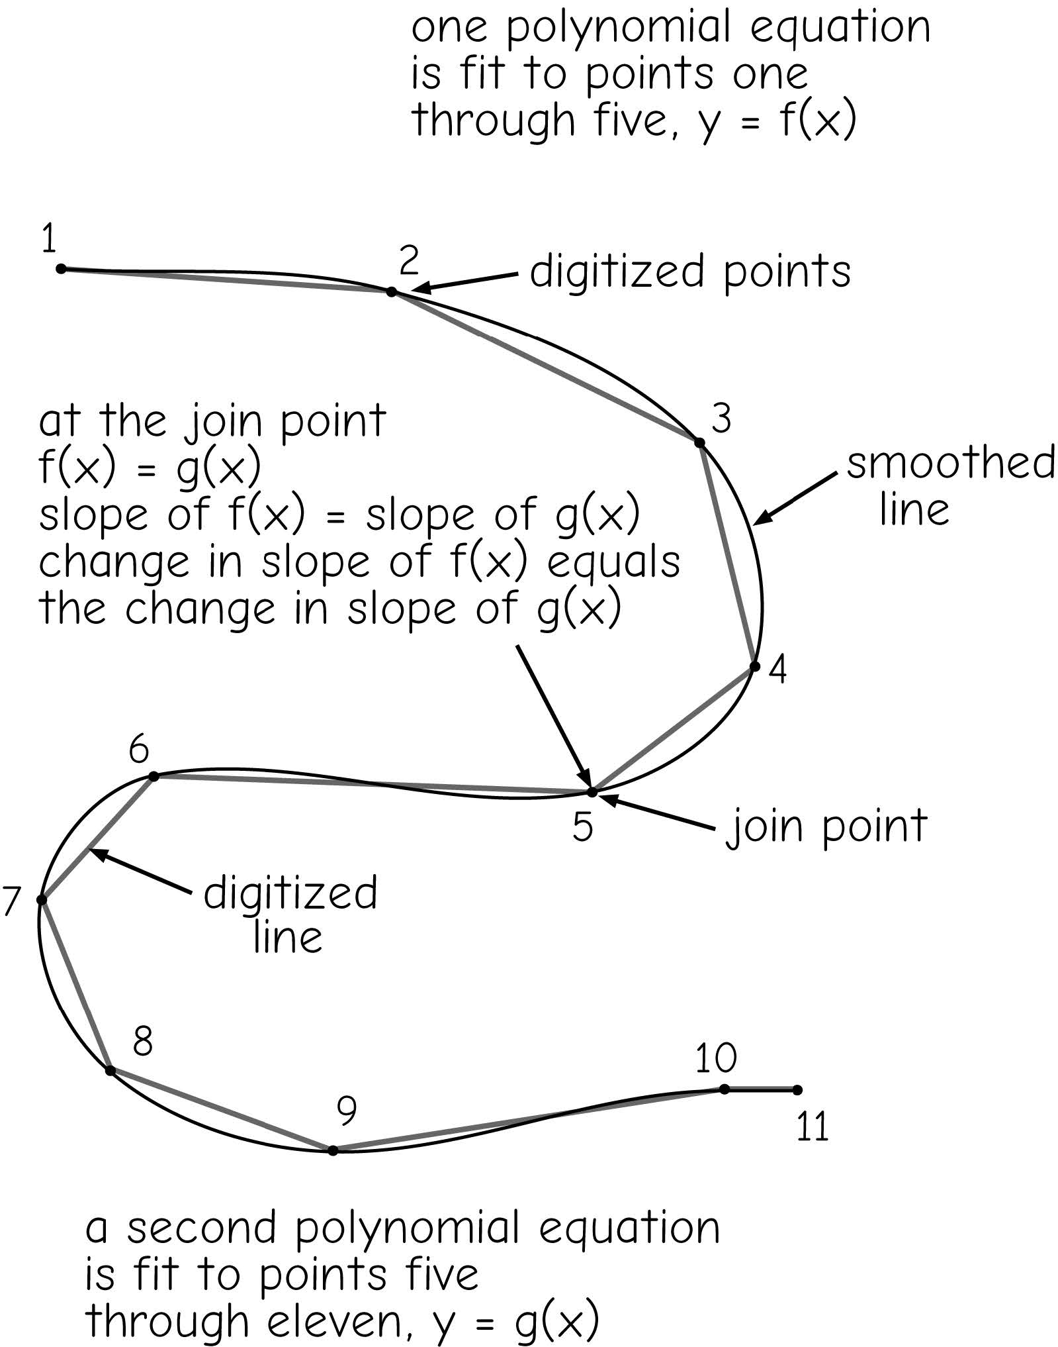
Spline
Bolstad 2019

Slide 19
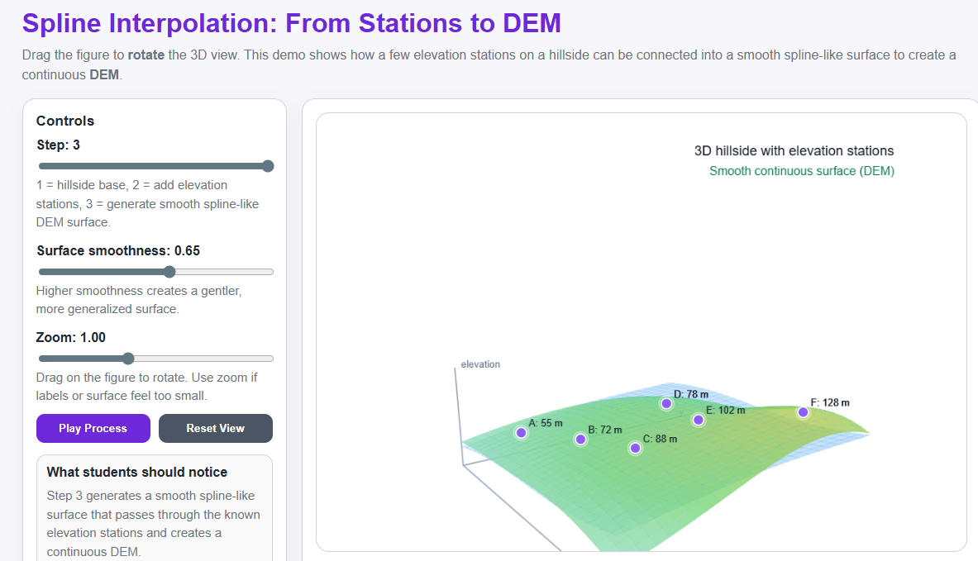
Spline Interactive Tool

Slide 20
Imagine there are only 10 weather stations in the state.
How do weather apps estimate the temperature at your exact location?
A. They measure temperature everywhere B. They estimate based on nearby stations C. They randomly generate numbers

Slide 21
Which concept explains why nearby locations tend to have similar environmental values?
Expected answer:
Tobler’s First Law of Geography
“Everything is related to everything else, but near things are more related than distant things.”

Slide 22
Density map

Slide 23
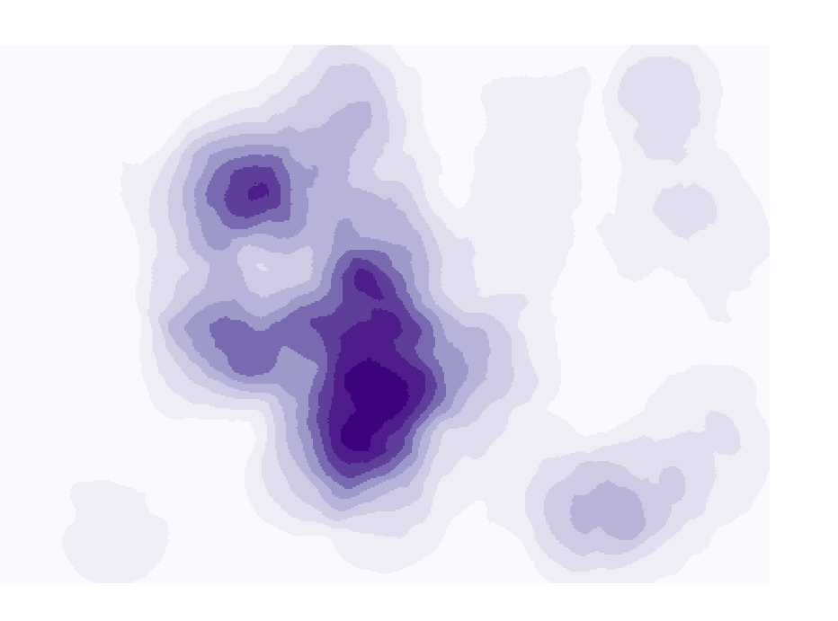
Point Density/ Line Density
Calculates the magnitude per unit area for point or line features that fall within a neighborhood around each cell
Line length/area
Number of points/area
Can incorporate weights
Must specify neighborhood shape and size
Notes:
You may be interested in obtaining a raster-based measure of density for point or line features. This can be accomplished using the Point Density or Line Density tools.
These tool are yet another example of methods that make use of neighborhood analysis or moving windows.
The user must define the size and shape of the moving window. The tool then will calculate the number of points or length of lines within the window.
On the center cell for each window, the tool will return a measure of density. For points this will be the number of points per unit area.
For lines, this will be the length of lines per unit area.
The size and shape of the window can have a large impact on the output. More global or generalized patterns will be produced with larger windows whereas more local patterns will be observed if a smaller window is used.
There is not necessarily a correct window size, as this depends on the goals of the analysis.

Slide 24
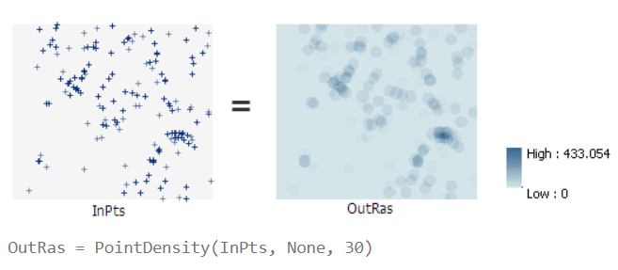
Point Density

Slide 25
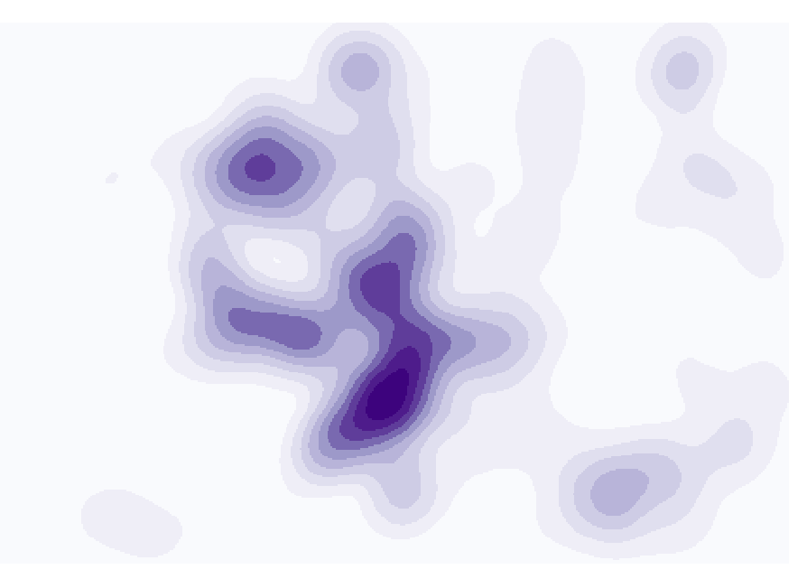
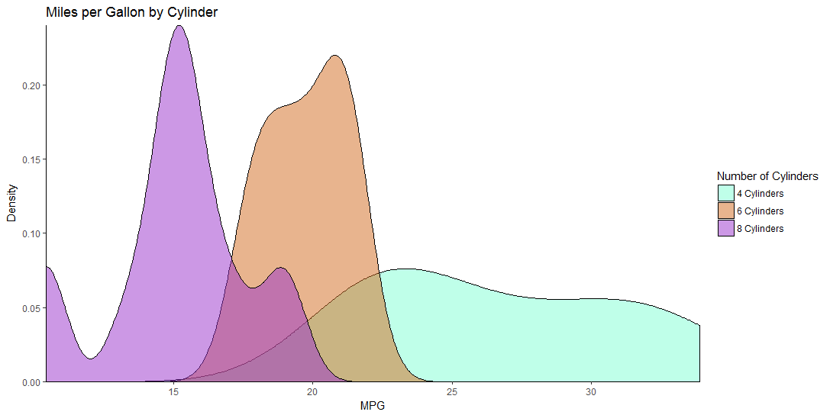
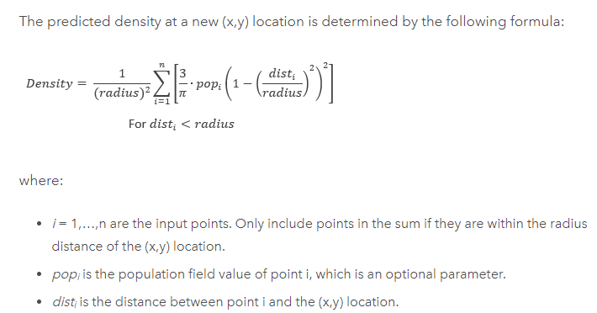
Kernel Density
Fits a kernel function to estimate density
Notes:
Kernel density is similar to point or line density, accept that a different method is used to calculate density.
Specifically, this method makes use of a kernel function. The next slide provides and explanation of this method.
Please take the time to read through this explanation.

Slide 26
Thank you!

