Slide 1

GEOG 3403: Geographic Information Systems II
Lecture 07 Geographically Weighted Regression
Yanan Wu, PhD
Assistant Professor
Department of Geography

Slide 2
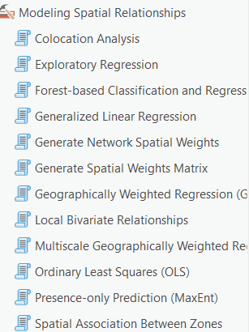
Overview
Spatial statistics
Regression
Simple regression
Multiple regression
Geographically weighted regression (GWR)
Model assessment
GWR example

Slide 3
Regression

Slide 4
What is regression used for?
Regression can be used to explore the relationship between variables
You can predict a continuous variable using other variables
Dependent Variable: what you are trying to predict
Independent Variable(s): what is used to predict the independent variable
Notes:
We will end this module with a brief introduction to regression and geographically weighted regression.
Regression techniques can be used to explore the relationship or correlation between variables and also predict a continuous variable using other variables.
There are forms of regression designed for probabilistic or classification problems, like logistic regression, but we will not discuss those here.
Regression can be used to predict a dependent variable using one or more independent variables.

Slide 5
Which of the following geographic questions would MOST likely require regression?
A. Where are the rivers located? B. What is the relationship between median income and housing price across counties? C. What is the area of Arkansas? D. What projection is used in this map?

Slide 6
If we want to predict urban heat island intensity using percent impervious surface and population density:
What is the dependent variable?
What are the independent variables?

Slide 7
Simple Regression
y = β₀ + β₁x₁
Predict Y using one independent variable

Slide 8
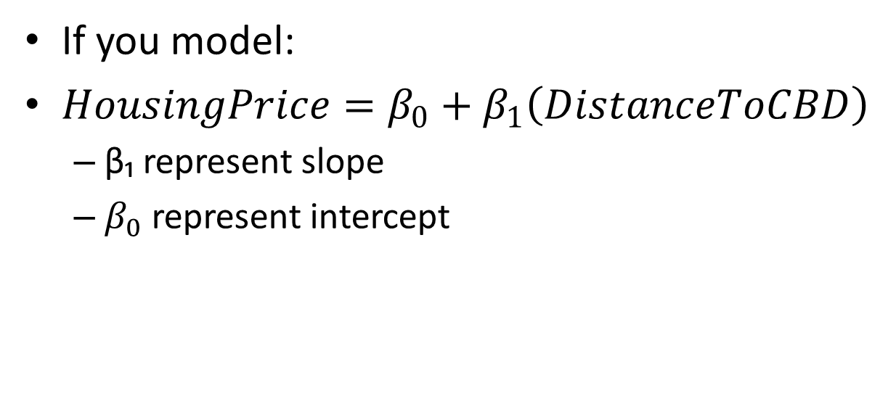
If you model:
$HousingPrice=β_{0}+β_{1}\left(DistanceToCBD\right)$
β₁ represent slope
$β_{0}$ represent intercept

Slide 9
In simple regression, only one independent variable is used.

Slide 10
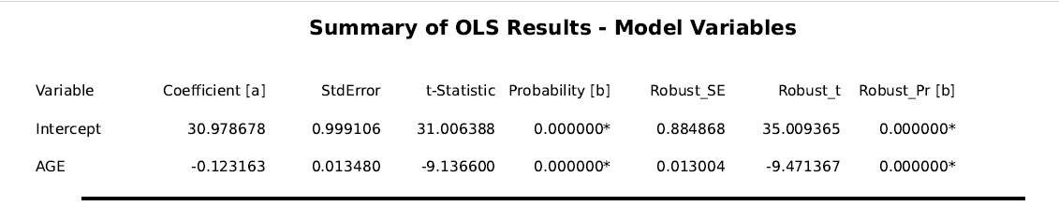
Simple regression
Meaning of slope and intercept

Slide 11
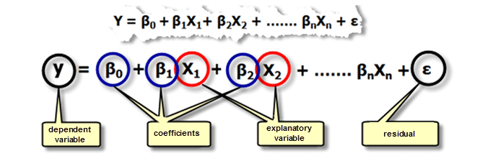
Multiple Regression
y = β₀ + β₁x₁ + β₂x₂ + β₃x₃ + ……….. β_{n}x_{n} + ε
Predict Y using more than one independent variable
Notes:
It is also possible to predict the dependent variable using more than one independent variable.
This is known as multiple regression.
In this case a linear equation will be produced that includes a y-intercept and coefficients for all x variables.
β₀ is the y intercept while β_{n} represents the coefficient or slope for the n^{th} x variable.

Slide 12
Multiple Answers
Which geographic studies would require multiple regression?
A. Predicting crop yield using rainfall only B. Predicting flood risk using elevation, slope, and land cover C. Predicting crime rate using income, unemployment, and education D. Measuring river length

Slide 13
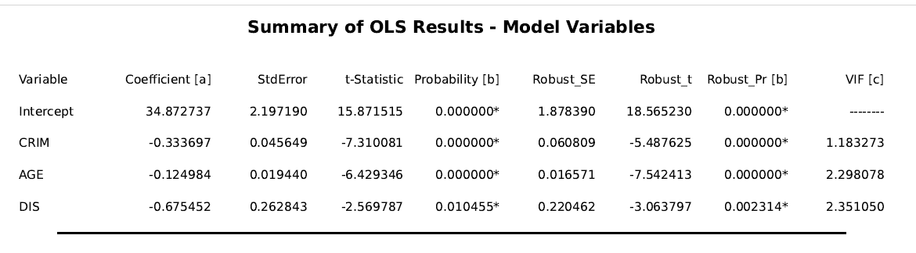
Multiple regression

Slide 14
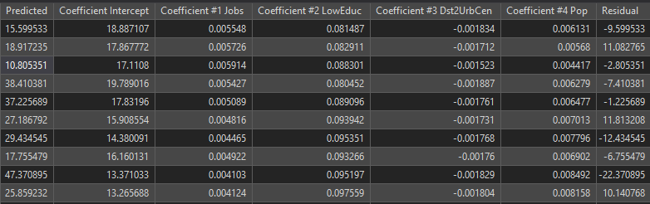
GWR
What if the relationship between y and x varies across space?
In this case, a single regression equation could be misleading or weak
It is possible to create regression equations that change over space
There will be a different intercept (β₀) and coefficients (β_{n}) across the map space
Notes:
What if the relationship between the dependent and independent variables vary over space? Or, what if there is spatial heterogeneity in relationships? In this case, it may not be appropriate to generate one regression equation for all features or the entire mapped extent.
Instead, it might be more appropriate to allow the equation to vary over space to capture the changing relationships. This is the concept of geographically weighted regression or GWR. Note that there are different forms of GWR.
When using GWR, the regression equation will vary across the map space or for each mapped feature. Specifically, different coefficients will be calculated, as demonstrated in the provided table.
This is a powerful technique for improving the suitability of linear regression for making predictions over map space where relationships can vary.

Slide 15
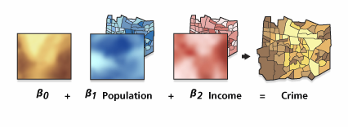
GWR
https://desktop.arcgis.com/en/arcmap/10.3/tools/spatial-statistics-toolbox/geographically-weighted-regression.htm
Notes:
As highlighted in the provided examples, the coefficients vary over the map space when using GWR as opposed to the same coefficients or a single equation across the map space.

Slide 16
Why might a single global regression model be misleading in geography?
A. Because maps are colorful B. Because relationships between variables may vary across space C. Because regression only works in Excel D. Because spatial data cannot be modeled

Slide 17
Ture of False
GWR produces different coefficients for different locations.

Slide 18
In which situation would GWR be more appropriate than global multiple regression?
A. National average temperature modeling B. Modeling poverty rate influence on crime in a single small town C. Modeling housing price determinants across an entire state with urban and rural differences D. Measuring elevation

Slide 19
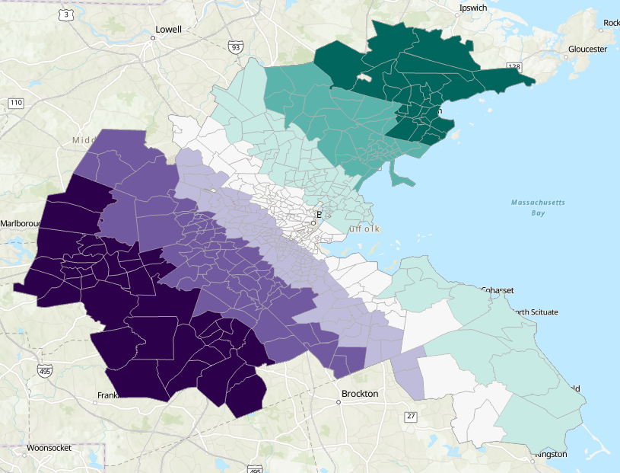
GWR: Coefficient of each variable

Slide 20
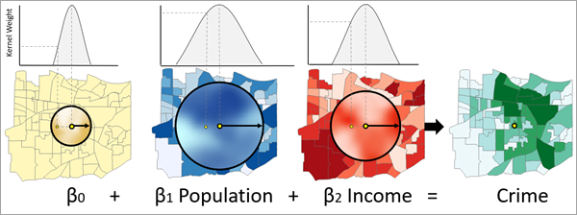
Multiscale GWR (MGWR)
The number of neighbors to be used in the model for each independent variable are different.
https://pro.arcgis.com/en/pro-app/latest/tool-reference/spatial-statistics/multiscale-geographically-weighted-regression.htm

Slide 21
What makes MGWR different from traditional GWR?
A. It uses only one predictor B. Each independent variable can have a different spatial scale C. It ignores spatial relationships D. It does not use regression

Slide 22
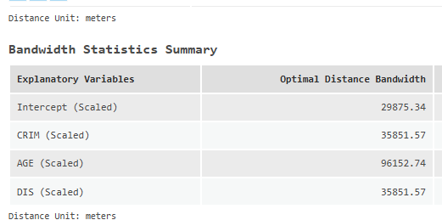
Multiscale GWR (MGWR)
The number of neighbors to be used in the model for each independent variable are different.

Slide 23
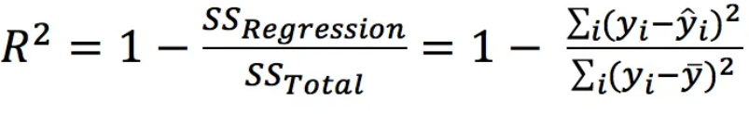
Model Assessment
R²
Measures how much variability in the dependent variables can be explained by the model.
Ranges from 0 to 1. 1 means 100% of the variability in the dependent variables can be explained by the model.
In general, a higher R-squared indicates a better fit for the model.
The problem of R² is that additional input variable will make the R² stay the same or increase, even if the additional input variables show no relationship with the output variables.

Slide 24
If R² = 0.85, this means:
A. 85% of the spatial pattern is random B. 85% of variation in Y is explained by the model C. The model is perfect D. The model has no residuals

Slide 25
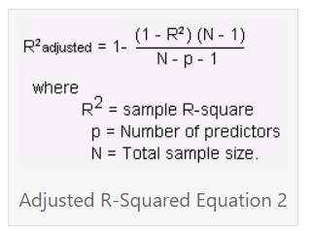
Model Assessment
Adjusted R²
A modified version of R² that adjusts for predictors that are not significant in a regression model.
Measures how much variability in the dependent variables can be explained by the model.
Ranges from 0 to 1. 1 means 100% of the variability in the dependent variables can be explained by the model.

Slide 26
Why is Adjusted R² preferred over R² in multiple regression?
A. It always gives a higher value B. It penalizes unnecessary predictors C. It removes residuals D. It ignores sample size

Slide 27
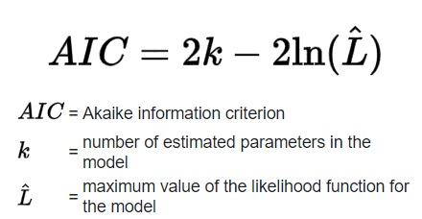

Model Assessment
Akaike's Information Criterion (AIC)
An estimator of prediction error
The lower the AIC value, the better the model performance
When the sample size is small, AIC will select models that have too many parameters
Akaike's Information Criterion Correction Version (AICc)
The lower the AIC value, the better the model performance

Slide 28
When comparing two models:
Model A: AIC = 120 Model B: AIC = 105
Which model is better?

Slide 30
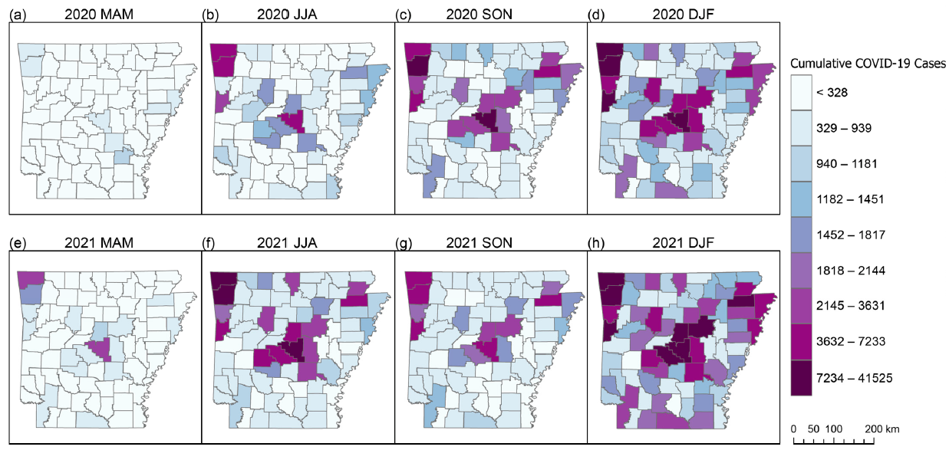
Multiscale GWR Example
Figure 1

Slide 31
Multiscale GWR Example
Figure 2

Slide 32
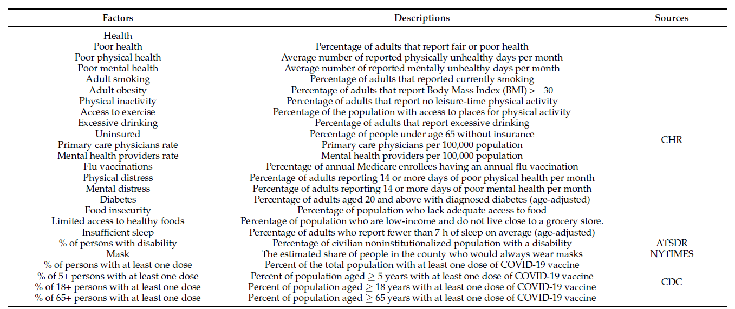
Multiscale GWR Example
Table 2

Slide 33
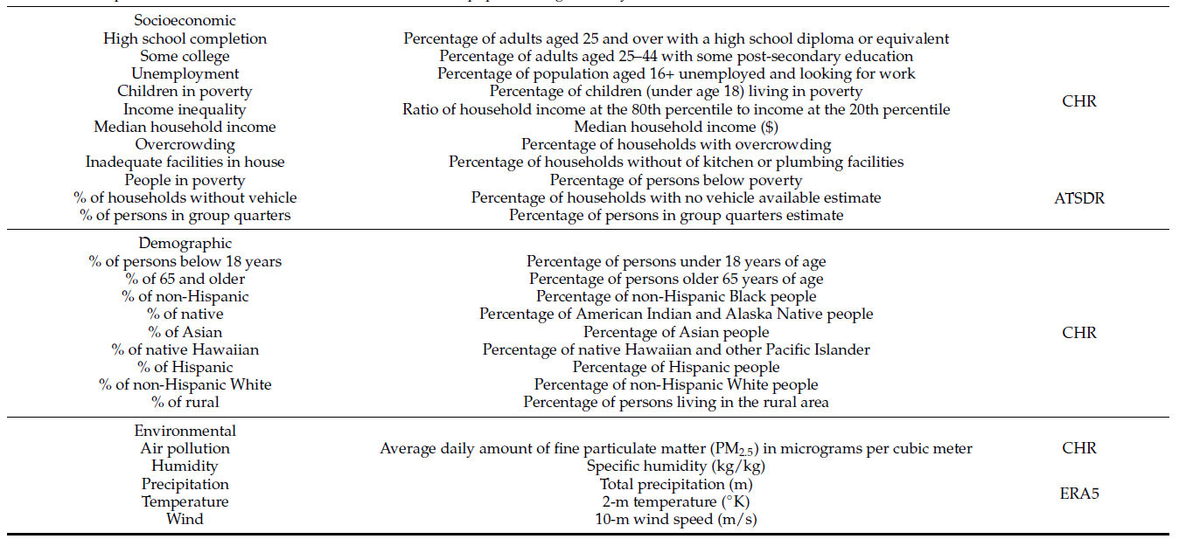
Multiscale GWR Example
Table 2

Slide 34
Multiscale GWR Example
Figure A1

Slide 35
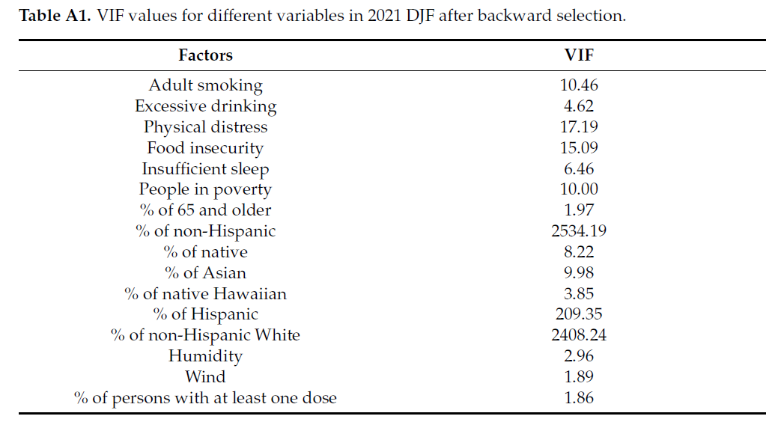
Multiscale GWR Example
Variance Inflation Factor (VIF)

Slide 36
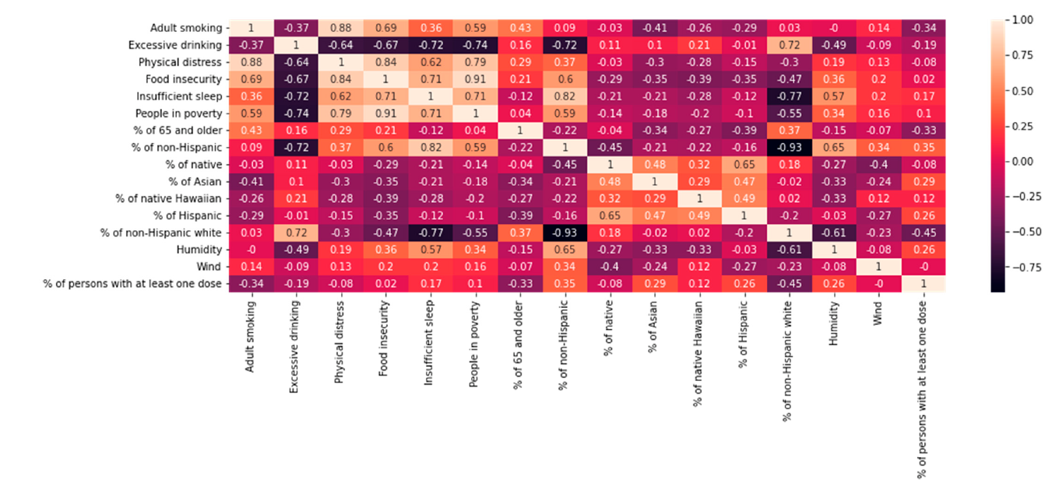
Multiscale GWR Example
Pearson’s correlation coefficients
Figure A2

Slide 37
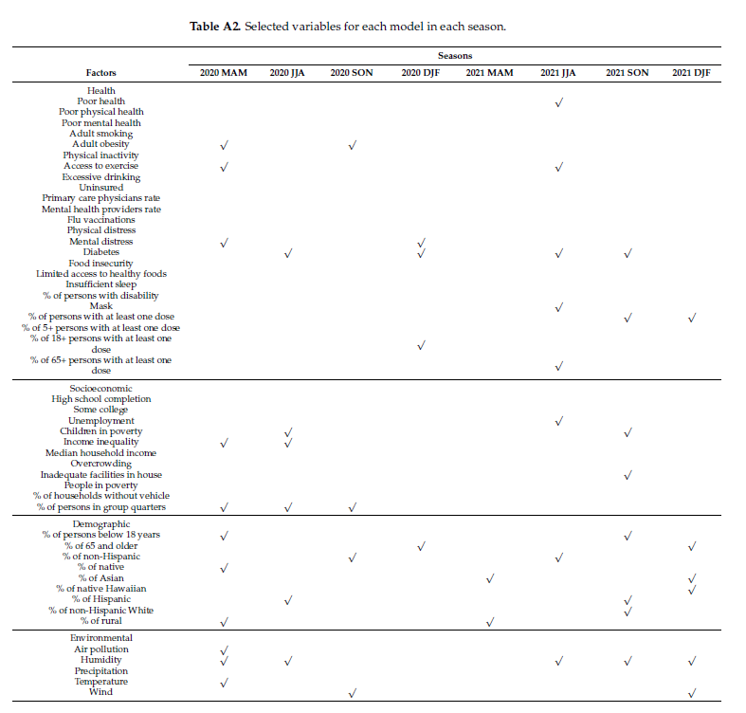
Multiscale GWR Example

Slide 38
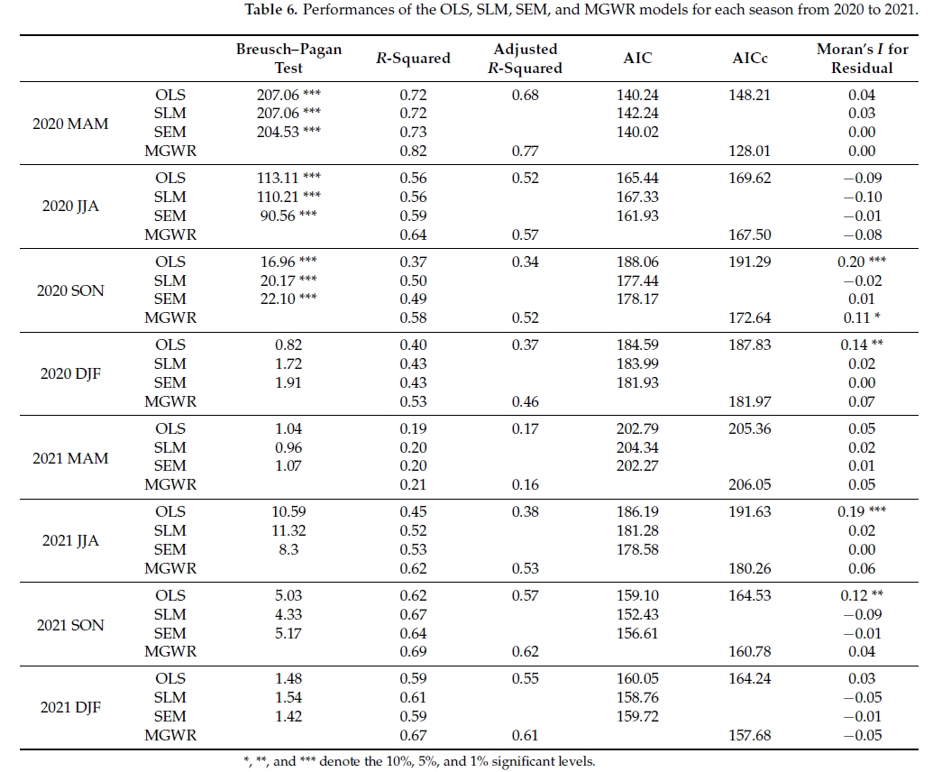
Multiscale GWR Example

Slide 39
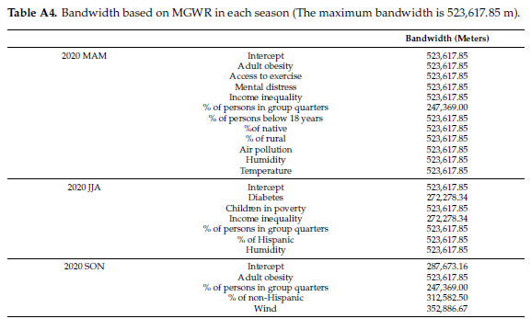
Multiscale GWR Example

Slide 40
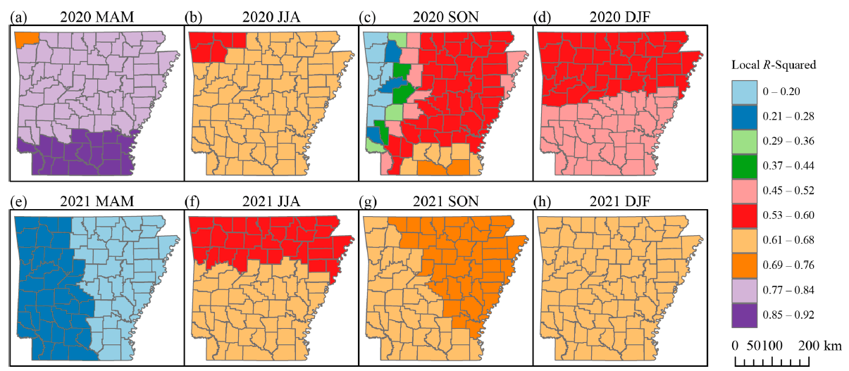
Multiscale GWR Example
Figure 4

Slide 41
Multiscale GWR Example

Slide 42
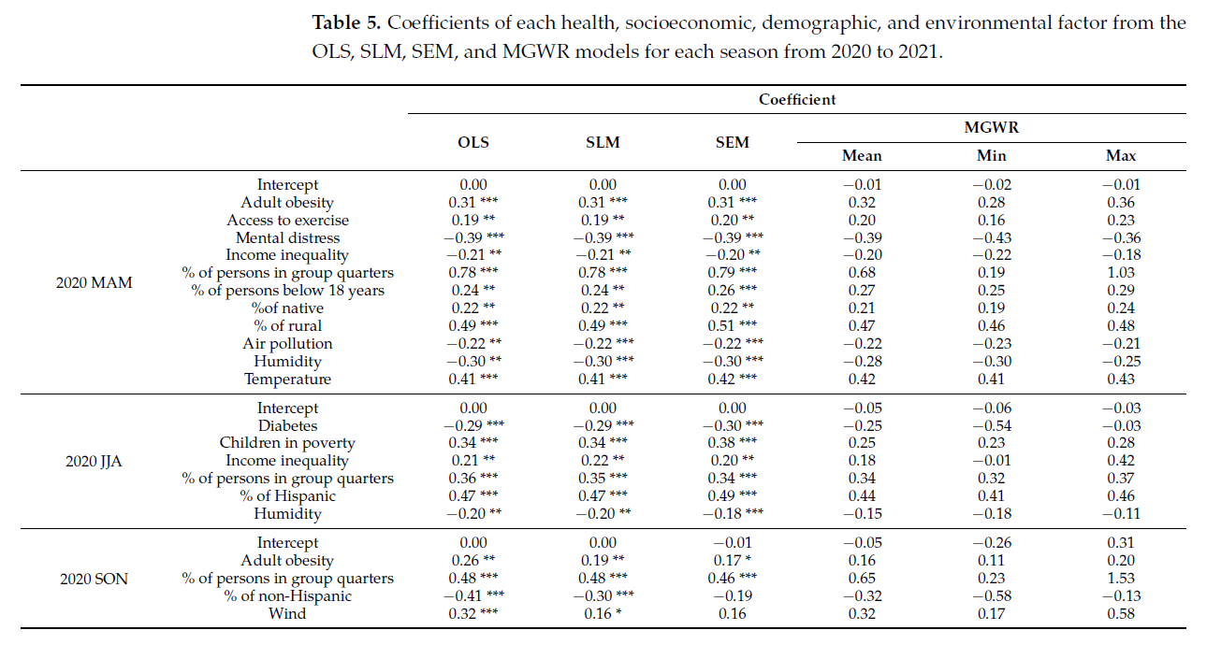
Multiscale GWR Example

Slide 43
Multiscale GWR Example
Figure 5

Slide 44
Thank you!

