Slide 1
Yanan Wu
Visiting Assistant Professor
Geography Department, Clark University

Slide 2



Introduction
2019-2024 Doctor of Philosophy in Geospatial Information Sciences
2017-2019 Master of Arts in Geography
2012-2016 Bachelor of Science in Resource Environment and Urban-Rural Planning Management
In the past years, I have served as …
Research Assistant
Teaching Assistant
Instructor

Slide 3
Research
Interaction between urban and human

Slide 4
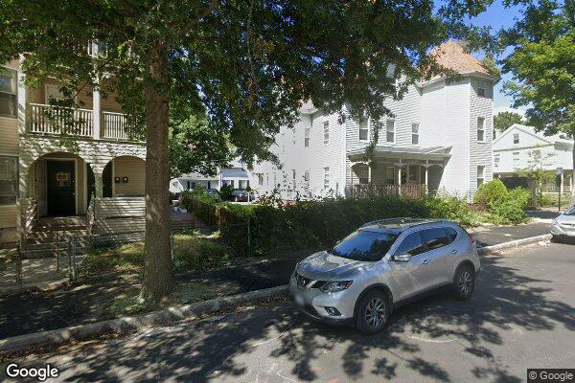
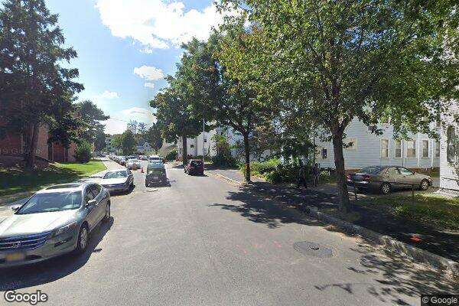
Neighborhood environment
Data Source: Google Street View

Slide 5
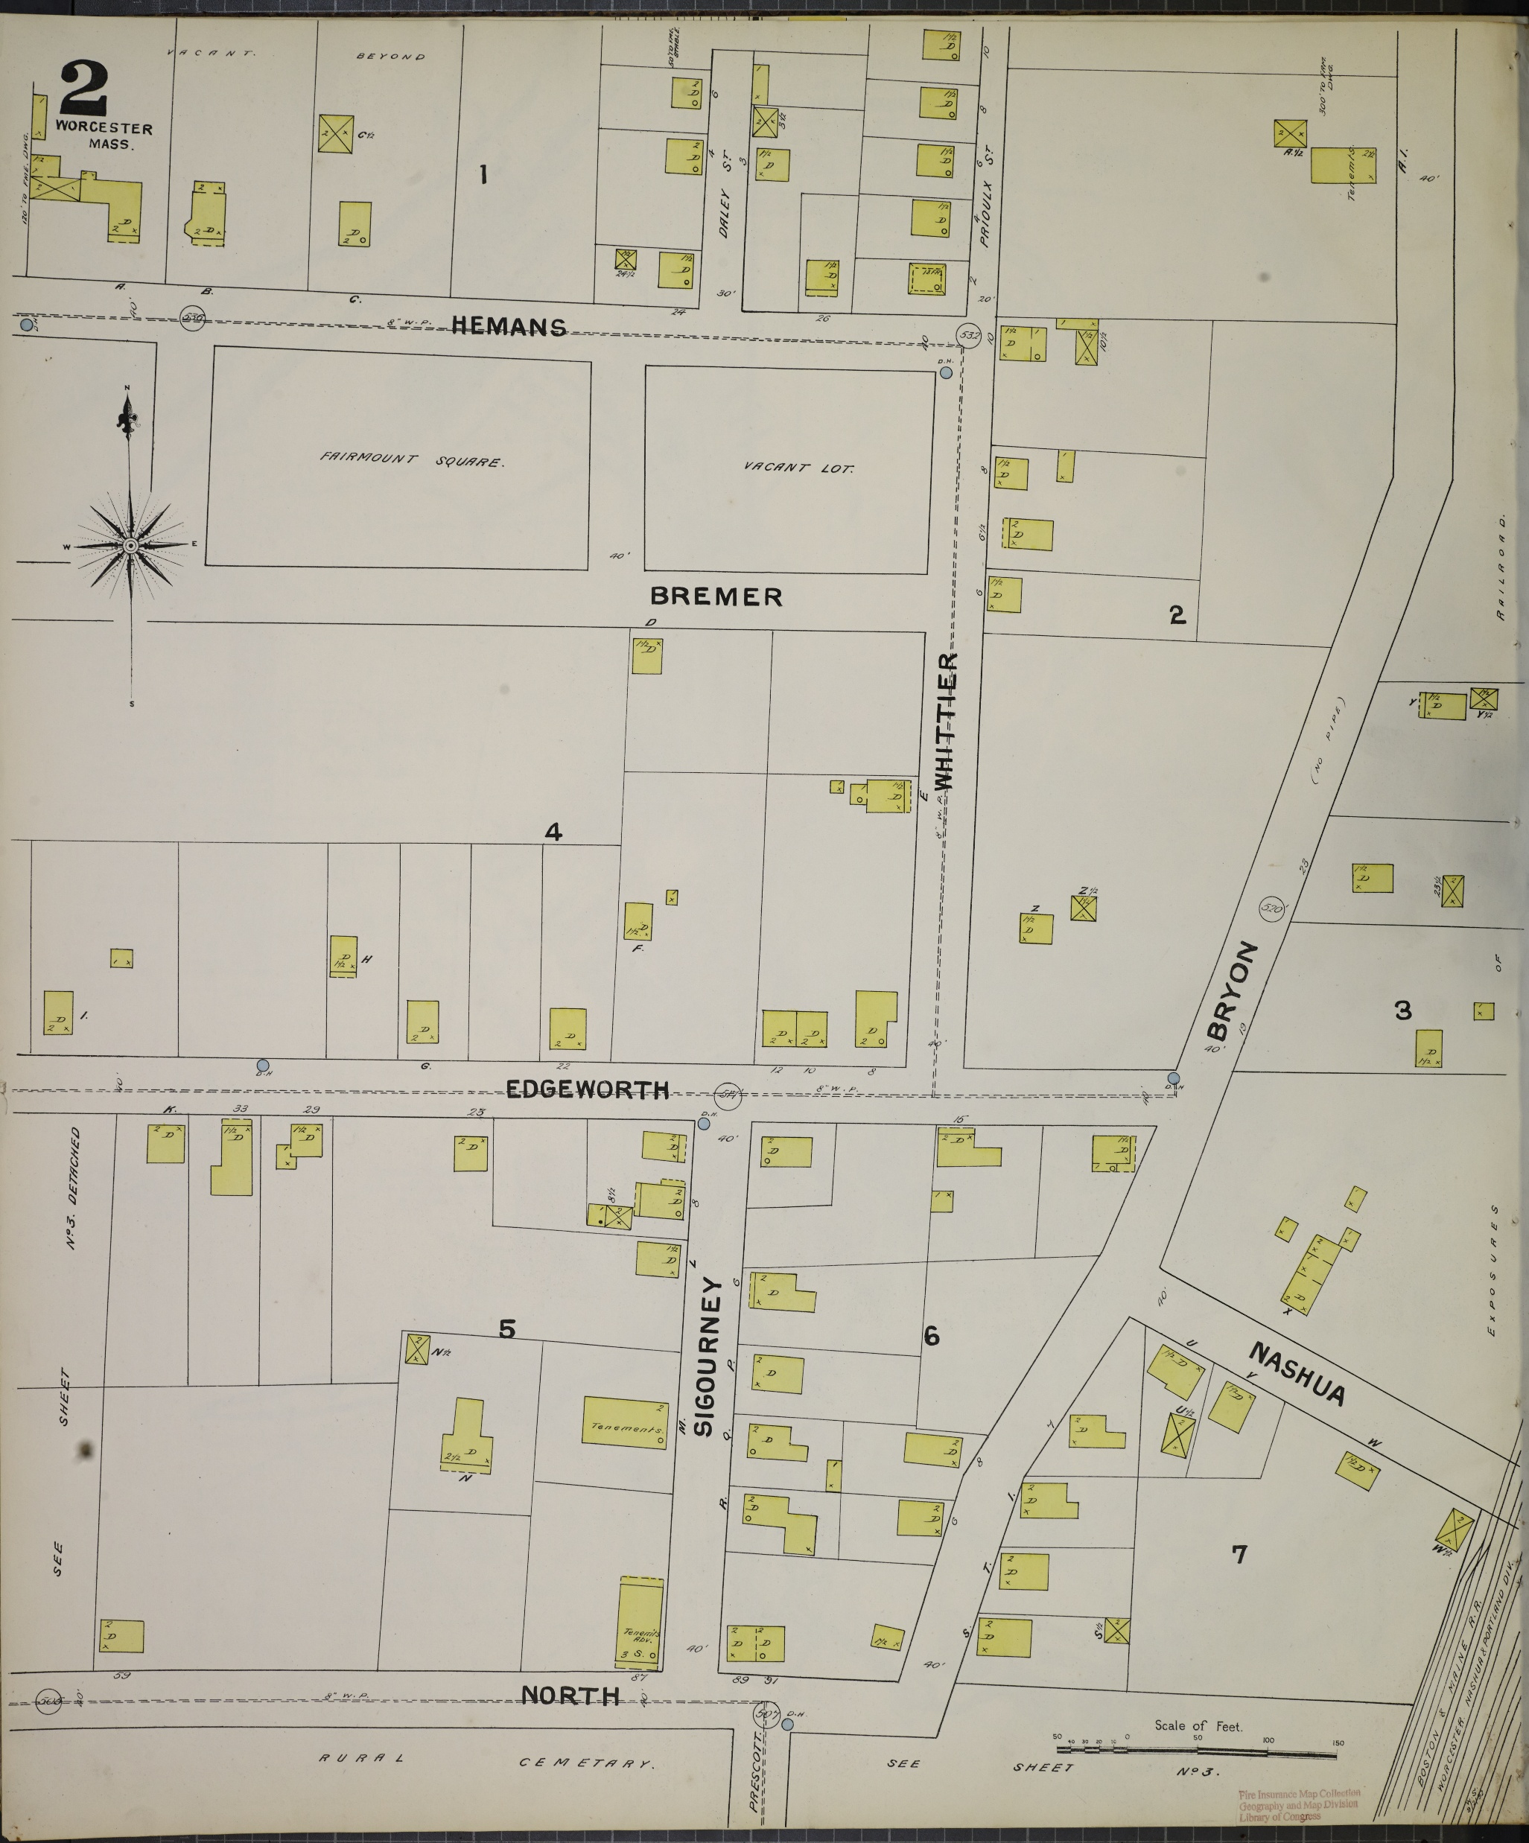
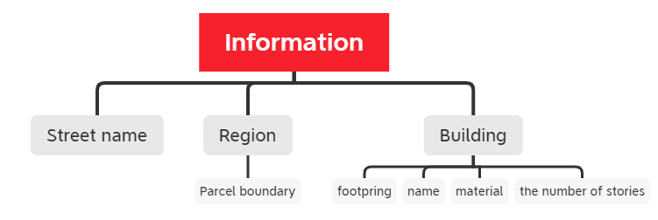
History Geography
1892,1910,1936,1937, and 1950
Building footprint, Worcester
Detailed information down to building level:
Data Source: Sanborn Fire Insurance Map

Slide 6
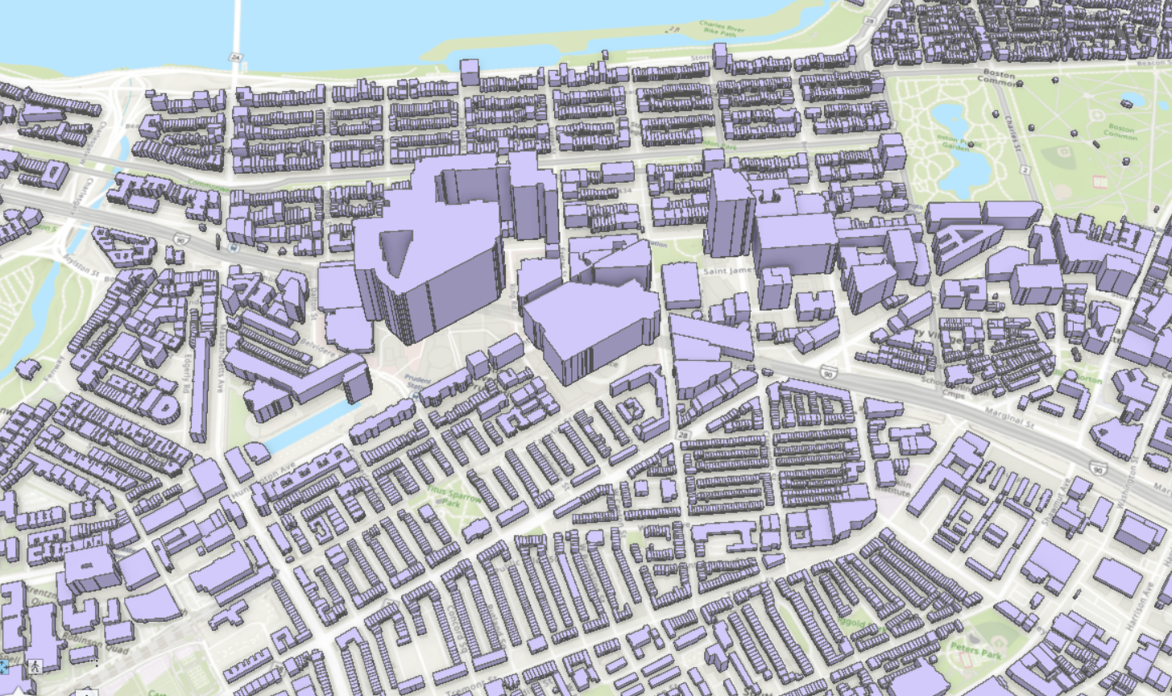
Urban Geography
Microsoft Building Footprint with Heights, Boston, 2019
Urban Density Analysis
Environmental Impact of Urban Form
Data Source: https://www.arcgis.com/home/item.html?id=3b0b8cf27ffb49e2a2c8370f9806f267

Slide 7
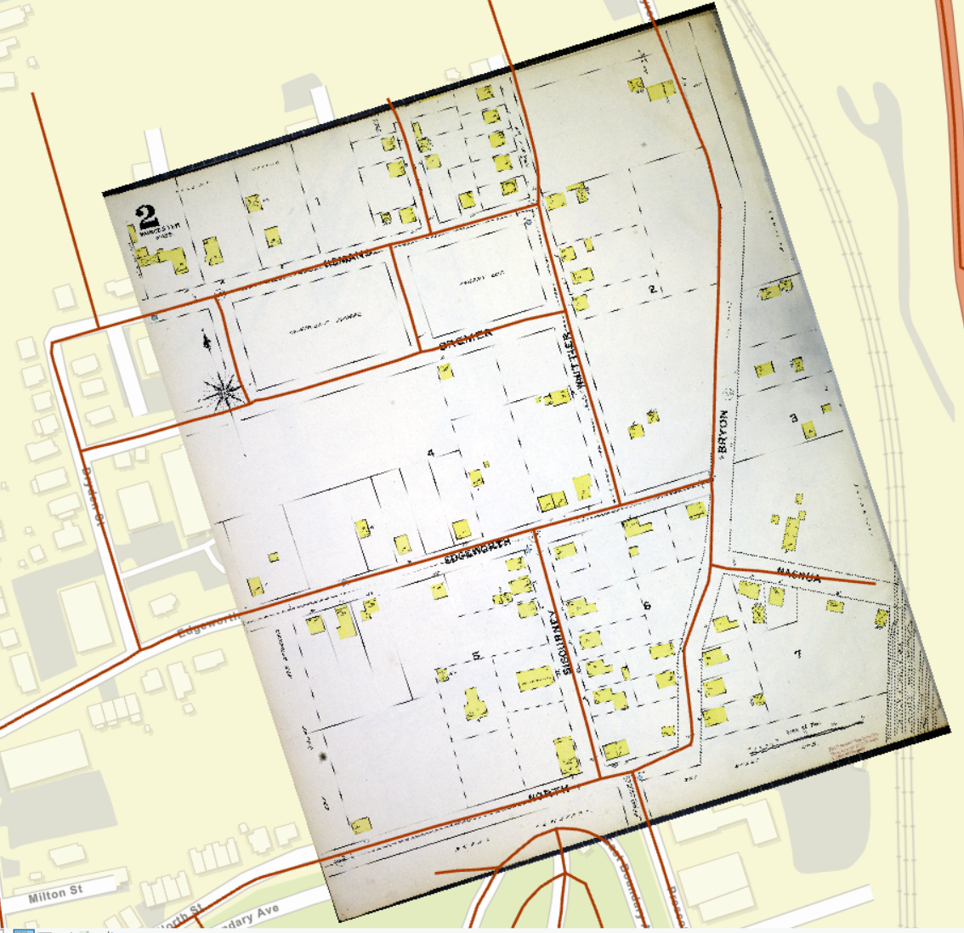
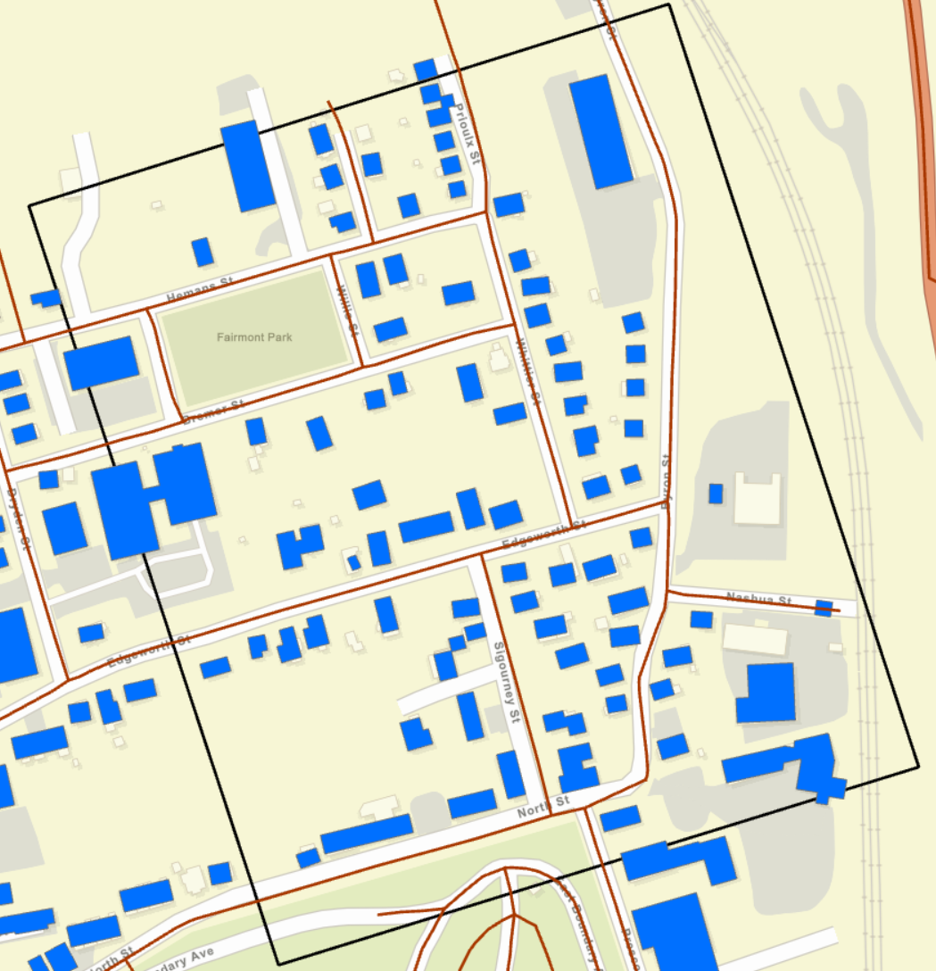
Evolution of the city
1892
Building footprint, Worcester
2014-2024
Building footprint, Worcester

Slide 8
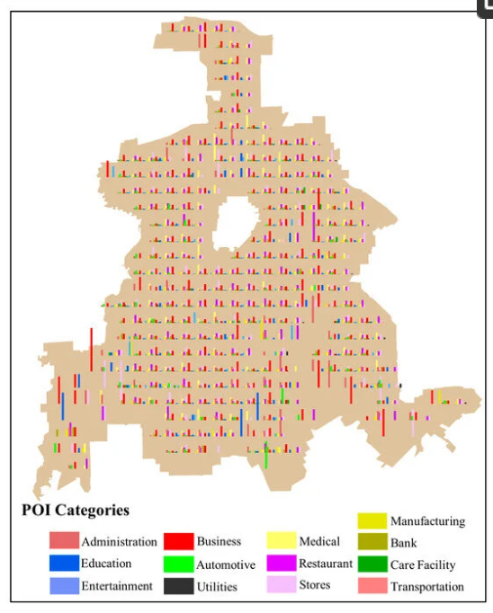
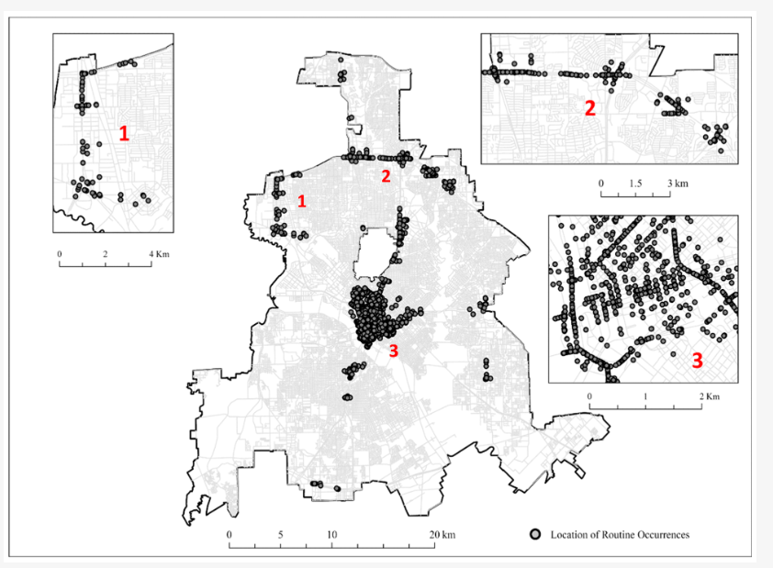
Transportation Geography

Slide 9
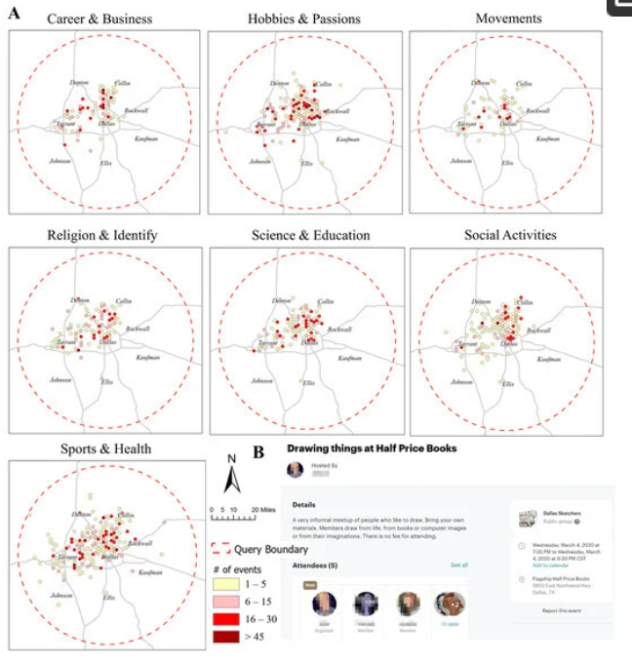
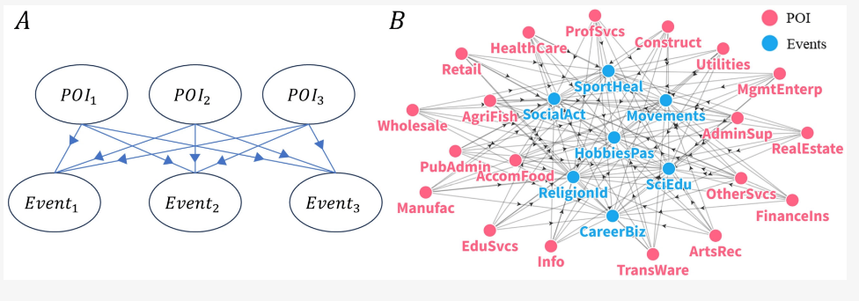
Social Geography

Slide 10
Teaching
Fall 2024

Slide 11
SSJ 30262 Web mapping & Open Source GIS
GitHub
Personal Website
Free Hosting and Custom Domain Support
Version Control and Collaboration
Open Source and Learning Opportunity
Course website
Accessibility and Convenience for Students

Slide 12
SSJ 30262 Web mapping & Open Source GIS
Various tools to create interactive map
Leaflet in R
Shiny in R
ArcGIS Products
Leafmap in Python
ArcGIS JavaScript API
3D Visualization

Slide 13
SSJ 302 Python Programming for GIS
Course website
Python Fundamental
Pandas
Arcpy
Data Visualization
Raster
Custom Tools in ArcGIS

Slide 14
Teaching
Spring 2025

Slide 15
Course Schedule
Spatial Database
QGIS, DuckDB, Python
Manganin, querying, and analyzing spatial data with database systems.
Intermediate Statistics
R
Spatial statistics
Python Programming in GIS
Python
Data visualization, spatial data processing,

