Slide 1

WEEK 06
Instructor: Yanan Wu
TA: Khadija Nisar
Spring 2025

Slide 2
5.1 Model selection

Slide 3
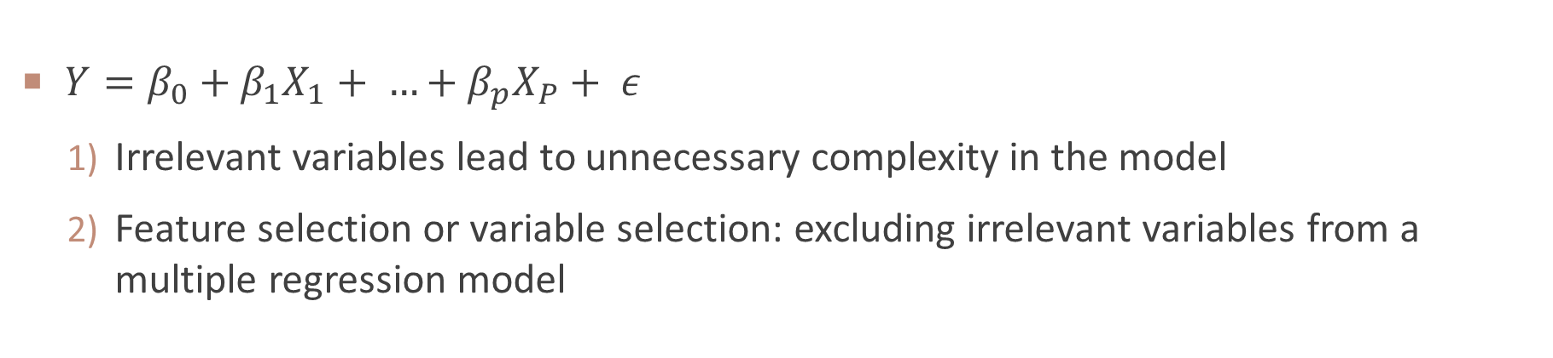
Standard linear model
$Y=β_{0}+β_{1}X_{1}+ …+β_{p}X_{P}+ ε$
Irrelevant variables lead to unnecessary complexity in the model
Feature selection or variable selection: excluding irrelevant variables from a multiple regression model

Slide 4
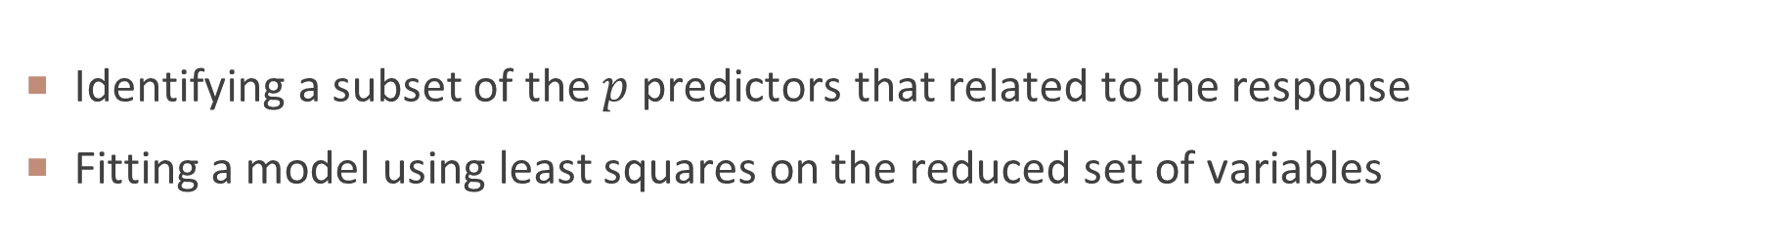
Subset selection
Identifying a subset of the $p$ predictors that related to the response
Fitting a model using least squares on the reduced set of variables

Slide 5
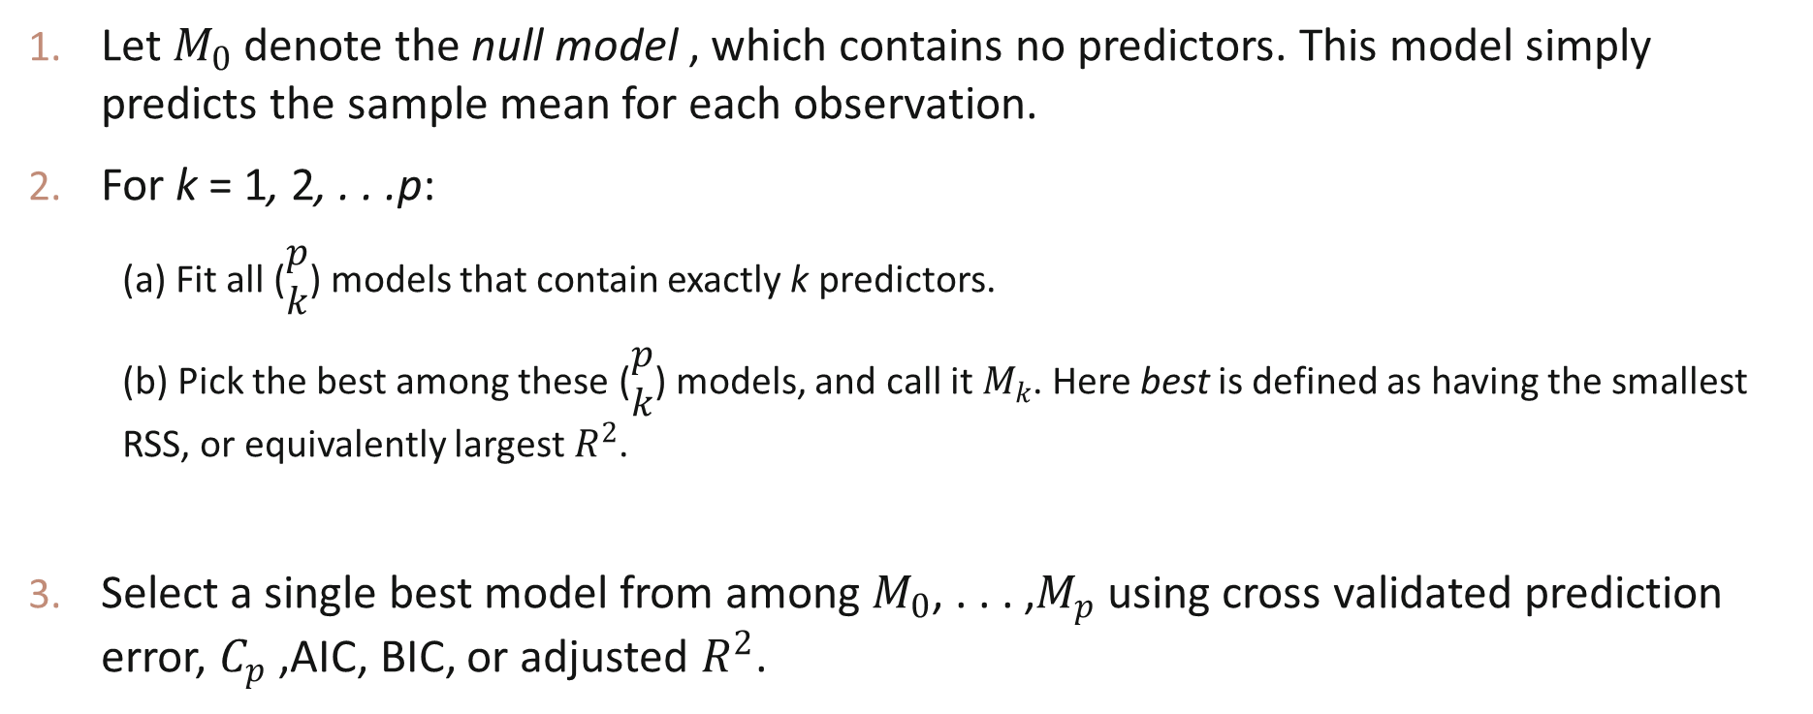
BEST Subset selection
Let $M_{0}$ denote the null model , which contains no predictors. This model simply predicts the sample mean for each observation.
For k = 1, 2, . . .p:
(a) Fit all ($\begin{matrix}p \\ k\end{matrix}$) models that contain exactly k predictors.
(b) Pick the best among these ($\begin{matrix}p \\ k\end{matrix}$) models, and call it $M_{k}$. Here best is defined as having the smallest RSS, or equivalently largest $R^{2}$.
Select a single best model from among $M_{0}$, . . . ,$M_{p}$ using cross validated prediction error, $C_{p}$ ,AIC, BIC, or adjusted $R^{2}$.

Slide 6
Boston housing price data
Variable | Description
medv | Median value of owner-occupied homes in $1000s
crim | Per capita crime rate by town
zn | Proportion of residential land zoned for large lots
indus | Proportion of non-retail business acres per town
chas | Charles River dummy variable (1 if tract bounds river; 0 otherwise)
nox | Nitrogen oxide concentration (parts per 10 million)
rm | Average number of rooms per dwelling
age | Proportion of owner-occupied units built before 1940
dis | Weighted mean of distances to employment centers
rad | Index of accessibility to radial highways
tax | Property tax rate per $10,000
ptratio | Pupil-teacher ratio by town
black | Proportion of Black residents per town
lstat | Lower status population percentage
$$medv=β_{0}+{β_{1}zn+ β}_{2}crim+…β_{13}lstat$$

Slide 7
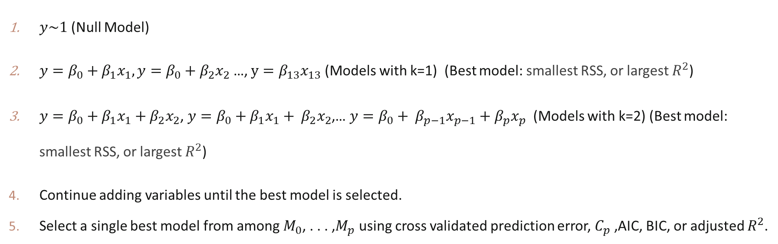
Best subset selection for Boston data
$y\sim 1$ (Null Model)
$y=β_{0}+β_{1}x_{1}, y={β_{0}+β}_{2}x_{2}$ …, $y=β_{13}x_{13}$(Models with k=1) (Best model: smallest RSS, or largest $R^{2}$)
$y=β_{0}+β_{1}x_{1}+β_{2}x_{2}$​, $y=β_{0}+β_{1}x_{1}+ β_{2}x_{2}$,… $y={β_{0}+ β}_{p−1}x_{p−1}+β_{p}x_{p}$ (Models with k=2) (Best model: smallest RSS, or largest $R^{2}$)
Continue adding variables until the best model is selected.
Select a single best model from among $M_{0}$, . . . ,$M_{p}$ using cross validated prediction error, $C_{p}$ ,AIC, BIC, or adjusted $R^{2}$.

Slide 8
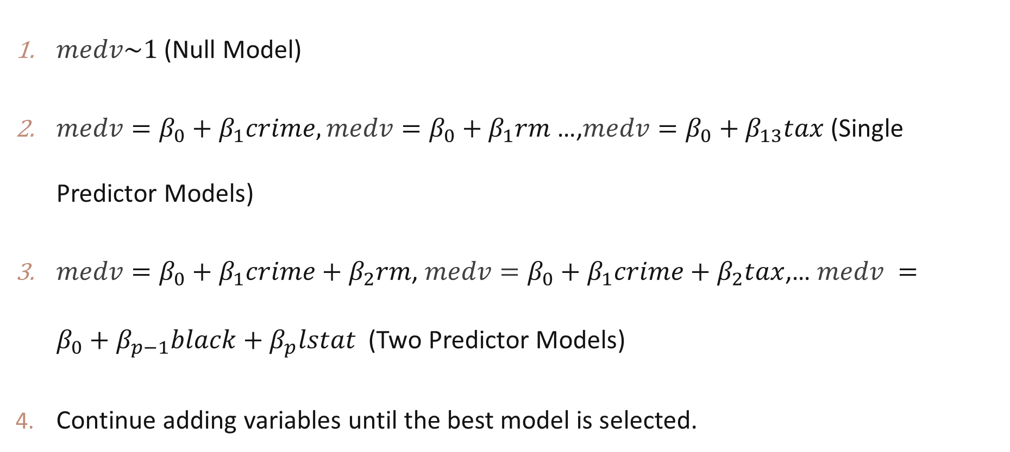
BEST Subset selection
$medv\sim 1$ (Null Model)
$medv=β_{0}+β_{1}crime,medv={β_{0}+β}_{1}rm$ …,$medv={β_{0}+β}_{13}tax$(Single Predictor Models)
$medv={β_{0}+β}_{1}crime+β_{2}rm$​, $medv=β_{0}+β_{1}crime+β_{2}tax$,… $medv ={β_{0}+β}_{p−1}black+β_{p}lstat$ (Two Predictor Models)
Continue adding variables until the best model is selected.

Slide 9
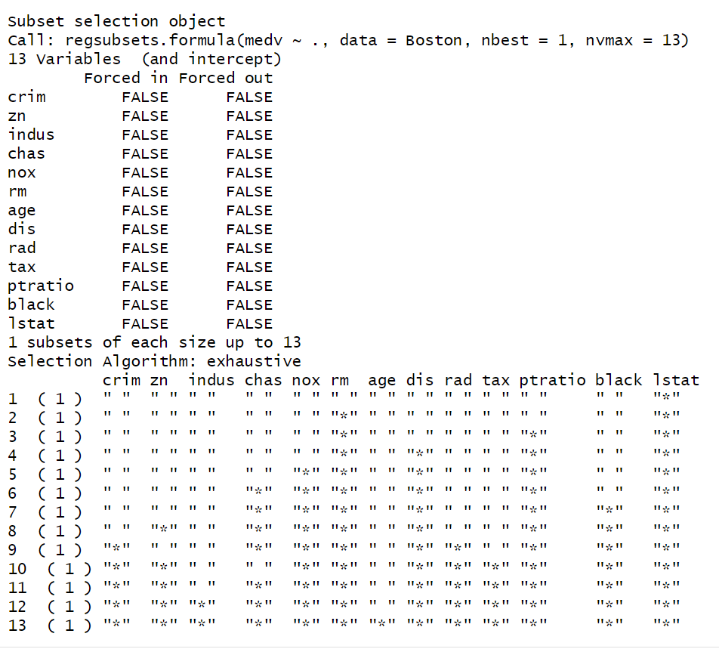
regsubsets() in R

Slide 10
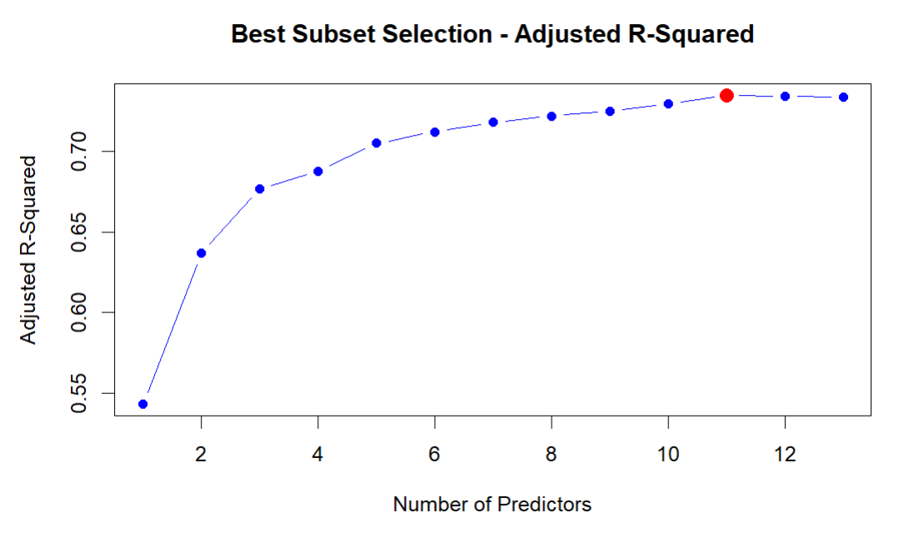
Best model based on ADJUSTED $R^{2}$

Slide 11
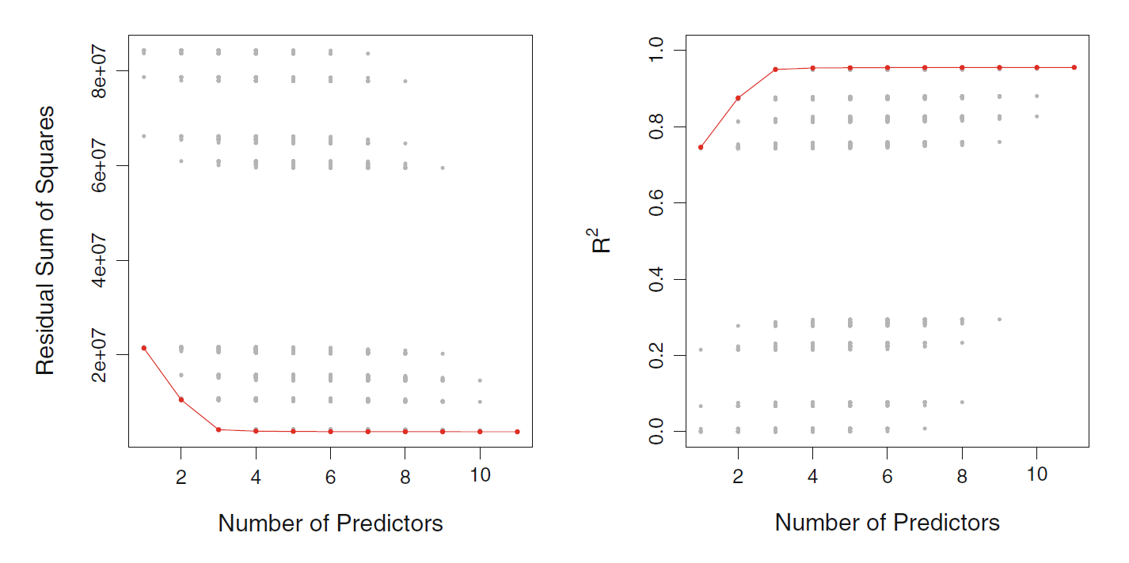
RSS and $R^{2}$ change with the number of predictors increase
James, G., Witten, D., Hastie, T., Tibshirani, R., & Taylor, J. (2023). An introduction to statistical learning: With applications in python. Springer Nature.

Slide 12
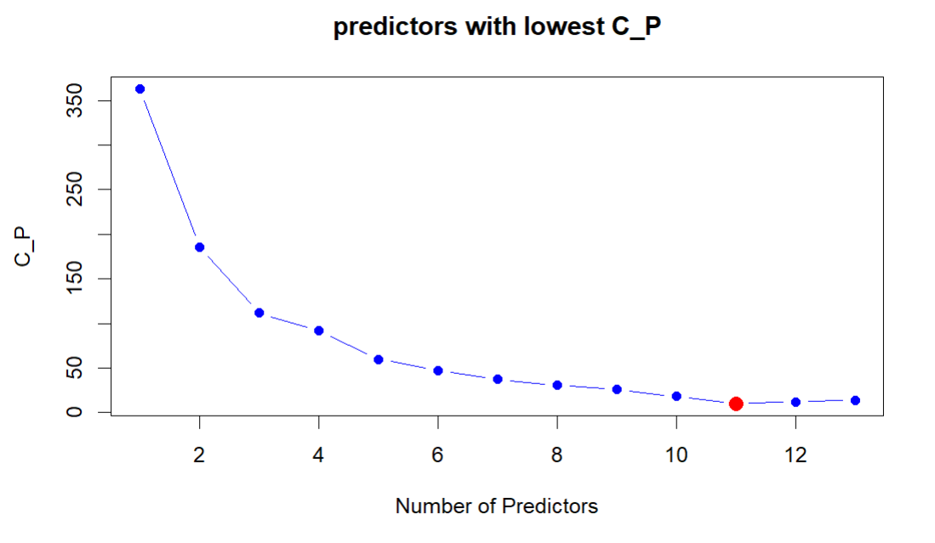
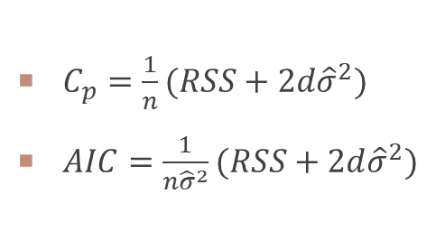
Best model based on $C_{p},AIC$
$C_{p}=\frac{1}{n}(RSS+2d{\hat{σ}}^{2})$
$AIC=\frac{1}{n{\hat{σ}}^{2}}(RSS+2d{\hat{σ}}^{2})$
$C_{p}$ and $AIC$ are proportional to each other

Slide 13
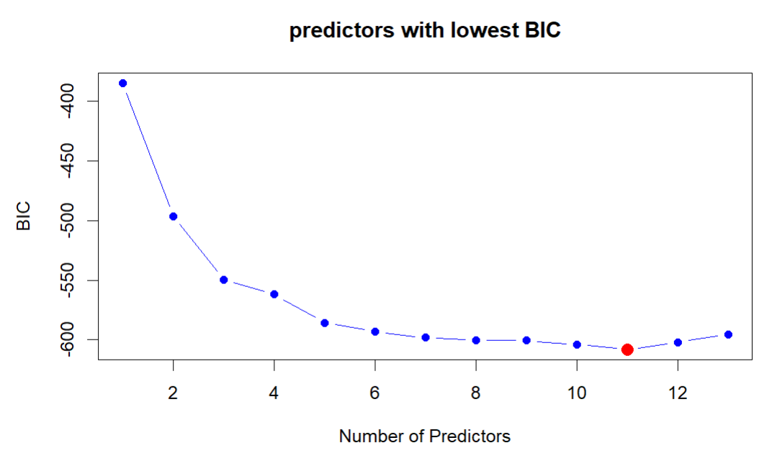
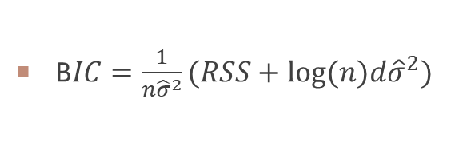
Best model based on $BIC$
B$IC=\frac{1}{n{\hat{σ}}^{2}}(RSS+log(n)d{\hat{σ}}^{2})$

Slide 14
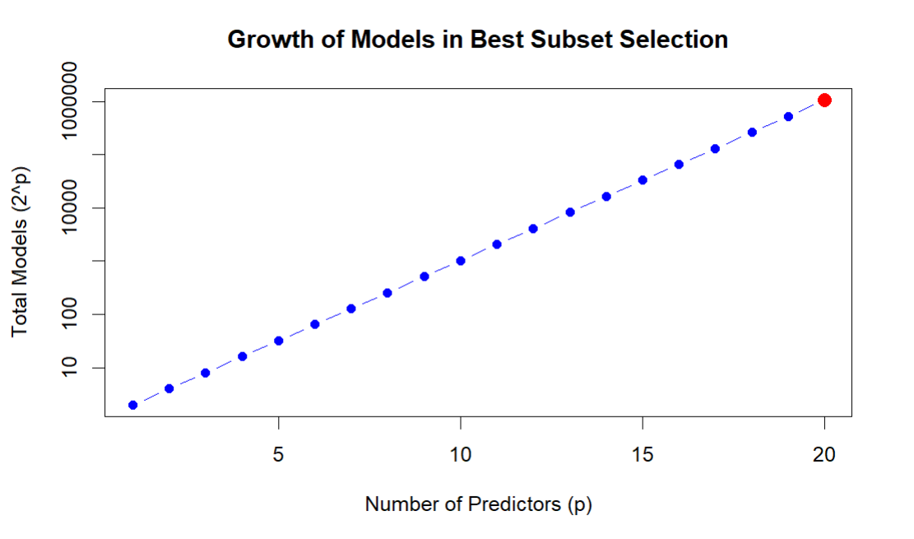
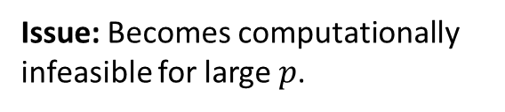

Exponential Computational Complexity
Issue: Becomes computationally infeasible for large $p$.
$2^{p}$ models for $p$ predictors

Slide 15
Stepwise selection
Stepwise selection
Forward stepwise
Backward stepwise
Hybrid approach

Slide 16
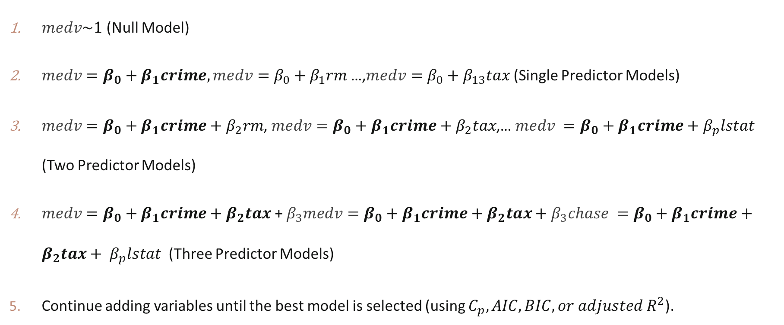
Forward stepwise selection
$medv\sim 1$ (Null Model)
$medv=β_{0}+β_{1}crime,medv={β_{0}+β}_{1}rm$ …,$medv={β_{0}+β}_{13}tax$(Single Predictor Models)
$medv={β_{0}+β}_{1}crime+β_{2}rm$​, $medv={β_{0}+β}_{1}crime+β_{2}tax$,… $medv ={β_{0}+β}_{1}crime+β_{p}lstat$ (Two Predictor Models)
$medv={β_{0}+β}_{1}crime+β_{2}tax$​ + $β_{3}medv={β_{0}+β}_{1}crime+β_{2}tax+β_{3}chase ={β_{0}+β}_{1}crime+{β_{2}tax+ β}_{p}lstat$ (Three Predictor Models)
Continue adding variables until the best model is selected (using $C_{p}, AIC, BIC, or adjusted R^{2}$).

Slide 17
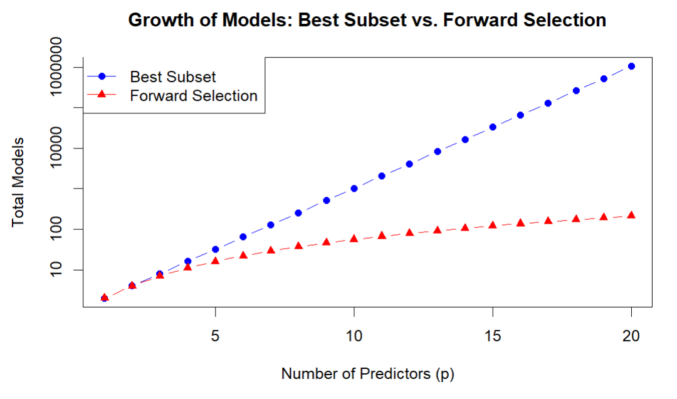
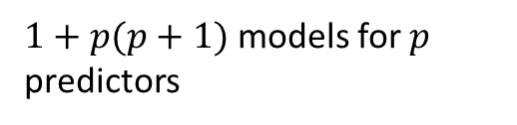
Comparison on growth of models
$1+p(p+1)$ models for $p$ predictors

Slide 18
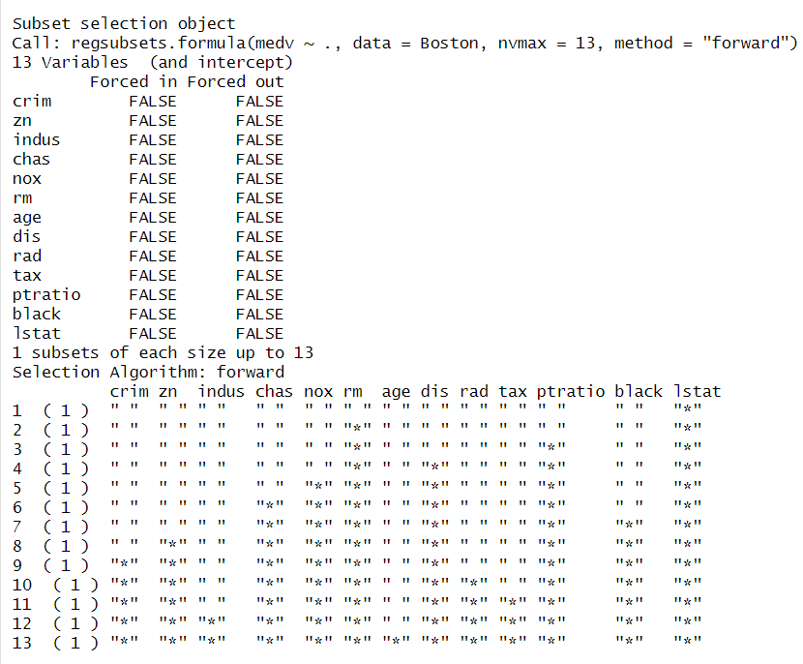
BEST MODEL BASED ON FORWARD SELECTION

Slide 19
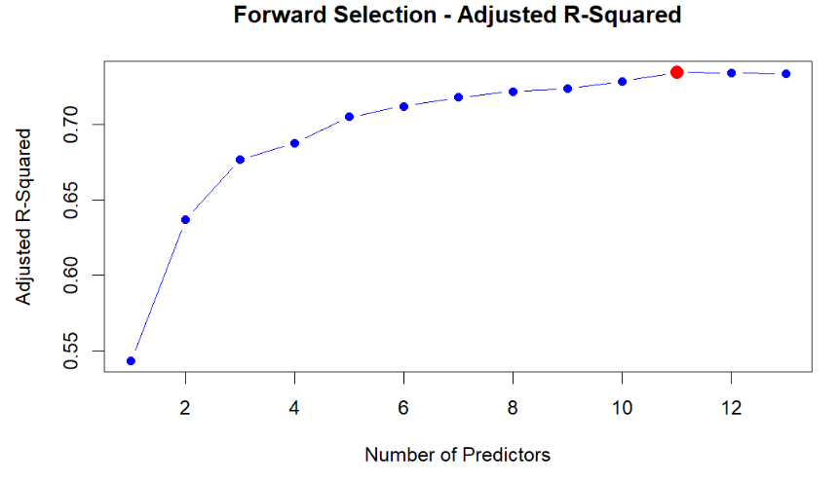
Adjusted $R^{2}$

Slide 20
POTENTIAL ISSUE IN FORWARD SELECTION
Forward Selection follows a greedy approach, adding one variable at a time, which can lead to suboptimal models.
Once a variable is included, it cannot be removed later, even if adding another variable would result in a better model.
If two predictors are highly correlated, Forward Selection may pick one too early, preventing the other from being added—even if the other would lead to a better overall model.

Slide 21
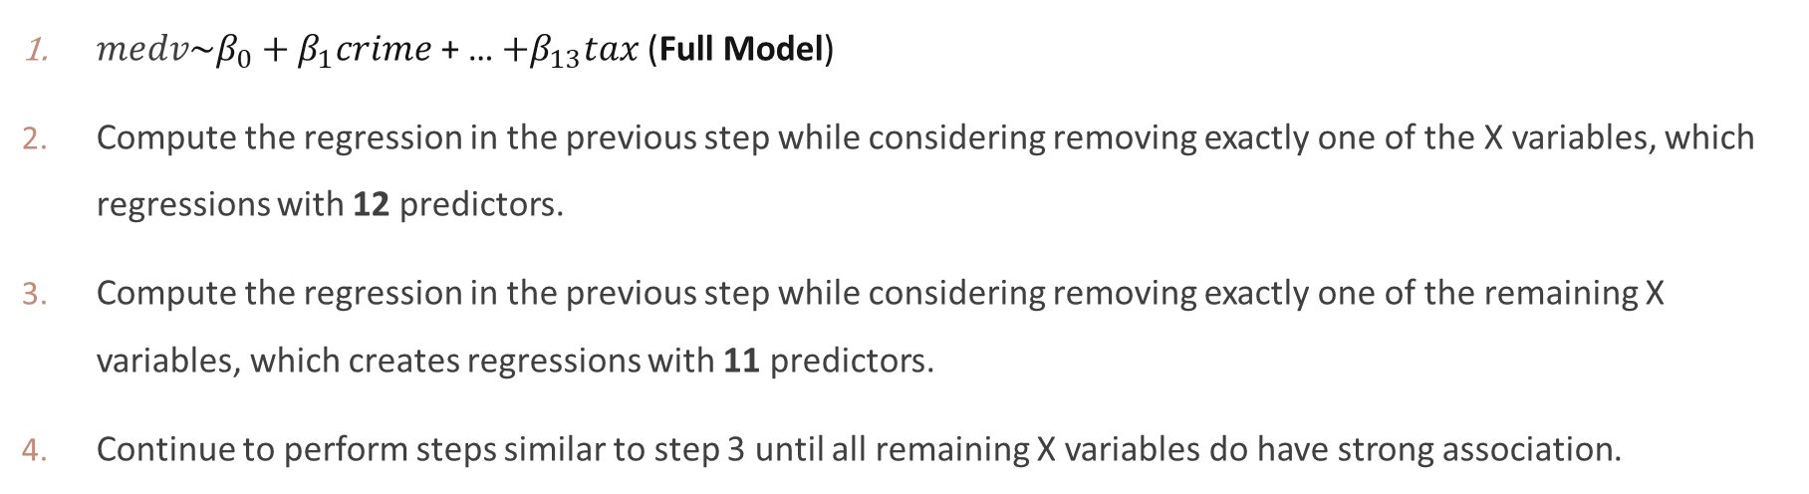
BACKWARD stepwise selection
$medv\sim β_{0}+β_{1}crime$ + … ${+β}_{13}tax$(Full Model)
Compute the regression in the previous step while considering removing exactly one of the X variables, which regressions with 12 predictors.
Compute the regression in the previous step while considering removing exactly one of the remaining X variables, which creates regressions with 11 predictors.
Continue to perform steps similar to step 3 until all remaining X variables do have strong association.

Slide 22
BACKWARD stepwise selection in R
full_model <- lm(medv ~ ., data = Boston
AICbackward_model <- step(full_model, direction = "backward
summarysummary(backward_model)
By default, step() selects the model that minimizes AIC.

Slide 23
Updated
Task 2.d and 2.b in Lab 03

Slide 24
WEEK 03 CODE DEMO session
Instructor: Yanan Wu
TA: Khadija Nisar
Spring 2025

