Slide 1

WEEK 01
Instructor: Yanan Wu
TA: Nisar Khadija
Spring 2025

Slide 2
Preamble
A good online textbook, Hands-on Programming with R, for R beginner.
Explore the R project website: https://www.r-project.org/
Explore R Studio: https://posit.co/

Slide 3
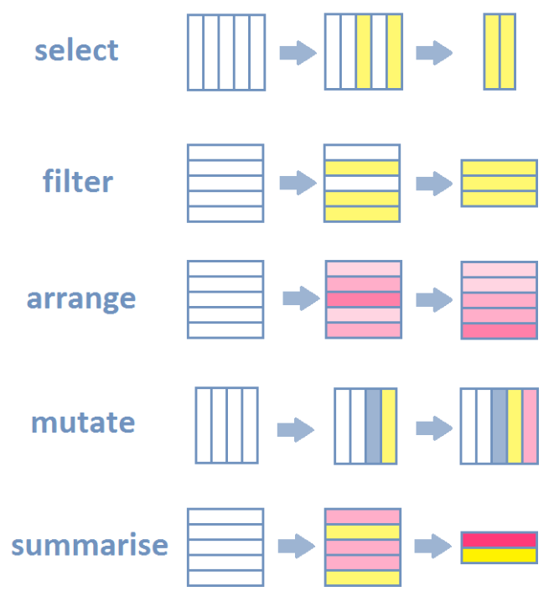
R-INTRODUCTION
An online free learning source: An Introduction to R
Data Manipulation
Data Visualization
Data Visualization Section in R for Data Science
Modern Data Visualization with R
Interactive Applications
Shiny Gallery in R

Slide 4
R - Introduction
Statistical Analysis
Geospatial Data Analysis
Descriptive analysis (mean, median., etc)
Regression analyses (linear, logistic, ect)
Time series analysis (ARIMA, etc)
Multivariate analysis (PCA, factor analysis)
A handbook of statistical analysis in R
Handle raster and vector data
Analyze spatial data with sf, sp or raster

Slide 5
R - Introduction
Machine Learning
Implement supervised learning (classification, regression).
Apply unsupervised learning (clustering, dimensionality reduction).
Perform deep learning with packages like keras or torch.
Evaluate models using cross-validation and other metrics.

Slide 6

Rstudio – Introduction
Open-source IDE (integrated development environment)
Open-source IDE (integrated development environment)

Slide 7
WEEK 01 lab session
Instructor: Yanan Wu
TA: Nisar Khadija
Spring 2025

Slide 8
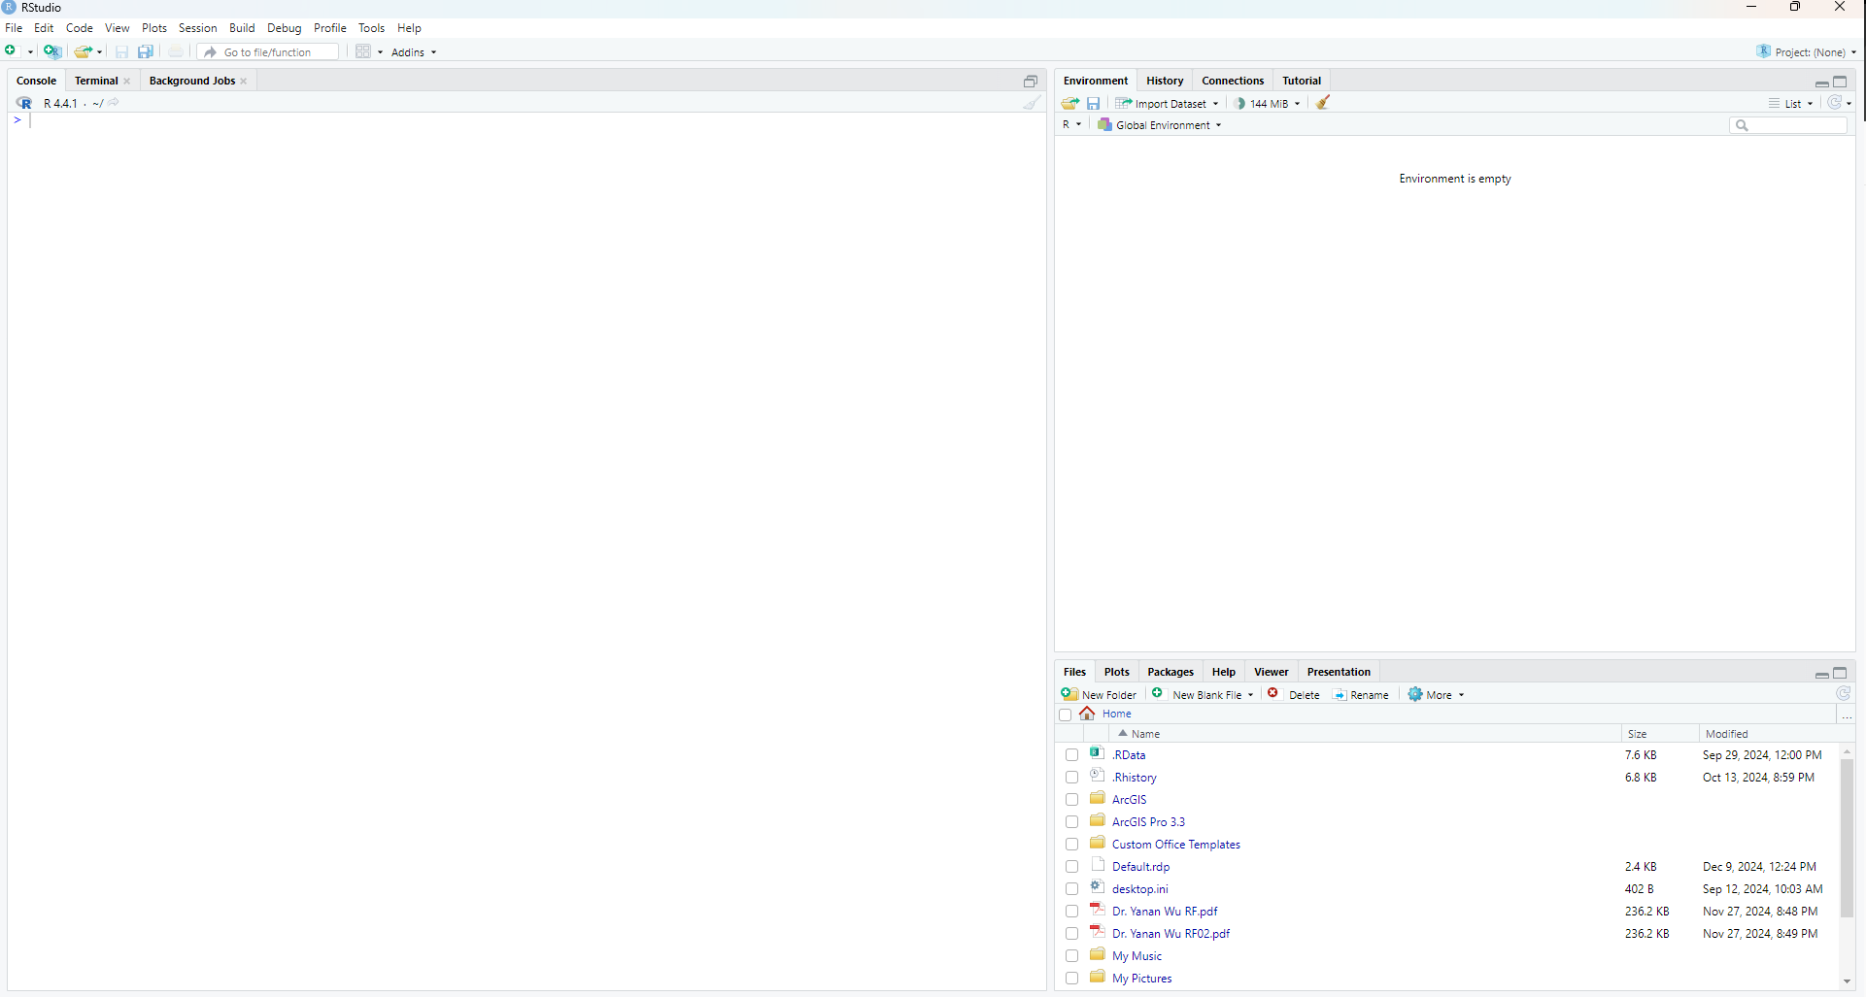
Overview of RSTUDIO INTERFACE
The panes
Left pane: R console
Right top pane: includes tabs such as Environment and History
Right bottom pane: File, Plots, Packages, Help and Viewer

Slide 9
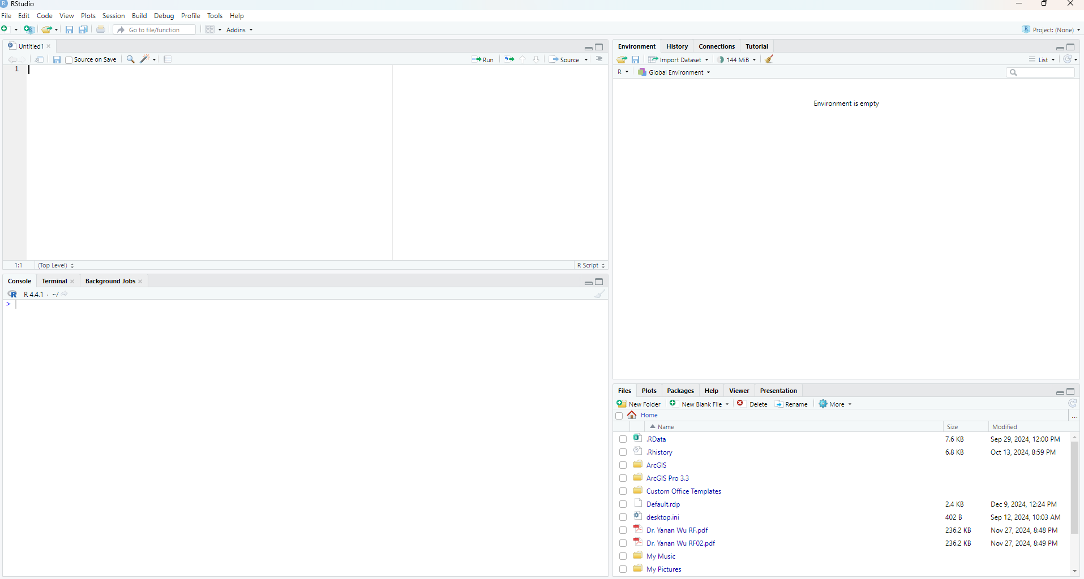
Overview of RSTUDIO INTERFACE
Starts a new pane on the left
File – New File – R Script

Slide 10
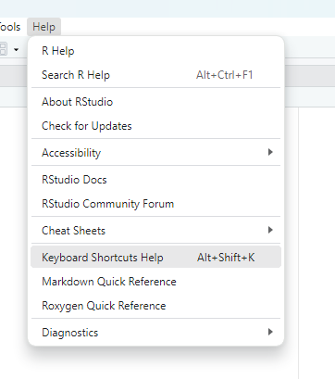
Overview of keyboard shortcuts
Keyboard shortcuts
Help – Keyboard Shortcuts Help

Slide 11
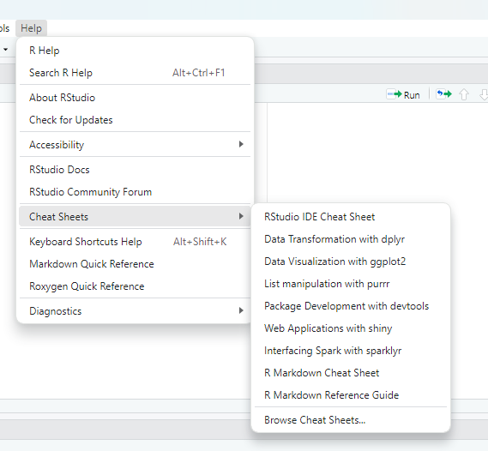
Overview of Cheatsheets
Cheatsheets in Rstudio
Help - Cheatsheets

Slide 12

Global setting
.RData
Save your workspace, including variables, data frames, lists, and other objects
Cons
Causing confusions especially when we share code with others and assume they have this .Rdata file
Tools – Global Options
Change the setting as below

Slide 13
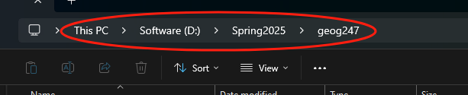
Working directory
Get working directory where your scripts and workspaces are stored
getwd()
Run this command:
Ctrl + Enter
Or Run in R
The returning strings, e.g.,"C:/Users/yy00021/Documents“ is the path to the working directory
The windows convention uses slash \ to separate sub-directories
However, R uses forward slash / or a double backward slash \\
Change working directory
I suggest you to setup a specific directory for this course
setwd('D:\\Spring2025\\geog247’)
Now check your working directory again

Slide 14
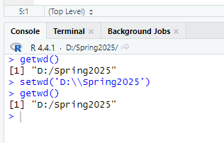
Console window
The character > in CONSOLE window indicates that R is ready to receive new commands
It show up when R completed executing a script

Slide 15

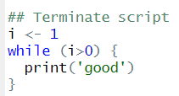
Terminate script
The Esc Key or pressing in the CONSOLE window to terminate the script

Slide 16
Get help
Get help for activate libraries
help('dplyr’)
?dplyr
Get help for all installed libraries
??dplyr
help.search('dplyr’)

Slide 17
Interacting with the R-CONSOLE
All commands (or programs) can be stored in external *.R script-files
Single command or a set of highlighted commands can be run using shortcut (shift+enter) or Run button in R
All commands can be run use the Source button in R
Scroll through the history of previously commands in R
Using shortcut key (Ctrl + L ) or broom icon to clean the Console window

Slide 18
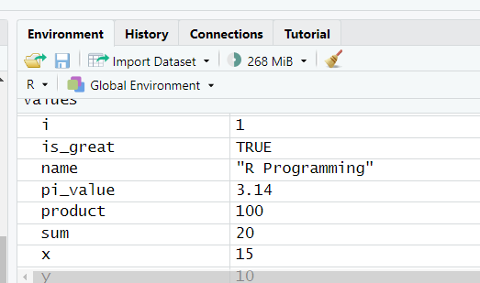
Variables in r
Variable names
Variables are created using the assignment operator <
Variables can store different types of data (numeric, character, logical, etc.).
Variables can be reassigned new values anytime.
The document shows professional naming for your code
Object in the ENVIRONMENT
Any data structure or function that is defined using commands becomes an object in the ENVIRONMENT

Slide 19
Remove objects
The objects can be removed from the ENVIRONMENT
rm(x)
Clean ENVIRONMENT
Broom icon in the ENVIRONMENT mean bar
or rm(list=ls())

Slide 20
LIST IN R
Creating a list
A list in R is a flexible data structure that can contain elements of different types: numbers, characters, vectors, matrices, data frames, or even other lists.
It's like a container for multiple objects.
Accessing elements in a list
Use [[ ]] to access elements by position or name.
Use $ to access elements by name.

Slide 21
Data sets
Read csv
read.csv() for reading CSV files.
Check columns
Accessing column names using colnames()
Add new columns
Adding columns based on calculations or conditions

Slide 22
WEEK 01 PRACTICES
Instructor: Yanan Wu
TA: Nisar Khadija
Spring 2025

Slide 23
practices
Explore Tools and Help in RStudio
Explore the different tables in RStudio

