Slide 1

WEEK 10
Instructor: Yanan Wu
TA: Khadija Nisar
Spring 2025

Slide 2
10.1 Introduction to Tree-Based Methods

Slide 3
Learning Objectives
Understand how decision trees work.
Distinguish between regression and classification trees.
Learn how to build, interpret, and prune decision trees.
How to use Cross Validation for hyperparameter tuning.
Apply decision trees practically using R

Slide 4
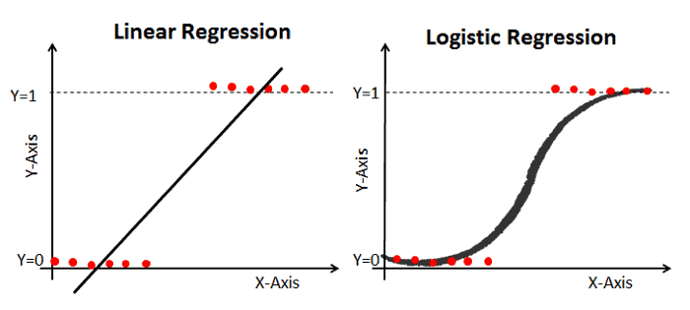
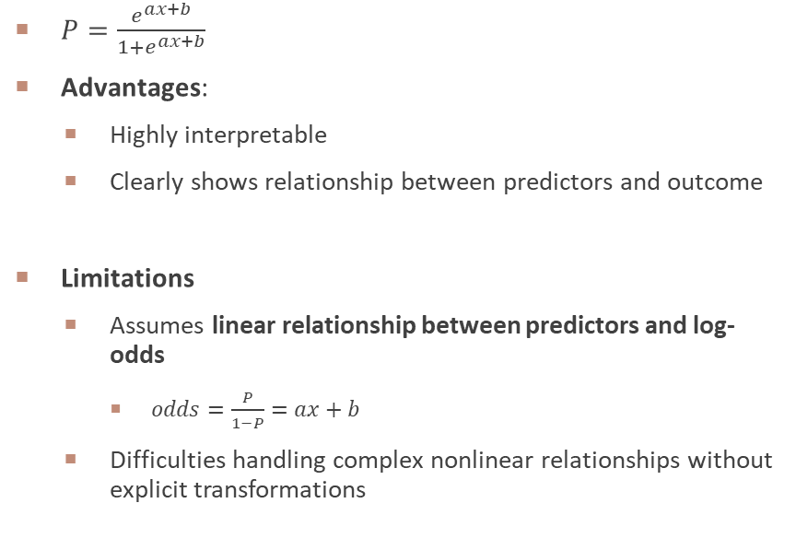
Brief Review of Logistic Regression
$P=\frac{e^{ax+b}}{1+e^{ax+b}}$
Advantages:
Highly interpretable
Clearly shows relationship between predictors and outcome
Limitations
Assumes linear relationship between predictors and log-odds
$odds=\frac{P}{1−P}=ax+b$
Difficulties handling complex nonlinear relationships without explicit transformations

Slide 5
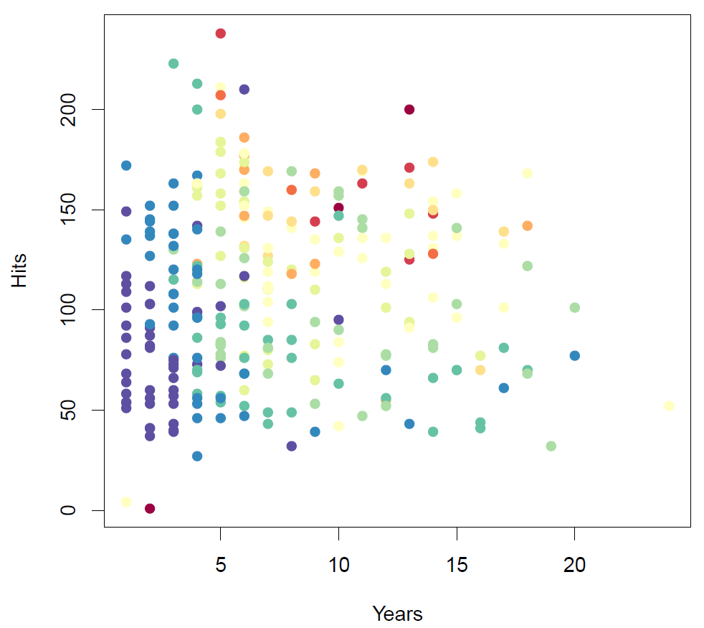
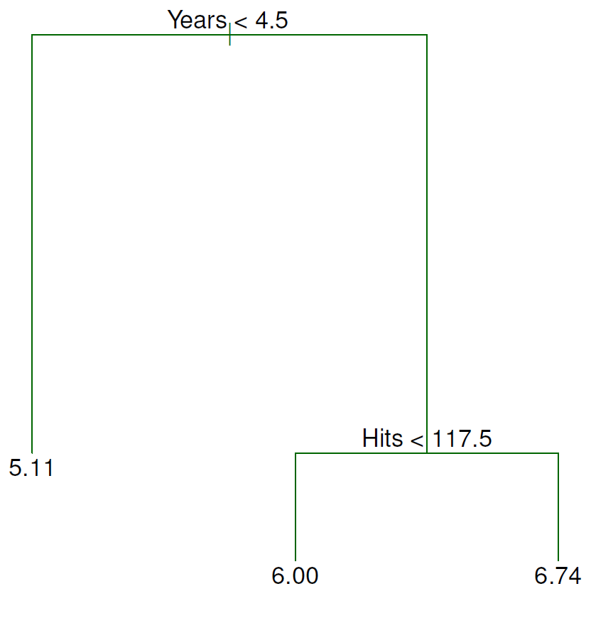
Motivation for Tree-Based Models
Decision trees handle nonlinearities naturally by segmenting predictor space into simple regions.
They automatically detect interactions between variables and handle categorical predictors without dummy variables.
Interpretability: Mimic human decision-making processes through clear hierarchical decisions.
Baseball salary data: how would you stratify it?
Salary is color-coded from low (blue, green) to high (yellow, red)
Basic Decision tree for these data

Slide 6
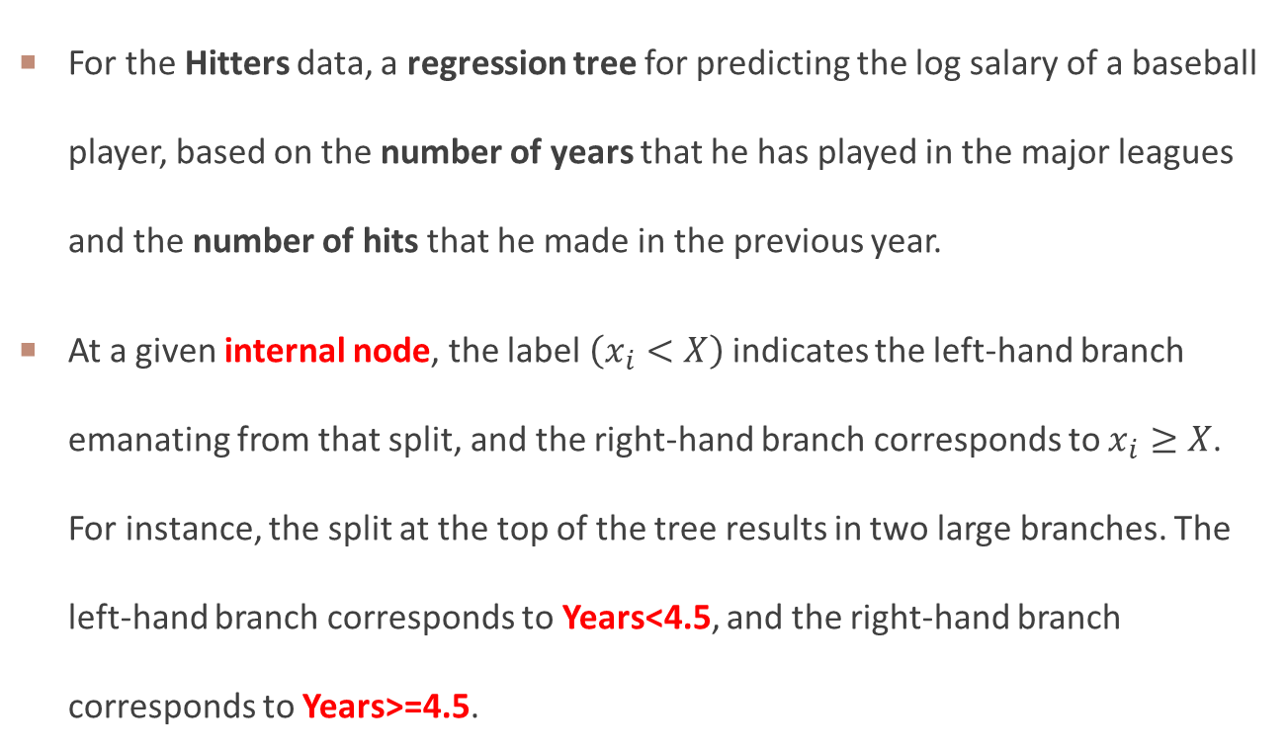
Details / interpretation of decision tree
For the Hitters data, a regression tree for predicting the log salary of a baseball player, based on the number of years that he has played in the major leagues and the number of hits that he made in the previous year.
At a given internal node, the label $\left(x_{i}<X\right)$indicates the left-hand branch emanating from that split, and the right-hand branch corresponds to $x_{i}≥X$. For instance, the split at the top of the tree results in two large branches. The left-hand branch corresponds to Years<4.5, and the right-hand branch corresponds to Years>=4.5.
Notes:
1. Why it’s regression tree instead of classification tree?

Slide 7
Details / interpretation of decision tree
The tree has two internal nodes and three terminal nodes, or leaves. The number in each leaf is the mean of the response for the observations that fall there.
From this tree, we can get that Years is the most important factor in determining Salary, and 4.5 years of career is an important split for the level of Salary.
Given that a player is less experienced, the number of Hits that he made in the previous year seems to play little role in his Salary. But among players who have been in the major leagues for five or more years, the number of Hits made in the previous year does affect Salary
Notes:
1. Why it’s regression tree instead of classification tree?

Slide 8
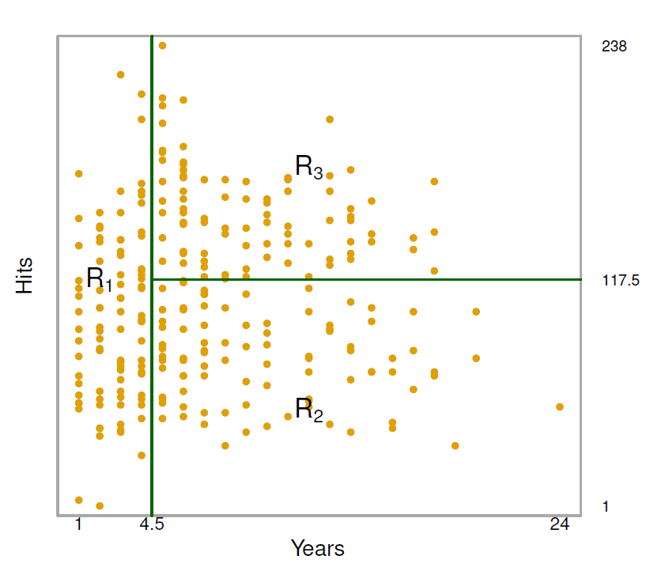
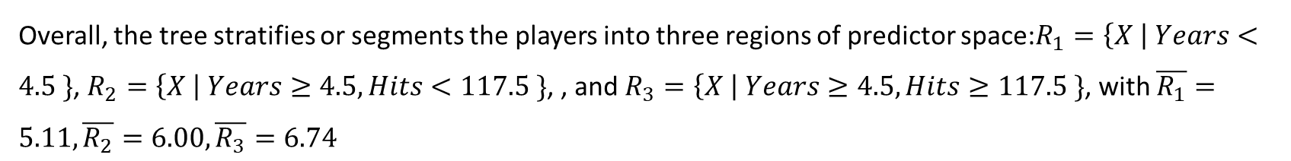
Model interpretation
Overall, the tree stratifies or segments the players into three regions of predictor space:$R_{1}=\left\{X \right| Years<4.5 \}$, $R_{2}=\left\{X \right| Years≥4.5, Hits<117.5 \}$, , and $R_{3}=\left\{X \right| Years≥4.5, Hits≥117.5 \}$, with $\overline{R_{1}}=5.11,\overline{R_{2}}=6.00,\overline{R_{3}}=6.74$
Notes:
1. Why it’s regression tree instead of classification tree?

Slide 9
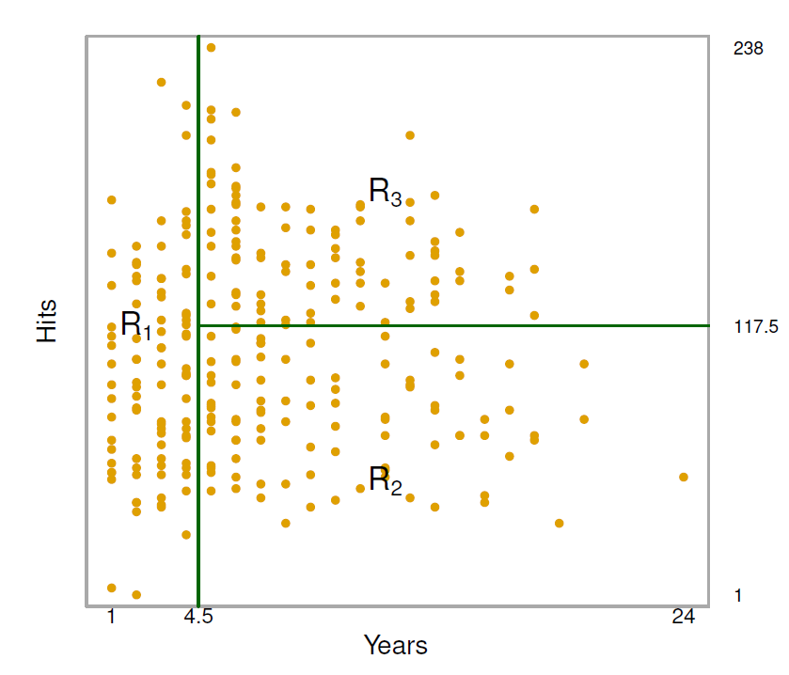
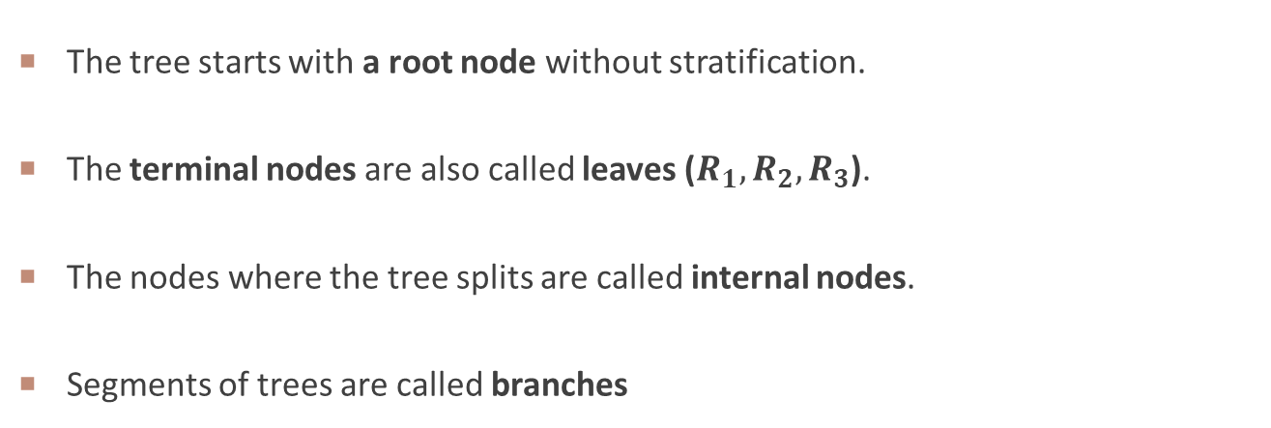
Terminology for Trees
The tree starts with a root node without stratification.
The terminal nodes are also called leaves ($R_{1},R_{2},R_{3}$).
The nodes where the tree splits are called internal nodes.
Segments of trees are called branches

Slide 10
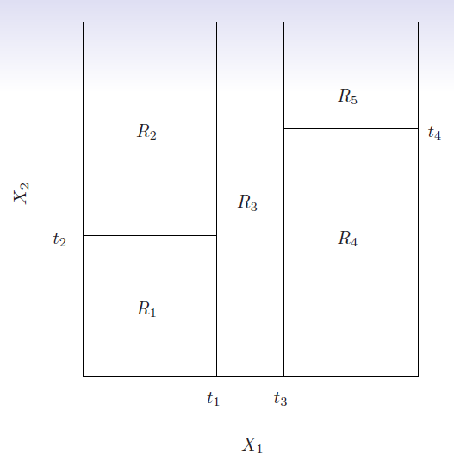
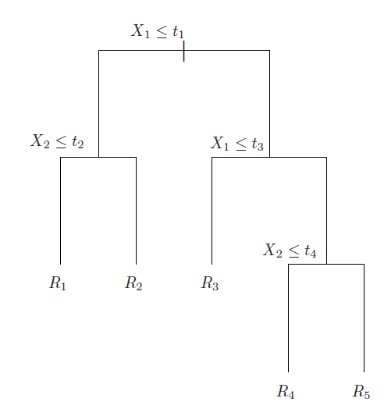
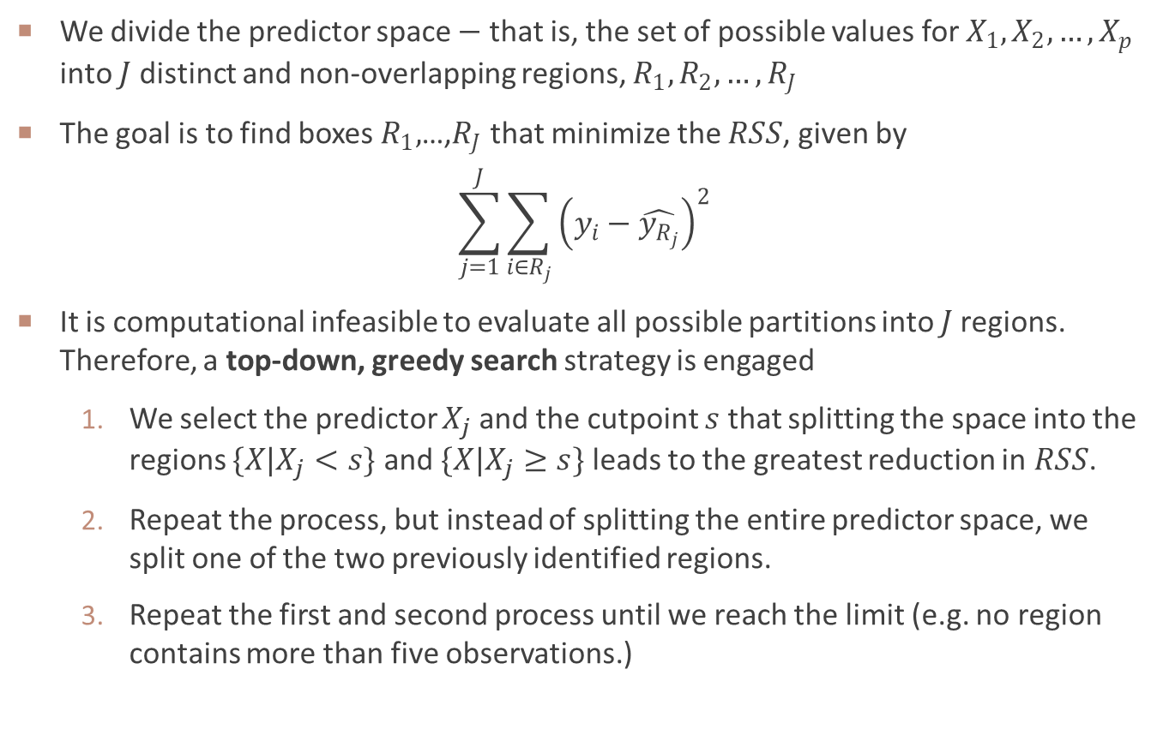
UNDERLYING IDEA
We divide the predictor space $−$ that is, the set of possible values for $X_{1},X_{2},…,X_{p}$ into $J$ distinct and non-overlapping regions, $R_{1},R_{2},…, R_{J}$
The goal is to find boxes $R_{1},$…,$R_{J}$ that minimize the $RSS$, given by
$$\sum_{j=1}^{J}{\sum_{i∈R_{j}}{{\left(y_{i}−\hat{y_{R_{j}}}\right)}^{2}}}$$
It is computational infeasible to evaluate all possible partitions into 𝐽 regions. Therefore, a top-down, greedy search strategy is engaged
We select the predictor $X_{j}$ and the cutpoint $s$ that splitting the space into the regions $\{X|X_{j}<s\}$ and $\{X|X_{j}≥s\}$ leads to the greatest reduction in$RSS$.
Repeat the process, but instead of splitting the entire predictor space, we split one of the two previously identified regions.
Repeat the first and second process until we reach the limit (e.g. no region contains more than five observations.)

Slide 11
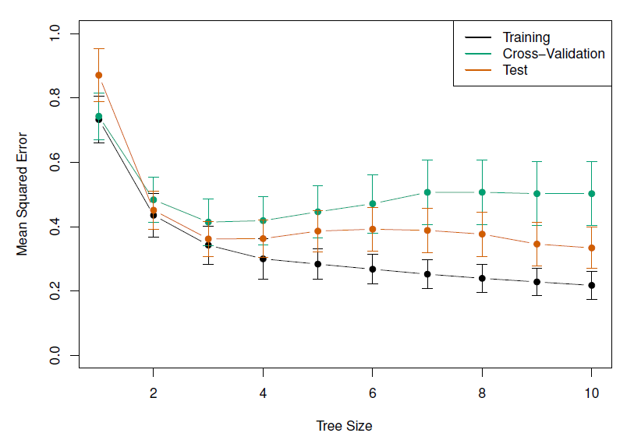
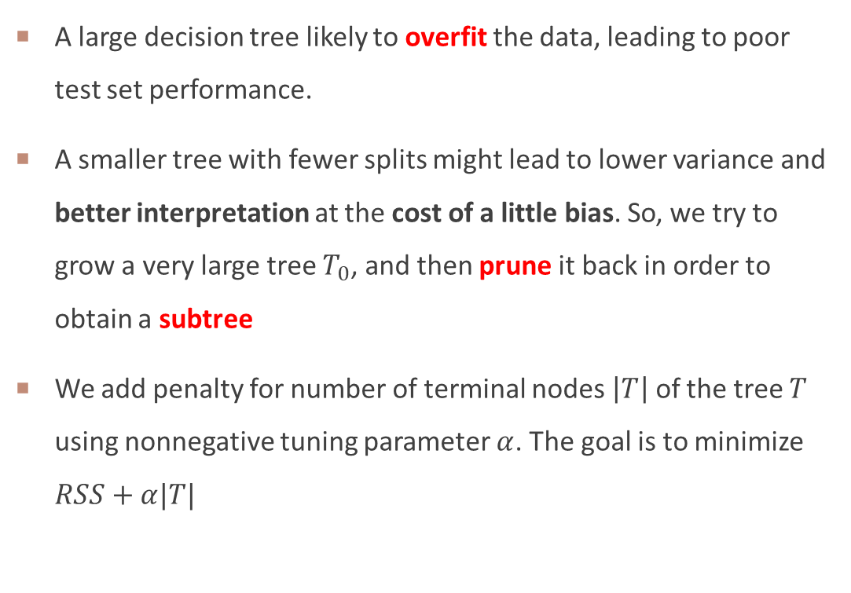
Tree Pruning
A large decision tree likely to overfit the data, leading to poor test set performance.
A smaller tree with fewer splits might lead to lower variance and better interpretation at the cost of a little bias. So, we try to grow a very large tree $T_{0}$, and then prune it back in order to obtain a subtree
We add penalty for number of terminal nodes $\left|T\right|$ of the tree $T$ using nonnegative tuning parameter $α$. The goal is to minimize $RSS+α|T|$
Regression tree analysis for the Hitters data.

Slide 12
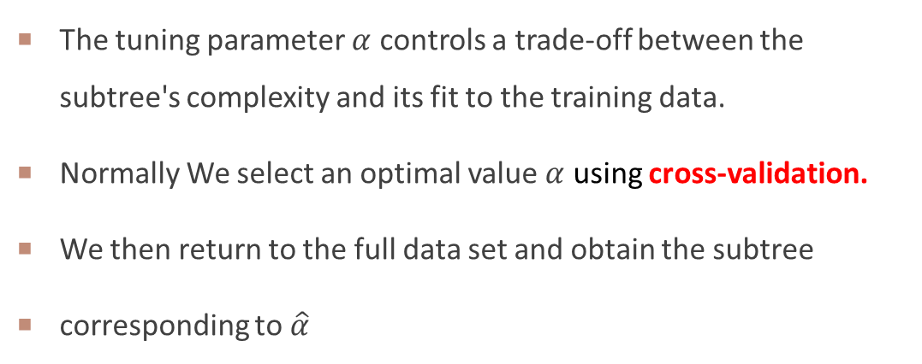
Choosing the best subtree
The tuning parameter $α$ controls a trade-off between the subtree's complexity and its fit to the training data.
Normally We select an optimal value $α$ using cross-validation.
We then return to the full data set and obtain the subtree
corresponding to $\hat{α}$
Regression tree analysis for the Hitters data.

Slide 13
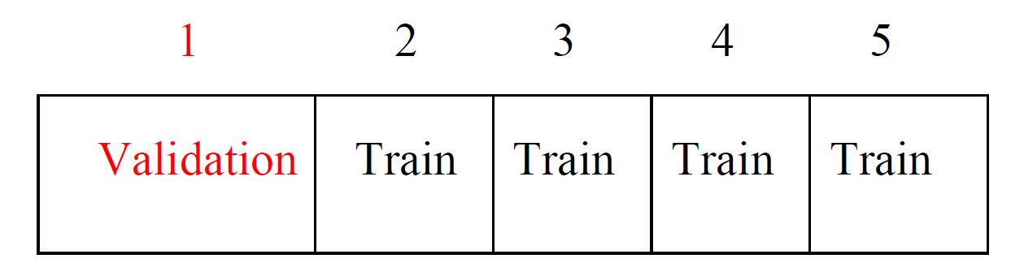
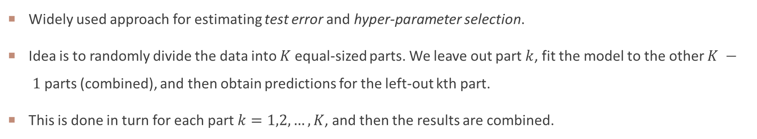
K-fold Cross-validation
Widely used approach for estimating test error and hyper-parameter selection.
Idea is to randomly divide the data into $K$ equal-sized parts. We leave out part $k$, fit the model to the other $K − 1$parts (combined), and then obtain predictions for the left-out kth part.
This is done in turn for each part $k=1,2,…,K$, and then the results are combined.
Divide data into K roughly equal-sized parts ($K = 5$here)

Slide 14

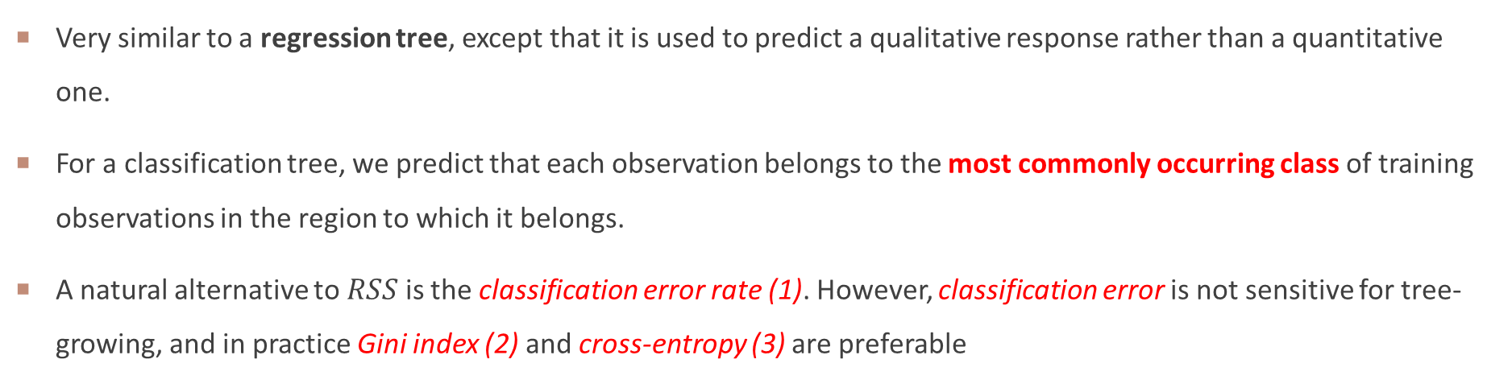
Classification trees
Very similar to a regression tree, except that it is used to predict a qualitative response rather than a quantitative one.
For a classification tree, we predict that each observation belongs to the most commonly occurring class of training observations in the region to which it belongs.
A natural alternative to $RSS$ is the classification error rate (1). However, classification error is not sensitive for tree-growing, and in practice Gini index (2) and cross-entropy (3) are preferable
$E=1−\max_{k}\left({\hat{p}}_{mk}\right)$
$G=\sum_{k=1}^{K}{{\hat{p}}_{mk}(1−{\hat{p}}_{mk})}$
$−\sum_{k=1}^{K}{{\hat{p}}_{mk}\log{{\hat{p}}_{mk}}}$
${\hat{p}}_{mk}$ represents the proportion of training observations in the $mth$region that are from the $kth$ class.

Slide 15
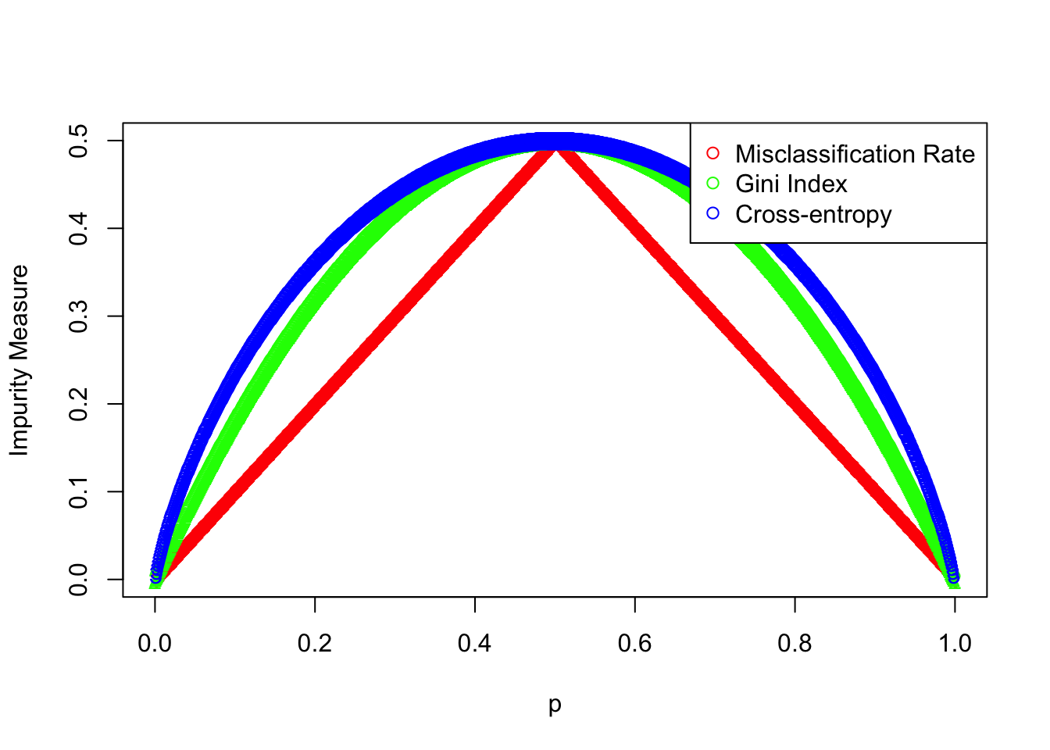
interpretation of Gini index and cross entropy
Gini index
A measure of total variance across the K classes. For this reason, the Gini index is referred to as a measure of node purity
Value ranges from [0,1]
a small value indicates that a node contains predominantly observations from a single class.
Cross Entropy
A measure of uncertainty or disorder across the K classes. For this reason, the Cross Entropy is also referred to as a measure of node purity.
Value ranges from [0,1]
Similar to Gini index, A small value indicates that a node predominantly contains observations from a single class.

Slide 16
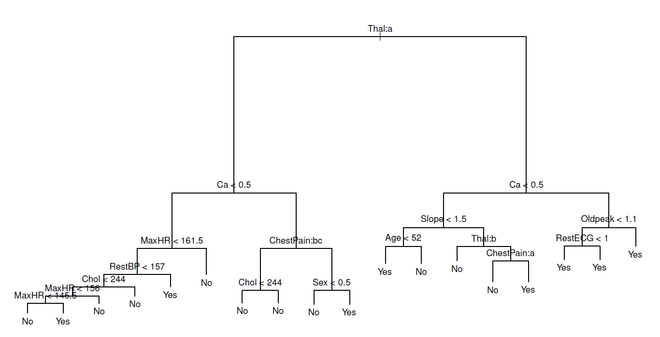
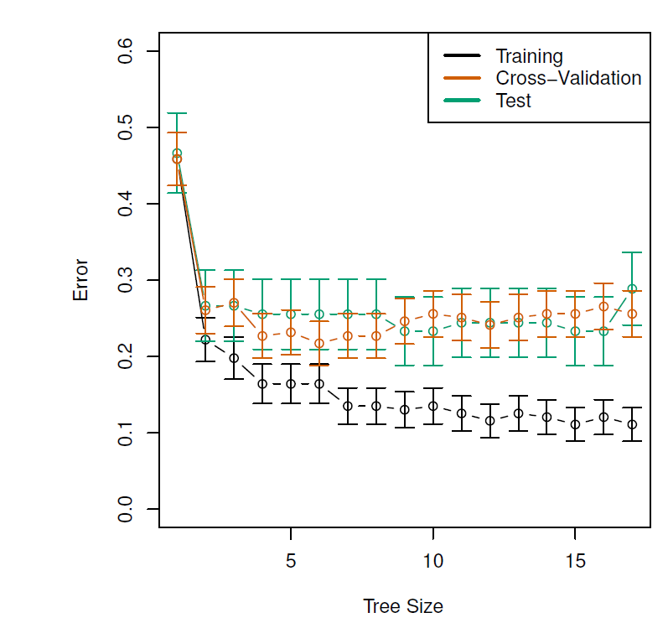
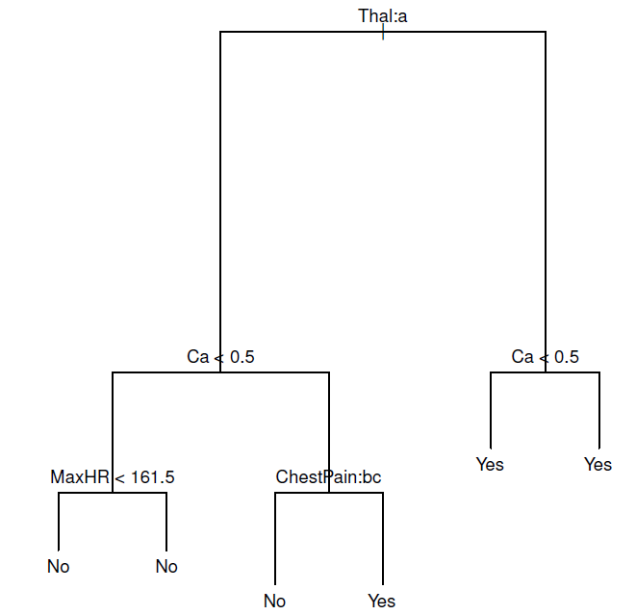
Example: heart data
These data contain a binary outcome HD for 303 patients who presented with chest pain.
An outcome value of Yes indicates the presence of heart disease based on an angiographic test, while No means no heart disease.
There are 13 predictors including Age, Sex, Chol (a cholesterol measurement), and other heart and lung function measurements.
Cross-validation yields a tree with six terminal nodes.
Pruning

Slide 17
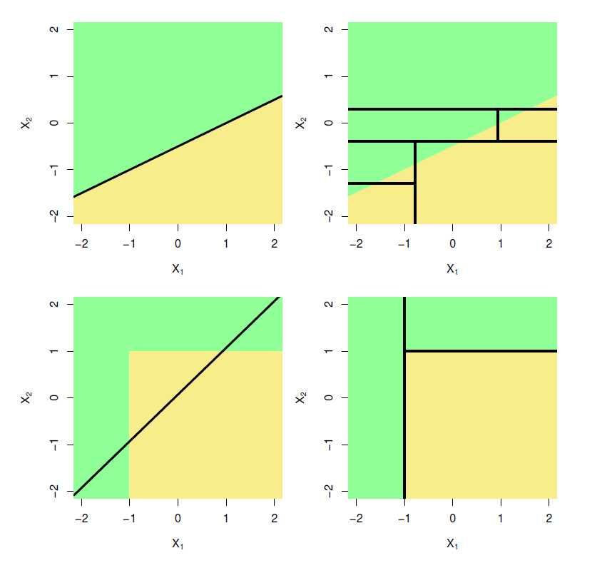
Advantages and Disadvantages of Trees
Advantages
Trees are very easy to explain to people.
Trees can be displayed graphically.
Trees can easily handle qualitative predictors without the need to create dummy variables.
Trees will not consider irrelevant features; no feature selection is needed.
Disadvantages
Standard pruned trees usually do not achieve the same predictive accuracy than other regression or classification methods
Trees can be very volatile from sample to sample, i.e., they exhibit a high variance. This leads to refined tree-building strategies aimed at reducing the variance.
Top Row: True linear boundary; Bottom row: true non-linear boundary.
Left column: linear model; Right column: tree-based model

Slide 18
WEEK 09 CODE DEMO session
Instructor: Yanan Wu
TA: Khadija Nisar
Spring 2025

