Slide 1

WEEK 02
Yanan wu
Spring 2025

Slide 2
Preamble
A good online textbook, Hands-on Programming with R, for R beginner.
Explore the R project website: https://www.r-project.org/
Explore R Studio: https://posit.co/

Slide 3
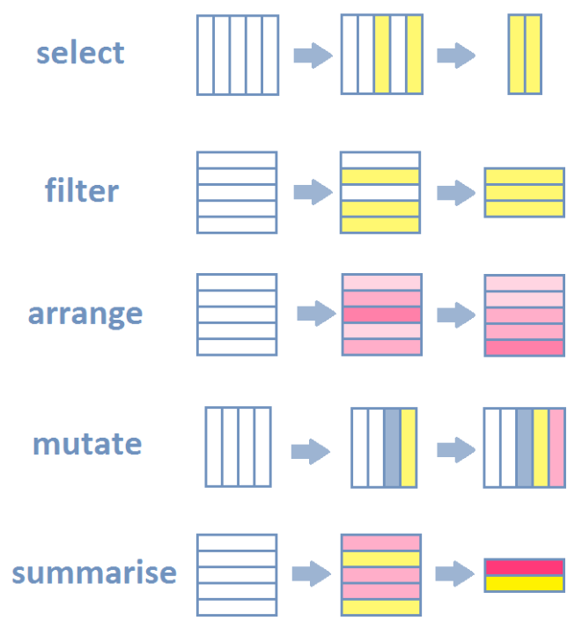
R-INTRODUCTION
An online free learning source: An Introduction to R
Data Manipulation
Data Visualization
Data Visualization Section in R for Data Science
Modern Data Visualization with R
Interactive Applications
Shiny Gallery in R

Slide 4
R - Introduction
Statistical Analysis
Geospatial Data Analysis
Descriptive analysis (mean, median., etc)
Regression analyses (linear, logistic, ect)
Time series analysis (ARIMA, etc)
Multivariate analysis (PCA, factor analysis)
A handbook of statistical analysis in R
Handle raster and vector data
Analyze spatial data with sf, sp or raster

Slide 5
R - Introduction
Machine Learning
Implement supervised learning (classification, regression).
Apply unsupervised learning (clustering, dimensionality reduction).
Perform deep learning with packages like keras or torch.
Evaluate models using cross-validation and other metrics.

Slide 6
Rstudio - introduction

