Slide 1

WEEK 02
Instructor: Yanan Wu
TA: Khadija Nisar
Spring 2025

Slide 2
2.1.1 population and sample

Slide 3
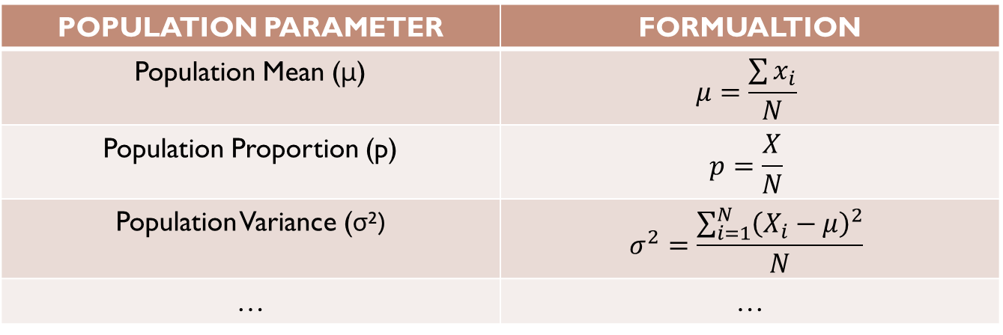
Population parameter
A population parameter is a fixed, but often unknown, numerical value that describes a characteristic of an entire population.
POPULATION PARAMETER | FORMUALTION
Population Mean (μ) | $$μ=\frac{\sum{x_{i}}}{N}$$
Population Proportion (p) | $$p=\frac{X}{N}$$
Population Variance (σ²) | $$σ^{2}=\frac{\sum_{i=1}^{N}{{\left(X_{i}−μ\right)}^{2}}}{N}$$
… | …
But complete populations are difficult to collect data on, so we use sample statistics as point estimates for the unknown population parameters of interest

Slide 4
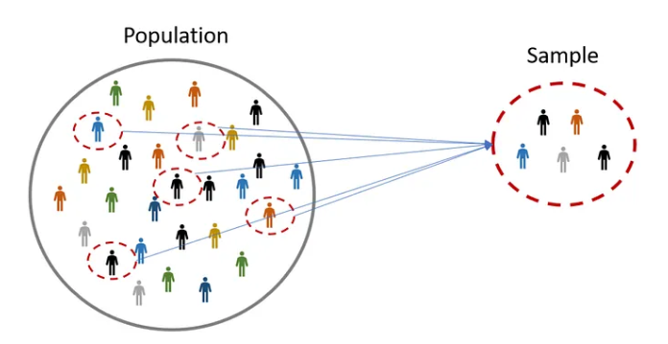
Population & sample
A sample is a subset of individuals or data points taken from a larger population to make inferences about the population as a whole.

Slide 5
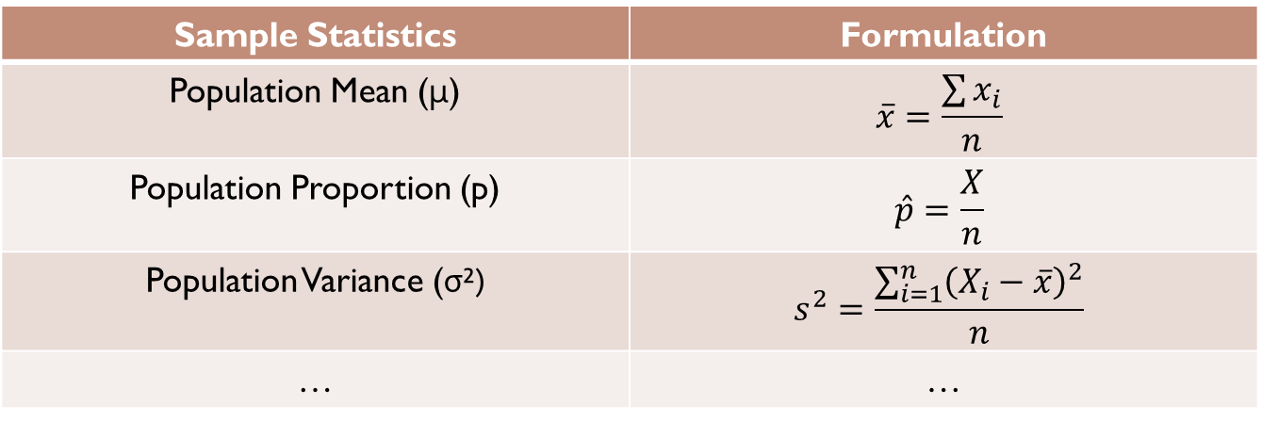
Sample statistics (Point estimates)
Sample statistics: A value that describes your sample.
Point estimates: The use of a sample statistic to estimate a population parameter
Sample Statistics | Formulation
Population Mean (μ) | $$\overline{x}=\frac{\sum{x_{i}}}{n}$$
Population Proportion (p) | $$\hat{p}=\frac{X}{n}$$
Population Variance (σ²) | $$s^{2}=\frac{\sum_{i=1}^{n}{{\left(X_{i}−\overline{x}\right)}^{2}}}{n}$$
… | …

Slide 6
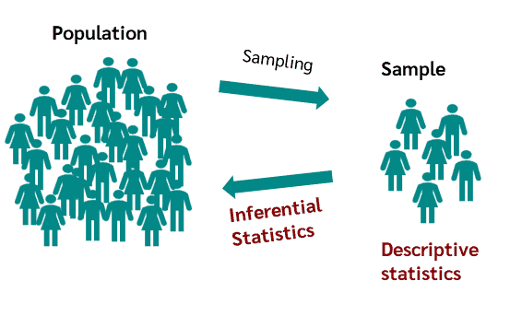
Descriptive versus Inferential Statistics
Descriptive statistics describe data.
Inferential statistics compute metrics from a sample to make inferences concerning parameters in a population. Inferential statistics is a subset of descriptive statistics.

Slide 7
Time to think🤔
If you have collected data from an entire population (a census), do you need to perform inferential statistics?

Slide 8
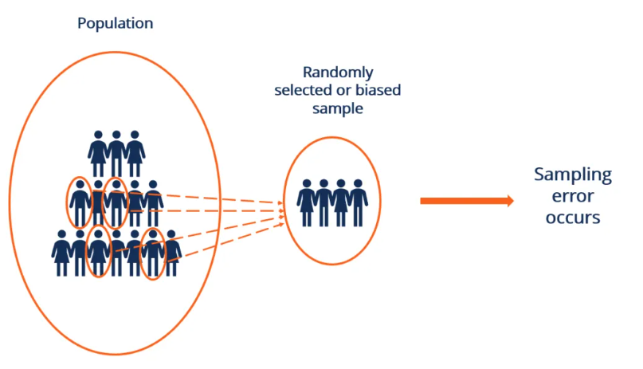
Error and sampling error
Error in the estimate = difference between population parameter and sample statistic
Sampling error describes how much an estimate will tend to vary from one sample to the next.

Slide 9
Sampling distribution - proportion
you might sample from the population and use your sample proportion as the best guess for the unknown population proportion.
Suppose you want to estimate the proportion of university students who regularly use public transportation, but you don’t have access to the entire student population. In this case, you could take a sample of students from different campuses and use the proportion of students in your sample who use public transportation as your best guess for the unknown proportion in the overall student population.
Sample, with replacement, 1000 students from the population, and record whether they use public transportation or not
Find the sample proportion.
Plot the distribution of the sample proportions obtained

Slide 10
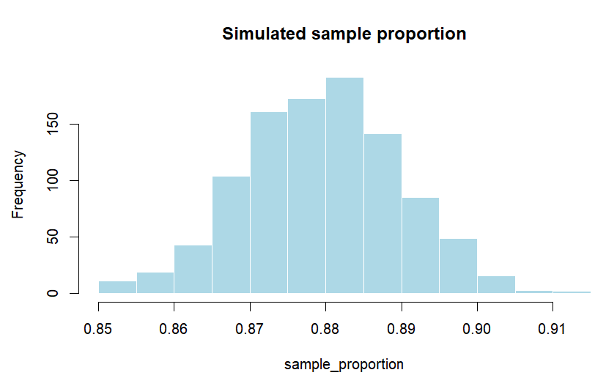
Sampling distribution - proportion
A reasonable guess for the true population proportion is the center of this distribution, approximately 0.88.

Slide 11
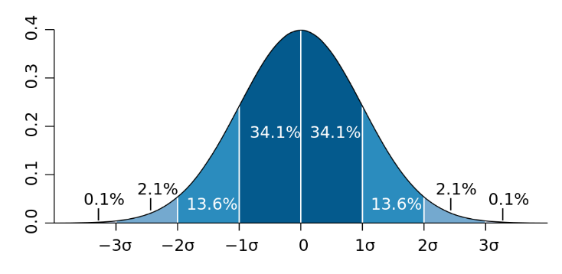
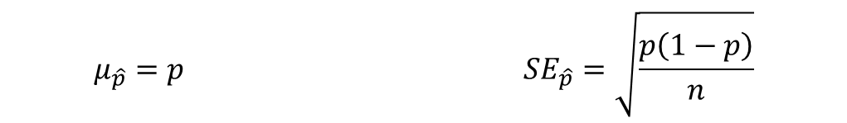
Central limit theorem
The sample size is sufficiently large, the sample proportion $\hat{P}$ will tend to follow a normal distribution with the following mean and standard error:
$$μ_{\hat{p}}=p SE_{\hat{p}}=\sqrt{\frac{p\left(1−p\right)}{n}}$$

Slide 12
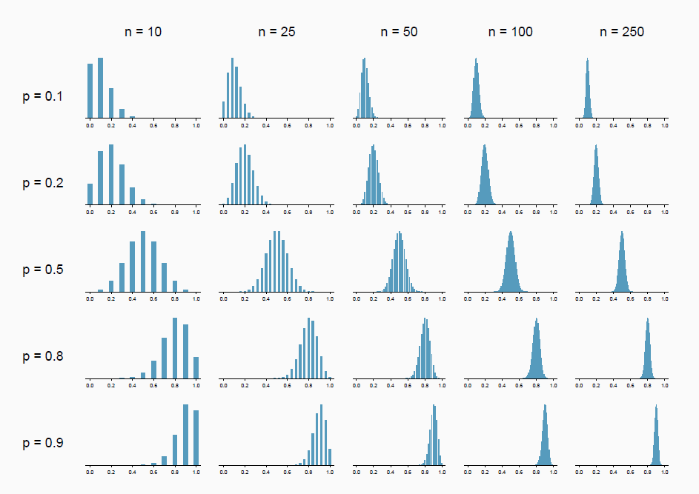
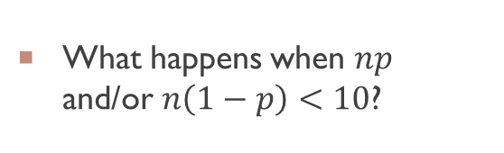
What happens when $np$ and/or $n\left(1−p\right)<10$?

Slide 13
2.1.2 Confidence interval

Slide 14
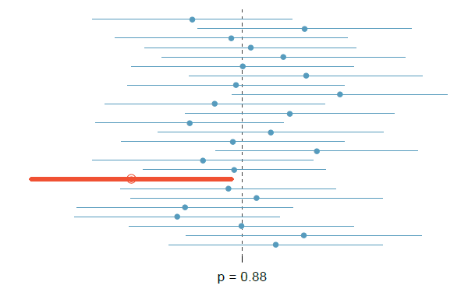
Confidence interval of proportion
A confidence interval (CI) is a range of values that is likely to contain the true population parameter (such as the mean or proportion) with a certain level of confidence

Slide 15
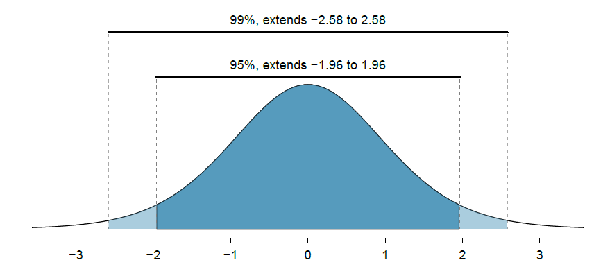
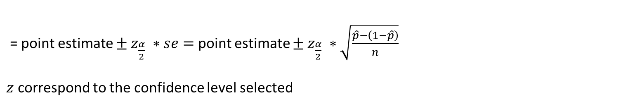
Confidence level in confidence ineterval
= point estimate $± z_{\frac{α}{2}} ∗se=$point estimate $± z_{\frac{α}{2}} ∗\sqrt{\frac{\hat{p}−\left(1−\hat{p}\right)}{n}}$
$z$ correspond to the confidence level selected

Slide 16
2.1.2 hypothesis testing

Slide 17
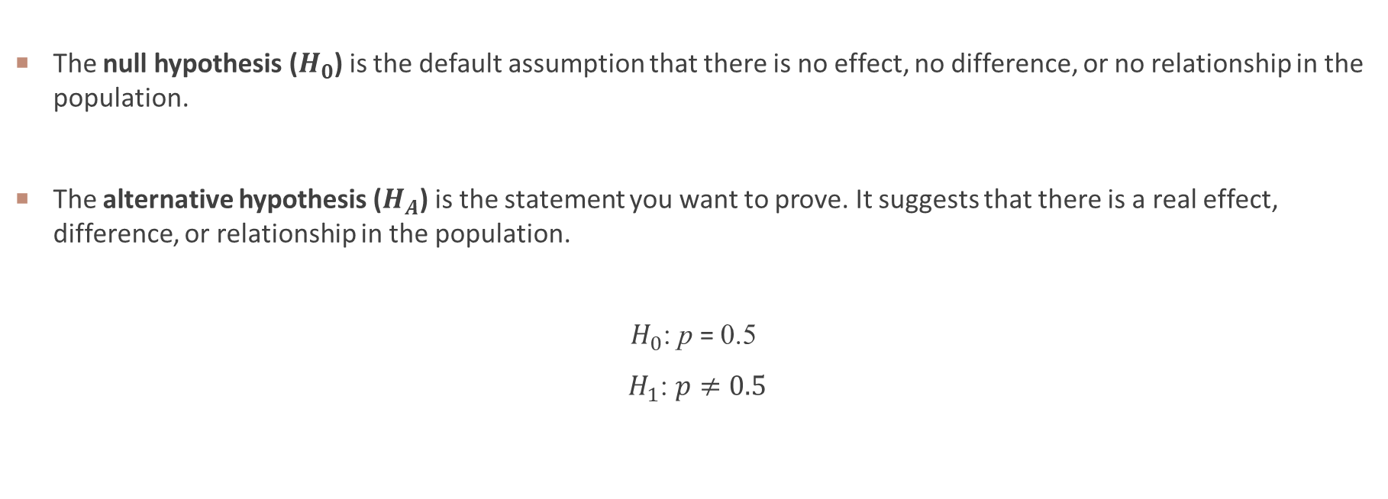
Null and alternative hypothesis
The null hypothesis ($H_{0}$) is the default assumption that there is no effect, no difference, or no relationship in the population.
The alternative hypothesis ($H_{A}$) is the statement you want to prove. It suggests that there is a real effect, difference, or relationship in the population.
$H_{0}$: p = 0.5
$H_{1}$: $p≠0.5$

Slide 18
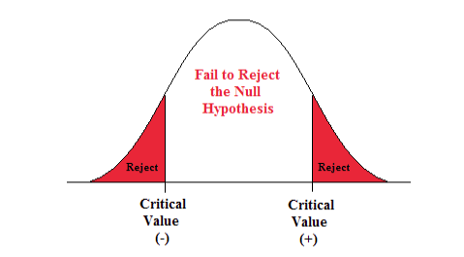
P-value
The p-value approach is the likelihood or probability that a sample will result in a statistic such as the one obtained if the null hypothesis is true.
If p-value ≤ α, reject the null hypothesis.
If p-value > α, fail to reject the null hypothesis.

Slide 19
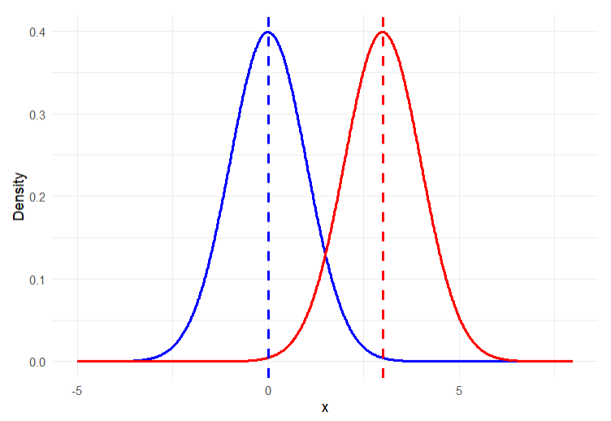

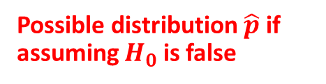
Distribution of $\hat{p}$ if $H_{0}$ is true
Possible distribution $\hat{p}$ if assuming $H_{0}$ is false

Slide 20
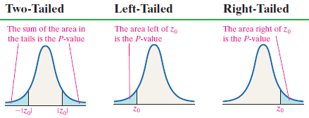

Calculation of p-value
$$z_{0}=\frac{\hat{p}−{ p}_{0}}{\sqrt{\frac{p_{0}\left(1−p_{0}\right)}{n}}}$$

Slide 21
WEEK 02 demo session
Instructor: Yanan Wu
TA: Khadija Nisar
Spring 2025

