Slide 1

WEEK 02
Instructor: Yanan Wu
TA: Khadija Nisar
Spring 2025

Slide 2
2.1 population and sample

Slide 3
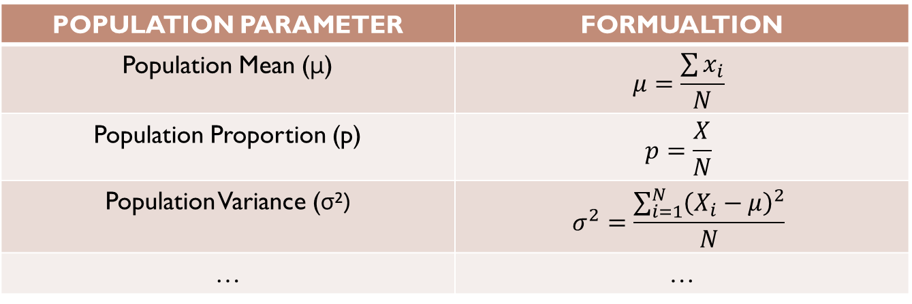
Population parameter
A population parameter is a fixed, but often unknown, numerical value that describes a characteristic of an entire population.
POPULATION PARAMETER | FORMUALTION
Population Mean (μ) | $$μ=\frac{\sum{x_{i}}}{N}$$
Population Proportion (p) | $$p=\frac{X}{N}$$
Population Variance (σ²) | $$σ^{2}=\frac{\sum_{i=1}^{N}{{\left(X_{i}−μ\right)}^{2}}}{N}$$
… | …
But complete populations are difficult to collect data on, so we use sample statistics as point estimates for the unknown population parameters of interest

Slide 4
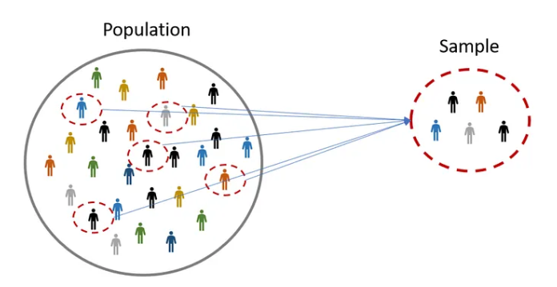
Population & sample
A sample is a subset of individuals or data points taken from a larger population to make inferences about the population as a whole.

Slide 5
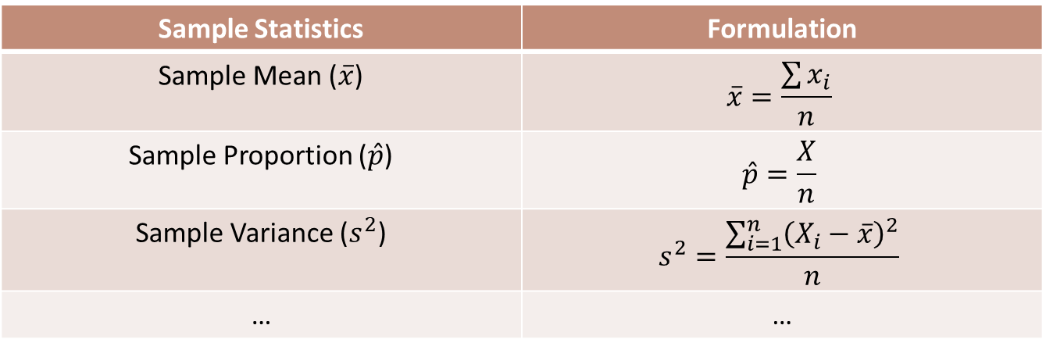
Sample statistics (Point estimates)
Sample statistics: A value that describes your sample.
Point estimates: A single value used to approximate a population parameter
Sample Statistics | Formulation
Sample Mean ($\overline{x}$) | $$\overline{x}=\frac{\sum{x_{i}}}{n}$$
Sample Proportion ($\hat{p}$) | $$\hat{p}=\frac{X}{n}$$
Sample Variance ($s^{2}$) | $$s^{2}=\frac{\sum_{i=1}^{n}{{\left(X_{i}−\overline{x}\right)}^{2}}}{n}$$
… | …

Slide 6
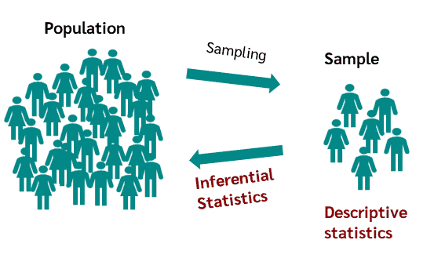
Descriptive versus Inferential Statistics
Descriptive statistics describe data.
Inferential statistics compute metrics from a sample to make inferences concerning parameters in a population. Inferential statistics is a subset of descriptive statistics.

Slide 7
Descriptive? Or inferential?
Mean
Standard Deviation
Hypothesis Testing
Variance
Confidence Interval

Slide 8
Time to think🤔
If you have collected data from an entire population (a census), do you need to perform inferential statistics?

Slide 9
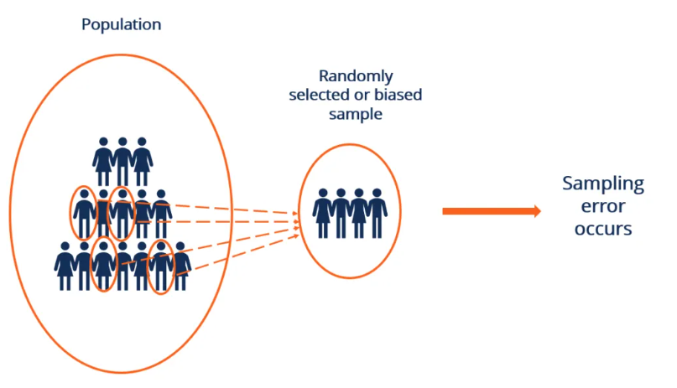
Error and sampling error
Error in the estimate = difference between population parameter and sample statistic
Sampling error describes how much an estimate will tend to vary from one sample to the next.

Slide 10



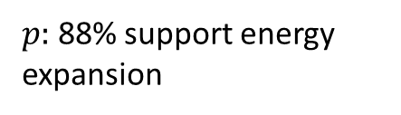
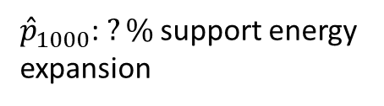

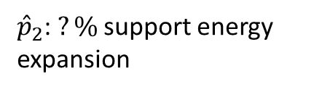
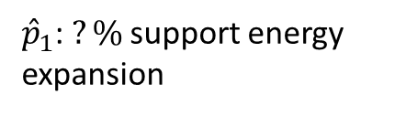
Experiment: variability of the sample
${\hat{p}}_{1}$: $?\%$ support energy expansion
$p:$88% support energy expansion
${\hat{p}}_{2}$: $?\%$ support energy expansion
$$…$$
${\hat{p}}_{1000}$: $?\%$ support energy expansion

Slide 11
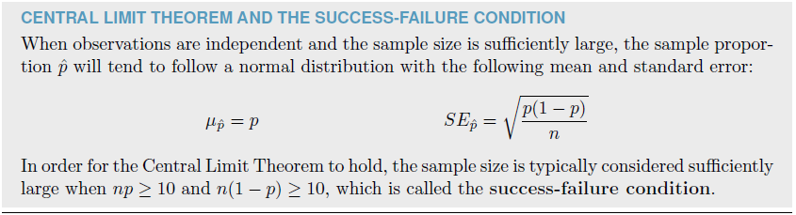
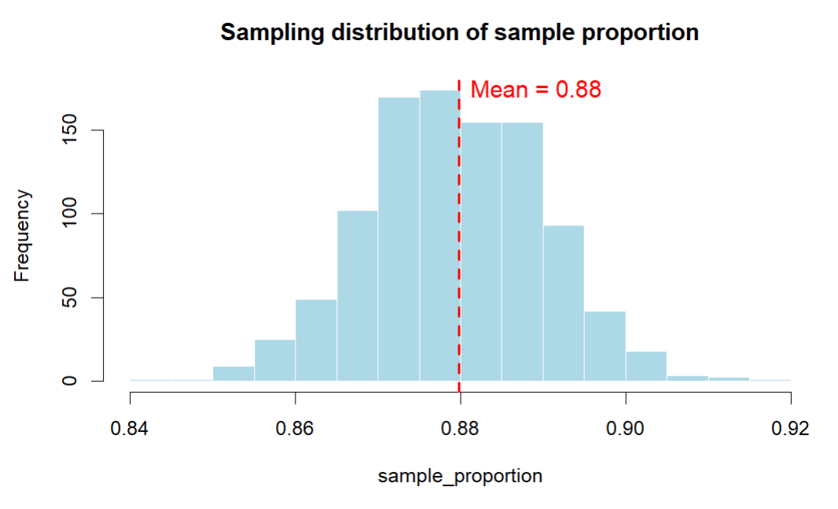
Central limit theorem

Slide 12
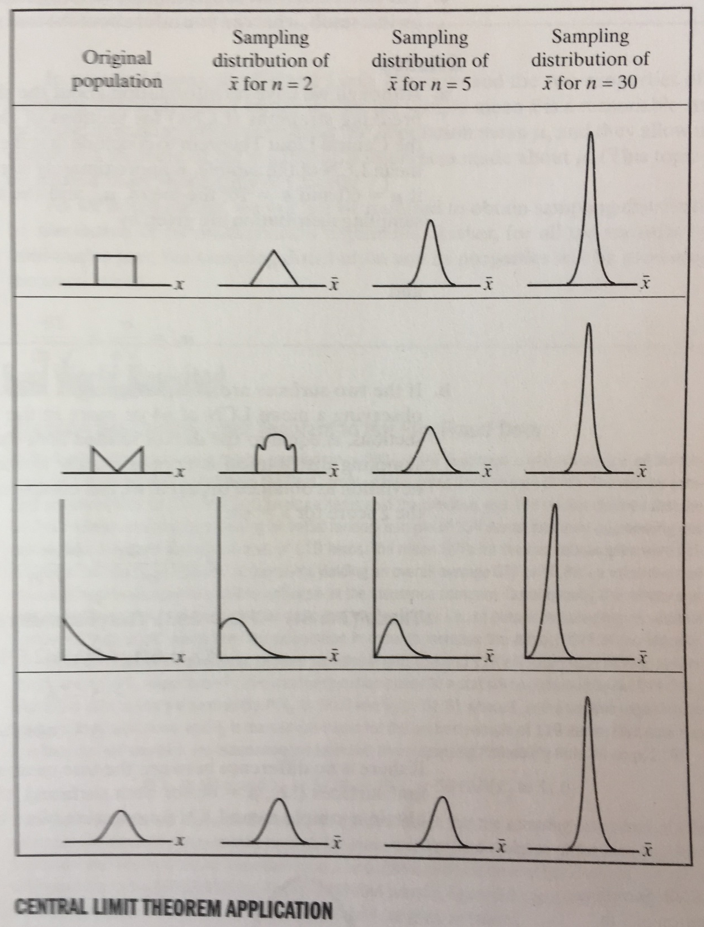
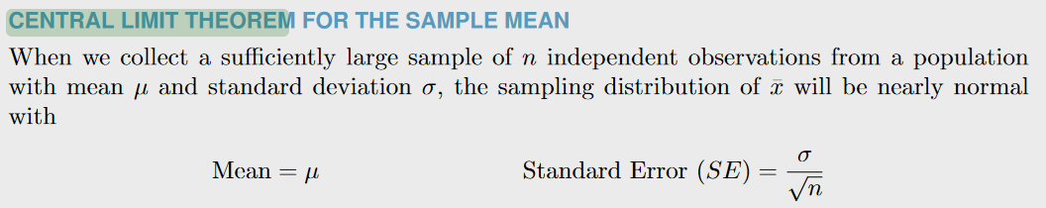
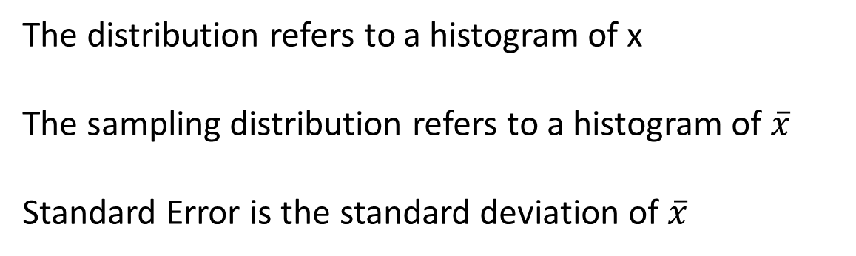
Central Limit Theorem according to OpenIntroStatistics Version4
The distribution refers to a histogram of x
The sampling distribution refers to a histogram of $\overline{x}$
Standard Error is the standard deviation of $\overline{x}$

Slide 13
2.2 Confidence interval

Slide 14
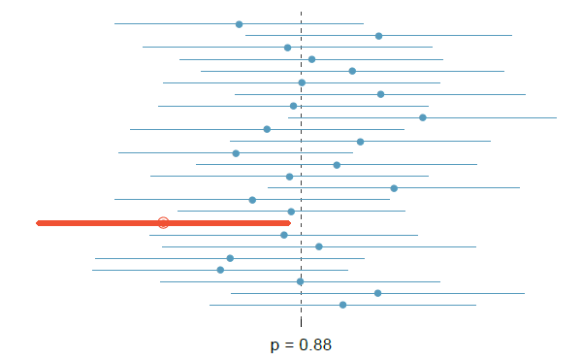
Confidence interval of proportion
A confidence interval (CI) is a range of values that is likely to contain the true population parameter (such as the mean or proportion) with a certain level of confidence

Slide 15
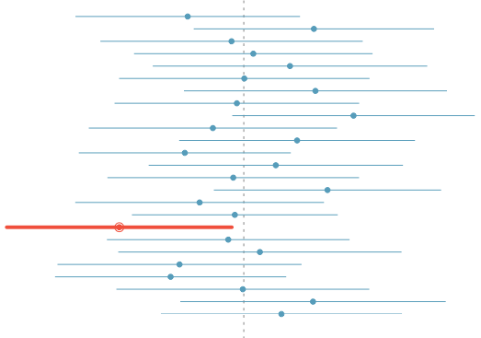
What does 95% confident mean?
Some people tell Pontius that a (1-alpha)% confidence interval means that we are (1-alpha)% confident that the interval contains the population parameter. Pontius asks “What is the meaning of confident?”
Suppose we repeated an experiment several times and built a 95% confidence interval from each experiment using the expression:
point estimate ± Z_{α/2} (Standard Error)
Then we expect about 95% of those intervals would contain the population parameter.
The figure shows 25 confidence intervals, each of which derives from an experiment that takes several random samples. Each experiment examines different data because of random sampling.
The dashed line shows the population parameter. We see that 24 of the 25 resulting confidence intervals contain the population parameter while one does not.
μ

Slide 16
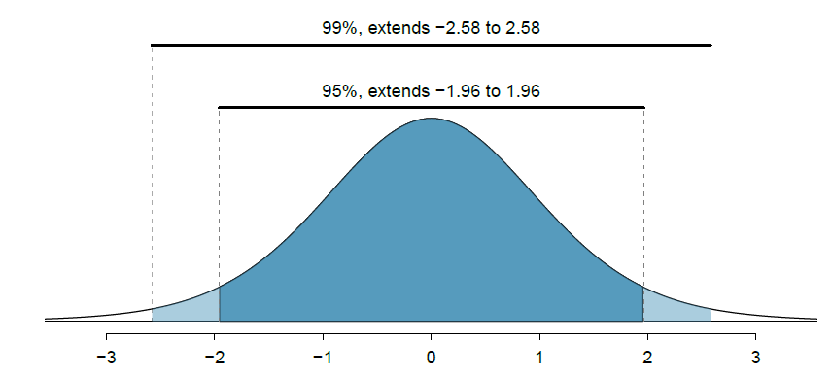
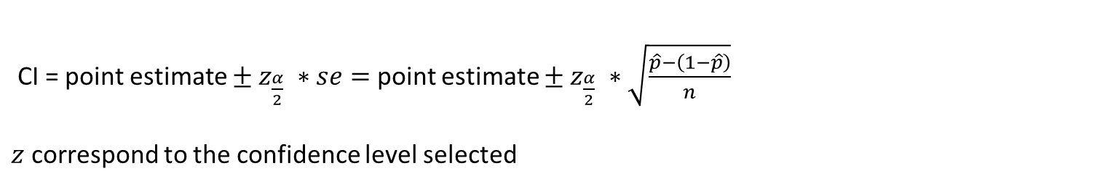
Confidence level in confidence ineterval
CI = point estimate $± z_{\frac{α}{2}} ∗se=$point estimate $± z_{\frac{α}{2}} ∗\sqrt{\frac{\hat{p}−\left(1−\hat{p}\right)}{n}}$
$z$ correspond to the confidence level selected

Slide 17
2.3 hypothesis testing

Slide 18
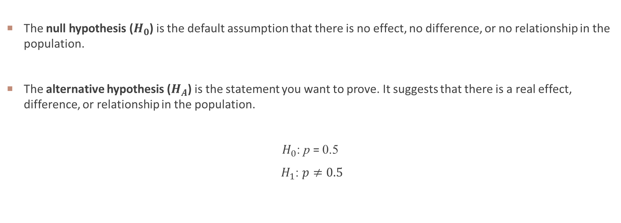
Null and alternative hypothesis
The null hypothesis ($H_{0}$) is the default assumption that there is no effect, no difference, or no relationship in the population.
The alternative hypothesis ($H_{A}$) is the statement you want to prove. It suggests that there is a real effect, difference, or relationship in the population.
$H_{0}$: p = 0.5
$H_{1}$: $p≠0.5$

Slide 19
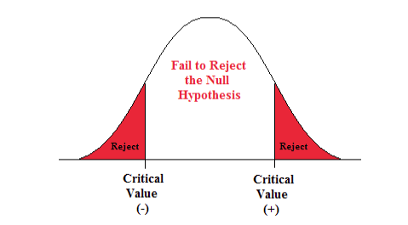
P-value
The p-value approach is the likelihood or probability that a sample will result in a statistic such as the one obtained if the null hypothesis is true.
If p-value ≤ α, reject the null hypothesis.
If p-value > α, fail to reject the null hypothesis.

Slide 20
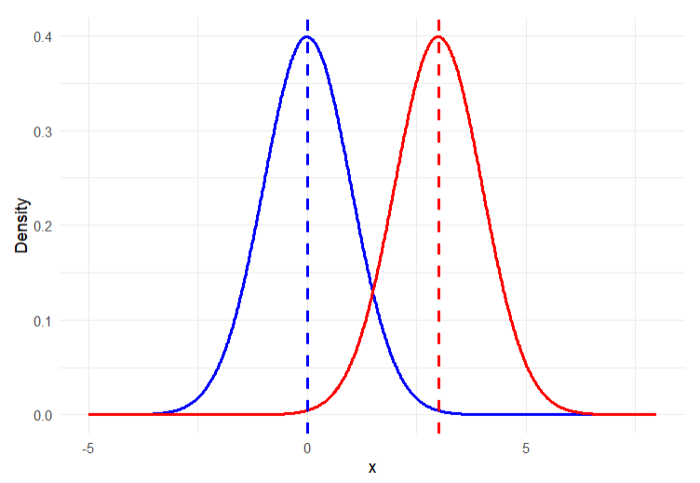

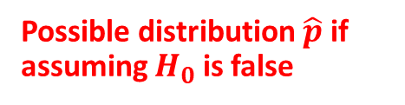
Distribution of $\hat{p}$ if $H_{0}$ is true
Possible distribution $\hat{p}$ if assuming $H_{0}$ is false

Slide 21
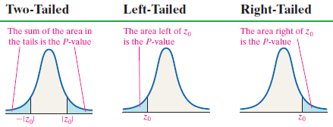

Calculation of p-value
$$z_{0}=\frac{\hat{p}−{ p}_{0}}{\sqrt{\frac{p_{0}\left(1−p_{0}\right)}{n}}}$$

Slide 22
WEEK 02 demo session
Instructor: Yanan Wu
TA: Khadija Nisar
Spring 2025

