Slide 1

WEEK 01
Instructor: Yanan Wu
TA: Nisar Khadija
Spring 2025

Slide 2
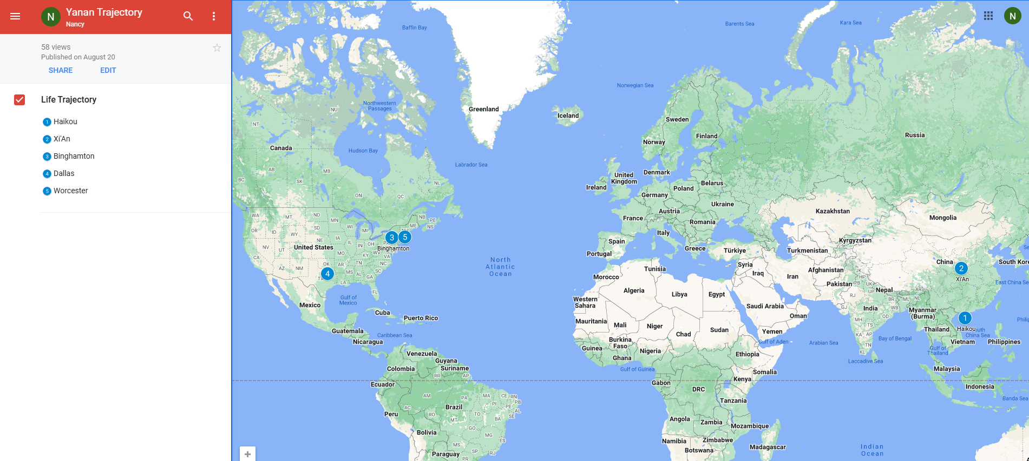
Yanan wu – visiting assistant professor
Education & Experience

Slide 3
teaching
Intermediate Statistics
Python Programming in GIS
Manipulating spatial data
Web mapping
Processing Raster
Data Analysis
Creating Custom Tool
Data visualization
Spatial Database

Slide 4
Instructor office hour
Instructor: Yanan Wu
Email: yanawu@clarku.edu
Hours: Tuesday & Thursday 1:30 pm – 2:30 pm
Location

Slide 5
Ta introduction
Office Hours:
Office Location

Slide 6
How about you?
Your background (e.g., name, major, where you come from)
What is your funniest thing that happened during your winter break?
What relevant experience do you have with statistics?
What are your expectations for this course?

Slide 7
Resources
Introductory text is available for free via https://www.openintro.org/book/os/
Intermediate book is Joseph Hair, William Black, Barry Babin and Rolph Anderson. Multivariate Data Analysis. Edition 7 or 8. Upper Saddle River NJ: Prentice Hall.
Amazon.com usually offers used copies for less than $30.
https://www.amazon.com/Multivariate-Analysis-Joseph-Anderson-William/dp/9353501350/ref=pd_cp_14_2/144-5828787-2724822?_encoding=UTF8&pd_rd_i=9353501350&pd_rd_r=397e3554-2af1-476b-8336-5c1018af6453&pd_rd_w=Q3cmn&pd_rd_wg=XzEv7&pf_rd_p=0e5324e1-c848-4872-bbd5-5be6baedf80e&pf_rd_r=FYB3ZG6A42Z1ANQMRH1V&psc=1&refRID=FYB3ZG6A42Z1ANQMRH1V

Slide 8
Course requirements
Assignments: 9 in total
For any graded assignment, if the you do not agree with the grade received, the instructor and TA must be notified within one week after the assignment is graded.
Late policy for lab (excluding midterm and final project)
One final project (oral presentation and paper report)

Slide 9
evaluation
Assignments 80% = nine assignments
Each assignment need to be completed using R
You can ask for help with assignments from the instructor and TA, No plagiarism is allowed
Final Project 20% = 15% oral + 5% written
To apply & to interpret statistical procedures
To make an oral presentation of a statistical analysis
To write a report
A | 93.0 - 100.0 | B+ | 88.0 - 89.9 | C+ | 77.0 - 79.9 | D+ | 67.0 - 69.9
 |  | B | 83.0 - 87.9 | C | 73.0 - 76.9 | D | 60.0 - 66.9
A- | 90.0 - 92.9 | B- | 80.0 - 82.9 | C- | 70.0 - 72.9 | F | 0.0 - 59.9

Slide 10
Important dates
Jan 22. Add/Drop ends (& last day to request audit) Full Semester
No class
Jan 20. University holiday
Feb 17. Wellness day
March 3-7 Spring Break
March 24-27 AAG Conference
Final project
April 14-24 Working on final project
April 28 – May 1 Final project presentation
May 5 Final report due

Slide 11
Course WEBSITE
Clark Canvas
Course Website on Github

Slide 12

software
R
R-Studio
Open-source IDE (integrated development environment)

Slide 13
Preamble
A good online textbook, Hands-on Programming with R, for R beginner.
Explore the R project website: https://www.r-project.org/
Explore R Studio: https://posit.co/

Slide 14
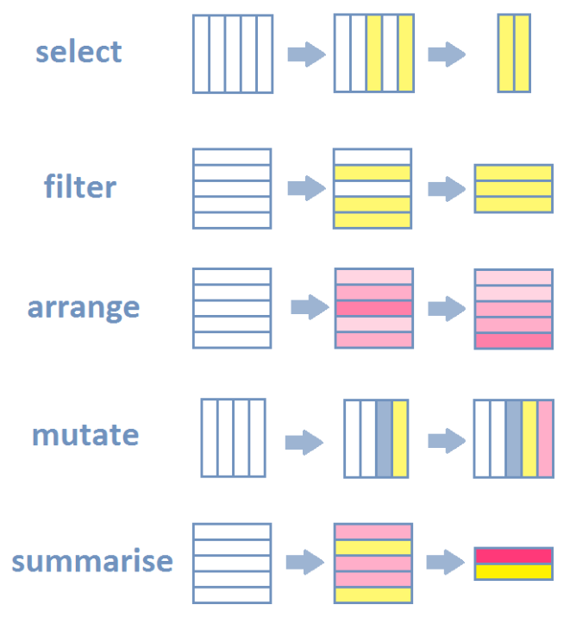
R-INTRODUCTION
An online free learning source: An Introduction to R
Data Manipulation
Data Visualization
Data Visualization Section in R for Data Science
Modern Data Visualization with R
Interactive Applications
Shiny Gallery in R

Slide 15
R - Introduction
Statistical Analysis
Geospatial Data Analysis
Descriptive analysis (mean, median., etc)
Regression analyses (linear, logistic, ect)
Time series analysis (ARIMA, etc)
Multivariate analysis (PCA, factor analysis)
A handbook of statistical analysis in R
Handle raster and vector data
Analyze spatial data with sf, sp or raster

Slide 16
R - Introduction
Machine Learning
Implement supervised learning (classification, regression).
Apply unsupervised learning (clustering, dimensionality reduction).
Perform deep learning with packages like keras or torch.
Evaluate models using cross-validation and other metrics.

Slide 17
COURSE TOPICS
Week 2
Foundations of Inferential Statistics
Point estimates and sampling variability
Confidence intervals and hypothesis testing
…
Inference for numerical data
t-distribution
…

Slide 18
WEEK 01 lab session
Instructor: Yanan Wu
TA: Nisar Khadija
Spring 2025

Slide 19
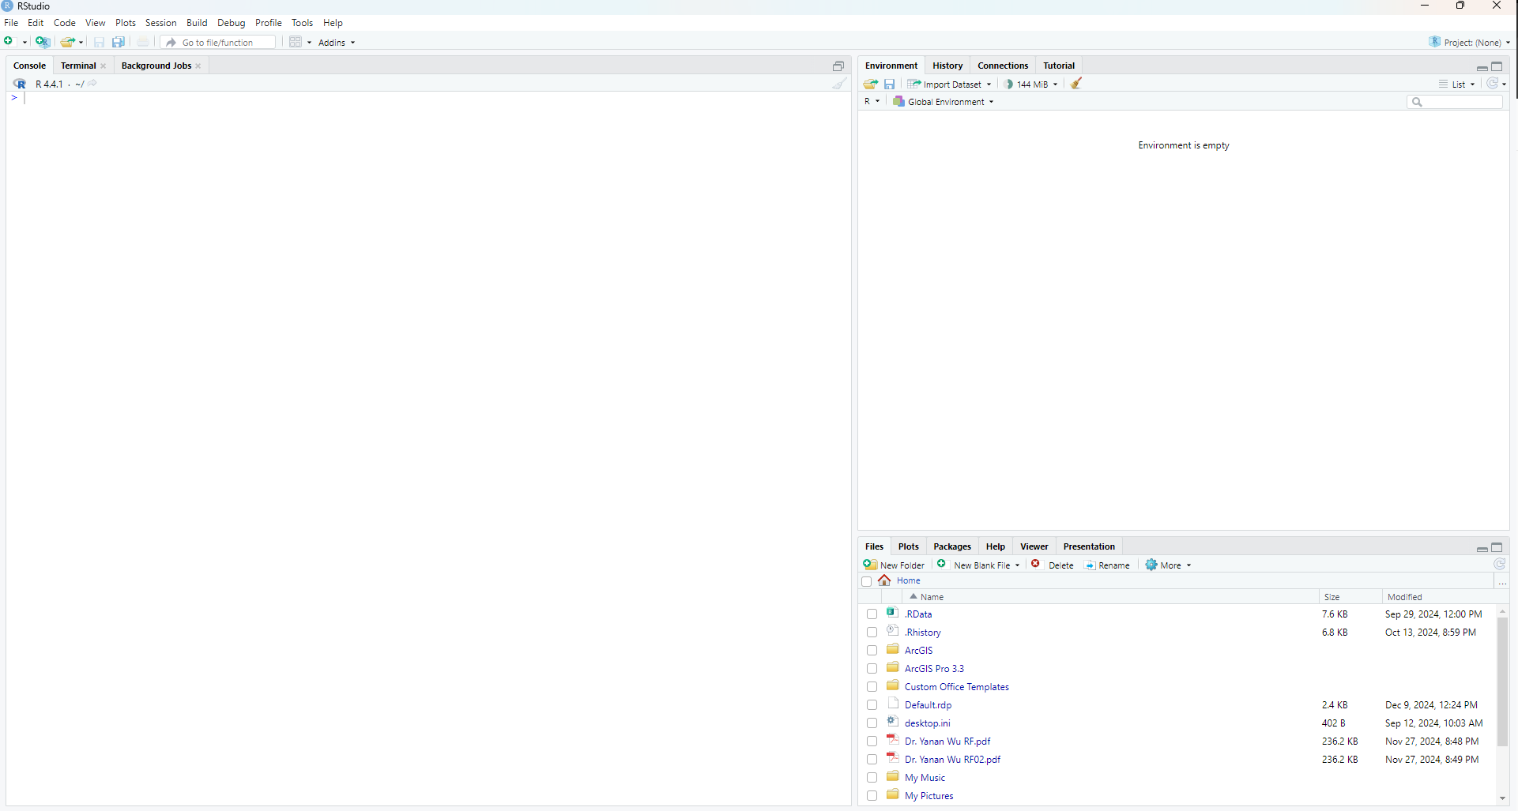
Overview of RSTUDIO INTERFACE
The panes
Left pane: R console
Right top pane: includes tabs such as Environment and History
Right bottom pane: File, Plots, Packages, Help and Viewer

Slide 20
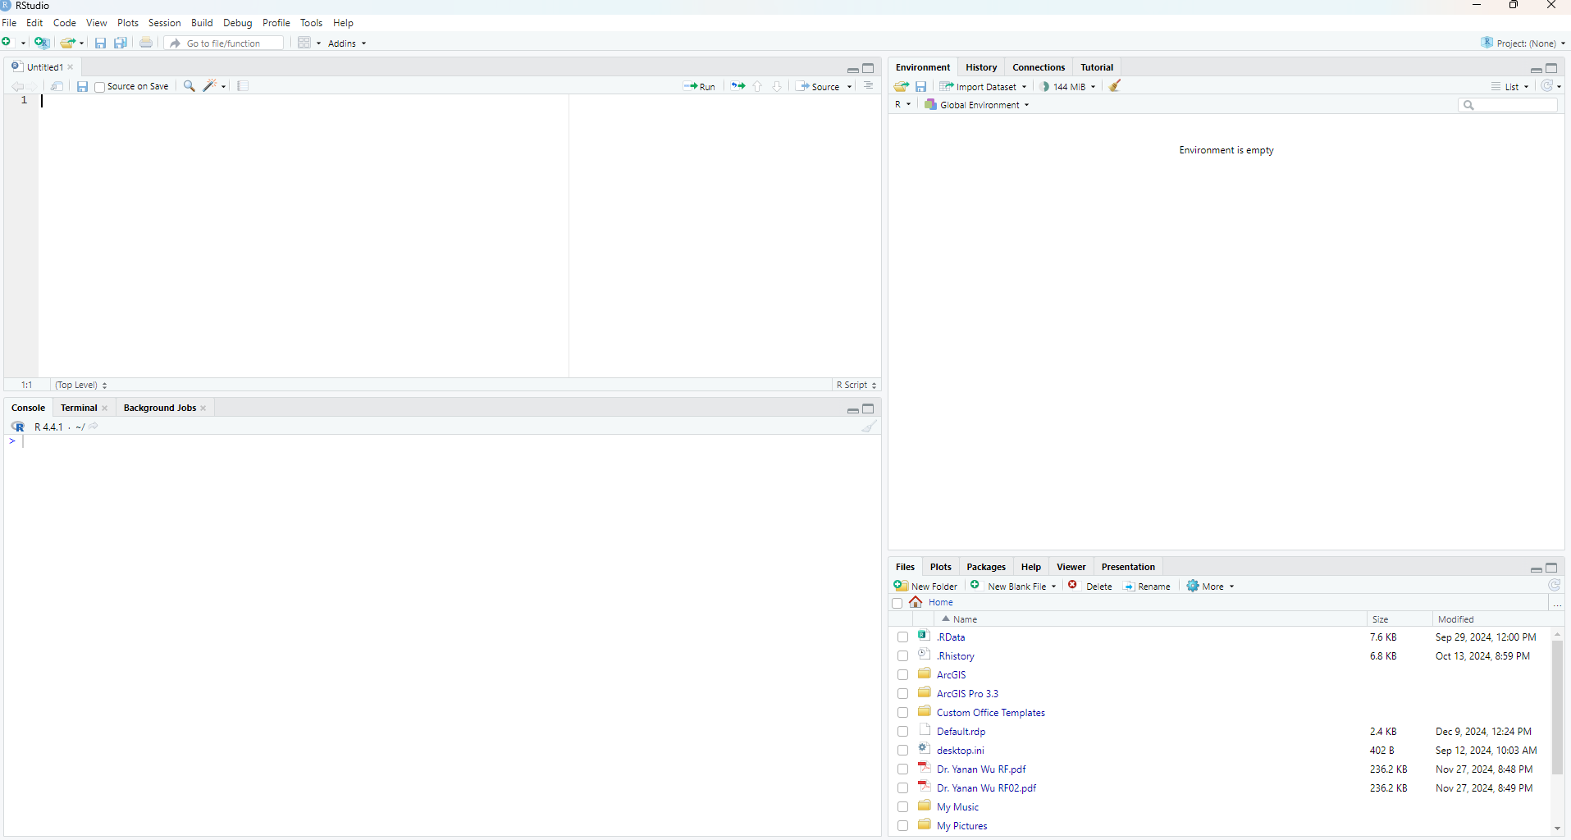
Overview of RSTUDIO INTERFACE
Starts a new pane on the left
File – New File – R Script

Slide 21
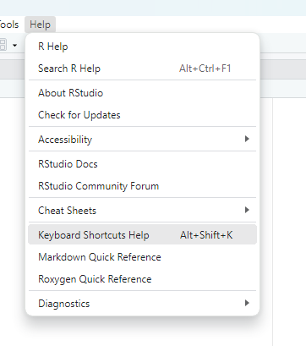
Overview of keyboard shortcuts
Keyboard shortcuts
Help – Keyboard Shortcuts Help

Slide 22
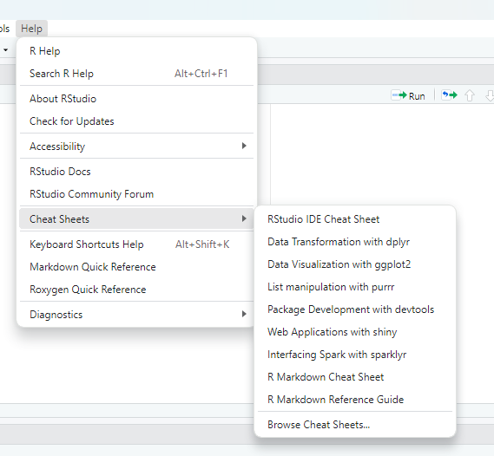
Overview of Cheatsheets
Cheatsheets in Rstudio
Help - Cheatsheets

Slide 23

Global setting
.RData
Save your workspace, including variables, data frames, lists, and other objects
Cons
Causing confusions especially when we share code with others and assume they have this .Rdata file
Tools – Global Options
Change the setting as below

Slide 24
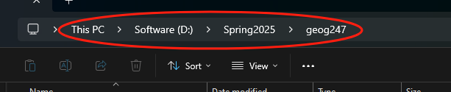
Working directory
Get working directory where your scripts and workspaces are stored
getwd()
Run this command:
Ctrl + Enter
Or Run in R
The returning strings, e.g.,"C:/Users/yy00021/Documents“ is the path to the working directory
The windows convention uses slash \ to separate sub-directories
However, R uses forward slash / or a double backward slash \\
Change working directory
I suggest you to setup a specific directory for this course
setwd('D:\\Spring2025\\geog247’)
Now check your working directory again

Slide 25
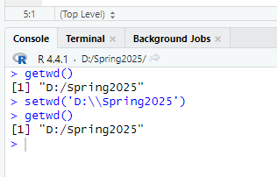
Console window
The character > in CONSOLE window indicates that R is ready to receive new commands
It show up when R completed executing a script

Slide 26

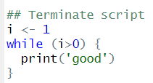
Terminate script
The Esc Key or pressing in the CONSOLE window to terminate the script

Slide 27
Get help
Get help for activate libraries
help('dplyr’)
?dplyr
Get help for all installed libraries
??dplyr
help.search('dplyr’)

Slide 28
Interacting with the R-CONSOLE
All commands (or programs) can be stored in external *.R script-files
Single command or a set of highlighted commands can be run using shortcut (shift+enter) or Run button in R
All commands can be run use the Source button in R
Scroll through the history of previously commands in R
Using shortcut key (Ctrl + L ) or broom icon to clean the Console window

Slide 29
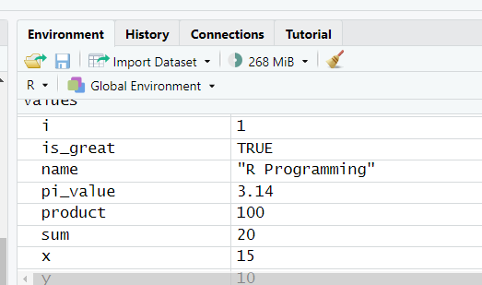
Variables in r
Variable names
Variables are created using the assignment operator <
Variables can store different types of data (numeric, character, logical, etc.).
Variables can be reassigned new values anytime.
The document shows professional naming for your code
Object in the ENVIRONMENT
Any data structure or function that is defined using commands becomes an object in the ENVIRONMENT

Slide 30
Remove objects
The objects can be removed from the ENVIRONMENT
rm(x)
Clean ENVIRONMENT
Broom icon in the ENVIRONMENT mean bar
or rm(list=ls())

Slide 31
LIST IN R
Creating a list
A list in R is a flexible data structure that can contain elements of different types: numbers, characters, vectors, matrices, data frames, or even other lists.
It's like a container for multiple objects.
Accessing elements in a list
Use [[ ]] to access elements by position or name.
Use $ to access elements by name.

Slide 32
Data sets
Read csv
read.csv() for reading CSV files.
Check columns
Accessing column names using colnames()
Add new columns
Adding columns based on calculations or conditions

Slide 33
WEEK 01 PRACTICES
Instructor: Yanan Wu
TA: Nisar Khadija
Spring 2025

Slide 34
practices
Explore Tools and Help in RStudio
Explore the different tables in RStudio

